Slide 1
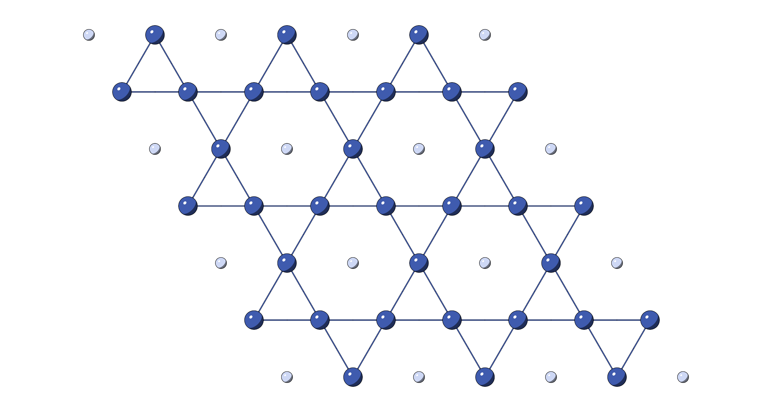
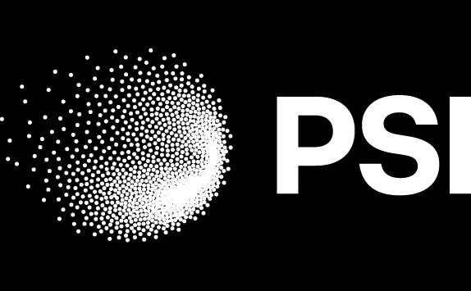
Revealing the superconducting gap structure of kagome metals via μSR and complementary techniques
Jennifer Graham and Zurab Guguchia
Paul Scherrer Institute

Slide 2
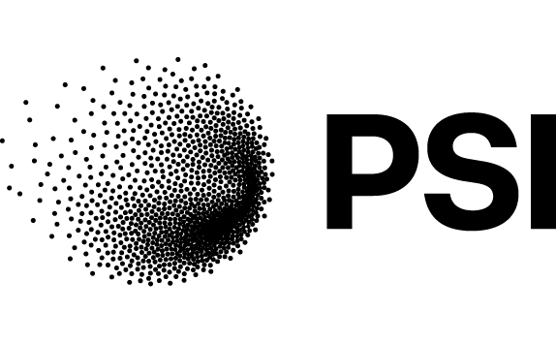







Acknowledgements
Stephen Wilson
Andrea Salinas
M. Zahid Hasan
Zurab Guguchia
Sohel Islam
Debarchan Das
Vahid Sazgari
Chip Mielke
Rustem Khasanov
Hubertus Luetkens
Andrin Doll
Ritu Gupta
Z. Wang
Y. Li
Y. Yao
Yigui Zhong
Kozo Okazaki
Hai Deng
Jiaxin Yin
Tommaso Morresi
Hechang Lei

Slide 3

Overview
Superconductivity in undoped compounds
Enhancing superconductivity
BCS or something more exotic?
T_{C}
C. Mielke III et al. Nature 602, 245-250 (2020) • R. Gupta et al. Comms. Phys. 5, 232 (2022)
Z. Guguchia et. al., Nat. Commun. 14, 153 (2023) • J. N. Graham et al. arXiv:2411.18744 (2024)

Slide 4
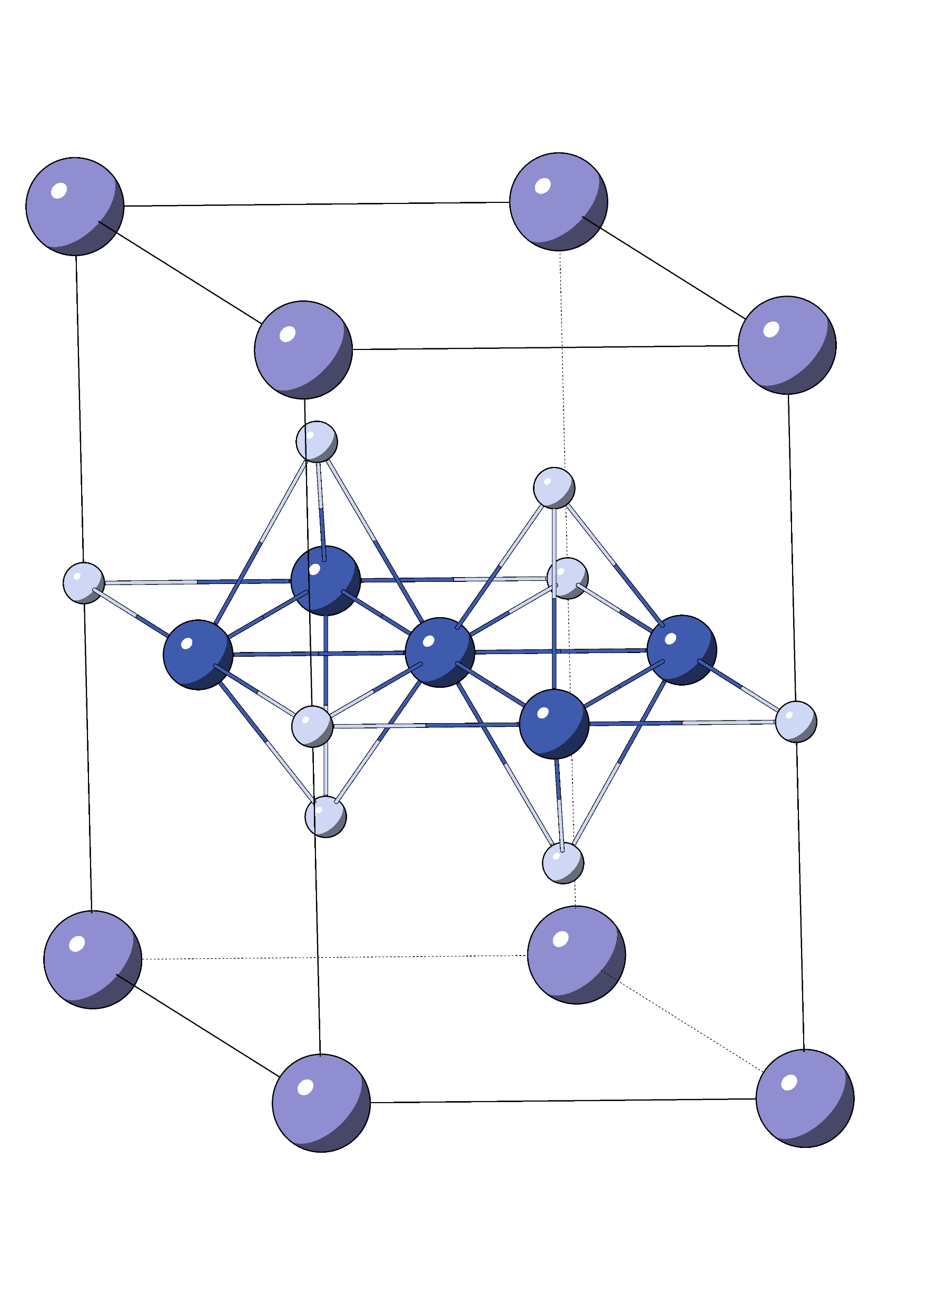
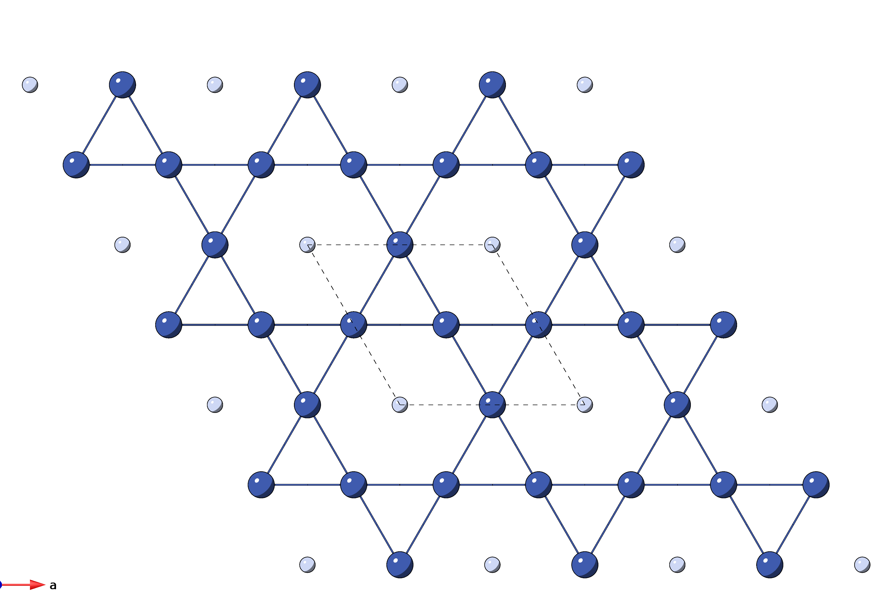
AV₃Sb₅ (A = K, Rb, Cs)
RVS
CVS
KVS
T_{C} (K)
0.75
0.93
2.5
A
V Sb
 | T_{c} (K) | T_{CO} (K)
K | 0.93 | 80
Rb | 0.75 | 110
Cs | 2.5 | 90
b
c
a
b
a
P6/mmm space group
B. R. Ortiz et al. Phys. Rev. Mater 3, 094407 (2019), K. Jiang et al. Natl. Sci. Rev. 10, 2, nwac199 (2023),
Y. Zhong et al. Nature 617, 488 (2023), Y. Liu et al. Phys. Rev. Mater. 6, 124803 (2022).
Notes:
Add TRSB orbital currents to kagome

Slide 5
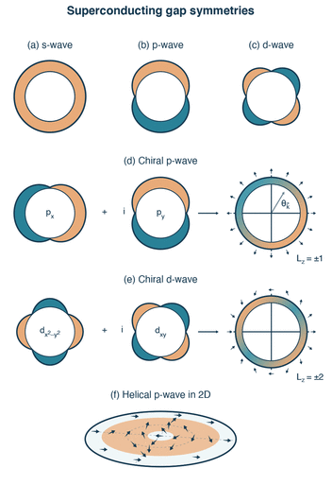
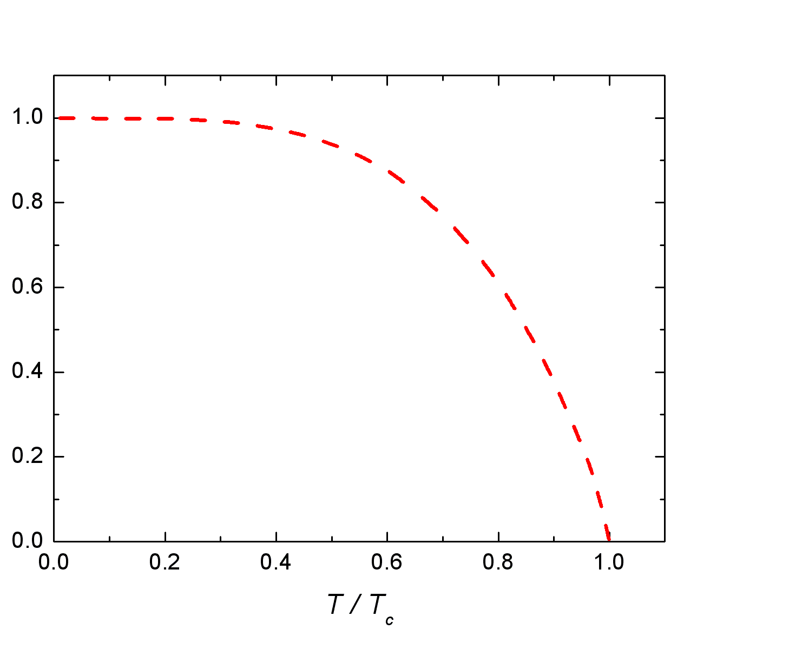
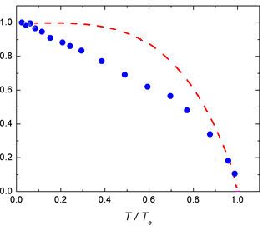




Pairing symmetries with μSR
s-wave
p-wave
d-wave
ℓ = 0
ℓ = 1
ℓ = 2
Chiral d-wave
Nodeless (s)
Nodeless (s)
Nodal (d)
Nodeless (s, p, chiral d)
Nodal (d)
$$d_{x^{2}−y^{2}}$$
$$d_{xy^{}}$$
$$+ i$$
L_{z} = $± 2$
How to distinguish more exotic symmetries from s?
s and d – no TRSB || p and chiral d – TRSB
J.E. Sonier et al, PRL 72, 744 (1994)

Slide 6
Superfluid response
RVS
CVS
KVS
T_{C} (K)
0.75
0.93
2.5
(μs)
Weak TF μSR measurements of KV₃Sb₅ (Dolly)
C. Mielke III et al. Nature 602, 245-250 (2020)

Slide 7
2 band superconductor
RVS
CVS
KVS
T_{C} (K)
0.75
0.93
2.5
Superfluid density of KV₃Sb₅
No saturation → nodal
Two step behaviour = 2 weakly coupled gaps
d
C. Mielke III et al. Nature 602, 245-250 (2020), V. Kogan, et. al., PRB 80, 014507 (2009)

Slide 8
Does nodal behaviour persist under pressure?

Slide 9
Gap structure
RVS
CVS
KVS
T_{C} (K)
0.75
0.93
2.5
μSR measurements under pressure for RbV₃Sb₅ (GPD)
Gap changes from two nodal to single nodeless
Z. Guguchia et. al., Nat. Commun. 14, 153 (2023)

Slide 10
Phase diagrams
RVS
CVS
KVS
T_{C} (K)
0.75
0.93
2.5
RbV₃Sb₅
KV₃Sb₅
RbV₃Sb₅
KV₃Sb₅
Phase diagrams constructed from μSR and AC susceptibility
Change in gap structure under pressure
Saturation of superconductivity coincides with full suppression of charge order
Charge order influences superfluid density and superconducting gap structure
Z. Guguchia et. al., Nat. Commun. 14, 153 (2023)

Slide 11
How does chemical doping affect superconductivity?

Slide 12
Chemical doping
CVS
Ta-CVS
Nb-CVS
T_{C} (K)
2.5
4.4
5.2
Doping changes gap structure from nodal to nodeless
Y. Zhong, J. Liu, X. Wu, Z. Guguchia et. al. and K. Okazaki, Nature 617, 488-492 (2023).
J. N. Graham et. al., arXiv:2411.18744 (2024).

Slide 13
ARPES
CVS
Ta-CVS
Nb-CVS
T_{C} (K)
2.5
4.4
5.2
 | muSR (meV) | ARPES (meV)
Nb-CVS | 0.59(5) | 0.54(6)
Ta-CVS | 0.80(5) | 0.77(6)
Y. Zhong, J. Liu, X. Wu, Z. Guguchia et. al. and K. Okazaki, Nature 617, 488-492 (2023),
J. N. Graham et. al., arXiv:2411.18744 (2024).

Slide 14
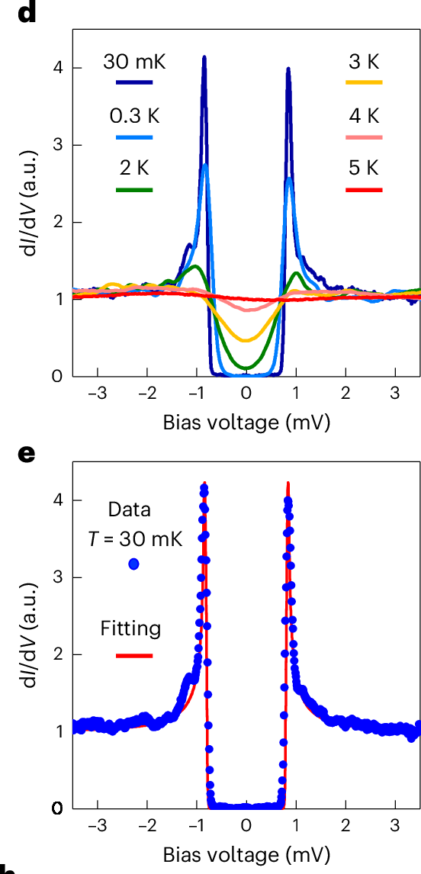
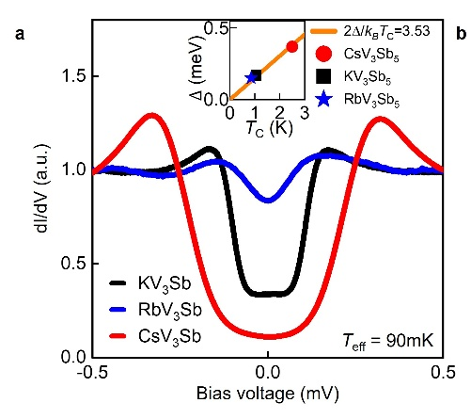
STM
CVS
Ta-CVS
Nb-CVS
T_{C} (K)
Ta-CVS
2.5
4.4
5.2
Nb-CVS
STM shows nodeless gap structures for doped compounds consistent with μSR and ARPES
Undoped compounds are nodal
J. N. Graham et. al., arXiv:2411.18744 (2024),
H. Deng, G. Liu, Z. Guguchia et. al., Nature Materials 23, 1639–1644 (2024)

Slide 15
What if we combine pressure and doping?

Slide 16
Pressure Dependence
CVS
Ta-CVS
Nb-CVS
T_{C} (K)
2.5
4.4
5.2
AC χ data and b. μSR measurements at different pressures
J. N. Graham et. al., arXiv:2411.18744 (2024)

Slide 17
Pressure Dependence
CVS
Ta-CVS
Nb-CVS
T_{C} (K)
2.5
4.4
5.2
AC χ data and b. μSR measurements at different pressures
J. N. Graham et. al., arXiv:2411.18744 (2024)

Slide 18
Pressure Dependence
CVS
Ta-CVS
Nb-CVS
T_{C} (K)
2.5
4.4
5.2
AC χ data and b. μSR measurements at different pressures
J. N. Graham et. al., arXiv:2411.18744 (2024)

Slide 19
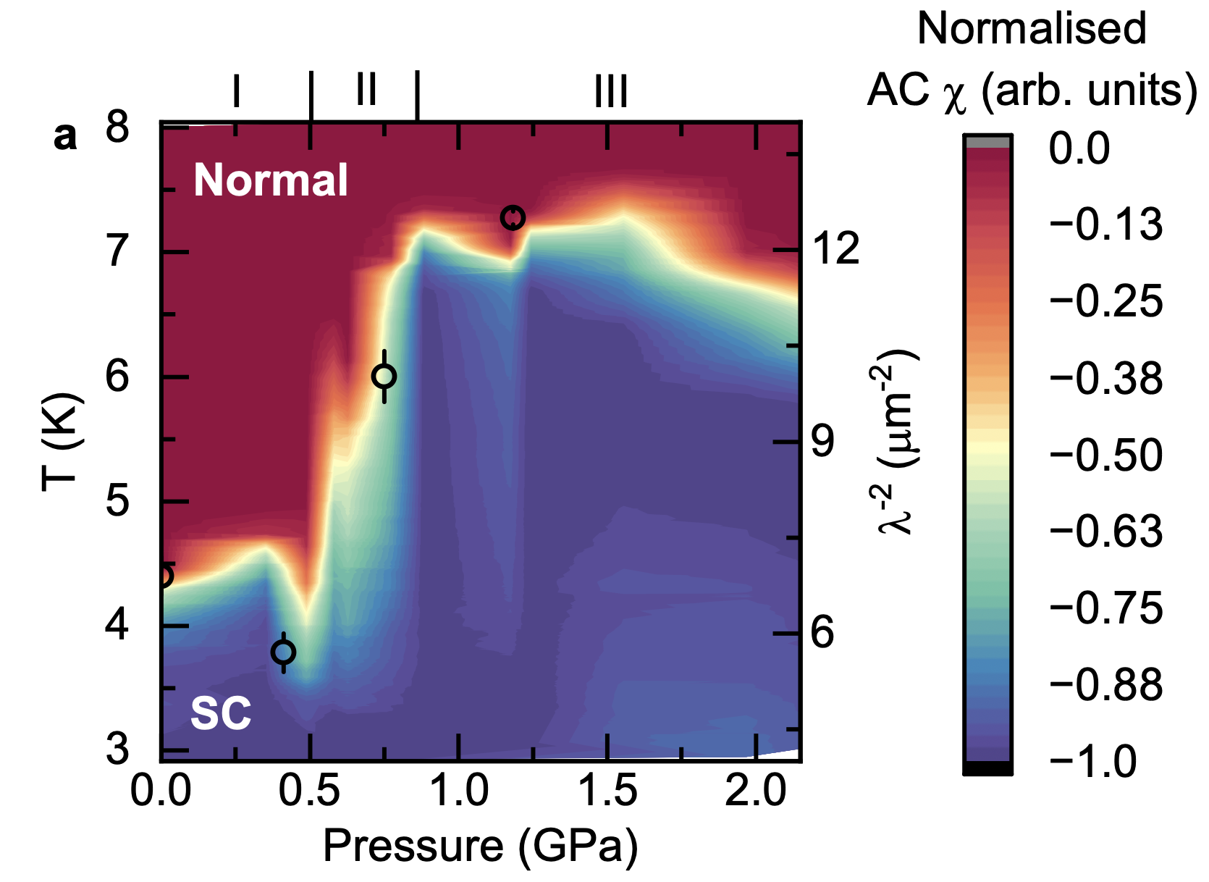
Pressure phase diagram
CVS
Ta-CVS
Nb-CVS
T_{C} (K)
2.5
4.4
5.2
Pressure enhances superconductivity
Chemical doping enhances superconductivity
Always nodeless
Critical pressure smaller than undoped CVS (1.75 GPa)
Pressure phase diagram from AC susceptibility measurements
J. N. Graham et. al., arXiv:2411.18744 (2024)

Slide 20
BCS or more exotic?
Nodal → nodeless superconductivity
Suppression of charge order
→ TRSB across T_{C}
Universal feature of AV₃Sb₅ superconductors
J. N. Graham et. al., arXiv:2411.18744 (2024)
Theory (chiral-d) : M.L. Kiesel and R. Thomale, Phys. Rev. Lett. 110, 126405 (2013), X. Wu et. al., Phys. Rev. Lett. 127, 177001 (2021), S.C. Holbaek et. al., Phys. Rev. B 144508 (2023), Y. Dai et. al., Phys. Rev. B 110, 144516 (2024).

Slide 21
Conclusions
Multigap nature, small superfluid density and nodal structure in (K/Rb)V₃Sb₅
Pressure and doping induce crossover from nodal to nodeless gap when charge order weakened
TRSB across T_{c} indicated unconventional (chiral d) superconductivity
T_{C}
C. Mielke III et al. Nature 602, 245-250 (2020) • R. Gupta et al. Comms. Phys. 5, 232 (2022)
Z. Guguchia et. al., Nat. Commun. 14, 153 (2023) • J. N. Graham et al. arXiv:2411.18744 (2024)

Slide 22
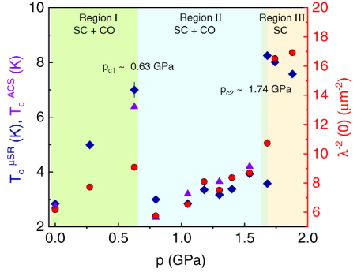
CsV₃Sb₅
RVS
CVS
KVS
T_{C} (K)
0.75
0.93
2.5
Two strongly coupled nodeless gaps
Pressure has complex evolution
T_{c} maximised after full suppression of charge order
R. Gupta et al. Comms. Phys. 5, 232 (2022)

Slide 23
Superconducting Gap: Pressure
 | 0 GPa | 0.4 GPa | 0.8 GPa | 1.2 GPa
T_{c} (K) | 3.000(6) | 3.25(1) | 6.67(7) | 6.94(2)
λ⁻²(T = 0) (μm⁻²) | 6.9(3) | 5.7(3) | 10.0(4) | 12.5(1)
λ(T > 0) (nm) | 381 | 419 | 315 | 283
Δ₁ (meV) ω₁ (%) | 0.54(9) 100 | 0.47(7) 100 | 0.65(5) 73(4) | 1.56(4) 100
Δ₂ (meV) ω₂ (%) | - | - | 3.5(9) 27(4) | -
λ = London penetration depth, Δ = Gap size, ω = Phase fraction

