Slide 1

Non‑destructive depth‑selective quantification for carbon in steel using negative muon lifetime analysis
Kazuhiko Ninomiya
ninomiya-kazu@hiroshima-u.ac.jp

Slide 2

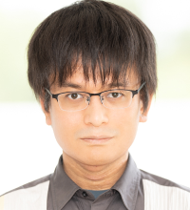
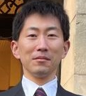
Collaborators
The 16th International Conference on Muon Spin Rotation, Relaxation and Resonance (μSR2025)
Hiroshima University
Kosei Yakushi
International Christian University
Michael Kenya Kubo
Kyoto University
Makoto Inagaki
KEK
Go Yoshida, Soshi Takeshita, Naritoshi Kawamura, Patrick Strasser, Yasuhiro Miyake, Koichiro Shimomura
National Museum of Japanese History
Tsutomu Saito
Dr. Inagaki
Dr. Yoshida

Slide 3
Contents
The 16th International Conference on Muon Spin Rotation, Relaxation and Resonance (μSR2025)
Introduction
Muonic atom formation and muon decay
Muon lifetime measurement
Experimental
Results and Discussion
Lifetime spectrum analysis
Calibration
Depth profile analysis
Application to Japanese sword analysis
Summary
Published : K. Ninomiya et al., Scientific Reports, 14, 1797 (2024)

Slide 4
Muonic atom formation and muon decay
The 16th International Conference on Muon Spin Rotation, Relaxation and Resonance (μSR2025)
A muonic atom forms when a muon is captured into a muon atomic orbit.
Muonic X-rays are emitted in the de-excitation process of a muonic atom.
After a muon reaches to the muonic 1s state, the muon decays into an electron or is absorbed in a nucleus.
muon
nucleus
nuclear absorption
or
electron
decay into electron
muonic X-ray

Slide 5

Muon lifetime measurement
The 16th International Conference on Muon Spin Rotation, Relaxation and Resonance (μSR2025)
ν_{µ}
ν_{µ}
µ⁻
n
Z
Z
e⁻
γ-ray
ν_{e}
Nuclear absorption
(λ_{absorption})
Decay
(λ_{decay}：constant)
τ：muon life time
λ_{absorption} varies by element
(larger with increasing atomic number)
Identify elements by lifetime measurement
A. Knecht et al., Eur. Phys. J. Plus 135, 777 (2020)
T. Yamazaki et al., Phys. Scr. 11, 133 (1975)

Slide 6
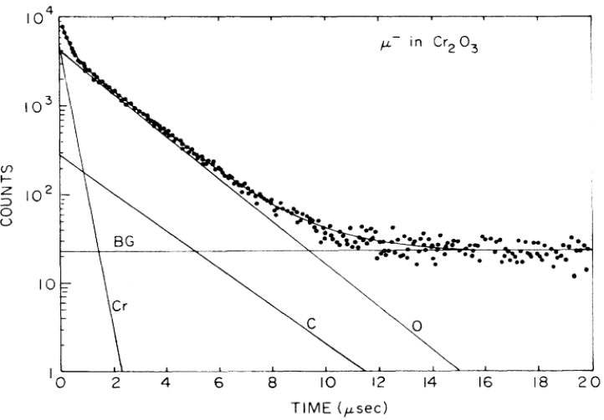




Muon lifetime measurement
The 16th International Conference on Muon Spin Rotation, Relaxation and Resonance (μSR2025)
The atom captured muon can be identified by lifetime
Intensity for each element corresponds to the number of captured muons
 | Z | Lifetime/ns [2]
Cr | 24 | 255.3±2.0
O | 8 | 1795.4±2.0
C | 6 | 2026.3±1.5
Quantitative elemental analysis is possible
lifetime spectrum for Cr₂O₃^{[2]}
Sample
Plastic scintillation counter
e⁻
µ-
Electron detection timing
Lifetime spectrum
Muon induced timing
Schematic view of lifetime measurement
[2] T. Suzuki et al., Phys. Rev. C, 35 (1987) 2212.

Slide 7
Muon lifetime measurement
The 16th International Conference on Muon Spin Rotation, Relaxation and Resonance (μSR2025)
Why the muon lifetime analysis method ?
Analyze the inside of materials non-destructively.
Stopping depth can be controlled by the incident energy of the muon.
High energy decay electron (~50 MeV) escapes from the bulk material
Highly sensitive to light elements
Muons captured by heavy elements disappear quickly
Muons captured by light elements can be observed in a long time window
=> analysis of trace elements, especially for light elements, is possible
Decay electrons can be detected by a μSR spectrometer
Additional detection system is not necessary
We selected steel (Fe + small amount C) as the first target

Slide 8
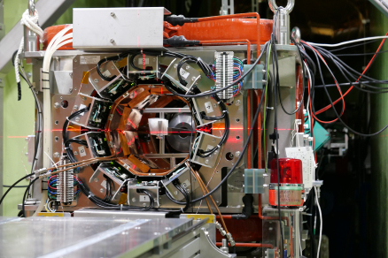
Experimental
The 16th International Conference on Muon Spin Rotation, Relaxation and Resonance (μSR2025)
Muon irradiation experiment was conducted at the muon facility in J-PARC.
µSR spectrometer at D1 area in J-PARC (KALLIOPE)[3] was used for lifetime measurement
2000 ch plastic scintillation counter system
e⁻
µ-
Plastic scintillation counters
sample
Schematic view of experimental setup
[3] K M Kojima et al 2014 J. Phys.: Conf. Ser. 551 012063

Slide 9
Experimental
The 16th International Conference on Muon Spin Rotation, Relaxation and Resonance (μSR2025)
Experiment 1 (Standard Fe samples (Fe-STD)) : Calibration curve (quantitative analysis)
Experiment 2 (Layered sample) : Demonstration of non-destructive depth-profiling
Structure of layered sample
Sample | Incident muon momentum (MeV/c) | Range in Fe (mm)
Fe-STD C: 30ppm | 43 | 0.95
Fe-STD C: 0.42% | 43 | 0.95
Fe-STD C: 4.46% | 43 | 0.95
 | 51 | 1.63
Layered sample | 32 | 0.35
 | 40 | 0.73
 | 46 | 1.21
*0.5 mm thickness in each
Muon beam
C:1.03%
C:0.51%
C:0.20%

Slide 10

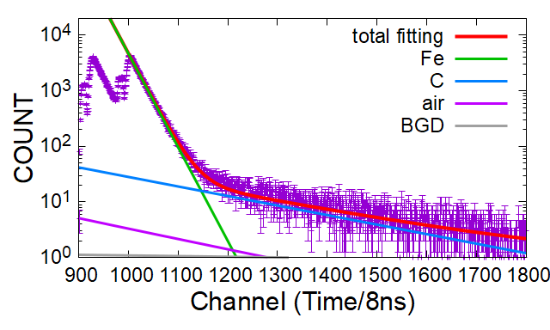
Lifetime analysis
The 16th International Conference on Muon Spin Rotation, Relaxation and Resonance (μSR2025)
The spectra were fitted by 4 components; Iron, Carbon, Air and BGD.
The component of Air was estimated from the results of pure Fe.
N(t)： electron counts at time “t”
A_{i}： captured muon in component “i”
τ_{i}： life time of components “i”
 | Fe | C | air | BGD
lifetime /ns^{[2]} | 206 | 2026 | N: 1907 O: 1795 Ar: 537 | 20000
[2] T. Suzuki et al., Phys. Rev. C, 35 (1987) 2212.

Slide 11
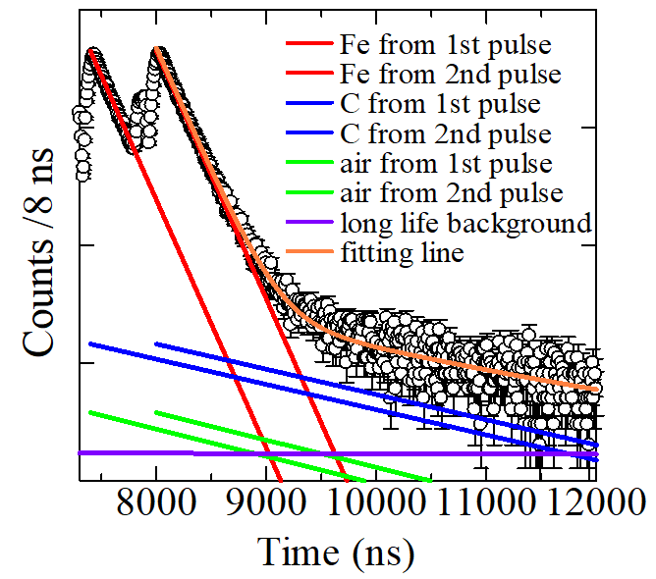
Calibration data
The 16th International Conference on Muon Spin Rotation, Relaxation and Resonance (μSR2025)
Linear relation between intensity and content of C/Fe
Estimated detection limit was 140 ppm by 2-hour measurement
Sample: Fe-STD C:0.42 %

Slide 12
Depth profile analysis
The 16th International Conference on Muon Spin Rotation, Relaxation and Resonance (μSR2025)
Lifetime spectra were clearly changed by changing muon incident momentum (muon stopping depth)
C:0.20 %
C:1.03 %
40 MeV/c
32 MeV/c
C:0.51 %
Muon beam
0.5 mm thickness in each

Slide 13
Depth profile analysis
The 16th International Conference on Muon Spin Rotation, Relaxation and Resonance (μSR2025)
Lifetime spectra were clearly changed by changing muon incident momentum (muon stopping depth)
C:0.20 %
C:1.03 %
C:0.51 %
Incident muon momentum /MeV/c | Carbon contents by muon analysis /% | Certified value /%
32 | 1.084±42 | 1.03
40 | 0.192±11 | 0.20
46 | 0.494±20 | 0.51
Depth profile analysis is successfully demonstrated
Muon beam
0.5 mm thickness in each

Slide 14
Japanese sword analysis
The 16th International Conference on Muon Spin Rotation, Relaxation and Resonance (μSR2025)
Sample: Kyusyu Higo Dodanuki Hyobu: 九州肥後同田貫兵部 (late 16th century)
Muon irradiation position
Experimental condition
Surface part (hard iron)
皮金（Kawa Gane）
Incident muon momentum of 38, 43, 49, 57 and 63 MeV/c
(muon range : 0.6 ~ 3.2 mm)
Muon beam
Core part (soft iron)
芯金（Shin Gane）
Irradiation time : 3 ~ 6 hours
Sn mask with
5 x 30 mm hole
Typical structure of Japanese sword
Thickness ~6 mm

Slide 15
Japanese sword analysis
The 16th International Conference on Muon Spin Rotation, Relaxation and Resonance (μSR2025)
Depth profile of carbon contents in the Japanese sword was non-destructively investigated
The carbon contents in surface is relatively higher than these in core part, this profile was consistent with the known property of Japanese swords
Core part
(soft iron)
Surface part
(hard iron)

Slide 16
Summary
The 16th International Conference on Muon Spin Rotation, Relaxation and Resonance (μSR2025)
We have developed a novel non-destructive light element analysis method for bulk materials by muon lifetime analysis.
A linear relation was found between intensity and the content of C/Fe. Quantitative analysis is possible using the calibration data.
The detection limit was 140 ppm for a 2-hour measurement.
In the analysis of a layered sample with 3 iron standard samples having different carbon contents, each layer was selectively analyzed by adjusting the incident muon momentum.
Carbon contents of a Japanese sword can be investigated non-destructively.

