Slide 1
Spin Liquid Properties of a Spin-1/2 Kagome Metal-Organic-Framework Compound
Francis Pratt
ISIS Muon Group

Slide 2
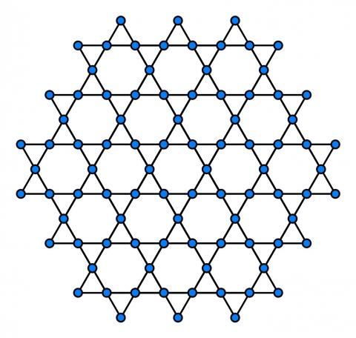
Kagome-lattice 2D Quantum Spin Liquids
Theory for the nature of the QSL state in the S=1/2 kagome lattice is not at all settled:
Gapped or gapless?
U(1) or Z₂ gauge symmetry?
Chiral or not?
Spinon Fermi surface or quadratic or linearly dispersing spinons?
The experimental situation for the ideal kagome lattice is also often unclear, e.g. due to site mixing and non-symmetric lattices in mineral-based kagome systems
MOFs provide a promising new avenue
Notes:
, e.g. site mixing

Slide 3
Kagome MOF system Cu₃(HOTP)₂
HOTP is hexaoxytriphenylene
Kagome-lattice of S = ½ Cu in the
Metal-Organic-Framework (MOF) Cu₃(HOTP)₂
also known as Cu₃(HHTP)₂
Semiconductor (Mott-insulator)
E_{A} = 0.17 eV
Misumi et al, J. Am. Chem. Soc. 142, 16513 (2020)

Slide 4
Exchange Coupling and Residual Entropy
From Curie-Weiss fit: J = 2θ/z = 1.7 K
From high T series expansion: J = 2.0 K
Residual entropy is 30% of R ln 2
Consistent with a QSL ground state (prediction is 40 %)
Misumi et al, J. Am. Chem. Soc. 142, 16513 (2020)

Slide 5
Power Laws for Specific Heat and Magnetic Susceptibility
Low temperature specific heat
Low temperature magnetic susceptibility
Power law n_{C} = 0.52
Power law n_{χ} = -0.31
Misumi et al, J. Am. Chem. Soc. 142, 16513 (2020)

Slide 6
Electronic Structure from DFT
Calculations by Diego López-Alcalá and Jose Baldoví (Valencia)
Spin density is 79% on Cu with the rest mainly on the O ligands
Slipped configuration between adjacent layers is more stable than the eclipsed configuration by ~1 eV
(note that there are 12 equivalent slip directions for a pair of layers)
Broken symmetry DFT+U calculations allow the exchange coupling J to be calculated
The experimental value J ~ 2 eV is matched for the reasonable U parameter values of 7.3 eV on Cu and 4 eV on C and O
Interlayer exchange coupling is 0.13 eV and interlayer dipolar coupling is -0.07 eV, giving a combined interlayer coupling of 0.06 eV
The predicted anisotropy ratio for intralayer versus interlayer diffusion is then D_{ǁ}/D⊥ = 2.0/0.06 = 33

Slide 7
Electronic Structure from DFT: Regular Stacking Models
Decoupled 2D layers
Regular AB zigzag slipped stacking
Regular AA eclipsed stacking
Small gap 2D semiconductor
1D metal
Very 1D metal

Slide 8
Frustrated Layer Stacking Enhances the Two-dimensionality
Two-fold degeneracy for the slip angle of each successive layer due to the interlayer interaction between next-nearest layers
Result is random stacking which kills coherent interlayer transport and enhances two-dimensionality

Slide 9
μSR Data from the HiFi Instrument at ISIS
Samples from ICMol Valencia: Victor Garcia-Lopez,Miguel Clemente-León and Eugenio Coronado
No evidence for ordering or freezing in ZF down to 50 mK
Nuclear relaxation contribution quenched in LF
Electronic relaxation revealed in the form of a slow Lorentzian
Relaxation persists to high field signifying fast spin dynamics

Slide 10

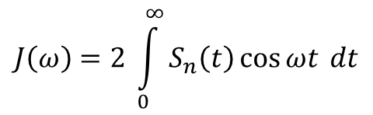
Spin Dynamics from LF-μSR
2D spin diffusion model:
where
$$J\left(ω\right)=2 \int_{0}^{∞}{S_{n}\left(t\right)}\cos{ωt} dt$$
with n=2 and
$$S_{n}\left(t\right)={\left[e^{−2tD_{ǁ}}I_{0}\left(2tD_{ǁ}\right)\right]}^{n}$$
2D spin diffusion model describes the LF-μSR relaxation well at all T
( clearly not a 1D metal! )

Slide 11
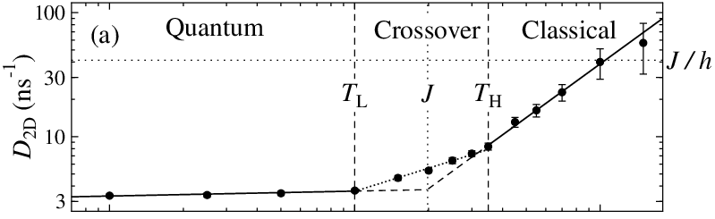
Classical to Quantum Crossover
T dependence of the 2D diffusion rate
High T classical region:
v = (2J/h) a and l = a
so we expect D_{2D} = J/h
Line is fit to
J = 2.6(4) K and n = 0.03(3)
Triangular-lattice system YbZnGaO₄ PRB 106, L060401 (2022)

Slide 12
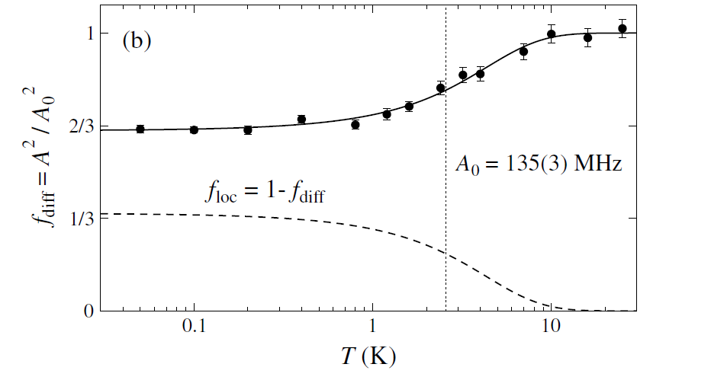
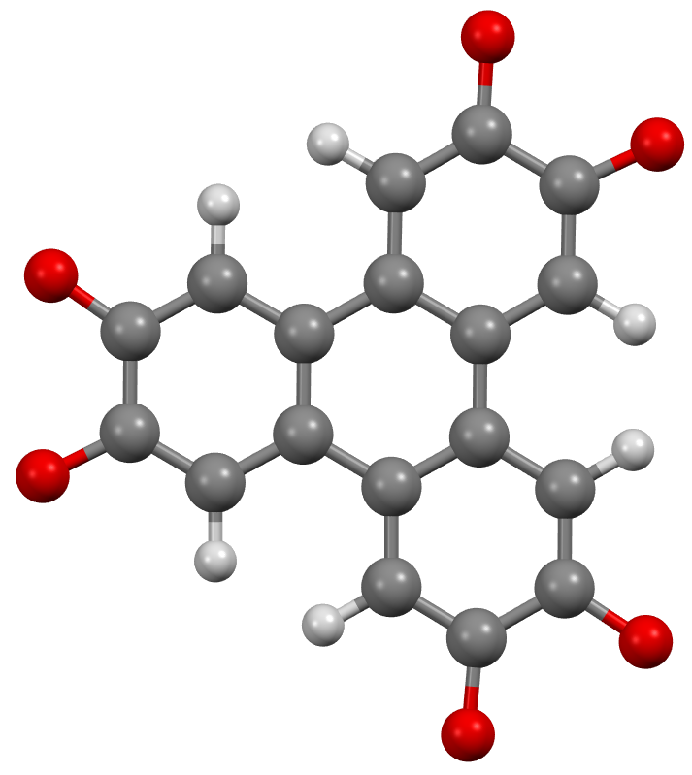
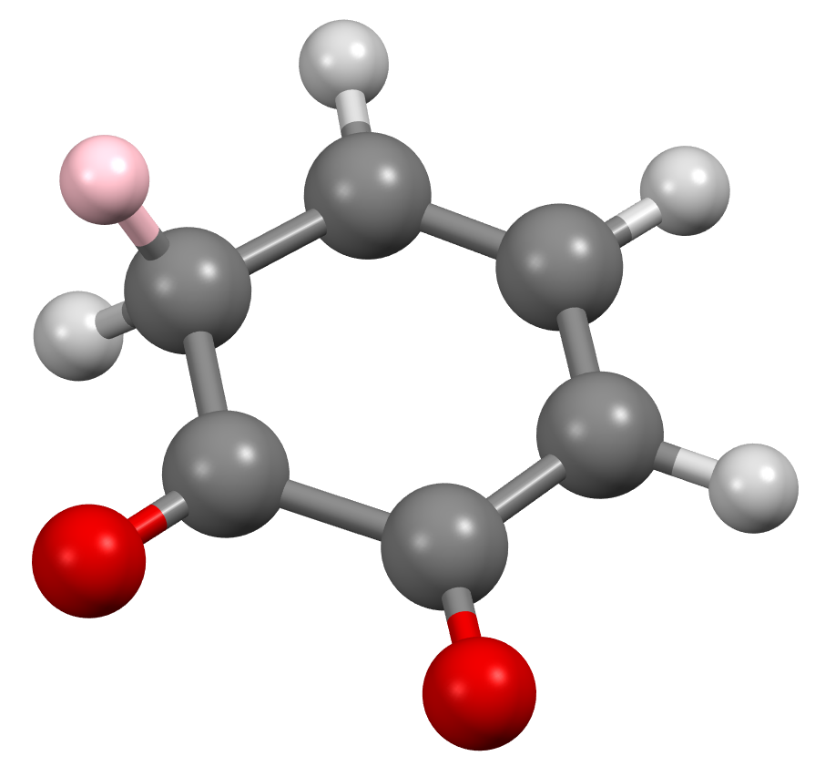
HFC of Muon Probe and Localised versus Diffusive states
Use 1,2-dioxyphenylene as a model for 1/3 of HOTP
Mu
DFT+μ for addition of Mu to the molecule using Gaussian16 (B3LYP/cc-pVDZ) gives a bare HFC value of A = 110 MHz
This becomes A = 135 MHz after quantum correction for the muon zero-point motion, matching the observed A₀
A is not expected to vary strongly with T
The apparent drop in A at low T coincides with the emergence of a non-diffusive term in the spectral density
This reflects localised excitations that are only present in the quantum region
The localised term has a Lorentzian spectral density with a low field cut-off below 20 mT

Slide 13
Quantum Entanglement: Quantum Fisher Information
Quantum Fisher Information (QFI) as an Entanglement Witness
Hauke et al, Nat. Phys. 12, 778 (2016)
Laurel et al, PRL 127, 037201 (2021)

Slide 14
Quantum Entanglement Length
Entanglement length ξ_{E}
Verstraete et al, PRL 92, 027901 (2004)
From F_{Q}:
ξ_{E} ∝ F_{Q}^{1/2}
From D_{2D}:
D_{2D} = 0.5 v / l
When v is independent of T (e.g. FS or linear nodal QSL)
D_{2D} ~ 1/l and can associate l with entanglement length ξ_{E}
ξ_{E} ∝ 1 / D_{2D}

Slide 15
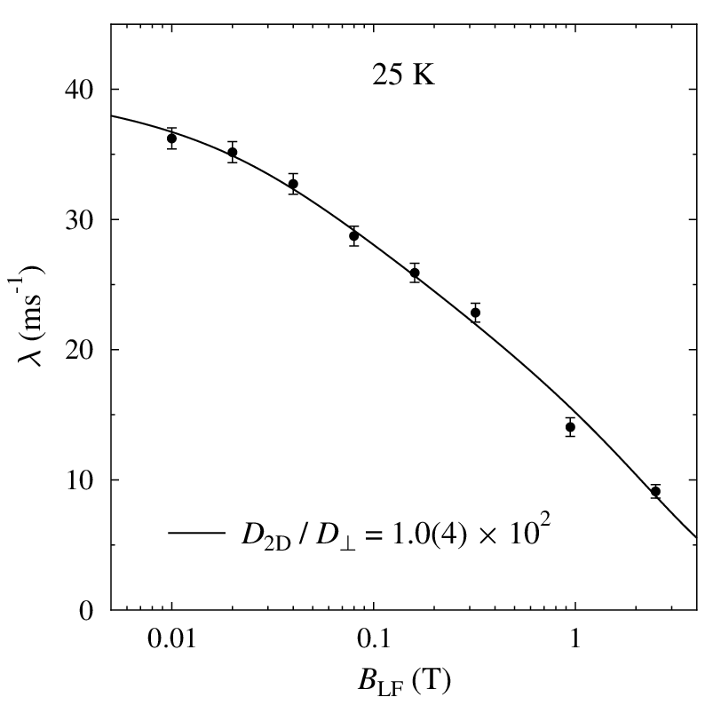
Just how 2D is it?
With slow interlayer hopping we get a modified autocorrelation function:
We can then fit the spectral density to this modified model:
At 25 K, the fitted ratio D_{2D} / D⊥ is 10²
This indicates an inter-layer coupling of 0.02(1) K
(the computed estimate was a bit larger at 0.06 K)
At 50 mK, D_{2D} / D⊥ is even larger, with a lower limit of 10⁴
Quantum entanglement is further suppressing
the inter-layer interaction

Slide 16
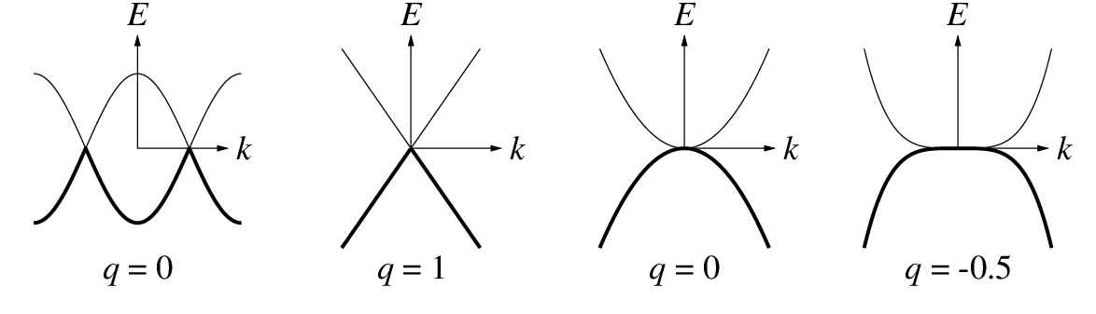
Dispersion, Power Laws and Quantum Criticality
For low-energy dispersion of form E ∝ k^{m}
Density of states: DOS ∝ E^{q} where q = 2/m-1
Quantum Critical power laws
Spin Diffusion: n_{D} = 2/ν – 2 from n_{D} = 0.03(3), we get ν = 0.673(7)
c.f. 0.672 for O(2)
0.748 for O(4)
Magnetic susceptibility: n_{χ} = -(2 - η)ν + q from n_{χ} = -0.31 and η = 0.04, ν = 0.673 we get q = 1.0
Specific heat: n_{C} = 3ν − 1 + q from n_{C} = 0.52 and ν = 0.673 we get q = -0.5

Slide 17
Low Energy Excitations versus Experiment
n_{c}=2.02 for Dirac spinons would be very hard to separate from the vibrational term
Z₂-linear QSL with Dirac spinons and specific heat dominated by non-magnetic singlet excitations

Slide 18
Summary
Electronic structure of the kagome MOF Cu₃(HOTP)₂ was studied using DFT+U, reproducing the exchange coupling J = 2 K and demonstrating the frustrated stacking and weak inter-layer coupling
QSL properties were confirmed experimentally in ZF-μSR and a detailed LF-μSR study was carried out to characterise the spin dynamics
2D spin diffusion provides a good description of the spin dynamics, implying that the kagome layers are well decoupled magnetically as well as electronically
Classical to quantum crossover was observed at k_{B}T ~ J and changes in the diffusion rate and spectral density function were linked to quantum entanglement
When low-temperature thermodynamic, magnetic and spin transport properties are compared, evidence is found for Dirac-type linear nodal dispersion of the spin excitations
PHYSICAL REVIEW RESEARCH 7, 023007 (2025)

Slide 19
Using LF-μSR to probe diffusive spin dynamics
Key ideas:
Random walk for the unpaired spin that propagates via the nearest neighbour exchange interaction
Intermittent hyperfine interaction with the static muon sitting at one probe point in the structure
Spin autocorrelation function S(t) follows from all possible diffusion paths that return to the muon site
Spectral density of spin fluctuations J(ω) is the Fourier transform of S(t)
Spectral density is probed at a frequency ω that tracks the applied field
μ

Slide 20
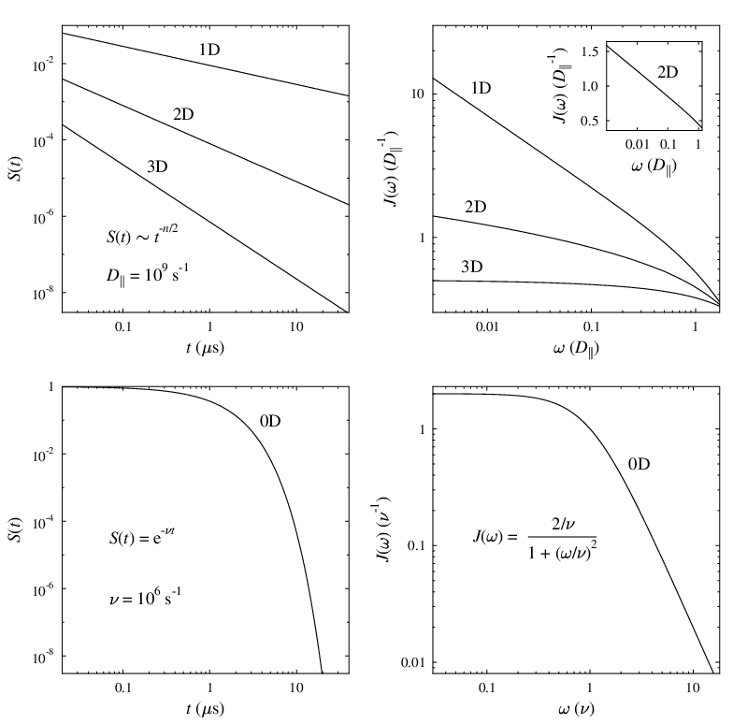

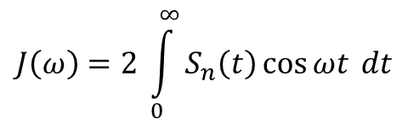
Diffusive spin dynamics in low dimensional materials
Autocorrelation function for n dimensional diffusion
$$S_{n}\left(t\right)={\left[e^{−2tD_{ǁ}}I_{0}\left(2tD_{ǁ}\right)\right]}^{n}$$
$$J\left(ω\right)=2 \int_{0}^{∞}{S_{n}\left(t\right)}\cos{ωt} dt$$
LF-μSR relaxation rate
λ ∝ J(ω) ω ∝ B_{LF}
Corresponding spectral density
Diffusion for n = 1 to 3
Spin diffusion
Comparison with localised fluctuations
(n = 0)
BPP/Redfield model (NMR)

Slide 21
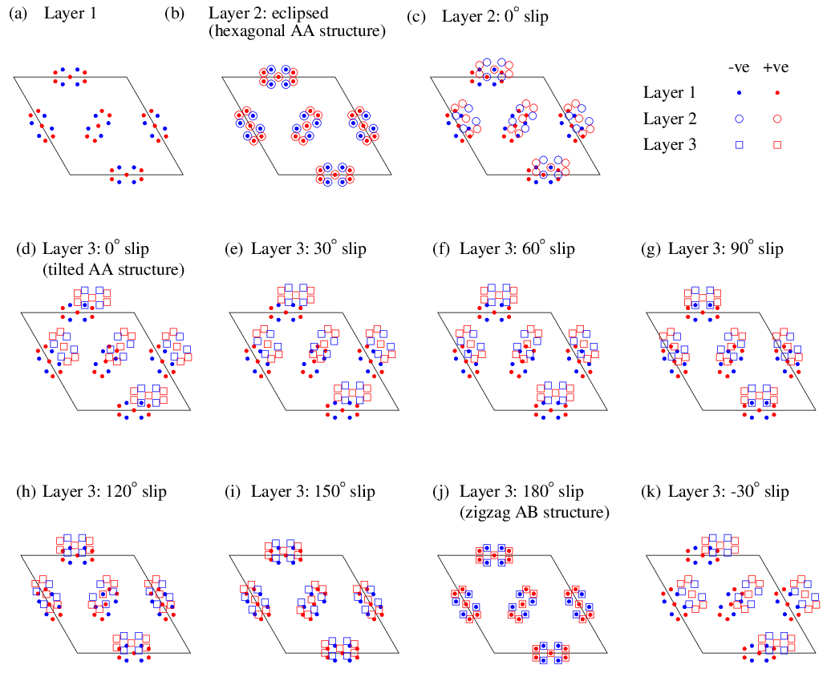
Frustrated layer stacking - first layer
Charge distribution in the layer

Slide 22
Frustrated layer stacking – second layer
12 equivalent
slip directions

Slide 23
Frustrated layer stacking – third layer
slip directions for third layer now inequivalent versus NNN layer interaction

Slide 24
Effect of random stacking on electronic properties
Theoretical study of Ni3(HITP)2
(in HITP NH replaces the O in HOTP)
Foster et al, J. Phys. Chem. Lett. 9, 481 (2018)
Effect of layer displacement on inter-layer dispersion within a 10-layer unit cell

Slide 25
Further Evidence for Localised States at Low Field
Comparison of low-field part of the LF data measured at 50 mK and 10 K. The dashed lines show the extrapolation of the 2D field dependence derived from fitting the full field range of the data. At 50 mK there is a significant deviation from the 2D fit at 0.01 T and below, signifying the presence of a slowly fluctuating localized 0D term in the spectral density.

Slide 26
O(2) versus O(4) criticality in a Z₂ QSL
Phase diagram for a Z₂ QSL spinon-vison double Chern-Simons model
Xu and Sachdev, Phys. Rev. B 79, 064405 (2009)

