Slide 1
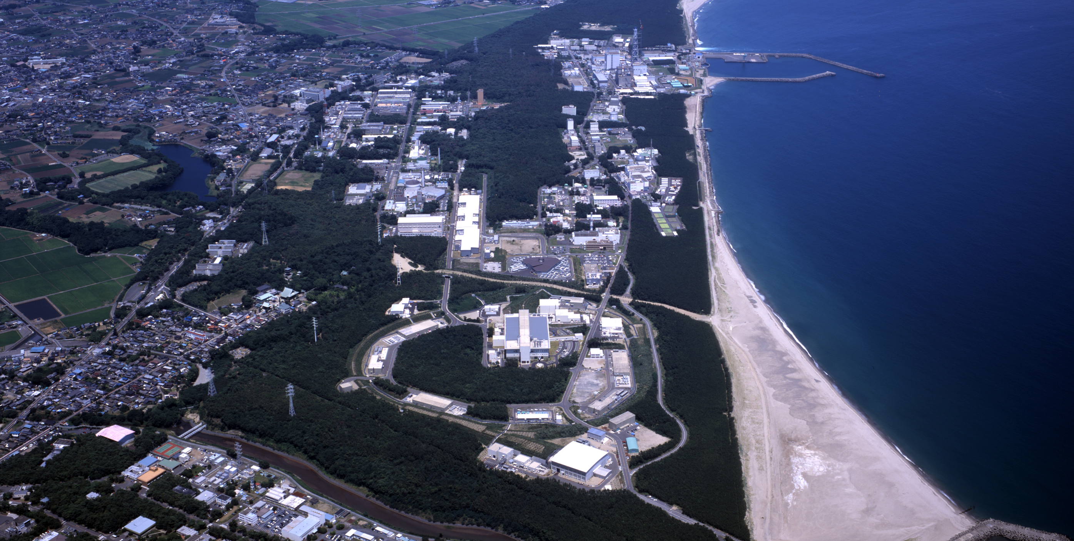





Transmission Muon Microscopy and Scanning μSR Microscopy
16th International Conference on Muon Spin Rotation, Relaxation and Resonance
μSR2025
St. John’s 22/Jul/2025
Yukinori NAGATANI
High Energy Accelerator Research Organization :KEK
Institute of Materials Structure Science :IMSS
Grant-in-Aid for Scientific Research (S)
JP24H00028 (2024-2028, PI: Y.N)
Transmission Muon Microscopy
Supported by MEXT Grant-in-Aid for Scientific Research (S)

Slide 2
What we can do by Muons
Accelerated μ：Strong Permeability thru Materials
Transmission analysis of thick objects
Positive μ： μSR Spectrum Analysis
Distribution and fluctuation of Magnetic Fields in materials
Status of hydrogen, Density of Fermi-surface, …
Negative μ： Characteristic X-ray analysis
Elementary-analysis, Isotope-analysis, Chemical state-analysis
Both +/- μ： Soft/Hard error analysis of IC/LSI
All are applicable to Microscopies!

Slide 3
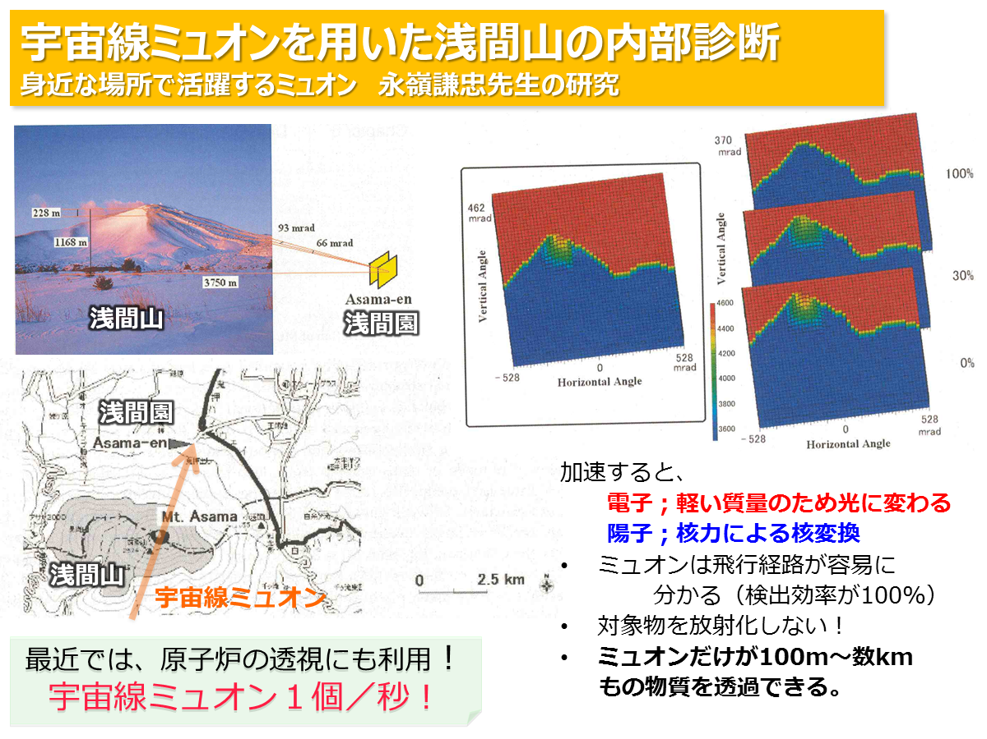
Visualization of Volcano by Cosmic-ray Muon (Nagamine)
Cosmic-Ray Muon
Detector
Mt. Asama
High-energy muons penetrate a mountain (thickness～100m)
and visualize internal structure.
Recently, it is applied to Atomic reactors, Pyramids and so on.
Applying it to microscopy ➡ Transmission Muon Microscopy

Slide 4
Our Muon Microscopy Projects at J-PARC
TμM:
Transmission Muon Microscopy
Sμ⁺M:
Scanning μSR Microscopy
Sμ⁻M:
Scanning negative Muon Microscopy

Slide 5
TµM:
Transmission Muon Microscopy
Main Project:
It visualizes Electromagnetic Fields
in thick specimen

Slide 6
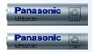
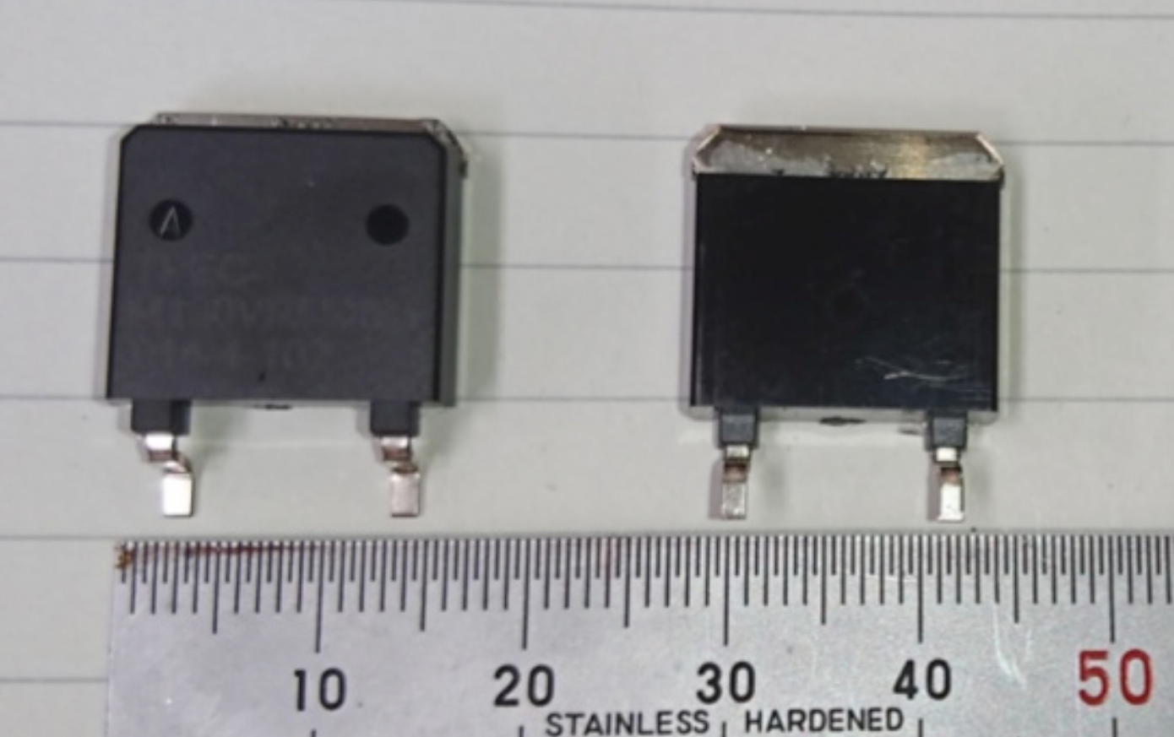
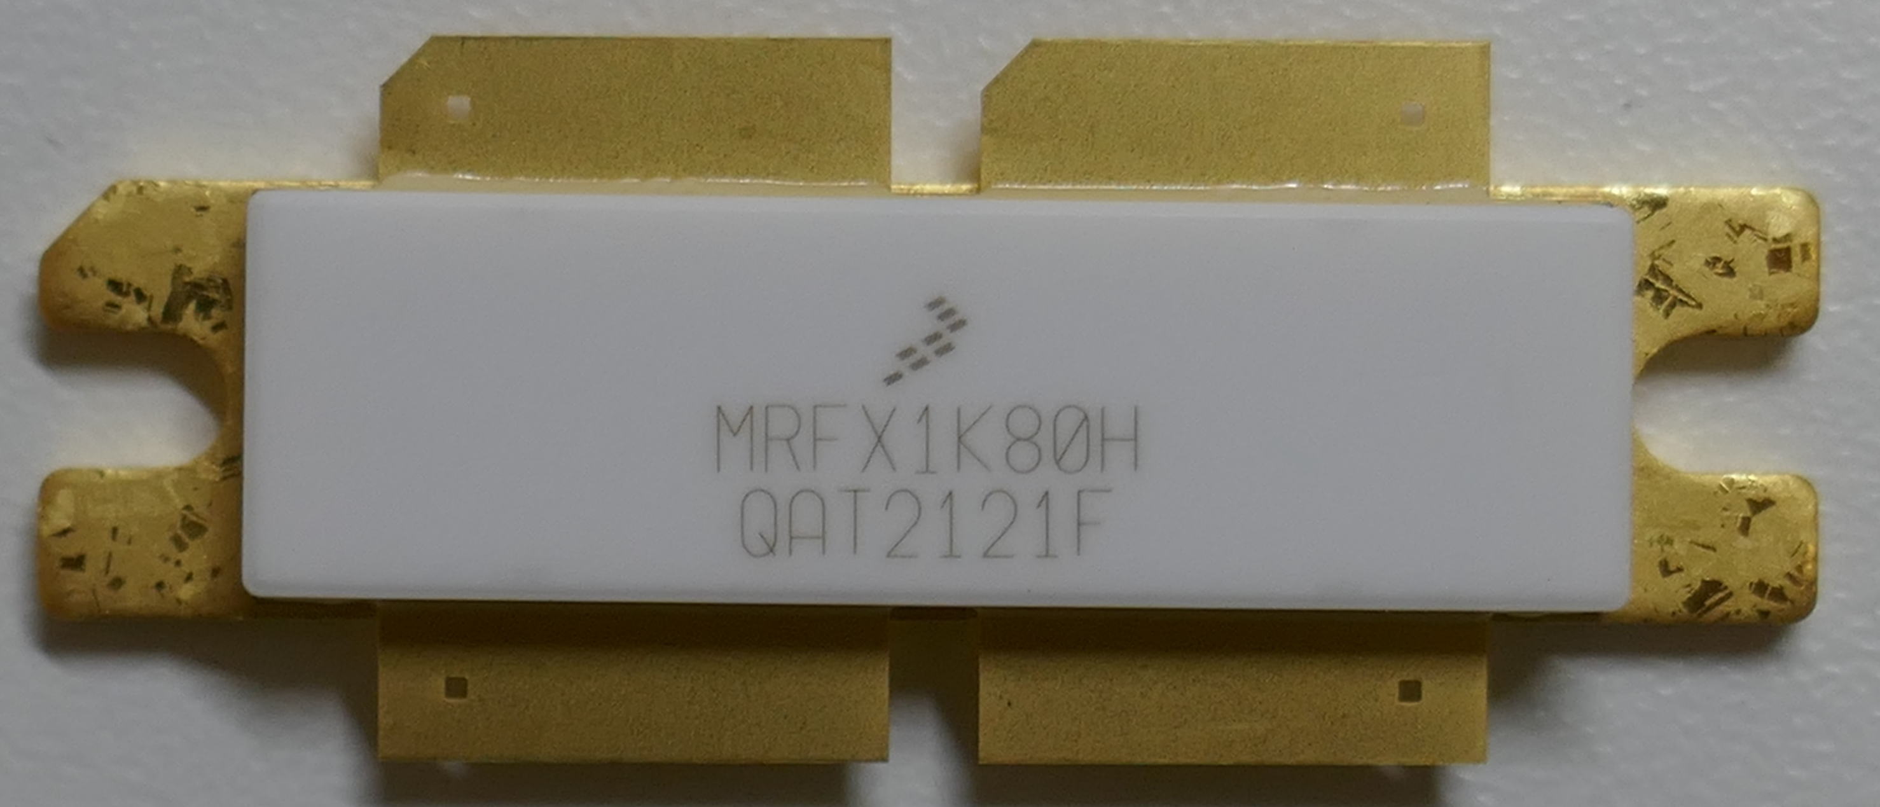
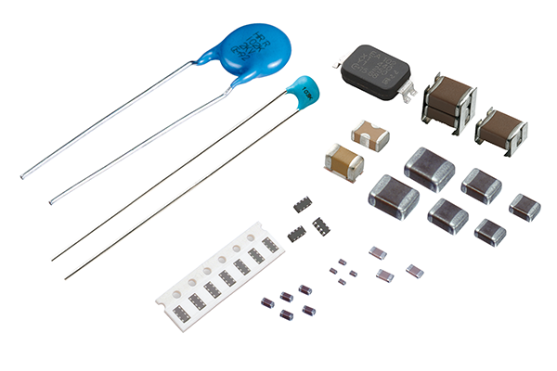
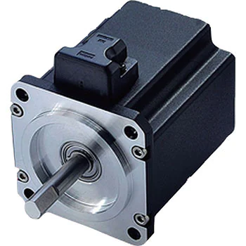
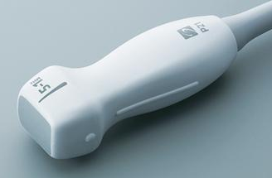

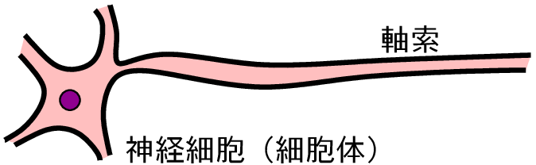
Our Aims by Visualizing Ele/Mag-field
Our modern civilization is constructed on Electromagnetism.
Computer / Semiconductor / Communication dev. / EV / Rader / …
Power Devices: Power / RF Tr, Capacitor, Magnet, Battery, Piezo, …
Making them higher voltage / higher speed / higher efficiency
contributes to industrial benefits and SDGs of our society.
Visualization of EM-field in devices makes them higher performance.
eg.：Specifying field concentration design of relaxation → Higher voltage dev.
Mitochondria: Energy by mem-Potential.
Brain / Nerves system: Thinking by network of action potential
Ultrasonic Medical Dev.
→
←
Axon fiber
neuron
Visualization of EM-field in bulk object is quite important subject
in wide fields including industry and life science.

Slide 7
Muon can visualize EM-fields in objects
Muon is charged particle ➡ Sensitivity both E and B field
The highest material permeability by acceleration
Mass production by accelerator
High resolution and high sensitivity of EM fields by beam-cooling
Magnification of Image / Visualization of EM field by TEM tech.
High-resolutional Image-detection by Direct CMOS Sensors for TEM
Combining accelerator technology and
electron microscopy one allows us it!

Slide 8
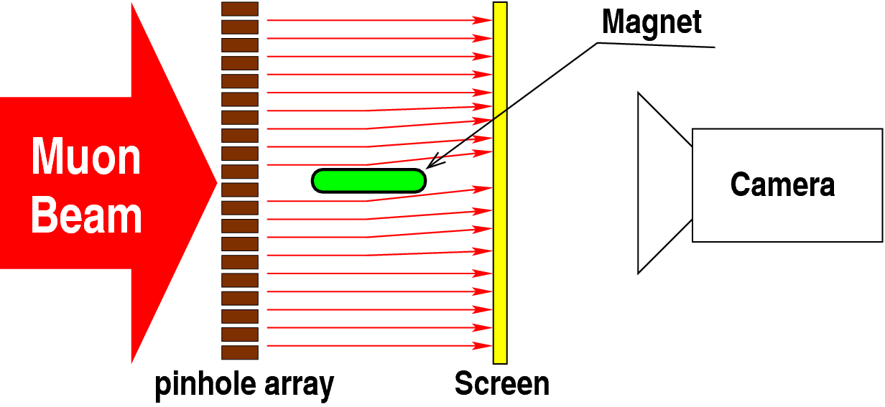
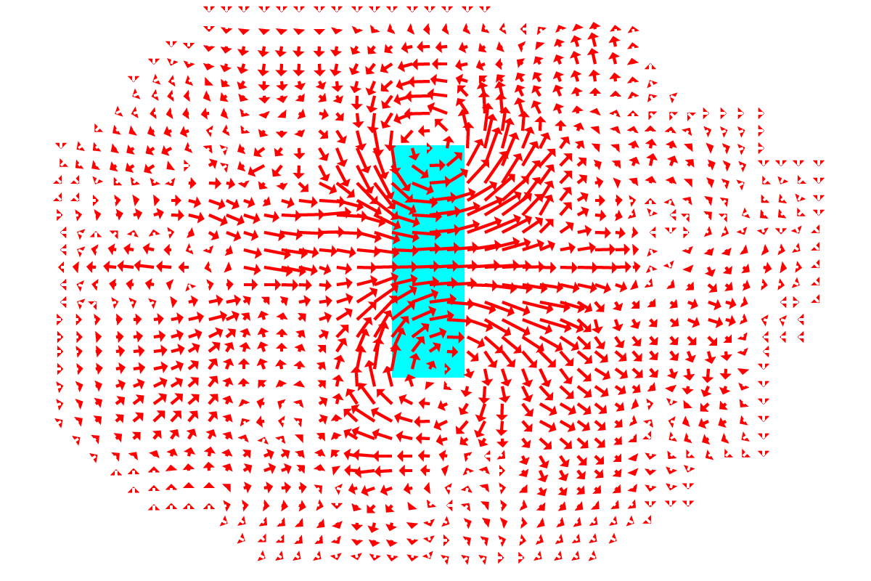
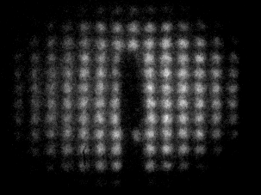
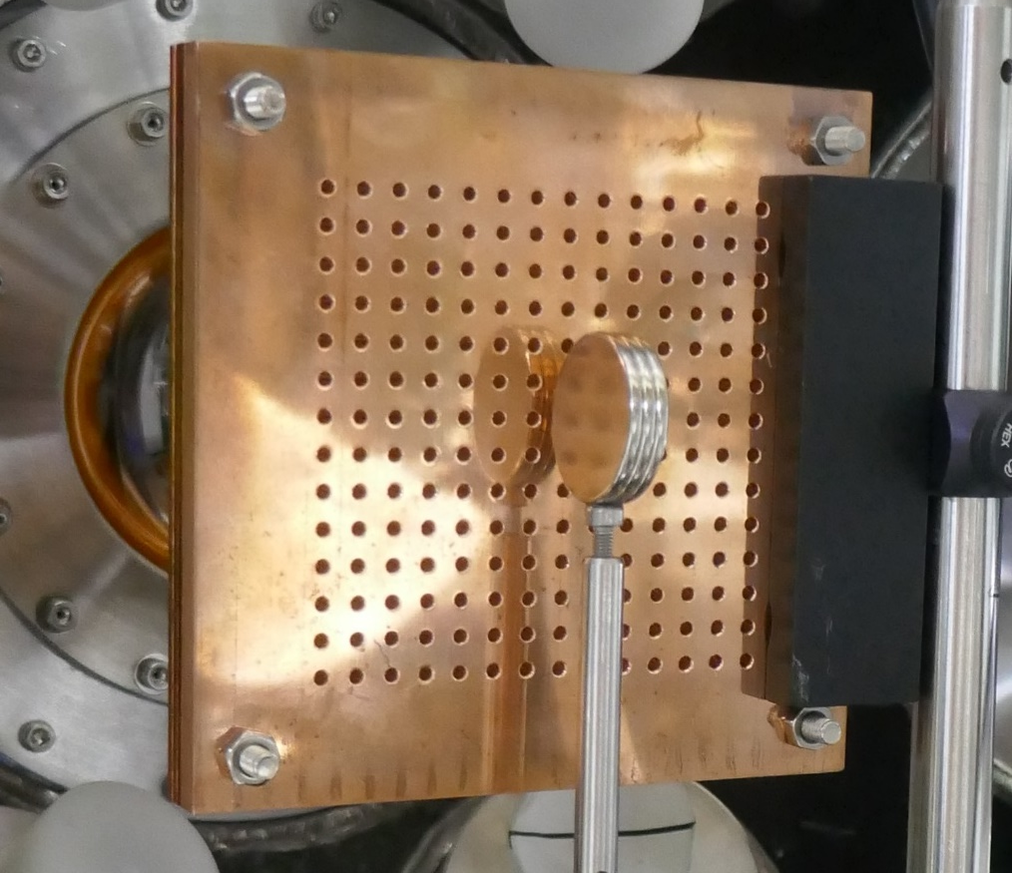
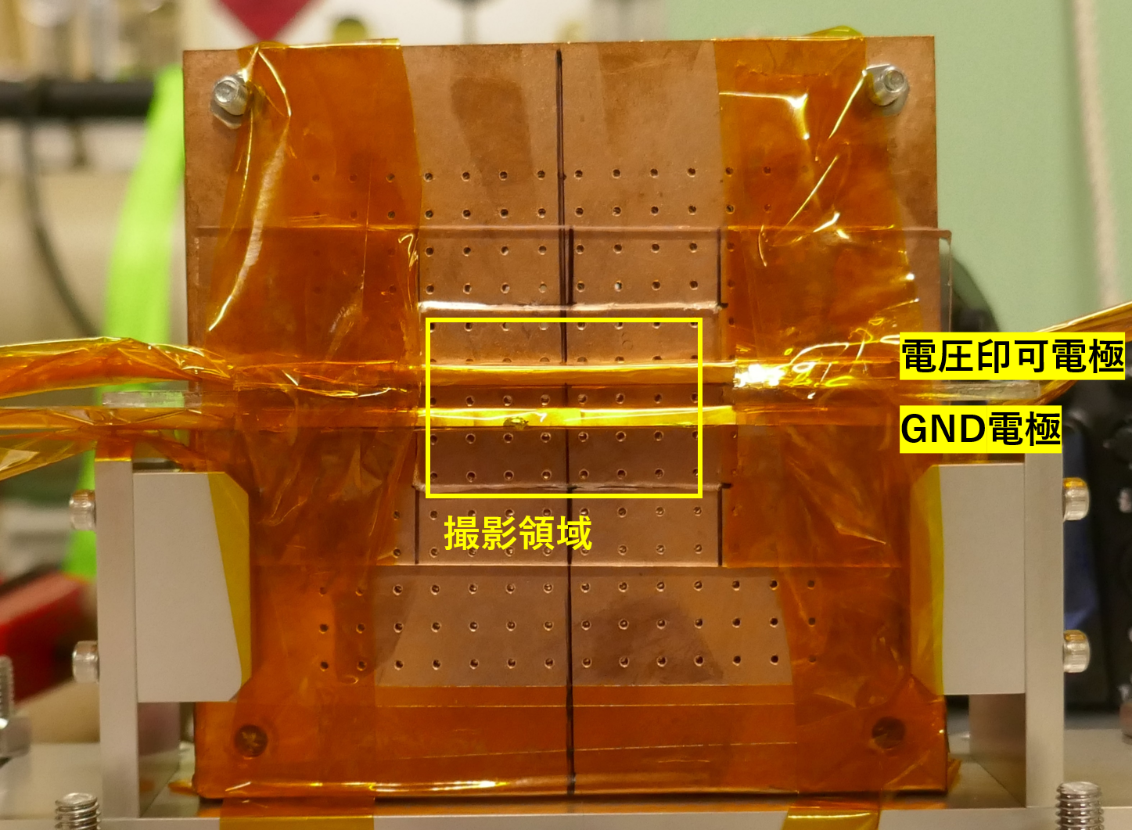
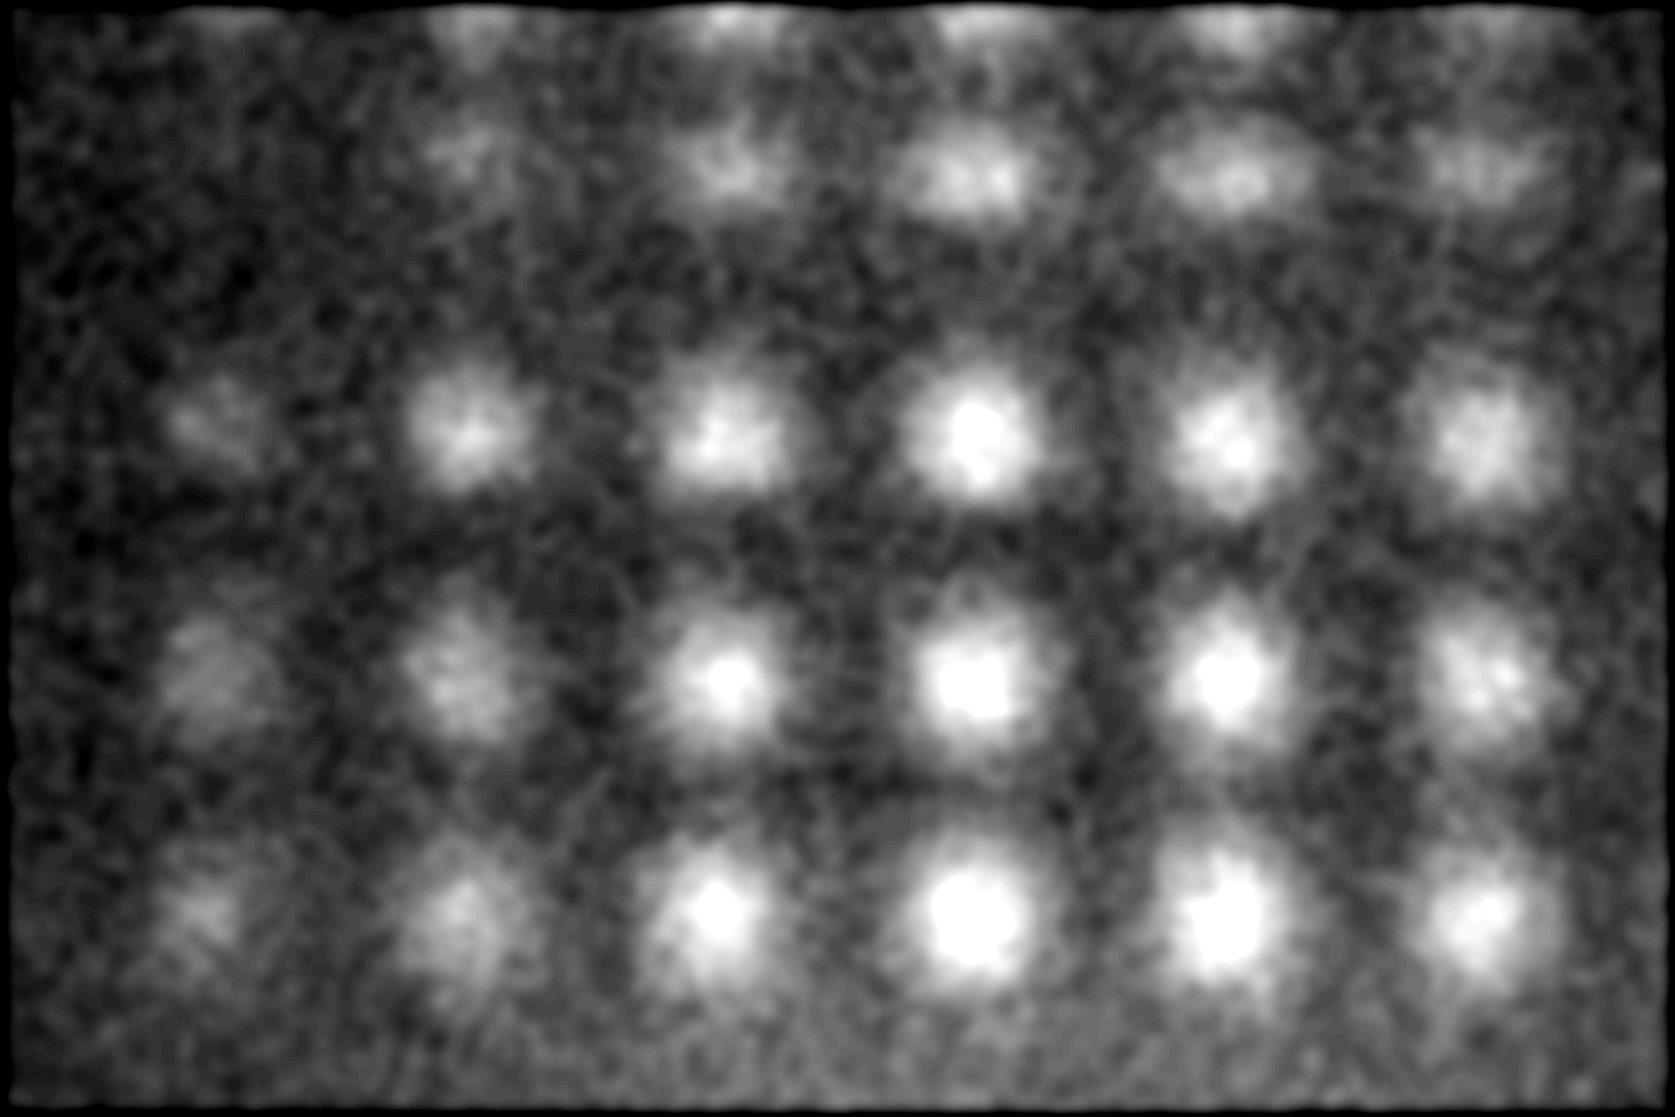
Demonstration : Visualization of Ele- and Mag- fields in Air
Magnetic field made by a magnet
is reconstructed as projected-field
by the muon imaging
vac
air
2kG φ20mm
Kapton win
Transparent image thorough magnetic field in air
Image processing
2kG
note）Inside of the magnet (cyan part) is
calculated by an interpolation
５ｍｍ
2kG 相当
Electric Field
in Air is also
visualized by μ!
±15kV

Slide 9
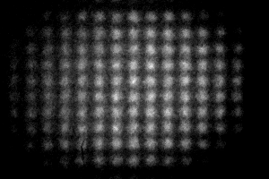
Image of acc-gen muon beam array

Slide 10
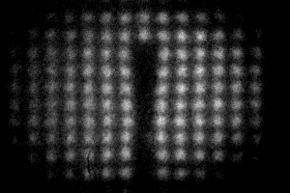
Image of acc-gen muon beam array with Magnet

Slide 11
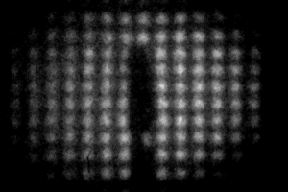
Image of acc-gen muon beam array with Magnet flipped

Slide 12
Reconstructed Magnetic Field in Air by μ-Beam
5mm
note）
Inside of the magnet (cyan part)
is calculated by an interpolation
2kG

Slide 13
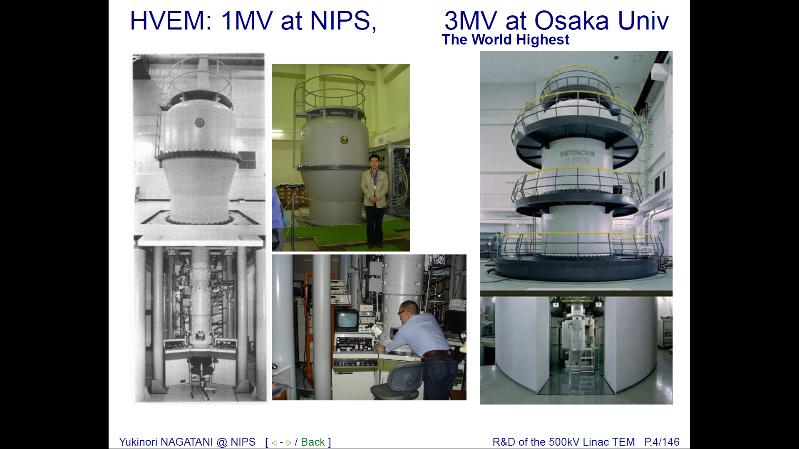
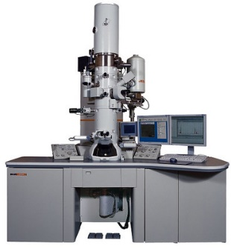
Transmission Electron Microscopy (TEM)
It visualizes EM-field by highest resolution:
Methods： Lorentz Microscopy, Electron Holography (Tonomura),
Phase-Contrast TEM (Nagayama)
Targets： Transistor (Rau), Mag-field among atoms (Shibata),
Membrane potential of liposomes (Sigworth), …
Specimen should be Ultra-thin
（depending on beam energy）
World Highest
200 kV cryo-TEM
1 MV HV-TEM @ NIPS
3 MV HV-TEM @ Osaka U.
Observable Thickness | ～200 nm | ～１ µm | ～３µm

Slide 14
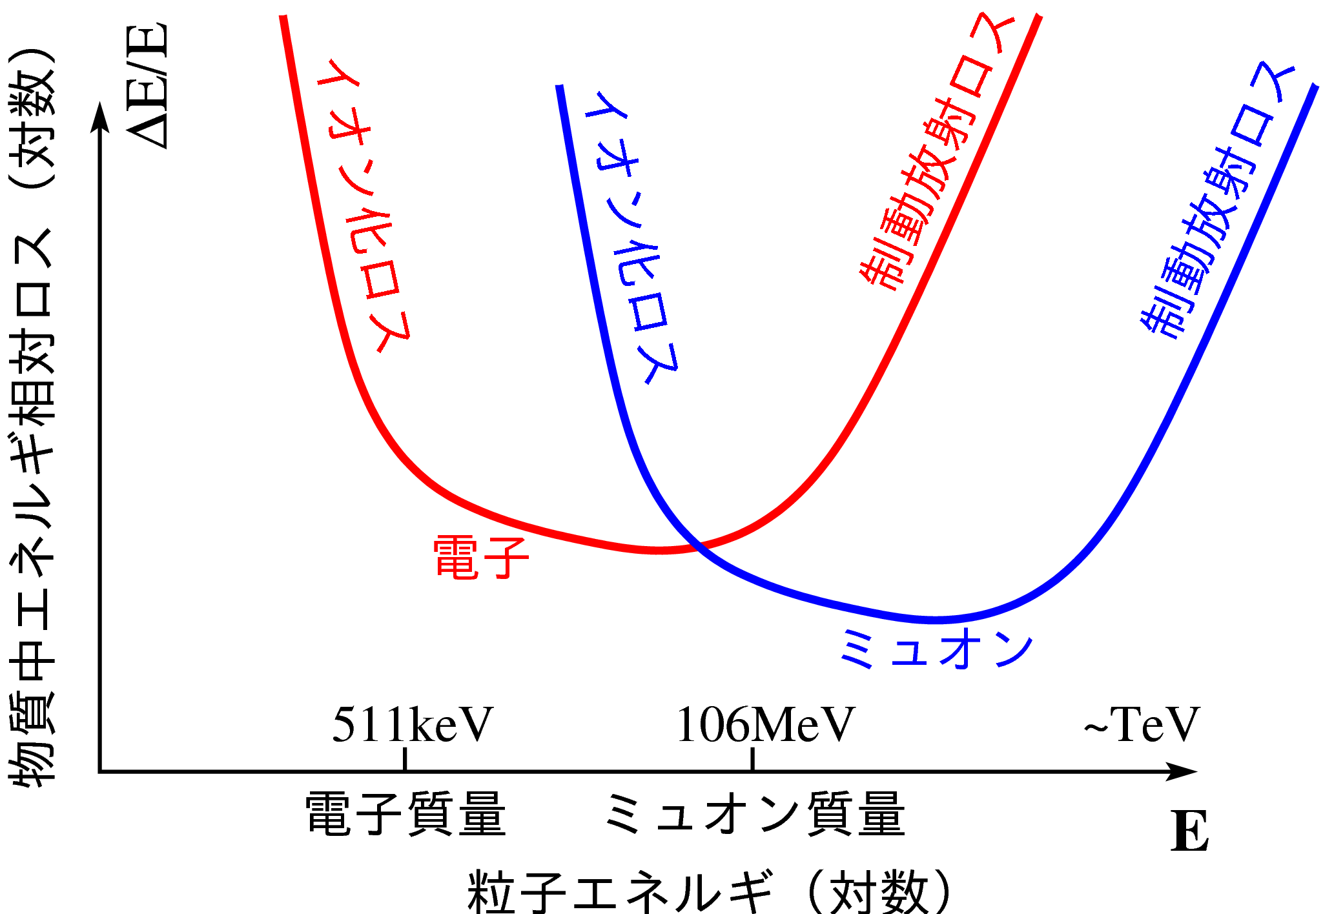
Penetration-capability of e and μ
Bremsstrahlung Loss
Ionization Loss
Bremsstrahlung Loss
More breaking
Ionization Loss
More breaking
TEM
Relative Energy Loss in Material（log）
HV-TEM
Cosmic-ray muon imaging for mountains, pyramids,
atomic-reactors, ….
More penetrating
More penetrating
Electron
TµM
Muon
Electron’s mass scale
Muon’s mass scale
Kinetic Energy（log）

Slide 15
Concept of Transmission Muon Microscopy (TμM)
By employing accelerated muons instead of electrons in TEM, Electric- and Magnetic-fields in thick object are visualized.
Comparing with present methods
 | Mag-field | Ele-field | Penetration Power | Versatility of specimen
muon (TμM) | 〇 | 〇 | 〇 10μｍ～cm | Widely acceptable
electron (TEM) | 〇 | 〇 | × 100s nｍ～a fewμm | should be Ultra-thin
Neutron | 〇 | × | 〇 a few cm | Widely acceptable except for B, Gd, Cd, ….
Circular polarized X-ray | △indirect | × | △ 10μm | should has X-ray magnetic circular dichroism.
Optical Kerr scope | △indirect | △indirect | transparent or surface | Limited to transparent magnetic or nonlinear optical materials.
Ca-Imaging fluorescence microscope | × | △indirect | transparent life-tissue | Ca density measurement in life.

Slide 16
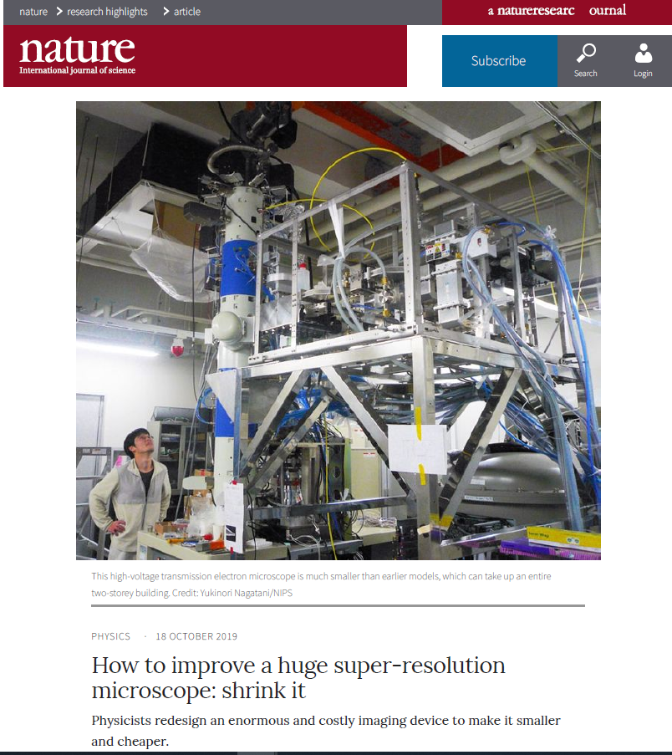
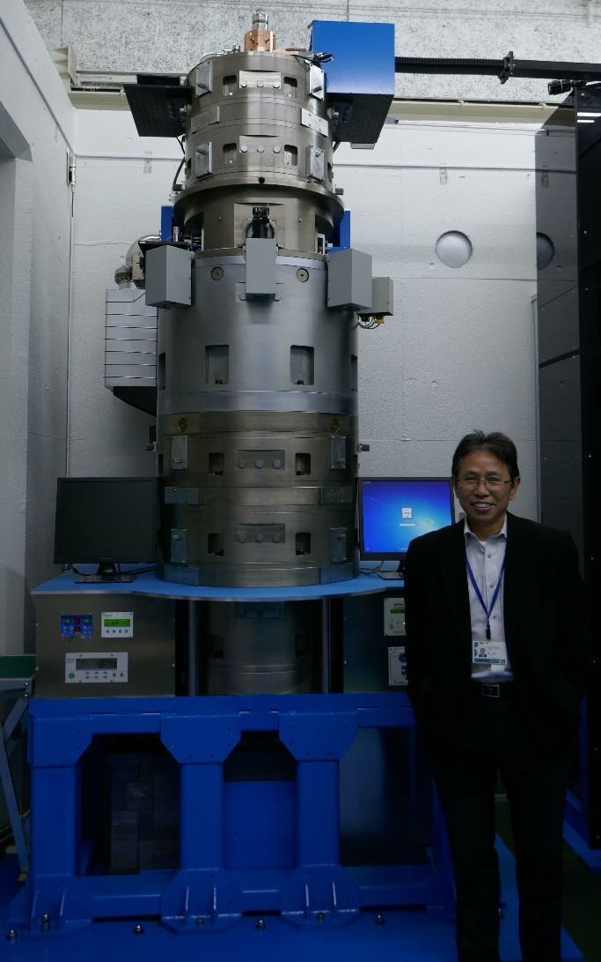
Recent Topics : HV-TEMs are realized by RF-Accelerators
Recently, linear accelerators are applied into HV-TEMs.
NIPS 500kV
Linac TEM
by Y.N. grp.
[PRL123(15)2019]
Osaka U. 3MV
RF-Gun TEM
by J. Yang
[Microscopy, 291-295 (2018)]
Sub-nanometer resolution achieved even using a linear accelerator!
Now, it is the time to apply TEM technology to Accelerator World
Notes:
Recently smaller high-voltage TEMs by employing linear accelerator using microwave to accelerate beams, instead of using DC accelerators, are being developed.
Even for using microwave for acceleration, sub nano meter resolution is realized.

Slide 17
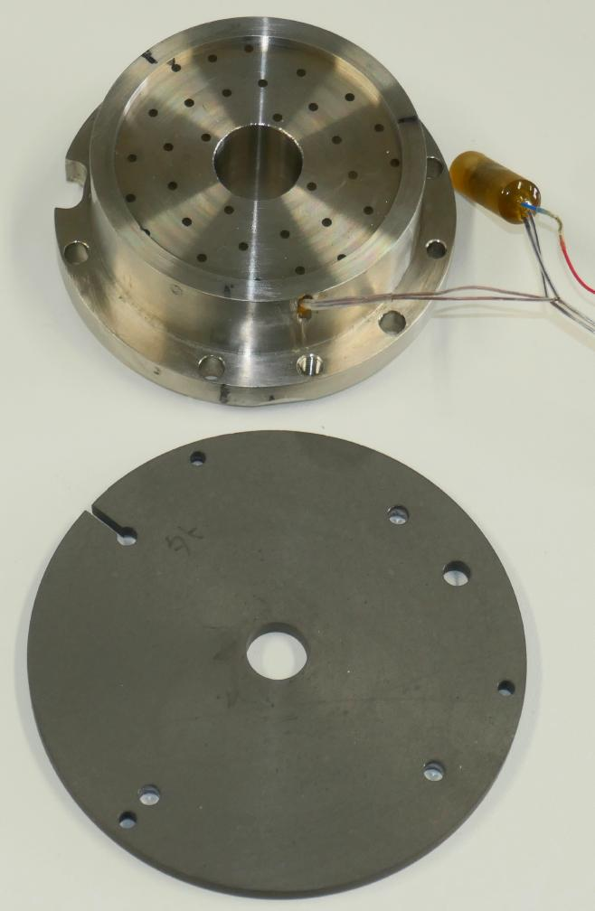
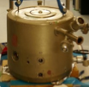
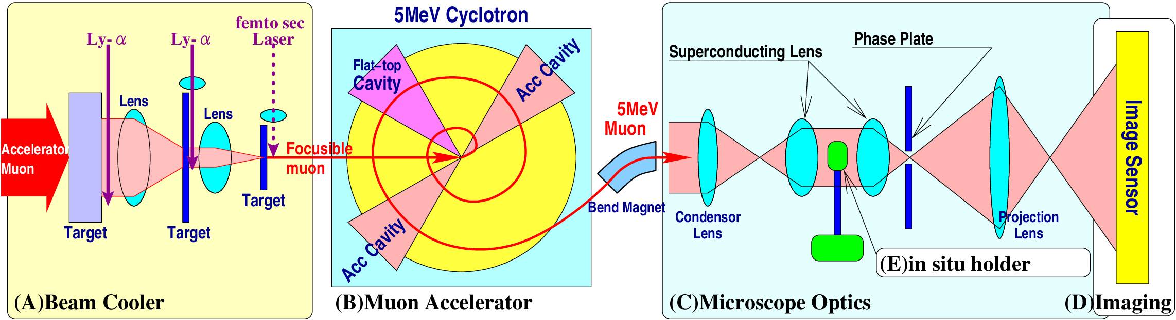
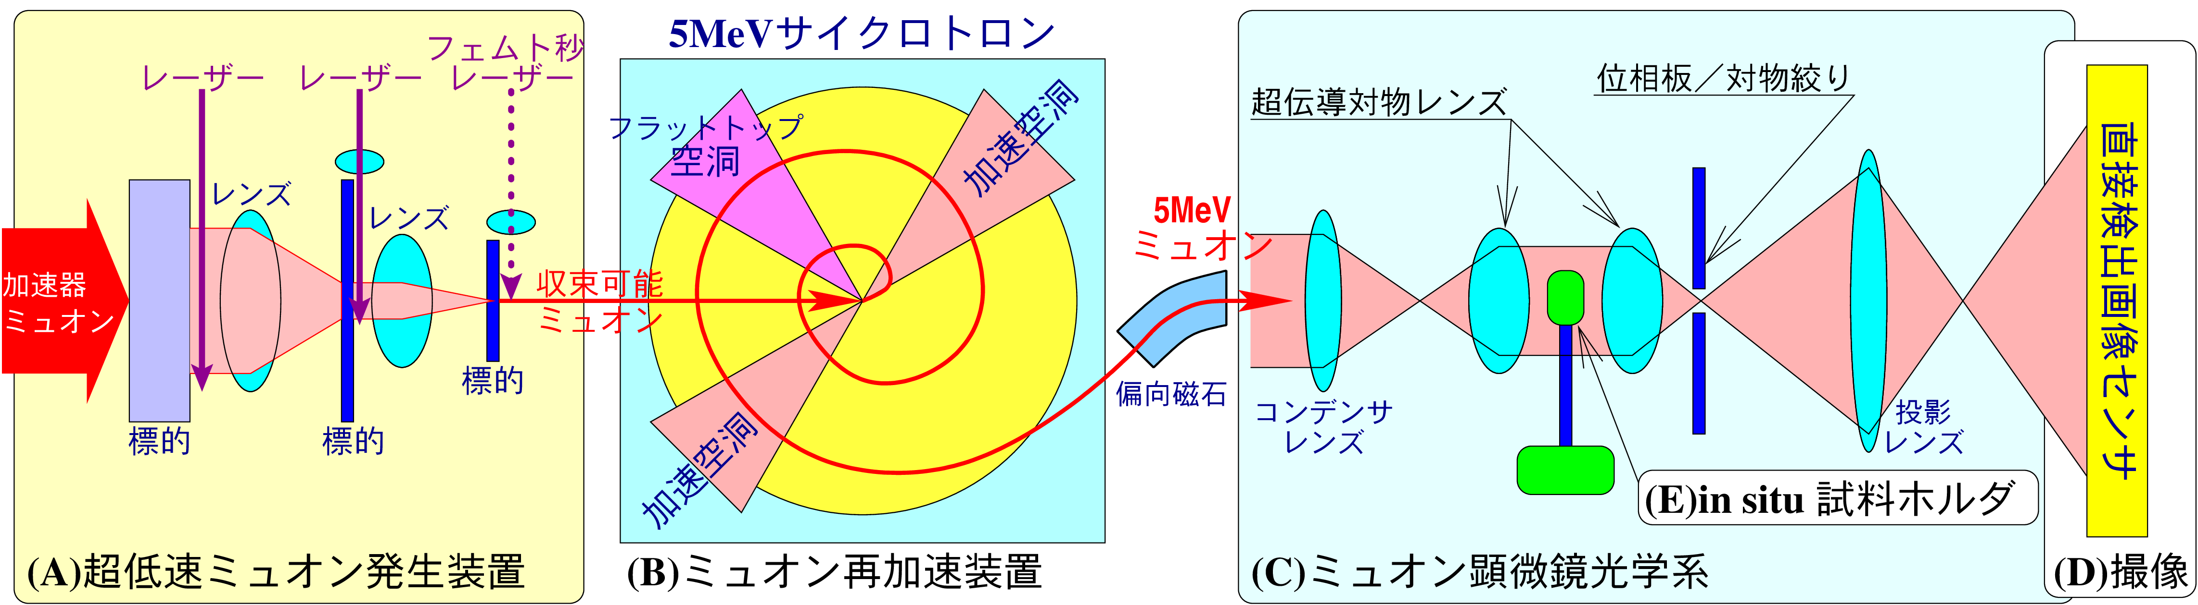
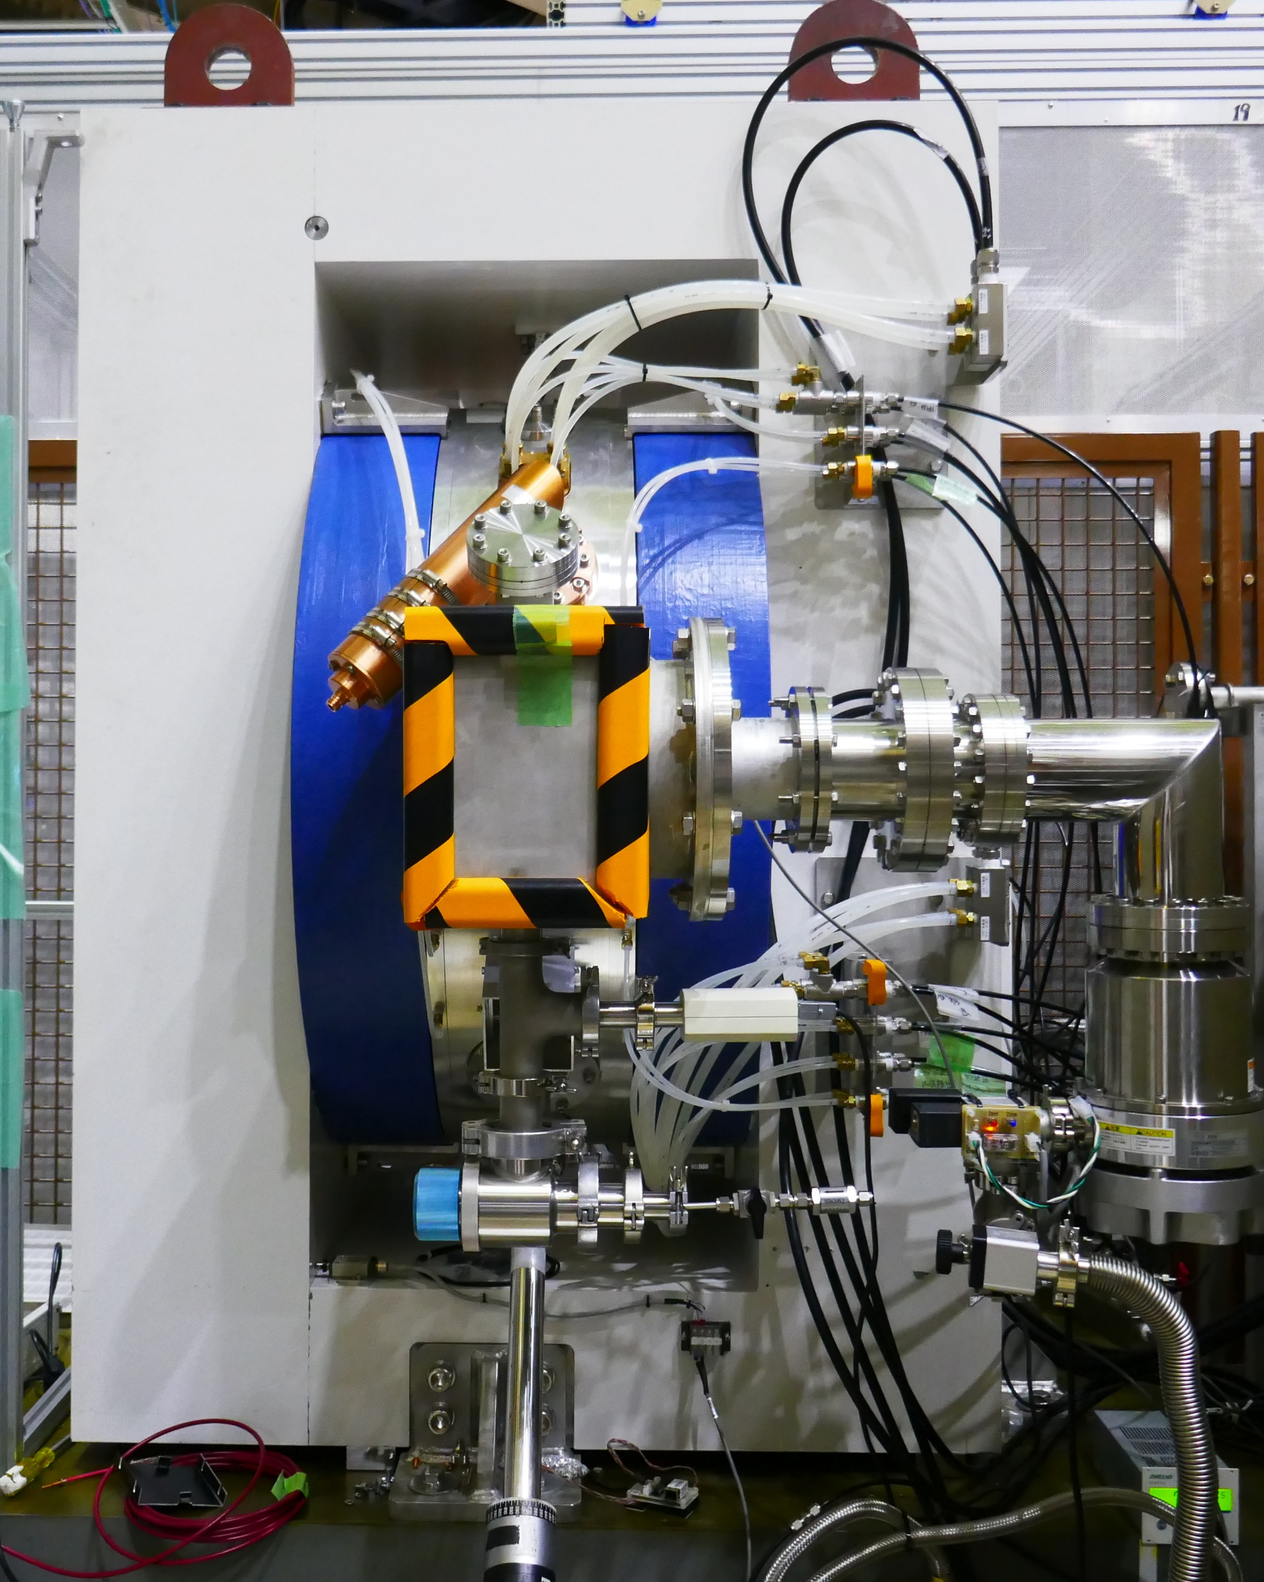
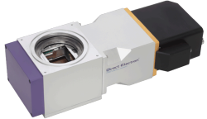
The 5MeV TμM under construction at J-PARC
Muon Beam Cooling
It converts low-luminance beam into high-luminance one.
Superconducting Object Lens
focuses accelerated μ-beam
Lorentz / Phase-contrast optics to visualize EM-fields
５MeV Muon Cyclotron
・It gives penetration-capability.
・AVF-type, Flat-top RF accel.
・ΔＥ／Ｅ～10⁻⁵ (goal)
・Time to accel. <１μsec
In situ specimen holder
for Power-device / Life
CMOS Image Sensor
for TEM is employed
Notes:
研究計画では、透過ミュオン顕微起用を開発し、各種の可視化実験を行います。
装置は超低速ミュオン発生装置、ミュオン再加速装置のサイクロトロン、ミュオン顕微鏡光学系の本体、画像センサ、試料ホルダより構成されます。
超低速ミュオン発生装置の１段目はレーザー装置も含めて安定稼働状態にあり、本研究で２段目、３段目と順次段数を増やし、より高輝度なミュオンビームを生成し、分解能と電磁場への感度を順次向上させます。
最終段はフェムト秒レーザーとし、ミュオンの極短パルスビームを得ます。
加速に用いるミュオンサイクロトロンはすでに開発がほぼ完了しており、Ｊ－ＰＡＲＣに設置ずみです。
顕微鏡光学系は、日本電子ＪＥＯＬより現物とともにＫＥＫに技術供与された超伝導対物レンズ、電磁場を可視化する光学系、カメラ、試料ホルダより構成されます。カメラは電顕用の直接検出型ＣＭＯＳ画像センサを用います。我々は既にＣＭＯＳ画像センサによるミュオンビーム像の直接検出に成功しております。

Slide 18


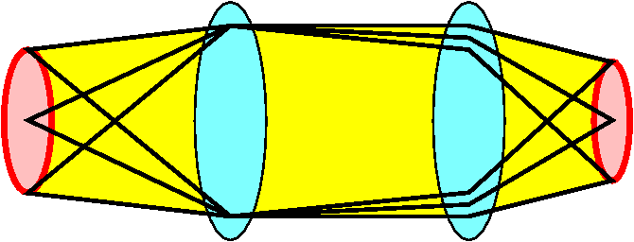
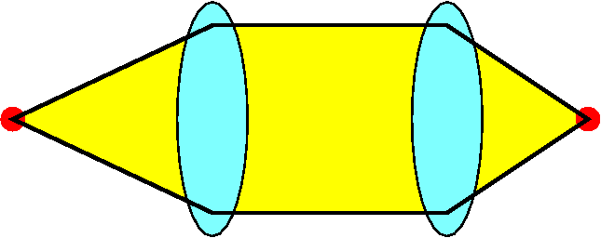
The need for beam cooling
Muon beam
generated by Accelerator
Muon beam
like a Laser beam
Cooling
Light by Flashlight
Laser Beam
High current, but
● Diffusible
● Incoherent
Low luminance
●Focusable
●Coherent
High luminance
While beam by a fuzzy source can only be blurry focused,
Source
Image
Source
Image
Lens
Lens
Lens
Lens
cooled beam can be focused into a small spot!
Beam cooling converts a low-luminance beam into a high-luminance beam that can be focused into a very small spot!

Slide 19
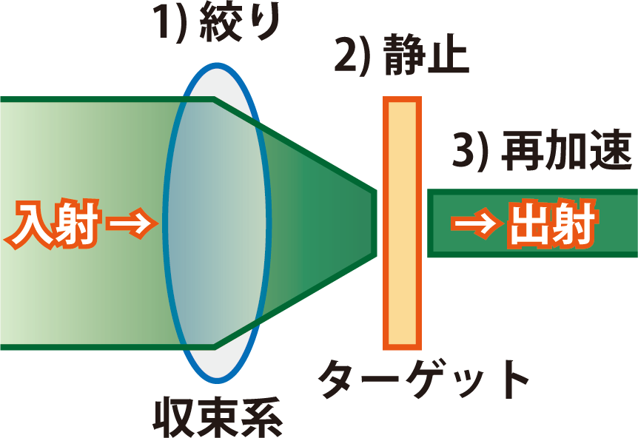
Essence of the Beam Cooling
1) Focus
2) Stop
Beam
Input
Cooled Beam
Output
3) Extract and
4)Re-accelerate
Target
Condenser Lens
Momentum distribution is cleared by stopping.
Volume in phase space (emittance) is shrunken down. = Beam-Cooling
Iteration of this process can cool the beam down much more.

Slide 20
Single- / Multi- step Muon-Beam Cooling
100μJ Lyman-α＋355nm Laser
Single-step
SOA Lens System
1mm focusable
Ultraslow
Muon Beam
GND
Surface
muon
beam
Surface
muon
beam
Mu
μ
μ:Dissociation
μ
Our Current System
＋30kV Extraction
Target
SiO2-AG
Mu: bound state among μ⁺ and e⁻
100μJ Lyman-α
+ 355nm Laser
1mJ femto-sec
pulse IR Laser
500μJ femto-sec
pulse IR Laser
10μJ femto-sec
pulse IR Laser
30nm focusable
pico-sec pulsed
Ultraslow
Muon Beam
Multi-step
D=50mm
Surface
muon
beam
Surface
muon
beam
Mu
D=1mm
D=30μm
D=1μm
GND
3kV
3kV
3kV
30kV
1st target
SiO2-AG
2nd target
Mesoporous
SiO₂ foil
3rd target
Mesoporous
SiO₂ foil
4th target
Mesoporous
SiO₂ foil
Transmission ～ 10%
Luminance ×10⁸
Ultrashort pulse
0cm
10cm
20cm

Slide 21
Concrete Design of the multistep cooler
1mJ NIR femto-sec pulse Laser
100μJ Lyman-α
+ 355nm
Half-cylinder
D=80mm
28kV Accel.
Surface
muon
beam
表面
ミュオンビーム
30nm-focusable
pico-sec pulsed
muon beam (30kV)
Mu
D=1mm
D=30μm
D=1μm
⊗
GND
2kV
2kV
2kV
2kV
28kV
The 1st stage
The 2nd
The 3rd
The 4th
Total Length
～180mm
47mm
33mm
30mm
30mm
40mm
The 1st stage consists of the SiO2-AG target and Half-cylinder cooler.
The 2nd～4th stages consist of a SiO2 mesoporous film and Immersion/Einzel lenses.

Slide 22
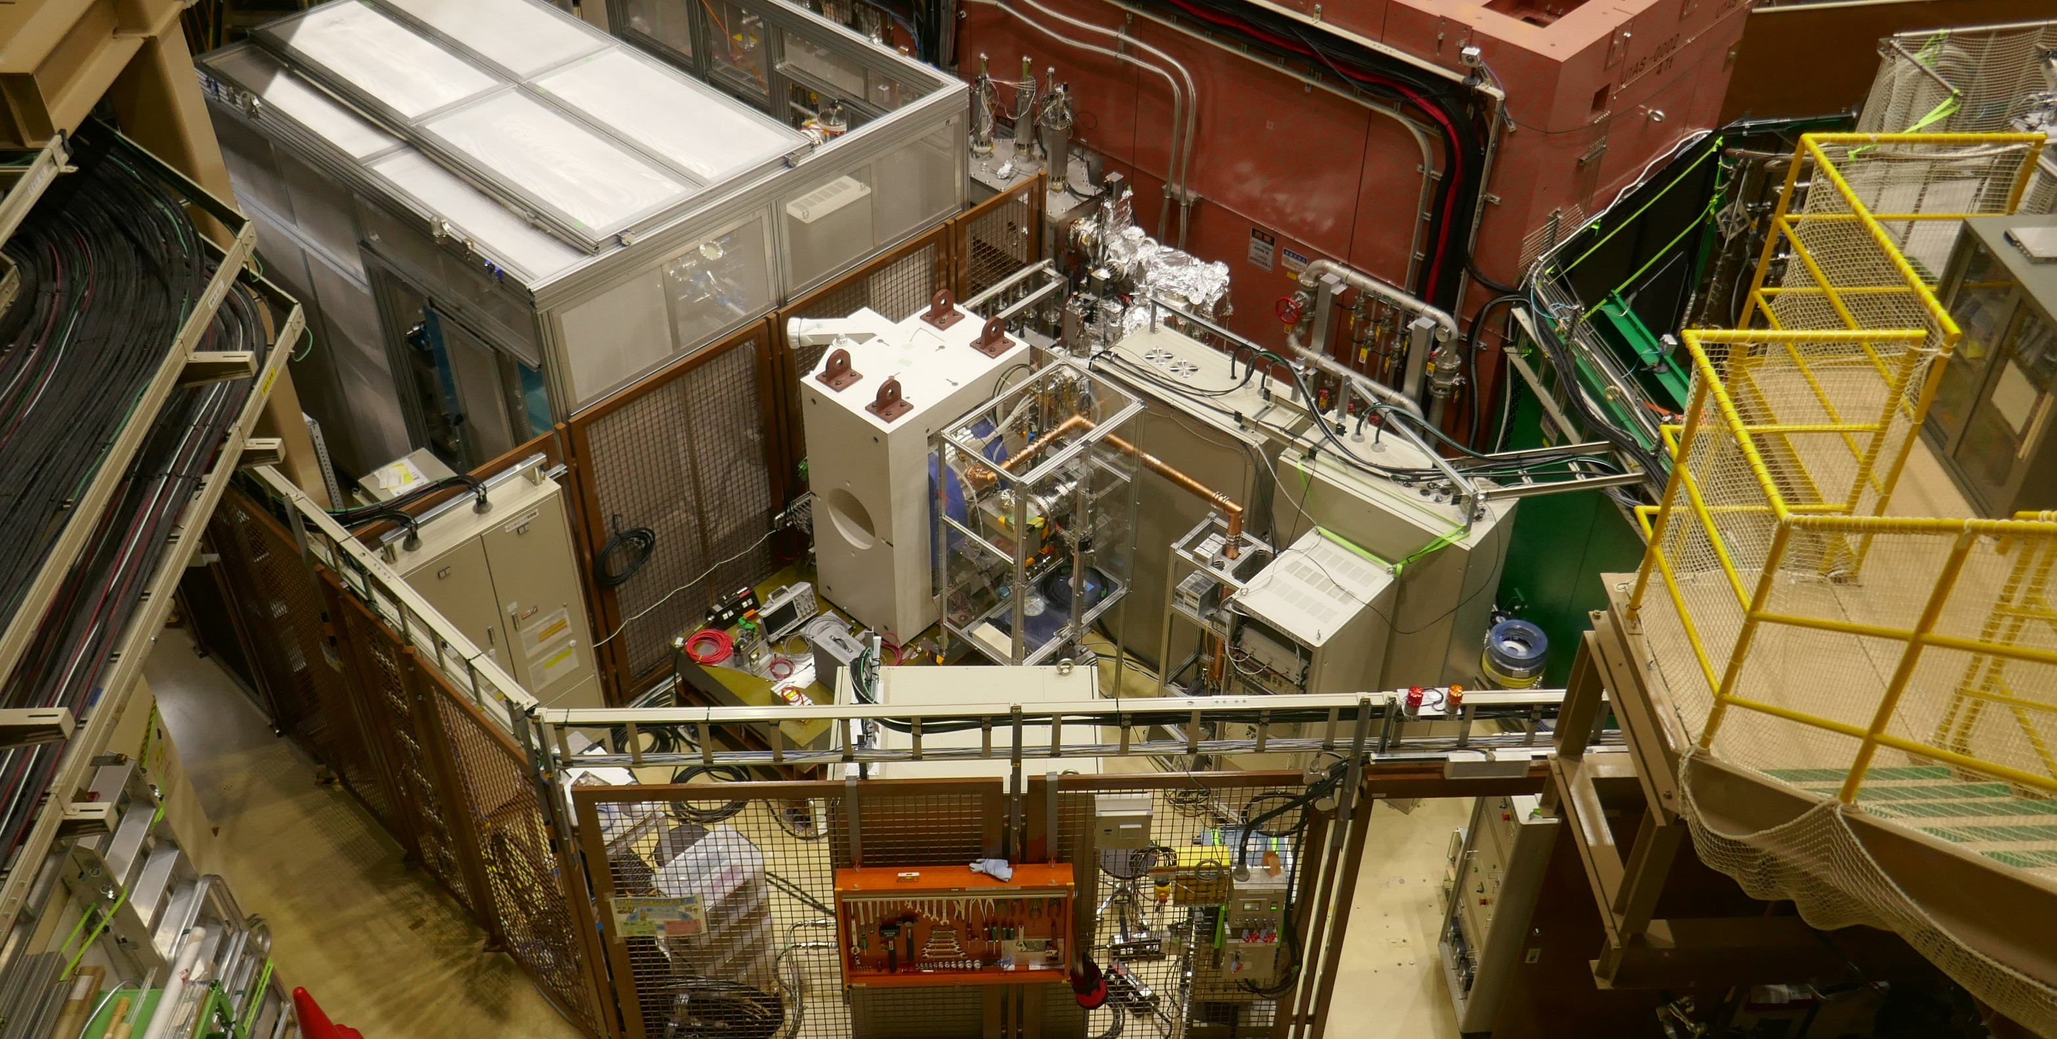
Cyclotron constructed in U1B area of J-PARC
Ultraslow Muon Beam Line
Muon Cyclotron
RF Amplifier
RF Co-ax
Vacuum Pumps
RF Controller
PS for RF-Amp
Indicators
Servers
Coil PS
EM-Stop Button

Slide 23
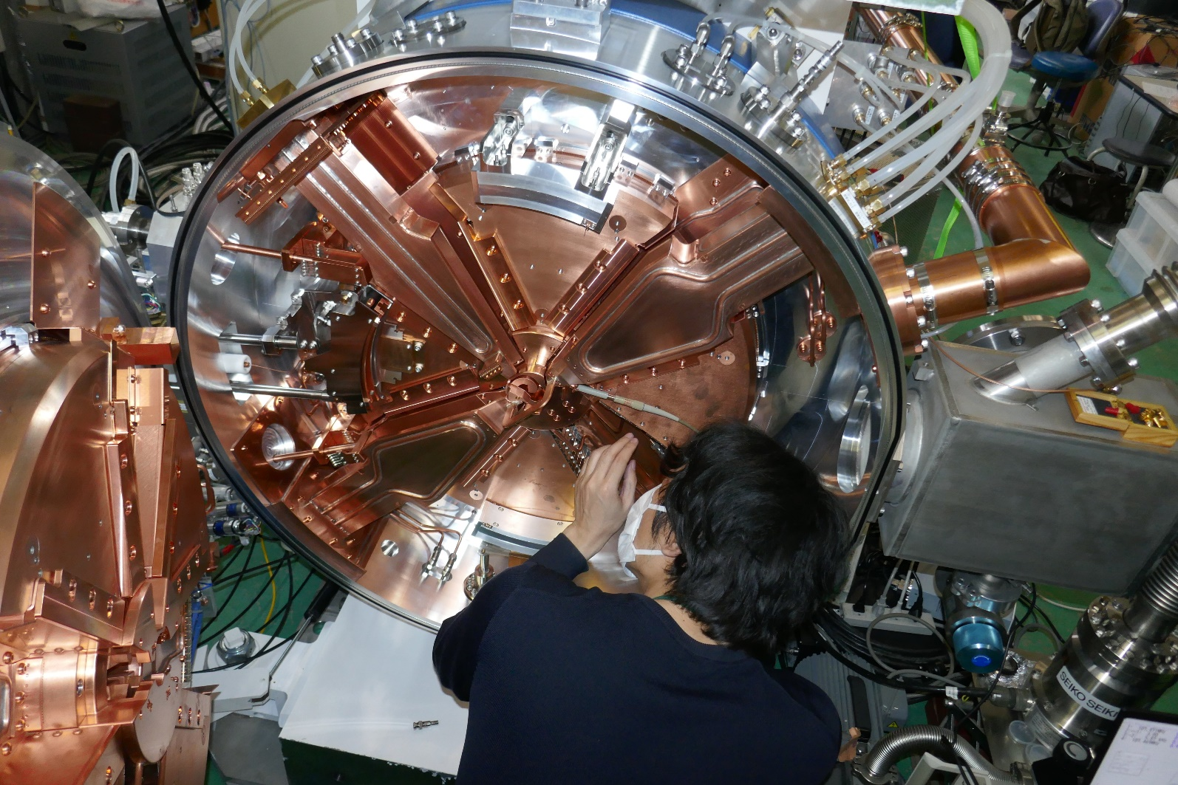
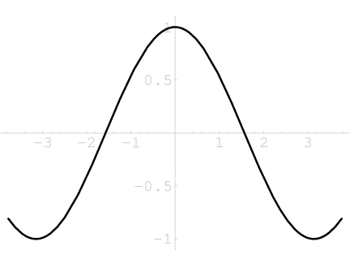
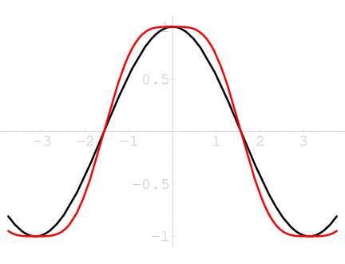
Inside of the 5MeV Muon Cyclotron
about 70-turns in 1μsec
Flat-top
3F-Dee
RF Co-ax
1F-Dee
Beam Extraction
5MeV Muon-beam
Flat-top Acceleration
1F-Dee
ΔE/E～10⁻⁵
Beam-pipe
Conventional Acceleration
Inflector
injects muon beam from back into circular orbit
Notes:
ミュオン顕微鏡に用いるミュオンサイクロトロンは概ね完成し、Ｊ－ＰＡＲＣに設置されております。装置はセクタ磁石、２本の基本波Ｄｅｅ空洞と、１本のフラットトップＤｅｅ空洞より構成され、中心のインフレクタから入射されたビームは、６０回周回で5MeVまで加速され、取り出されます。基本波に加え3倍波を加えたフラットトップ加速で、10のマイナス5乗台の安定度を得て、ナノメートル分解能を可能にします。

Slide 24
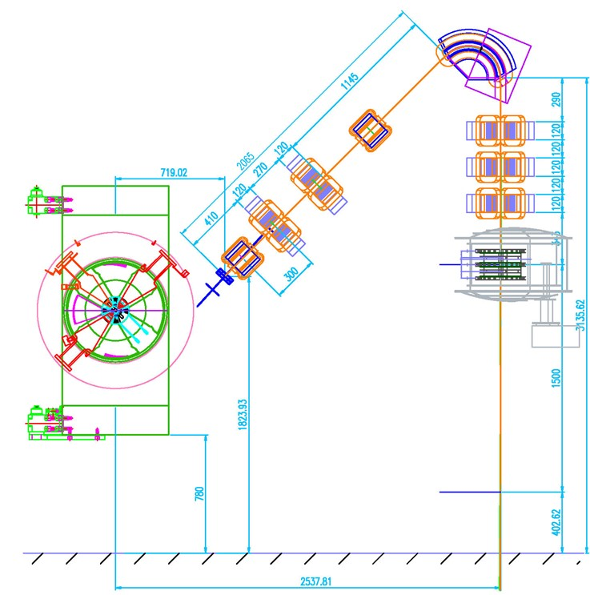

5MeV TµM：Cyclotron + Main Column of TμM
135-deg Bend Magnet
５MeV Muon
Cyclotron
Condenser Lens
Q-magnet Doublet
Condenser Lens
Q-magnet Triplet
Superconducting
Object Lens
Specimen
Height～3m
5MeV Muon Beam
Camera
5MeV Acceleration in 1µsec, stability ΔE/E~10⁻⁵, vertical microscope column
Notes:
This is side view of the cyclotron and the transmission muon microscope.
We developed a new 5MeV cyclotron to accelerate the muon beam.
To reduce a chromatic aberration, a flat top RF acceleration is employed.
We use superconductor object lens, which is developed by Isolde Dietrich, and is transferred from JEOL to KEK.

Slide 25
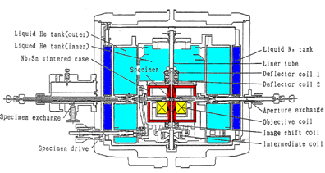
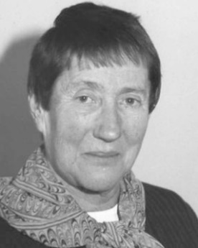
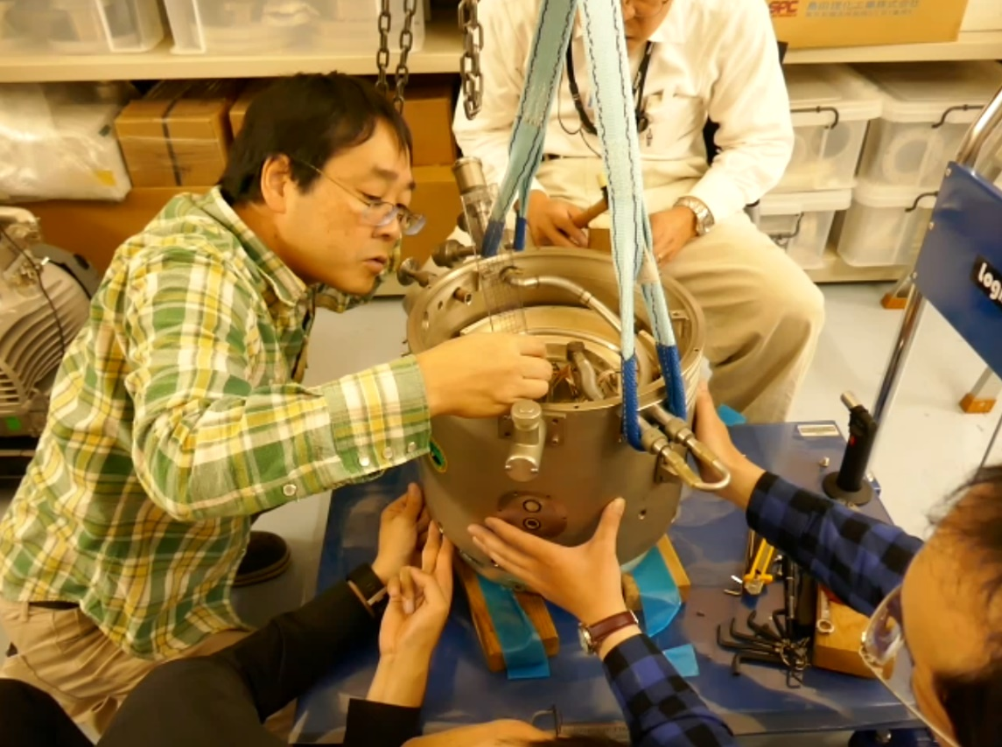
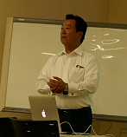
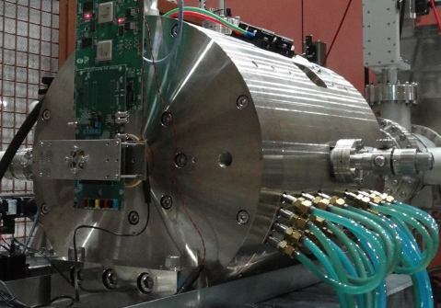
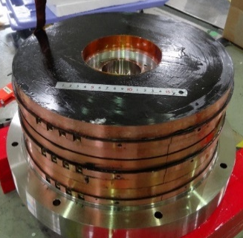
R&D of Lenses for TµM
Superconducting Object Lens
Developed by I. Dietrich
Transfer from JEOL to KEK
Normal Conductor Lens
Magnetic field is
guided to be focused
by Meissner shields
rather than pole-piece / yoke.
Superconducting Coil
with persistent current SW
Meissner Shield
for field convergence
5MeV TμM becomes 3m Height,
40MeV TµM becomes 9m Length.
Notes:
This is an object lens for 300keV transmission muon microscope. Normal conductor lens is used.
The next is the currently constructing 5MV lens.
The superconductor lenses should be required for over 5MeV muon microscopy.

Slide 26
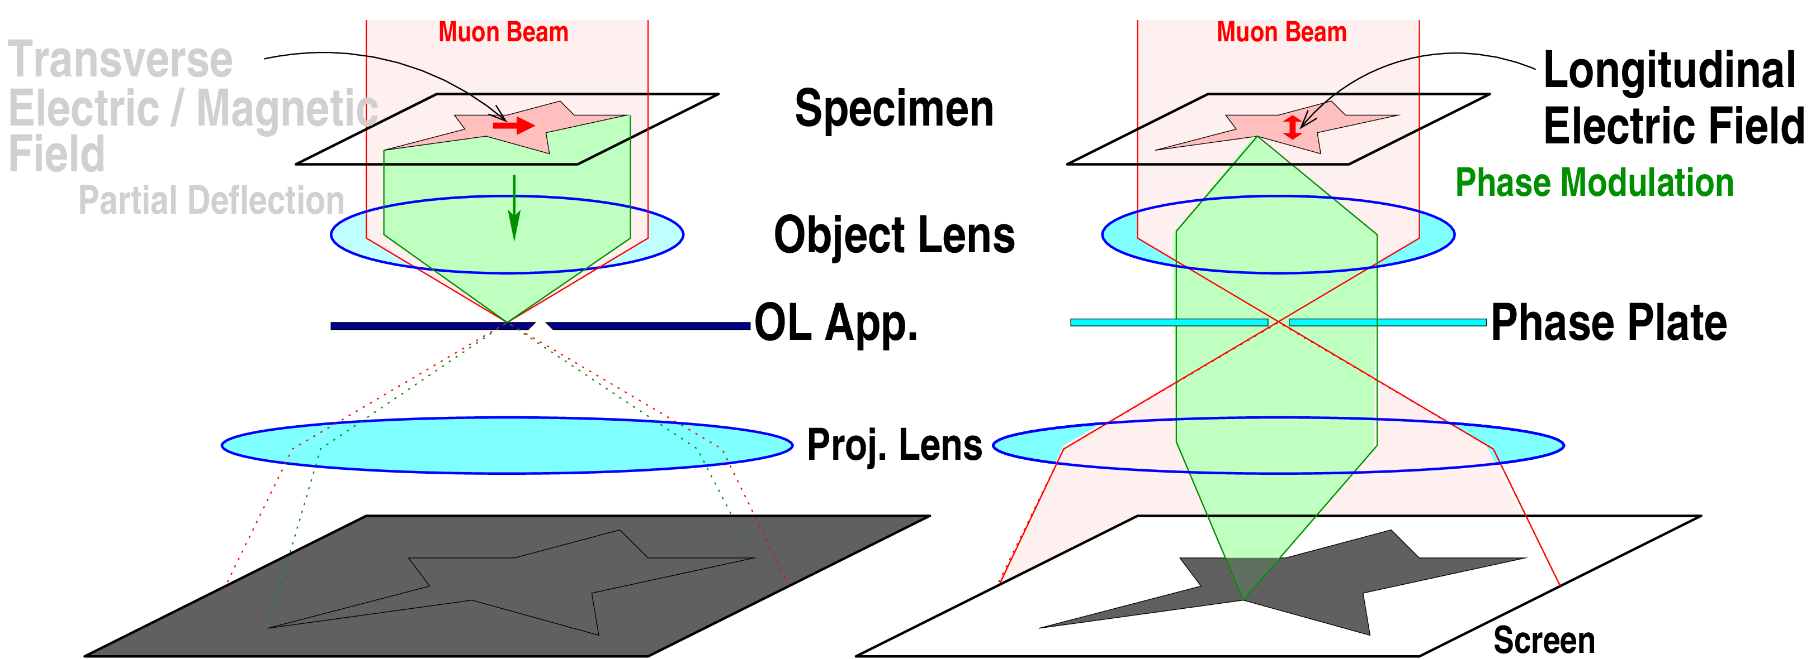
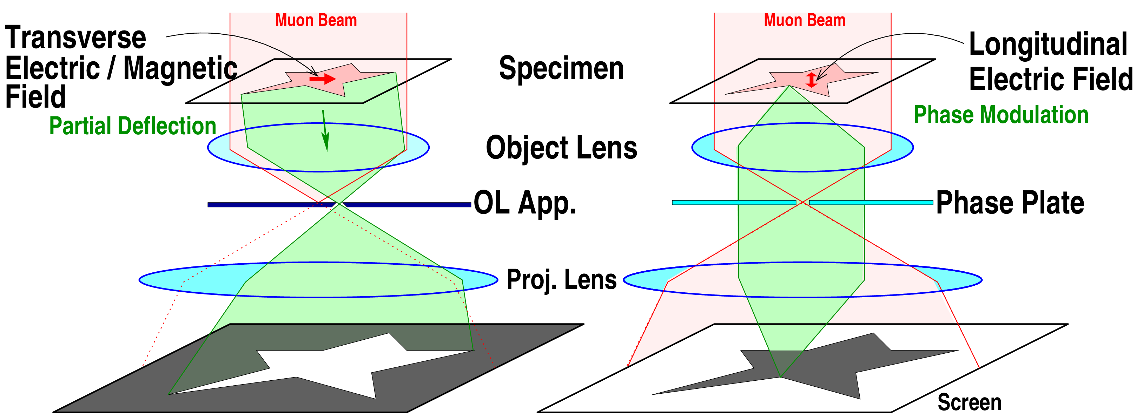
Visualization of Electromagnetic Fields
Lorentz Method
Zernike Method
visualizes distribution of beam deflection:
visualizes electrostatic potentials:
TµM can visualize electromagnetic field in a bulk specimen.
The 3D distribution is also obtained by Computed Tomography.
Notes:
What we can see by muon microscopy?
It is enough to use optical microscopies,
if we want to see a structure of the macroscopic specimen simply.
One of the important merits of transmission muon microscopy is visualization of electric and magnetic field in macroscopic bulk object.
The transmission muon microscopy can import almost of all methods developed for transmission electron microscopies,
including a Lorentz method and a Zernike phase contrast method.
These methods can visualize distribution of electromagnetic field in the specimen.
The Lorentz method visualizes distribution of transversal bending force in the specimen.
The muon beam is partially deflected by the force distribution.
By inserting the object aperture into the back focal plane,
the deflection patten in the specimen arises on the camera screen.
This is principle of the well-known Lorentz method.
The next is the Zernike phase contrast method. It can visualize distribution of electrostatic field in specimen as a contrast image on the camera screen.
It can see distribution of action potentials, whose voltage is 10mV to 100mV in neurons.

Slide 27
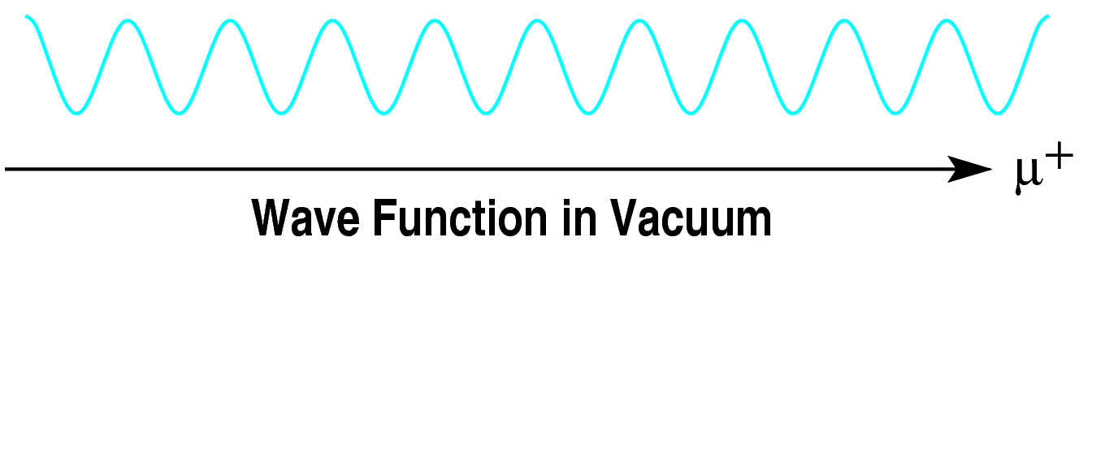
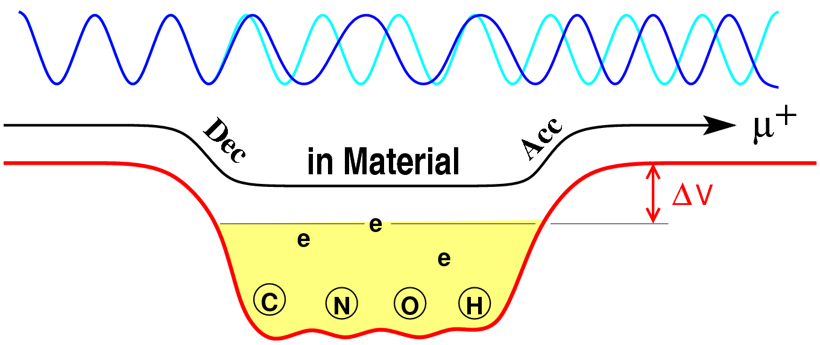
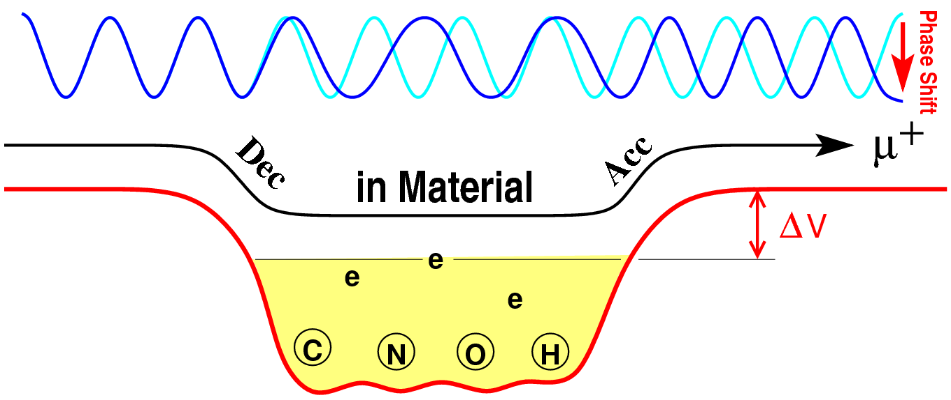
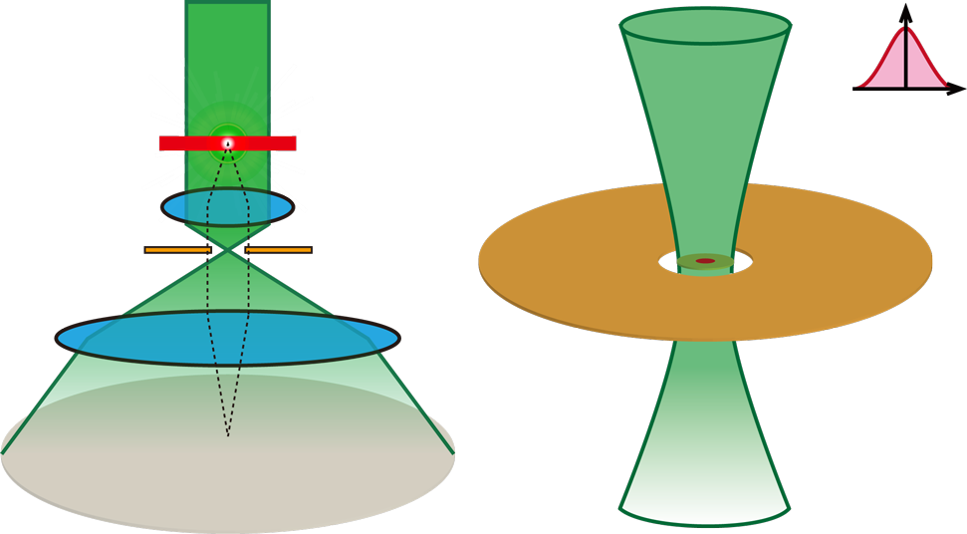
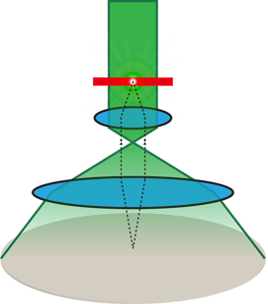


Visualization of Elec-Potential by Phase-Contrast
Phase Shift:
θ ＝ (e/h) ΔV×Passing-Time
Muon beam
Muon beam
Center hole
Beam spot
Carbon foil
t～10nm
Specimen
φ～1μm
Zernike Phase Plate
Object Lens
Phase Plate
$I\left(x\right) = { \left\|e^{iθ(x)}\right\|}^{2} = 1,$ …No Contrast
Projection
Lens
Sensitivity：25mV/μm thickness
➡It can visualize the electric potentials of
Mitochondria and Neurons （～100mV）
Insertion of the Zernike Phase Plate
$IZPP\left(x\right) = {\frac{1}{2}\left\|{1+ e}^{iθ\left(x\right)}×e^{iπ/2}\right\|}^{2}= \frac{1}{2}−\frac{1}{2}\sin{θ\text{(}x\text{)}}$.
Phase-shift is converted into Contrast
Notes:
真空中をミュオン波動関数が進むのに比べ、物質中の電気ポテンシャル中を通過すると、物質に入るときには減速、出るときには加速され、位相差が生じます。その位相差は背景との電位差と通過時間に比例します。
この様な波動関数を通常の結像法で検出しても位相は検出できません。
しかし、後方焦点面に炭素薄膜に中心穴を開けた位相板を挿入すると、位相シフトがコントラストに変換され、可視化できるようになります。

Slide 28




Test of muon imaging by CMOS Image Sensor
CMOS Image Sensors for TEM are too expensive for test (>$150k).
We have tested imaging-capability of commercial digital camera ($3k) Nikon Z7II.
Sensor size 35.9×23.9mm
Pixels 8256×5504、
Unit-pixel size 43μm× 43μm
Setup and Result
μ
CMOS Sensor
Horse plastic models
10mm

Slide 29
Expected Resolutions
Phase 1: 5MeV TμM at U-Line
A prototype microscope for Proof-of-Concept :
Max specimen thickness: ～ 10 μm
Spatial resolution: ～ several 10s nm
Exposure-time: ～ 1day for (0. 5K)² pixels image with 8bit depth
Phase 2: 40MeV TμM at H-Line collaborated with the Muon g-2/EDM exp.
A practical microscope for industrial and scientific applications:
Max specimen thickness: ～ 1 mm
Spatial resolution: ～ a few nm (Goal)
Exposure-time: ～ 40 min for (1K)² pixels image with 8bit depth
～ 1 day for (1K)³ voxels CT

Slide 30


Electric field in High Voltage Transistor (AIST)
AIST Power Electric Group developed 14kV SiC MOS FET.
（Highest commercial device is 3.3kV）
Simulated Electric Field Distribution
By finding points of electric field concentration and break-down,
we can develop higher voltage devices.
➡ down-sizing, energy-saving ➡ Efficient EV, Power-Grids ➡ SDGs。
By pico-seconds Stroboscopic imaging, RF fields are also visualized
➡Speed up the communication network, Higher performance Rader, …

Slide 31

For High Performance Electric Devices
2017 MLCC Market Shares,
World：￥8,617 oku ≃ ＄80B
Ceramic Condenser（MLCC）
Higher dielectric strength in unit volume
is essential for market competition.
E= (C/2)×V²
TμM visualizes the field concentration and break-down phenomena.
➡ It helps to develop higher performance condensers.
Motor, transformer, generator → EV, Power Grid,
Piezo, ultrasonic devices → Medical、 Non-destructive inspection.
Ohters
Murata
TaiyoYuden
Ref: J-Chip User Kai 2018

Slide 32

Meas. of all Mitochondrial Membrane Potentials
A cell contains thousands of mitochondria.
They form tubular network structures throughout the cytoplasm, which constantly divide and fuse.
These mitochondrial dynamics are related to energy metabolism, and abnormalities are
involved in disease.
Present methods can not observe correlation
among dynamics and function (mem-potentials).
Division
Fusion
Image by Optical Microscopy
https://www.biophys.jp/highschool/A-31.html
Cryo-TμM measures the local membrane potential distribution of all mitochondria within a cell.
➡ A breakthrough in cell biology
Notes:
細胞内小器官のミトコンドリアは、その膜電位を基盤として細胞のエネルギー生産を司りますが、
単離したミトコンドリアはTEMで十分に観察可能な大きさです。
ヒト精子の実際のTEM像を示しますが、位相差像の長波長成分には膜電位を反映したコントラストが含まれています。
本研究では、位相差コントラスト形成理論を下にした画像解析手法を構築し、電顕にもミュオン顕微鏡にも使える膜電位の定量測定法を確立します。
同一ミトコンドリア試料の観察で、TEMとミュオン顕微鏡の測定の連続性を証明します。
この応用として、ミュオン顕微鏡で細胞内のミトコンドリア群の全体の膜電位の網羅的な測定を行います。
細胞内で、ミトコンドリアの個数はときに数千個に及び、細胞質全体に管状の網様構造を形成し、絶えず分裂と融合を繰り返していますが、
このミトコンドリアダイナミクスの詳細な機序や、細胞にとっての生理学的な意味や目的も不明です。
クライオミュオン顕微鏡で細胞をCT撮影し、細胞内の全ミトコンドリアの膜電位を網羅測定します。
これによりミトコンドリアの形態と膜電位の関係を明らかにし、これらの細胞生理の謎を解く基盤データを与えます。

Slide 33


Functional Visualization of Neurons by TµM
3D Tomography of action-potential in neurons frozen just after an electrical stimulation
The neuron are cultured on the electric microscope grid.
Freezing rapidly with liquid ethane
just after an electric pulse stimulation
to a neuron..)
TµM with cryo-holder and stage.
3D measurement by the tomography
of phase contrast.
Stroboscopic movie of action-potential propagation in living neurons in environmental cell
Visualization of living neurons/networks.
Live cells/organs in an environmental cell.
in bio-liquid at room temp and pressure
with windows.
Electric pulse stimulation is synchronized with the muon pulse.
Timing delayed Δt is scanned.
Notes:
What is scientifically interesting?
We have 2 plans,
one is an environmental cell for living neurons,
We prepare an environment in the cell where neurons or a nervous or brain tissue are living and are working by keeping normal pressure, normal temperature, biological liquid environment, and so on.
The environmental cell has vacuum window for passing the muon beam. The transmission muon microscopy can observes such a thick environmental cell.
By applying electric stimulation pulse to the nervous tissue synchronized with the muon pulse, we can take stroboscopic images of electric works of the nervous tissue.
By scanning delta t between stimulation pulse and muon pulse, we obtain 2 dimensional movie of the electric fields in the neural networks.
So we can see the propagation of neural excitation in high resolution.
Another is taking a 3-dimensional snap shot of the neural network.
First an electric stimulation pulse is applied into the tissue.
After waiting a suitable time ~ several milliseconds, the tissue is rapidly frozen by using liquid ethane.
By the rapid freezing, the distribution of the electric field is also frozen, because electric field is given by distributions of ions
and the ion-distributions are also frozen.
The computed tomography of the frozen specimen given the 3-dimensional snapshot of electric field in the neural network.

Slide 34

EM-fields Imaging for Macroscopic Object
Distribution of beam-deflection in large object is visualized
by Talbot-Law like system, without beam-cooling and reacceleration.
Lens
Lens
Lens
Partially
deflected
beam
Incoherent
Muon Beam
Lau Slit
Specimen
Talbot Slit
Image
on screen
Lattice-like multi-slits
distribution of deflections
Image of the Lau-slit
is projected on it.
High-energy, high-current and low-luminance beam is directly employed.
Object of 10cm scale is visualized, while resolution is limited ～ 100 μm.
Notes:
At the initial stage of the development, the quality of the beam may be not so good.
Even for incoherent muon beam, we develop this new method to visualize the electromagnetic field in specimen.
This is a kind of modification of the Talbot-Lau interferometer which is often used in X-ray imaging and X-ray microscopy.
We prepare two overlapped transfer-doublets.
At the first plane, a multi slit of lattice pattern is inserted, as a kind of Lau lattice.
The lattice pattern is projected onto the 3rd plane, namely back focal plane.
At the back focal plane, inverted pattern of the multi slit is inserted, as a kind of analyzer lattice of the Talbot-Lau interferometer.
If the specimen on the second plane has no deflection, beam is obscured by the Talbot-slit, and dos not reach to camera screen.
If there is a pattern of deflection in the specimen, the pattern arises on the camera screen.
This is very similar to the Talbot-Lau interferometer which can visualize small deflection and differential phase distribution.
This method employs transfer-doublets instead of the Talbot effect.

Slide 35


For High Performance Accelerator (TITech Hayashizaki)
Particle Accelerator uses strong RF field in resonant cavity.
Higher RF field makes higher performance accelerator （～100MV/m）,
Electric break-down of high RF field limits the highest acceleration.
Physics of the electric break-down in high RF field is unknown.
Visualization of RF break-down and transitional phenomena
helps us to develop ultra-high performance accelerators.

Slide 36




For High Performance Propulsion System in Aerospace
Ion engine / Hall thruster： generate plasma-jet by electricity.
Anode
flow m.
gas isolator
Xe-tank
Wave
Gude
Discharge
Chamber
OSC
DC Block
3 Grids
RF-amp
Cathode
DC Block
Neutralizer
Ref:Nakanishi, Tohoku Univ.
Ref: Yamamoto Lab. Kyushu Univ.
Ref:Tukizaki, ISAS
There arises Complex interactions among EM-, RF- fields, ions and electrons.
➡ Measurement of 4D EM field helps up to make them more efficient and more thrust.
Rail-gun：An acceleration system by Lorentz force.
At high velocity（～7km/sec）, velocity skin effect limits the highest velocity.
Current concentration ➡ plasma generation ➡ dissipation➡ velocity limit.
Muon visualizes the Lorentz force directly!
4D visualization of velocity skin effect makes design of higher velocity Rail-gun.
Ref: Wikipedia: The velocity skin effect in railgun.

Slide 37
Sµ⁺M:
Scanning μSR Microscopy
The 2nd Project:
Nano-resolutional 3D mapping of
μSR spectroscopy in specimens

Slide 38

Sμ⁺M : Scanning μSR Microscopy
as an application of pico-sec pulsed 30nm-focused polarized μ-beam
Specimen is Scanned by focused μ⁺ beams,
μ＋
decay
positron
and μSR-spectra are detected
point by point.
Depth-scan by energy-scan and 2D-scan allow us 3D-Imaging in 30nm-resolution.
Long established μSR method is upgraded into 3D Volumatic Microscopy.
Notes:
Our aim of the muon microscopy is
functional visualization of macroscopic object in nanometer resolution
by combining the strong penetration power of the accelerated muon beam and
high resolution obtained by fine emittance of the ultraslow muon beam.
This combination is realized by synergy with the muon g-2/EMD experiment.
Muon microscopies are categorized into two types, namely,
a transmission muon microscopy and a scanning muon microscopy.
This talk mainly focuses on the transmission muon microscopy,
while the whole of the project contains development of
not only the transmission muon microscopy
but also the scanning muon microscopy.

Slide 39

Problem of Depolarization by the simple USM
Laser
Electrons in target are unpolarized (50% _{e}⇑ and 50% _{e}⇓)
Surface μ beam
100% polarized
( _{μ}⇑)
Mu
Mu target
Status of the generated Mu consist of
|_{μ}⇑ _{e}⇑ 〉and |_{μ}⇑ _{e}⇓ 〉.
|_{μ}⇑ _{e}⇑ 〉 has no time evolution.
|_{μ} _{e} 〉 whose muon-spin rotates in Mu Hyperfine frequency (f=4.4633GHz)
Muon-polarization is reduced into 1/2 by the step, if no care.
For the 4-step cooler：depolarizations make the muon-polarization into 1/16.
Start-timing of spin-rotation of |_{μ}⇑ _{e}⇓ 〉 is the formation of Mu≃μ-injection timing to the target
By synchronizing the μ-injection timing, μSR of Mu becomes Coherent rotation!
⇓
⇑
⇑
⇓
Hint for Solution

Slide 40

Zero-field μSR of Mu in SiO₂-crystal / -Aerogel and Vac.
Hyperfine Interaction 19, 939–944, (1984)
The sharp peak (f=4.4962GHz) means that
μ-spin rotation of Mu in SiO₂ can be coherent.
[Dehn 2021:Phys. Rev. Res. 3, 013029]
f_{SiO2-AG} = 4.3927 GHz
|f_{SiO2-AG} / f_{vac} - 1| = 3×10⁻⁴, ➡Q～3000.
It allows us synchronization of |_{μ} _{e} 〉
during ΔT= 190nsec at SiO₂-AG and Vacuum.
⇑
⇑
⇓
⇓

Slide 41

Polarization-maintained Multistep μ-cooling
μ-spin rotation in Mu (f=4.46GHz)
_{μ}
⇑
femto-sec Laser
femto-sec Laser
femto-sec Laser
ｔ
_{μ}
⇓
D=50mm
30nm-focasable, Pico-sec,
½-polarized USM beam
表面
ミュオンビーム
Surface
muon
beam
Mu
D=1mm
D=30μm
D=1μm
GND
2kV
2kV
2kV
30kV
The 1st tgt
The 2nd tgt
The 3rd tgt
The 4th tge
The Laser pulses (and 1st extraction) are synchronized with the μ-spin rotation of Mu.
➡ The μ-spin rotations in Mu at the 2nd, 3rd, and 4th targets become coherent.
➡ Final polarization of 30nm-fosacable beam becomes ½.

Slide 42
Synchronized Laser Irradiation System
1 nsec, １shot
100ns after
160f sec 1shot
mirror
mirror
mirror
mirror
100 nsec delaying path
(446-times of 4.46GHz)
Ly-α +
355nm
NIR femto-sec
pulsed Laser
mirror
mirror
MS Cooler
D=50mm
mirror
mirror
Single-shot / multi-shots
of pico-sec-pulsed beam
表面
ミュオンビーム
Surface
Muon Beam
Mu
D=1mm
D=30μm
D=1μm
GND
2kV
2kV
2kV
30kV
1st tgt
2nd tgt
3rd tgt
4th tgt
mirror
mirror
L= (N×6.67cm) Mirror Resonator
pulse-compressed
extraction
just after 355nm shot
mirror
mirror
L=6.67cm (4.46GHz) Reflector Pair
100 nsec delaying path
(446-times of 4.46GHz)
The laser path length is always set to an integer multiple of 6.72 cm (4.46GHz).
mirror
mirror
mirror
mirror

Slide 43








Team Members
Direction： Y.N（KEK、Fusion of
Microscopies and Accelerators）
Superconducting Lens：
Kenicih Sasaki
（KEK Cryo-G、SC-Magnets）
Laser Devices：
Yu Ohishi（KEK、Lyman-α Devices）、
Shinki Nakamura（Ibaraki U.、Yb:YAG Laser）
Optics：
Y. Arai (Terabase)
Power Devices：
Hiroshi Sato（AIST、MOSFET）
Life Sciences：
N. Usuda, M. Fukazawa (Fujita Med. U, Brain),
K. Jokura, K. Kameya (Shinshu U. Med.),
K. Muratra (NIPS, TEM), T. Senda (KEK, TEM/X-ray)
Cyclotron and Beamlines：
Junichi Ohnishi（Riken、Cyclotron）、
Takayuki Yamazaki（KEK、Beamline Develop.）、
Akira Goto（Riken/KEK、Cyclotron）
Beamline Management：
K. Shimomura （KEK）

Slide 44

Summary
TμM visualizes Electromagnetic fields in bulk specimen:
This capability is widely applicable to sciences and engineering fields,
including power-devices and life.
Sµ+M works as 3D-Scanning μSR Microscopy:
The long-established μSR is upgraded to a nano-resolution 3-dim microscope.
Acknowledgements
This research is supported by MEXT Grant-in-Aid for Scientific Research (S) JP24H00028, PI: Y.N “Transmission muon microscopy for visualizing electromagnetic fields inside of power-devices and life”.
TμM Kick-off Workshop 29-30/Aug/2024 J-Parc
Notes:
We introduce collaboration members and partners.
In KEK, not only muon group, but also the muon g-2 EDM experiment collaboration, accelerator facility, and cryogenic group are collaborating.
RIKEN and Tokyo institute of technology are also members.
I summarize this talk.
g-2/EDM & Muon Microscope have strong synergy.
TµM clarifies how our brain works, by functional imaging of macroscopic neural systems in nanometer resolution.
Visualization of electromagnetic fields in bulk object is
widely applicable to material science and engineering fields.

Slide 45



Work of the Method
Lorentz-like and
Talbot-Lau-like
Lens
Lens
Lens
Incoherent
Muon Beam
Lau Slit
Specimen
Talbot Slit
Image
on screen
Lattice-like multi-slits
distribution of deflections
Image of the Lau-slit
is projected on it.
Bends in
Upper Half
specimen
No Bends in
specimen
Bends in
Lower Half
specimen
There arises
Image of
distribution
of the bends

Slide 46

Ultra-short pulsed USM-beam Compressor
Harmonic-like distributed potential
for extraction is applied by pulse.
Laser
Voltage
Time
USM
★
focus
Side view
Target Stack
Each muon arrives
at the same time.
Surface
μ
Mesh electrodes for
distributed extraction voltages.
Laser
Top view
Surface
μ
Harmonic-like potential
Acceleration
GND
Voltage divider registors
パルス
HV
GND

Slide 47
Beam Compression Ratio
Laser for
Mu-dissociation
Angular-dispersion
μ injection
Convergence-angle
Mu
Mu-gen Tgt
Angular dispersion (room temp) ～ √(0.03eV/3kV) ～ 3mrad
Due to emittance conservation.
Compression＝Angular-dispersion/Convergence-angle
1st step：Large Diam（50mm）beam should be focused into as possible as large-convergence angle into next target
➡ Half-cylinder type optics based on Pierce-type e-gun.

Slide 48

1st step: Half-cylinder Muon Cooler
Surface Muon
Surface Muon
1st Target : SiO2-AG
1st Target : SiO2-AG
⊗
Laser
Laser
40mm
Distributed
Wires
Cutaway-model seen from the Laser incident direction
2nd Target
femto-sec
IR Laser
2nd Target
Cutaway-model parallel to the laser-beam
Printed circuit board
Laser
Distributed electrodes form
1/r potential distribution.
It converges muons dissociated
by straight laser-beam
by large-converging angle.

Slide 49

The cooler is “KAMABOKO” in Japanese
Kamaboko, often referred to as 'fish cake' in English, is a traditional Japanese food made primarily from pureed fish.
Surface Muon Beam
1st Target : SiO2-AG
Lyman-α/355nm
Printed circuit board
femto-sec
Laser
Vacuum with electric-field for beam convergence
USM Beam

Slide 50


Design of 1/30 shrinking optical system
Acceleration Immersion Lens
HV=3kV
Deceleration Einzel Lens
HV=3kV
Mu Target (Mesoporous SiO₂ membrane)
Next Mu Target

Slide 51


Diffusion in the thin target
Diffusions of Mu in mesoporous silica are evaluated
t=100nm, ρ=1.1g/cm³, D=1.6×10⁻⁴cm²/sec＝16 nm²/nsec.
2keV muon stopping
t=0nsec
t=10ns
Muon Density (Rate/nm)
t=50ns
t=100ns
SRIM Simulation
➡ Diffusion Equation Analysis
t=200ns
➡
Front Evaporation
➡
Back Evaporation
Target Depth / nm
Mu-distribution : f(t,x),
Eq: df/dt=D△f, BC: f(t, _{surface}) =0, f(0,x)={SRIM-Result}.

Slide 52


Mu-Evaporation from the target
Mu-Flux : F=-D∇f_{surface}
Total Ratio : R(T) =∫₀^{T} dt f(t, _{surface})
from Back plane
from Back plane
Outgoing Muonium Flux
Total Evaporated Muoniums
from Front plane
from Front plane
Time / nsec
Time / nsec
Muoniums are evaporated
～60% from back plane and ～30% from front plane.
Rate for passing thorough additional 3steps ～ >10%.
The 3 steps-cooler improves ×10⁸ Luminance for US-Muon beam.

Slide 53
Sµ⁻M:
Scanning negative-muon Microscopy
The 3rd Project:
2D/3D mapping of elements/isotopes
in μm-resolution

Slide 54
Scanning negative Muon Microscopy: Sμ⁻M
Specimen is scanned by focused μ⁻ beam,
X-ray
and detect characteristic X-ray
induced by negative muon.
2D/3D mapping of elements, isotopes and chemical situations.
High sensitivity for light elements
➡ Applicable to Life consisting from C, N, O.

Slide 55
Benefits of negative muon induced X-ray
Muonic X-ray energy is 200-times of ordinary one,
because muon’s orbit in atom is 1/200 of electron’s.
Almost all elements are analyzable, including He, Li and C,N,O.
High efficiency
Several X-ray photons are always emitted by a single muon.
Efficiency is more than 10000-times of EDX/EDS.
No damage of specimen even for analyzing light elements like C/N/O.
Isotope-identification
X-ray depends on nucleus status, because muon orbits very close to the nucleus.
Chemical property analysis
X-rays depends on valence, bonding state and electron density.

Slide 56

Beam Cooling of negative muon
(1) Focus
(2) Stop
Beam
Input
Cooled Beam
Output
(3) Extract
(4) Re-accel
Target
Lens
Using μCF reaction for (2) stopping and (3)extracting [Nagamine]。
Fusion Fuels
Fusion
～few keV
Low energy muons are emitted after μCF reaction.

Slide 57

Generation of Focused neg. Muon Beam.
Muon Catalyzed Fusion (μCF)
is applied to the beam-cooling. Captured muon into atom is dissociated with low energy ～10keV after μCF .
Accelerator muon is captured by solid H2 with mm-thickness.
pμ is converted into dμ, and dμ diffuses in mm-range by Ramsauer–Townsend effect.
μCF on thin DT-layer on solid H2 dissociates the muon. The muon is transported into center by E-field.
Muon beam is extracted, is cooled frictionally, and is focused on specimen.

Slide 58






Negative Muon Collector

Slide 59
Use of Ramsauer Townsend Effect
Solid H2 Layer : 1mm : 99.9% H₂ + 0.1% T₂,
Solid DT Layer : 1μm : 70% D₂ + 30% T₂.
Injected μ⁻ stops at Solid H2 Layer ➡ pμ is formed.
Isotope exchange: pμ ＋ t → tμ ＋ p
tμ obtains kinetic energy around E～40eV.
Thermally tμ relaxes into sub meV.
At the way, its scattering cross section becomes almost zero at E～1eV by Ramsauer Townsend effect.
Finally, tμ diffuses in sub mm range.

Slide 60








Negative Muon Collector

Slide 61

Simulation of Muon Collector
η₀ : Initial Beam Input as Gaussian
ミュオン密度
Density of Muons
半径
Distance from Center of Muon Collector

Slide 62

Simulation of Muon Collector
η₁ : Distribution after 1-time of μCF reaction
ミュオン密度
Density of Muons
半径
Distance from Center of Muon Collector

Slide 63

Simulation of Muon Collector
η₂ : Distribution after 2-times of μCF reactions
ミュオン密度
Density of Muons
半径
Distance from Center of Muon Collector

Slide 64

Simulation of Muon Collector
η₃ : Distribution after 3-times of μCF reactions
ミュオン密度
Density of Muons
半径
Distance from Center of Muon Collector

