Slide 1
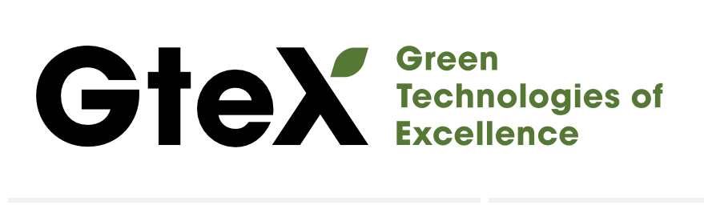
Observation of Na and Li Ion Diffusion in Battery Materials NaCrO₂ and LiCrO₂ by μSR
16th International Conference on Muon Spin Rotation, Relaxation and Resonance (μSR2025)
Izumi UMEGAKI (KEK)
2025. 7.21.

Slide 2
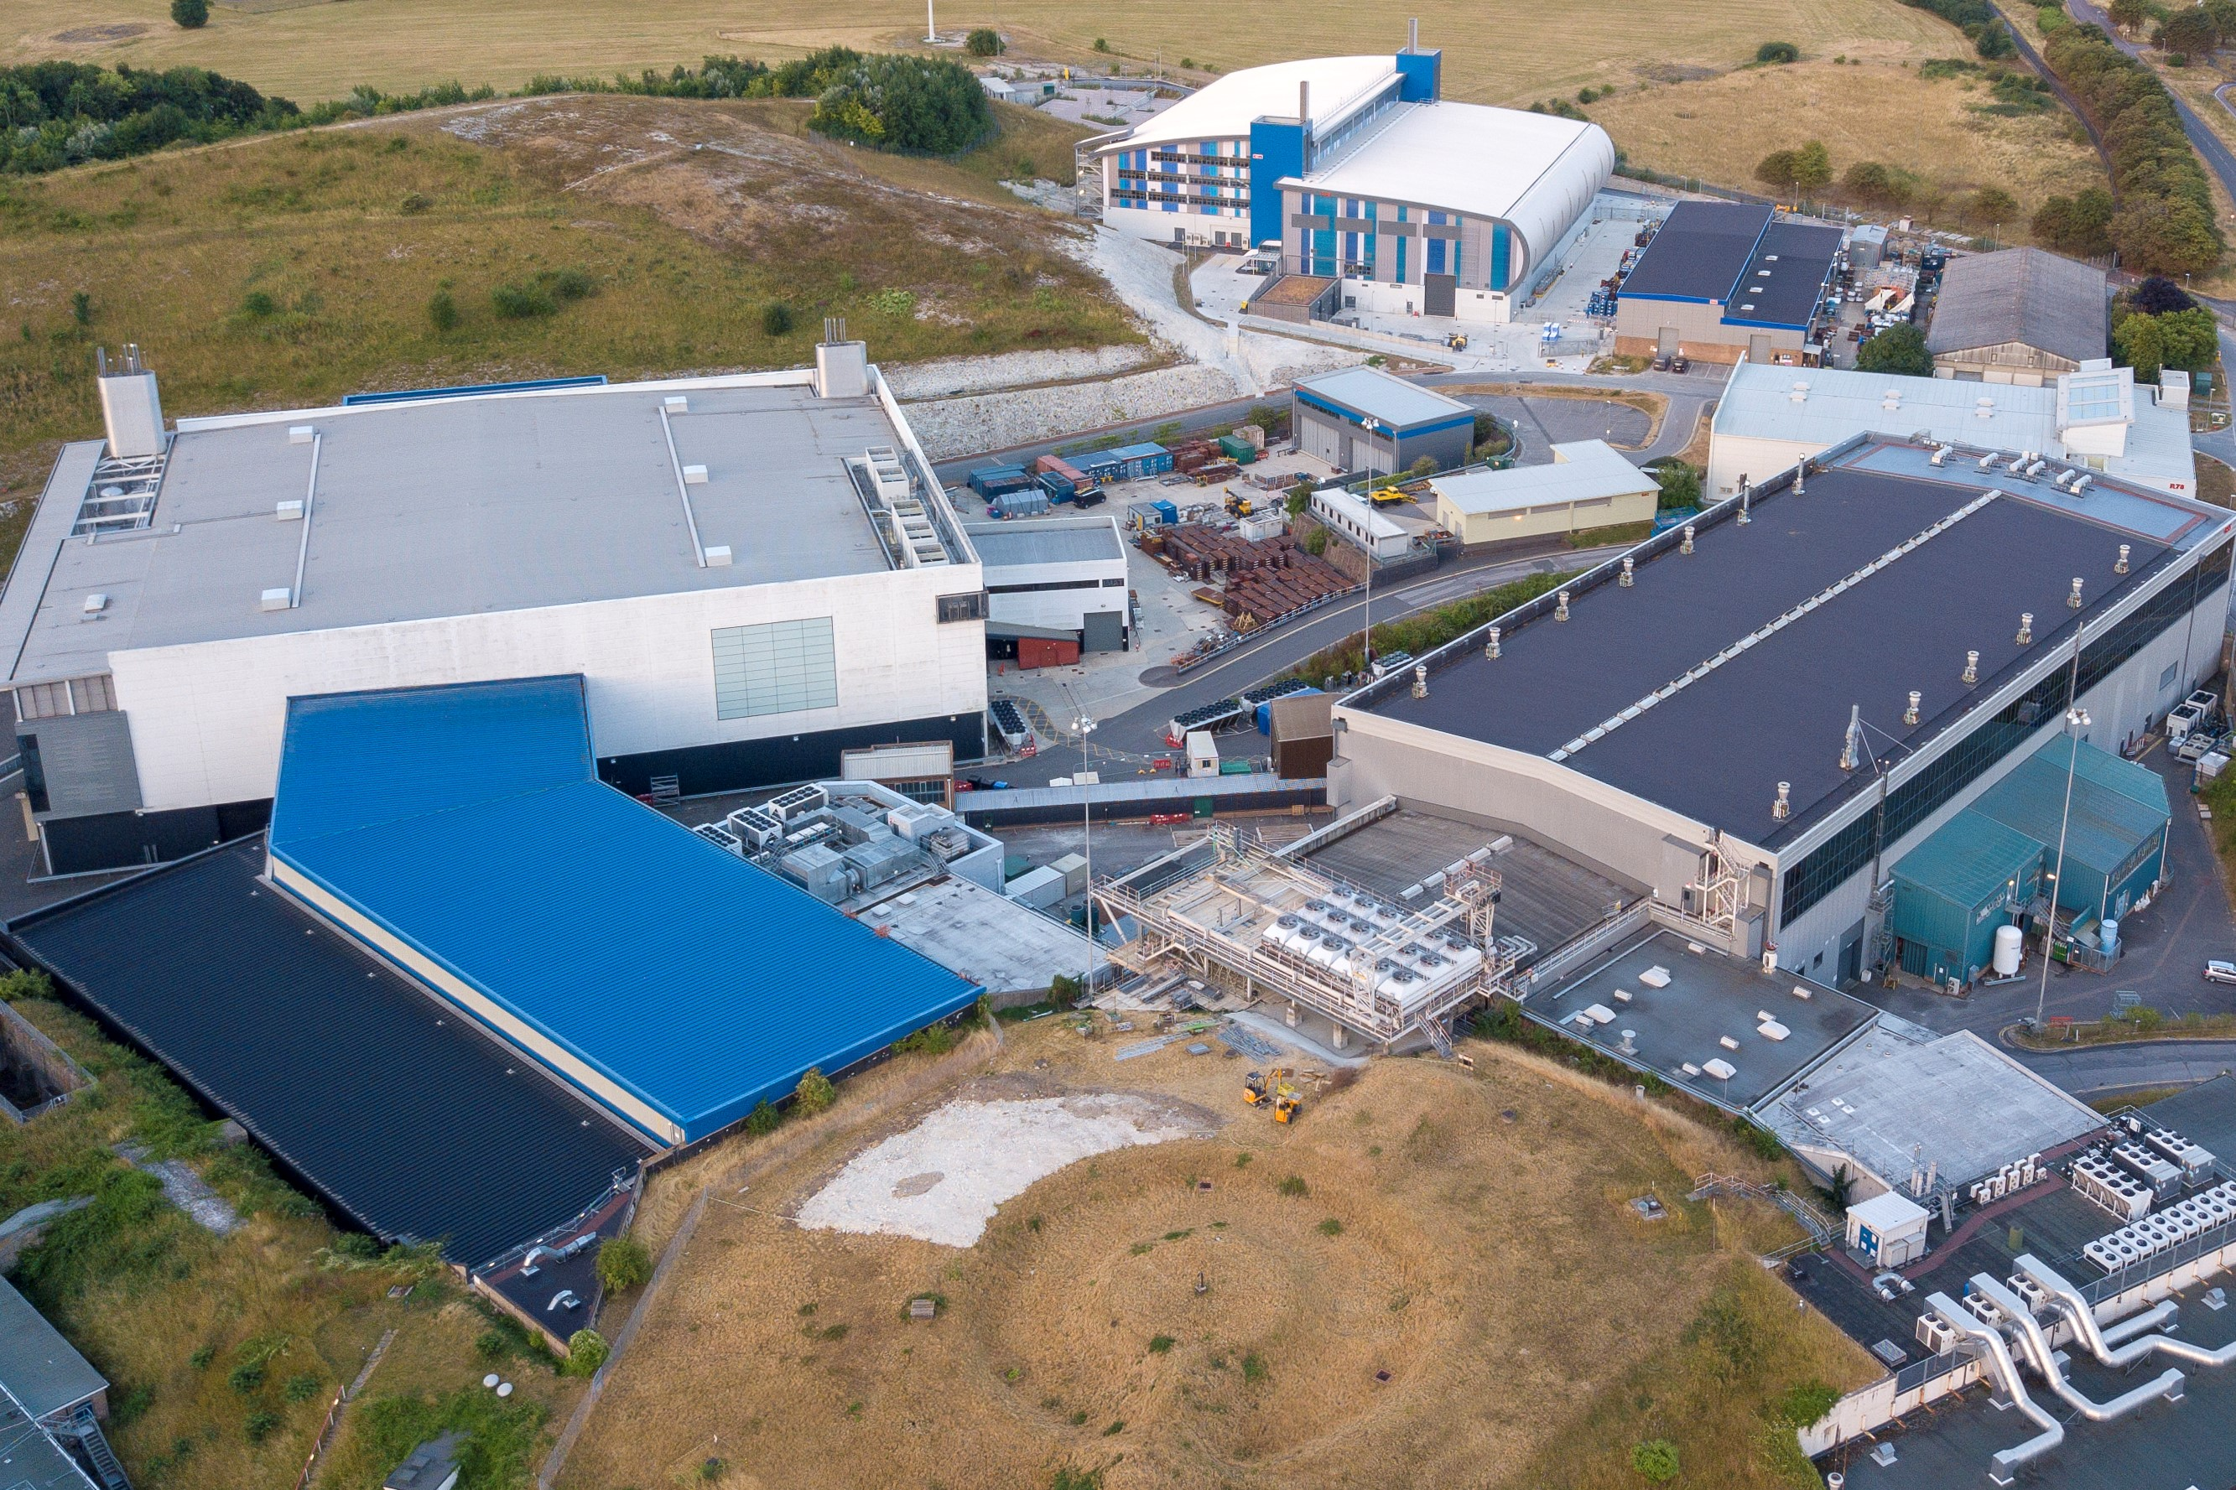
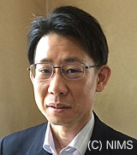
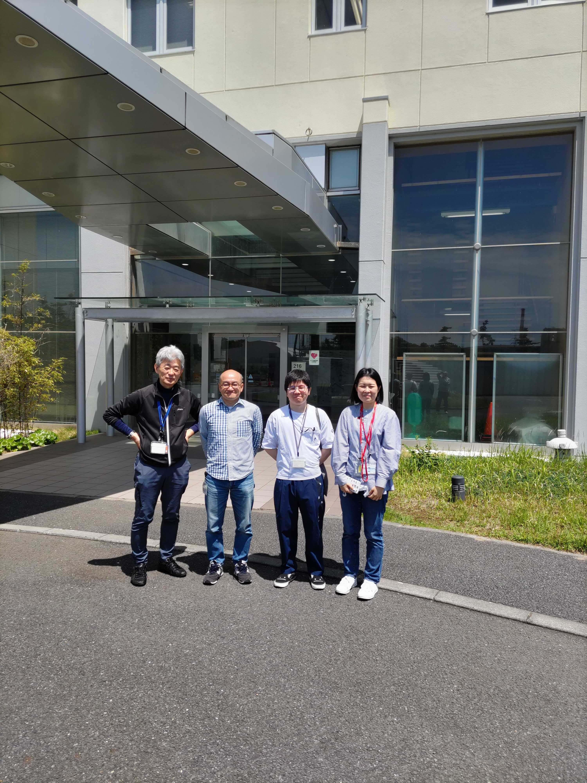
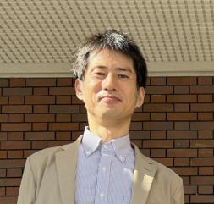

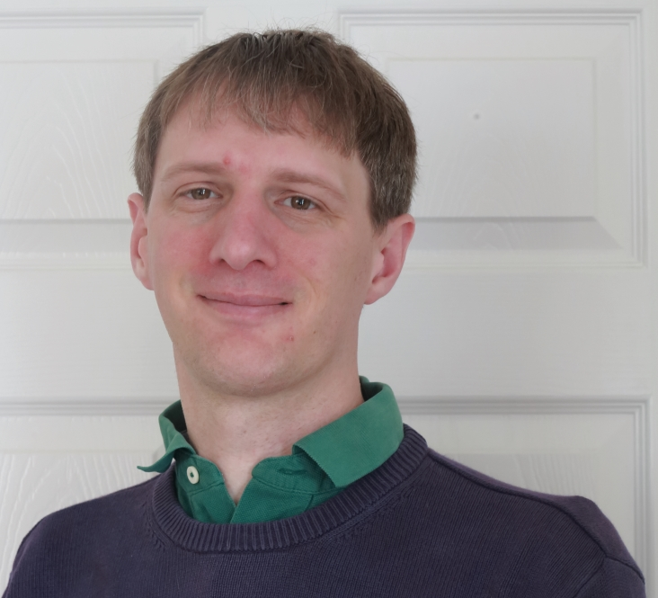
Collaborators
16th International Conference on Muon Spin Rotation, Relaxation and Resonance (μSR2025)
Yuya Sakurai（NIMS）
Hiroto Ota (Doshisya Univ.)
Kazuki Ohishi（CROSS）
Martin Månsson (KTH, Sweden)
Jun Sugiyama（CROSS）
Peter Baker （ISIS, U.K.）
ISIS Neutron and muon
Rutherford Appleton labs.

Slide 3
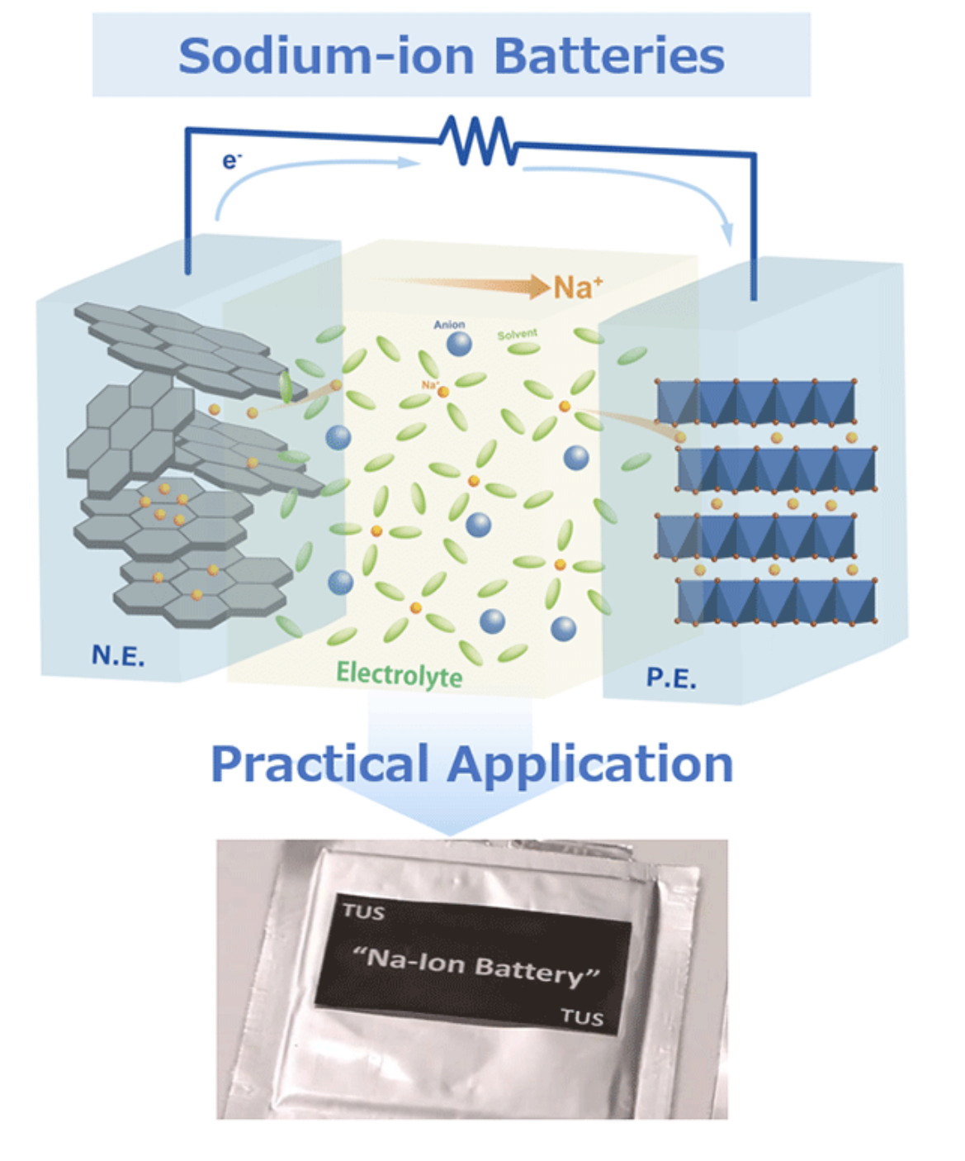
16th International Conference on Muon Spin Rotation, Relaxation and Resonance (μSR2025)
The Green Technologies of Excellence (GteX) Program
The GteX program aims to contribute to the realization of GX (Green transformation)
from the perspective of creating innovative technology seeds and nurturing human resources
by supporting R&D and human resource development at universities
and national institutes, etc.,
making the most of the high potential and accumulation
of basic research capabilities in academia in Japan.
There are storage battery, hydrogen and biomanufacturing areas:
Development of Sodium-Ion Batteries Free from Resource Constraints
Study of Na-ion batteries with muon beam PI: Izumi Umegaki
KEK Long-term S2-type proposal (2024MS01)
https://www.jst.go.jp/gtex/en/overview/index.html

Slide 4

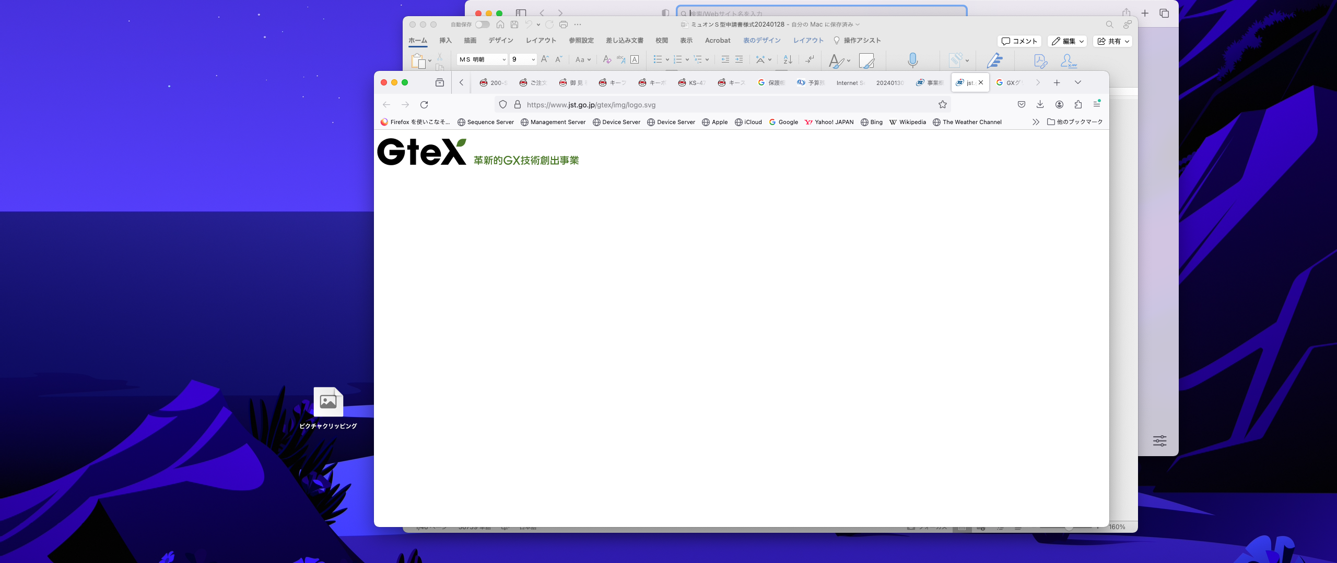
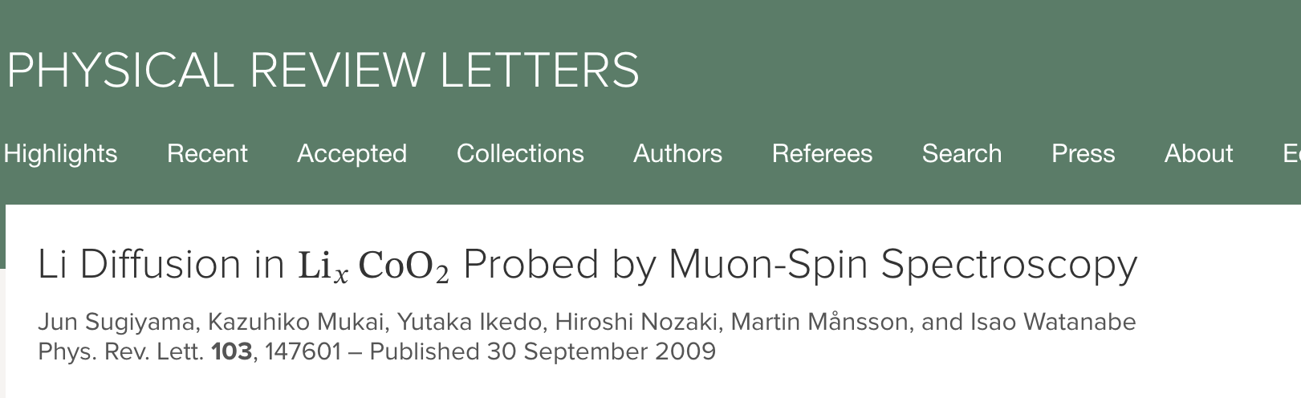
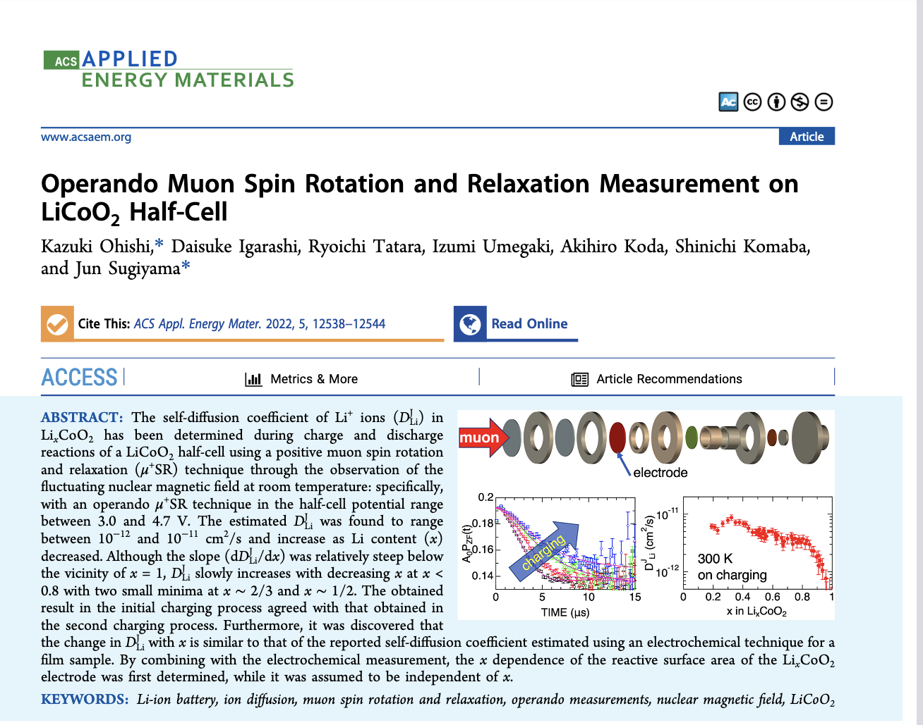
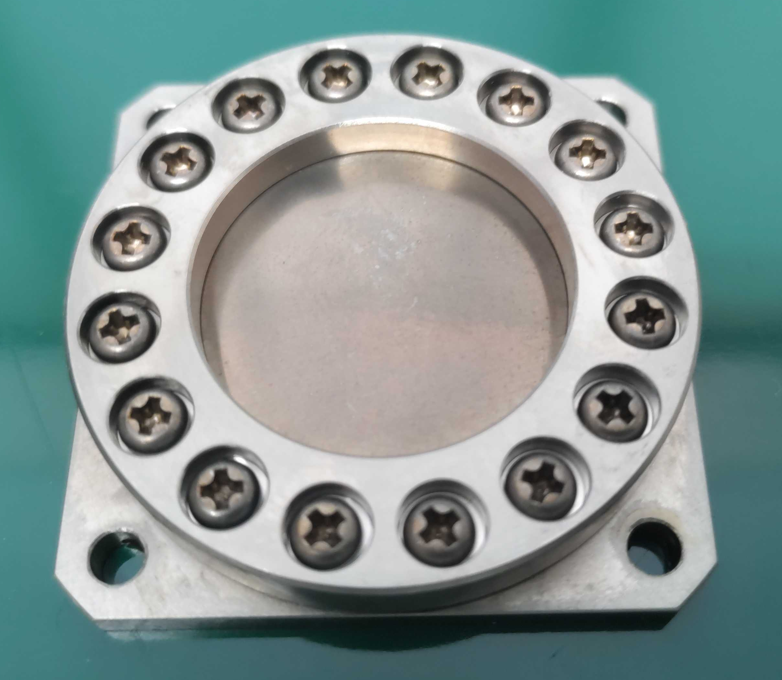
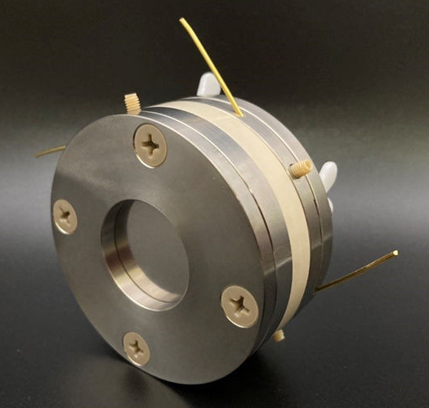
16th International Conference on Muon Spin Rotation, Relaxation and Resonance (μSR2025)
History
2009
2013
2014
2017
2019
2021
2022
2025
join (2012)
13th μSR conf.
Switzerland
14th μSR conf.
Sapporo
15th μSR conf.
Italy
16th μSR conf.
Canada
First publication (2009)
by Dr. J. Sugiyama
First publication on
operando experiment (2022)
by Dr. K. Ohishi
Grant approved
(2023)
Operando μSR cell
Ti cell
for μSR

Slide 5
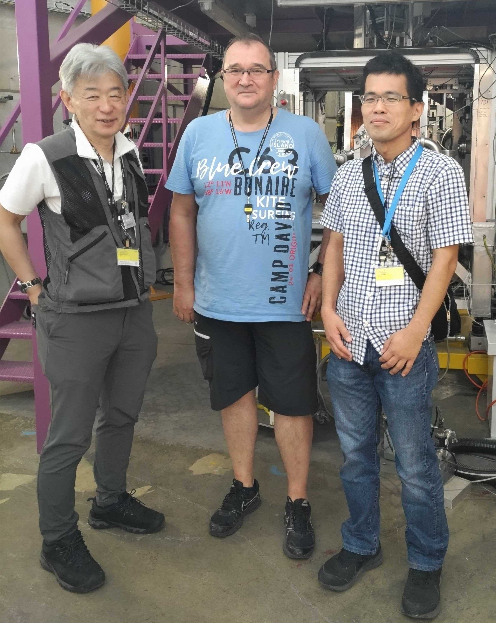
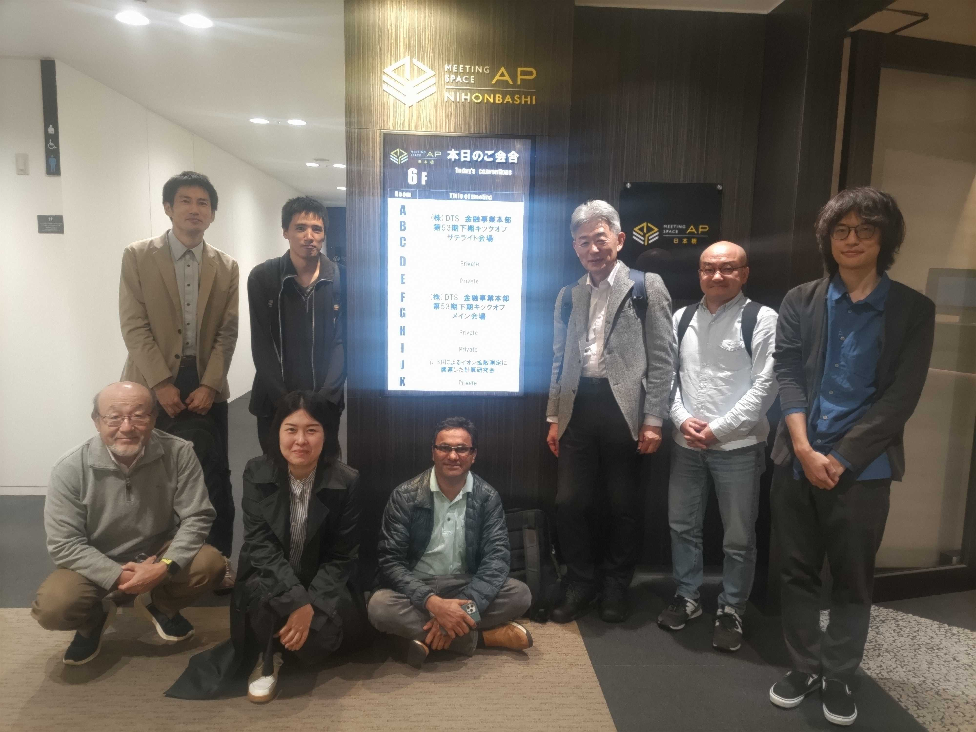
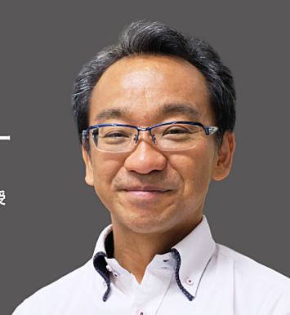
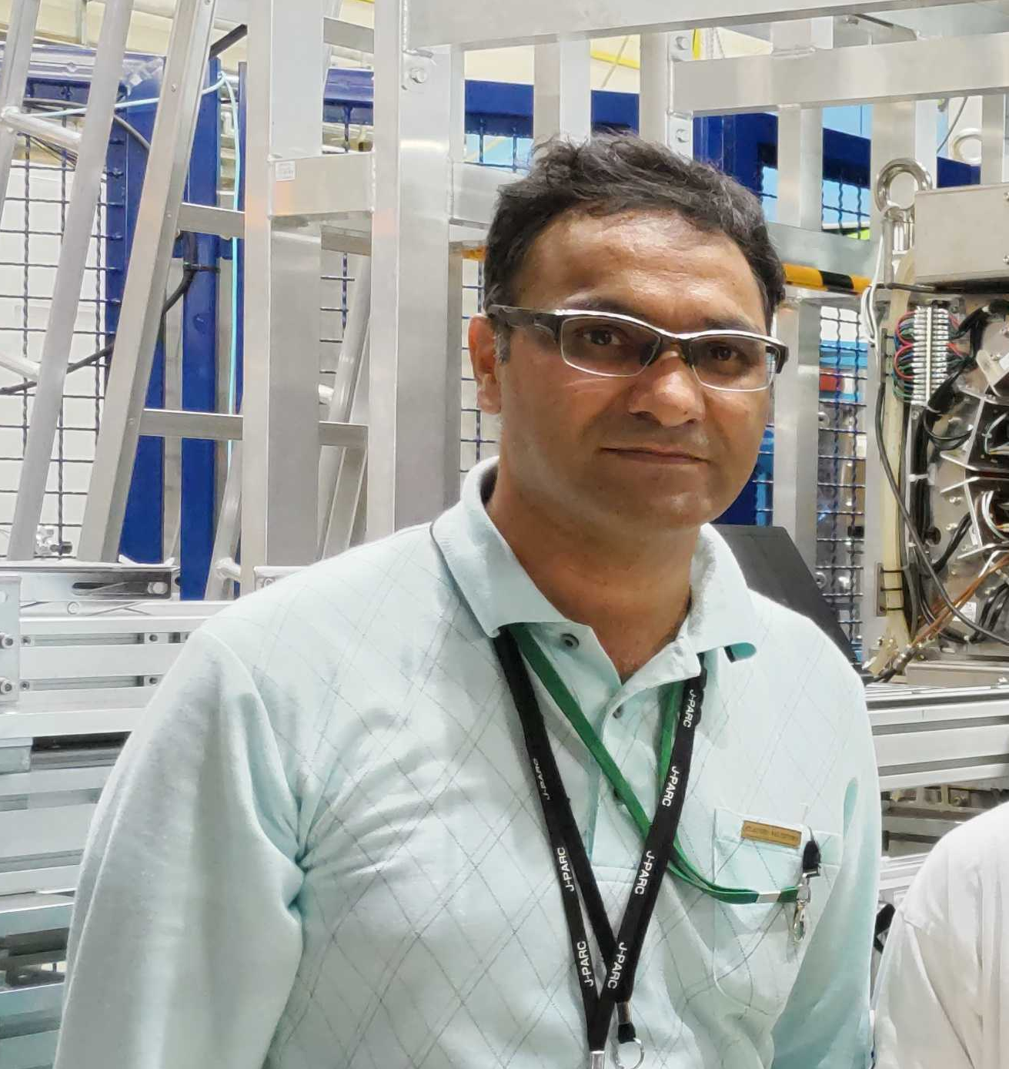
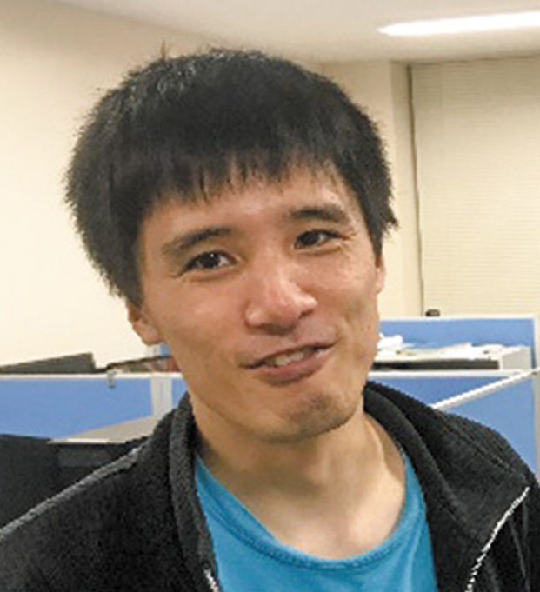
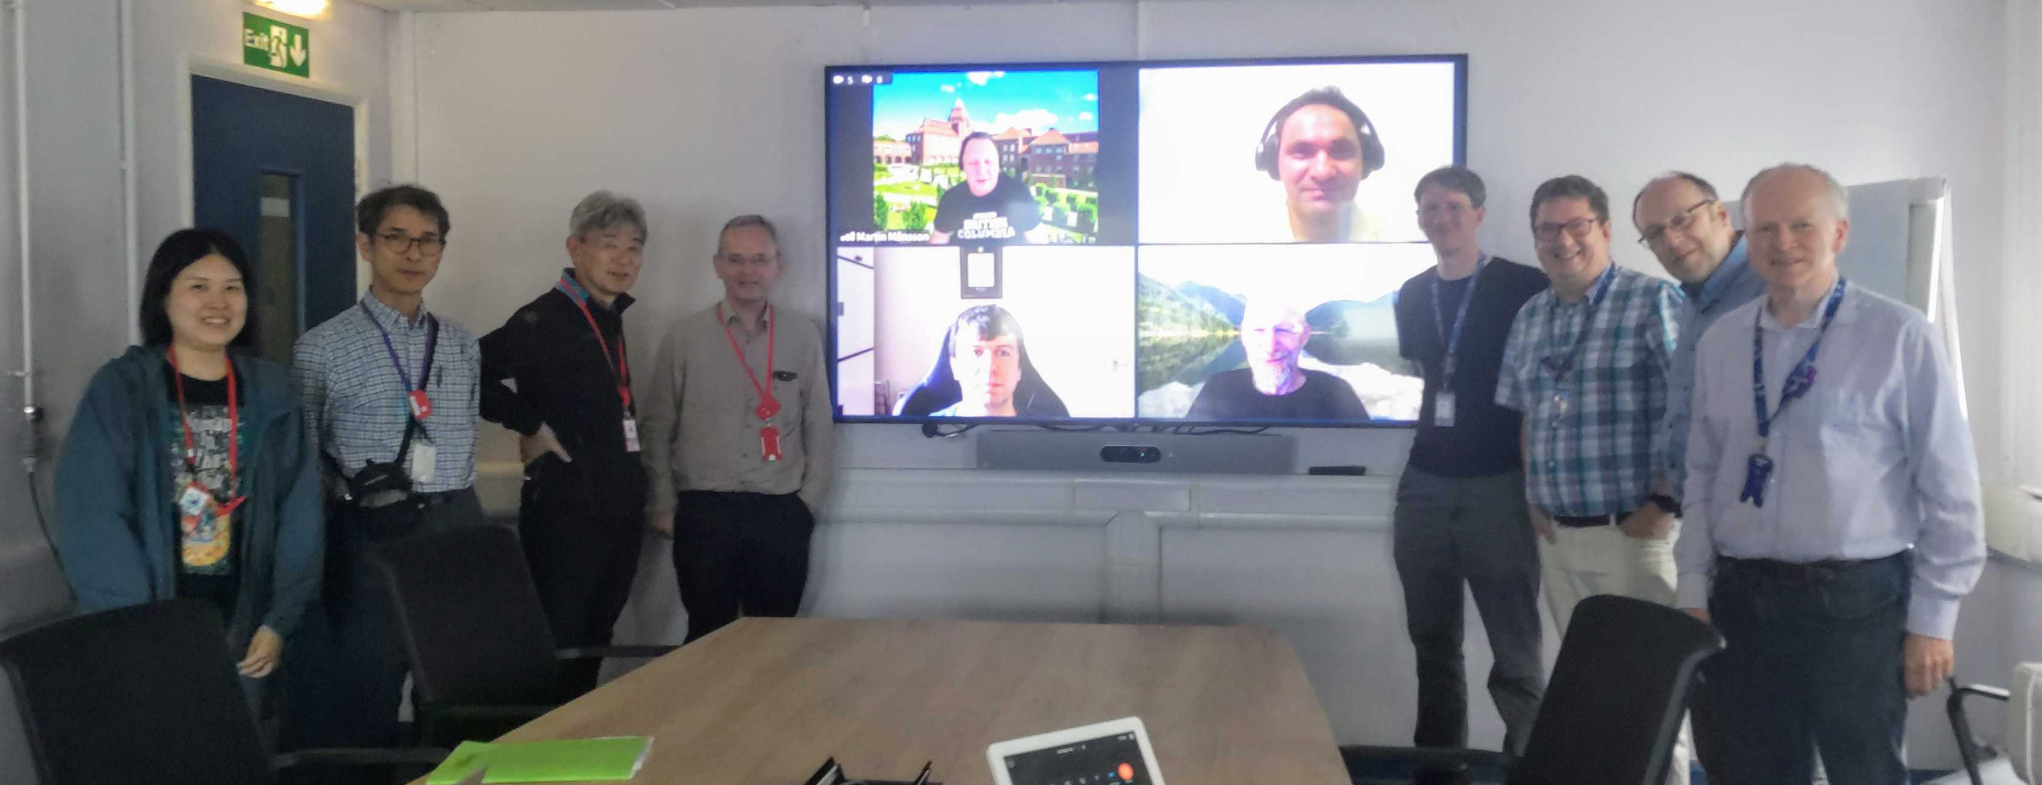
16th International Conference on Muon Spin Rotation, Relaxation and Resonance (μSR2025)
Our group and activity
Collaboration with theorists
At J-PARC
Pressure exp. at PSI
Prof. Sugino
Collaboration with ISIS
Prof. Komaba
PI of GteX program

Slide 6

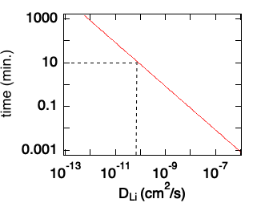
16th International Conference on Muon Spin Rotation, Relaxation and Resonance (μSR2025)
Diffusion coefficient
(a)
radius d=10 μm
(b)
Active cathode material
Li⁺
Time(mins.)
x
Electrolyte
average distance <x>²
Rechargeable battery for EV
requires fast-charging.
Time for Li⁺ to achieve the center of the material < 10 mins.
How fast Li ion moves in the material
⇒Diffusion coefficient
Diffusion coefficient D_{Li} >10⁻¹¹cm²/s
D_{Li} indicates an intrinsic physical property
related to battery performance

Slide 7
16th International Conference on Muon Spin Rotation, Relaxation and Resonance (μSR2025)
Advantage of μSR to observe ion diffusion
Compared with…
Electrochemical Method
・independent of reaction area
・independent of condition of battery
・intrinsic property of material
NMR
・relatively small effect
from magnetic elements
Neutron（QENS）
・slower but suitable time window
for diffusion in a battery material
J. Sugiyama, JPSJ 82, SA023 (2013).

Slide 8
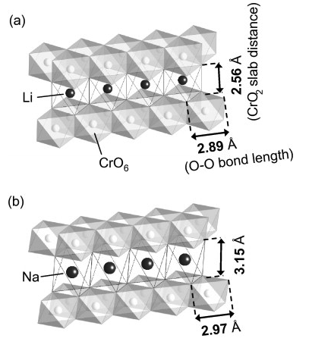
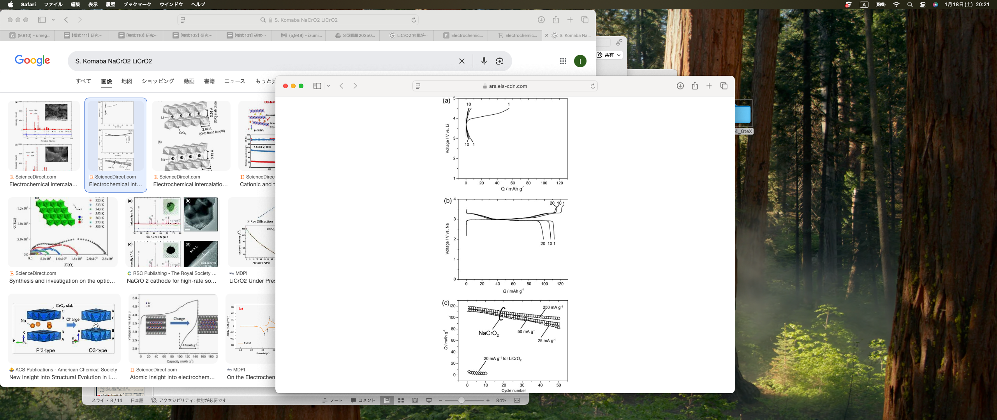
16th International Conference on Muon Spin Rotation, Relaxation and Resonance (μSR2025)
Cathode materials LiCrO₂ and NaCrO₂
S. Komaba et al., Electrochemistry Communications, 12, 3, (2010) 355-358.
LiCrO₂ and NaCrO₂ share the same crystal structure. NaCrO₂ has a large charge capacity, while LiCrO₂ is inactive.

Slide 9
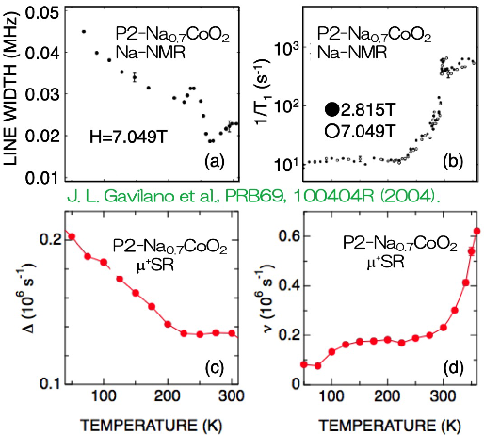
Na ion diffusion by μSR
16th International Conference on Muon Spin Rotation, Relaxation and Resonance (μSR2025)
Na ion diffusion in cathode materials were measured by μSR and
its result are consistent with the ones obtained by Na-NMR.

Slide 10
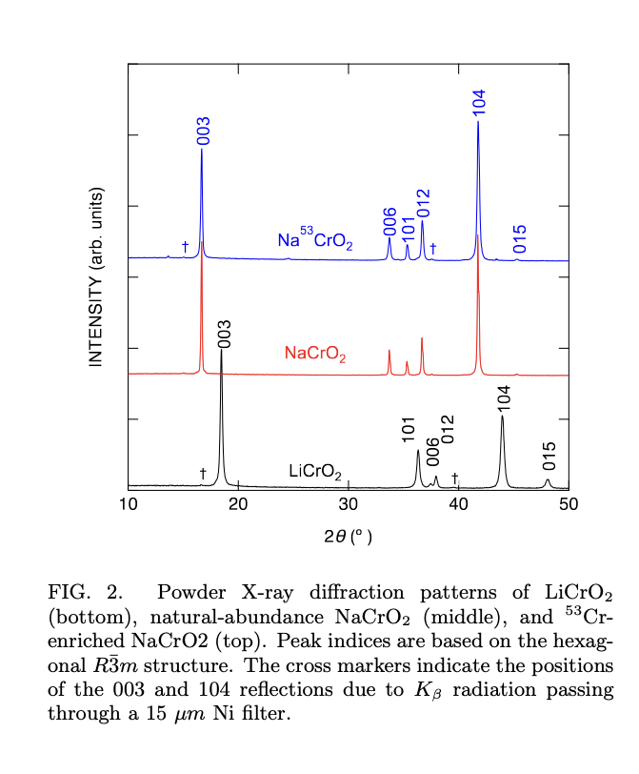
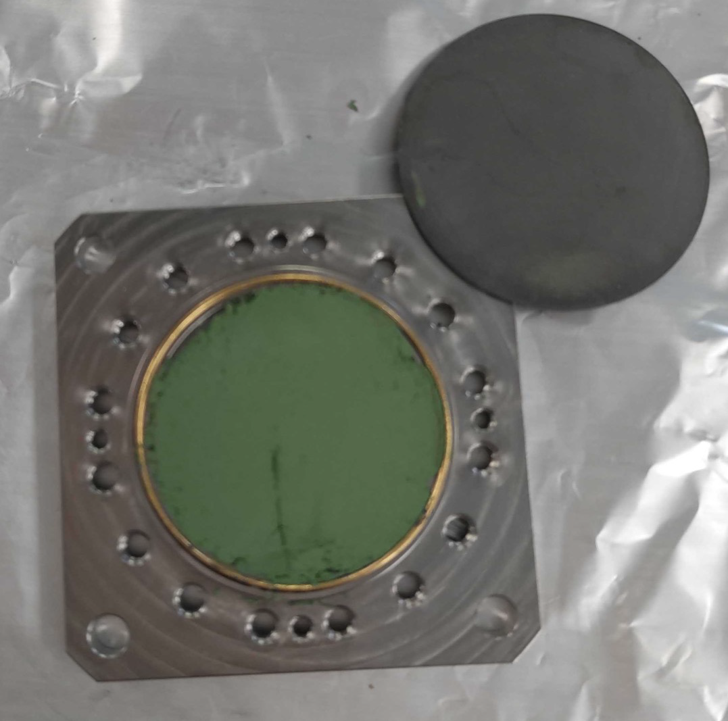
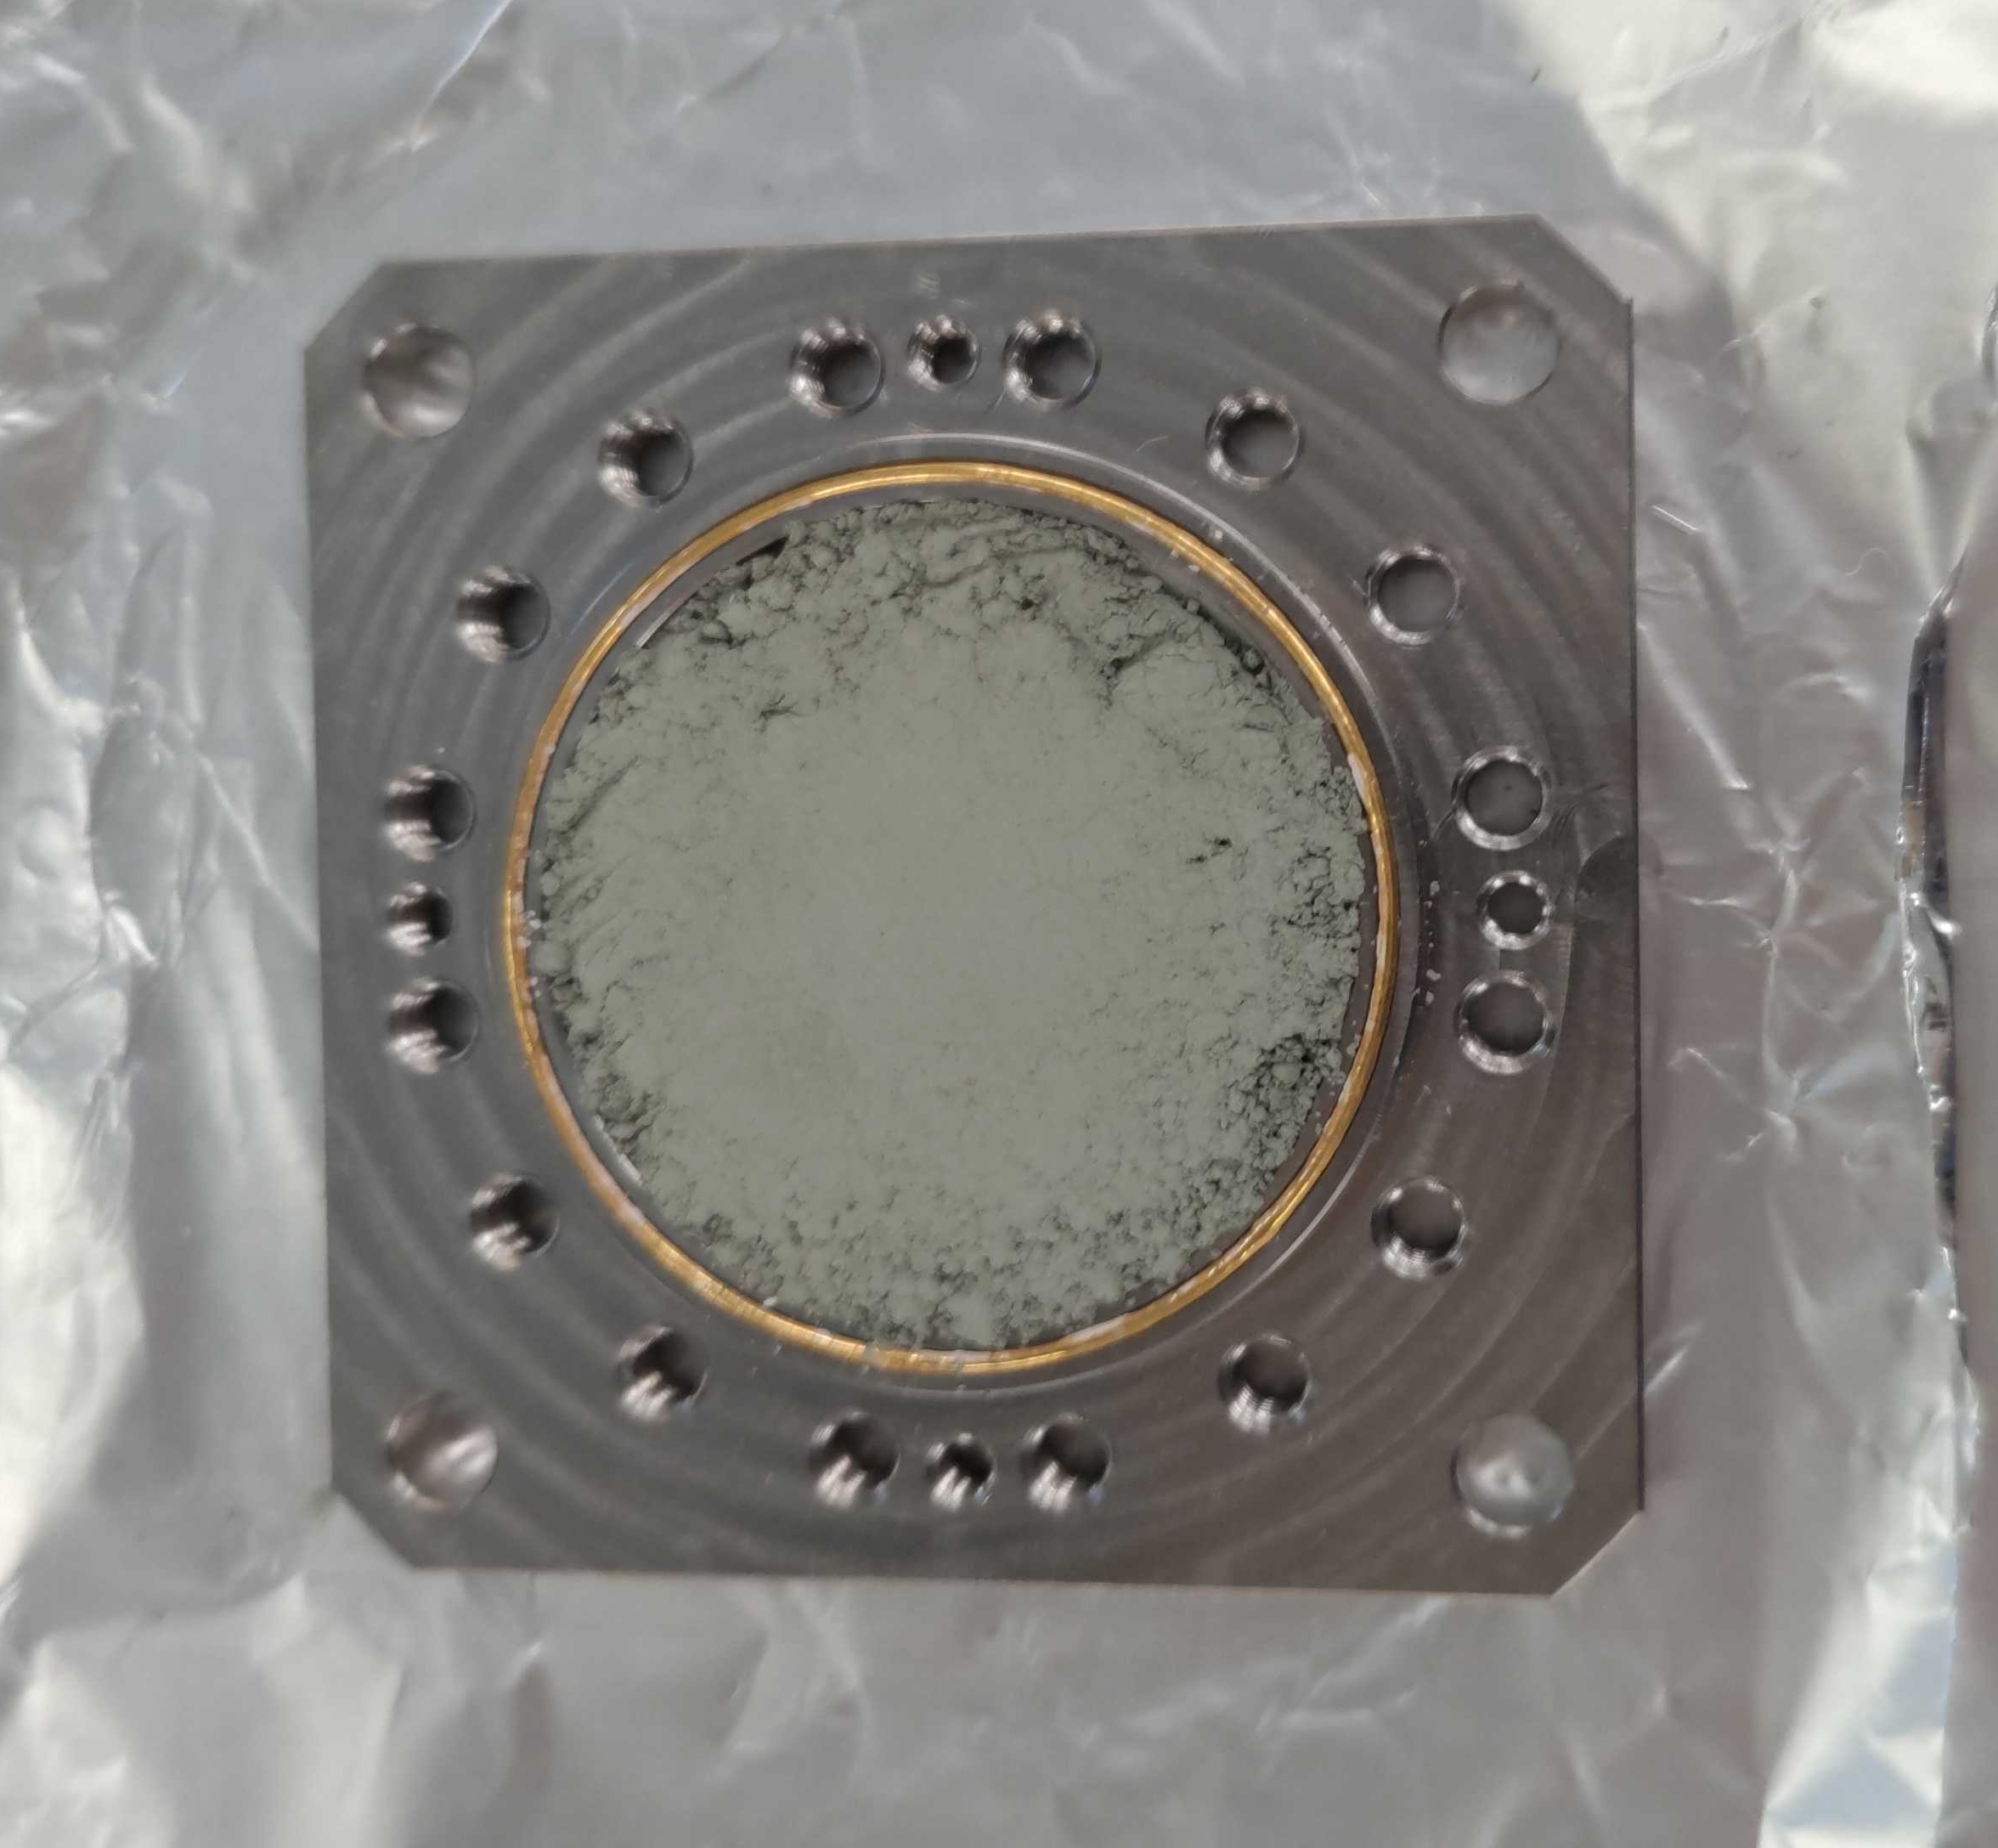
16th International Conference on Muon Spin Rotation, Relaxation and Resonance (μSR2025)
Samples
LiCrO₂ powder Ti holder φ26 mm, 1 mmt Ti window Gold O-ring
NaCrO₂ powder Ti holder φ26 mm,1 mmt Ti window Gold O-ring

Slide 11
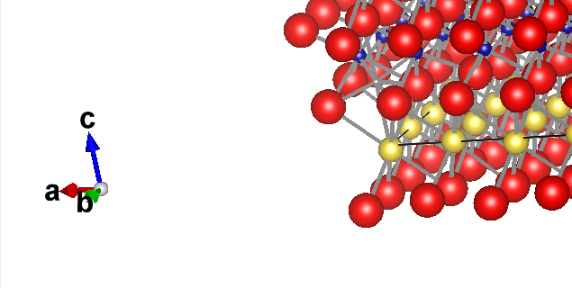
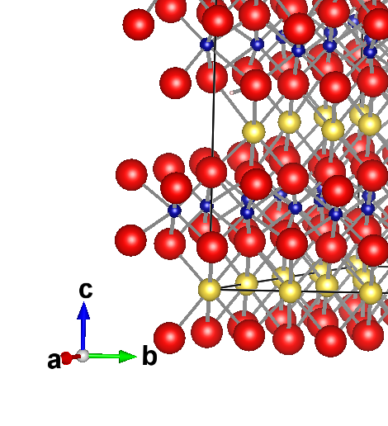
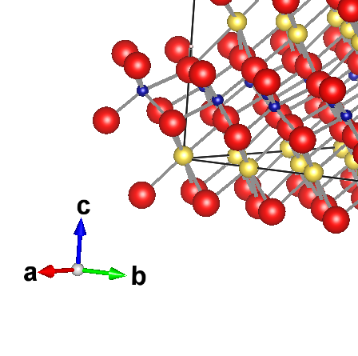
16th International Conference on Muon Spin Rotation, Relaxation and Resonance (μSR2025)
Muon stopping site
μ1（0, 0, 0.115）
μ2（0.120, 0.240, 0.4050）
μ3（0, 0, 0.300）
NaCrO₂
→μ1（0, 0, 0.2425）
→μ2（0.03585, 0.07170, 0.41276）
→μ3（0, 0, 0.27716）
μ3
Na
Cr
O
μ2
μ1
Colomb potential
energy
基準
−6.71829725 eV
Stable
−0.73230285 eV

Slide 12
16th International Conference on Muon Spin Rotation, Relaxation and Resonance (μSR2025)
Muon stopping site
NaCrO₂
μ1（0, 0, 0.2425）
μ2（0.03585, 0.07170, 0.41276）
μ3（0, 0, 0.27716）
μ3
Na
Cr
O
μ2
μ1
Colomb potential
energy
基準
−6.71829725 eV
Stable
−0.73230285 eV
Field distribution widthΔ
1.278 Oe
1.775 Oe
2.025 Oe

Slide 13
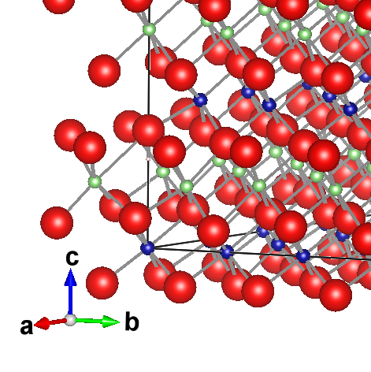
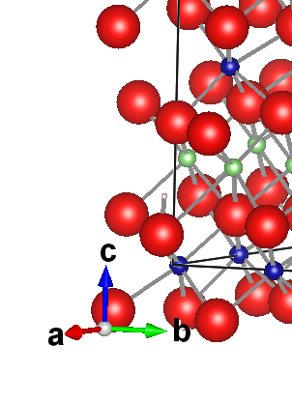
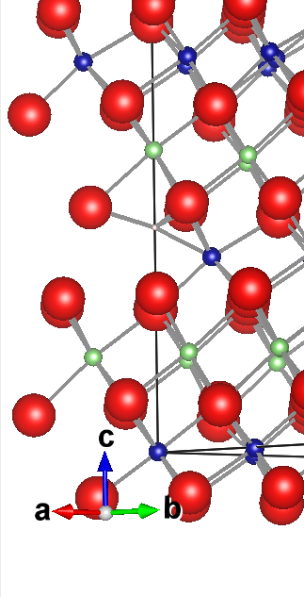
16th International Conference on Muon Spin Rotation, Relaxation and Resonance (μSR2025)
Muon stopping site
μ1（0, 0, 0.180）
μ2（0.24667, 0.12333, 0.12333）
μ3（0, 0, 0.3950）
LiCrO₂
→μ3（0, 0, 0.38299）
→μ1（0, 0, 0.20325）
→μ2（0.15980, 0.08285, 0.13072）
Li
Cr
O
μ1
μ2
μ3
Colomb potential
energy
基準
−9. 2395 eV
Stable
−0.3291 eV

Slide 14
16th International Conference on Muon Spin Rotation, Relaxation and Resonance (μSR2025)
Muon stopping site
LiCrO₂
μ3（0, 0, 0.38299）
μ1（0, 0, 0.20325）
μ2（0.15980, 0.08285, 0.13072）
Li
Cr
O
μ1
μ2
μ3
Colomb potential
energy
基準
−9. 2395 eV
Stable
−0.3291 eV
Field distribution widthΔ
3.460 Oe
3.457-3.489 Oe
2.358 Oe

Slide 15
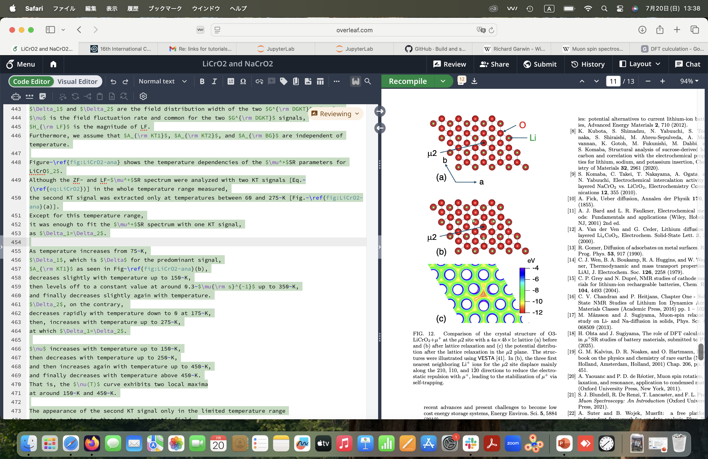
16th International Conference on Muon Spin Rotation, Relaxation and Resonance (μSR2025)
Self-trapping and potential energy
Before
After
Putting μ moves the closest Li ions away.
The potential energy at the muon site is lower by ~ 2 eV
than that around μ, which indicates that μ is stable.

Slide 16
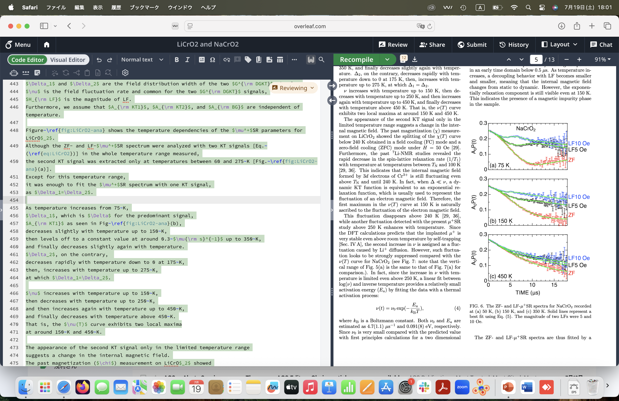
16th International Conference on Muon Spin Rotation, Relaxation and Resonance (μSR2025)
μSR measurements on NaCrO₂
Temperature dependence of spectra
0
5
10
15
0
5
10
15
TIME (μs)
TIME (μs)
With increasing temperatures,
μSR spectra become dynamic
ZF μSR spectrum is decoupled with LF=10G
→ magnetic field that μ feels 〜 10 G
A₀P(t)=A_{KT}G^{DKT}(Δ,ν,H,t) exp(-λ_{ΚΤ}t)+ A_{F}exp(-λ_{F}t) +A_{BG}

Slide 17
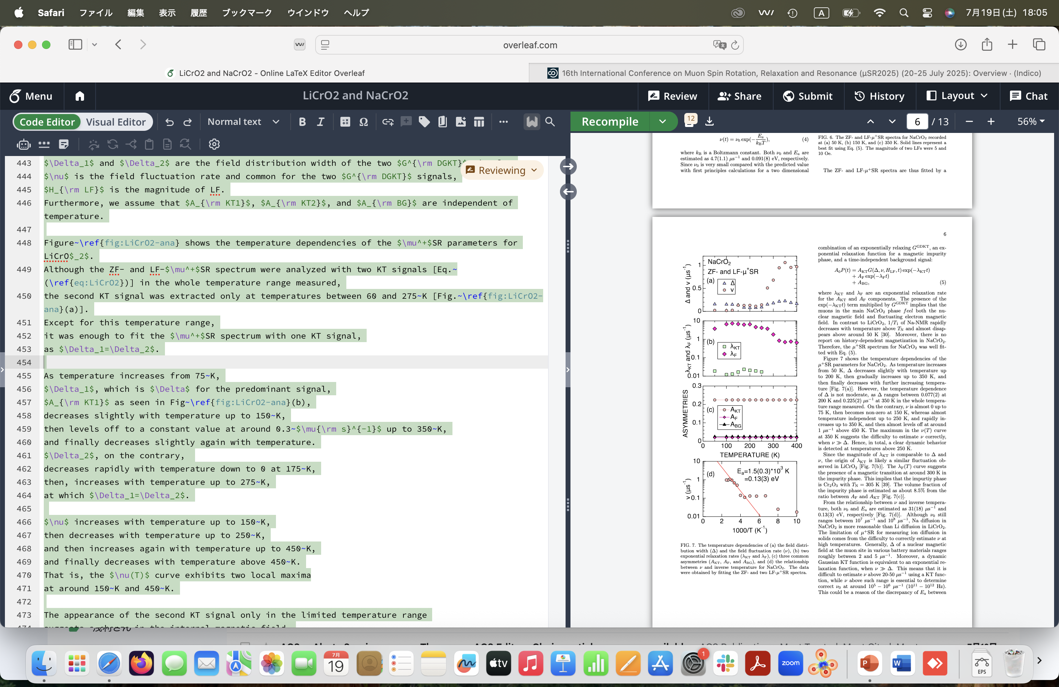
16th International Conference on Muon Spin Rotation, Relaxation and Resonance (μSR2025)
μSR measurements on NaCrO₂
With increasing temperature,
Field fluctuation rate ν increases
above 250 K
Activation energy E= 0.130 eV
A₀P(t)=A_{KT}G^{DKT}(Δ,ν,H,t) exp(-λ_{ΚΤ}t)+ A_{F}exp(-λ_{F}t) +A_{BG}

Slide 18
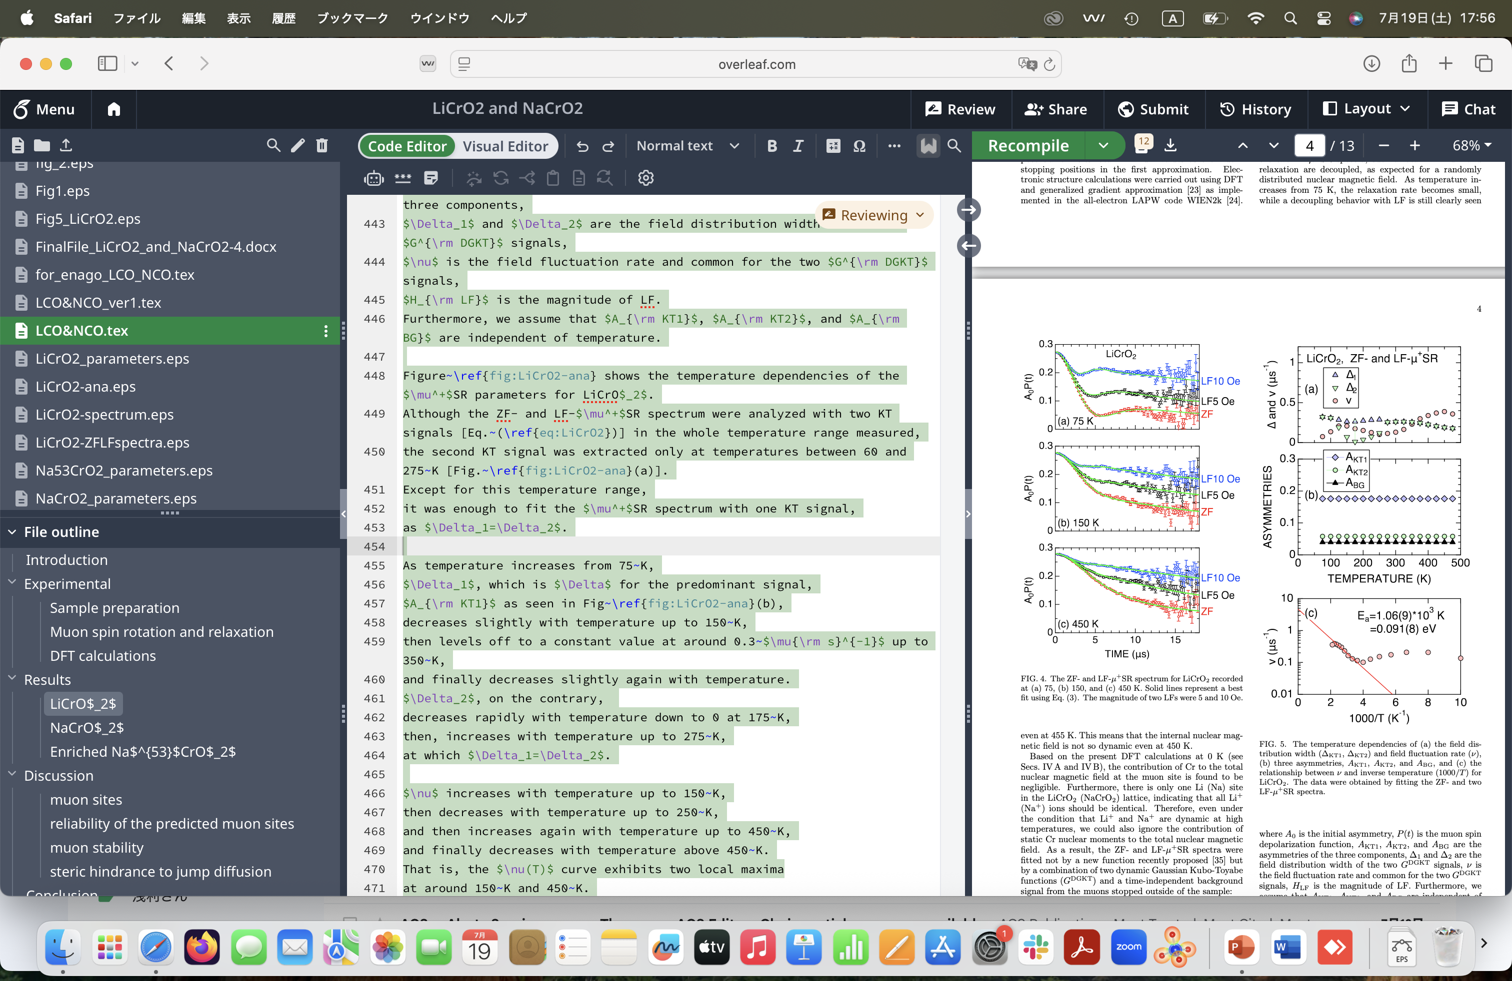
16th International Conference on Muon Spin Rotation, Relaxation and Resonance (μSR2025)
μSR measurements on LiCrO₂
Temperature dependence of spectra
0
5
10
15
0
5
10
15
TIME (μs)
TIME (μs)
With increasing temperatures,
μSR spectra become dynamic
ZF μSR spectrum is decoupled with LF=10G
→ magnetic field that μ feels 〜 10 G
A₀P(t)=A_{KT1}G^{DKT}(Δ₁,ν,H,t) + A_{KT2}G^{DKT}(Δ₂,ν,H,t) +A_{BG}

Slide 19
16th International Conference on Muon Spin Rotation, Relaxation and Resonance (μSR2025)
μSR measurements on LiCrO₂
A₀P(t)=A_{KT1}G^{DKT}(Δ₁,ν,H,t) + A_{KT2}G^{DKT}(Δ₂,ν,H,t) +A_{BG}
With increasing temperature,
Field fluctuation rate ν increases a little
Activation energy E= 0.091 eV
ν behavior at low temperatures is considered to be related to magnetic properties
Not only dipole but quadrupole interaction between μ-Li may explain

Slide 20
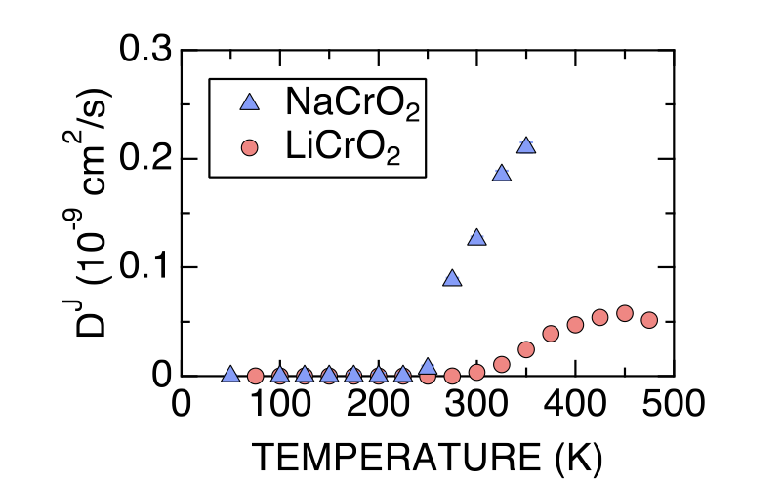
16th International Conference on Muon Spin Rotation, Relaxation and Resonance (μSR2025)
Comparison with LiCrO₂ and NaCrO₂
0
100
200
300
400
500
0
100
200
300
400
TEMPERATURE (K)
TEMPERATURE (K)
 | LiCrO₂ | NaCrO₂
Distance between CrO₂ | 0.256 nm | 0.315 nm
Charge capacity | < 20 mAh/g | 120 mAh/g
ν at 350 K | 0.2 μs⁻¹ | 1 μs⁻¹
D^{J} at 350 K (10⁻⁹) cm²/s | 0.025 | 0.2
Activation Energy | 0.091 eV | 0.13 eV
D_{Na} > D_{Li.} above 250 K
The diffusive nature observed in LiCrO₂ was strongly suppressed compared to that of NaCrO₂.
This difference is consistent with the difference in electrochemical properties between LiCrO₂ and NaCrO₂.

Slide 21
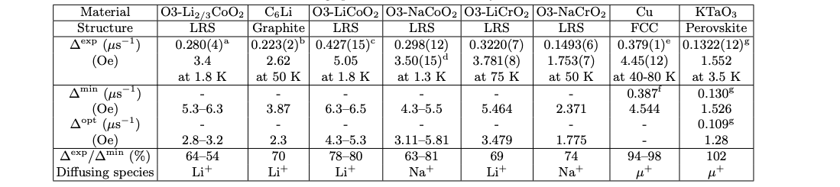
16th International Conference on Muon Spin Rotation, Relaxation and Resonance (μSR2025)
Comparison between
experiment Δ and simulated Δ
In these battery materials, Δ^{exp}/Δ^{min} is lower than 80%.
As a result, muons is stable thanks to self-trapping effect.
The stability of muon can be represented by Δ^{exp}/Δ^{min}.
Muon diffusion
is reported

Slide 22
16th International Conference on Muon Spin Rotation, Relaxation and Resonance (μSR2025)
Conclusion
Cathode materials LiCrO₂ and NaCrO₂ share the same crystal structure. However, LiCrO₂ is inactive, while NaCrO₂ has a large charge capacity.
We performed μSR measurements with powder samples of LiCrO₂ and NaCrO₂ at EMU, ISIS. As a result, both show dynamic behavior above 250 K. We observed that Li diffusion in LiCrO₂ is strongly suppressed. Even at x=1, Li hardly diffuses in LiCrO₂. The composition dependence of Li diffusion / Na diffusion is planed at J-PARC with an operando cell soon.
The difference between D^{J} is most likely related to the distance between CrO₆ plane and ionic radius. We also performed μSR measurements under pressure at GPD, PSI.
This research was supported by GteX(Green Technologies of Excellence) JPMJGX23S4.

Slide 23
16th International Conference on Muon Spin Rotation, Relaxation and Resonance (μSR2025)
Thank you for your attention.

