Slide 1
Non-destructive Analysis of Bronze Heritages
using Muon Induced X-rays in J-PARC
M.Tampo¹, T. Kutsuna², M. Sakai³, K. Murakami³, M. Asahi³, T. Yamashita⁴,
R. Murata⁴, A. Pant¹, Y. Miyake¹, and K. Shimomura¹
1. High Energy Accelerator Research Organization (KEK)
2. National Museum of Nature and Science
3. Nagoya Castle Research Center
4. Faculty of Science and Graduate School of Science, Tohoku University

Slide 2
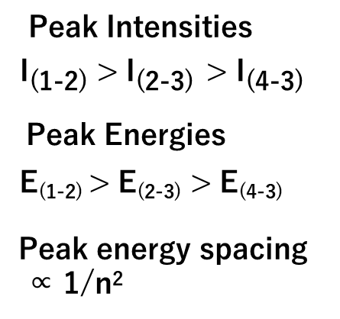
High-energy characteristic X-rays are emitted from atoms that capture negative muons.
μ−
e
Like electrons, muons undergo
quantum transitions and
emit element-specific X-rays
as they cascade down
to the ground state.
eKα-X線 Al(n=2->1) :1.2 keV
n=3
電子の基底状態
（これ以上落ちない）
A negative muon acts as an electron
200 times heavier inside an atom.
n=2
μLβ-X Al (n=3->2): 65keV
Therefore, the X-rays emitted during
quantum transitions are hundreds of times
more energetic than those from electrons.
μKα-X Al (n=2->1): 360keV
Even when muons are implanted deep inside a material,
muonic characteristic X-rays can still emerge at the surface.
n=1
Al nucleus

Slide 3

Negative muons are absorbed into nucleus.
In the case of heavy nuclei, the ground-state orbital is closer to the nucleus,
so the negative muon is absorbed by the nucleus before muon decaying.
The internal energy (~50 MeV) of the muon is released into the nucleus.
μ(-)
γ
p(+)
n(neutral）
50~80%
probability
+
proton
neutron
n
p
n
p
Nucleus
Nucleus is excited and neutron, proton and gamma rays are generated.

Slide 4
Bronze artifacts are found globally as part of cultural heritage, and compositional analysis offers valuable insights into the cultural exchanges that took place in the past.
China ~A.D.1
@PSI
Part of collection
at the Shimane University
(From Prof. Iwamoto)
Japan ~A.D.10
However, due to aging, the surface has altered into copper oxides and copper carbonates, changing its original composition. Therefore, analytical methods such as X-ray fluorescence, which only measure the surface, cannot accurately evaluate the original bronze composition at the time of manufacture.

Slide 5
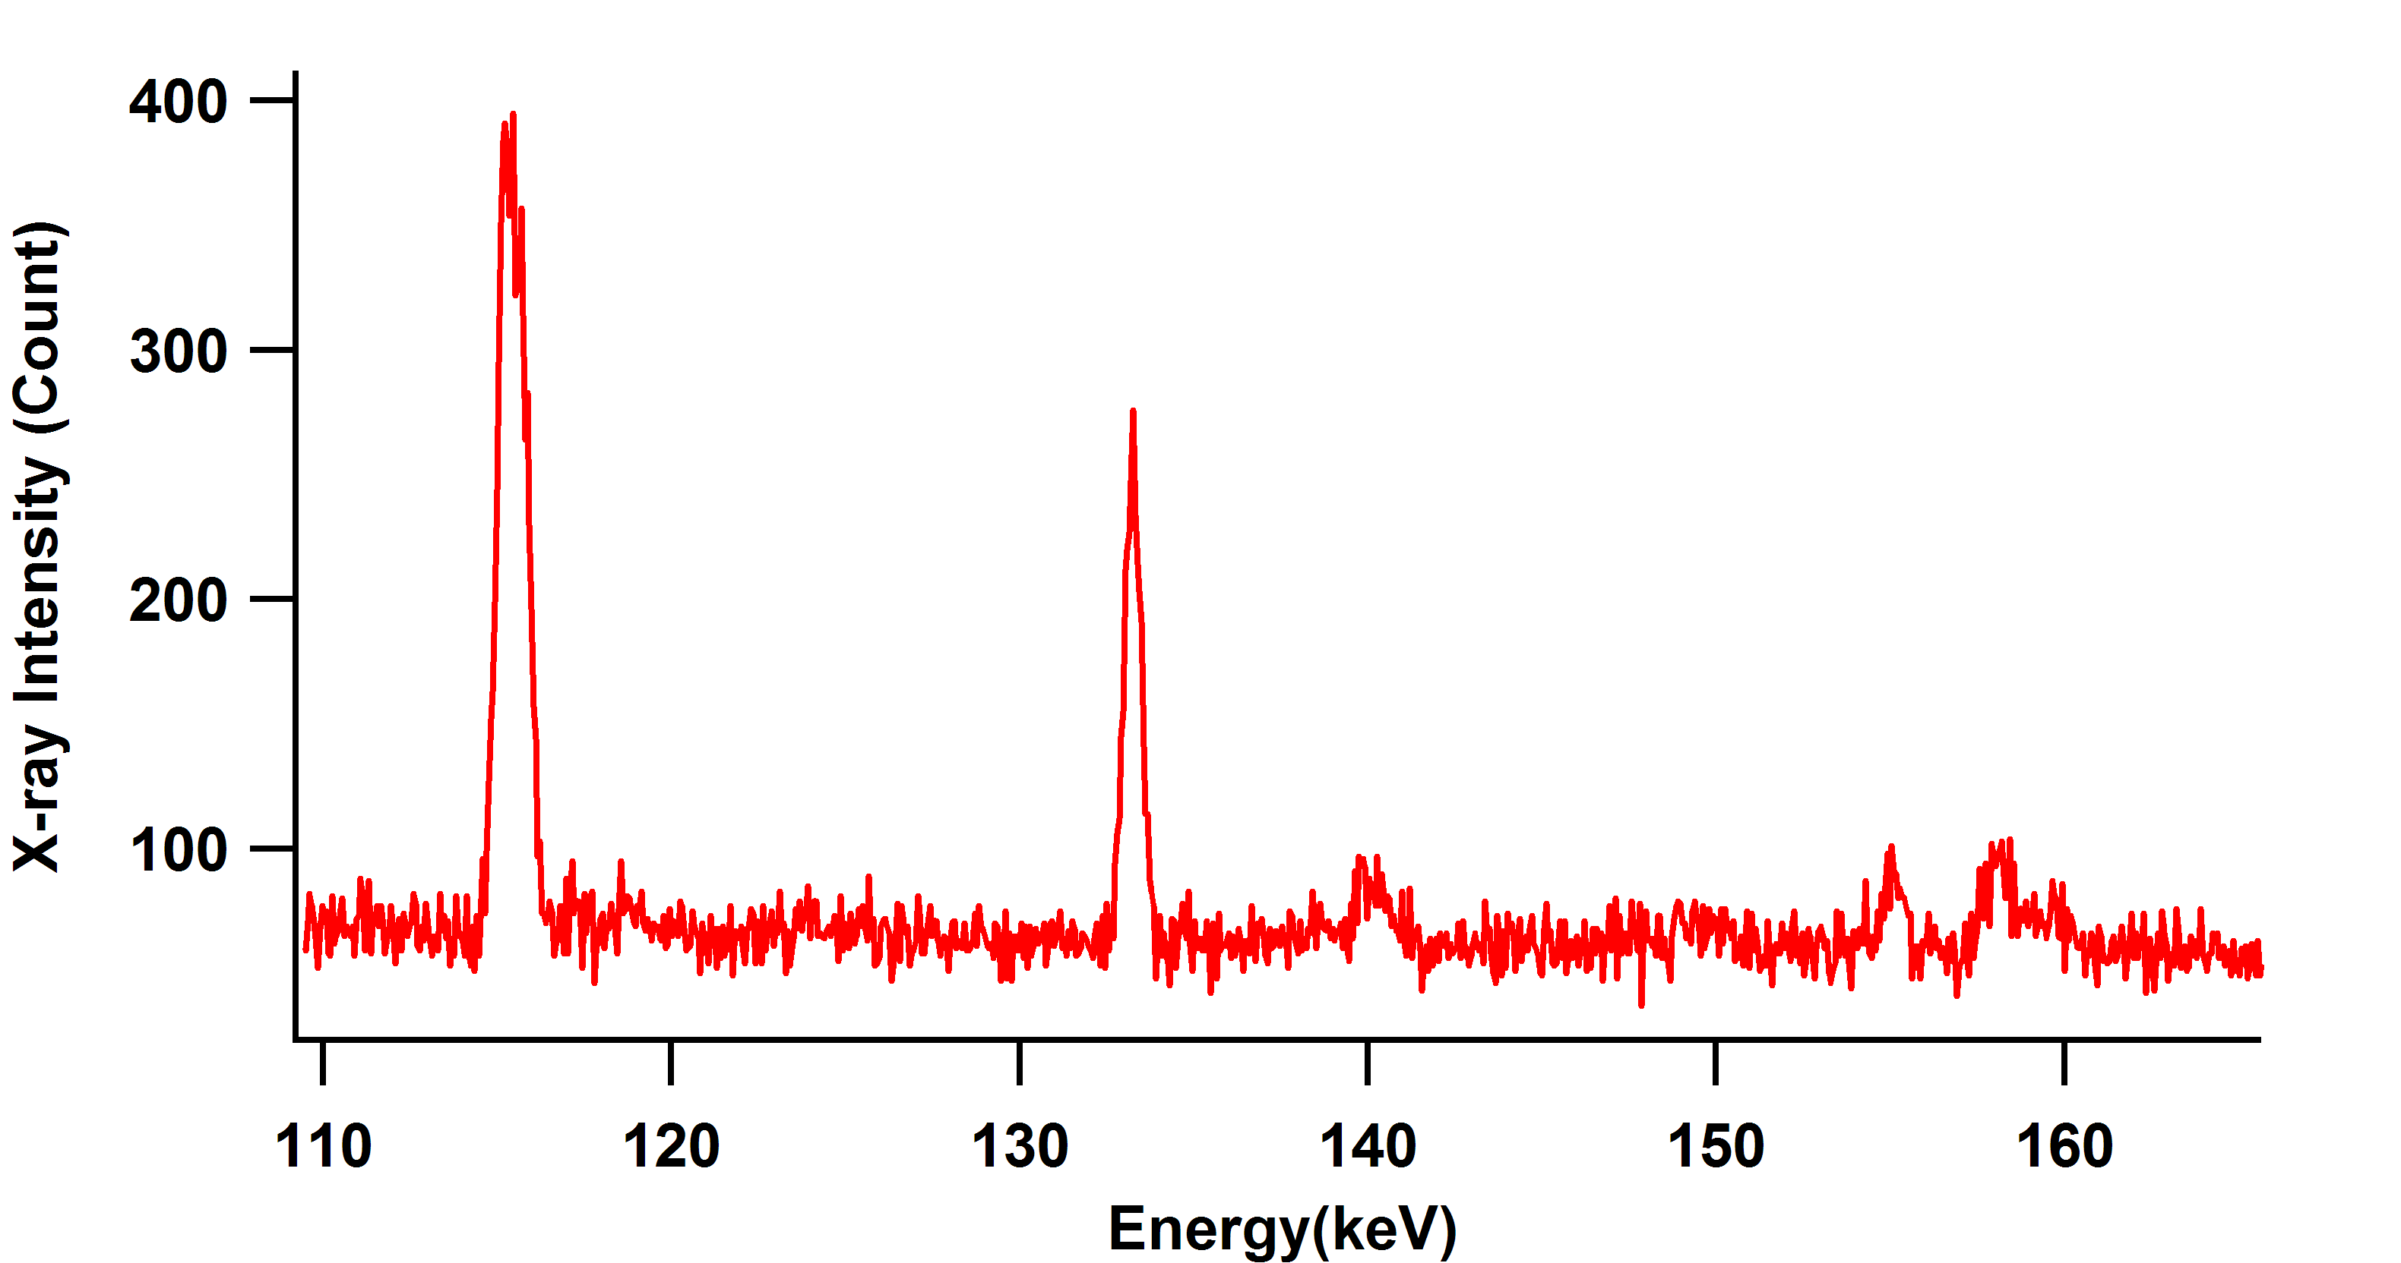
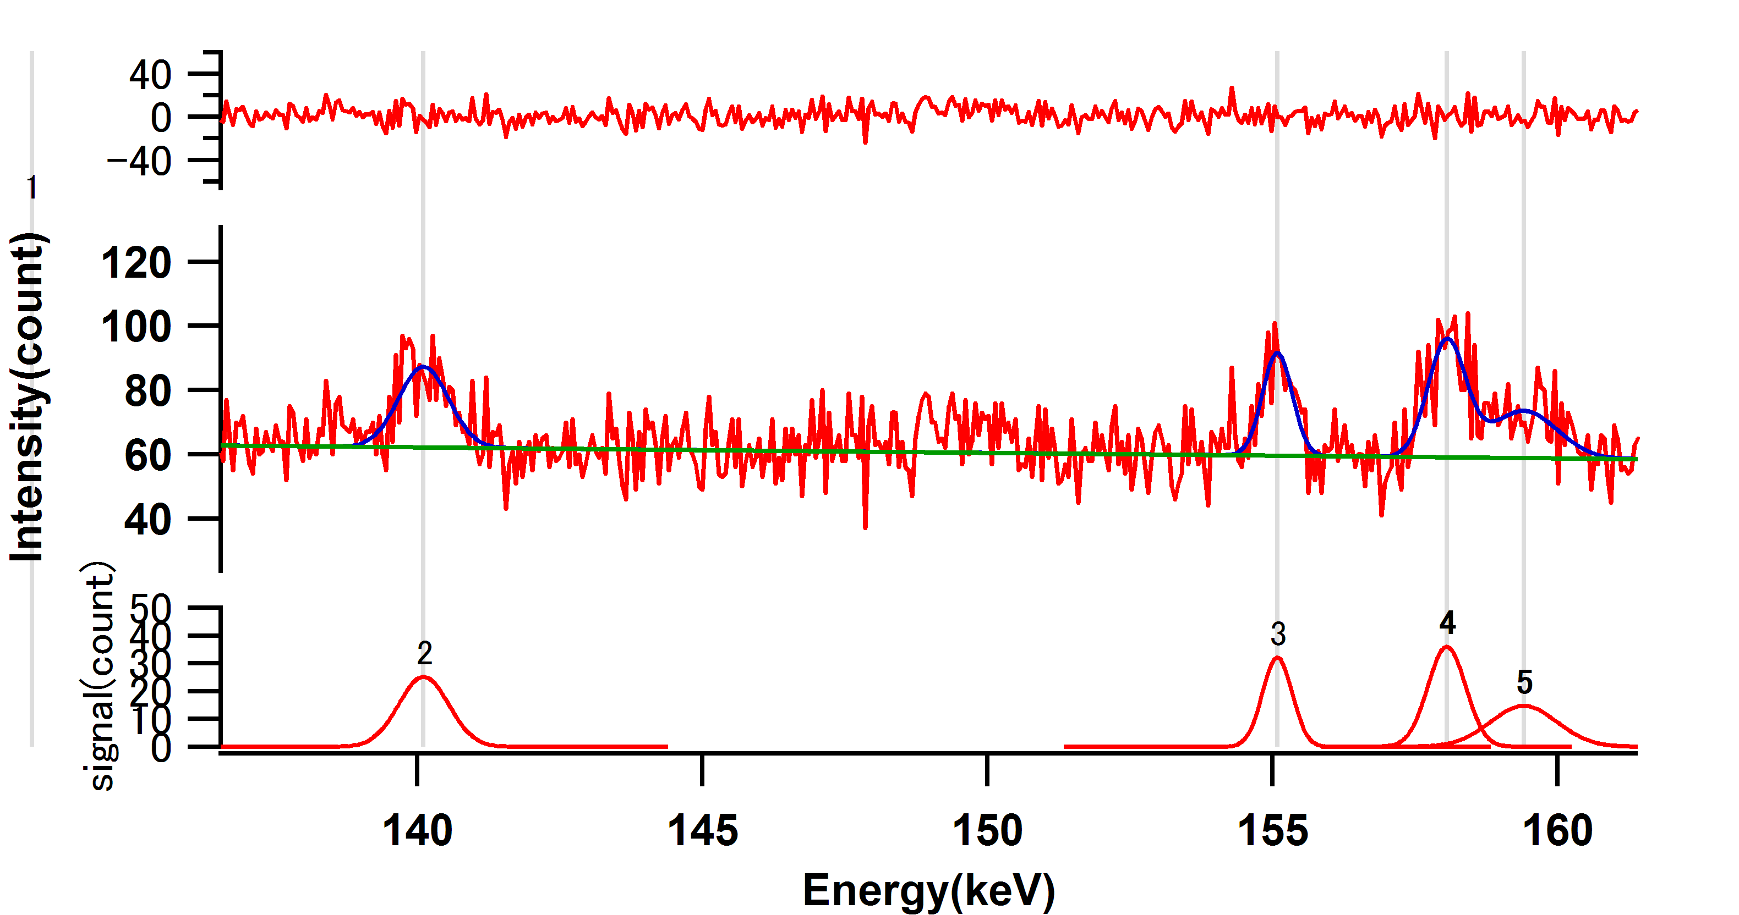
Spectral Overlapping
Even when using muons, overlapping muonic X-ray peaks can make the analysis difficult
O(3-1)
159.21keV
Sn(5-4)
158.78keV
In the case of oxygen, the O(2–1) to O(3–1) peak ratio
may vary depending on its valence state,
making it difficult to evaluate the Sn(5–4) peak intensity based on this ratio.
Cu(4-3)
115keV
O(2-1)
133keV
Pb(7-6)
140keV
Sn(5-4)
158+160keV
It is necessary to select muonic X-ray peaks that do not overlap and have high detection efficiency—that is, peaks with high transition probabilities.
It is advisable to examine peak overlaps of pure
elements (Cu, Pb, Sn) across a wide energy range.

Slide 6
GMX(Ge crystal with
5cm diameter x 5cm thickness)
We have two type of Ge detectors
100keV~several MeV
LEGe(Ge crystal with
1cm diameter x 1cm thickness)
10keV~200keV

Slide 7
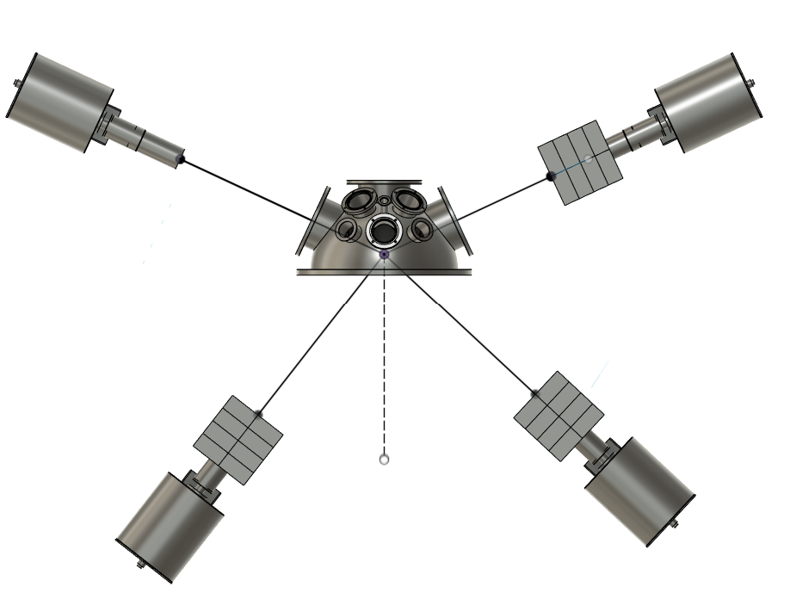
Setup
J-PARC MUSE D2
26MeV/c (MaskandSlit)
DSL2 UD20 LR15
DSL3-2 UD120 LR15
CH8
CH9
573+(127)
700mm
Peak Intensities
CH1~CH7: LEGe (distance 160mm)
I₍₁₋₂₎ > I₍₂₋₃₎ > I₍₄₋₃₎
Samples: Pure Cu, Pb, Sn and
Bronz standard
Peak Energies
643+(57)
E₍₁₋₂₎ > E₍₂₋₃₎ > E₍₄₋₃₎
638+(62)
38deg
47deg
Peak energy spacing
∝ 1/n²
CH11
The probability of
overlap becomes lower.
We have expectation to
obtain intense signal
for GMX
CH10
We expected to use GMX detectors.

Slide 8
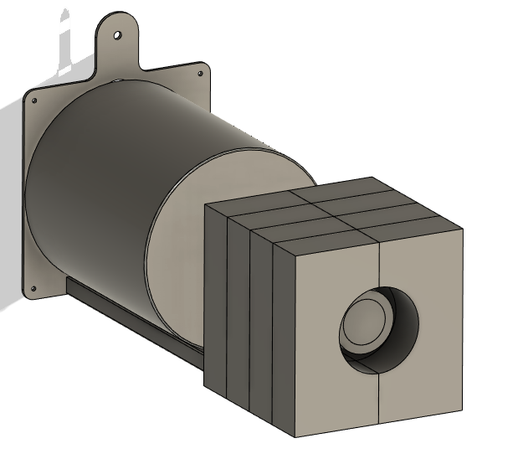
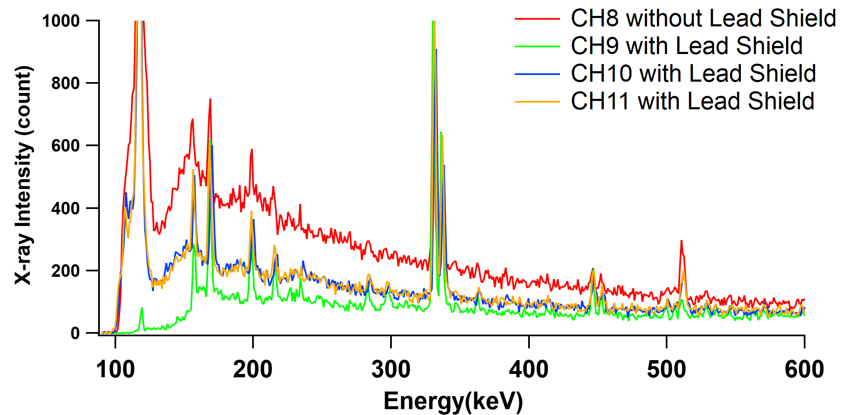
Lead shielding is essential when using GMX detectors at MUSE.
CH8
573+(127)
700
CH9
638+(62)
643+(57)
CH10
38deg
47deg
CH11

Slide 9
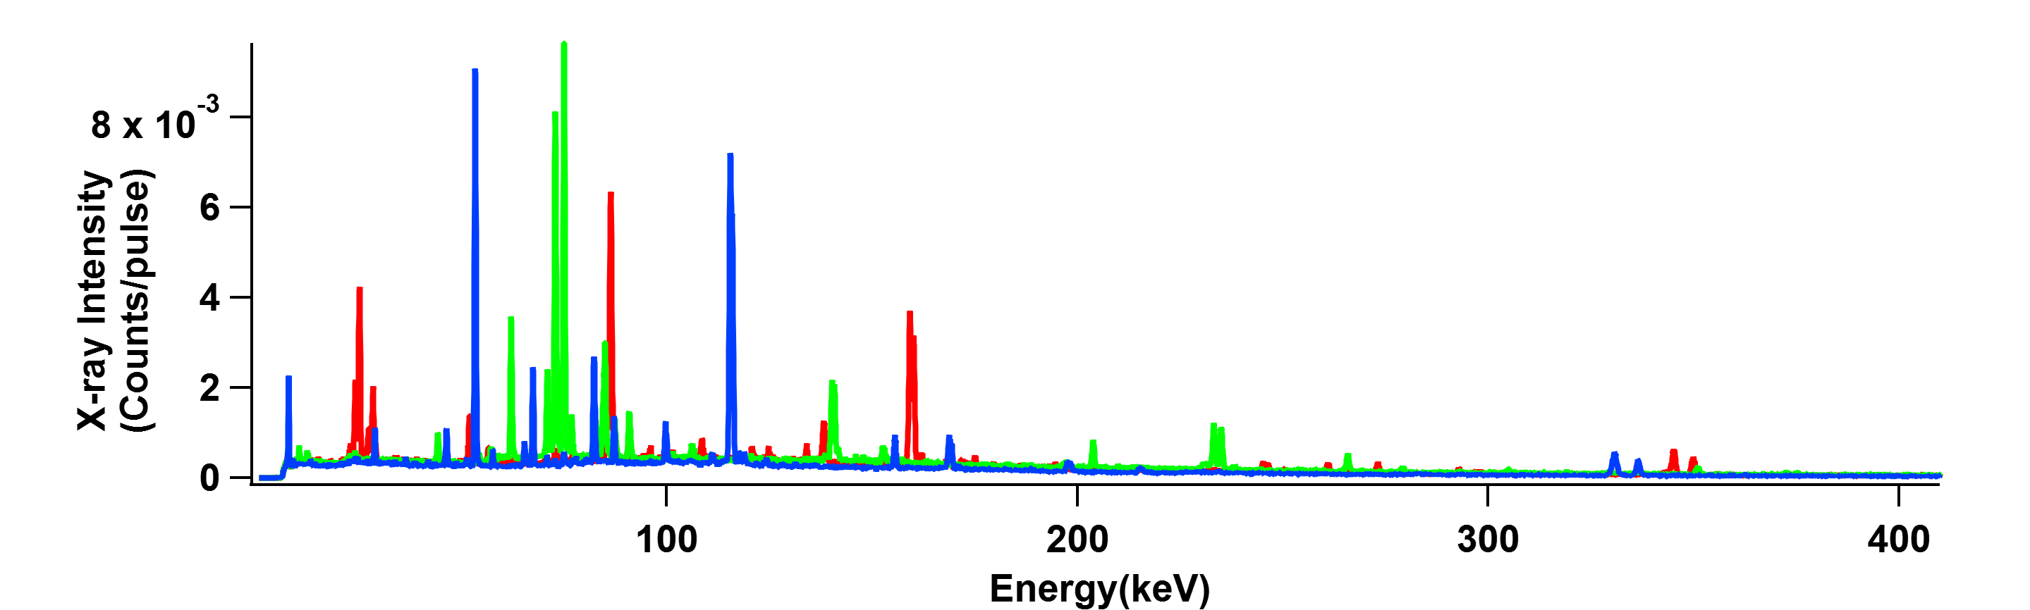
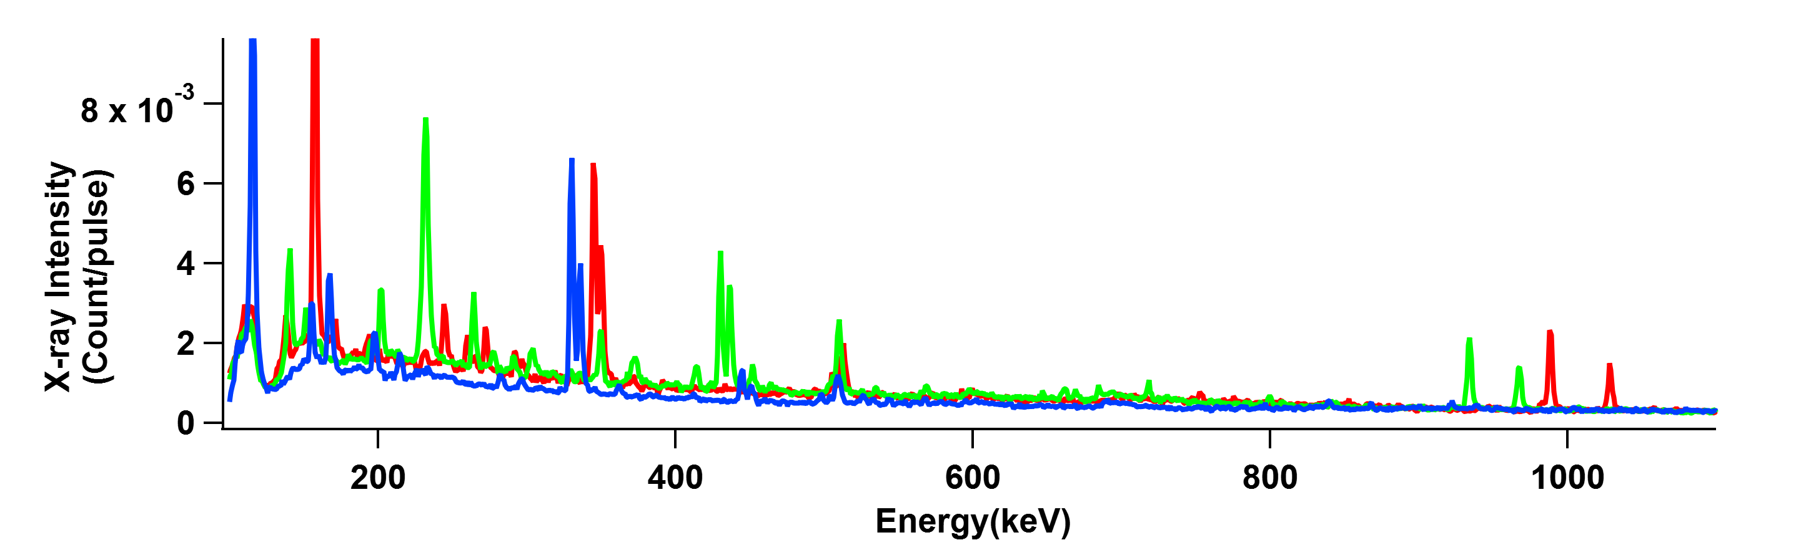
Pure Cu, Pb and Sn has been experimentally obtained in broad energy ranges
Cupper(Cu)
LEGe
LEAD(Pb)
Tin (Sn)
Issue is how to choose a independent “Sn” peak
Almost Sn peaks are overlapping !
GMX

Slide 10
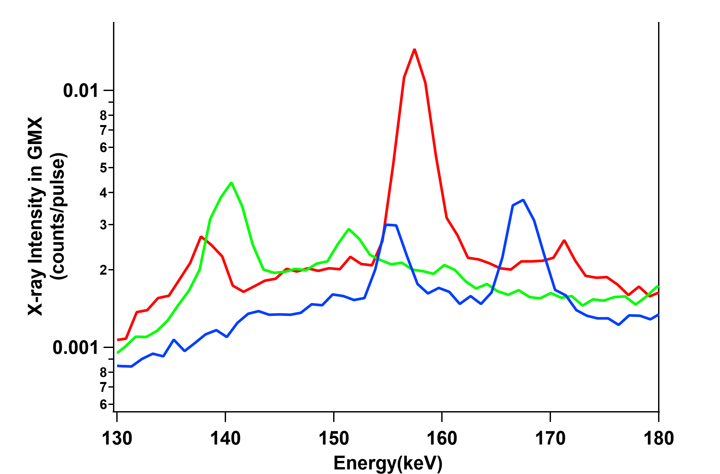
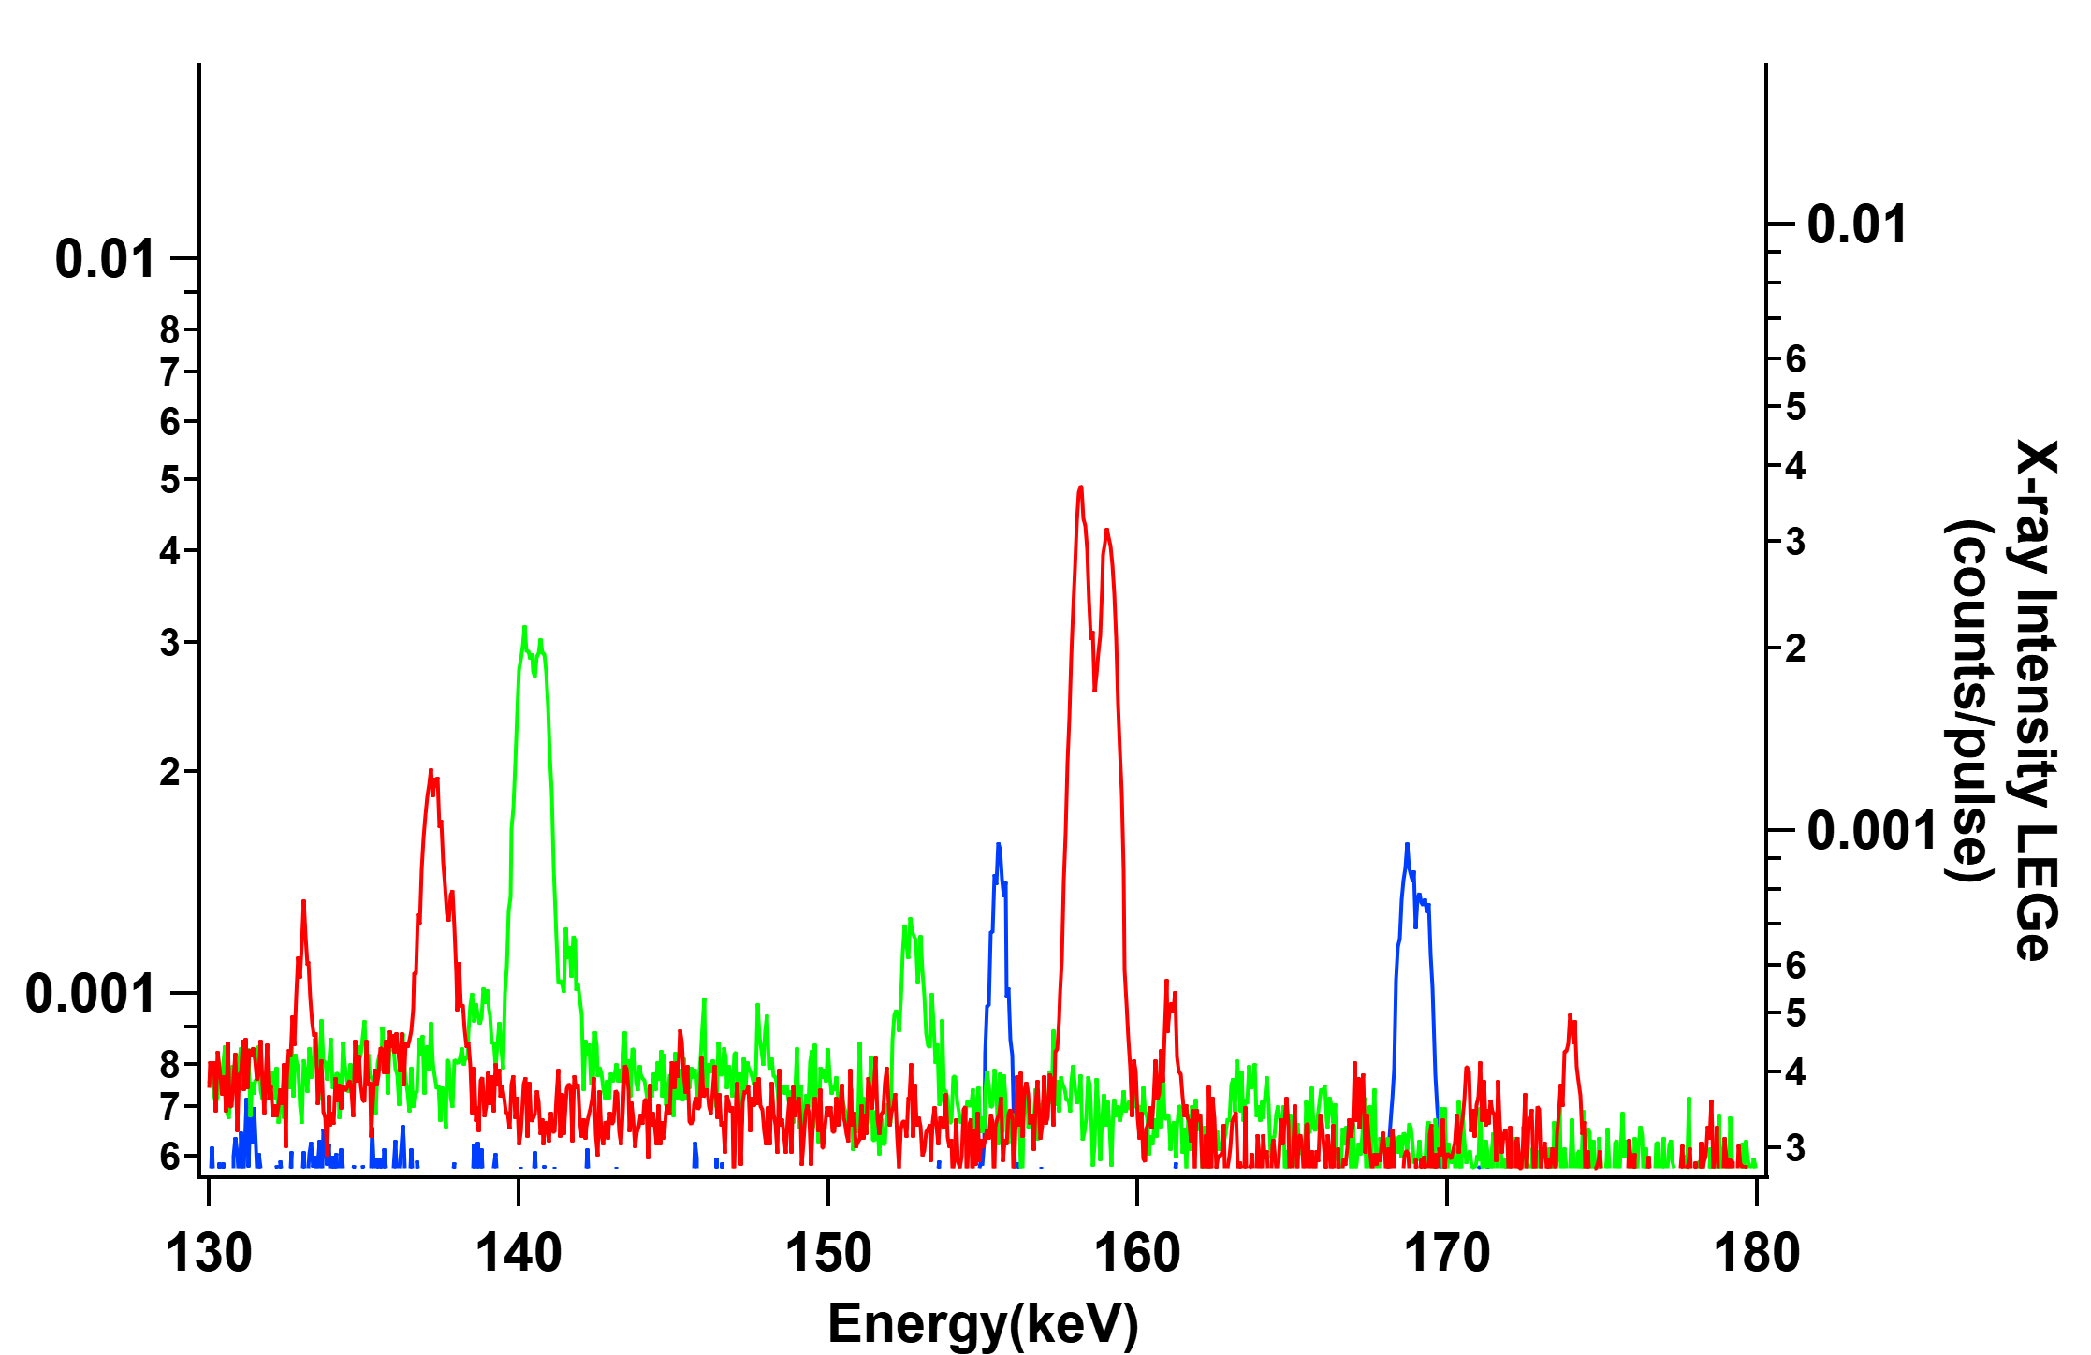
Spectral
Overlapping
around
GMX
Sn(5-4)
158.8keV
63Ni is produced from 63, and 65Cu
after nuclear absorbing -μ
63Ni
155.5keV
?s
Due to the limited resolution
of the GMX detector,
the Sn(5–4) peak overlaps with
a 63Ni peak originating from copper.

Slide 11
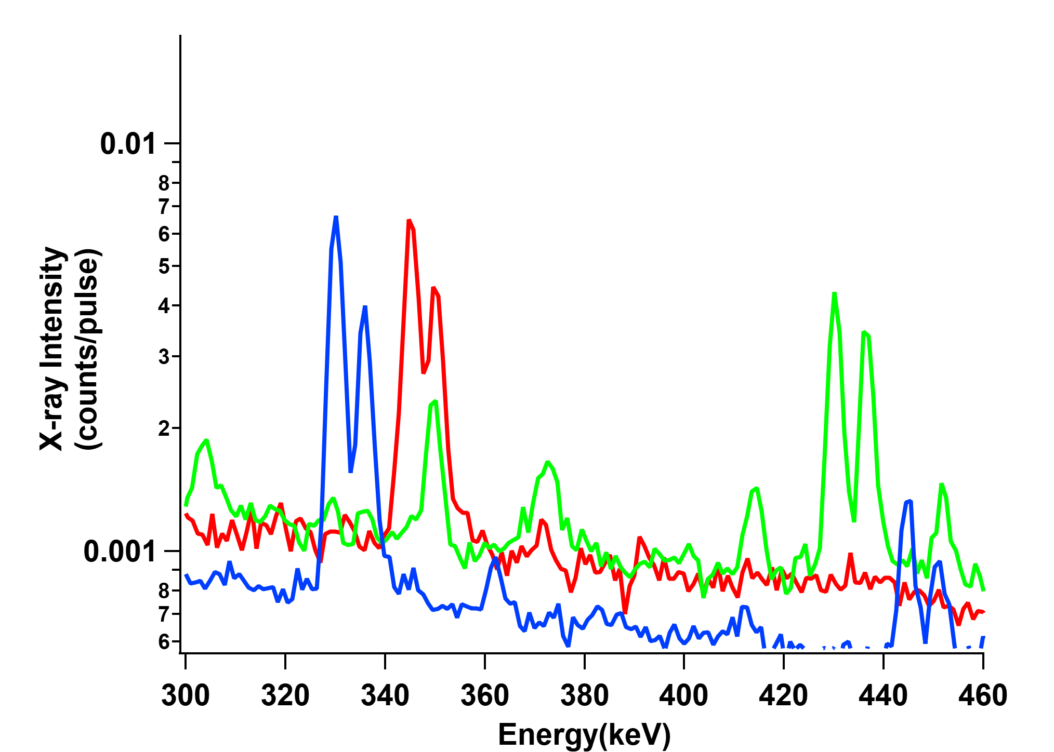
Spectral
Overlapping
around
GMX
Sn(4-3)
343.8keV
Sn(4-3)
344keV
Pb(5-4)
430keV
207Tl is produced from 206, 207 and 208Pb
after nuclear absorbing -μ
207Tl
351keV
30ps
Since Sn(4-3) peak includes Pb signals,
Therefore, Sn(4-3) is not able to use !
Otherwise, 207Tl is subtracted from Sn(4-3)
by using relation with Pb(5-4) to 207Tl
however, error will be increased !

Slide 12
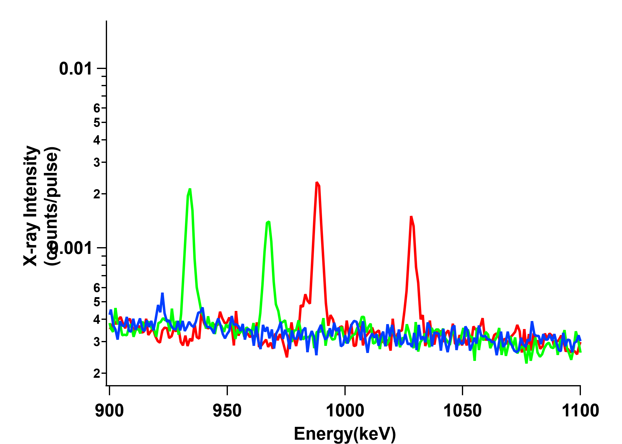
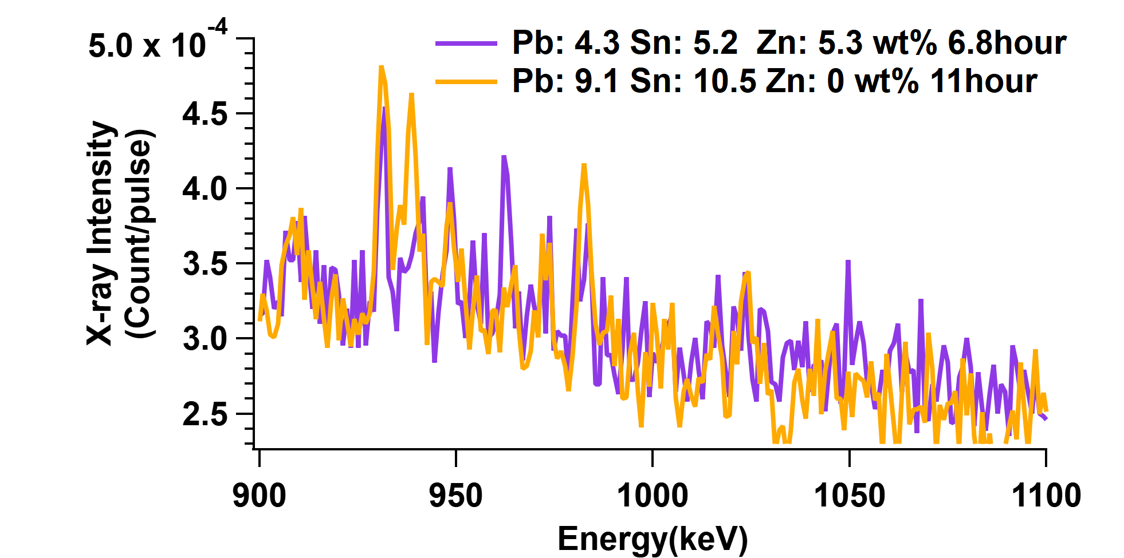
Spectral
Overlapping
around
GMX
Sn(5-4)
934keV
Pb(4-3)
934keV
Sn(3-2)
989keV
Sn(3-2)
1028keV
Pb(4-3)
965keV
?? Less Statics…

Slide 13
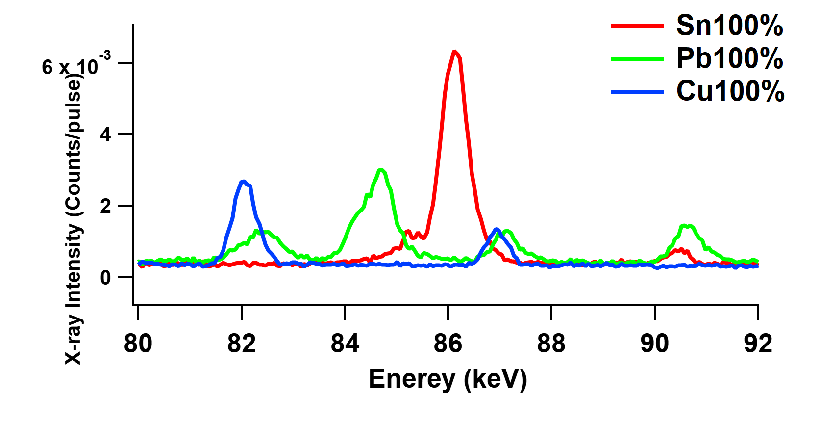
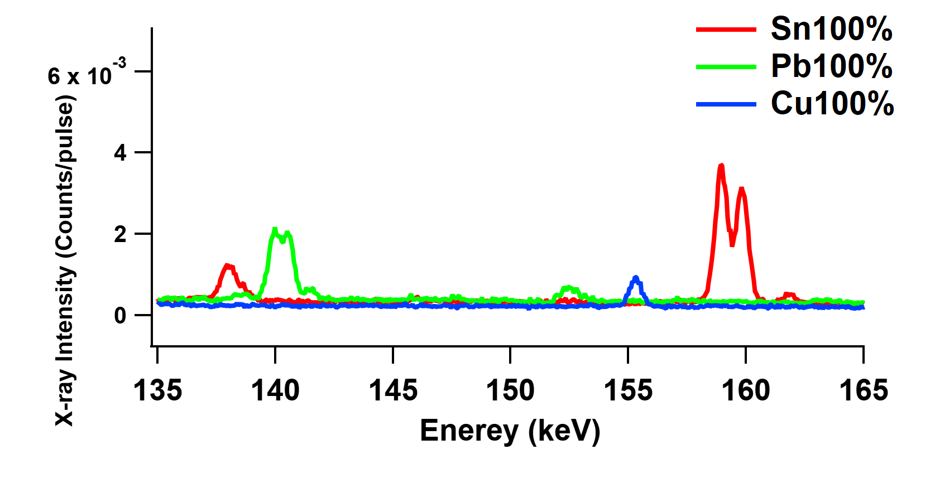
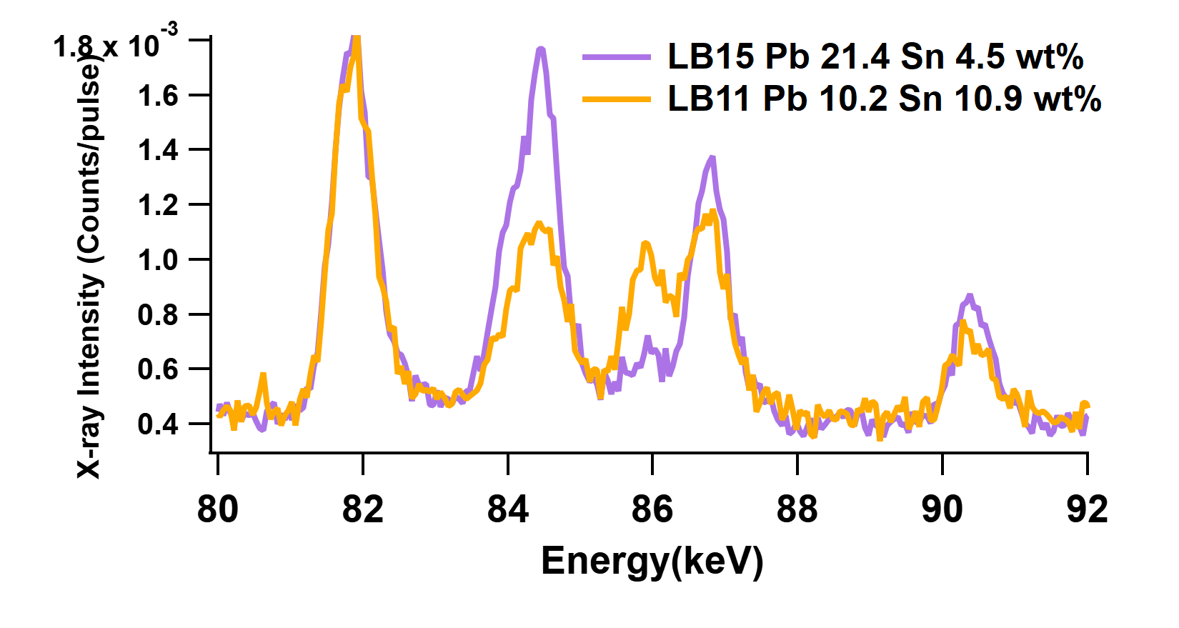
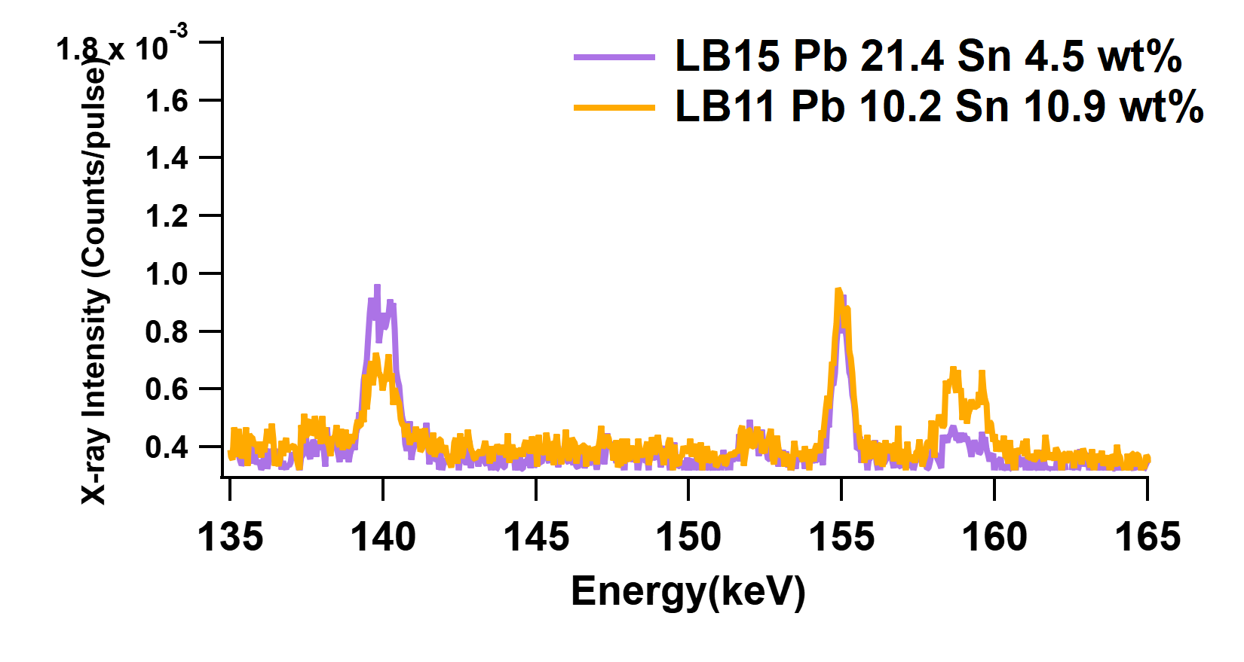
The LEGe detector enables the measurement of muonic X-ray peaks
from copper, lead, and tin with less spectral overlap.
Sn(6-5)
86.2keV
Sn(5-4)
158.8keV
Cu(6-4)
82.2keV
Pb
ekβ2
Pb(7-6)
140.1keV
Pb
ekβ3
Pb(8-7)
90.1keV

Slide 14

The Bronze Shachihoko of Nagoya Castle
The Shachihoko is a mythical creature with the head of
a tiger and the body of a carp, traditionally believed
to have the power to control rain and protect buildings from fire
On the roof of main gate
of Castle before 1945
The pelvic fin of the shachihoko
appears to be composed of
two distinct parts.
~1m40cm
100mm
Part of collection at the
Nagoya Castle General Administration Office

Slide 15
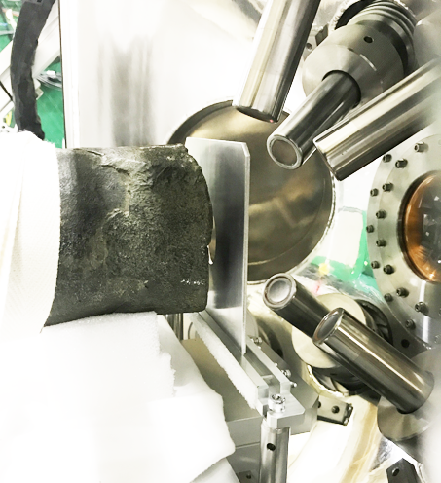
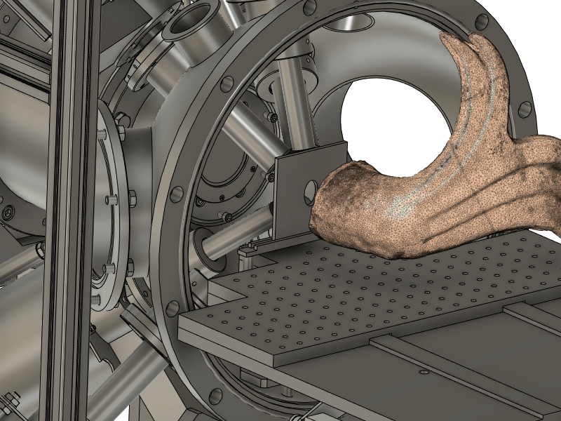

Slide 16
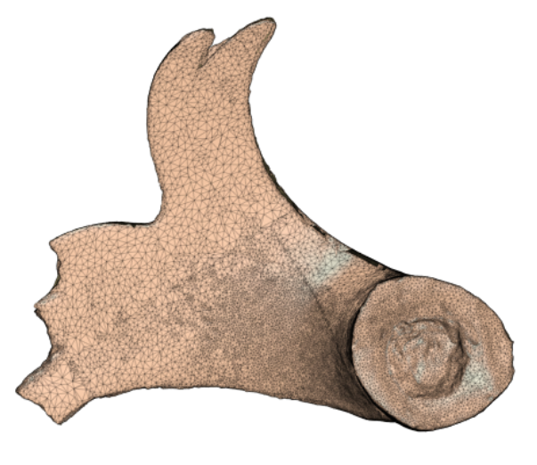
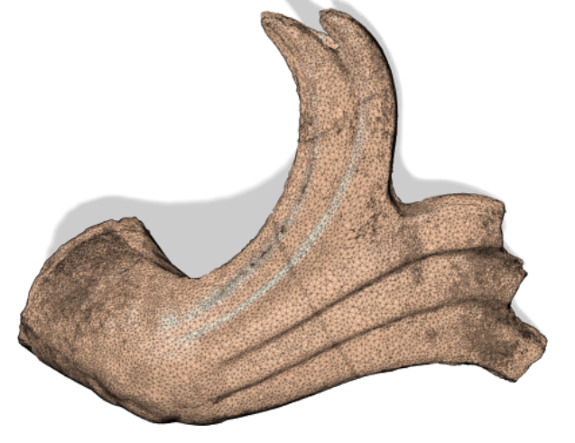
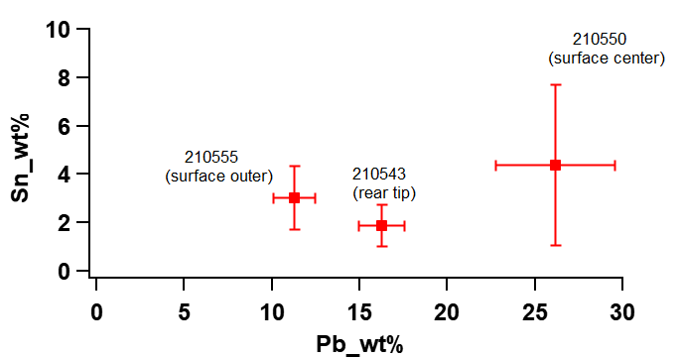
In the central part of the shachihoko's pelvic fin, bronze with a low melting point
was used.
30MeV/c implant
~280μｍ depth

Slide 17
Summary
Bronze artifacts have been found worldwide in cultural heritage sites, and analyzing their composition
is essential for understanding ancient production techniques, cultural diffusion, and historical connections.
Elemental analysis using negative muons enables investigation of the original composition
by probing deep layers unaffected by aging.
In muonic X-ray measurements, caution is required regarding peak overlaps among Cu, Pb, and Sn,
especially due to the overlap of the muonic X-ray lines of Sn
with nuclear de-excitation gamma rays from Cu and Pb.
We presented a case study analyzing the bronze shachihoko ornament mounted
at the main gate of Nagoya Castle.

