Slide 1
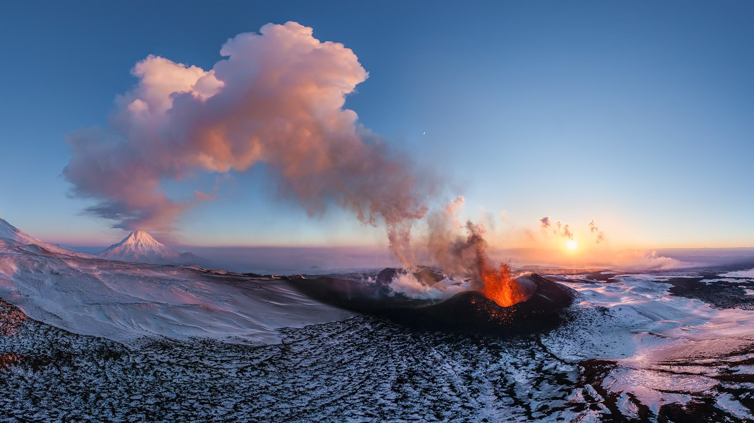
Towards Fluctuating Magnetism in Zn-doped Averievite
Towards Fluctuating Magnetism in Zn-doped Averievite
Gediminas Simutis
Laboratory for Neutron and Muon Instrumentation
PSI Center for Neutron and Muon Sciences
Gediminas Simutis
Laboratory for Neutron and Muon Instrumentation
PSI Center for Neutron and Muon Sciences
24 July 2025
airpano.com/360video/video-kamchatka-volcano-plosky-tolbachik

Slide 2
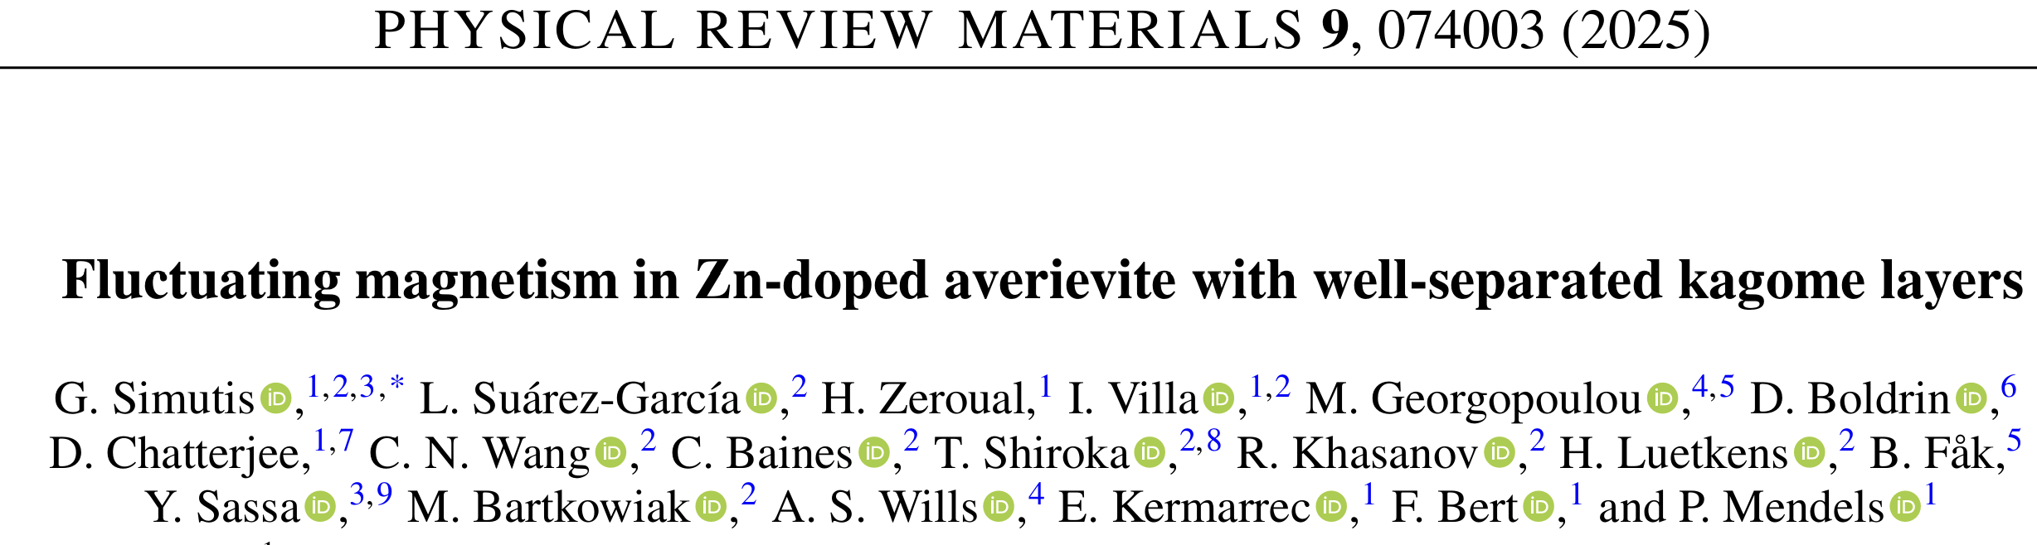


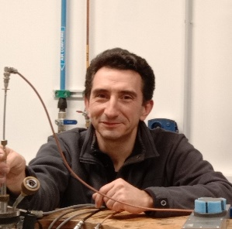

Lara Suarez-Garcia Madeleine Georgopoulou Fabrice Bert Philippe Mendels

Slide 3
Unconventional magnetic states
T/J
Bethe (1931)
Néel (1932)
Landau (1933)
Anderson (1952)
Mermin and Wagner (1966)
Chakravarty et al., (1989)
Chubukov et al., (1994)
Balents (2010)
Savary and Balents (2016)
Broholm et al., (2020)
1/S, 1/z, 1/D, frustration

Slide 4
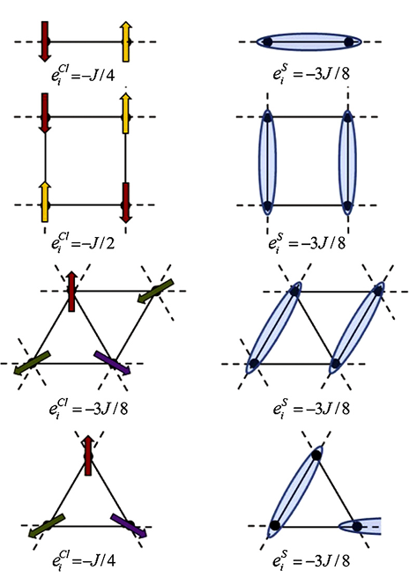

Energetics and connectivity

Slide 5
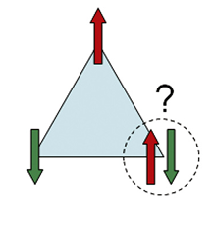
Energetics and connectivity

Slide 6

Energetics and connectivity

Slide 7
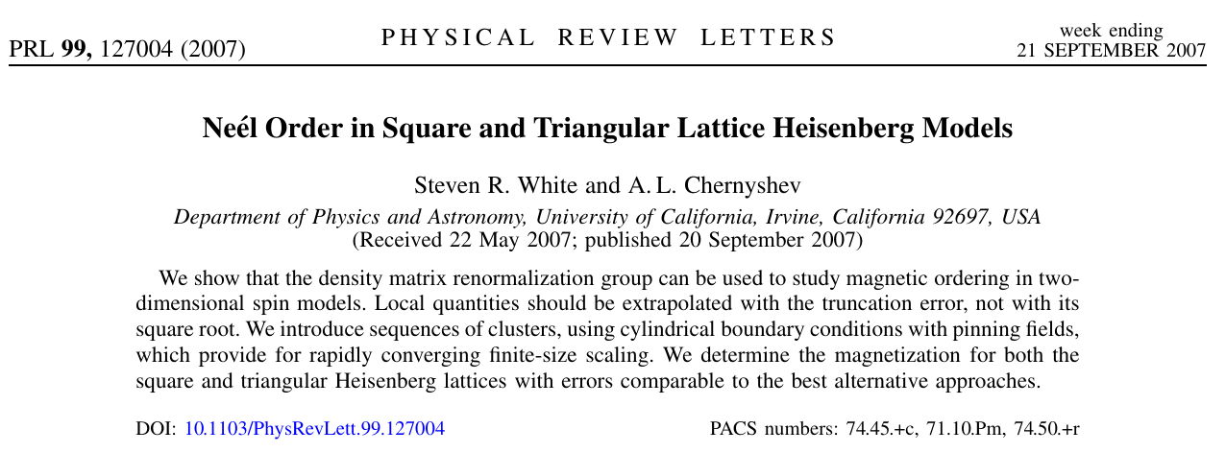
Numerics
Triangular lattice has Neel state with reduced (40%) ordered moment
Kagome is expected to have no ordered moment
Many subsequent theoretical reports about absence of order in the Kagome lattice

Slide 8
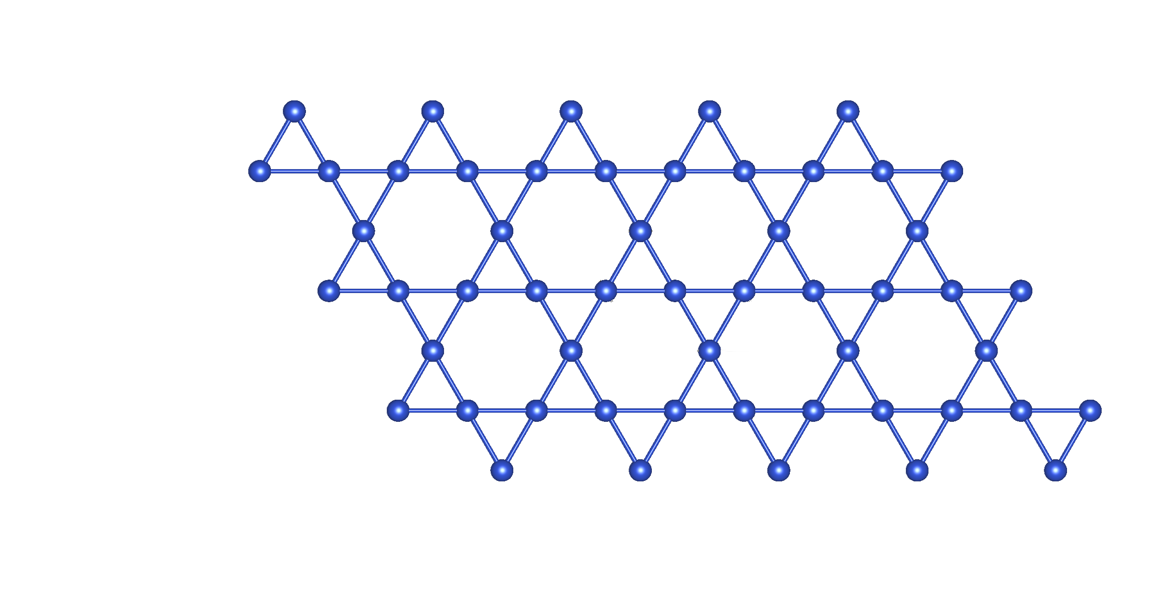
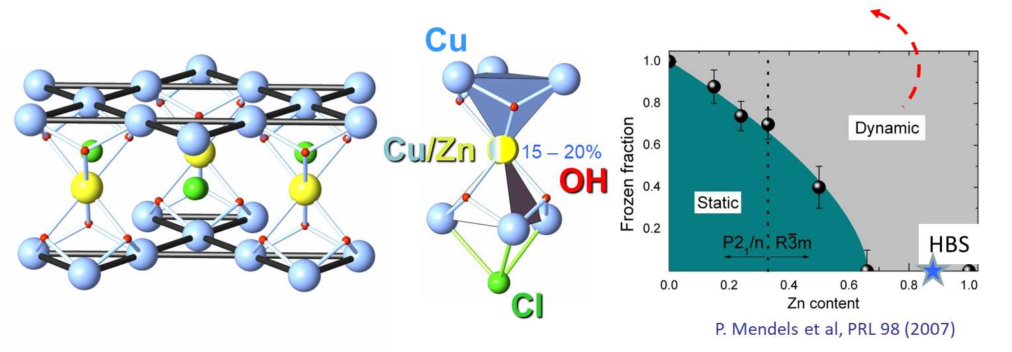
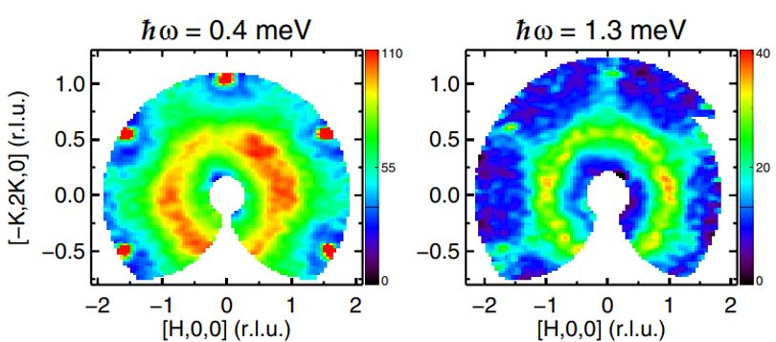
What are the properties ?
S = ½ on a Kagome – The only isotropic NN model for QSL
What type of QSL?
Theory:
No exact solution
Many states near in Energy
VMC gapless
Many other methods - gapped
Depends on how the problem is truncated
Tensor Network Wavefunctions truncate the Ansatz wavefunctions and suggest gapless state
- How stable is it ? (DM, impurities, inter-layer, anisotropy) Truncation is hard:
Gapless spin liquids in disguise
Ferrari, Parola, Becca
PRB 103, 195140 (2021)
Experiments:
Few (any?) perfect lattices
Always DM present
Disorder…
Layer intermixing?
Herbertsmithite example
(..other materials emerge..)
?

Slide 9
Where are the materials?
Volcanoes as mineral forges
> 100 new minerals from Tolbachik (Kamchatka) Eruptions: 1975, 2012 Averievite: Cu5V2O10(CsCl) (Dokl. Earth Sci. 359, 804 (1998))
airpano.com/360video/video-kamchatka-volcano-plosky-tolbachik

Slide 10
Where are the materials?
Volcanoes as mineral forges
> 100 new minerals from Tolbachik (Kamchatka) Eruptions: 1975, 2012 Averievite: Cu5V2O10(CsCl) (Dokl. Earth Sci. 359, 804 (1998))
Synthetic versions: Towards Cu4Zn1V2O10(CsCl)
Botana et al., PRB 98 (2018)
Towards Cu3Zn2V2O10(CsCl) Georgopoulou et al., arXiv:2306.14739 using solid state reaction
airpano.com/360video/video-kamchatka-volcano-plosky-tolbachik

Slide 11
Previous studies – parent compound
Cu²⁺ distorted kagome layer
Zn
Cu²⁺ - V⁵⁺ honeycomb layer
Cs spacer
Cu²⁺ - V⁵⁺ honeycomb layer
Cu²⁺ distorted kagome layer
Magnetic order
T_{N} = 24 K
θ_{CW} = 185 K
Series of structural transitions for the parent compound
Low - > T distorted pyrochlore slab
Kagome plane sandwiched by two Cu²⁺ - V⁵⁺ honeycomb layers
A.S. Botana et al., Phys. Rev. B 98 (2018)
M. Georgopoulou et al, ArXiv 2306.14739

Slide 12
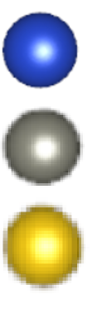
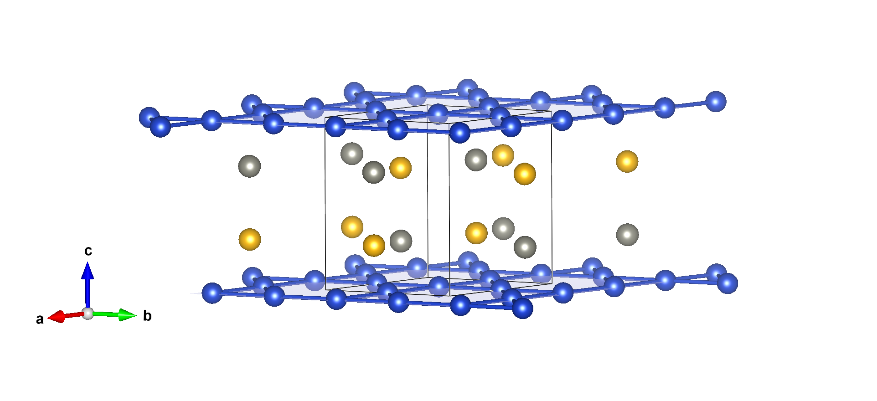



Averievite: Cu_{5-x}Zn_{x}V₂O₁₀(CsCl)
Cu
Zn
V
Kagome layers
$$x=0$$
$$x=1$$
$$x=2$$
2-dimensionality
Notes:
- Kagome layer with copper, magnetic atom with spin ½ + 2 honeycomb layers in between, also with copper
- If we dope with Zn (non magnetic), it replaces Cu in interlayer, so we decouple Kagome layers + avoid problems with defects
- There were already studies up to x=1

Slide 13
Averievite: Cu_{5-x}Zn_{x}V₂O₁₀(CsCl)
T. Biesner et al., Phys. Rev. B 105 (2022)
A.S. Botana et al., Phys. Rev. B 98 (2018)
Notes:
- Kagome layer with copper, magnetic atom with spin ½ + 2 honeycomb layers in between, also with copper
- If we dope with Zn (non magnetic), it replaces Cu in interlayer, so we decouple Kagome layers + avoid problems with defects
- There were already studies up to x=1

Slide 14
Averievite: Cu_{5-x}Zn_{x}V₂O₁₀(CsCl)
T. Biesner et al., Phys. Rev. B 105 (2022)
When does the system become dynamic?
What are the ground states for different substitutions?
How do the ground states evolve?
-> muon experiments on Zn0, Zn1, Zn2
A.S. Botana et al., Phys. Rev. B 98 (2018)
M. Georgopoulou et al, ArXiv 2306.14739
Notes:
- Kagome layer with copper, magnetic atom with spin ½ + 2 honeycomb layers in between, also with copper
- If we dope with Zn (non magnetic), it replaces Cu in interlayer, so we decouple Kagome layers + avoid problems with defects
- There were already studies up to x=1

Slide 15
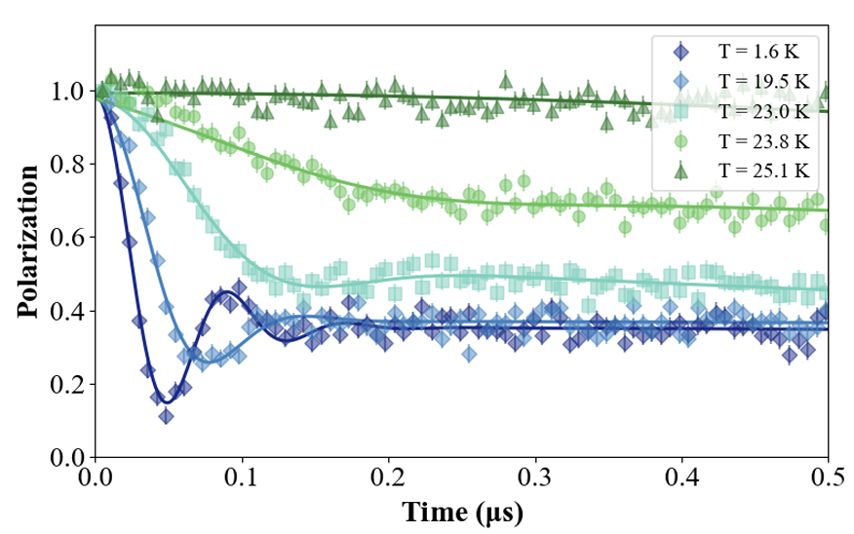
Muon measurements – Zn0 case
Comparing with the neutron results
Magnetic order setting in at ~24 K Excitations can be modelled as spin waves (all powder measurements)

Slide 16
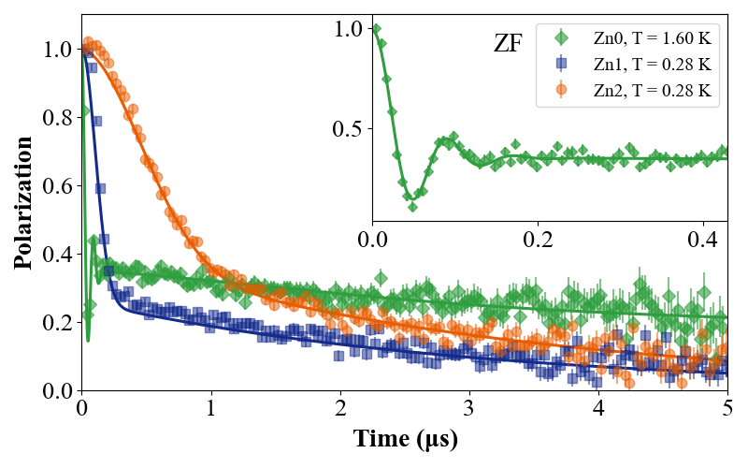
Muon measurements – Further removal of copper from interlayers

Slide 17
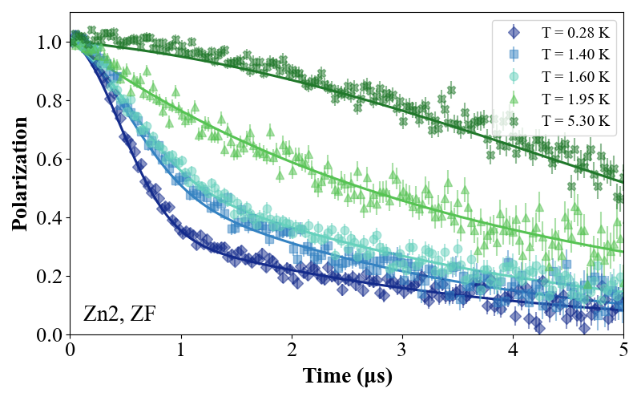

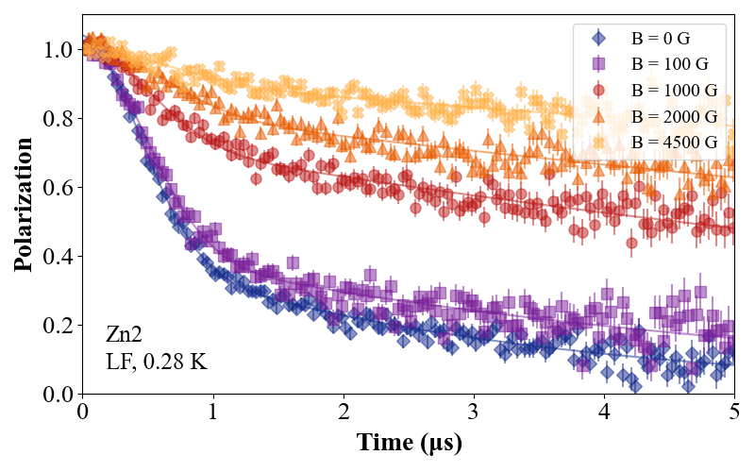
Muon measurements – Zn2
Gaussian + exponential relaxation components
If it were static, decoupling expected at ~100 G
Not the case! A dynamical state at T =0.28 K << J
ZF
LF

Slide 18
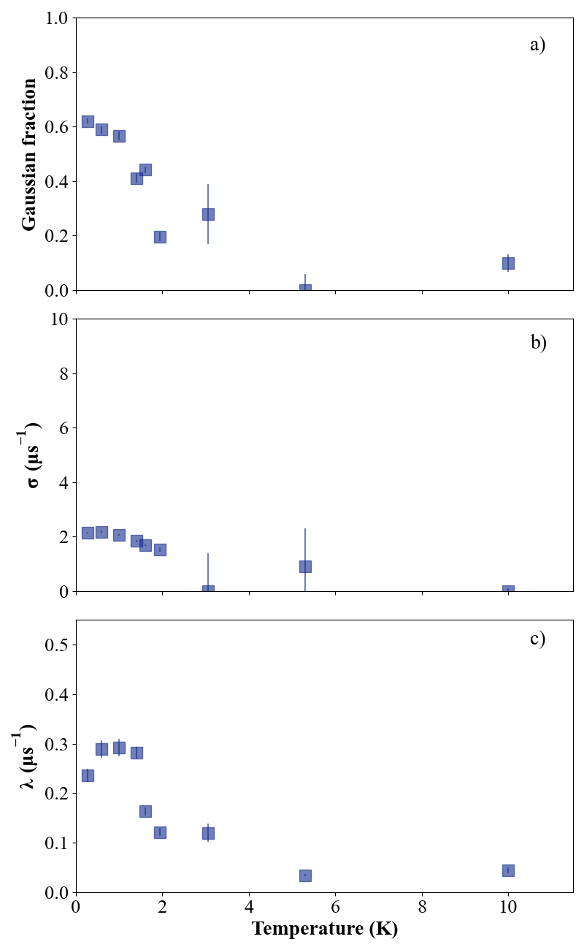
Muon measurements – Zn2
Gaussian fraction
Gaussian relaxation
Exponential relaxation

Slide 19
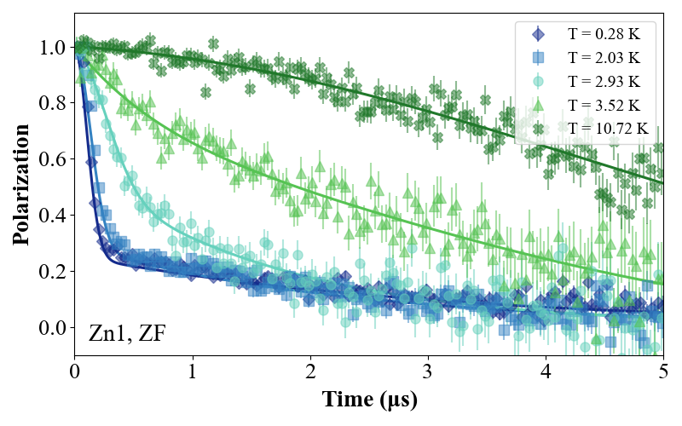
Muon measurements – Zn1

Slide 20
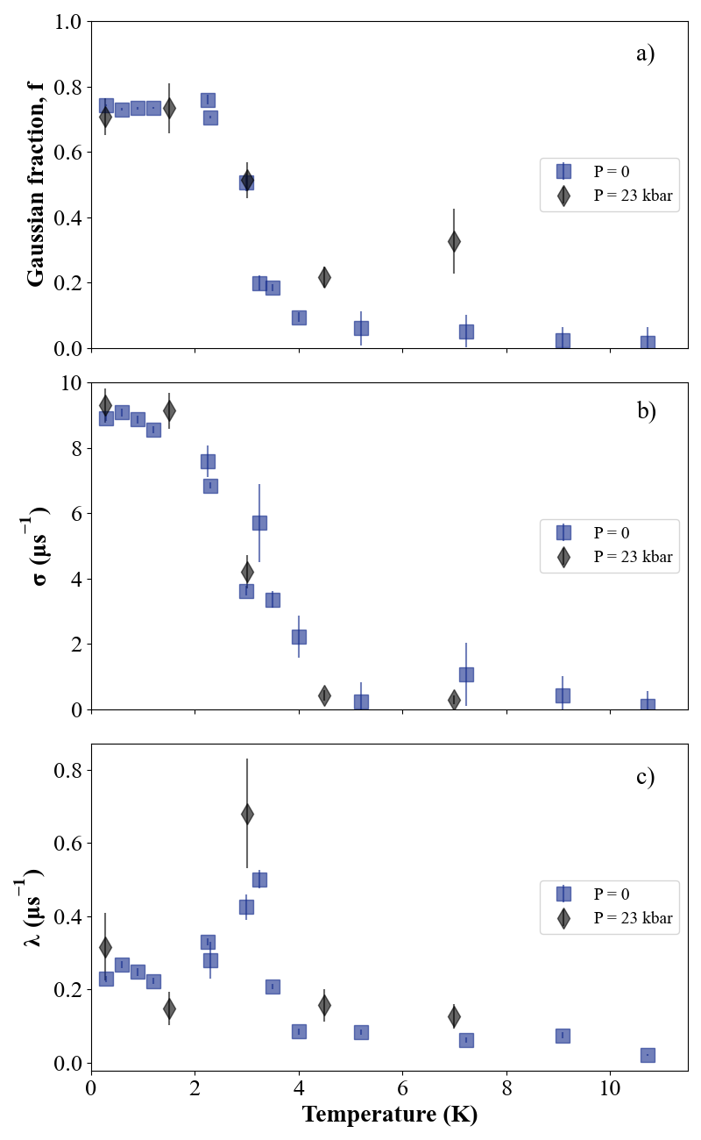
Muon measurements – Zn1
Gaussian fraction
Gaussian relaxation
Exponential relaxation

Slide 21
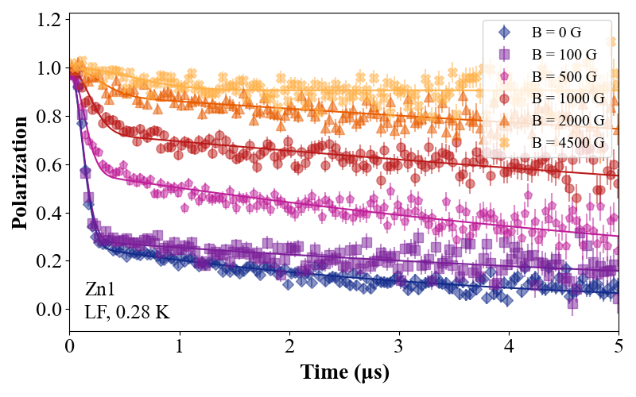
Muon measurements – Zn1 – a quasi-static state
Gaussian fraction
Gaussian relaxation
Exponential relaxation

Slide 22

Comparing with neutron results
Zn₀
Zn₁
Zn₂
B. Fak (1959-2024)
Spin waves
Diffuse magnetic scattering
Magnetic fluctuations for
Q<0.3 Å⁻¹ best seen for δE<0

Slide 23
Averievite – Cu_{5−x}Zn_{x}V₂O₁₀(CsCl) - a new Kagome on the block!
From x=0 to 2, progressive decoupling between the kagome planes to reach a dynamic state
Two spacer layers available – better controlled decoupling
x= 2 averievite is a new experimental platform for the study of QSL
x = 1 averievite still has a transition to a mixed disordered frozen / fluctuating state (Tg=3.5 K) with likely a variety of environments (spin glass/fluctuating clusters?)
What next?:
Single crystal studies to understand the correlations Better understanding the muon response
Can Zn2 be externally tuned ?
Bonus:
Different to hydroxide compounds, potential for doping (theoretical proposals of Zn²⁺ -> Ga³⁺ and V⁵⁺ -> Ti⁴⁺)
Cu
V
Zn/Cu
8.4 A

Slide 24
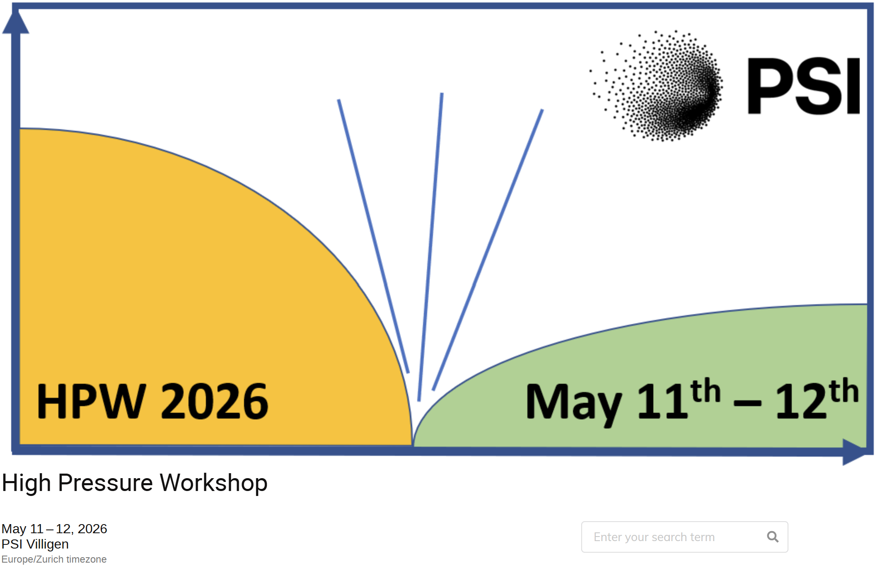

High-Pressure Workshop at PSI
High pressure science using - muons - neutrons - X-rays - and other techniques
and technical developments
https://indico.psi.ch/event/17608/

Slide 25
Averievite – Cu_{5−x}Zn_{x}V₂O₁₀(CsCl) - a new Kagome on the block!
From x=0 to 2, progressive decoupling between the kagome planes to reach a dynamic state
Two spacer layers available – better controlled decoupling
x= 2 averievite is a new experimental platform for the study of QSL
x = 1 averievite still has a transition to a mixed disordered frozen / fluctuating state (Tg=3.5 K) with likely a variety of environments (spin glass/fluctuating clusters?)
What next?:
Single crystal studies to understand the correlations Better understanding the muon response
Can Zn2 be externally tuned ?
Bonus:
Different to hydroxide compounds, potential for doping (theoretical proposals of Zn²⁺ -> Ga³⁺ and V⁵⁺ -> Ti⁴⁺)
Cu
V
Zn/Cu
8.4 A

Slide 26
Towards Fluctuating Magnetism in Zn-doped Averievite
Gediminas Simutis
Laboratory for Neutron and Muon Instrumentation
PSI Center for Neutron and Muon Sciences
24 July 2025

Slide 27
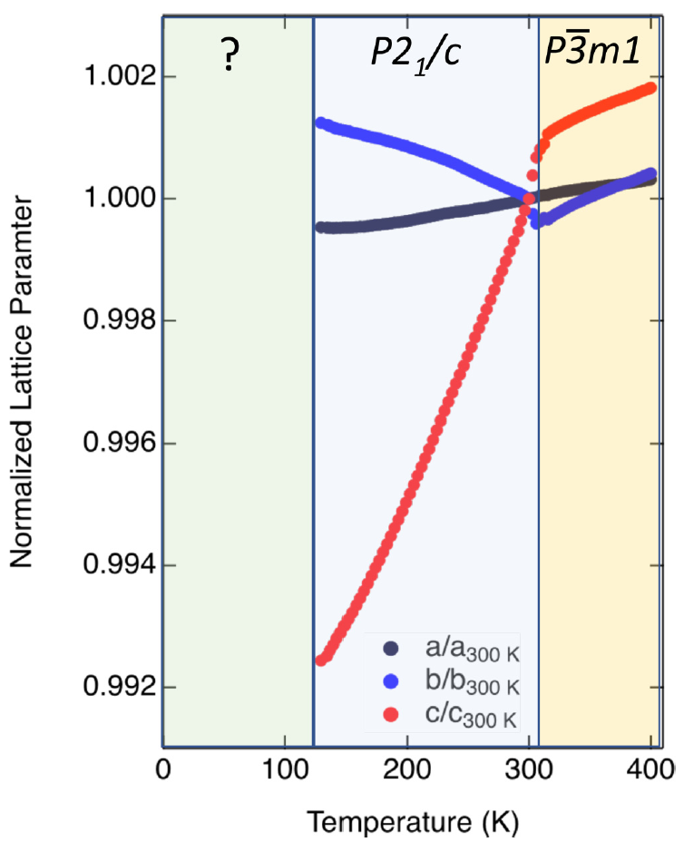
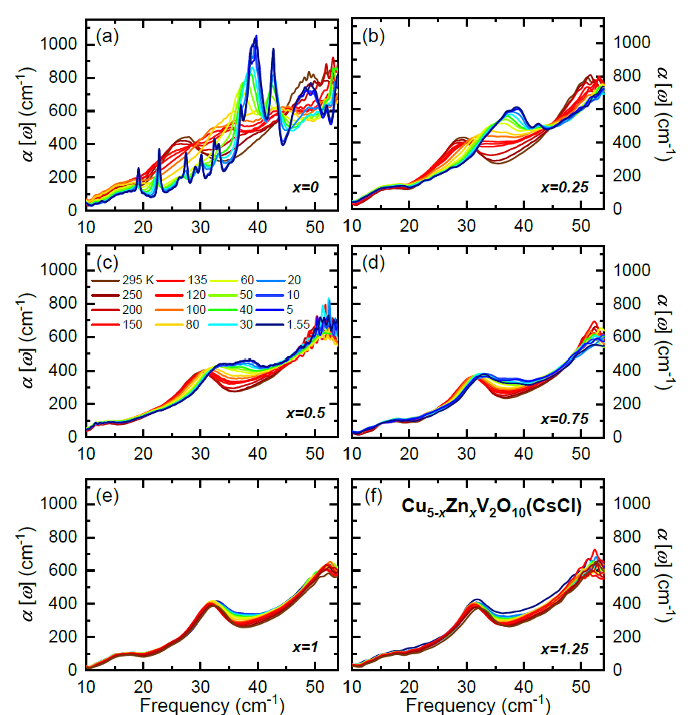
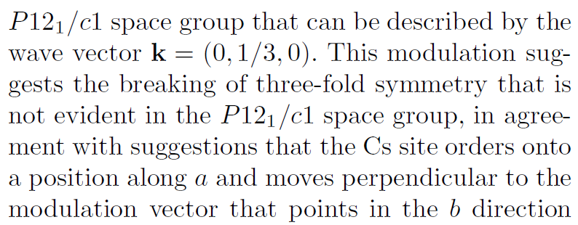
A.S. Botana et al., Phys. Rev. B 98 (2018) M. Georgopoulou et al, ArXiv 2306.14739
T. Biesner et al., Phys. Rev. B 105 (2022)

Slide 28
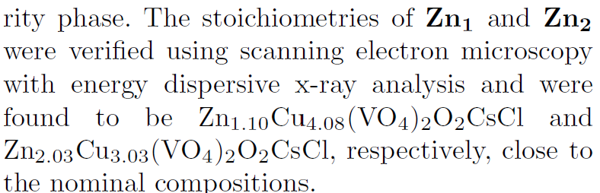
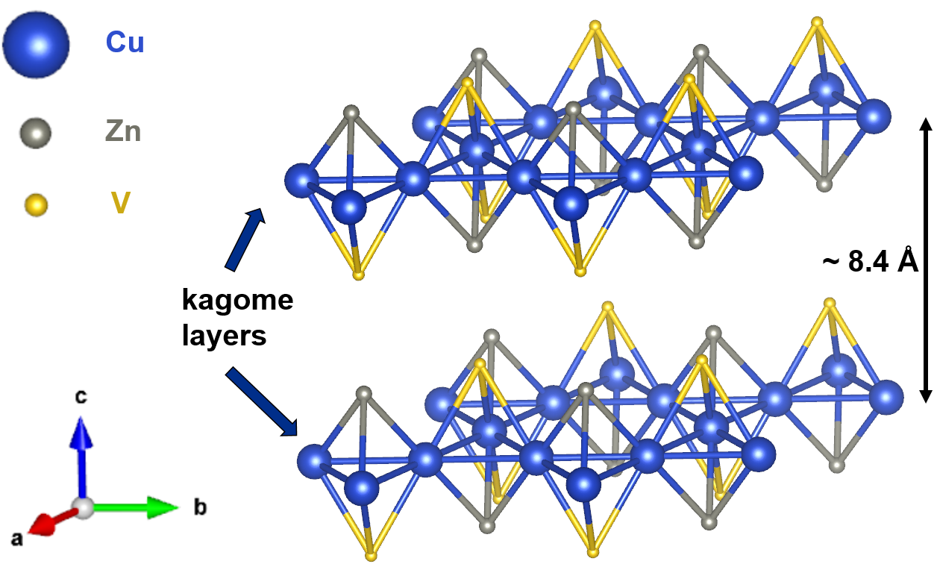
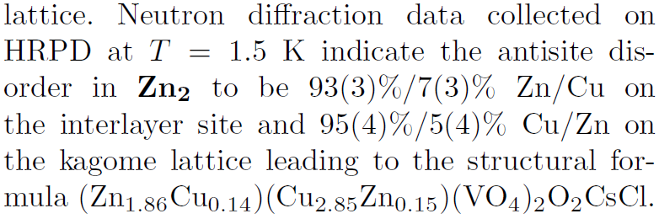
Zn2 averievite
(Zn_{1.86}Cu_{0.14})(Cu_{2.85}Zn_{0.15})(VO₄) ₂CsCl
CF - in herbertsmithite element specific anomalous x-ray diffraction indicated
a 15% Cu occupancy of the interlayer site
and no site disorder on the kagome lattice
In the kagome plane, Cu has square planar coordination In the honeycomb planes, Cu is surrounded instead by five O with the short Cu-O apical bonds lying along the c axis

Slide 29
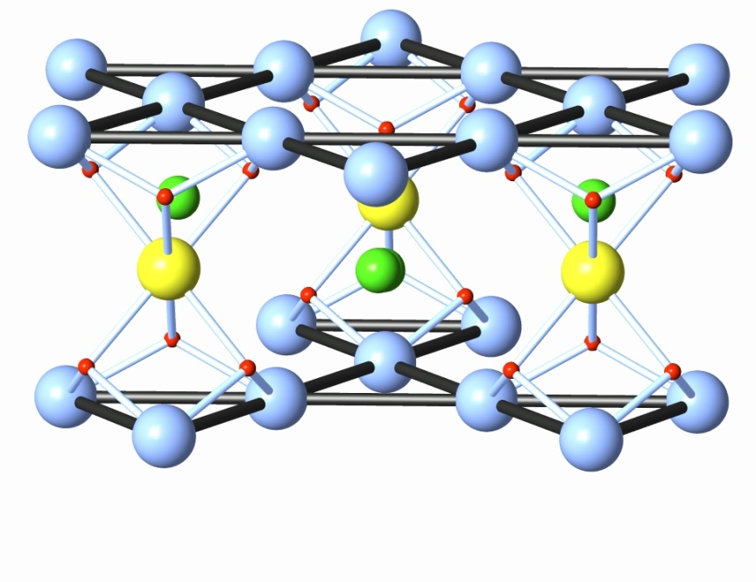
Herbertsmithite
Zn2 averievite
5.1 Å
(Zn_{0.85}Cu_{0.15})(Cu₃)(OH)₆Cl ₂
(Zn_{1.86}Cu_{0.14})(Cu_{2.85}Zn_{0.15})(VO₄) ₂CsCl

