Slide 1
Contrasting in-plane and c-axis uniaxial stress effects on superconductivity and stripe order in La_{2-x}Ba_{x}CuO₄ (x = 0.125, 0.115)
Shams Sohel Islam
μSR 2025, 23 July 2025

Slide 2
Acknowledgements
PSI Center for Neutron and Muon Sciences
Technische Universität Dresden
Tsung-Dao Lee Institute
Zurab Guguchia
Vahid Sazgari
Debarchan Das
Gediminas Simutis
Toni Shiroka
Rustem Khassanov
Mathias Elender
Alex Amato
Marc Janoschek
Hubertus Luetkens
Jennifer Nadine Graham
Orion Gerguri
Petr Král
Jonas A. Krieger
Thomas J Hicken
Hrishikesh Gopakumar
Marek Bartkowiak
Markus Müller
Hans-Henning Klauss
Rajib Sarkar
Shreenanda Ghosh
Felix Brückner
Vadim Grinenko
MPI, Stuttgart
Clifford Hicks
Brookhaven National Laboratory
John M. Tranquada
Genda Gu
Sophia University
Ikuya Maetsu
Tadashi Adachi
University of Zürich
Johan Chang
Julia Küspert
DESY
Martin Von Zimmermann
Oleh Ivashko
Tohoku University
Yoji Koike

Slide 3
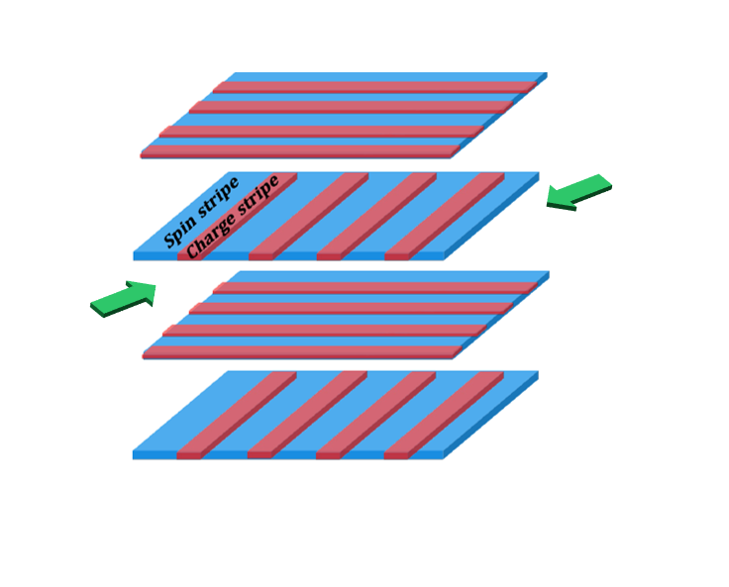
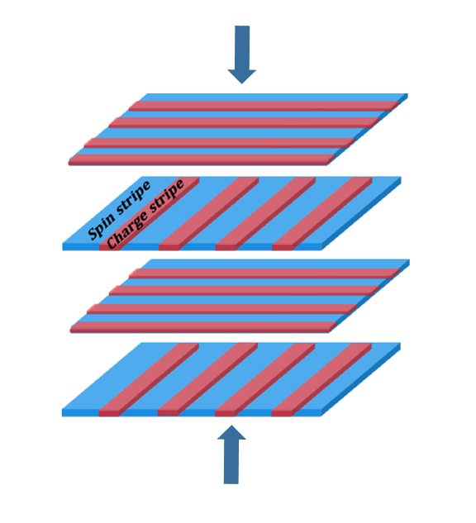
Outline of the talk
La_{2-x}Ba_{x}CuO₄ (LBCO) – rich phase diagram of Intertwined orders
Motivation – Uniaxial Strain study
Strain apparatus - μSR and ac susecptibility
Results
Conclusion
In-plane uniaxial stress effect on superconductivity, spin-stripe order and structural transitions in LBCO (x = 0.125)
Contrasting c-axis and in-plane uniaxial stress effects on superconductivity and stripe order in LBCO (x = 0.115)
S. S. Islam et. al., Commun. Phys. 8, 291 (2025)

Slide 4
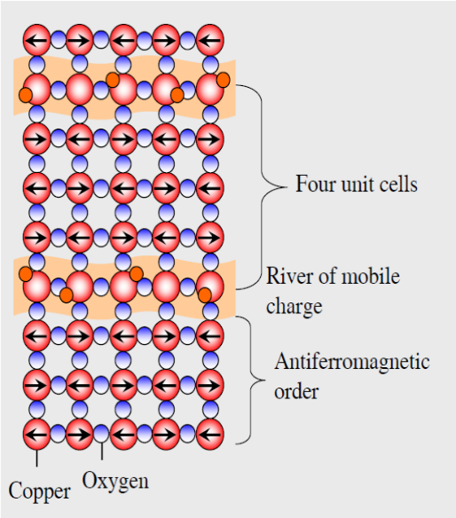
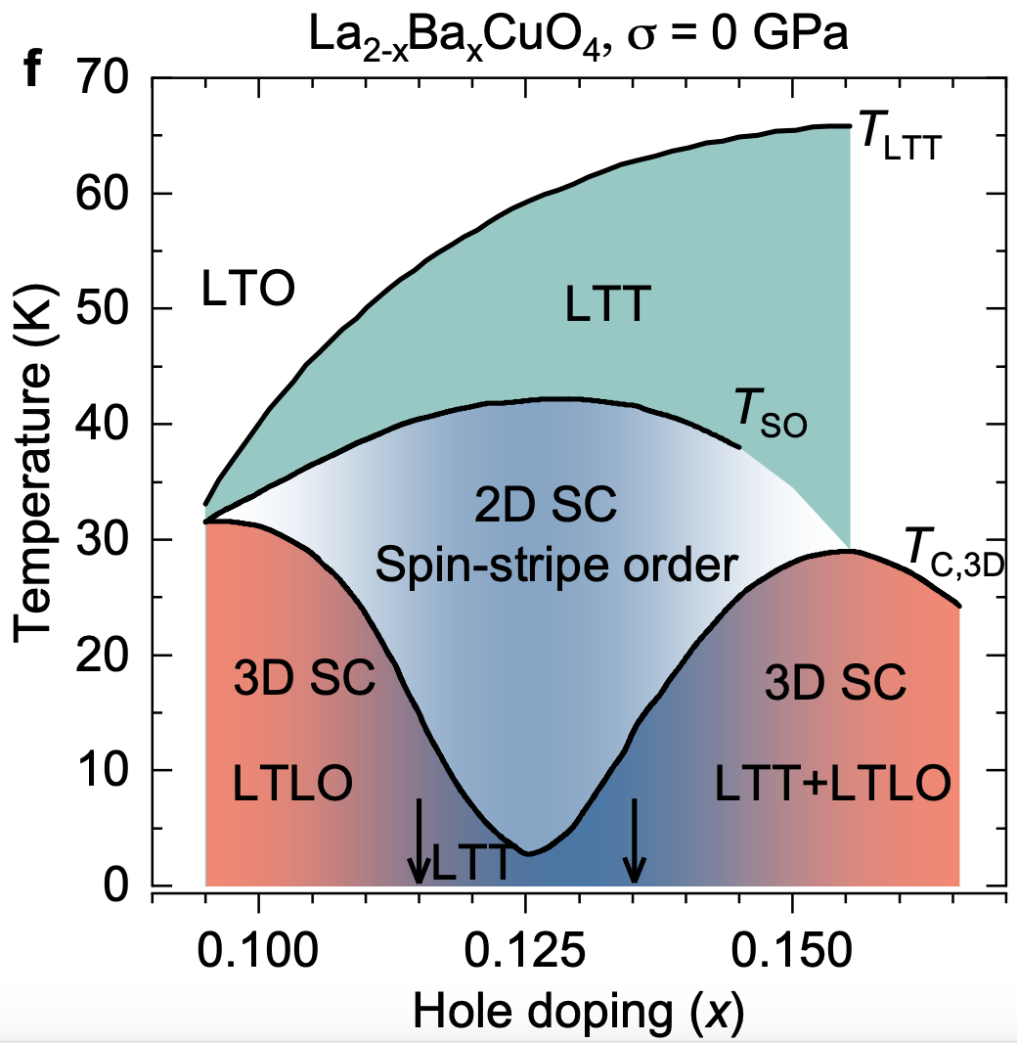
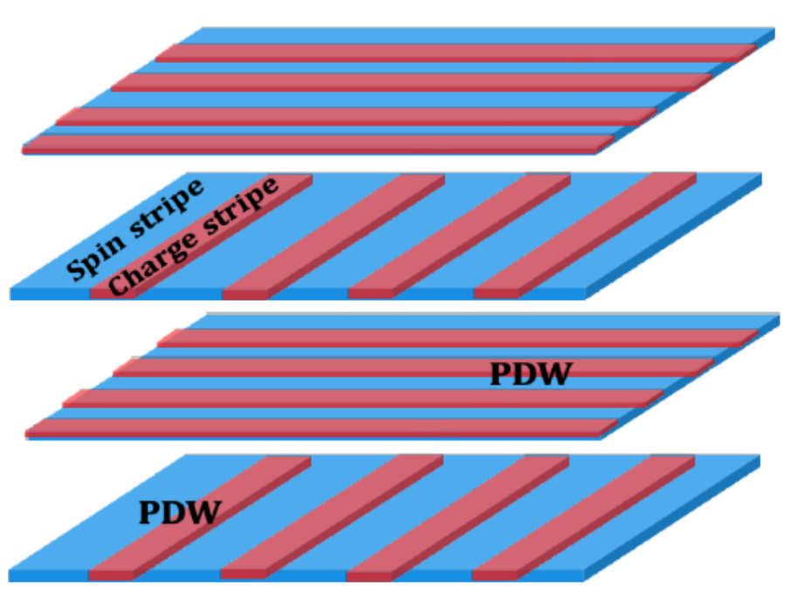
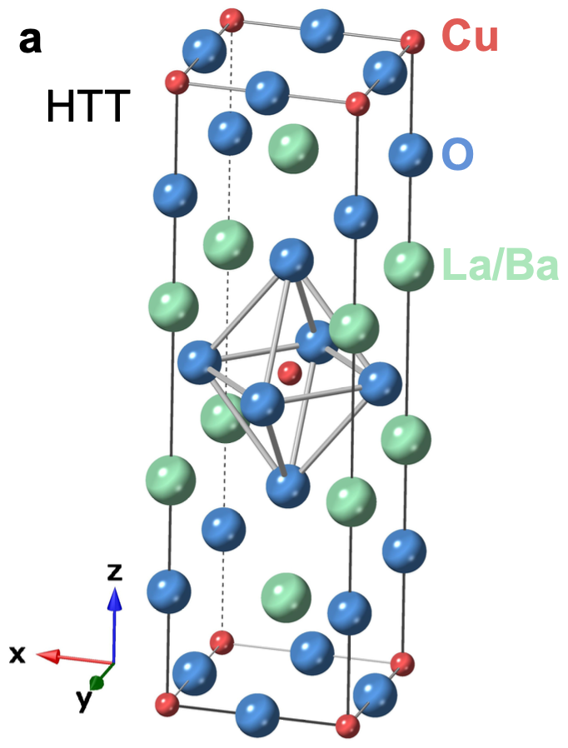
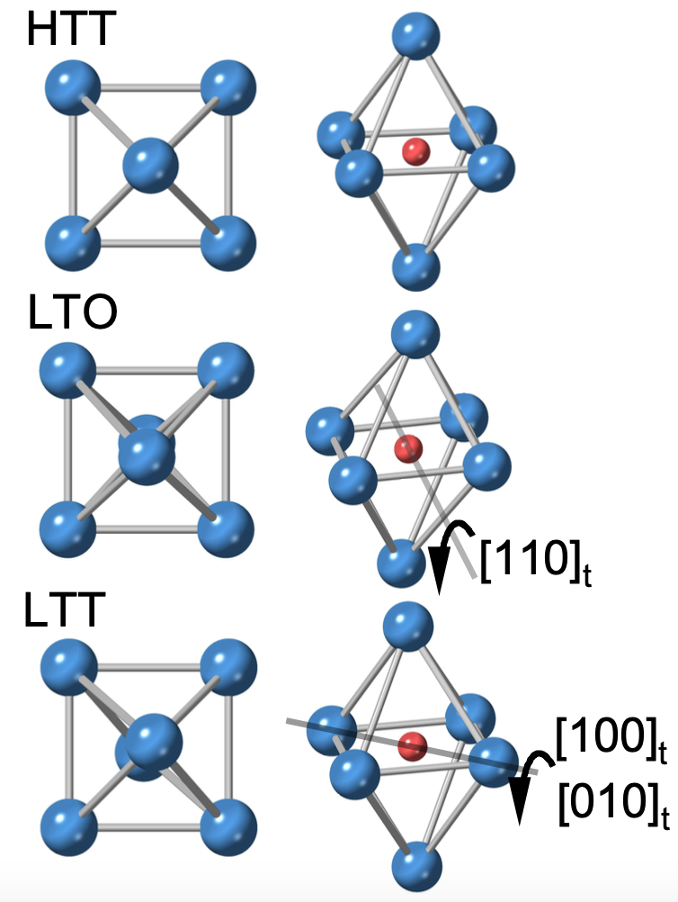
Complex phase diagram of HTSC La_{2-x}Ba_{x}CuO₄ (LBCO)
a
c
a
b
b
Onset of 2D SC correlations at
T_{c,2D} (T_{so}),>>T_{c,3D}
Loss of inter-layer Josephson coupling between 2D SC layers
[1] Li et. al., Phys. Rev. Lett. 99, 067001 (2007).
[2] J. Tranquada et. al., Phys. Rev. B 78, 174529 (2008).
Origin?
[3] M. Hücker et. al., Phys. Rev. B 83, 104506 (2011).

Slide 5
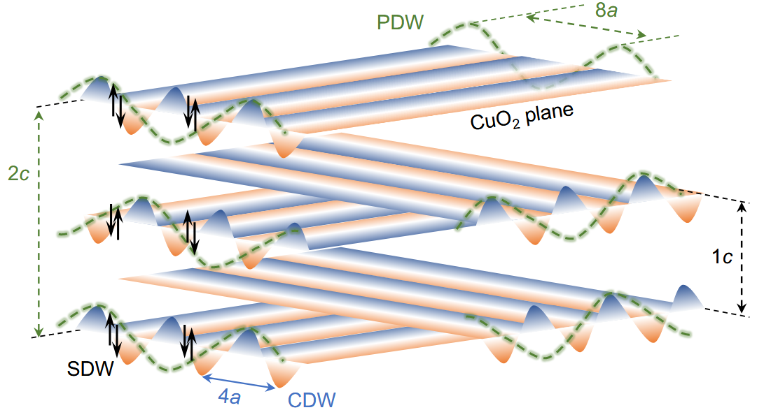
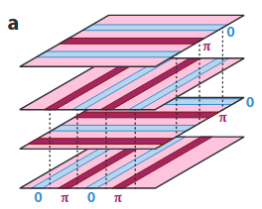
Theory of Intertwined Orders in High-T Superconductors
Adapted from [3]
Adapted from [1]
Schematic cartoon illustrating stripes in real-space^{[3]}
The predicted phase modulation in the PDW state^{[4]}
Question
What governs the interplay between such intertwined orders?
How to Study them?
Prediction of 2D PDW SC order: SC pairing occurs along quasi-1D charge stripes.
The phase of the pair wave function alternates by π between neighboring charge stripes^{[1-2]}.
In adjacent CuO₂ layers, anti-phase PDW states on orthogonal charge stripes frustrate the interlayer Josephson coupling^{[1-2]}
Compatible with the suppressed uniform 3D SC, and 2D SC correlations.
[1] E. Fradkin, S.A. Kivelson, J.M. Tranquada, Rev. Mod. Phys. 87, 457 (2015).
[2] E. Berg et. al., Phys. Rev. Lett. 99, 127003 (2007).
[3] J.-S. Lee et. al., arXiv:2310.19907 (2023).
[4] D. F. Agterberg et. al., Ann. Rev. Cond. Matt. Phys. 11, 231 (2020).

Slide 6
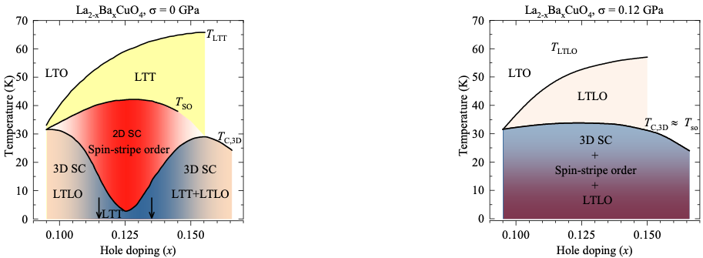
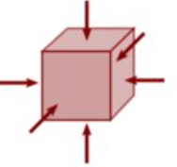

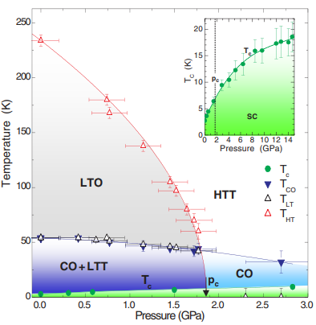
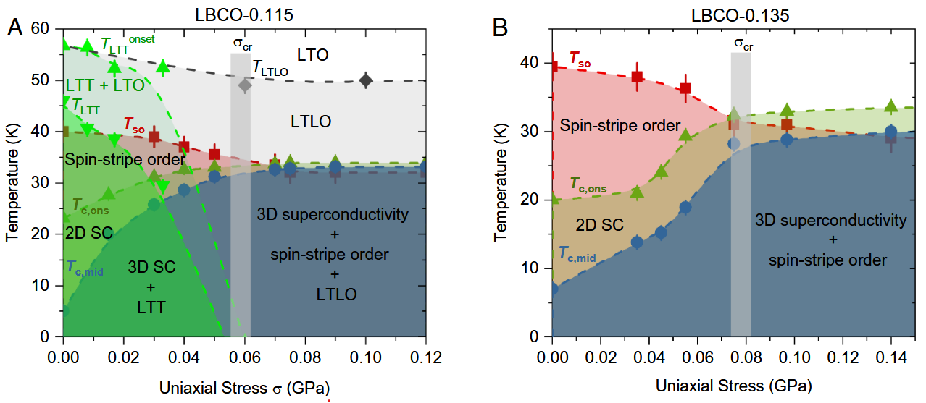
Study of intertwined orders and perturbative techniques
External perturbation (Pressure)
controlled, continuous, reversible
Hydrostatic Pressure
Uni-axial stress
Isotropic perturbation
Does not allow exploring anisotropic / direction dependent behaviors
Anisotropic perturbation
Enabling the precise tuning of lattice parameters along specific crystallographic directions
T_{CDW}
Motivation
What happens for x = 0.125 under in-plane stress ?
Can we establish a general (T-x) phase-diagram under stress ?
M. Hücker et. al., Phys. Rev. Lett. 104, 057004 (2010).
Z. Guguchia et. al., Phys. Rev. Lett. 125, 097005 (2020).
Z. Guguchia et. al., Proc. Natl. Acd. Sci. U.S.A. 121, e2303423120 (2024).
L. Thomarat, et. al., Commun. Phys. 7, 271 (2024).

Slide 7
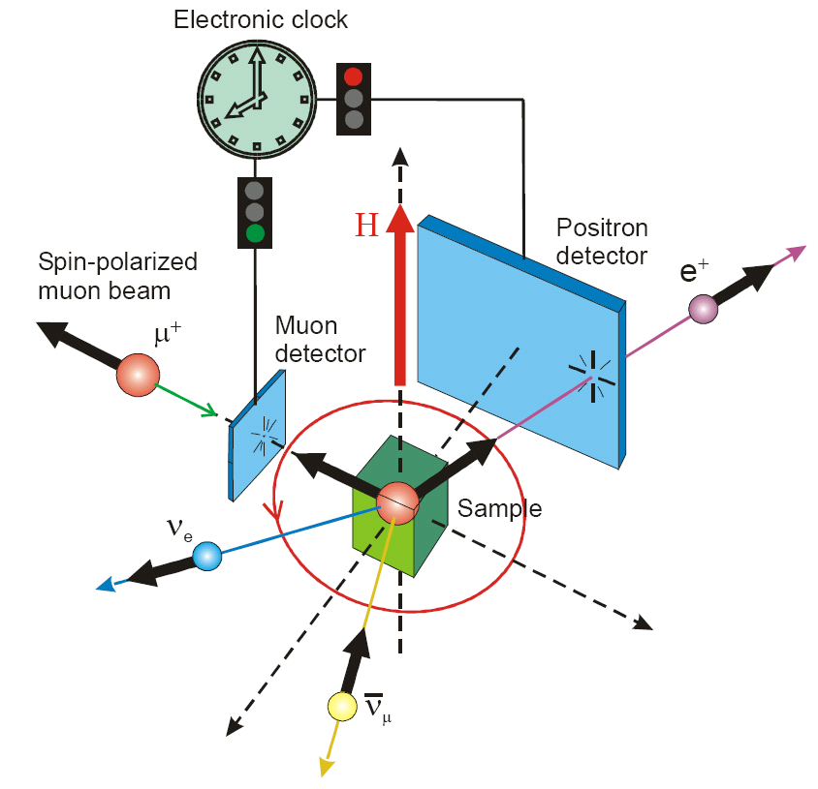
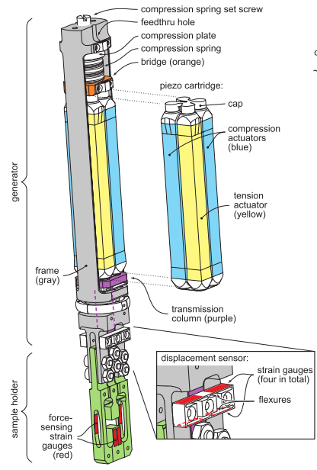
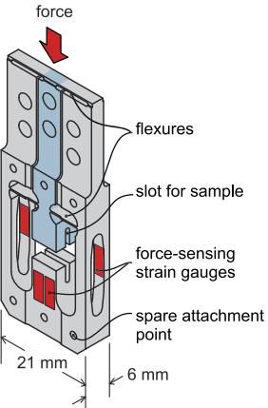
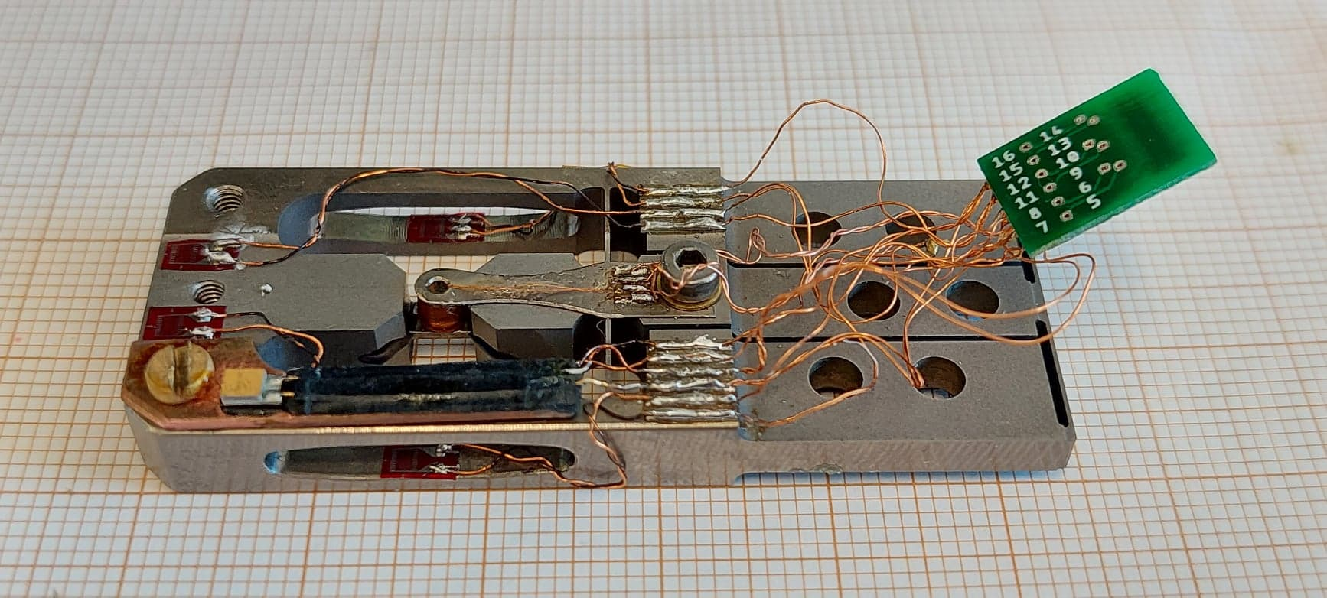
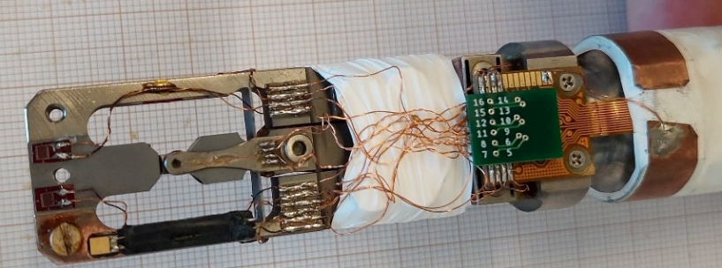
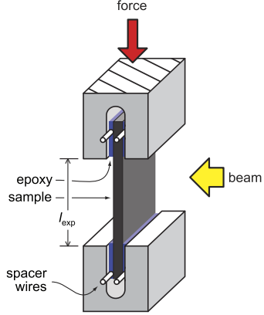
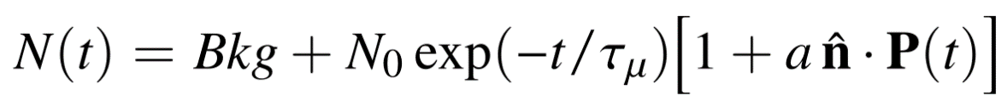
In-situ piezoelectric-driven uniaxial stress device for μSR
(PSI-TU Dresden-MPI Stuttgart collaboration)
Core mechanism: The relative length of the actuators determines the fraction of the preload that is transferred to the sample.
Strain Gauges
B_{µ}
Sample
AC Coil
[1] C.W. Hicks et. al., JPS Conf. Proc. 21, 011040 (2018), [2] S. Ghosh et. al., Rev. Sci. Instrum. 91, 103902 (2020), [3] V. Grinenko et. al., Nature Physics 17, 748 (2021).

Slide 8
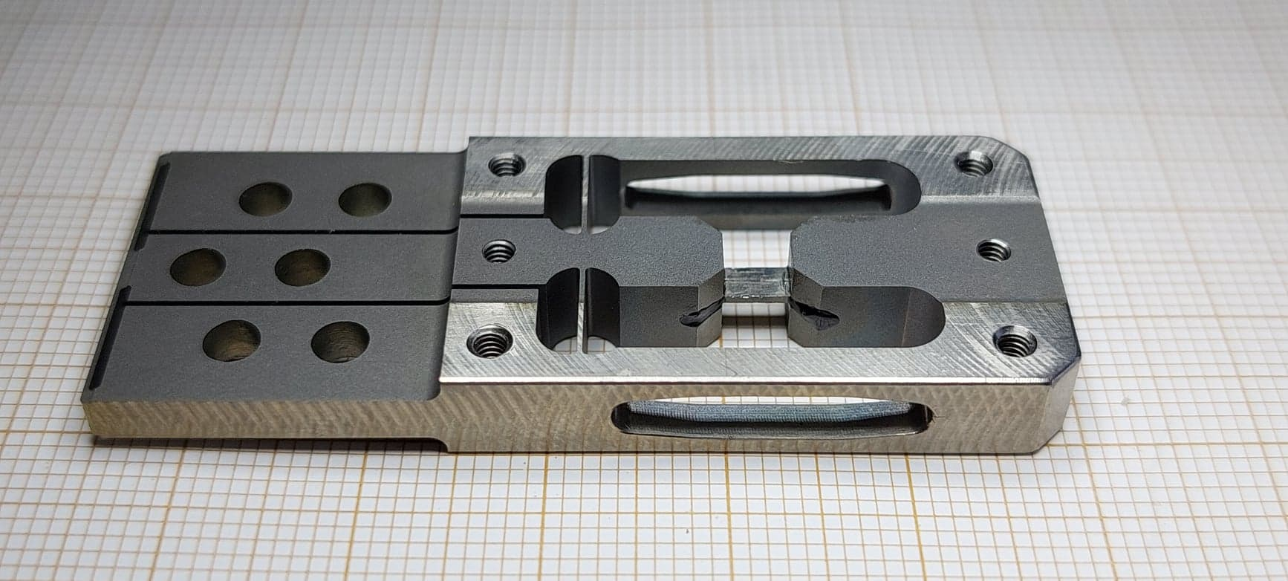

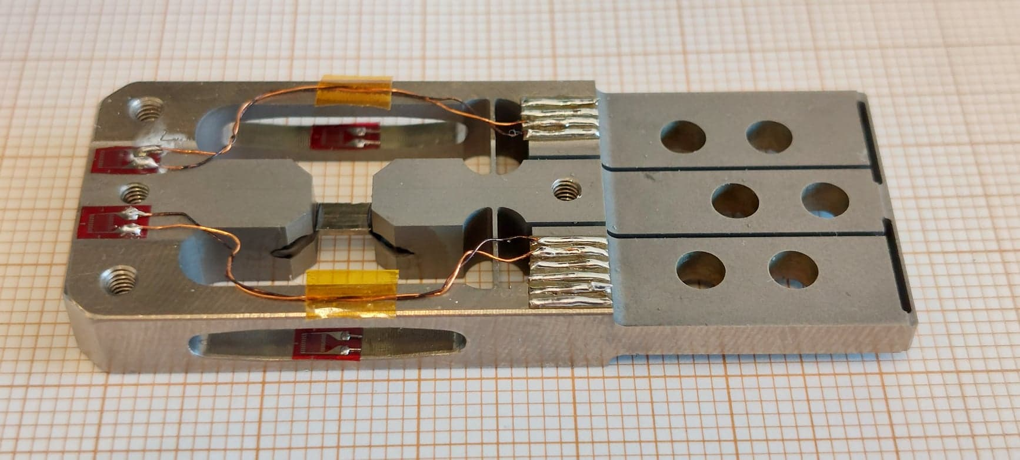
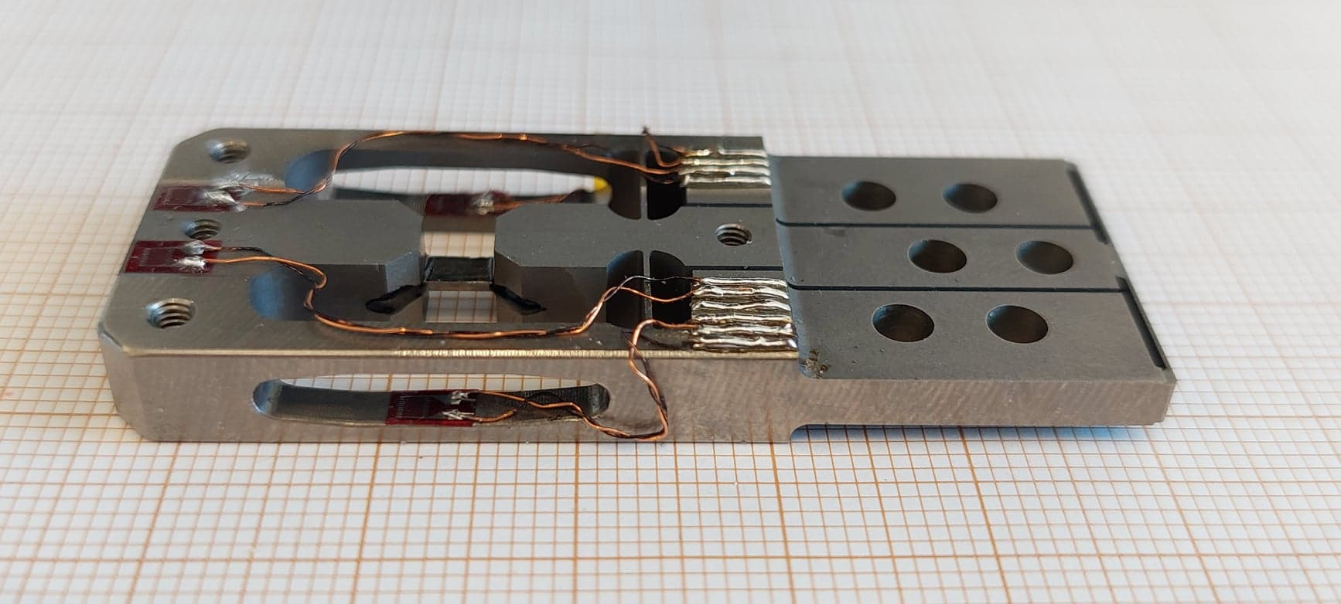
Piezoelectric-driven uniaxial stress device for μSR

Slide 9
In-plane uniaxial stress effect on superconductivity, spin-stripe order in La_{1.875}Ba_{0.125}CuO₄

Slide 10
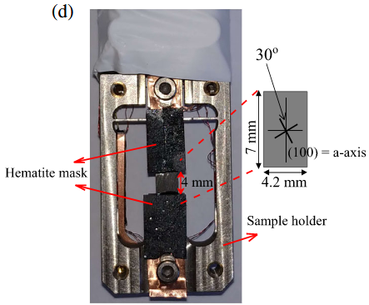
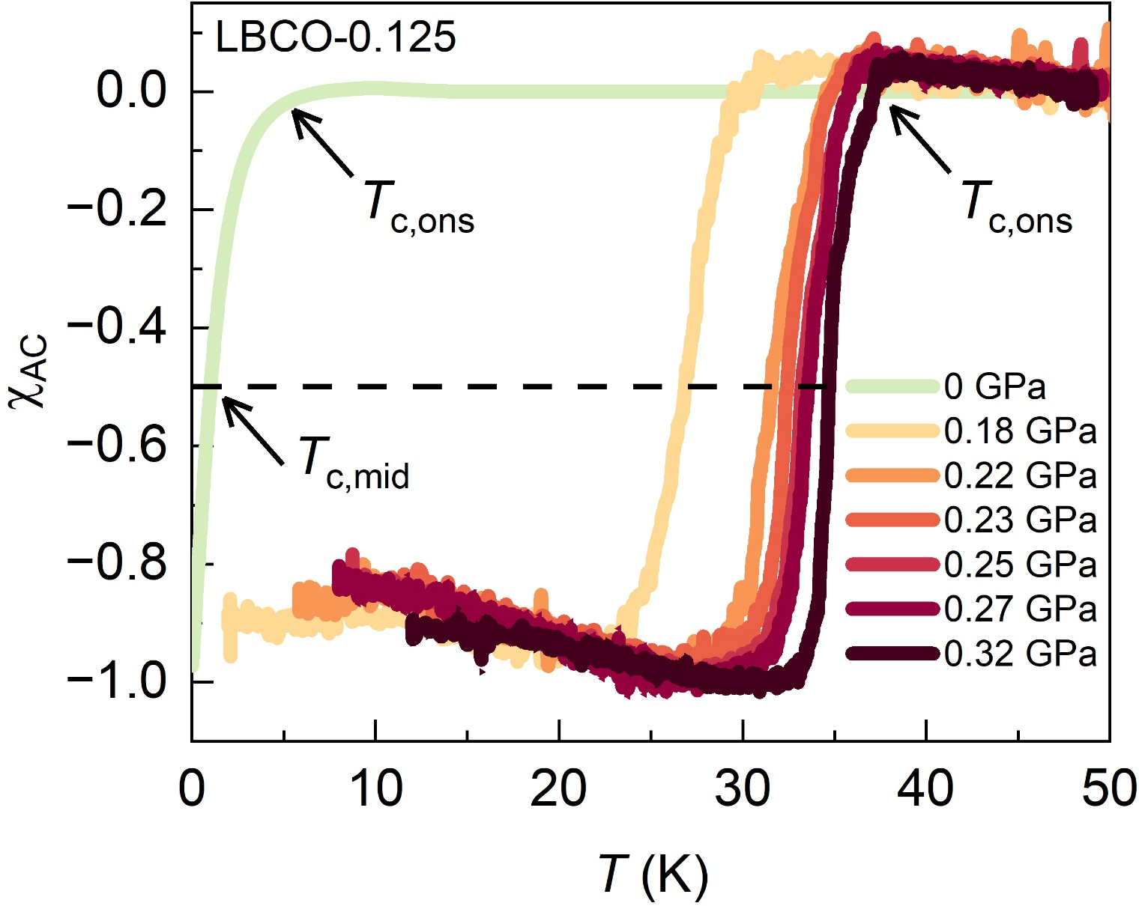
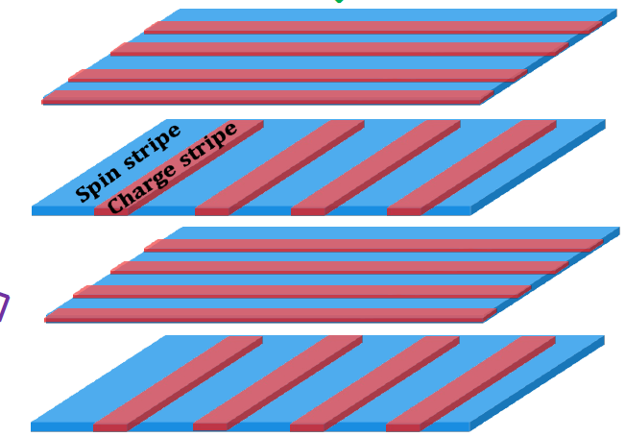
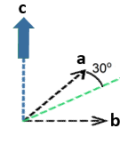
La_{1.875} Ba_{0.125} CuO₄: Magnetic susceptibility under in-plane compression
45º
45º

Slide 11
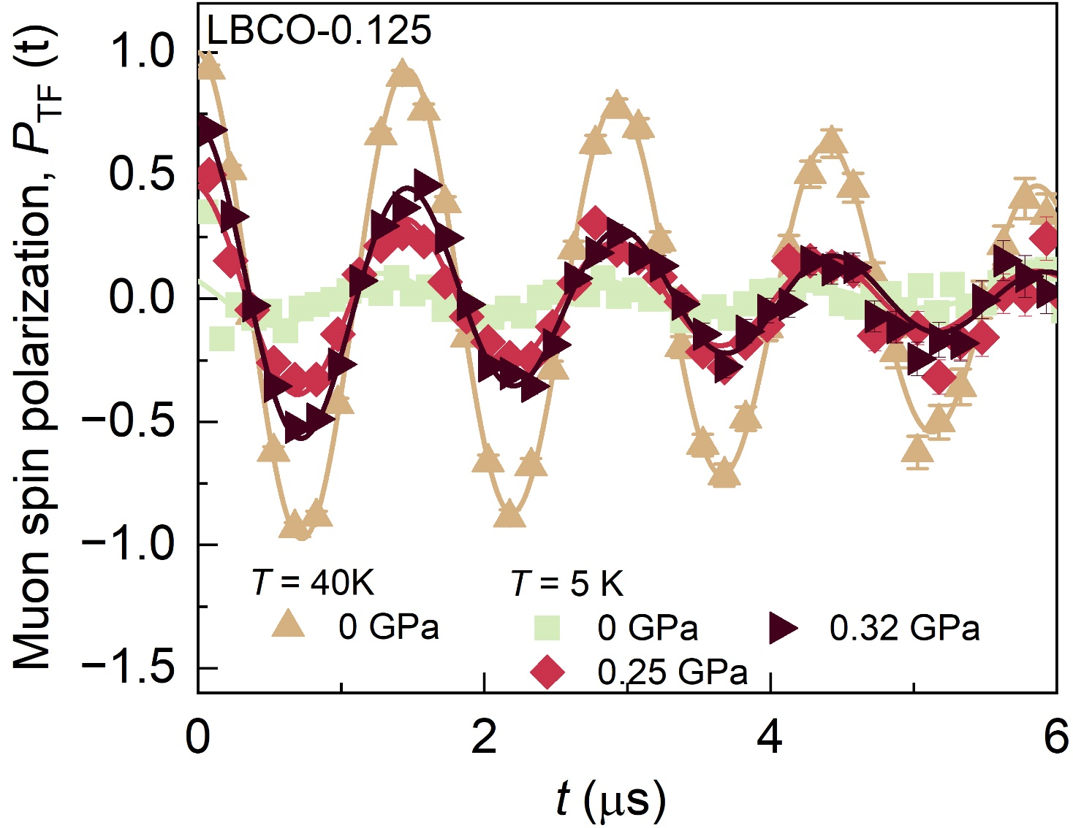
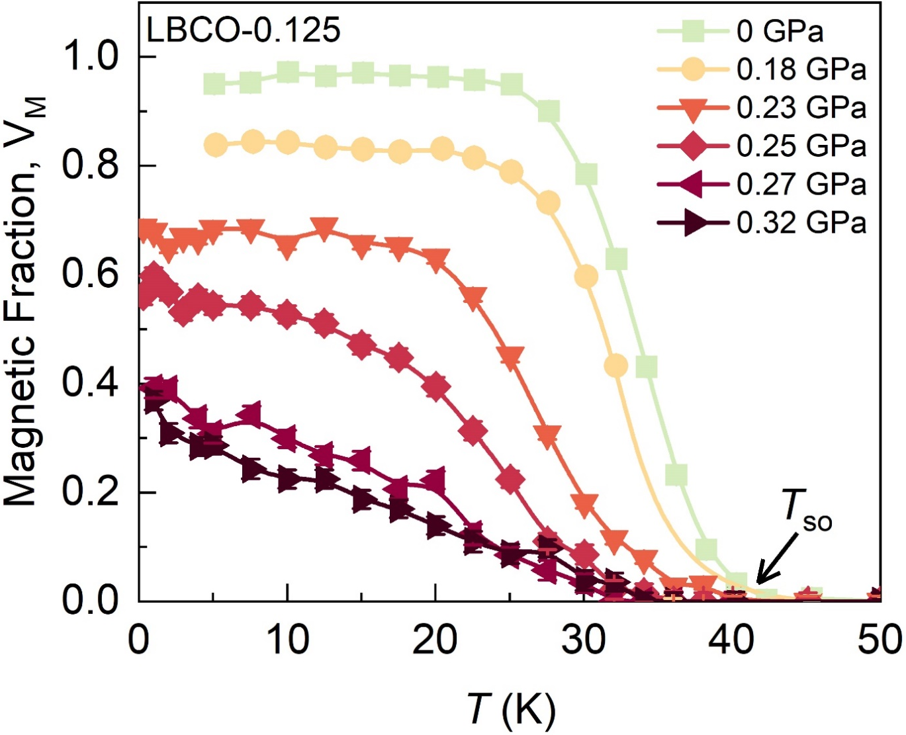


La_{1.875} Ba_{0.125} CuO₄: Magnetic volume fraction under in-plane compression
Weak-TF μSR
Static spin-stripe order persist up to the highest applied uniaxial stress, but with reduced volume fraction.

Slide 12
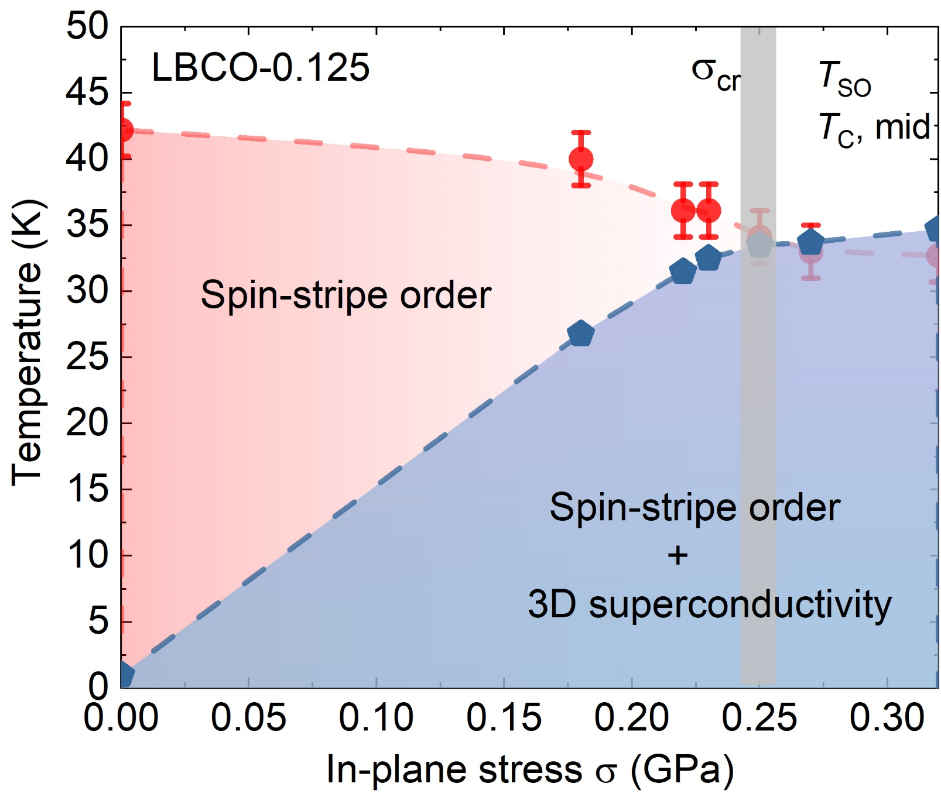
La_{1.875} Ba_{0.125} CuO₄: Phase diagram under in-plane compression
Z. Guguchia et. al., Phys. Rev. Lett. 125, 097005 (2020).
Z. Guguchia et. al., Proc. Natl. Acd. Sci. U.S.A. 121, e2303423120 (2024).

Slide 13
Resulting phase diagram of LBCO under uniaxial Compression
𝝈_{in-plane}
0.25
Copper
Oxygen

Slide 14
Contrasting c-axis and in-plane uniaxial stress effects on superconductivity and stripe order in La_{1.885}Ba_{0.115}CuO₄
S. S. Islam et. al., Commun. Phys. 8, 291 (2025)

Slide 15
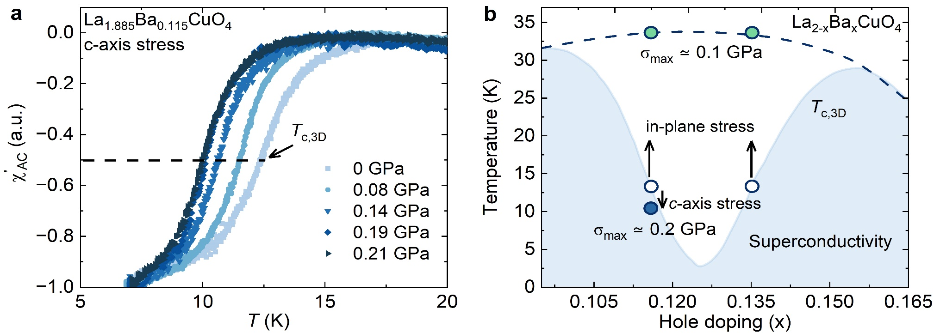

Magnetic susceptibility under c-axis compression
c-axis compression:

Slide 16
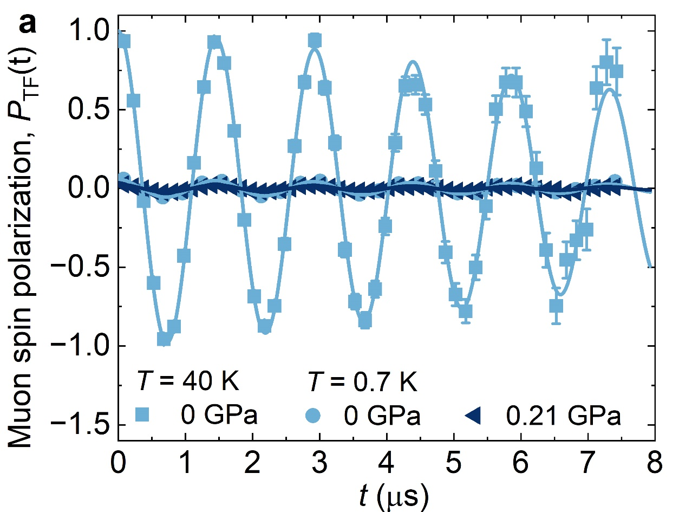

Weak-TF μSR under c-axis compression

Slide 17

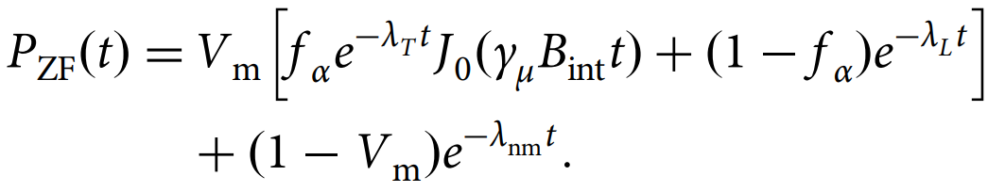
ZF-μSR under c-axis compression

Slide 18
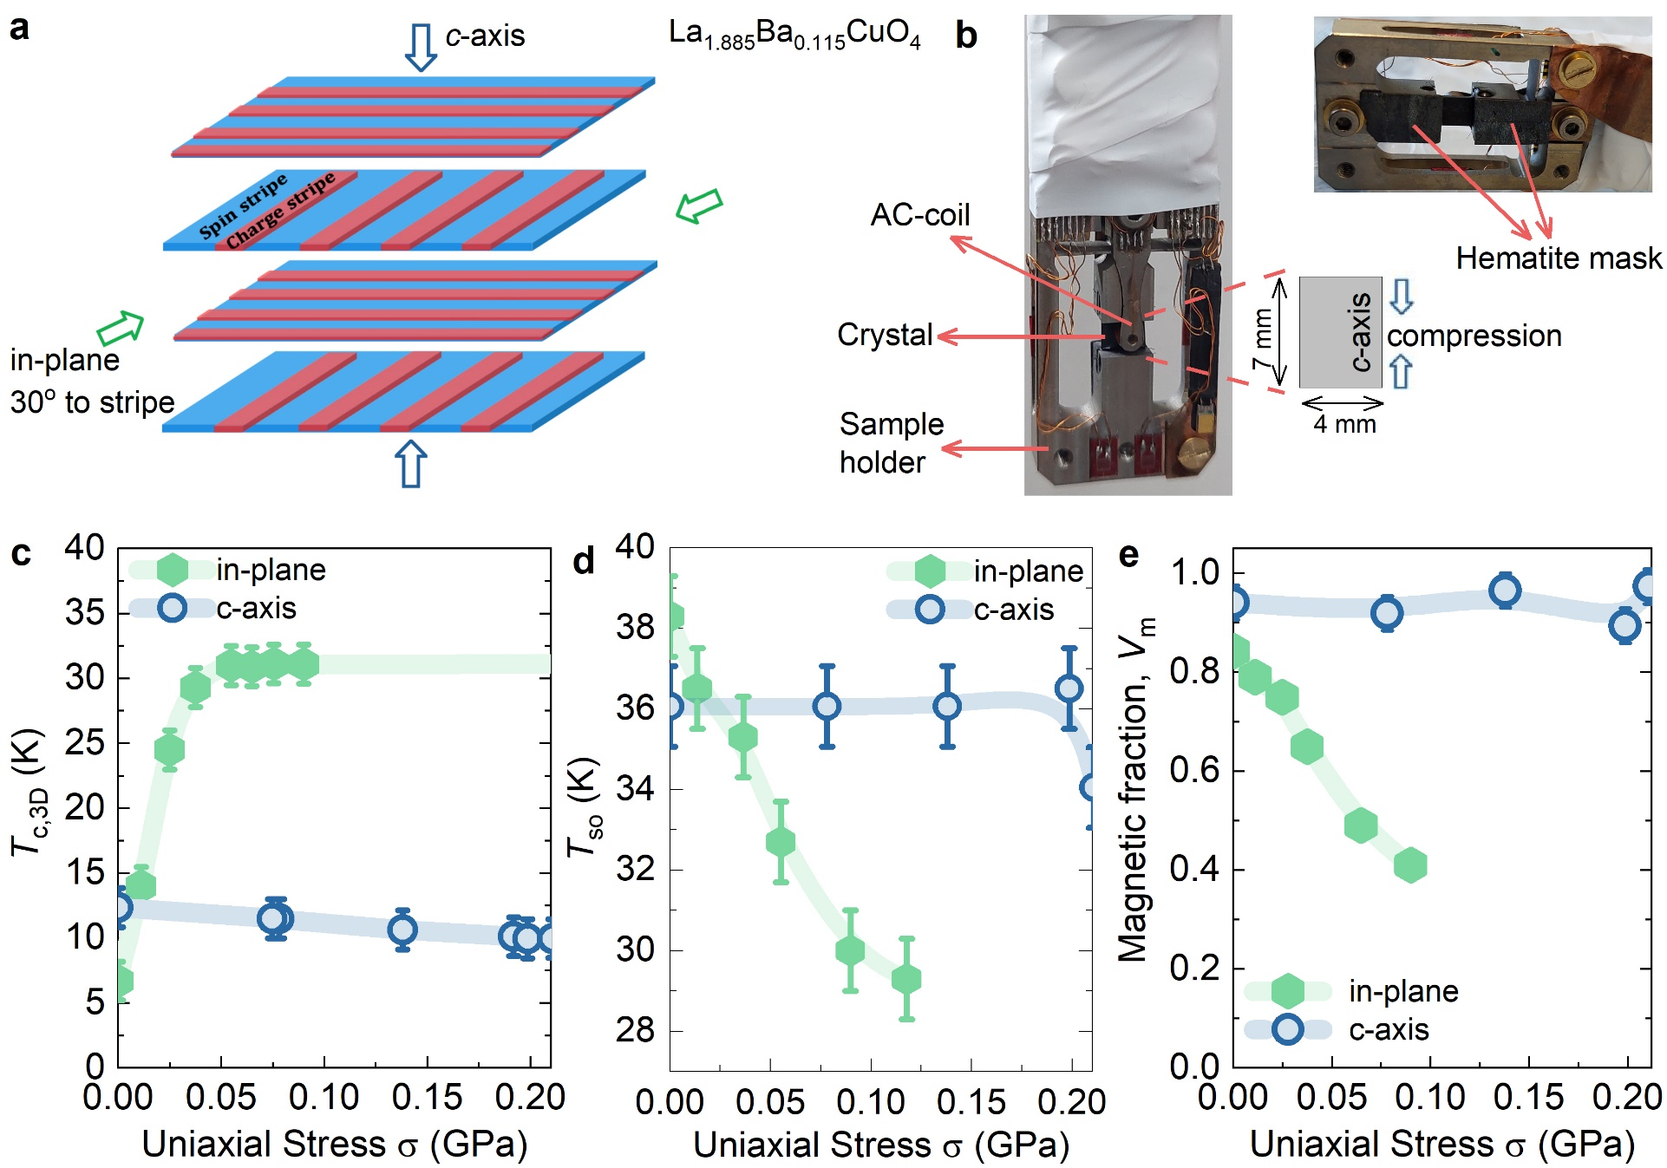
Contrasting effects of in-plane and c-axis compression on stripe order

Slide 19
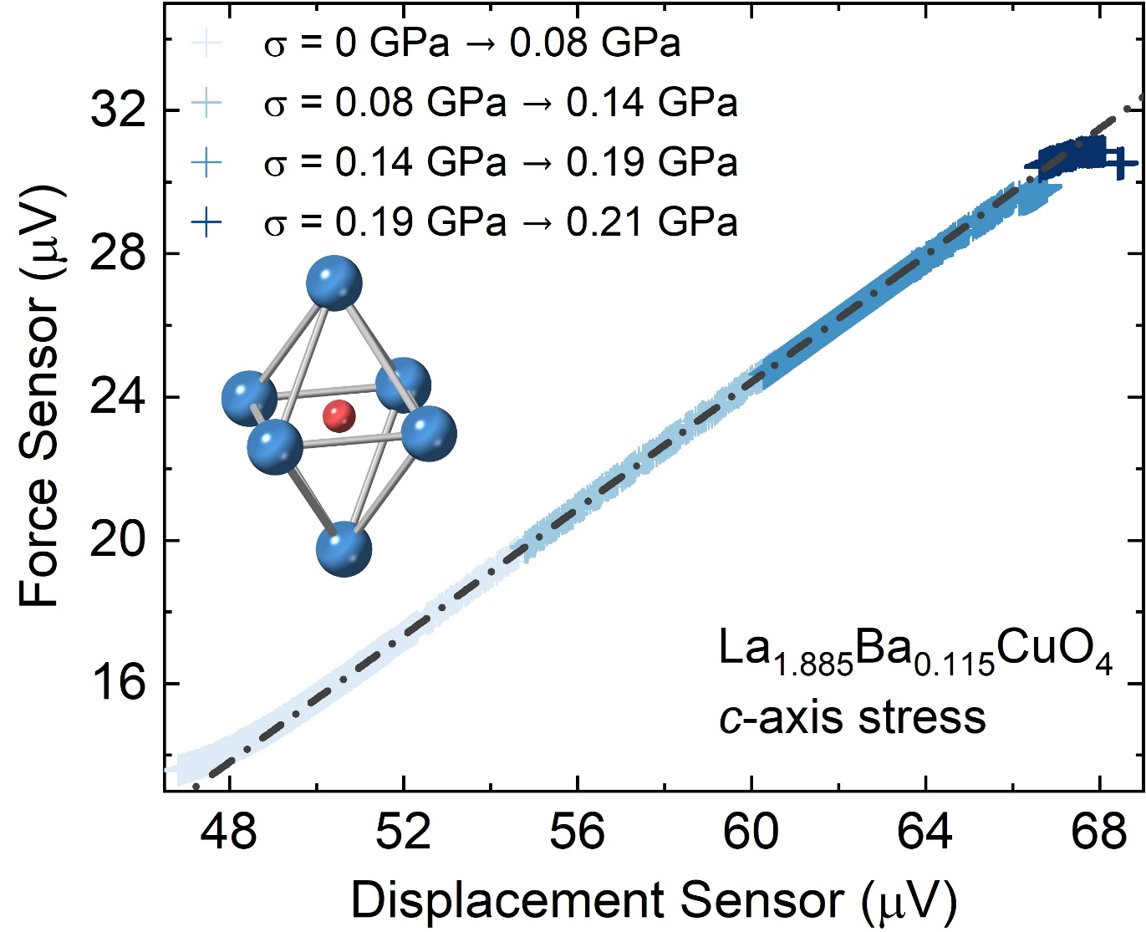
Robustness of stripe order under c-axis compression

Slide 20
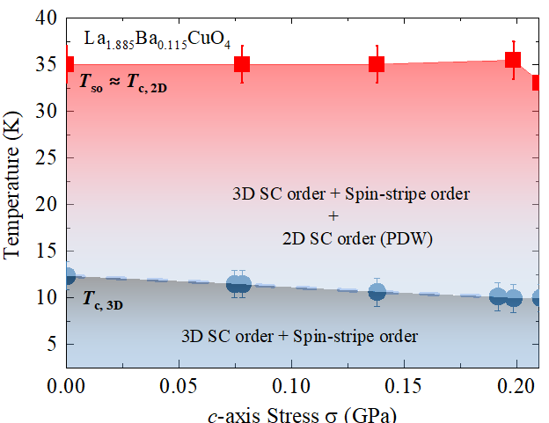
Physical Interpretation - contrasting in-plane and c-axis stress Effects
d-wave
d-wave
In-plane stress
c-axis stress
lifts
Inter-layer frustration of
Josephson coupling
promote
d-wave
d-wave
d-wave
d-wave
S. S. Islam et. al., Commun. Phys. 8, 291 (2025).
Z. Guguchia et. al., Proc. Natl. Acd. Sci. U.S.A. 121, e2303423120 (2024).
Z. Guguchia et. al., Phys. Rev. Lett. 125, 097005 (2020).

Slide 21
Conclusion
Large-volume-fraction spin-stripe order is anti-correlated with 3D SC coherence.
An extremely low in-plane uniaxial stress of 0.1 GPa induces a dramatic rise in the onset of 3D superconductivity. These states are very finely balanced.
The onset temperatures of 3D superconductivity and spin-stripe order are very similar above critical pressure.
c-axis strain causes the reduction of T_{c}, has a negligible effect on the magnetic fraction and T_{so}.
Highly anisotropic strain response for both superconductivity and spin-stripe order.
This could suggest underlying pairing mechanism for 2D (PDW) and uniform 3D SC orders are essentially same.
Impose an important constraint on theoretical models!
Critical role of crystallographic anisotropy in governing competing electronic phases in LBCO.
S. S. Islam et. al., Commun. Phys. 8, 291 (2025)

Slide 22
Acknowledgements
PSI Center for Neutron and Muon Sciences
Technische Universität Dresden
Tsung-Dao Lee Institute
Zurab Guguchia
Vahid Sazgari
Toni Shiroka
Rustem Khassanov
Debarchan Das
Mathias Elender
Alex Amato
Gediminas Simutis
Marc Janoschek
Hubertus Luetkens
Jennifer Nadine Graham
Orion Gerguri
Petr Král
Jonas A. Krieger
Thomas J Hicken
Hrishikesh Gopakumar
Marek Bartkowiak
Markus Müller
Hans-henning Klauss
Rajib Sarkar
Shreenanda Ghosh
Felix Brückner
Vadim Grinenko
MPI, Stuttgart
Clifford Hicks
Brookhaven National Laboratory
John M. Tranquada
Genda Gu
Sophia University
Ikuya Maetsu
Tadashi Adachi
University of Zürich
Johan Chang
Julia Küspert
DESY
Martin Von Zimmermann
Oleh Ivashko
Tohoku University
Yoji Koike
Thank you for your attention!

Slide 23
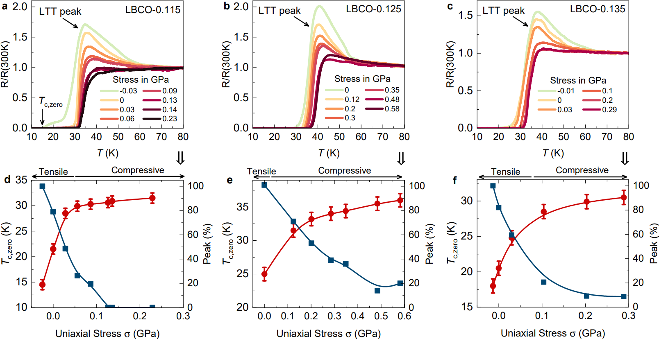
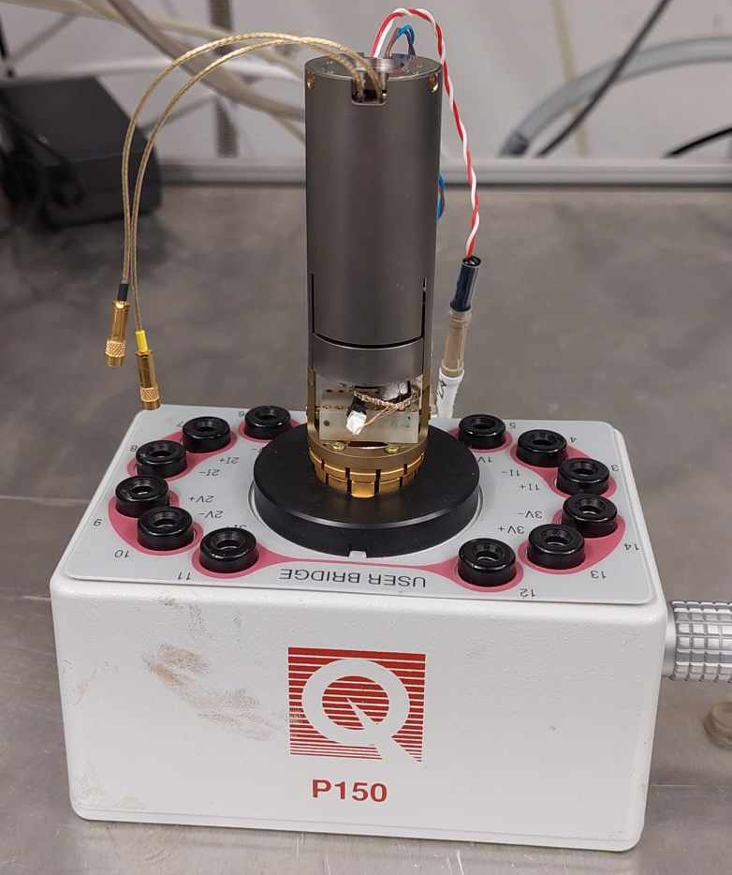
LBCO: Transport measurements under in-plane stress

Slide 24
In-plane uniaxial stress effect on the crystal structure of La_{2-x}Ba_{x}CuO₄ (x = 0.115)
LBCO Strain Research at LMU-PSI: An Overview
Elastic X-ray scattering scans of the (020)o/(200)o Bragg peaks at several temperatures through the transition from the LTO phase to the LTT phase with coexistence of the two phases at intermediate temperatures.
Z. Guguchia et. al., Proc. Natl. Acd. Sci. U.S.A. 121, e2303423120 (2024).

Slide 25
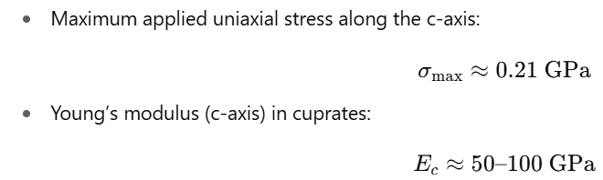

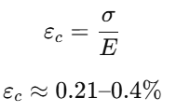
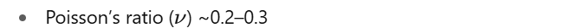

Estimated Lattice Parameter Changes Under c-axis Compression
G. B. Salvetat et al., Elastic properties of La₂​CuO₄​, J. Phys.: Condens. Matter 5, 7543 (1993).

Slide 26
Position of piezos during different modes

Slide 27
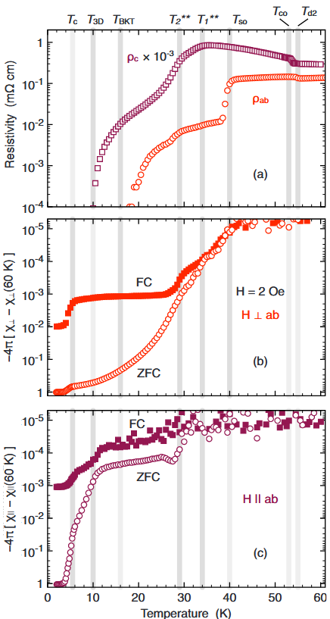
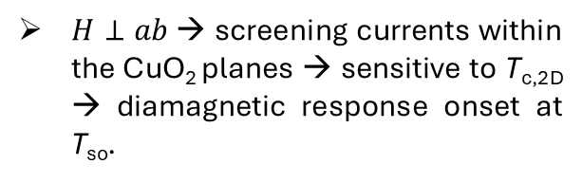
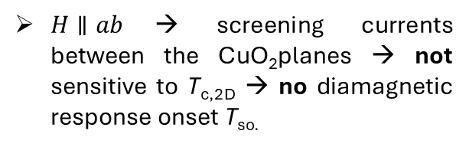
Evidence for unusual 2D superconducting correlations
Sharp drop in ρ_{ab} at T_{so}
but no corresponding change in ρ_{c}.
La_{1.875}Ba_{0.125}CuO₄
$H⊥ab$→ screening currents within the CuO₂ planes → sensitive to T_{c,2D} → diamagnetic response onset at T_{so}.
Existence of 2D SC correlations, T_{c,3D} ≪ T_{c,2D} (T_{so})
$H∥ab$→ screening currents between the CuO₂planes → not sensitive to T_{c,2D} → no diamagnetic response onset T_{so.}
Loss of inter-layer Josephson coupling between 2D SC layers
Origin?
consistent with the onset of 2D SC correlations at T_{so}.
[1] Li et. al., Phys. Rev. Lett. 99, 067001 (2007).
[2] Tranquada et. al., Phys. Rev. B 78, 174529 (2008).
Taken from Ref. [2]

Slide 28
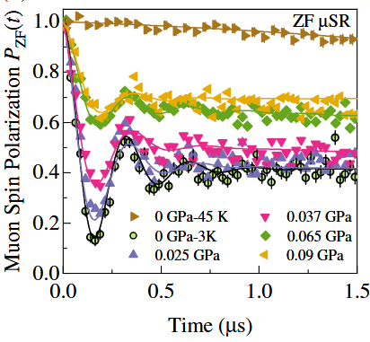
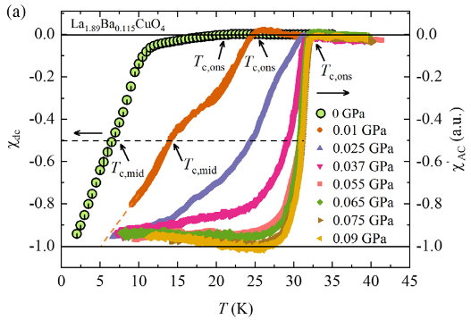
In-plane uniaxial stress effect on Superconductivity and stripe order (x = 0.115)
LBCO Strain Research at LMU-PSI: An Overview
Z. Guguchia et. al., Phys. Rev. Lett. 125, 097005 (2020).

Slide 29
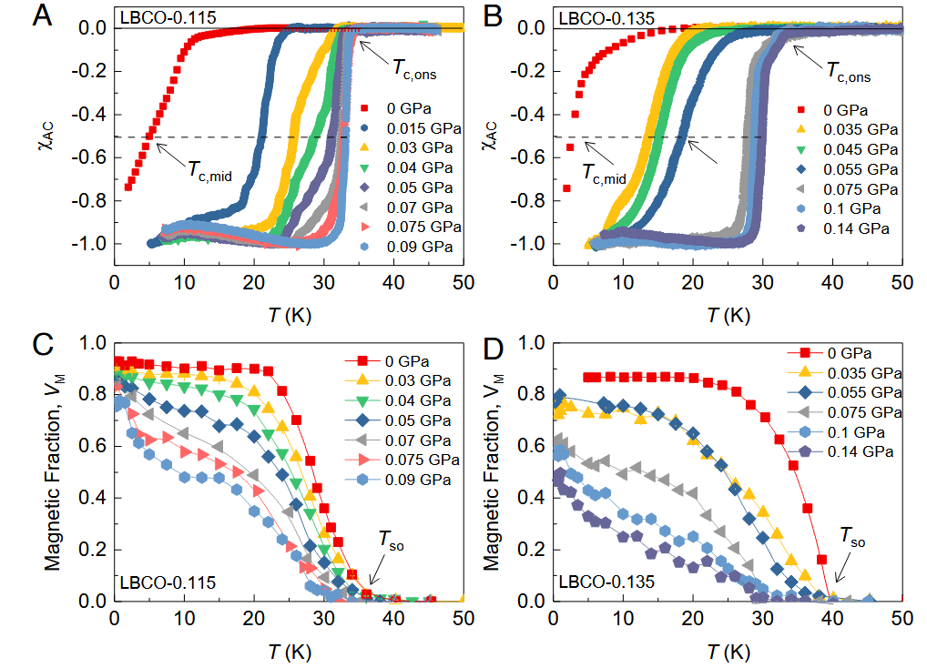
In-plane uniaxial stress effect on La_{2-x}Ba_{x}CuO₄ (x = 0.115, 0.135)
LBCO Strain Research at LMU-PSI: An Overview
45º
Static spin-stripe order persist up to the highest applied uniaxial stress, but with reduced volume fraction.
Z. Guguchia et. al., Proc. Natl. Acd. Sci. U.S.A. 121, e2303423120 (2024).

