Slide 1
Field-orientation-dependent magnetic phases in GdRu₂Si₂ probed with muon-spin spectroscopy
Ben Huddart
µSR2025
B. M. Huddart et al., Phys. Rev. B 111, 054440 (2025)

Slide 2





Acknowledgements
Durham University
Alberto Hernández-Melián
Tom Lancaster
Jožef Stefan Institute
Matjaž Gomilšek
University of Warwick
George Wood
Daniel Mayoh
Geetha Balakrishnan
Paul Scherrer Institut
Thomas Hicken
Zurab Guguchia
Chennan Wang
University of Oxford
Stephen Blundell

Slide 3
Talk outline
GdRu₂Si₂ as a host of magnetic skyrmions
Establishing the nature of the muon stopping site in GdRu₂Si₂
Detection of magnetic phases using transverse-field µSR
Observing a transition between two distinct magnetic phases using zero-field µSR

Slide 4
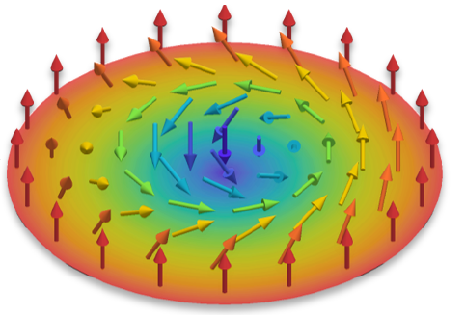
Magnetic skyrmions
Topological objects, found in some chiral or polar magnetic materials.
Generally stabilized by Dzyaloshinskii-Moriya Interaction (DMI) → non-centrosymmetric systems
Proposed applications: Digital memory, spintronics, reservoir computing
Skyrmion
SkL
T. Lancaster, Contemp. Phys. 60, 246 (2019).
T. Kurumaji et al., Science 365, 914 (2019).

Slide 5
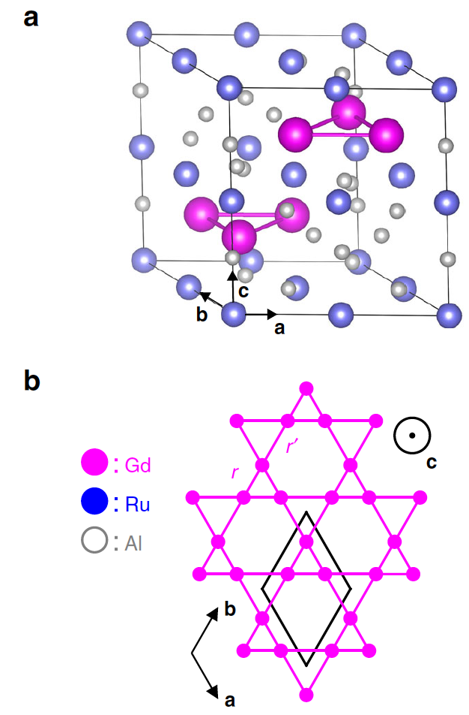
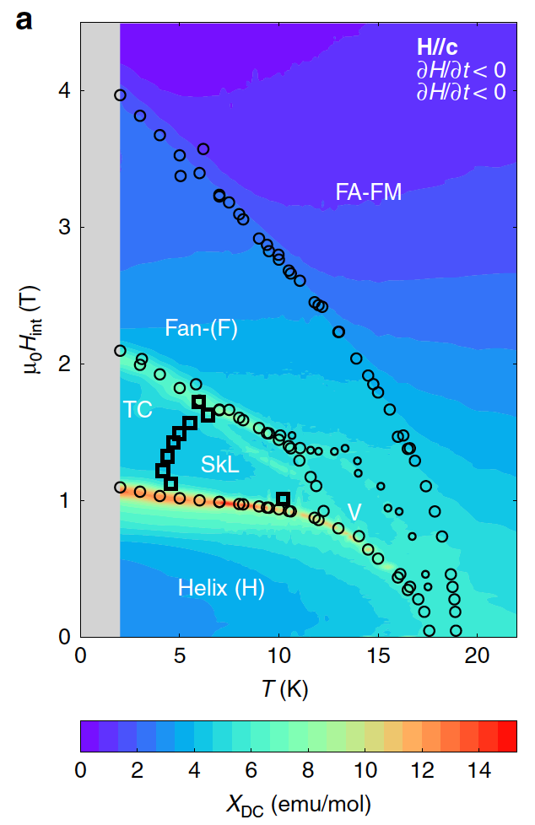
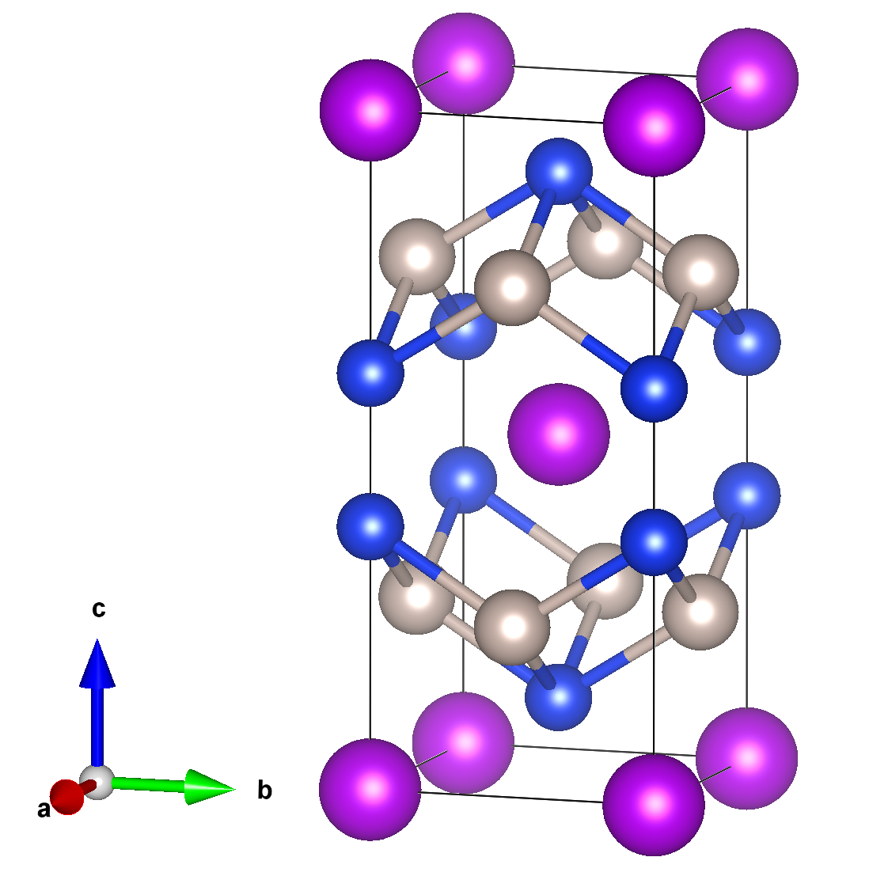
Skyrmion lattices in centrosymmetric systems
Gd₂PdSi₃
Gd₃Ru₄Al₁₂
GdRu₂Si₂
T. Kurumaji et al., Science 365, 914 (2019)
M. Hirschberger et al., Nat. Commun. 10, 5831 (2019)

Slide 6
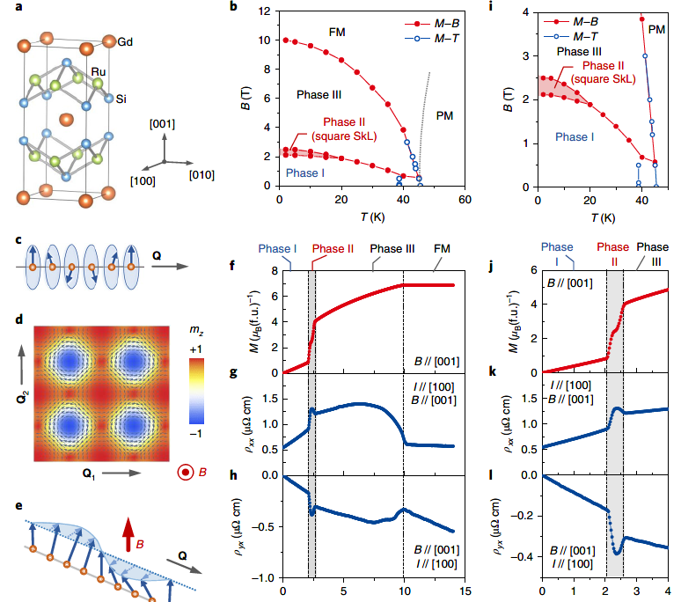
Square SkL in GdRu₂Si₂
B – T phase diagram mapped out using magnetisation, longitudinal resistivity and hall resistivity
Find square skyrmion lattice using resonant elastic x-ray scattering
N. Khanh et al., Nat. Nanotechnol. 15, 444 (2020)

Slide 7
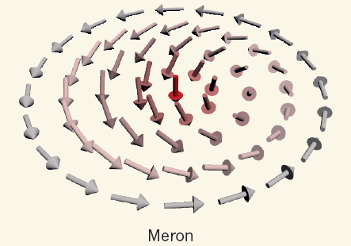
Phase diagrams in GdRu₂Si₂
Different phase diagrams result for H ∥ [001] and H ∥ [100]
Magnetic structures identified from polarisation analysis of resonant x-ray scattering
N. D. Khanh et al., Adv. Sci. 9, 2105452 (2022)

Slide 8
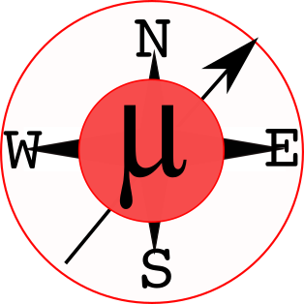
Muon stopping sites
Muon stopping sites calculated using the MuFinder program.
Find two crystallographically distinct sites, one ≈ 0.3 eV higher in energy.
Experiment suggests only one crystallographically distinct site.
B. M. Huddart et al., Comput. Phys. Commun., 108488 (2022)
https://gitlab.com/BenHuddart/mufinder

Slide 9
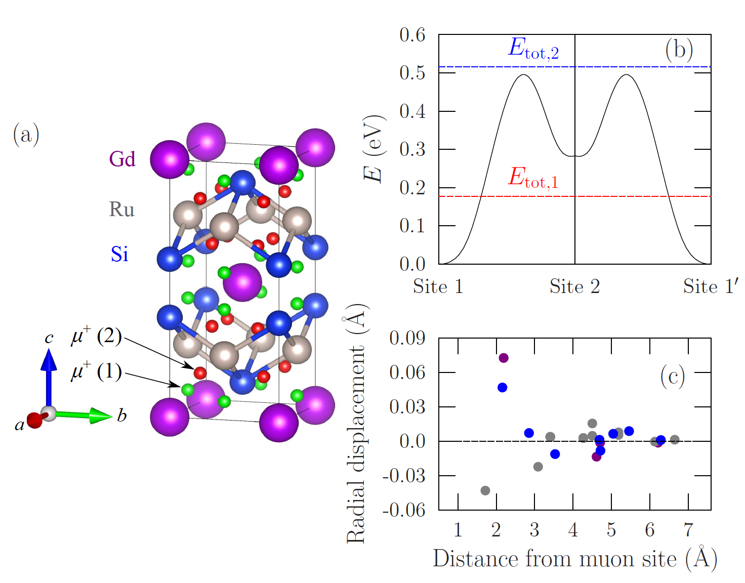
Energy barriers and zero-point energy
ZPE2
ZPE1
Estimate zero-point energy of the muon at each site
using phonon calculations and the harmonic approximation.

Slide 10
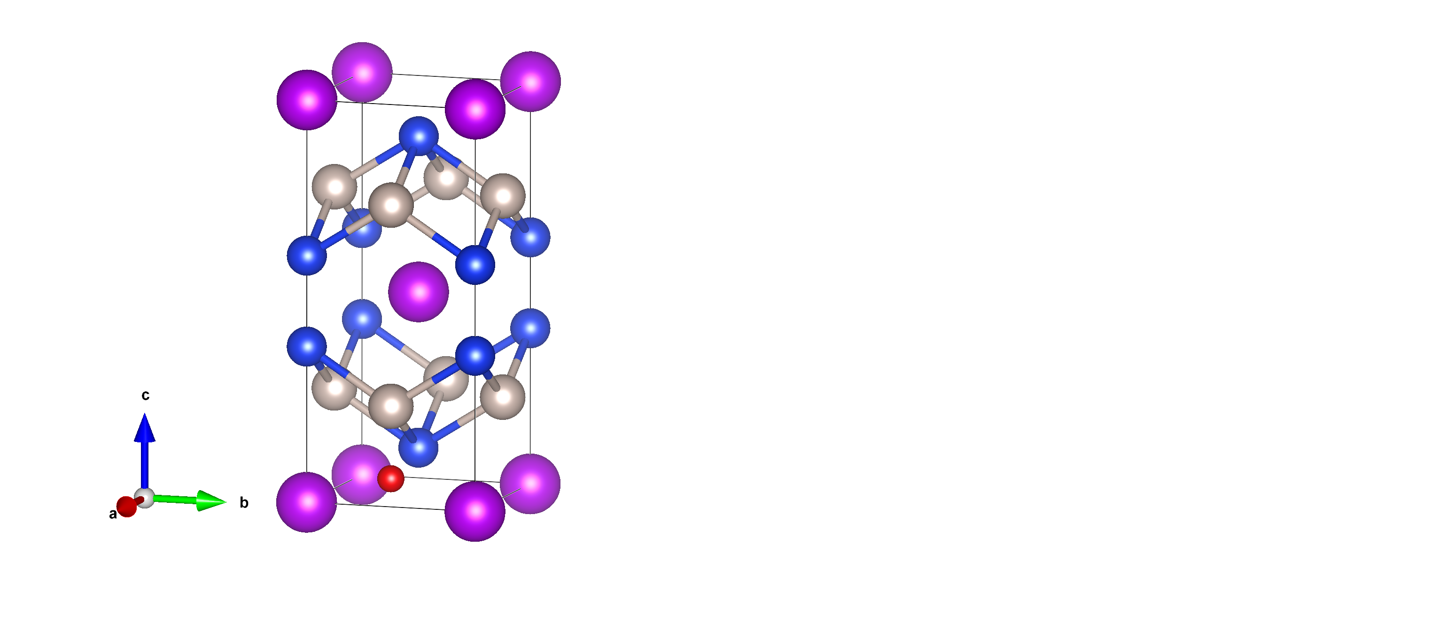
Energy barriers and zero-point energy
Energy barriers obtained using nudged elastic band method.

Slide 11

Energy barriers and zero-point energy
Energy barriers obtained using nudged elastic band method.

Slide 12

Energy barriers and zero-point energy
Energy barriers obtained using nudged elastic band method.

Slide 13
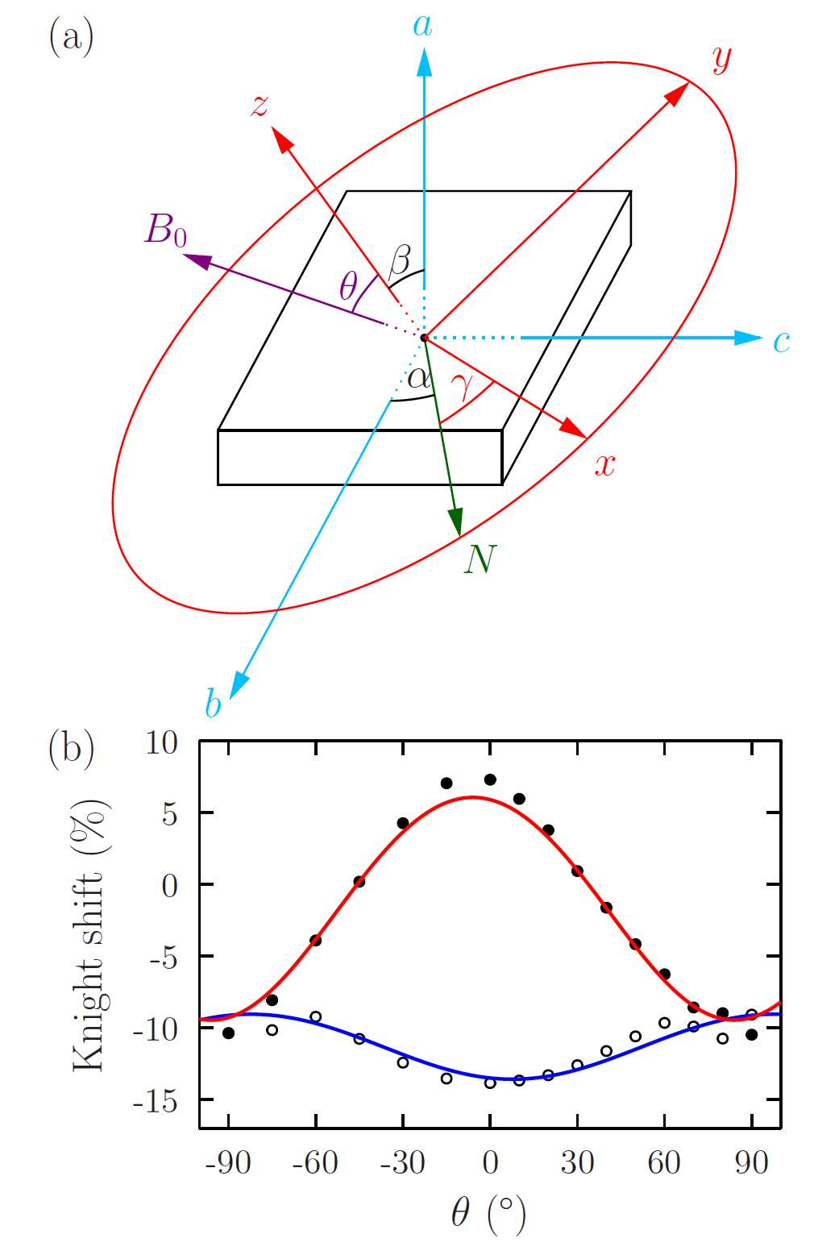
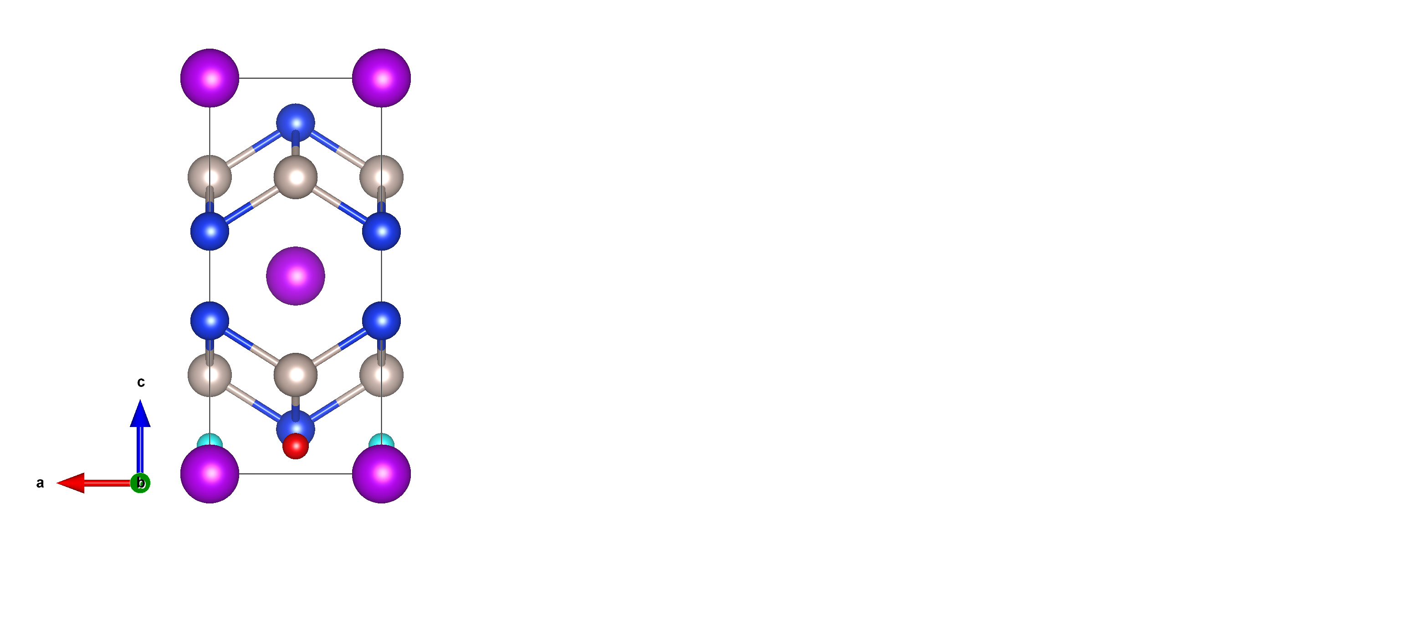
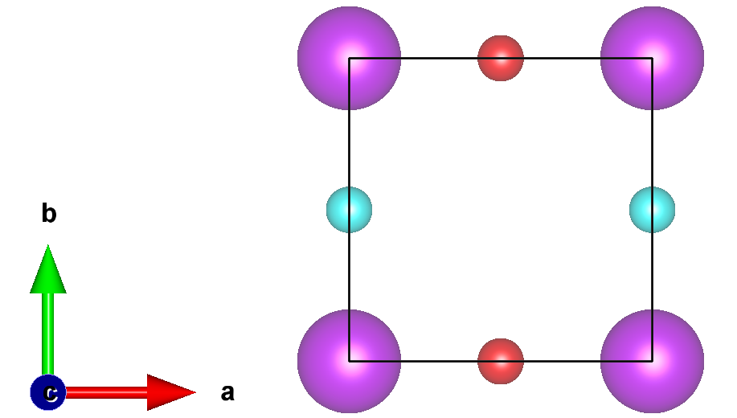

Experimental verification of muon site
$$K_{i}=\frac{B_{i}−B_{0}}{B_{0}}$$
Muon Knight shift

Slide 14
Experimental verification of muon site
$$K_{i}=\frac{B_{i}−B_{0}}{B_{0}}$$
Muon Knight shift

Slide 15
Experimental verification of muon site
$$K_{i}=\frac{B_{i}−B_{0}}{B_{0}}$$
Muon Knight shift

Slide 16
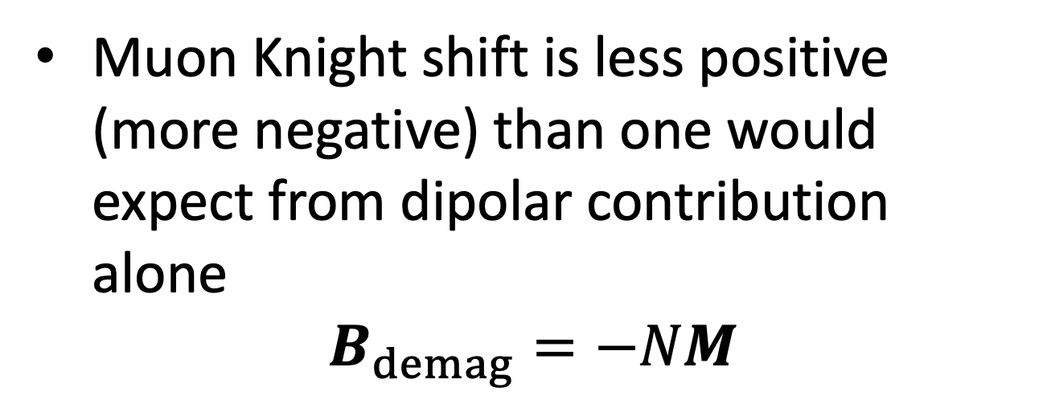
Muon Knight shift – hyperfine contribution
Muon Knight shift is less positive (more negative) than one would expect from dipolar contribution alone
$$B_{demag}=−NM$$
Data also suggest a significant negative contact hyperfine interaction between muon and spin polarised conduction electrons
→ Evidence for RKKY interactions.

Slide 17
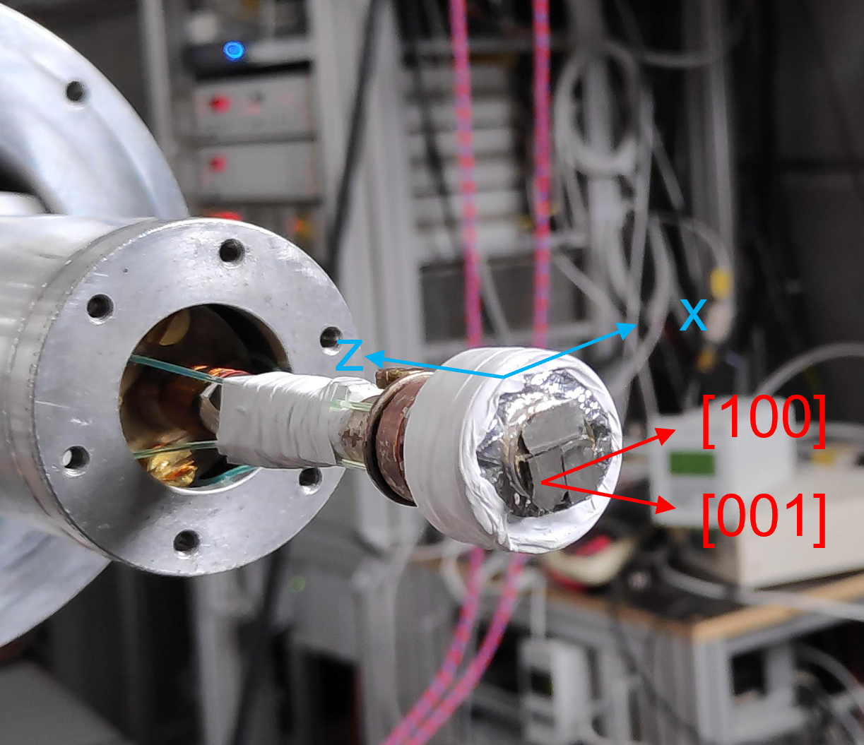
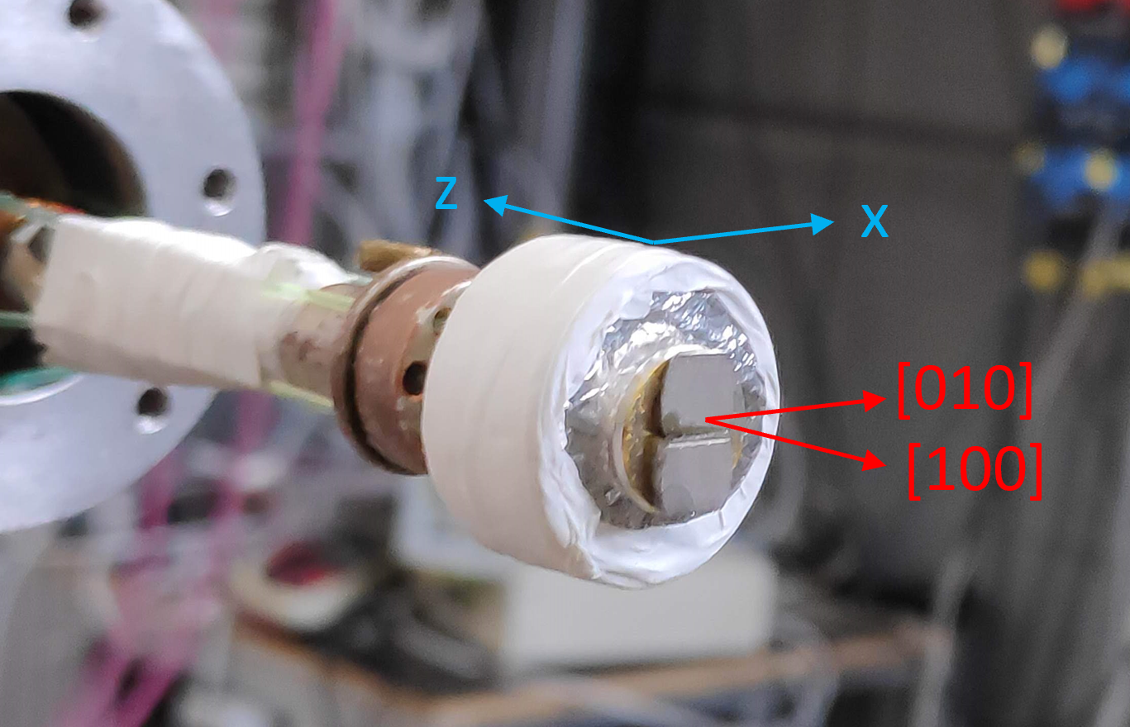
Transverse-field µSR
Field along [001]
Field along [100]

Slide 18
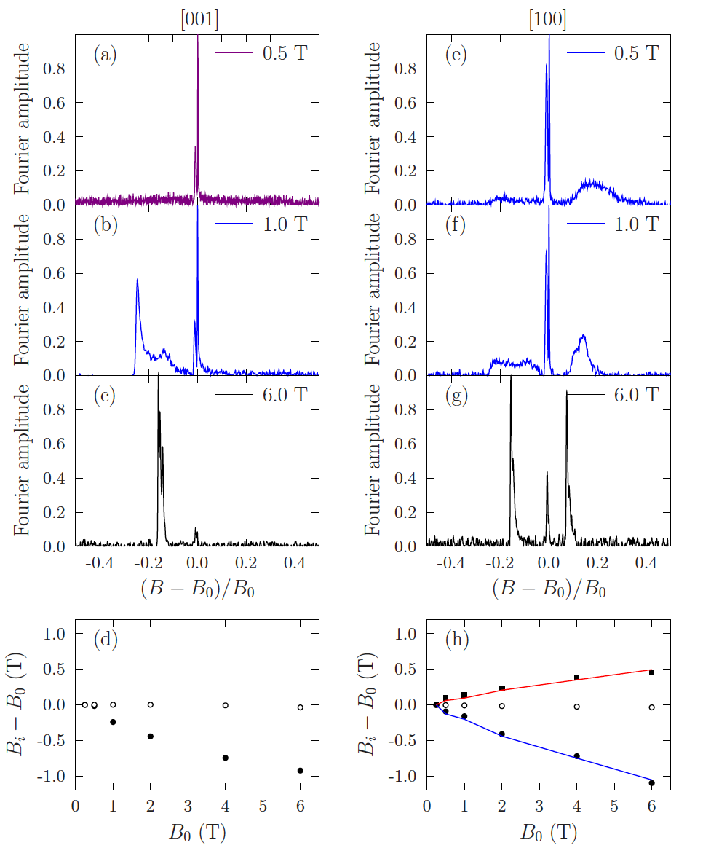
TF µSR at 40 K
Can access field polarized state at high fields at this temperature.
Multiplicity of peaks for each field orientation is consistent with the muon stopping site.
Locations of the peaks requires a significant hyperfine field.

Slide 19
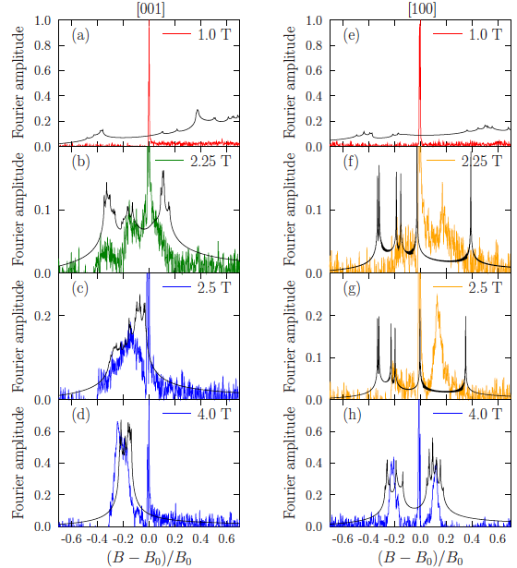
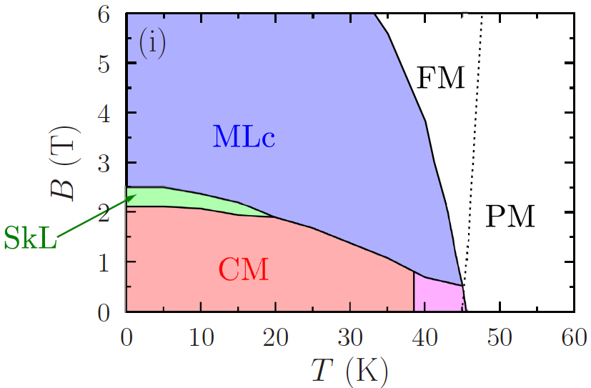
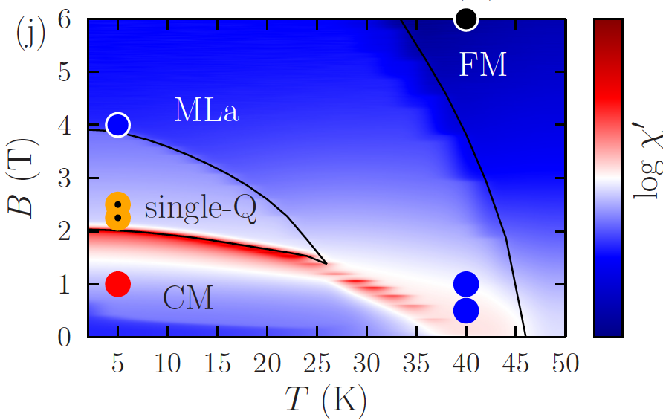


TF µSR at 5 K
$$B_{0}∥[001]$$
$$B_{0}∥[100]$$

Slide 20
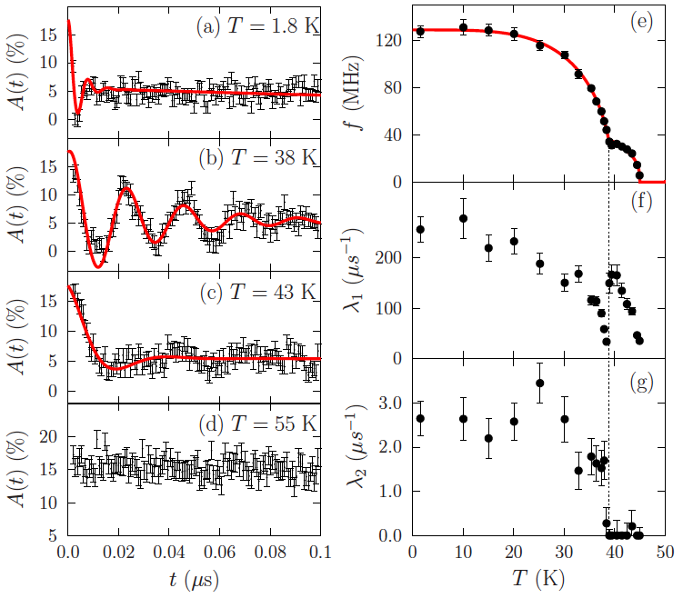
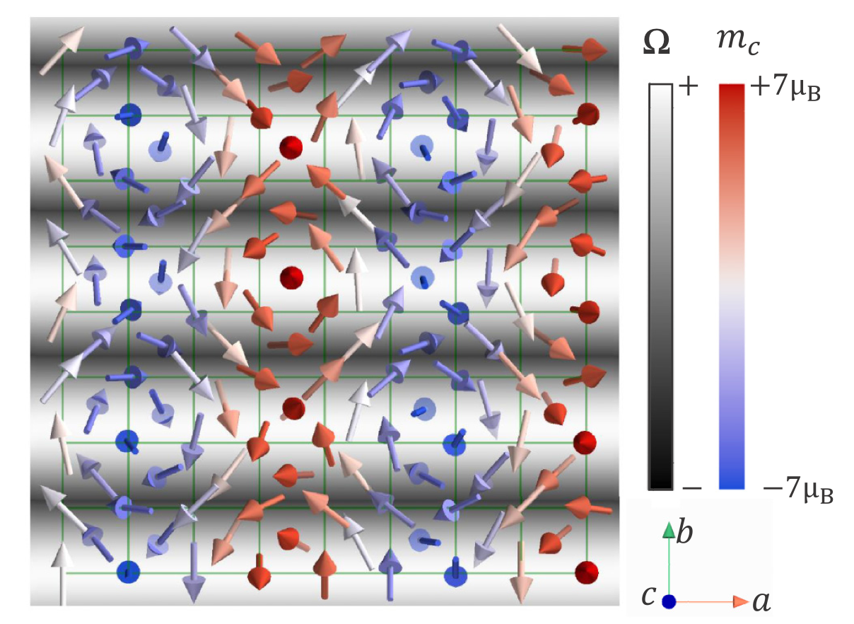
ZF µSR
Clear evidence for a transition between two distinct magnetically ordered phases.
G. D. A. Wood et al., Phys. Rev. B 107, L180402 (2023)

Slide 21
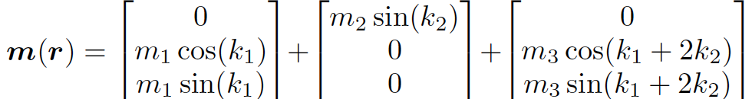
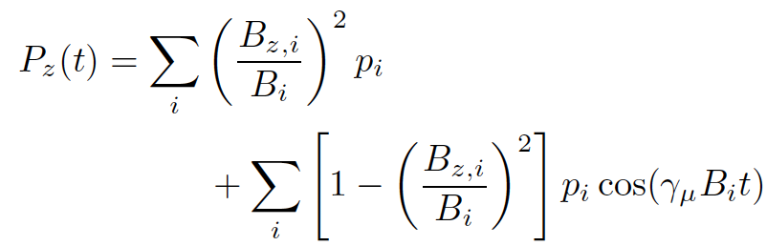
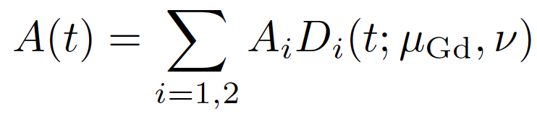


ZF µSR - modelling
+
MuESR
SCA
{B_{i}}
$$D_{i}$$
$$ν$$
P Bonfà et al., JPS Conf. Proc. 21, 11052 (2018)
G. Allodi and R. De Renzi, Phys. Scr. 89, 115201 (2014)

Slide 22
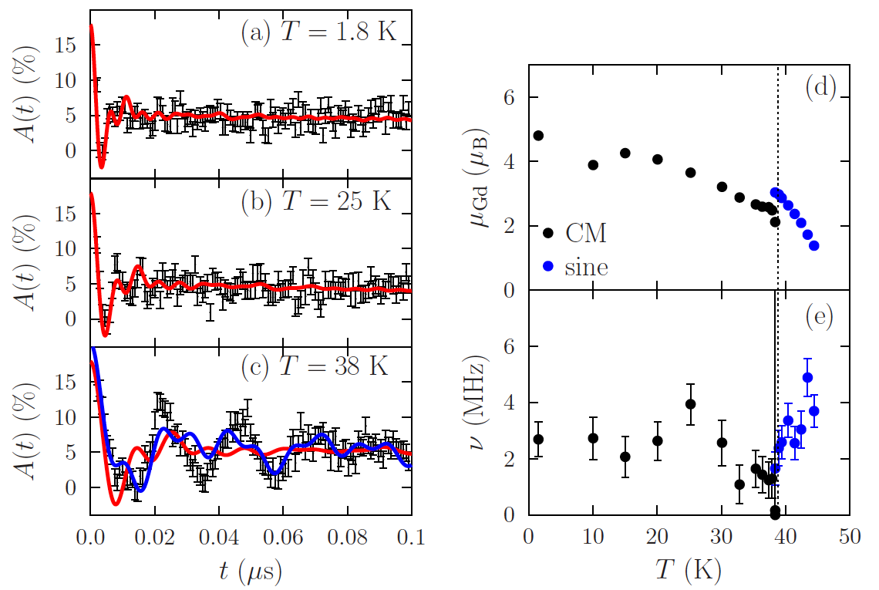


ZF µSR - modelling
PND proposed three possible structures for higher-T phase, µSR spectra most consistent with sinusoidal structure with moments along [011].
µSR parameters
material parameters
f
µ_{Gd}
$$λ$$
$$ν$$

Slide 23
Summary
The muon stopping state in GdRu₂Si₂ has been calculated using DFT and confirmed experimentally using angular dependent measurements if the muon Knight shift, which also suggest the existence of RKKY-driven muon hyperfine coupling.
The magnetic phases in this system are distinguished via their distinct muon response, which are compared with simulations based on candidate magnetic structures.
Zero-field µSR provides clear evidence for a transition between two distinct magnetically-ordered phases at 39 K.

