Slide 1
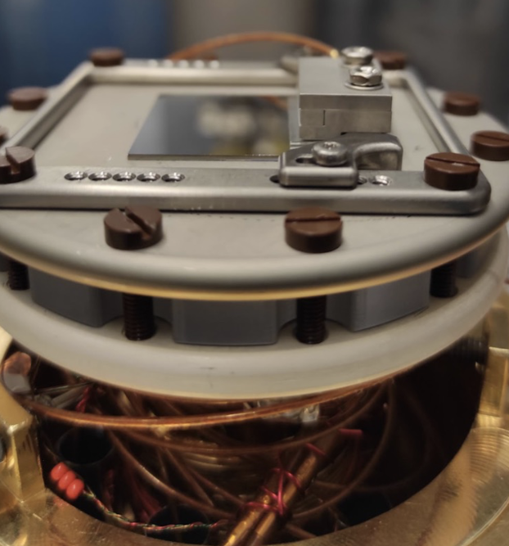
Observation of charge carrier manipulation with nm depth-resolution at semiconductor-oxide interfaces
Thomas Prokscha
μSR2025, St. John’s, Canada, 24 July 2025

Slide 2
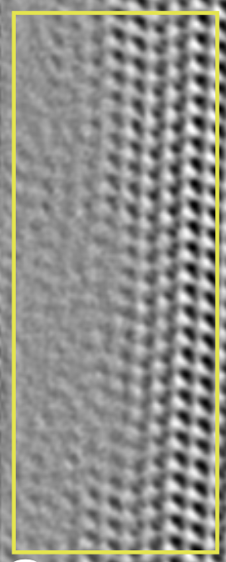
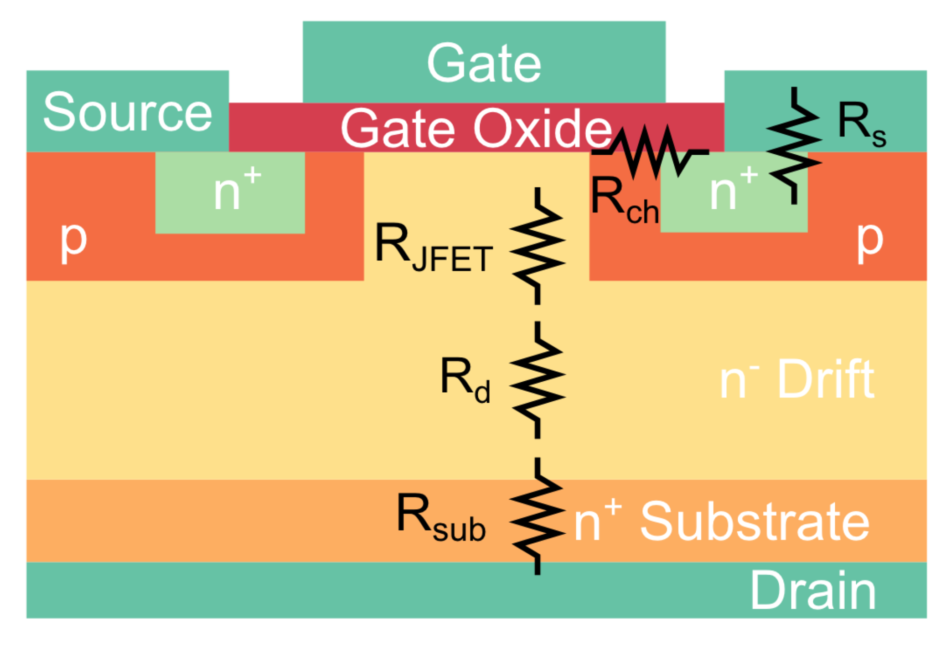
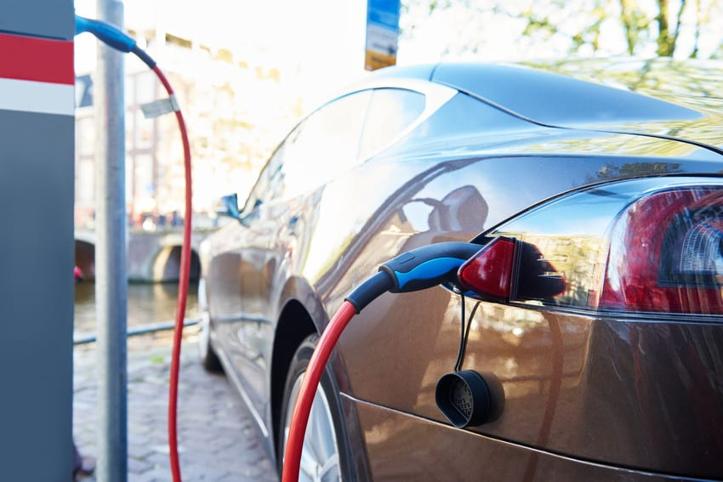
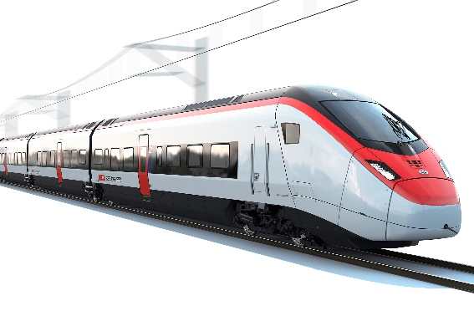
Muonium as a tool to characterize semiconductor interfaces
Why is this interesting?
Controlled manipulation of charge carrier concentration in nanometer-thin layers is the basis of current semiconductor technology. Usually, macroscopic transport measurements and modeling are used to determine charge carrier profiles across interfaces – however, depth resolution is limited to tens of nm or even > 100 nm.
In the attempt to build more energy-efficient devices the understanding of the characteristics of semiconductor interfaces with nanometer depth resolution is of prime importance.
The formation and spin-depolarization of muonium is sensitive to the presence of free charge carriers and defects.
Page 2
Notes:
2

Slide 3
Muonium as a tool to characterize semiconductor interfaces
Why is this interesting?
Low-energy μ⁺SR (1-30 keV, mean depths 5-200nm) as a local probe technique with nm depth resolution can provide hitherto unaccessible direct information about carrier/defect profiles and dynamics at semiconductor surfaces and interfaces (e.g., metal-oxide-semiconductor MOS structures, pn-junctions).
Here: use the SiO₂/Si and SiO₂/4H-SiC interfaces in a MOS structure as prototype systems to test the feasibility of detecting the variation of charge carrier concentrations at the interface by applying a gate bias to the MOS.
Application to technologically and scientifically relevant devices: solar cell structures (Coimbra team, Xiaojie Ni et al.), oxide-semiconductor interfaces in advanced power devices, quantum well structures etc.
Page 3
Notes:
3

Slide 4
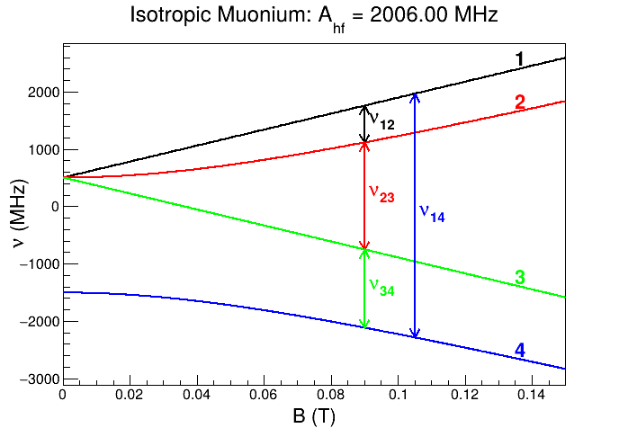
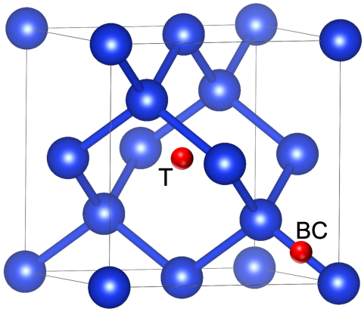
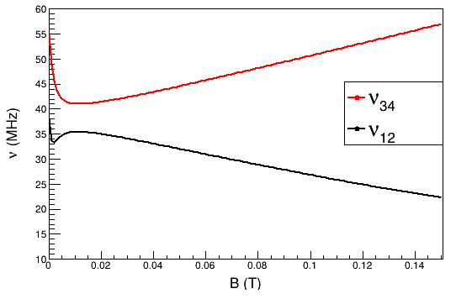

Muonium Mu⁰ in Si: Mu_{T}⁰, Mu_{BC}⁰
Mu_{T}⁰
Mu_{T}⁰: isotropic, A = 2006 MHz, charge states Mu_{T}⁰, Mu_{T}⁻
Mu_{BC}⁰: anisotropic, A|| = 16.8 MHz, A = 92.6 MHz, charge states Mu_{BC}⁰, Mu_{BC}⁺
@0.15 T, Mu_{T}⁰: ν₁₂ = 756.4 MHz, ν₃₄ = 1249.6 MHz (unobservable in LEM)
@0.15 T, Mu_{BC}⁰: ν₁₂ = 22.3 MHz, ν₃₄ = 57.0 MHz
Mu_{BC}⁰
High field limit:
ν_{μ}: Larmor precession frequency of μ⁺, 20.4 MHz at B = 0.15 T
θ: angle between Mu symmetry axis (<111> in Si) and applied magnetic field, 54.7º if B || <100>
Notes:
4

Slide 5
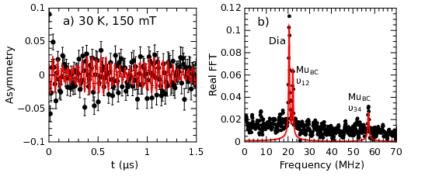
Muonium Mu⁰ in Si: Mu_{T}⁰, Mu_{BC}⁰
Mu_{T}⁰: isotropic, A = 2006 MHz, charge states Mu_{T}⁰, Mu_{T}⁻
Mu_{BC}⁰: anisotropic, A|| = 16.8 MHz, A = 92.6 MHz, charge states Mu_{BC}⁰, Mu_{BC}⁺
@0.15 T, Mu_{T}⁰: ν₁₂ = 756.4 MHz, ν₃₄ = 1249.6 MHz (unobservable in LEM)
@0.15 T, Mu_{BC}⁰: ν₁₂ = 22.3 MHz, ν₃₄ = 57.0 MHz
Mu_{BC}⁰
High field limit:
ν_{μ}: Larmor precession frequency of μ⁺, 20.4 MHz at B = 0.15 T
θ: angle between Mu symmetry axis (<111> in Si) and applied magnetic field, 54.7º if B || <100>
Notes:
5

Slide 6
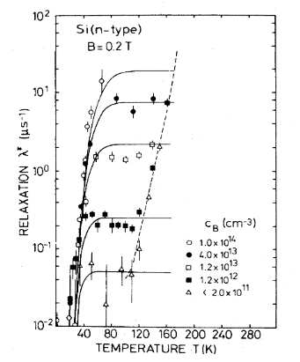
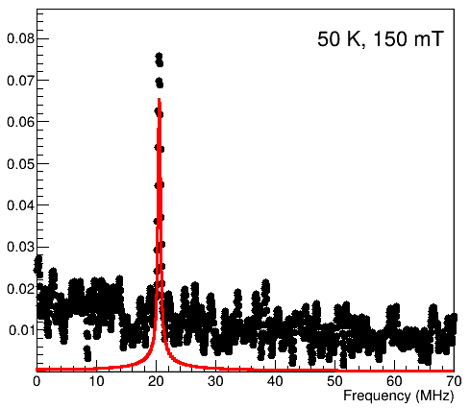
μ⁺SR in Si: Mu_{BC} as a sensitive probe for free charge carriers
In the presence of free electrons with concentration n,
spin-exchange with the bound electron in Mu_{BC}⁰ causes
fast depolarization of the muon spin:
If n > 10¹³ cm⁻³, λ > 2 μs⁻¹, ν₁₂ + ν₃₄ disappear
Here: Si n-doping 2x10¹⁷ cm⁻³
30 K: «carrier freeze-out», donors not ionized
50 K: n ~ 10¹⁶ cm⁻³, Mu lines disappeared
B.D. Patterson, Rev. Mod. Phys. 60, 69 (1988).
Page 6
Notes:
6

Slide 7
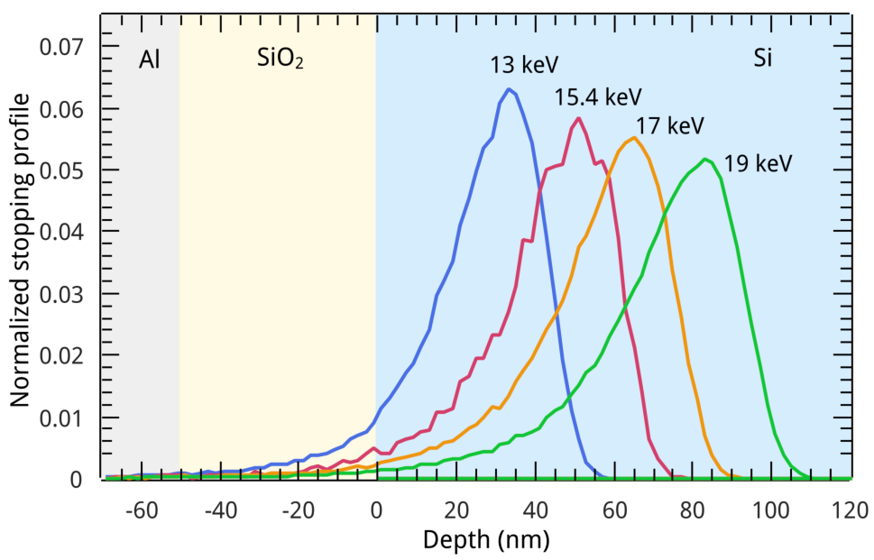
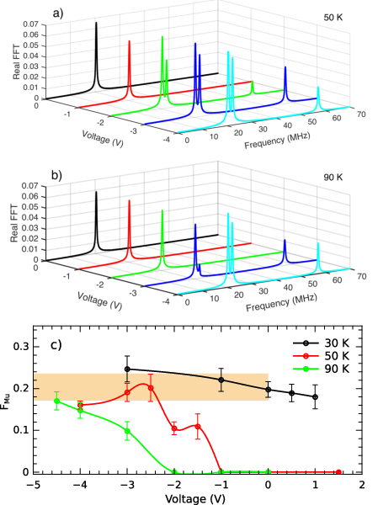
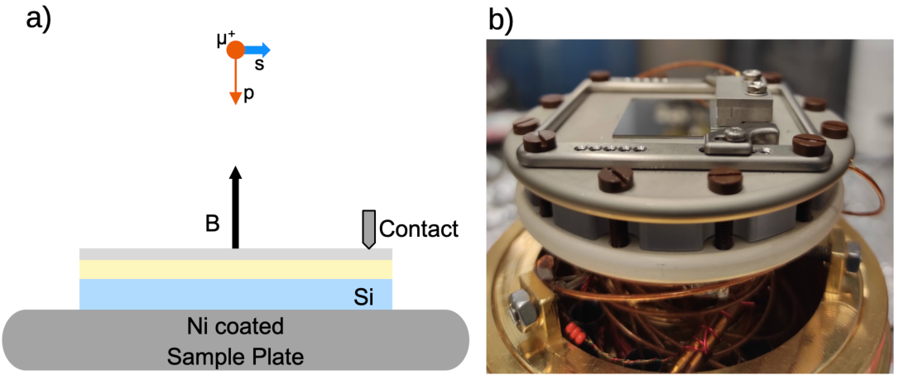
Observation of charge carrier manipulation in a Si-MOS
Setup for “electric field low-energy μSR (EF-LEM)”
M. M. Martins et al., https://arxiv.org/abs/2405.18211
Bias voltage scan at 15.4 keV of Mu fraction F_{Mu}
Notes:
7

Slide 8
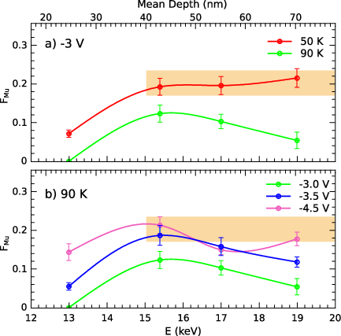
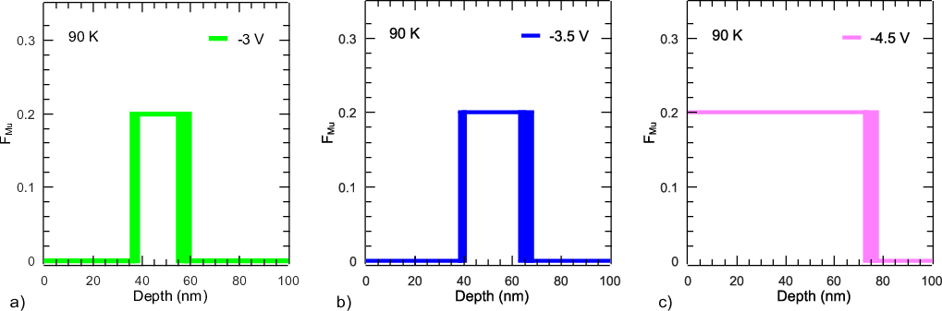
Observation of charge carrier manipulation in a Si-MOS
Fit of F_{Mu} data assuming a sharp transition from
F_{Mu} = 0, n >> 10¹³ cm⁻³
F_{Mu} = 0.2, n < 10¹³ cm⁻³
electron depletion region clearly visible
A.F.A.Simões,H.V.Alberto,et al., n, Rev. Sci. Instrum. 91, 023906 (2020)
M. Mendes Martins et al, J. Phys.: Conf. Ser. 2462, 012025 (2023)
M. M. Martins et al., https://arxiv.org/abs/2405.18211
Notes:
8

Slide 9
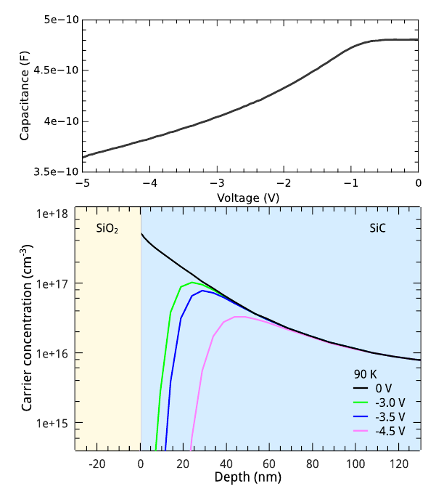
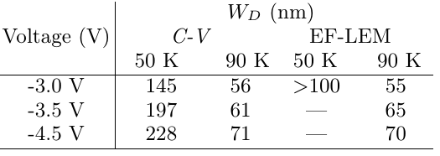
Comparison with C-V measurements and TCAD simulations
C-V measurement at 300 K
Depletion width W_{D} determined from C-V and EF-LEM
Observations:
Good agreement in determination of W_{D}
However, electron accumulation in the first 35 nm cannot be reproduced by C-V/TCAD measurements/simulation
Role of fixed positive charge in SiO₂ not properly reproduced by C-V/ TCAD
TCAD (Technology Computer-Aided Design) simulation based on C-V measurements
M. M. Martins et al., https://arxiv.org/abs/2405.18211
Notes:
9

Slide 10
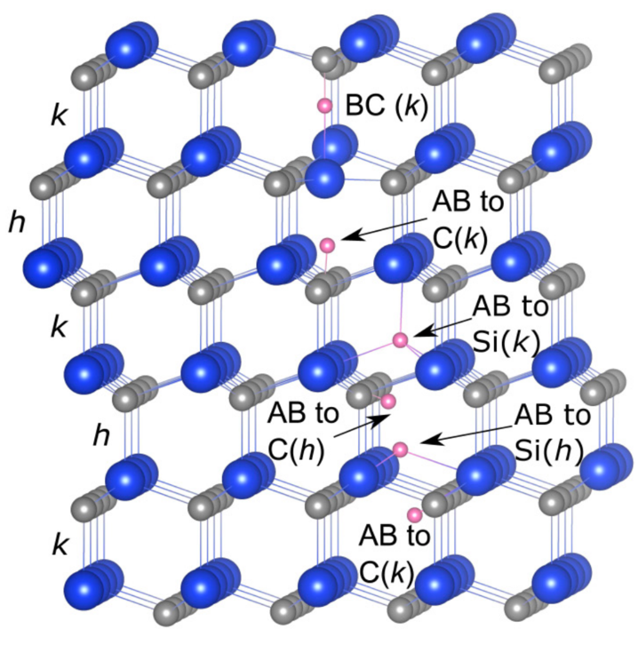
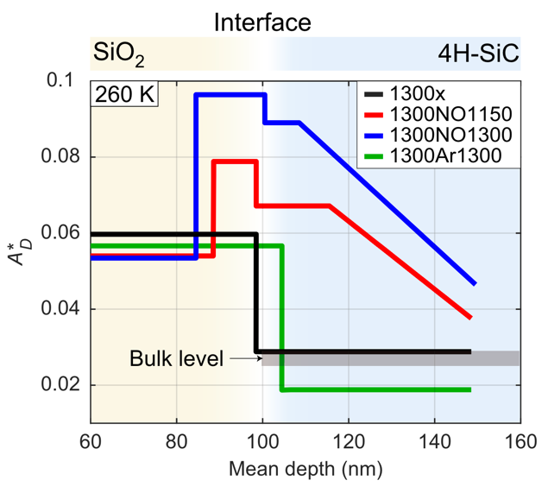
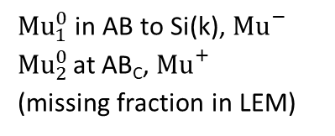
Muonium complexes in 4H-SiC, annealing effects
4H-SiC
${Mu}_{1}^{0}$in AB to Si(k), ${Mu}_{}^{−}$
${Mu}_{2}^{0}$ at AB_{C}, ${Mu}_{}^{+}$
(missing fraction in LEM)
Name | N_{D} (cm⁻³) | Annealing process
N15-1300x | 2.6 × 10¹⁵ | no annealing
N15-1300NO | 2.6 × 10¹⁵ | 1300 ◦C in NO
N17-1300NO | 1.0 × 10¹⁷ | 1300 ◦C in NO
Diamagnetic fraction F_{D}
In SiC: F_{D} ↑ due to Mu⁻ formation
n ≳ 1×10¹⁶ cm⁻³
Annealing in NO at 1300℃ introduces N which acts as donor.
N_{D}=10¹⁷ cm⁻³
R. L. Lichti, et al., Phys. Rev. B 70, 165204 (2004)
M. E. Bathen, et al., J. Appl. Phys. 127, 085701 (2020)
Notes:
In Si, we will focus on the BC state. MuBC0 ionizes a
In 4H-SiC: Mu0 in AB to Si(k)
Which is also likely to be acceptor.

Slide 11
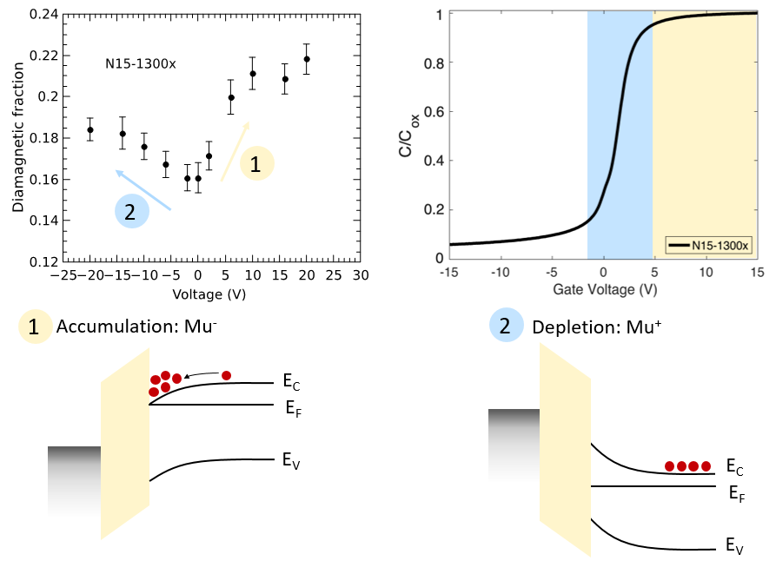
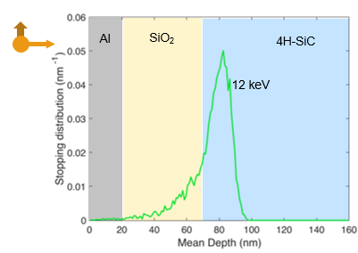
Results N15-1300x, T = 260 K
Courtesy: Maria Martins

Slide 12
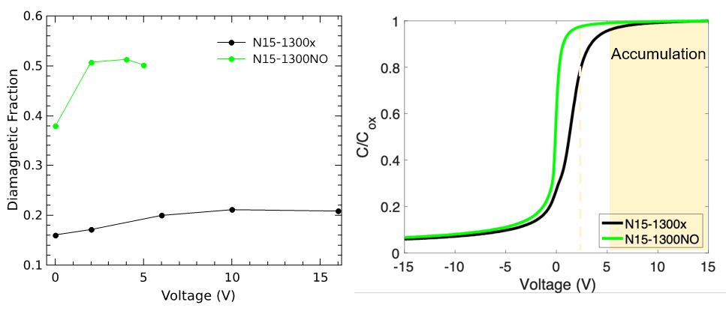
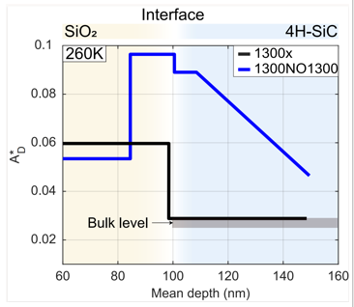
Accumulation: N15-1300NO vs N15-1300x, T = 260 K
↑ F_{D} due to the presence of electrically active N near SiO₂/SiC interface.
Good agreement between saturation voltage of F_{D} and C-V.
Courtesy: Maria Martins

Slide 13
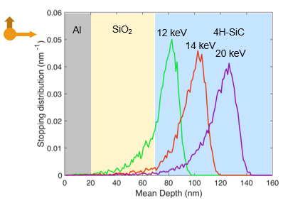
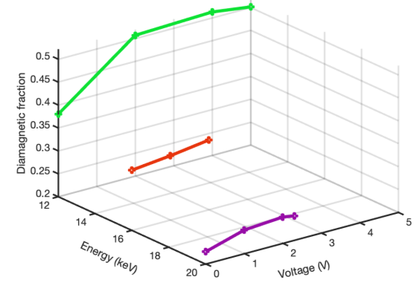
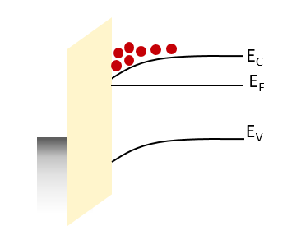
Results N15-1300NO, T = 260 K
10-20 nm near the interface are affected by the electron concentration increase in accumulation condition.
Applied bias does not affect F_{D} formation further from the interface.
Courtesy: Maria Martins

Slide 14
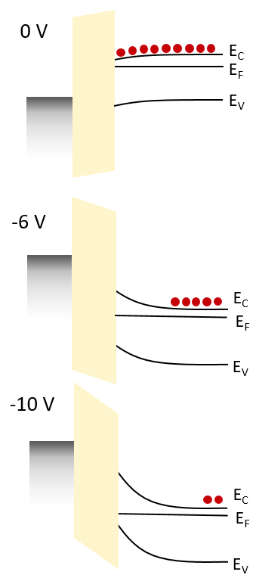
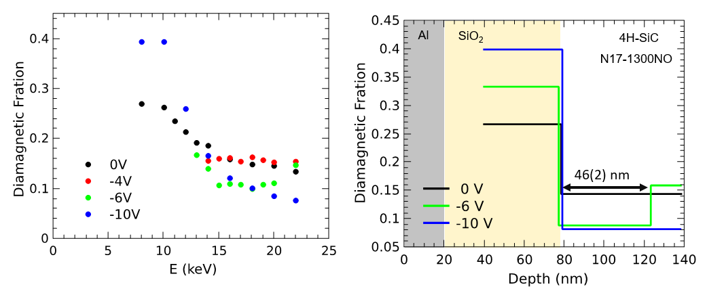
Results N17-1300NO, T = 260 K
A.F.A.Simões,H.V.Alberto,et al., n, Rev. Sci. Instrum. 91, 023906 (2020)
M. Mendes Martins et al, J. Phys.: Conf. Ser. 2462, 012025 (2023)
Courtesy: Maria Martins

Slide 15
Summary
Electric-Field low-energy-μSR (EF-LEM) is a novel extension to LE-μSR to study semiconductor interfaces with nanometer depth resolution under applied electric bias
In Si- and 4H-SiC-MOS structures, the final state of muonium is affected by the applied gate bias, providing information about charge carrier accumulation/depletion profiles with unprecedented depth resolution
The observed band-bending conditions – with increased precision around the oxide-semiconductor interface – agree with C-V measurements
In SiO₂/Si, an unexpected electron accumulation was observed in a 30-nm-wide region at the oxide interface, which cannot be reproduced by TCAD simulations
In 4H-SiC, the observed “induced electron accumulation” as a function of depth confirms the unintentional N doping caused by post-oxidation-annealing in NO

Slide 16
LE-μSR publications related to defects, charge carrier profiles and band bending in semiconductors
M. Martins et al., https://arxiv.org/abs/2405.18211
P. Kumar et al., Materials Science in Semiconductor Processing 174, 108241 (2024)
M. Martins et al., Advanced Materials Interfaces 10, 2300209 (2023)
P. Kumar et al., Physical Review Applied 19, 054025 (2023)
P. Kumar et al., Materials Science Forum 1062, 315 (2022)
H. Alberto et al., Advanced Materials Interfaces 9, 2200374 (2022)
J. Woerle et al., Materials Science Forum 1004, 581 (2020)
J. Woerle et al., Physical Review Applied 14, 054053 (2020)
T. Prokscha et al., Physical Review Applied 14, 014098 (2020)
M. Curado et al., Applied Materials Today 21, 100867 (2020)
J. Woerle et al., Physical Review B 100, 115202 (2019)
H. Alberto et al., Physical Review Materials 2, 025402 (2018)
T. Prokscha, Journal of Physics: Conference Series 551, 012049 (2014)
T. Prokscha et al., Physical Review B 90, 235303 (2014)
T. Prokscha et al, Scientific Reports 3, 2569 (2013)

Slide 17
Acknowledgement
Maria Mendes Martins (PSI/ETH Zürich)
Zaher Salman (PSI)
Marianne Bathen (U Oslo/ETH Zürich)
Piyush Kumar (ETH Zürich)
Ulrike Grossner (ETH Zürich)
Funding:
SNSF grant number 192218
ETH Zürich Postdoctoral Fellowship
Thank you for your attention!

Slide 18
Muon signal in SiO₂ and 4H-SiC at 0.7 mT
M. Mendes Martins, et al., Adv. Mater. Interfaces, 10, 2300209 (2023)
Courtesy: Maria Martins

