Slide 1
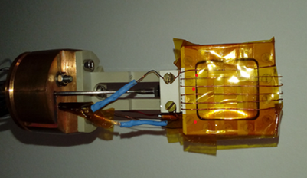
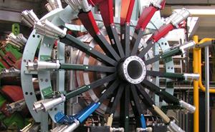
Exploiting and Developing
Time Integral and Differential RF methods:
An RF-µSR study of the
2-Norbornyl Radical in Norbornene
Stephen Cottrell and Sean Giblin
(Data measured on EMU at ISIS)

Slide 2
Overview
Work originally motivated by the question …
‘Can we use a 90º RF pulse to characterise muoniated radicals?’
(following the example of NMR/EPR spectroscopists)
By ‘characterise’ …
    Determine parameters such as muon isotropic hyperfine coupling, A_{iso}, dipolar anisotropy, D, nuclear hyperfine parameters, A_{n}, etc.
To get an answer, we needed a test system …
Norbornene chosen because radicals already (very well) studied with Spin Rotation (TF) and Avoided Level Crossing (ALC) techniques.

Slide 3
Radio-Frequency (RF) µSR

Slide 4
RF-µSR? Resonance?
Scan either field or RF frequency, v_{RF}
When RF frequency, matches transition a resonance is observed
The RF field was generated by a few turns of ~0.5mm Cu wire wrapped around the sample,
tuned and matched at 170.5 MHz
Breit-Rabi energy level diagram for a simple muon-electron system
A couple ways of doing the experiments …

Slide 5
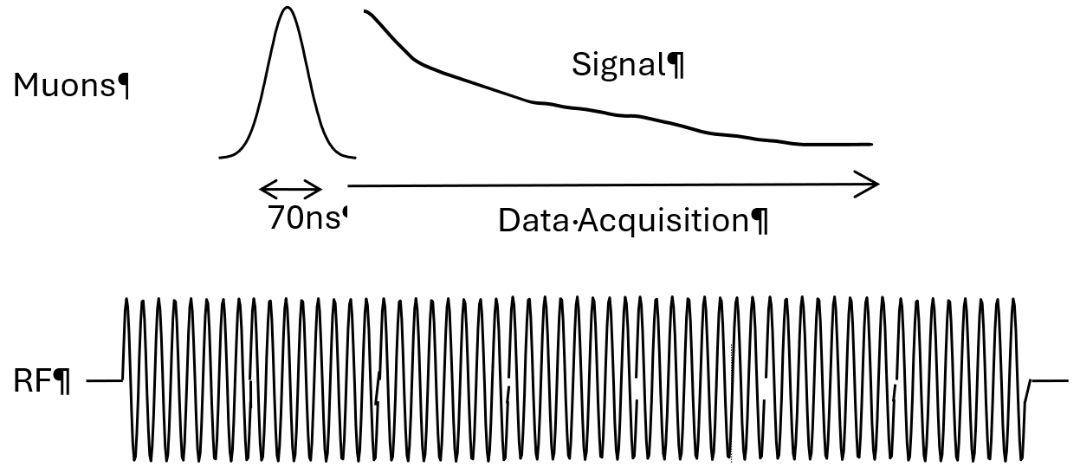
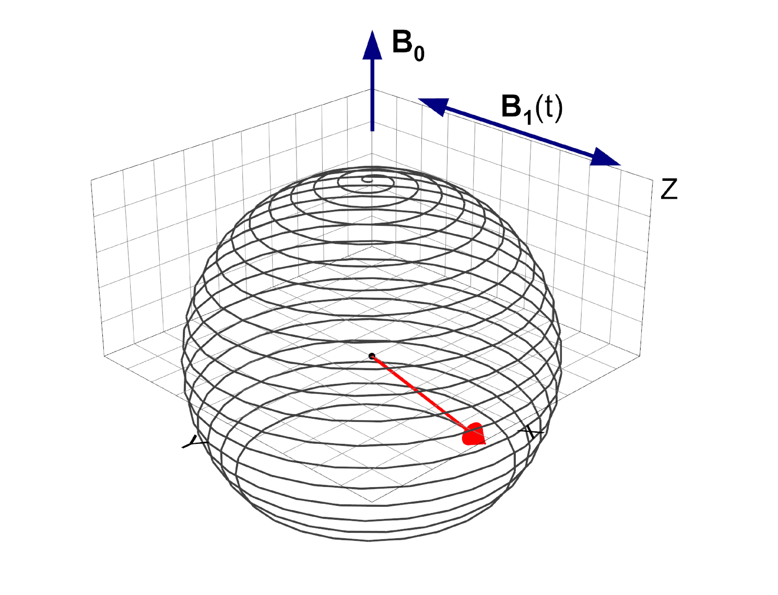
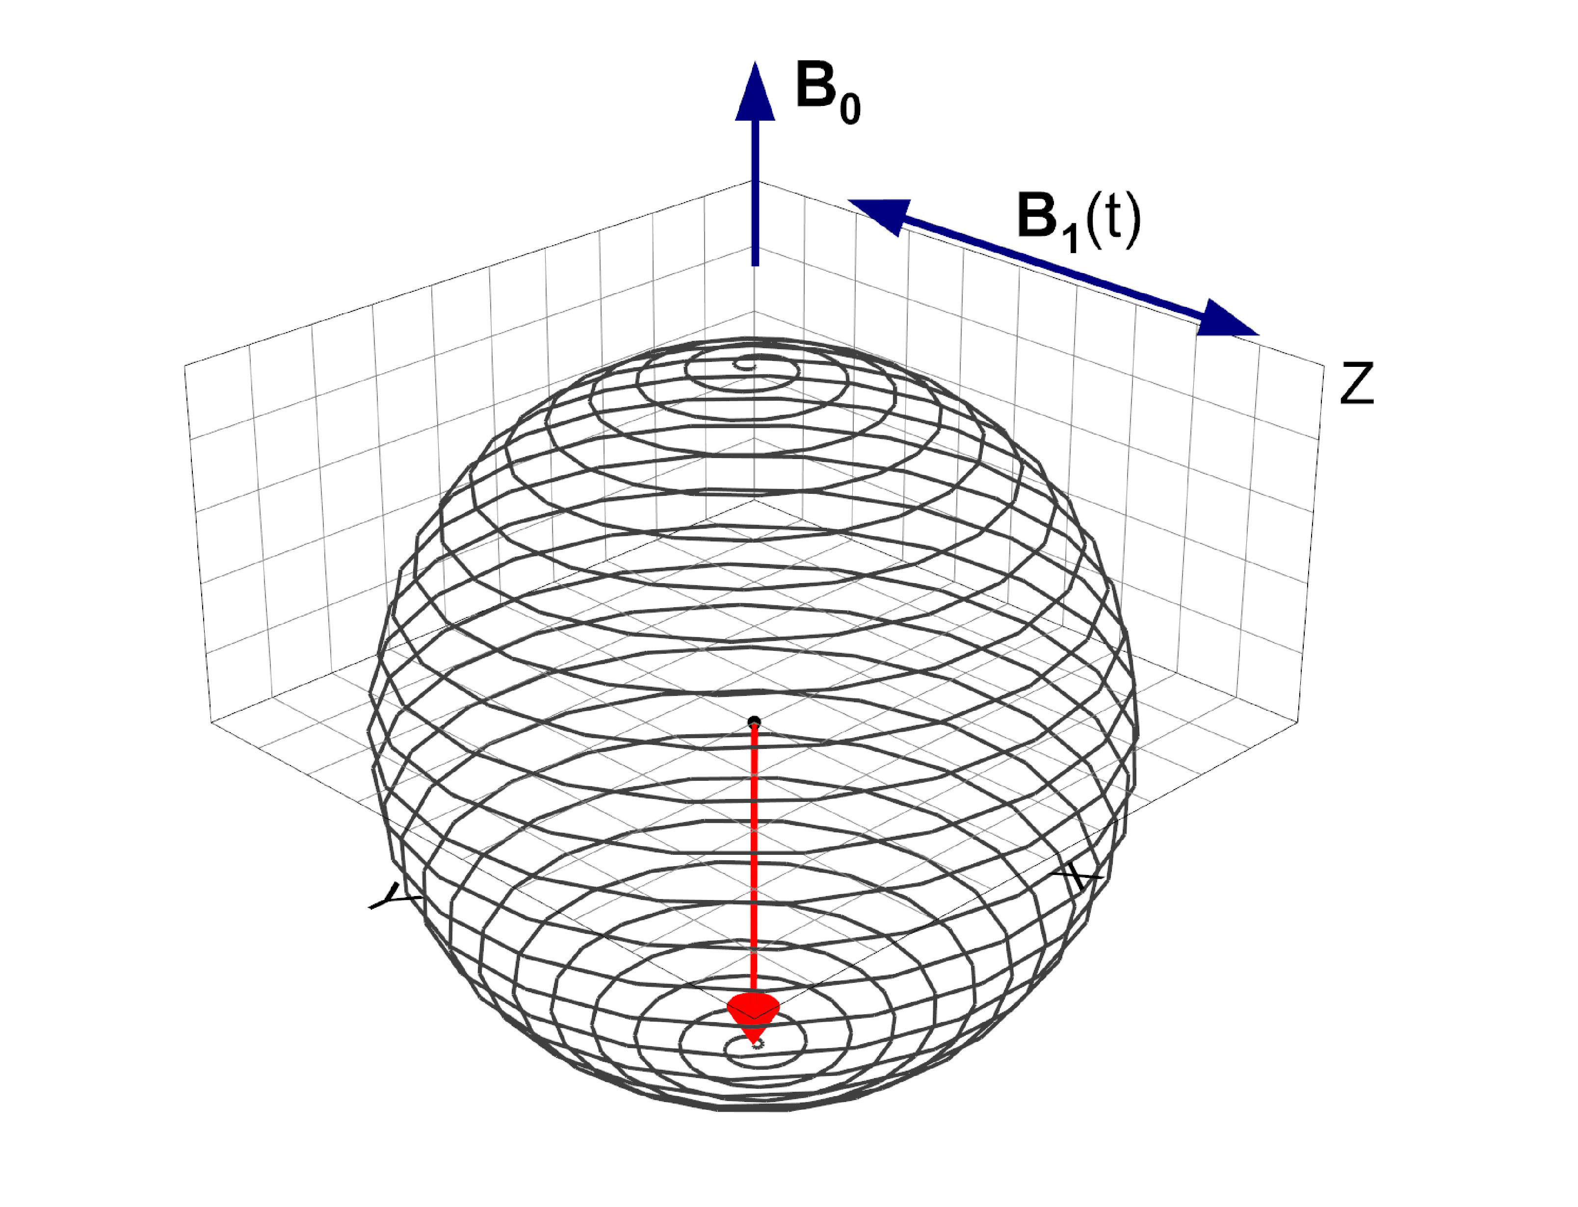
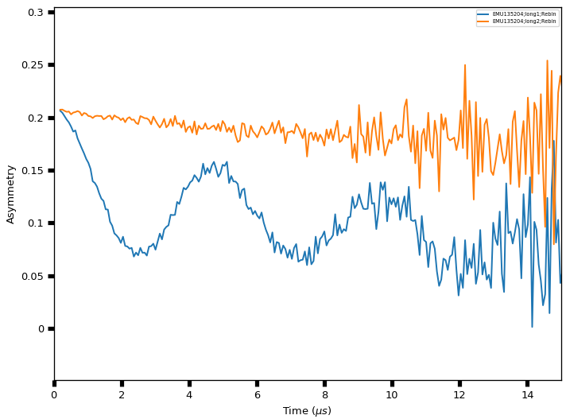
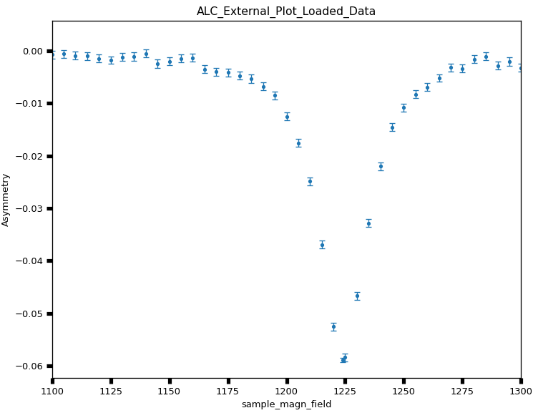
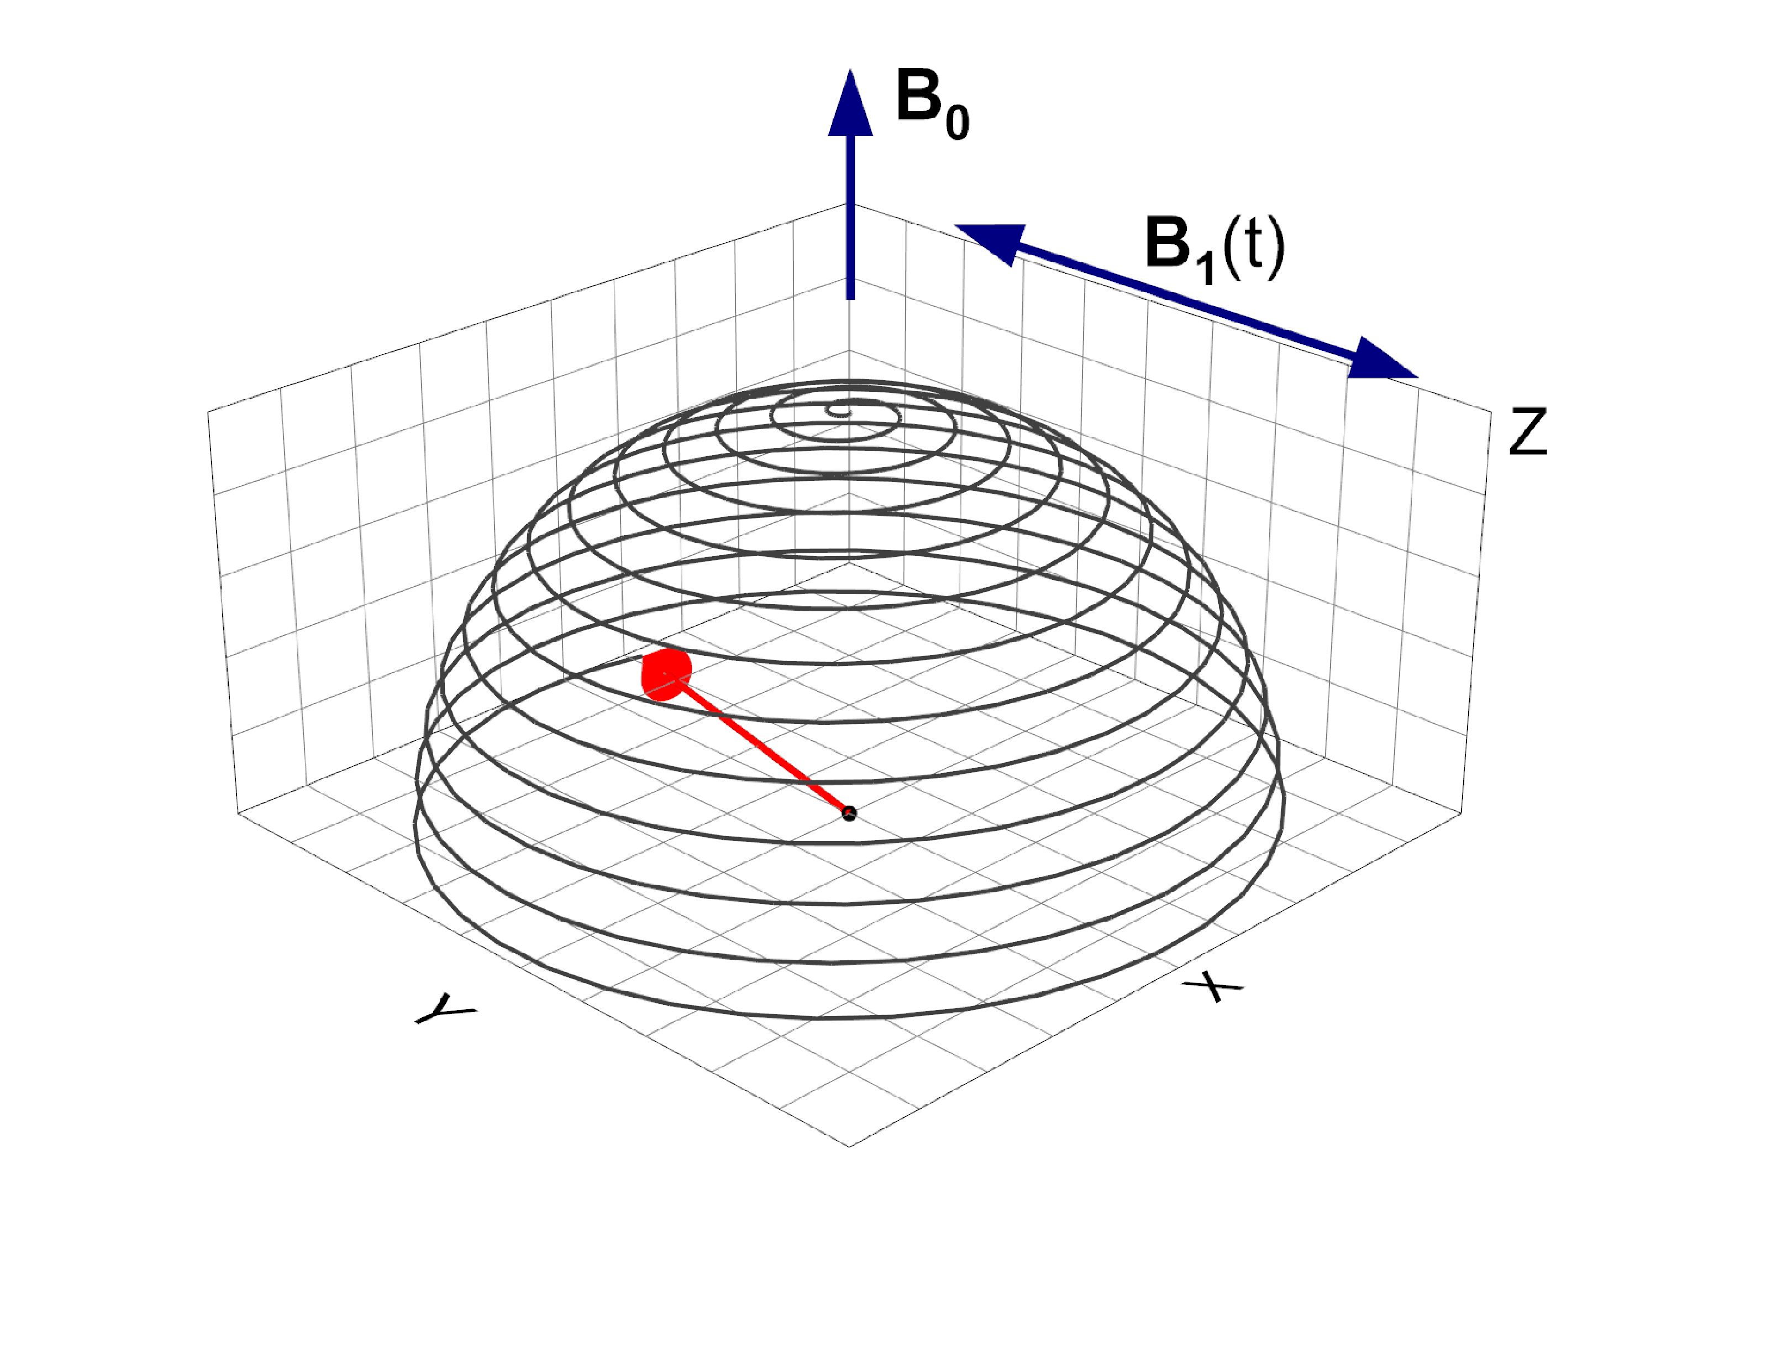
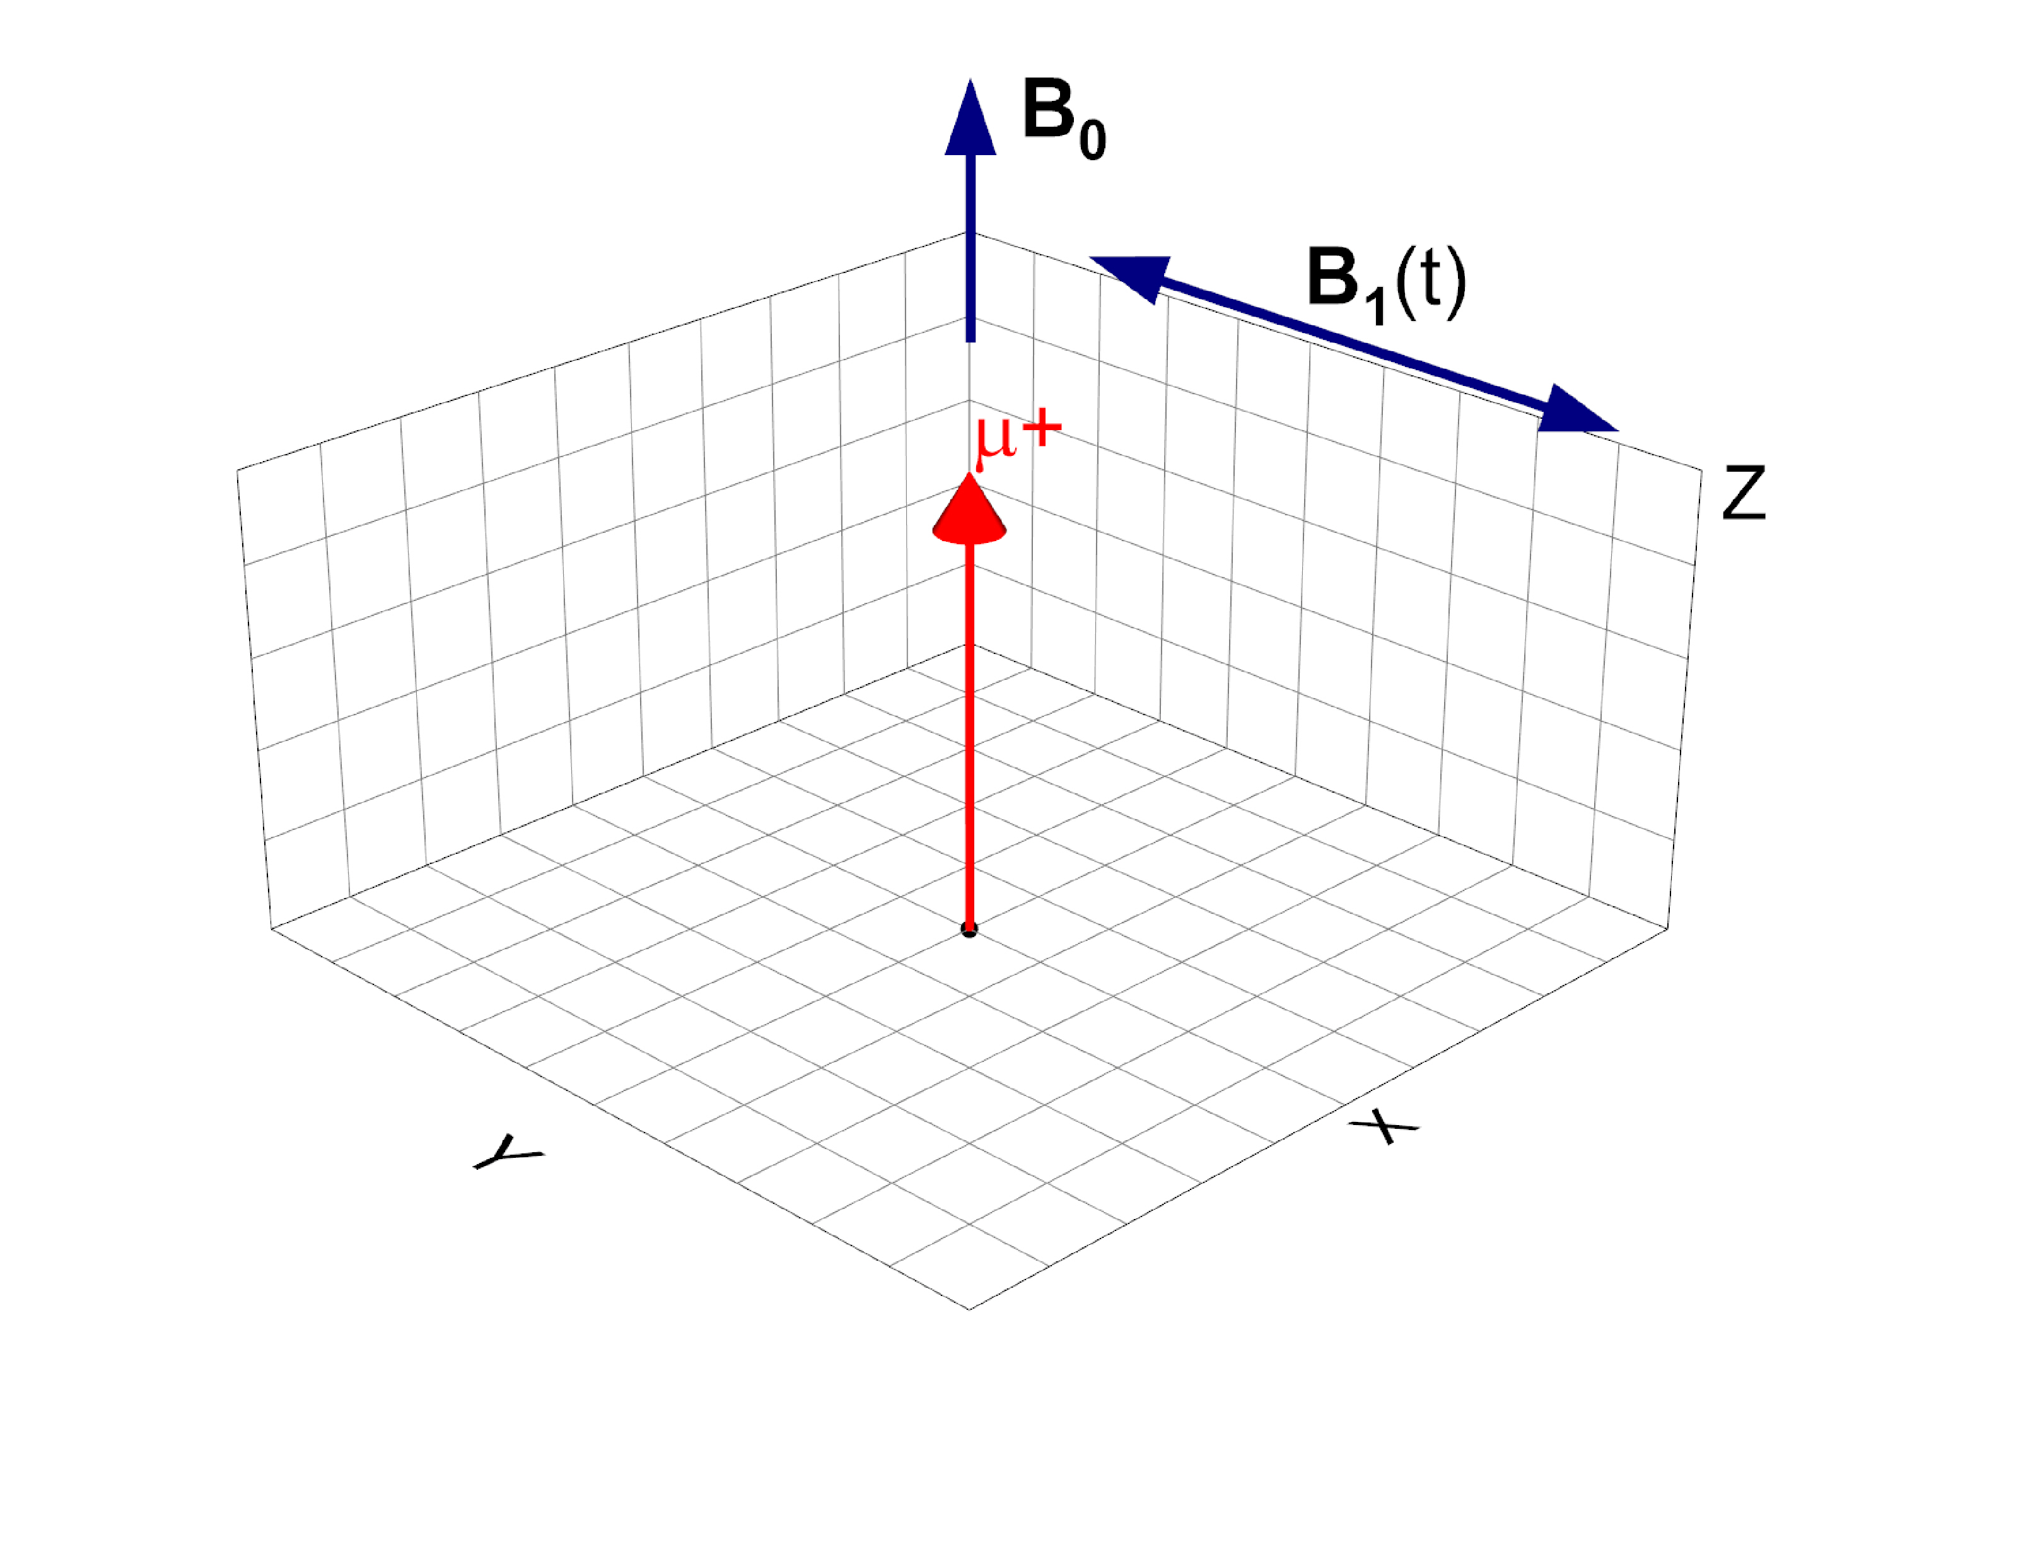
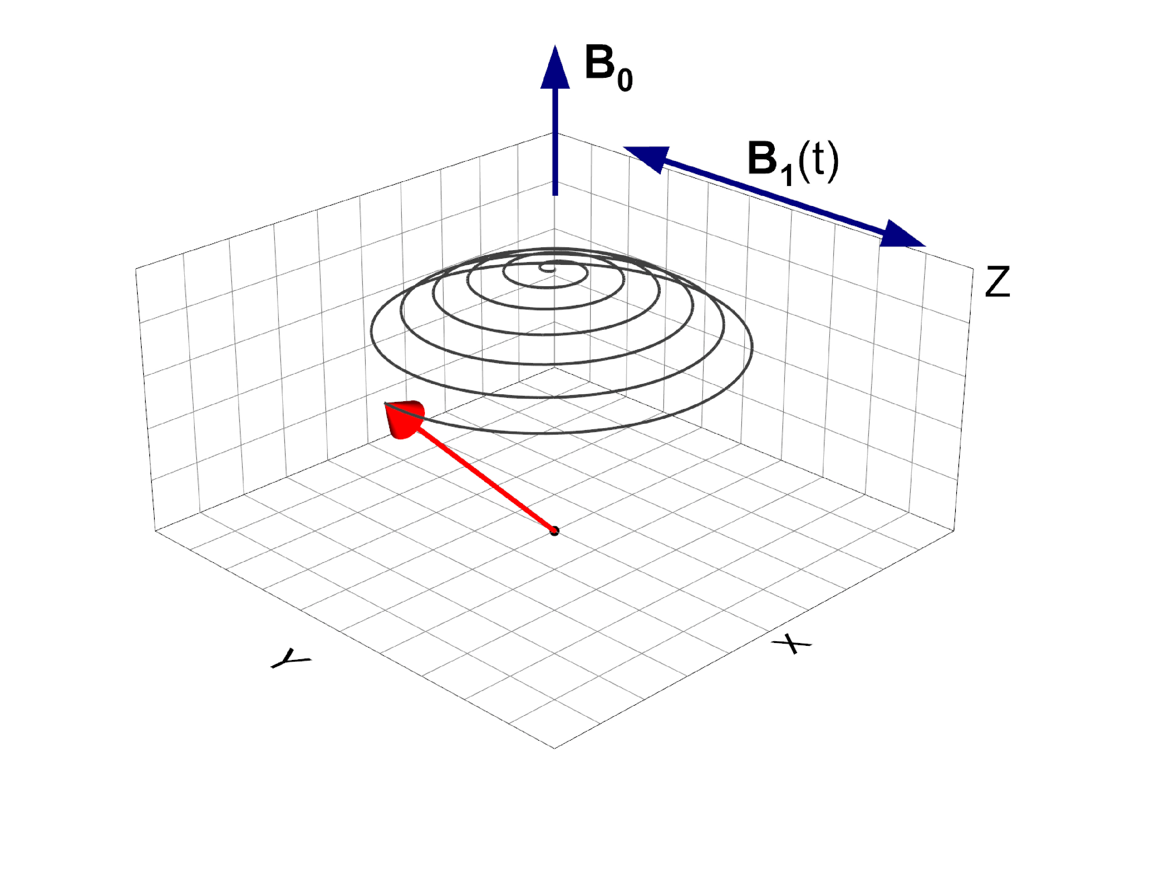
Swept field RF-µSR:
Scan B₀ to map out resonance
RF Sequence:
RF Sequence:
On resonance:
Plotted for B₀ = 50 * B₁
Orange: RF Off
Blue: RF On
Field, B₀
Polythene, µ⁺, ~16.6 MHz

Slide 6
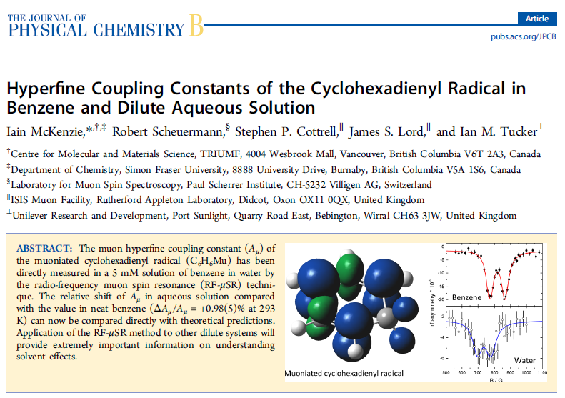
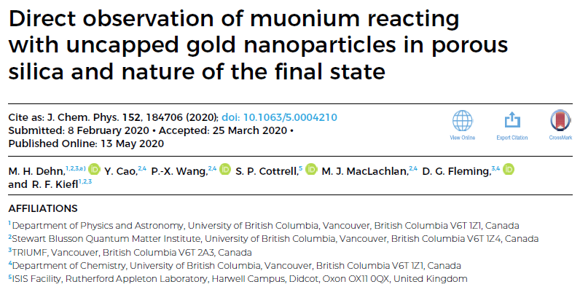
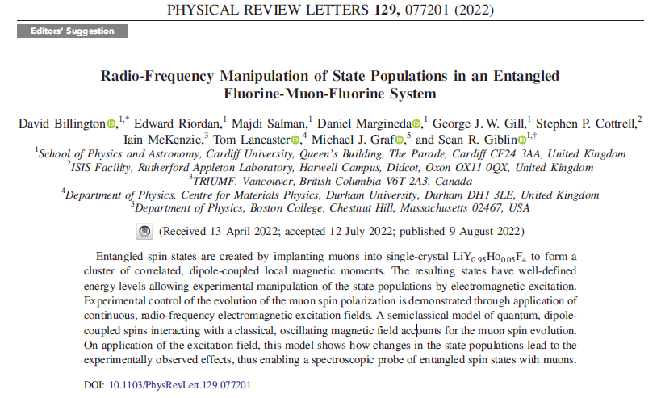
Swept field RF-µSR:
Slowly formed radicals
Final state determination
Manipulating state populations

Slide 7
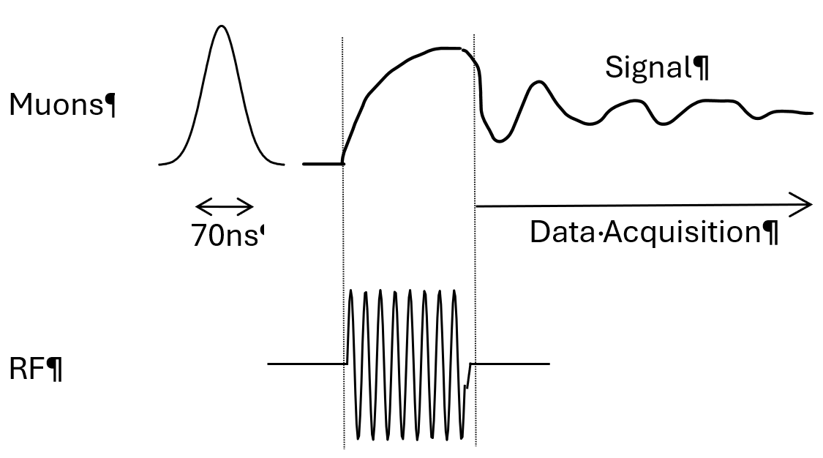
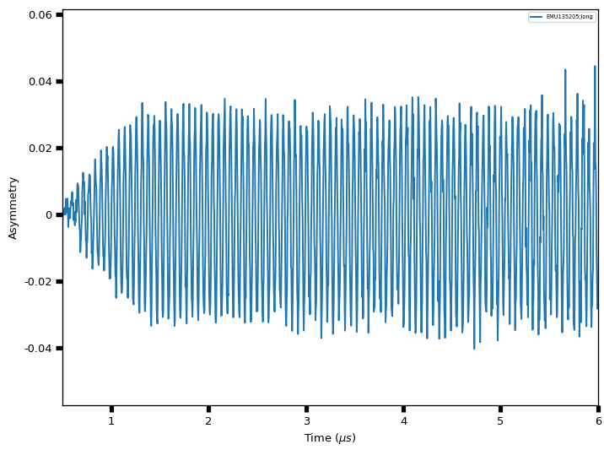
Pulsed RF-µSR:
Assume ν_{RF} is ‘at resonance’
Time RF pulse to tip spin pol. by 90°
RF Sequence:
Measure free precession in x-y plane (Transverse)
RF
Free precession
On resonance:
Plotted for B₀ = 50 * B₁
Polythene, µ⁺, ~16.6 MHz

Slide 8
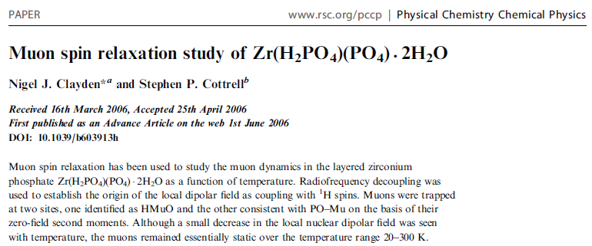
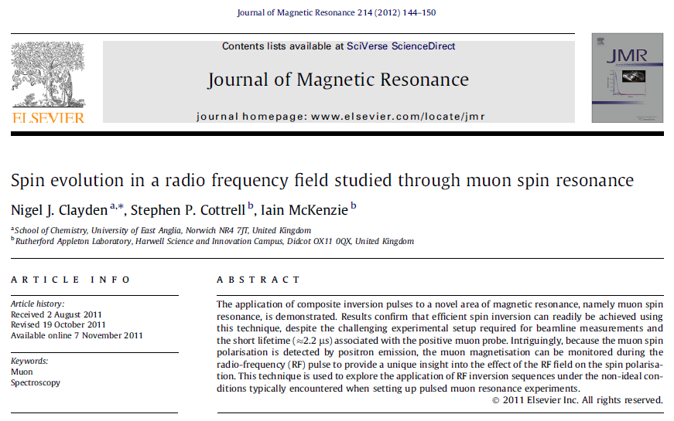
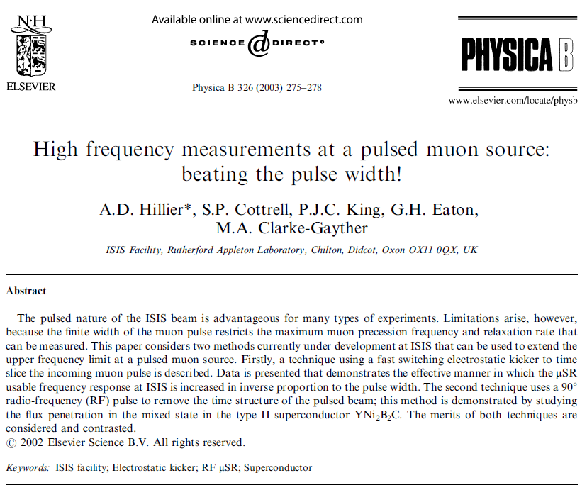
Pulsed RF-µSR:
RF Decoupling (‘NMR style’)
Spin evolution in RF field
Extend ISIS frequency response
Start to exploit pulse bandwidth to multiplex information
in a free precession signal – FT-NMR ⇒ FT-RFµSR

Slide 9
Why use Norbornene as our example?

Slide 10
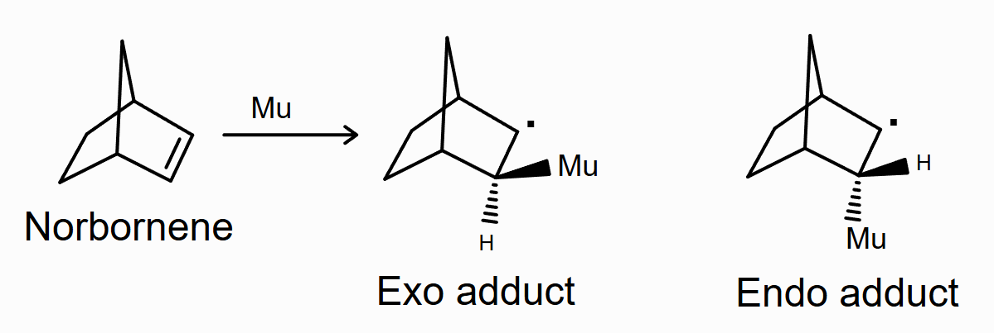
Norbornene
Mu addition across double bond;
Muoniated radicals well characterised
(TF and ALC studies – Riccò et al; Roduner et al)
‘Exo’ and ‘Endo’ isomers depend on geometry;
‘Exo’ has nice T-dep for A_{iso} and D.
Plastic phase above ~129K.
Averaging of D, but not completely!
RF line sensitive to D, but not too broad!

Slide 11
Analysing the data
Numerical simulations of the response of the muon polarisation to RF fields in these systems was carried out using Quantum, developed by James Lord (Physica B, 374, 2006, 472)
H_{eff} = <H_{Zeeman} + H_{HF}>_{avg}, where H_{HF} includes isotropic A_{iso}, and axial dipolar, D_{µ}‖, couplings
Polycrystalline sample (pressed into a bag)
Data fitting to obtain hyperfine parameters, etc, carried out using Mantid (mantidproject.org). In this case we’re using Quantum as a fit function
D_{µ}‖ for A_{iso} = 419 MHz

Slide 12
Resonances for ‘Exo’ adduct
For Exo adduct in Norbornene, ν₁₂ resonances expected at ~500G and ~2000G @ 170.5MHz
Cleaner signal for high field transition - used in these experiments

Slide 13
Swept Field RF Experiments
‘Exo’ isomer in Norbornene

Slide 14
+ sweep static field to map out resonance line

Slide 15
T-dep for RF ν₁₂ line (ν_{RF} = 170.5 MHz)
250K
200K
150K
Lines broaden and develop a powder structure as molecular motion is frozen out cooling through plastic phase
Quantum model fits to the data are shown

Slide 16
Comparison of RF data for A_{iso}
Starting with earlier TF results …
(taken from Riccò et al, J. Chem. Phys. 86 4198 (1987))
Adding values from RF data measured on cooling …
Now add values from RF data measured on warming …
Good agreement – no scatter or hysteresis in RF results

Slide 17
Comparison of RF data for D_{µ}‖
Starting with earlier ALC results …
(taken from Roduner et al, Ber. Bunsenges. Phys. Chem. 93 1194 (1989))
Adding values from RF data measured on cooling …
Now add values from RF data measured on warming …
Good agreement on magnitude,
but RF and ALC suggest opposite sign for D_{µ}‖ (to investigate!)

Slide 18
Signal in the brittle phase (<~129K)
RF signal disappears in brittle phase (as for TF/ALC)
Radicals are still formed – seen in repolarisation data
Lines are likely very broad – suggested by simulations
D_{µ}‖ for A_{iso} = 419 MHz

Slide 19
Pulsed RF Experiments
Studying the ‘Exo’ isomer with a 90° pulse

Slide 20
+ FT of free precession signal

Slide 21
Why Pulsed RF?
Efficiency – use a short, broadband RF pulse to multiplex information in free precession signal – standard for NMR.
Measure relaxation parameters (e.g. T₂) in free precession signal.
Easier to ‘find’ resonances.
May be challenging to multiplex signals 100MHz+ apart (?) but could access proton splittings (a few MHz apart), for example.
Pulsed RF-µSR
(ISIS)
ν_{RF} = 79.32MHz
60ns 90° pulse
Simulated Bz line, split by proton HFCCs
(conditions as in McKenzie et al, J. Phys Chem B 117 13614 2013)

Slide 22
Setting up the 90° pulse
Determine resonance (swept field experiment).
Measure with a long RF pulse at resonance.
Precession frequency about RF field, B₁, gives us the time required for a 90° rotation.
Frequency ~0.23 MHz, so 1/4 period is ~1µs.

Slide 23
Free precession signals - A_{iso}
Two temperatures explored so far:
λ = 1.47(7) µs⁻¹
250K
λ = 2.54(4) µs⁻¹
188K
Now add values of A_{iso} determined from pulsed RF data …
(fit frequency → Hyperfine coupling)

Slide 24
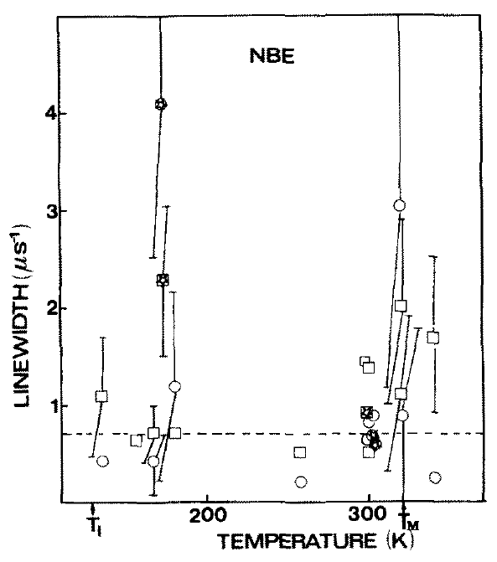
Free precession signals - Relaxation
Two temperatures explored:
λ = 1.47(7) µs⁻¹
250K
λ = 2.54(4) µs⁻¹
188K
Previous linewidths for polycrystalline data for the ‘exo’ radical circled.

Slide 25
Line shape - D_{µ}‖
Experimental data, asymmetric line …
a shoulder appears on the high frequency edge, particularly at 188 K.
Simulations show similar for D_{µ}‖ ~1 MHz.
Consistent with expected value for D_{µ}‖, but still positive.
FFT:
250K
188K

Slide 26
Conclusions

Slide 27
Swept Field RF study provides another view to compare to previous
TF Spin Rotation and ALC studies of the 2-Norbornyl radical.
Consider RF techniques alongside other methods to get a complete microscopic picture of a system, but resilient to slowly formed states.
90° Pulsed RF techniques can access hyperfine parameters and relaxation rates, though experiments aren’t easy!
Just as in NMR/EPR, broadband pulsed techniques promise benefits:
a gain in efficiency and the possibility of ‘clever’ pulse sequences.
However, significant technical challenges remain for this method to become routine, e.g. the need for reliable high-power/frequency RF pulses.
Instrument design at pulsed sources needs to catch-up in capability,
e.g. resolution (~170 MHz instead of <10 MHz!), solid angle coverage (for spin rotated muons), etc. Likely to come at ISIS with Endeavour instruments.

