Slide 1
Muonium Formation and Dynamics in Double Perovskites Cs₂AgBiX₆
(X = Cl, Br)
By: Katie Curvelo
Supervisor: Dr. Sarah Dunsiger

Slide 2
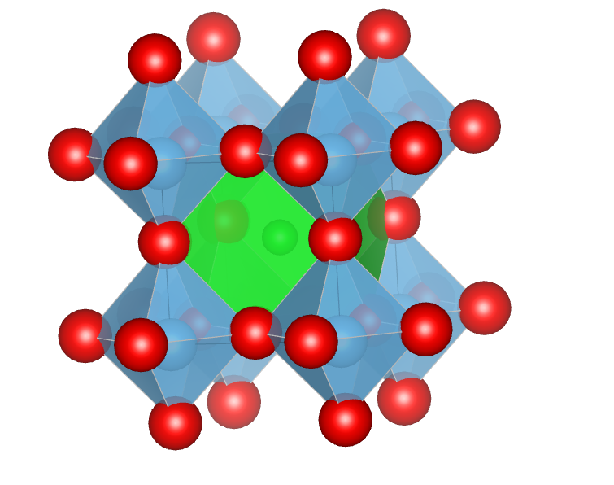
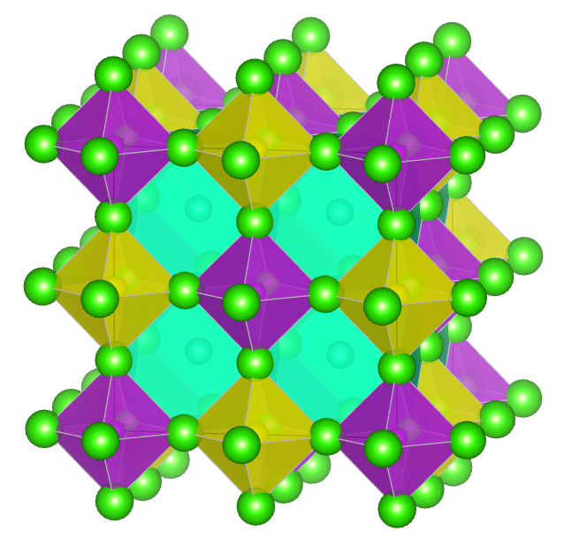
Perovskite Structure
(Yasuda et al., J Synchrotron Rad 2009, 16 (3), 352–357.)
Perovskites are based on octahedral oxygen cages
Perovskite structure: ABO₃
A = Rare or alkaline earth metals
B = First-row transition metals
O = Oxygen
Double perovskites structure: A₂B’B’’X₆
A, B’ = Monovalent cations
B’’ = Trivalent cations
X = Halide
Samples studied - Cs₂AgBiCl₆ Cs₂AgBiBr₆
Example of general perovskite BaTiO₃
Structure of Cs₂AgBiCl₆
(Gao, Wang, Shen, Zhou, & Zhang, RSC Adv. 2024, 14 (50), 37322–37329. )

Slide 3
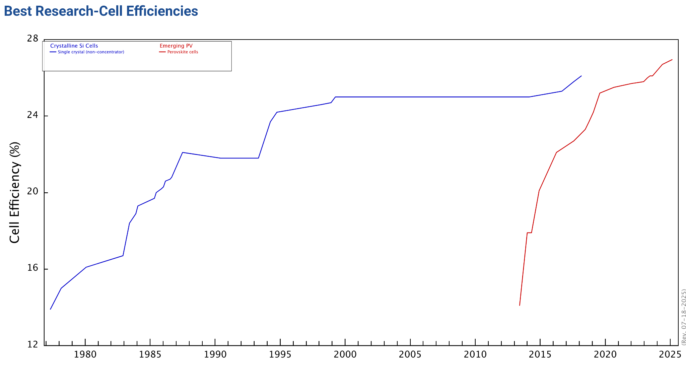
Why Study Perovskites?
Perovskite
Si
Highly tunable
Defect tolerance
Photovoltaic applications
Light emission
Radiation detection
Comparing solar cell efficiencies over time. Retrieved from https://www.nrel.gov/pv/cell-efficiency

Slide 4
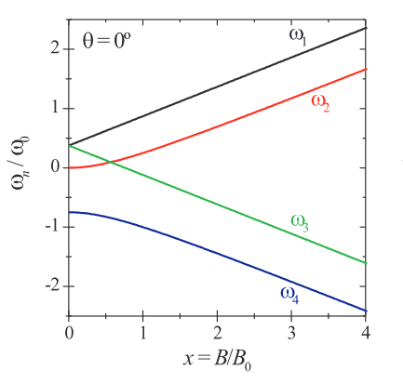
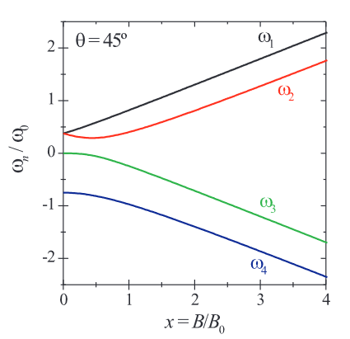
Muonium
Hydrogen analogue, often forms in semiconductors
Electron and muon interact through hyperfine coupling
Hyperfine interaction may be isotropic or anisotropic
Combining Zeeman and hyperfine interactions results in triplet and singlet states
Duarte, Joao Pedro Piroto Pereira., Diss. Universidade de Coimbra (Portugal), 2006.

Slide 5
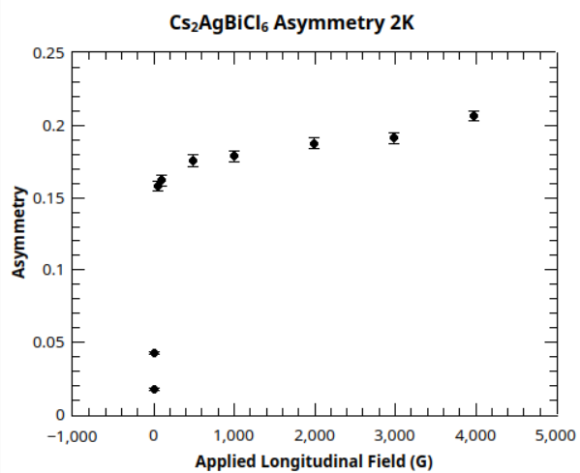
Experimental Evidence For Muonium
Unpolarized electrons means equal chance electron spin is aligned versus anti-aligned with muon spin
Spins aligned is an eigenstate, will not change
Spins anti-aligned leads to very fast precession
Increased fields change asymmetry due to Zeeman interaction

Slide 6

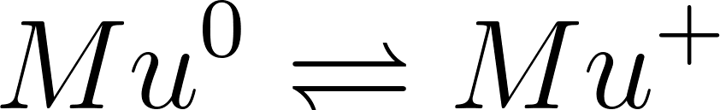
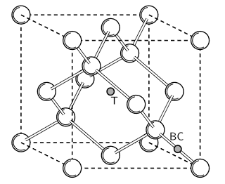

Dynamics of Muonium
Charge exchange, muon gaining and losing electron cyclically
Spin flip of the muonium electron
Structure of Si showing tetrahedral (T) and bond centered (BC) muon sites.
Diffusing between sites
Blundell, S. J., Contemporary Physics 1999, 40 (3), 175–192.

Slide 7
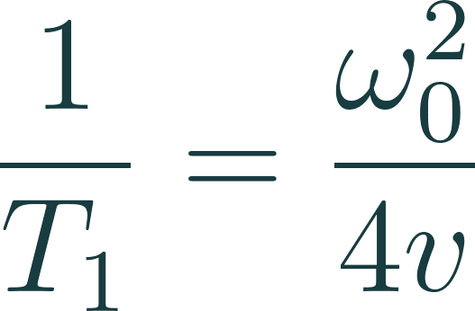

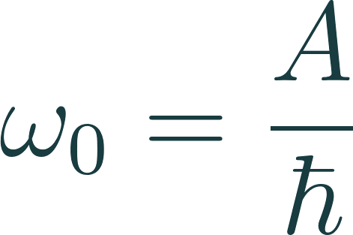
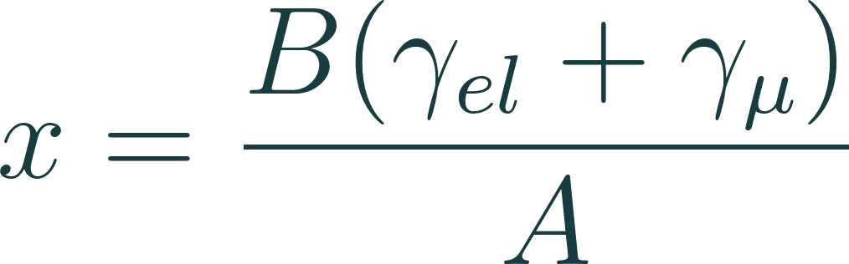

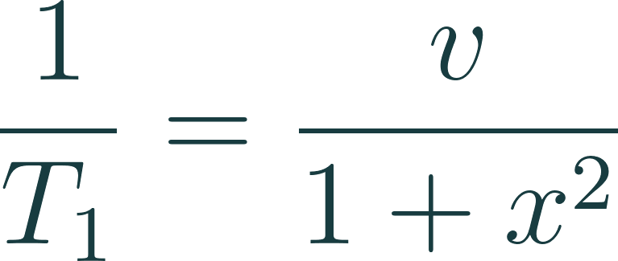


What Would Spin Exchange Look Like?
Spin flip rate
Gyromagnetic ratios
Hyperfine coupling strength
Applied magnetic field
Fast Spin Flip
Slow Spin Flip
Formulas from: Nosov & Yakovleva, Soviet Physics JETP 1963, 16 (5)

Slide 8
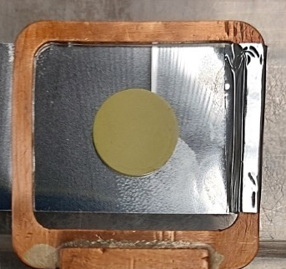
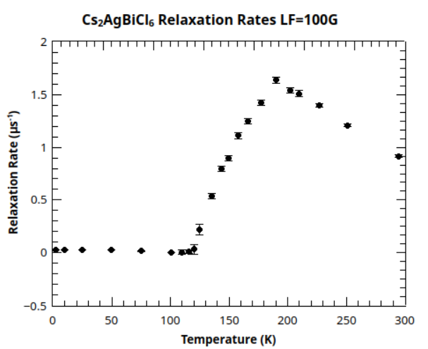
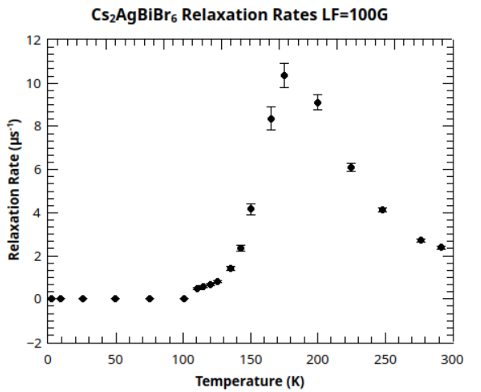
Pressed powder sample of Cs₂AgBiCl₆
Temperature Scans

Slide 9
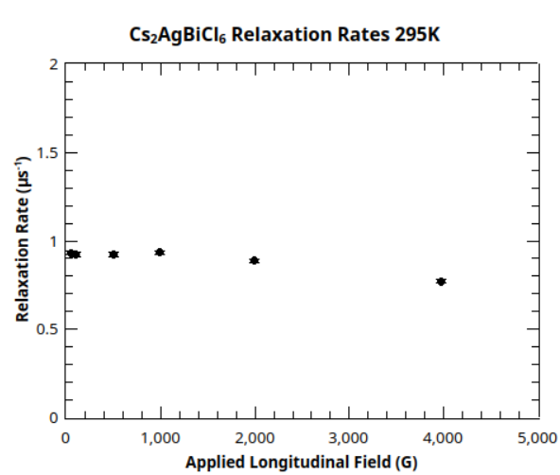
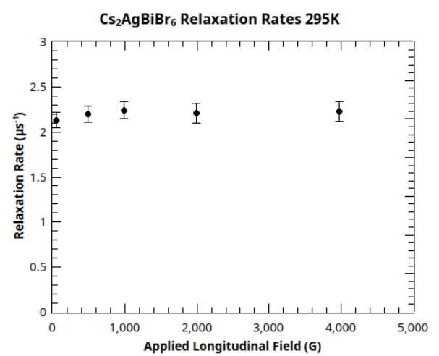
Field Scans - Fast Spin Flip

Slide 10
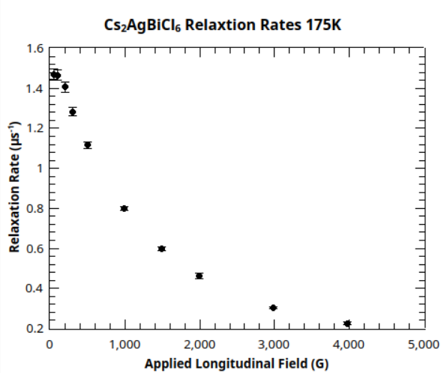
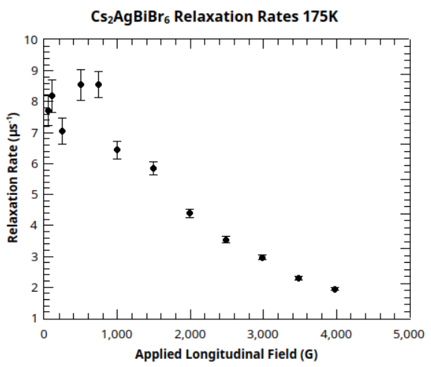
Field Scans - Slow Spin Flip

Slide 11
Summary
Studied double perovskite samples with 𝜇SR
Interested in the structures for photovoltaic applications
We see a loss of asymmetry that repolarizes with applied longitudinal field - evidence for muonium formation
The muon polarization relaxes, implying some dynamics occur
Similar temperature and field dependencies between two samples
Temperature and field scans suggest spin exchange is occurring, with the spin flip rate matching hyperfine coupling strength just under 200K

Slide 12
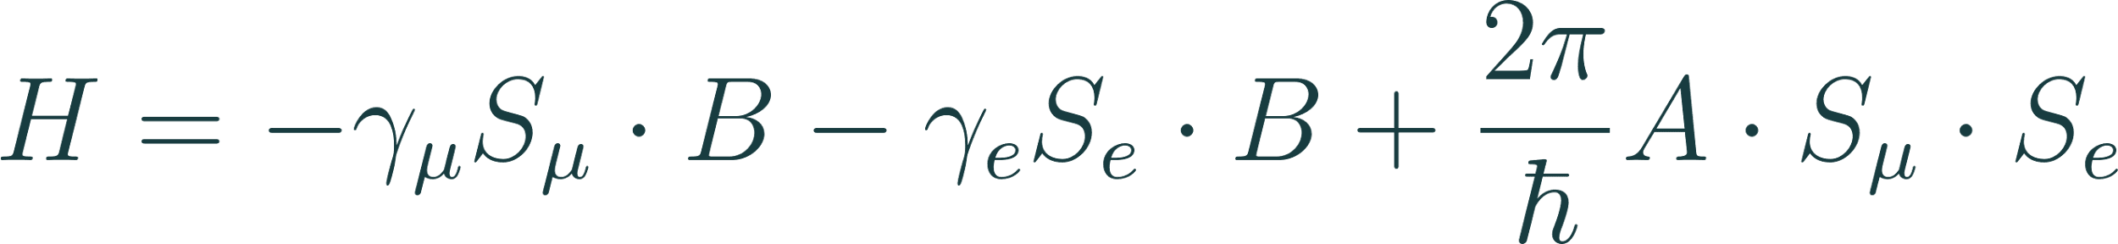
Hamiltonian
First term Zeeman interaction of muon
Second term Zeeman interaction of electron
Third term hyperfine coupling of muon and electron spins
Hyperfine Couplings
Vacuum Mu A = 4463 MHz
Si tetrahedral site = 2006.4 MHz
Si bond-centered site = 16.82 MHz & 92.59 MHz
Gyromagnetic Ratios
Muon = 135.54 MHz/T
Electron = 27992.48 MHz/T

Slide 13
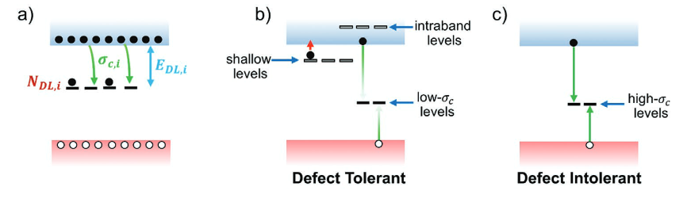
Defect Tolerance
σ_{c,i}: capture cross section; N_{DL,i}: concentration; E_{DL,i}: energy depth
Pecunia et al., Assessing the Impact of Defects on Lead-Free Perovskite-Inspired Photovoltaics via Photoinduced Current Transient Spectroscopy. Advanced Energy Materials 2021, 11 (22), 2003968. https://doi.org/10.1002/aenm.202003968.

Slide 14
References
BaTiO3 CIF: Yasuda, N.; Murayama, H.; Fukuyama, Y.; Kim, J. E.; Kimura, S.; Toriumi, K.; Tanaka, Y.; Moritomo, Y.; Kuroiwa, Y.; Kato, K.; Tanaka, H.; Takata, M. X-Ray Diffractometry for the Structure Determination of a Submicrometre Single Powder Grain. J Synchrotron Rad 2009, 16 (3), 352–357. https://doi.org/10.1107/S090904950900675X.
Cs2AgBiCl6 CIF: Gao, H.; Wang, C.; Shen, H.; Zhou, H.; Zhang, X. Crystal Structure, Bandgap, Photoluminescence and Resistivity Properties of Double Perovskite Cs2AgBiCl6 Single Crystal and Its Thin Film. RSC Adv. 2024, 14 (50), 37322–37329. https://doi.org/10.1039/D4RA06936F.
Solar Cell Efficiency Chart: Best Research-Cell Efficiency Chart | Photovoltaic Research | NREL. https://www.nrel.gov/pv/cell-efficiency (accessed 2025-07-18).
Breit Rabi Diagrams: Duarte, Joao Pedro Piroto Pereira. Study of hydrogen in phthalocyanine semiconductors using µSR technique. Diss. Universidade de Coimbra (Portugal), 2006.
Si Structure: Blundell, S. J. Spin-Polarized Muons in Condensed Matter Physics. Contemporary Physics 1999, 40 (3), 175–192. https://doi.org/10.1080/001075199181521.
Spin Exchange Formulas: Nosov, V. G.; Yakovleva, V. DEPOLARIZATION OF JJ.+ MESONS IN SOLIDS., Soviet Physics JETP 1963, 16 (5)

