Slide 1
Time-Reversal Symmetry Breaking Superconductivity in HfRhGe:
A Noncentrosymmetric Weyl Semimetal
Adrian Hillier
ISIS Neutron and Muon source, STFC, UK

Slide 2

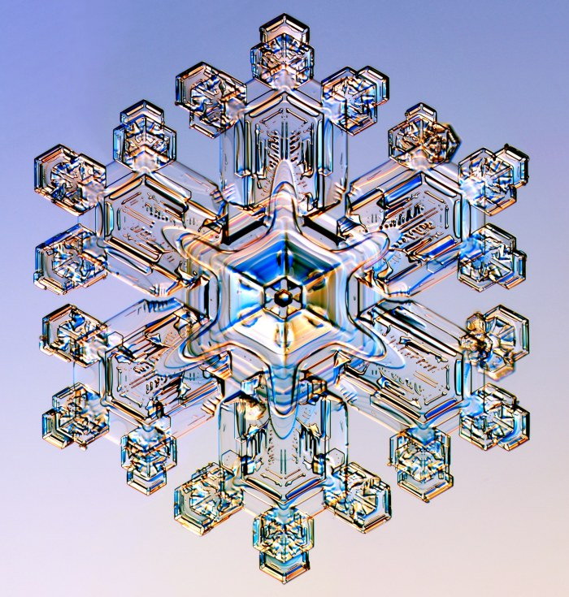
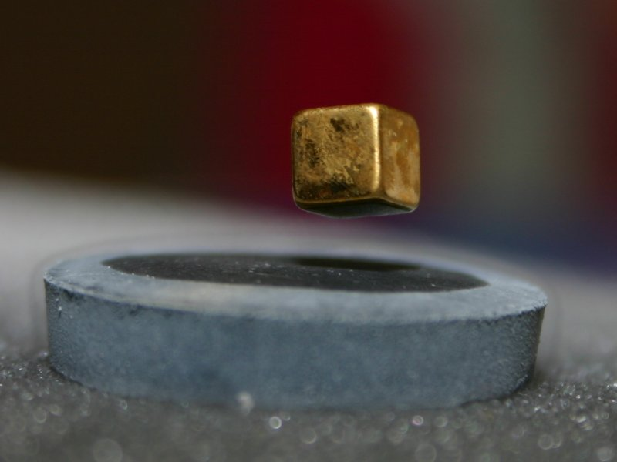

Unconventional superconductors
‘Unconventional’ superconductors:
HTSC, Sr₂RuO₄, PrOs₄Sb₁₂, (UTh)Be₁₃ , ...
May exhibit non-phonon mediated superconductivity
Photo: Kenneth G. Libbrecht, snowflakes.com
Photo: commons.wikimedia.org
Photo: Eddie Hui-Bon-Hoa, www.shiromi.com
Notes:
2
Part 1 Crystal symmetry image one shows water where no sysmmetries are broken: image2 shows ice where point symmetry is broken
Part 2 Gauge symmetry if this was not broken then you wouldn’t get Meissner effect
Part 3 Rotational and Time reversal – this give a definition of unconventional superconductors (but not necessary non-BCS ) as Time and Rotational are not broken

Slide 3
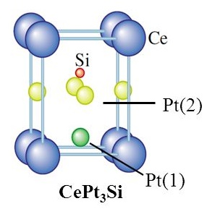

Noncentrosymmetric superconductors
Antisymmetric spin-orbit coupling
The lack of inversion centre introduces an antisymmetric spin-orbit coupling (ASOC)
This ASOC lifts the spin degeneracy of Fermi surface
ASOC
Antiparallel spin pair
k_{z}
k_{z}
k_{y}
k_{y}
${\text{Ĥ}}_{so}$ $\sim$ $μ_{B}$ (E $×P$)$∙σ/mc$
k_{x}
k_{x}
E. Bauer et. al, Springer-Verlag, Heidelberg, (2012)
New J. Phys. 11 055054 (2009)

Slide 4
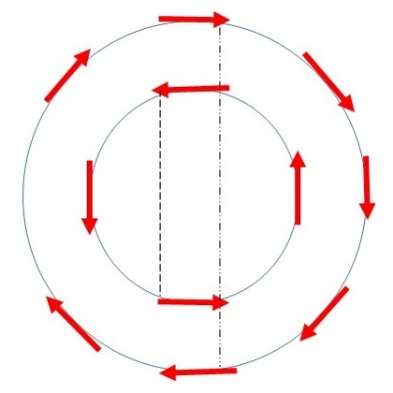

Noncentrosymmetric superconductors
Admixed singlet-triplet pairing
In the presence of ASOC, the electrons constituting the Cooper pair can be formed from different Fermi surfaces
An admixed singlet-triplet pairing is possible with mixing ratio determined by strength of ASOC
Nodes in the superconducting gap
Upper critical field exceeding Pauli limit
Broken time reversal symmetry but only a few!
$$+$$
Non-degenerate Fermi surface
Singlet pair
Triplet pair
Conventional s-wave
Li₂Pd₃B
ASOC
Triplet, and nodes
Li₂Pt₃B
Presence of strong SOC alone is not the reason behind this phenomenon
As some of these materials display properties of fully gapped conventional BCS-type
AIP Conf. Proc. 850, 633–634 (2006)

Slide 5
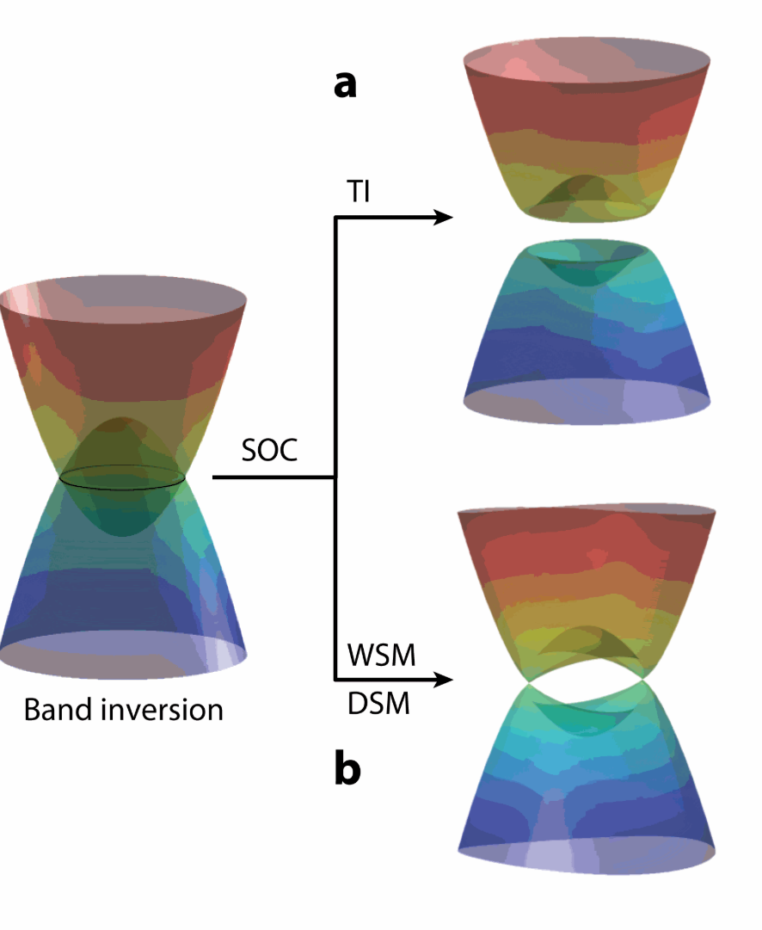
Weyl Semimetal superconductors
Weyl semimetals are a special class of topological quantum materials
Non-centrosymmetric Weyl superconducting semimetals lead to non-trivial Berry curvature
Momentum-independent pairing
topological superconductivity
Interplay of:
Crystal Symmetry
Electronic Structure
Spin orbit coupling
Those that break time reversal symmetry
Intrinsic superconducting diode effect
Possible Quantum electronics
Yan Annu. Rev. Condens. Matter Phys. 8:337

Slide 6
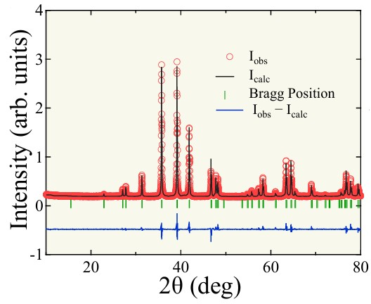
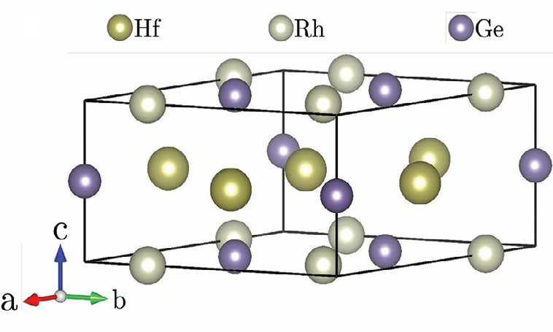
HfRhGe: Crystal Properties
_
Hexagonal P62m
Noncentrosymmetric,
Point group, D_{3h}
Confirmed from Xray Diffraction Rietveld refinement
Adv. Mater. 2025, 37, 2415721

Slide 7
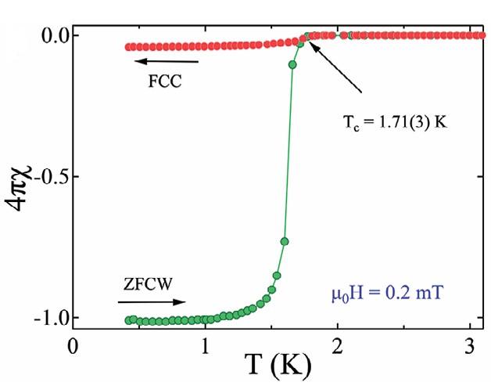
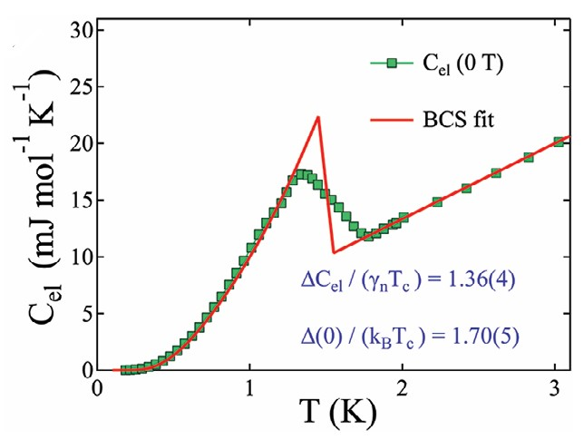
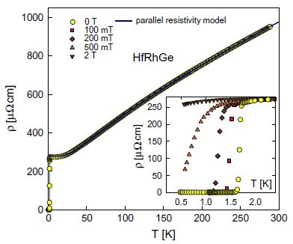
HfRhGe: Superconducting Properties
Tc ≈ 1.7 K
Verified by magnetization, resistivity and specific heat
Full diamagnetic screening
Specific Heat Analysis
Fully gapped BCS-type behavior
ΔC/γ_{n}T_{c} = 1.46, Δ₀/k_{B}T_{c} = 1.70(5)
Adv. Mater. 2025, 37, 2415721

Slide 8
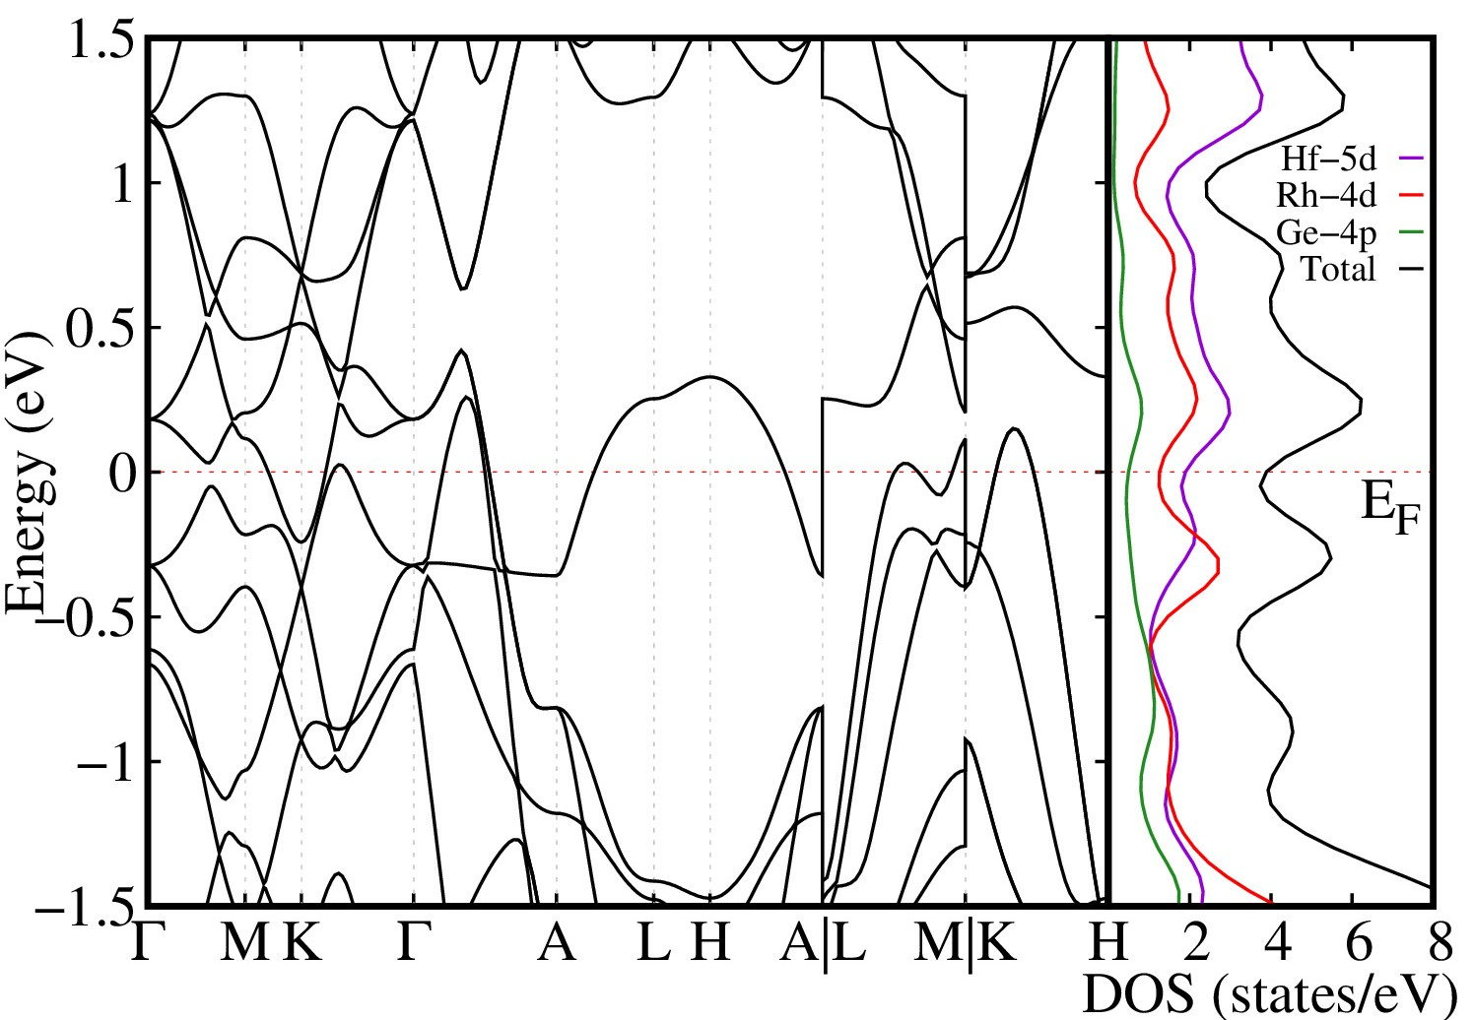
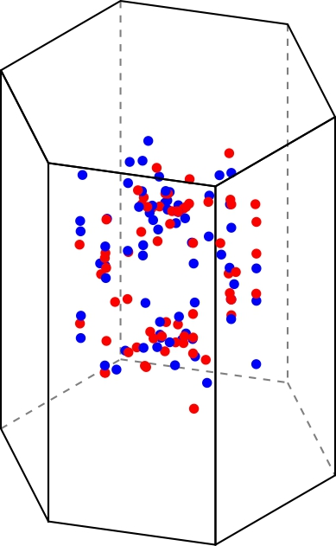
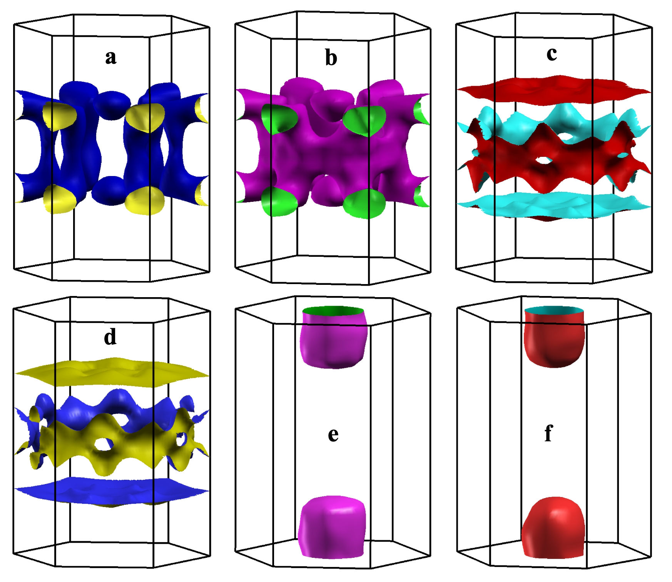
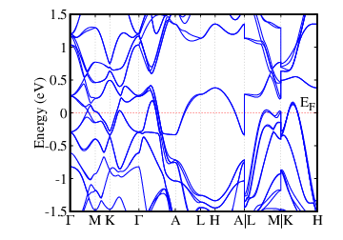
Electronic Structure & Topology
Strong antisymmetric SOC (ΔE ~ 100 meV)
Multiband nature (Hf-5d, Rh-4d, Ge-4p)
Fermi surfaces of HfRhGe show no nodes
Multiple Weyl Points
Adv. Mater. 2025, 37, 2415721

Slide 9
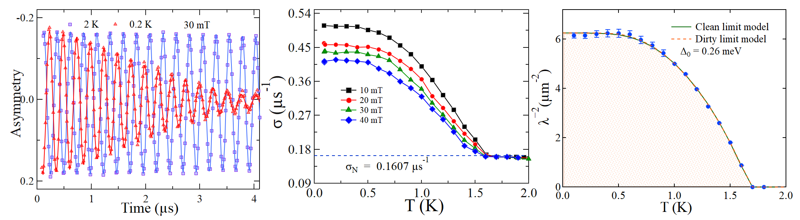
TF Muon Results
A representative asymmetry spectra collected above and below T_{c} at different applied fields
Since the upper critical field of HfRhGe is low
Transverse field measurements were performed at different applied field 100 Oe, 200 Oe, 300 Oe and 400 Oe
Temperature and field dependence was obtained
Adv. Mater. 2025, 37, 2415721

Slide 10
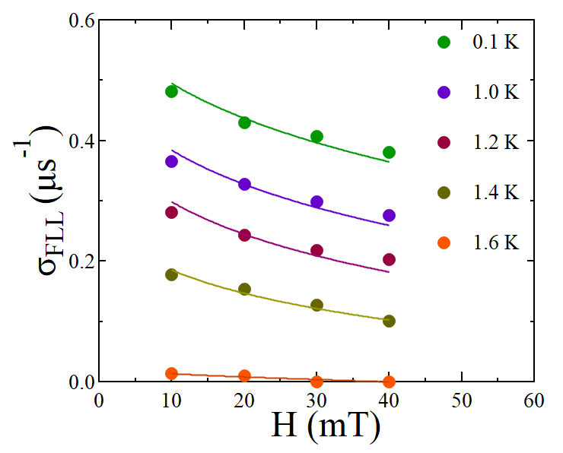

TF Muon Results
The contribution from FLL was extracted and the σ(H) were found from isothermal cuts and fitted with the following equation
Temperature-dependent inverse square penetration depth shows a fully gapped isotropic s-wave state
Gap value: Δ₀ = 0.26(1) meV → Δ₀/k_{B}Tc = 1.77
Remarkable agreement with Heat Capacity 1.70(5)
Adv. Mater. 2025, 37, 2415721

Slide 11
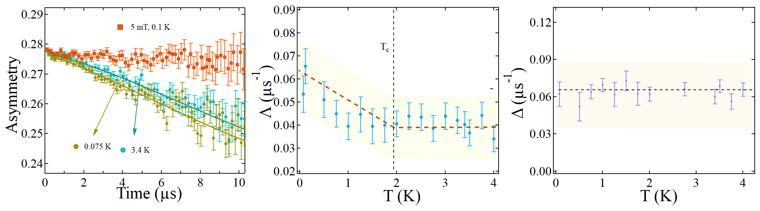


ZF Muon Spin relaxation
ZF– μSR spectra show a distinct difference between spectra collected below and above T_{c}
LF – μSR, decoupling in a weak field
Data were fitted with a Gaussian Kubo-Toyabe function with electronic relaxation rate and a background asymmetry A_{BG}
Adv. Mater. 2025, 37, 2415721

Slide 12
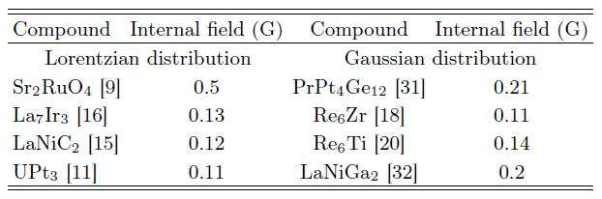
ZF Muon Spin relaxation
Onset of spontaneous fields below T_{c}
Temperature-independent nuclear depolarization rate (Δ)
Electronic relaxation rate (Λ) increases with reducing temperature, indicating time reversal symmetry breaking
Internal field B_{int} ≈ 0.15 G
Adv. Mater. 2025, 37, 2415721

Slide 13
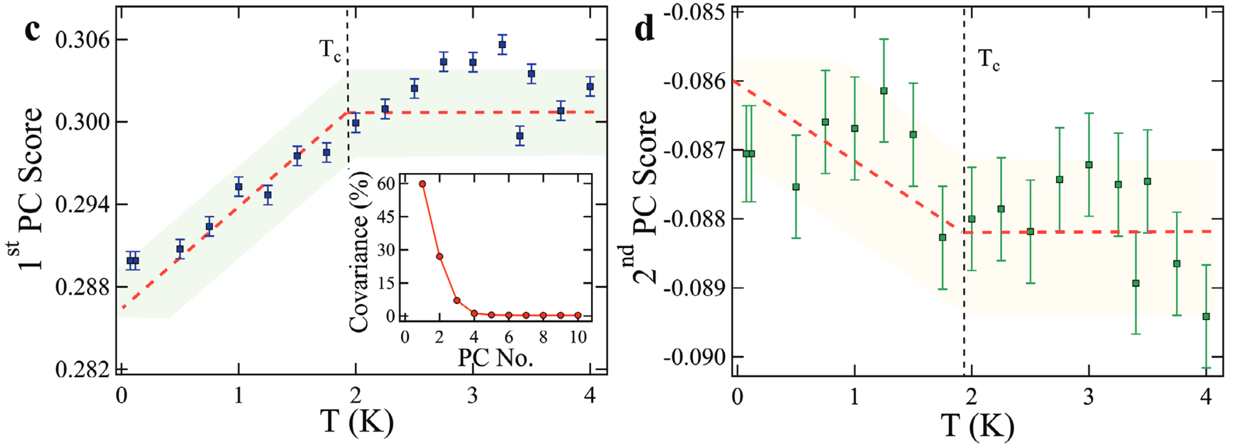
Principle Component Analysis
Model independent Analysis
Clear transition observed
Adv. Mater. 2025, 37, 2415721

Slide 14
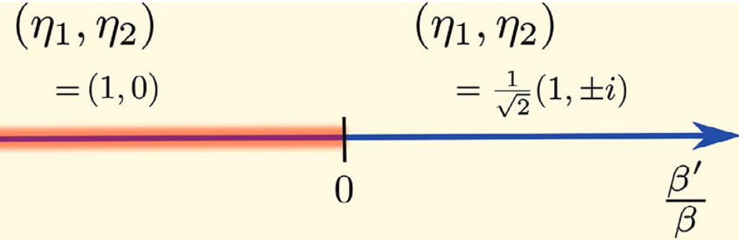
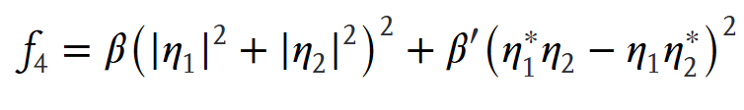

Symmetry Analysis
HfRhGe – D_{3h} point group
Irreducible Representation
Four 1-D
Two 2-D
Taking Ginzburg-Landau free energy
Only two symmetries allowed
Adv. Mater. 2025, 37, 2415721

Slide 15





Superconducting order parameter
Assuming Strong SOC
E’
Singlet Triplet
E’’
Singlet Triplet
Note: d⁽¹⁾ and d⁽²⁾ are non-unitary c.f. LaNiC₂ and LaNiGa₂
Non-Centrosymmetric with strong Spin Orbit Coupling allows mixed singlet and triplet
Adv. Mater. 2025, 37, 2415721

Slide 16
Superconducting order parameter
Assuming Strong SOC
E’
Singlet Triplet
Gives Point Nodes: θ = 0 and π
E’’
Singlet Triplet
Gives Point Nodes: θ = 0, π/2, π
Umm… but experimental evidence strongly suggests fully gap s-wave
Adv. Mater. 2025, 37, 2415721

Slide 17
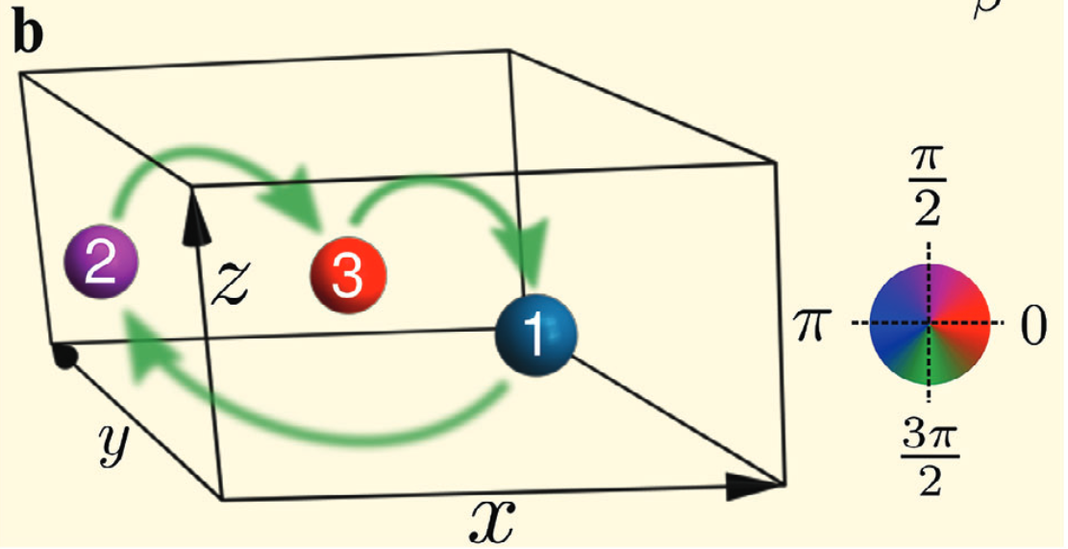

Reconciling Theory and experimental
Electronic band structure calculations suggest multi-band nature
A loop supercurrent order mechanism is proposed
Needs several symmetry related sites
Can explain Time reversal symmetry breaking
Gives real space pairing –Singlet!
Adv. Mater. 2025, 37, 2415721

Slide 18
Conclusions
HfRhGe is a rare example of a noncentrosymmetric Weyl semimetal that exhibits:
Bulk superconductivity with a fully gapped, weak-coupling s-wave gap
Spontaneous time-reversal symmetry breaking (TRSB) below Tc, confirmed via ZF-μSR
Symmetry analysis rules out conventional TRSB states (singlet/triplet/mixed), which are nodal, contradicting the observed isotropic gap
Combining Theory and Experiments supports a loop supercurrent state, a multiband, TRSB superconducting state with internal Josephson currents but no gap nodes
The coexistence of
Topological Weyl nodes
TRSB superconductivity
Positions HfRhGe as a compelling platform for topological superconductivity and intrinsic superconducting diode effect (SDE)
Future work: High-quality single crystals, directional transport measurements, and phase-sensitive probes will be crucial to uncover nonreciprocal effects and fully map the topological SC state
Adv. Mater. 2025, 37, 2415721

Slide 19
Acknowledgments
Sajilesh. K. P., Roshan Kumar Kushwaha, Dibyendu Samanta, Pavan Kumar Meena, Shashank Srivastava, Deepak Singh, Ravi Prakash Singh
IISER Bhopal, India
Tymoteusz Tula,
Université de Sherbrooke, Canada
Amit Kanigel,
Technion-Israel Institute of Technology
Sudeep Kumar Ghosh
Indian Institute of Technology
Funding: SERB (India), UGC, (Government of India), IIT Kanpur Andromeda server and STFC for beamtime

Slide 21
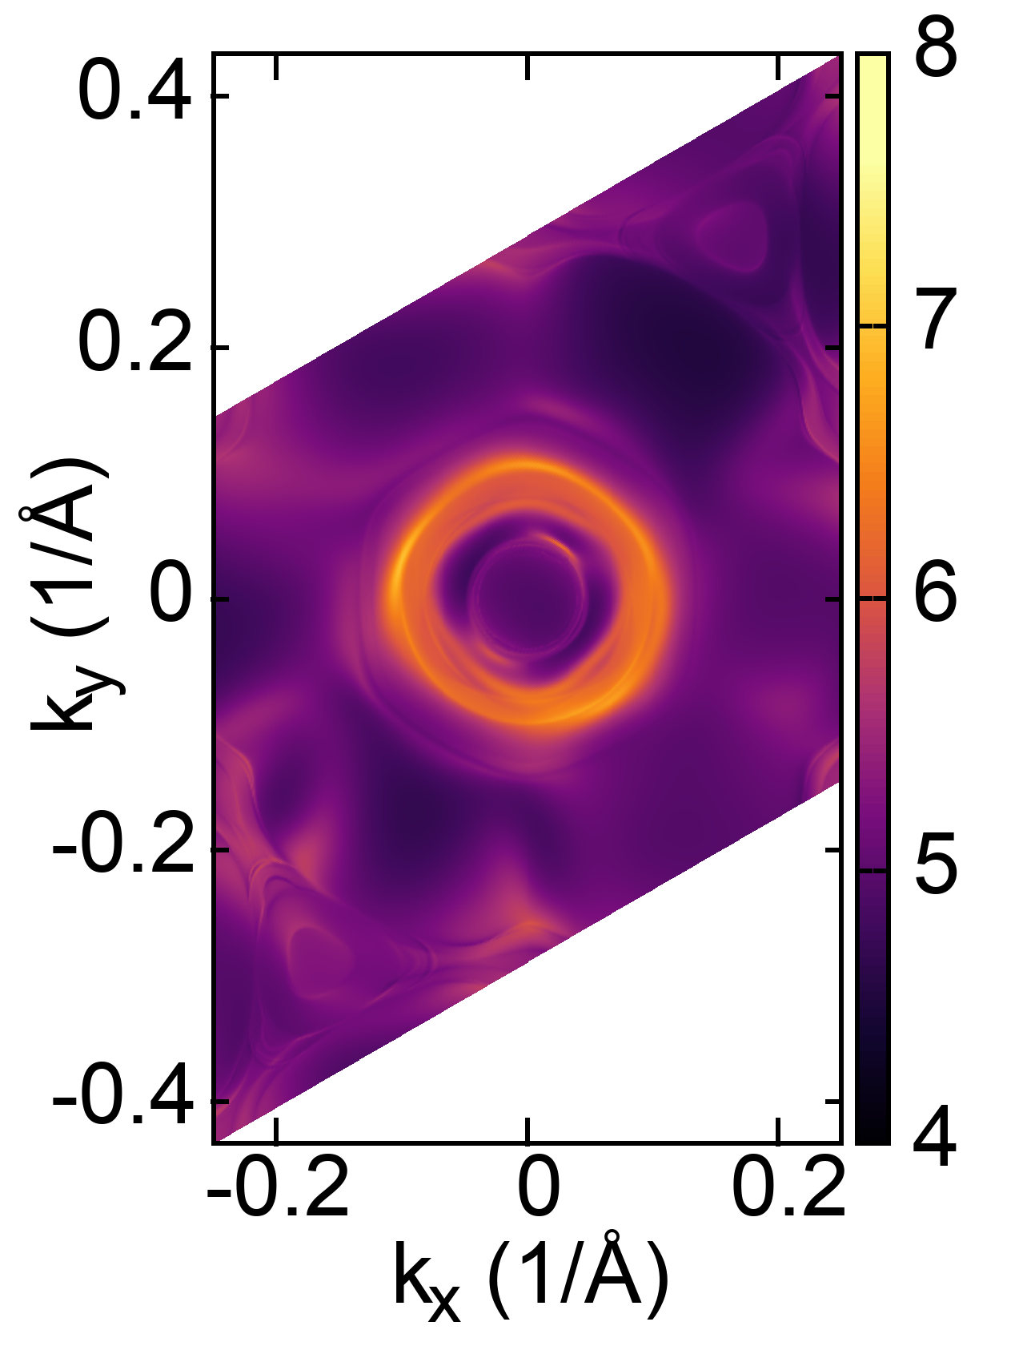
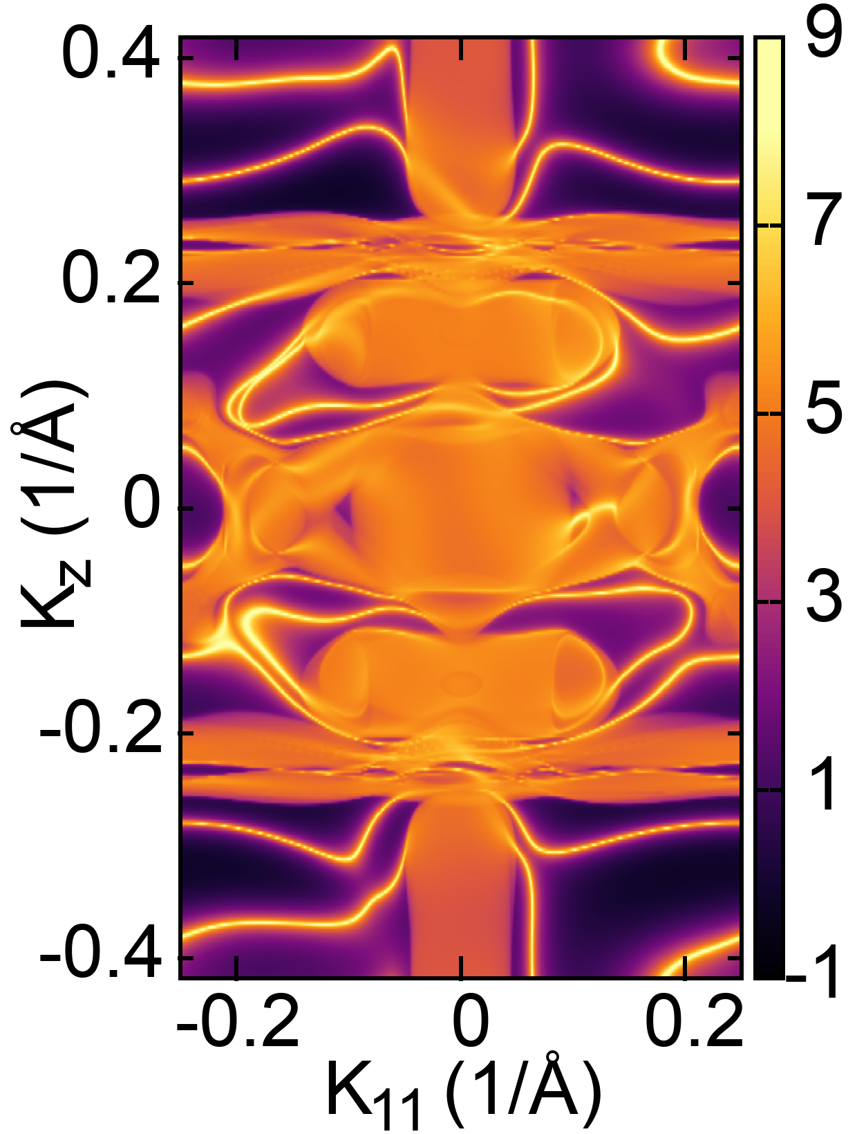
Electronic Structure & Topology
• Topological Features:
Multiple Weyl points (positive (red dots)/negative (blue dots) chirality) in BZ
Surface Fermi arcs on (001), (100), and (110) planes
Surface energy spectra at the constant energy = – 0.216 eV projected onto the (001) and (110) surface Brillouin zones. Here, k₁₁ denotes the direction along the k_{y} = −k_{x} line
Adv. Mater. 2025, 37, 2415721

Slide 22
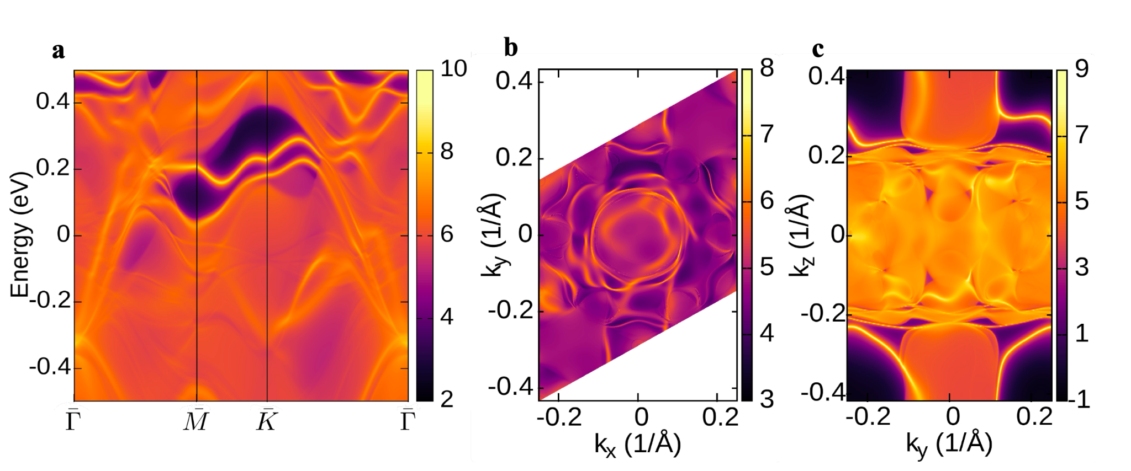
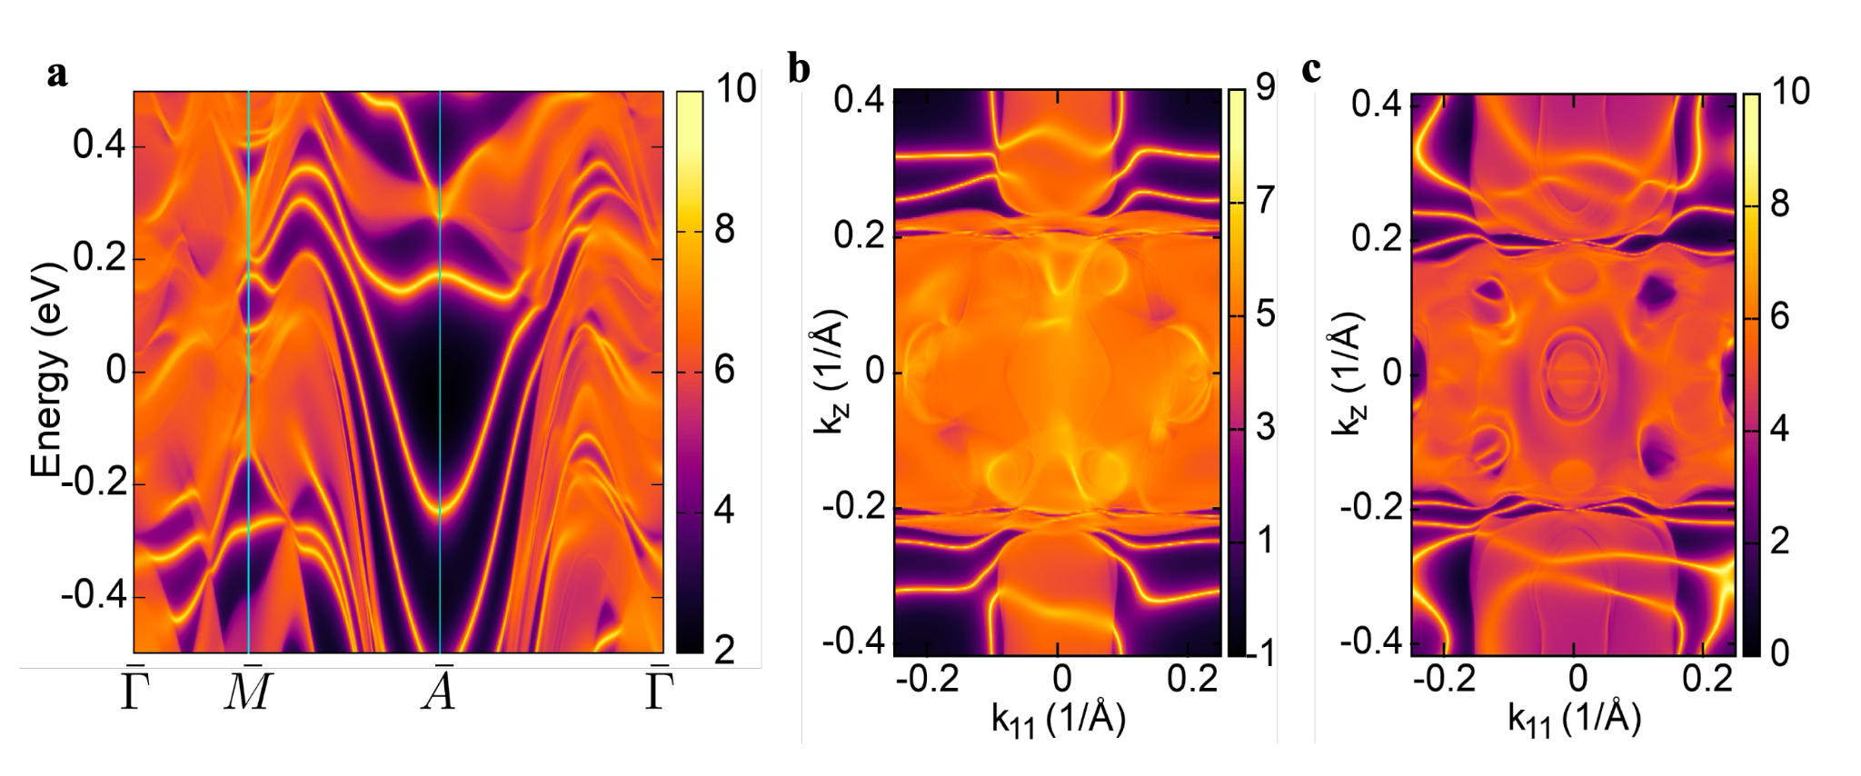
Maximally localized Wannier functions (MLWFs) were computed for a precise representation of electronic structure, using WANNIER90 package.
Using these MLWFs, the Fermi surfaces were calculated for six bands crossing the fermi energy, and side views of these fermi surface sheets with SOC are shown in the Fig1.
Further the surface state projections onto (001), (100), (110), were calculated using WANNIER TOOLS package.
Fig1.
The surface spectrum of HfRhGe, projected onto (100) along high symmetry points, is shown in Fig 2a., while constant energy (0.022eV) Fermi arcs projected on (001) and (100) surfaces are shown in Fig2b and Fig2c respectively.
Figure 3a. illustrates the energy dispersion on (110) surface Brillouin zone while constant energy fermi arcs at -0.07 eV and 0.14 eV are shown in Figure 3b and Figure 3c respectively.
Fig2.
Fig3.

