Slide 1
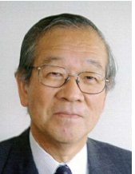
Farewell to Toshi Yamazaki
16th MuSR Conference at St. Jones
K. Nagamine
U. Tokyo, KEK, RIKEN
Died Jan 31 2025

Slide 2
Toshi Ysmazaki Scientific Achievement
Report of Japan Science Academy
1．Discovery of meson-exchange effect in nuclear moment 1966-73
2．Development of Muon Spin Rotation, Relaxation（μSR） 1973-89
3．Discovery of quasi-stable pHe and anti-matter science1989-2003
4．Deeply bound pionic atom physics
5．High-density K mesic atom and super-strong nuclear force
6．Discovery of high-density Kaonic atom
7．Ｋmesic Proton matter (KPM) prediction and investigation
Toshi and Ken collaboration was atarted in 1970, for nuclear physics studies of muonic atom with polarized nuclear targets.

Slide 3
Pointing–out of
Zero-Field Muon Spin Relaxation Sensitivity to Slow matter-relaxation
Spin-dynamix detection in Spin Glass
Qoantum Diffusionof μ⁺ in Metal
Anti-ferro magnetism in High Tc related materials
Notes:
Zero- and Low-Field Spin Relaxation Studied by Positive Muons. R.S. Hayano, Y.J. Uemura, J. Imazato, N. Nishida, T. Yamazaki and R. Kubo, Phys. Rev. B20 (1979) 850.

Slide 4
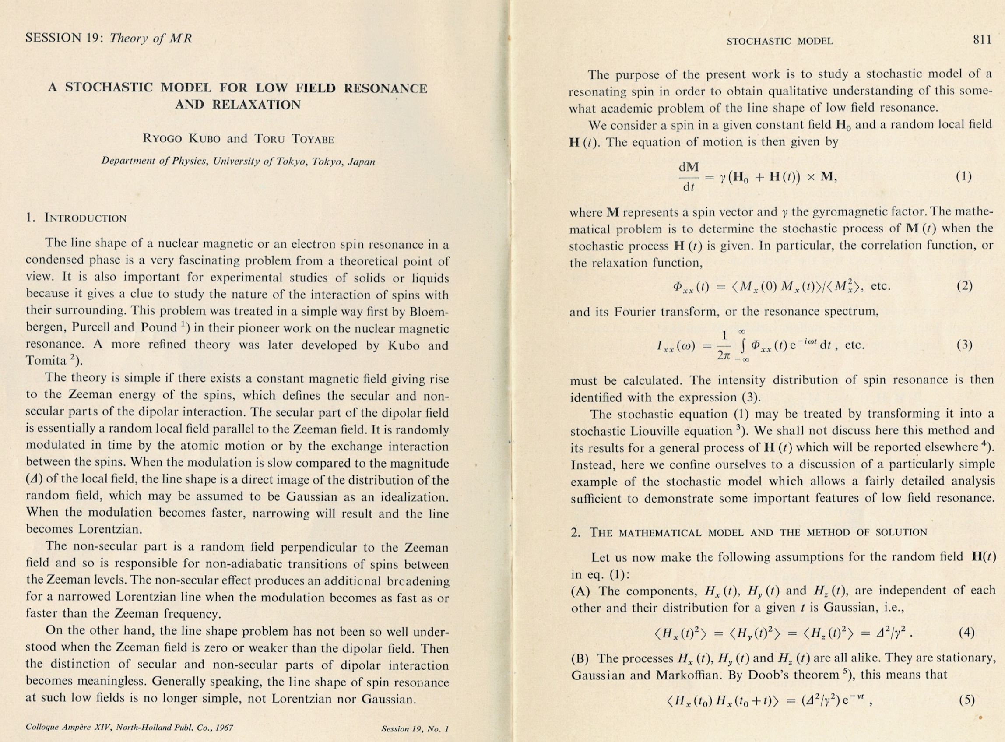
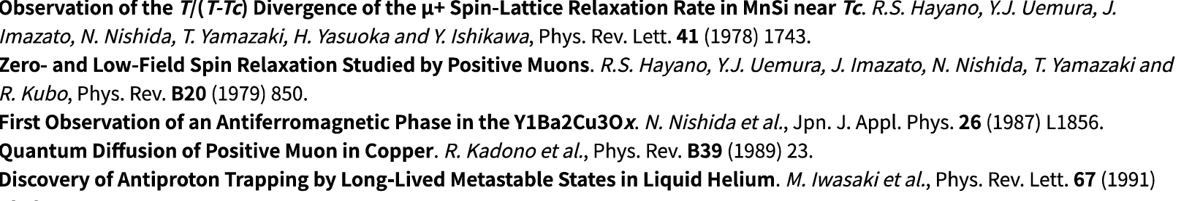
Kubo-Toyabe theory applied to MuSR by Toshi Yamazaki

Slide 5
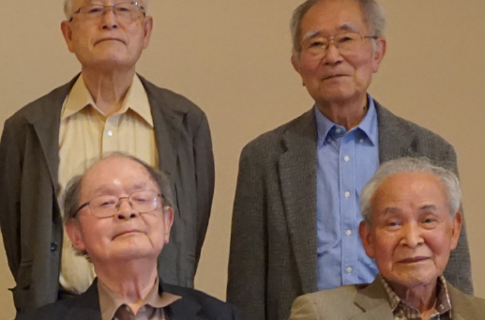
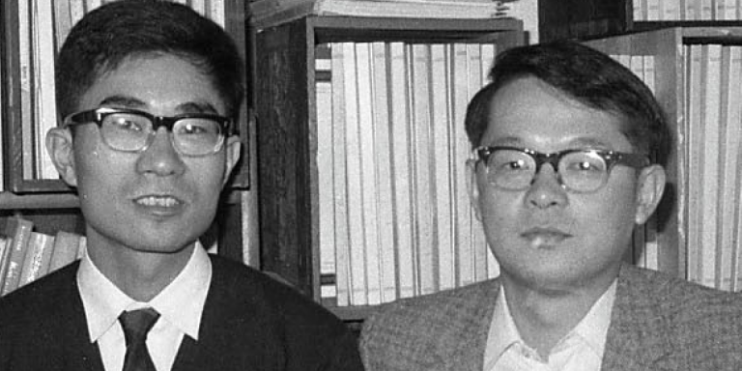
Toru Toyabe and KN are Good Friend since 1959 same class and next seat
In 1965 In April 2025, at old-boys assembly
at Toyabe’s Master Thesis writing
KN
KN
TT
TT
TT

Slide 6
Development of Meson Science like μSR
Pointing –out of Zero-Field Muon Spin Relaxation isensitivity to Slow matter-relaxation and apply to he study of μ⁺ Quantum Diffusion, Spin glass, High Tc SC, etc.
Development of the world-first pulsed muon facility at UT-KEK meson science laboratory and stating of user-community creation.

Slide 7
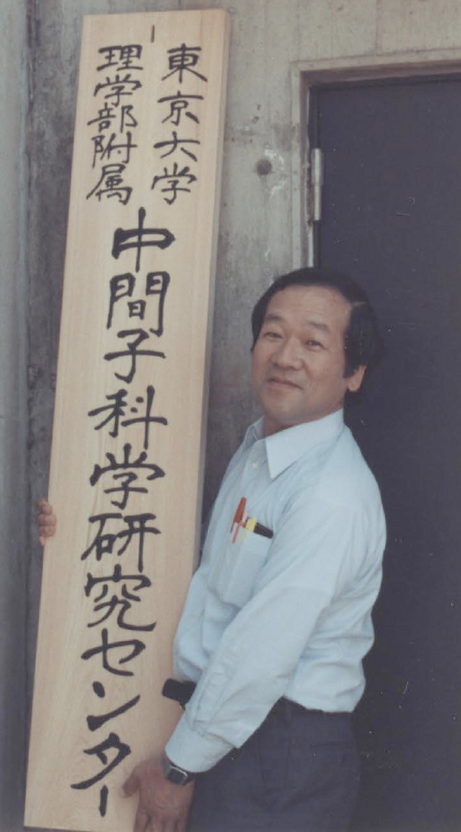
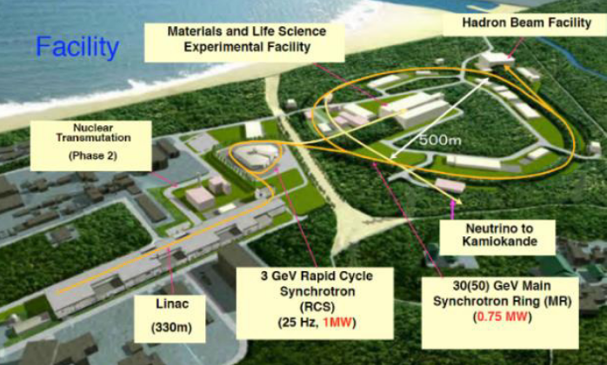
Opening of
Meson Science Lab, Univ. Tokyo
In April 1979
The First Pulsed Muon
J-PARC MUSE
In Aprl 2020
The Strongest Pulsed Muon
K. Nagamine, “Pulsed µSR Facility at KEK-BOOSTER”, Hyperfine Interactions 8 (1981) 787.
Reporting the successful construction of the first Pulsed Muon Facility in the world by his group.

Slide 8
Farewell to
Toshi Yamazaki

