Slide 1
ISIS Muon Facility Report
Adrian Hillier, ISIS Muon Group
MUSR2025 St John’s Canada
July 2025

Slide 2


New ISIS Director
Notes:
This year we are celebrating 40 years of ISIS operation. Forty years characterised by scientific excellence, technical innovation and leadership. 40 years that includes 35,000 proposals to use the facility; 80,000 instrument days delivered; 60,000 user visits from 40 countries; and over 15,000 publications.
ISIS is a world-leading asset for UK science and has the potential to continue to be, well into the future.

Slide 3
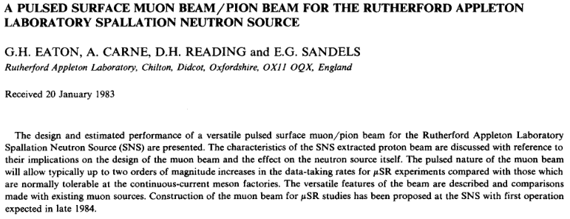
Over Forty Years ago – Muons @ISIS

Slide 4
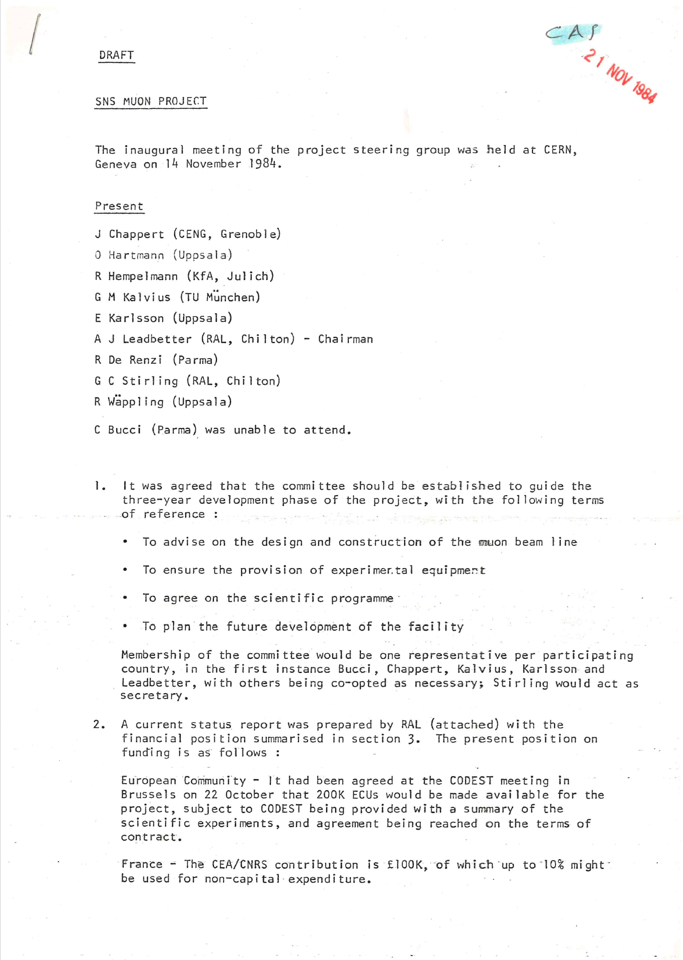
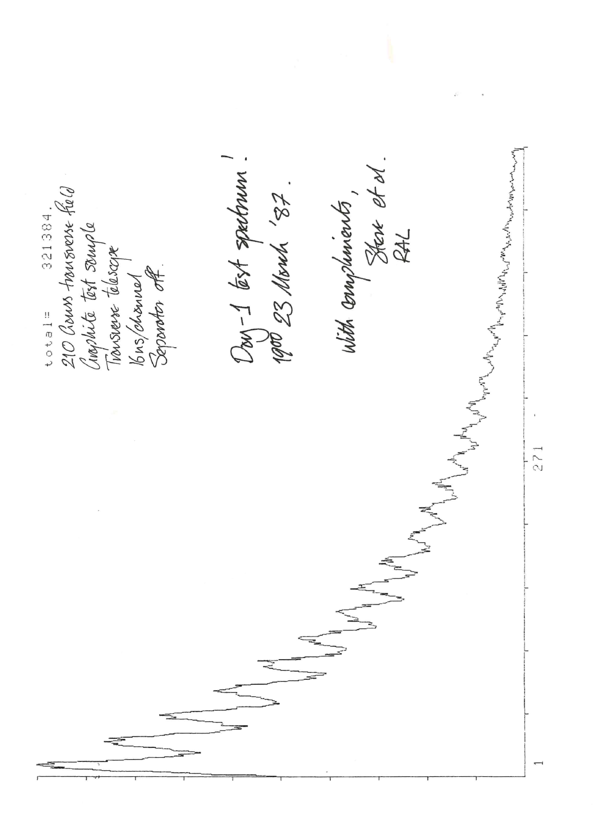
40 years since the inception of muons
14 November 1984 – first meeting to discuss the concept of muons at ISIS
2.5 years later first muons

Slide 5
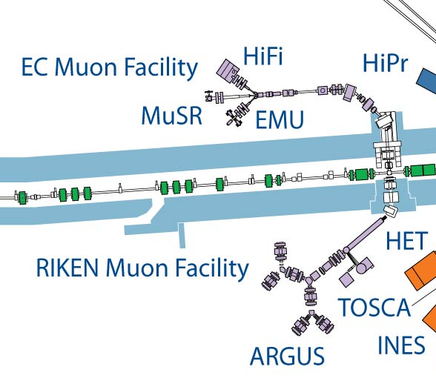
The ISIS Muon Facility
EC Muons
Fixed Momentum Muons ~27MeV/c
Positive muons
Longitudinal fields upto 5 T
Transverse fields upto 600+ G (pulse width limited)
Temperature range 30mK – 2000K
Laser excitation
Pulsed techniques e.g. RF, EF, Light, ac susceptibility
RIKEN-RAL
Variable Momentum Muons ~15 – 120 MeV/c
Positive or negative muons
Longitudinal fields up to 0.4 T
Transverse fields up to 600+ G (pulse width limited)
Temperature range 300mK – 500K
Pressure
Elemental Analysis
Ports for long term experiments
e.g. proton charge radius experiment
MuX/MEIS

Slide 6
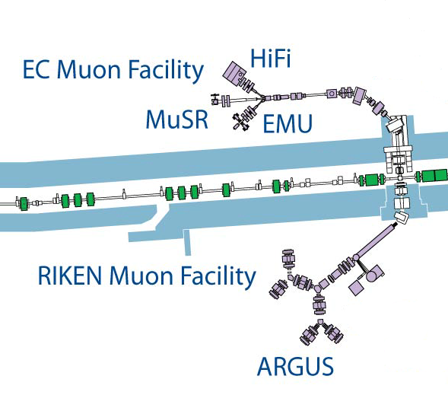
ISIS Muon Instrument Suite
Instrument | Detectors | Rate (MEv/h) [Double pulse]
ARGUS | 192 | 50 [100]
EMU | 96 | 150
HiFi | 64 | 80
MuSR | 64 | 70
Surface muons
Also, on the ISIS RIKEN-RAL beamlines:
Negative muon elemental analysis – MuX
Effects of Muons on electronics - MEIS
FAMU muonic hydrogen experiment – Port 1
Muon development beamline – Port 3
MuX/MEIS
Surface and decay muons

Slide 7
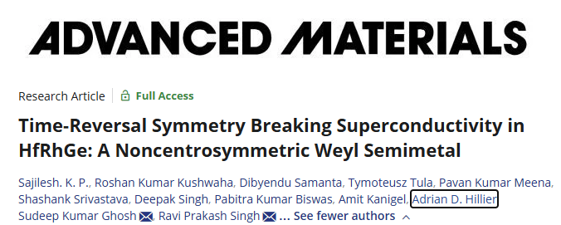

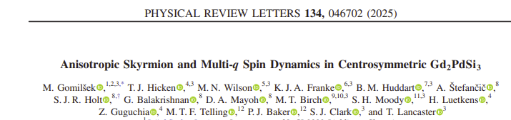

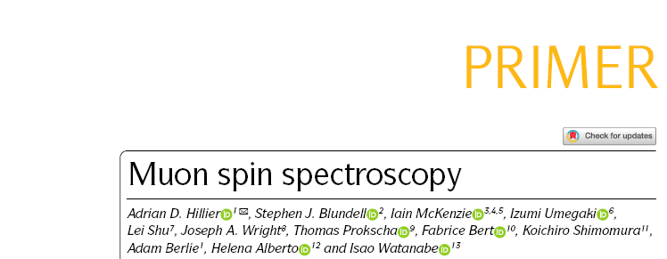
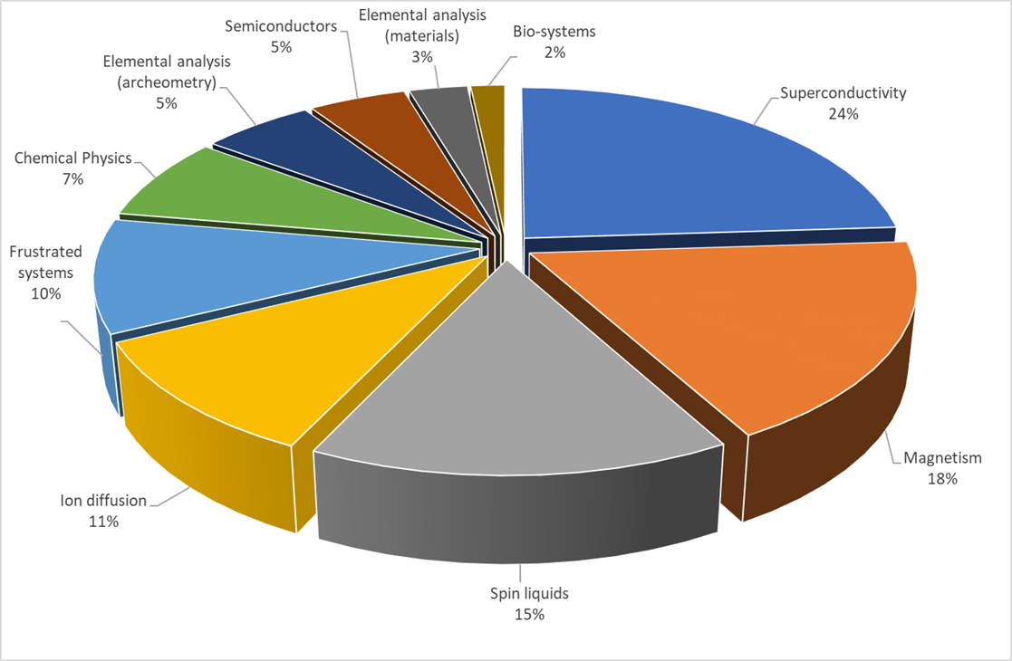
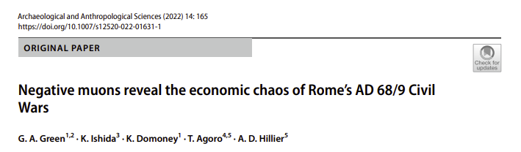
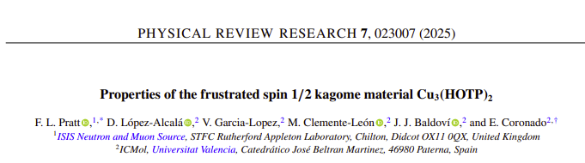
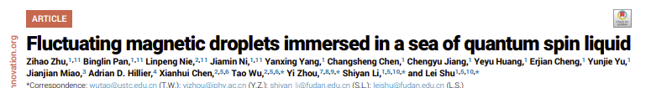
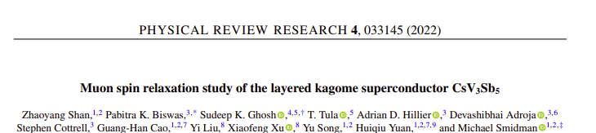
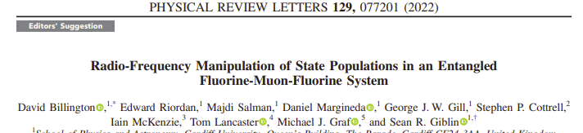
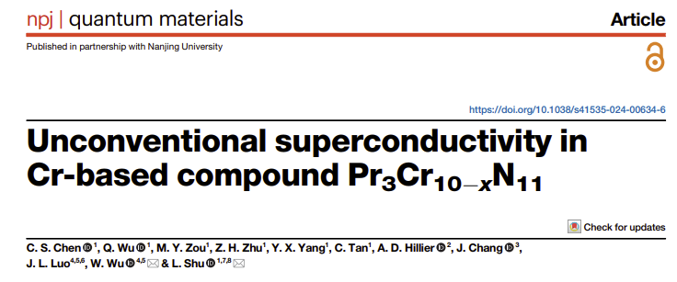
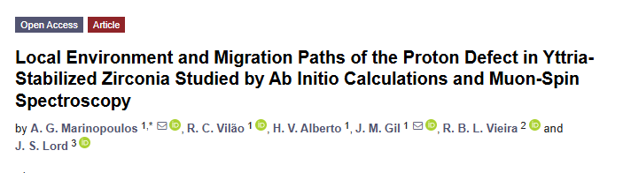
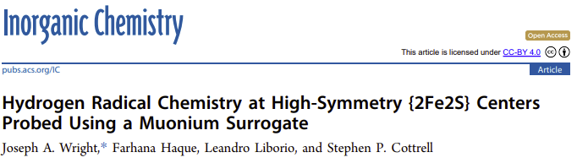
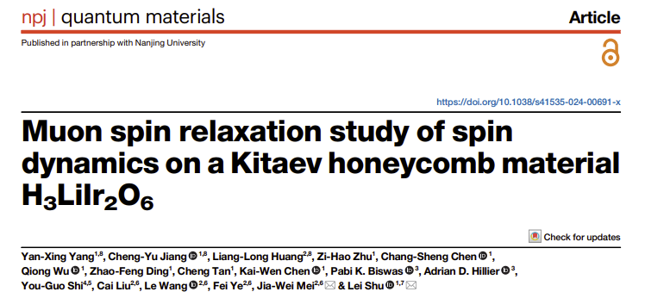
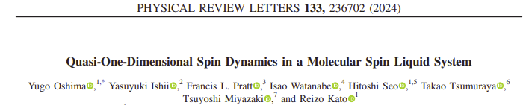
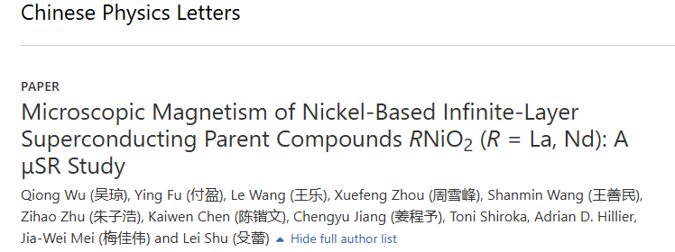
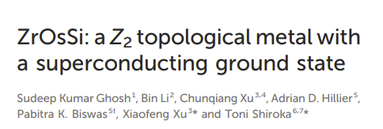
Breadth of Science

Slide 8
Recent Developments

Slide 9
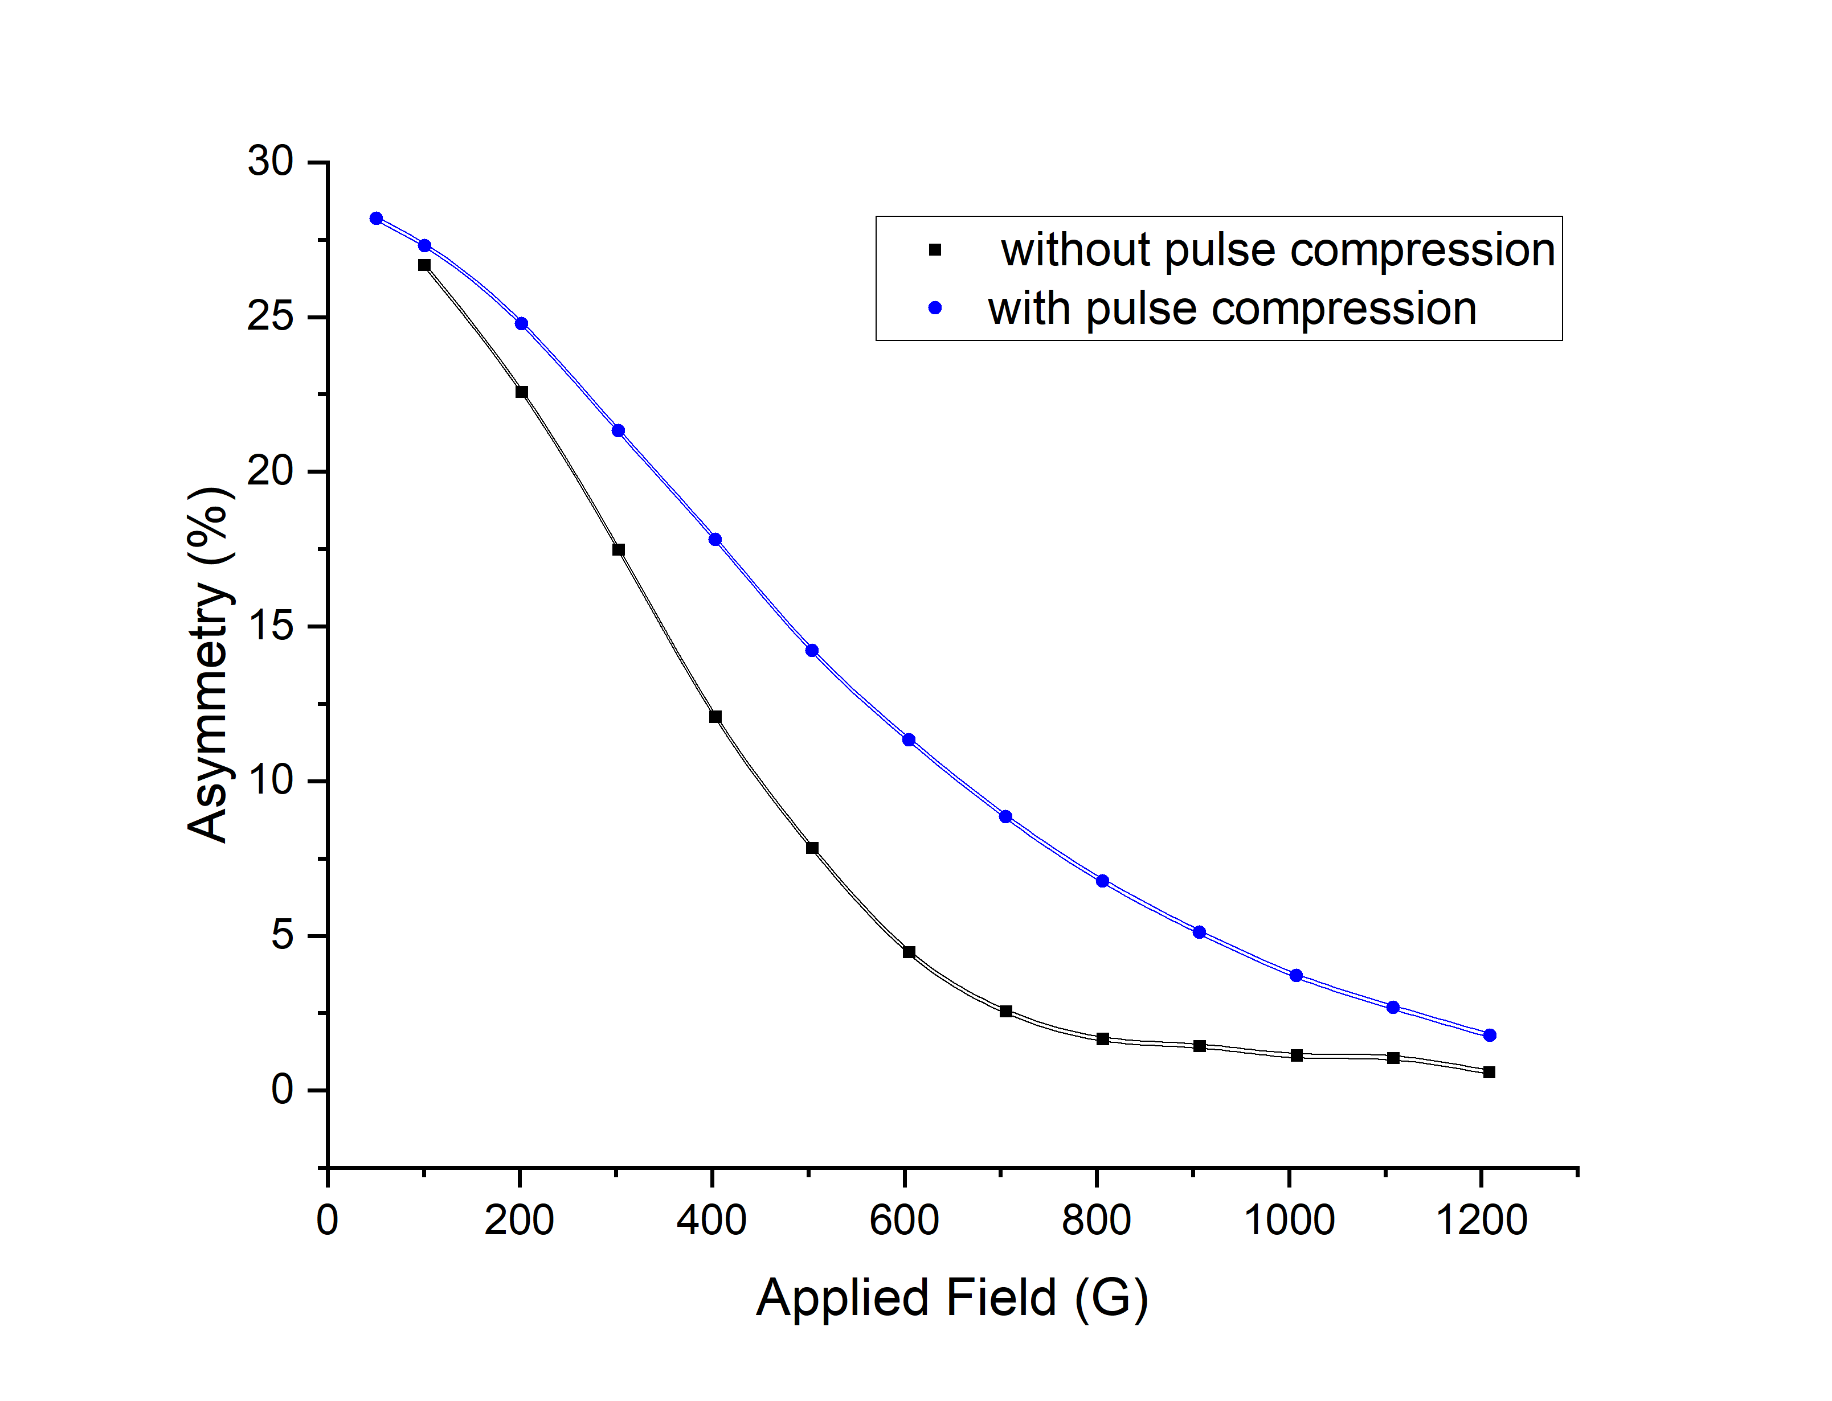
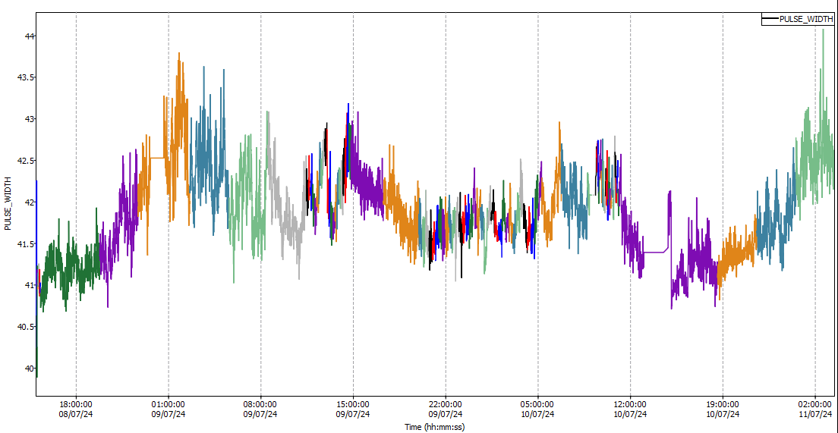
ISIS Proton Pulse Compression
Improving the performance of the muon spectrometers by optimising the proton beam
Shorter pulses give a better frequency response
Rotating phase space in the final stages of the proton acceleration reduces the pulse width (time)
Frequency response with and without pulse compression – MuSR Cycle 23/5

Slide 10
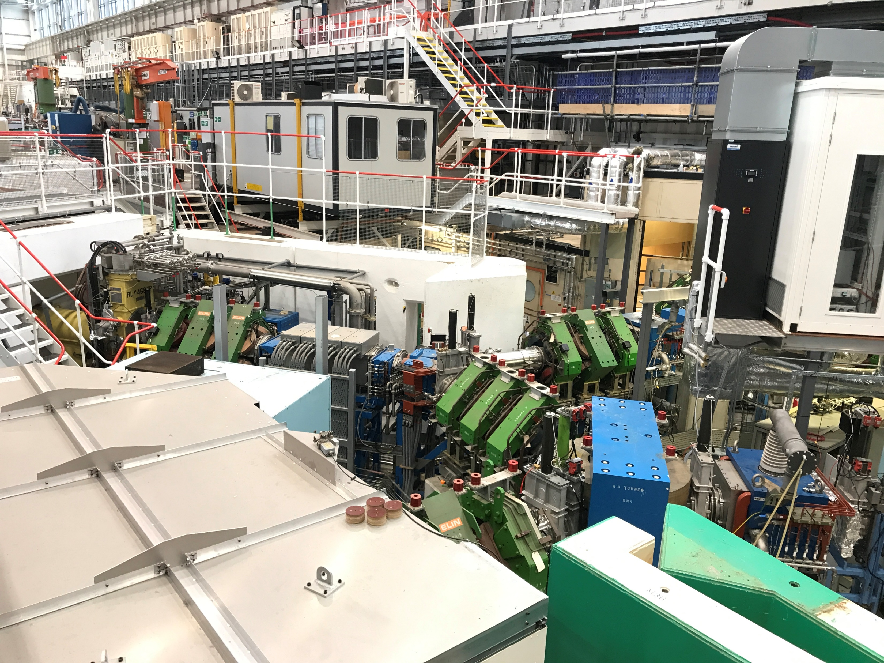
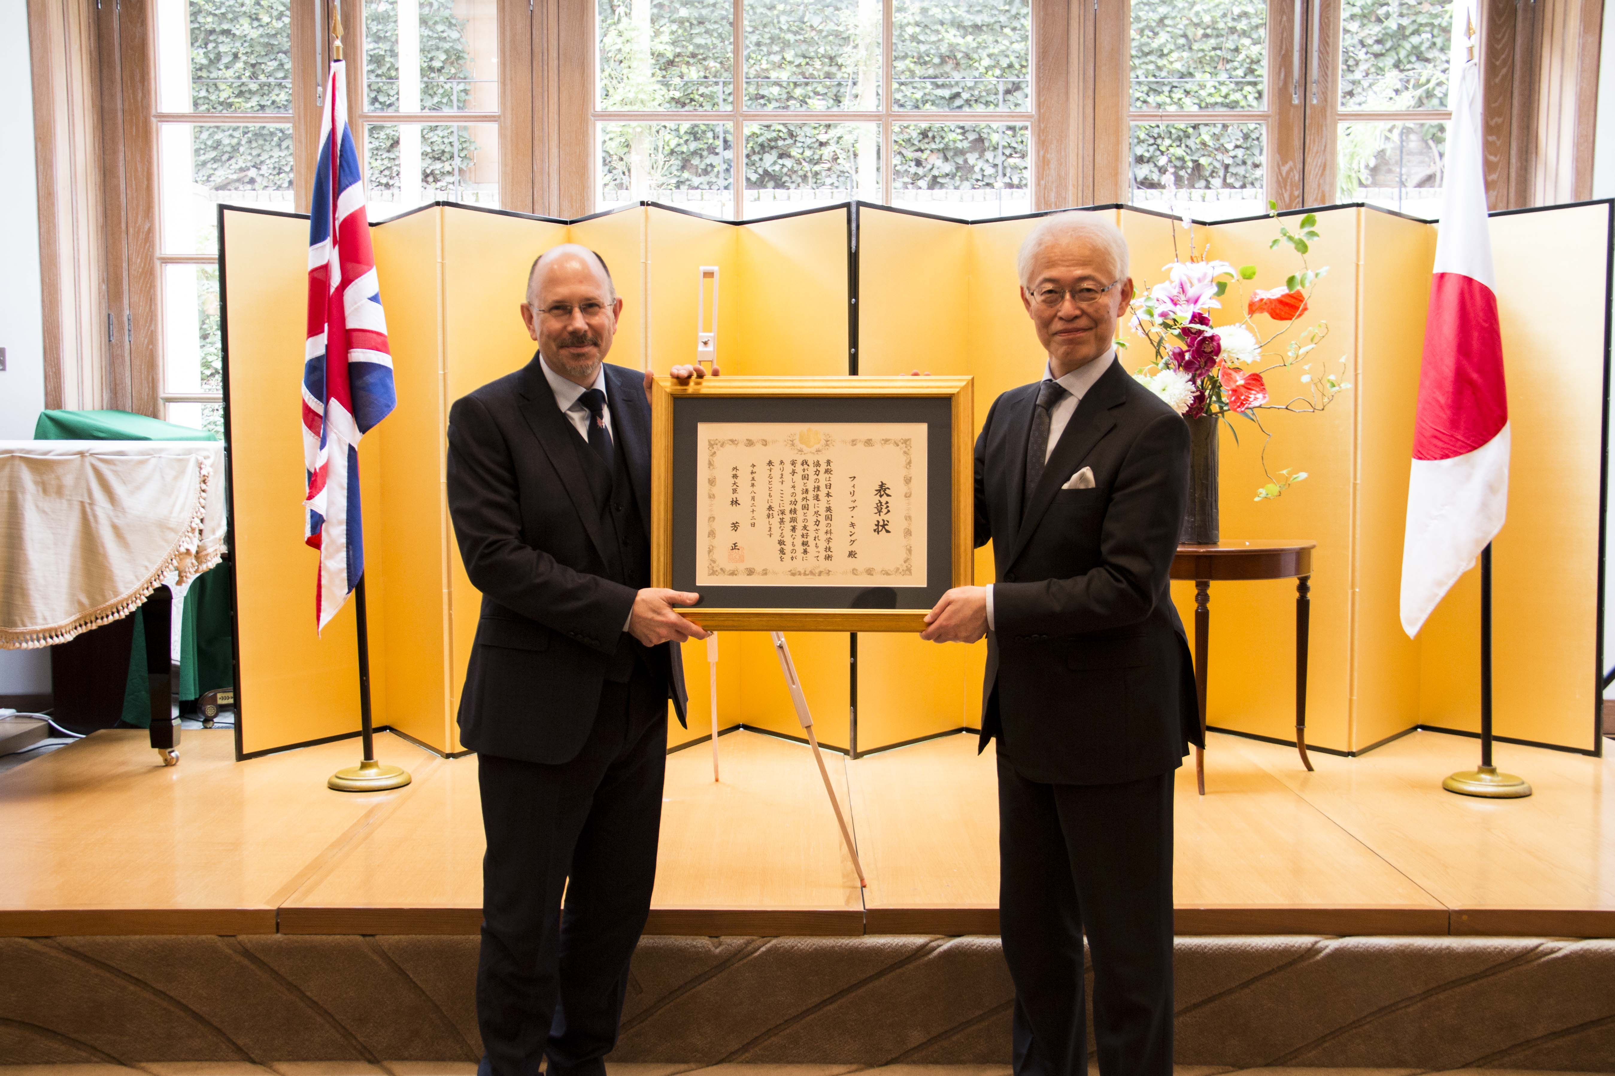

RIKEN-RAL Beamlines
Now fully Transitioned to ISIS ownership (2023)
£3.5M Refurbishment Program Complete
Instrument developments on both EC and RIKEN muons give a coherent facility
Celebrate the continuing collaboration with RIKEN

Slide 11
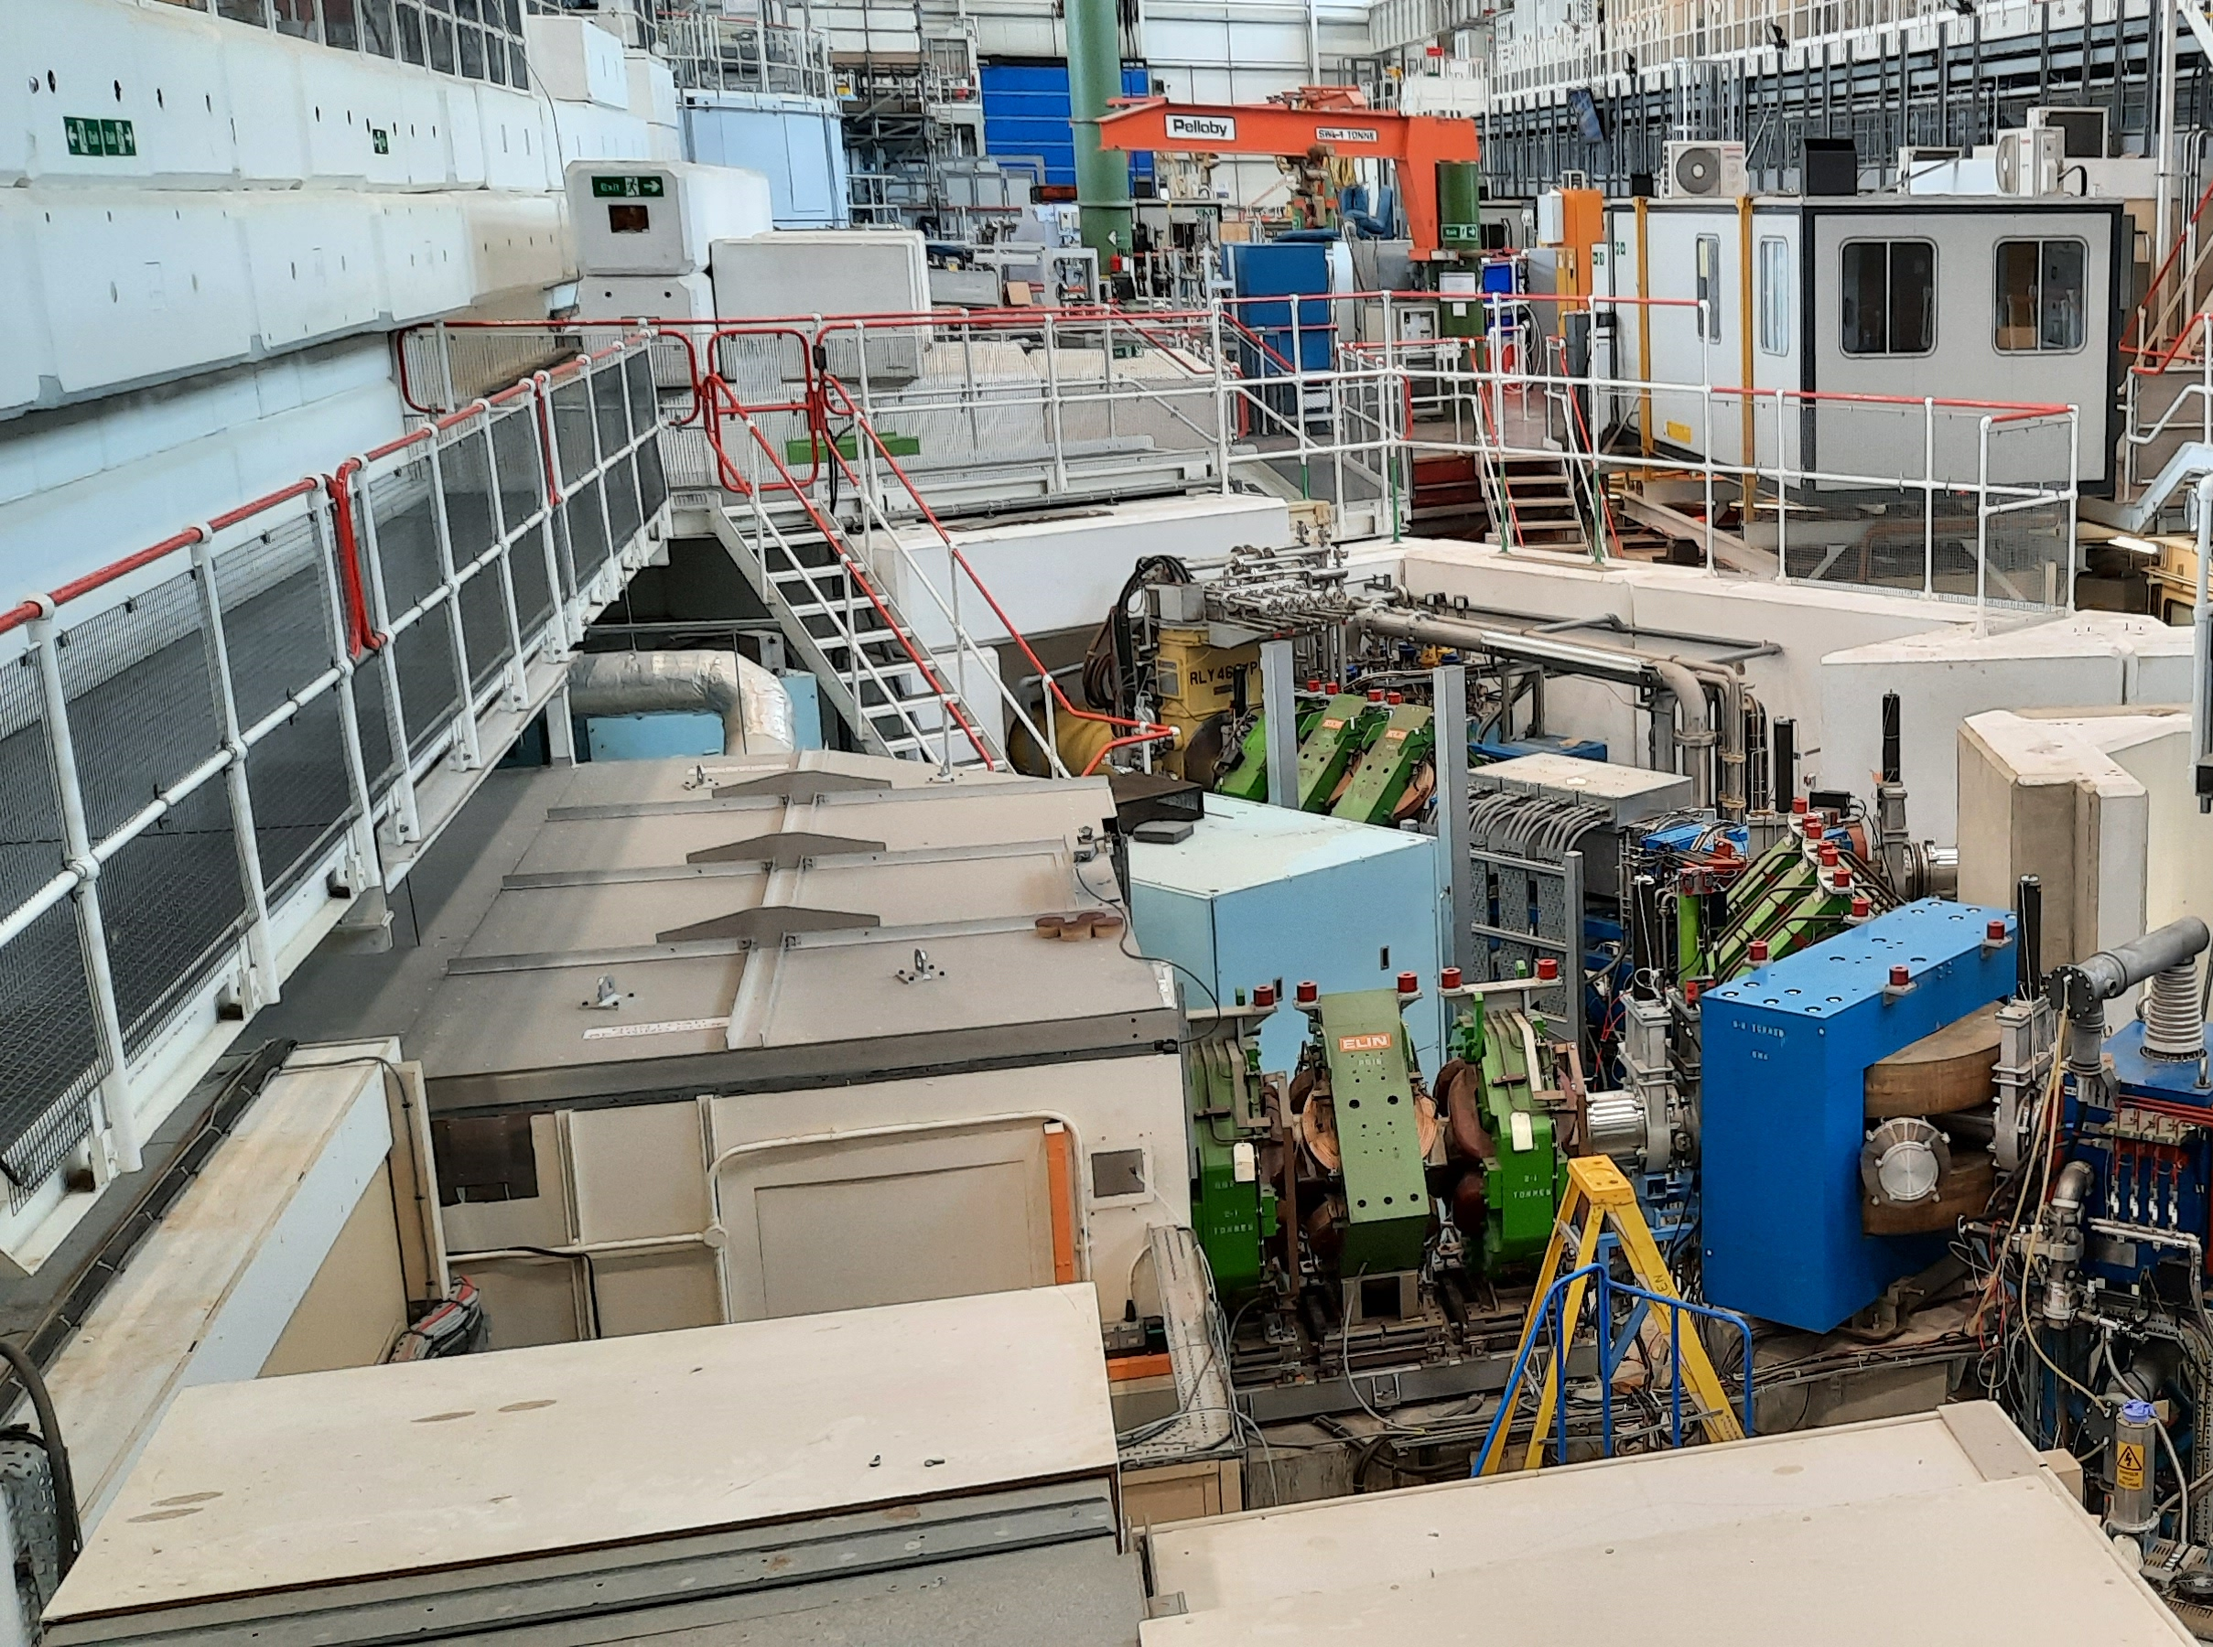
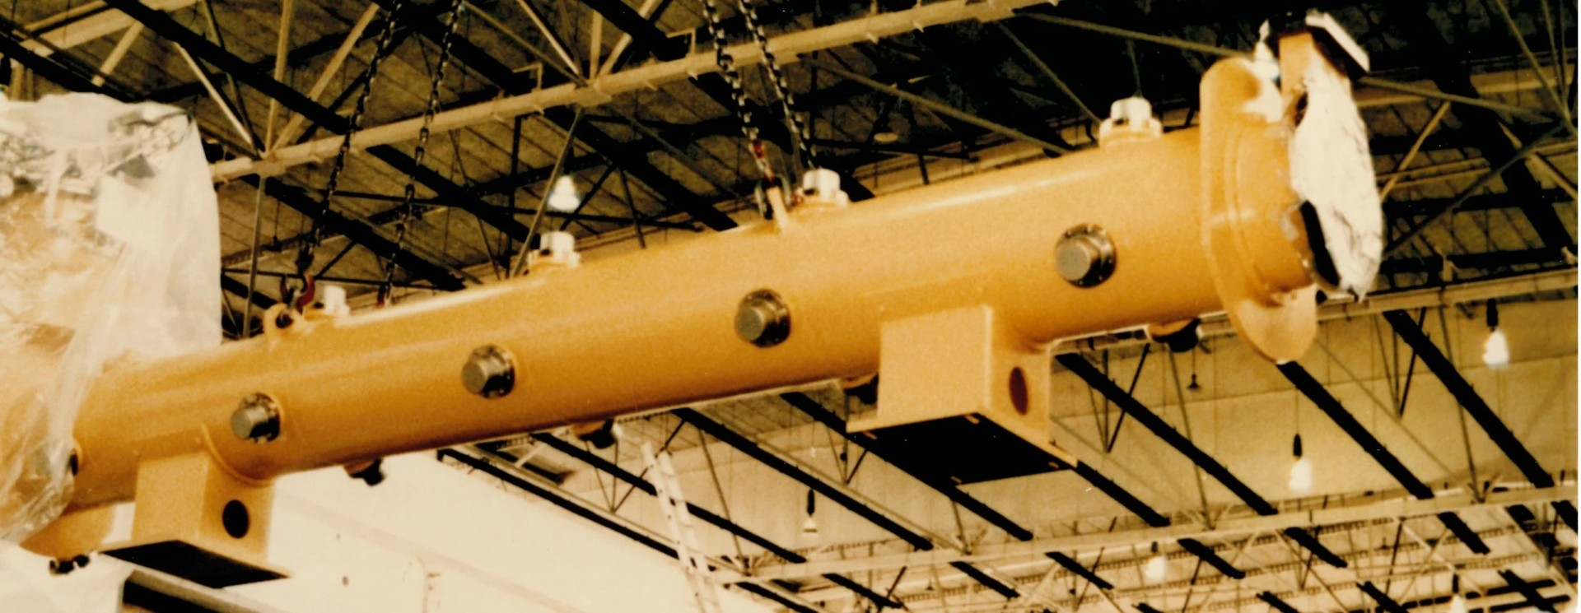
RIKEN Solenoid replacement
Still the original solenoid
Showing signs of age
Solenoid Ordered
Simple automated control
Cryogen-free
Operating costs greatly reduced
Pays for itself within 2 years
Massive reduction CO2 emissions

Slide 12
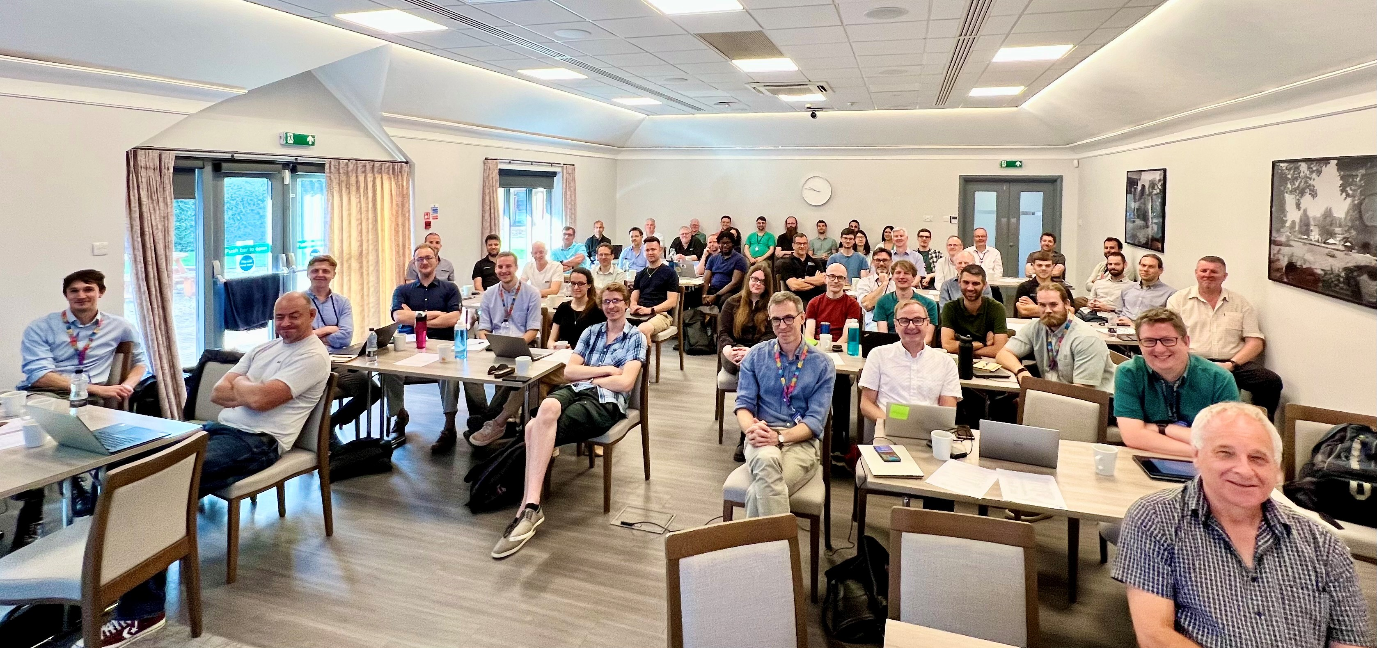
Draft phasing
Endeavour Programme Management: project phasing
Implementation Review Meeting 6th Sept 2023

Slide 13
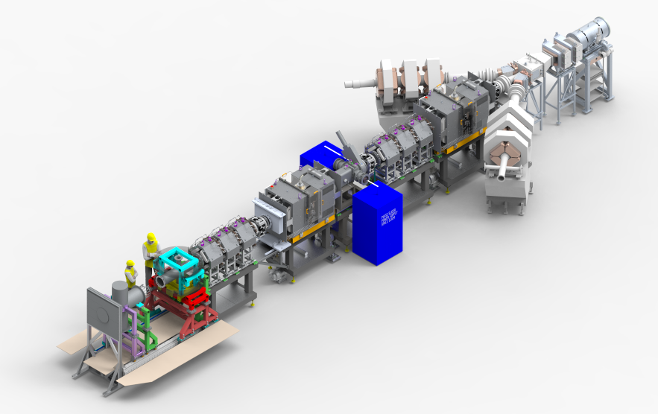
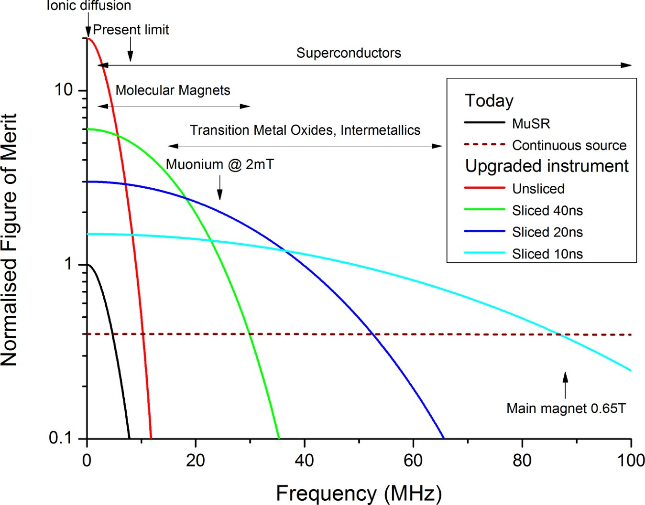
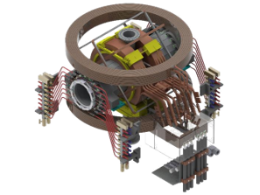
Super-MuSR
Detector and instrument improvements
Beamline improvements
Use full muon flux and maximise information per muon
New transverse magnet and cruciform with flypast tube
Better zero-field (correcting quadrupolar terms)
Pulse slicer reducing muon pulse length to ~10ns
Spin rotators allowing higher transverse field experiments

Slide 14
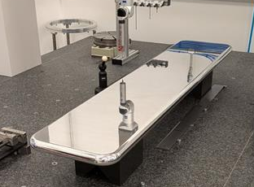
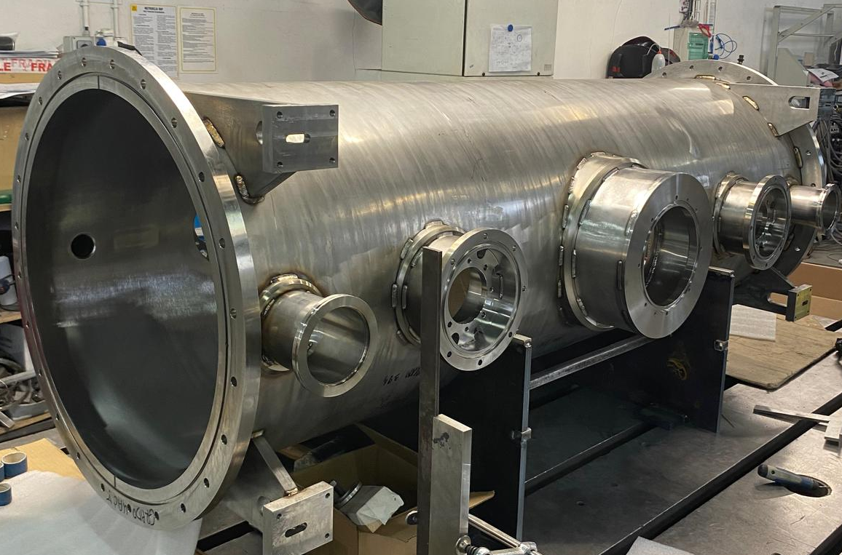
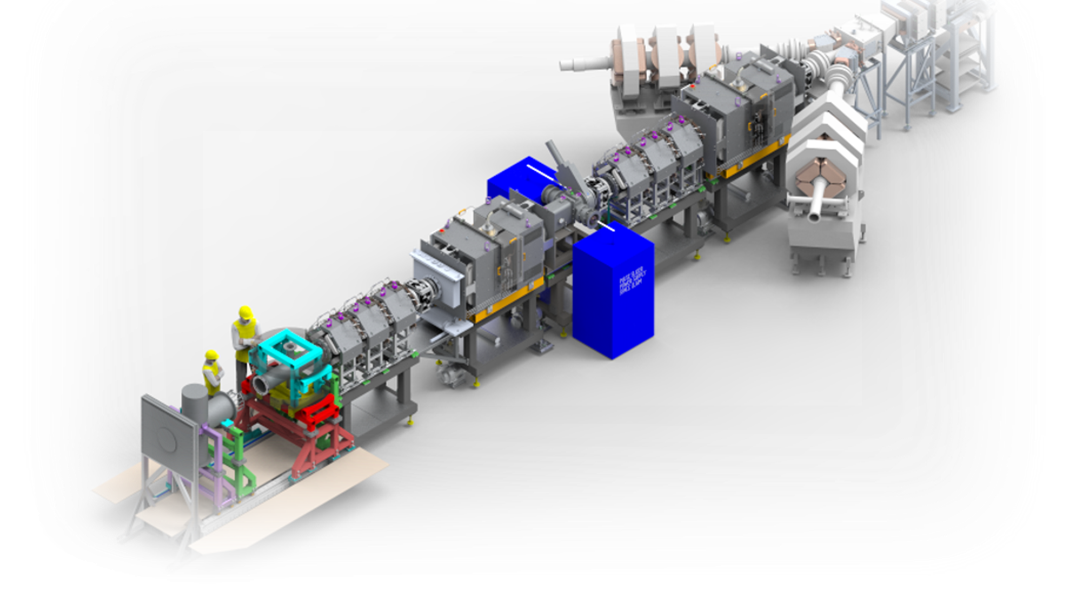
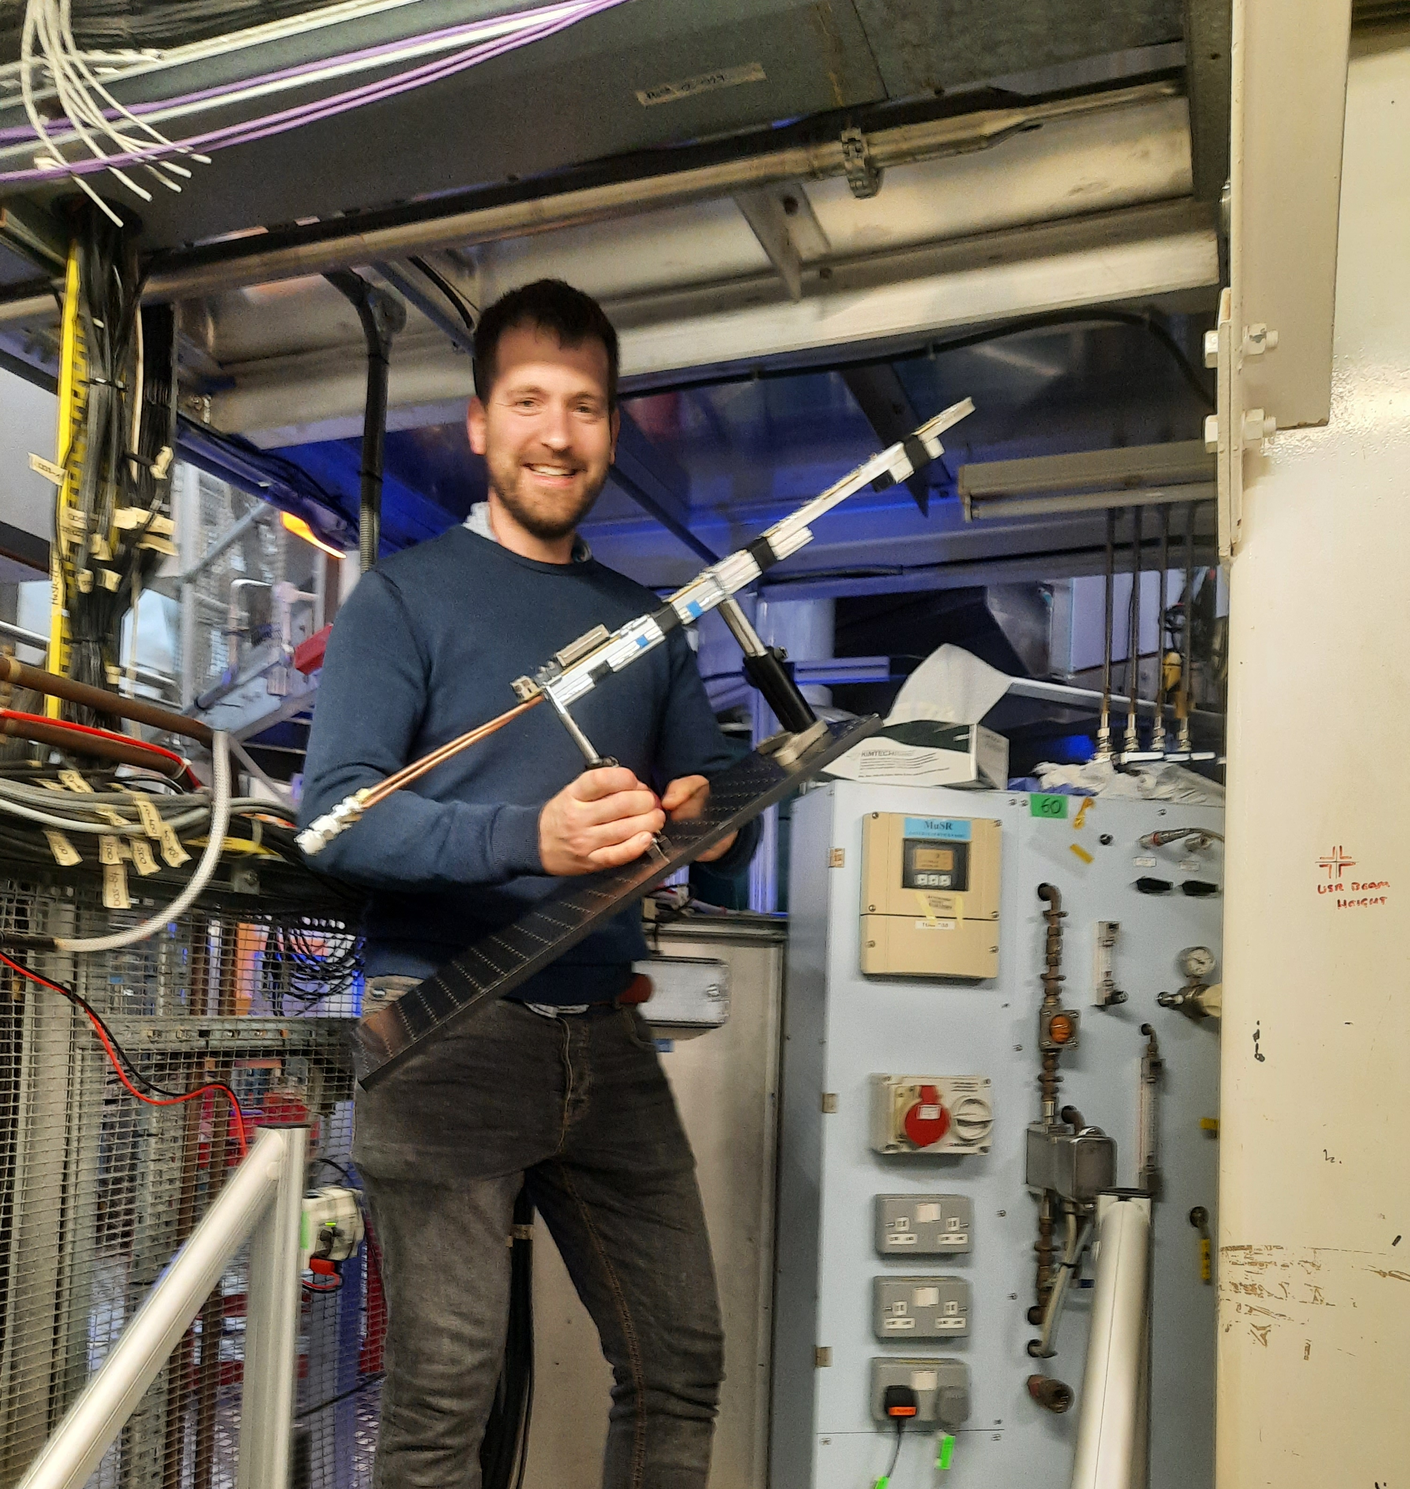
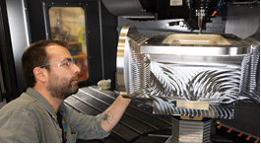
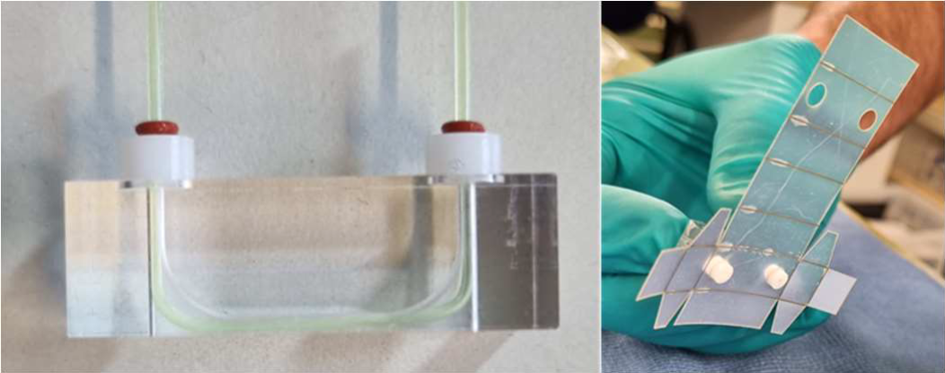
Super-MuSR
Spin Rotators in caliboration with PSI
In manufacture, with some components already delivered to site.
High voltage testing to begin in July 2025.
The project is progressing very well, with the beamline components now in manufacture and testing and new data acquisition software being tested on HIFI and MUSR.
Spectrometer
Detector R&D completed, and manufacture started in June 2025.
Spectrometer magnet design completed and now in procurement and manufacture
Spectrometer framework final design progressing well.
Pulse Slicer
Design completed, components in manufacture and assembly due to be completed in June 2025.
Testing of the pulse slicer and pulse slicer power supply is underway.

Slide 15
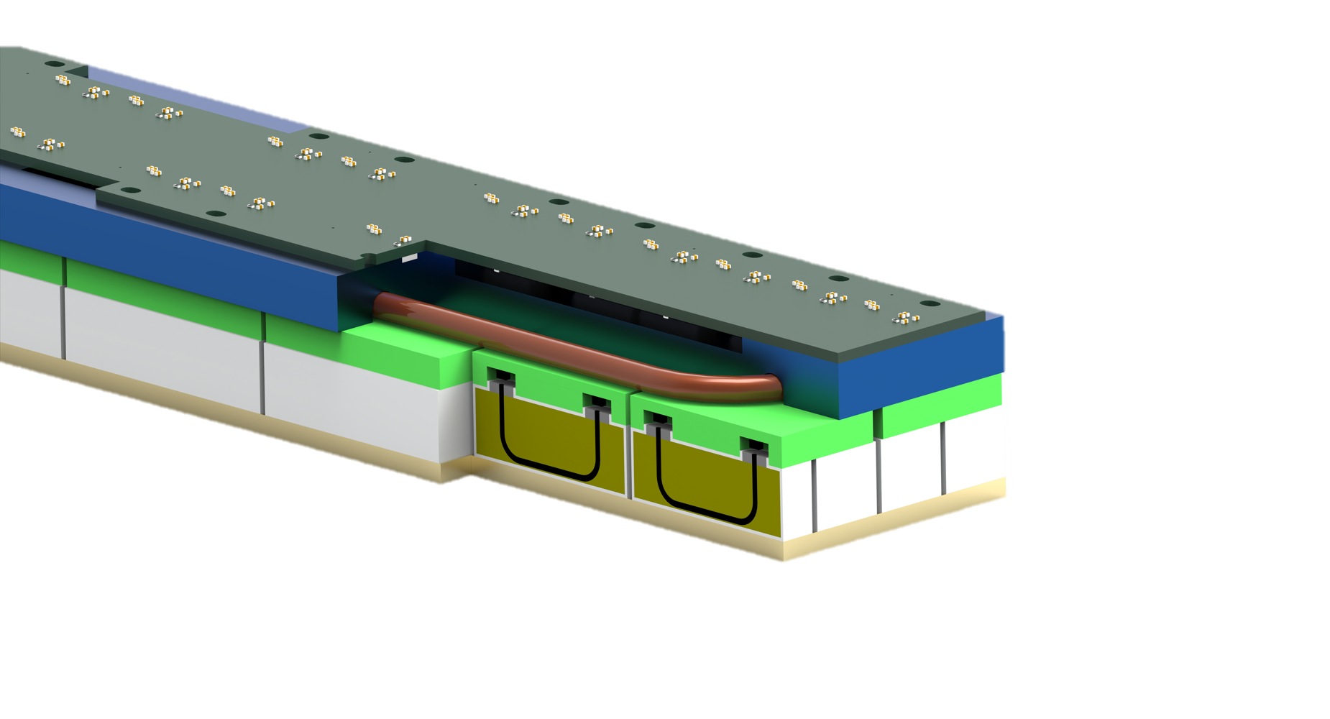

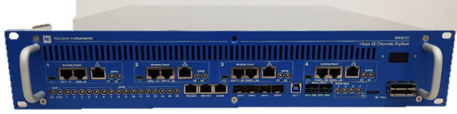
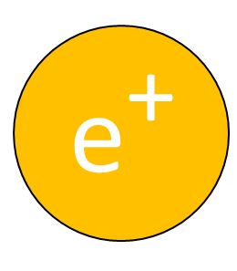
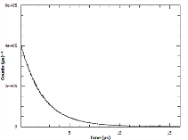

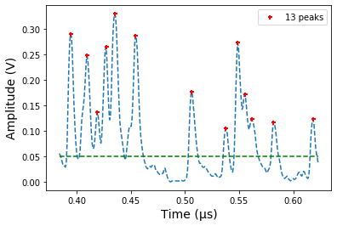



Digital Muons
Signals are streamed directly to a broker
Lots of particles arrive at the detector
NI DAQ 121
2024: SCD Ada Lovelace Centre
Data Analysis & Retention
Event Filtering
Event Formation Unit
Creation of .nxs files and archiving
Power Signal Processing: options from peak-finders to Machine Learning.
Flexibly select the events that are important for analysis. Filter on parameters such as sample temperature or laser status.
Notes:
"The design of this pipeline is strongly influenced on the ESS streaming based data acquisition architecture, which was a collaborative project between the ESS DMSC and ISIS."
worth highlighting
that fact that the core of the architecture is the same as what was done for the ESS and
b) the fact that we are using off the shelf, standard, open source technologies wherever possible.
A large benefit is using the skills ISIS has from the ESS collaboration and taking advantage of standard/off the shelf software solutions where possible
Contact Dan Nixon / Dan Kirk

Slide 16
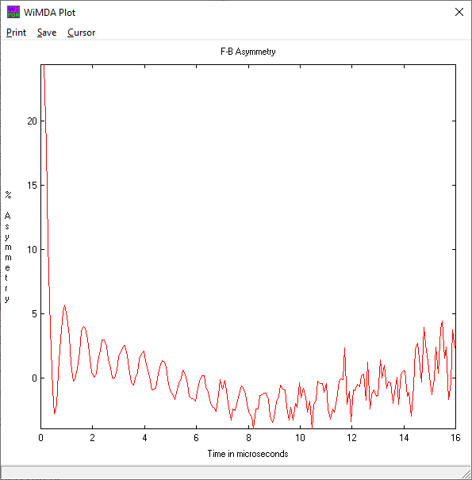
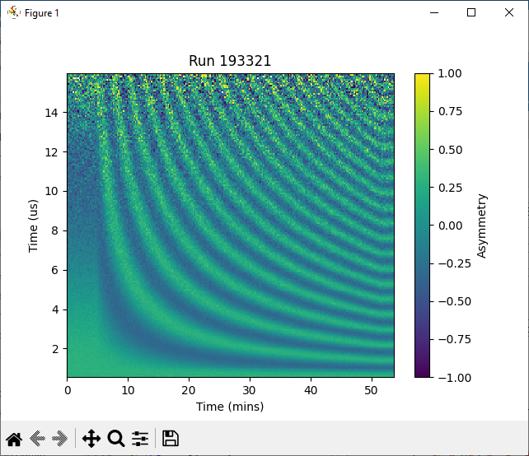
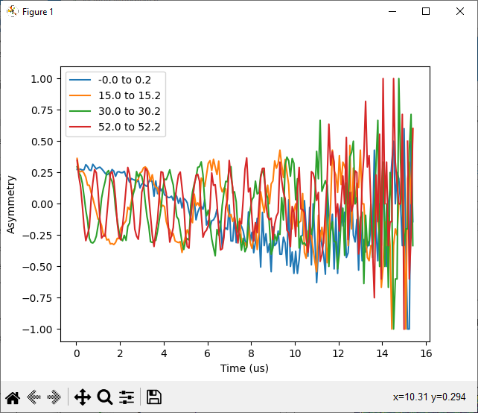
Digital Muon enables
Sweeping parameters
Event driven
Data Filtering
Multi-hit rejection
Swept TF field on HiFi
From 4G to 95 G
No dephasing!

Slide 17
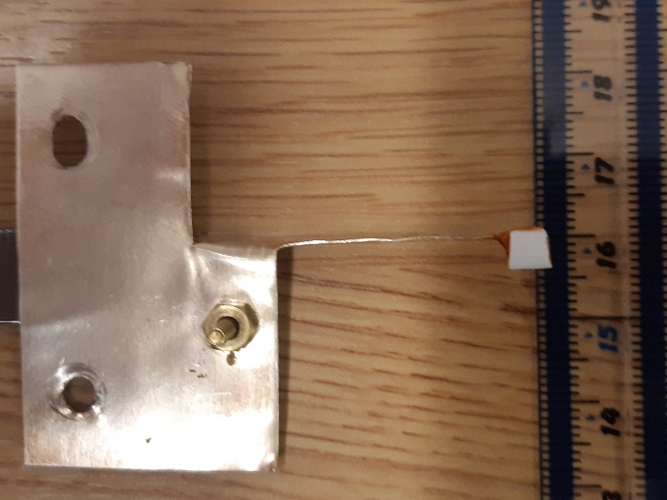
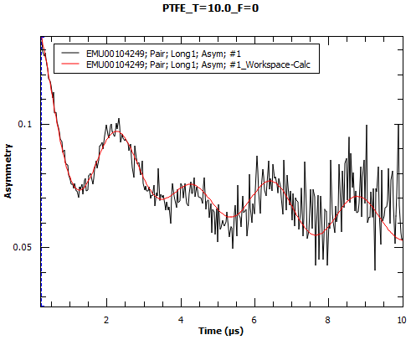
Optimising Muon Measurements of Small Samples
Test by measuring characteristic F-µ-F signal in a 4x4mm piece of PTFE suspended in beam
For suspended samples:
less than ~10mg of sample reqd.
for clear, undistorted spectra.
At least an order of magnitude mass reduction compared typical sample mounting.
Successful in the Dilution Fridge
Sample
(EMU data)

Slide 18
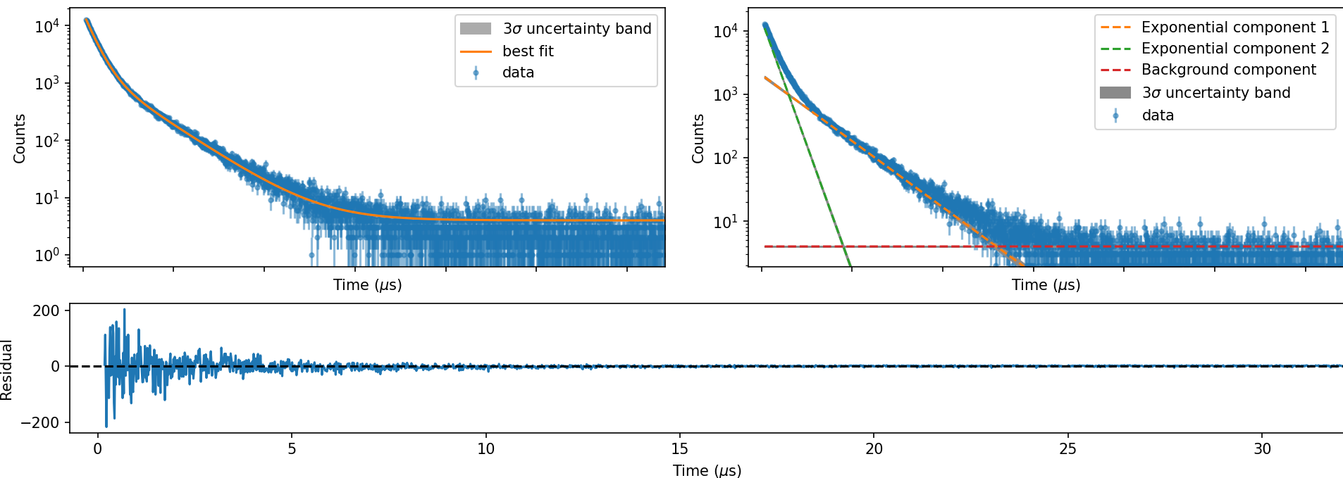

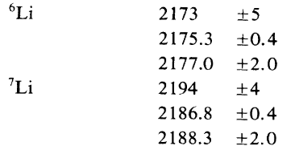
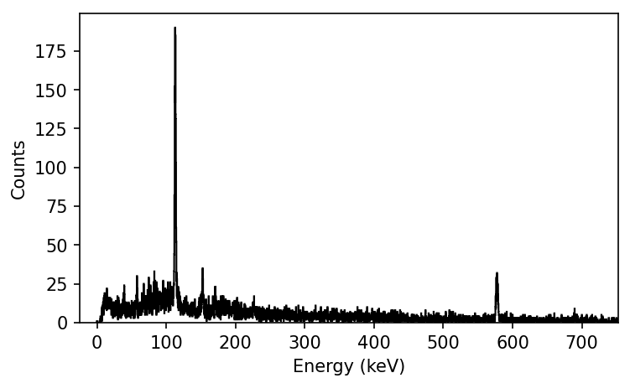



Composition from
Muon life time
$$\frac{15170.51}{2016.61}×\frac{0.18}{1.32}=1.03$$
Li: 2.083(15) µs
Cl: 0.548(1) µs
Cl L_{α}
Cl L_{α}
Li K_{α}?
Cl L_{β}
Cl M_{β}
LiCl
Cl M_{α}
µ⁻ @ 70 MeV/c
T. Suzuki et al, Phys. Rev. C 35, 2212 (1987)
Cl L_{β}
Cl K_{α}
Cl K_{β}

Slide 19

Muography MeV/c Dependence – 10 min (decay µ⁺)
Muon Beam
27 MeV/c
Scintillator and Camera
32 MeV/c
Sample
37 MeV/c
42 MeV/c
Images from Tom Ashton UCL

Slide 20




Alkaline Battery (70 MeV/c µ⁻)
Zinc anode
(7.14 g cm³)
MnO₂ cathode
(5.03 g cm³)
SS cell casing
(≈ 8.00 g cm³)
AA
AAA
AAAA
Images from Tom Ashton UCL

Slide 21
Future Developments

Slide 22





Muon target optimisation
Currently 45°, 10mm path
Previous simulations
New geometries
Bungau 2014 Berg 2016
μ⁺, π⁺, and π⁻ collected perpendicular to the proton beam axis, simulated in Bungau et al. 2014
Simulations show that a target more parallel to the proton beam increases surface muon yield (Bungau 2014, Berg 2016)
Interaction length of ISIS target less than beam diameter – opposite limit to PSI
X-shaped targets with same interaction length increase surface muon yield >50% while maintaining decay muon yield
Working to improve simulations of these targets and the coupling with the beamline transport

Slide 23



Muon Future Plans: Proposed instruments
MuX
NuEMU
Chimera
Fully developed instrument for elemental analysis x100+ in rate
High data rate
Improved frequency response
Small samples
Enhanced Laser facility
State-of-the-art instrument to replace a 30+ year old spectrometer
Optimised for µ⁻ and µ⁺ with variable muon momentum

Slide 24


New Instrument MuX
Instrument dedicated to elemental analysis studies.
Currently in the review process for Endeavour phase 3
Solve the Data Rate and Sensitivity Problem:
Aiming for two orders + magnitude in rate
Improved detector coverage with high segmentation
Enhanced sample automation
Automatic sample changer
How to analysis all this data!
Easier data analysis c.f. XRF methods (EVA)
Machine Learning

Slide 25

ISIS-II: the successor to ISIS
The UK‘s next-generation neutron and muon source
ISIS‘s scientific leadership with (more) modern technologies
2030s
2040s
ISIS-II at RAL

Slide 26









Accelerator and target options
Greenfield facility
Three types of pulse compression ring are under consideration
Accumulator Ring (AR) – like SNS
Rapid Cycling Synchrotron (RCS) – like ISIS and J-PARC
Fixed-Field Alternating-gradient accelerator (FFA) – novel concept
1.2 GeV energy has been chosen as a good working point
AR will require a full-energy 1.2 GeV linac
RCS and FFA will require a ~500 MeV linac and will then accelerate the beam to 1.2 GeV
Overall source power could be up to 2.4 MW, dependent on target technology
Rotating targets required to reach high powers, but have not yet been proven – ESS and SNS plan to use them
Fixed targets have been proven to be reliable, but power on any one target would be limited to ~500 kW
Upgrade to existing ISIS facility
180 MeV linac injection into the present ISIS RCS
Overall source power limited to ~500 kW
Remains reliant on ageing equipment and infrastructure
Performing an evaluation of the environmental impact of the lifetime of ISIS-II based on Life Cycle Assessment.

Slide 27


Muon target: Comparing two options
TS1
TS2
Simultaneously accelerates both H⁺ and H⁻ in LINAC
H⁺ used for muon generation, H⁻ to synchrotron
Tailor the time structure for our purposes (by changing H⁺ injection)
Flux will be moderate
Familiarity, reliable, low cost
At least 10X improvement in muon flux
significant upgrade on TD-μSR
future LE-μSR source
other muon applications
... Likely option

Slide 28


Important dates
Muon Advanced School
Next long shutdown
Planned 2027
likely to be 9 months
allows for larger accelerator projects
MEBT, Linac high power amp, TS2 Cryo control
allows for installation of Super-MuSR and RIKEN Solenoid
Muon target water, Muon target shielding

Slide 29












John Wilkinson
Koji Yokoyama
Steve Cottrell
Adrian Hillier
Rhea Stewart
Sayani Biswas
Alex Louat
James Lord
Adam Berlie
Francis Pratt
Mark Telling
Peter Baker

Slide 31



nuEMU: Beamline extension
SuperMuSR beamline
EMU
0
Current beam spot very large in horizontal direction due to dispersion from the kicker
Additional magnets in nuEMU enable
Canceling the dispersion
More focused beam (current 27 mm → 10 mm)
10x improvement for small samples
Pulse slicer for 10 ns pulse width
Unlocks new materials which can be studied
nuEMU

Slide 32

CHIMERA
Improved data quality
New detector array matched to the beamline
Improved Solid angle coverage
Digital muons
Smaller Samples
Smaller beam spot by a new slit package
Open access design for novel SE
Large aperture magnets
High homogeneity magnet fields

