Slide 1




Atypical vortex lattice and the magnetic penetration depth in superconducting Sr₂RuO₄ deduced by μSR¹
16th International Conference on Muon Spin Rotation, Relaxation and Resonance (μSR2025)
Student Day
Michael Yakovlev
Jeff Sonier
Zoe Kartsonas
[1] M. Yakovlev et al., Phys. Rev. B 111, 094509 (2025)
Notes:
Good afternoon, everyone. I am a master’s student in the group of Dr. Jeff Sonier at Simon Fraser University. Today, it is my pleasure to present our recent publication titled “Atypical vortex lattice and the magnetic penetration depth in superconducting Sr₂RuO₄ deduced by μSR.” This work employs transverse-field μSR to investigate the temperature dependence of the superfluid density in Sr₂RuO₄ and explores new constraints on its superconducting order parameter.

Slide 2
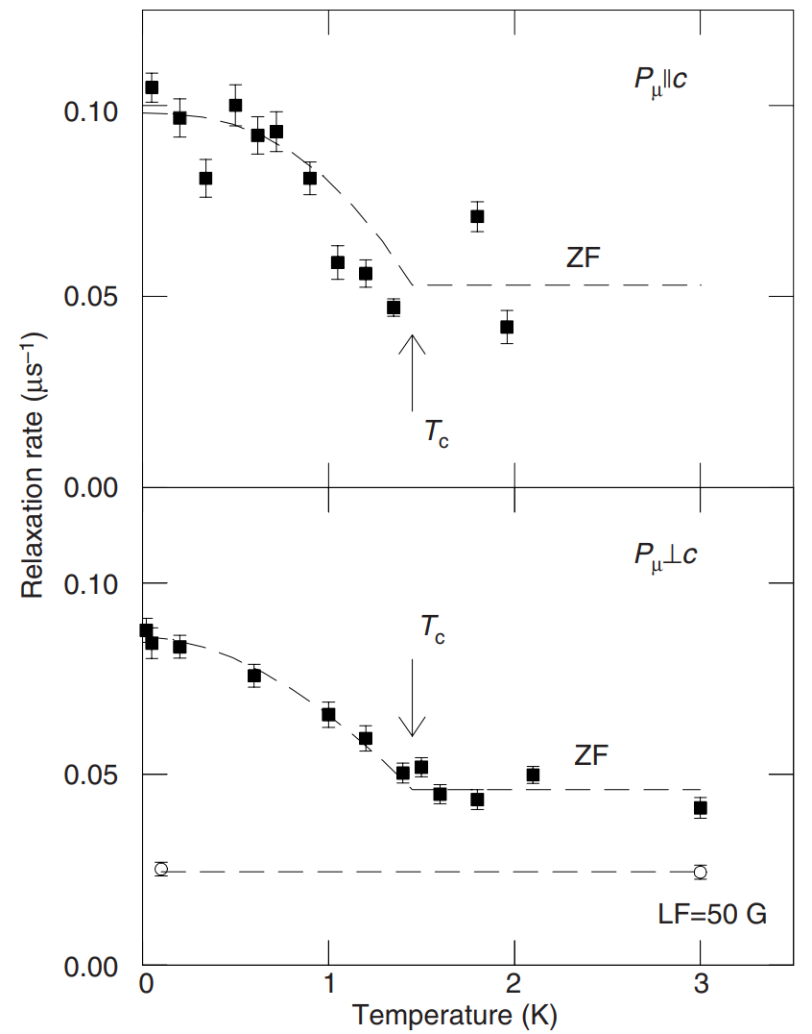
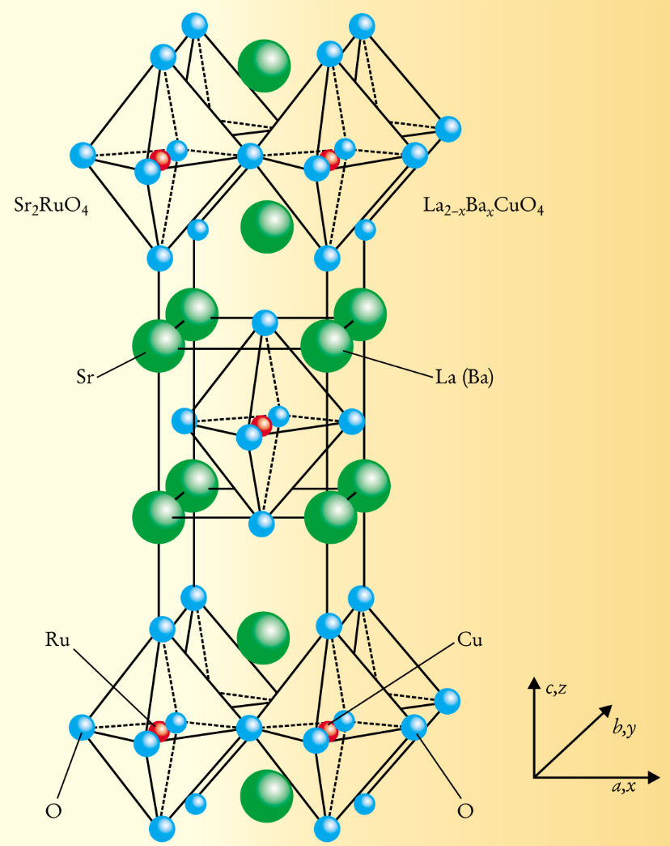
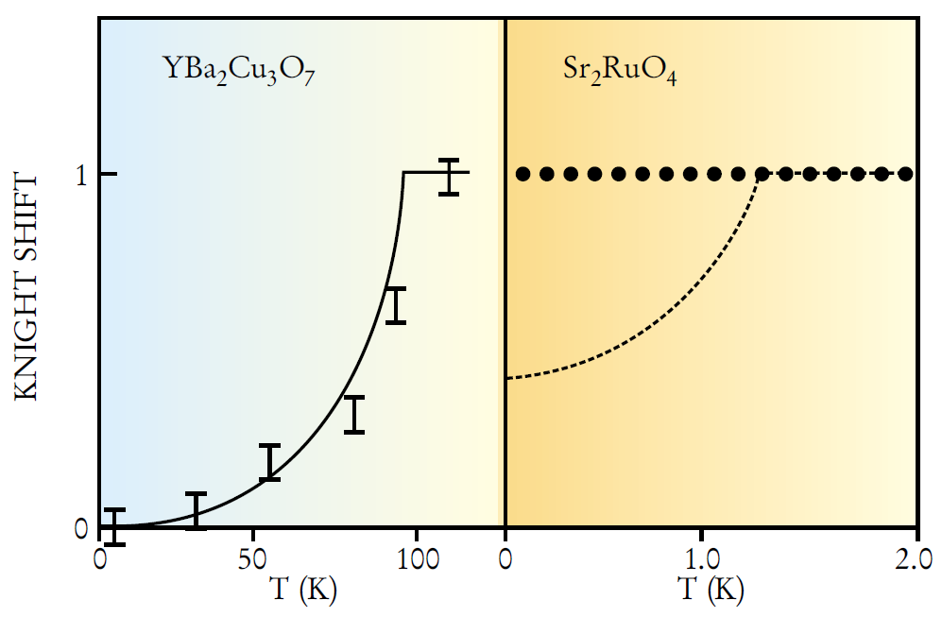
Introduction
Fig. 1. Crystal structure of Sr₂RuO₄².
Fig. 2. Early NMR Knight shift measurement on Sr₂RuO₄^{3,2}.
Fig. 3. The ZF-μSR measurement on Sr₂RuO₄⁴.
2
[2] Y. Maeno, T.M. Rice & M. Sigrist, Physics Today 54, 42 (2001) [3] K. Ishida et al., Nature 396, 658 (1998) [4] G. Luke et al., Nature 394, 558–561 (1998)
Notes:
It has been over 30 years since superconductivity in Sr₂RuO₄ was discovered, and yet its pairing symmetry remains unresolved. The early NMR Knight shift measurements observed no change in spin susceptibility below [T-c], taking it as the evidence of spin-triplet pairing. Then, zero-field μSR measurement observed the development of spontaneous magnetic fields in Sr2RuO4, when it is cooled below [T-c], inferring the breaking of time reversal symmetry breaking. Thus spin-triplet chiral p-wave superconductivity was proposed Sr₂RuO₄. However, more recent Knight shift and polarized neutron scattering data suggest the pairing is actually a spin-singlet, with the time-reversal symmetry breaking also being questioned.
FIGURE 1. STRONTIUM RUTHENATE (Sr2RuO4) forms a layered perovskite structure. As shown in the upper panel, the crystal’s RuO2 layers are separated by Sr layers, and each Ru ion is enclosed in an octahedral cage of oxygen ions. The same structure is also found in La2CuO4, which is the parent compound of the high-Tc superconductor La2–xBaxCuO4. Despite their structural similarity, the ruthenate and the cuprate have very different electronic properties: Sr2RuO4 is strongly metallic and a superconductor at low temperature, whereas La2CuO4 is an antiferromagnetic insulator. FIGURE 3. THE KNIGHT SHIFT for oxygen-17 in yttrium barium copper oxide (left) and strontium ruthenate (right). In materials whose superconductivity is mediated by spin-singlet Cooper pairing, Knight-shift data exhibit a drop in the spin susceptibility in the superconducting state. Such a drop occurs in YBa2Cu3O7, but not in Sr2RuO4, whose superconductivity is most likely mediated by spin-triplet Cooper pairs (the dashed line is a prediction based on spin-singlet Cooper pairing). (Adapted from ref. 7.) Zero field relaxation rate Λ for the initial muon spin polarization k c (top) and ⊥ c (bottom). Tc from ac-susceptibility indicated by arrows. Circles in bottom figure give relaxation rate in BLF = 50 G ⊥ c. Curves are guides to the eye.

Slide 3
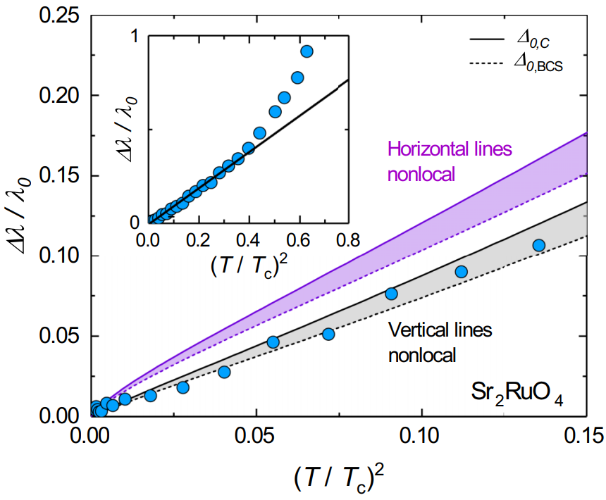
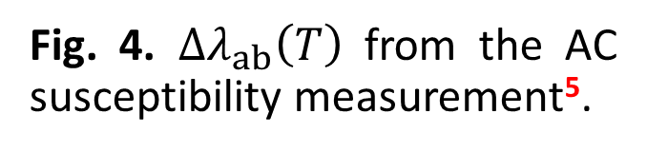
Introduction
Fig. 4. $Δλ_{ab}\left(T\right)$ from the AC susceptibility measurement⁵.
3
[5] J. F. Landaeta et al., Phys. Rev. B 110, L100503 (2024)
Notes:
One way to probe the superconducting pairing state of a material through the temperature dependence of the magnetic penetration depth, [lambda]. Multiple techniques have been used to investigate the change in [lambda] in the Meissner state in Sr₂RuO₄. For instance, the results of AC magnetic susceptibility measurements are presented on the slide. The Meissner state studies observed the change in [lambda] to follow T-square dependence at low-temperatures, which - when accounting for nonlocal effects - suggests the presence of line nodes in the superconducting energy gap.
FIG. 3. λ/λ0 vs (T/Tc ) 2 in Sr2RuO4. The gray and violet lines show the expected behavior of λ/λ0 for vertical and horizontal line nodes in the nonlocal electrodynamic limit, respectively. The dotted lines are for the BCS value of the gap 20,BCS/(kBTc ) = 3.53 and the full lines for 20,C/(kBTc ) = 3.16 extracted from specific heat [38,47]. The inset shows the data in a larger temperature range with a straight line indicating the temperature range up to ≈0.5Tc in which a T 2 behavior is found.

Slide 4
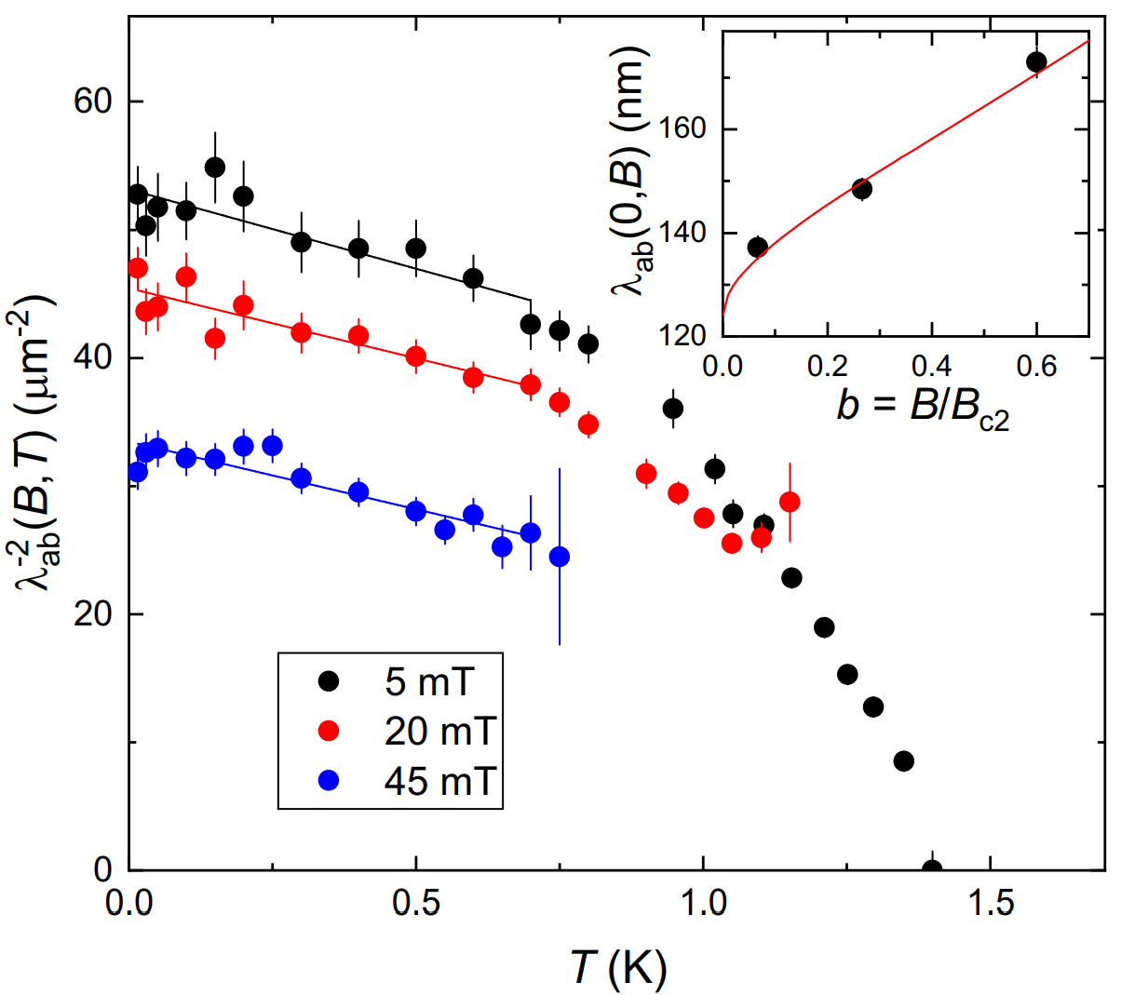
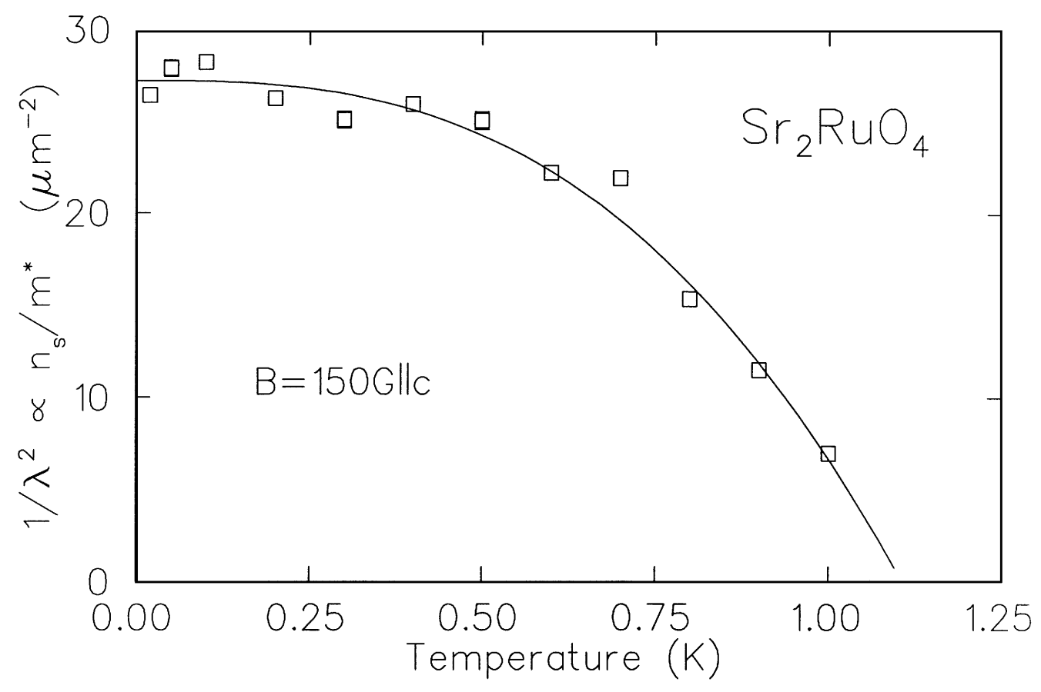
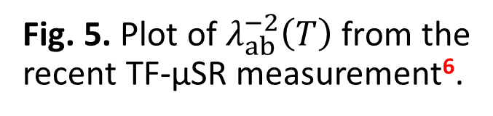
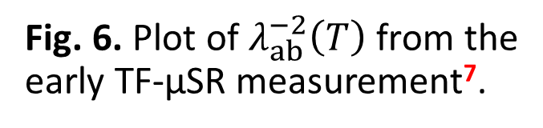
TF-μSR Studies of Sr₂RuO₄
Fig. 5. Plot of $λ_{ab}^{−2}\left(T\right)$ from the recent TF-μSR measurement⁶.
Fig. 6. Plot of $λ_{ab}^{−2}\left(T\right)$ from the early TF-μSR measurement⁷.
4
[6] R. Khasanov et al., Phys. Rev. Lett. 131, 236001 (2023) [7] G. M. Luke et al., Phys. B: Condens. Matter 289-290, 373 (2000)
Notes:
In contrast, transverse-field μSR experiments can be used to determine the absolute value of the penetration depth. A recent study by Khasanov et al. reported a T-linear dependence of the superfluid density, which is proportional to the inverse square of [lambda]. This behavior implies the presence of gap nodes, and aligns with Meissner state results. In contrast, in the earlier paper by Luke et al. no clear T-linear behaviour was observed. Our goal was to bring both data sets under a consistent analysis method to determine whether this discrepancy reflects a genuine physical difference - such as sample quality - or whether it arises from differences in methods chosen. Additionally, we wanted to explore how the choice of the analysis method influences the magnetic field profile inside the vortex lattice of Sr₂RuO₄.

Slide 5
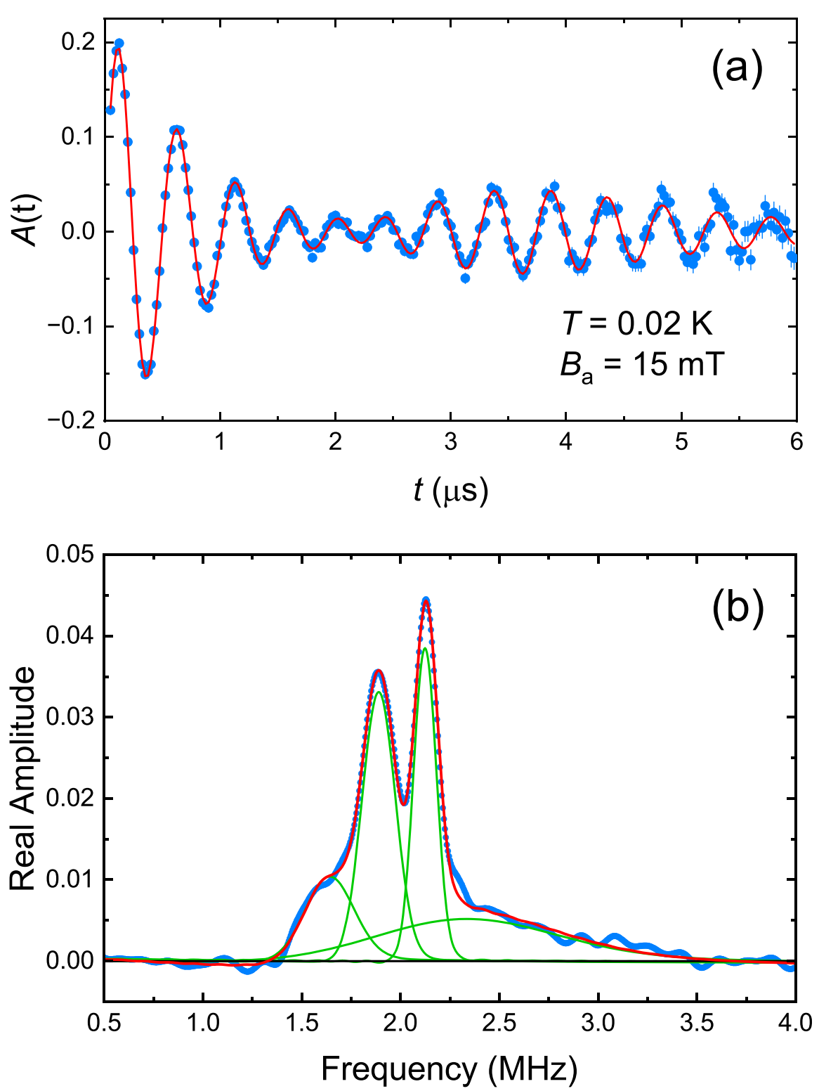


Common Analysis Method
$$A\left(t\right)= \sum_{i=1}^{n}{a_{i}e^{−σ_{i}^{2}t^{2}}\cos\left(γ_{μ}B_{i}t+φ\right)}+a_{bg}e^{−σ_{bg}^{2}t^{2}}\cos\left(γ_{μ}B_{bg}t+φ\right)$$
$${\left\langle ΔB\right\rangle }^{1/2}=A\left(1−b\right)×\left[1+1.21{\left(1−\sqrt{b}\right)}^{3}\right]λ_{ab}^{−2}$$
$A\left(t\right)$ Asymmetry
$a_{i}$ Amplitude
$σ_{i}$ Depolarization rate
$γ_{μ}=851.615 MHz/T$ Muon gyromagnetic ratio
$B_{i}$ Mean internal magnetic field
$φ$ Phase
“bg” subscript Background contribution
$A$ VL geometry coefficient
$b=B_{a}/B_{c2}$ Reduced applied magnetic field
Fig. 7. (a) Sample TF-μSR asymmetry spectrum from the early study⁷ (blue) with the fit to the second moment method (red). (b) Fourier transform of (a)¹.
5
[1] M. Yakovlev et al., Phys. Rev. B 111, 094509 (2025) [7] G. M. Luke et al., Phys. B: Condens. Matter 289-290, 373 (2000)
Notes:
We began our investigation by analyzing the early μSR data using the method employed in Khasanov’s paper. This approach involves fitting the transverse-field μSR asymmetry spectra with a sum of Gaussian-damped cosine functions, which account for the sample signal, plus a background term representing muons that miss the sample. The second momement of the internal field distribution is used to calculate the penetration depth using a Ginzburg-Landau expression presented on the slide.

Slide 6
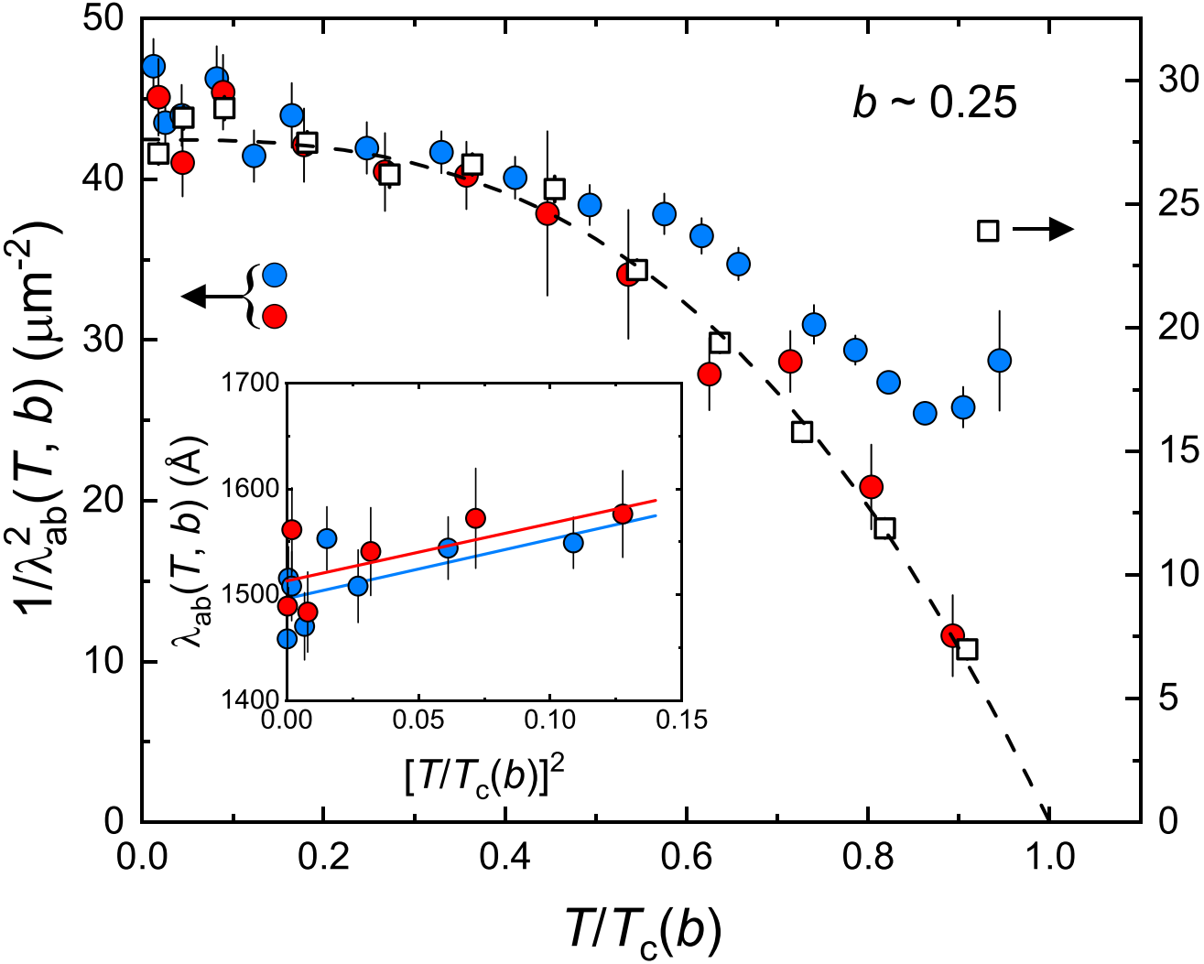
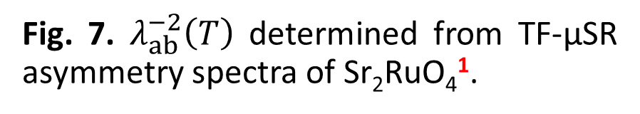
Common Analysis Method
Second moment analysis of the recent⁶ TF-μSR data
Second moment analysis of the early⁷ TF-μSR data
Original analysis of the early⁷ TF-μSR study
Fig. 7. $λ_{ab}^{−2}\left(T\right)$ determined from TF-μSR asymmetry spectra of Sr₂RuO₄¹.
6
[1] M. Yakovlev et al., Phys. Rev. B 111, 094509 (2025) [6] R. Khasanov et al., Phys. Rev. Lett. 131, 236001 (2023) [7] G. M. Luke et al., Phys. B: Condens. Matter 289-290, 373 (2000)
Notes:
Our reanalysis shows that applying the second moment method yields superfluid density curves that closely agree between the two data sets below a reduced temperature of 0.4. The divergence observed above this temperature is likely due sample-component frequencies being less-distinct in the sample from the Khasanov’s paper. In that dataset, only two sample Gaussian-damped cosine functions were needed to fit the asymmetry spectra, compared to three in the earlier study by Luke et al. As shown in the inset of the graph, the variation in the absolute value of the penetration depth of both datasets prevents a definitive distinction between T-linear and T-square behavior. This makes the results not incompatible with Meissner-state measurements of change in [lambda-T], which, as stated earlier, follow a T-square dependence.

Slide 7
Common Analysis Method
Second moment analysis of the recent⁶ TF-μSR data
Second moment analysis of the early⁷ TF-μSR data
Original analysis of the early⁷ TF-μSR study
The second moment analysis requires 𝜅 ≥ 5 and ,yet applying the method yields 𝜅 = 2.06
The method treats vortices as circular for square lattice
Fig. 7. $λ_{ab}^{−2}\left(T\right)$ determined from TF-μSR asymmetry spectra of Sr₂RuO₄¹.
6
[1] M. Yakovlev et al., Phys. Rev. B 111, 094509 (2025) [6] R. Khasanov et al., Phys. Rev. Lett. 131, 236001 (2023) [7] G. M. Luke et al., Phys. B: Condens. Matter 289-290, 373 (2000)
Notes:
Although the second moment analysis yielded consistent results between the two data sets, it is important to recognize the approximations involved in this approach. The Ginzburg-Landau expression used to convert the second moment of the internal magnetic field to the penetration depth is itself an approximation, valid only within specific ranges of the Ginzburg-Landau parameter [kappa]. However, the second moment analysis yields a [kappa] value of approximately 2.06, which lies outside the range for which the expression is strictly valid. Additionally, the conversion formula neglects the finite size of the vortex cores and treats them to have circular crossection, which is incompatible with square vortex lattice in Sr₂RuO₄.

Slide 8

Theoretical Models of the Local Magnetic field
$$A\left(t\right)=a_{s}e^{−\left(σ_{n}^{2}+σ_{dis}^{2}\right)t^{2}}\sum_{r}{\cos\left[γ_{μ}B\left(r\right)t+φ\right]}+a_{bg}e^{−σ_{bg}^{2}t^{2}}\cos\left(γ_{μ}B_{bg}t+φ\right)$$
$A\left(t\right)$ Asymmetry
$a_{s}$ Sample amplitude
$σ_{n}$ Depolarization rate – nuclear dipoles
$σ_{dis}$ Depolarization rate – VL disorder
$γ_{μ}=851.615 MHz/T$ Muon gyromagnetic ratio
$B(r)$ Local magnetic field inside VL
$φ$ Phase
“bg” subscript Background contribution
7
Notes:
As an alternative to the second moment method, the transverse-field μSR spectra can be fitted to a theoretical model for the magnetic field profile inside the vortex lattice [B-of-r]. The sample contribution is calculated at each position [r] within the vortex lattice unit cell, and the resulting sum is multiplied by Gaussian depolarization factors to which result from nuclear dipole moments and vortex lattice disorder. The background term is treated identically to that in the second moment method. The form of [B-of-r] depends on the specific theoretical model chosen for the analysis.

Slide 9
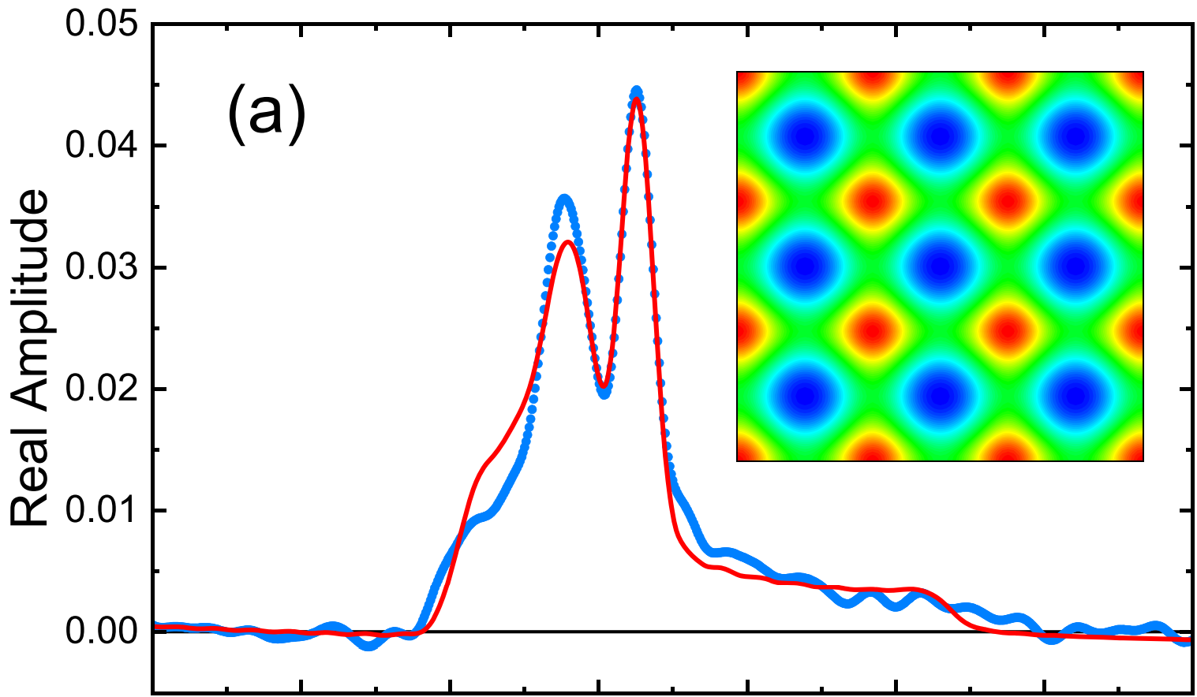
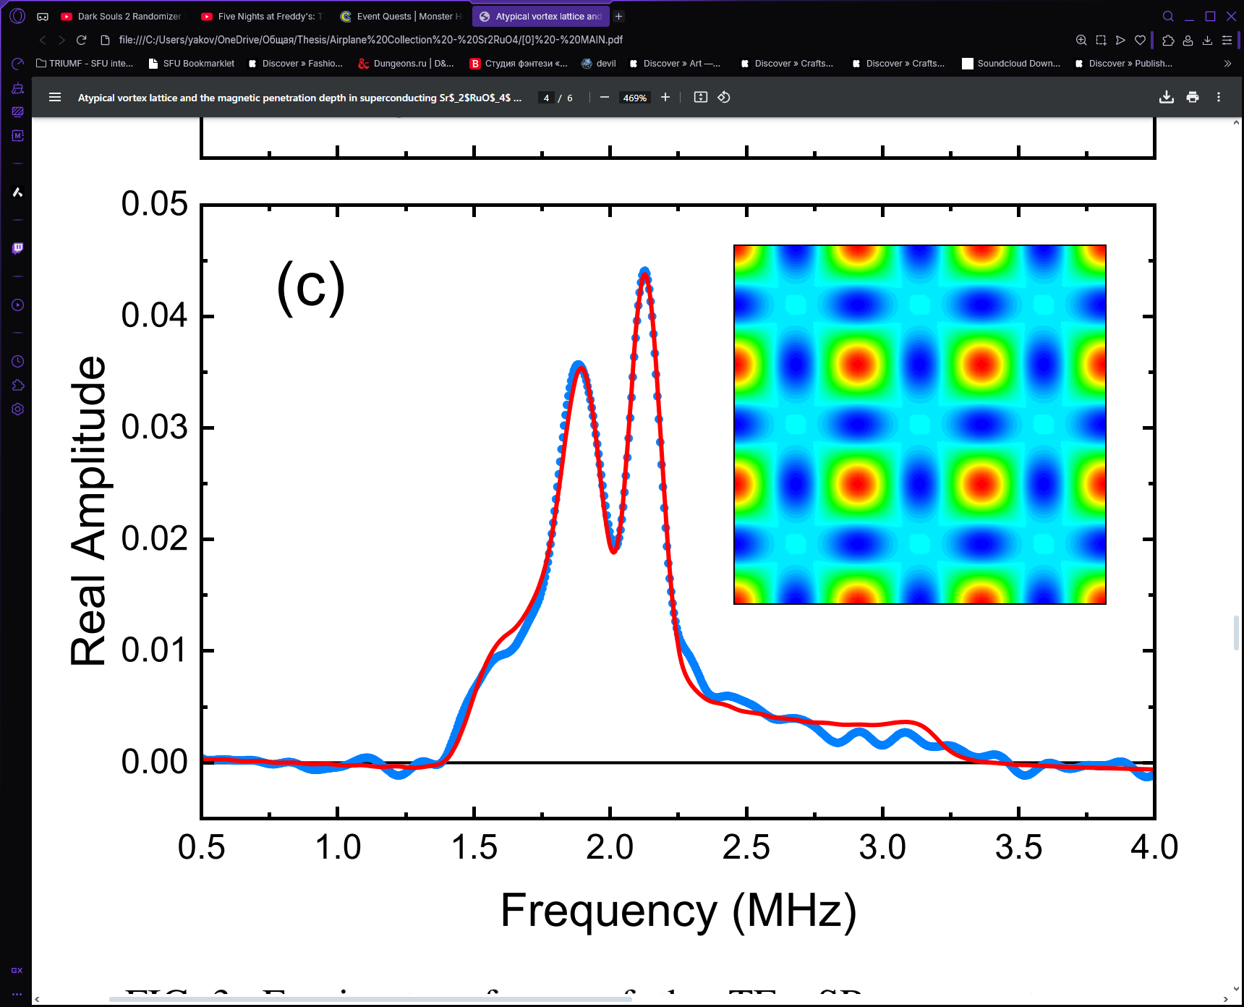
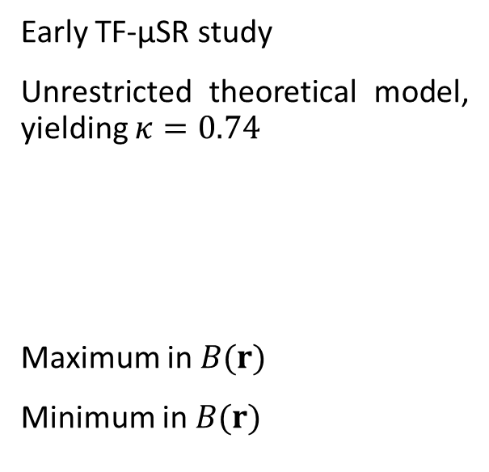
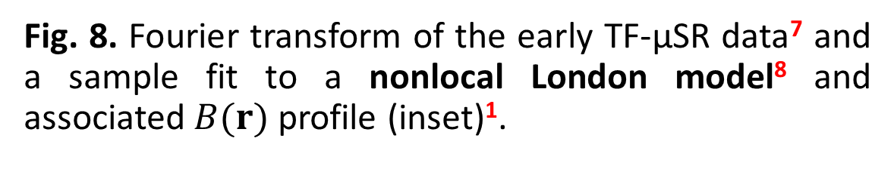
Theoretical Models of the Local Magnetic field
Early TF-μSR study
Unrestricted theoretical model, yielding $κ=0.74$
Theoretical model, with restricted $κ=2.06$
Maximum in $B(r)$
Minimum in $B(r)$
Fig. 8. Fourier transform of the early TF-μSR data⁷ and a sample fit to a nonlocal London model⁸ and associated $B(r)$ profile (inset)¹.
8
[1] M. Yakovlev et al., Phys. Rev. B 111, 094509 (2025) [7] G. M. Luke et al., Phys. B: Condens. Matter 289-290, 373 (2000) [8] J. E. Sonier et al., Phys. Rev. Lett. 93, 017002 (2004)
Notes:
First, we applied a nonlocal London model, developed by Kogan et al., to the data from the Luke’s paper. This model incorporates nonlocal corrections to the London equations, along with an anisotropic cutoff term that accounts for the finite size of the vortex cores. The graph shows the Fourier transform of the data and the model fit, with the contour plot being the field profile [B-of-r] from the fit. As you can see, the model fails to adequately capture the low-field shoulder - associated with the minimum field - and the left-side frequency peak, corresponding to the saddle point in the field distribution. This result is not unexpected, as the nonlocal London model is strictly valid only for high-[kappa] superconductors.

Slide 10
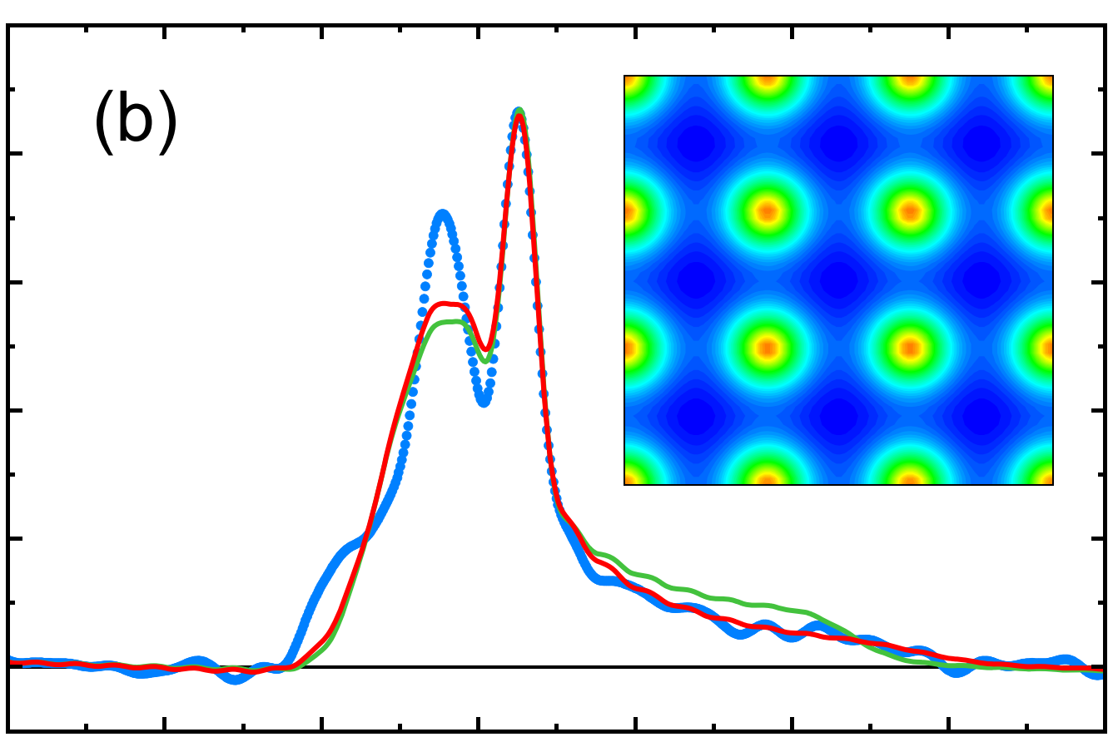
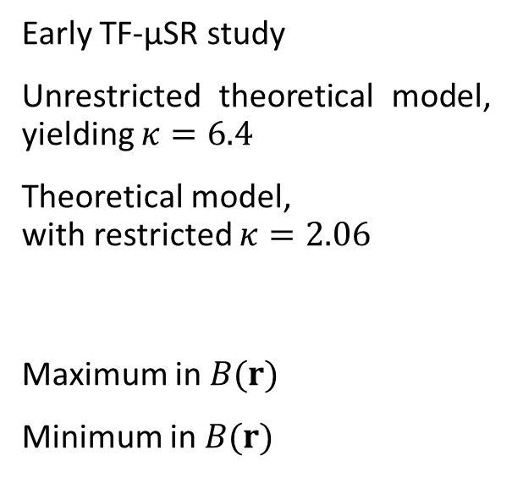
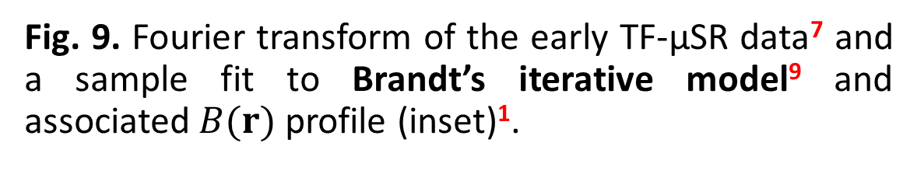
Theoretical Models of the Local Magnetic field
Early TF-μSR study
Unrestricted theoretical model, yielding $κ=6.4$
Theoretical model, with restricted $κ=2.06$
Maximum in $B(r)$
Minimum in $B(r)$
Fig. 9. Fourier transform of the early TF-μSR data⁷ and a sample fit to Brandt’s iterative model⁹ and associated $B(r)$ profile (inset)¹.
9
[1] M. Yakovlev et al., Phys. Rev. B 111, 094509 (2025) [7] G. M. Luke et al., Phys. B: Condens. Matter 289-290, 373 (2000) [9] E. H. Brandt, Phys. Rev. Lett. 78, 2208 (1997)
Notes:
Next, we applied was Brandt’s model, which iteratively solves the Ginzburg–Landau equations to accurately determine the field profile [B-of-r]. This approach is highly flexible, as it remains valid for type-II superconductors of any [kappa] value even at low reduced applied fields. Interestingly, the second moment method was actually derived from this model. We attempted to fit the data using both an unconstrained value of [kappa] and a fixed value of 2.06. In both cases, the fits were still unsatisfactory, indicating that this model does not adequately describe the vortex lattice in Sr₂RuO₄.

Slide 11

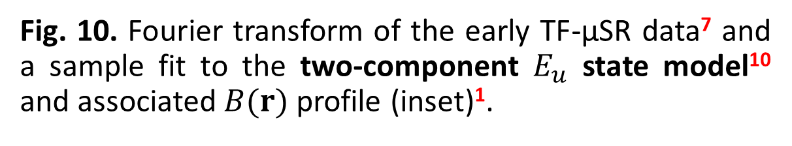
Theoretical Models of the Local Magnetic field
Early TF-μSR study
Unrestricted theoretical model, yielding $κ=2.65$
Theoretical model, with restricted $κ=2.06$
Maximum in $B(r)$
Minimum in $B(r)$
Fig. 10. Fourier transform of the early TF-μSR data⁷ and a sample fit to the two-component $E_{u}$ state model¹⁰ and associated $B(r)$ profile (inset)¹.
10
[1] M. Yakovlev et al., Phys. Rev. B 111, 094509 (2025) [7] G. M. Luke et al., Phys. B: Condens. Matter 289-290, 373 (2000) [10] D. F. Agterberg, Phys. Rev. B 58, 14484 (1998)
Notes:
Finally, we considered the two-component Eu state model used by Luke et al. in the earlier transverse-field μSR study. This model was developed at a time when spin-triplet chiral p-wave pairing was strongly favored for Sr₂RuO₄. It is derived from Ginzburg-Landau theory for a two-component complex order parameter belonging to the two-dimensional irreducible [E-u] representation of the tetragonal point group [D-4-h]​. As seen in the Fourier transform, this model closely reproduces the experimental data. The contour plot constructed from the fit reveals an unusual feature of the vortex lattice: the minimum field occurs midway between nearest-neighbor vortices, rather than at the center of the vortex lattice unit cell. Although revised NMR Knight shift measurements have ruled out an [E-u] order parameter for Sr₂RuO₄, this model nonetheless captures the unconventional location of the field minimum. We believe this unique vortex lattice feature reflects an intrinsic property of the true, yet-to-be-determined superconducting order parameter.

Slide 12

Summary
Using same analysis method showed agreement that the recent⁶ and early⁷ TF-μSR measurements of $λ_{ab}^{−2}\left(T\right)$.
Scatter in the $λ_{ab}^{}\left(T\right)$ from TF-μSR data makes it indistinguishable from measurements of ${Δλ}_{ab}^{}\left(T\right)$ deduced by Meissner state techniques.
Currently there is no valid model for $B\left(r\right)$ in Sr₂RuO₄.
A unique feature of the VL in Sr₂RuO₄ – location of the $B\left(r\right)$ minimum - was identified.
11
[6] R. Khasanov et al., Phys. Rev. Lett. 131, 236001 (2023) [7] G. M. Luke et al., Phys. B: Condens. Matter 289-290, 373 (2000)
Notes:
To summarize, by using a the second moment analysis method, we have shown that there is no significant difference between the temperature dependence of the superfluid density in Sr₂RuO₄ determined in the early and recent transverse-field μSR studies. We have also demonstrated that [lambda T] determine with this method from both studies reasonably follows a T-square dependence at low temperatures, consistent with Meissner-state measurements of the change in penetration depth. At the present day, there is no valid theoretical model that accurately captures the magnetic field profile inside the vortex lattice of in Sr₂RuO₄. Developing an appropriate model would require the knowledge of the material’s superconducting order parameter. However, we did identify that the minimum field in the vortex lattice of Sr₂RuO₄ is to be located between the neighbouring vortices. This unique feature serves as an additional constraint additional constraint in the ongoing search for the true superconducting order parameter.

