Slide 1
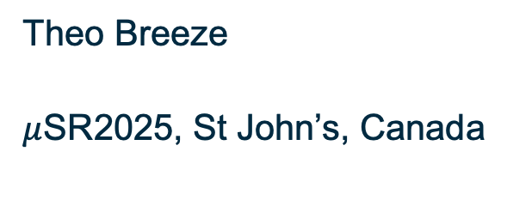
Anomalous magnetism in NiI₂: how structure affects dynamics
Theo Breeze
$μ$SR2025, St John’s, Canada
T.L. Breeze et al. Phys. Rev. B 111, 104420 (2025)

Slide 2


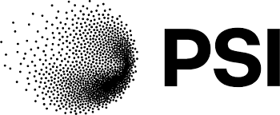
Acknowledgements
  Durham:
  Prof. Tom Lancaster
  Prof. Stewart Clark
  Nathan Bentley
  Southampton:
  Dr Alberto Hernández-Melián
  Oxford:
  Dr Benjamin Huddart
  ISIS:
  Dr George Wood
  Dr John Wilkinson
  Dr Francis Pratt
  PSI:
  Dr Thomas Hicken
  Warwick:
  Dr Daniel Mayoh
  Prof. Geetha Balakrishnan

Slide 3
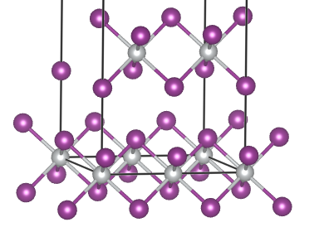
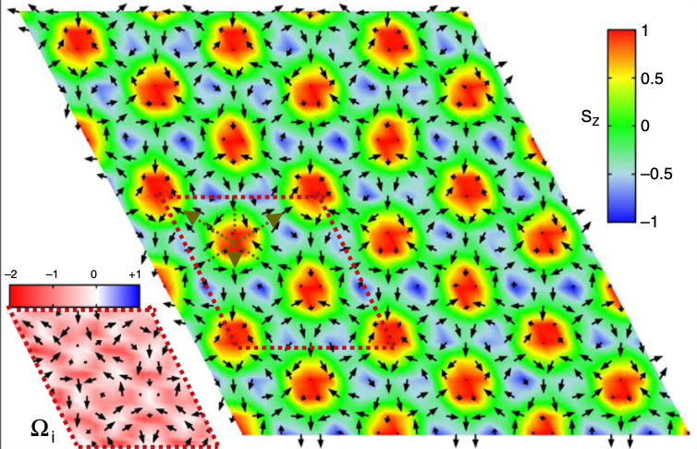
Material overview
  NiI₂ is a magnetic Van der Waals material
  Proposed to host a novel form of skyrmion phase in the 2D limit
  We were interested in probing bulk magnetic behaviour around the 2 magnetic transitions
D. Amoroso, P. Barone, and S. Picozzi, Nat. Commun. 11, 5784 (2020).

Slide 4
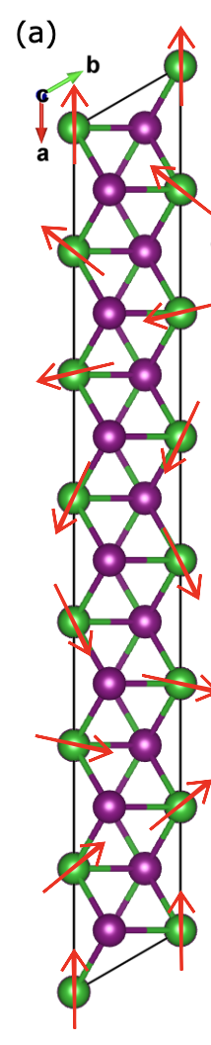
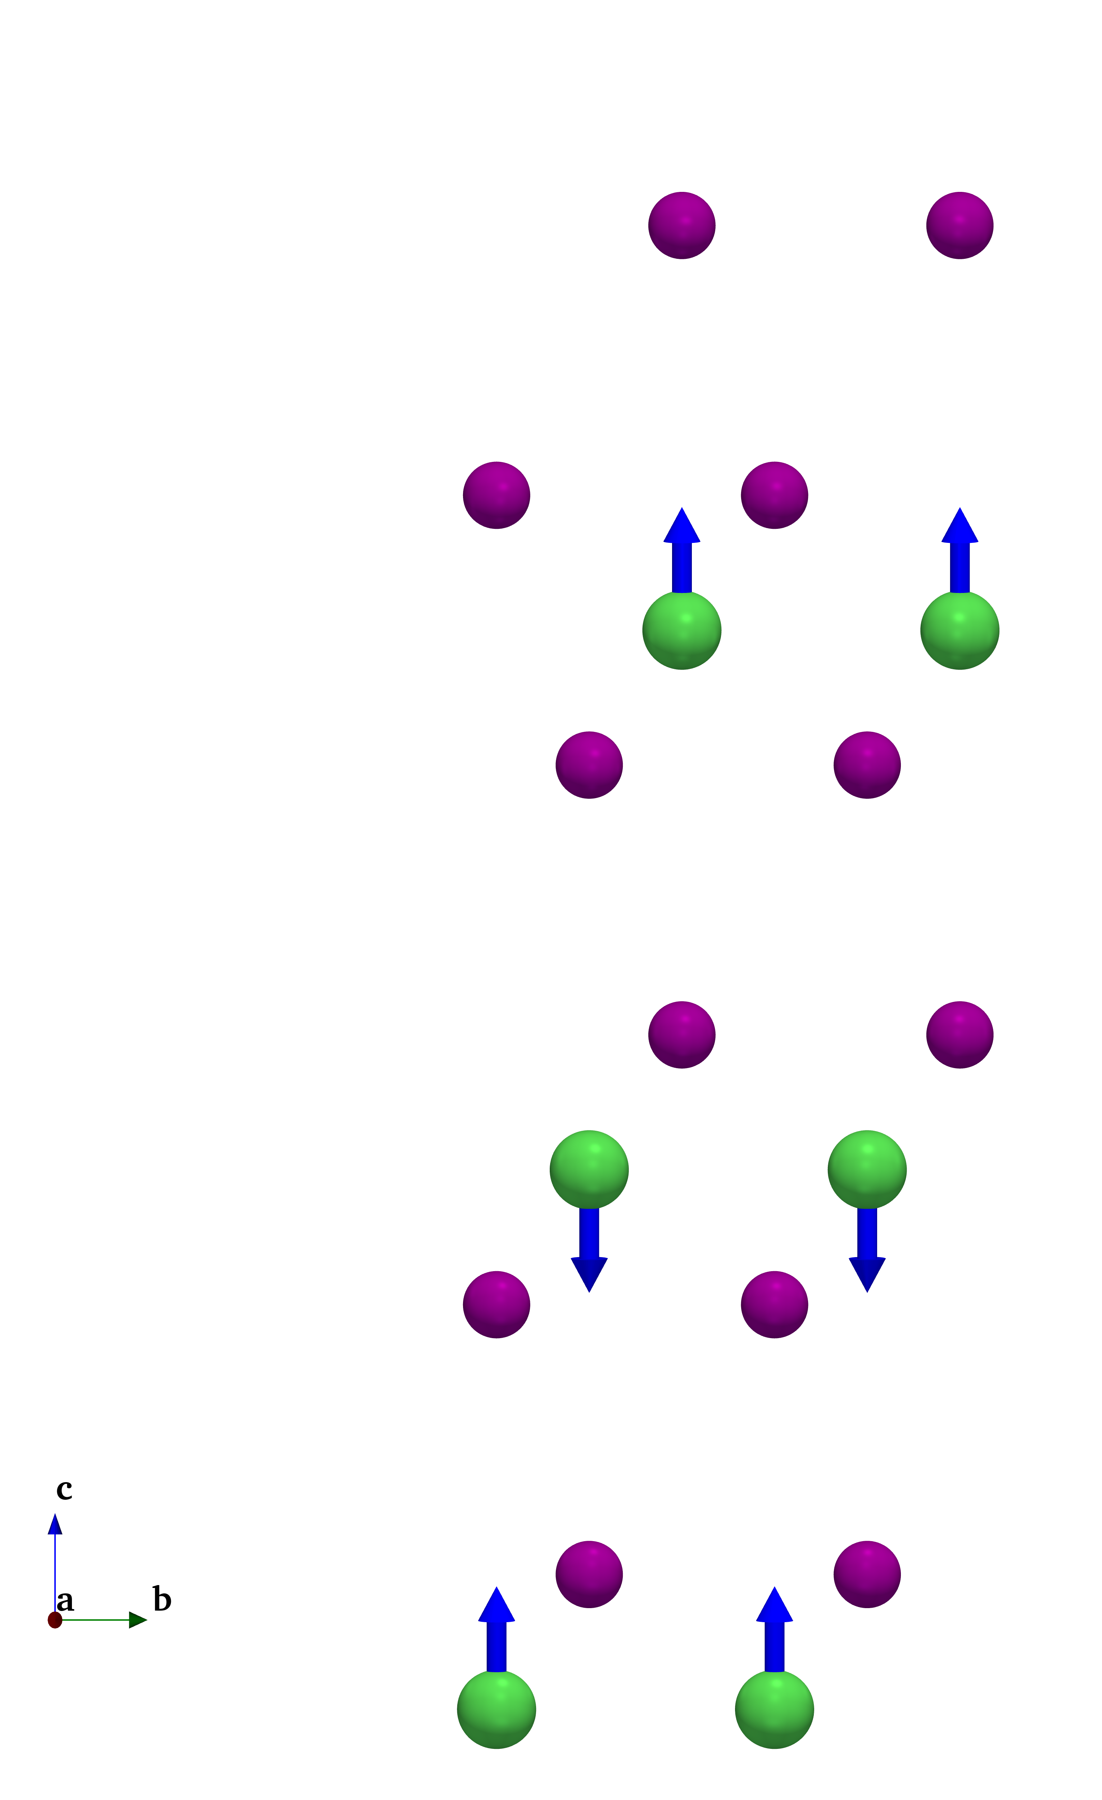
Bulk magnetism
  Two magnetic phase transitions at T_{N1}=73 K, T_{N2}=62 K
  Structural transition at T_{N2}, from rhombohedral above to monoclinic below

Slide 5
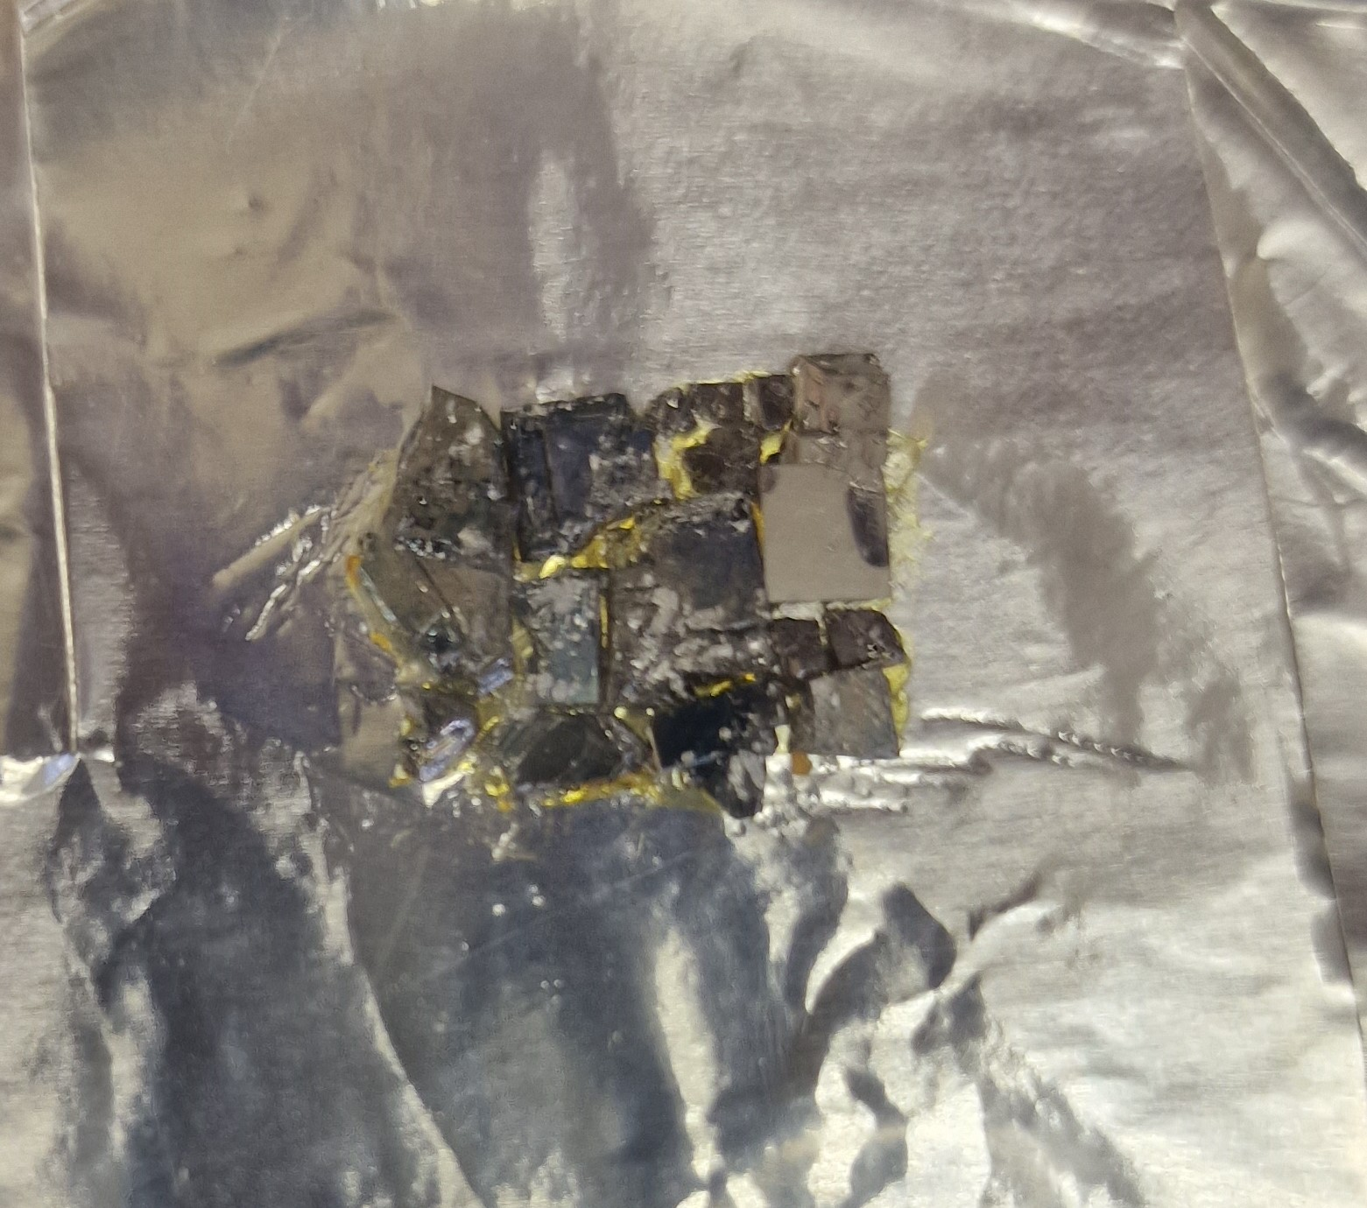
PSI data

Slide 6
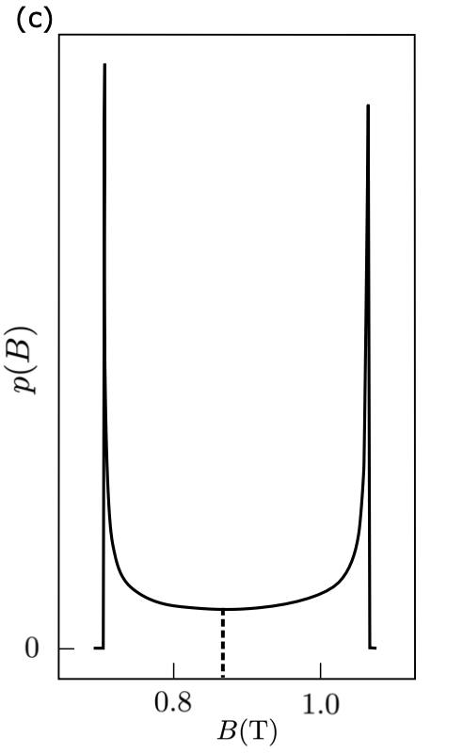
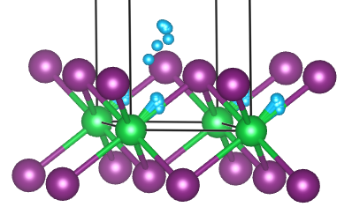
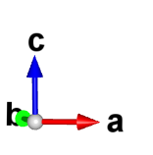
Muon site analysis

Slide 7
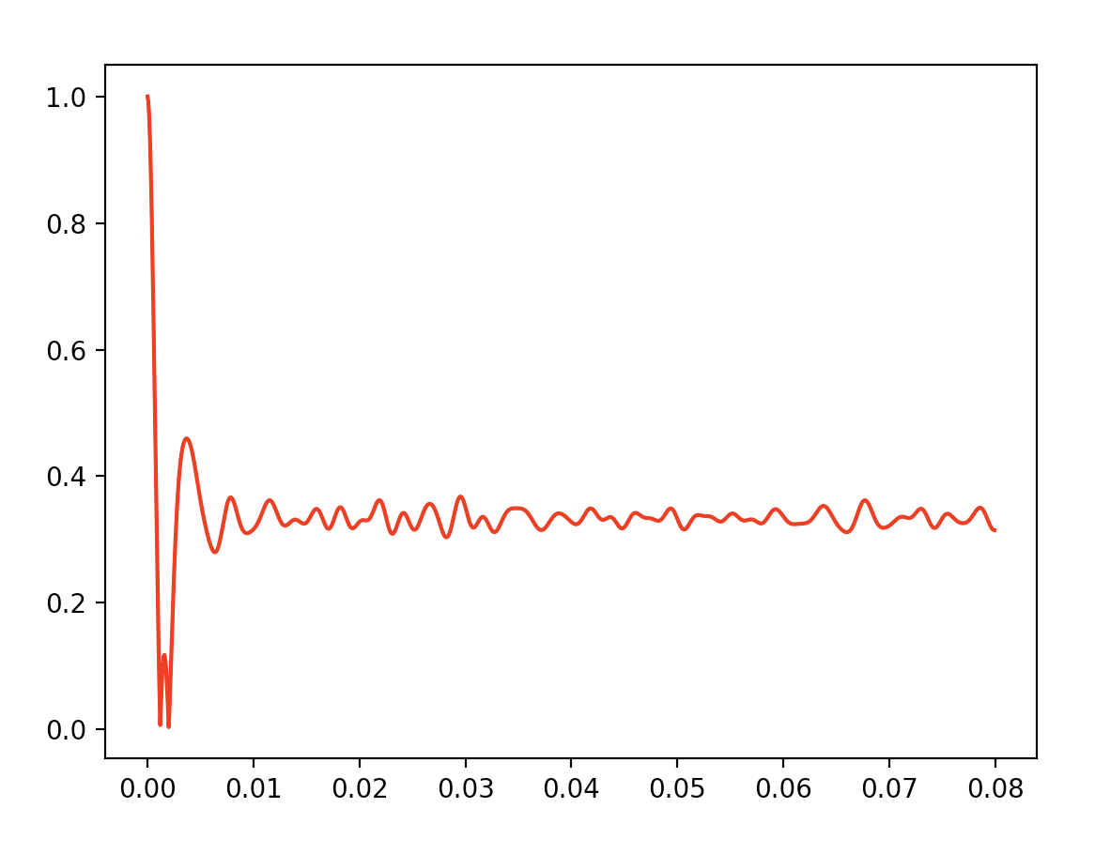
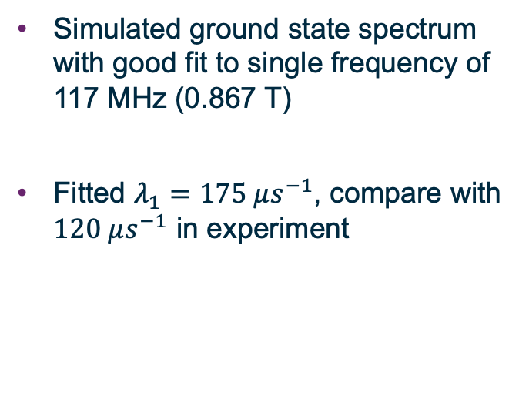
Simulated Spectra
  Simulated ground state spectrum with good fit to single frequency of 117 MHz (0.867 T)
  Fitted $λ_{1}=175 μs^{−1}$, compare with $120 μs^{−1}$ in experiment

Slide 8

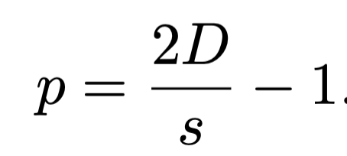
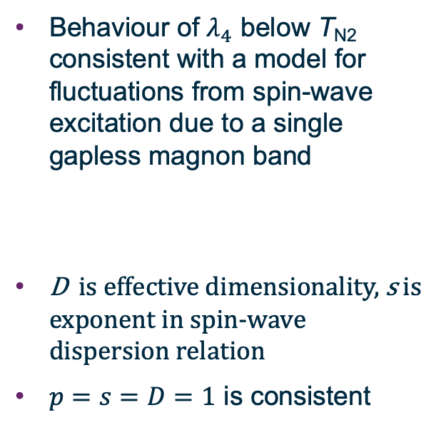
ISIS data
  Behaviour of $λ_{4}$ below T_{N2} consistent with a model for fluctuations from spin-wave excitation due to a single gapless magnon band
  D is effective dimensionality, s is exponent in spin-wave dispersion relation
  $p=s=D=1$ is consistent

Slide 9
ISIS data
  Temperature-indepence above T_{N2} is inconsistent with this model, suggesting qualitatively different dynamics in this region

Slide 10
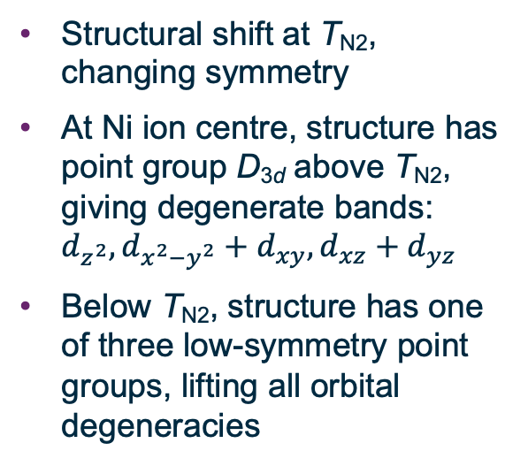
Group theory analysis
  Structural shift at T_{N2}, changing symmetry
  At Ni ion centre, structure has point group D_{3d} above T_{N2}, giving degenerate bands: $d_{z^{2}}, d_{x^{2}−y^{2}}+d_{xy}, d_{xz}+d_{yz}$
  Below T_{N2}, structure has one of three low-symmetry point groups, lifting all orbital degeneracies

