Slide 1



μSR Data Analysis with Bayesian Neural Networks
Hiroaki Miyahara¹⁾, Masanori Miyazaki¹⁾*, Akihiro Koda^{2,3)}, and Ryosuke Kadono²⁾
¹⁾ Graduate School of Engineering, Muroran Institute of Technology
²⁾ Institute of Materials Structure Science, High Energy Accelerator Research Organization (KEK)
³⁾ Department of Advanced Studies, The Graduate University for Advanced Studies (SOKENDAI)
Notes:
My name is Hiroaki Miyahara. I'm a first-year master's student at Muroran Institute of Technology.. My presentation title is μSR Data Analysis with Bayesian Neural Networks.

Slide 2
TOP
1 . Our research Motivation
2 . Overview of our research
1 . Our main issue and goal
3 . NNs results
4 . BNNS results
Notes:
Here are the topics I will cover in my presentation. First, I will introduce myself. Then, I will explain Our research Motivation . Finally, I will present an overview of our research.

Slide 3
1. Our research Motivation
Notes:
Second, I will talk about our research Motivation

Slide 4
Current issues
・Conventional mode of µSR data analysis
The time evolution of muon spin polarization, P(t).
A phenomenological model for P(t)—typically based on general spin relaxation theory —is used in the least-squares (χ²) fits.
The parameters are interpreted in terms of the physical models specific to the materials
・Current issues
・There is heavy reliance on human intervention to select the phenomenological model.
・ It is difficult to establish its correspondence to the physical model.
・J-PARC’s up-to-1 MW operation is expected to generate unprecedented volumes of data beyond
the capacity of the conventional analyses.
→ We need an enormous amount of time before yielding results.
Notes:
Conventionally, the time evolution of muon spin polarization is used in the least-squares χ² fits. We use a phenomenological model for P(t) typically based on general spin relaxation theory. After getting the parameters, They are interpreted in terms of the physical models specific to the materials.
The conventional method has the following issues. There is heavy reliance on human intervention to select the phenomenological model. It is difficult to establish its correspondence to the physical model. J-PARC’s up-to-1 MW operation is expected to generate unprecedented volumes of data beyond the capacity of the conventional analyses. We need an enormous amount of time before yielding results.

Slide 5

Our strategy
・Our strategy
AI analysis = an application of Supervised Deep Learning (DL),where multilayered neural
networks(NNs) are trained by large-scale simulation*
*NB: Human-created experimental data is like dust compared to that by a modern
computer, which is far from sufficient for proper training of AI.
・Merits
・No phenomenological model (relaxation functions, etc.) used for χ²-curve fit is necessary
・ P(t) can be derived directly from the physical models for target materials using computer
simulations, allowing dramatic expansion of the degree of freedom of analysis.
Notes:
Therefore, we use AI to analysis μSR data. We use an application of supervised deep learning, where multilayered neural networks are trained by large-scale simulation. This method has the following merits. No phenomenological model used for χ²-curve fit is necessary. P(t) can be derived directly from the physical target materials using computer simulations, allowing dramatic expansion of the degree of freedom of analysis.

Slide 6
2. Overview of our research
Notes:
Third, I will talk about overview of our research

Slide 7
Our main issue and goal
・Our main issue
Can the AI analysis quantitatively evaluate parameter errors properly?
Analysis without giving errors is physically meaningless. (null confidence).
・Our goals
G1) We establish a method to quantitatively evaluate the accuracy and errors
of analysis based on DL, and compare the results with those obtained from
χ² analysis.
G2) We investigate the feasibility of Bayesian Neural Networks (BNNs)
as a method for error estimation.
Notes:
Our main issue is Can the AI analysis quantitatively evaluate parameter errors properly? We think analysis without giving errors is physically meaningless. We set two our goals. first goals, we establish a method to quantitatively evaluate the accuracy and errors of analysis based on DL, and compare the results with those obtained from χ² analysis. Second, we investigate the feasibility of Bayesian Neural Networks (BNNs) as a method for error estimation.

Slide 8
Results and Discussion
1) Comparison between NNs-analysis and χ² fit
・The NNs outputs are in good agreement with the χ² fit results, suggesting that the NNs-based
analysis is feasible for the application to µSR.
・Since loss function can be regarded as a quantity similar to the χ² fit, the error estimated by
the NNs is concluded to correspond well to that from the χ² fit.
2) Error evaluation using BNNs
・BNNs can yield the uncertainty of the outputs without preceding calibrations by χ² fit,
suggesting that it is more efficient for error estimation.
Notes:
Summry is flowing.

Slide 9
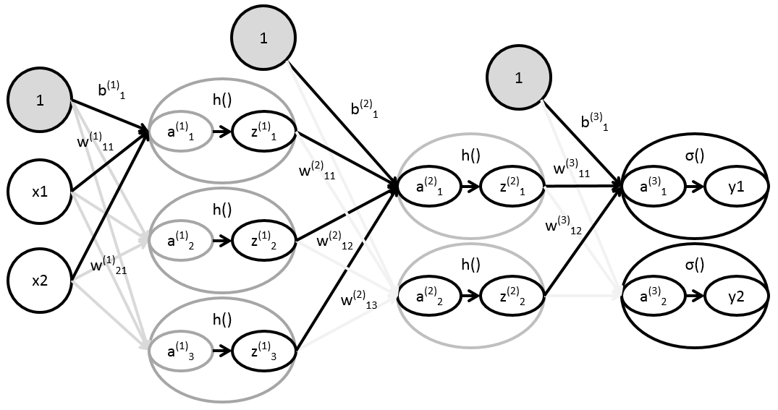
G1) Multilayered Neural Networks (NNs)
NNs are algorithms that can learn data patterns by using a large number of parameters.
Input layer
Hidden layer
Output layer
Input data
Training/
Evaluation
Activation function
z_{k} = h(a_{k})
Loss function
Bias
Output function
y_{k} = s(a_{k})
Training data
(Simulation)
Answer t_{k}
s()
S_{DL}
t₁
s()
t₂
Weight
…
…
…
NNs are composed of many parameters called “weights”. These weights are optimized in the automatic iteration process of minimizing the loss function that yields feedbacks to the weights based on the difference between the answers of training data and the outputs of the NNs. This process serves for NNs to learn features of the training data.
…
Kohki. Saito, Deep Learning from Scratch, O・REILLY(2016)
Notes:
This figure shows NNs algorithms.
NNs are algorithms that can learn data patterns by using a large number of parameters.
NNs are composed of many parameters called “weights”. These weights are optimized in the automatic iteration process of minimizing the loss function that yields feedbacks to the weights based on the difference between the answers of training data and the outputs of the NNs. This process serves for NNs to learn features of the training data.

Slide 10
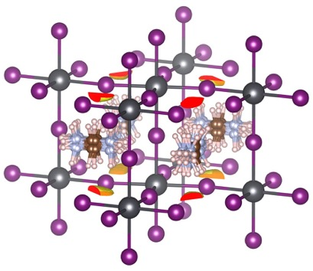
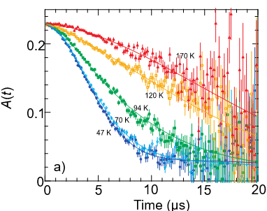

Example
FA(=HC(NH₂)₃)PbI₃
・Result of χ² fit analysis (5 points)
Pb
FA molecule
Mu
FA
I
Training data: Extended Kubo-Toyabe function
The fluctuation (with the rate ν_{i}) of the internal magnetic field H(t) due to
FA molecular rotation is described by an Edwards-Anderson (EA)-type autocorrelation.
Functional forms can only be computed with Monte Carlo simulations
We trained a NNs with the training data and created a model that outputs the fluctuation frequency ν_{i}.
T. U. Ito and R. Kadono, J Phys. Soc.Jpn 93, 044602 (2024). See R. Kadono tomorrow prezantation.
Notes:
We used the extended Kubo-Toyabe function to generate training data . It is expected that muons probe both fluctuating and static internal magnetic fields from the randomly rotating FA molecules and PbI₃ lattice. The fluctuation (with the rate ν_{i}) of the internal magnetic field H(t) due to FA molecular rotation is described by an Edwards-Anderson (EA)-type autocorrelation. The key point is that functional forms can only be computed with Monte Carlo simulations. We trained a NNs with the training data and created a model that outputs the fluctuation frequency ν_{i}.

Slide 11
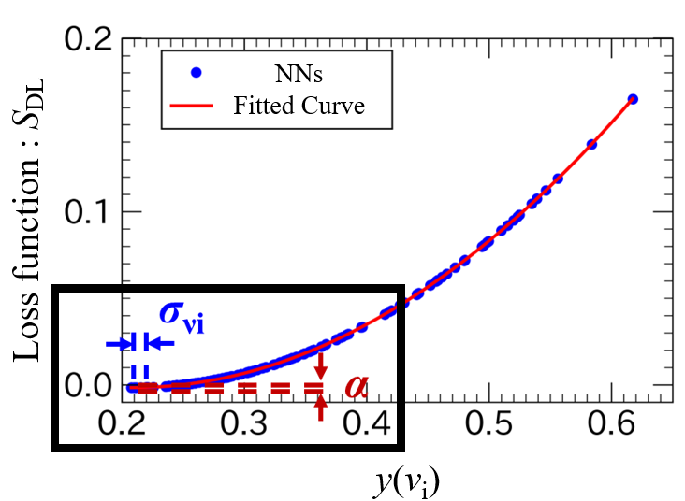
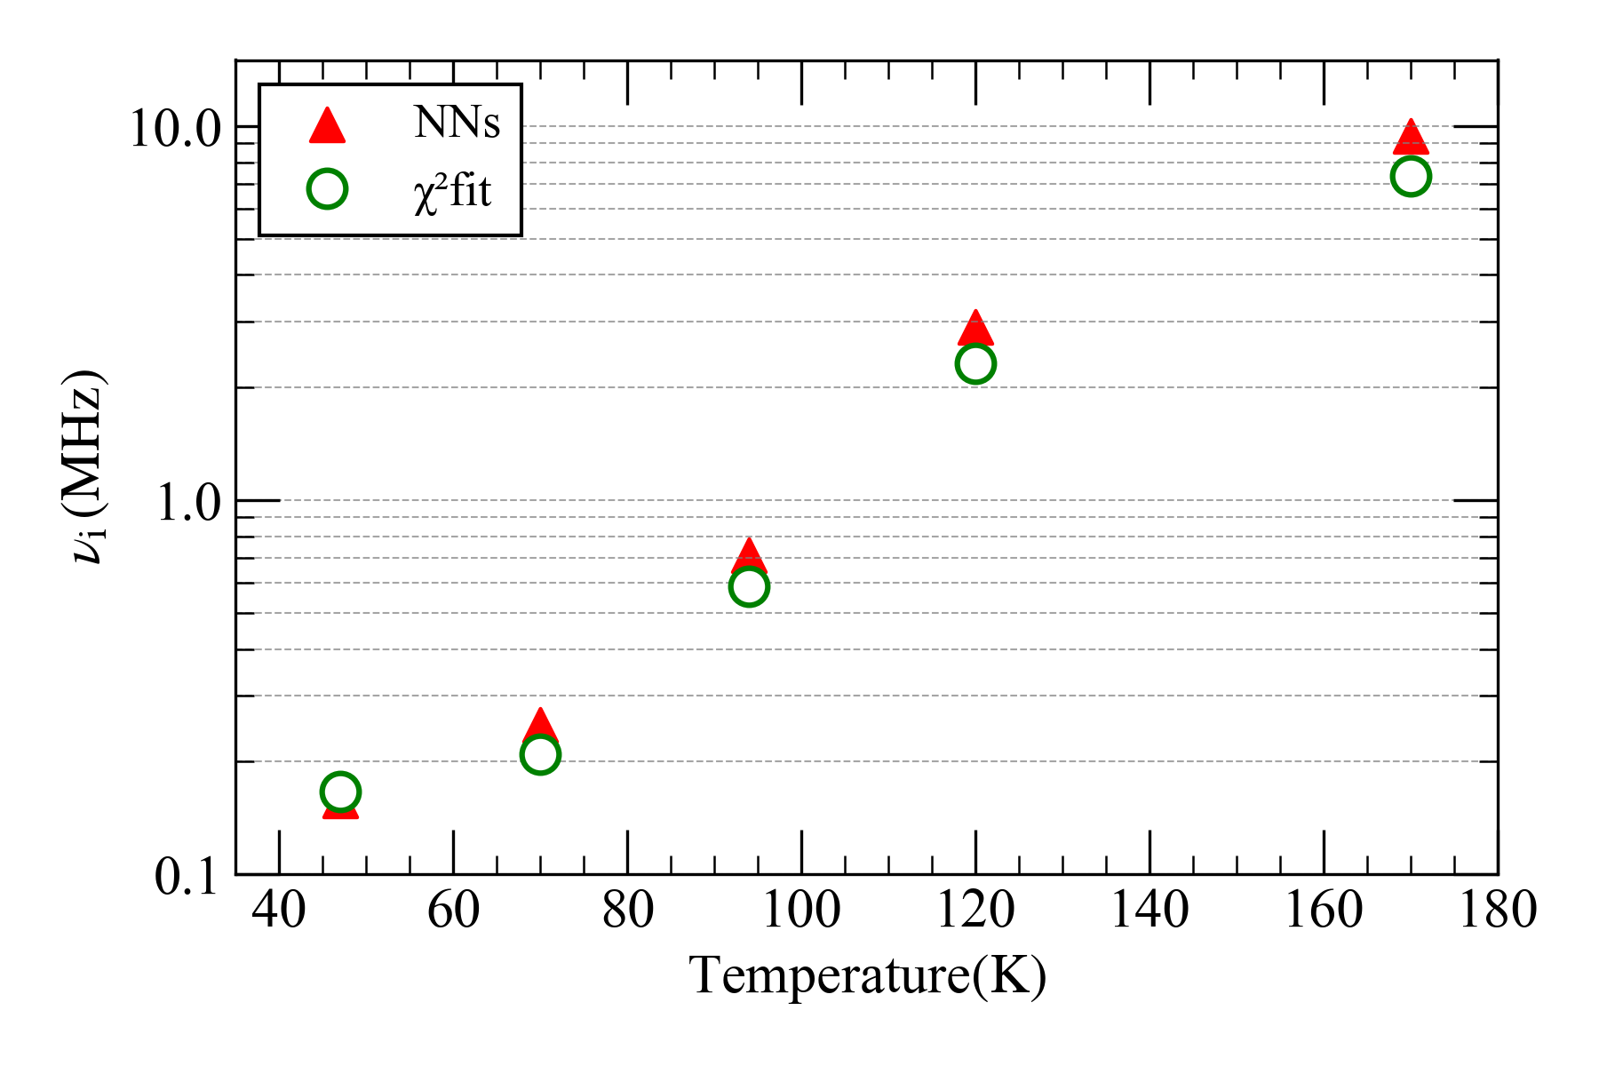
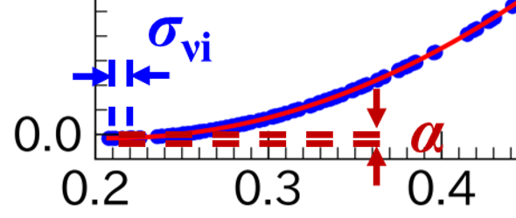
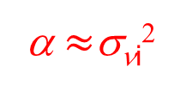
G1) AI vs χ² fits: NNs outputs
・AI vs χ² fits: NNs outputs
・Comparison between the NNs and χ² fit
α
Q=0.947(3)
Δ=0.191(1) MHz
α $≈$σ_{νi}²
σ_{νi} (MHz)
α is defined as the amount of change in S_{DL}
when the deviation σ_{νi} in the χ² fit was varied.
The NNs’ output values close to those
obtained by the χ² fit.→The feasibility
of analysis using NNs is demonstrated.
α is proportional to the squared deviation σ²_{νi} from the χ² fit,
→ the error estimated by the NNs corresponds well to that of the χ² fit.
Notes:
This figure shows AI vs χ² fit : NNs outputs. The NNs’outputs values close to those obtained by the χ² fit. Therefore, The feasibility of analysis using NNs is demonstrated. This figure shows the definition of a parameter , α. α is defined as the amount of change in the S_{DL} when the deviation σ_{νi} in the χ² fit was varied. This figure shows relationship between α and σ_{νi.} α is proportional to the squared deviation σ²_{νi} from the χ² fit. Therefore, the error estimated by the NNs corresponds well to that of the χ² fit.

Slide 12
G2) Bayesian Neural Networks (BNNs)
Input layer
Hidden layer
Output layer
Input data
Training/
Evaluation
Activation function
z_{k} = h(a_{k})
Loss function
Bias
Output function
y_{k} = s(a_{k})
Training data/
Answer t_{k}
s()
S_{DL}
t₁
s()
t₂
Weight
…
…
…
Key features
The weight parameters are treated as random variables generated by a certain probability distribution, and the model directly outputs the uncertainty.
Y. Gal and Z. Ghahramani, Proc. of The 33rd Inter. Conf. on Mach. Lear.: Proc. Mach. Lear. Rese. (PMLR) 48, 1050-1059 (2016).
Notes:
This figure shows Bayesian Neural Networks algorithms.
BNNs’ key feature is that the weights parameters are treated as random variables generated by certain probability distribution, and the model directly outputs the uncertainty.

Slide 13
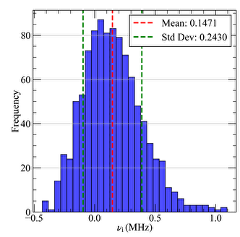
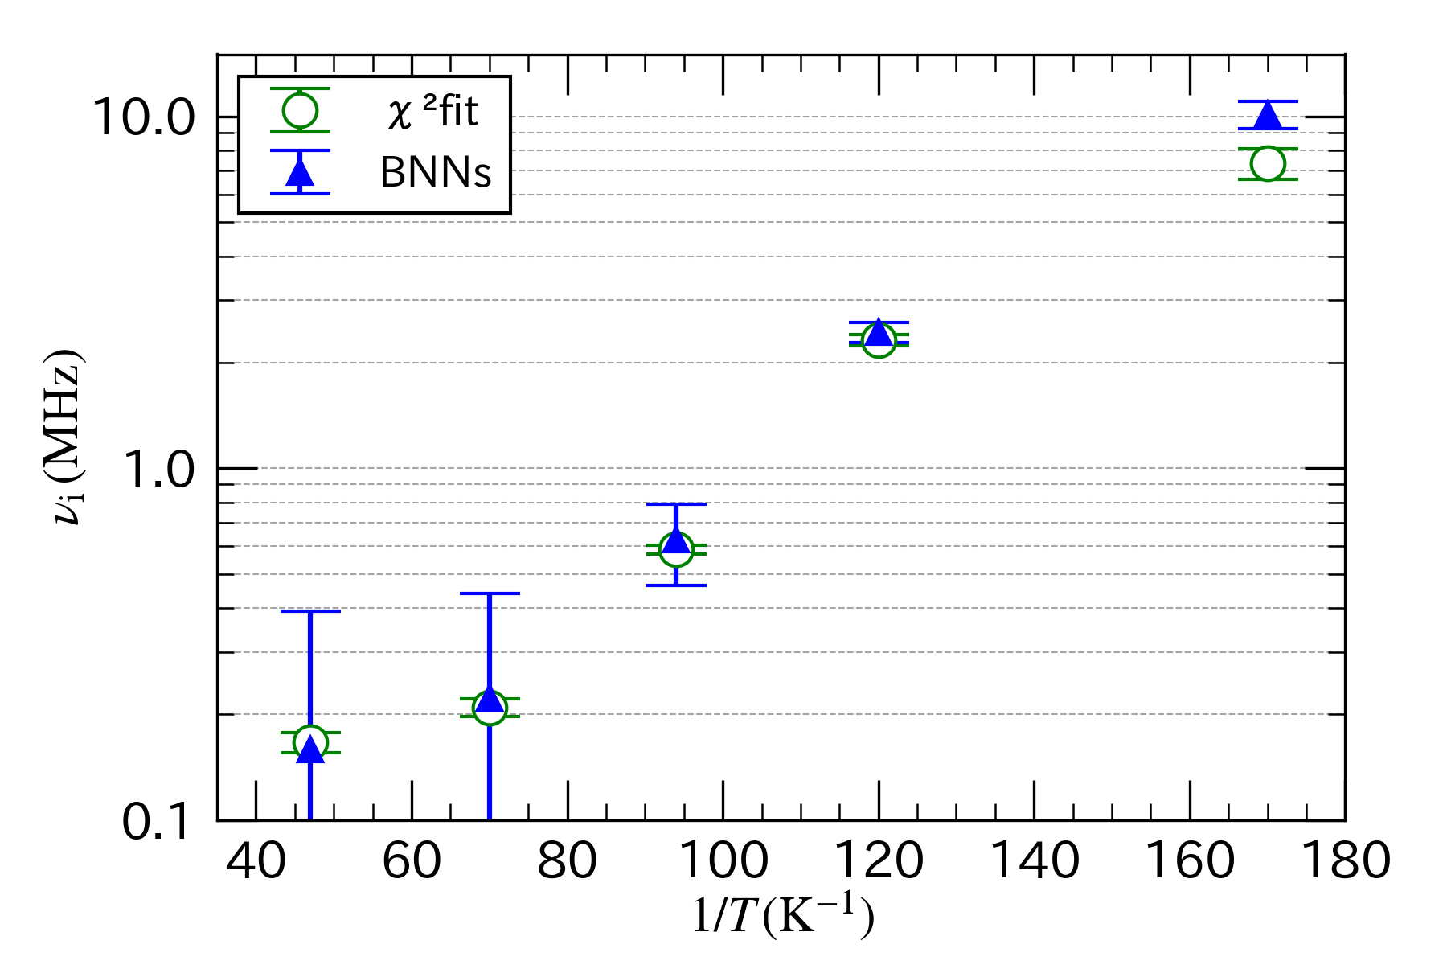
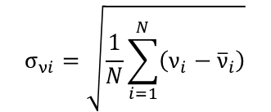
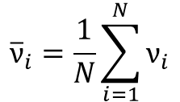
G2) BNNs outputs
Q=0.947(3)
Δ=0.191(1) MHz
$$σ_{νi}=\sqrt{\frac{1}{N}\sum_{i=1}^{N}{\left(ν_{i}−{\overline{ν}}_{i}\right)}}$$
$${\overline{ν}}_{i}=\frac{1}{N}\sum_{i=1}^{N}{ν_{i}}$$
The results demonstrated the potential of using a BNNs
to evaluate uncertainty. However, a remaining challenge is to separate the uncertainty originating from the NNs itself and statistical errors.
BNNs can produce outputs with uncertainty.
→ The error was evaluated using the mean
and standard deviation.
Notes:
This figure shows outputs of the BNNs. BNNs can produce outputs with uncertainty. Therefore, The error was evaluated using the mean and standard deviation. The results demonstrated the potential of using a BNNs to evaluate uncertainty. However, a remaining challenge is the inability to separate the uncertainty originating from the NNs itself and statistical errors.

Slide 14
Summry
1) Comparison between NNs-analysis and χ² fit
・The NNs outputs are in good agreement with the χ² fit results, suggesting that the NNs-based
analysis is feasible for the application to µSR.
・Since loss function can be regarded as a quantity similar to the χ² fit, the error estimated by
the NNs is concluded to correspond well to that from the χ² fit.
2) Error evaluation using BNNs
・BNNs can yield the uncertainty of the outputs without preceding calibrations by χ² fit,
suggesting that it is more efficient for error estimation.
Notes:
Summry is flowing.

Slide 15
fin
Notes:
Thank you.

