Slide 1
Investigating Structural Relaxations in epoxy – A unification of Microscopic and Macroscopic methods
B A Orton, S P Cottrell N K Chalashkanov

Slide 2
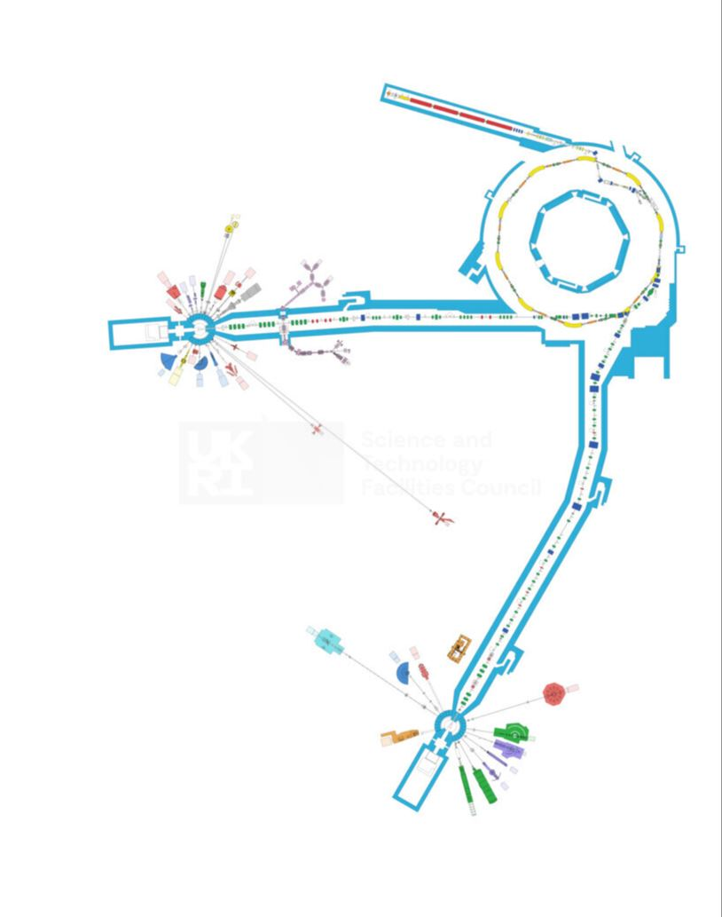
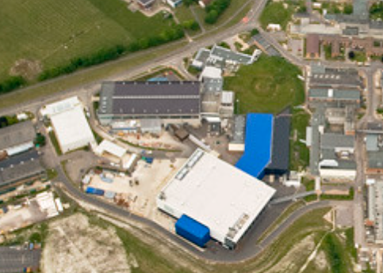
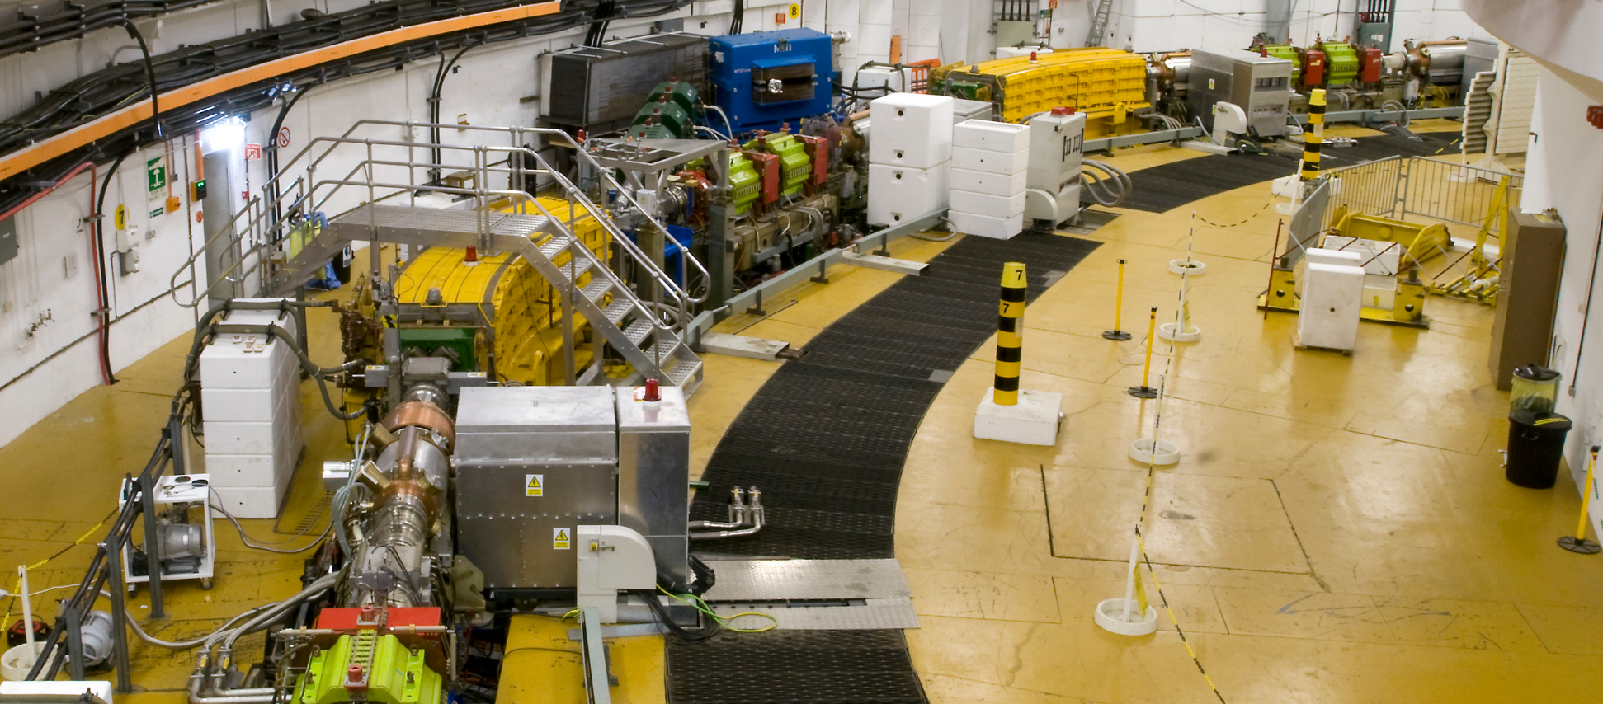
ISIS facility / Motivation
ISIS – The source
Main Magnets
Notes:
1 min
Work at ISIS source , Oxon UK
ISIS produces high energy muons and neutrons for physical science experiments by means of particle accelerators.
Accelerated particles controlled using electromagnetic fields produced by powerful electromagnets
Electromagnets breaking down – the reason why this work came about. This study is a study into the underlying mechanisms that cause breakdown

Slide 3

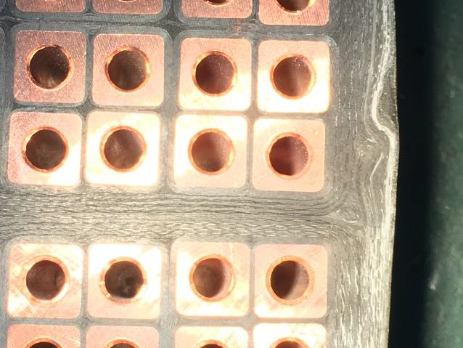
Breakdown
Mica tape
Glass tape
Epoxy resin (DGEBA)
Breakdown
Dielectric separating conductors is unable to prevent conduction current flowing due to physical changes in composition
Charge distribution and dynamics are ultimately responsible for breakdown
We are looking at macroscopic and microscopic methods of studying charge dynamics and how it is affected by the underlying structural dynamics
Notes:
1 min
Dielectric
LH fig: magnet cross section – showing conductors separated by the complex dielectric – consisting of mica and glass tapes embedded in epoxy – DGEBA
Upper RH fig: composition of complex dielectric – individual components
Breakdown
Breakdown is ultimately caused by the distribution and dynamics of charges, and therefore we must understand them in order to be able to understand it.
Increase in field due to charge distribution gives charges more energy & the above ionisation energy causing physical destruction
We are looking at micro and macroscopic ways of studying this charge

Slide 4
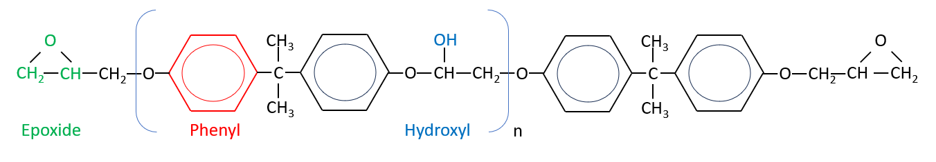
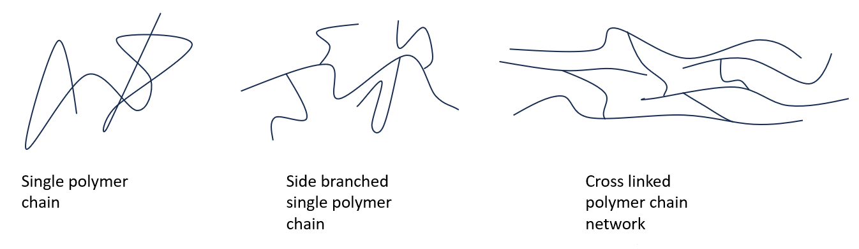
Polymer structure / Relaxations
Monomers add to form polymer (single chain)
Backbone of main chain – Carbon and Phenyl ring
Hardened to form network
Relaxations involve motion of chains and parts of chains
Relaxation | Alpha | Beta | Gamma
Motion | Cooperative main chain motion | Segmental main chain / side branch motion | Phenyl ring motion
Timescale | 100 s | 100us – 100 s | 1 us
Temperature | 370 K | 325 K | 120 K
Notes:
2 mins
We are primarily concerned with the epoxy
Normally carbon in the chain or backbone
In this case the monomer contains a Phenyl ring
Chains exist singly, with some side branches until a hardener is added when they form a crosslinked network.
The hardened network undergoes physical changes as f(T) – and the electrical and mechanical properties of the polymer undergo gross changes
IN DGEBA there are 3 temperature regions where distinct physical changes occur. The regions are known as relaxations.
These are each related to specific motions, each with their own timescale
Starting with the highest temperature relaxation (alpha) the physical changes are cooperative main chain motion, where the entire network of polymer chains is free to move.
The glass transition region (where the epoxy goes from a glassy to a rubbery state and the conductivity increases enormously) is synonymous with the alpha relaxation
Going down in temperature the next relaxation is the beta relaxation, associated with motion of small segments of individual chains (no cooperative motion anymore) 4 C atoms or side branches
Lastly, at the lowest temperatures is the gamma relaxation which is caused by motion of the Phenyl rings

Slide 5
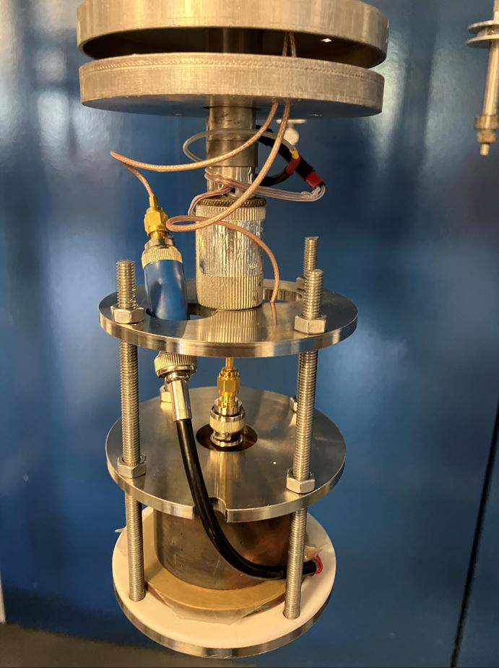
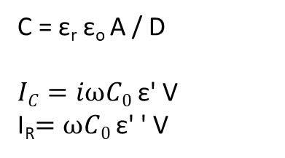
Comparison of Microscopic and macroscopic methods
Muon spectroscopy (uSR) | Broadband dielectric spectroscopy (BDS)
Microscopic | Macroscopic
Local probe | Bulk probe
Muon implantation / Polarization measurement | Voltage application / Impedance measurement
us (MHz) | us – s (MHz – uHz)
Structural dynamics (in this application) | Electrical characteristics
Measurement electrode
Epoxy sample
≈ 200 um thick
C = ε_{r} ε_{o} A / D
$IC=iωC0$ ε' V
I_{R}$=ωC0$ ε' ' V
Forcing electrode
Notes:
2 mins
Several aspects to this work:
Study charge dynamics and distribution
Examine areas of dielectric / polymer relaxation
Unite micro and macroscopic methods in order be able to attribute electrical phenomena with changes in charge dynamics caused by microscopic structural changes.
Comparison of methods
See table
BDS is a bulk method that measures the contributions from all
Processes – at high frequencies only fast processes such as ring motion are measured
At lower frequencies slower processes such as chain motion are measured but so are the high frequency processes
It is not a selective method!
Conversely, uSR is site specific – not bulk, and also only high frequency process are measured – it is selective, but cannot measure low
Frequency processes
RH Fig: BDS setup. The sample is representative of the epoxy in the magnets that undergo breakdown

Slide 6
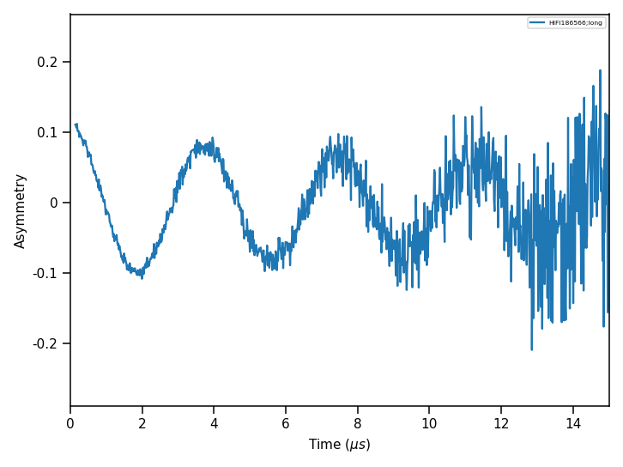
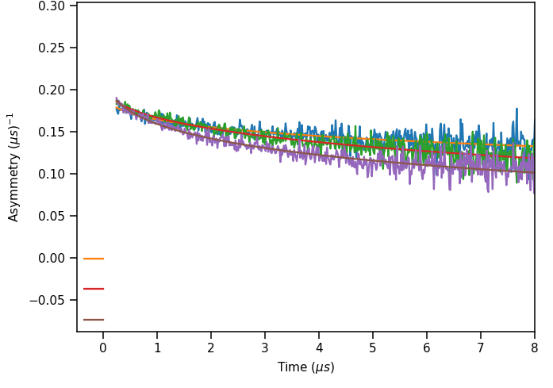
TF and LF measurements
75 K
375 K
435 K
Notes:
1 min
Carried out TF measurements with a low field (20 G) applied to determined the paramagnetic fraction.
Total asymmetry of EMU is around 0.26.
Fig at top left shows initial A of approx. 0.11 indicating around 60 % of the muons form Muonium
Relaxation at 100 G in LF
Initial LF at 100 G measurements: significant dependence of A and lambda on T

Slide 7
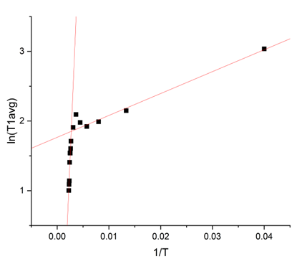
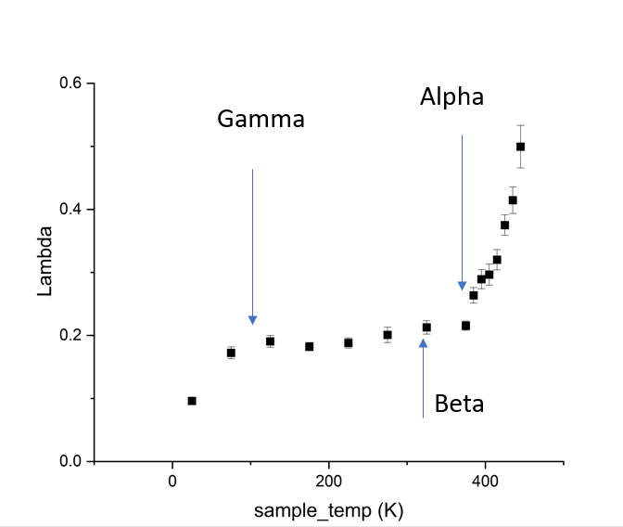
Tg / Activation energy
Tg (K) | Method
350 K | DSC
380 K | uSR
370 K | BDS
Ea (eV) | Method
a,0.18 | uSR
a,2 | BDS
γ,0.015 | uSR
γ,0.048 | BDS*
* Istebreq A. Saeedi, Nikola Chalashkanov, Leonard A. Dissado, Alun S. Vaughan, Thomas Andritsch,
The nature of the gamma dielectric relaxation in diglycidyl ether Bisphenol-A (DGEBA) based epoxies,
Polymer, Volume 249,2022, doi.org/10.1016/j.polymer.2022.124861.
Notes:
3 mins
LF measurements taken over a range of B fields and temperatures
A single field is shown (100 G)
There is a step change in the T1 relaxation at around 120 K corresponding to the gamma relaxation.
There is a small but statistically significant peak in the in T1 at around 320 K where the beta relaxation is expected.
Note that as the beta relaxation is similar to the alpha relaxation in that in involves main chain motion – just on a localised scale – it is hard to discern from the alpha relaxation. This is the case with BDS measurements as well and it is commonly postulated that the beta process is actually subsumed by the alpha process
Lastly the T1 relaxation rises exponentially in the alpha relaxation region.
This unites macro and micro indirectly – the relaxations are observable using both methods at equal temperatures, however to truly attribute the macroscopicalby observable phenomena to the microscopic changes there needs to be certainly that it is the same process being observed, and so we turn to the acactication energy. If it is the same process ebing observed with both methods the Ea should be the same.
Arrhenius plots (fig right) were derived from the T1 measurements, with the slope providing the activation energy.
Unfortunately, Ea alpha are clearly very dissimilar, however, this is not unexpected:
BDS measurements encompass main chain motion on the timescale of 100s., and therefore the major contribution to Ea arises from this motion. This is invisible to usr due to the time scale.
However, the gamma relaxation does not involve chain motion, just rPhenyl ring motion, and so the Ea for both methods should be equal., and indeed the correlation between the Ea gamma is very good.

Slide 8
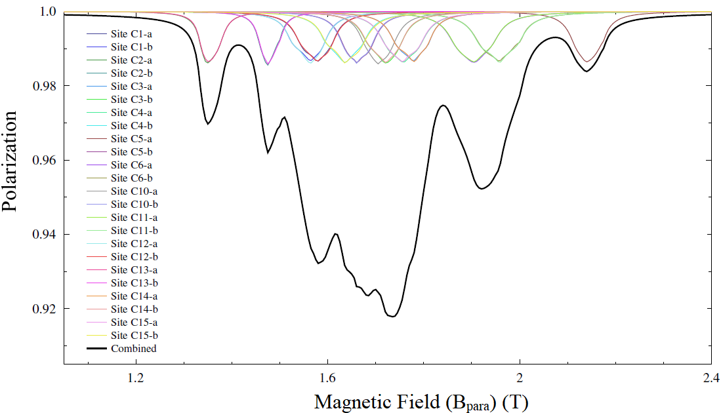
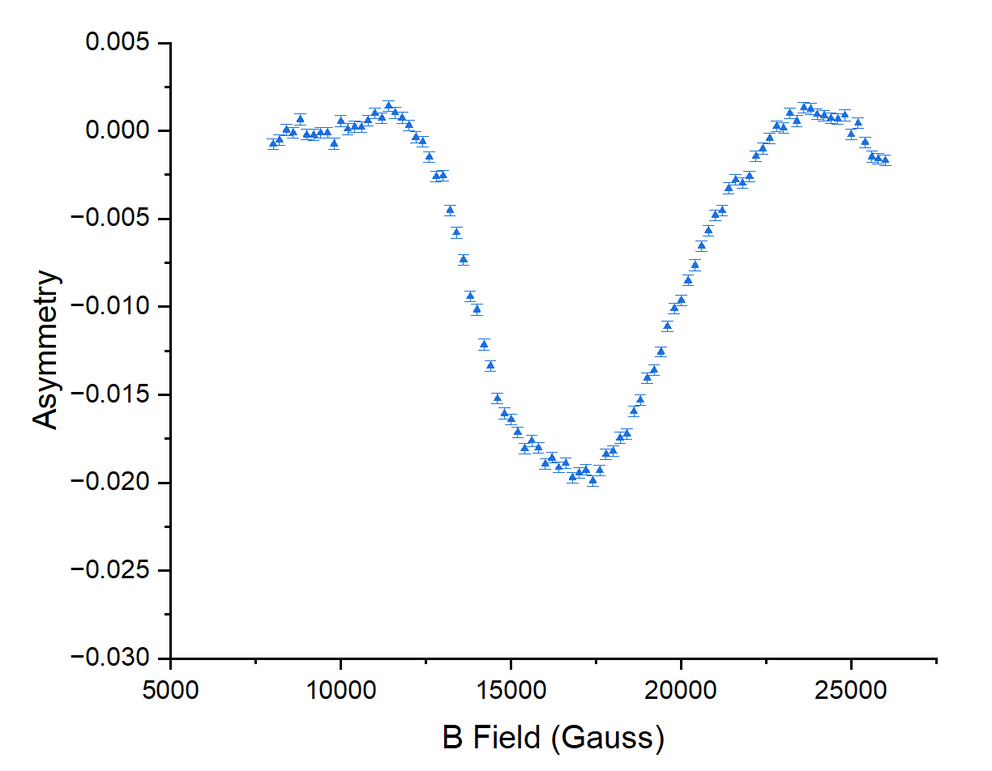
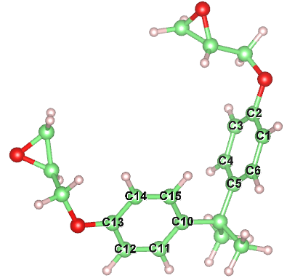
DFT / ALC and site assignment
B_{res} ≈ 1.75 T
Notes:
LH fig: DFT
Inset: site assignments
RH fig: ALC spectra (300 K) that was guided by DFT and corroborates the site assignment
Good correlation between ALC and DFT Bres, peak width and overall lineshape
Conclusion:
Muonium goes on to form Muoniated radicals on the ring (due to high electron density)
Note: Disordered system – many sites, many possible orientations, indicated by DFT

Slide 9
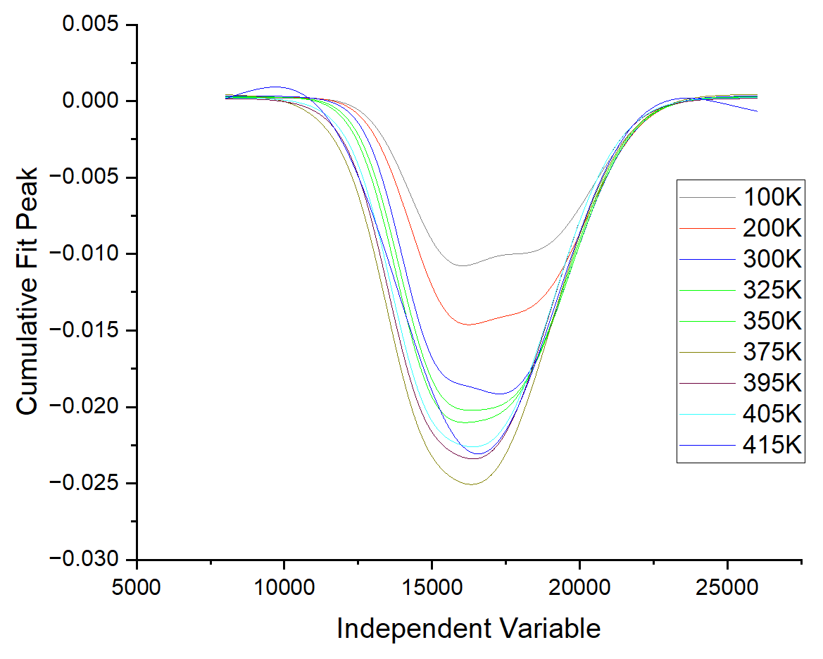
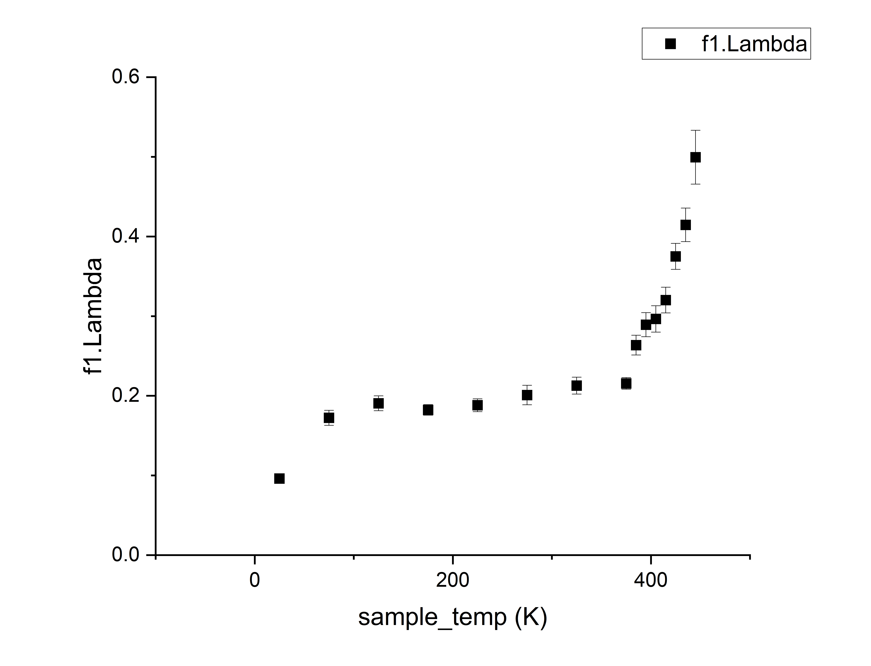
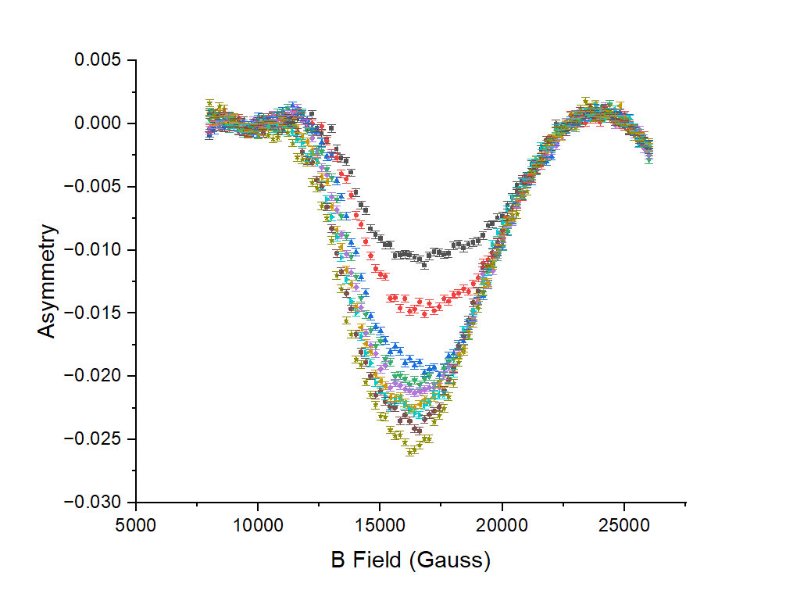
ALC spectra and Relaxations – correlation
Alpha (375 K)
Gamma (100K)
Beta (315 K)
Notes:
Ploits:
LH: Fits to ALC data - 2 peak Lorentzian using origin
RH: Plot showing the temperatures at which the alpha, beta and gamma relaxations occur
The 2 lowest temperature spectra show a low amplitude response with a distinct trend in asymmetry towards low fields
These are slightly above the gamma relaxation region
At 300K, around the beta transition, the amplitude has increased and the asymmetry has shifted towards higher fields, this asymmetry then shift back again to lower field as the alpha relaxation is approached
At 375K the asymmetry has almost disappeared. However, the amplitude now starts to decrease, until 415 K when it starts to rise again.
Interestingly this marks the onset of the glass transition temperature, and indeed above this temperature the spectra appears to remain fairly symmetrical, again until it reaches 415 K where the high field trend recurs
We are looking at the delta 1 resonance changes in dipolar coupling change the powder opattern
The powder pattern
Motion of the molecule, such at rotation bout the axis will change the low and high field sides, which will alter the width of the delta m 1 linewidth, so these changes should an be used to investigate the type of motion we observe during each of the different relaxations
Summary
There are very notable changes in asymmetry and amplitude at the temperatures corresponding to the relaxation regions, and each region where a particular type of ring becomes activated has its own distinct spectral form. Changes in this spectral form could well indicate the type of motion the ring is undergoing, for example, torsional, rotational or vibrtational

Slide 10
Hypothesis
As the temperature increases the rings come into close proximity as the whole ring moves on the (moving) main chain. Consequently, the probability of charge hopping and tunnelling increases, thereby increasing the conduction current
Notes:
0.5 mins
One las closing point – all well and good attributing electrical characteristics to structural changes, but how for example to they actually cause these changes???
That needs further investigation, however we have a working hypothesis….

Slide 11
Summary
Muonium is present in DGEBA and forms a radical on the Phenyl rings
There are distinct changes in the muon relaxation at temperatures corresponding to polymeric relaxations
The glass transition temperature is easily determined from uSR
Activation energies can be determined from uSR and BDS and show a good correlation at cryogenic temperatures in the gamma relaxation region
ALC scans show distinct families of lineshape in the different relaxation regions
Combined with DFT and simulations they can potentially be used to determine the type of ring motion
Notes:
1 min

Slide 12
Future work
Carry out more detailed uSR and BDS measurements in the gamma relaxation temperature region to improve the accuracy of the activation energy calculations as well as in the beta region to establish an Eaβ
Further model ALC spectra and carry out simulations to determine in what manner the motion of the Phenyl ring changes

Slide 13
Thanks
I would like to thank the ISIS facility for use of the EMU and HiFI instruments, Steve Cottrell for all of his input as well as the rest of the muon group for their help over the years

