Slide 1
CFI IF 2025 and Beyond for ALPHA/HAICU in FYP 2025-30
CFI 2025: ALPHA Upgrade and R&D for quantum measurements
Modernization of aging equipment
Preparation for entirely new ways to do antimatter measurements: fountain, modularization
IF 2028: HAICU@ALPHA
A major project, to build fountain at ALPHA@CERN
Upgrade HAICU infrastructure at TRIUMF
TRIUMF FYP 2030 - 35
Quantum Physics with Antimatter: Fountain, Interferometer, Antihydrogen molecules
Makoto and Andrea for ALPHA/HAICU
PP Meeting, May 16, 2024

Slide 2
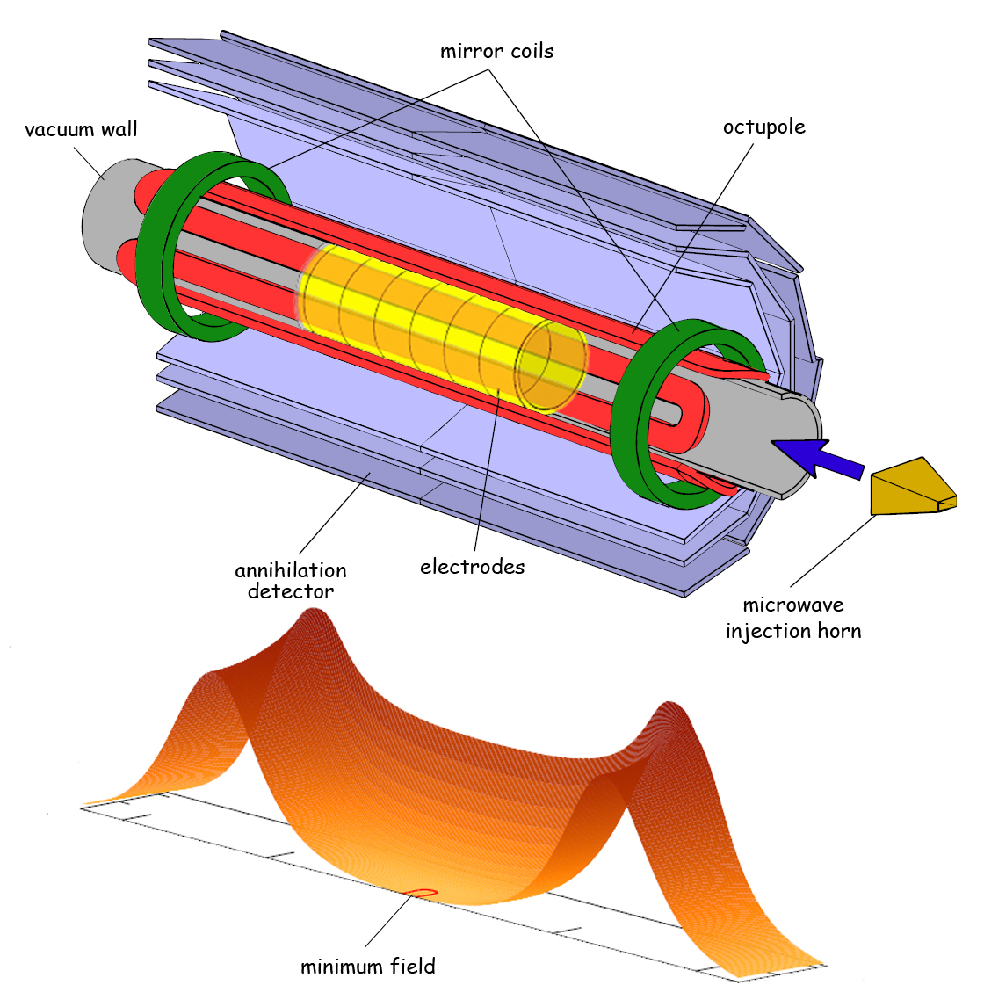
Longer term vision
Magnetic trap: success and curse
Since 2010, has allowed many success of ALPHA
Magnetic field inhomogeneity; exponentially increasing complexity; lack of access
New paradigm is needed! (i) hydrogen loading, (ii) modularization
HAICU
ALPHA Upgrade
New conditions
Free free
Ultra-cold
High densities
Modularization
Decouple functionalities; trapping/cooling vs. physics
Fountains
Interferometers
Anti-atomic ”conveyer belt”
Moving trap
Optical trapping
Precision spectroscopy
Cryo, vauum
HiTc magnets
Anti-molecules

Slide 3
CFI: ALPHA Upgrade – Decision in Late 2025
Intervention during LS3 – time critical
CFI IF 2025
Currently aiming for CAD$10M to 18M – depending on university competitions
Budget Items [Both CFI funded and Internationally funded]
Detector upgrades — DAQ [TRIUMF, led by Andrea]
Microwave development – Pbar-NMR [Calgary]
LyA and other laser upgrade , e.g. 4-wave mixing or CW LyA [UBC]
ALPHA-3: new Penning trap, metrology [UK, Denmark]
Modernization (ALPHA-2 magnet control, e+ accumul sequencer, cat. trap, Penning trap amplifier etc [UK, Calgary]
Hydrogen in ALPHA [UBC]
ALPHA-g upgrades & support incl. cryo infrastructure [TRIUMF, Chukman, &UK]
Other R&D towards fountains, modulization (at CERN & off-site) [TRIUMF, Chukman]

Slide 4
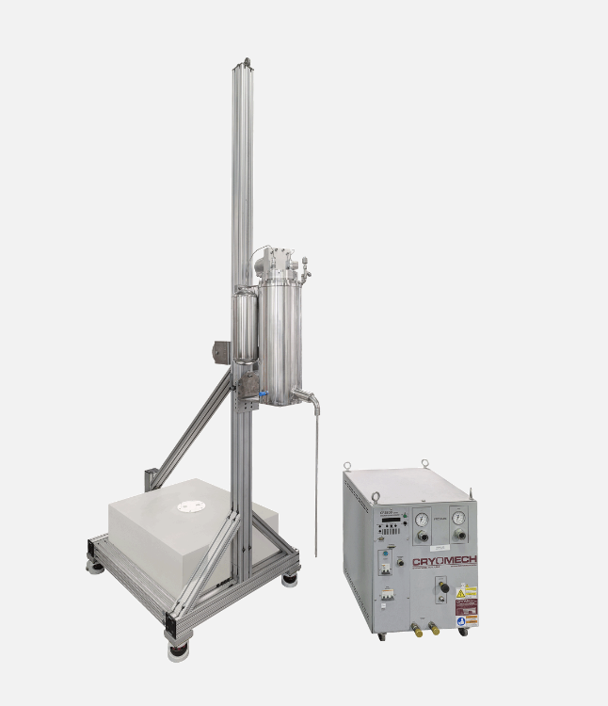
Some possible upgrade during LS3
ALPHA-g cryo improvement
Developments towards modulization:
Decoupling physics from production, trapping, and cooling
Challenge in designing a new experiment: Plasmas, Hbar production etc
Decoupling the initial trapping would allow significant simplifications
One possibility: Magnetic “conveyer”; strip line coils, inserted at top
(Note: once laser cooled, Hbars are very cold!)
1st step: release and detect Hbars at the other end
Next step: recapture, re-cool Hbars with another trap, e.g. HAICU type trap
Ultimately, probably want to replace ALPHA-g, but R&D can be done there
https://bluefors.com/products/liquid-helium-management-products/helium-reliquefiers/herl60-helium-reliquefier/
Mini He liquefier:
3 x 5W cryocoolers will cut He usage by half?
HAICU trap & Fountain
Also inject H from Decelerator?

Slide 5
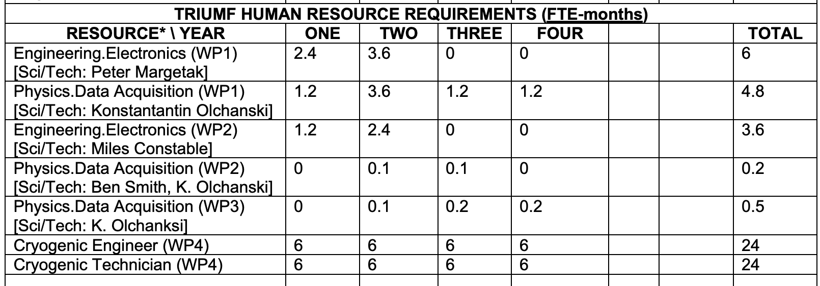
TRIUMF resources for IF 2025 (from Proj. Int. Sheet)
WP1: ALPHA-2 Si vertex readout/DAQ
WP2: ALPHA-g Barrel Veto upgrade, ancillary detectors
WP3: Hydrogen detectors (SiPM, MCP)
WP4: ALPHA-g cryo, fountain R&D

Slide 6
Back up

Slide 7
Possible CFI Timeline
“LS3 expected from Nov/Dec 2025 to Man/June 2027” (Butin)

Slide 8
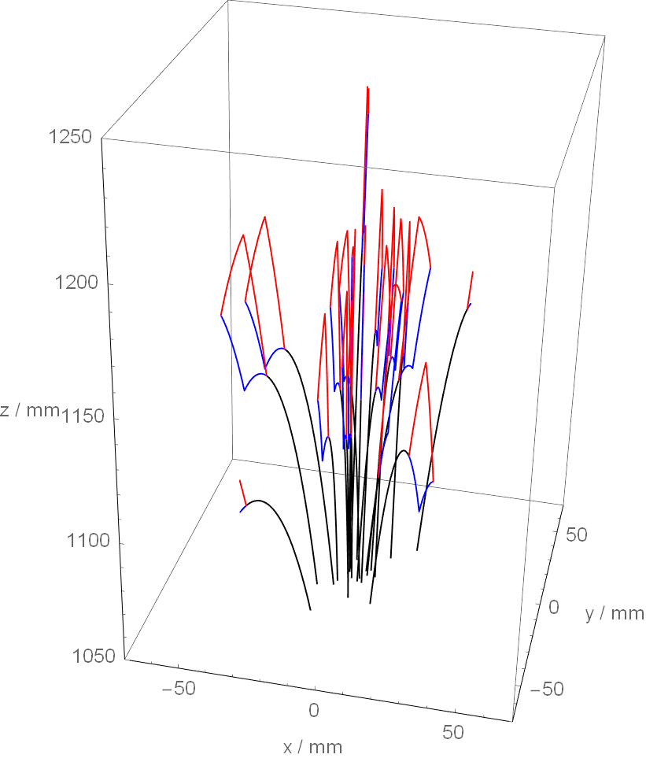
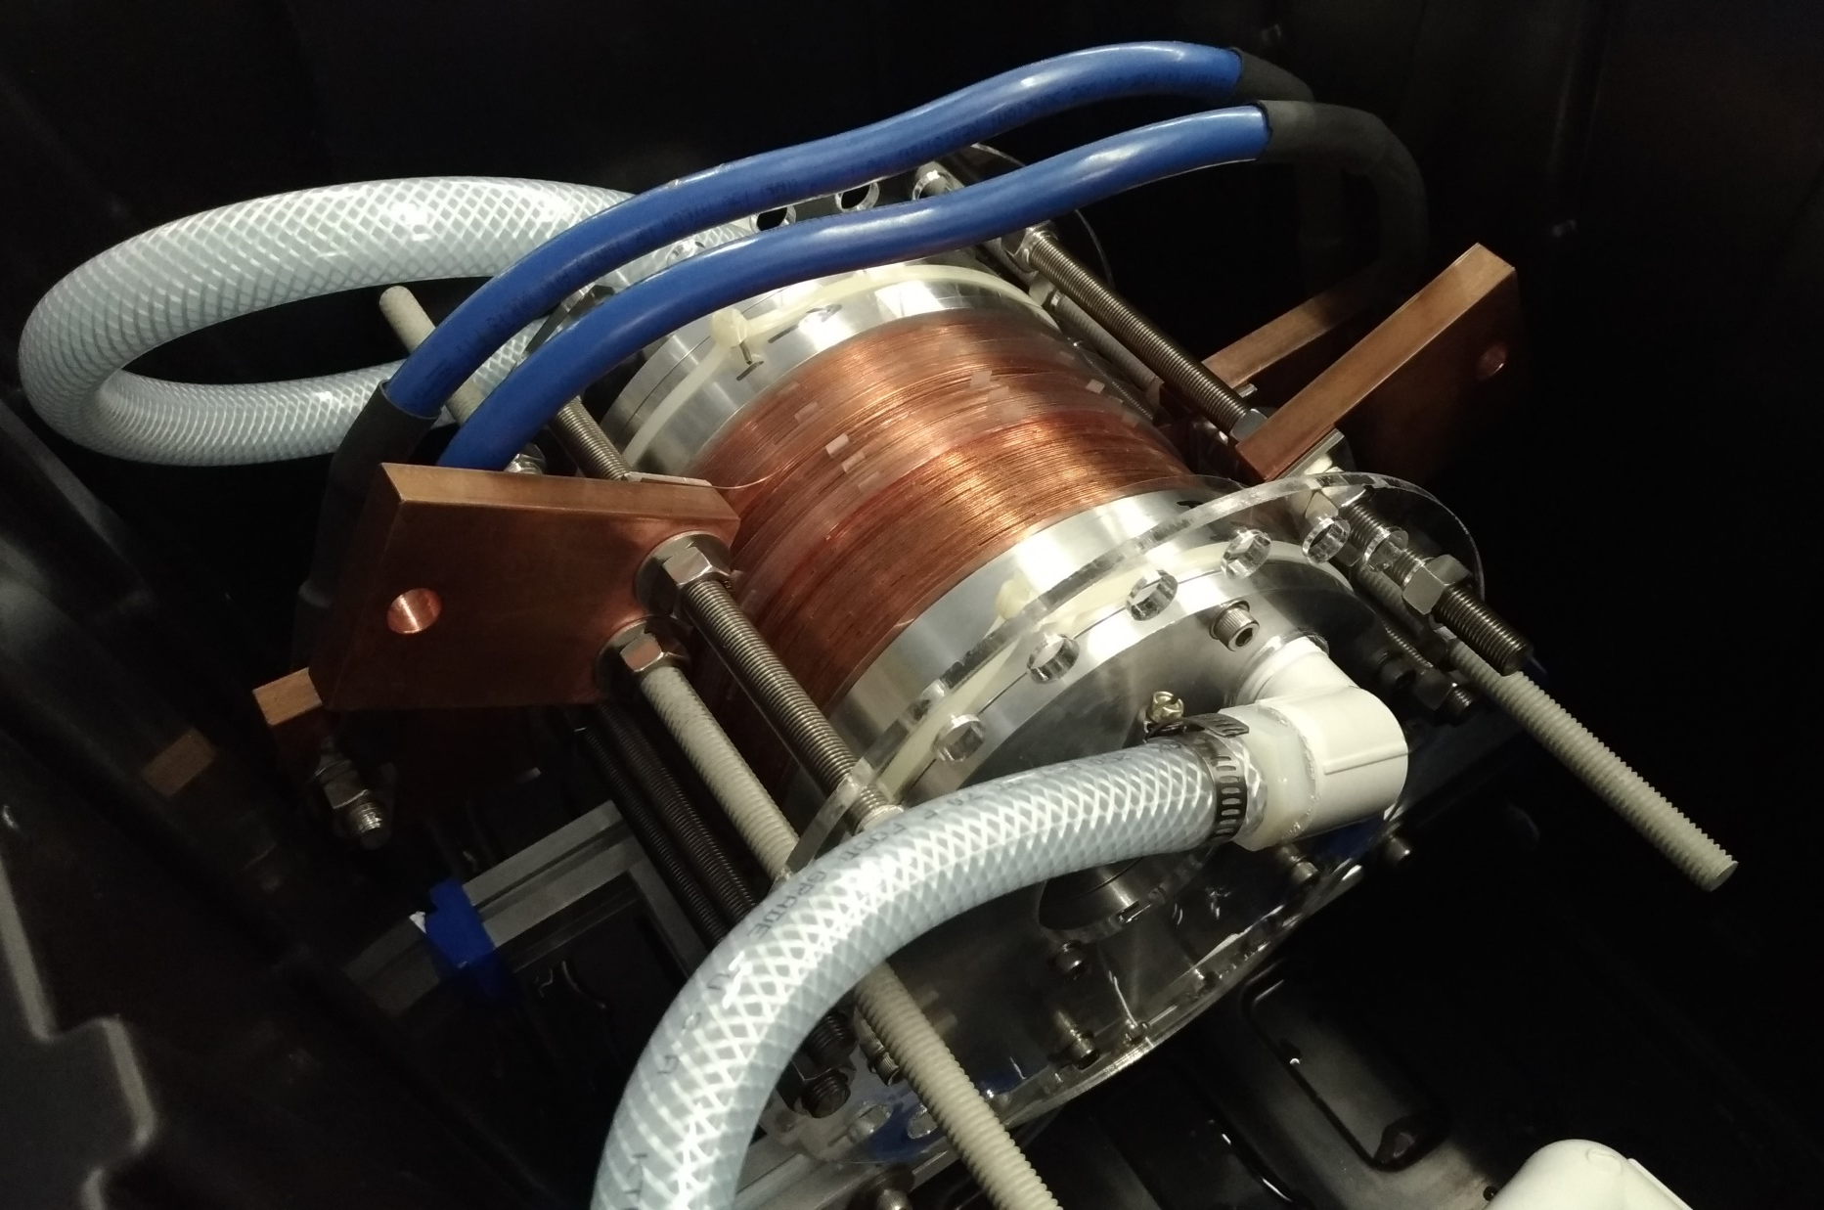
Towards HAICU@ALPHA
Antihydrogen fountain, interferometer & molecules – ultimate goals of some of us!
Physics objectives: see 2019 elog (https://alphacpc05.cern.ch/elog/ALPHA/24627)
Fountains — Gravity measurements at 10^-6 or better (Raman interferometer)
— HFS measurements at 10^-9 (Ramsey interferometer)
Extremely high densities —Formation of antihydrogen molecules, molecular ions, Hbar+ ions
Ultracold/field free —Precision 1S-2S spectroscopy with micro-K atoms
—Optical trapping in 2S or 1S states
Technical challenges
Temperature, temperature, temperature!
Magneto Optical Fridge —Strong magnetic field gradients, while allowing radial optical access
Current R&D
Normal conducting magnetic trap – ”Bitter” magnets
Hydrogen decelerator with bending sections
Hydrogen detection
Phased approach
Phase 1.1 (H trapping); 1.2 (3D laser cooling); 1.3 (2S preparation); 1.4 (Raman) → starting this year
Phase 2 trap: hydrogen fountain, interferometer
Phase 3 trap: antihydrogen fountain, interferometer
Future R&D
HiTc magnets for the trap
Plasma stability in Be cooled quadrupole trap?
More intense LyA for 1S state Raman scattering
Modularization – transporting Hbars out from the production trap
…
Aim for CFI application in 2027 (decision in 2028?)

