Slide 1
ALPHA/HAICU Perspectives: 2025-30 & Beyond
Makoto Fujiwara, Andrea Capra, Chukman So
PSD Retreat, May 24, 2024

Slide 2
Long-term goal of ALPHA
To make comparisons of hydrogen and antihydrogen at highest precision possible

Slide 3
ALPHA&HAICU: Taking Antimatter into Quantum Era
CFI 2025: ALPHA Upgrade and R&D for quantum measurements
Modernization of aging equipment
Preparation for entirely new ways to do antimatter measurements: fountain, modularization
IF 2028: HAICU@ALPHA
A major project, to build fountain at ALPHA@CERN
Upgrade HAICU infrastructure at TRIUMF
TRIUMF FYP 2030–35
Quantum Physics with Antimatter: Fountain, Interferometer, Antihydrogen molecules, Optical trapping
Possible timeline
Window of opportunities
for upgrading obsolete equipment, incl. detector DAQ
Mostly Sci/Tech resources +
Cryogenic engineering

Slide 4
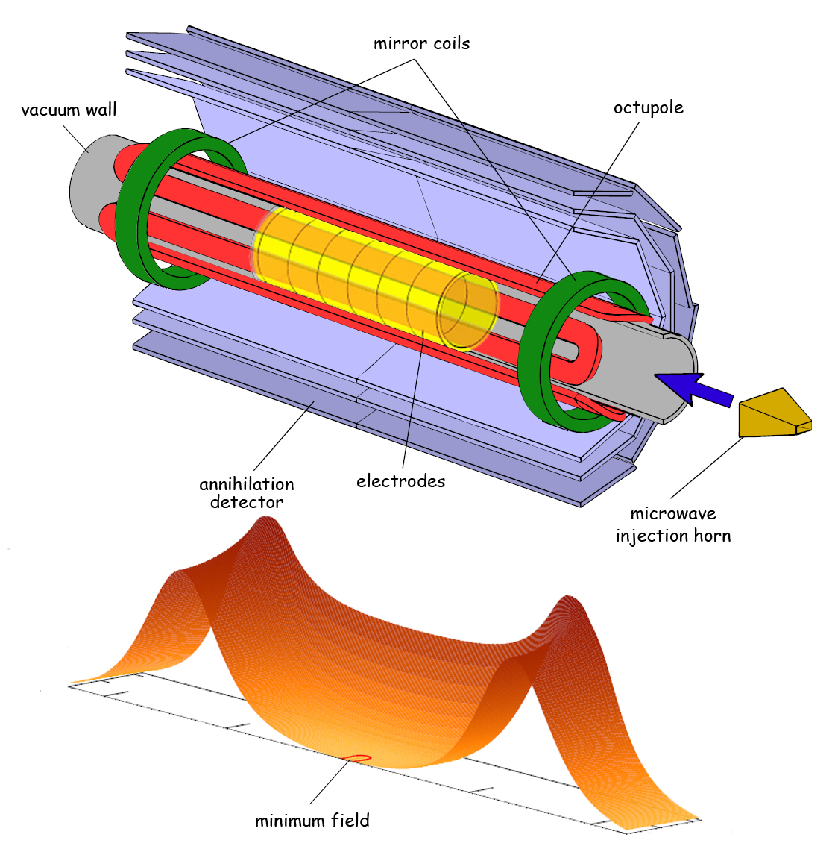
Next Steps in Anti-H research
!
Magnetic trap: success and curse
Since 2010, has allowed many success of ALPHA
Magnetic field inhomogeneity; exponentially increasing complexity; lack of access
New paradigm is needed!
HAICU
ALPHA Upgrade – New CFI
New conditions
Free free
Ultracold
High densities
Modularization
Decouple functionalities
Fountains
Interferometers
Anti-H Trapping, cooling
Anti-H
Science trap
e.g. Fountain, spectroscopy
H
H source
Anti-molecules
Precision spectroscopy
Anti-H transport
e.g. via ”conveyer belt”
Optical trapping

Slide 5
Summary
ALPHA/HAICU continues to push exciting antimatter science program well into 2030s
Projects technically very challenging, but we must keep breaking new grounds to stay competitive
CFI IF2025 will allow time-critical upgrades, but have limited impact on TRIUMF (DAQ, Cryo), though 2026 is a critical year (unless CERN LS3 is delayed)
More significant (>$20M) proposal is anticipated for IF2028 to realize an anti-atom interferometer at CERN
Strong synergies with other activities (Quantum, detector, AI, laser, accelerator, cryo, vacuum, HiTc magnets etc)

Slide 6
Back up

Slide 7
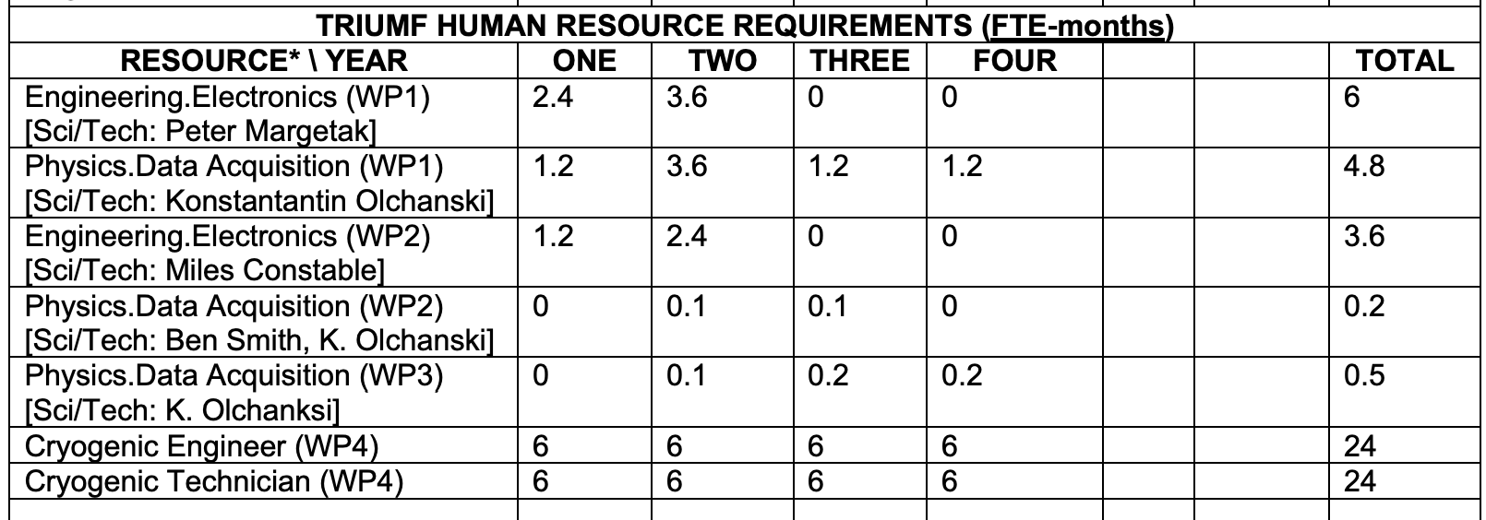
TRIUMF resources for IF 2025 (from Proj. Int. Sheet)
WP1: ALPHA-2 Si vertex readout/DAQ
WP2: ALPHA-g Barrel Veto upgrade, ancillary detectors
WP3: Hydrogen detectors (SiPM, MCP)
WP4: ALPHA-g cryo, fountain R&D

Slide 8
CFI: ALPHA Upgrade – Decision in Late 2025
Intervention during LS3 – time critical
CFI IF 2025
Currently aiming for CAD$10M to 18M – depending on university competitions
Budget Items [Both CFI funded and Internationally funded]
Detector upgrades — DAQ [TRIUMF, led by Andrea]
Microwave development – Pbar-NMR [Calgary]
LyA and other laser upgrade , e.g. 4-wave mixing or CW LyA [UBC]
ALPHA-3: new Penning trap, metrology [UK, Denmark]
Modernization (ALPHA-2 magnet control, e+ accumul sequencer, cat. trap, Penning trap amplifier etc [UK, Calgary]
Hydrogen in ALPHA [UBC]
ALPHA-g upgrades & support incl. cryo infrastructure [TRIUMF, Chukman, &UK]
Other R&D towards fountains, modulization (at CERN & off-site) [TRIUMF, Chukman]

