Slide 1
Scientific Computing in 2025-2030
W. Fedorko, R. Tafirout
Scientific Computing

Slide 2
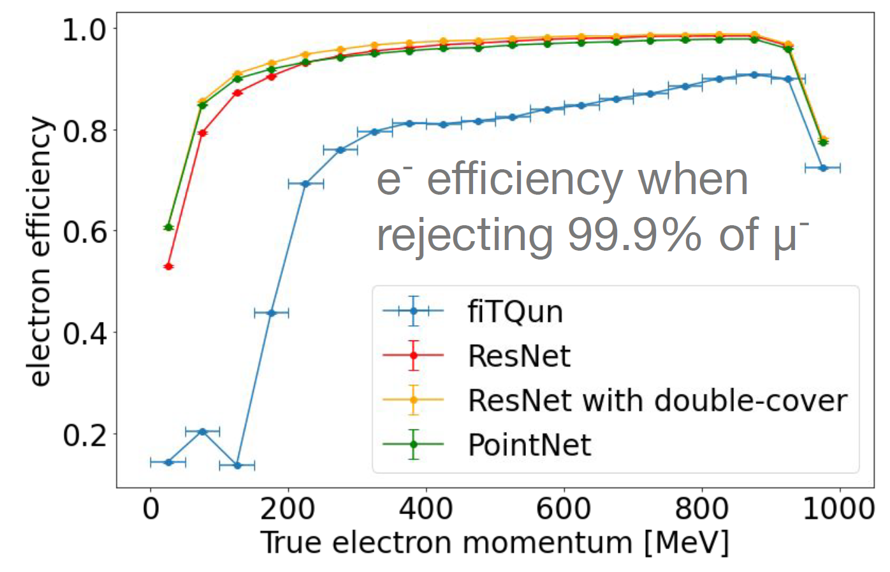
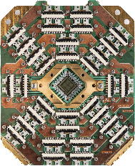
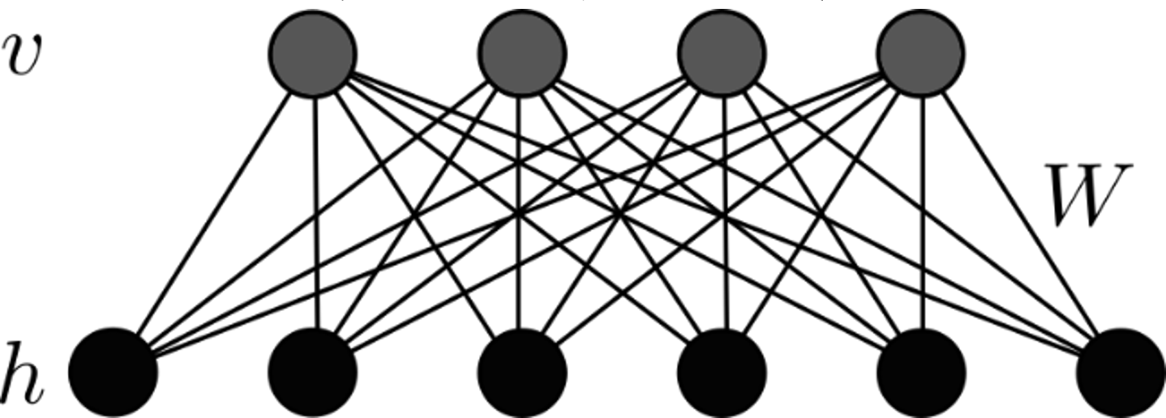
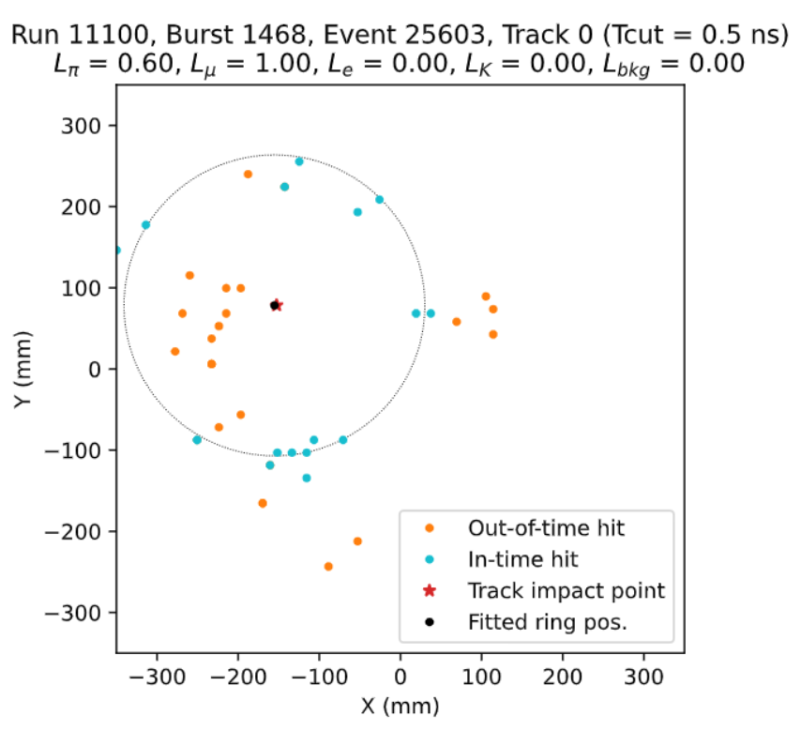
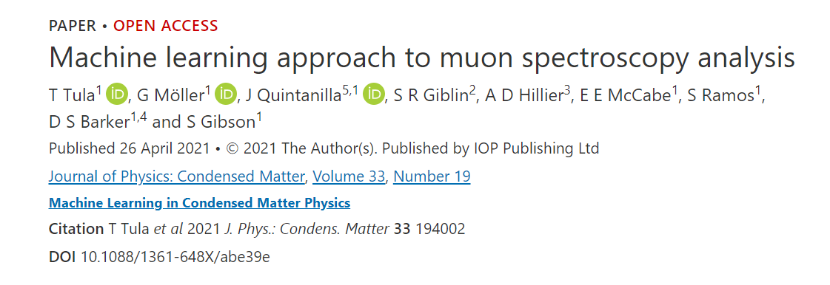
ML Activities: Success so far
Prior:
Restricted / Quantum Boltzmann Machine
ML engagement recent since 2018
Part of the current TRIUMF strategic plan
Supporting and driving multiple ML/QC aspects of projects:
Particle:
Water Cherenkov,
IWCD, WCTE, SK – planned tests with proprietary SK simulation + data! → publication
ATLAS
ML 4 pions / particle flow (public note)
FPGA / Real time ML for trigger
QML (publication submitted + new one in) NRC+AQC
ALPHA
NA62 (adopted, published)
Beam tuning on-going development, publication in internal review
→ support Operational Excellence
TIIGR
Some ‘consulting’ on SuperCDMS, Belle2
Supporting ML servers; new one for ATLAS ML projects + Beam Physics + other projects incidentally as a courtesy
DRAC not suited for rapid development
In-house machine will die, outdated
No active projects:
Nuclear physics
Initial engagements; lecture (series)
CMMS
Proposed or existing applications exist in literature
Demonstrated interest, full house at the Nuclear Physics ML Applications lecture
Manpower limited
Simulation with misalignment and apertures
Beam center and envelope x y (cm)
Distance along beamline (cm)
Physical Machine: MCIS source ¹⁶O+

Slide 3
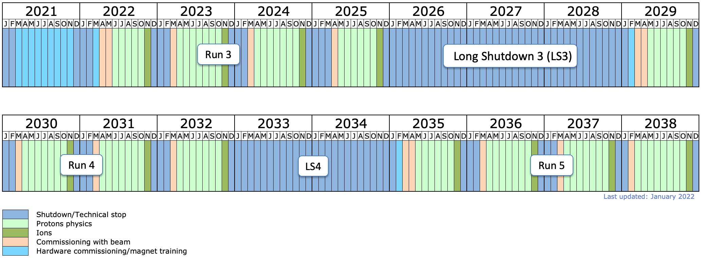
ATLAS Tier-1 Centre & next 5YP
Well established with ongoing 24/7 distributed computing operations and commitment.
No additional personnel nor capital for infrastructure and equipment is being requested from TRIUMF in the next 5YP.
Plan is for continuing 24/7 Tier-1 operations with existing TRIUMF staff complement.
New CFI IF 2025 proposal in preparation:
hardware refresh and significant expansion for the HL-LHC.
LHC long term schedule
personnel for software and computing R&D for the HL-LHC era.
Covers 2027-2031 time period (taking into account anticipated timeline for award finalization and in securing provincial matching funds).
Would bring infrastructure operating funds (IOF), primarily used for existing Tier-1 personnel (same as with prior CFI awards).
In parallel to CFI preparations, there are ongoing discussions with the Digital Research Alliance of Canada for seeking either partial or full support during 2025-2030 period (their next funding cycle request to ISED is in preparation).
Collaborating with SFU's Big Data Hub: work with non-academia entities to help them deal with data and computing challenges

Slide 4
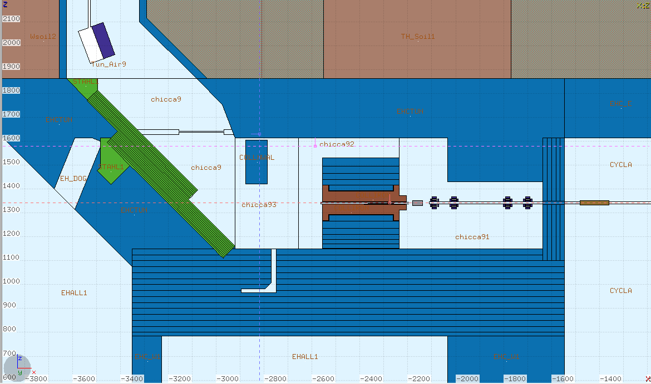
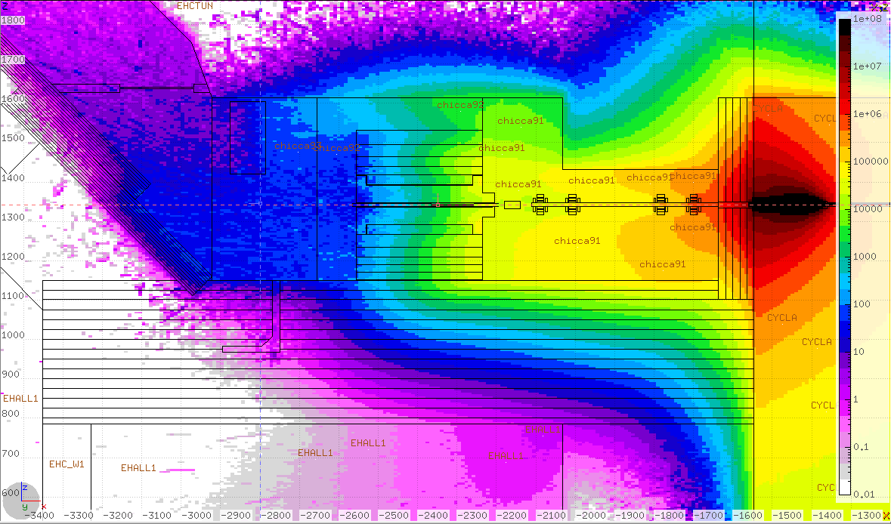
ARIEL support / FLUKA cluster
Since early 2020, a significant portion of the old ATLAS Tier-1 centre capacity is being utilized for large FLUKA simulations campaigns:
336 cores added to existing IS&T cluster via special network configuration (for security)
Crucial role in the design and construction of ARIEL shielding (time sensitive)
Typical simulation campaign lasts about 1 month when using 360 cores
FLUKA cluster also used by PIF/NIF and other projects, like FLASH.
Additional features implemented since early 2024:
HTCondor batch system to help in more efficient access and use by different users (dynamic scheduling)
Enhanced monitoring capability for cluster utilization and other metrics
CNSC approval received this week for BL4N operations with current shielding configuration.
Geometry model of proton cave
Equivalent dose radiation map

Slide 5
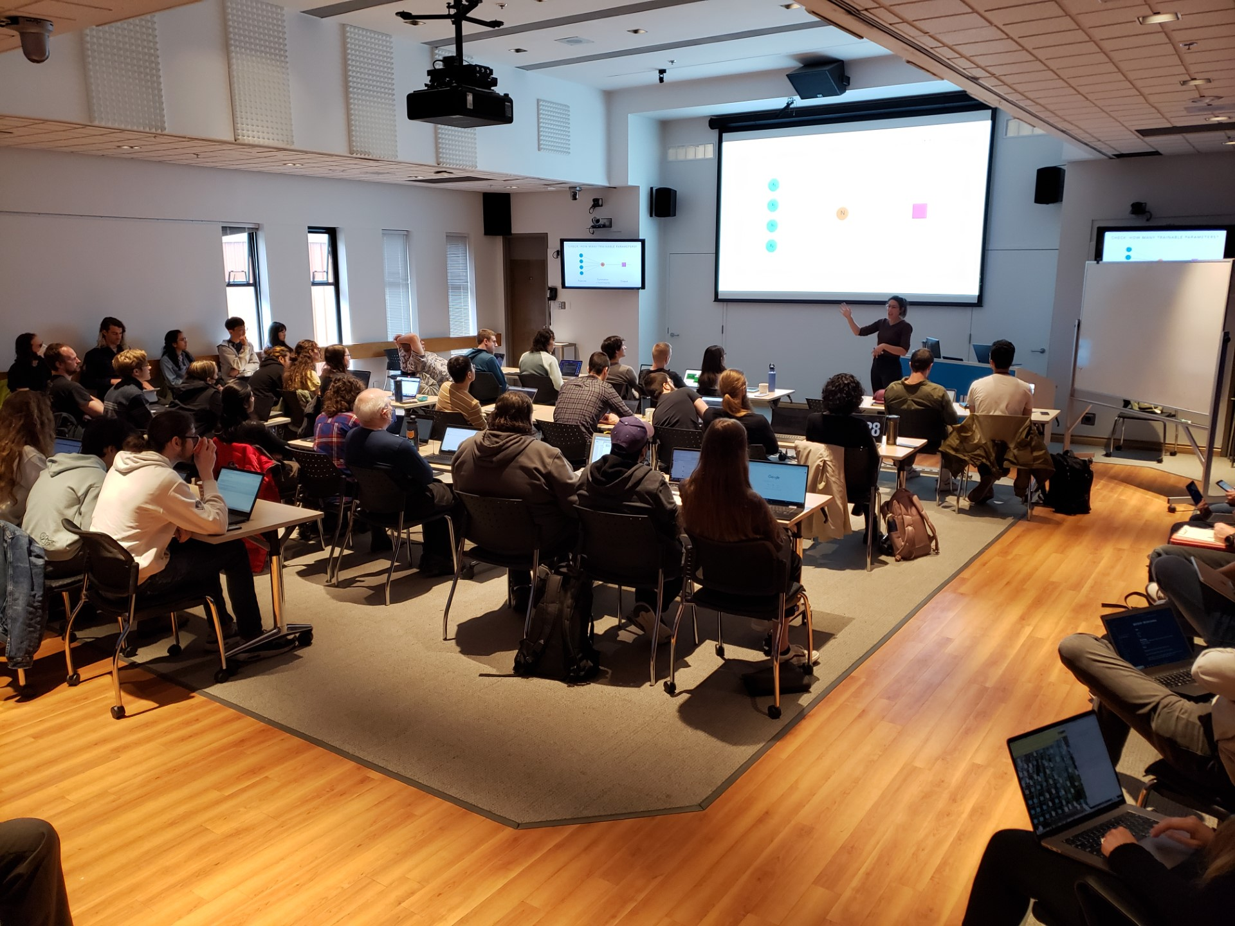
Talent, HQP, Training and Collaboration
HQP Since 2018:
Collaborated with (TRIUMF based):
6 Postdocs
3 Grad students
2 RAs
MITACS GRA/GRI x3 (1 postdoc, 2 grad)
Capstone projects
UBC Master of Data Science x4
BCIT x2
UBC Engineering Physics x3
Coops co-supervised: ~20
Hires at General Fusion, 1-Qbit, LinkedIn …, PhD Admissions
Demand is there!
Drives collaboration national and international (Helmholtz, Water Cherenkov, ATLAS, PI)
TSI: leadership and contributions (TRISEP, Cornerstones of QC)
Data Science Study Group w/GAPS

Slide 6
Next 5 years
Impacts Scenario 2:
Beam control project will be delayed (no stable isotope beams, no ISAC/ BNMR operations)
Small likelihood of TIIGR getting delayed dependent on what personnel gets re-allocated
In any scenario hard to maintain this, program ‘as is’ without new hire.
Pilot projects not possible to start up
Additional 1 FTE ML-dedicated personnel needed for existing program + modest expansion
Nuclear Physics, Material Science, Life Sciences
Longer term personnel needed → mitigate turn over
‘Pooling’ may not be realistic
Mitigation strategies in addition:
Work early with SciComp on your grant applications and include ask for grads and PDs
Formal project process (ugh)
Infrastructure:
RTI for in-house ML computing- need coordination with and support from projects
Support One-time funding requests for in-house
Need O(100k) every ~5 years for in house rapid development machine

Slide 7
Connection to Quantum Computing
Potentially transformative for selected core areas
Community is pursuing:
Parton shower modelling
Neutrino-nuclear matrix element calculations
Particle tracking
Radiation treatment design
@TRIUMF: NRC Applied Quantum Computing Challenge: generative Quantum-Assisted AI for Calorimeter simulation
Speculative and high risk
Maintain and expand expertise in QC and Quantum-assisted AI
Vehicle for taking advantage of National Quantum Strategy funding opportunities
Pillars:
Research (Alliance Quantum / International / Consortia)
Talent (CREATE / MITACS)
Commercialization Pillar (incl NRC AQC)
Missions:
Quantum computers and software
Quantum Communications
Quantum Sensors

Slide 8
Summary
Enhance collaboration between departments and divisions
More talent-power and domain knowledge
Identify and execute ML applications across the scientific domains
Infrastructure support
HQP training
Building and expanding on current success
Asking for 1 more FTE (+modest in-house computing)
Aligned with 20-year vision

