Slide 1

Particle Physics / Quantum Center
Chloe Malbrunot / Oliver Stelzer-Chilton (for Particle Physics)
PSD retreat
May 24th, 2024

Slide 2
Particle Physics Department
Particle Physics – O. Stelzer-Chilton
Deputy – M. Hartz
I. Trigger M. Vetterli (SFU)
O. Stelzer-Chilton D. Gingrich (UofA)
M. Swiatlowski P. Savard (UofT)
B. Stelzer (SFU) G. Azuelos (UdeM, emeritus)
A. Konaka D. Karlen (UVic)
M. Hartz (with IPMU) X. Li
W. Rau (with MI). J-M. Poutissou (emeritus)
K. Clark (with Queens, MI) T. Brunner (McGill)
S. Yen (emeritus)
M. Fujiwara A. Capra
R. Picker D. Gill (emeritus)
C. Malbrunot R. Helmer (emeritus)
A. Olin (emeritus) T. Numao (emeritus)
Monthly meetings inclusive to
Particle Physics,
Theory,
Science Technology
and Scientific Computing
department members
Dark Matter Forum Meetings
Science and Technology Seminars
Quantum Forum Seminars
Affiliated Scientists
S. Bhadra (YorkU)
D. Bryman (UBC)
M. Hasinoff (UBC)
R. McPherson (UVic)
S. Oser (UBC)
T. Momose (UBC)
W. Van Oers (Manitoba)
R. Thompson (Calgary)
B. Pointon (BCIT)
M. Danninger (SFU)
P. De Perio (IPMU/Tokyo)
A. Khramov (BCIT)

Slide 3

Particle Physics within the Physical Sciences Division
The departments of Particle Physics, Science & Technology and Scientific Computing address the areas:
High Energy Frontier
Neutrinos and Dark Matter
Precision Tests of Fundamental Interactions
Lead in Scientific Discovery through focus projects
Projects where we are involved in all areas
  detector design/construction, operations, data analysis
Ensure critical mass is established
Maintain leadership in all areas
Current experiments
  ATLAS, T2K/Hyper-K, ALPHA, TUCAN, SuperCDMS
New experiments expected to reach that point in the future
  DarkLight, nEXO, PIONEER

Slide 4
Enable Particle Physics in Canada and Abroad
TRIUMF is part of a network of laboratories and partner institutions
Leverage TRIUMF key expertise in accelerator, computing, detector and DAQ technologies
  Unique expertise in e.g. cryomodules, SiPM, TPC, gaseous detectors, DAQ, etc…
  Support for Accelerator and Engineering, Science Technology and Computing are crucial
SNOLAB: detector, facility and DAQ systems through Science and Technology involvement
-> SuperCDMS, nEXO, ARGO, DEAP, SNO+
CERN: In kind contributions to LHC and HL-LHC, share in detector upgrades -> ATLAS, ALPHA
-> global detector R&D organization (DRD)
KEK/J-PARC: beam monitoring accelerator contributions
share in detector upgrades -> T2K/Hyper-K
PSI: PIONEER
Gran Sasso: DAQ systems, SiPM -> DarkSide
Future involvement
  Ocean Networks Canada: -> P-One
  Future Collider

Slide 5
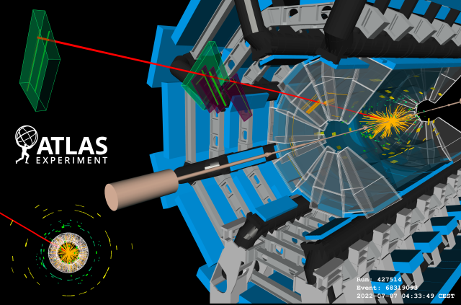
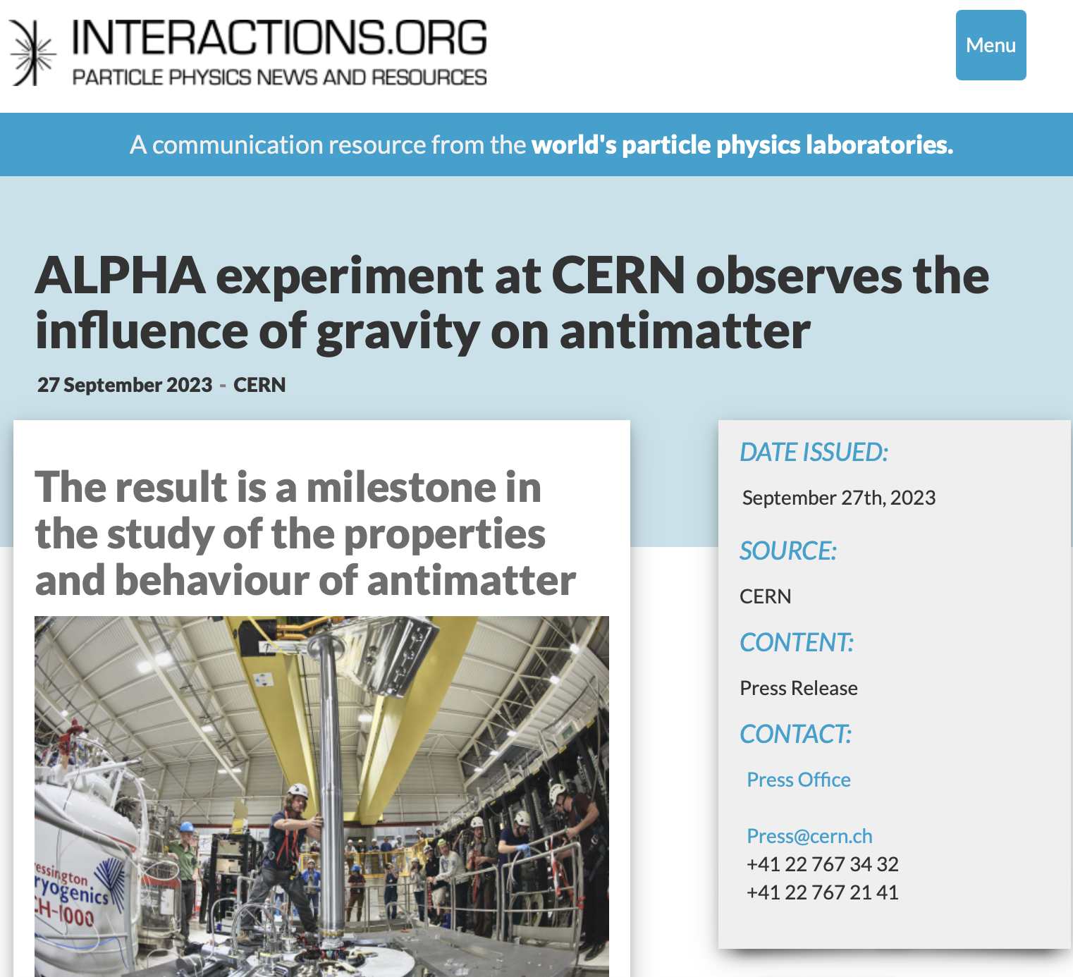
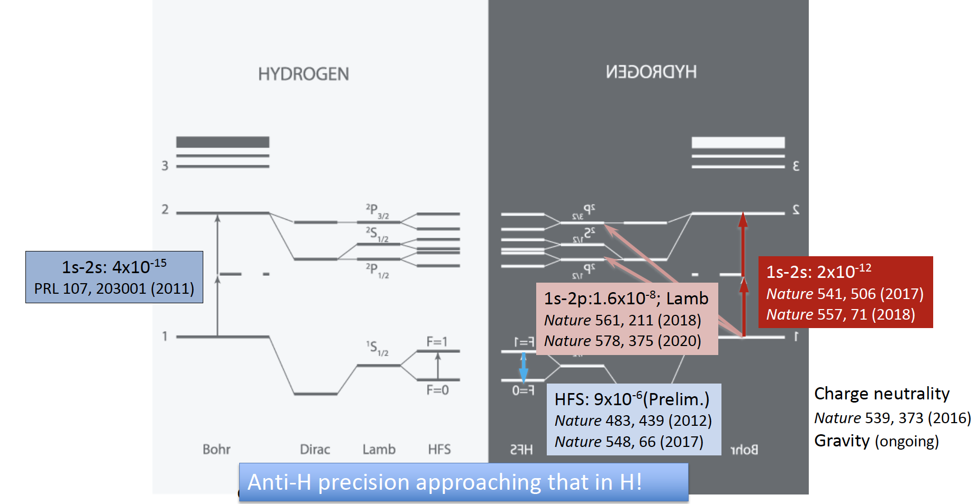
CERN
ATLAS
Deliver on upgrades for HL-LHC
Legacy measurements on
  Higgs potential, couplings, self-coupling
  Searches for New Physics and Measurements
ALPHA
ALPHA-g

Slide 6
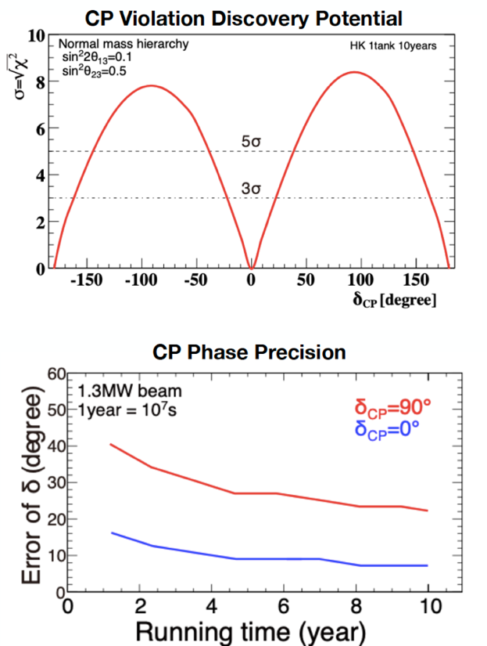
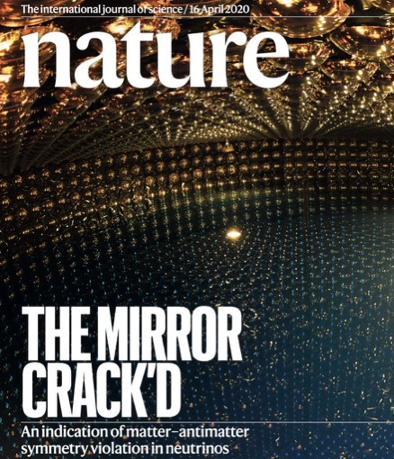
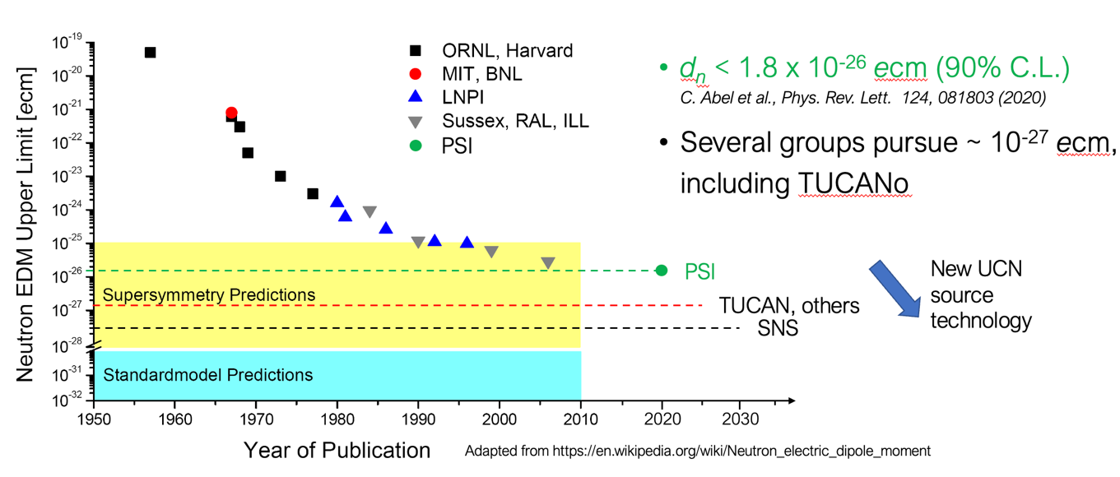
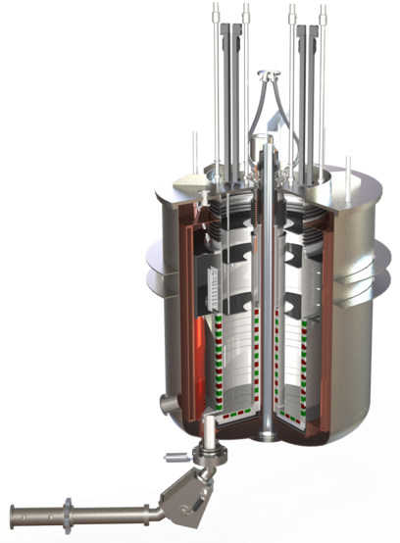
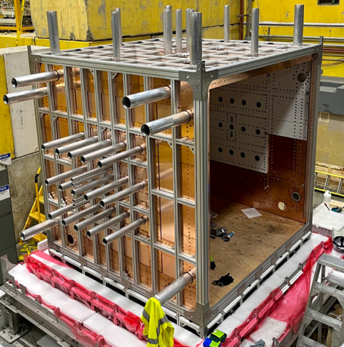
JAPAN
T2K/Hyper-K
Major goal is the search for CP violation in neutrino oscillations!
TUCAN
EDM experiment for search for strong CP violation
PENeLOPE (2nd port)
World’s best neutron lifetime measurement

Slide 7
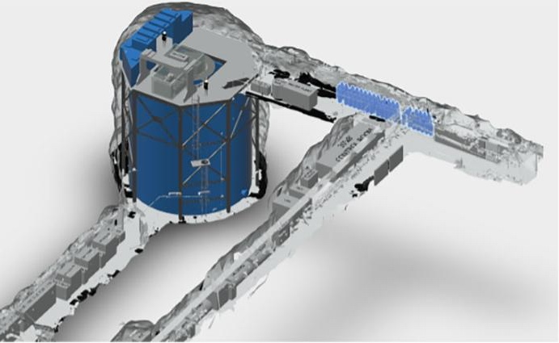
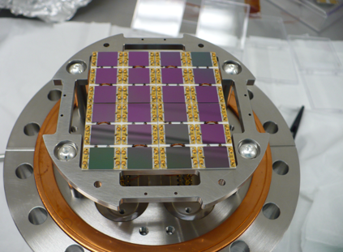
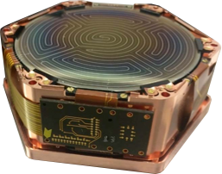
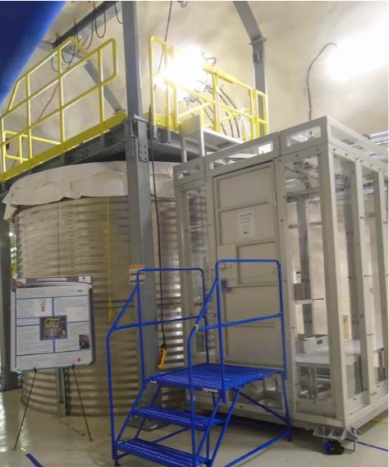
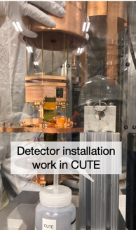
SNOLAB
nEXO
next generation neutrinoless double beta decay experiment under consideration for SNOLAB
Silicon photo-multiplier SiPM performances enable reaching nEXO target energy resolution
SuperCDMS
Direct dark matter search with cryogenic Ge and Si detectors
Focus on low-mass Dark Matter
CUTE (cryogenic underground test facility

Slide 8
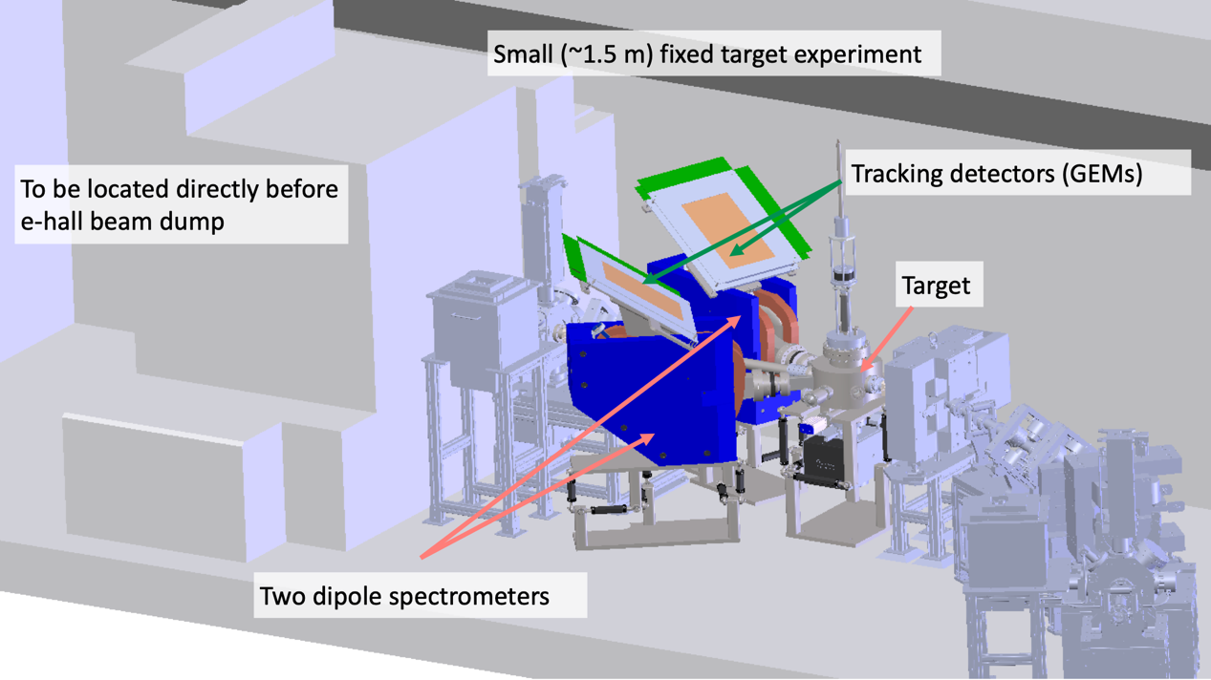
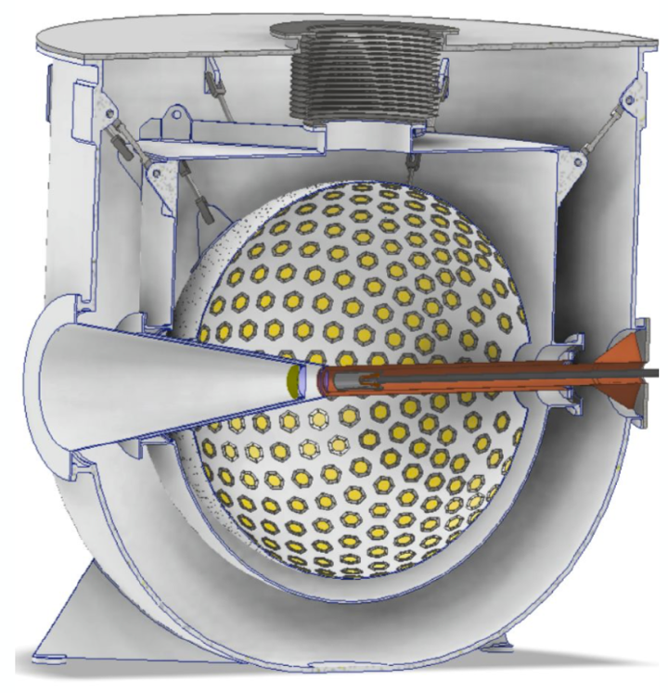
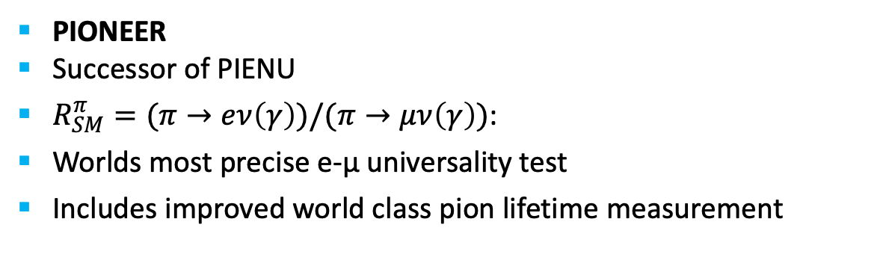
TRIUMF
DarkLight
Early science case for ARIEL
New experiment at e-linac to search for new low mass dark boson
PIONEER
Successor of PIENU
$R_{SM}^{π}=(π→eν\left(γ\right))/(π→μν\left(γ\right))$:
Worlds most precise e-µ universality test
Includes improved world class pion lifetime measurement

Slide 9
Exciting Science
Particle Physics addresses many of the most compelling questions
  Embedded in international collaborations
  Growing onsite effort with new opportunities
Expect many exciting results from Particle Physics by 2030
  ATLAS: Higgs boson potential, sensitivity to many new particles, precision measurements
  Hyper-K: Probing CP violation in neutrino sector
  UCN: World leading neutron EDM and neutron lifetime measurement
  ALPHA: Precision anti-matter spectroscopy and effect of gravity on anti-matter
  SuperCDMS & DarkSide 20k: Most sensitive Dark Matter results
  DarkLight: Sensitivity to find X17 related boson
  PIONEER: World’s most precise e-µ universality test

Slide 10
Hiring Priorities
Baseline highest priority for 2025-2030
  TUCAN
  Hyper-K (succession)
  Strengthening Science & Technology capabilities
  Growth area (possibly also with university partners / joint-hires - not ranked)
    Astro-particle / nEXO / DarkSide-20k (SNOLAB connection)
    PIONEER (secure critical mass)
    P-One (potentially big local experiment)
    Future Collider
    UCN
    Quantum/Precision
baseline
priority

Slide 11

CFI Proposals
Successful in IF 2022/23:
Hyper-K $6.4M (add total)
  200 mPMTs, photogrammetry calibration and
  water quality monitoring equipment
P-One $5.9M (total project $14.8M)
  Six instrumented mooring lines for neutrino telescope at Ocean Network Canada (OCN)
nEXO $12M
  Liquid Xenon detectors (TRIUMF part SiPM characterization)
IF 2025 (EOI ~December)
ATLAS-Tier-1
Integrated Detector Development (ID²)
ALPHA
PIONEER
TUCAN
nEXO
Liquid Ar

Slide 12

Centers at TRIUMF
First Five-Year Plan in decades without new major accelerator component
Centers for
  Detector Development
  Quantum Technologies
  Data Science / AI
Strengthen/re-gaining TRIUMF’s core competencies (especially for R&D) while aligning with government priorities around Quantum Technologies, AI and Sustainability
Alignment with 20-year vision
Consider focusing on one “Quantum & Instrumentation Center” for this Five-Year Plan

Slide 13





Criticality
Unique R&D staff and expertise that enables innovation, mission critical work and training
  Difficult to hire and retain on a temporary basis (e.g. CFI hires) and needs long term perspective
  Complementary to Science & Technology core mission
Funding multipliers for hardware and technical personnel through dedicated grants
Training
TRIUMF has an excellent track record on graduate student training and has a first-class undergraduate & coop program
Building on GRIDS, opportunity for e.g. a CREATE program
  On-the-job training in cutting-edge research environment
  Work integrated learning, in collaboration with e.g. BCIT

Slide 14
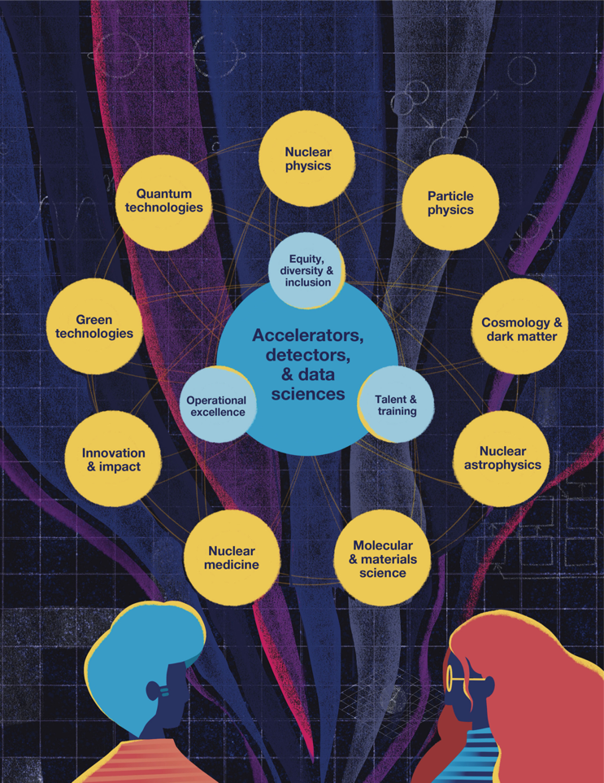
Quantum Center
Existing quantum experiments spans across the laboratory and departments
  Spin polarized beams μSR and βNMR, TUCAN, ALPHA/HAICU, RadMol, Francium trapping, etc
Require common expertise and infrastructure when pooled will allow for cross-fertilization and new R&D for novel use of quantum technologies
Take advantage of National Quantum Strategy and new programs from NSERC, MITACS and NRC

Slide 15

QUANTUM-ENABLED
FUNDAMENTAL SCIENCE
NEW OPPORTUNITIES
Quantum Center
ALPHA
BeEST
HAICU
RadMol
TITAN
TUCAN
ACCELERATOR-CONNECTED QUANTUM SCIENCE
RILIS
Polarized beams
OLIS
etc
etc
CRYOGENICS R&D
LASER & METROLOGY
POOLED RESOURCES
QUANTUM MATERIAL SCIENCE
QUANTUM MATERIAL CHARACTERIZATION
MAGNET DESIGN & PRECISION MAGNETOMETRY
$μ$SR
$β$NMR
etc
PRECISION FUNDAMENTAL SCIENCE

Slide 16
Quantum Center
TRIUMF
PRECISION PHYSICS
&
QUANTUM CENTER
POOL & DEVELOP EXPERTISE
TO SUPPORT & STRENGTHEN
EXISTING SCIENCE
CONNECT PEOPLE
ACCROSS DEPARTMENTS/DIVISIONS
& WIDER COMMUNITY
ENABLE NEW DIRECTIONS

Slide 17
Goals
Pool the resources and sustain the expertise in the long term and allow better cross- fertilization across departments and divisions
Span across TRIUMF’s existing divisional structure & connect to new fields (e.g. quantum chemistry)
Establish & support new flagship experiments at TRIUMF
Connect Canadian and international researchers in novel use of quantum and precision experiments in fundamental and applied science. The center will develop the existing Quantum forum initiative to the next level, leverage resources and be a structure that organizes workshops, conferences, and schools on precision, AMO and quantum physics and their connections to other fields.
Act as a wedge for longer-term growth in quantum & precision physics - strategically important areas for TRIUMF

Slide 18
Advantages
The fundamental aspect of TRIUMF quantum-related science program is relatively distinct in the Canadian quantum network ecosystem
Accelerator-based quantum-related science is certainly unique in Canada
The already existing wide scope (user-inspired/fundamental) of quantum-related research and precision experiments at TRIUMF is a strength for future cross-fertilization
TRIUMF existing quantum-related program extends beyond what was presented here (e.g. quantum computing for fundamental science ➙ connects to AI center proposal )

Slide 19
Summary
Particle Physics addresses many of the most compelling questions
  Many breakthrough results expected over the next Five-Year Plan
  Higgs, Probing CP violation in neutrinos, neutron EDM and lifetime, precision with antimatter…
Three scenarios on completing ARIEL and Accelerator Operations has limited impact on Particle Physics program (mostly external) with exception of
  DarkLight and UCN
  Availability of Science & Technology personnel
Case for new centers:
  Unique R&D staff and expertise that enables innovation for breakthrough science
  Difficult to hire and retain on a temporary basis (e.g. CFI hires) and needs long term perspective
  Funding multipliers for hardware and technical personnel through dedicated grants
Discussion on single “Quantum & Instrumentation Center”
  Start with most pressing needs for key personnel & seed funds ~$1M/year
  Opportunity with “Weft and Warp” to identify how to gain organizational efficiencies

Slide 20




Thank you
Merci
www.triumf.ca
Follow us @TRIUMFLab

Slide 21
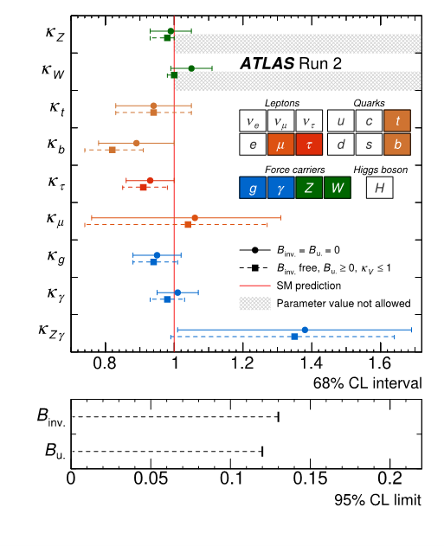
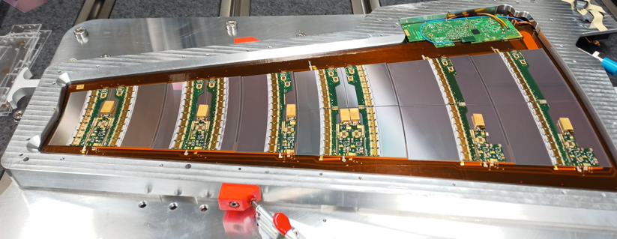
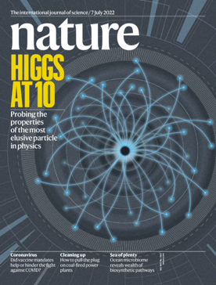
New Small Wheels
ATLAS
LHC Run 3 has started in 2022 and the New Small Wheels are starting to take data
First ATLAS ITK petal with all modules assembled in Vancouver!
Milestone measurements of Higgs boson properties,
couplings to matter​
10 Year anniversary
paper in nature
50% of sensor probing completed!

Slide 22
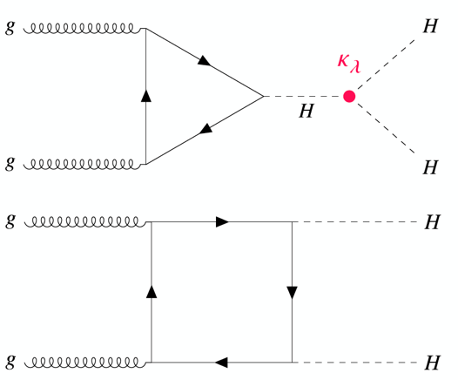
ATLAS
2030 will be half way through Run 4!
Physics with 3x the dataset: huge range of interesting physics options
  Higgs and Standard Model measurements become much more precise (Higgs couplings, M_{W}, etc)
  Search program - higher energy, new signatures, new detector
  Potential new discoveries in Dark Matter, VLQ, SUSY, long lived particles, new extended Higgs sector, …
A flagship analysis for future runs of the LHC
  Measuring κ_{λ} by measuring HH production
Κ_{λ} gives direct information on the Higgs potential
  Expect evidence of HH production by 2030!

Slide 23
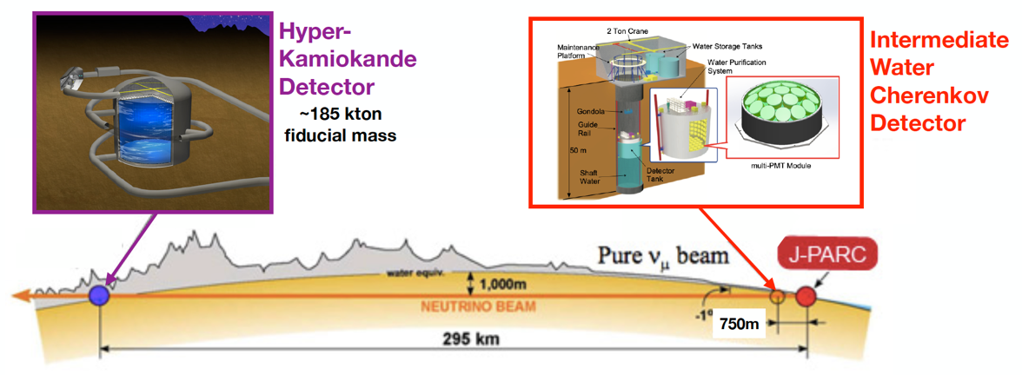

T2K / Hyper-K
Major goal is the search for CP violation in neutrino oscillations!
2020 T2K reported 2σ hint in nature!
2030 will be 2 years of Hyper-K data taking! – significance depends on δ_{CP}
Will also make precise measurements of parameters governing oscillations Θ₁₃, Θ_{23,} Δm²₃₂

Slide 24
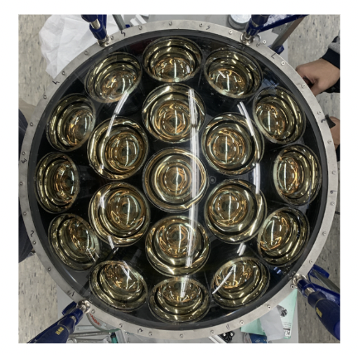
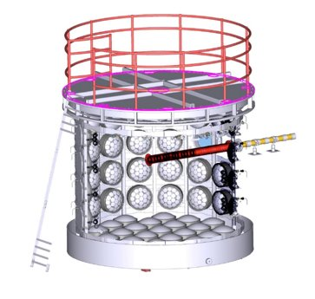
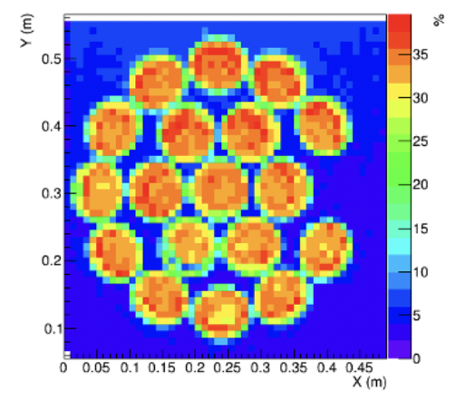
Fully Assembled multi-PMT
Hyper-K
Larger fiducial volume instrumented with water Cherenkov detectors
Higher granularity with more precision
Control of systematic uncertainties will be key!
multi-PMT
250 mPMT for WCTE, mass production for WCTE starting this summer
Production readiness review ongoing
CFI request for 200 mPMT for Hyper-K with a focus on calibration modules
multi-PMT test stand
Water Cherenkov Test Experiment (WCTE) approved by CERN Research Board, expected operation in 2024

Slide 25

ALPHA / HAICU
Test of CPT, Quantum Field Theory
Equivalence Principle
HAICU:
First H fountain, Interferometer
ALPHA-2 2023 run being prepared
HAICU, space at TRIUMF identified Infrastructure being prepared at TRIUMF

Slide 26
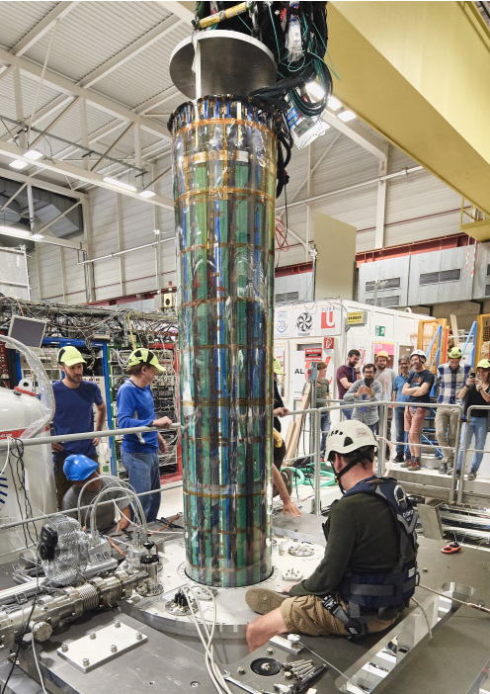
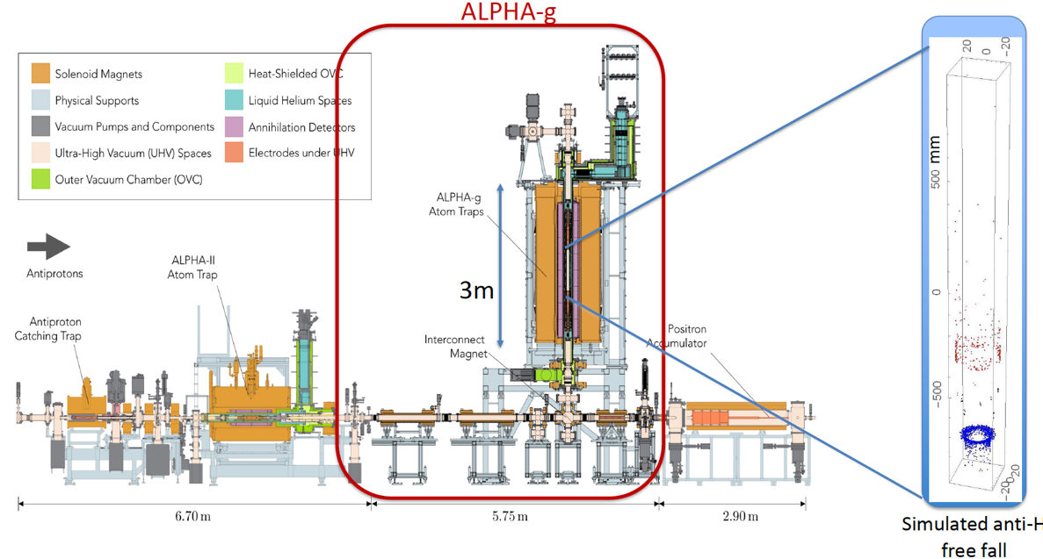
ALPHA / ALPHA-g
Detector for a measurement of gravity with antimatter
By 2030 potentially most precise measurement of g’
Commissioning of ALPHA-g
First data being analyzed!

Slide 27


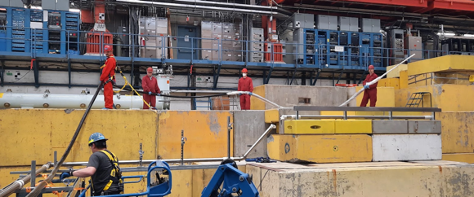
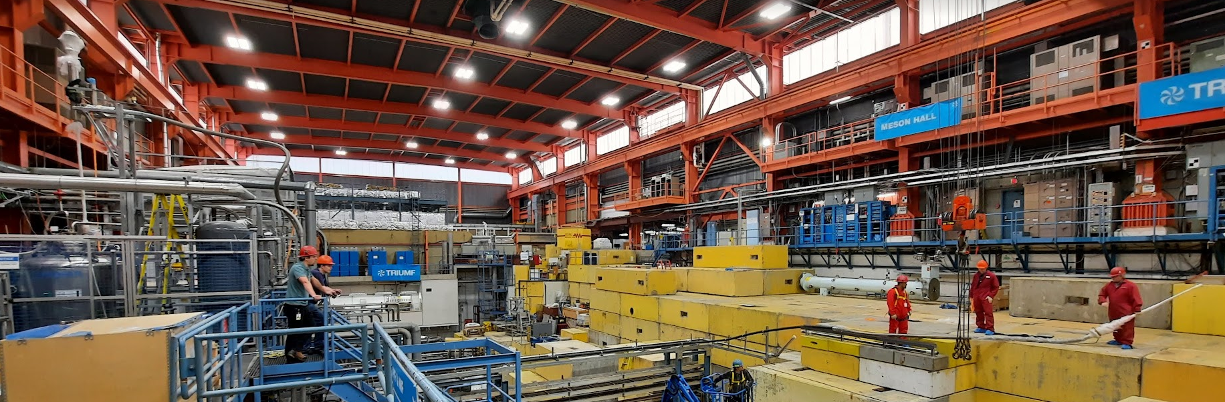
UCN
Progress towards the world’s strongest ultracold neutron source
Liquid He transfer & return lines tested
EDM storage cell tests at J-PARC completed
Magnetically Shielded Room for EDM experiment taking shape
First cryo testing July 2023, UCN production planned for 2024
Liquid helium transfer line

Slide 28
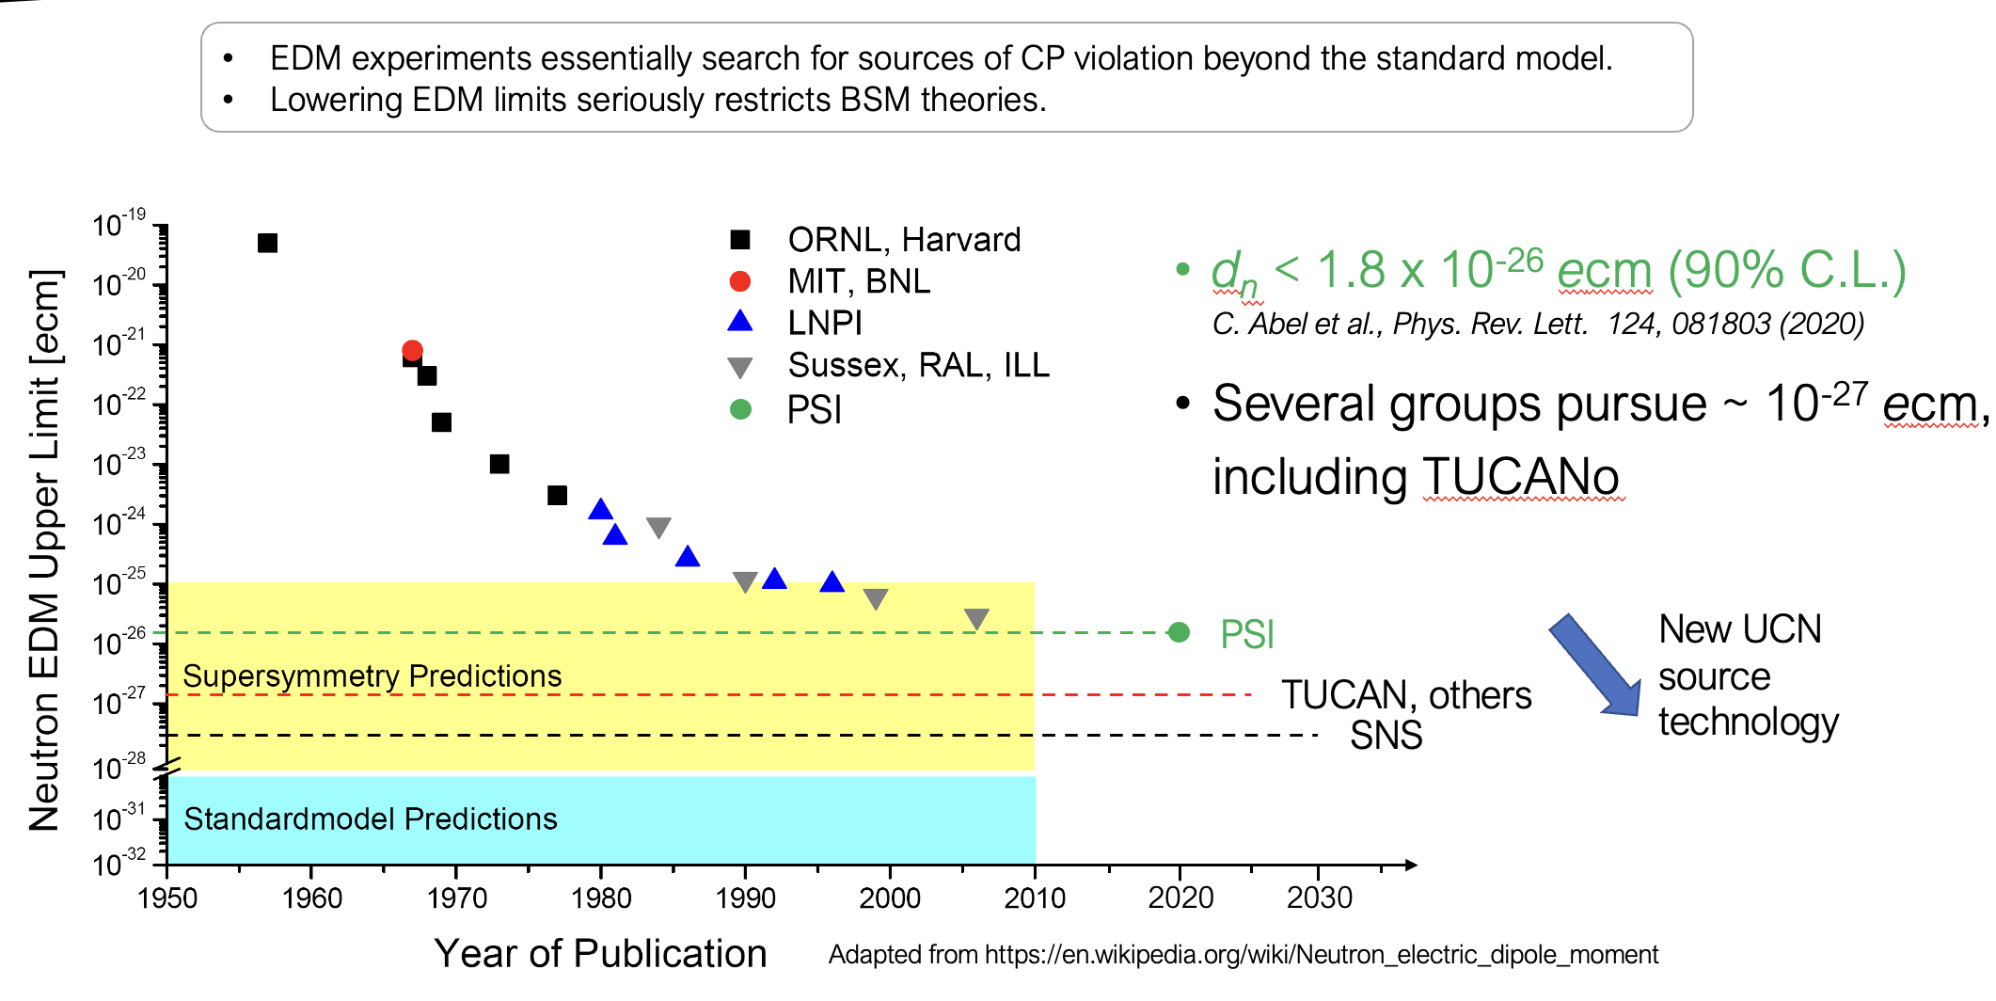
TUCAN - EDM
2030 sensitivity amongst the best in the world!

Slide 29

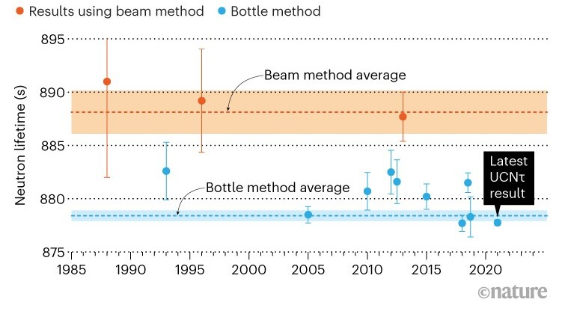
Neutron Lifetime measurement
Letter of Intent: Last Particle Physics - EEC
PENeLOPE (Precision Experiment on the Neutron Lifetime
Operating on Proton Extraction)
Using magneto gravitational storage in a superconducting
magnet developed at TU Munich
Received Gate 0 approval
Utilizing 2nd port of the UCN source seems feasible by 2030
Worlds best <0.1s measurement only requires ~2 months of data

Slide 30
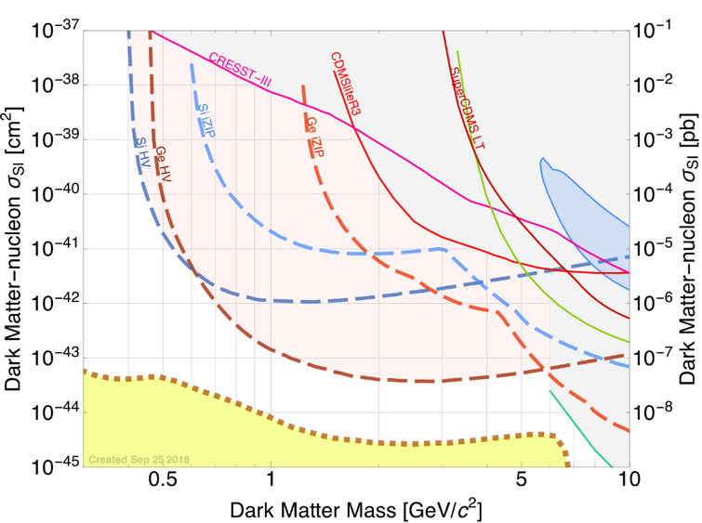
SuperCDMS
Direct dark matter search with cryogenic Ge and Si detectors
Focus on low-mass Dark Matter:
  few GeV range, with sensitivity down to eV range
Completing construction at SNOLAB
  First two detector towers arranging at SNOLAB on May 14th
CUTE (cryogenic underground test facility – to become SNOLAB user facility)
Expect 5-year data taking run to start this year
By 2030, expect worlds most sensitive low mass Dark Matter search results

Slide 31
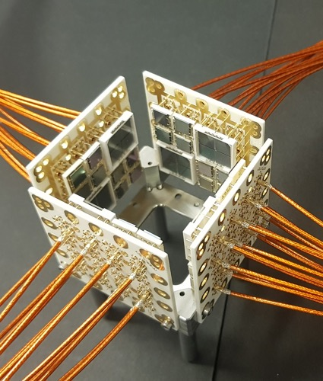

Fully assembled SiPM
PHORWARD
Physics focus on
  Weak decay (PIONEER and nEXO)
  Dark Matter (DEAP, DarkSide, and ARGO)
Technology focus on single photon detector (SiPM) with noble liquids (Xe, Ar)
World class SiPM developments and characterization
  VERA: Vacuum Efficiency Reflectivity and Absorption setup
  MIEL: Microscope for the Injection and Emission of Light
Light only liquid Xenon experiment LoLX with McGill
nEXO – next generation neutrinoless double beta decay experiment under consideration for SNOLAB
Major procurement items (clean room, laser, cryogenic test system) progressing well

Slide 32
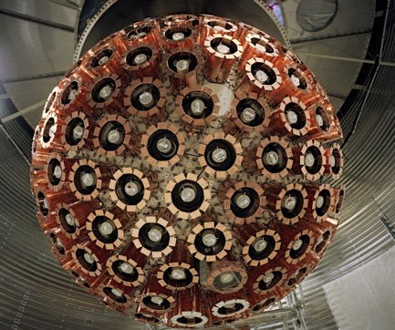
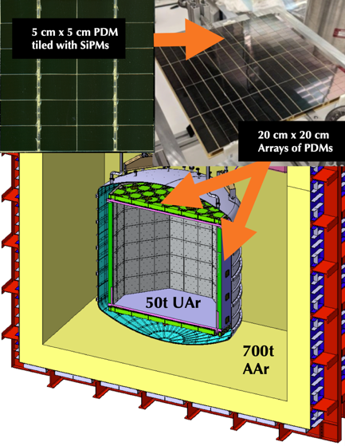
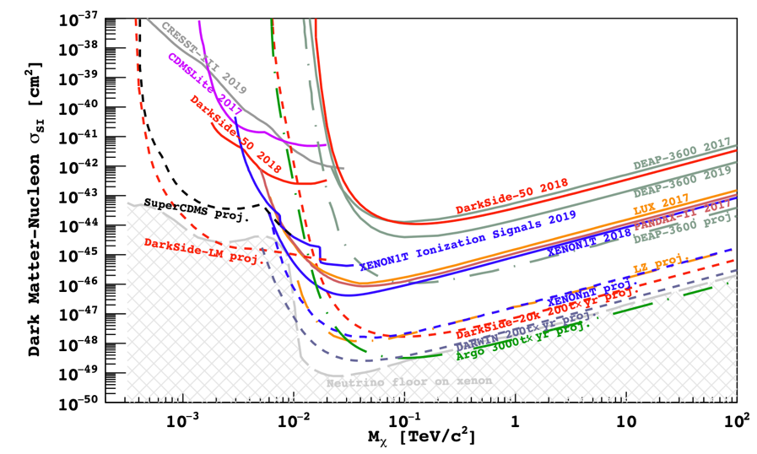
Dark Matter Search with Liquid Argon
DEAP-3600 - 3.6t at SNOLAB
  Demonstrated particle ID and ultrapure acrylic cryostat
DarkSide-20k - 50t at Gran Sasso
  First large-scale use of cryogenic Si photon detection modules (PDMs)
  Walls coated with wavelength shifter
ARGO – 300t at SNOLAB
  UV sensitive SiPM, photon to digital converter
Sensitivity with liquid Ar will reach “neutrino floor”
By 2030, expect first results from DarkSide-20k

Slide 33
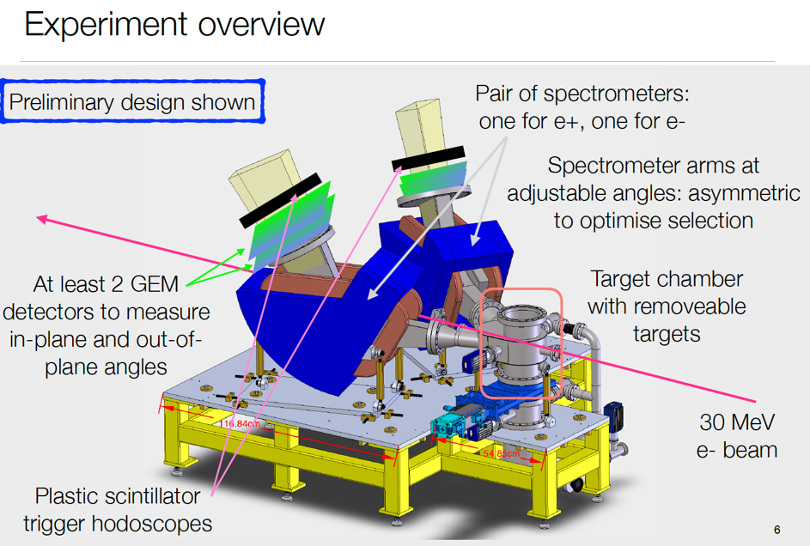
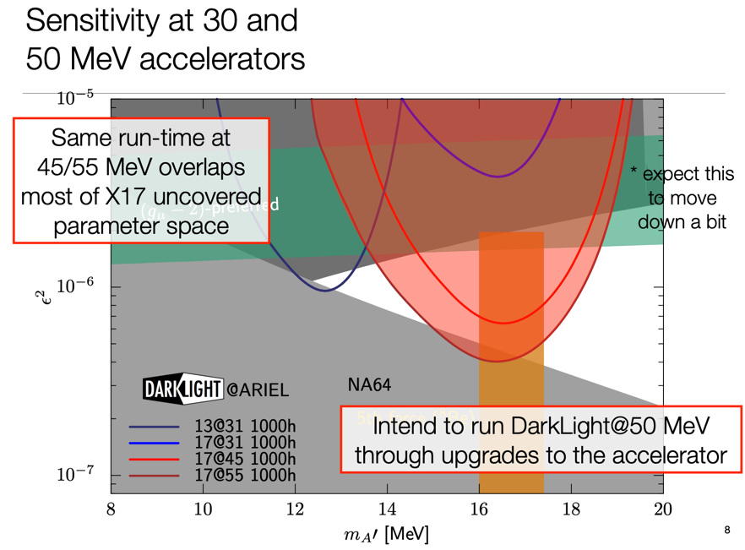
DarkLight
New experiment at ARIEL e-linac to search for new bosons around 10-20 MeV mass​ decaying to e⁺e
Experiment design essentially finalised, technical reviews in progress
Want to begin installation of 30 MeV experiment this fall
By 2030 full parameter scan completed

Slide 34
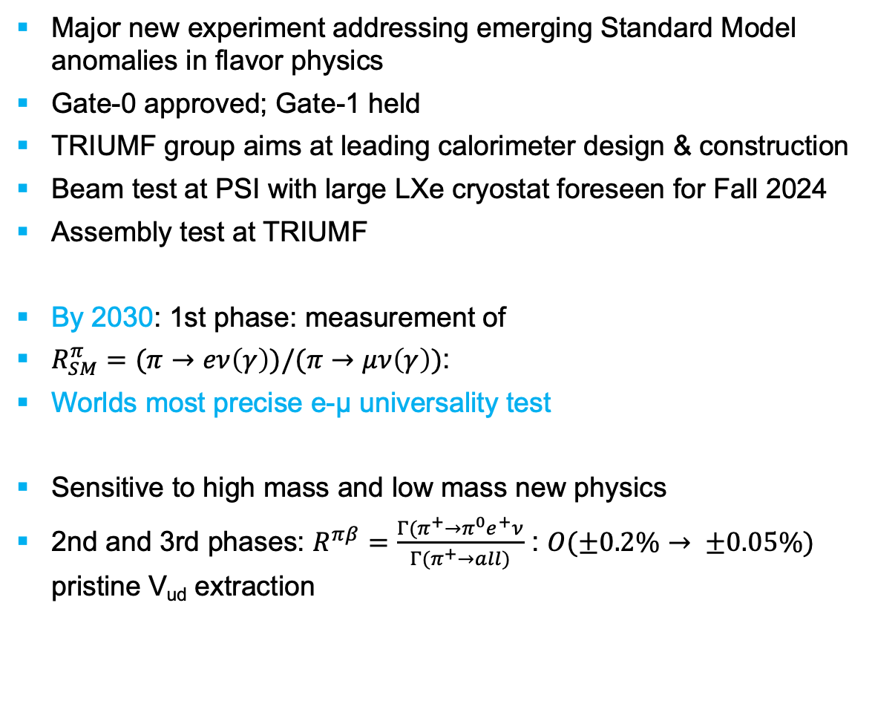
PIONEER@PSI
Major new experiment addressing emerging Standard Model anomalies in flavor physics
Gate-0 approved; Gate-1 held
TRIUMF group aims at leading calorimeter design & construction
Beam test at PSI with large LXe cryostat foreseen for Fall 2024
Assembly test at TRIUMF
By 2030: 1st phase: measurement of
$R_{SM}^{π}=(π→eν\left(γ\right))/(π→μν\left(γ\right))$:
Worlds most precise e-µ universality test
Sensitive to high mass and low mass new physics
2nd and 3rd phases: $R^{πβ}=\frac{Γ(π^{+}→π^{0}e^{+}ν}{Γ(π^{+}→all)}$ : $O(±0.2\%→ ±0.05\%)$ pristine V_{ud} extraction

