Slide 1
Particle Physics Faculty Meeting
Agenda
  News, ACOT etc
  Plenum Update
  Update from Committees
  Update from Groups
  AOB

Slide 2
SMM – Important Dates
Dates: 2019 | Event
March 19 | 2019 Federal Budget
March 21 | All Hands Meeting
March 21 – 22 | ARIEL Scientific Steering Committee Review
March 22 | CANREB Steering Committee Meeting
April 1 | TRIUMF Innovations Board Meeting, Ottawa
April 8 – 10 | ACOT Spring 2019 (Advisory Committee on TRIUMF)
April 25 – 26 | TRIUMF BOM Spring 2019 (Board of Management)
May 3 – 7 | ISAC Power Outage
June 10 – 21 | GRIDS (Graduate Instrumentation Detector School), TRIUMF
June 13 – 14 | LSPEC (Life Sciences Projects Evaluation Committee)
June 28 | Audit Committee Meeting
July 10 | TRIUMF Innovations Board Meeting
July 22 – August 2 | 2019 TRISEP (TRI-institute Summer School on Elementary Particles), TRIUMF
October 2 | TRIUMF Innovations Board Meeting
November 14 – 16 | ACOT Fall 2019 (Advisory Committee on TRIUMF)
December 5 – 6 | TRIUMF BOM Fall 2019 (Board of Management)

Slide 3
HR Update
Ian Doyle, HR Director, started yesterday
This note is to advise you of the year end cut-off time for the fiscal year 2018/19. The March month end will close on Thursday, March 28th.
Please ensure that your requests for payment, travel claim, and fund transfer, for fiscal year 2018/19 are submitted to Accounting by end of day Thursday, March 21st.
The last cheque run for the 2018/19 fiscal year will be on Thursday, March 28th.
Accounting

Slide 4
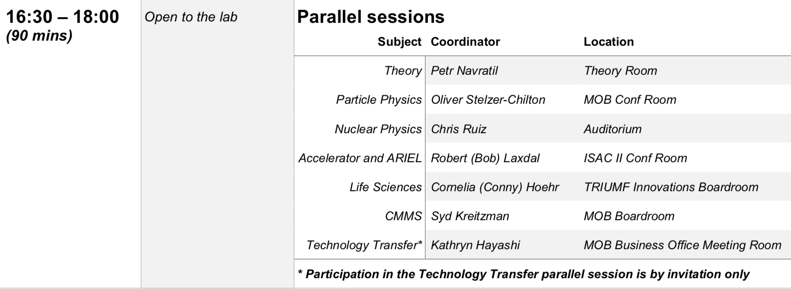
ACOT
April 8-10
Contacted YKK for input, awaiting response
  Assume for now new format: 10min updates from focus areas
  Suggestion to invite students and postdocs

Slide 5
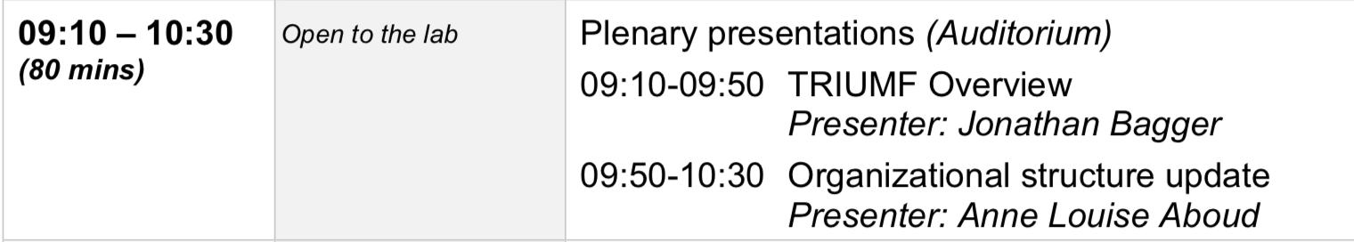
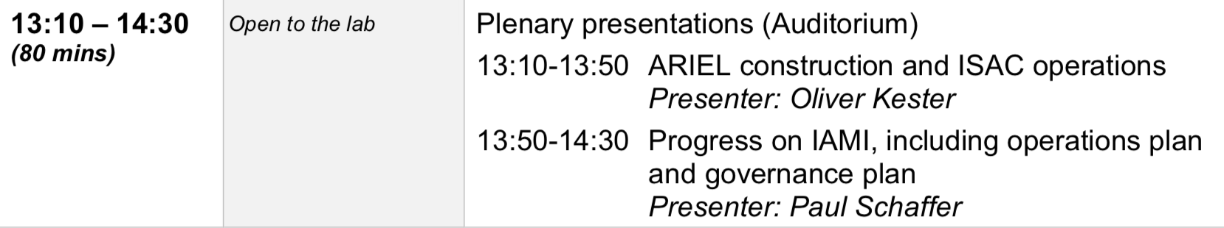
ACOT
Tuesday April 9

Slide 6
ACOT
From Reiner:
I am starting to get the 2018 publications statistics together for ACOT. Here is a list of the publications for Experimental Particle Physics that I know of via Web of Science.
Can you please review and let me know of other refereed publications I am not capturing here.
I will need an update by mid March
Have a look at attached list and send me missed papers of 2018

Slide 7
PS Divisional Goals 2019 (from Jens)
Lead, participate, and contribute to excellent research in Nuclear and Particle Physics (experiment and theory). Focus on flag-ship projects.
Lead, participate, and contribute to experimental research in molecular and material sciences, and quantum materials. Focus on growth of in-house research.
Support ARIEL and CANREB, with people, expertise, and space.
Support the community
  With scientific equipment and developments. Focus on core expertise and development of CFI proposals.
  By providing networking and collaboration opportunities: conference and workshop support, summer schools.
  Contribute and organise TRIUMF specific teaching opportunities
User support for PS Div core program: on-line inhouse program, science developments and equipment for in-house, off-site, and off shore.
Grow the Data Science portfolio

Slide 8
ATLAS BAE Search
Five candidates are visiting TRIUMF April 2nd (Tuesday) - April 8th (Monday)
Seminars will be 2pm – 3pm except on Thursday (10:30am – 11:30am)
What is the preferred format for Particle Physics group to meet with candidates?
  Propose 9 am meeting (coffee and snacks)
  Tour of facilities at 10:30, who is available
  Separate meeting with ATLAS group and Affiliated Scientists
  HR gave green light to share CV’s of five candidates with the department
Five Candidates
  Emma Kuwertz (CERN)
  Stefano Zambito (Harvard)
  Maximilian Swiatlowski (Chicago)
  Tamara Vázquez Schröder (CERN)
  Stefan Guindon (CERN)

Slide 9
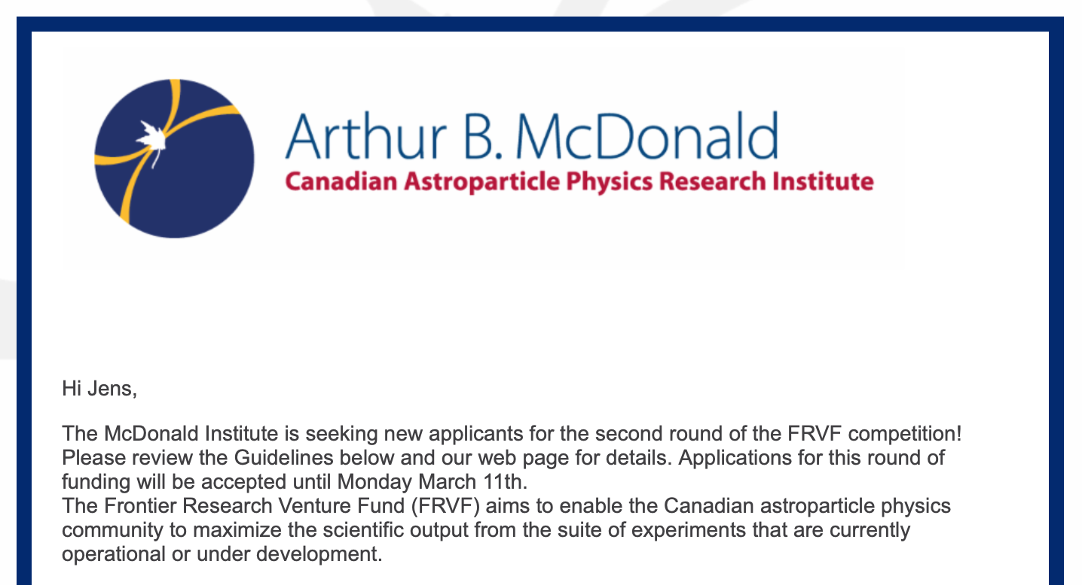
Arthur B. McDonald Institute
Application deadline Monday March 11th
Download the fund application form here
Download the program guidelines here

Slide 10
Miscellaneous
European Strategy for Particle Physics
  Discussion of the submitted inputs will take place at the
  Open Symposium in Granada (Spain) on 13-16 May 2019
  All the scientific and organizational details of the Symposium can be found at https://cafpe.ugr.es/eppsu2019/.
ILC announcement by Japanese government today:
  Government agrees with the Japanese particle physics community that the ILC is worth pursuing and that it will enter negotiations to host the machine. However, it will only give the ILC the final go-ahead if those negotiations are successful and if international support, particularly funding, can be found. It is expected that the government could supply half the $7.5bn with the other half needing to come from international partners such as the US, CERN and Europe as well as Canada.
  Another condition laid out by the government is that the ILC needs to be more widely supported by the Japanese scientific community.
https://physicsworld.com/a/disappointment-as-japan-fails-to-commit-to-hosting-the-international-linear-collider/?fbclid=IwAR1AinQeDAsD880YhZ6U_JQEKo84LJtRccF6j5g-GTaW8sqc-0abqo4Ksdk

Slide 11
Miscellaneous
Follow up from Dan Carney’s seminar
Jens suggested to hold a “theory workshop” end of this year
  new directions in particle physics
  quantum sensing
  "interferometry"
  other "new ideas"
  "TRIUMF sized" particle physics experiment
  gauging interest

Slide 12
Committee Updates
  Seminar/Colloquia
  Safety
  Space
  5S
  Academic
  Health & Wellness
  Data Science
  Summer schools
  Diversity committee
  Physical Sciences Division
  IPP
  CAP PPD

Slide 13
Project News
  ATLAS
  T2K/HyperK
  UCN
  ALPHA
  SuperCDMS
  Pienu
  NA62
  DEAP
  SNO+
  EXO
  HALO
  g-2
  Belle 2
  Theory

Slide 14
AOB
Next meeting Thursday April 11th 2019 12:30?

