Slide 1
Granularity Comparision

Slide 2
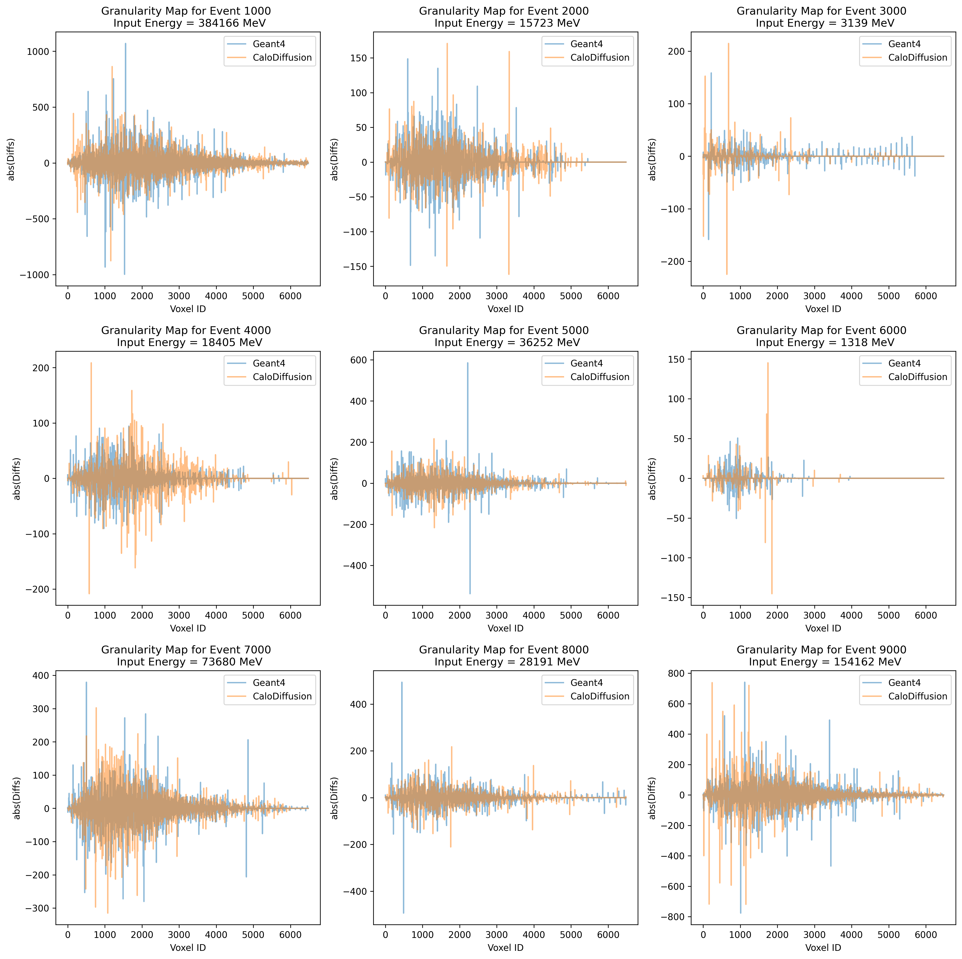

Slide 3
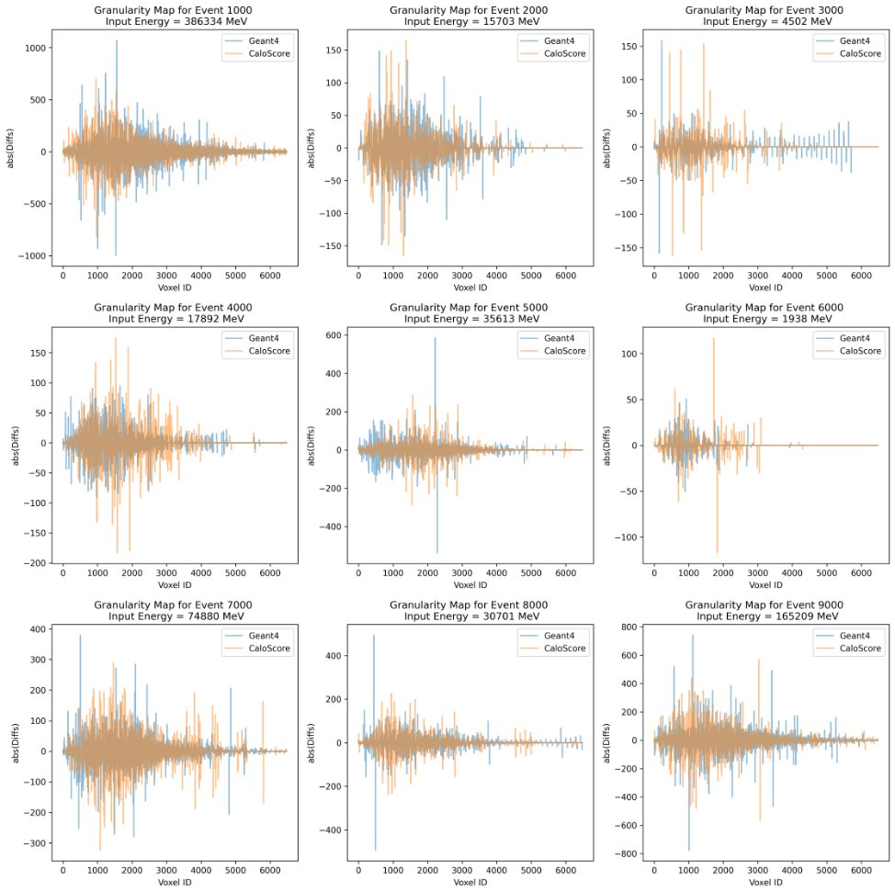

Slide 4
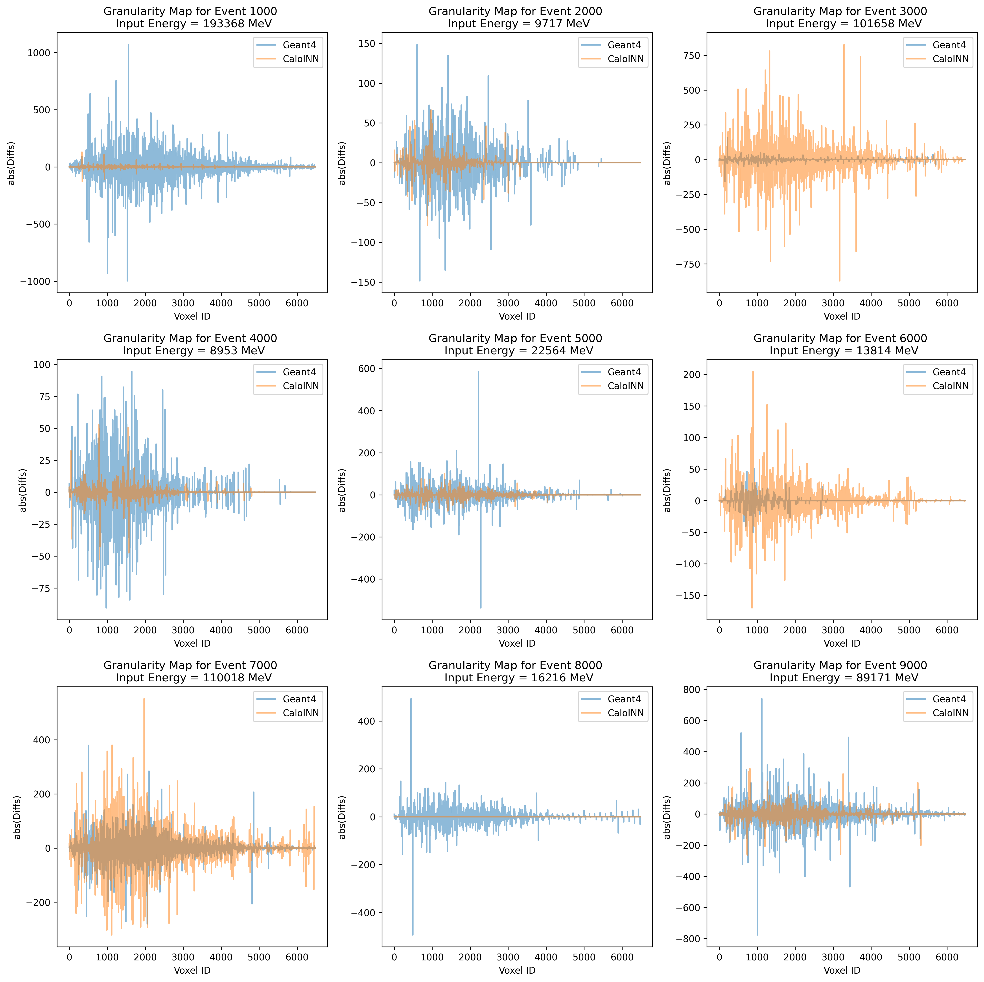

Slide 5
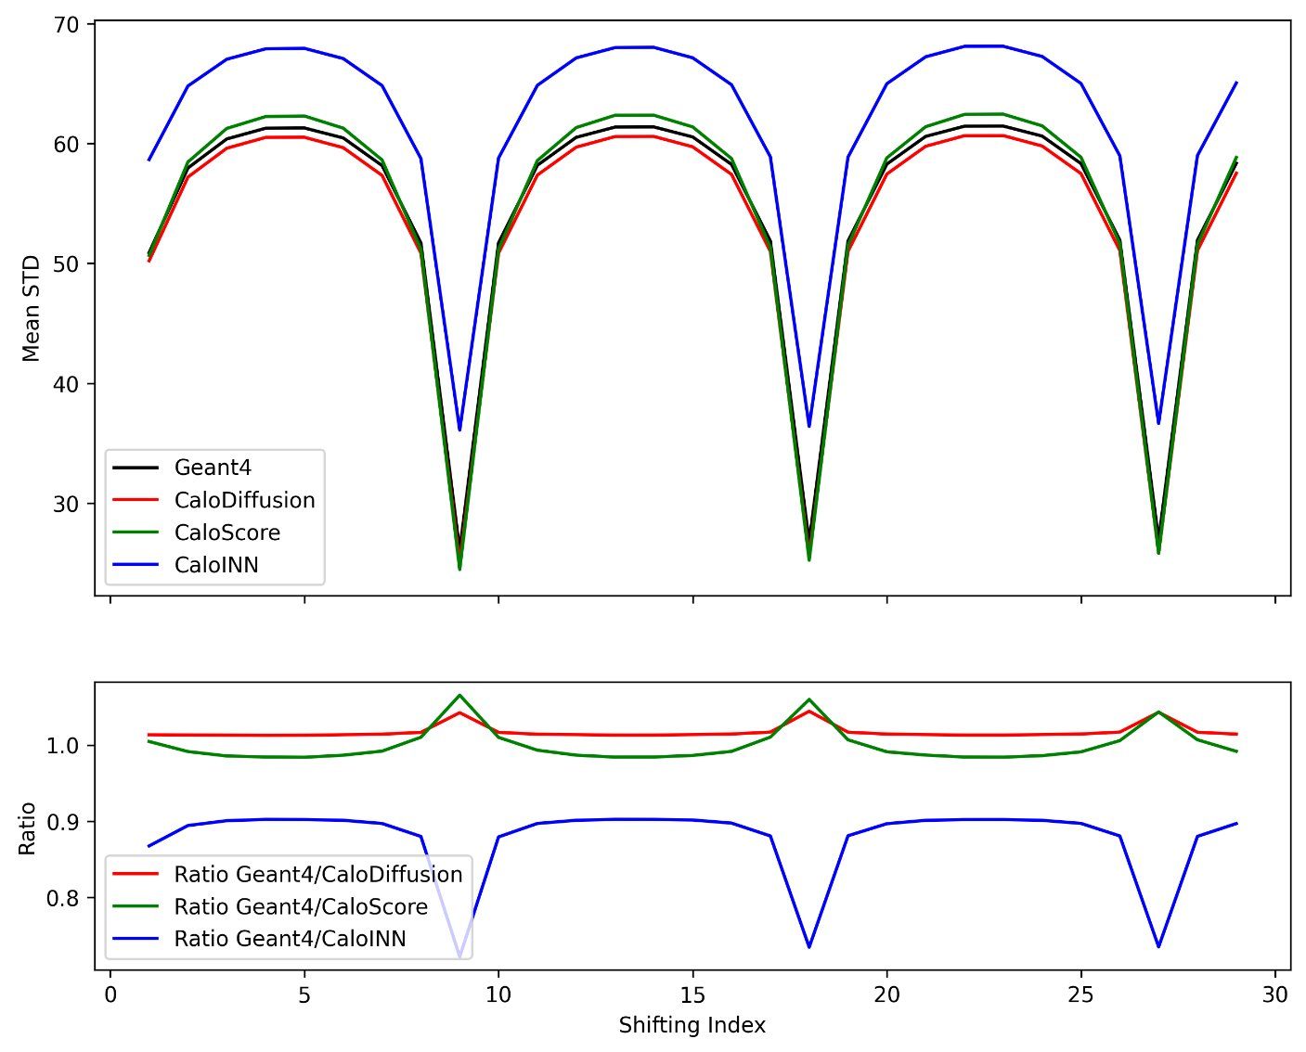

Slide 6
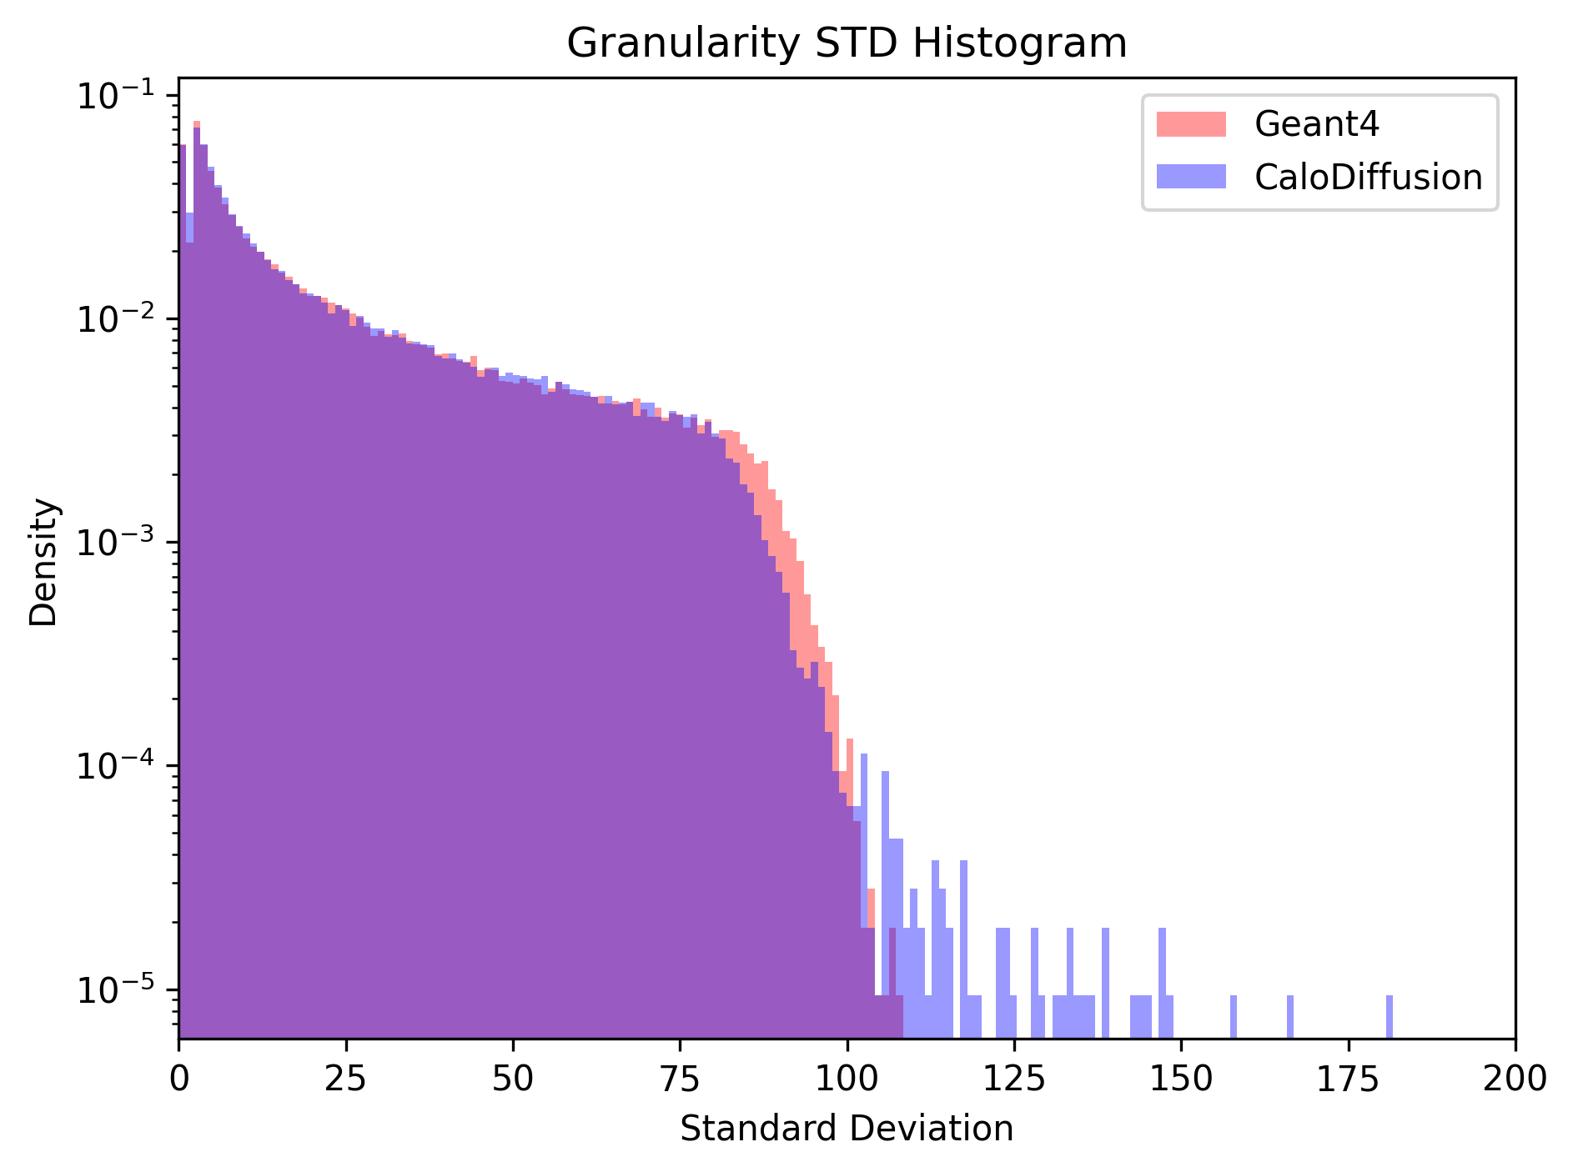
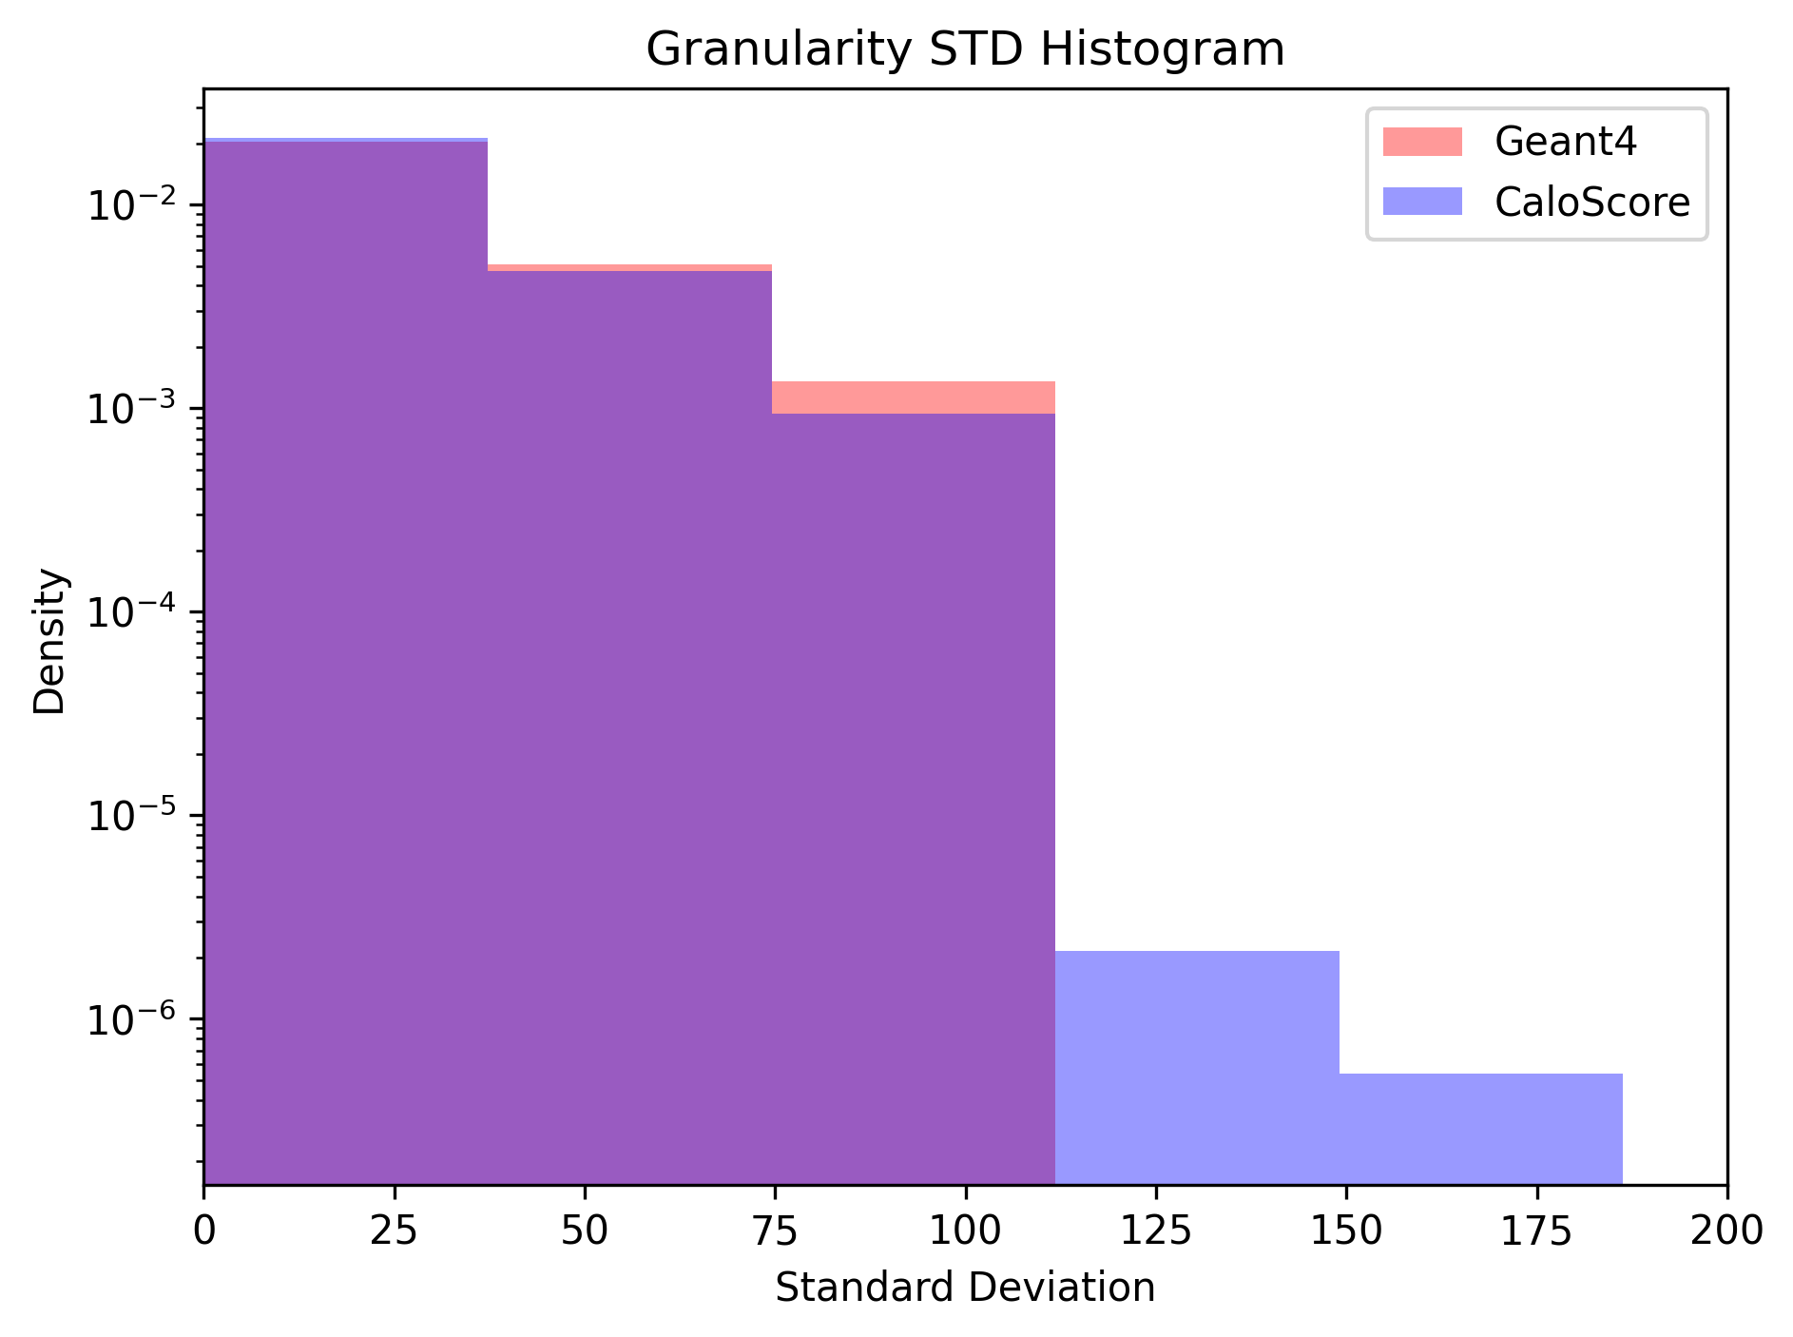
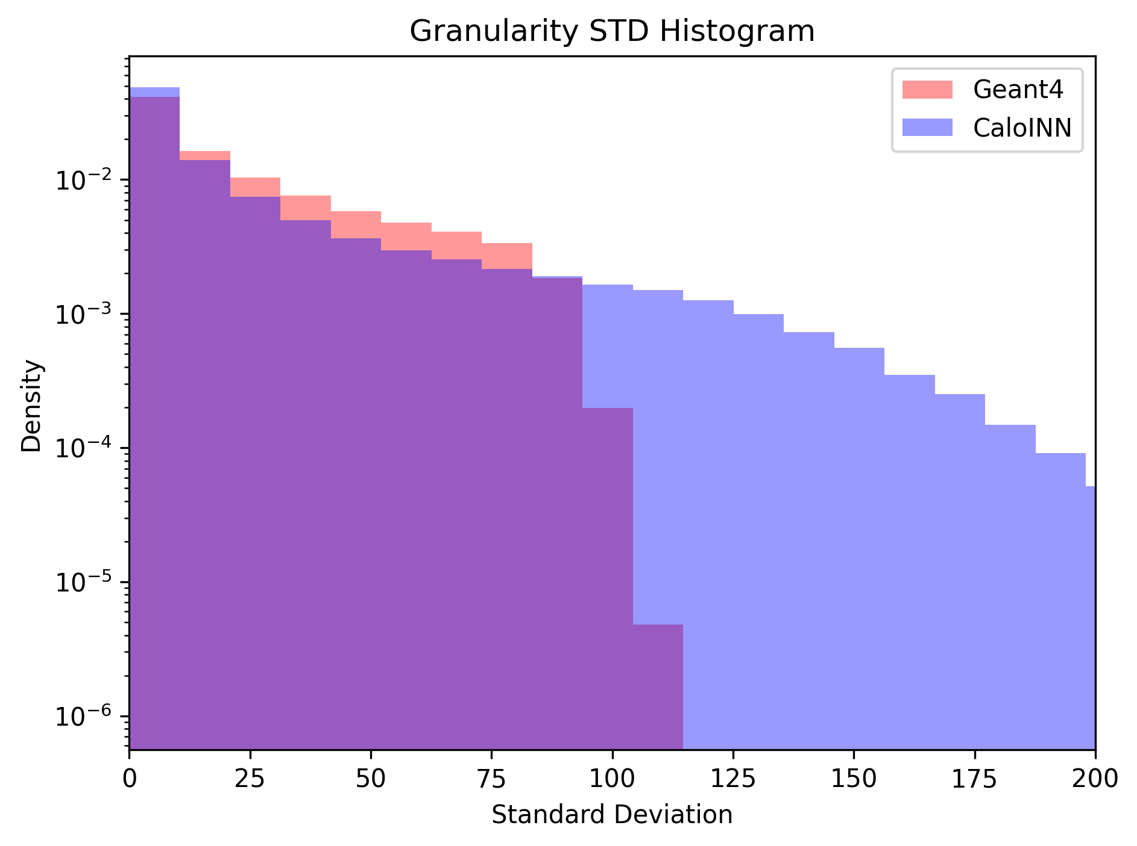
Bins=200

Slide 7
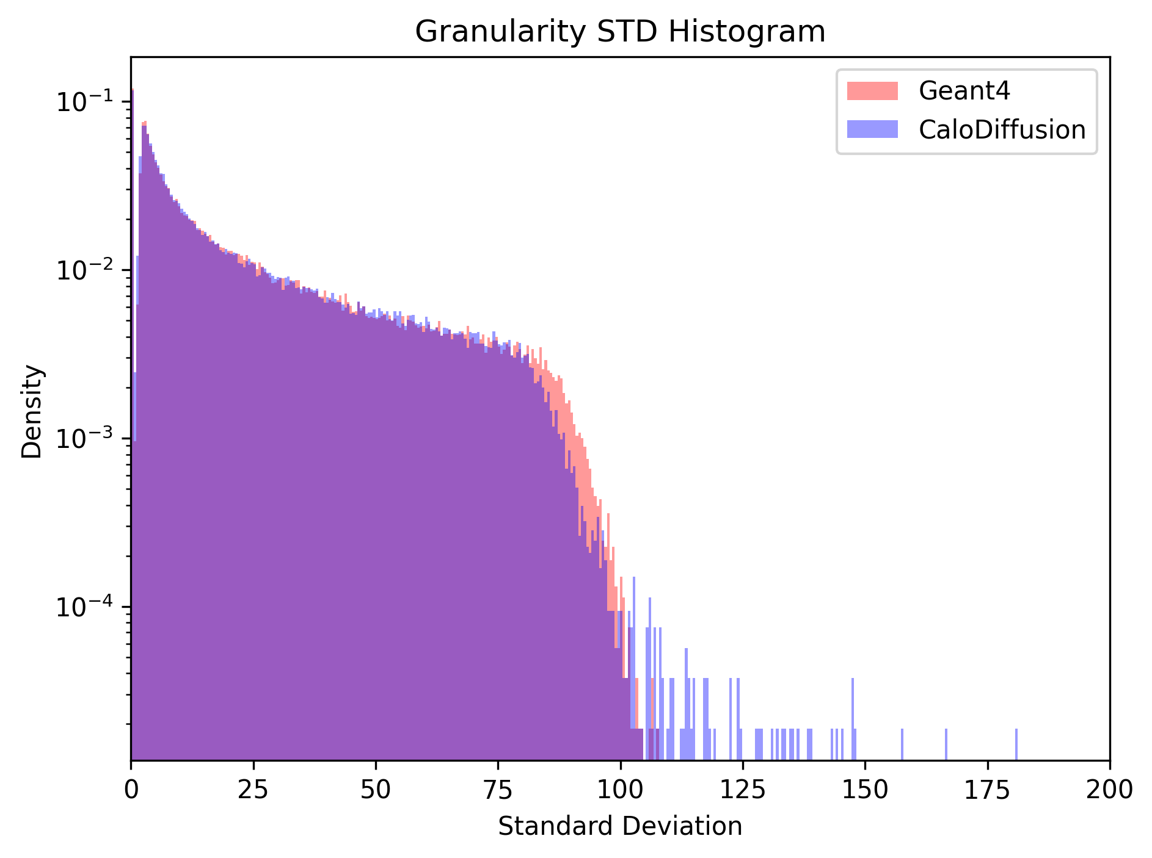
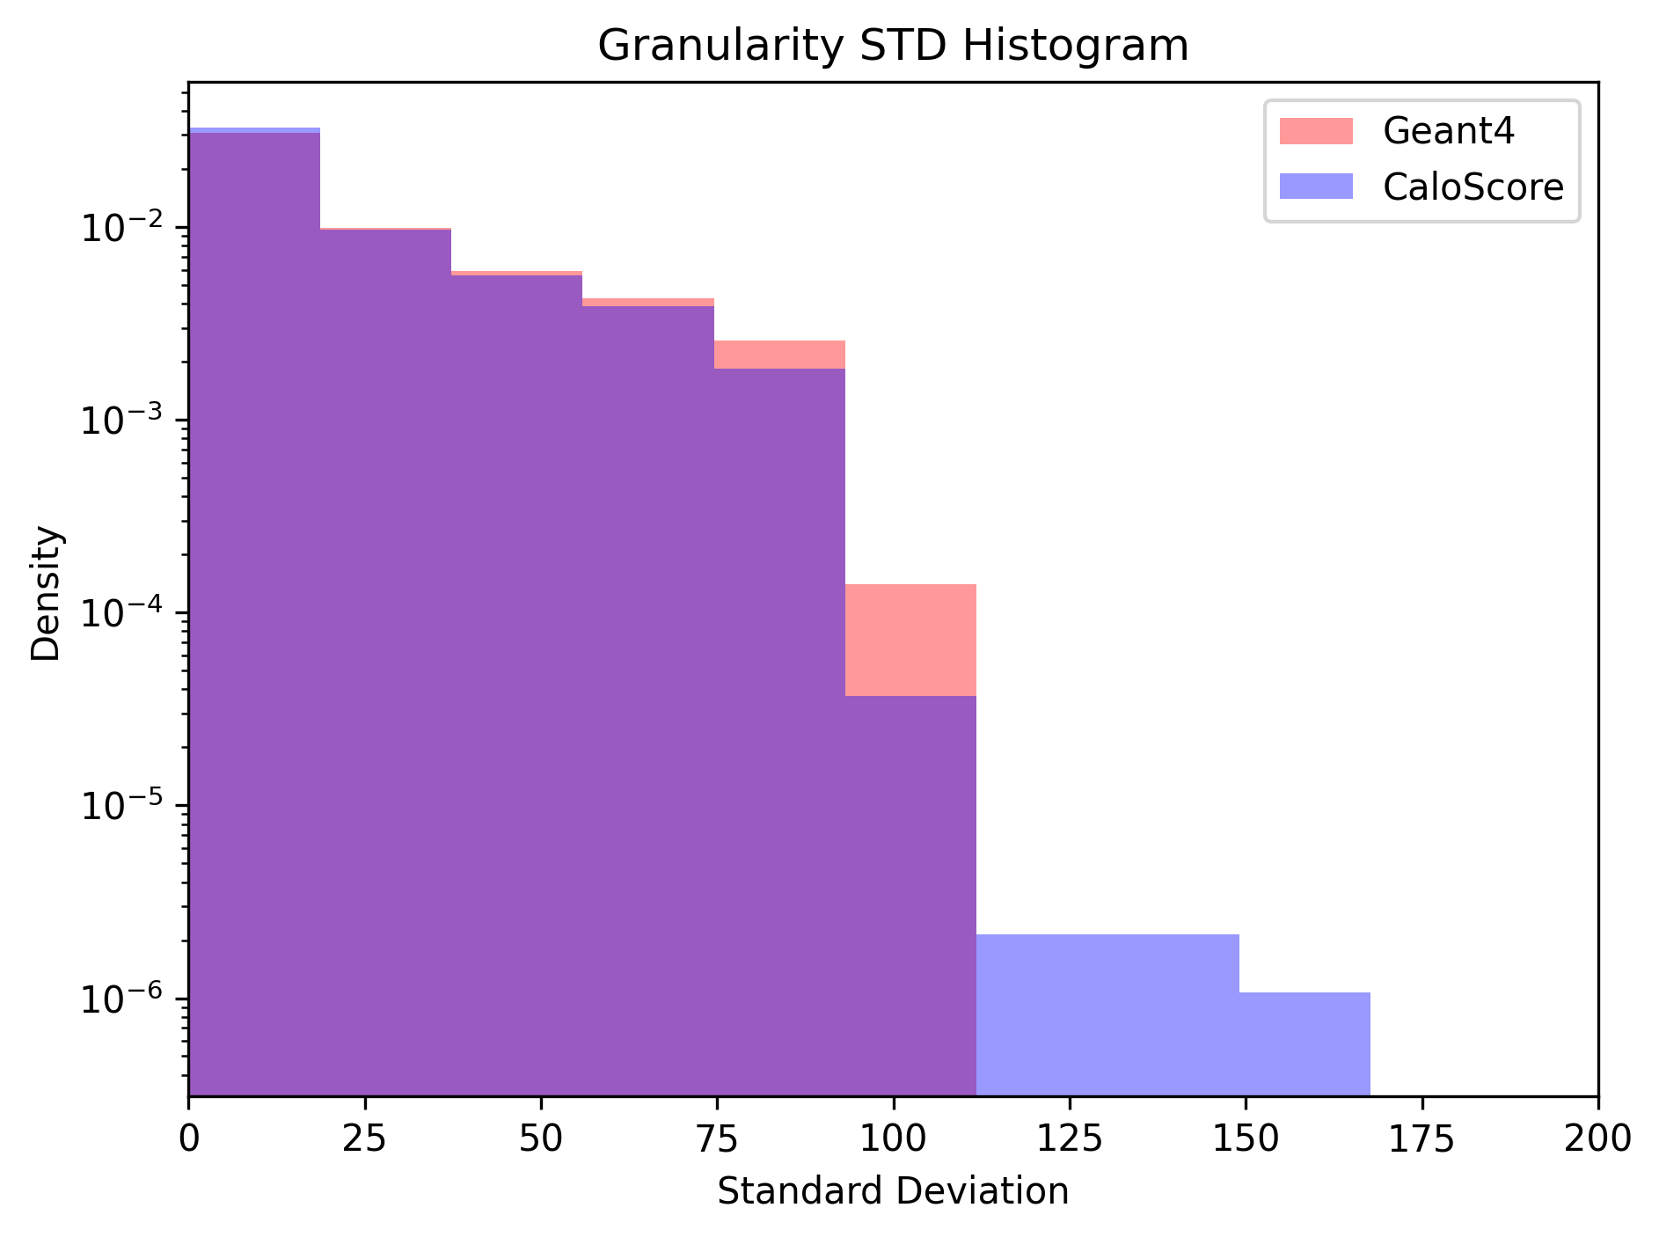
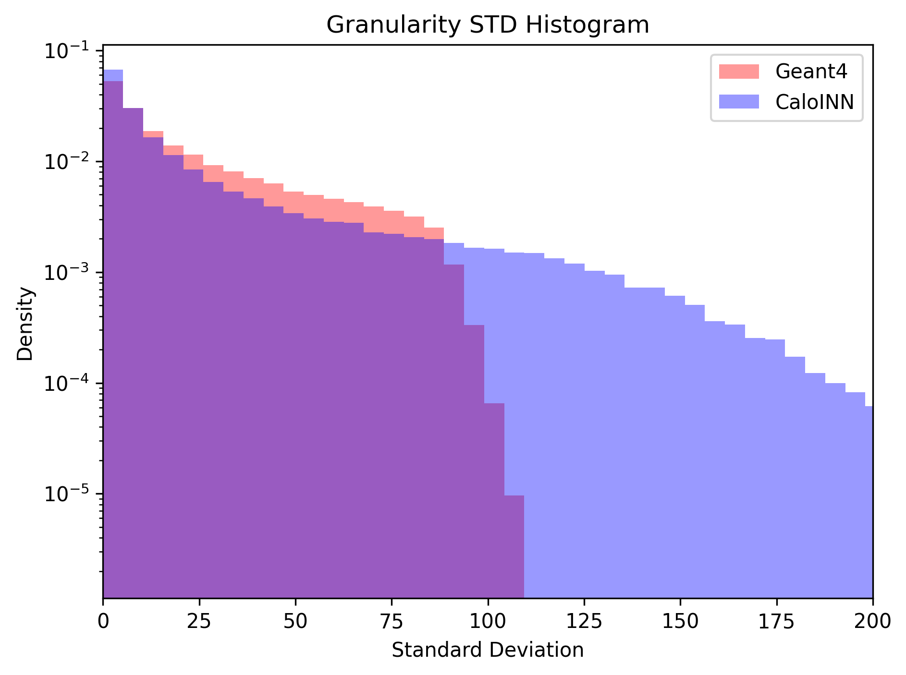
Bins=400

Slide 8
Pearson Correlation between layers
Computed energy sum for each layer (E_I) for all four samples.
Calculated Pearson Correlation Coefficient (PCC) across all layers.
In the graph, we are showing PCC for dataset 2.
Granularity suggests looking at voxel not layer correlations
Note large granularity is small correlation; roughly Granularity is proportional to (1-correlation)
Note: Generated samples are not preprocessed.

Slide 9
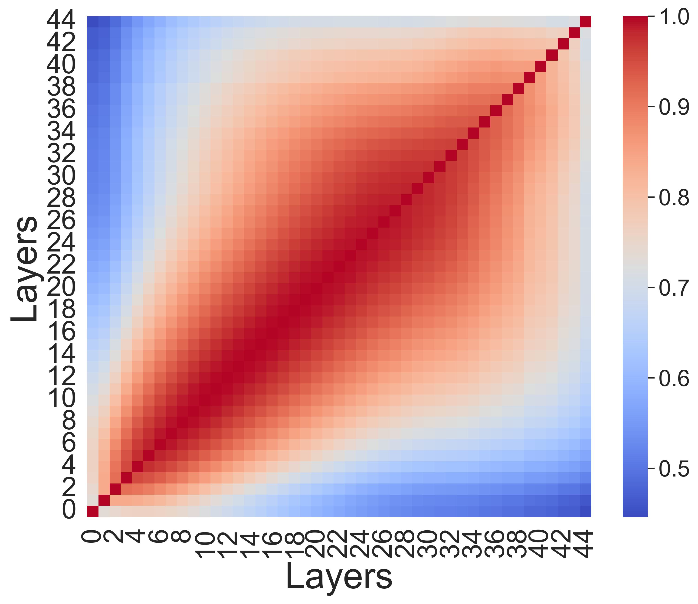
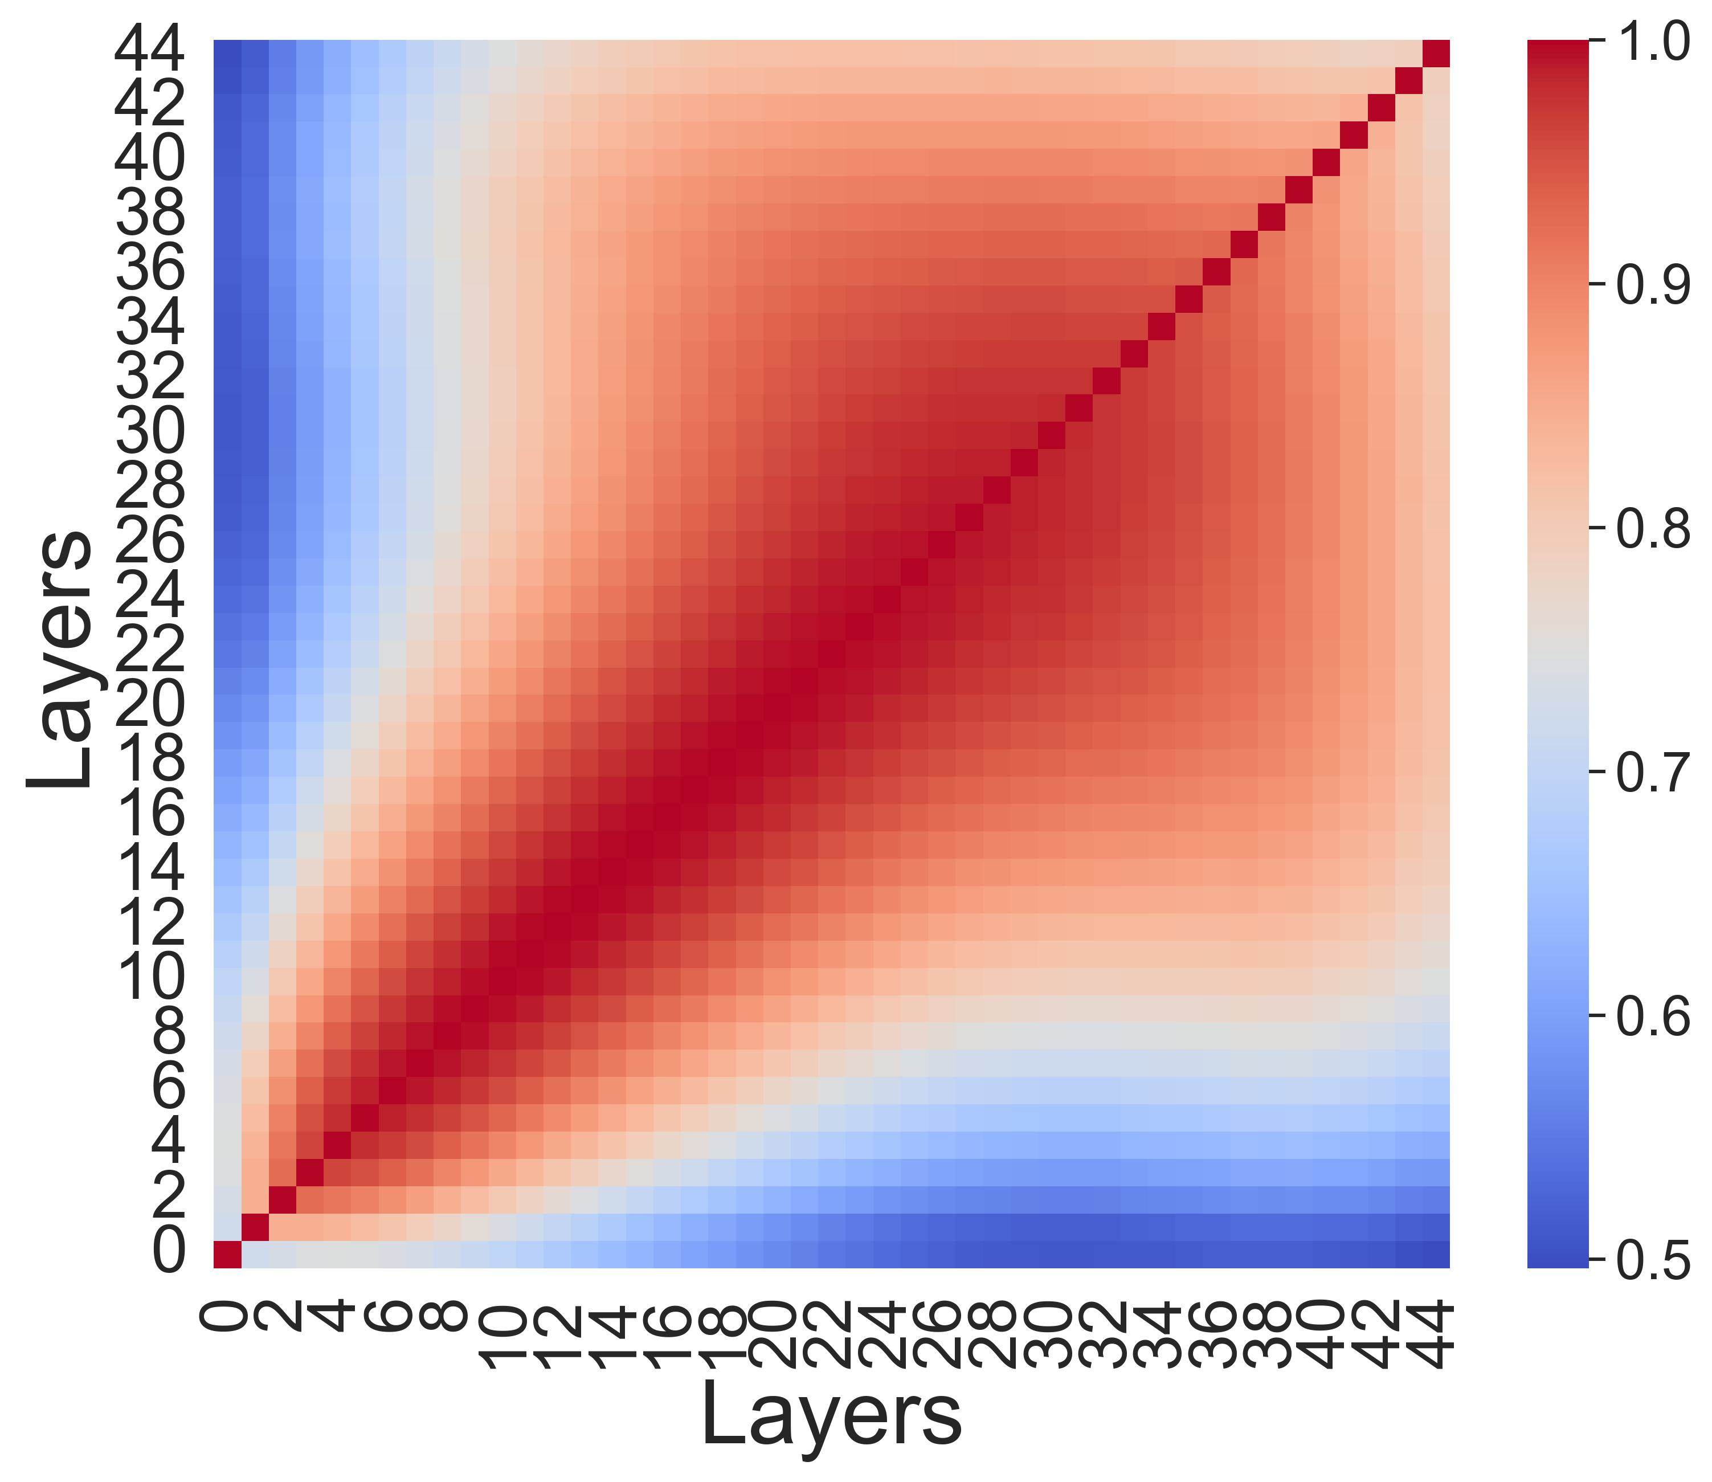
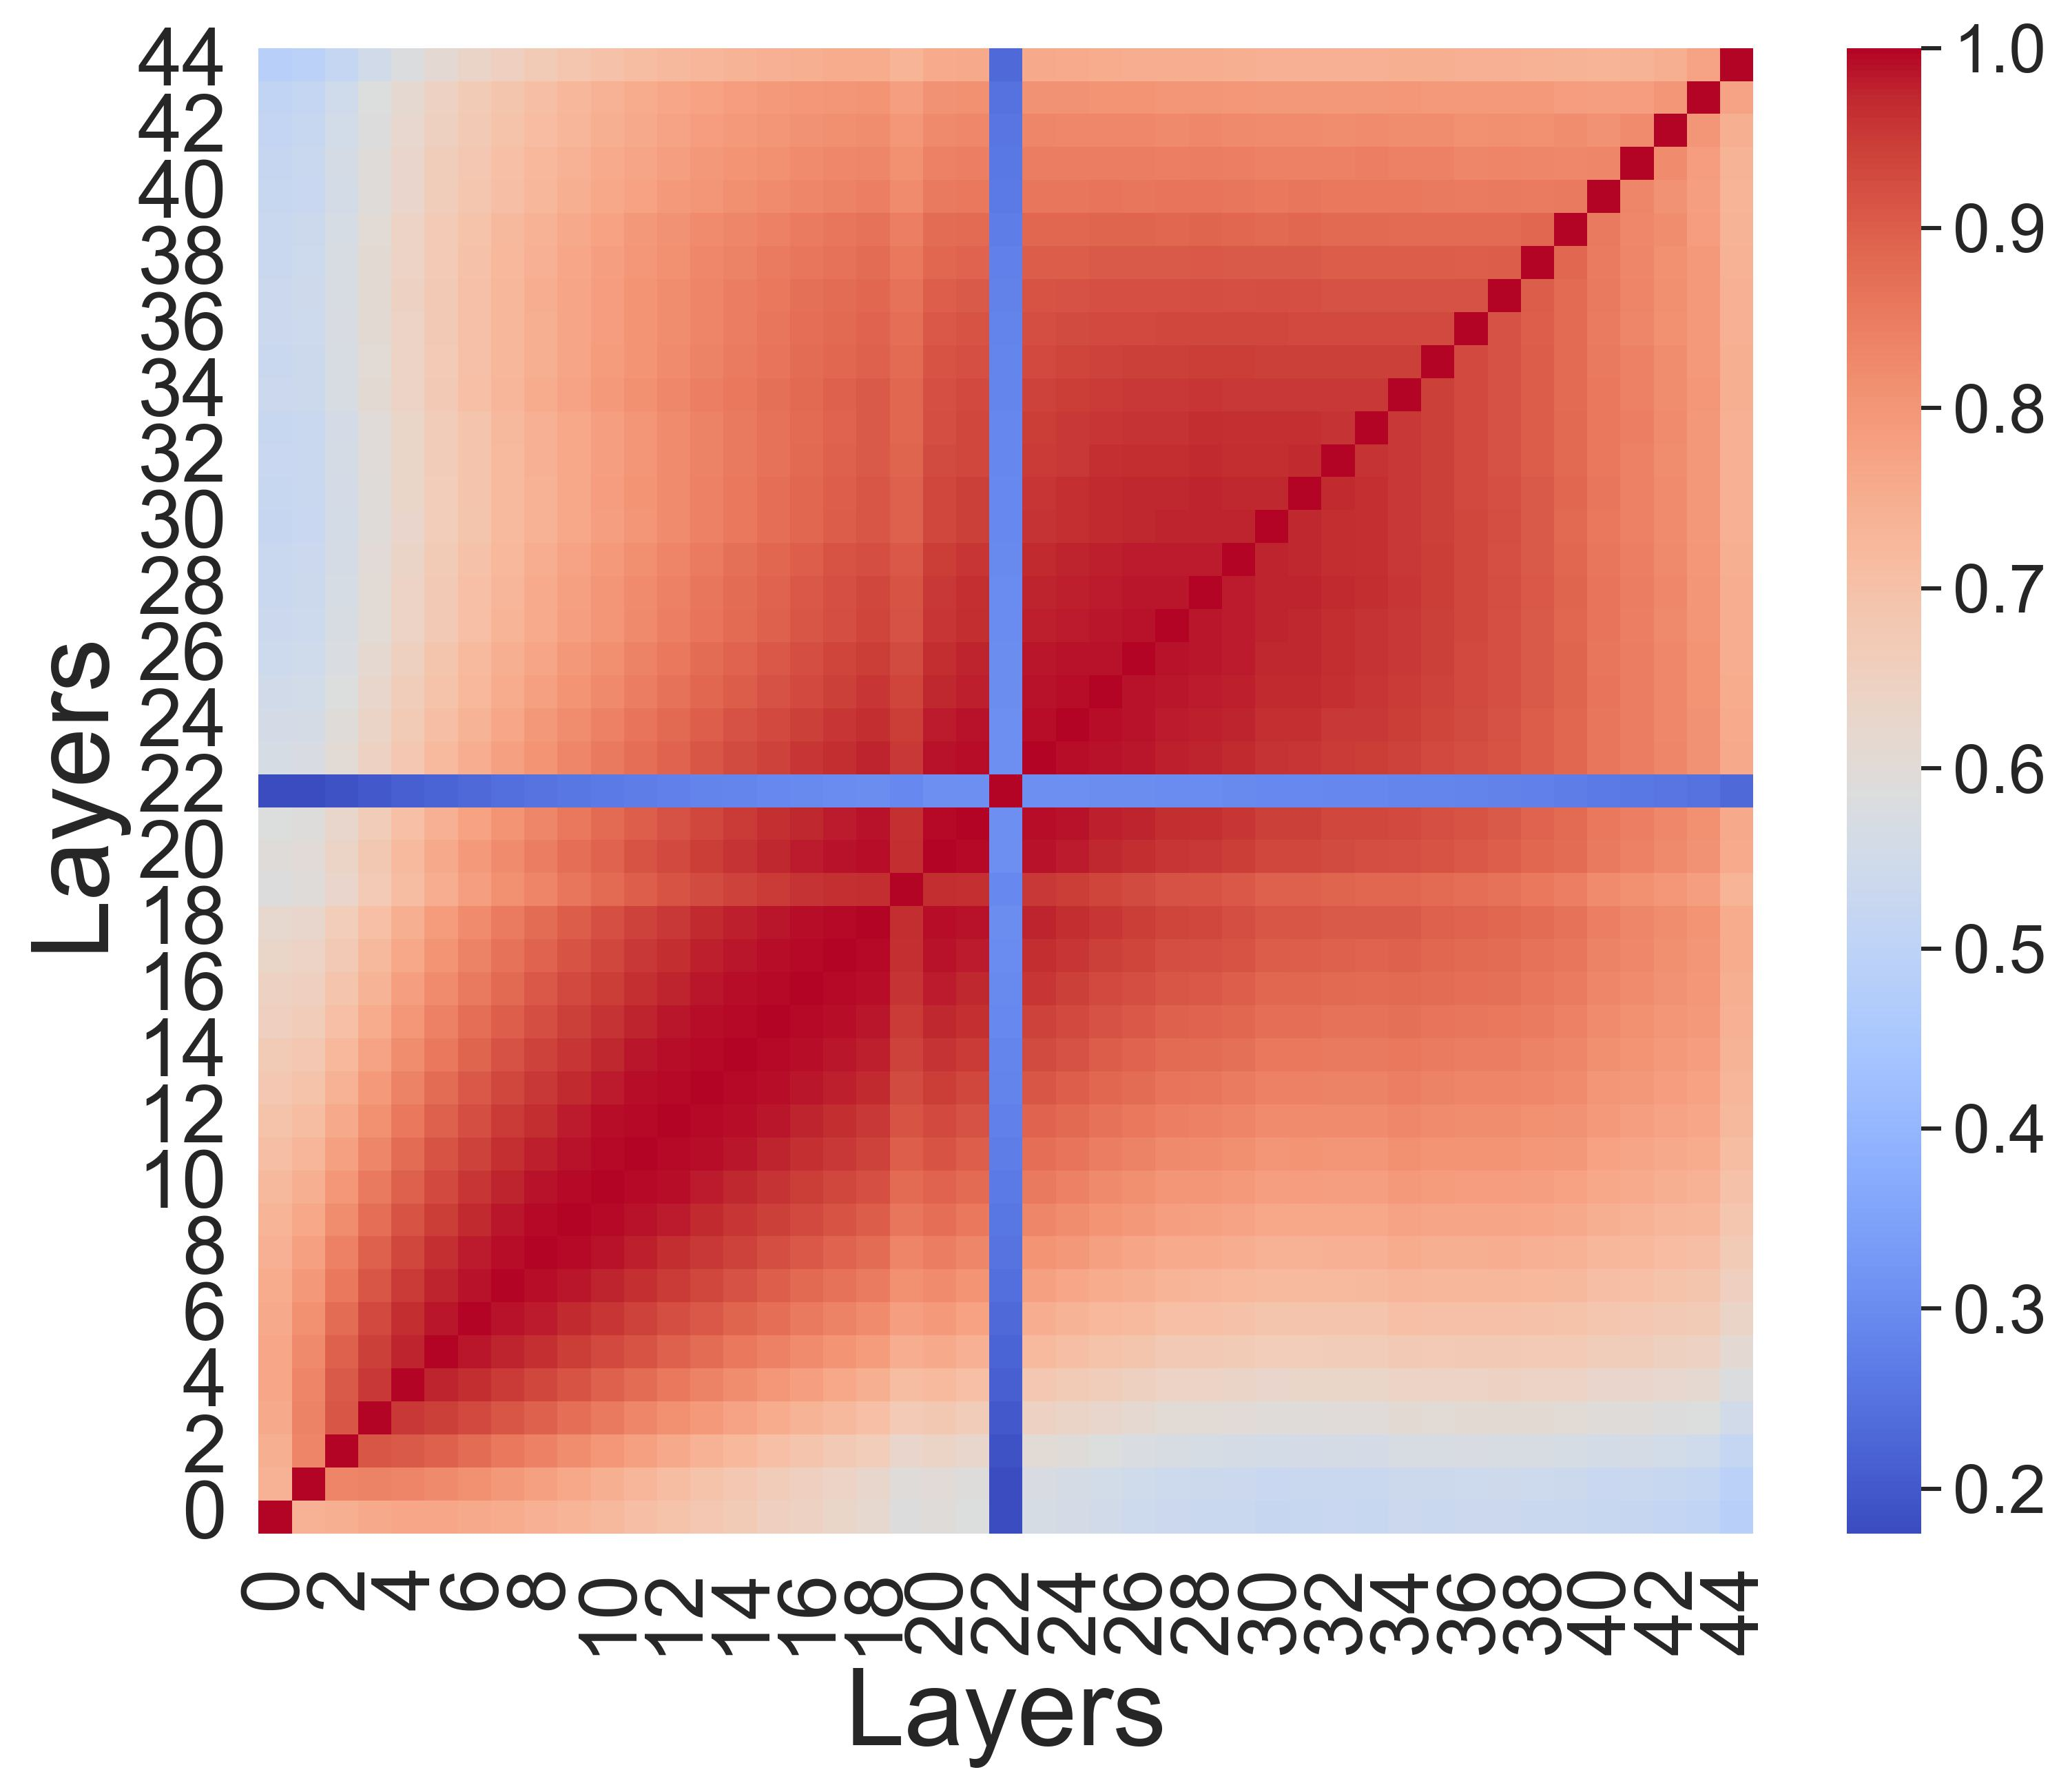
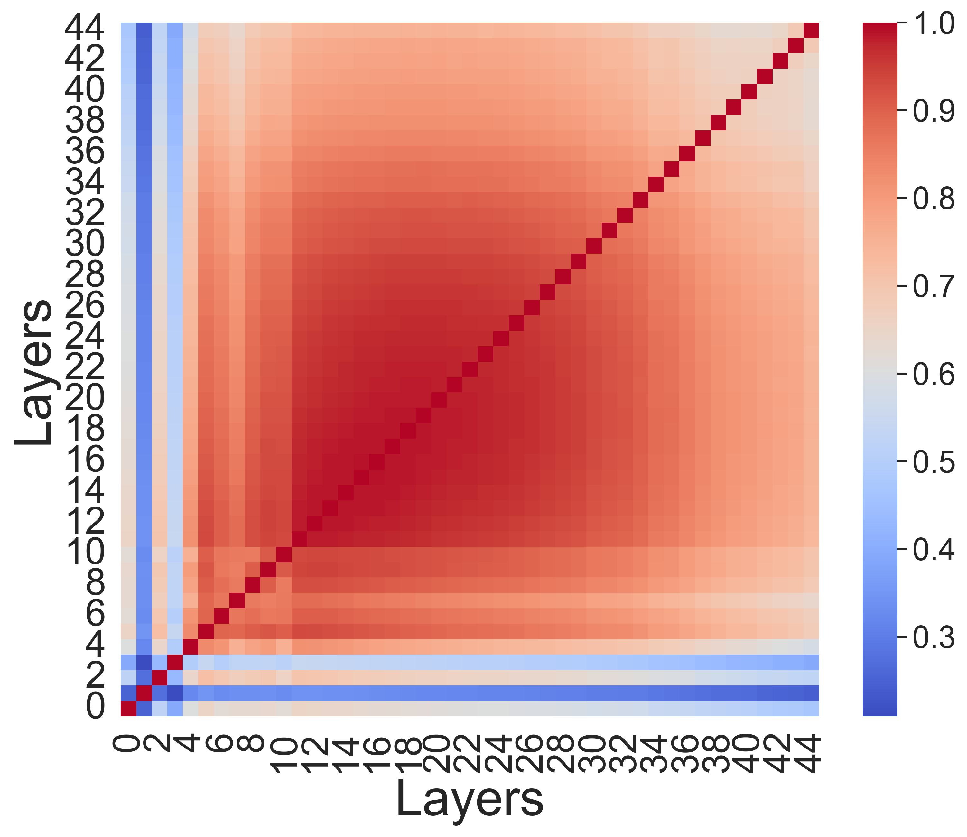
Geant4
CaloDiffusion
CaloScore
CaloINN

Slide 10
