Slide 1
Particle Physics Faculty Meeting
Agenda
  News/Update
  Research groups updates

Slide 2
TRIUMF is located on the traditional, ancestral, and unceded territory of thexʷməθkʷəy̓əm (Musqueam) people, who for millennia have passed on their culture, history, and traditions from one generation to the next on this site.
TRIUMF’s home has always been a seat of learning.

Slide 3
UCN Search
Long list interviews to be completed
Short list report submitted
Green light from director to go ahead, but with the ask that the committee assess again if there are potential additional (diverse) candidates that have opened up since the search was started
  Search committee
    Chen-Yu Liu (chair), University of Illinois Urbana-Champaign
    Brad Plaster, University of Kentucky
    Jeff Martin, University of Winnipeg
    Isabel Trigger, TRIUMF
    Ruediger Picker, TRIUMF

Slide 4
Shutdown Scenarios
From Petr:
FYI, after a unanimous endorsement by the Science Council, Leadership Team approved the shutdown scenario of the TRIUMF’s Five-Year Implementation Plan (2025-2030) at the retreat yesterday.
Please plan accordingly and start working on mitigations of the impact, e.g., on the HQP training etc.
Thanks,
Petr

Slide 5
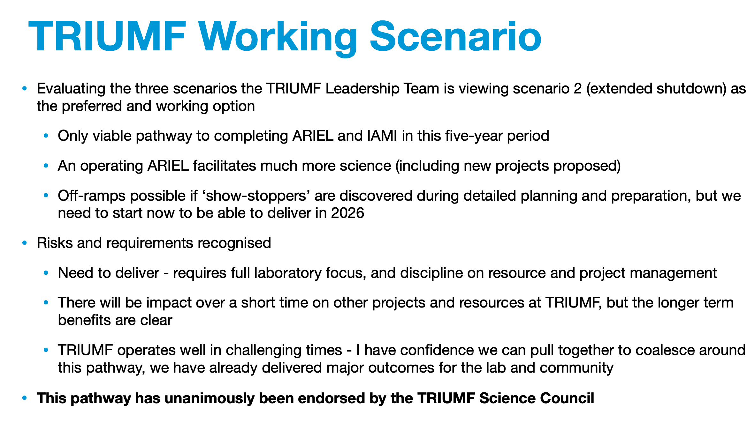

Slide 6
Desk needs
From Mark:
  Please update the spreadsheet for your HQP seating at:
  https://triumfoffice365-my.sharepoint.com/:x:/g/personal/mhartz_triumf_ca/ETTos5KLmCBLqx09OclyfhYB9kkTT8bmZ6FfnKXDP5ehJA?e=dc8jNX
  If you make a change or addition, please set the background in the name cell to yellow so they are easily tracked.

Slide 7

Physical Sciences
QUANTUM BC visit at TRIUMF
Thursday August 22nd 1-5pm (incl. tour)
Quantum BC
  Olivia Di Matteo
  Hannah Evans
  Daria Ahrensmeier
  Kero Lau
  Thomas Baker
TRIUMF
  Nigel Smith
  Iain McKenzie
  Chloe Malbrunot
  Wojtek Fedorko (remote)
  Reda Tafirout
  OSC
  Stephane Malbrunot-Ettenauer (on tour)
  Chukman So (on tour)

Slide 8

EDI Survey at TRIUMF
Sep 3 – 24, 2024
The survey targets 3 key areas that were identified in the Phase I interviews:
  A comprehensive demographic questionnaire
  Building our knowledge of how TRIUMF people interact with and experience administrative and structural processes
  Building our understanding about the TRIUMF community’s experiences and perceptions of belonging, safety and inclusion.
This data will provide invaluable knowledge that can be used to inform strategic decisions and to ensure that the needs of the community are well-understood and responded to.
The change starts with
YOU!

Slide 9
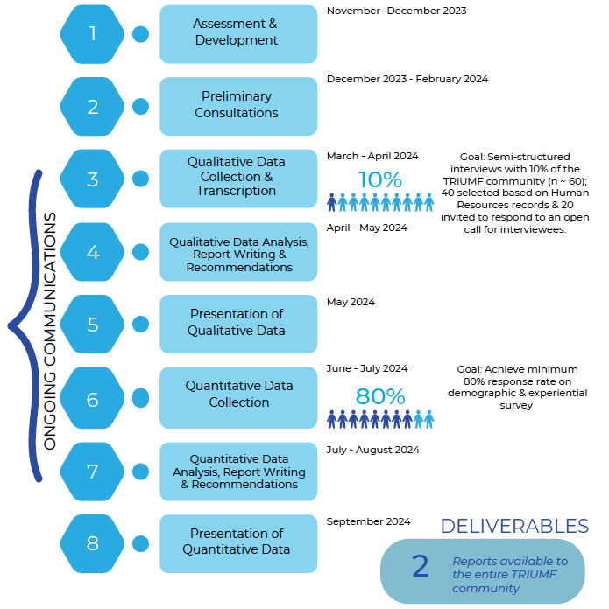
Timeline
Phase II
online survey
Sep 3 – 24, 2024
Oct - Nov 2024
Oct - Nov 2024

Slide 10
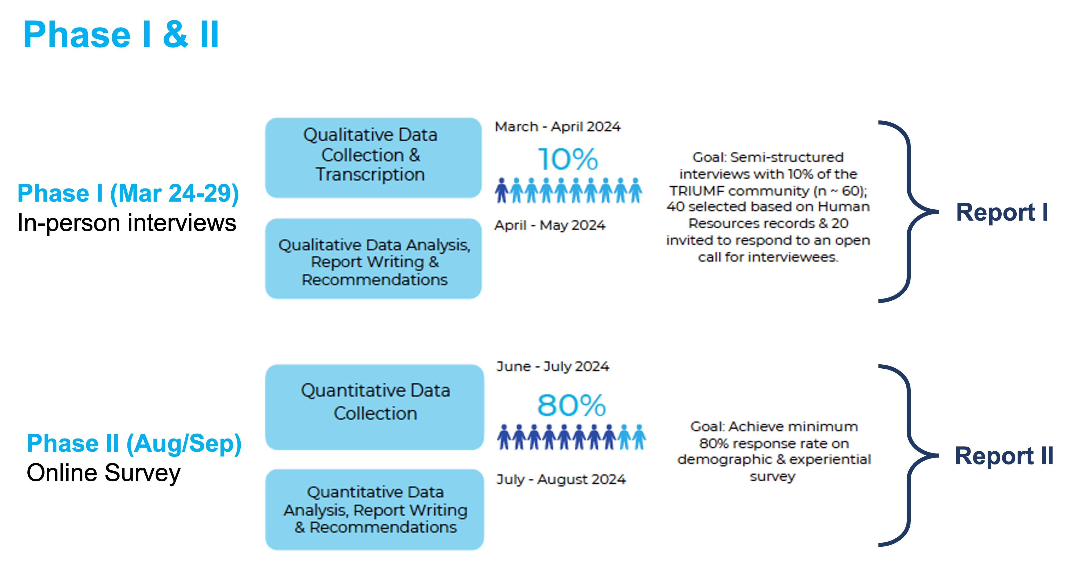
EDI Survey at TRIUMF
Sep 3-24, 2024
Online (~20 min)
Report II
Open to anyone who works or studies at TRIUMF
Approx. 20 min. (~30 questions)
Goal: 80% response rate to the site-wide online survey
Information will be treated anonymously and confidentially throughout the entire process!

Slide 11
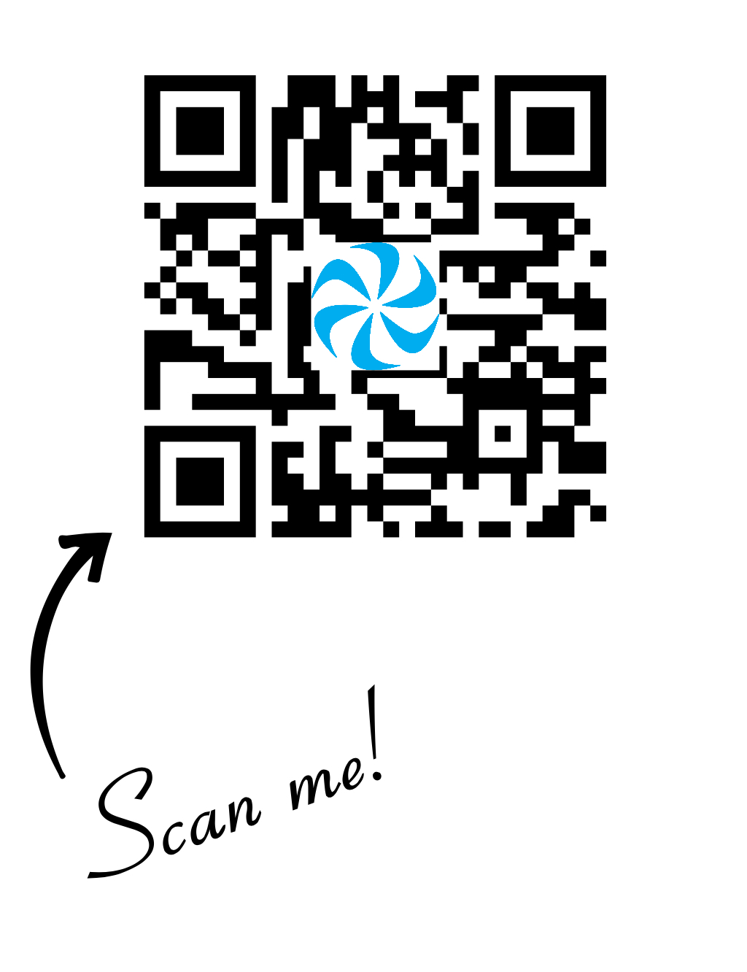
Survey with Coffee and Cookies*
Friday, Sep 6th, 8am – 10am, MOB Boardroom
Thursday, Sep 12th, 11am – 1pm, ISAC-II Conference Room
Monday, Sep 16th, 3pm – 6pm, MOB Conference Room
* More days and/or locations can be added upon request
Computers will be available in these locations for those who do not have them
For more information about the EDI survey, EDI reports from Phase I & FAQ

Slide 12

StrongerBC Future Skills Grant
Access up to $3,500 in short-term skills training (identified as needs by BC Labour Market Outlook). Full webpage here
Eligibility criteria includes Canadian citizen/PR, 19 years or older
Over 300 programs offered by more 24 colleges and universities
  Range of programs from trades, technology, HR/Leadership, EH&S, EDI, Project Management, Finance
  Institutions include UBC, SFU, Uvic, BCIT, Capilano, Emily Carr, JIBC, Langara College, Douglas College, etc.
  Mix of online, in-person, and hybrid programs
Enrollment now open for Fall 2024 programs in selected institutions. Individuals can enroll directly via the government page
Disseminate to your team in support of their P3 Development Objectives
If approved and proceeding, ensure program is completed in accordance with TRIUMF policies
Discovery,
accelerated

Slide 13
Various
QRPP rankings are out
Student and postdoc salaries, updated policies with clarifications from Marcello and Monika
New visitor’s policy in effect
Cybersecurity training for working while overseas taking effect mid-September

Slide 14
AOB

Slide 15
Round Table
  ATLAS
  T2K/HyperK
  TUCAN
  ALPHA
  SuperCDMS
  DarkLight
  n-EXO / PHORWARD
  PIONEER
  NA62
  P-One
  SNO+
  HALO
  g-2
  Belle
  Theory

Slide 16
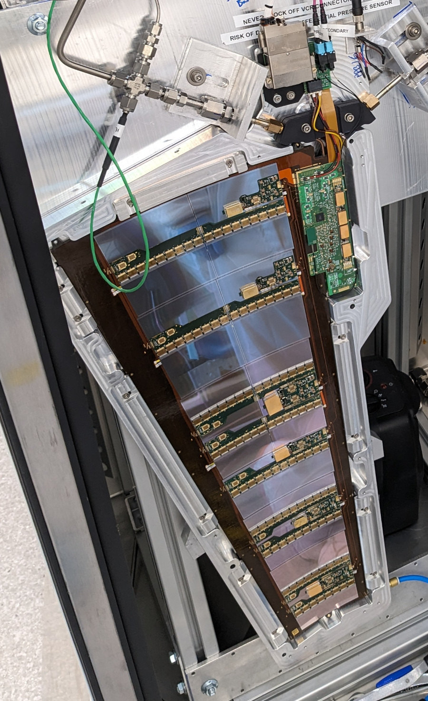
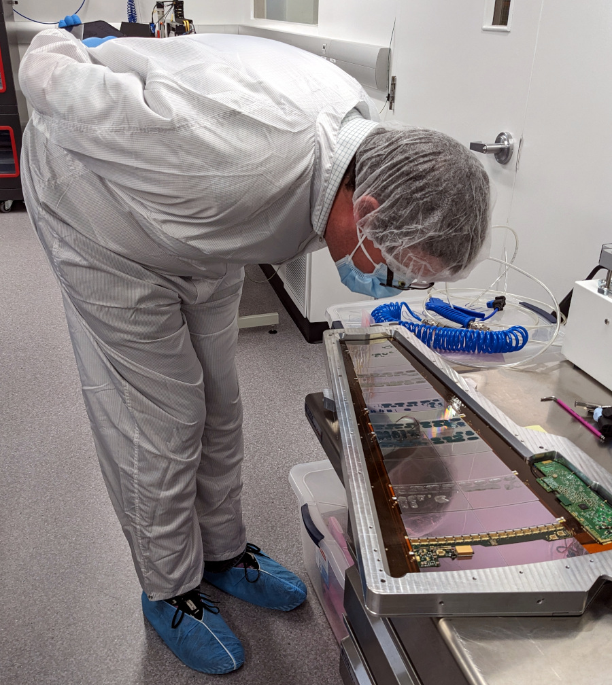
ATLAS Update
ITk Updates
Vancouver team leading the investigation into the prevention of damage on petals from cooling down below operating temperature
  First petals with alternative loading methods assembled and tested (for entire international ATLAS collaboration)
  First end-cap modules with built-in stress relief in the whole project assembled at SFU and TRIUMF
  Visits from ITk strips Project Leader, Upgrade Coordinator and Spokesperson-elect to observe progress
Publications:
Threshold bounce — occupancy-dependent modulation of the discriminating threshold in silicon detectors, M.J. Basso et al 2024 JINST 19 P06041

Slide 17
ALPHA Update
Spectroscopy campaign is ongoing (and progressing well)
  Established protocol to accumulate Hbar overnight (thousands!), laser-cool it and perform spectroscopy
  Novel protocol “adiabatic cooling expansion” to explore sub-Doppler cooling (paper submitted)
Switch to ALPHA-g in preparation for September
  Expected cooldown of external solenoid this week

Slide 18

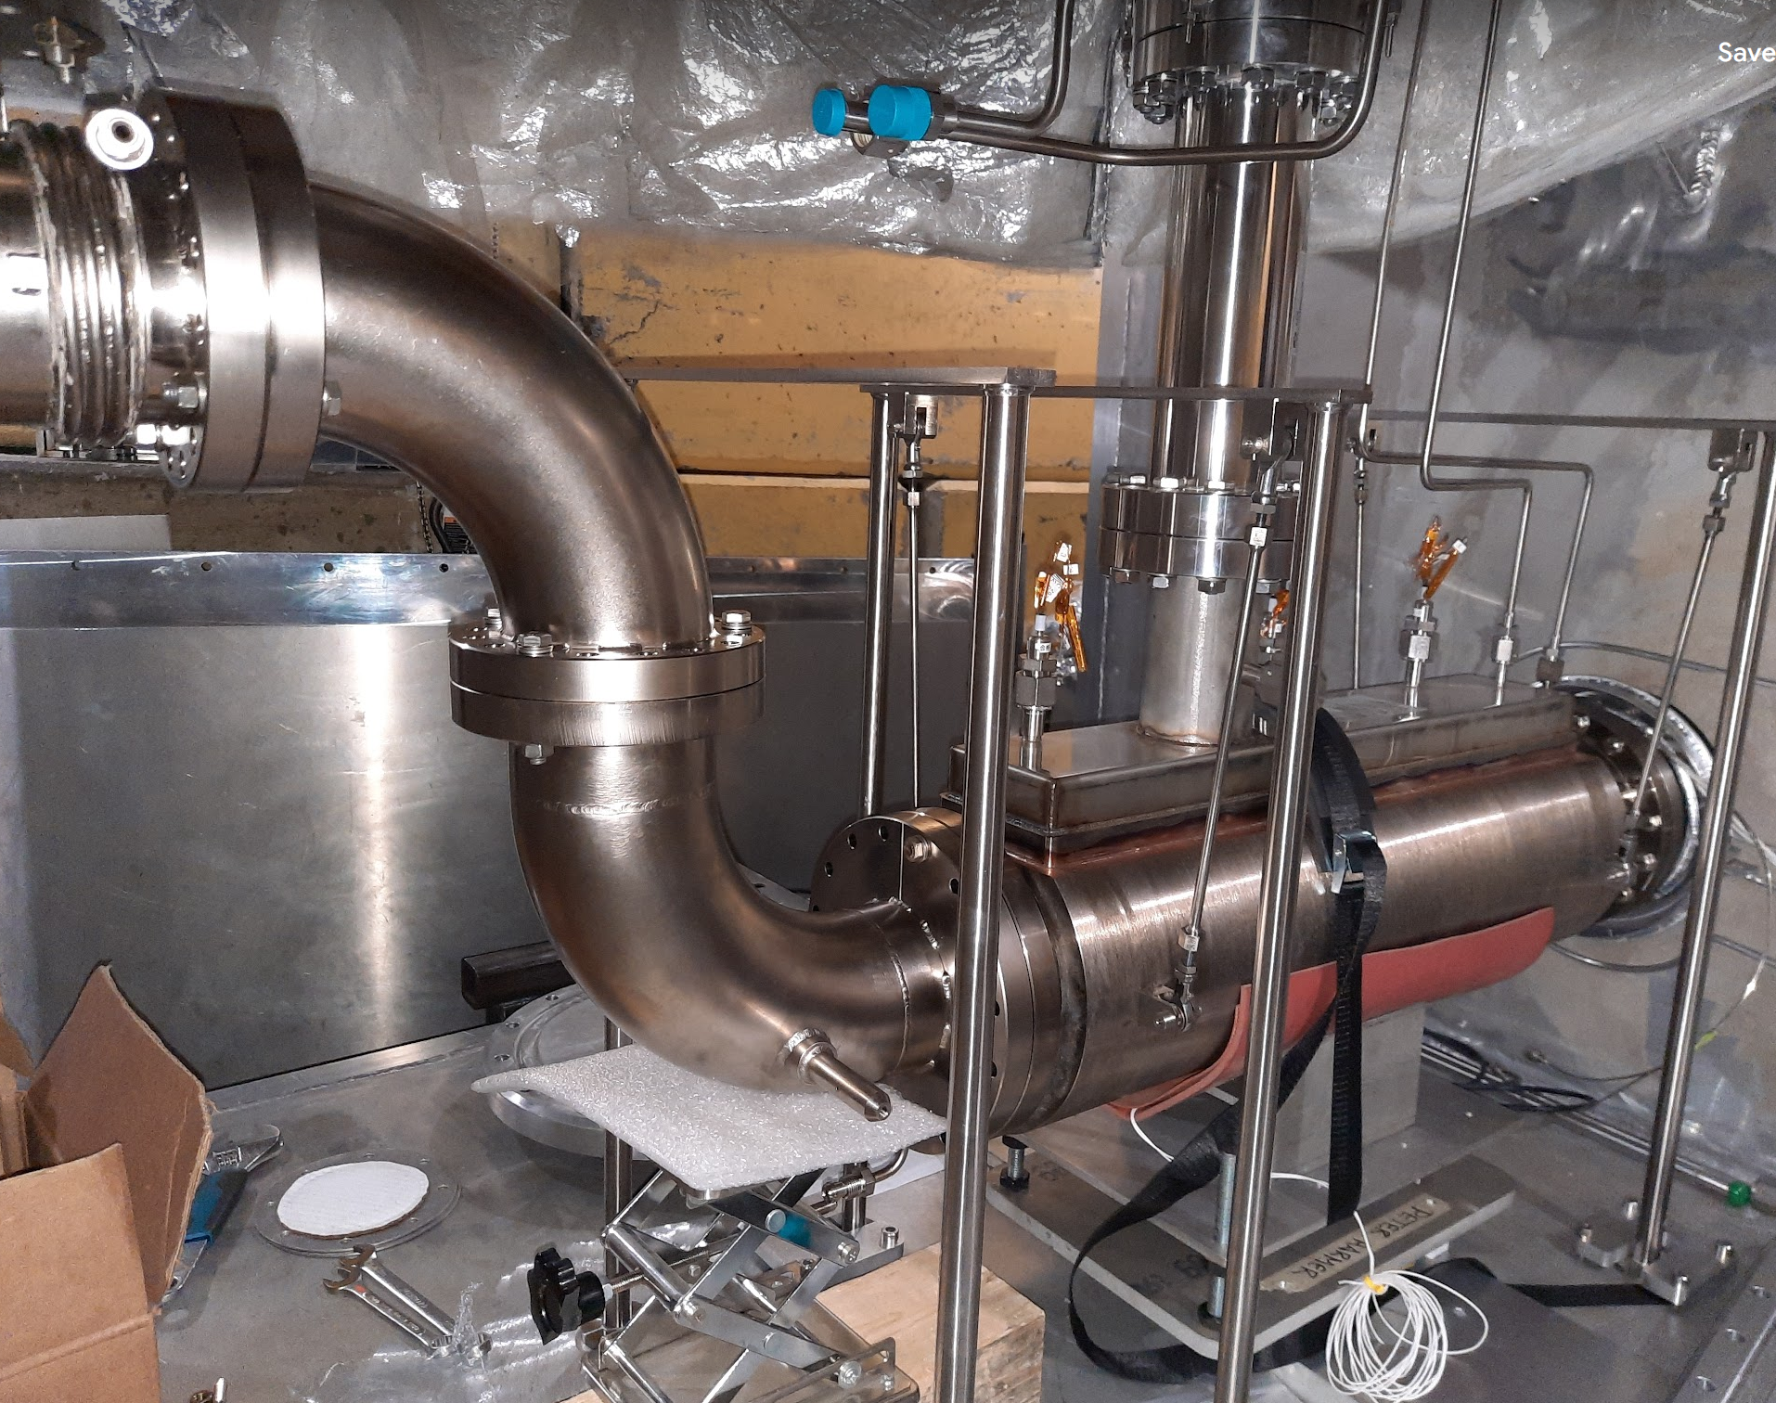
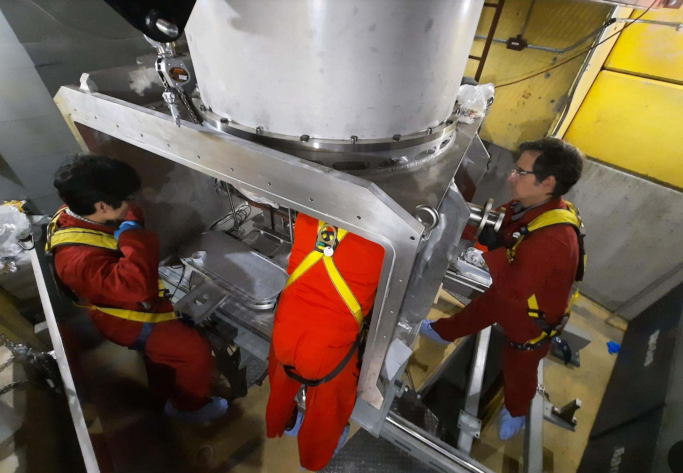
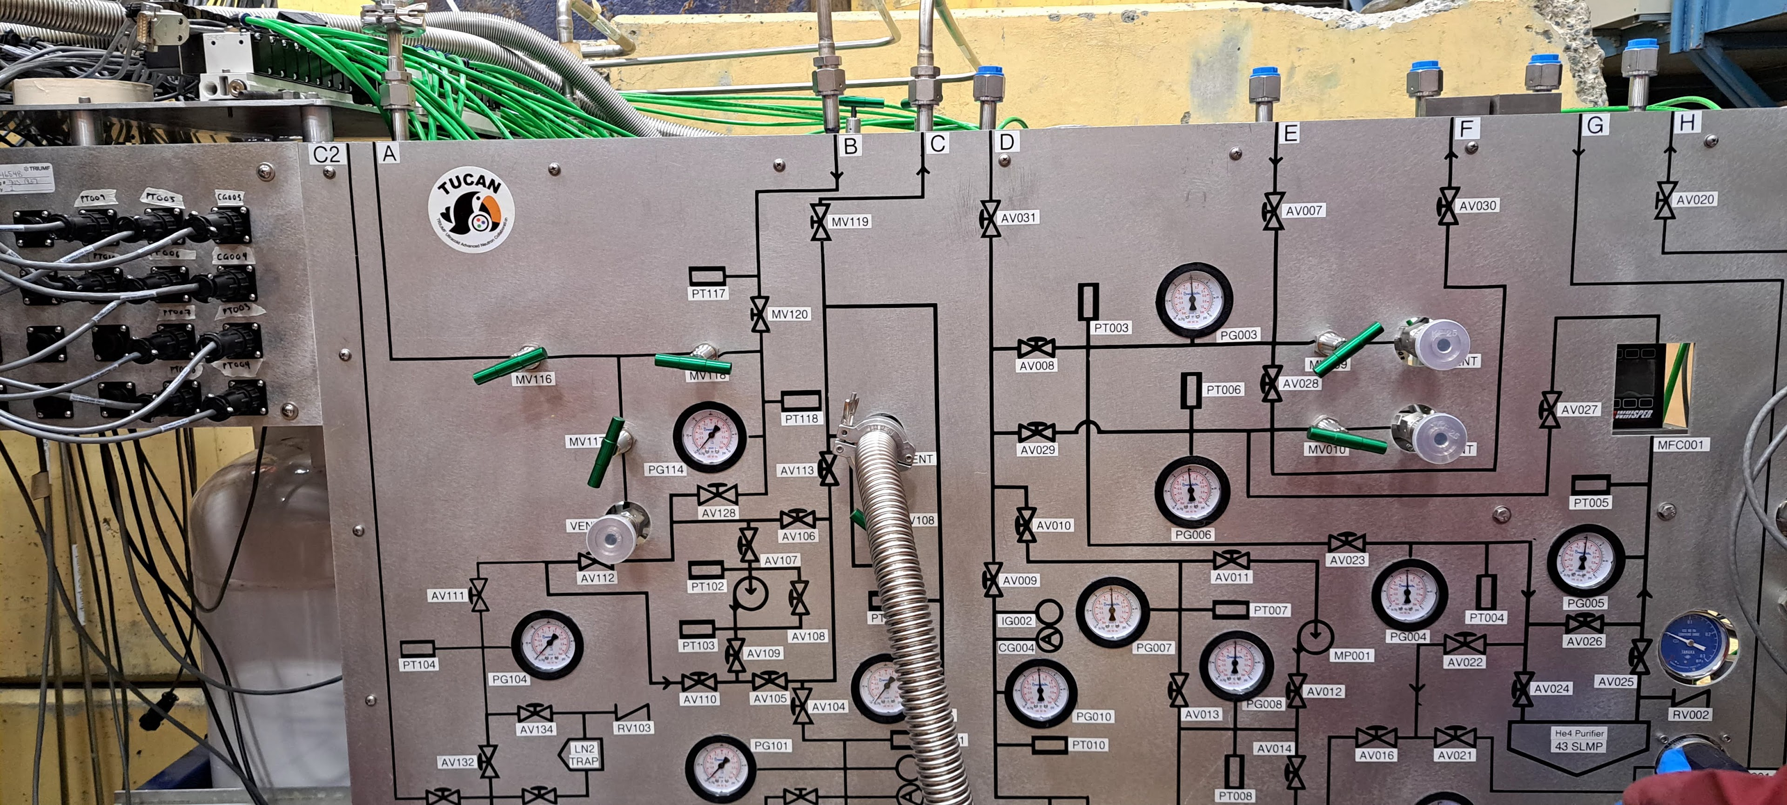
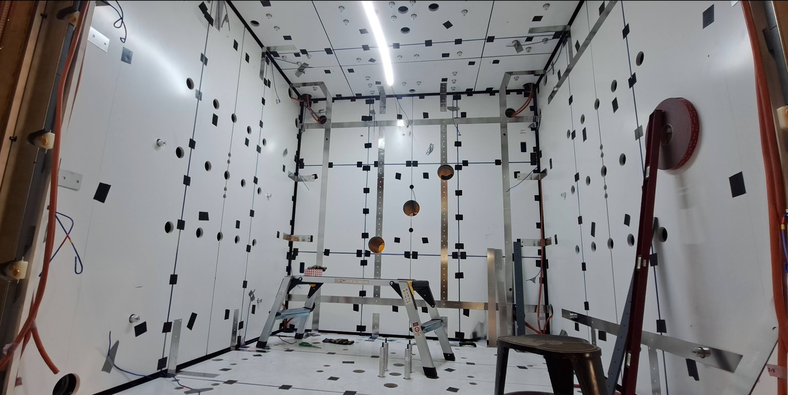
UCN Source / BL1U
UCN guide
Final heat exchanger (HEX1) installed and connected to tail section
UCN guide test fitted for last weld to be made.
Isopure gas system slow control ready for testing.
Beamline 1U commissioning:
  Max current, so far, 10 µA
  RPG surveys: shielding looks good for all public areas, some hot spots on top of 1A blocks.
  Currently trying to find optimal tune that creates a large enough beam spot while not spilling too much on collimator.
Submitted beam requests for UCN source runs in schedule 147.
1
2
2
3
2
1
HEX1
3
EDM
A
6th layer of MSR currently being installed.
Internal shim coil prototypes are being assembled.
B0 coil design advancing.
Isopure gas system
A
Cladding for layer 6 of MSR
Libertad Barron Pollos (UNAM, Mexico) and Jeff Martin (UWinnipeg) now at TRIUMF for sabbaticals.
Laser enclosure

Slide 19
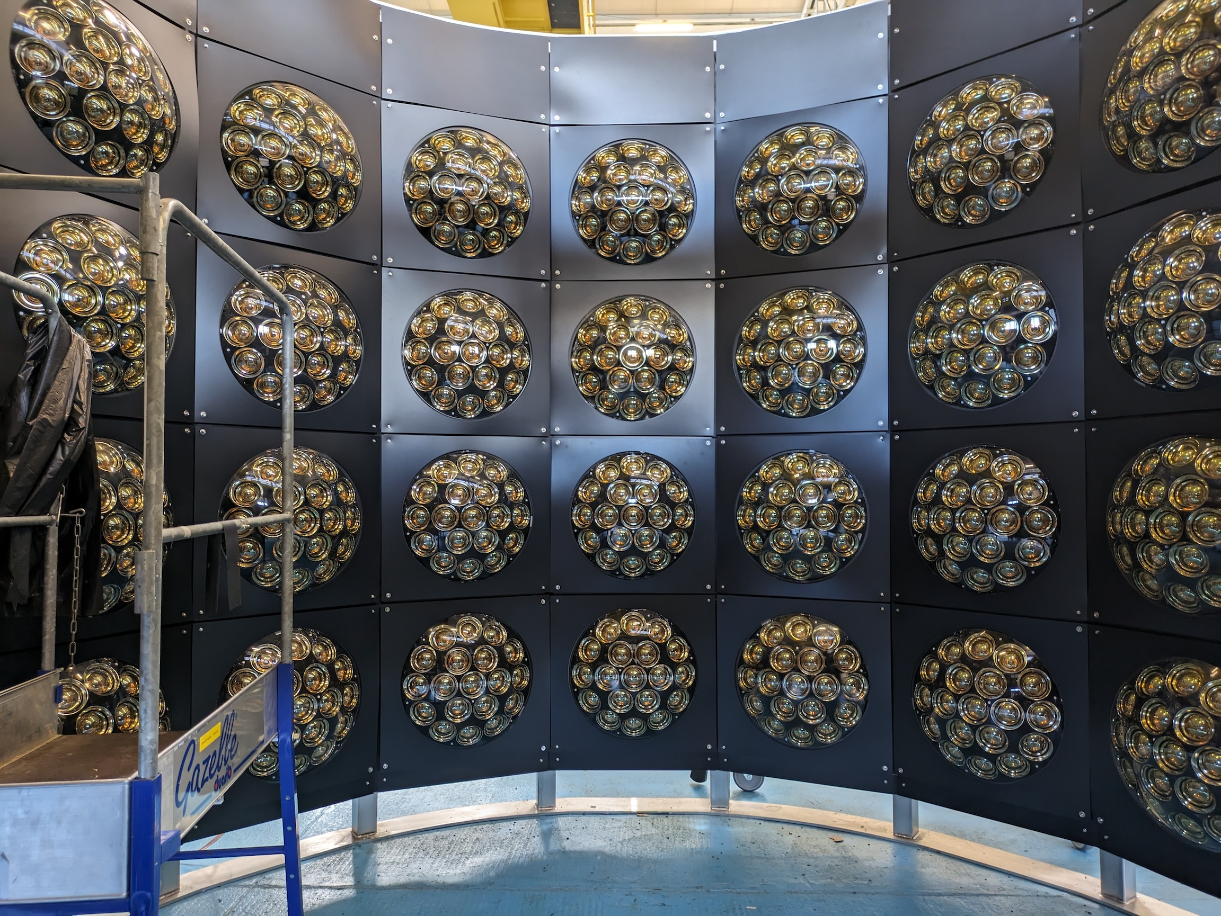
T2K/Hyper-K Update
WCTE Barrel Section with Multi-PMTs Installed
All multi-PMT photosensors built by TRIUMF have been shipped to CERN for installation in the Water Cherenkov Test Experiment (WCTE)
All multi-PMTs at CERN have been tested and installed on the WCTE mechanical structure (right)
Major milestone met with support from SciTech department
TRIUMF focus now on completing firmware and readout integration
On schedule for operation of WCTE in mid-October
Request from KEK for design work on Hyper-K Intermediate Water Cherenkov Detector (IWCD) outer barrier
  Included in QRPP request

Slide 20
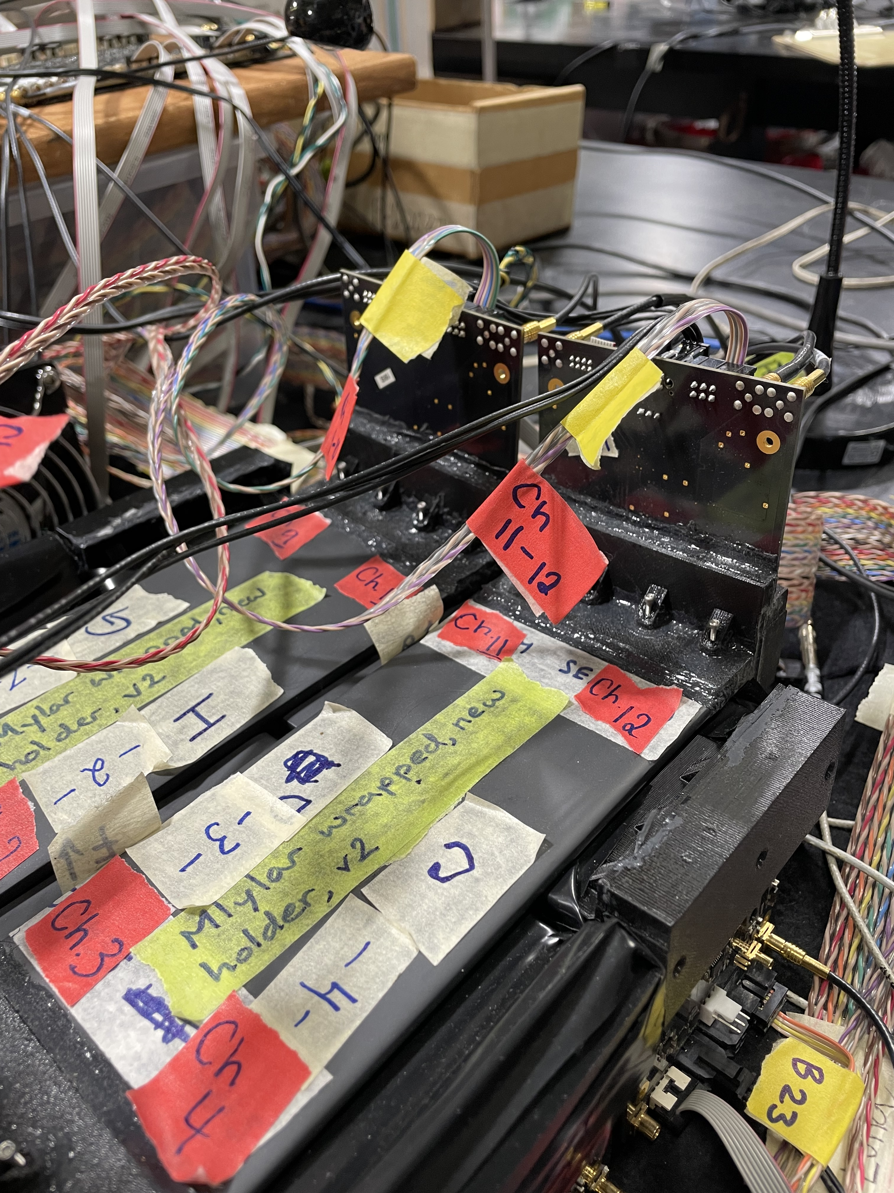
DarkLight Update
Trigger testing in detector facility
DarkLight aiming for installation in November.
  Timeline works well for accelerator division and beamline groups, while person power gets more constrained in following months
Difficult timeline to meet: need to pass numerous reviews and get a lot of hardware tested and shipped to TRIUMF in advance of that
  Whole collaboration working hard to try to make this happen
Requested all necessary person power for August-October at last QRPP; waiting for results
Gave PMOG a heads up that we will have our highest personnel needs ever in November, if all goes well

Slide 21
Next Meeting
  September 12th

