Slide 1


A connection between linearized Gauss-Bonnet gravity and classical electrodynamics
Mark Robert Baker
PhD Supervisors: Dr. Gerry McKeon, Dr. Sergei Kuzmin

Slide 2
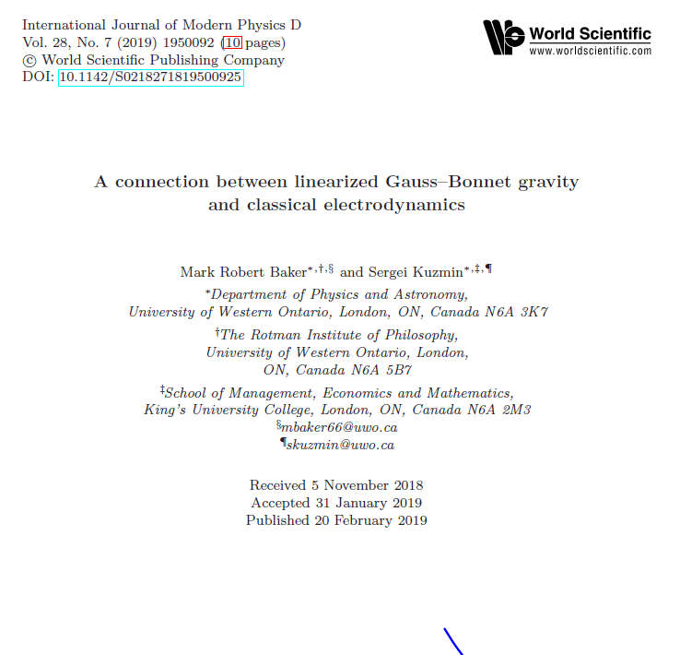

Slide 3
Outline
Motivation: Why we are doing this work
Methodology: What we are doing
Results: Benefits of this approach

Slide 4
Motivation
Classical electrodynamics has special property of complete gauge invariance
Complete gauge invariance of electrodynamics, each of the following is independently invariant: Lagrangian density, equation of motion, energy-momentum tensor, angular momentum tensor, dilatation tensor and conformal tensor
Other “gauge invariant” models don’t have precisely this property with respect to every component of the model

Slide 5

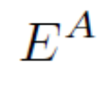
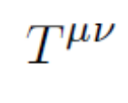
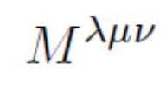
Example: Electrodynamics vs. Spin-2
 | Electromagnetism | Spin-2
Lagrangian
Equation of motion
Energy-momentum tensor
Angular momentum tensor

Slide 6
Questions
Do other models exist with the property of complete gauge invariance?
How do we find these models?

Slide 7
Methodology
Axiomatic approach to physics
Set of rules/ a procedure that can be used to uniquely determine physical model(s)

Slide 8
Axiomatic Approach to Physics: One to One
Axioms/
Procedures
Physical
Model
i.e. Mueller(2011), set of rules to
uniquely recover Quantum Mechanics

Slide 9
Axiomatic Approach to Physics: One to Many
Axioms/
Procedures
Physical
Model 3
Physical
Model 2
Physical
Model 1
our goal

Slide 10
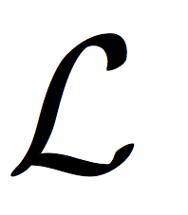
Noether’s Theorem
Equation(s) of Motion
Conservation
Laws

Slide 11

Noether’s Theorem: Electrodynamics
Maxwell’s Equations
Poynting’s Theorem
Maxwell Stress Tensor, etc.

Slide 12
1
2
3
Equation(s)
Of Motion
Cons.
Laws
Equation(s)
Of Motion
Cons.
Laws
Equation(s)
Of Motion
Cons.
Laws

Slide 13
Procedure
1
2
3
Equation(s)
Of Motion
Cons.
Laws
Equation(s)
Of Motion
Cons.
Laws
Equation(s)
Of Motion
Cons.
Laws

Slide 14
Basic Idea
Define criteria that can uniquely determine known Lagrangian densities from a clearly defined procedure
Criteria such as complete gauge invariance, number of dimensions, conformal invariance are example criteria

Slide 15
U
4D
Gauge Invariance
Noether’s Theorem
The Axiomatic Approach to Classical Field Theory, Mark Baker

Slide 16
U
4D
Gauge Invariance
Noether’s Theorem
The Axiomatic Approach to Classical Field Theory, Mark Baker

Slide 17
U
4D
CompleteGauge Invariance
Noether’s Theorem
The Axiomatic Approach to Classical Field Theory, Mark Baker

Slide 18

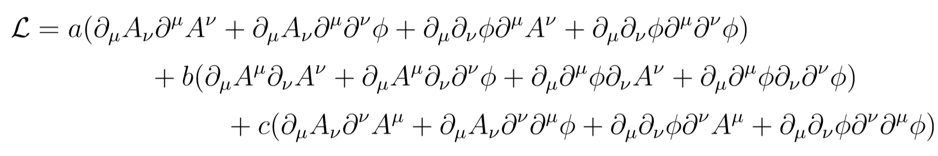
Example: Classical Electrodynamics
Developed a procedure to derive explicitly gauge invariant Lagrangian densities from completely general scalars

Slide 19
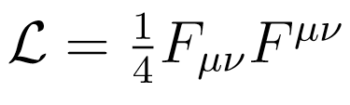
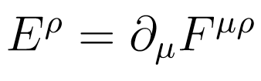
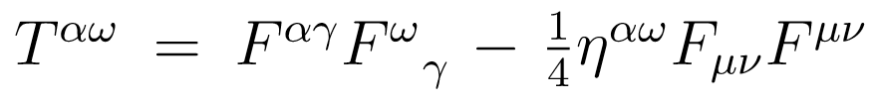
Example: Classical Electrodynamics
This procedure led to the classical electrodynamics model,

Slide 20
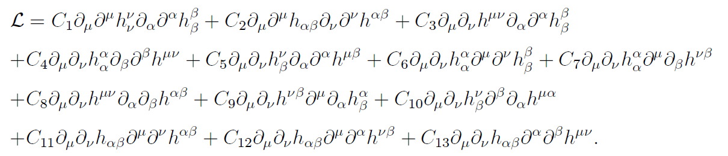
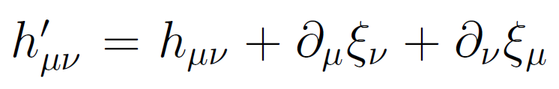
Higher Order, Second Rank Tensor Potential
First order quadratic terms do not yield a complete gauge invariant model, however in the second order,
We have a completely gauge invariant model under the spin-2 gauge transformation,

Slide 21
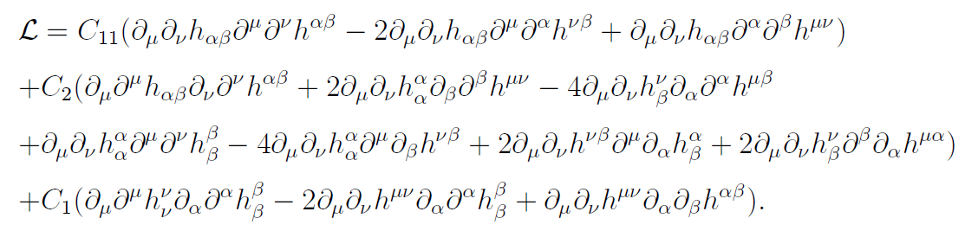

Higher Order, Second Rank Tensor Potential
System decouples into 3 independently gauge invariant terms,
After factoring these are contractions of the linearized Riemann tensor, Ricci tensor and Ricci scalar,

Slide 22

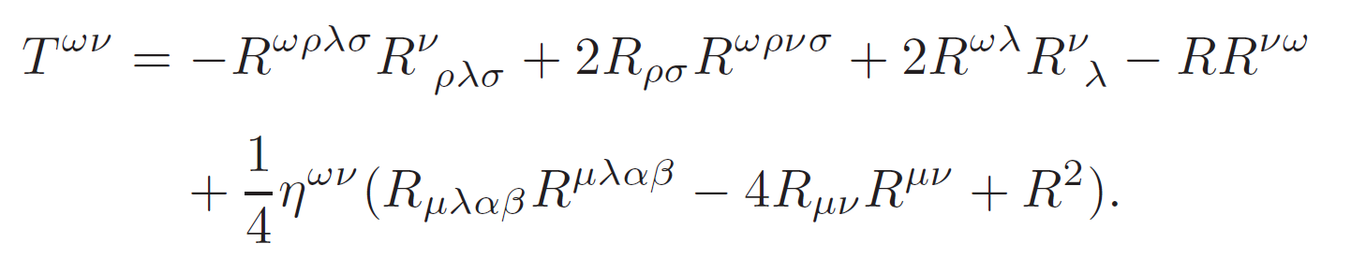
Linearized Gauss-Bonnet Gravity
Repeating the procedure for this higher order combination has a unique solution of the linearized Gauss-Bonnet model, with 0 contribution to the EOM,

Slide 23
Conclusions
Axiomatic approach to physics was used to derive classical electrodynamics and linearized Gauss-Bonnet gravity from a common set of axioms
Additional results, such as the general class of spin-2 Lagrangians from which the Fierz-Pauli action can be obtain, are in the paper
Possible fundamentally important characteristic of complete gauge invariance is worth exploring further

