Slide 1




Development of RANS-III for outdoor measurement
- RIKEN Center for advanced photonics (RAP)
Neutron Beam Technology Team
T.Kobayashi Y. Otake Y. Ikeda
T. Fukuchi M. Mizuta Y. Wakabayashi S. Ohgo
Tokyo Science University
S. Ikeda N. Hayashizaki

Slide 2

RIKEN Accelerator-driven Neutron Systems (RANS)

Slide 3
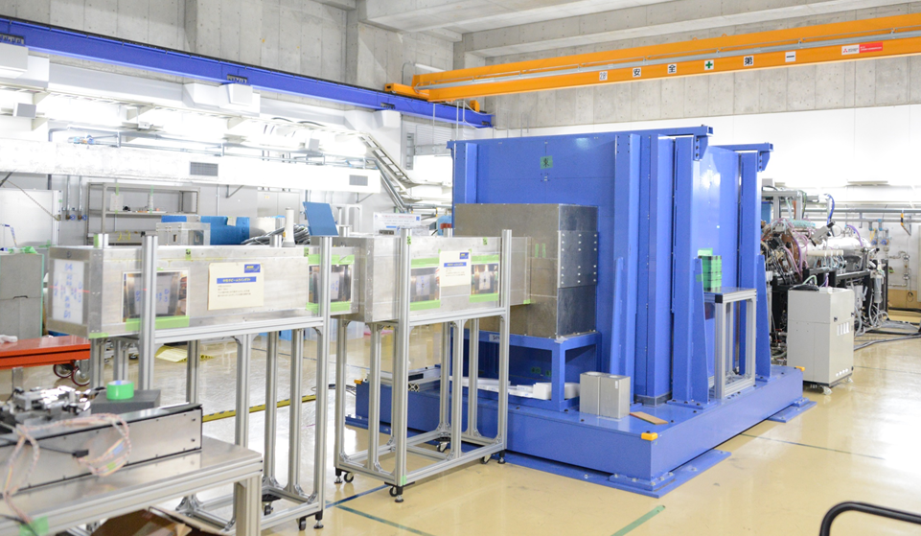
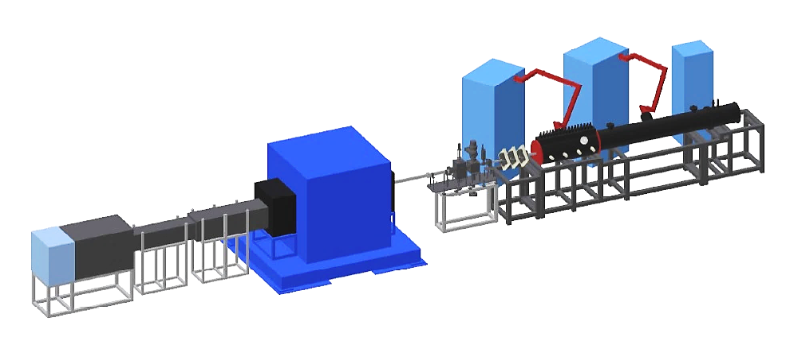
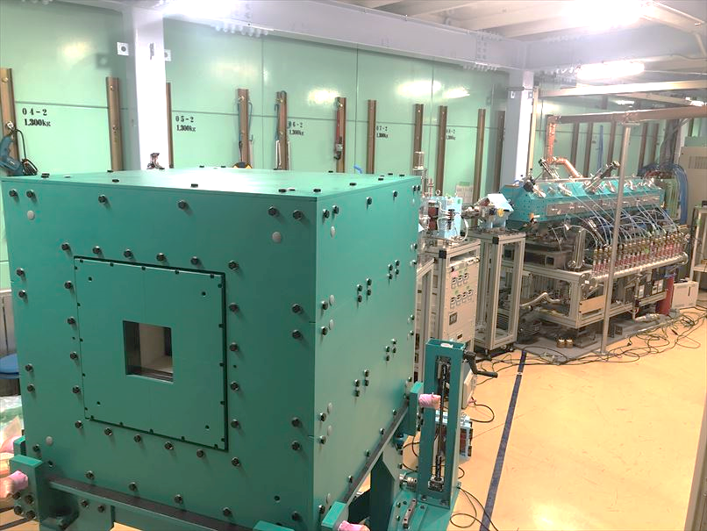
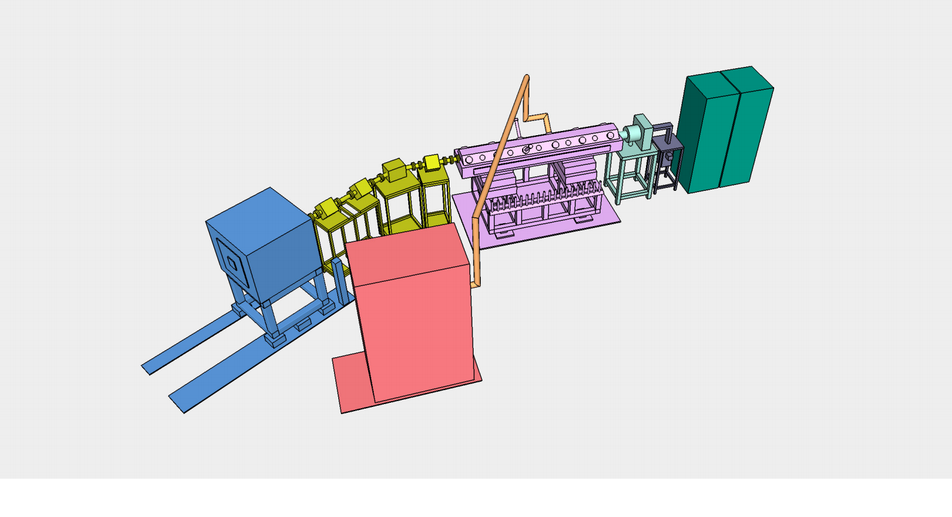


RIKEN Accelerator-driven compact Neutron Source
RANS and RANS-II
RANS
2013～
RANS
15m, 25t
7MeV-H⁺
Be Target
RANS-II
RANS-II
2019～
2.5MeV-H⁺
Li Target
5m, 8t
Details are given by Yoshie Otake at session 6 invited talk

Slide 4
RANS started operation (2013)
Dedicated building completed (2016.5)
Construction of RANS-II separation wall（2019.3.5）
RANS-II started operation（2019.7.22）
4.2m
RANS
15m
RANS
operation room
RANS-II
RANS-II operation space
21m
4

Slide 5
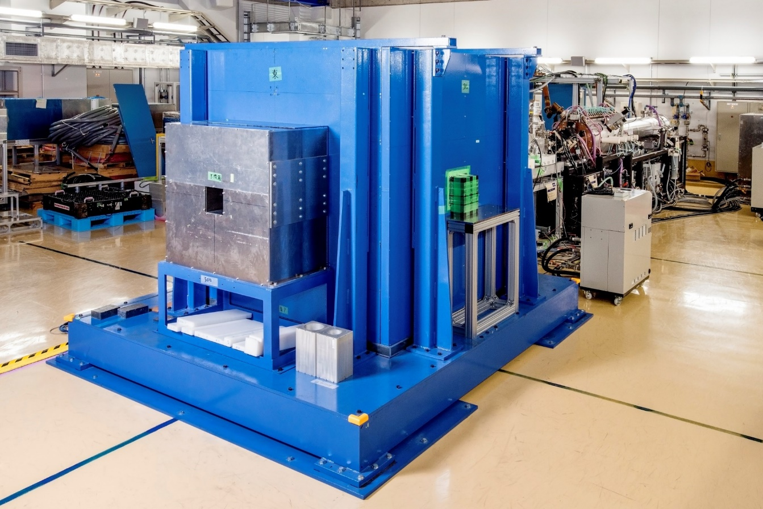
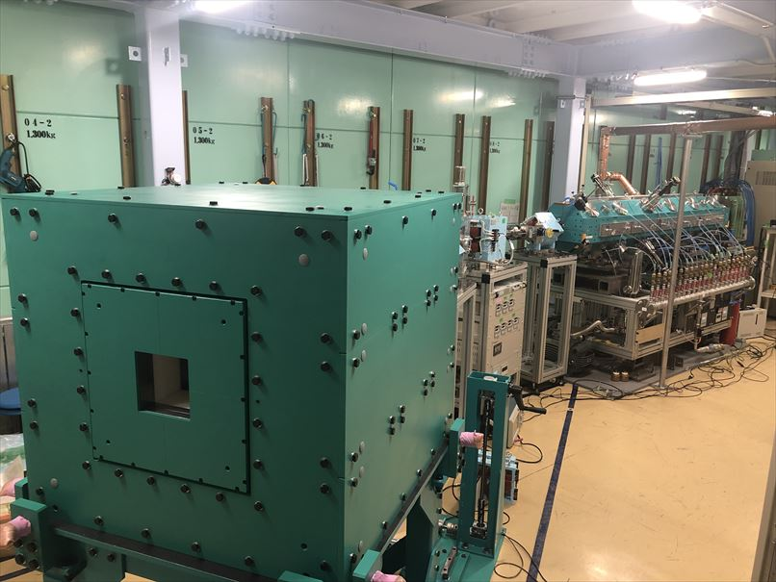
RANS
7MeV LINAC
2m
RANS-II
Neutron beam hole
2.5MeV LINAC
Be target
with shielding
(20t)
1m
Neutron beam hole
Li target
with shielding(3.5t)
Replaceable beam collimator
5

Slide 6
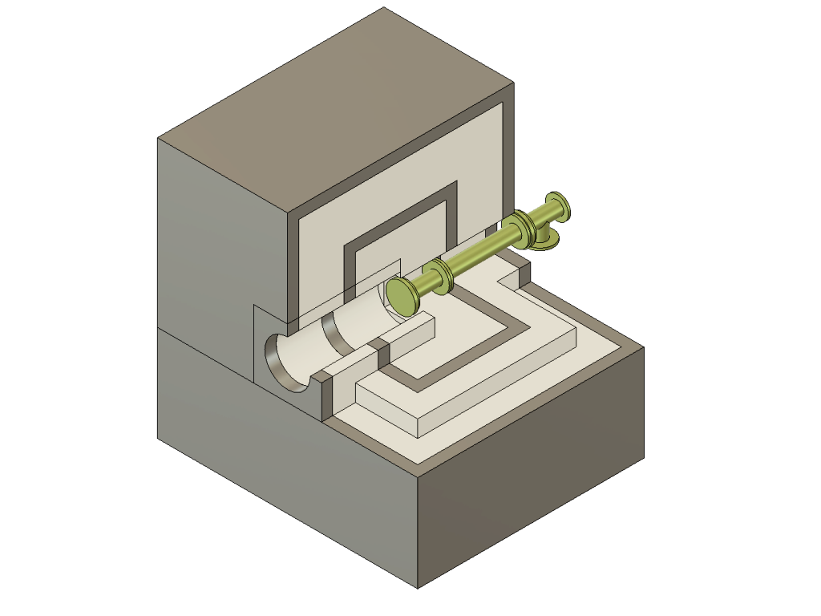
Target and multilayered shield
（RANS, RANS-II common）
Moderators
Polyethylene (for thermal neutrons)
He-cooled mesitylene (for cold neutrons)
Accelerator
Pb
H⁺ beam
BPE
Pb
PE
Be or Li target
Neutron beam
Multi-layer shielding
Neutrons are stopped by Polyethylene (PE) and Boron Polyethylene (BPE)
Gamma rays are stopped by lead (Pb).
Reducing the lead in the outermost shell reduces the total weight
2m (RANS)
1m(RANS-II)

Slide 7
RANS, RANS-II specification
 | RANS | RANS-II
Operation started | 2013～ | 2019～
Accelerated particle | Proton | Proton
Acceleration energy | 7 MeV | 2.5MeV
Max. current (time averaged) | 100 μA | 100 μA
Ion source | Duo-plasmatron | ECR plasma
Accelerator (LINAC type) | RFQ + DTL (AccSys Technology Inc.) | RFQ (TIME Co., ltd.)
Reaction | ⁹Be(p,n)⁹B | ⁷Li(p,n)⁷Be
Weight (Accelerator) | 5 t | 2.5 t
Weight (Shield) | 20 t | 3.5 t
Length (Accelerator+Shield) | 10 m | 5 m
Neutron energy | ～ 5 MeV | ～ 0.7 MeV
Neutron yield | ～ 10¹² /sec | ～ 10¹¹ /sec

Slide 8
RANS, RANS-II experiments

Slide 9

RANS, RANS-II Latest Themes
Visualization of water in corroded region
(Transmission Radiography) RANS
Parameter study for the development of a portable onboard neutron source
RANS-II → Examination of conditions for the production of RANS-III
Properties in plastic deformation of metals
(Neutron diffraction) RANS
Properties of soft materials
（SANS） RANS
Amplifier
RANS
Target
IS
Target
Neutron beamline
IS
RFQ
RFQ
RANS-II
DTL
Amplifier
Salinity analysis in concrete (PGA)
RANS, RANS-μ（RI source）
Detector and dosimeter development
RANS, RANS-II
Hydrogen implantation for metals
RANS-II
Cold neutron source development
RANS
Soundness analysis of reinforced concrete
(Transmission and backscatter imaging)
RANS, RANS-II
Prompt gamma and activation gamma imaging
RANS-II

Slide 10
Safety Assessment of Aging Infrastructure and RANS-III Development

Slide 11
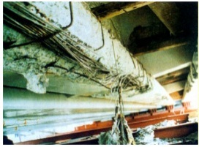
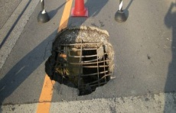

Increased need for non-destructive testing of social infrastructure (aging and construction defects)
Water and salt penetration into concrete, voids and corrosion of reinforcing steel → Neutrons are effective for detection

Slide 12
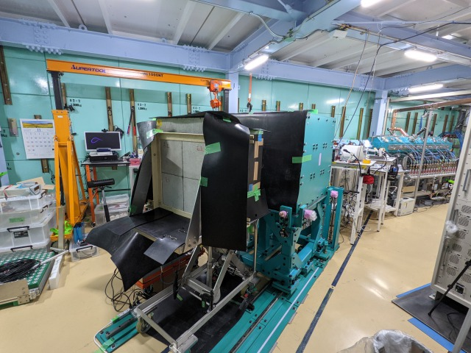
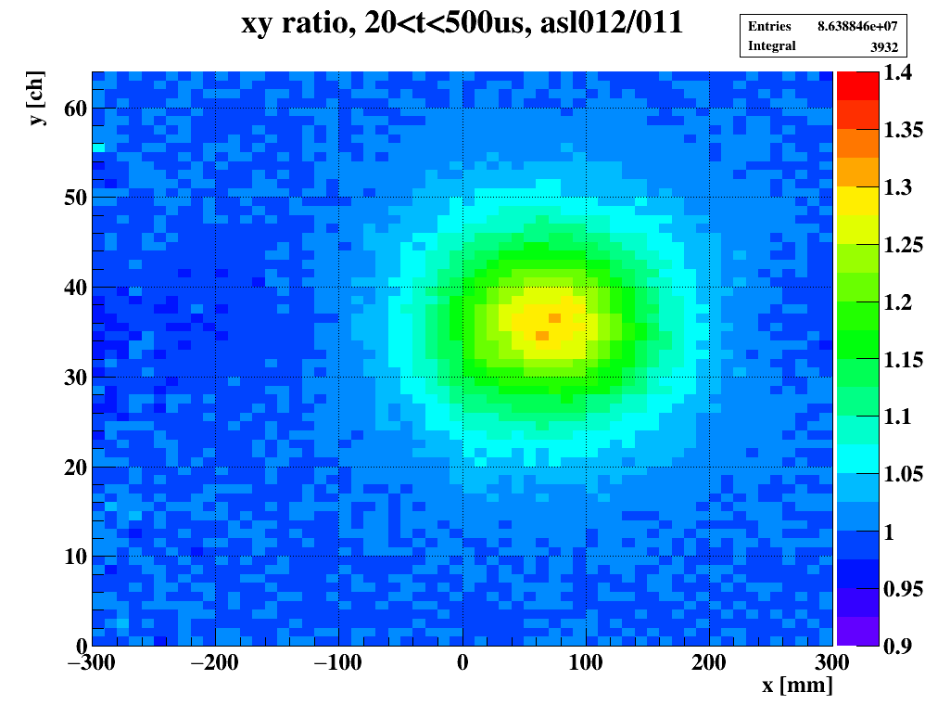
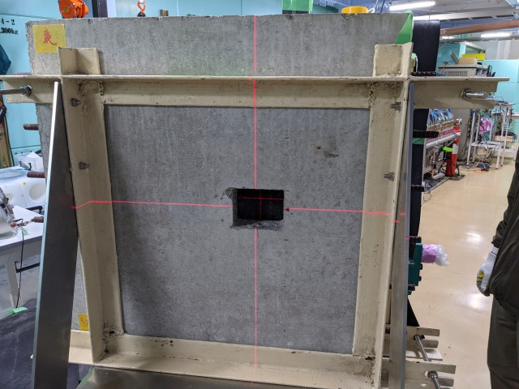
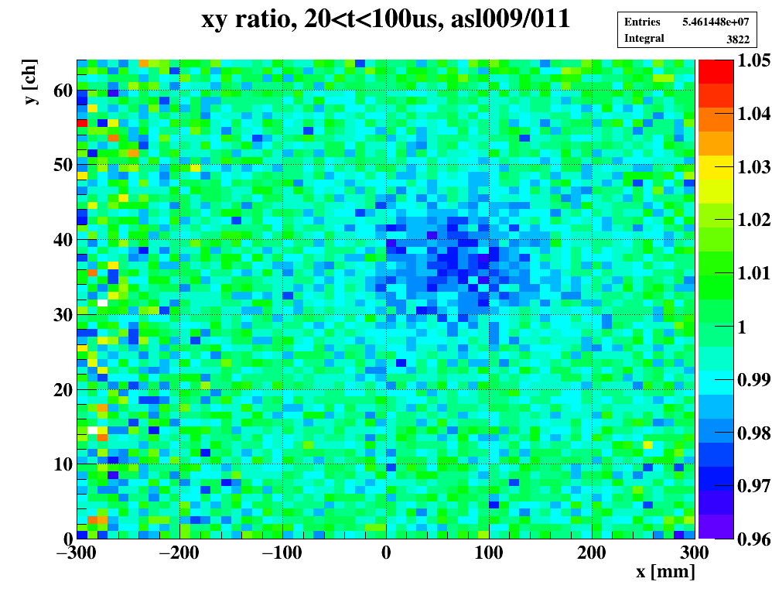
RANS, RANS-II common issues (diagnosis of infrastructure deterioration)
Backscatter measurement of samples simulating actual deteriorated bridge road surface (bedding)
PASJ2019 第16回年会（京都市）口頭発表会場
Neutron beam
Concrete
PE or Acryl
50 or 40mm
10 or 20mm
Asphalt
50mm
2nd
concrete
60mm
3rd
concrete
60mm
PASJ2017 第14回年会（札幌市）懇親会場
Neutron beam
Concrete+Asphalt
Sample
Concrete
PASJ2016 第13回年会（千葉市）懇親会場から
50 or 40mm
Void
10 or 20mm
Asphalt
50mm
2nd
concrete
60mm
Details are given by Tomonori Fukuchi at Poster session 1
3rd
concrete
60mm
2D-analysis with backscattered neutron

Slide 13


Another key technology for infrastructure degradation diagnosis (under development at RANS and RANS-II)
Prompt gamma analysis (PGA)
Measurement of salinity in concrete by gamma from chlorine
Neutron beam
γdetector
γdetector
concrete
Reinforcing bar
Details are given by Yasuo Wakabayashi at session 10
Gamma rays generated by neutron irradiation inside concrete

Slide 14
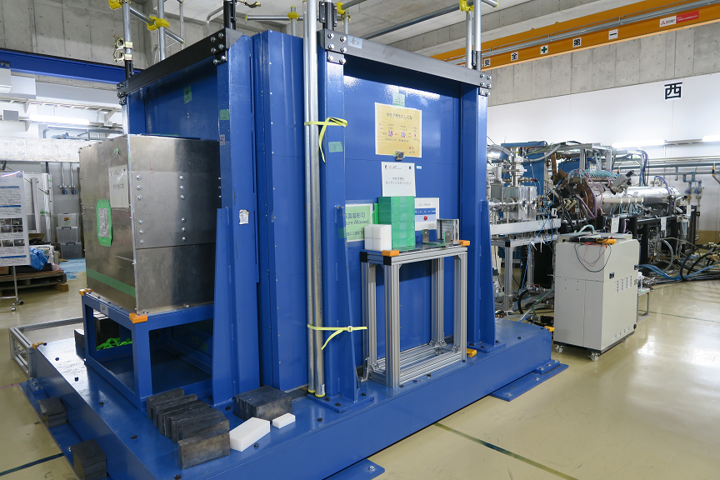
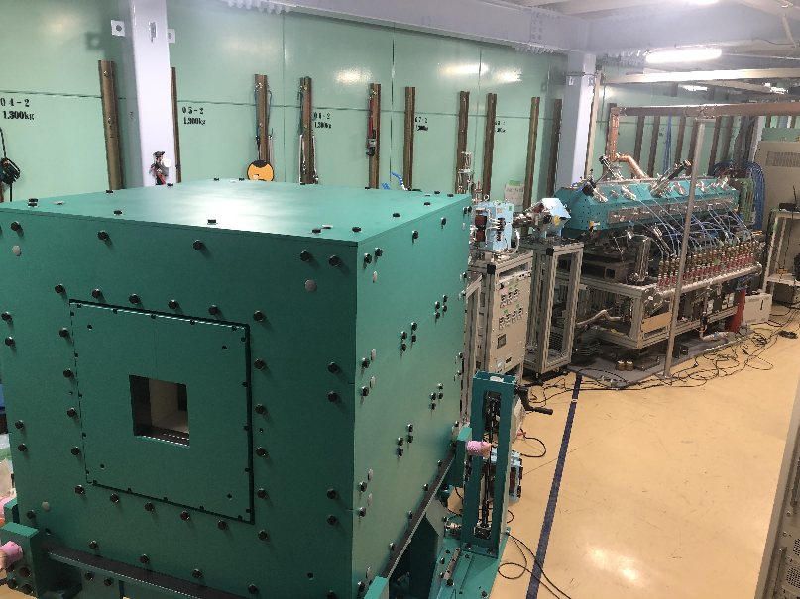
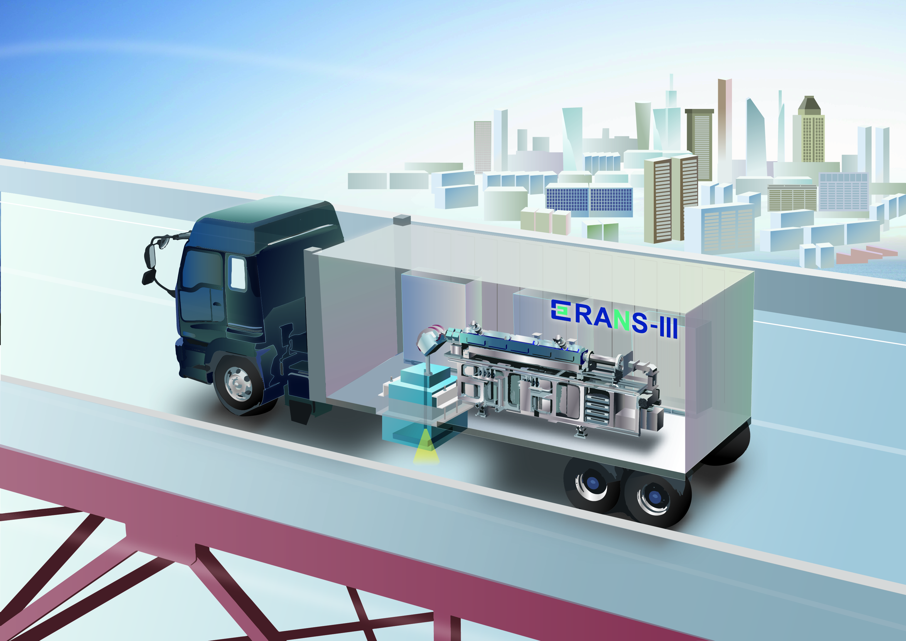
Role of 3 RANS
RANS Wide range of uses from technology to science.
RANS-II Prototype for transportable use. For laboratory use.
RANS-III Transportable
 | Energy [MeV] | Reaction | RF [MHz]
RANS | 7 | ⁹Be(p,n)⁹B | 425
RANS-II | 2.5 | ⁷Li(p,n)⁷Be | 200
RANS-III | 2.5 | ⁷Li(p,n)⁷Be | 500

Slide 15
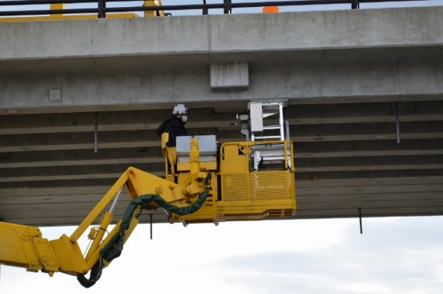
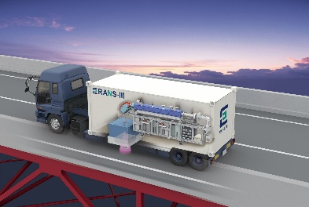
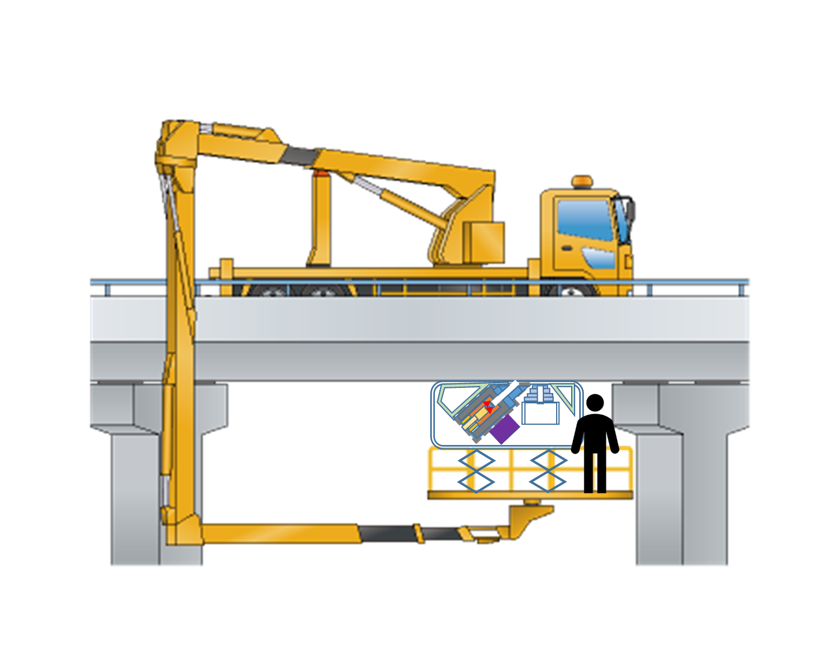



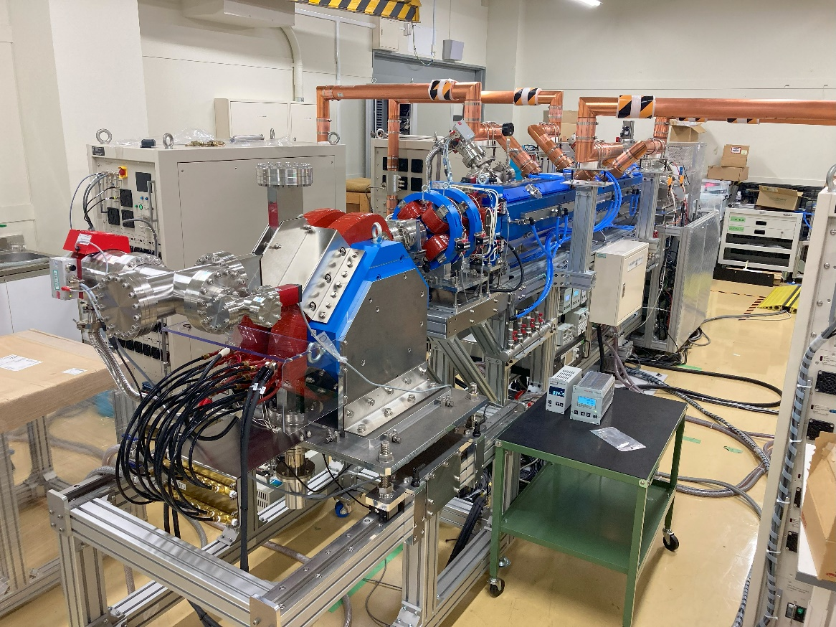
New tools for social implementation
RANS-III and RANS-μ
検出器
²⁵²Cf source with bucket track
Specialized in salt damage analysis by prompt gamma analysis.
In operation by RANSVIEW inc. （2023）
https://ransview.co.jp/
RANS-III, a smaller version of RANS-II, is mounted on a trailer. The main purpose is to inspect roadbeds.
Details are given by Yasuo Wakabayashi at session 10

Slide 16
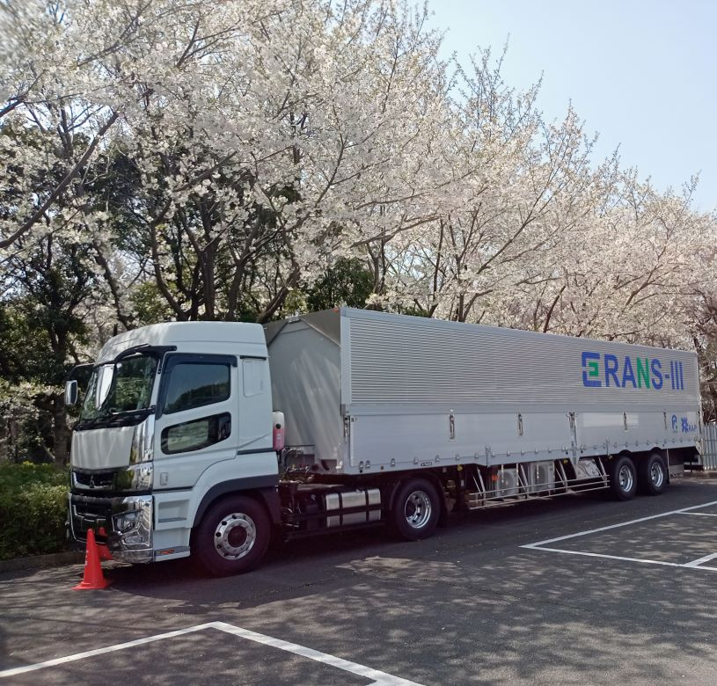
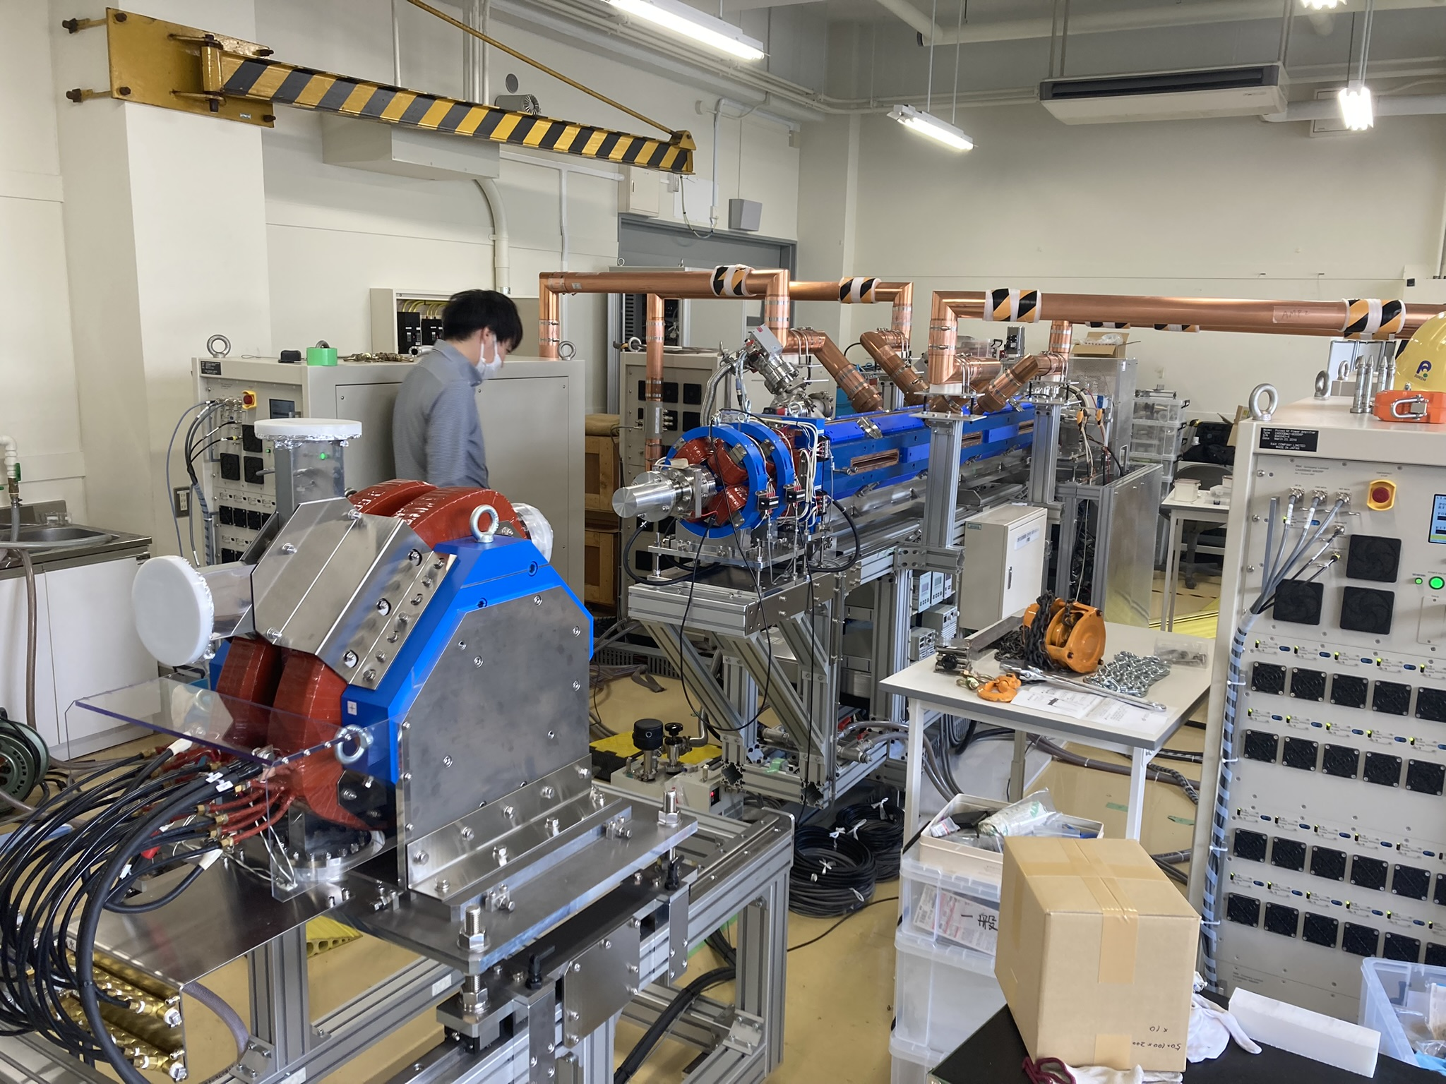
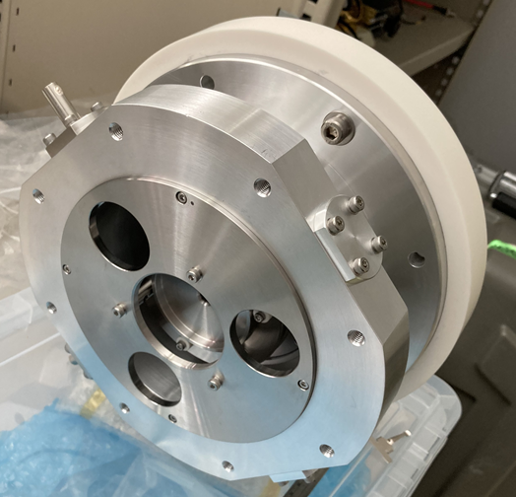
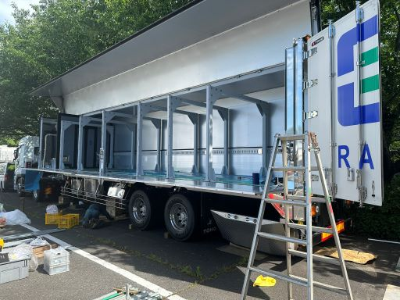
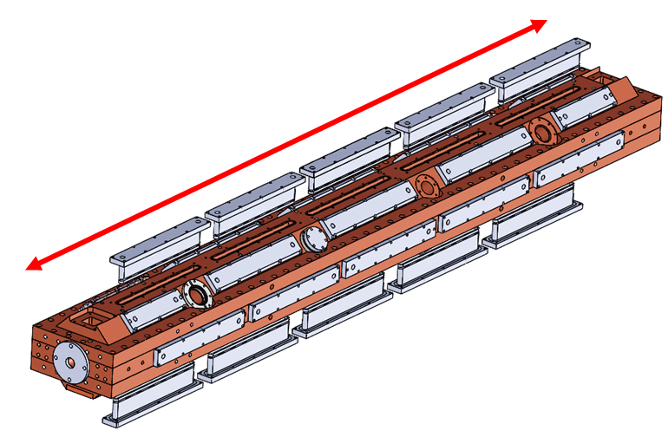
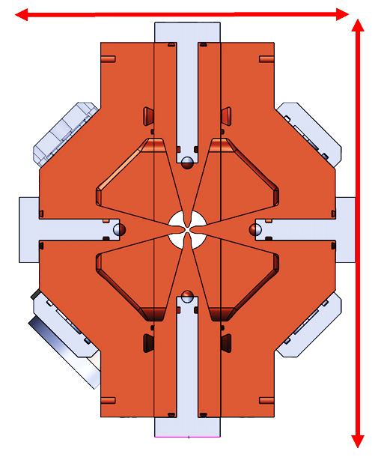
RANS-III development
Truck loading
2019-2024 in lab.
ECR-IS
RFQ
Apr. 2024
Bend mag.
20cm
330 mm
2370 mm
300 mm
(RFQ)
RANS-III(500MHz)/RANS-II(200MHz)
Diameter 1/2
Weight 1/4

Slide 17
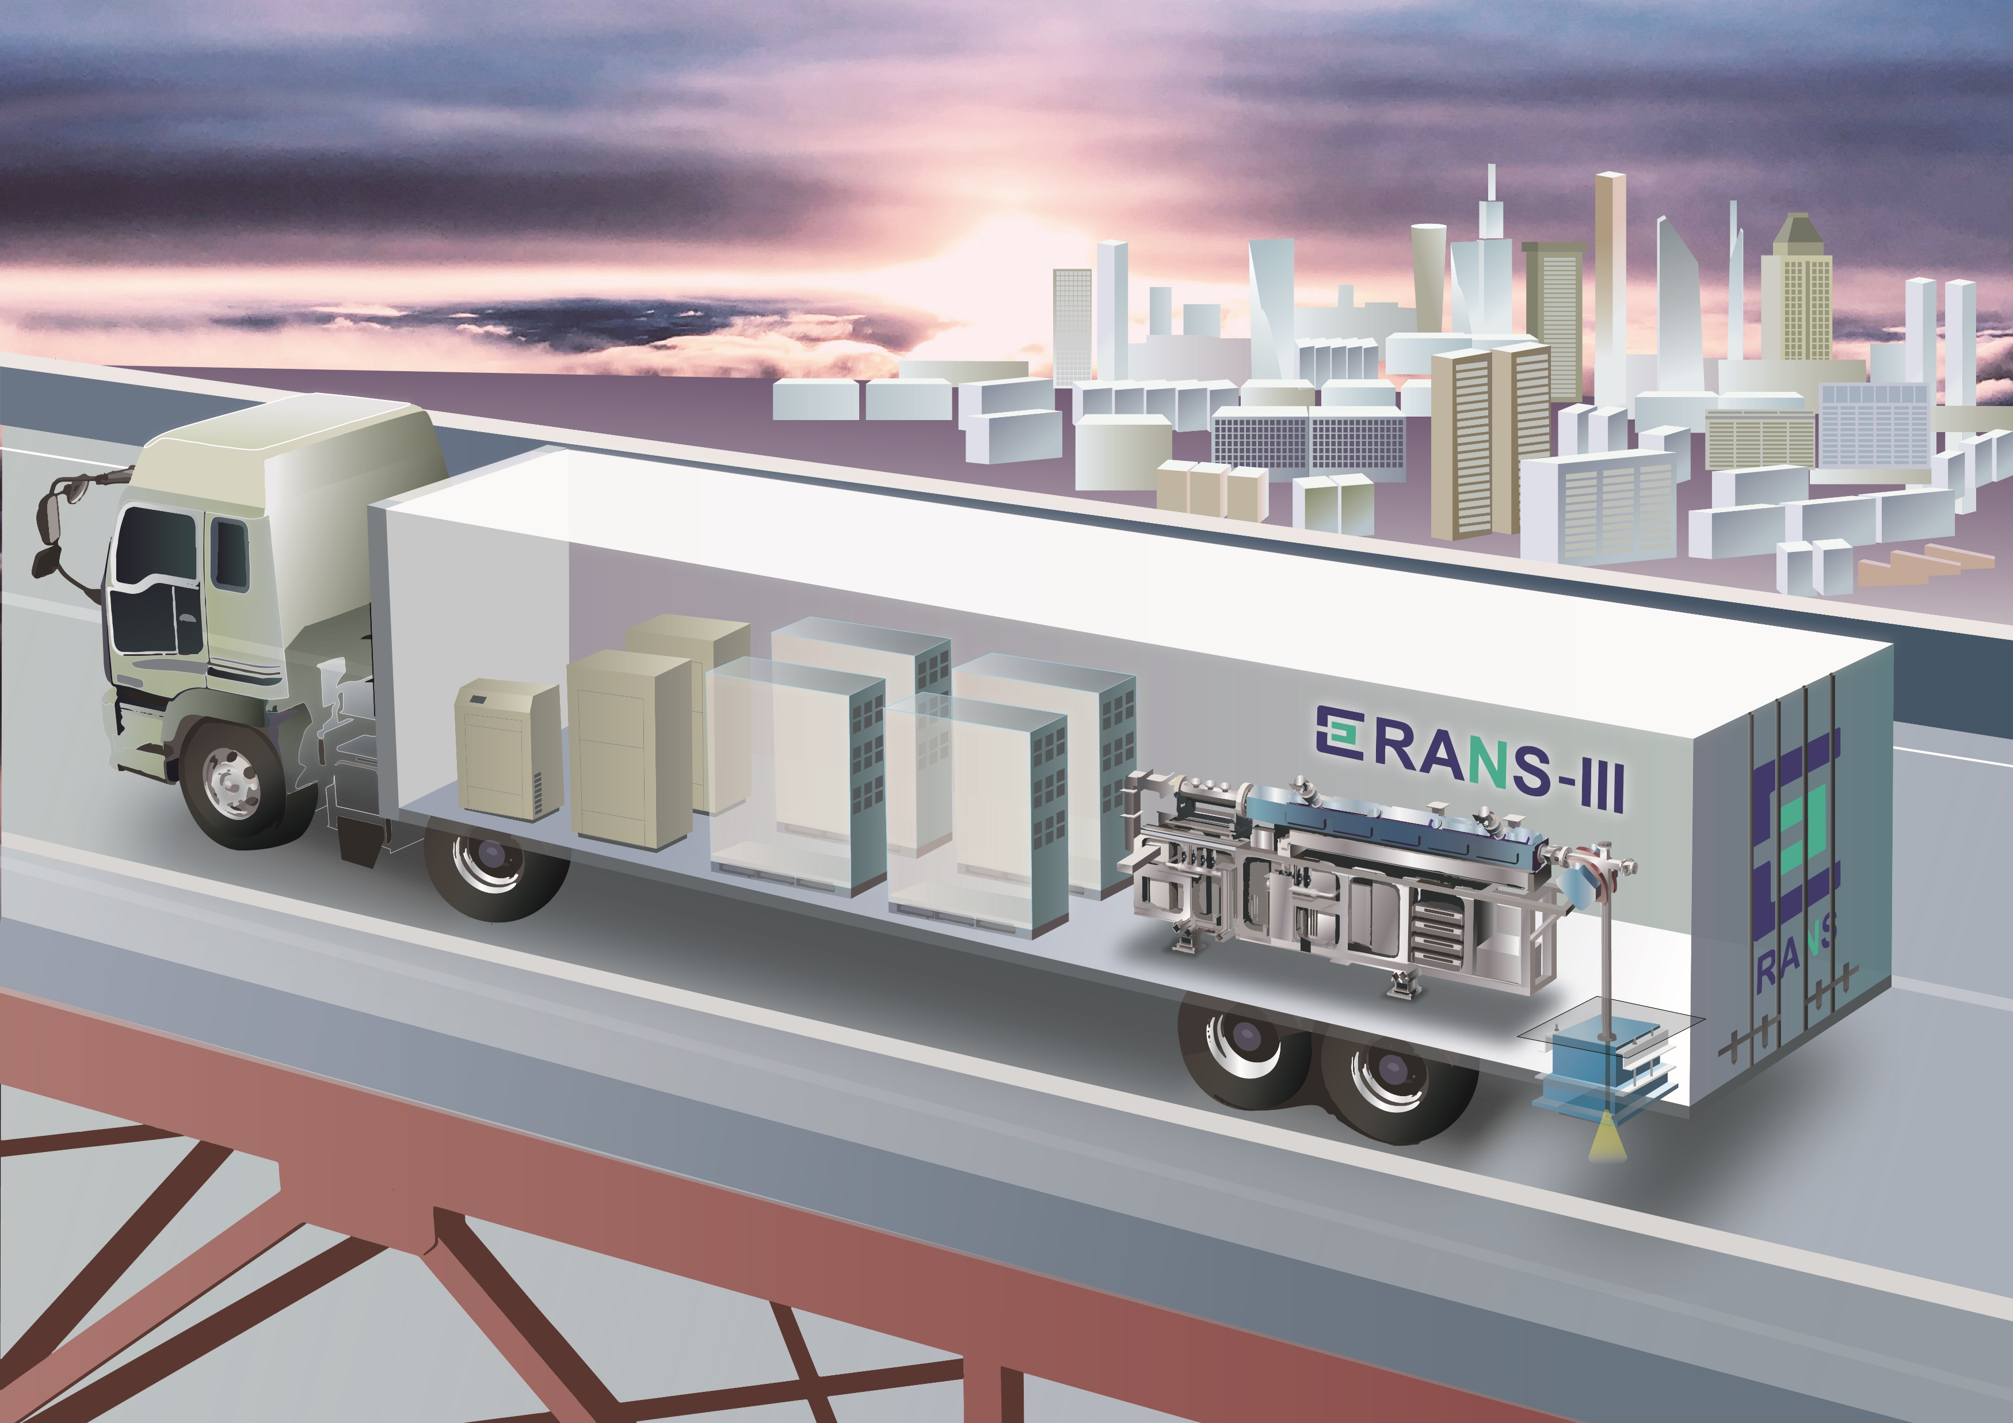
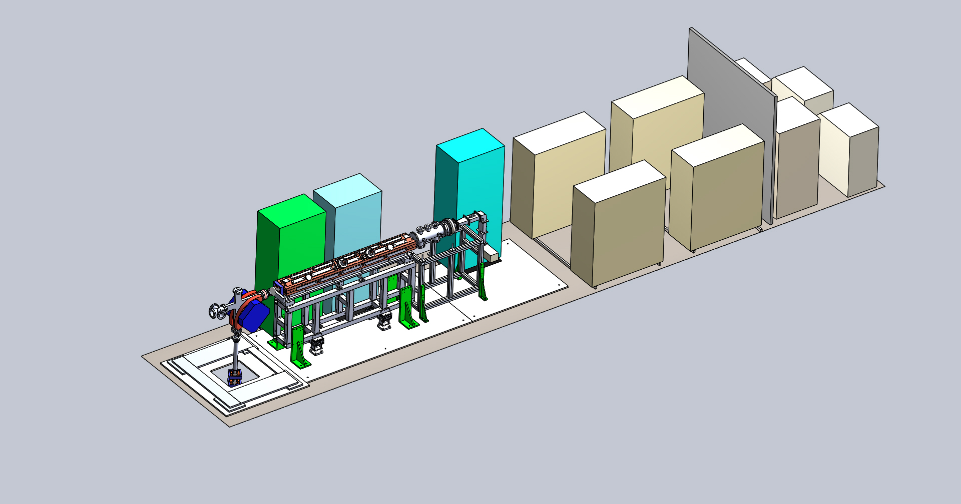
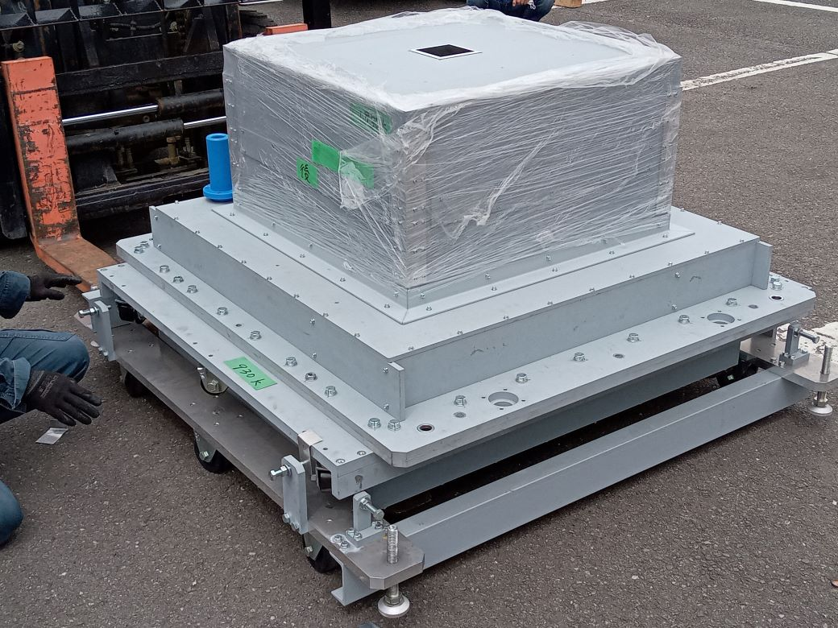
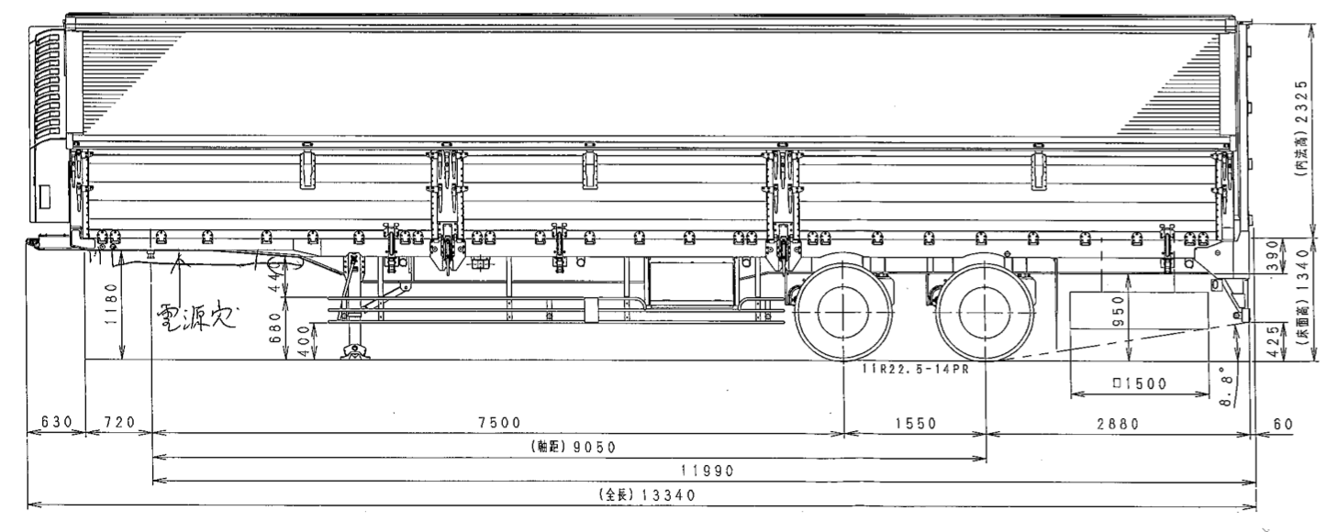
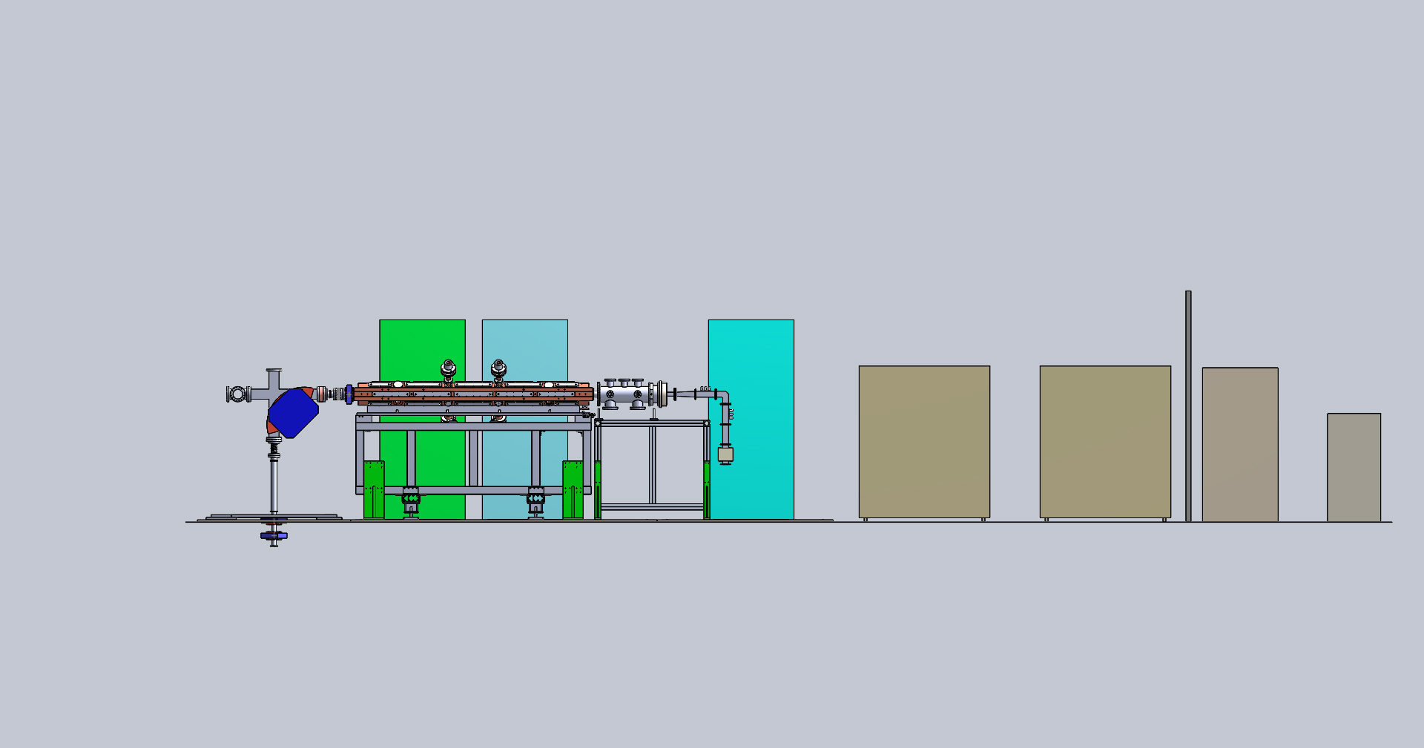
RANS-III development
Study for realization on-board （2023-24）
Chillers
Amplifiers
Amplifiers
Proton beam
Chillers
I.S.
Accelerator
Accelerator
Shield &
Detector
Considering the axle position and floor structure material, neutron generation position is moved to the rear of the trailer
Accelerator
Chillers
Amplifiers
Neutrons
Separate compartments for cooling system and amplifier and heat removal performance
Lightened target shielding with vertical drive mechanism

Slide 18
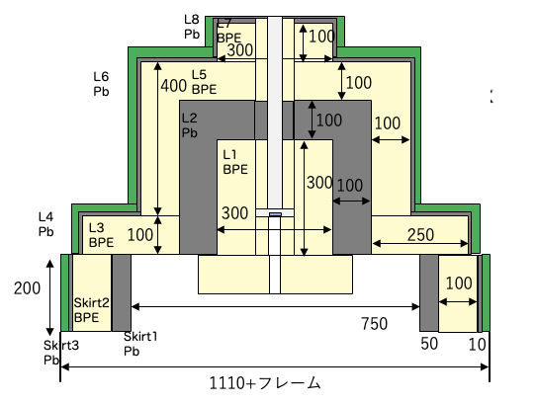
RANS-III lightweight target shield
Accelerator
Proton
Neutron
Shield(BPE)
Shield(lead)
Lithium target
Neutron
Collimator（BPE）
1110
Detector space

Slide 19
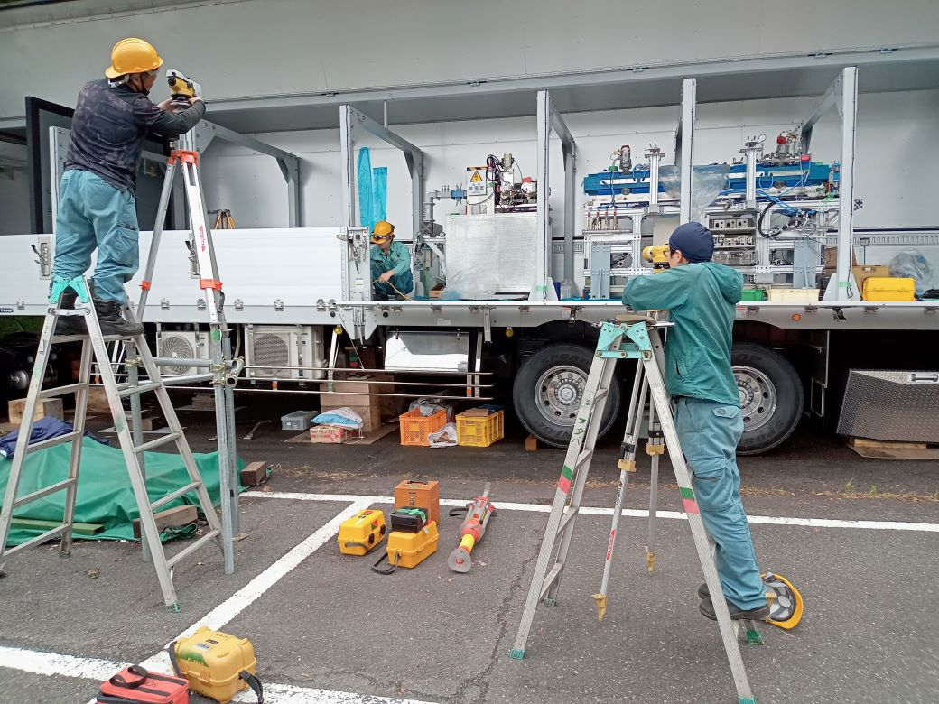
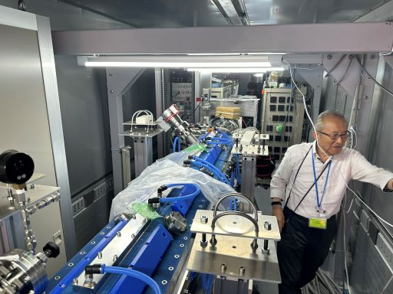
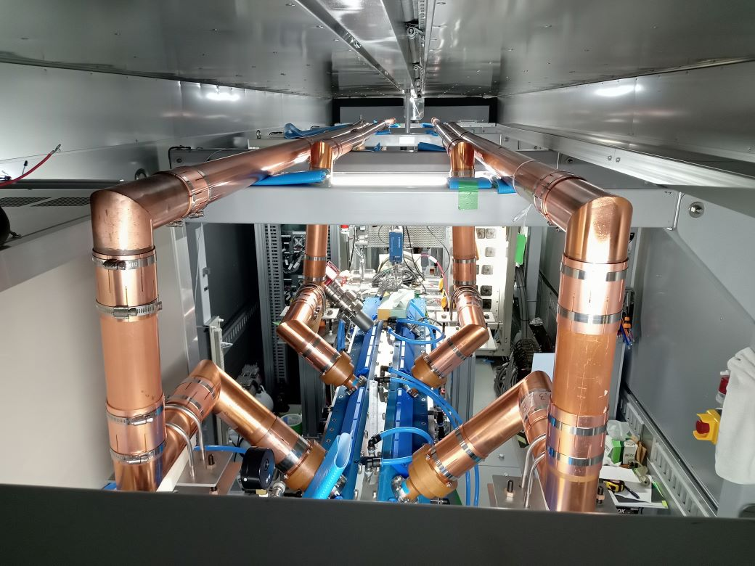
RANS-III on-board installation
May 2024
Jun. 2024
Jul. 2024

Slide 20
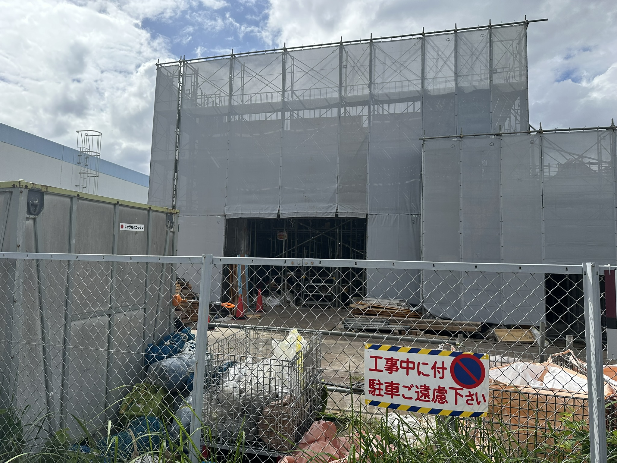
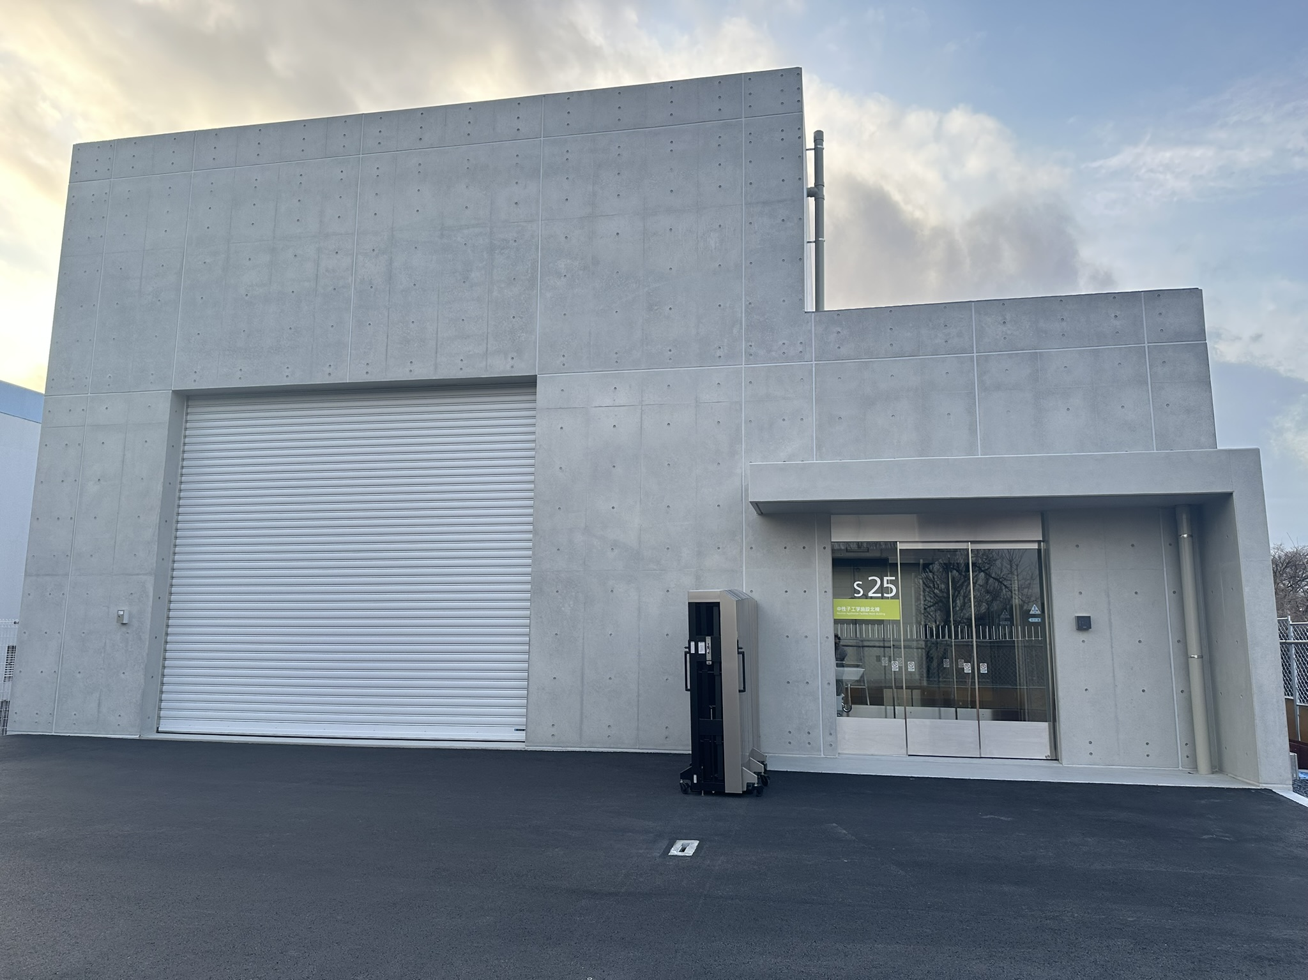
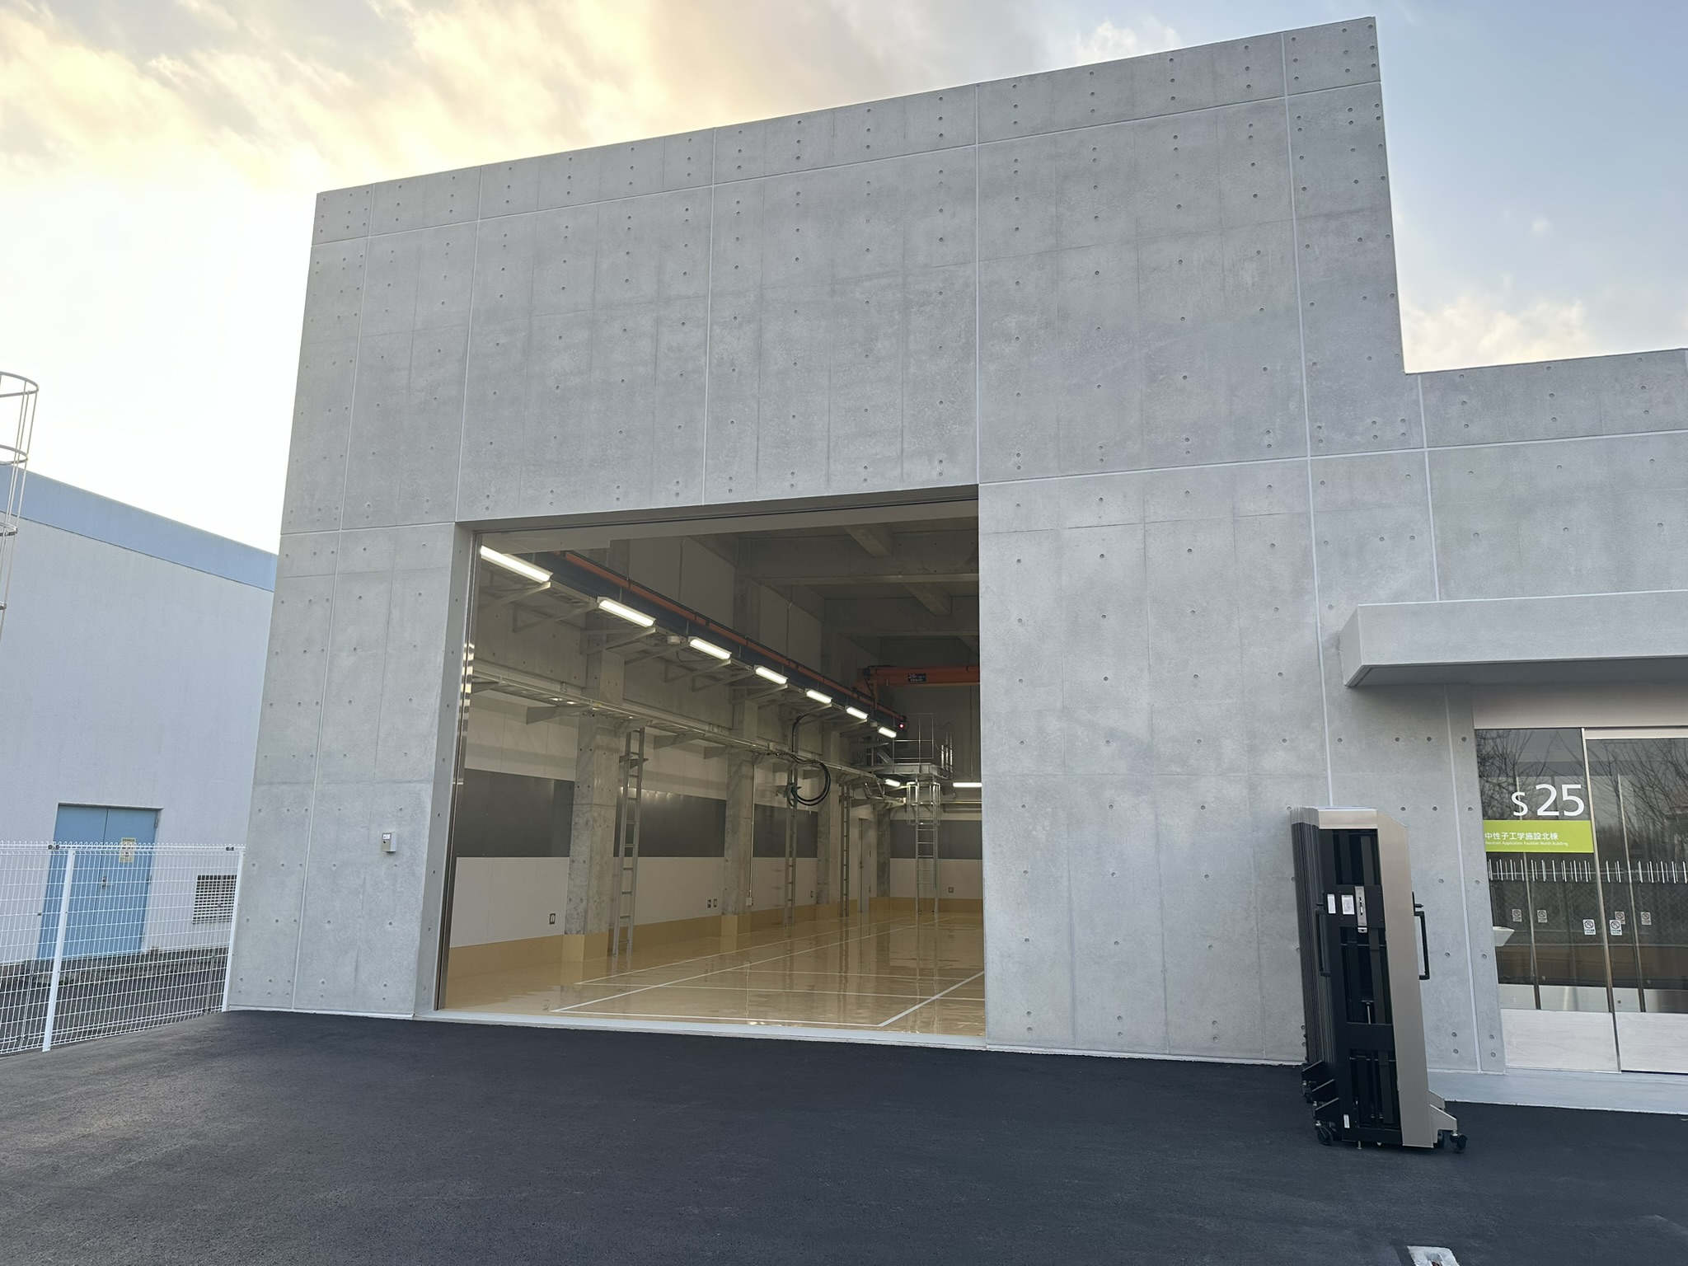
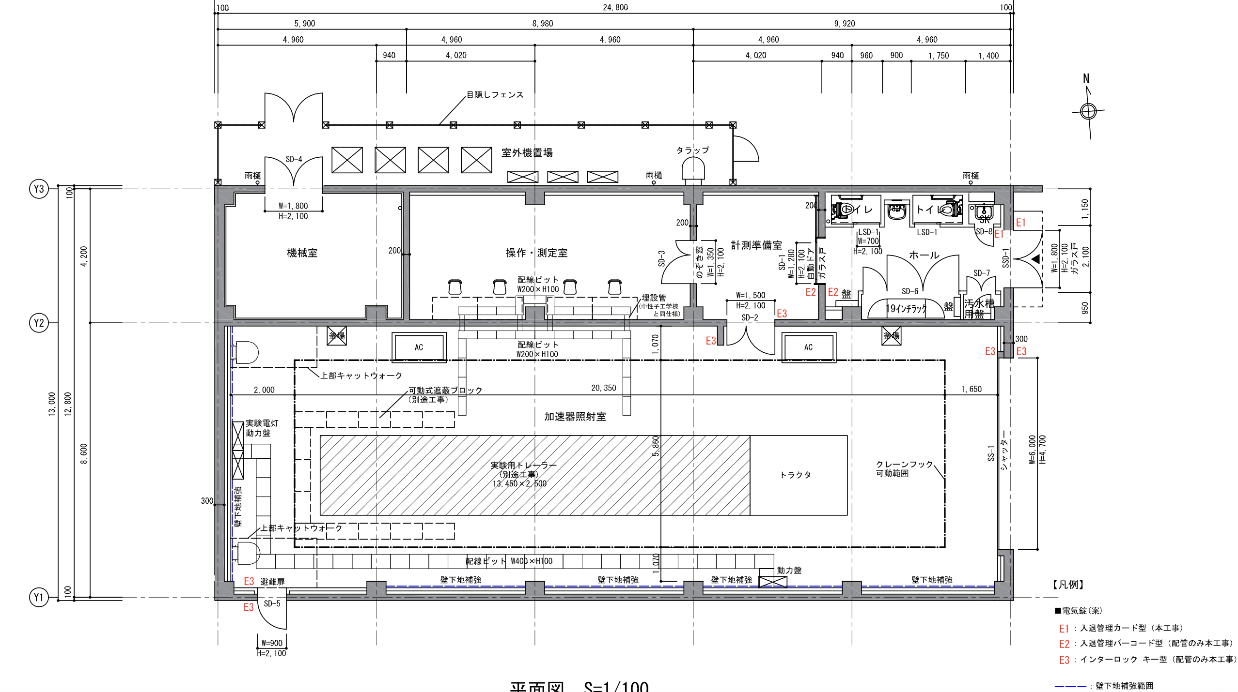
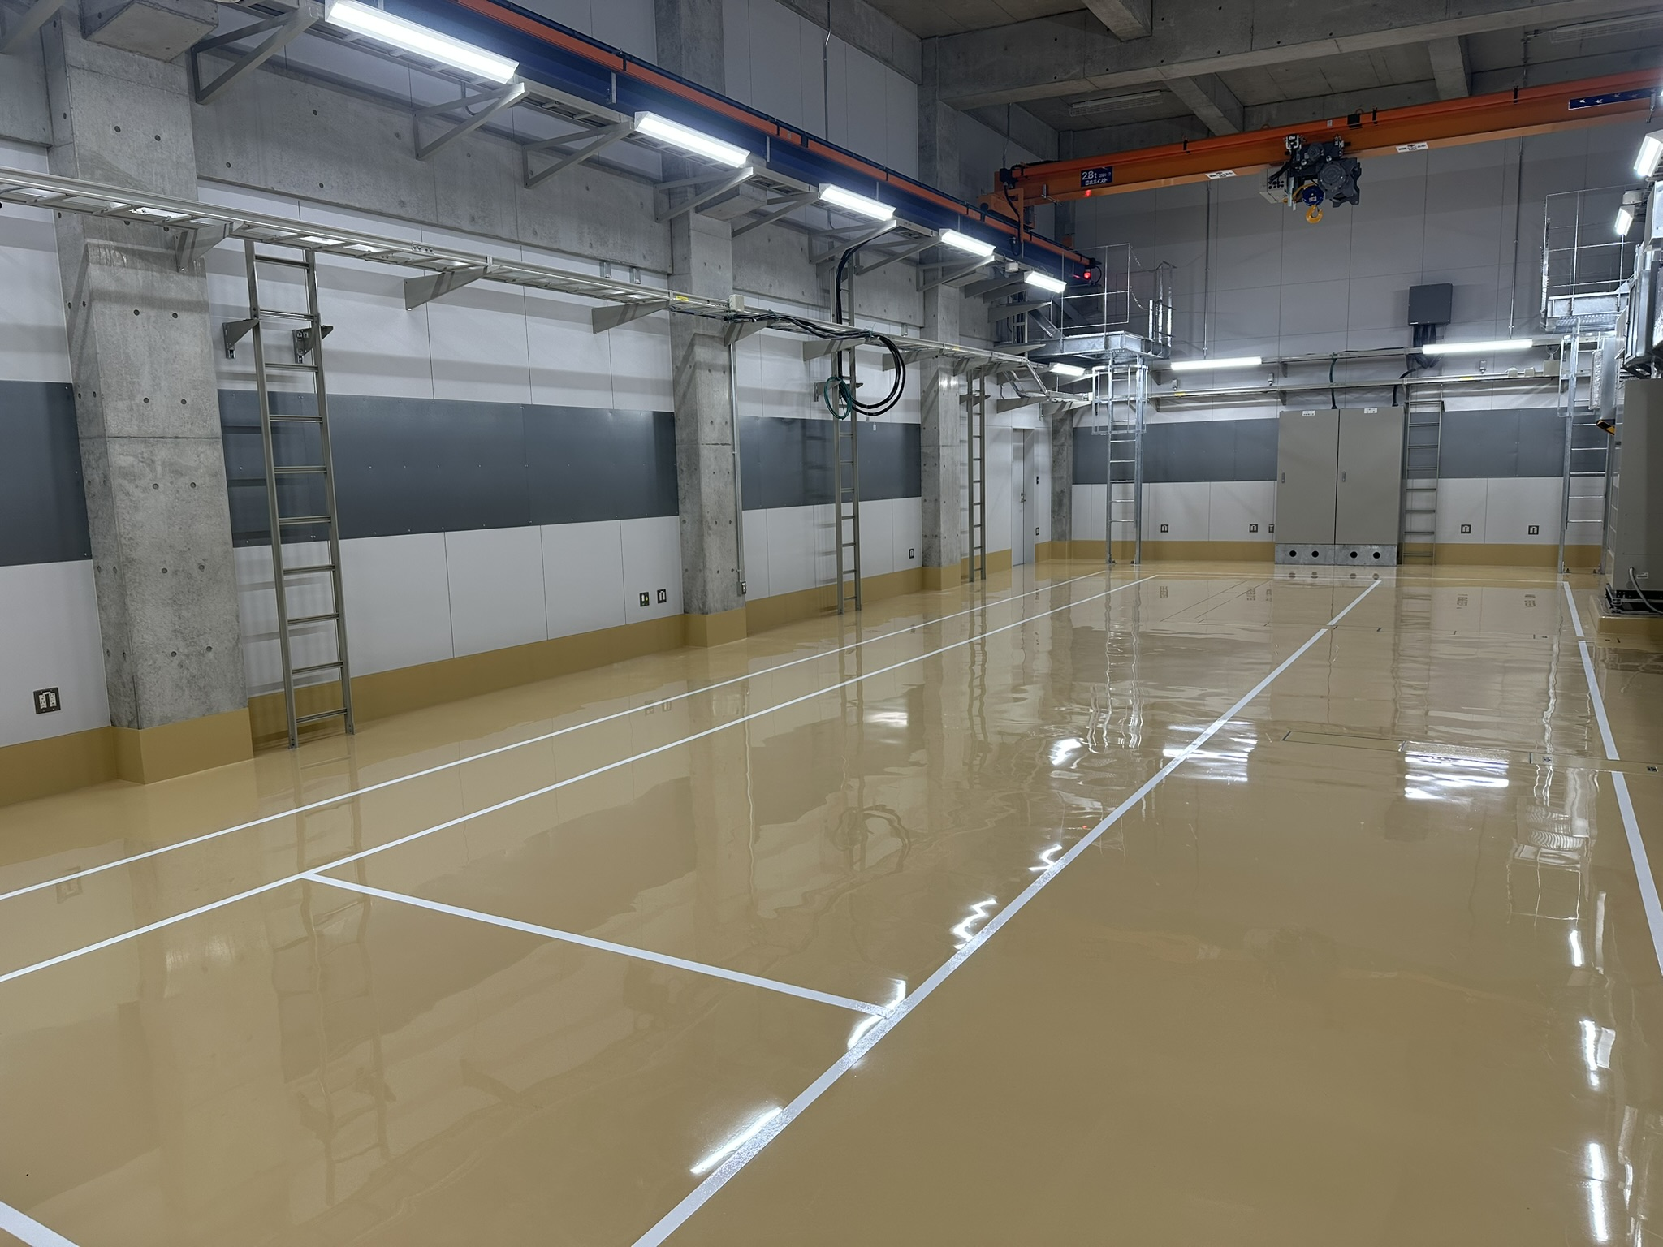
Construction of RANS-III test building
Completed in Jan 2025
Neutron scattering measurements, Radiation levels and Shielding capabilities will be investigated.

Slide 21


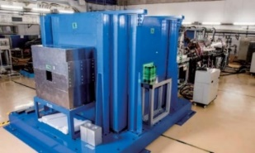
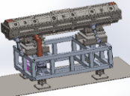
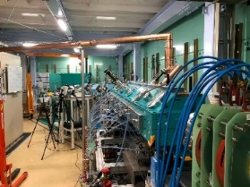

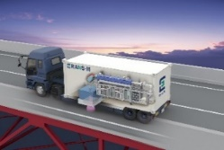
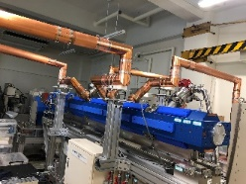

RANS summary
RIKEN Accelerator-driven compact Neutron Sources RANS
RANS: Fundamental Physics
Method Development
15m
5m
RANS-II: Portable study
Fast neutron
Backscattering
RANS-II is marketed by TIME Inc.
First delivery was made to Mirrotron Inc.
4m
RANS-III: Demonstration of portability
70cm
RANS-μ:
Specializing in salt measurement
2023 Commencement of commercialization

