Slide 1

PC-CANS - Conceptual Design of a Compact Accelerator Based Neutron Source for Canada
February 26, 2025
TRIUMF IH-DTL

Slide 2
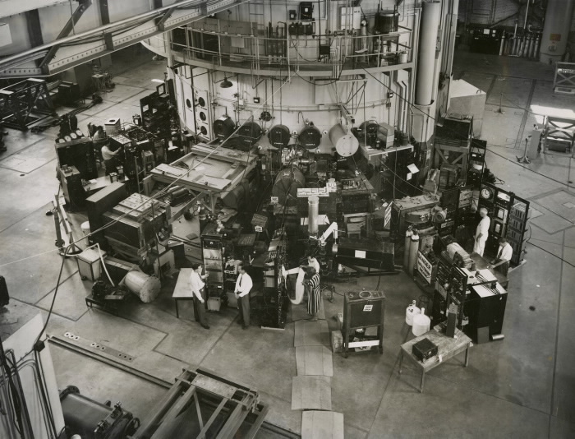
Current Status of Neutron Beams in Canada
Neutron Gap
  National Research Universal (NRU) reactor shut down in 2018
  Canada is facing a neutron gap
Similar story globally - major research reactors closed e.g. BER-II, JEEP and Orphée
Canada and global community need new (affordable) pathways for neutron production
PC-CANS - Conceptual Design of a Compact Accelerator Based Neutron Source for Canada Laxdal Feb. 26, 2025
Notes:
Why is there a neutron gap?
Who is affected?
What is available?
Highlight the fact that this is a problem, worldwide
What is there a demand for?

Slide 3
Accelerator Based Neutron Sources
Spallation sources
p/d on Be/Li
e- on heavy metal
Cost (M$)
3
PC-CANS - Conceptual Design of a Compact Accelerator Based Neutron Source for Canada Laxdal Feb. 26, 2025

Slide 4
Design Considerations
Beryllium target (despite toxicity) is favoured over Lithium in moderate beam power regime
For protons on Be choose E<13MeV to avoid tritium production
Yield (and accelerator costs) increase with energy - 10 MeV is a reasonable balance between cost and performance
Average beam power limited by target technology P_{beam} ~ < 10-20 kW
Neutron peak brightness enhanced by pulsing proton beam (proton pulse length 0.25-2.5ms @ 200 - 20Hz and 5% duty factor)
Neutron yield for Protons on Beryllium
4
PC-CANS - Conceptual Design of a Compact Accelerator Based Neutron Source for Canada Laxdal Feb. 26, 2025

Slide 5
PC-CANS (Prototype Canadian CANS)
PET
PC-CANS is a proposal for a high intensity pulsed neutron source at the University of Windsor (Ontario, Canada)
Neutrons for Science (cold and thermal)
Neutrons for BNCT (epithermal)
Protons for 18F for PET
45 keV
3 MeV
10 MeV
Proton Source
RFQ
5%
DTL
5%
TMR
LEBT
MEBT
HEBT
pulse rate 20-200Hz
BNCT
Station | Energy (MeV) | I_{ave} (µA) | DF (%) | P_{ave} (kW) | I_{peak} (mA) | P_{peak} (kW)
Neutron | 10 | 200 | 5 | 2 | 4 | 40
18F | 10 | 100 | 5 | 1 | 2 | 20
BNCT | 10 | 200 | 5 | 2 | 4 | 40
Stage 2 totals | 10 | 500 | 5 | 5 | 10 | 100
Stage 3 totals | 10 | 1000 | 5 | 10 | 20 | 200
[1] PC-CANS CDR, TRIUMF internal document, R. Laxdal editor, (2022)
[2] R. Laxdal, Journal of Neutron Research 2399-117, (2021).
PC-CANS - Conceptual Design of a Compact Accelerator Based Neutron Source for Canada Laxdal Feb. 26, 2025

Slide 6
Staged PC-CANS Performance – evolving target capabilities
Stage 1 – shared (I_{ave} / I_{peak} =200μA/4mA – 2kW)
Stage 2 – dedicated (I_{ave} / I_{peak} =500μA/10mA – 5kW)
Stage 3 – upgrade (I_{ave} / I_{peak} =1mA/20mA – 10kW)
PC-CANS - Conceptual Design of a Compact Accelerator Based Neutron Source for Canada Laxdal Feb. 26, 2025

Slide 7
Overview of Prototype Canadian CANS (PC-CANS)
F-18 for PET
0.1 mA, 1 kW
F-18 for PET
0.1 mA, 1 kW
PET
PET
45 keV
3 MeV
10 MeV
45 keV
3 MeV
10 MeV
Neutron Sciences
(Cold Neutrons)
1 (20) mA,10 kW
1x10⁶ (2x10⁷) n/cm²/s
Neutron Sciences
(Cold Neutrons)
1 (20) mA,10 kW
1x10⁶ (2x10⁷) n/cm²/s
TMR
RFQ
5%
DTL
5%
TMR
Proton Source
RFQ
5%
DTL
5%
Proton Source
LEBT
MEBT
HEBT
LEBT
MEBT
HEBT
BNCT
Design Parameter | Value
Proton Energy | 10 MeV
Duty Cycle | 5%
Total Peak Current | 20 mA
BNCT
Design Parameter | Value
Proton Energy | 10 MeV
Duty Cycle | 5%
Total Peak Current | 20 mA
BNCT
(Epithermal Neutrons)
1 mA, 10 kW
0.5x10⁹ n/cm²/s
BNCT
(Epithermal Neutrons)
1 mA, 10 kW
0.5x10⁹ n/cm²/s
7
PC-CANS - Conceptual Design of a Compact Accelerator Based Neutron Source for Canada Laxdal Feb. 26, 2025
Notes:
10 MeV proton linear accelerator (RFQ+DTL) and multiple target stations.
Peak beam intensity required is 10 mA with duty factor of up to 5% (0.5 mA average).
A pulsed switchyard in the high energy beam transport (HEBT) to distribute the beam to each of the three end stations simultaneously.

Slide 8
Linac studies
8
PC-CANS - Conceptual Design of a Compact Accelerator Based Neutron Source for Canada Laxdal Feb. 26, 2025

Slide 9
Base Parameters
Typically to reduce costs we choose the highest rf frequency that can satisfy the beam dynamics
There are many high intensity proton linacs in the regime from 300-400MHz
Based on these projects we choose an rf frequency of 352.2MHz as the baseline with an RFQ energy of 3 MeV
Project | Freq (MHz) | I_peak (mA)
CERN Linac 4 | 352 | 70
ESS | 352 | 70
SNS | 402.5 | 60
J-Parc | 324 | 60
FAIR p-linac | 325 | 70
CPHS (CANS) | 325 | 50
CSNS | 324 | 40
9
PC-CANS - Conceptual Design of a Compact Accelerator Based Neutron Source for Canada Laxdal Feb. 26, 2025

Slide 10
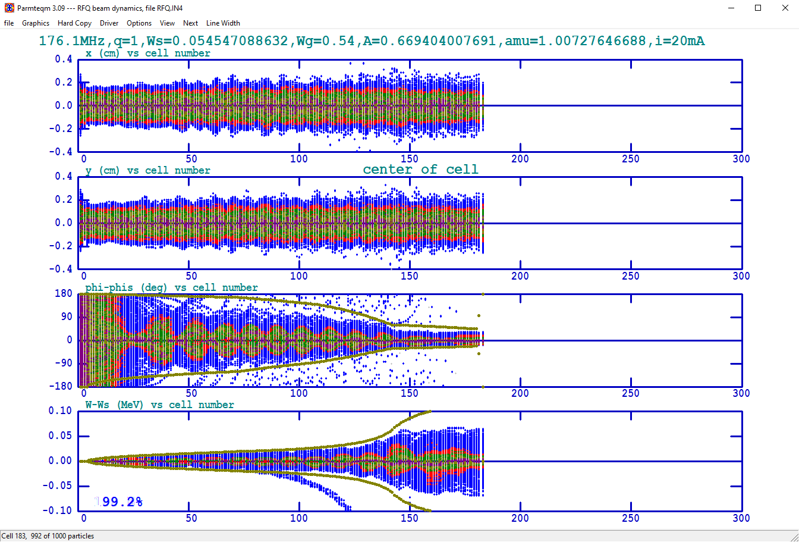
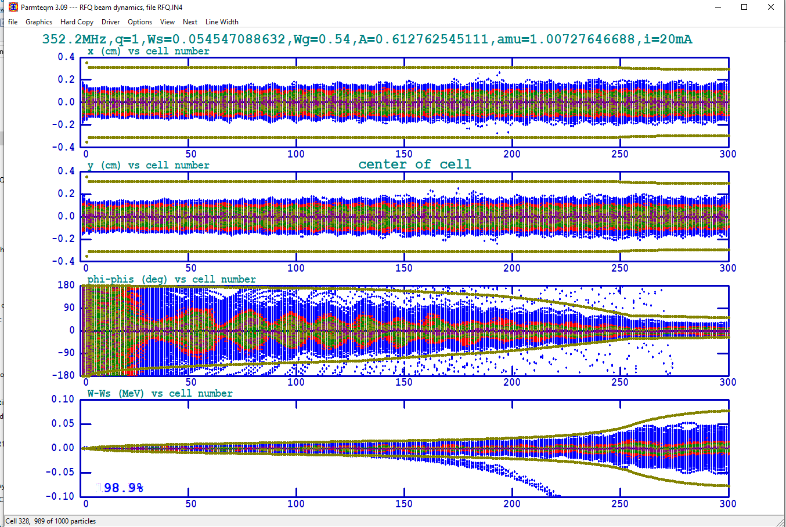
RFQ variants:
Parameters | 176.1 MHz RFQ | 352.2 MHz RFQ
Beam species | H+ | H+
Injection energy (MeV) | 0.045 | 0.045
Output energy (MeV) | 3 | 3
Resonant frequency (MHz) | 176.1 | 352.2
Peak beam current (mA) | 20 | 20
Inter-vane voltage (kV) | 130 | 78.3
Cavity length (m) | 3.6 | 3.2
minimum aperture a (cm) | 0.38 | 0.19
Ratio r_{v}/r₀ | 0.85 | 0.85
Maximum surface field (MV/m) | 26.1 (1.8 Kp) | 34.0 (1.8 Kp)
Input ɛ_{t} (n,rms)(cm.mrad) | 0.025 | 0.025
Output ɛ_{t} (n,rms)(cm.mrad) | 0.029 | 0.026
Output ɛ_{l} (n,rms)( MeV-deg (352)) | 0.238 | 0.135
Transmission (%) | 99.2% | 99 %
Number of cells | 181 | 326
RF power loss (peak kW) - est | 396 | 369
Two variants considered each giving 99% transmission for 20mA beam current from 45 keV to 3MeV as simulated in PARMTEQ:
Each optimized for same Kilpatrick and minimized length
176 MHz
  Subharmonic of DTL frequency
  RF structure – typically 4-rod
  Increased longitudinal emittance
352 MHz
  DTL frequency
  RF structure – typically 4-vane
  Shorter with improved output emittance
DTL studies preformed assuming 352MHz RFQ

Slide 11
DTL variants:
Alvarez:
Typical structure for high intensity proton acceleration
TM010 mode with βλ between gaps
Transverse focusing by quad magnets in drift tubes
Longitudinal focusing with rf phase at -25 degrees
H-mode:
TE11 (IH) or TE21 (CH) mode with βλ/2 between gaps
Choice of beam dynamics
Negative synchronous phase
  Periodic Transverse focusing by quad magnets between accelerating tanks
  Longitudinal focusing with rf phase at -25 degrees
KONUS dynamics
  Periodic Transverse focusing by quad magnets between accelerating tanks
  Longitudinal focusing with rf phase at -25 degrees
Alternate phase focusing (APF)
  Transverse and Longitudinal focusing with varying rf phase along the length

Slide 12
DTL Study
Each variant is Modeled in LANA and PARMILA
Establish 100% transmission with good quality
Calculate emittance growth for RMS and 99% contours
Estimate longitudinal and transverse acceptance
Parameter | Variant 1 | Variant2 | Variant3 | Variant4 | Variant5
Type | Alvarez | Alvarez | CH-KONUS | CH-DTL | CH-APF
Tanks | 1 | 1 | 2 | 3 | 1
Drift tubes | 25 | 25 | 12,15 | 13,10,14 | 46
Eo (MV/m) | 3.4 | 3.4 | 6.6 | 5 | 6.7
Synch. Phase ϕ_{s} | -30 | -30 | 0, -60, 0 | -28, -27, -28 | varying
PC-CANS - Conceptual Design of a Compact Accelerator Based Neutron Source for Canada Laxdal Feb. 26, 2025

Slide 13
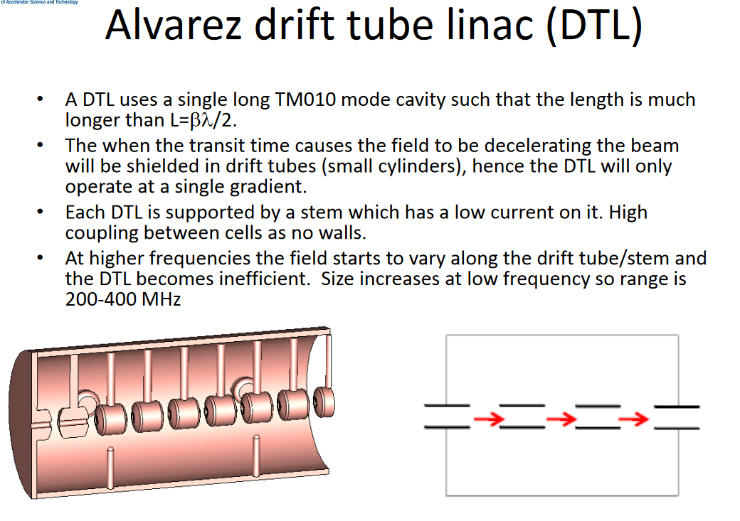
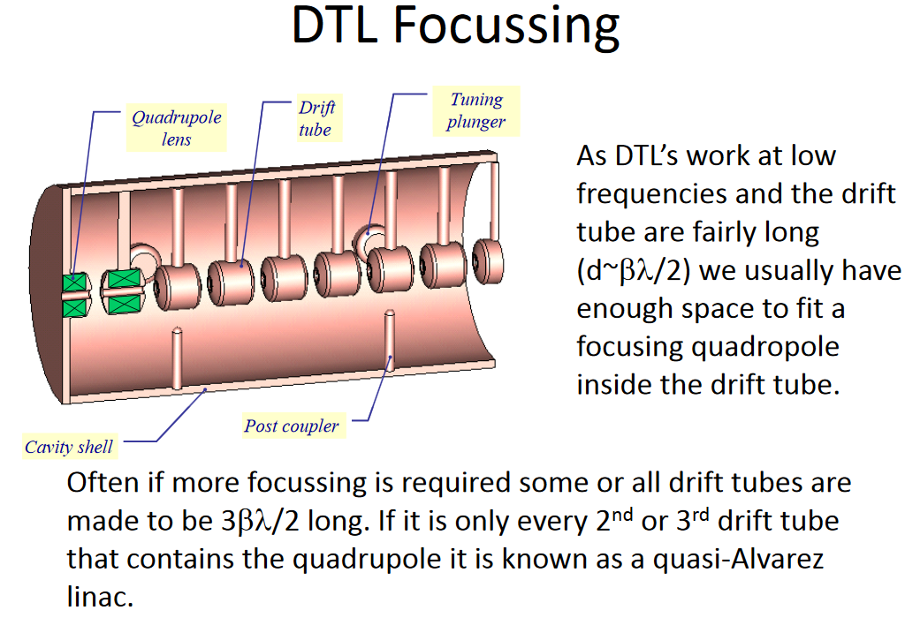
Alvarez
Adopt PMQs in every second drift tube in FODO lattice
  Strong transverse focusing
Longitudinal focusing with -30 deg synchronous phase
Two variants considered
  Variant 1 – no MEBT but with adjustable quadrupoles in first four drift tubes for transverse matching to the FODO
  Variant 2 – 4Q MEBT with buncher
Parameter | Value
Drift tubes | 26
Eo | 3.4 MV/m
Transverse Focusing | F-0-D-0 ±64T/m
Longitudinal focusing | ϕ_{s}=-30 degrees
Beam current | 20mA
Variant 1, L=2.6m
Variant 2, L=3.4m
PC-CANS - Conceptual Design of a Compact Accelerator Based Neutron Source for Canada Laxdal Feb. 26, 2025

Slide 14
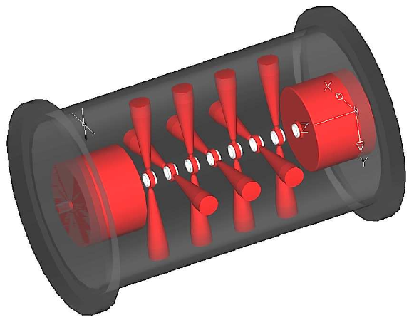
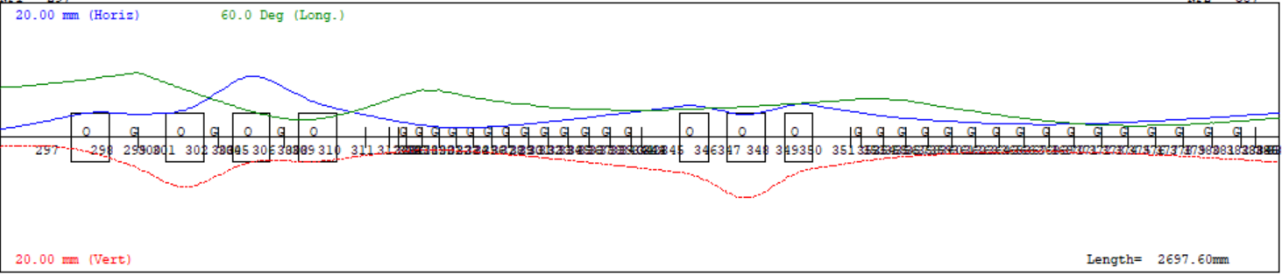
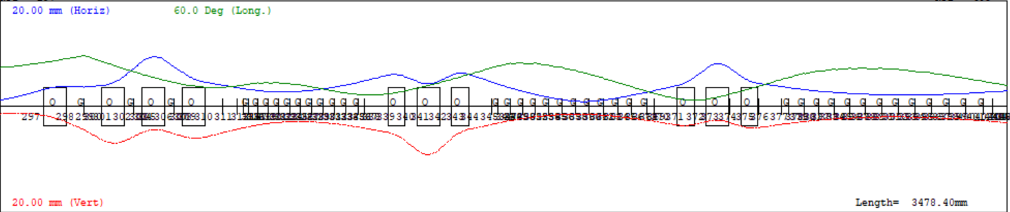
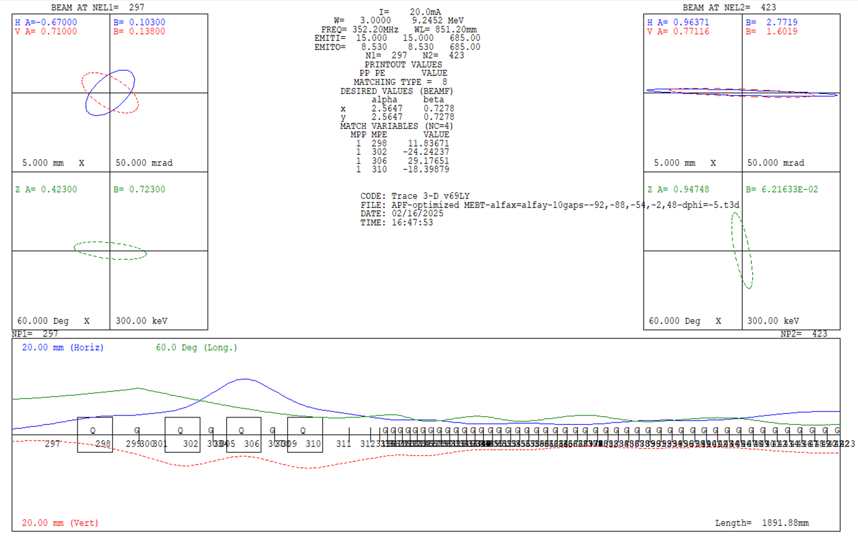
CH Structures
The accelerating sections are typically short with quadrupole triplets (or doublets) in between accelerating sections for periodic transverse focusing
Five variants considered:
  Variant 3: 0-degree synch phase (KONUS) beam dynamics – triplets
    E₀=6.6MV/m – two tanks
  Variant 4 – negative synch phase beam dynamics – triplets
    E₀=5 MV/m - three tanks
  Variant 5 - Alternate phase focusing (APF)
    E₀=6.7 MV/m – one tank
G. Clemente, PhD thesis, Frankfurt
Variant 3 - KONUS
Length= 2.61
Variant 4 – neg. synch phase
Length= 3.5
Variant 5 - APF
Variant 5
Length= 3.12

Slide 15
Summary plot – emittance growth 99%
All variants give reasonable results with 100% transmission in all cases
Alvarez with MEBT (Variant 2), KONUS (Variant 3) have the smallest longitudinal emittance growth.
The smallest transverse emittance growth is with the Alvarez with MEBT (Variant 2)
The largest transverse growth is from the APF (Variant 5)
The longitudinal and transverse acceptance is largest for Variant 2 (Alvarez with MEBT)
https://accelconf.web.cern.ch/linac2022/papers/fr1aa05.pdf
PC-CANS - Conceptual Design of a Compact Accelerator Based Neutron Source for Canada Laxdal Feb. 26, 2025

Slide 16
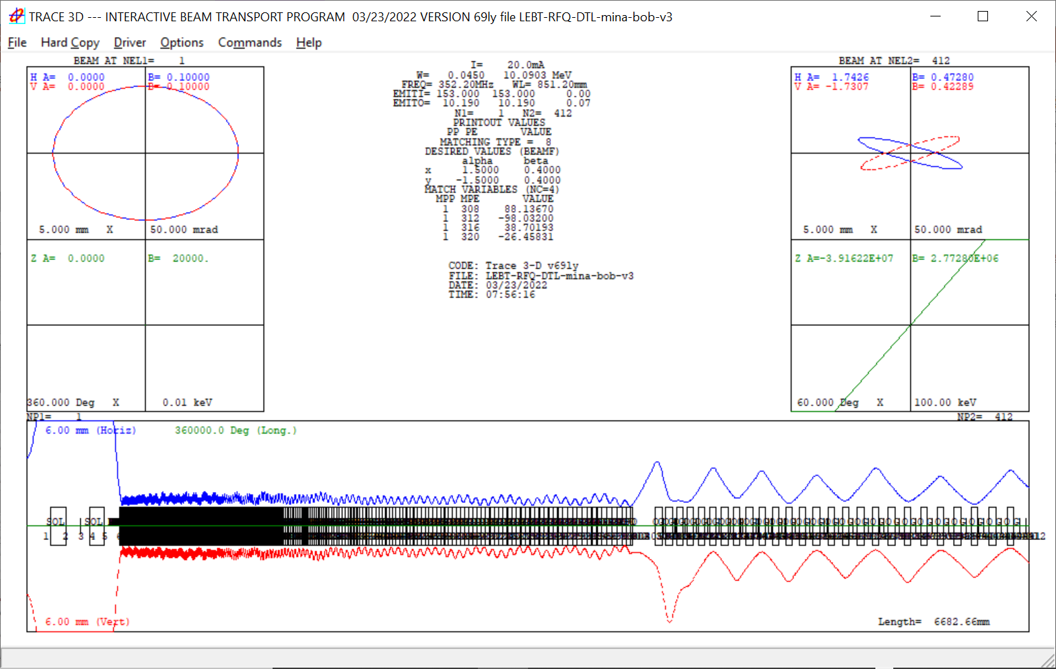
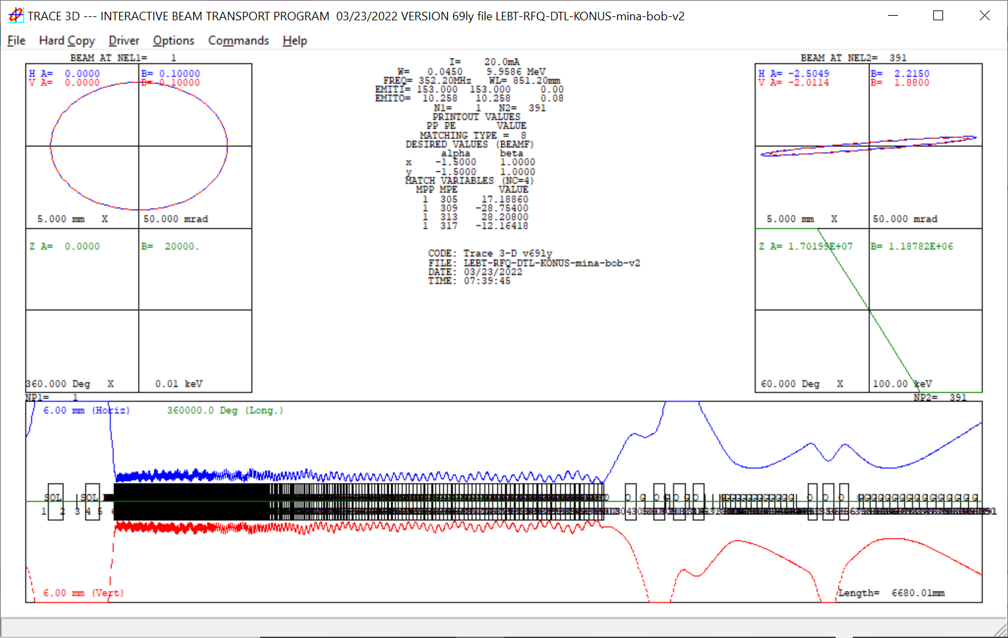
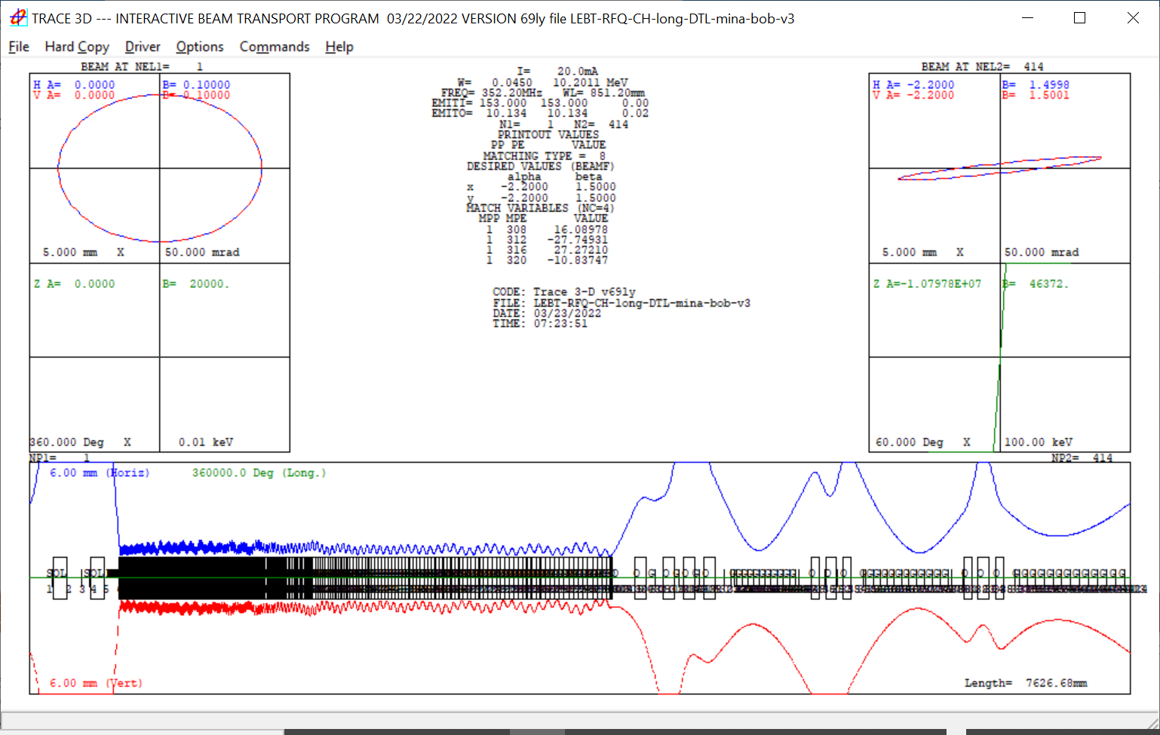
Summary
3.4MV/m Alvarez
Final choice will come down to cost and performance as well as ease of operation and robustness of design
Length = 6680mm
6.7 MV/m CH-KONUS
Accelerator Session Thursday – Mina Abbaslou TRIUMF
Design Considerations for a Proton Linac for a Compact Accelerator Based Neutron Source for Canada
Length = 6680mm
5 MV/m CH ϕ_{s} = -27
Length = 7627mm
16
PC-CANS - Conceptual Design of a Compact Accelerator Based Neutron Source for Canada Laxdal Feb. 26, 2025

Slide 17
High Energy Beam Transport (HEBT)
HEBT designed to deliver protons to all end stations simultaneously
Pulsed deflection kicker deflects selected bunches periodically
Deflected beam is separated from the undeflected beam followed by a DC septum magnet to further separate the beam
Rise and fall time depends on the Linac pulse frequency – for 200Hz separation between macro bunches is 4.7ms
PC-CANS - Conceptual Design of a Compact Accelerator Based Neutron Source for Canada Laxdal Feb. 26, 2025

Slide 18
TMR and End stations
18
PC-CANS - Conceptual Design of a Compact Accelerator Based Neutron Source for Canada Laxdal Feb. 26, 2025

Slide 19
Multi-user capability
PC-CANS - Conceptual Design of a Compact Accelerator Based Neutron Source for Canada Laxdal Feb. 26, 2025

Slide 20
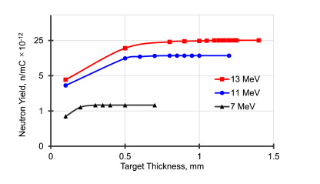
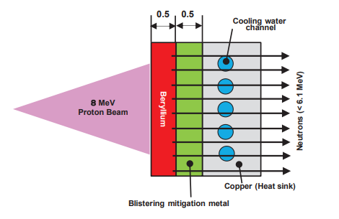
Target
Beryllium is used to generate neutrons through p,n reaction
Layered target technology with thickness chosen to reduce heating in Beryllium layer
A sandwich material is proposed to promote hydrogen diffusion (V or Pd) to reduce degradation through blisterning
Staging – P_{ave} = 2kW -> 5kW -> 10kW
V.V Subbotina et al, NIMA, Vol 1008, Aug. 2021

Slide 21
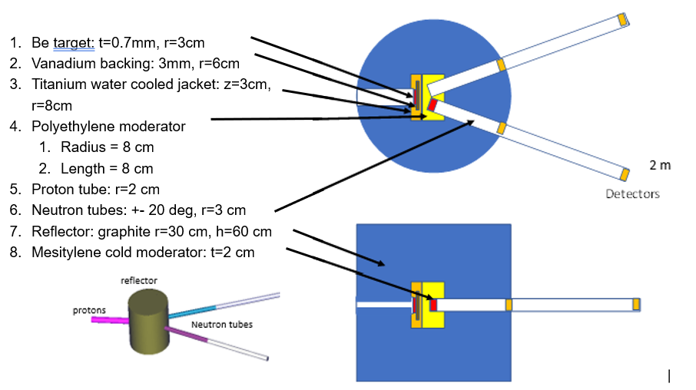
Moderator - Reflector
TMR studies have been completed considering a few geometries and different materials
  PC-CANS two tube geometry
  0.7mm Be target
  Polyethylene core R=8 cm
Studies
  cold moderator volume and material – cold methane vs mesitylene
  Reflector material – graphite vs lead vs Be and impact on neutron time structure and energy profile
External shielding
45 cm HDPE
5 cm BPE
6 cm Lead

Slide 22
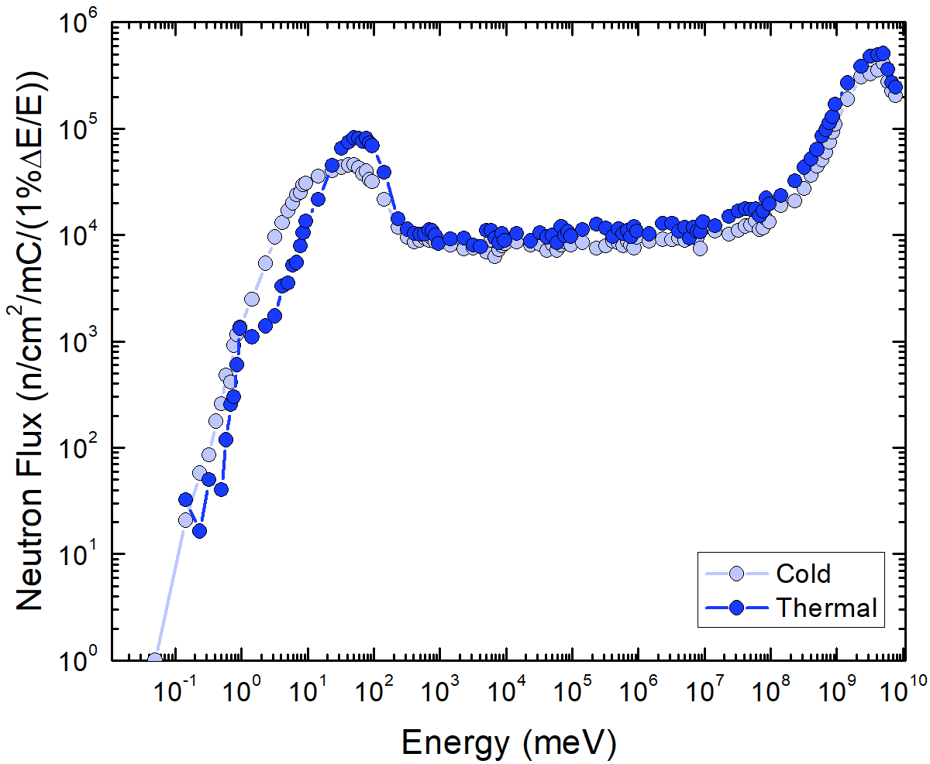
Neutron yield
 | Cold neutron tube (2cm Mesitylene – 20K)
 | Cold neutron flux | Thermal neutron flux | Epi-thermal/fast flux
 | n/cm²/mC | n/cm²/mC | n/cm²/mC
R=1m a = [0,5deg] | 4.2 E+06 | 4.5 E+06 | 4.5 E+07
R=2m a= [0,5deg] | 1.1 E+06 | 8.5 E+05 | 1.1 E+07
 | Thermal Neutron Tube
 | Cold neutron flux | Thermal neutron flux | Epi-thermal/fast flux
 | n/cm²/mC | n/cm²/mC | n/cm²/mC
R=1m a = [0,5deg] | 1.1 E+06 | 1.2 E+07 | 6.8 E+07
R=2m a = [0,5deg] | 2.2 E+05 | 2.7 E+06 | 1.6 E+07
PC-CANS - Conceptual Design of a Compact Accelerator Based Neutron Source for Canada Laxdal Feb. 26, 2025

Slide 23
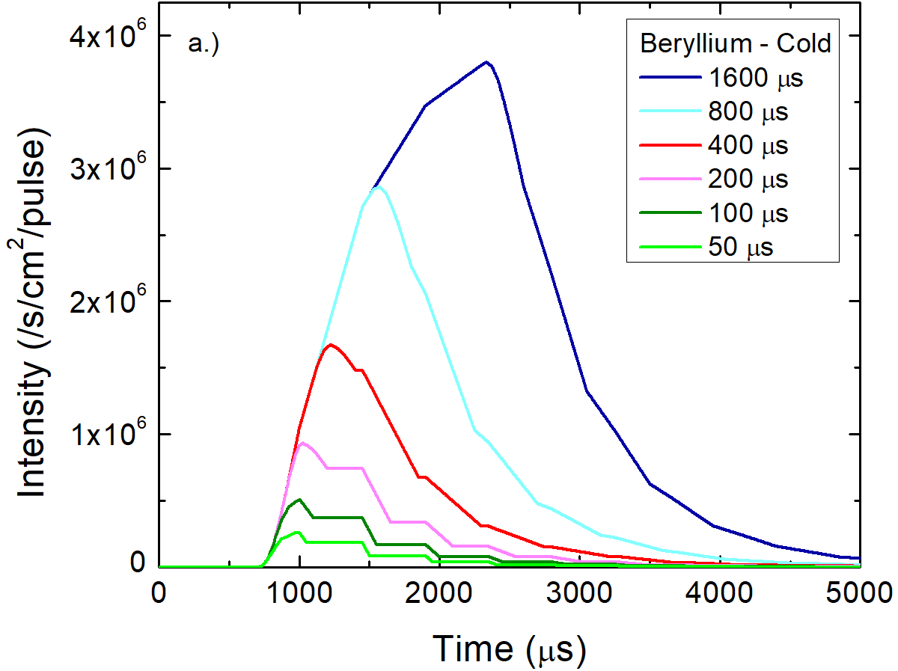
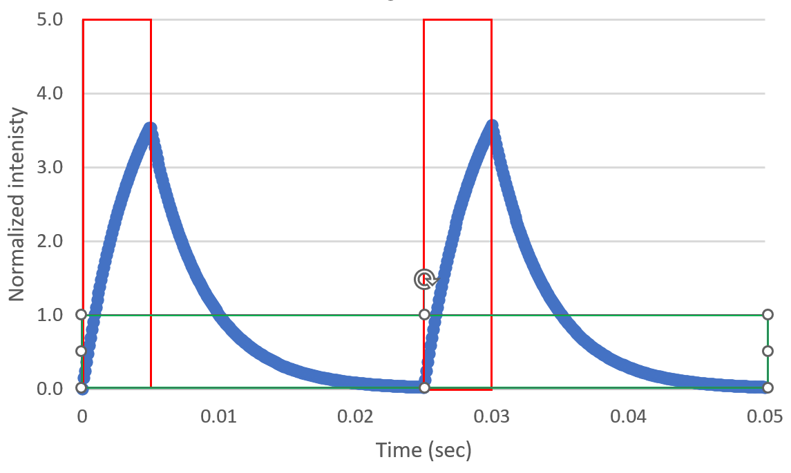
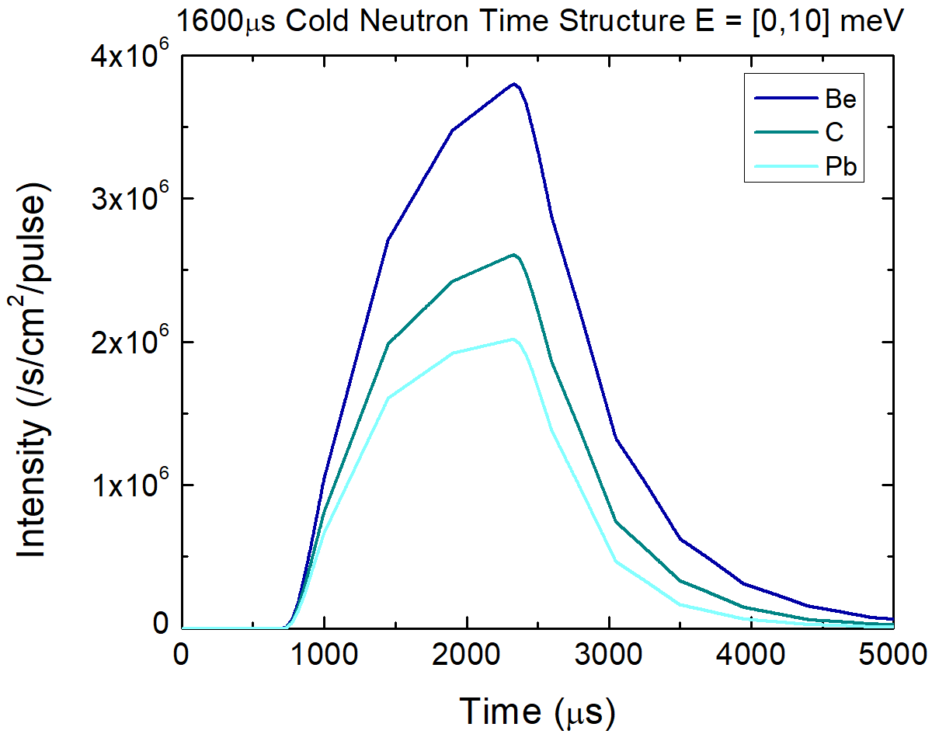
Time structure
Macro cycle defines the proton pulse length
  20-200Hz rep rates are typical -> corresponds to 2.5 – 0.25 msec pulse at 5% duty factor
Thermalized neutron production is delayed with respect to protons on target
Fill and decay times depend on TMR details – time constants and yield determined for Be, graphite, lead reflector
Example: DF=20%, T_{proton}=5ms, Rate=40Hz, τ=5ms

Slide 24
Small Angle Neutron Scattering (SANS) performance
Assume proton pulse width of 2msec and rep rate of 25Hz – 5% duty factor
Coll (m) | Sample to detector (m) | Diam of S1 (mm) | Diam of S2 (mm) | λ band (A) | Qmin (1/A) | Qmax (1/A) | Flux at sample (n/cm²/mC) | Flux (20mA) (n/cm²/s)
1 | 1 | 20 | 10 | 2 – 10.0 | 0.019 | 1.44 | 5.60E+04 | 1.12E+06
2 | 2 | 20 | 10 | 2 – 9.5 | 0.01 | 0.77 | 3.10E+04 | 6.2E+05
4 | 4 | 20 | 10 | 2 – 8.3 | 0.0057 | 0.39 | 7.70E+03 | 1.54E+05
6 | 6 | 20 | 10 | 2 – 7.4 | 0.0042 | 0.26 | 3.40E+03 | 6.8E+04
10 | 10 | 20 | 10 | 2 – 6.5 | 0.0029 | 0.16 | 1.20E+03 | 2.4E+04
PC-CANS - Conceptual Design of a Compact Accelerator Based Neutron Source for Canada Laxdal Feb. 26, 2025

Slide 25
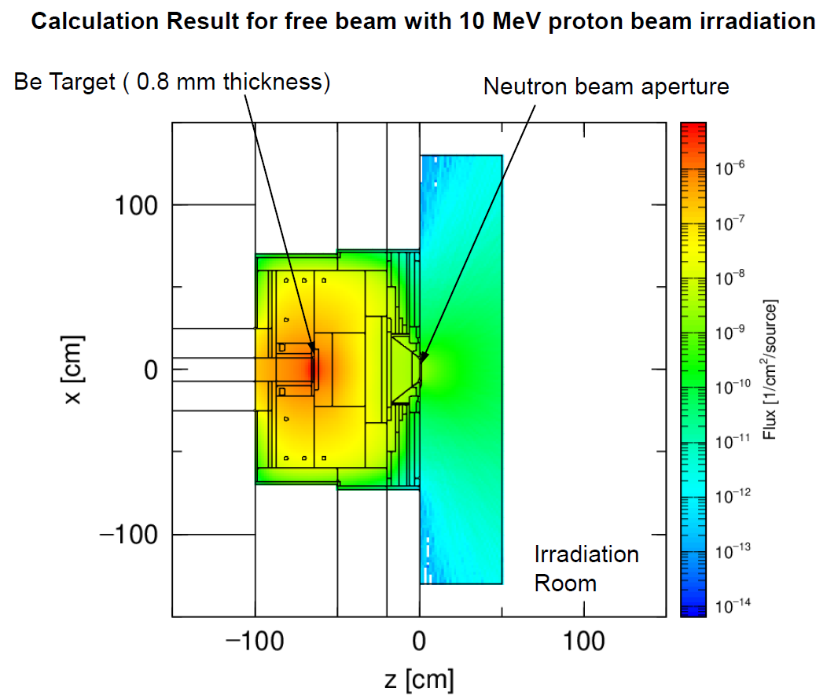
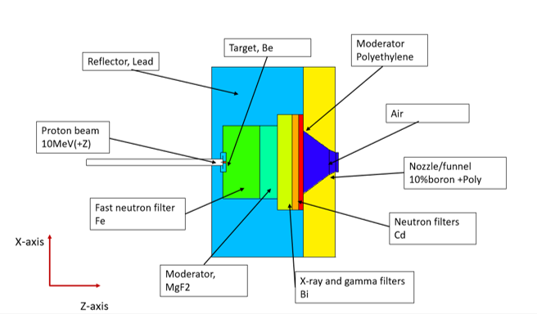
BNCT Station
IAEA - Clinical treatments require a epithermal neutron flux of ~1 E09 n/s/cm²
PC-CANS yield is expected to be 0.5 E09 at Stage 3 – within 50% of clinical flux certainly sufficient for BNCT development even in Stage 1
Be target with MgF2 moderator
iBNCT simulation
PC-CANS - Conceptual Design of a Compact Accelerator Based Neutron Source for Canada Laxdal Feb. 26, 2025

Slide 26
Expected Performance
Applications |  | I_{ave}/I_{peak} (mA)
 |  | PC-CANS1 0.1/2 | PC-CANS1 0.2/4 | PC-CANS2 0.5/10 | PC-CANS3 1/20
Neutron Science | Cold (a) (n/cm2/s) | - | 2.2x10⁵/ 4.4x10⁶ | 5.5x10⁵/ 1.1x10⁷ | 1.1x10⁶/ 2.2x10⁷
 | Thermal (a) (n/cm2/s) | - | 5.4x10⁵/ 1.1x10⁷ | 1.4x10⁶/ 2.7x10⁷ | 2.7x10⁶/ 5.4x10⁷
 | SANS (d) (n/cm2/s) | - | 3.1x10⁴ | 7.7x10⁴ | 1.5x10⁵
BNCT | Epithermal (b) (n/cm2/s) | - | 1x10⁸ | 2.5x10⁸ | 5.0x10⁸
PET | 18F (GBq) (c) | 240
Yield at 2m from target
Yield from MgF2
Saturated yield
Assuming Δλ=2-8.3 A, Q_{min}=0.006 A⁻¹
26
PC-CANS - Conceptual Design of a Compact Accelerator Based Neutron Source for Canada Laxdal Feb. 26, 2025

Slide 27
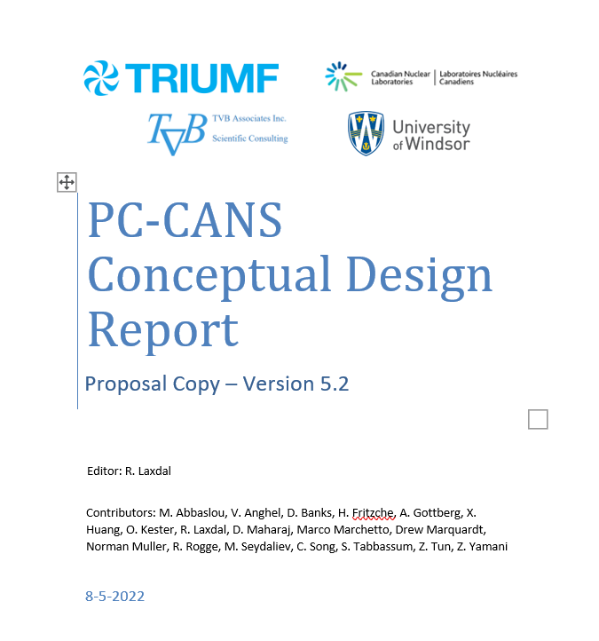
Present status
Conceptual design released in support of proposal
Plan is to prepare a detailed technical proposal for a future funding opportunity
Linac studies including further analysis, RF design, detailed costing are continuing
27
PC-CANS - Conceptual Design of a Compact Accelerator Based Neutron Source for Canada Laxdal Feb. 26, 2025

Slide 28




Acknowledgments
Dalini Maharaj (Julich)
Sana Tabbassum (Purdue)
Mina Abbaslou (TRIUMF/UVic)
Marco Marchetto (TRIUMF)
Zahra Yamani (CNL)
Vinicius Anghel (CNL)
Ronald Rogge (CNL)
Helmut Fritsche (CNL)
Daniel Banks (TVB Associates)
Zin Tun (TVB Associates)
Alexander Gottberg (TRIUMF/UVic)
Oliver Kester (TRIUMF/UVic)
Drew Marquardt (UWindsor)
Philipp Kolb (TRIUMF)
This work is supported by NFRF-E Grant Number NFRFE-2018-00183

Slide 29




Thank you
Merci
www.triumf.ca
Follow us @TRIUMFLab

Slide 30
DTL – length – rf power
The tank (rf) length is directly related to the chosen gradient while the linac length is impacted by the number of external focusing sections required.
Total power is reduced for lower gradients but may require additional triplets in the CH variants.
Choice of the gradient will come from a cost optimization of structure and rf power.

Slide 31
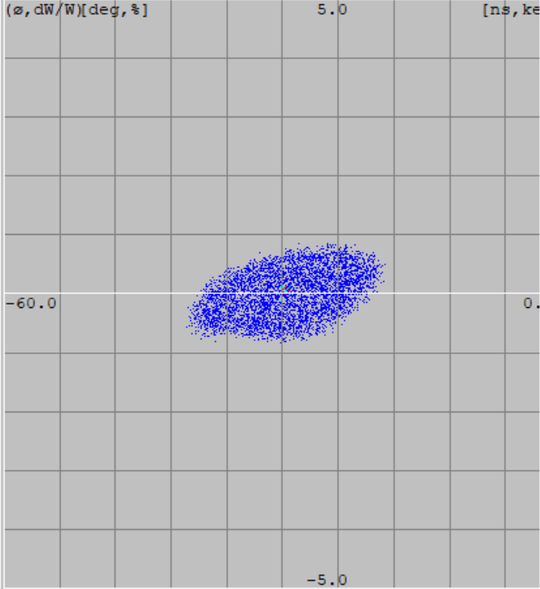
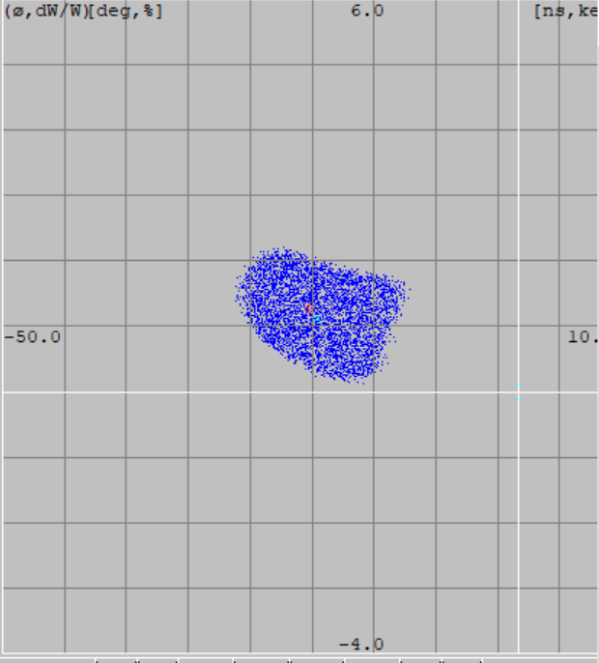
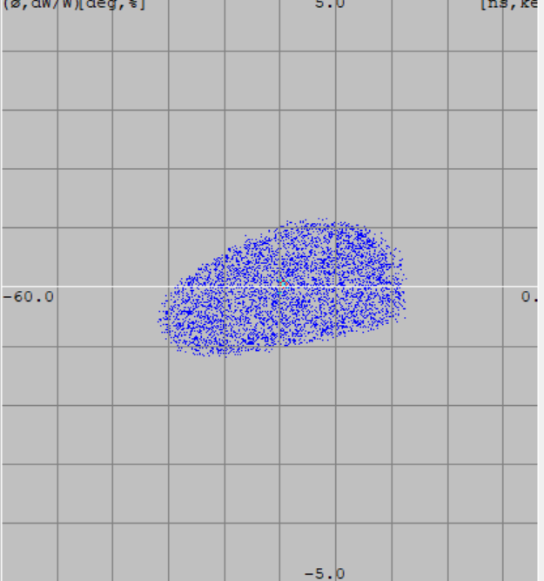
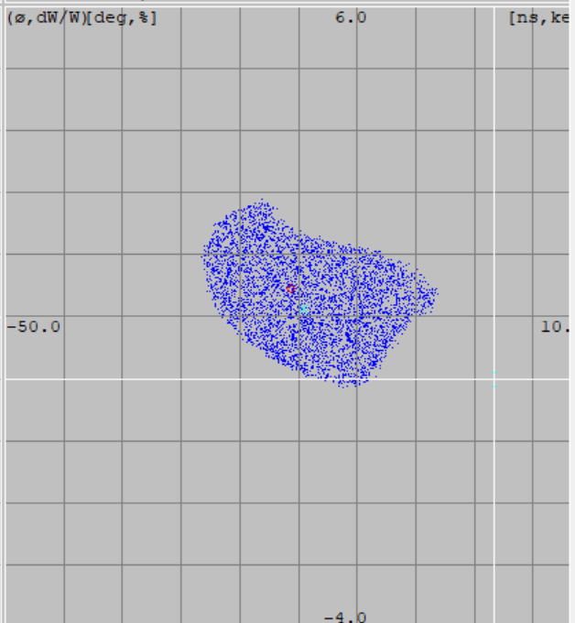
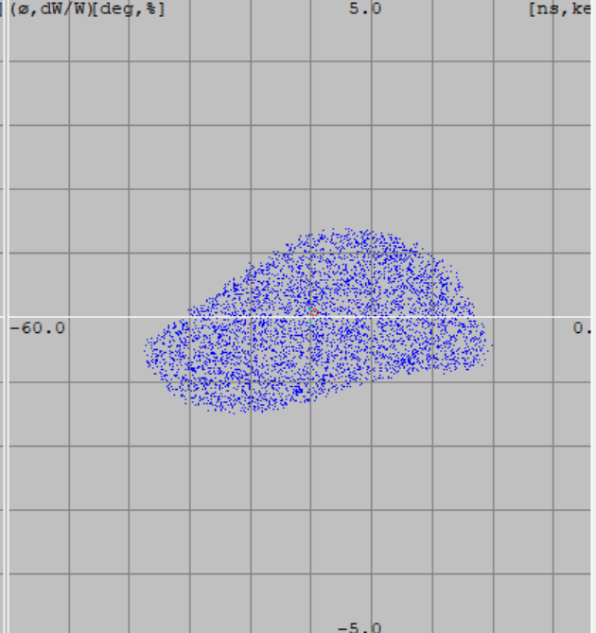
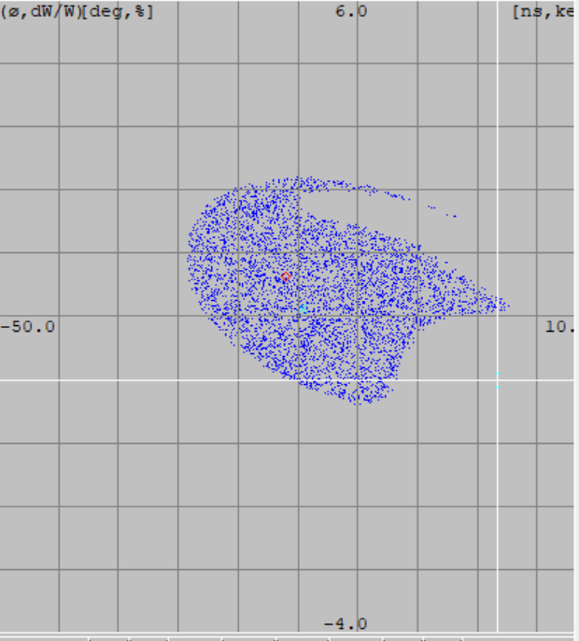
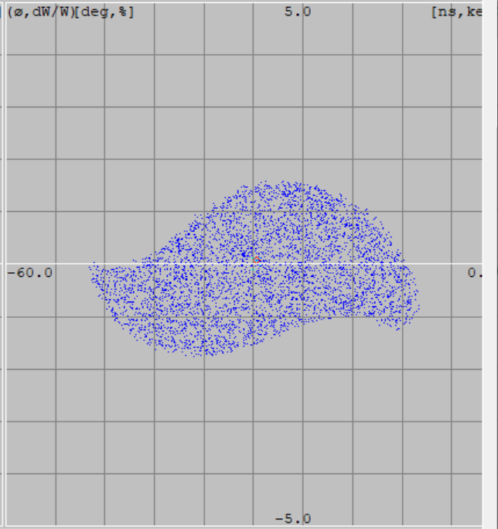
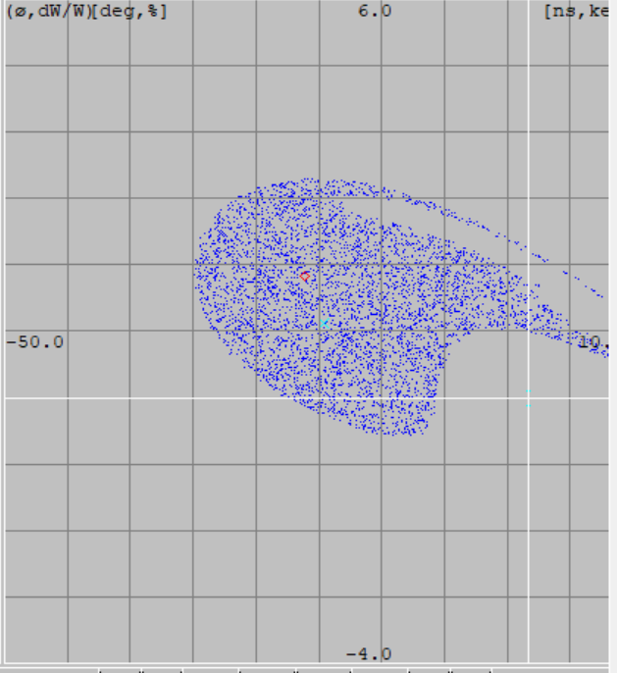
Longitudinal acceptance
Variant 2
Alvarez
Variant 3 CH-KONUS
Longitudinal acceptance is estimated by looking at the fractional emittance growth for sequentially increasing input emittances
1x
2x
3x
4x
PC-CANS - Conceptual Design of a Compact Accelerator Based Neutron Source for Canada Laxdal Feb. 26, 2025

Slide 32
Transverse acceptance
Transverse acceptance is estimated by looking at the transmission for sequentially increasing input emittances
PC-CANS - Conceptual Design of a Compact Accelerator Based Neutron Source for Canada Laxdal Feb. 26, 2025

