Slide 1





A LENS RETROSPECTOIVE
(UCANS-11, 2025 Feb. 27)
David V. Baxter
Low Energy Neutron Source
Center for Exploration of Energy and Matter (CEEM),
Indiana University
Notes:
35 MINUTES + 5 MIN QUESTIONS

Slide 2
Thanks to:
Daniel Loveless
Mike Snow
Roger Pynn
Paul Sokol
Helmut Kaiser
Dobrin Bossev
Tom Rinckel
Tom Todd
Jak Doskow
Gerard Visser
Mark Luxnut
John Ostler
Laddie Derenchuk
…
Many many students and postdocs:
Sam McKay
Steve Parnell
Steve Kuhn
Fankang Li
Jaizhou Shen
Paul Stonaha
Rana Ashkar
T. Wang
A. Washington
N. Remmes
Chris Lavelle
…

Slide 3
2005: LENS Missions
Education
Innovation
LENS
Materials research

Slide 4
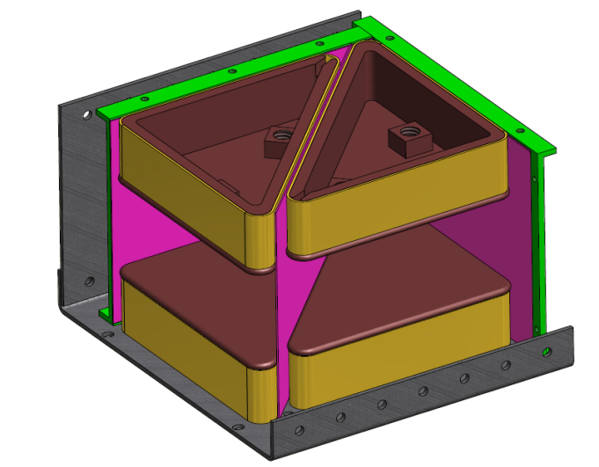


HTS Magnetic Wollaston Prisms
(Quantum View) A neutron WP acts as a birefringent medium for neutrons. It allows one to entangle the neutron spin with either momentum or position:
  Introduction of entangled spin states into neutron scattering
120 mm

Slide 5
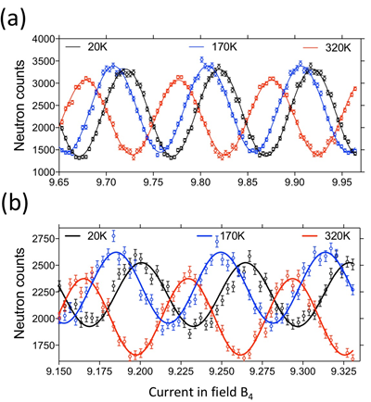
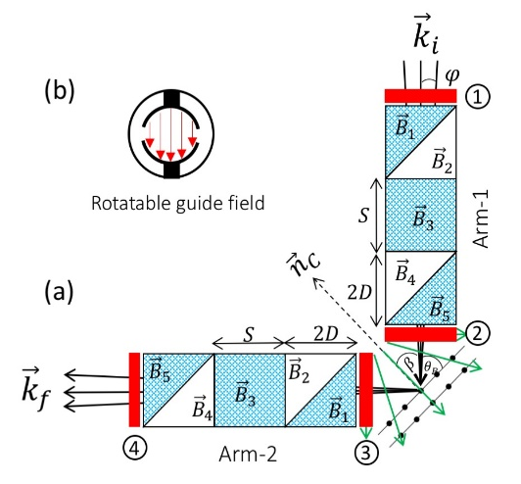
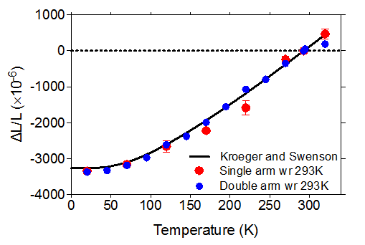
Larmor Diffraction with MWP
F. Li Sci. Rep. 7, 865 (2017).

Slide 6
Total Cross section of D₂O
Data collected at 10Hz with 0.15ms pulse width for full energy range.
12 hour data collection(6 hour sample in, 6 hour sample out).
Statistics could be improved by using different accel. settings for large and small energy portions of the data.
Background rate in the ³He detector is very small. (0.15/min)
J. I. M. Damian et al. Il. Nu. Cim. 38C, 178 (2016)
Notes:
Measured with a fixed 150 us pulse width at 10 Hz. Going to a longer pulse width and longer counting times could reduce error bars below 100 ueV.

Slide 7
LENS students/postdoc locations

Slide 8
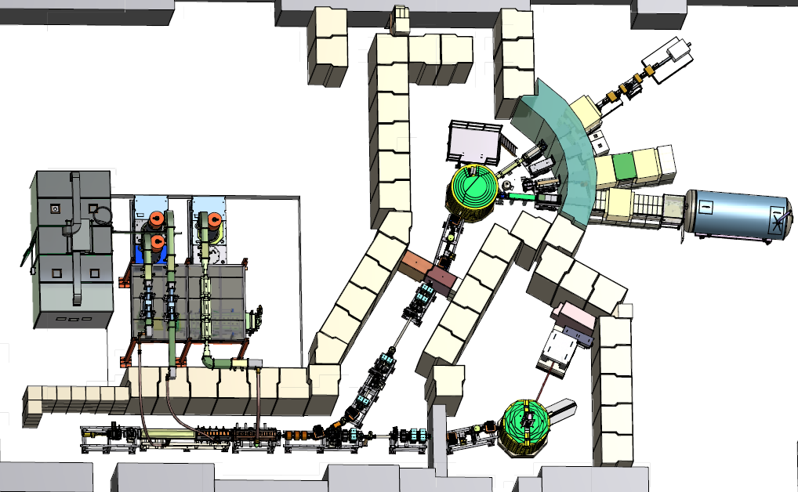
Layout of current LENS facility
TMR2: Cold neutrons,
materials research
SESAME
RF power
systems
MIS
instrument
SANS
Radiography
3, 7, 13 MeV
Linacs
TMR1: Fast
neutrons, NREF

Slide 9
LENS within “MESH” ca. 2010

Slide 10
Loss of Cyclotron service: 2014

Slide 11
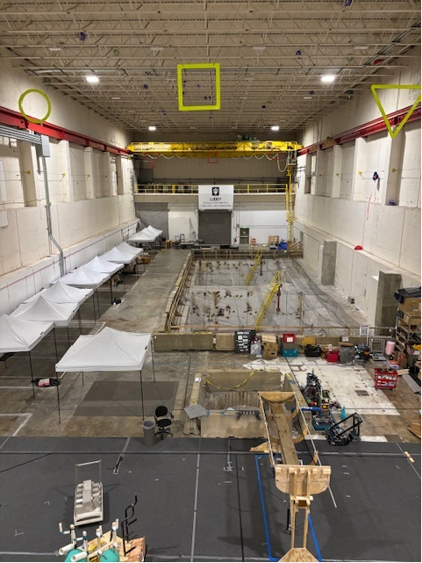
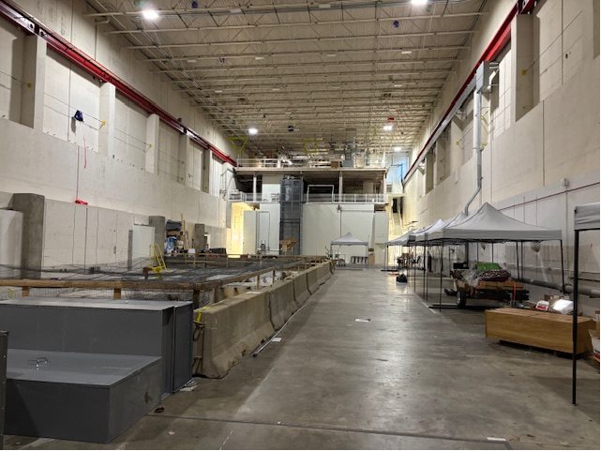
Current state of MPRI

Slide 12
History of support staff:
LENS: was born within a research facility with O(120) technical staff with expertise in:
  Accelerator design/construction/operation
  RF and electronics engineering
  Cryogenic/Radiation safety and other expertise
Reduced to a skeleton crew of 3 with support from various retirees upon MPRI closure.
Those 3 have retired just before/after COVID-19 and LENS has not operated since March 2020.

Slide 13
Thanks to:
Daniel Loveless
Mike Snow
Roger Pynn**
Paul Sokol
Helmut Kaiser
Dobrin Bossev
Tom Rinckel**
Tom Todd**
Jak Doskow**
Gerard Visser
Mark Luxnut
John Ostler
Laddie Derenchuk
…
Many many students and postdocs:
Sam McKay**
Steve Parnell**
Steve Kuhn **
Fankang Li**
Jaizhou Shen**
Paul Stonaha
Rana Ashkar
T. Wang
A. Washington
…
**Key folks who kept us productive in lean years.

Slide 14
History of support staff:
LENS: was born within a research facility with O(120) technical staff with expertise in:
  Accelerator design/construction/operation
  RF and electronics engineering
  Cryogenic/Radiation safety and other expertise
Reduced to a skeleton crew of 3 with support from various retirees upon MPRI closure.
Those 3 have retired just before/after COVID-19 and LENS has not operated since March 2020.
There is now an effort to revive it with a primary mission in the field of reliable electronics.

Slide 15
Thanks to:
Daniel Loveless##
Mike Snow
Roger Pynn**
Paul Sokol
Helmut Kaiser
Dobrin Bossev
Tom Rinckel**
Tom Todd**
Jak Doskow**
Gerard Visser##
Mark Luxnut##
John Ostler##
Laddie Derenchuk
…
Many many students and postdocs:
Sam McKay**
Steve Parnell**
Steve Kuhn **
Fankang Li**
Jaizhou Shen**
Paul Stonaha
Rana Ashkar
T. Wang
A. Washington
…
## Folks working on bringing LENS back online.

Slide 17
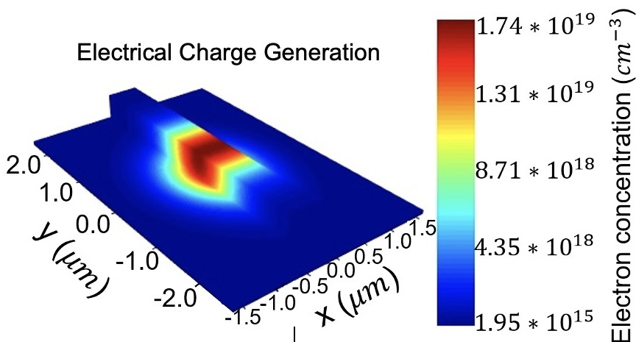
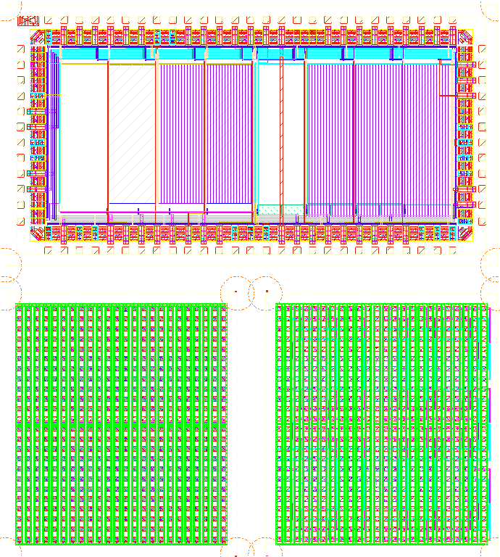
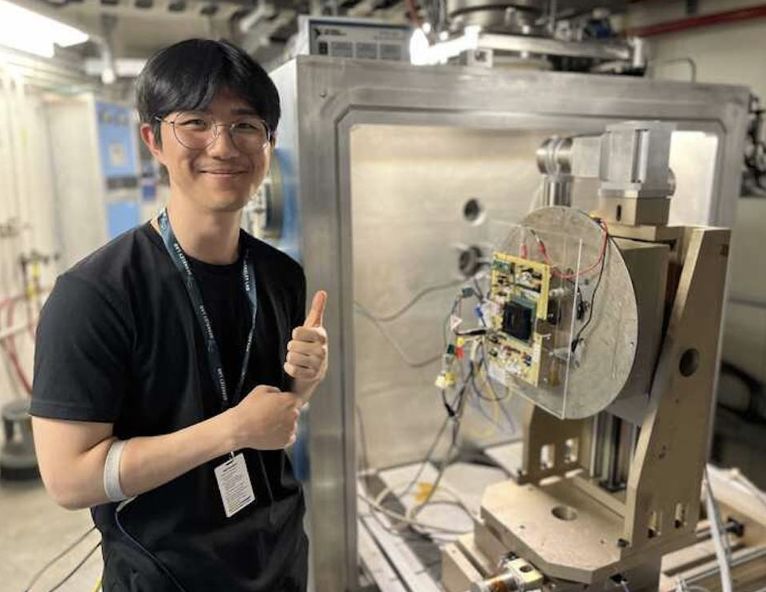
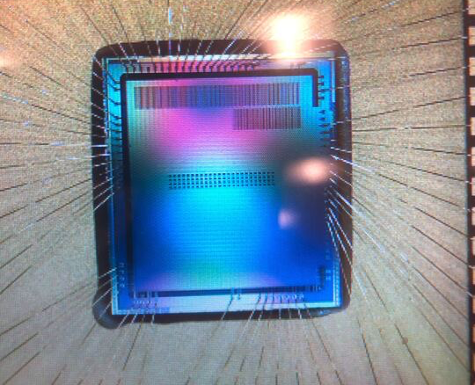

IU Center for Reliable and Trusted Electronics Workforce Ecosystem for Radiation-Tolerant Microelectronics
Technical Objectives:
  Discover relevant radiation and reliability failure mechanisms in emerging technologies (i.e., physics of failure)
  Design modeling and simulation methods appropriate for emerging technologies (e.g., highly integrated heterogeneous devices, nonvolatile memories)
  Provide radiation-hardened (RH) solutions for DoD applications
  Design independent verification and validation (V&V) approaches for high-reliability systems
  Develop and enhance radiation-testing infrastructure**
  ** This is where LENS comes in
  Partners:
  IU Luddy School of Informatics, Computing and Engineering (SICE)
  IU Intelligent Systems Engineering (ISE)
  IU Physics and Center for Exploration of Energy in Matter (CEEM)
  IU O'Neill School for Public Policy
  IU Kelley School of Business
  Reliable Microsystems, LLC
  Synopsys, Inc.

Slide 18
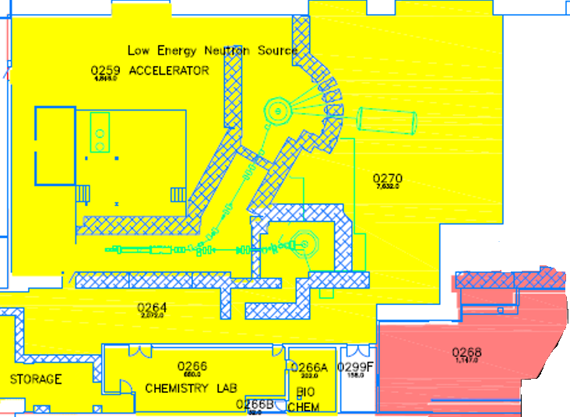
LENS Updates
Completed overhaul of all LENS subsystems: refurbished deionized water cooling system, low / high-vacuum components, HV supplies, entire interlock chain, main klystrons
Primary focus on increasing reliability and (later) output intensity of entire LENS operations: accelerator, infrastructure, TMRs
System now under high vacuum, new turbo and scroll pump controller
All controls software re-installed, updated, new power backups
All interlocks / redundancy verified and stress tested
Proton ion source has been turned on, currently being optimized
New 1150 sq. ft space, secured, fully enclosed, for external users.
Compliant with all T0238 physical cybersecurity requirements.

Slide 19
Conclusions
LENS has made several important contributions to the CANS community over last 20 years.
Evolution of the context in which the facility operated provided operational challenges and may serve as an example to others.
New funding for a targeted mission in reliable electronics holds promise for bringing the facility back online within the next year.

Slide 20
Single Crystal Reflector/Filter

Slide 21
Key points to cover:
  Design/capabilities
  Operation/funding
  Evolution of the fiscal/technical environment
    Can I find a slide with IUCF layout including cyclotrons and cooler?
  Highlights from operation
    Low-D moderators
    Educational footprint.
    Entangled probe scattering
    D2O XS (and others?), wide energy range, low background
  Shutdown due to the pandemic
  Revitalization from IU CREATE

Slide 22
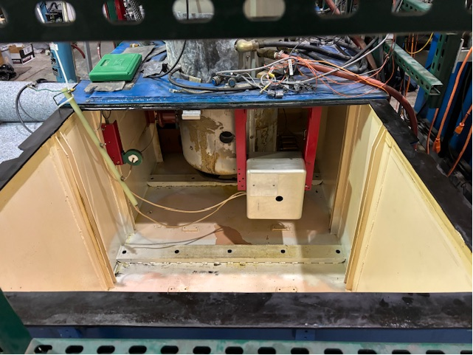
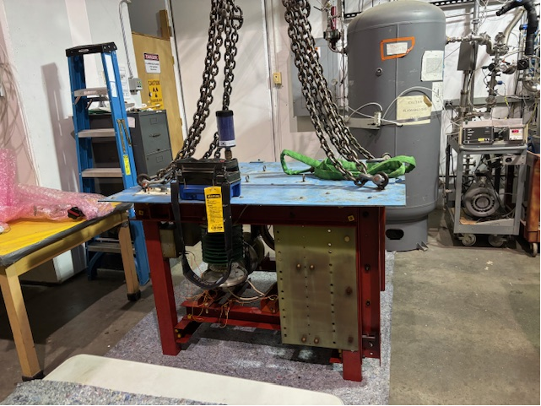

Slide 23
Transmission entangled beam Expt. at ISIS
This affords an experiment like Hasegawa’s, but with a MICROSCOPIC and CONTROLAB:LE entanglement length ξ! NOW ADD SAMPLES!

Slide 24
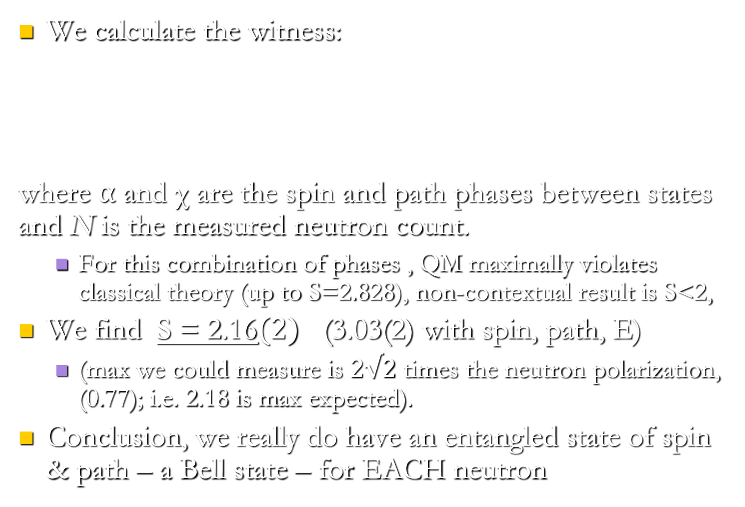

The results are….
We calculate the witness:
where ⍺ and χ are the spin and path phases between states and N is the measured neutron count.
  For this combination of phases , QM maximally violates classical theory (up to S=2.828), non-contextual result is S<2,
We find S = 2.16$(2)$ (3.03(2) with spin, path, E)
  (max we could measure is $2√2$ times the neutron polarization, (0.77); i.e. 2.18 is max expected).
Conclusion, we really do have an entangled state of spin & path – a Bell state – for EACH neutron
$$S=E\left(0,\frac{π}{4}\right)+E\left(0,−\frac{π}{4}\right)−E\left(\frac{π}{2},\frac{π}{4}\right)+E(\frac{π}{2},−\frac{π}{4})$$
$$E\left(α,χ\right)=\frac{N\left(α,χ\right)+N\left(α+π,χ+π\right)−N\left(α,χ+π\right)−N\left(α+π,χ\right)}{N\left(α,χ\right)+N\left(α+π,χ+π\right)+N\left(α,χ+π\right)+N\left(α+π,χ\right)}$$
Notes:
If one achieves the Tsirelson bound of 2sqrt(2) the input must be a Bell state (this is a theorem)

Slide 25
Neutrons and QIS
Hasegawa et al., PRA 81, 032121 (2010)
Neutron interferometry has been used for fundamental tests of QM for some time (e.g. above contextuality measurement with triply entangled beams) M=2.558(4) (NCHVT require <2).
Problems: the entanglement geometry is macroscopic and fixed by interferometer geometry, no easy way to direct beam to a sample of interest.

Slide 26
The Low Energy Neutron Source (LENS)
Italics and underlined:
Used for the CRP
SESAME
TMR2: Cold neutrons,
Mod. Studies, Mat. Res.
RF Power
Systems
MIS
SANS*
Radiography
3, 7, 13 MeV
Linac
TMR1: Fast
Neutrons,
NREF

Slide 27
HTS Magnetic Wollaston Prisms
(Classical View) A neutron WP allows you to encode neutron trajectory information into the neutron phase (spin orientation). With this you can decouple momentum resolution from neutron intensity facilitating:
  Increased energy resolution in neutron scattering
  Spin-echo approaches to real-space correlations in materials
  New contrast mechanisms to neutron radiography
120 mm
Mu metal
Pole piece
HTS tape
HTS film
See Li et al. Rev. Sci. Inst. 86, 023902 (2014), Li and Pynn, J. Appl. Cryst, 47,1849 (2014) & perspective by F. Mezei, J. Appl. Cryst 47,1807 (2014)
Neutron spin orientations

Slide 28
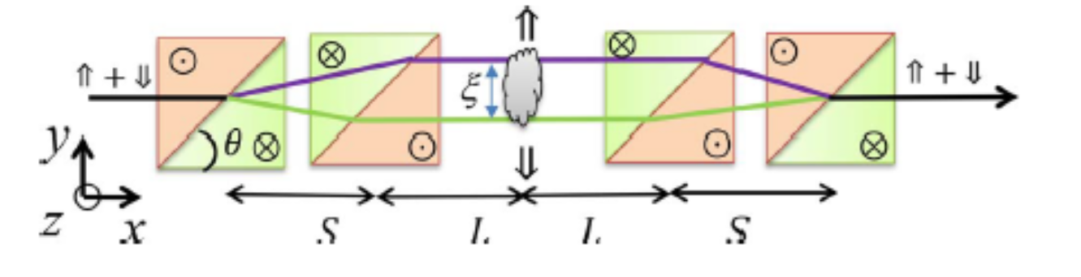
SESAME Instrument
On-line ³He polarization (SEOP) analysis
S. R. Parnell et al., Rev. Sci. Inst. (2015)
P_{s}(ξ)/P_{o}(ξ)=exp(Σ_{t}[G(ξ)-1])
Real space correlations are determined directly from measuring the normalized polarization of the outgoing beam.
= cBSλ²Bcot(θ) ; c=2.476x10¹⁴ T⁻¹ m⁻²
= 30nm at λ=0.5nm, B=1mT, S=0.5m

Slide 29
SESAME Instrument
On-line ³He polarization (SEOP) analysis
S. R. Parnell et al., Rev. Sci. Inst. (2015)
P_{s}(ξ)/P_{o}(ξ)=exp(Σ_{t}[G(ξ)-1])
Real space correlations are determined directly from measuring the normalized polarization of the outgoing beam.
What if we measure more than just the polarization as a function of ξ?
= cBSλ²Bcot(θ) ; c=2.476x10¹⁴ T⁻¹ m⁻²
= 30nm at λ=0.5nm, B=1mT, S=0.5m

Slide 30
Fast neutron induced background
At 150 μs/pulse
With 10% detector at
0.1nm.
D. Baxter and Rinckel Il Nuo. Cim. 38C, 183 (2016)

Slide 31
SANS on worm-like Micelles (CTAB/NaSaI)
Das et al. Langmuir, 28 11963 (2012)
The micelle diameter (2 nm) and persistence length (4-5 nm) are independent of temperature and concentration for a fixed surfactant/salt ratio, but contour length decreases with T and saturates with concentration.
CTAB:CetyltrimethylammoniumBromide
NaSaI: Sodium Salicylate
Notes:
CTAB: Cetyltrimethylamonium-bromide// NaSaI: Sodium Salicylate

Slide 32
Graphene Oxide nanocomposites
Fractal structure was first indicated in experiments at LENS, which were used to apply for beam time on SANS-2d at ISIS.
Weir et al. , Chem. Mat. 28, 1698 (2016)

Slide 33
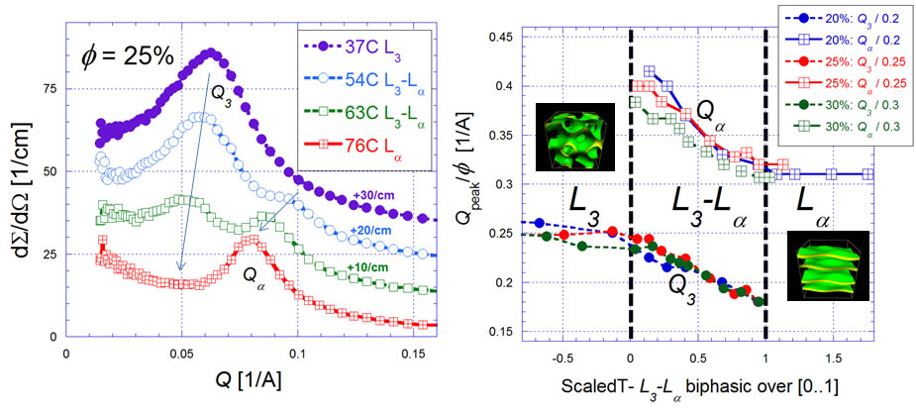
Miscibility gap in AOT
Data from the LENS SANS instrument. 20 minutes per temperature.
Suitable for strong scatterers at intermediate Q, parametric studies
W. A. Hamilton and
S. R. Parnell (unpubl.)

