Slide 1

The CoolGal target: core of the Phase 0 NEPIR (NEutron and Proton IRradiation) facility
Dr. Elizabeth Musacchio-González, Ing. Alberto Monetti, Ing. Alberto Campagnolo,
Dr. Jeffery Wyss, Dr. Pierfrancesco Mastinu, Dr. Luca Silvestrin

Slide 2
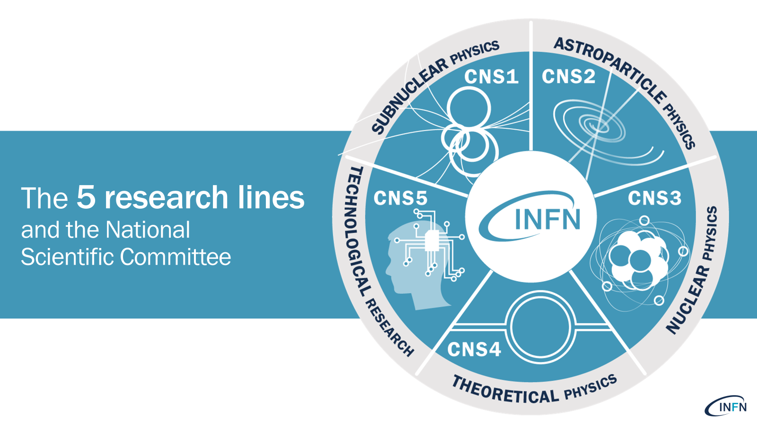
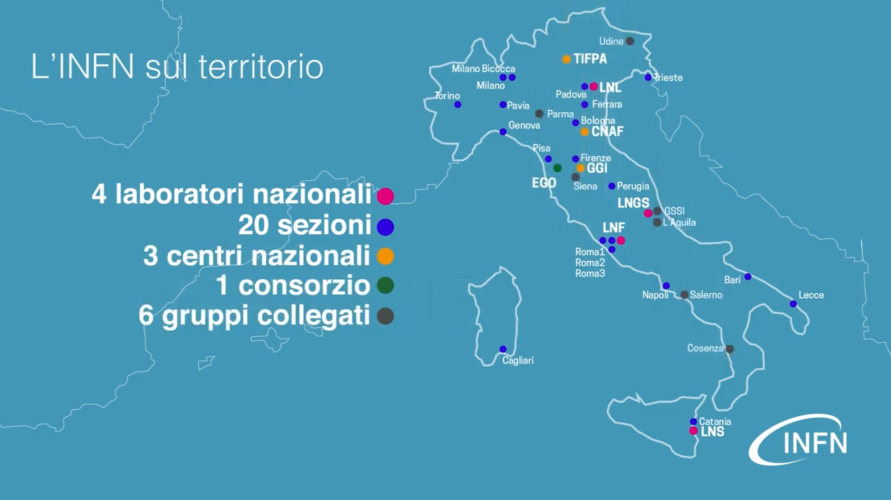
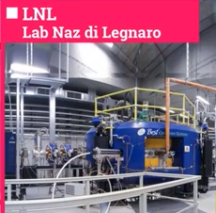
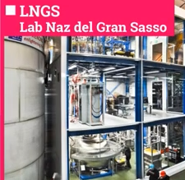
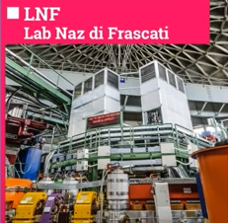
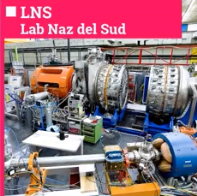
INFN- National Institute for Nuclear Physics
4 National laboratories
20 Divisions
3 National Centers and School
1 International Consortia
6 Associated groups
INFN facilities

Slide 3
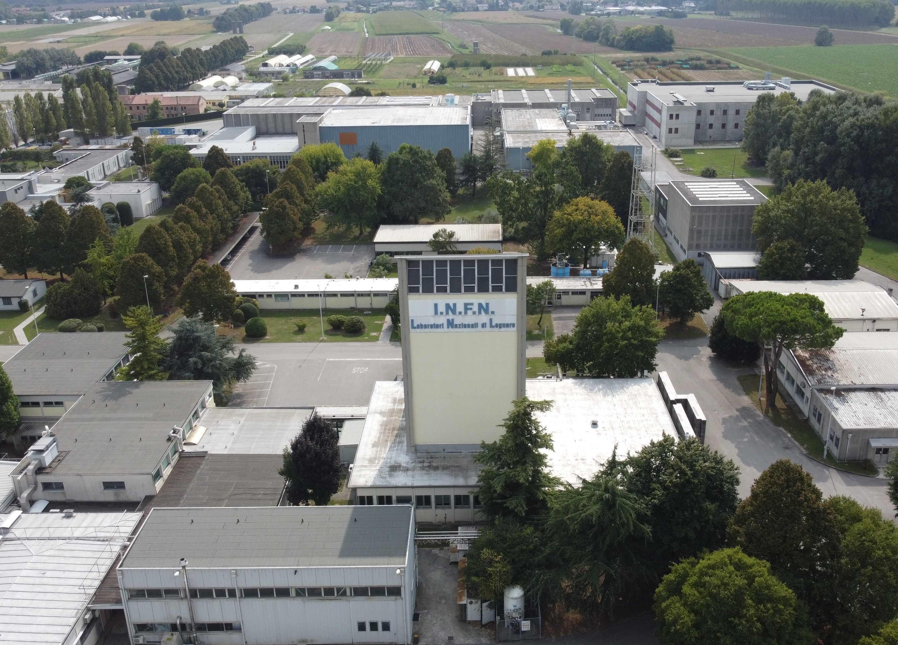

INFN- National Institute for Nuclear Physics
4 National laboratories
20 Divisions
National Laboratories of Legnaro
3 National Centers and School
1 International Consortia
6 Associated groups
INFN facilities

Slide 4
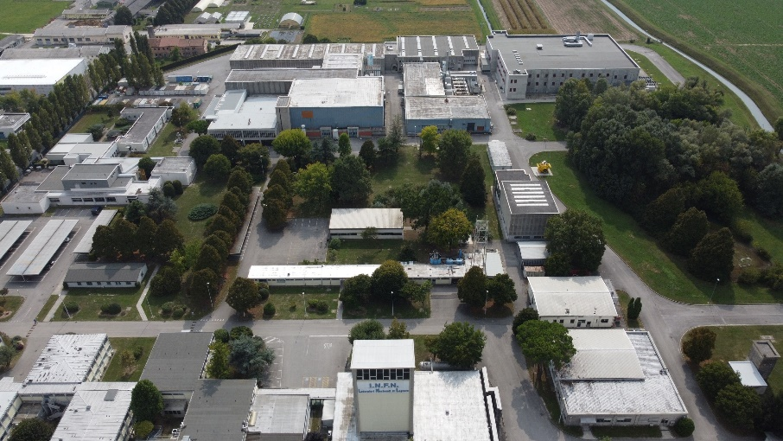
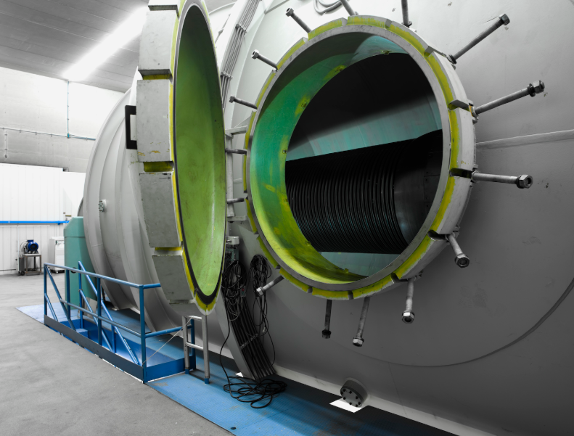
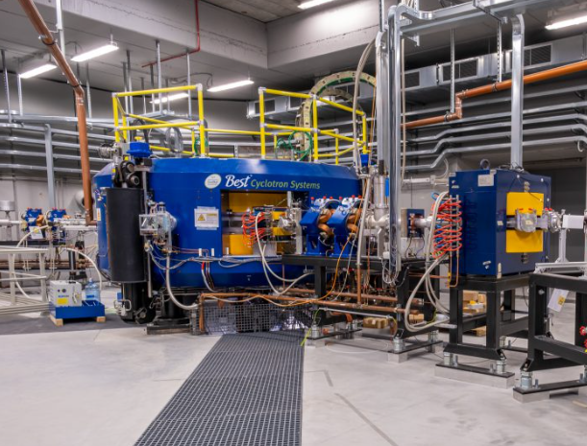
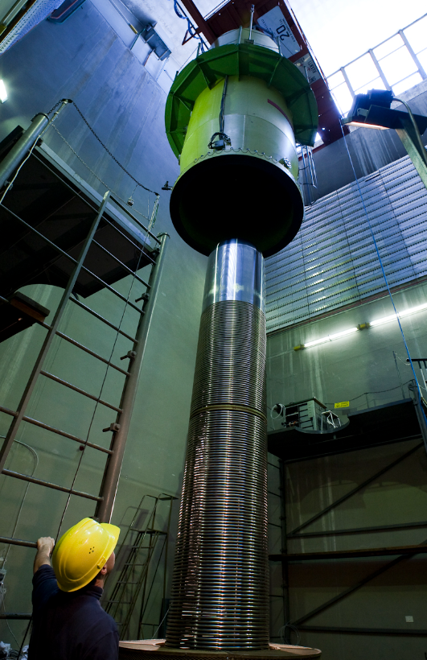
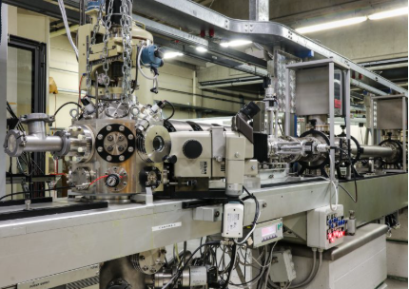
LNL-INFN – National Laboratories of Legnaro
14 MV
Linear with superconducting cavities
35-70 MeV
ALPI
TANDEM
SPES CYCLOTRON
ACCELERATOR COMPLEX
CN
AN
2 MV electrostatic
(micro beam)
6 MV Van de Graaff electrostatic

Slide 5
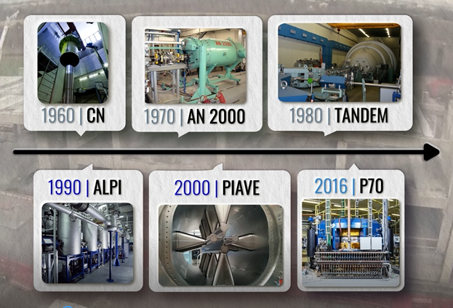
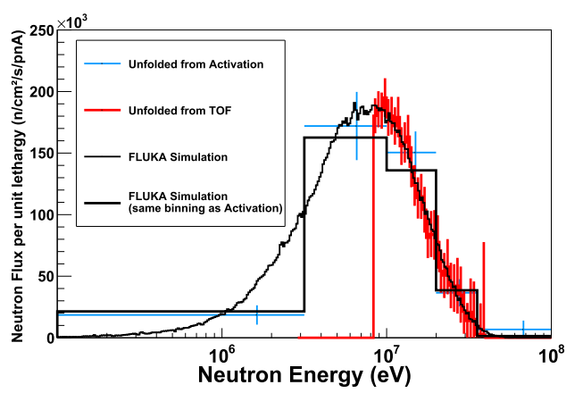
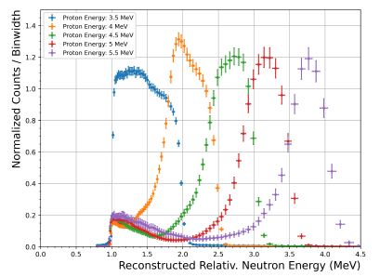

Neutron sources @ LNL-INFN
Neutron Sources
Lithium target
@ CN accelerator
Neutrons
@ SPES (P70)
Inverse reactions
@ Tandem accelerator
Maxwell-Boltzmann-like spectrum
Quasi-monoenergetic neutrons

Slide 6

Neutron sources @ LNL-INFN
Neutron Sources
Lithium target
@ CN accelerator
Neutrons
@ SPES (P70)
Inverse reactions
@ Tandem accelerator
This talk

Slide 7
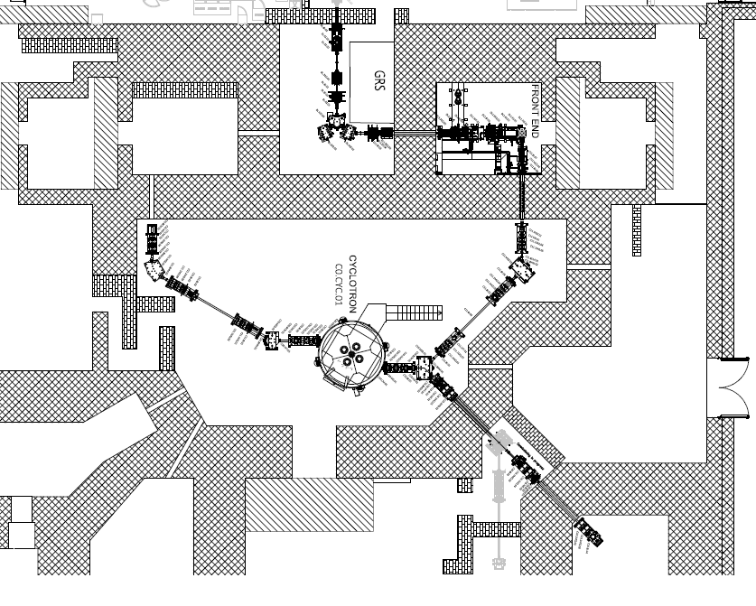
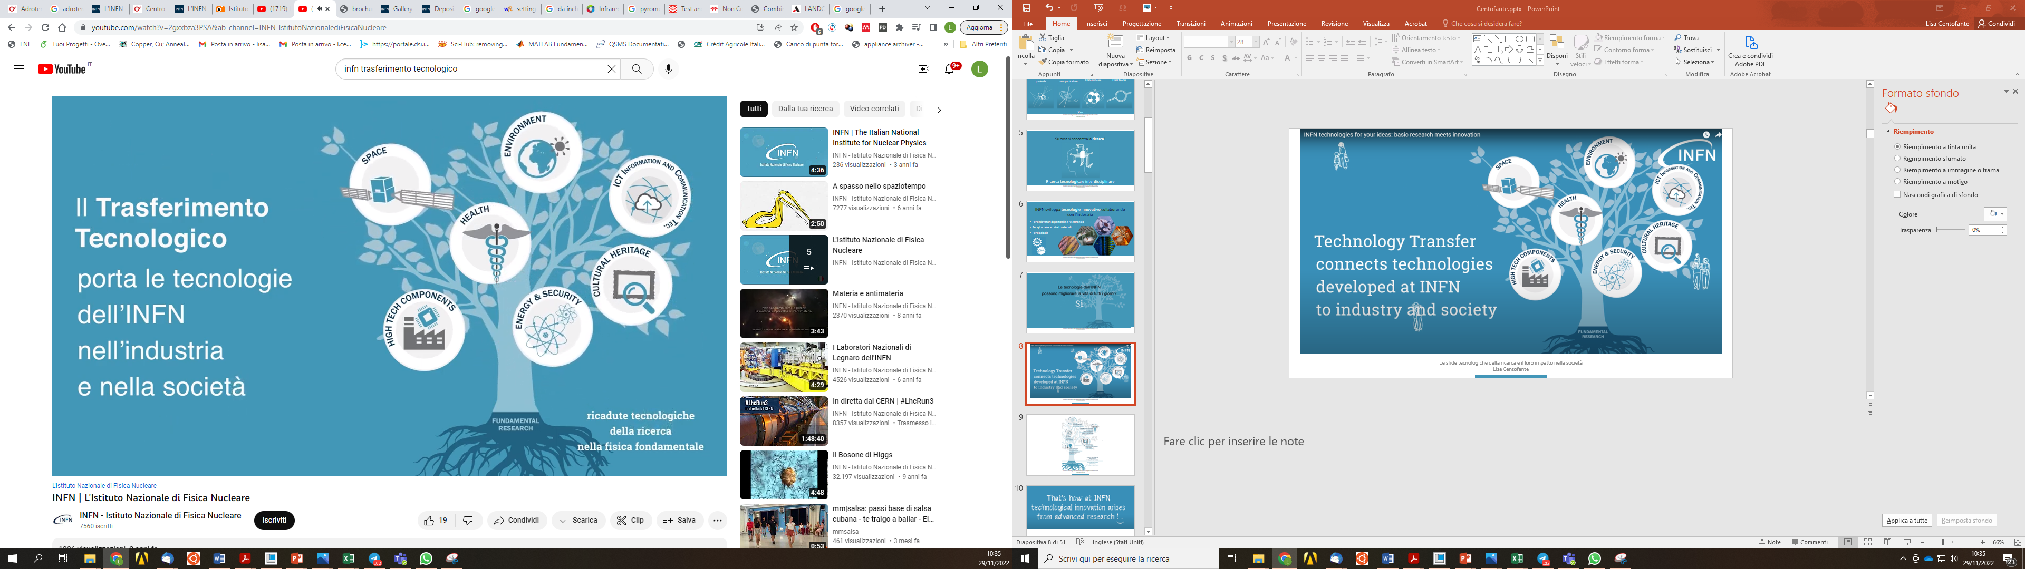
Neutrons @ SPES facility
NEutron and Proton IRradiation facility
(multidisciplinary project)
ISOL 2
ISOL 1
Fast neutron irradiation facility
Neutrons @ SPES
NEPIR-0
NEPIR-1
White neutron spectrum (CoolGal)
Quasi Mono-energetic Neutron (QMN)
Atmospheric Neutron Emulator (ANEM)
NEPIR
Main machine parameters
Type | Cyclotron with 4 sectors, resistive magnet
Particles | Protons (H–)
Energy | 35 - 70 MeV
Maximum current intensity | 750 µA
Extraction | Double
Maximum magnetic field | 1.6 T (Bo = 1 T)
The facility has been partially funded by the MIUR within the PRIN (2022JCS2CN) project and the SPARE (Space Radiation Shielding) project.

Slide 8
Neutrons @ SPES facility
NEutron and Proton IRradiation facility
(multidisciplinary project)
NEPIR Applications
Shielding performance
Production of quality nuclear data
Radiation damage in electronics
Bio-medical
Radiation instrumentation
Fast neutron irradiation facility
Study the neutron-induced radiation effects in electronics for Space, Avionics, HEP, and Information Technology.
Cross-sections of neutron production and neutron driven reactions for basic science and for nuclear physics applications.
Neutrons @ SPES
NEPIR-0
NEPIR-1
White neutron spectrum (CoolGal)
Quasi Mono-energetic Neutron (QMN)
Atmospheric Neutron Emulator (ANEM)
Oncology with direct fast neutrons;
Exposure to secondary neutrons at hadron therapy facilities;
Space health.
Benchmark experiments of innovative materials for hadron therapy facilities and for space colonization.
Manufacturers/users of instrumentation;
Dosimeters (energy response and calibration);
Development of novel neutron detection systems.
The facility has been partially funded by the MIUR within the PRIN (2022JCS2CN) project and the SPARE (Space Radiation Shielding) project.

Slide 9
Neutrons @ SPES facility
NEutron and Proton IRradiation facility
(multidisciplinary project)
NEPIR Applications
Shielding performance
Production of quality nuclear data
Radiation damage in electronics
Bio-medical
Radiation instrumentation
Fast neutron irradiation facility
Study the neutron-induced radiation effects in electronics for Space, Avionics, HEP, and Information Technology.
Cross-sections of neutron production and neutron driven reactions for basic science and for nuclear physics applications.
Neutrons @ SPES
NEPIR-0
NEPIR-1
White neutron spectrum (CoolGal)
Quasi Mono-energetic Neutron (QMN)
Atmospheric Neutron Emulator (ANEM)
Oncology with direct fast neutrons;
Exposure to secondary neutrons at hadron therapy facilities;
Space health.
Benchmark experiments of innovative materials for hadron therapy facilities and for space colonization.
Manufacturers/users of instrumentation;
Dosimeters (energy response and calibration);
Development of novel neutron detection systems.
The facility has been partially funded by the MIUR within the PRIN (2022JCS2CN) project and the SPARE (Space Radiation Shielding) project.

Slide 10
Neutrons @ SPES facility
ISOL 2
ISOL 1
Neutrons @ SPES
NEPIR-0
NEPIR-1
White neutron spectrum (CoolGal)
Quasi Mono-energetic Neutron (QMN)
Atmospheric Neutron Emulator (ANEM)
NEPIR

Slide 11
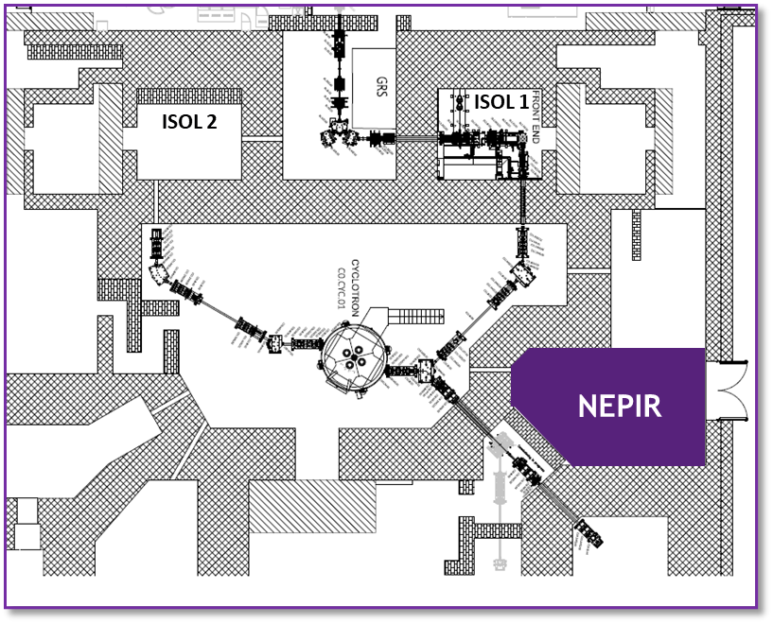
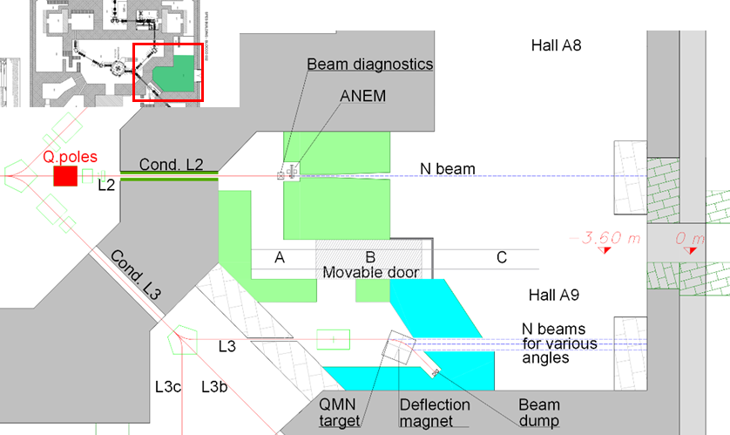
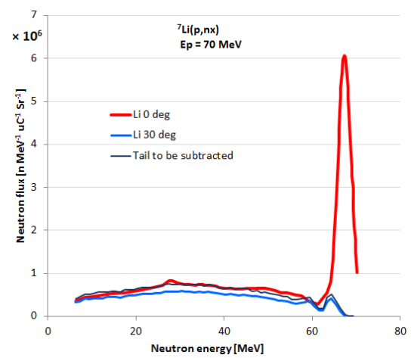
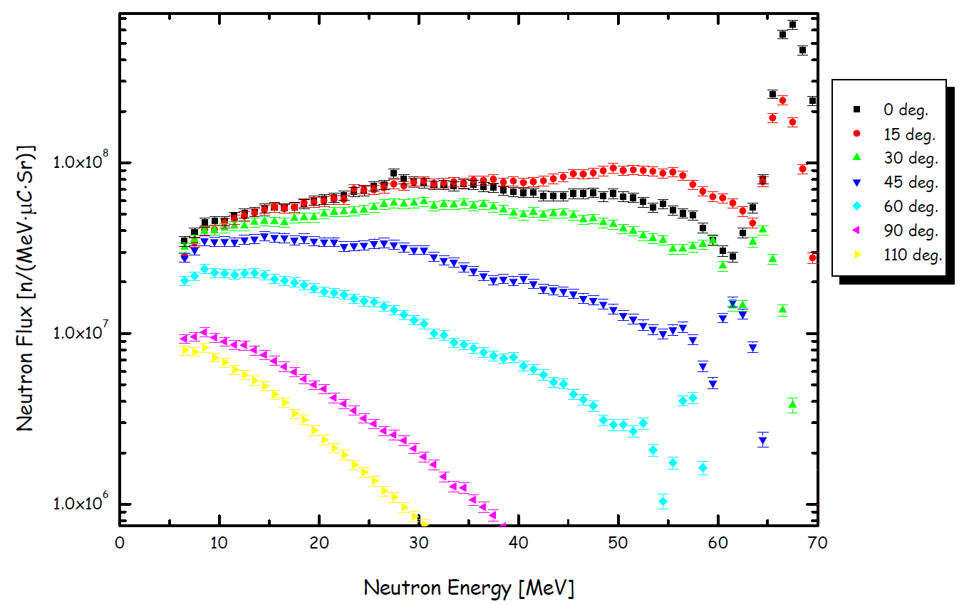
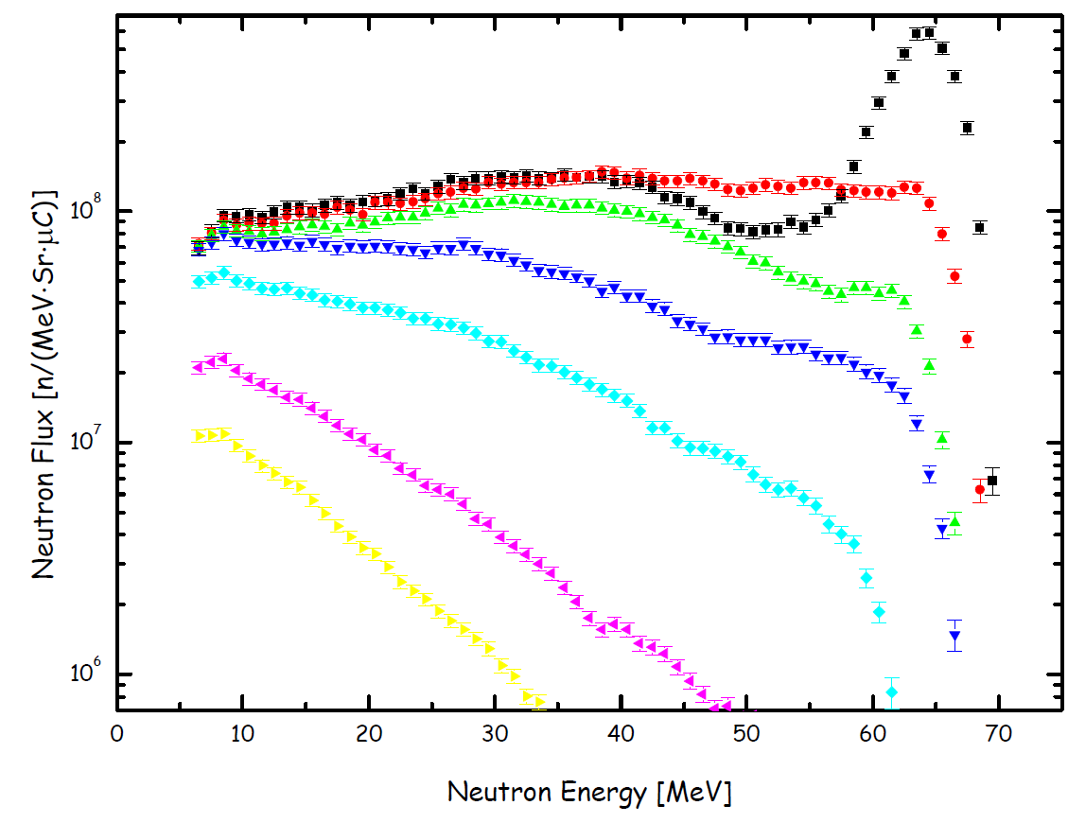
Quasi mono-energetic neutrons (QMN)
NEPIR-1
Angular dependence at E_{proton} = 70 MeV
The “good” truly mono-energetic neutrons are produced mainly in the direction of the proton beam.
Neutron spectrum for Li (4.7 mm)
Cross-section data for basic science
Radiation instrum. (detectors & dosimeters)
Shielding-benchmark experiments
QMN applications
Accelerators in research & medicine
Electronics industry
Neutron spectrum for Be (4 mm)
Thin lithium and beryllium targets (1-4 mm thick).
Controllable neutron energy peak in the 35-70 MeV energy range.
The protons that pass through the thin targets are deflected by a bending magnet and guided to a heavily shielded beam dump.
Kamata S., Itoga T., Unno Y., Baba M. (CYRIC ANNUAL REPORT 2005)
Journal of the Korean Physical Society, Vol. 59, No. 2, August 2011, pp. 1676-1680

Slide 12
Neutrons @ SPES facility
ISOL 2
ISOL 1
Neutrons @ SPES
NEPIR-0
NEPIR-1
White neutron spectrum (CoolGal)
Quasi Mono-energetic Neutron (QMN)
Atmospheric Neutron Emulator (ANEM)
NEPIR

Slide 13
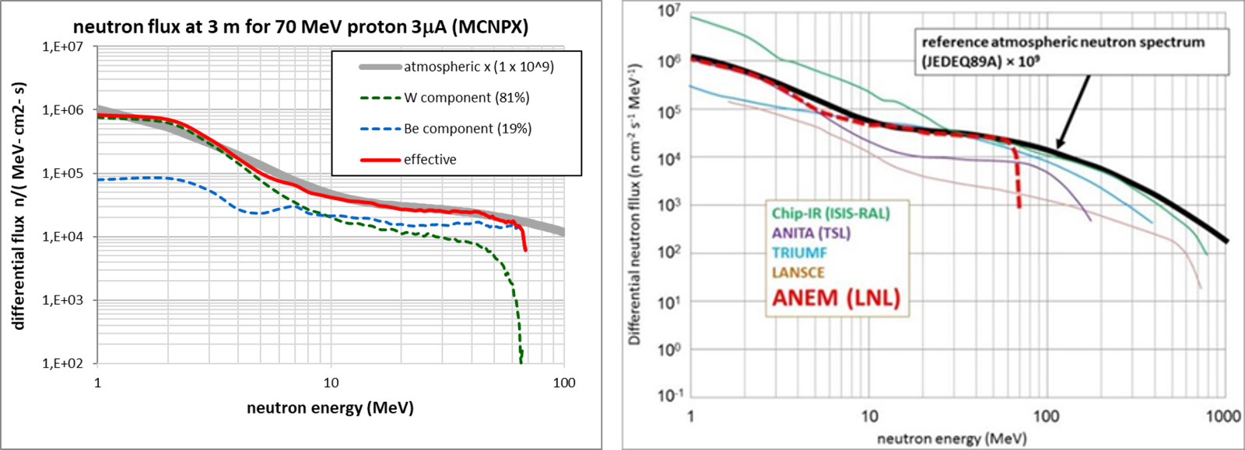

Atmospheric Neutron Emulator (ANEM)
NEPIR-1
Thickness
W: 5 mm (beam stopping)
Be: 24 mm
A coaxial rotating Be sector and W disk intercept the off-axis proton beam; a stainless-steel rotating drum houses a helicoidal water cooling circuit.
An intense source of fast neutrons (E > 1 MeV) with a continuous energy distribution.
Atmospheric-like energy distribution in the 1-65 MeV energy range, found at flight-altitudes and at sea-level.
Designed to handle 2.1 kW (30 μA @ 70 MeV). The maximum 10 μA proton current is set by radioprotection constraints, A < 1 Bq/g.
ANEM applications
Study radiation damage effects of atmospheric neutrons on material, in particular electronic devices and systems at sea level, but also at flight altitudes (avionics) where the neutron flux is 300–450 times higher.

Slide 14
Neutrons @ SPES facility
ISOL 2
ISOL 1
Neutrons @ SPES
NEPIR-0
NEPIR-1
White neutron spectrum (CoolGal)
Quasi Mono-energetic Neutron (QMN)
Atmospheric Neutron Emulator (ANEM)
NEPIR

Slide 15
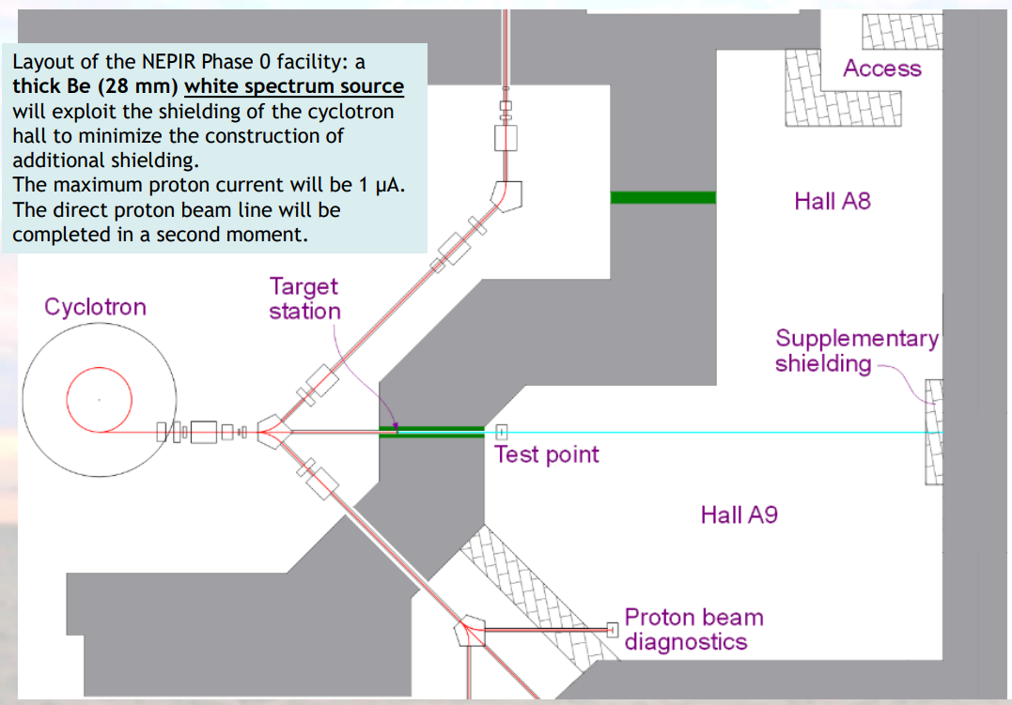
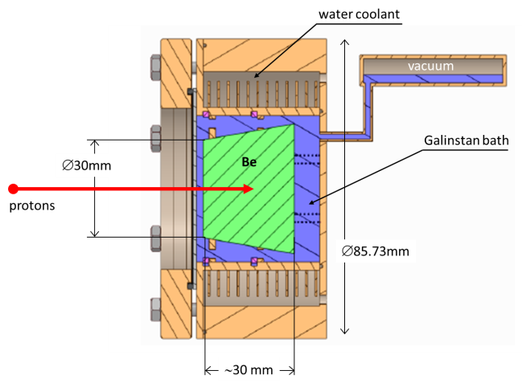
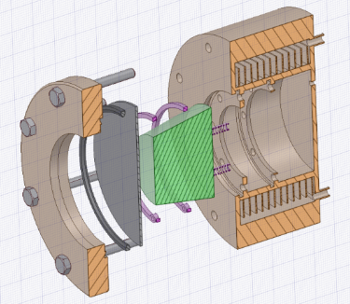
CoolGal
NEPIR-0
Havar window
A simplified Phase-0 fast neutron irradiation facility, still attractive for academic and electronics industrial users.
Based on a thick proton stopping Be target, that produces a continuous energy neutron beam.
The Be is immersed in a static bath of a liquid metal Galinstan (eutectic alloy of gallium, indium and tin).
Due to radioprotection constraints, the 70 MeV proton current is limited to 1 μA.
Too complicated for low power target
First prototype without Galinstan
High power target
2 kW - 54 kW

Slide 16
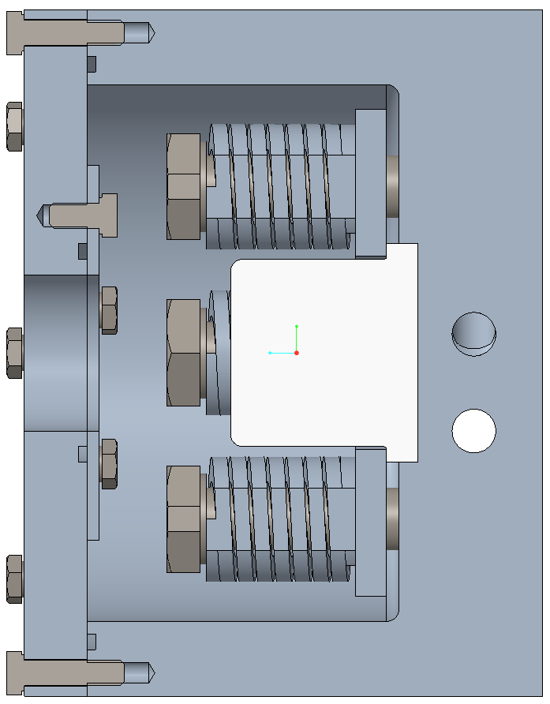
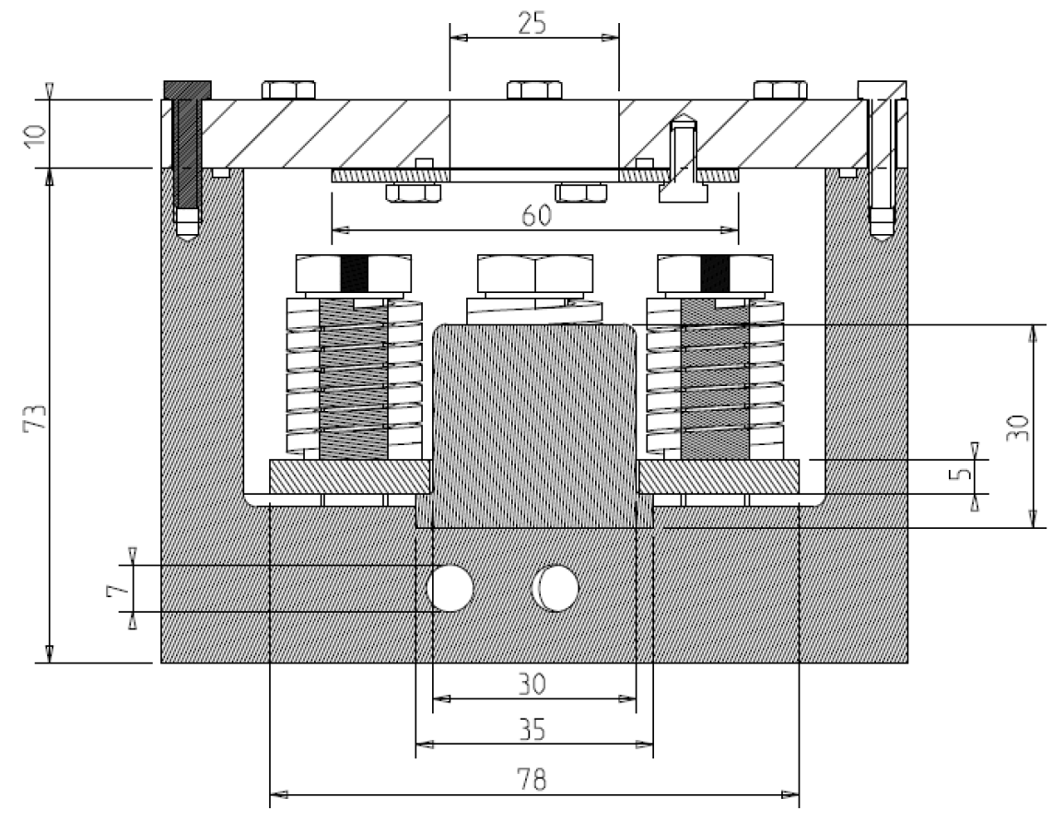
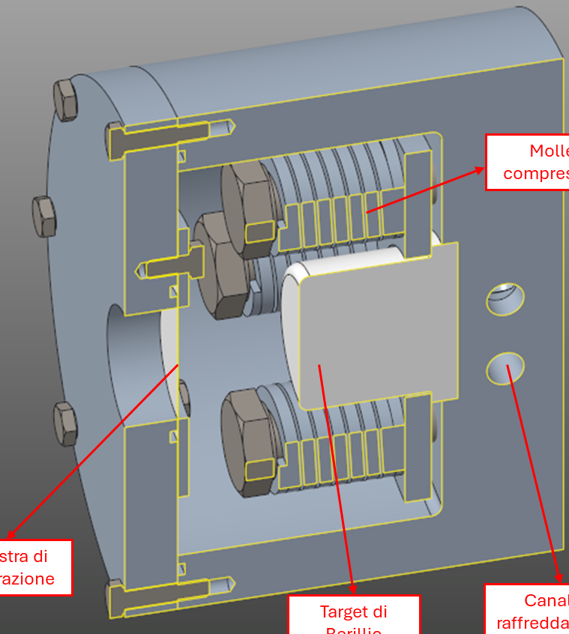
CoolGal
NEPIR-0
Compression springs
Window
Windows
Be target
Diagnostic system
Material & thickness
Thickness
Temperature
Cooling system
Neutron spectrum
Simulations
Coolant & Power dissipated
protons
Be
Aluminum chamber
Cooling channels
The target consists of:
The beryllium target (30 mm thick).
A separation window to divide the vacuum of the target from that of the accelerator, thus preventing contamination of the line.
Aluminum chamber containing the target and the cooling system.
Target compression springs for thermal dissipation.
The target diagnostics system.
Compression springs
Window
Be target
Cooling channels

Slide 17
CoolGal
NEPIR-0
Window
Material request
Low density (low Z)
High thermal conductivity
Limited residual radioactivity
Resistance to radiation damage
Cost & availability on the market
Gas impermeability
Low thermal expansion coefficient
Havar
0.05 mm
Aluminum alloy 6061
0.1 mm
Titanium alloy grade 5
0.03 mm
Titanium alloy grade 9
0.03 mm
protons

Slide 18
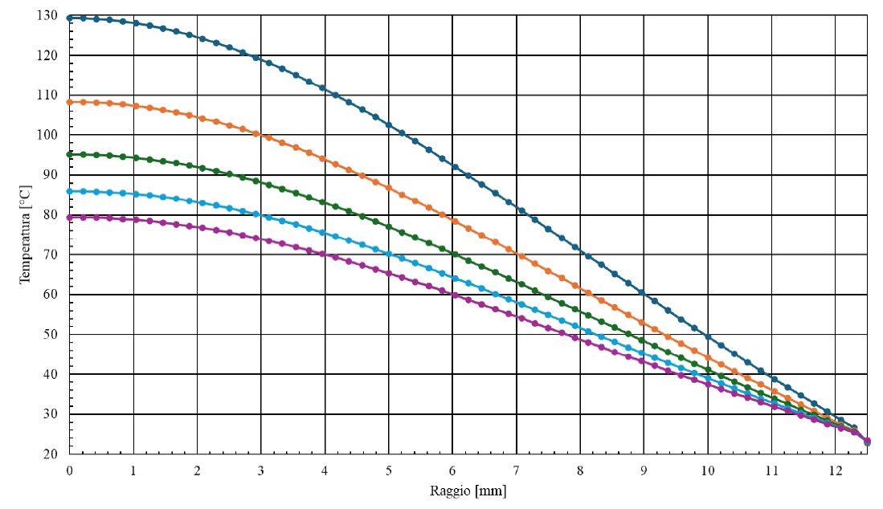
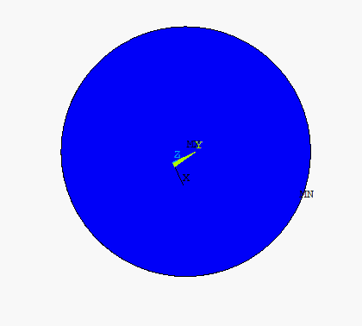
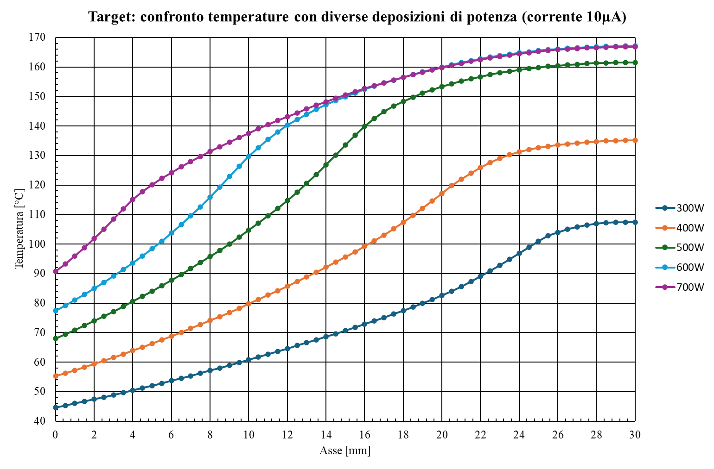
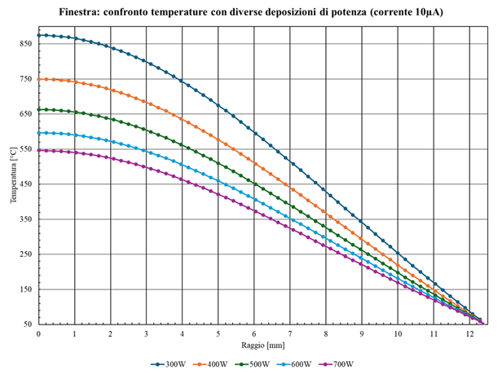
CoolGal
NEPIR-0
Window
Havar Window
Material request
Low density (low Z)
High thermal conductivity
Limited residual radioactivity
Resistance to radiation damage
Cost & availability on the market
Gas impermeability
Low thermal expansion coefficient
I = 1 μA
Temperature [°C]
0.05 mm
Havar
0.1 mm
Havar
Maximum temperature at the center of the window
Aluminum alloy 6061
0.1 mm
I = 10 μA
Titanium alloy grade 5
0.03 mm
Radius [mm]
Titanium alloy grade 9
0.03 mm
Temperature [°C]
protons
Radius [mm]

Slide 19
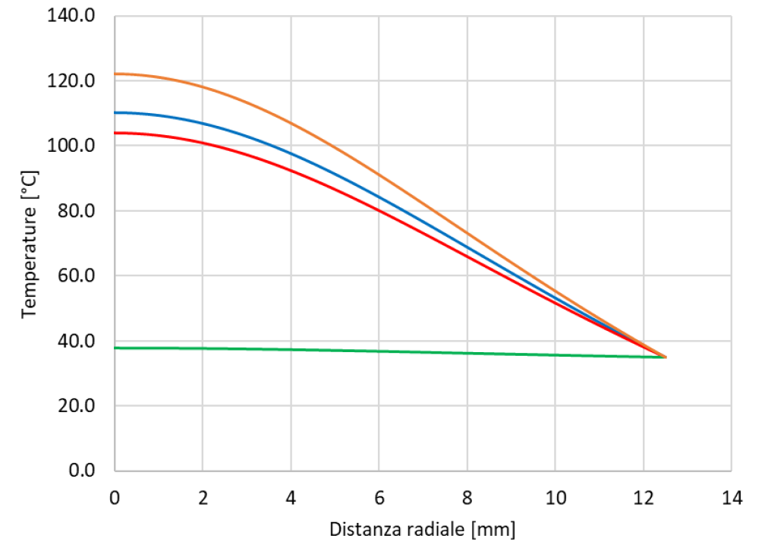
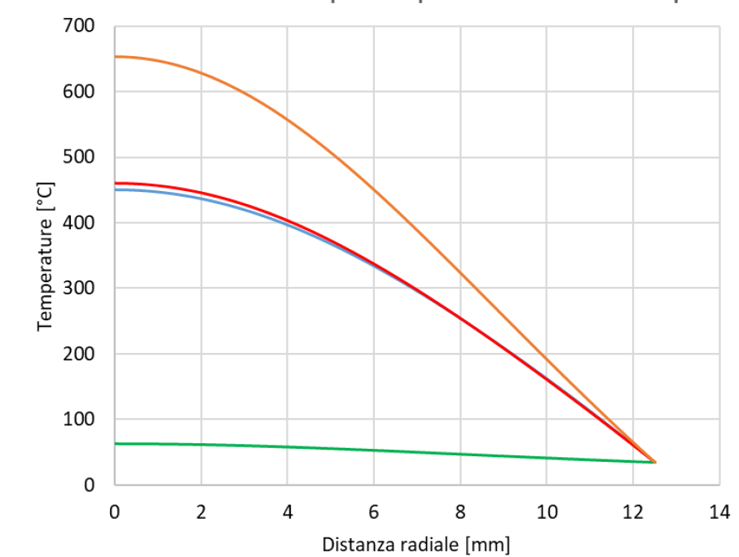

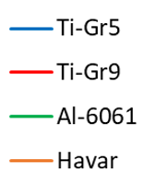

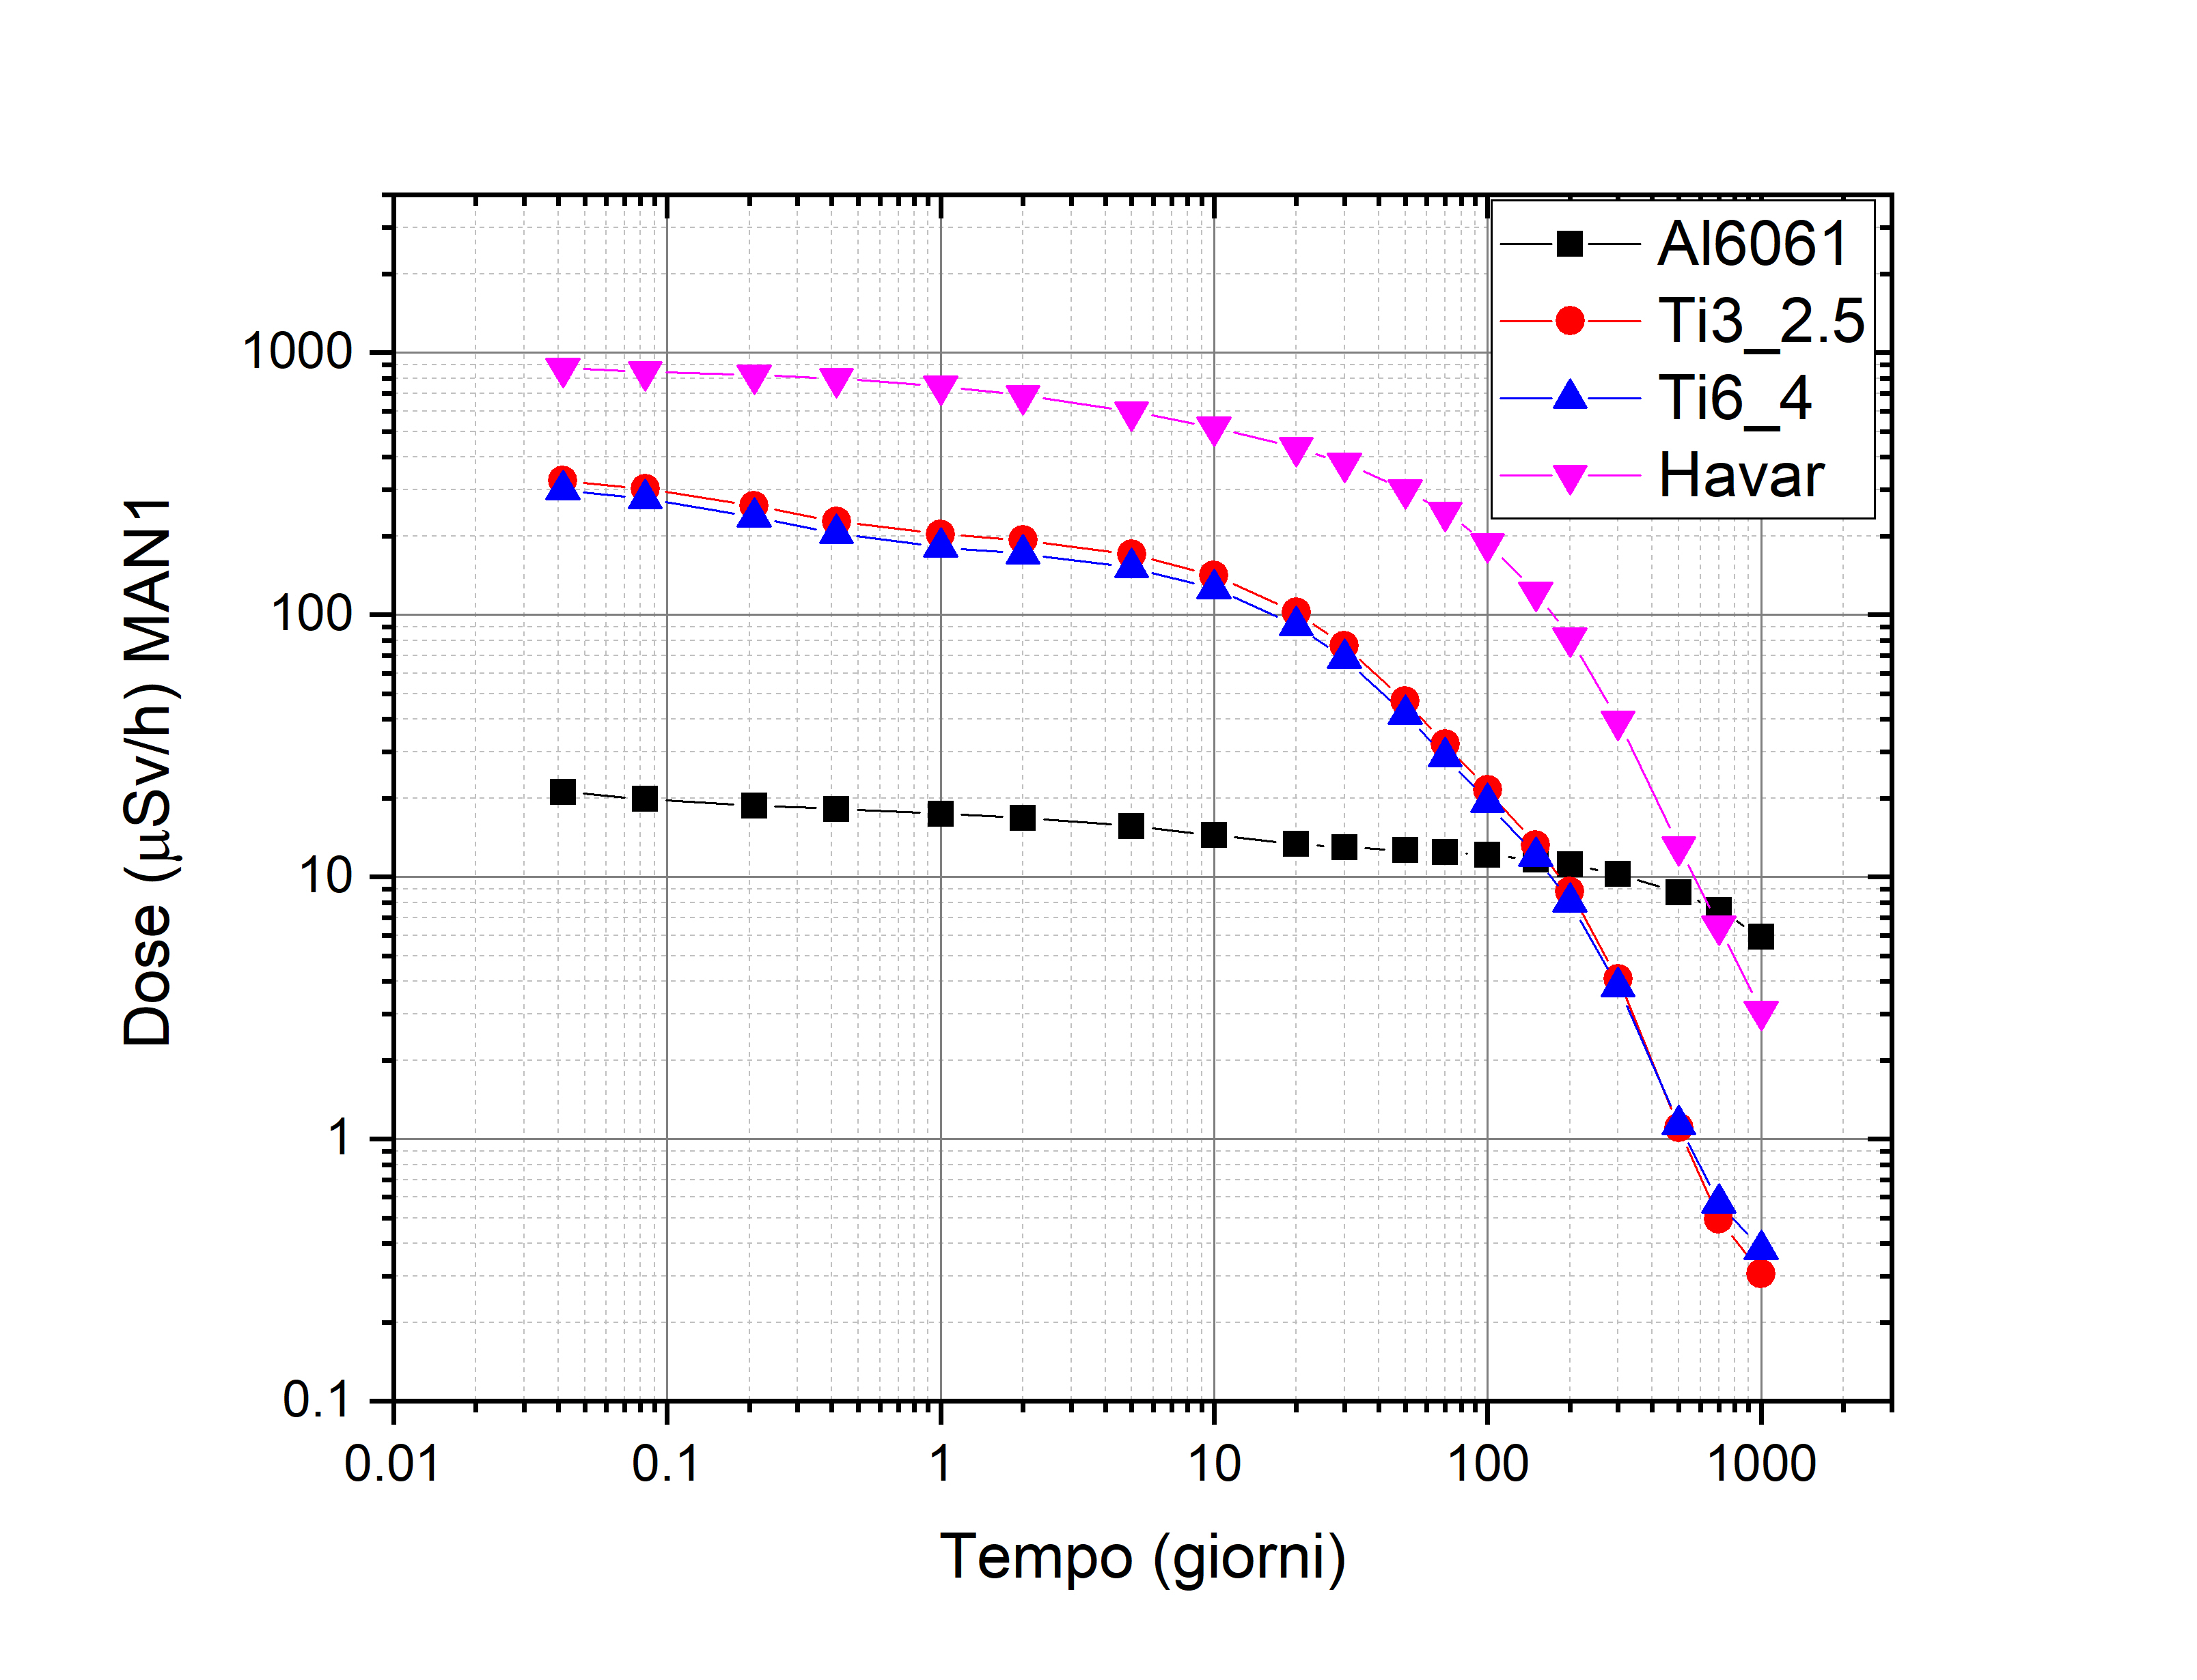
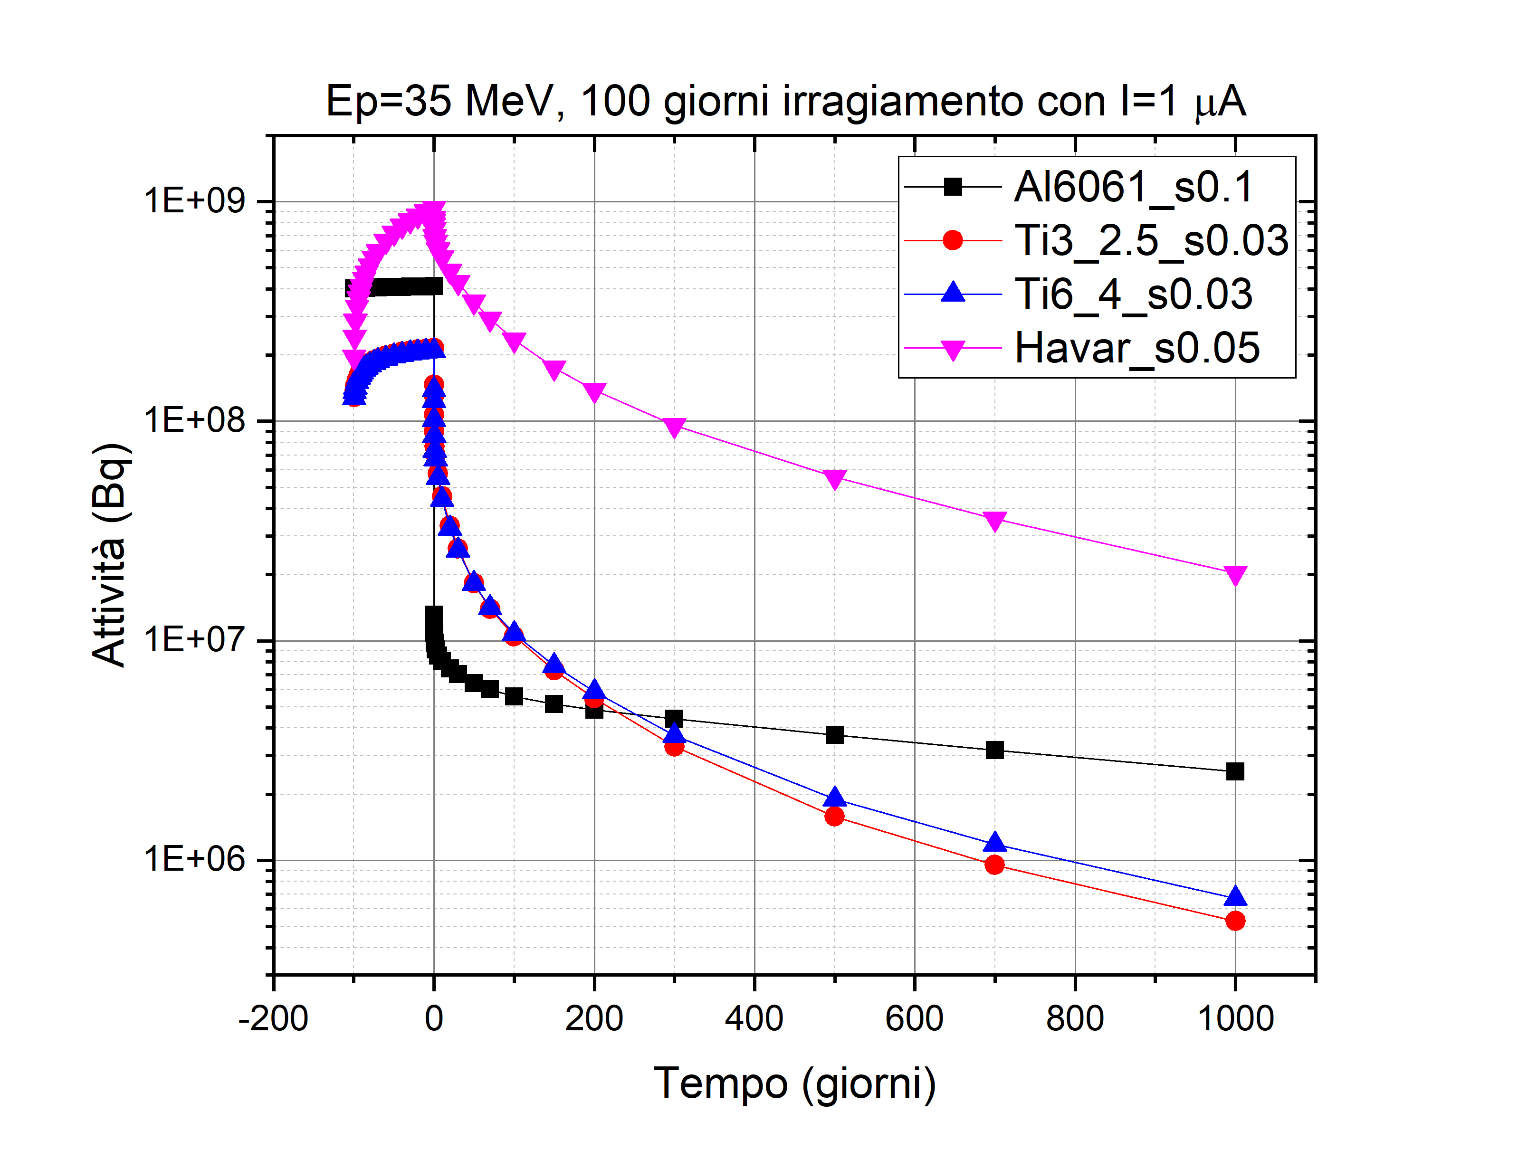
CoolGal
NEPIR-0
Window
Material request
Low density (low Z)
High thermal conductivity
Limited residual radioactivity
Resistance to radiation damage
Cost & availability on the market
Gas impermeability
Low thermal expansion coefficient
Temperature (1μA – 35MeV)
Temperature (10μA – 35MeV)
Titanium
Aluminum
Havar
Havar
0.05 mm
Aluminum alloy 6061
0.1 mm
Radial distance [mm]
Radial distance [mm]
Maximum dpa
Dose at 1m (100d irrad. 1 μA - 35 MeV)
Activity (100d irrad. 1 μA - 35 MeV)
Titanium alloy grade 5
0.03 mm
Titanium alloy grade 9
0.03 mm
Activyty [Bq]
protons
Aluminum Titanium Havar
Material
Time[days]
Time[days]

Slide 20
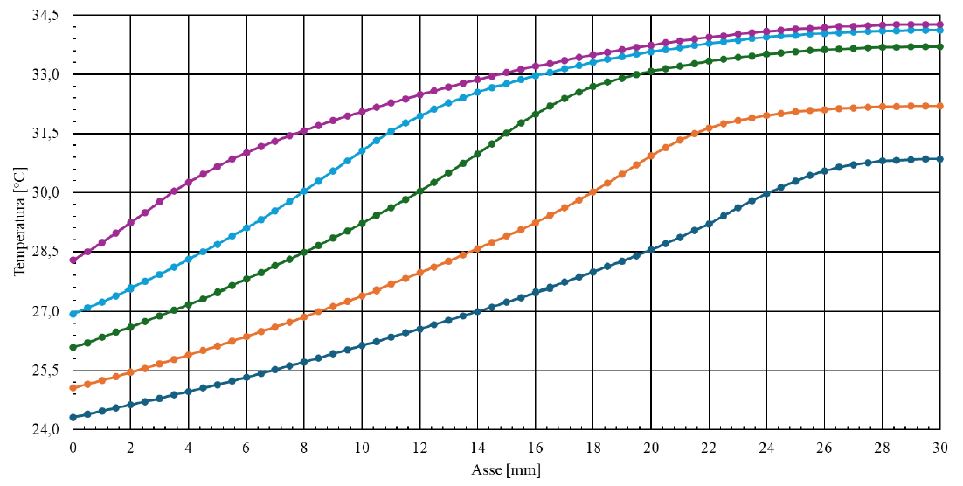
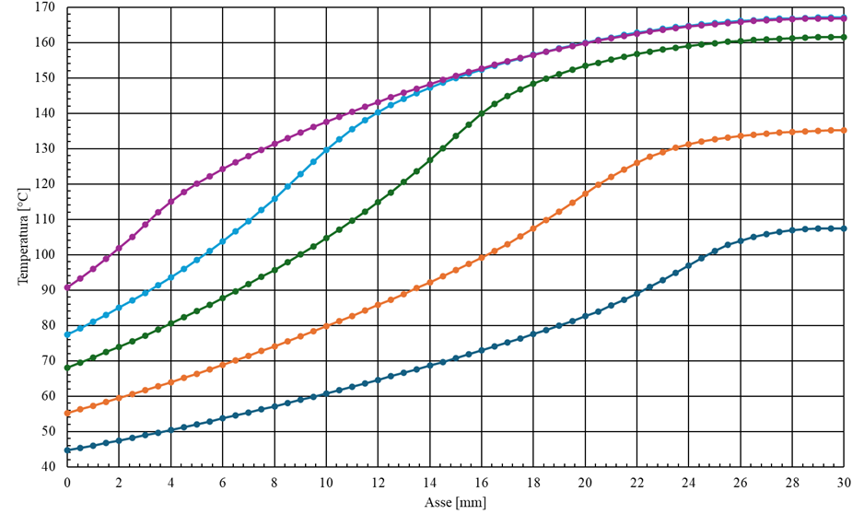
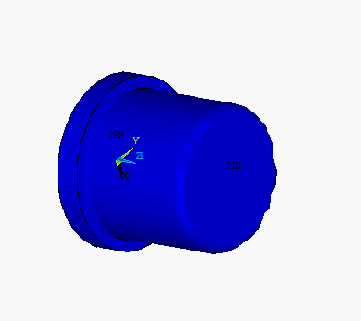
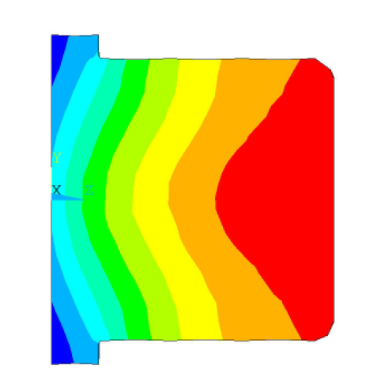
CoolGal
NEPIR-0
Beryllium target
I = 1 μA
Maximum temperature on the upper surface; Change in slope at the point where the Bragg peak occurs.
Temperature [°C]
protons
I = 10 μA
Axis[mm]
Be Target (70 W)
Temperature [°C]
1 μA & 70 MeV
(70 W)
T_{max} =35°C
Axis[mm]

Slide 21
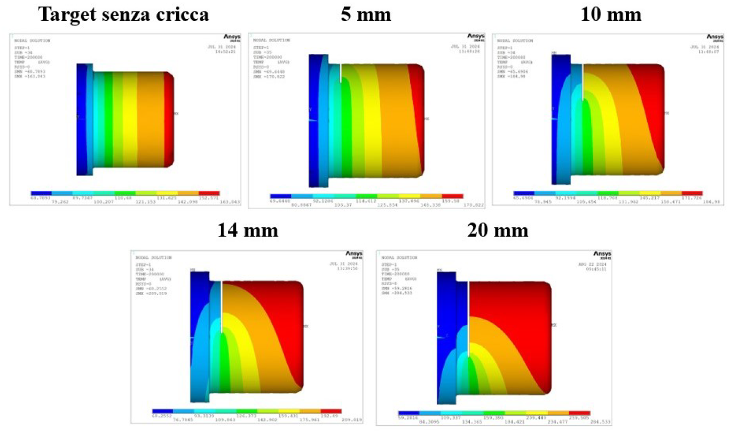
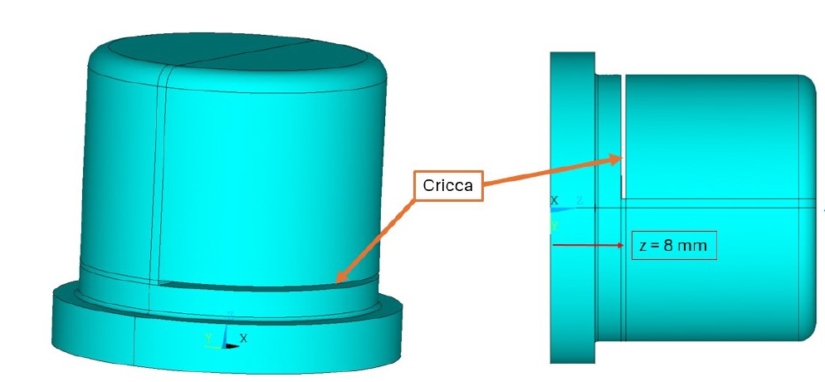
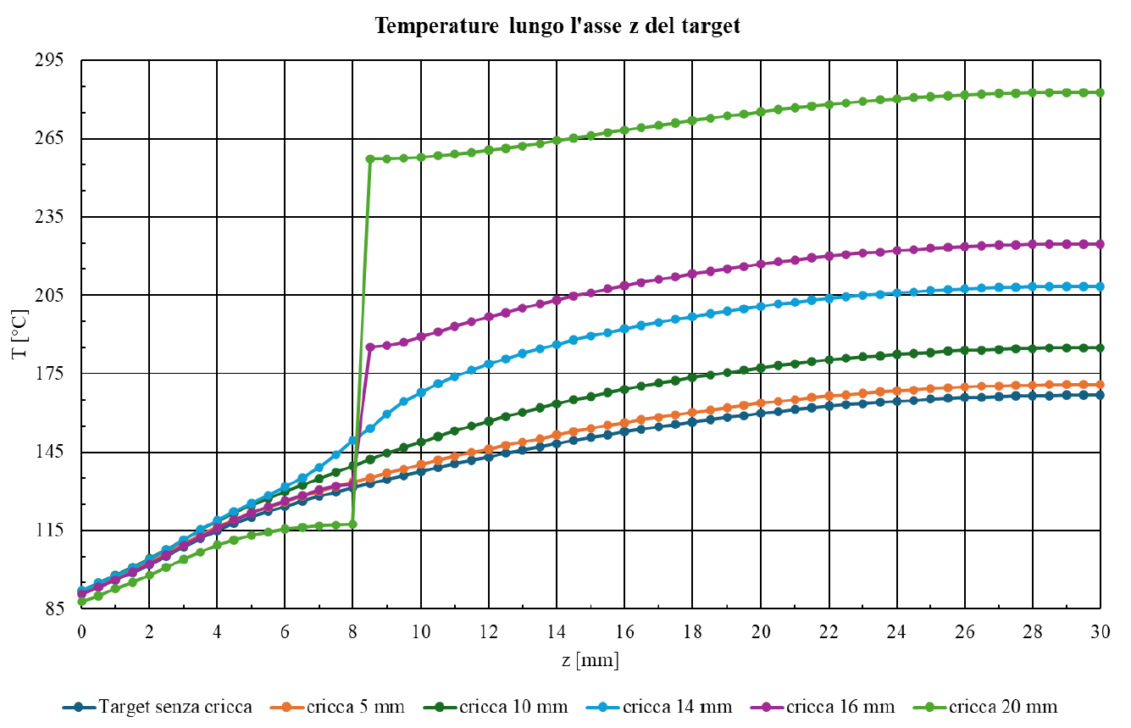
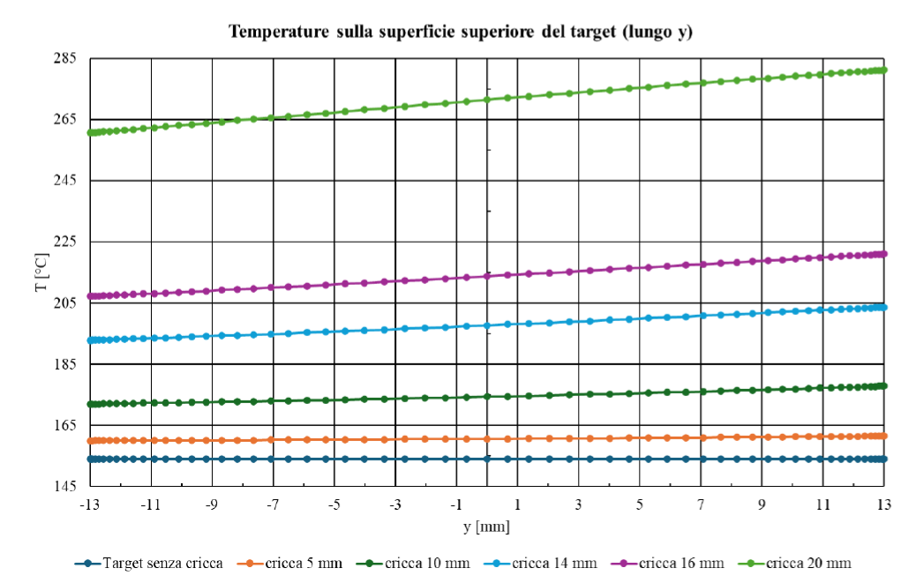
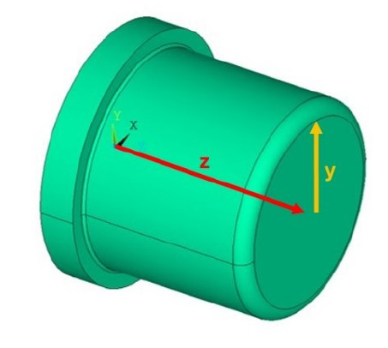
CoolGal
NEPIR-0
Diagnostic system
The crack made on the target under consideration is a lateral fissure, 0.5 mm thick, with increasing length.
Without crack
P = 700 W
crack
protons
Temperature along the z axis
Temperature on the upper surface of the target (along y axis)
Without crack
Crack of 5 mm
Crack of 10 mm
Crack of 14 mm
Crack of 16 mm
Crack of 20 mm

Slide 22
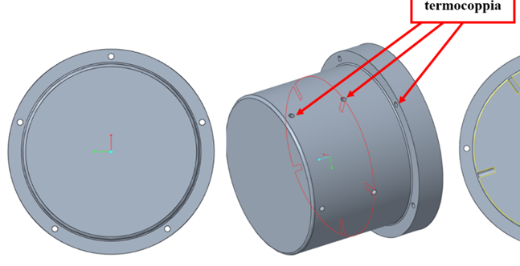
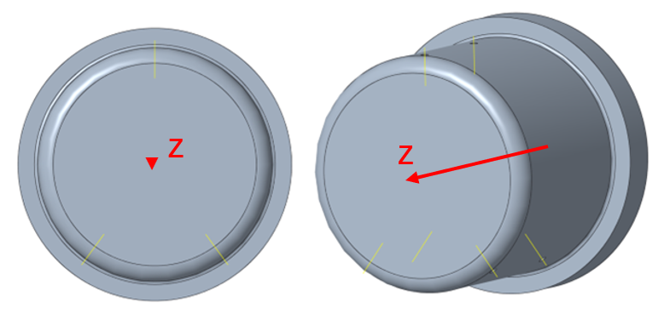
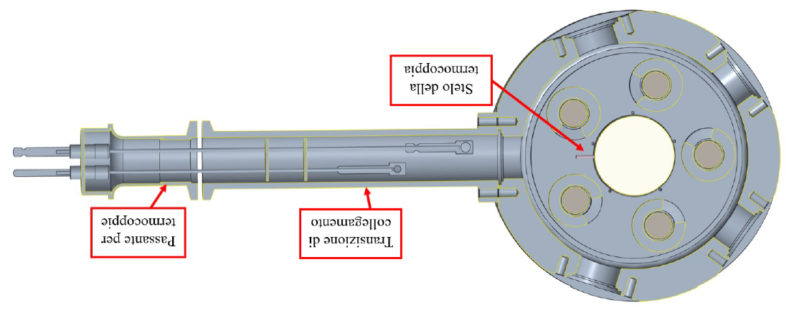



CoolGal
NEPIR-0
Diagnostic system
Hole for thermocouples
3 thermocouples at z = 13 mm from the base;
Temperature monitoring of the target
3 thermocouples at z = 27 mm from the base;
3 thermocouples in the shoulder (2.5 mm).
Thermocouple junction
Through thermocouple
Connection transition
Temperature along the circumference at different z heights
z = 2.5 mm
z = 13 mm
z = 27 mm
Without crack
Crack of 5 mm
Crack of 10 mm
Crack of 20 mm
Angle [°]
Angle [°]
Angle [°]

Slide 23


CoolGal
NEPIR-0
Cooling system
Designed to dissipate a power of 700 W with a water flow rate of about 200 l/h, resulting in a maximum temperature increase of 55°C at the point of contact with the beryllium target.
1° channel
P_{diss} = 377 W
Natural convection
P_{diss} = 20 W
Compress air
P_{diss}=70-150 W
Water
I = 0.1-0.3 μA
I = 1-2 μA
P_{diss} > 150 W
I > 2 μA
Liquid metal
P_{diss} > 1400 W
I > 20 μA
2° channel
P_{diss} = 322 W

Slide 24

CoolGal
NEPIR-0
Neutron spectrum
All protons are stopped at the Be, increasing the probability of blistering.
Neutron spectrum (new target)
Neutron spectrum (new target)
Thickness change
30 mm 26 mm
7% less neutrons but with En < 3 MeV

Slide 25
CoolGal
NEPIR-0
Neutron spectrum
Neutron spectrum (new target)
Pseudo-monocromatic neutrons
All protons are stopped at the Be, increasing the probability of blistering.
Thickness change
30 mm 26 mm
Expected neutron energy spectra (in the forward direction, with a 3° semi-angle, at 1 m) with 26 mm Be target and 0.1 mm aluminum window
≈ 10⁶ n/cm²/s

Slide 26





Final layout of the CoolGal target
Aluminum chamber containing the Be target (26 mm thickness) with the aluminum window.
The target is electrically isolated from the surrounding elements.
Directly measure the number of protons deposited and the actual alignment of the target measuring the current on target.
Passive collimation system that, under nominal conditions, should not measure any beam current.
Manual valve to safely close the target after irradiation and a flange with a chain for quick detachment of the system after irradiation.
Vacuum valve
(acc. side)
Chain for quick detachment
Manual valve
(target side)
Target chamber
(suppressed)
Active collimator
(suppressed)
Passive collimator
(suppressed)

Slide 27



Conclusions
The Neutron and Proton Iradiation (NEPIR) facility was presented, and the applications of the facility were discussed.
Phases 0 and 1 were explained, emphasizing the main characteristics of the QMN, ANEM and CoolGal beam.
The CoolGal target was presented in more detail since it is the core of the Phase 0 of NEPIR. In particular, thermo-structural analysis of the main components was discussed, and the expected neutron spectrum was shown.
The target system is composed of thick beryllium block pressed to a water-cooled aluminum vacuum chamber. The target vacuum is enclosed by using a thin window, such as aluminum or titanium, to exclude Beryllium contamination of the overall beam pipe.
We will gather data and experience in view of a potential prototype (high power target) with Galinstan.
Near future developments
Offline test
To validate the thermal and structural simulations (window, Be and cooling system).
Online test
Test and verification of the Target’s Mechanical & Diagnostic System
Measure the neutron spectrum → Activation foils → Calibrated scintillator detector
Needs E_{p} = 35 - 70 MeV and I = 0.1 - 10 µA.
(probable measurement at ISOL2 bunker of SPES facility).
The first CoolGal target is under production
and will be delivered and tested within this year

Slide 28







Thank you for your attention!

Slide 30
More spectra comparison
0.88 (12%)

Slide 31
Comparison old and new prototype
10 μA & 70 MeV
(700 W)
T_{max} =100°C
protons
1 μA & 70 MeV
(70 W)
T_{max} =35°C
1 μA & 70 MeV
(70 W)
T_{max} =28°C
10 μA & 70 MeV
(700 W)
T_{max} =165°C

Slide 32

Deposition at the window

Slide 33








Selective Production of Exotic Species (SPES)
Selective
Production of
Exotic
Species
Cyclotron
Proton Beam
Radioactive Beam
SPES bunker
Main machine parameters
Type | Cyclotron with 4 sectors, resistive magnet
Particles | Protons (H–)
Maximum energy | 70 MeV
Maximum current intensity | 700 µA
Extraction | Double
Maximum magnetic field | 1.6 T (Bo = 1 T)
Target chamber
Target

Slide 34



Thermo analysis all target– 700 W, 10 μA, 4 MPa

Slide 35

Galinstan advantages & disadvantages
NEPIR-0
“The Effect of Static Liquid Galinstan on Common Metals and on-Metals at Temperatures up to 200 °C” Philip Geddis, et.al. Canadian Journal of Chemistry; 5 August 2020; https://doi.org/10.1139/cjc-2020-0227
Galinstan (GaInSn) is a non-toxic liquid metal, a eutectic alloy of gallium (Ga), indium (In), and tin (Sn)
Pre-test photos
After-test photos
Experimental test
Galinstan on:
GaInSn droplets and corrosion areas after test
For nickel-alloy and stainless-steel samples, no obvious differences between the control & test specimen were observed
visually or at high magnification.
Duration test of 2000 h except for A2 500 h instead.
Aluminum
Pro:
To cool down the havar window;
To ensure a good thermal contact and heat transfer to the cladding for conduction;
To keep the debris of beryllium if/when blistering occurs;
Allow thermal dilatation of the beryllium;
Thanks to natural convection, distribute the heat on the whole surface of the cladding.
Havar;
Titanium (alternative window);
Gold (copper block coating);
Steel;
Chromium;
and finally, also on beryllium.
Copper
Cons:
Cost;
Corrosive material, study the effect with the materials in contact;
More complicated geometry with an external vessel;
Becomes radioactive.
25°C
100°C
200°C
Proved too complicated, with no significant advantages
First prototype without Galinstan
“Corrosion of Beryllium” P. D. Miller and W. K. Boydj ; DMIC Report 242, 11 December 1967
In the case of beryllium ,it is reported that the corrosion to gallium is good to 500°C, limited at 600°C, and poor at 800°C. Indium and thallium are very likely less corrosive than gallium.
Notes:
The top row for
each metal shows the sample before cleaning, and the lower row shows the sample afterwards.
are shown in (A)
AL1100 (B) CDA122.
Smaller images are from after testing. Exposure at 25 °C is shown in A1, B1, and C1. Exposure at 100 °C is shown in A2, B2, and C2.
Exposure at 200 °C is shown in A3, B3, and C3.
is shown due to severe degradation of the 2000 h sample.

