Slide 1

Towards the development of a very cold neutron source
For the high brilliance neutron source (HBS)
UCANS11 2025 | 27.02.2024 I Dalini D. maharaj

Slide 2
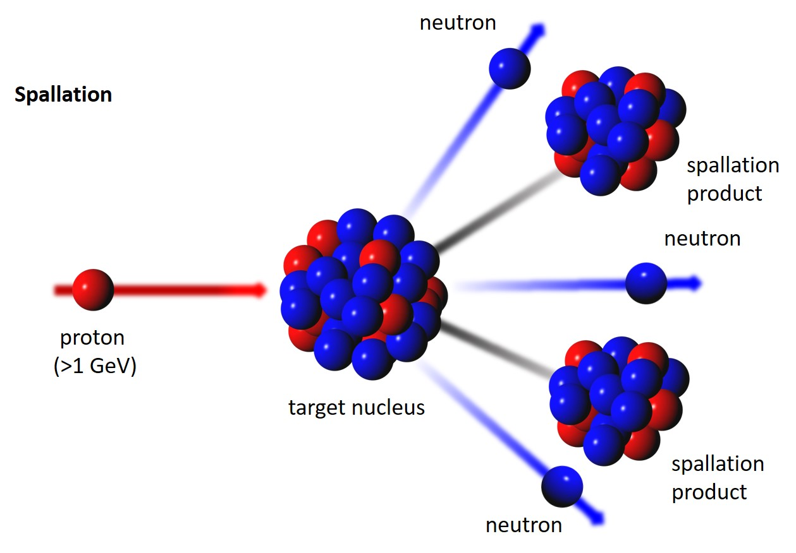
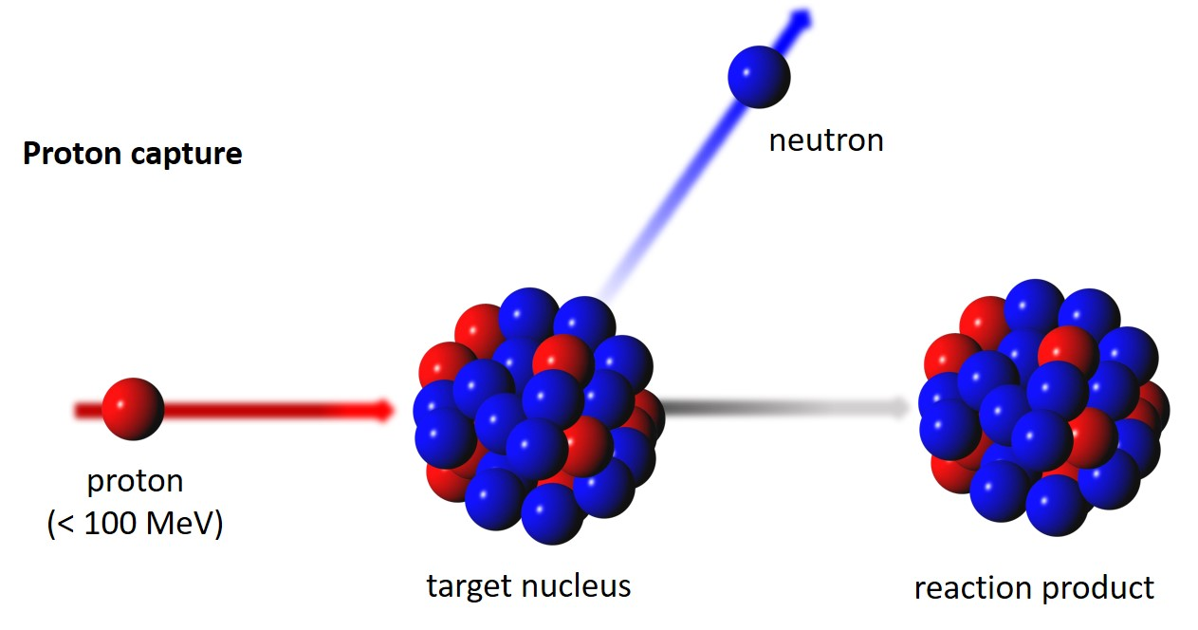
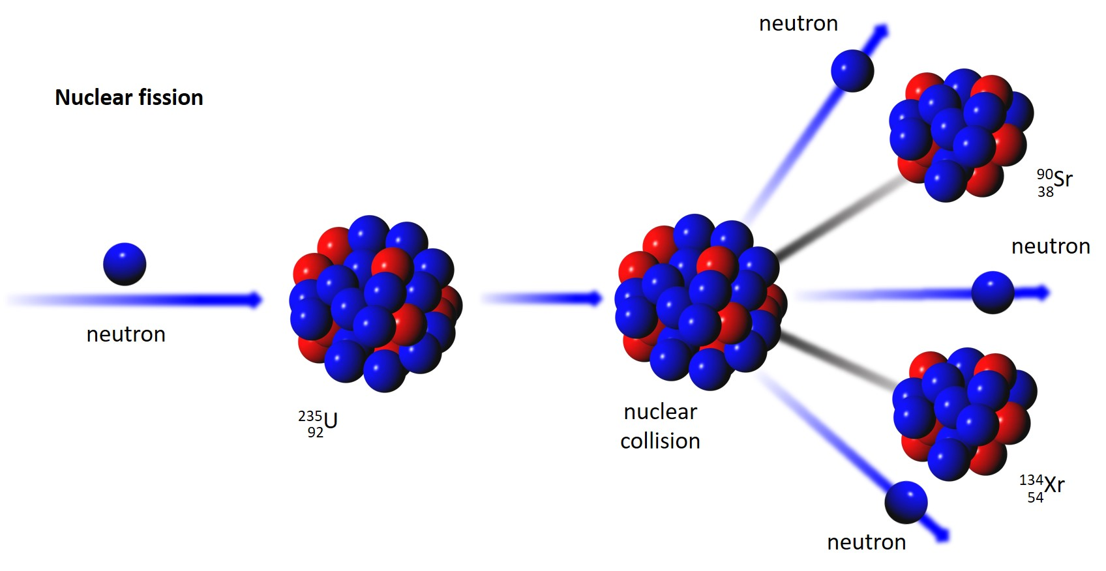
Neutron production pathways
Nuclear fission
Spallation
Nuclear processes
Nuclear fission
Reactor based
neutron source
(ILL, FRM II, NIST, JINR,
ANSTO a.m.m.)
Spallation based
neutron source
(ESS, ISIS, SINQ, SNS,
CSNS, J-PARC, KEK)
Accelerator based neutron source
(LENS, RANS, HUNS, NUANS, IREN a.o.)
Notes:
Most if not all of us are familiar with neutron productr

Slide 3
Neutron production
Spallation
~ 27 n/p
Nuclear processes
~ 0.02 n/p
We produce less neutrons with nuclear processes,
so we need to use the produced ones more effectively
=> Optimize brilliance transfer
27 February 2025
Page 3

Slide 4
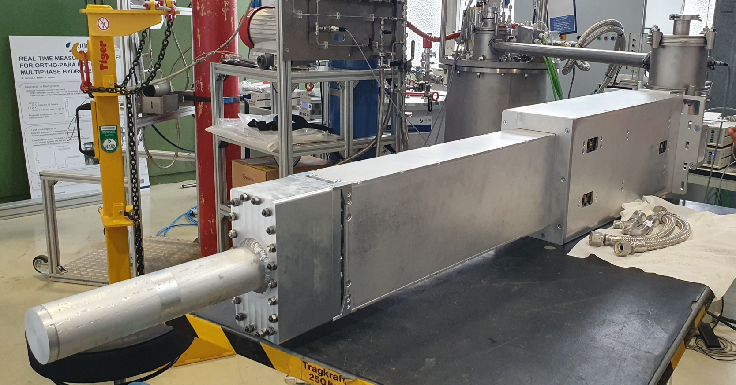
A Very cold neutron source for the HBS
High Brilliance Neutron Source – A HiCANS facility
Linac Parameters
100mA, 70 MeV proton source
Multiplexer
Proton beam distributed among 3 Tantalum target stations
Target Stations
Each target station operated at distinct frequency
Optimize thermal spectrum for each target-moderator combination
6-8 instruments per target station
Dedicated beam port for each instrument
  Can have its own cold source as needed
High degree of flexibility makes the HBS adaptable
[4] J. Baggemann, DENIM XII Jülich.
Notes:
Make sure to emphasize that this is not the HBS-I which Paul presented
High degree of flexibility

Slide 5
What is the HBS?
High Brilliance Neutron Source – A HiCANS facility
Linac Parameters
100mA, 70 MeV proton source
Multiplexer
Proton beam distributed among 3 Tantalum target stations
Target Stations
Each target station operated at distinct frequency
Optimize thermal spectrum for each target-moderator combination
6-8 instruments per target station
Dedicated beam port for each instrument
  Can have its own cold source as needed
HBS TDR: https://www.fz-juelich.de/en/jcns/jcns-2/news/announcements/2023/hbs-tdr
J. Baggemann, “Development of Neutron Extraction Plugs for HBS”, DENIM XII Jülich, 21st September 2023

Slide 6
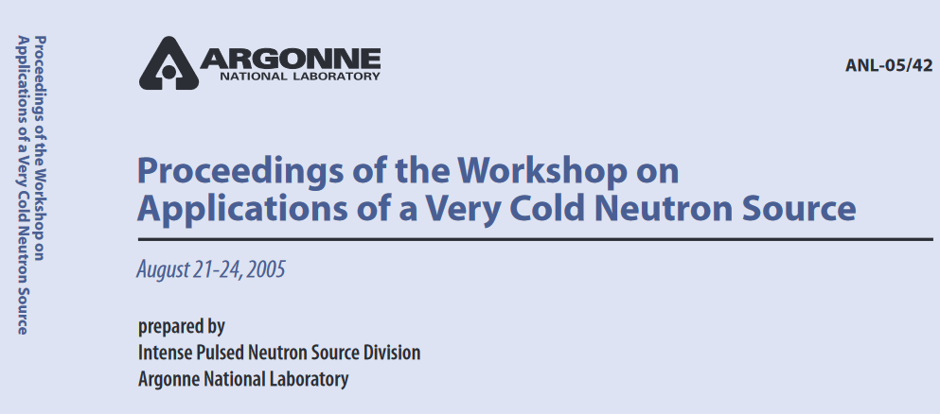
motivation
Very Cold Neutrons for Materials Investigations
Range of very cold neutrons
10 - 100 Å
0.81 meV
0.05 meV
0.008 meV
10 Å
40 Å
100 Å
[1] J.M Carpenter and B.J. Micklich, (2005).
Access to longer length and time scales – large biological structures on the nanoscale
Significant improvement of gains in intensity and resolution for some neutron instruments
Can apply light optics methods to control neutron beams as refracting power ≈ λ²
Notes:
Make a point that it has been possible to generate cold and ultra cold neutron beams, but not VCN beams. Mention the materials.
Make a point here about how the very cold neutron regime is untapped for neutron experiments.

Slide 7
motivation
Very Cold Neutrons for Materials Investigations
Range of very cold neutrons
10 - 100 Å
0.81 meV
0.05 meV
0.008 meV
10 Å
40 Å
100 Å
[1] J.M Carpenter and B.J. Micklich, (2005).
Access to longer length and time scales – large biological structures on the nanoscale
Significant improvement of gains in intensity and resolution for some neutron instruments
Can apply light optics methods to control neutron beams as refracting power ≈ λ²
Notes:
Make a point here about how the very cold neutron regime is untapped for neutron experiments

Slide 8
motivation
Very Cold Neutrons for Materials Investigations
Range of very cold neutrons
10 - 100 Å
0.81 meV
0.05 meV
0.008 meV
10 Å
40 Å
100 Å
[1] J.M Carpenter and B.J. Micklich, (2005).
Access to longer length and time scales – large biological structures on the nanoscale
Significant improvement of gains in intensity and resolution for some neutron instruments
Can apply light optics methods to control neutron beams as refracting power ≈ λ²
Previously difficult to extract VCN beams from conventional cold sources
Lower temperature cross sections not previously available

Slide 9
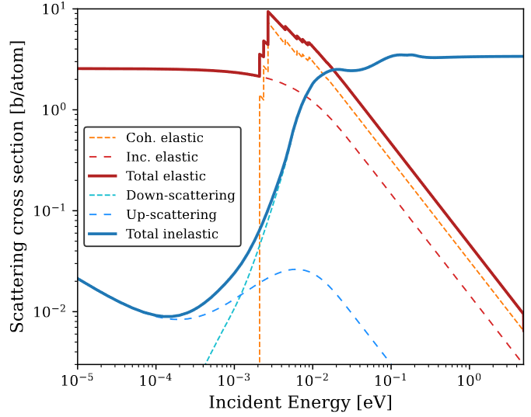
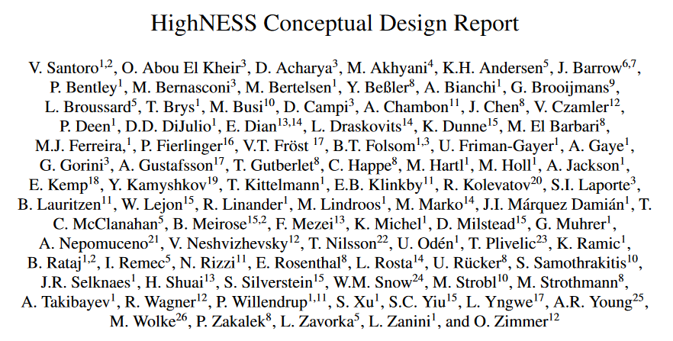
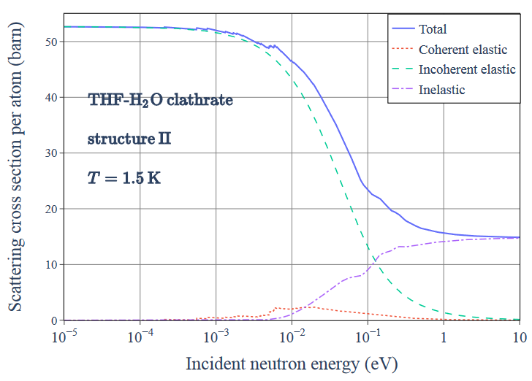
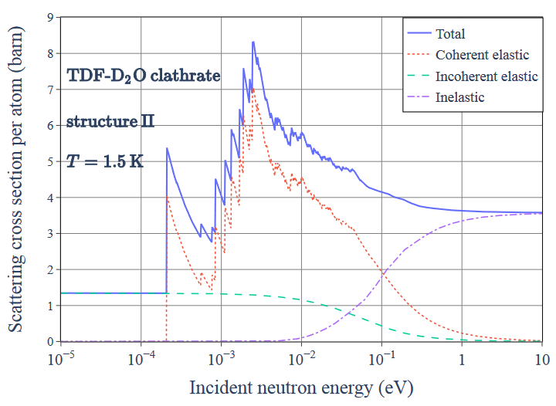
Why now?
Recent advances in development of tools for calculating low temperature neutron scattering kernels developed through the HighNESS project
Cross sections available for new materials
[2] V. Santoro et al. (2023)
[2] V. Santoro et al (2023).
[3] S. Xu, et al (2023)
Provides the opportunity to explore VCN concepts for new facilities with Monte Carlo particle transport

Slide 10
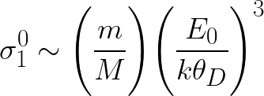
producing very cold neutrons
Neutrons can also excite vibrational modes in solid state materials
Cross section due to lattice drops precipitously at temperature scales well below Debye temperature
Accessible low energy modes, ideally not restricted by a dispersion relation
Solid D₂
Methane (in phase II)
Clathrates – THF-hydrates, methane hydrate

Slide 11
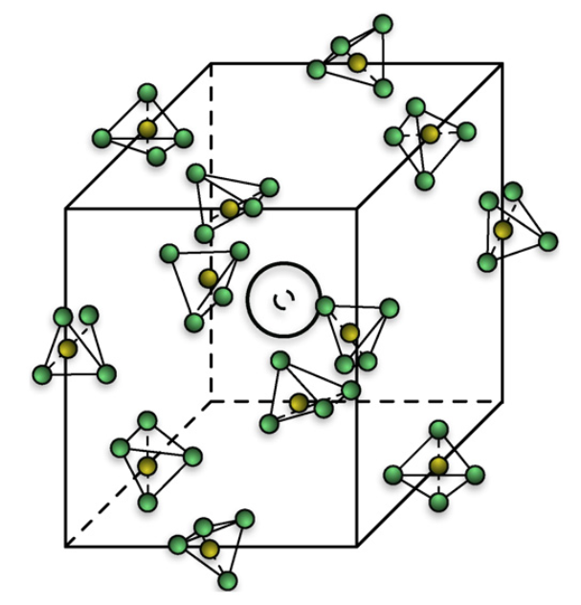
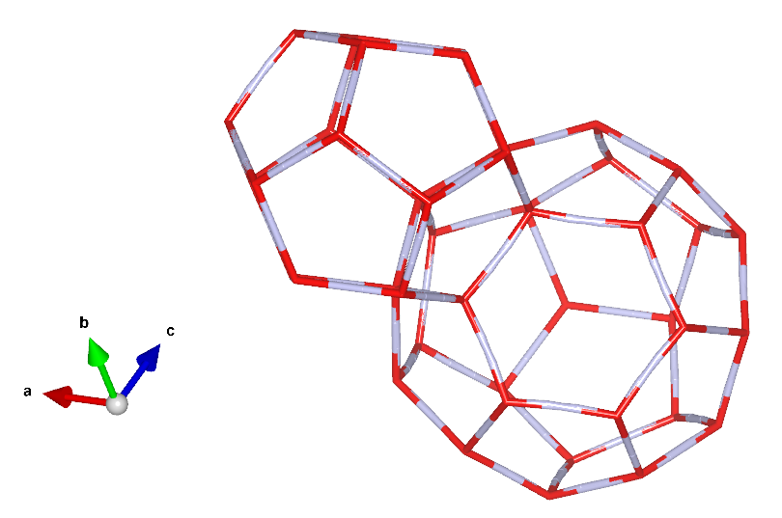
Candidate very cold moderators
Methane (in phase II)
Phase II below 20.4 K
Free rotor at O_{h} site
Pros:
Very good moderator due to high density of hydrogen atoms
Cons:
Radiolysis, or radical formation needs to be managed
Solid D₂
Rotational modes and vibrational modes
Operates at 5 K
Pros:
Low neutron absorption
Cons:
Large volumes required because neutron path length is long
Clathrates (THF, methane)
Cages host guest molecules including
  O₂ (ZF – 0.4meV)
  CH₄
  THF
  Pros:
  High albedo for CN
  Cons:
  Operation at 2.4 K
  Large volumes required
[5] Y. Shin et al.

Slide 12

CONCEPT DEVELOPMENT for the hbs
Scope of Study
Requirements and considerations
Compact design for Hi-CANS – selection of materials
Technically feasible
Goal
Evaluate proposed VCN moderator-reflector designs with respect to flux and brilliance
Must demonstrate competitive advantage over the cold, low dimensional parahydrogen source below 1 meV
Computational Tools
PHITS – Particle and Heavy Ion Transport code System
Notes:
Make statement about flu vs brilliance

Slide 13
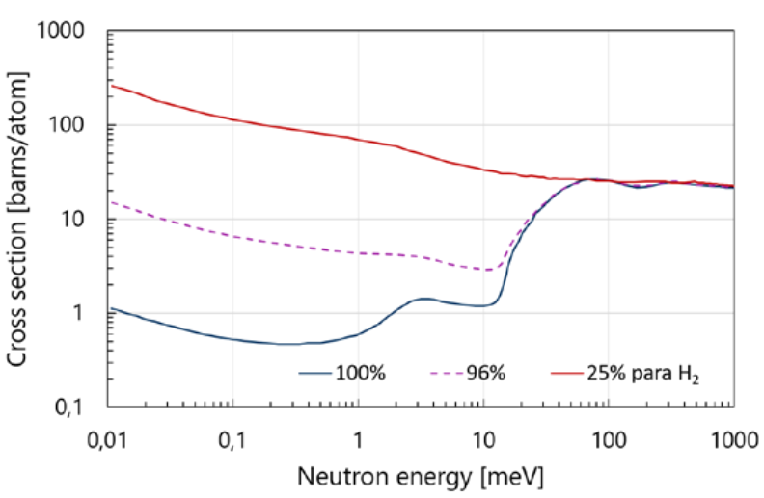
Concept development for the hbs
Choice of Materials - Motivation
Neutron
Extraction
Material 1 – Para-hydrogen
  Produces high brilliance source of cold neutrons
  Desirable compact design: (r ~ 1cm, l ~ 10 cm)
  Produces high brilliance source of cold neutrons
Cold parahydrogen
Moderator
Target
Ta
Lead
Reflector
H₂O Thermal
Moderator

Slide 14
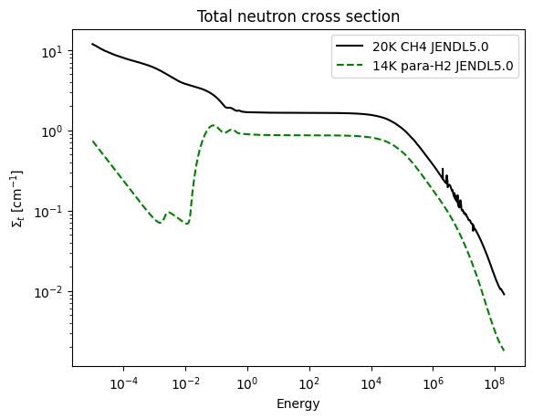
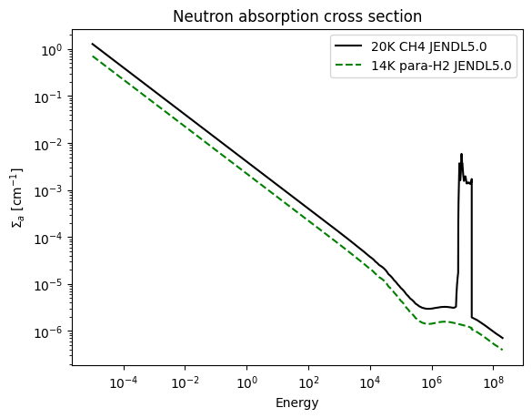
Concept development for the hbs
Choice of Materials - Motivation
Material 1 – Para-hydrogen
  Produces high brilliance source of cold neutrons
  Desirable compact design: (r ~ 1cm, l ~ 10 cm)
  Produces high brilliance source of cold neutrons
Material 2 – Solid methane
  Produces softer, but lower energy spectrum
Caveats
  Path length for cold neutrons in methane is ~1cm, thin geometries important else suffer absorption
Energy (eV)
Energy (eV)

Slide 15
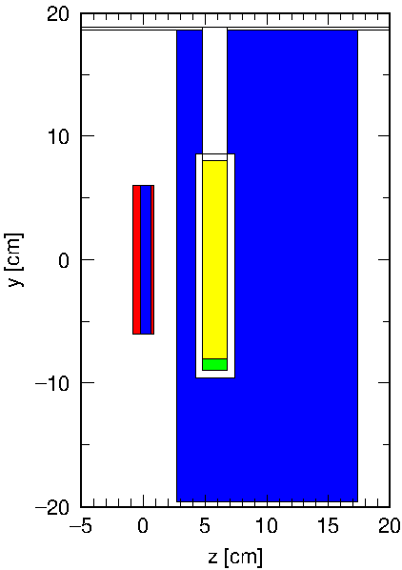
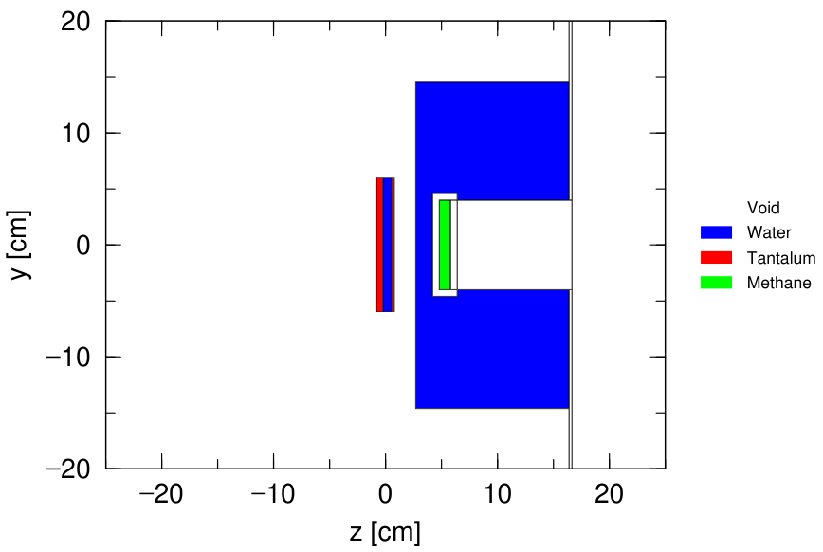
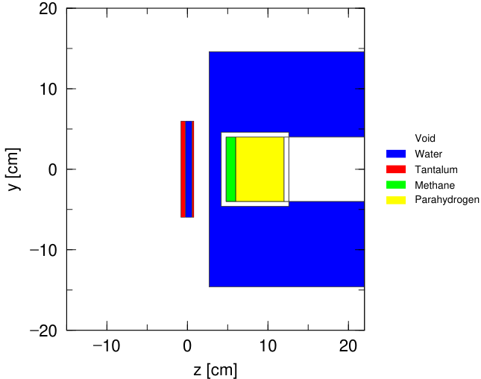
Concept development for the hbs
Geometries Considered
Starting Point
Concept #1
Concept #2
Concept #3
Notes:
Highlight differences
Wise selection of parameters

Slide 16

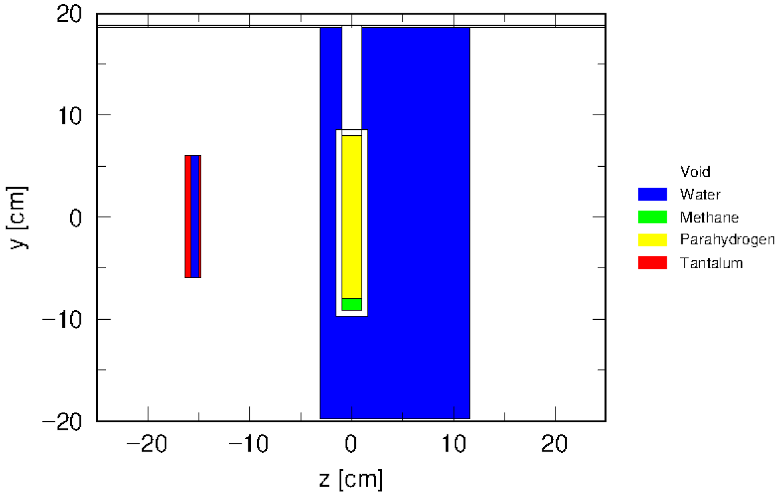
CONCEPT DEVELOPMENT for the hbs
Simulation Description
Detector
Optimization challenge – Monte Carlo computationally demanding to get good statistics for very cold neutrons
Solution!
Source: Start from thermal neutrons embedded in pre-moderator
Explore performance of a given geometry
Do full-fledged simulation with optimal geometry
Tally: Point Tally for simulation efficiency
Comparisons with parahydrogen pencil to be done with a real source
Neutron
Extraction
Target
System

Slide 17
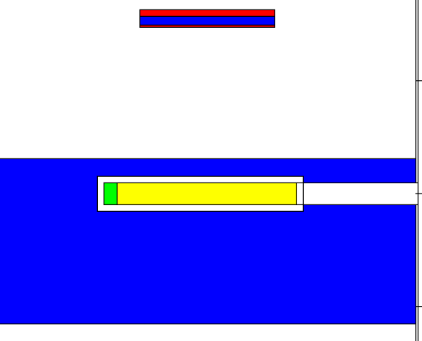
CONCEPT DEVELOPMENT for the hbs
Tally Description
Source – “Artificial” monoenergetic 25 meV neutron source (gray)
Neutron mask
L = 100cm
2r
R = 1cm
(x,y,z)
B = Φ / Ω
Ω = πr²/l²
Compute: brilliance, flux at detector position

Slide 18
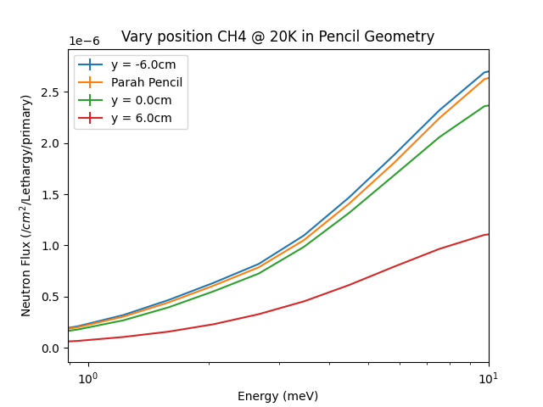
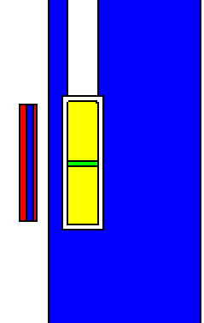
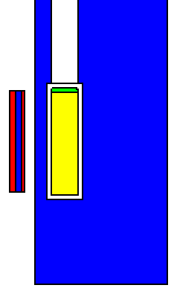
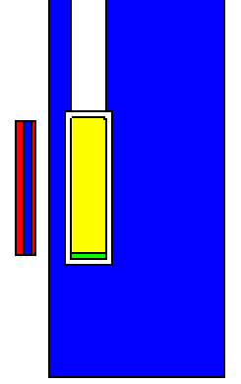
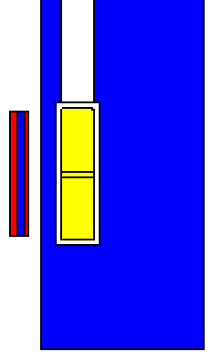
CONCEPT #1
Assessing the ideal position of the methane slab
Para Block
Methane
Centred
Methane
Top
Methane
Bottom
Para
Pencil
Page 18

Slide 19
CONCEPT DEVELOPMENT
Assessing the ideal position of the methane slab
Para Block
Methane
Centred
Methane
Top
Methane
Bottom
Para
Pencil
Best solution is with methane at opposite end of tube in
extraction channel! Why?
Page 19

Slide 20
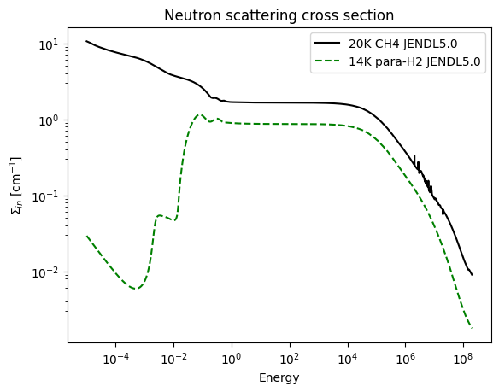
methane vs parahydrogen cross sections
Energy (eV)
Energy (eV)
Energy (eV)
-Parahydrogen is transparent to cold and very cold neutrons
-Methane effectively suppresses the transmission properties of parahydrogen

Slide 21
Geometrical survey
Neutron
Extraction
Parameter Space
l_{para} = [6, 20], 2 cm steps
l_{met} = [0.8, 1.6], 0.4 cm steps
R = [0.5, 2.5], 0.5 cm steps
96 combinations
Calculated quantities
A. Flux (n/cm²)
B. Brilliance (n/cm²/sr)
Two energy groups
I. Cold neutron [1-10] meV
II. Very cold neutron [0-1] meV
Target
System
l_{para}
l_{met}
R

Slide 22
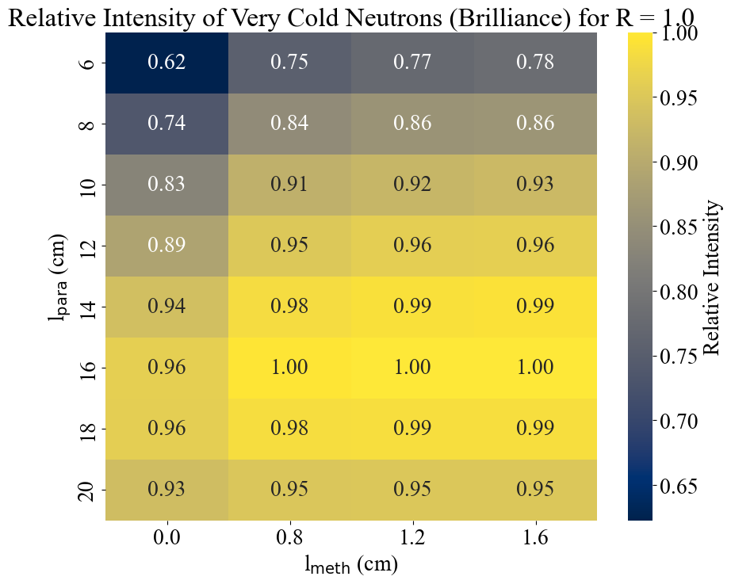
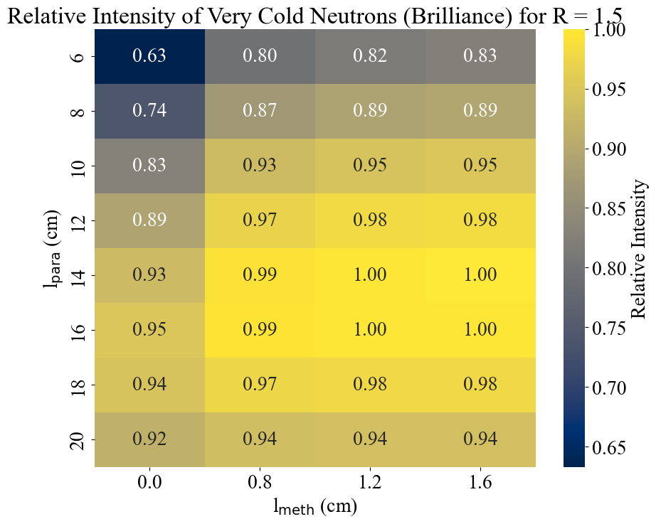
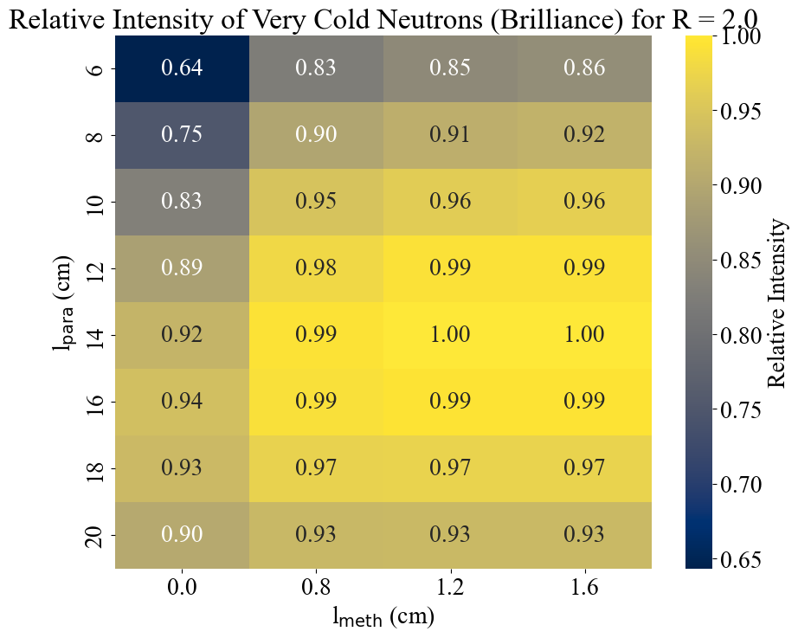

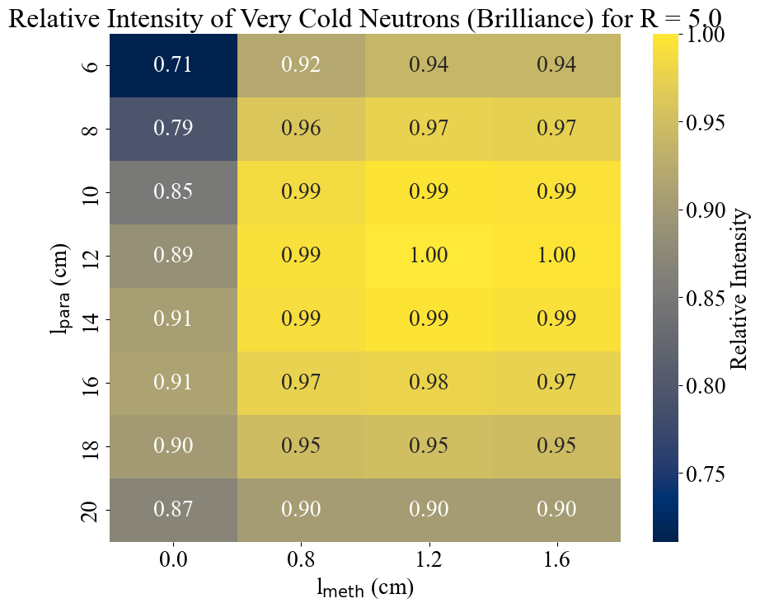
VCN Intensity

Slide 23
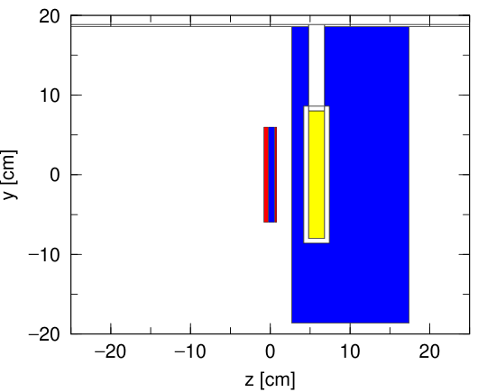
Concept #1 -
Comparison with parahydrogen pencil source

Slide 24
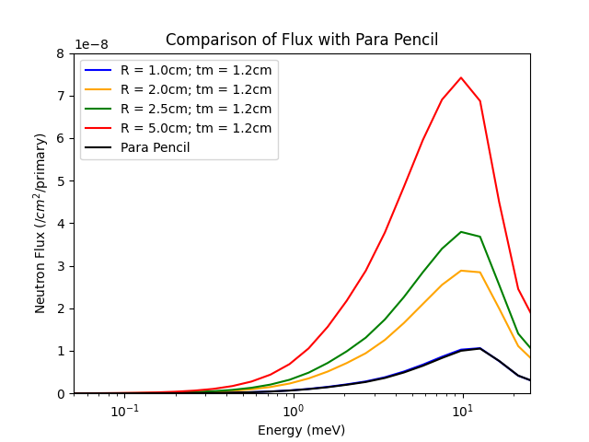
Very Cold Neutron Flux E < 1 meV
R (cm) | Flux (n/cm²/pr) | Ratio, Φ/Φ_{max} | Ratio, Φ/Φ_{2d-para}
1.0 | 1.69E-09 | 0.1 | 1.03
2.0 | 5.68E-09 | 0.33 | 3.49
2.5 | 7.80E-09 | 0.47 | 4.78
5.0 | 1.68E-08 | 1.0 | 10.3
Para Pencil | 1.63E-09 | 0.1 | 1

Slide 25
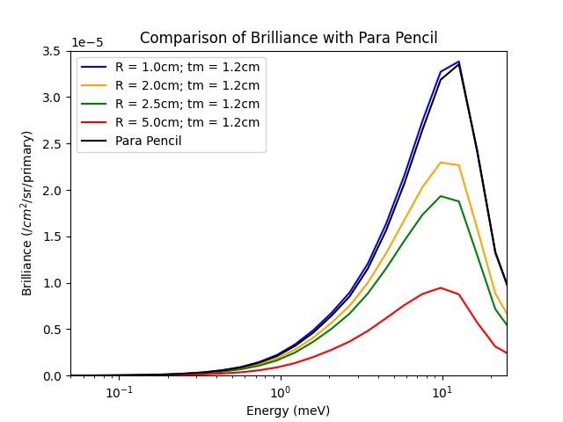
Very Cold Neutron Brilliance E < 1 meV
R (cm) | Brilliance (n/cm²/sr/pr) | B_{ratio}
1.0 | 5.38E-06 | 1
2.0 | 4.52E-06 | 0.84
2.5 | 3.97E-06 | 0.74
5.0 | 1.48E-06 | 0.28
Para Pencil | 5.19E-06 | 0.96
B = Φ / Ω
Ω = πr²/l²

Slide 26
Summary – concept #1
Dependency on the methane thickness is very weak
  Not surprising – cold/very neutron path length is ~ 1 cm in methane
R=1.0, 4% gain in VCN intensity
R=5.0, 10% gain in VCN brilliance

Slide 27
CONCEPT #2
Motivational questions
How does plate-like methane compare to para hydrogen pencil?
Benefit for neutron extraction parallel to direction of proton beam?
R
Parameter Space
l_{met} = [0.5, 1.0]
R = [1.0, 6.0], 1.0 cm steps
Calculated quantities
A. Flux (n/pr/cm²)
B. Brilliance (n/pr/cm²/sr)
l_{met}

Slide 28
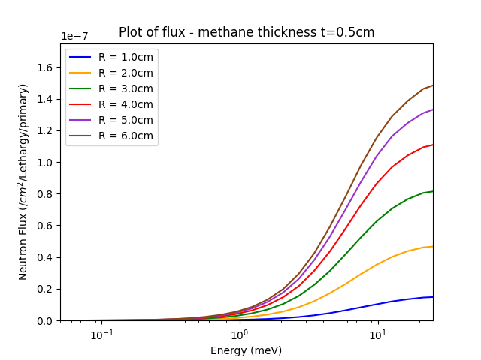
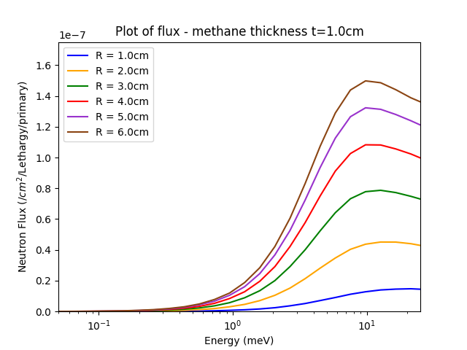
Flux
t = 0.5 cm cases are undermoderated compared with t = 1.0cm cases

Slide 29
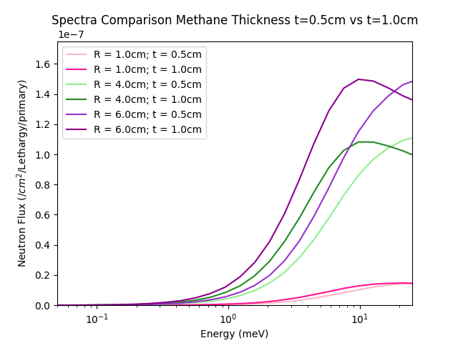
Flux
t = 0.5 cm cases are undermoderated compared with t = 1.0cm cases

Slide 30
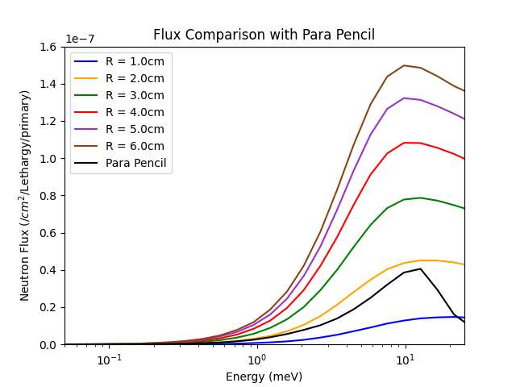
Very Cold Neutron Flux E < 1 meV
R (cm) | Flux (n/cm²/pr) | Ratio, Φ/Φ_{max} | Ratio, Φ/Φ_{2d-para}
1.0 | 4.53E-10 | 0.06 | 0.3
2.0 | 1.92E-09 | 0.25 | 1.2
3.0 | 3.63E-09 | 0.48 | 2.2
4.0 | 5.27E-09 | 0.69 | 3.2
5.0 | 6.66E-09 | 0.88 | 4.1
6.0 | 7.61E-09 | 1 | 4.6
Para Pencil | 1.64E-09 | 0.21 | 1

Slide 31
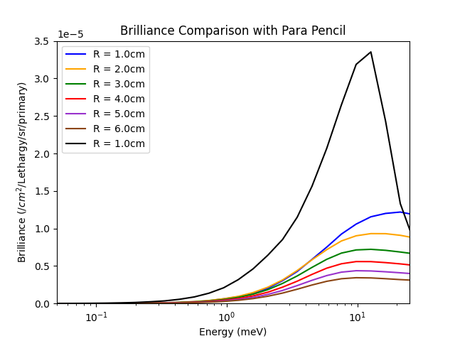
Very Cold Neutron Brilliance E < 1 meV
R (cm) | Brilliance (n/cm2/sr/pr) | B_{ratio}
1.0 | 1.44E-06 | 0.28
2.0 | 1.53E-06 | 0.29
3.0 | 1.28E-06 | 0.25
4.0 | 1.05E-06 | 0.20
5.0 | 8.48E-07 | 0.16
6.0 | 6.73E-07 | 0.12
Para Pencil | 5.22E-06 | 1
B = Φ / Ω
Ω = πr²/l²

Slide 32
CONCEPT #3
Motivational Questions
Parahydrogen as a booster - can we improve CN moderation by “backing” methane with parahydrogen? If yes, by how much?
l_{para}
R
l_{met}

Slide 33
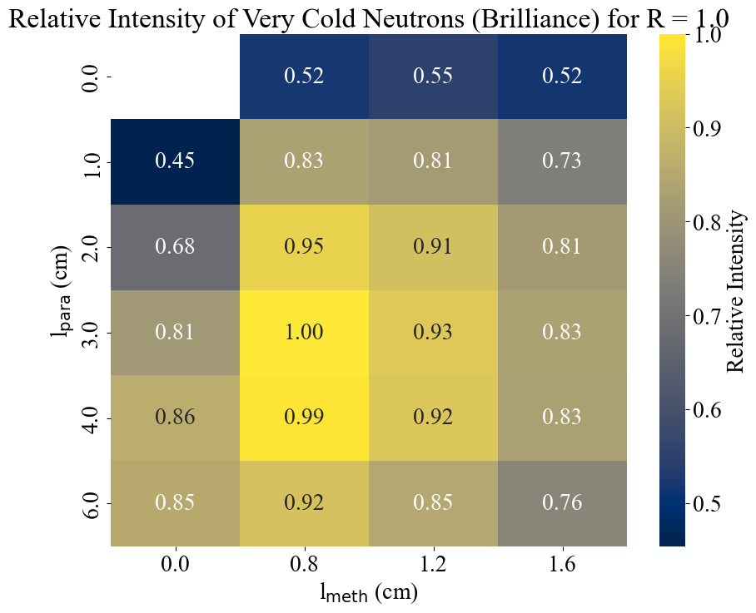
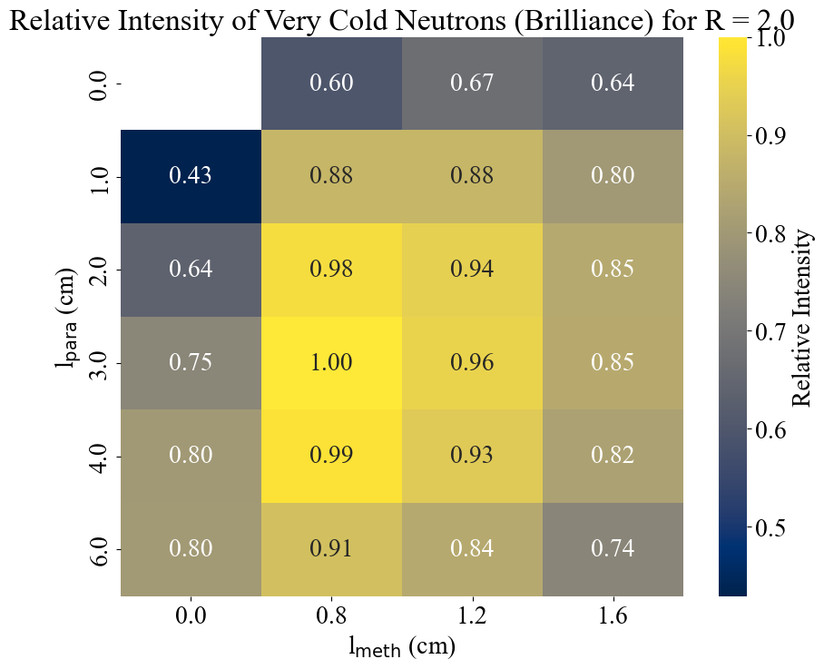
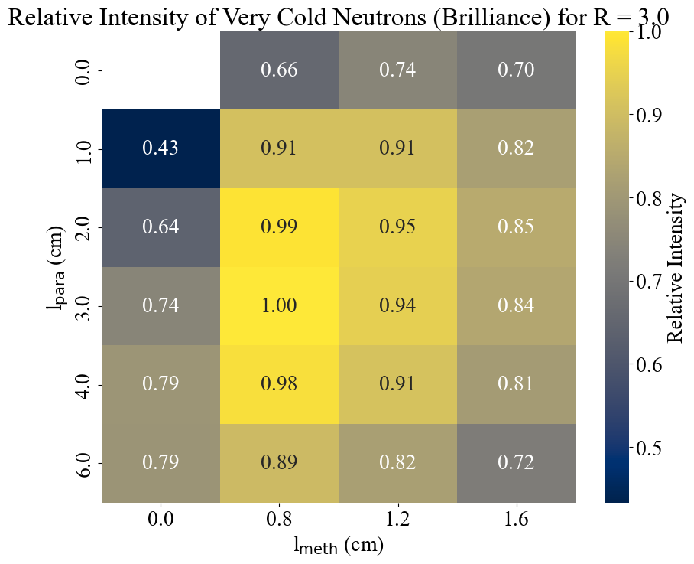
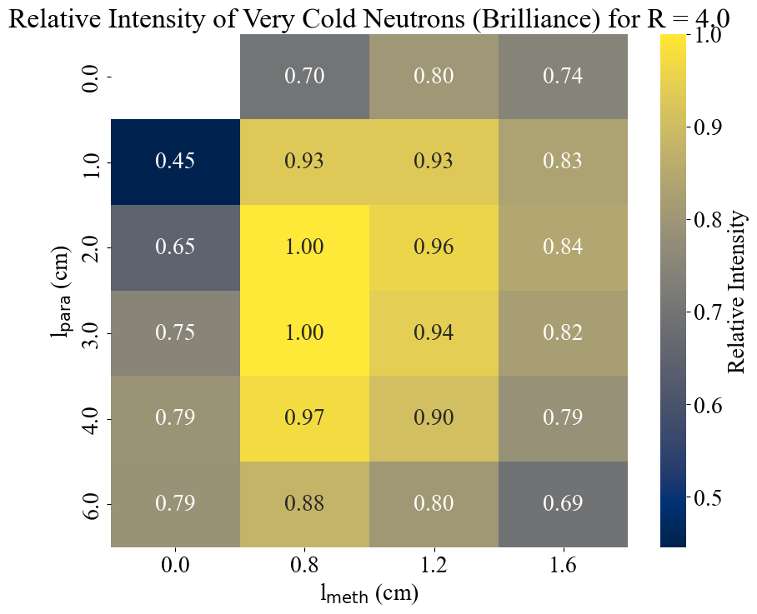
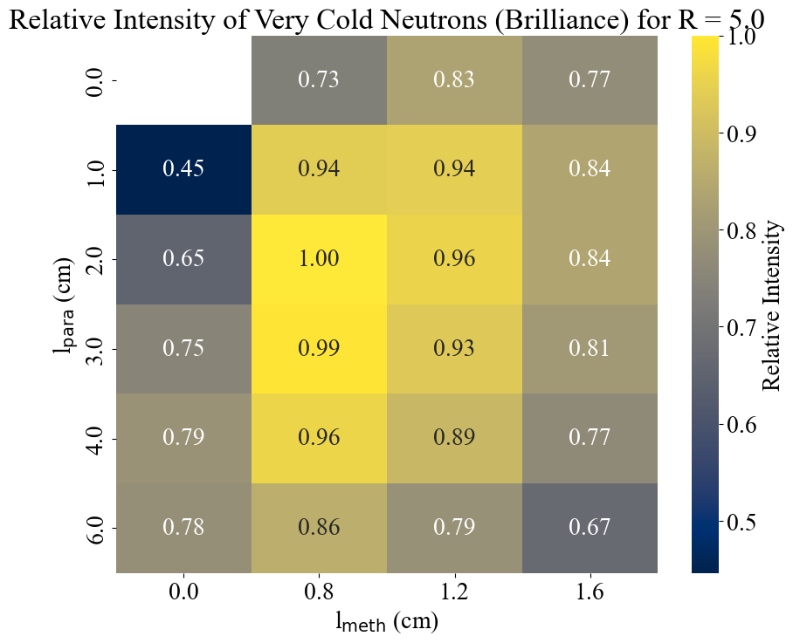
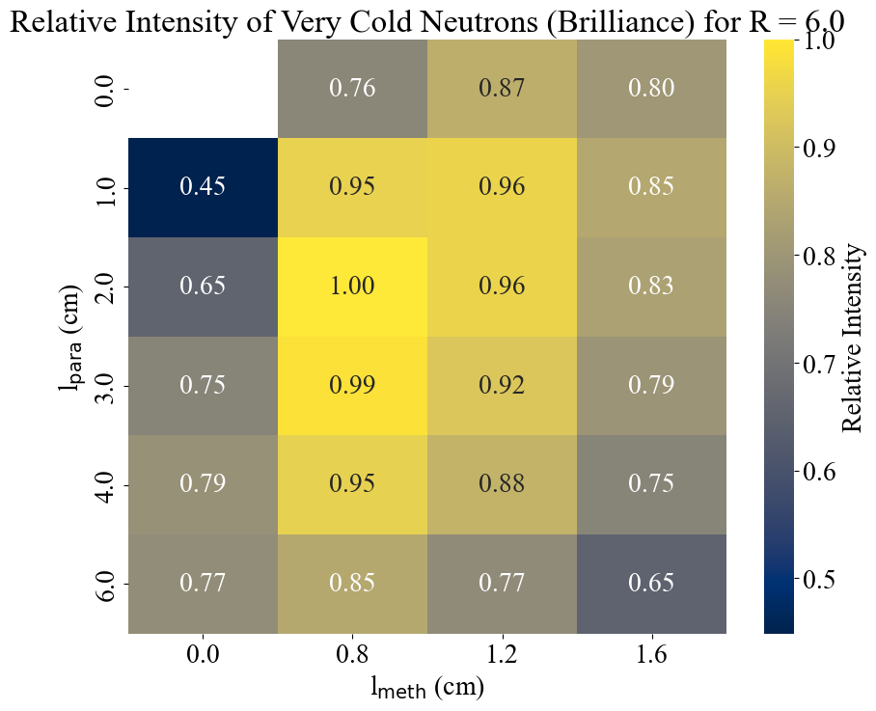
VCN Intensity

Slide 34
Concept #3 -
Comparison with parahydrogen pencil source

Slide 35
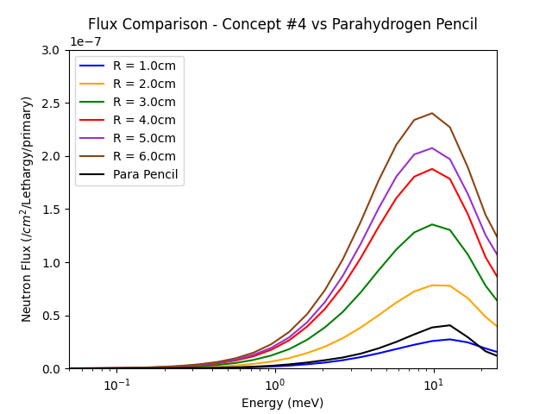
Very Cold Neutron Flux Comparison E < 1 meV
R (cm) | L_{para} (cm) | L_{meth} (cm) | Flux (n/cm²/pr) | Ratio ϕ/ϕ_{max} | Ratio ϕ/ϕ_{2d-para}
1.0 | 3.0 | 0.8 | 1.21E-09 | 0.08 | 0.74
2.0 | 3.0 | 0.8 | 4.29E-09 | 0.28 | 2.6
3.0 | 3.0 | 0.8 | 8.05E-09 | 0.54 | 4.9
4.0 | 3.0 | 0.8 | 1.16E-08 | 0.77 | 7.1
5.0 | 2.0 | 0.8 | 1.28E-08 | 0.85 | 7.9
6.0 | 2.0 | 0.8 | 1.49E-08 | 1 | 9.1
Para pencil | 16.0 | - | 1.63E-09 | 0.1 | 1.0

Slide 36
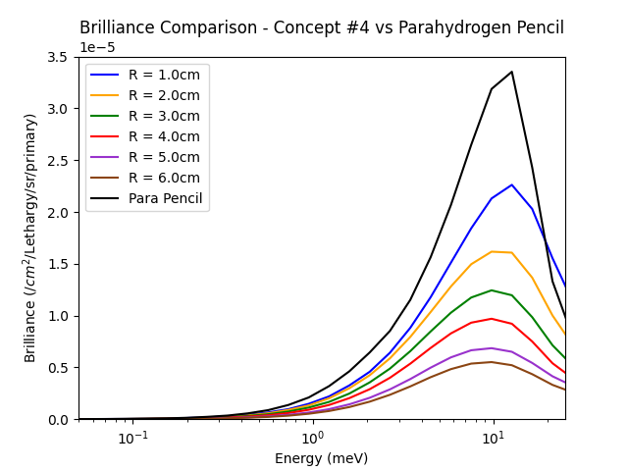
Very Cold Neutron Brilliance Comparison E < 1 meV
R (cm) | L_{para} (cm) | L_{meth} (cm) | Brilliance (n/cm²/sr/pr) | Ratio B/B_{max}
1.0 | 3.0 | 0.8 | 3.85E-06 | 0.73
2.0 | 3.0 | 0.8 | 3.41E-06 | 0.65
3.0 | 3.0 | 0.8 | 2.85E-06 | 0.54
4.0 | 3.0 | 0.8 | 2.31E-06 | 0.44
5.0 | 2.0 | 0.8 | 1.63E-06 | 0.31
6.0 | 2.0 | 0.8 | 1.32E-06 | 0.25
Para pencil | 16.0 | - | 5.22E-06 | 1.0

Slide 37
Improvements and future outlook
Next Steps
Concept #3:
  Run R = 3.0 cm case with 5K methane. Shift spectrum to lower energies?
  Comparison against performance with concept #1 with R = 3.0 cm
  Assess what combination of instruments + optics can be optimally fed from a large surface area methane source
    Determine what gain is necessary, below ~1 meV, to either (i) be of practical use for a particular technique (ii) boost instrument performance.
II. Identify new VCN materials appropriate for Hi-CANS
Simulation comparison with other hydrogenous moderator materials e.g. methane clathrate
Critical to identify new materials and develop collaborations for the experimental testing and development of cross sections for potential VCN moderator materials

Slide 38
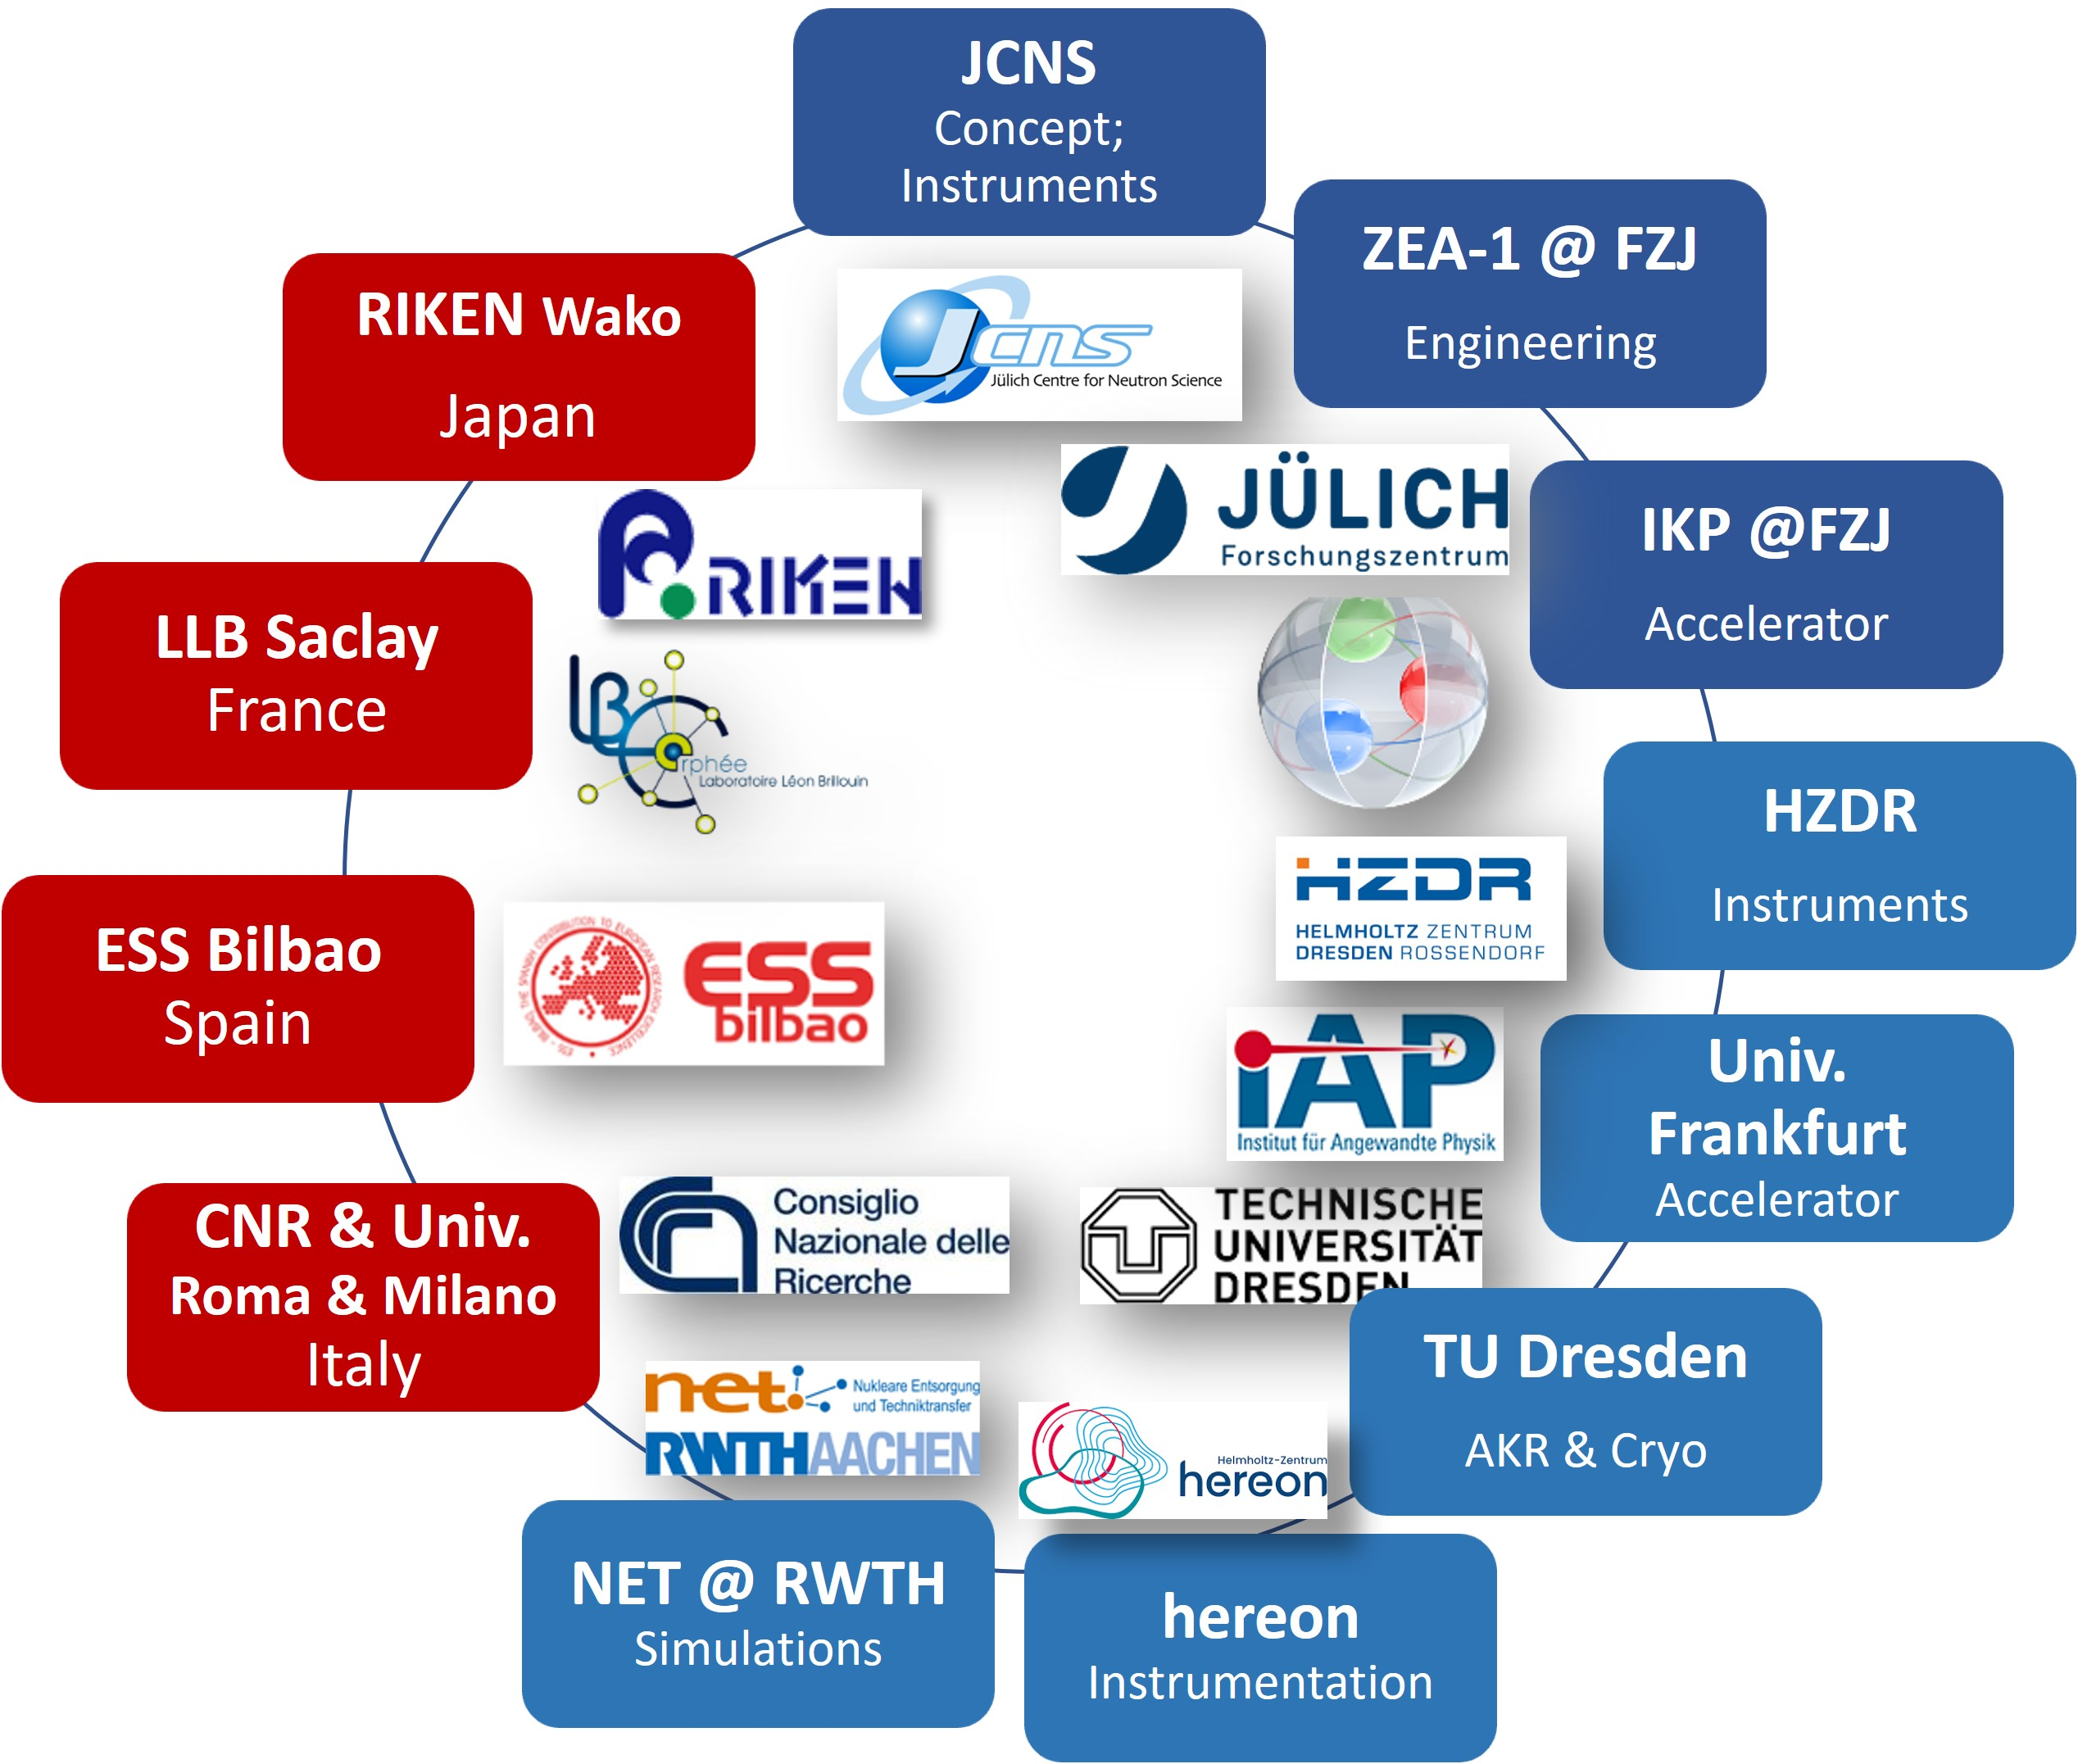




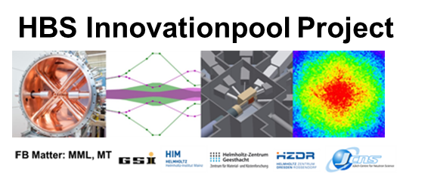






HBS Team
J. Baggemann
Th. Brückel
J. Chen
T. Claudio-Weber
T. Cronert (†)
Q. Ding
P.-E. Doege
M. El Barbari
T. Gutberlet
J. Li
K. Lieutenant
Z. Ma
E. Mauerhofer
N. Ophoven
U. Rücker
N. Schmidt
A. Schwab
E. Vezhlev
J. Voigt
P. Zakalek
- Design, verification,
instrumentation
ZEA-1:
Y. Bessler
R. Hanslik
R. Achten
F. Löchte
M. Strothmann
- Engineering
IKP-4:
O. Felden
R. Gebel
A. Lehrach
M. Rimmler
R. Similon
- Nuclear physics
INM-5:
B. Neumaier
- Radio isotopes
S. Böhm
R. Nabbi
- Nuclear simul.
Ch.Haberstroh
M. Klaus
S. Eisenhut
C. Lange
- Liquid H₂, AKR-2
H. Podlech
O. Meusel
- Accelerator
W. Barth
- Accelerator
/ HIM
@hbsneutron
https://hbs.fz-juelich.de/
J. Fenske
- Instrumentation

Slide 39
Acknowledgement
This project has received funding from the European Union’s Horizon 2020 research and innovation programme under the Marie Skłodowska-Curie grant agreement No 101034266.
References
[1] J.M Carpenter and B.J. Micklich, ANL (05/42) (2005).
[2] V. Santoro et al, HighNESS Conceptual Design Report. arXiv:2309.17333v3 [physics.ins-det] (2023).
[3] S. Xu, EPJ Web of Conferences 286 06003 (2023)
[4] J. Baggemann, “Development of Neutron Extraction Plugs for HBS”, DENIM XII Jülich, 21st September 2023
[5] Y. Shin et al, Nuc. Ins. Meth Phys Res A 620 pp. 382–390 (2010).

