Slide 1
Development of entangled-probe scattering with neutrons
UCANS11, Vancouver
February 25th, 2025
INDIANA UNIVERSITY BLOOMINGTON

Slide 2
Indiana University
Sam McKay
Quan Le Thien
Jiazhou Shen (PSI)
Steve Kuhn (ORNL)
A. A. M. Irfan (Waterloo)
Shufan Lu
Patrick Blackstone
David V. Baxter
Mike Snow
Gerardo Ortiz
Roger Pynn
ORNL
Fankang Li
Jon Leiner
Peter Jiang
Kaleb Burrage
Fumiaki Funama
Matthew Loyd
ISIS
Robert Dalgiesh
Steven Parnell
MLZ
Johanna Jochum
Denis Mettus
Lukas Beddrich
Christian Franz
Christian Pfleiderer
TU Wien
Niels Geerits

Slide 3
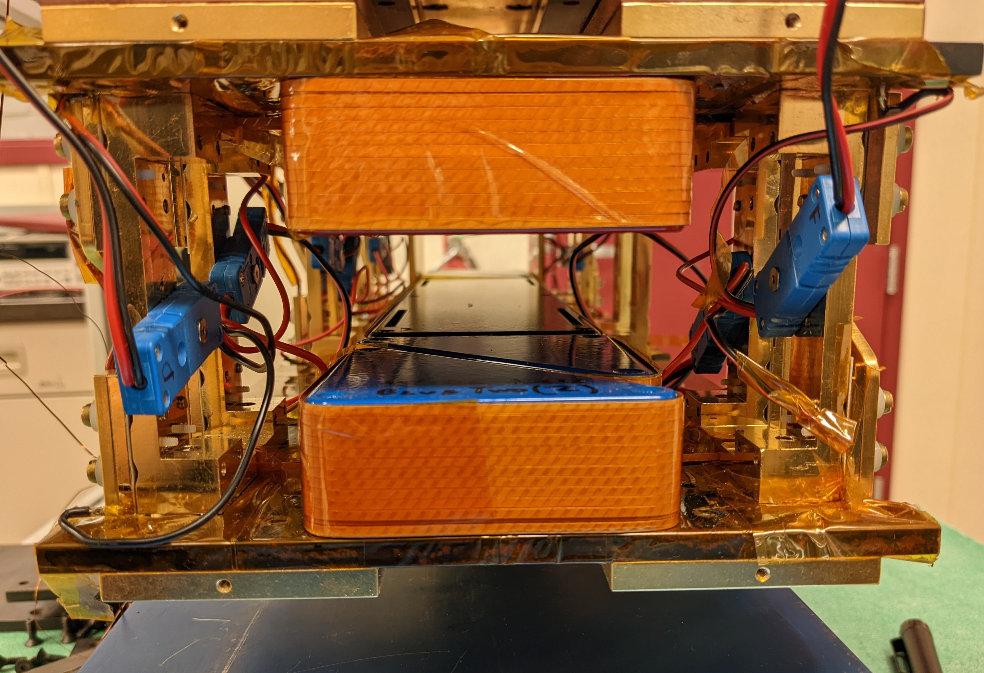
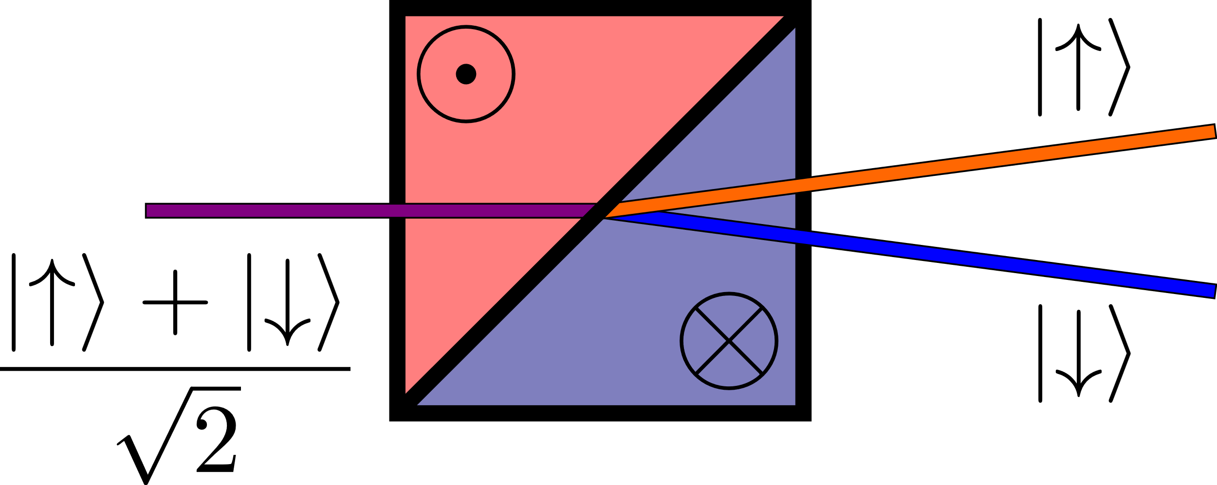
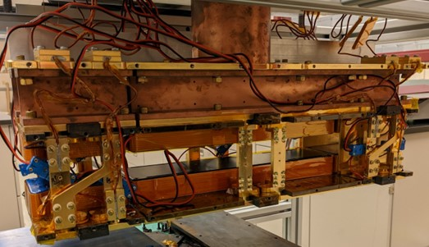
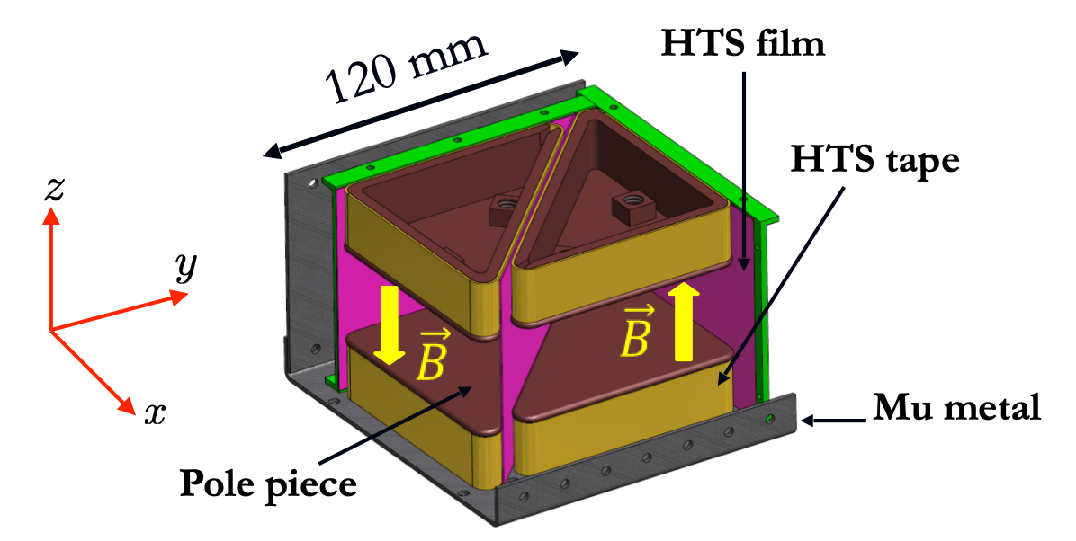
Magnetic Wollaston prisms (MWPs)
Triangular magnetic field regions act as birefringent, polarized neutron beam splitters
HTS coils create strong magnetic field (~100 mT)
HTS films contain field (Meissner screens)

Slide 4
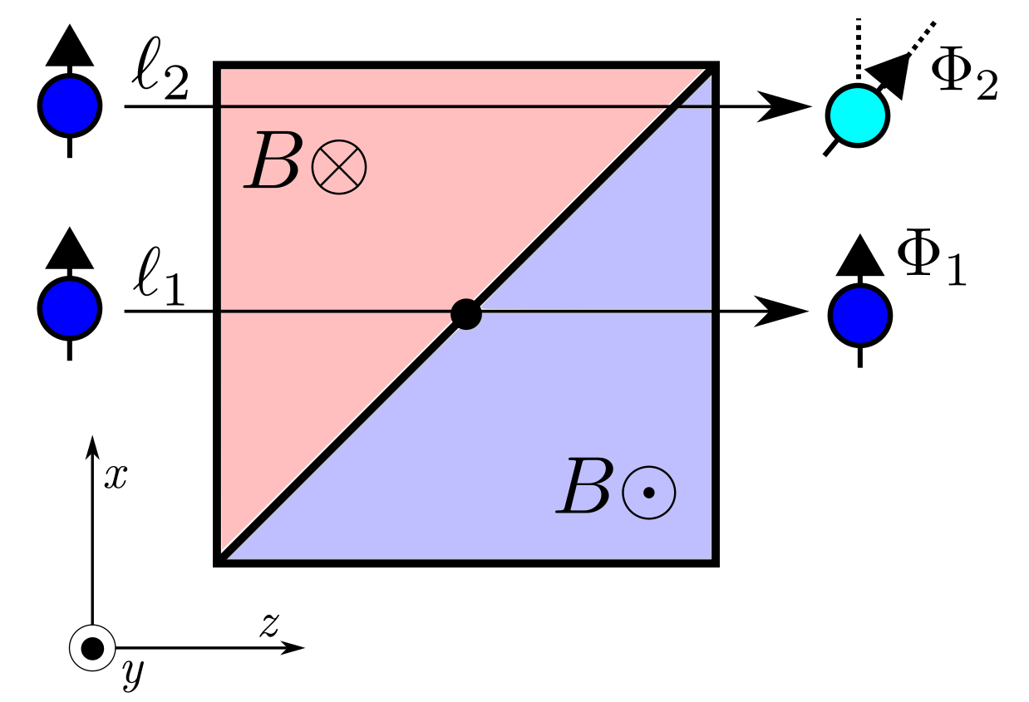
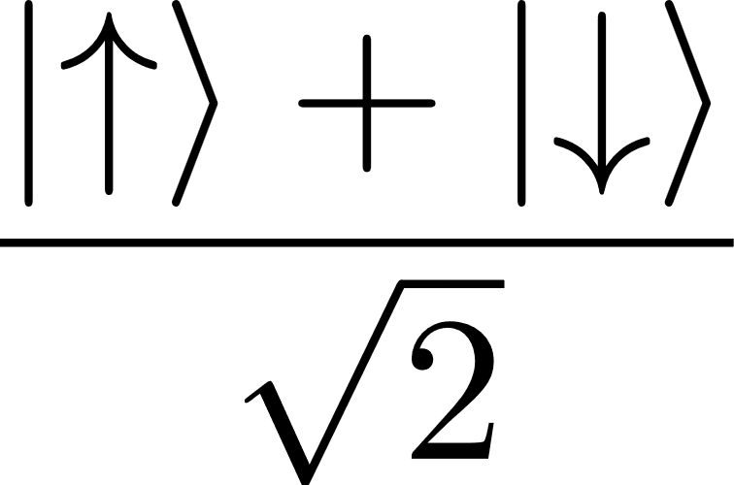
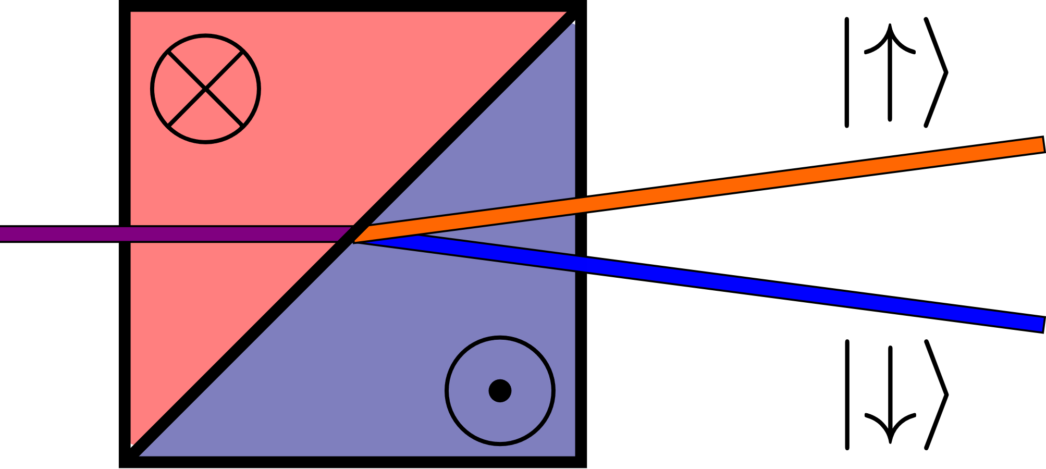
MWPs: focused polarizing beam splitters
Linear phase gradient

Slide 5
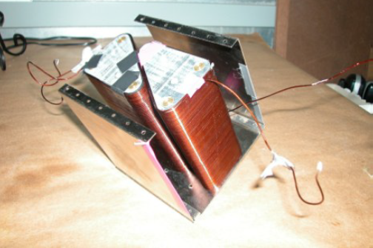
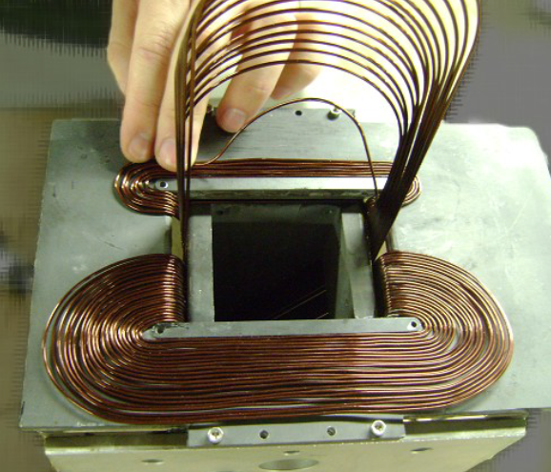
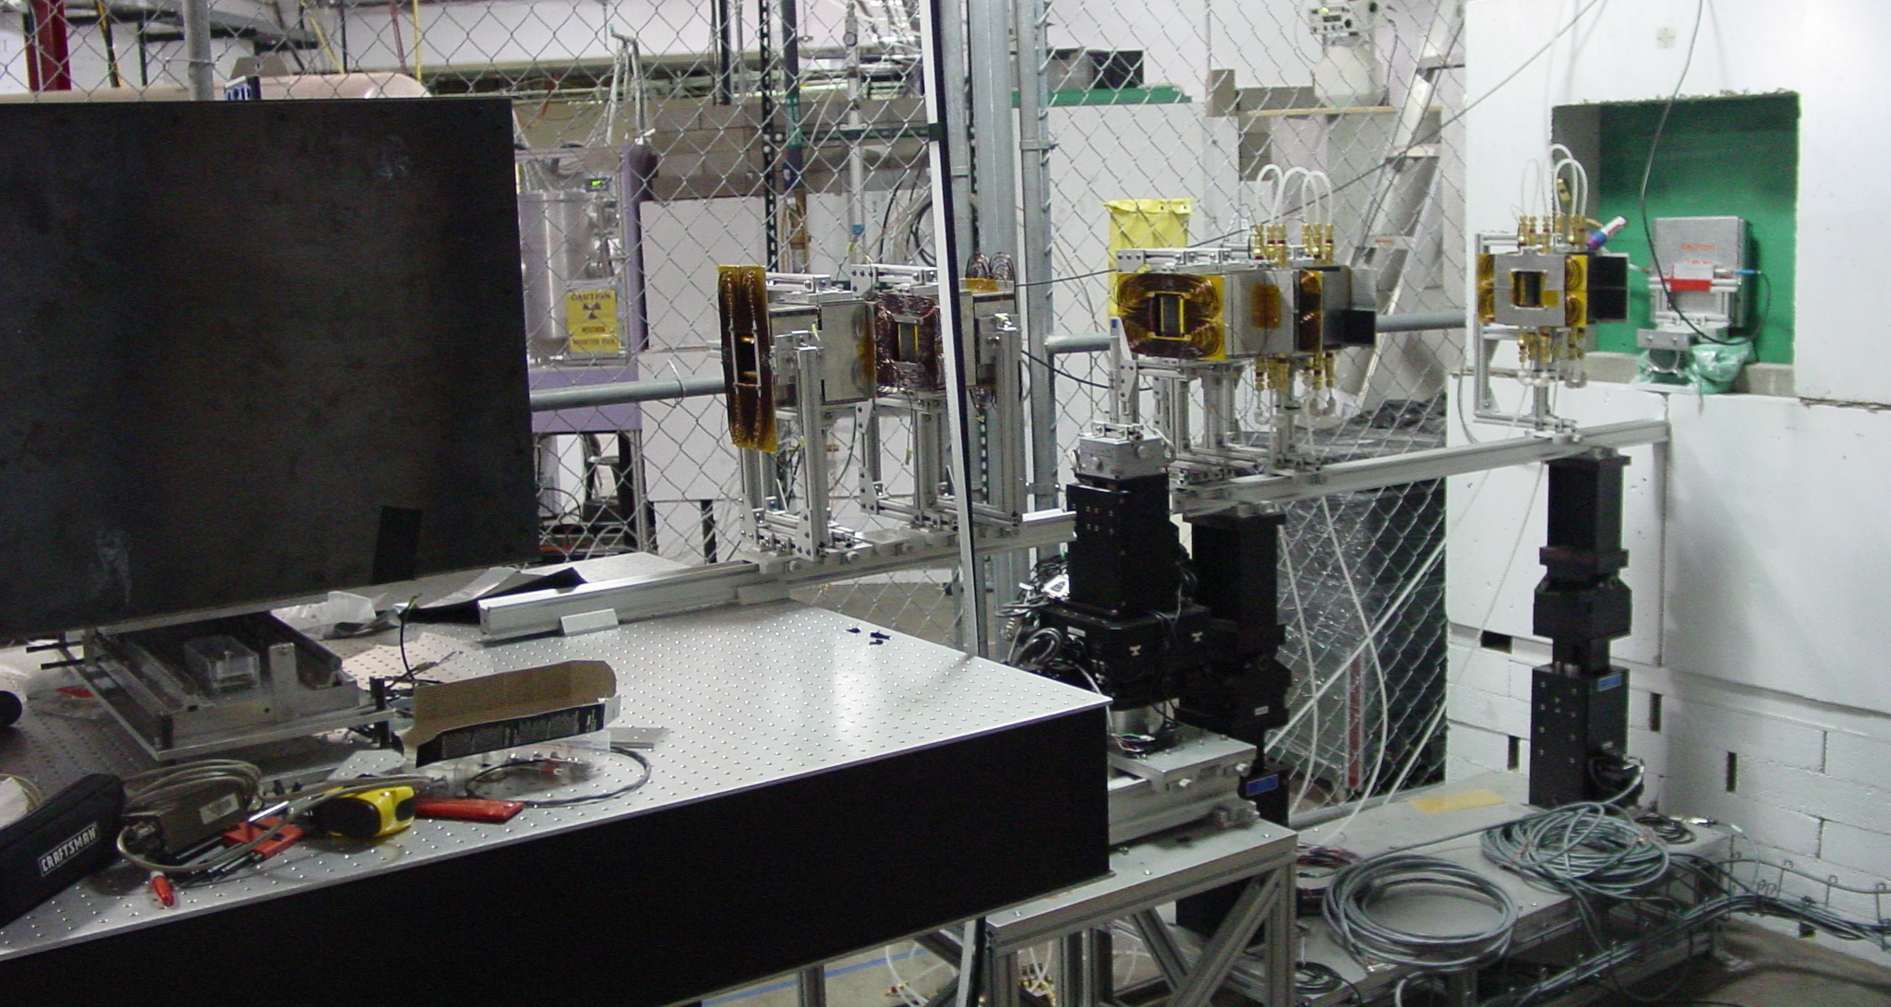
Developments at LENS: SESAME beamline
LENS provided beam time to facilitate the evolution of the MWP design.
Early work pointed to the need to avoid wires in the beam (depolarization and absorption)
Gen 3 MWPs use split HTS coils and HTS films (Meissner screens)
Gen 1 MWP
Gen 2 on SESAME at LENS
Gen 2

Slide 6
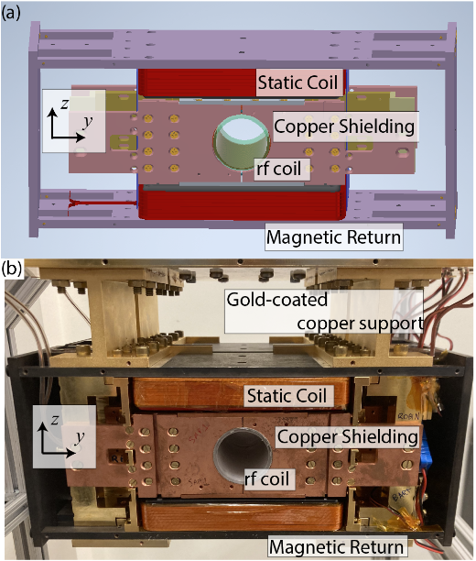
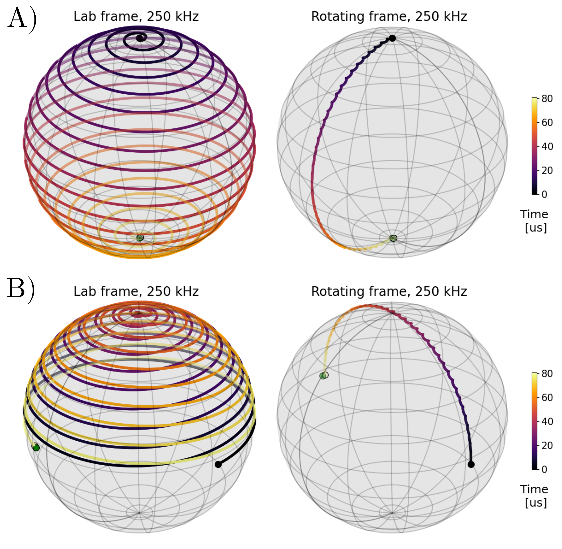
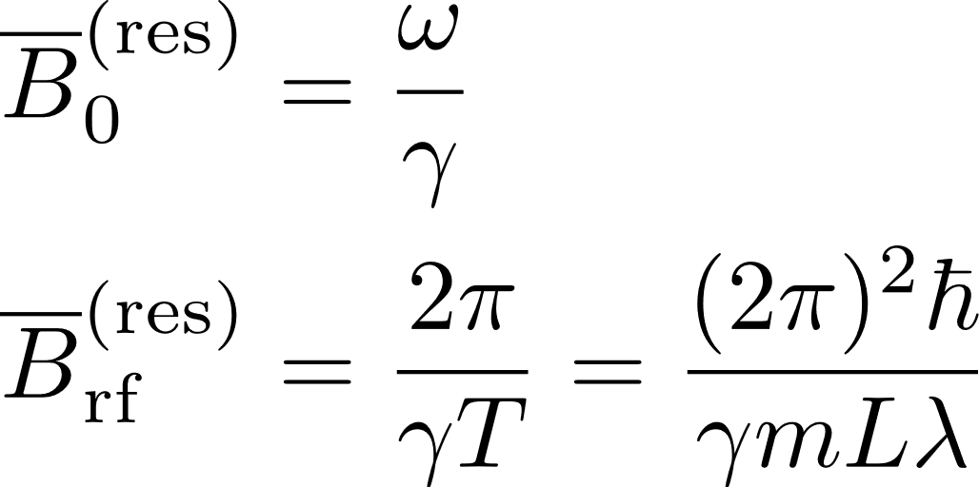
Resonant radio-frequency (RF) flippers
Requires uniform, strong static field and weak oscillating rf field
Equivalent* to MWPs for this talk
S. McKay, Rev Sci Inst, 95, 113906, 2024

Slide 7
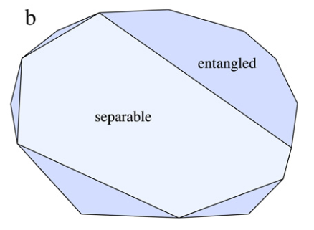
Witnesses quantify entanglement
Divide phase space into entangled and separable regions: Bell polytope
Many entanglement measures:
Entropy:
Fisher info: global entanglement
Discord: correlations beyond entanglement
Model independence is ideal
O. Gühne, Phys. Rep., 474, 2009

Slide 8
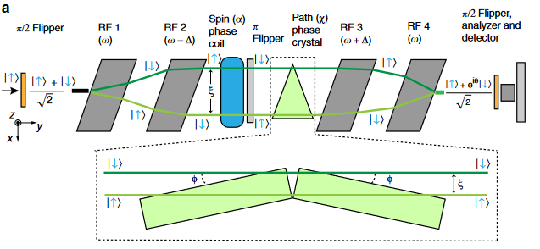
MWPs (RF flippers) entangle neutrons
Creates Bell (GHZ) state; max entangled:
Verify by measuring CHSH (Mermin) witness: S
Neutron phase shifters:
Path: quartz blocks
Energy: rf frequency
Spin: precession coil
J. Shen, Nat. Comms., 11, 1, 2020

Slide 9
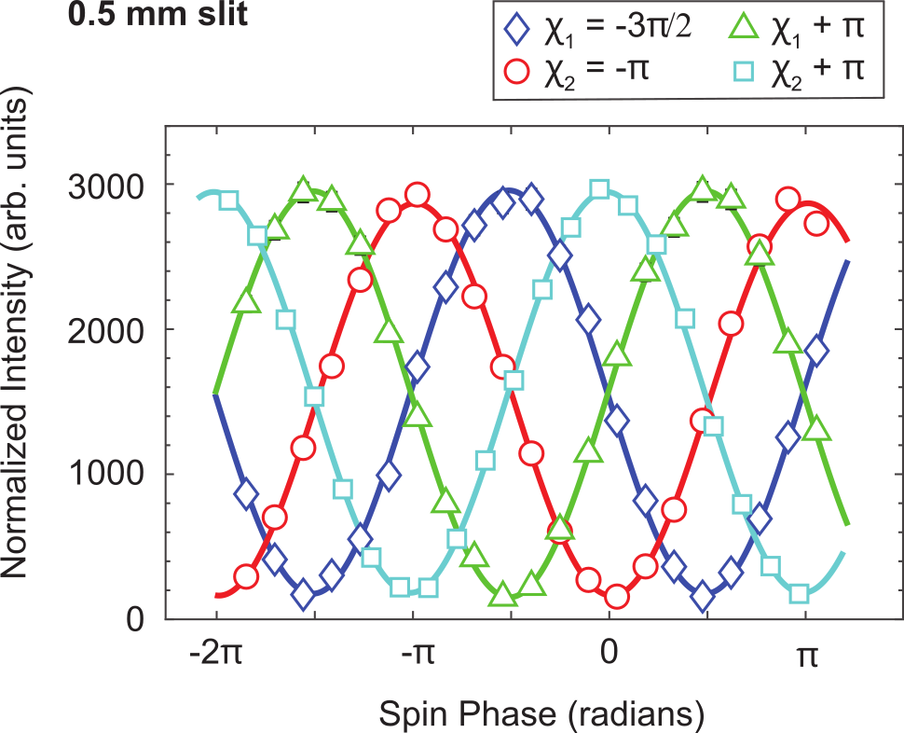
The CHSH witness: the workhorse
Spin-path example:
Best choice for 2 qubits with 2 measurements, 2 outcomes each
Requires 4 joint measurements with different phase shifts
Want to maximize CHSH for a given Bell state:

Slide 10
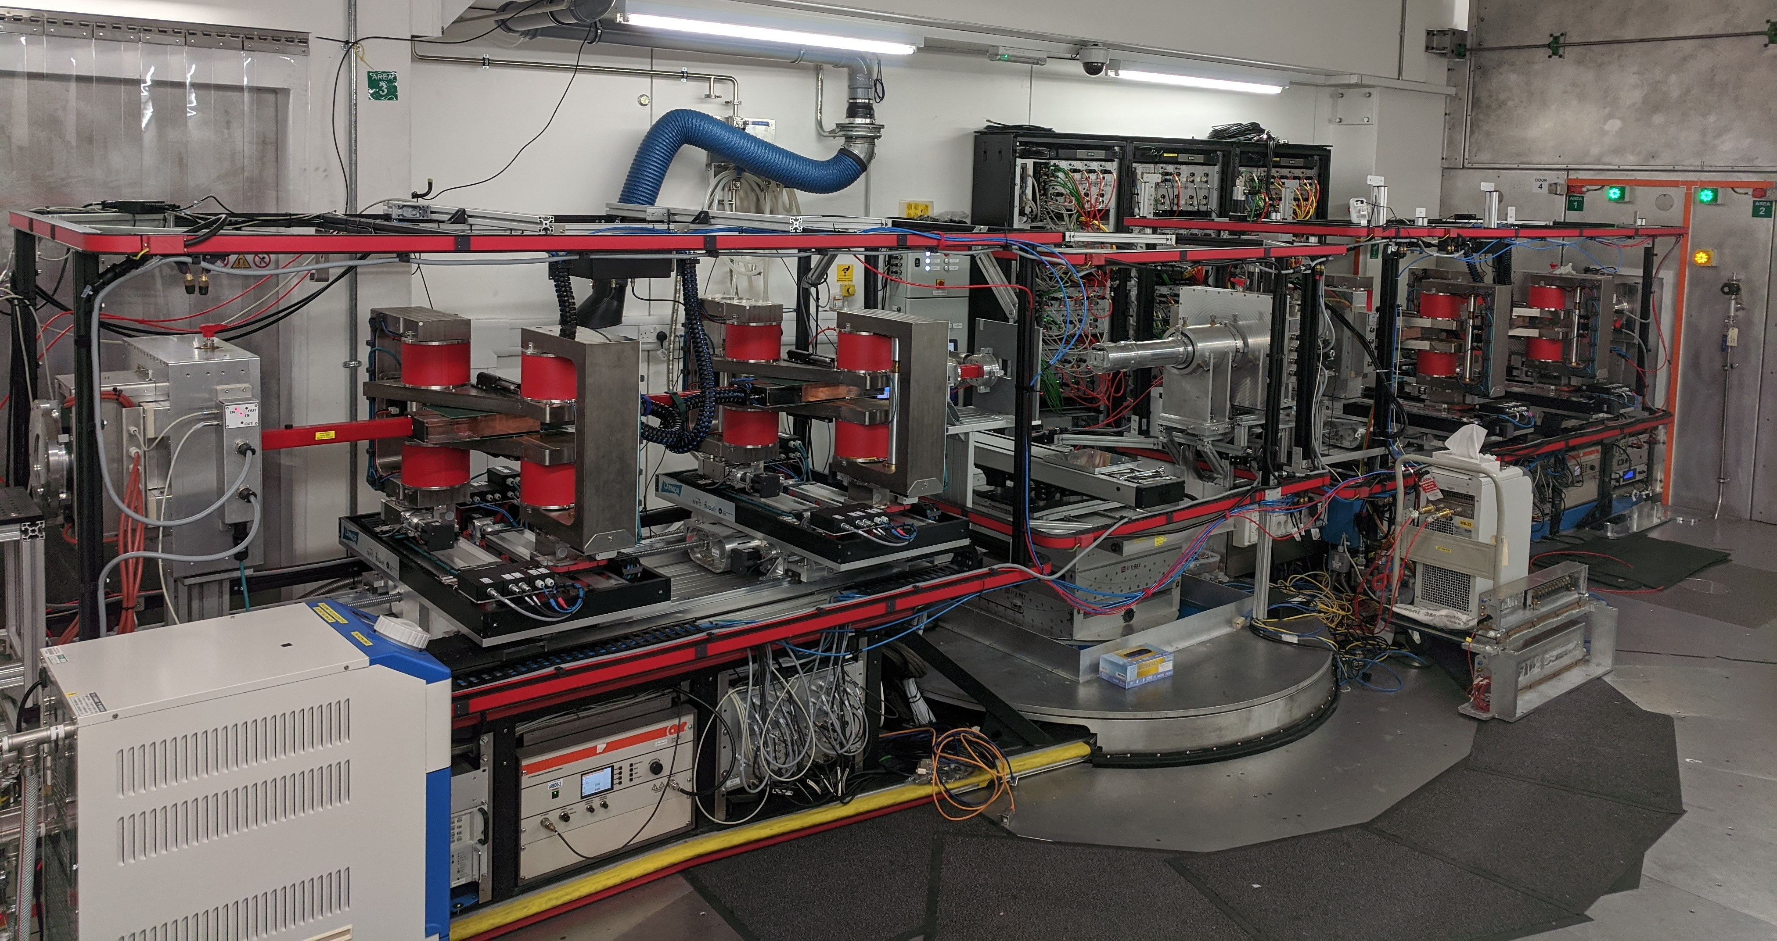
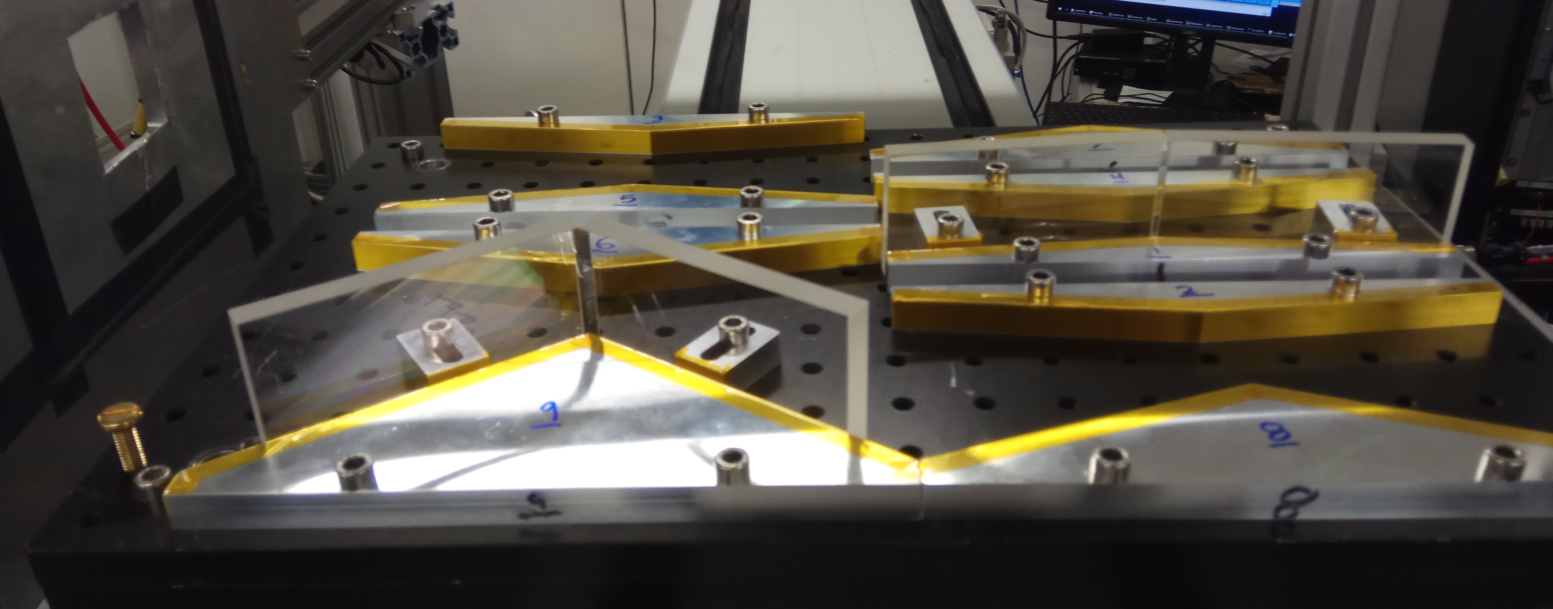

Slide 11
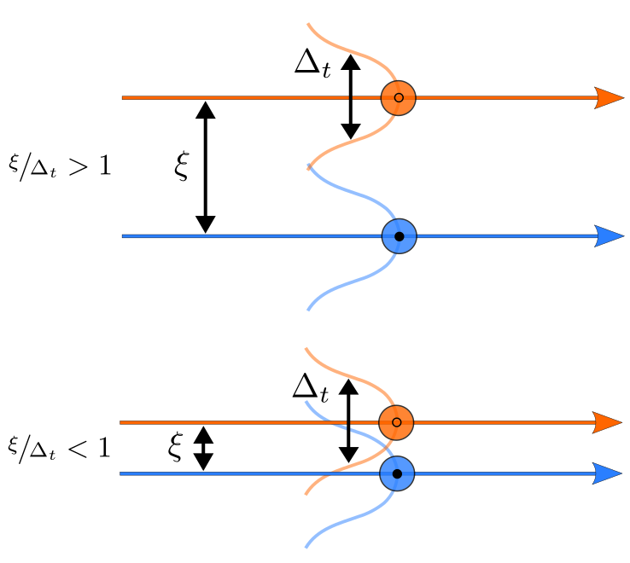
Follow ups: entanglement robustness?
Are the 2 paths still distinguishable when overlapping?
Does the wavepacket size affect the polarization?
Apply to magnetic samples?
Apply to thin multilayers?

Slide 12
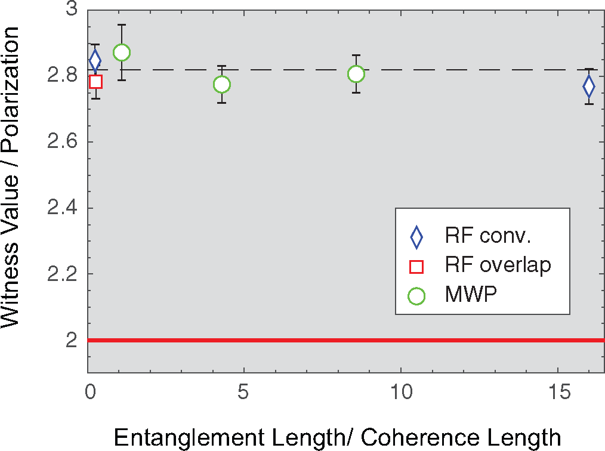
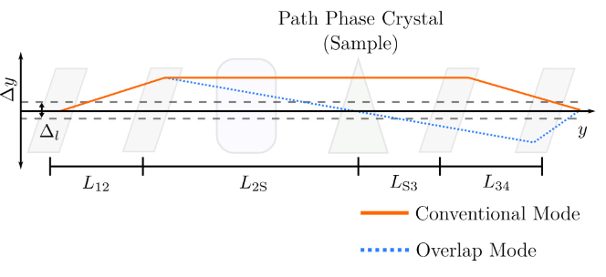
1. Overlap doesn’t affect entanglement
S. Kuhn, Phys. Rev. Res., 3, 2, 2021

Slide 13
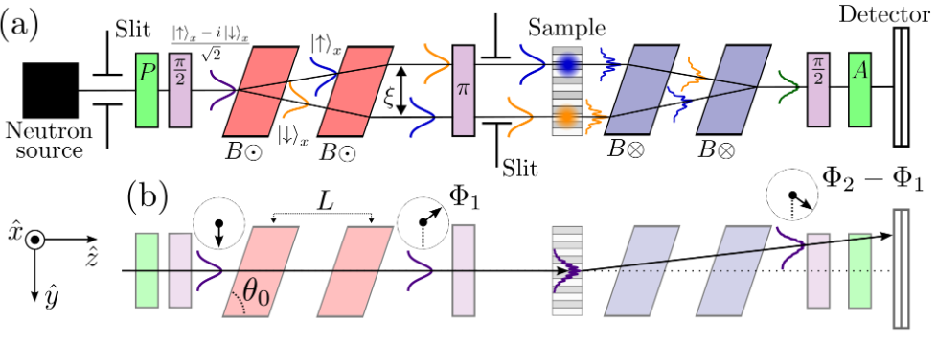
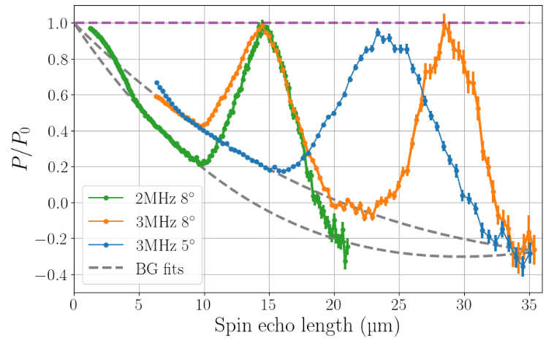
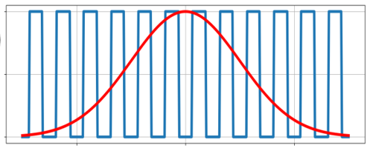
2. Verifying the 2-path model
Independent of
Depends on
S. McKay, PRA, 109, 042420, 2024

Slide 14
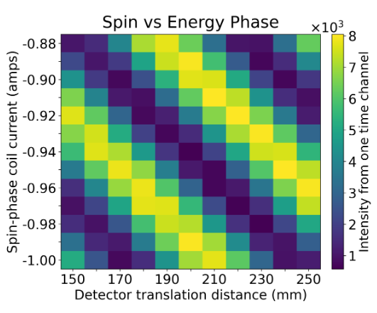
3. MIEZE for magnetic materials
Mach-Zehnder interferometer in time
J. Leiner, PR Applied, 22, 3, 2024

Slide 15
4. ENR and the Goos-Hänchen shift
Incident and reflected rays don’t intersect at the surface when totally reflected
Evanescent wave penetrates the reflecting surface
Optical GH shift: usually a few wavelengths in size
Jens Uwe Nöckel
University of Oregon
https://pages.uoregon.edu/noeckel/gooshanchen/

Slide 16
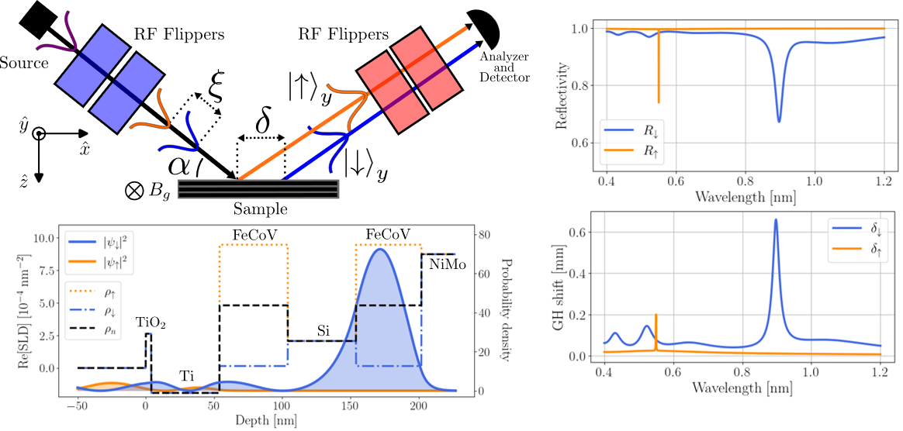

Slide 17
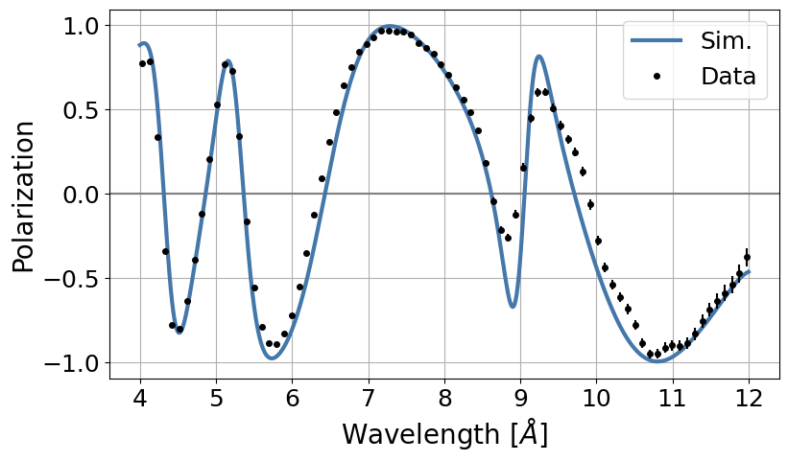
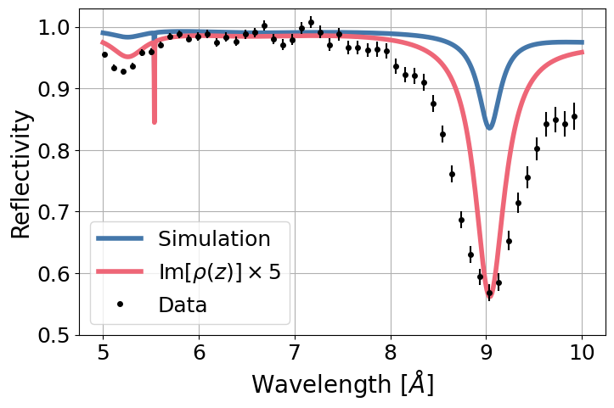
Observed a 0.65 mm GH shift:
Unveils magnetism from thin magnetic multilayer samples
S. McKay, PRL (accepted)

Slide 18
Demonstrated how to generate entangled neutron beams using high-fidelity polarized neutron instrumentation.
Entangled neutron beams enhance resolution and may be able to unveil entanglement in quantum materials.
Entangled beams are ready to be applied to many types of materials, both conventional and quantum (e.g. hierarchal, spintronic).
Questions?

Slide 19
A probe of massive entanglement?
Topological insulators: edge modes
Quantum spin liquids
Unconventional superconductors
Low-dimensional spin systems: spin chains, spin ladders
A. A. M. Irfan, New J. Phys., 23 8, 2021
L. Savary, Rep. Prog. Phys., 80, 1, 2017

Slide 20
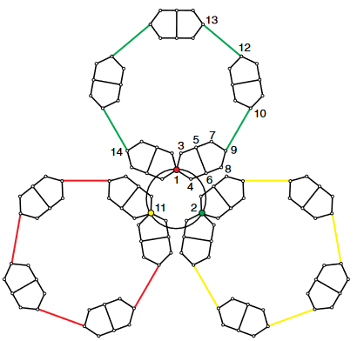
Kochen-Specker contextuality
Generalizes Bell non-locality
Imagine a value function v that assigns the pre-existing values:
v cannot exist (dim > 2) with the required properties:
B. Costantino, Rev. Mod. Phys., 94, 4, 2022

Slide 21
Example: Mermin-Peres Magic Squares
Each row and column are mutually commuting observables: context
Assign +1 or -1 to each observable
Rows (cols) require total product to be +1 (-1)
Contraction! Therefore, the observables must be context-dependent
D. Mermin, Rev. Mod. Phys., 65, 3, 1993

Slide 22
CHSH requirements
Min polarization: ~70.7%
Requires precise phase-shifter control
Only valid for 2 qubits systems; generalized by Mermin witnesses
D. Alsina, PRA, 94, 3, 2016

Slide 23
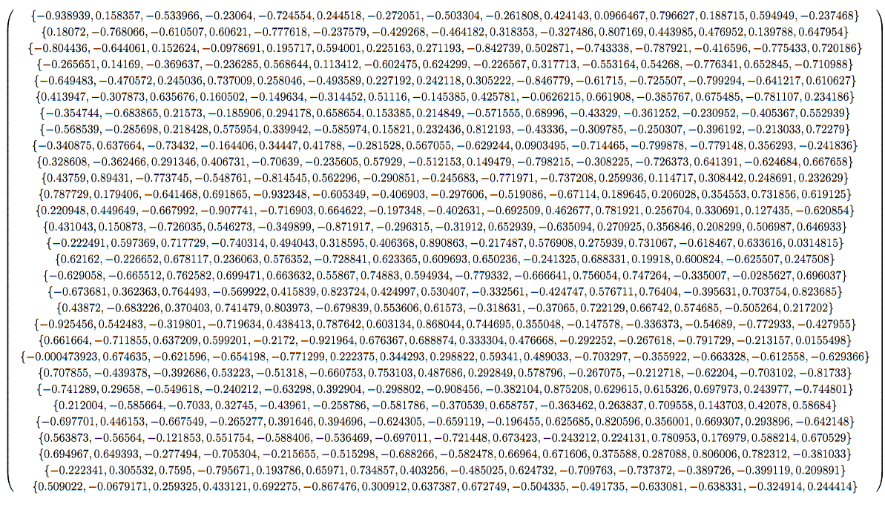
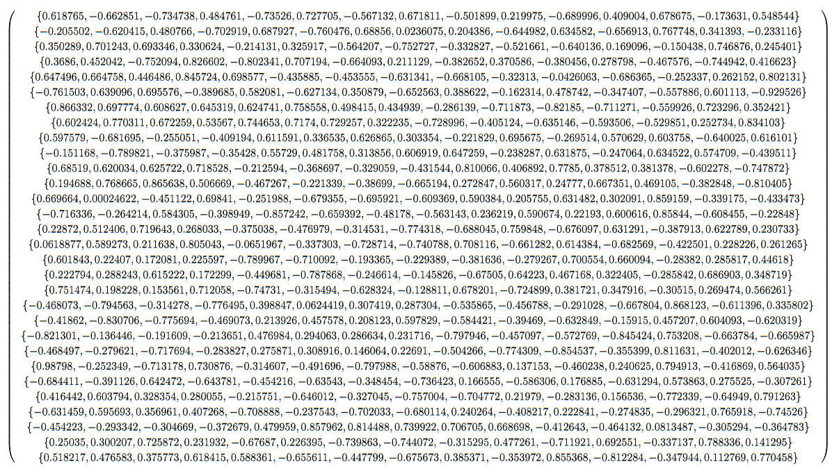
Critical visibility:
70.54% < 70.71%
A. Tavakoli and N. Gisin, Quantum, 06-04, 2000

Slide 24
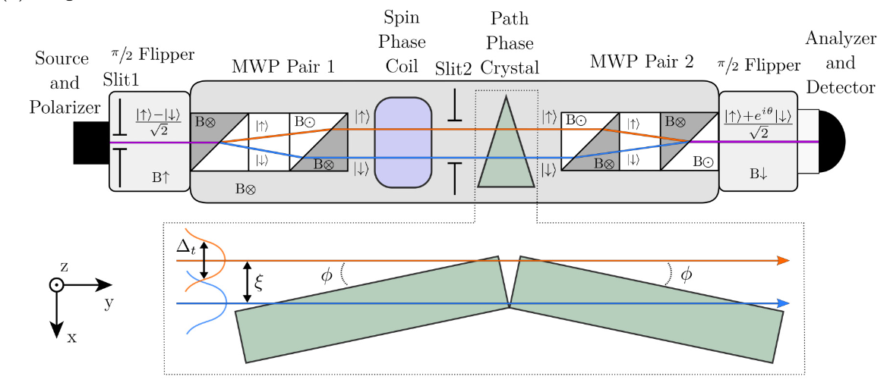
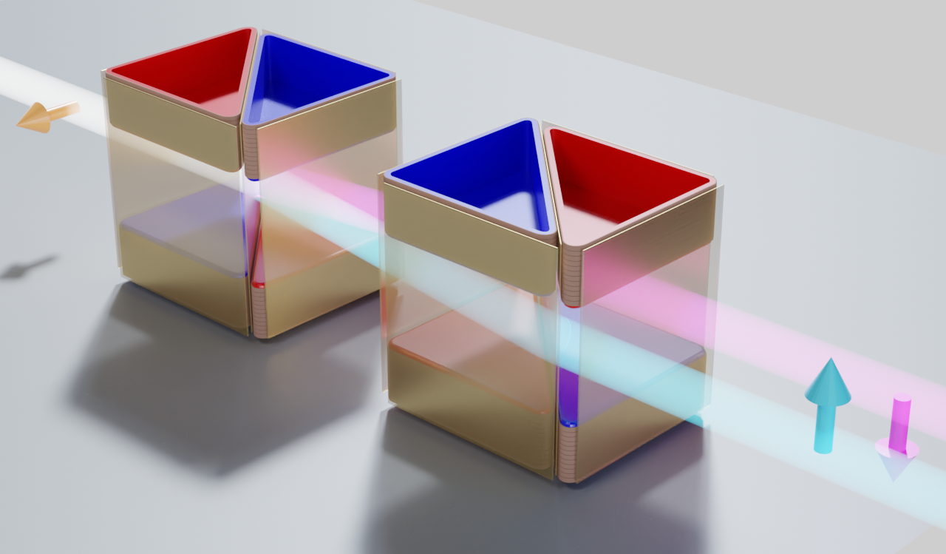
MWP spin-path entanglement

Slide 25
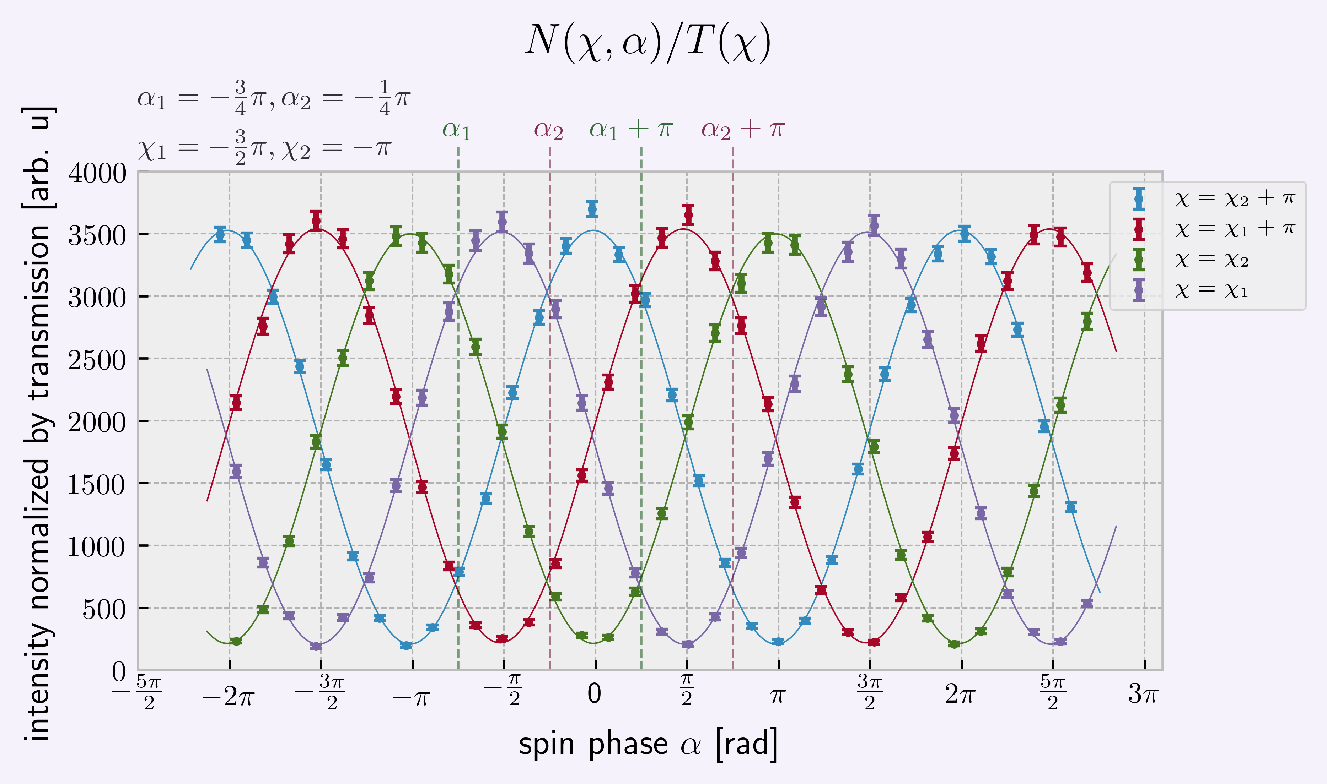
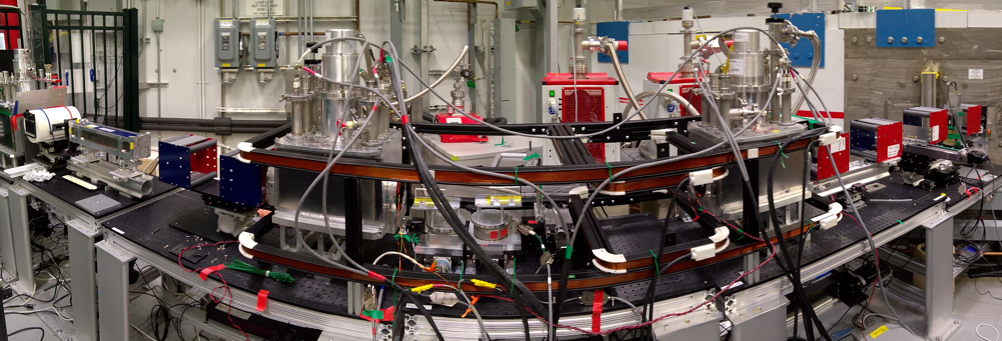
MWP spin-path entanglement

Slide 26
One of the key roles that CANS facilities play in the international neutron ecosystem is providing the abundant beam time necessary for developing novel ideas in neutron instrumentation. Over the last two decades, LENS has devoted considerable effort to the development of spin manipulation devices, in particular the Magnetic Wollaston Prisms that have been used for various spin-echo techniques for high-resolution diffraction, direct measurements of projected density-density correlation functions, dark-field radiography among other techniques. We have recently demonstrated that such devices create mode-entangled states of neutrons. Viewed in this light, the high resolution obtained by SE techniques is seen as an example of quantum-enhanced sensing exploiting an interferometric approach, and we have embarked on an effort to explore the physics that may be investigated with such beams The talk will review the development of the instrumentation and applications along with describing recent results from experiments performed at international-scale facilities using these ideas.

