Slide 1
We CANS Do It: A Step Towards a Canadian PC-CANS
Isabel Giurdanella
Maksymilian Dziura
Department of Chemistry and Biochemistry
University of Windsor

Slide 2
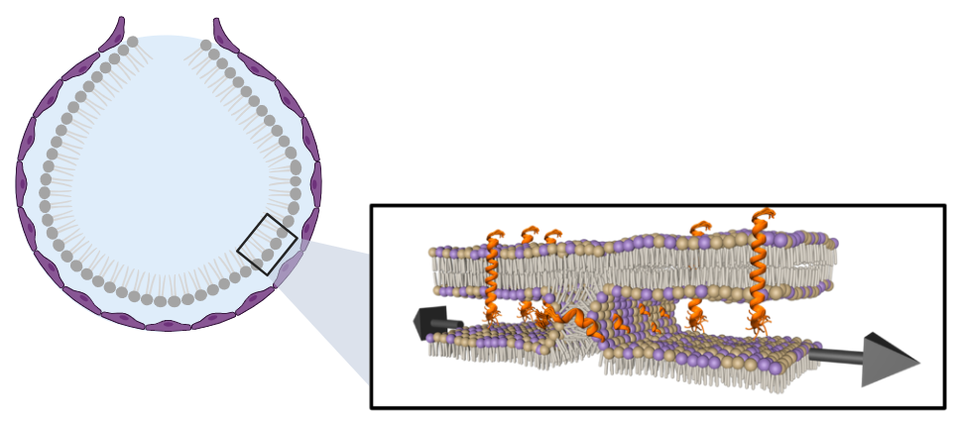
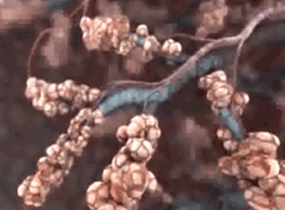
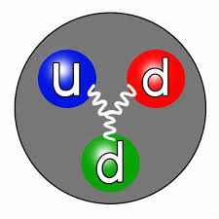
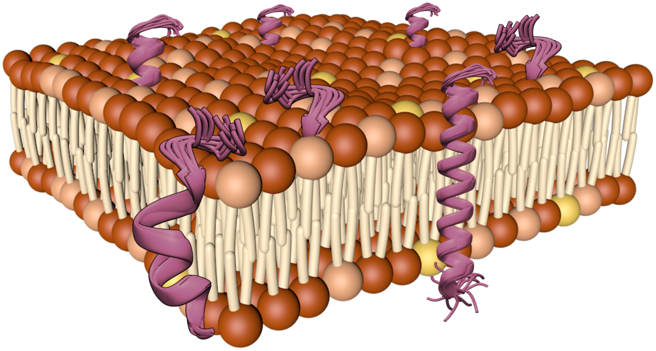
My Current Research – as an End User
https://gfycat.com
Allow us to probe nanoscale properties of materials at the atomic and molecular levels.
2
Notes:
Introduction as an end user → research interest lies in membrane biochemistry, specifically, PS, through the lens of membrane mimics
These membrane mimics are used are investigated from various systems in under various conditions → much of this work use neutrons to probes nanoscale properties only attainable through the use of neutron instruments makings these this overall project important for forming opportunities for Canadians scientists, as well as users around the world

Slide 3
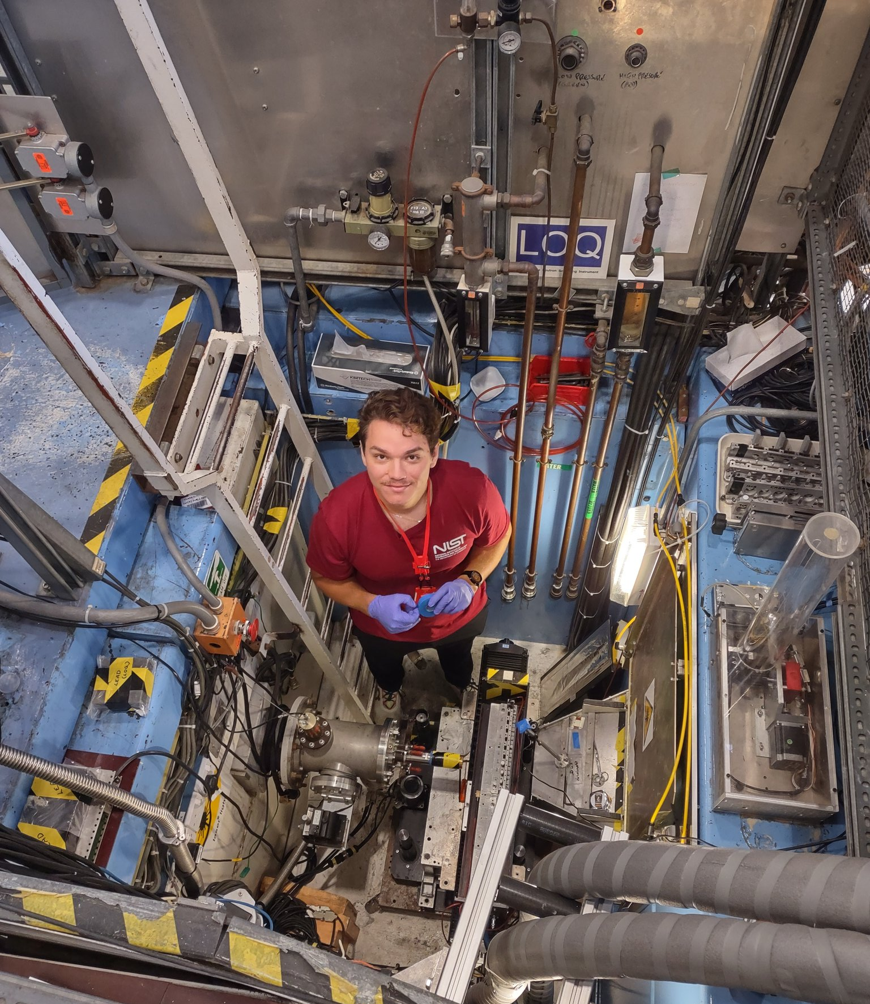
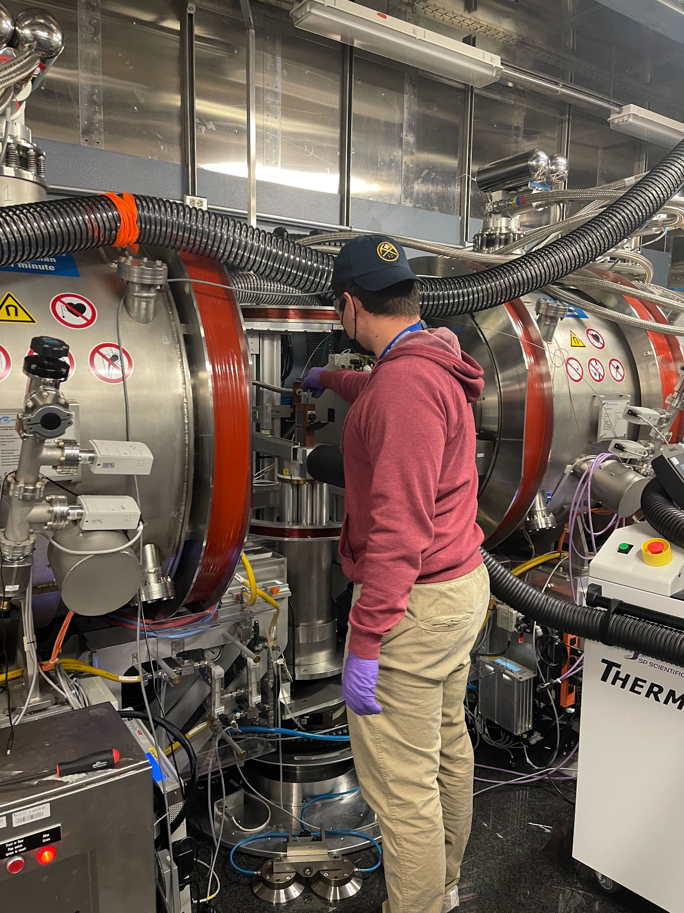
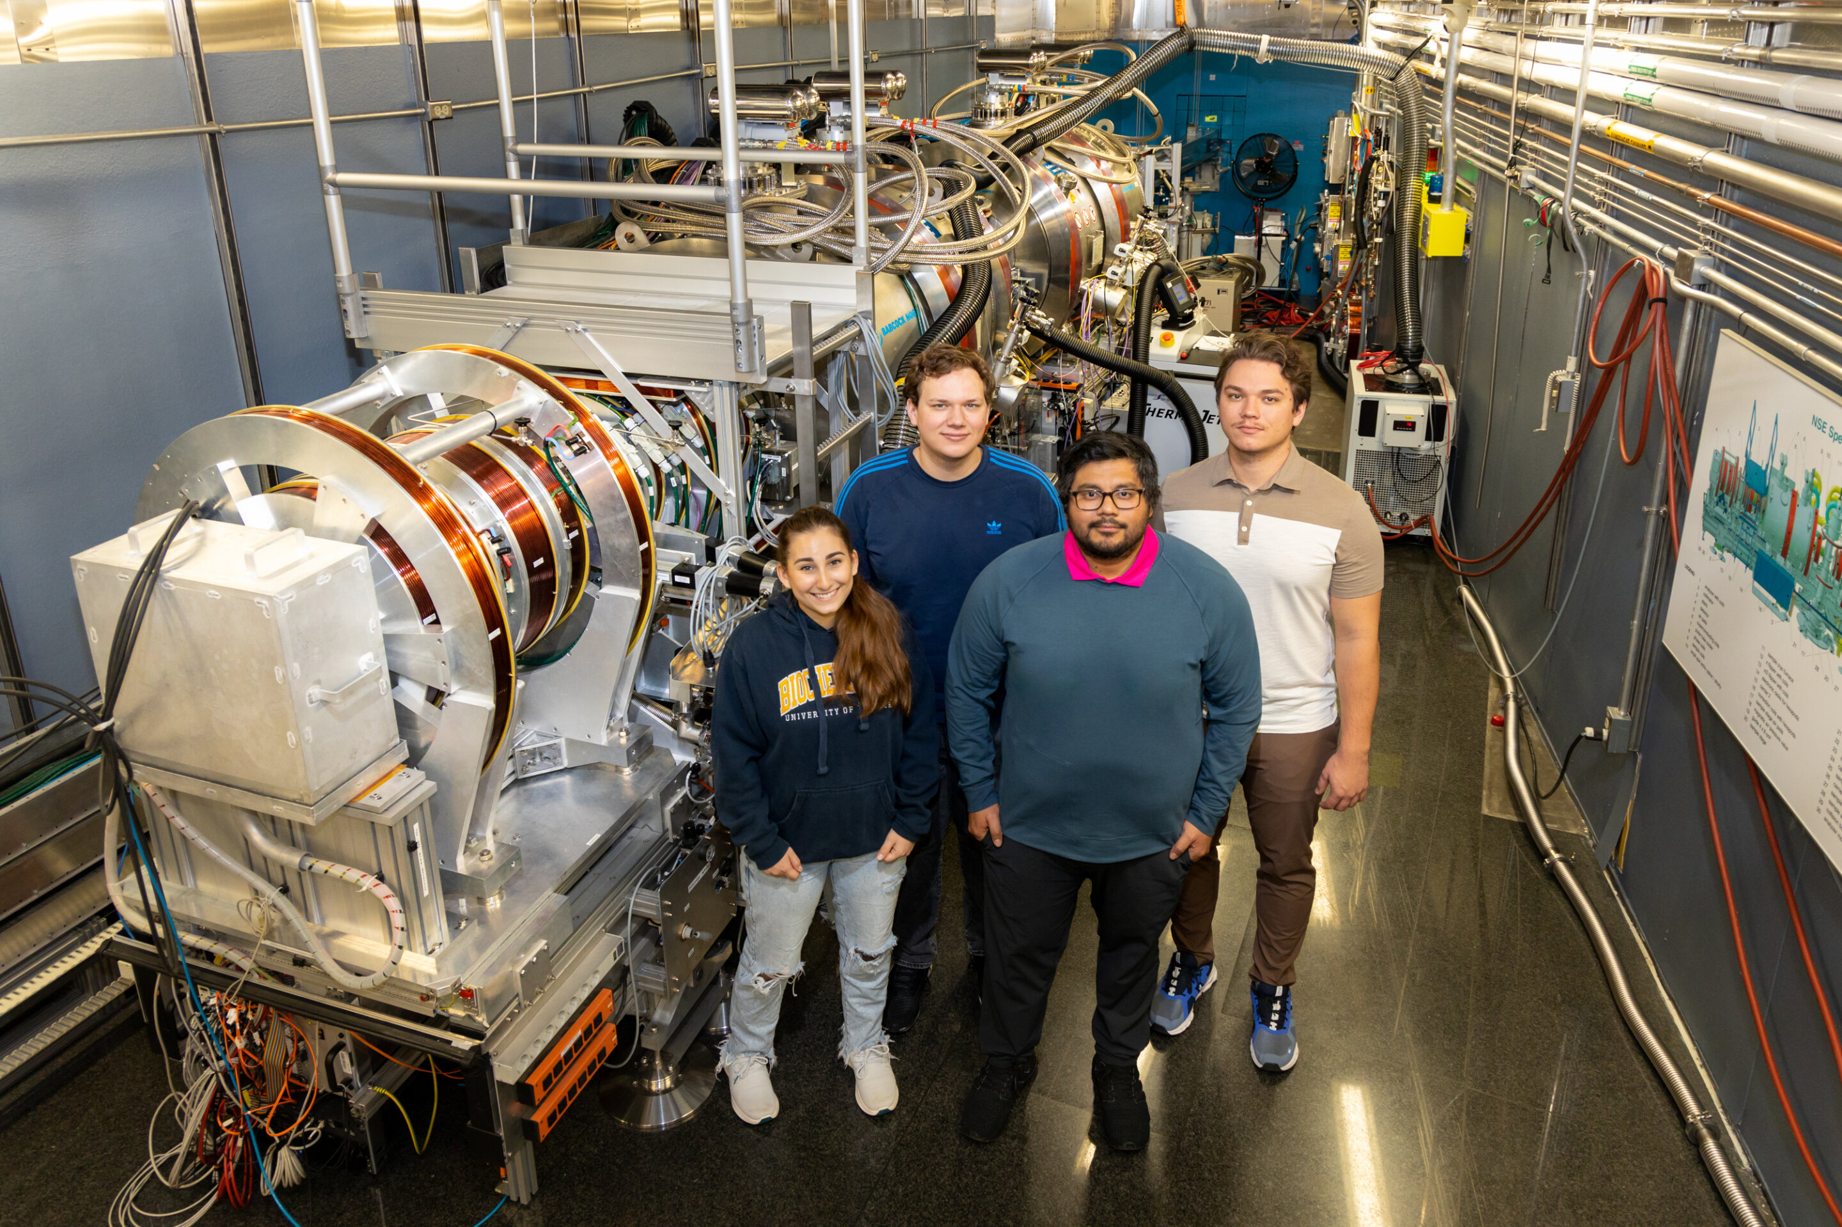
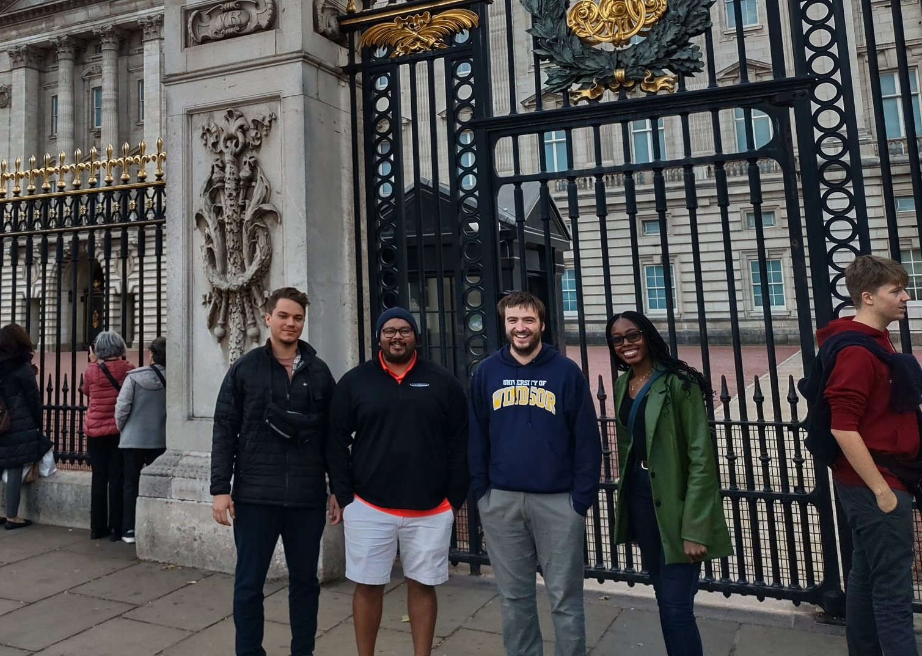
3
Notes:
Currently my research has taken me to countless facilities around the world, however one country lacking a strong user program is Canada
These experiments ranged across a variety of instrument from NSE, neutron reflectometry, back scattering, to SANS
Each experiment being vital to my overall growth as a Canadian researcher, stressing the importance of a potential Canadian instrument to the progression of science in Canada

Slide 4
4
Laxdal, R., Maharaj, D. D., Abbaslou, M., Tun, Z., Banks, D., Gottberg, A., ... & Marquardt, D. (2021). A prototype compact accelerator-based neutron source (CANS) for Canada. Journal of Neutron Research, 23(2-3), 99-117.
Notes:
Currently the only production of neutrons in Canada is at TRIUMF (here in BC), and at the McMaster Reactor (in Hamilton), however the thought would be to create a CANS Compact Accelerator-based Neutron Source to Canada, specifically projecting to build a Prototype in Windsor
So where do these efforts originate
TRIUMF – has an ultra cold source
“Aiming for a small-angle neutron scattering instrument with 1/7th of the brightness of the LOQ instrument at ISIS is unlikely to bring new opportunities to the Canadian community, and even later phases are only commensurate with it and LOQ is quite an old instrument now.”

Slide 5
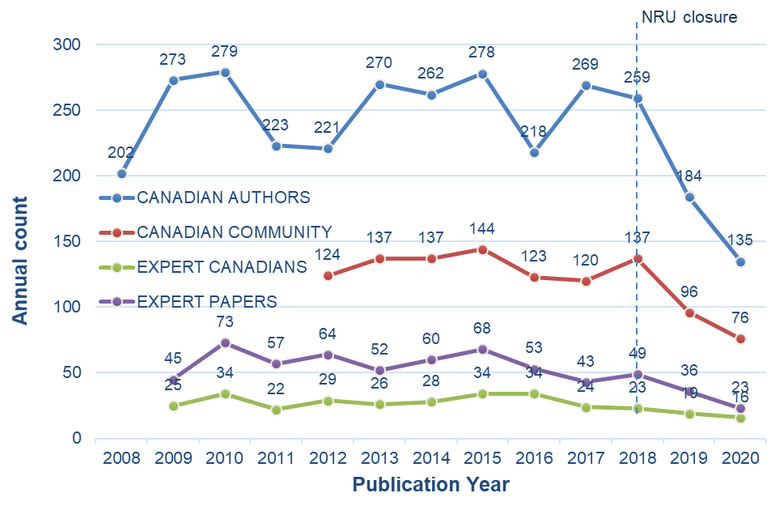
Bringing Neutrons to Canadians
Many Canadian users (40%) have not conducted neutron experiments since the shutdown of the National Research Universal reactor in 2018.
Results in decrease of exploratory research, decrease in user base, with an inevitable decrease in neutron expertise
5
Notes:
This idea for developing neutron usage, example for Canada, can be strengthened by the trends of neutron expertise in Canada
Since the closure of the NRU reactor in Canada, the last major source for neutron research, the amount of neutron related authors and publications has seen a decline, not only showing a decrease in production, but also warns for a loss of expertise in the Canadian community moving forwards.
Neutrons are hard to come by, so efforts to gain access, will only help drive the field.

Slide 6
Bringing Neutrons to Canadians
Propose the idea of building a Compact Accelerator-based Neutron Source (CANS) in Canada.
Pros: Cost efficient alternative compared to traditional sources.
Cons: Neutron yield will be lower
Provides a cost-effective way to provide Canada with a medium-brightness sources
So, what’s stopping us?
C$100-200 million
6
Notes:
To fill the void of a top-tier user program, there are efforts in brining a CANS to Canada
So two specify the two-fold kinda pro and cons ideas of a SANS → the cost of the facility will be generally lower compared to a common spallation/nuclear source
Helps with the idea of money being hard to come by, which is something evidently seen with universities in Canada (maybe specifically Ontario)
In contrasts – you will be having a smaller neutron yield comparatively, which could put into question the effectiveness perhaps of a SANS instrument
However, at the end of the day, what is stopping us from building? → money → a proposed CANS would cost around 100-300 million

Slide 7
Starting “Smallish”
We propose to build a Prototype Canadian CANS (PC-CANS)
Competitive neutron fluxes to show CANS can be used as a cost-effective alternative
Designed for university/industry needs
Performance approximately a factor of 5 lower brightness than TS1 at ISIS
Price Range = approximately C$10 million
7
Laxdal, R., Maharaj, D. D., Abbaslou, M., Tun, Z., Banks, D., Gottberg, A., ... & Marquardt, D. (2021). A prototype compact accelerator-based neutron source (CANS) for Canada. Journal of Neutron Research, 23(2-3), 99-117.
Notes:
However, it is proposed to start smallish → this will help not only show the promise of a CANS but additionally help with overall CANS development
This further introduces the idea of the PC-CANS – the prototype Canadian Compact Accelerator-based Neutron Source, which would be a significantly lower initial price, but also showcase the technology

Slide 8
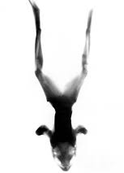
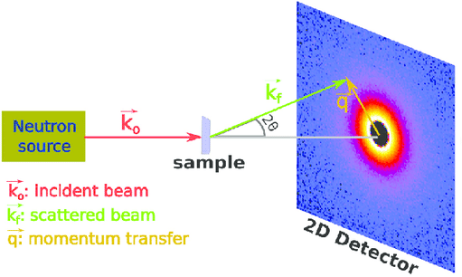
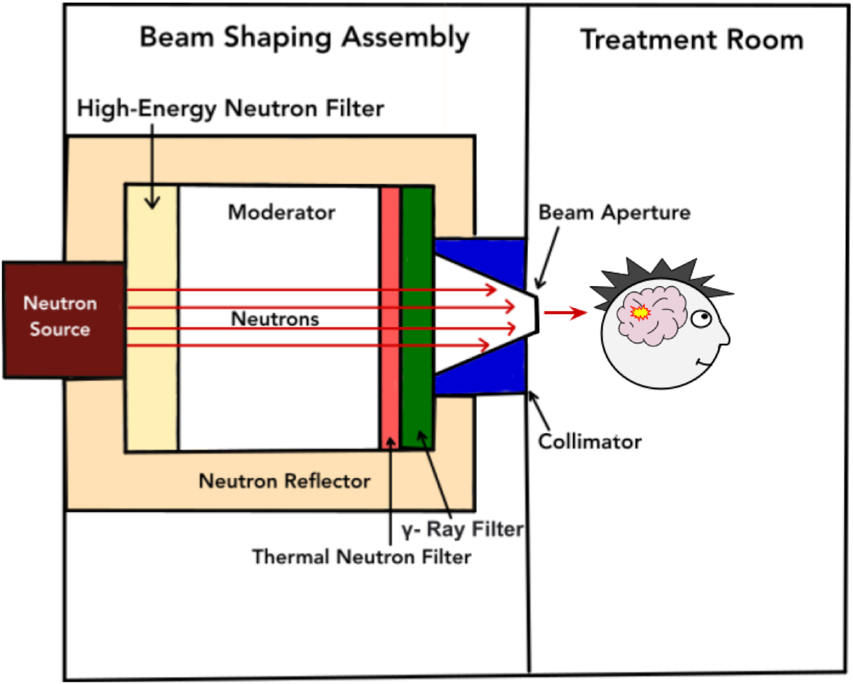
Prototype Canadian CANS (PC-CANS)
One of the main missions
Develop usable instruments for research
Small-angle neutron scattering
(SANS)
Diffraction/Neutron imaging
Boron Neutron Capture Therapy (BNCT)
Neutron Imaging
SANS
BNCT
8
Dziura, D., Tabbassum, S., MacNeil, A., Maharaj, D. D., Laxdal, R., Kester, O., ... & Marquardt, D. (2023). Boron neutron capture therapy in the new age of accelerator-based neutron production and preliminary progress in Canada. Canadian journal of physics, 101(8), 363-372.
Liu, D., Song, K., Chen, W., Chen, J., Sun, G., & Li, L. (2022). Current progresses of small-angle neutron scattering on soft-matters investigation. Nuclear Analysis, 1(2), 100011.
Notes:
Aside from demonstrating capability and potential of CANS technology
This will also allow for the development of usable research instrument to be showcased on the PC-CANS
I will be specifically focusing in on the potential performance of the envisioned SANS instrument

Slide 9
SANS End Station
There is an appeal for SANS due to the multi-disciplinary appeal and oversubscription at most facilities
Further allows for demonstration of CANS viability in terms of a SANS instrument
9
Laxdal, R., Maharaj, D. D., Abbaslou, M., Tun, Z., Banks, D., Gottberg, A., ... & Marquardt, D. (2021). A prototype compact accelerator-based neutron source (CANS) for Canada. Journal of Neutron Research, 23(2-3), 99-117.
Notes:
Low scattering wavelength experiments can handle large uncertainty in neutron wavelength –allowing for SANS at a low intensity pulse source
This PC-CANS is proposed to use a cold-finger moderator to tune neutron spectra
Today’s researchers rely on high-brightness facilities for this access to cold neutrons to accommodate certain experiments to prove specific length scales
This would help alleviate some of the stress on higher subscribed facilities
Expected to have similar performance to LENS and CPHS

Slide 10
Justifying a SANS End Station on a PC-CANS
Ran samples at ISIS Neutron and Muon Source on LOQ instrument
Altering the flux through changing the aperture setting (by a factor of 6x)
Examined multiple benchmark samples:
Well-characterized scatterers (ex. Instrument standards)
Structural analysis (ex. Liposome bilayer thickness)
Contrast variation (ex. Lipid domain monitoring)
Configuration | Flux | Aperture 2
LOQ configuration | 2.0 x 10⁵ neutrons/(cm²∙s) | 20 mm (r = 10 mm)
Proposed PC-CANS configuration | 0.3 x 10⁵ neutrons/(cm²∙s) | 8 mm (r = 4 mm)
LENS (Indiana University Bloomington) | 1.0 x 10⁴ neutrons/(cm²∙s)
CPHS (Tsinghua University) | 1.0 x 10⁴ neutrons/(cm²∙s)
Configuration | Flux
LOQ configuration | 2.0 x 10⁵ neutrons/(cm²∙s)
Proposed PC-CANS configuration | 0.3 x 10⁵ neutrons/(cm²∙s)
LENS (Indiana University Bloomington) | 1.0 x 10⁴ neutrons/(cm²∙s)
CPHS (Tsinghua University) | 1.0 x 10⁴ neutrons/(cm²∙s)
10
Notes:
LOQ arguably the most successful SANS instrument on a pulsed spallation source
PC-CANS will have a large beam size (narrower wavelength band)
Stage 1 – roughly 6.5x less than that of LOQ
Stage 3 – configuration should be comparable to LOQ
Only means measurements will take 6.5x longer to gain same quality as LOQ
LOQ is able to do samples at 10-30mins → would only mean 1 to 3.5hrs
“Aiming for a small-angle neutron scattering instrument with 1/7th of the brightness of the LOQ instrument at ISIS is unlikely to bring new opportunities to the Canadian community, and even later phases are only commensurate with it and LOQ is quite an old instrument now.”

Slide 11
Accounting Counts
Through adjusting the diameter of aperture 2, the flux of the instrument was altered to the desired configurations of interest
20 mm vs 8 mm
Roughly a 6x decrease in counts
11
Notes:
First we wanted to ensure the difference of neutron flux was being modified through the change of aperture 2
And in the second plot we are seeing the neutron distribution is about a factor of 6 reduced when making the 2nd aperture smaller

Slide 12
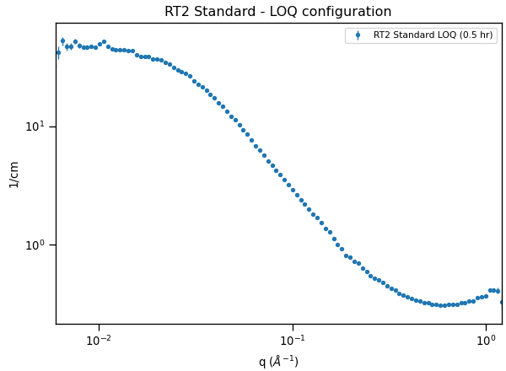
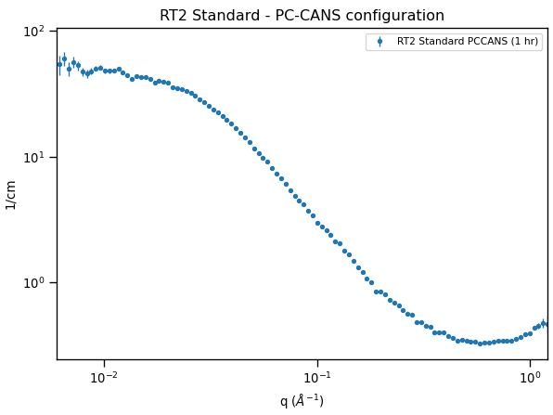
Confirming Proper Configurations
LOQ
A2 = 20 mm
PC-CANS
A2 = 8 mm
12

Slide 13
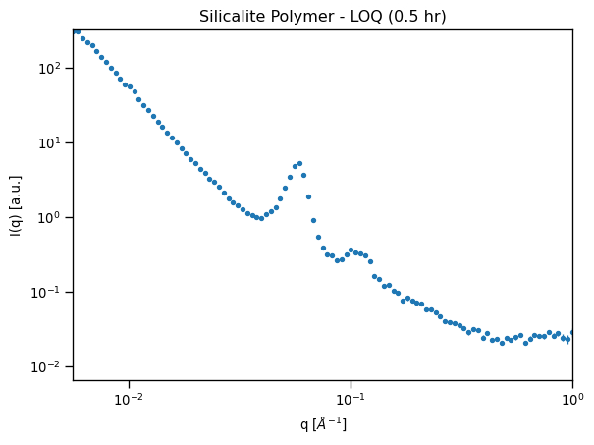
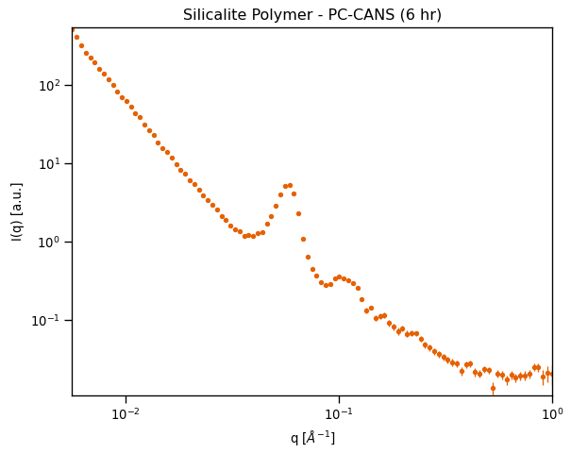
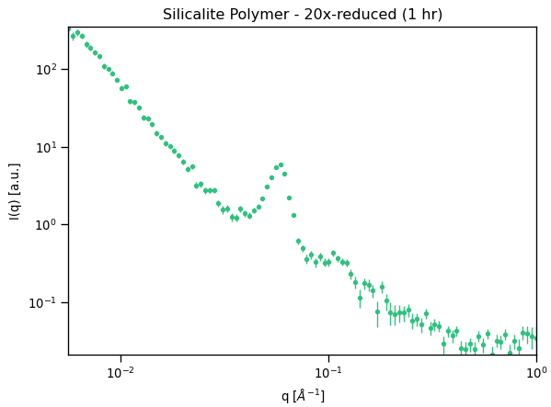
How far can you push this limit?
A2 = 20 mm
A2 = 8 mm
A2 = 4 mm
13
Notes:
Additionally, if you may think that the modulation may be teetering on enough of a reduction in flux, then we played around with an even smaller aperture, while looking at this specific polymer, we still get relatively reproducible data when adapting

Slide 14
Number of Peak | Q_{peak} (Å⁻¹) LOQ | Q_{peak} (Å⁻¹) PC-CANS | Q_{peak} (Å⁻¹) Literature
1st | 0.1034 | 0.1035 | 0.1086
2nd | 0.2029 | 0.2099 | 0.2154
14
Nyam-Osor, M., Soloviov, D. V., Kovalev, Y. S., Zhigunov, A., Rogachev, A. V., Ivankov, O. I., ... & Kuklin, A. I. (2012, March). Silver behenate and silver stearate powders for calibration of SAS instruments. In Journal of Physics: Conference Series (Vol. 351, No. 1, p. 012024). IOP Publishing.

Slide 15
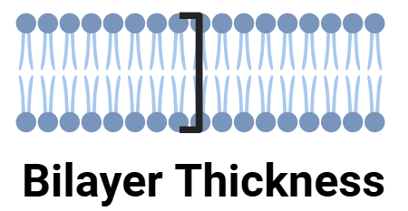
Structural Analysis: Bilayer Thickness (15 mg/mL)
Configuration | Bilayer Thickness (Å) | Measurement Time | Literature Thickness (Å)
LOQ | 39.00 ± 0.08 | 1 hour | 39.1 ± 0.78 at 30 °C
PC-CANS | 38.90 ± 0.12 | 6 hour
15
Kučerka, N., Nieh, M. P., & Katsaras, J. (2011). Fluid phase lipid areas and bilayer thicknesses of commonly used phosphatidylcholines as a function of temperature. Biochimica et Biophysica Acta (BBA)-Biomembranes, 1808(11), 2761-2771.

Slide 16
Structural Analysis: Bilayer Thickness cont. (5 mg/mL)
Configuration | Bilayer Thickness (Å) | Measurement Time | Literature Thickness (Å)
LOQ | 39.16 ± 0.16 | 1 hour | 39.1 ± 0.78 at 30 °C
PC-CANS | 38.94 ± 0.18 | 6 hour
16
Kučerka, N., Nieh, M. P., & Katsaras, J. (2011). Fluid phase lipid areas and bilayer thicknesses of commonly used phosphatidylcholines as a function of temperature. Biochimica et Biophysica Acta (BBA)-Biomembranes, 1808(11), 2761-2771.

Slide 17
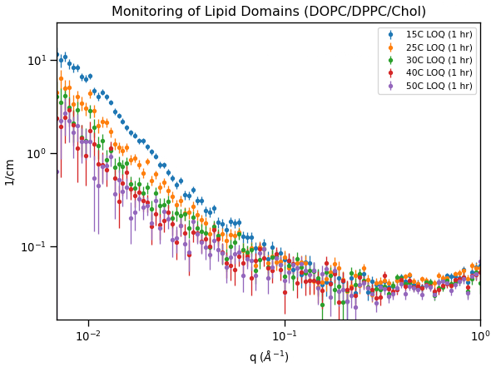
Contrast Variation: Domain Monitoring
Domains Present
(Neutron Contrast)
Domains Melted
(No Neutron Contrast)
Configuration | T_{m}(°C) | Measurement Time
LOQ | 23.81 ± 0.39 | 1 hour / temp
PC-CANS | 24.93 ± 0.81 | 6 hour / temp
17
Nickels, J. D., Chatterjee, S., Stanley, C. B., Qian, S., Cheng, X., Myles, D. A., ... & Katsaras, J. (2017). The in vivo structure of biological membranes and evidence for lipid domains. PLoS biology, 15(5), e2002214.
DiPasquale, Mitchell, et al. "The antioxidant vitamin E as a membrane raft modulator: Tocopherols do not abolish lipid domains." Biochimica et Biophysica Acta (BBA)-Biomembranes 1862.8 (2020): 183189
Notes:
Next we look at something other than structure, we looked at the temperature dependence of lipid domains
Using a contrast-matched scheme, matching a fully mixed sample to the solvent, we were able to monitor the formation/decay of domains as a function of temperature
Integrated total scattering intensity (Porod) was normalized and plotted as a function of temperature
A simple logistic function eq 4 was used to relate the contrast decay with temperature.
Matches a well-characterized membrane sample that our group uses → to a melting points where 50% of samples have been melted of being ~24C
Something like this (9 temperatures) → a temp scan like this at 30 mins -1hr per temp would take 5-10 hours, however something like this at 6 hours a sample could take over a day
However still shoes it can be done

Slide 18
In conclusion
We were able to attain respectable data using a flux proposed for the SANS instrument for the PC-CANS
Count times can be an issue for certain samples
Viable option for stable samples that can withstand longer count times
Was to emulate initial stages of a SANS instrument
Upgrades and advances in technology can help increase performance
Techniques to optimize count time can be also introduced
18
Notes:
-key parameters can be changed

Slide 19
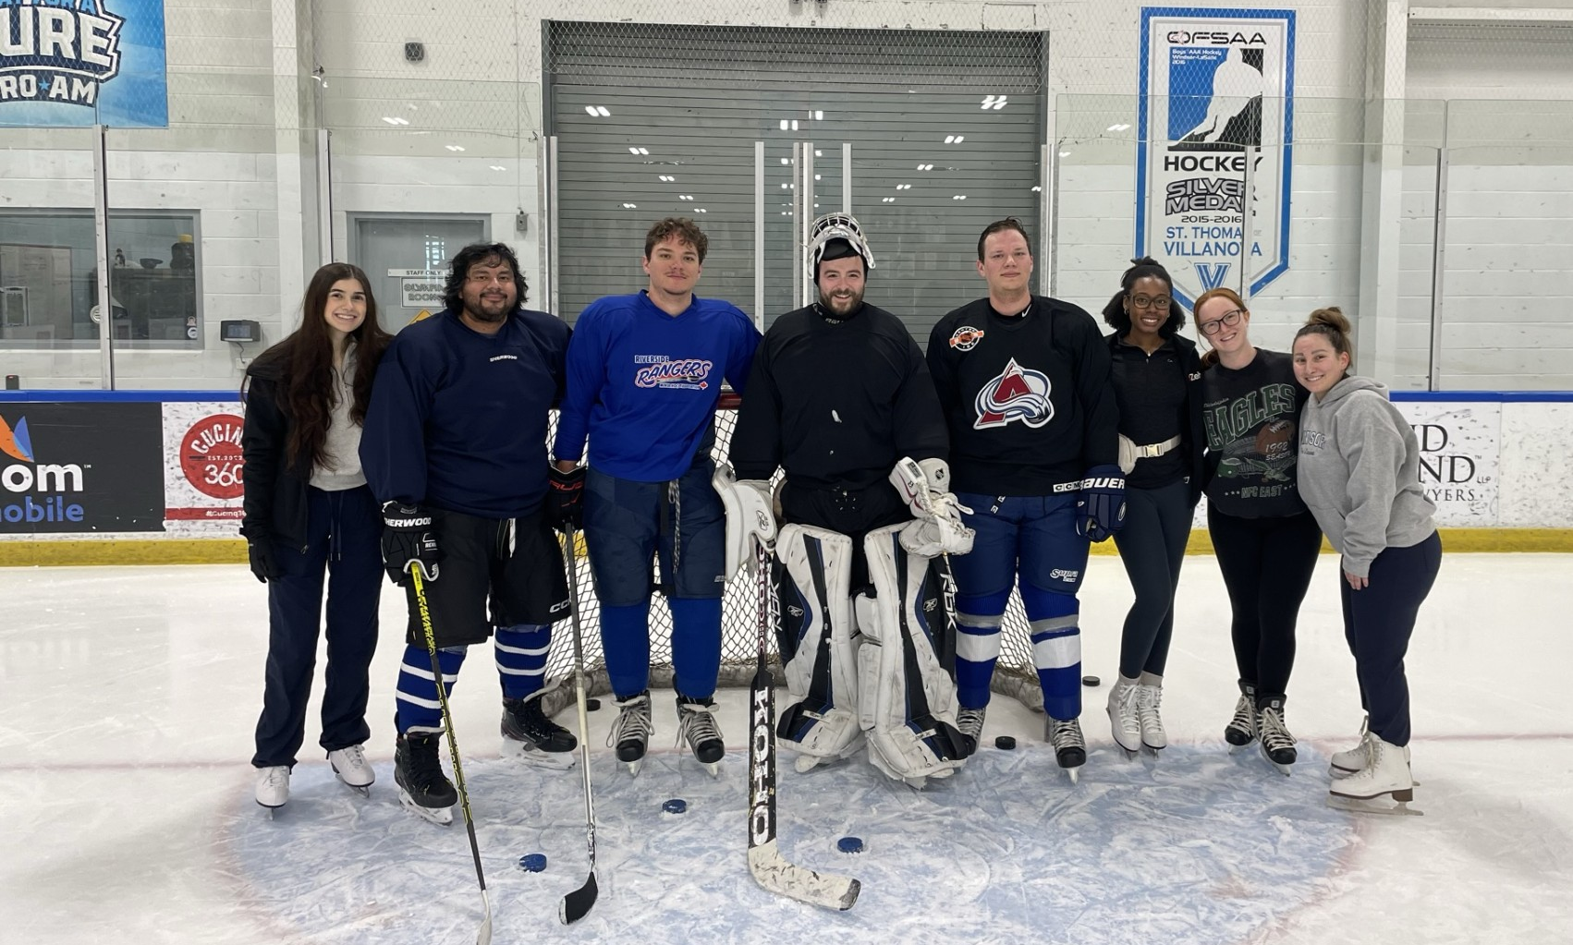
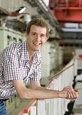
Acknowledgement
Dr. Drew Marquart
Stuart Castillo
Dr. Stephen King and the ISIS SANS team
All those involved with the Canadian CANS initiative
LABR Group
International Science Partnership Fund
Dr. Stephen King
19
Notes:
Nserc
UK research fund

