Slide 1

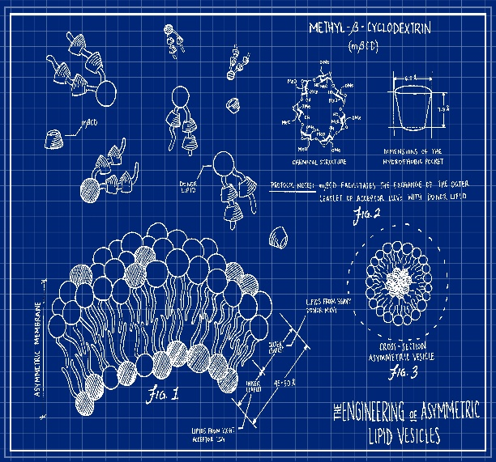
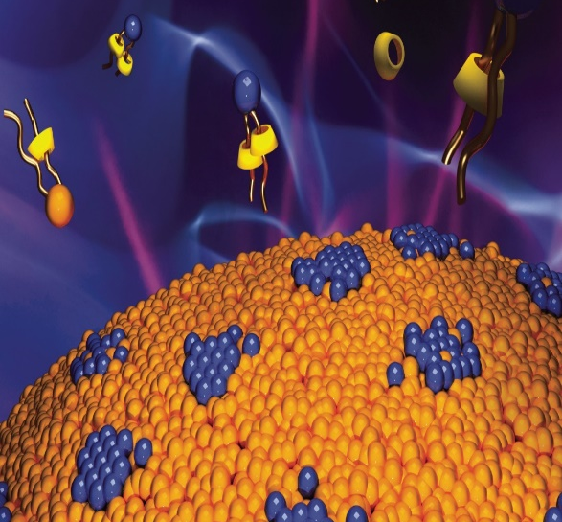
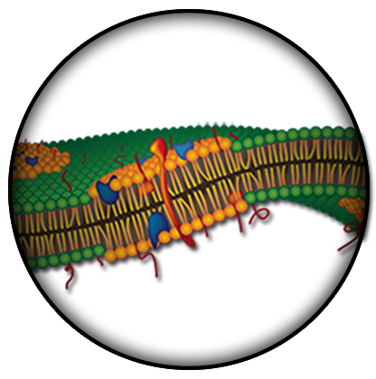
A CANS for Canada: Future neutron source for Canada
Drew Marquardt
      Associate Professor
      Department of Chemistry and Biochemistry
      University of Windsor
UCANS 11
February 25, 2025
Canadian Centre for Neutron Research and Therapeutics

Slide 2
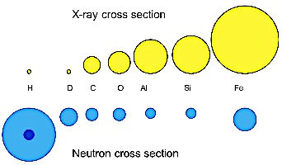
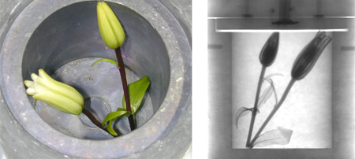
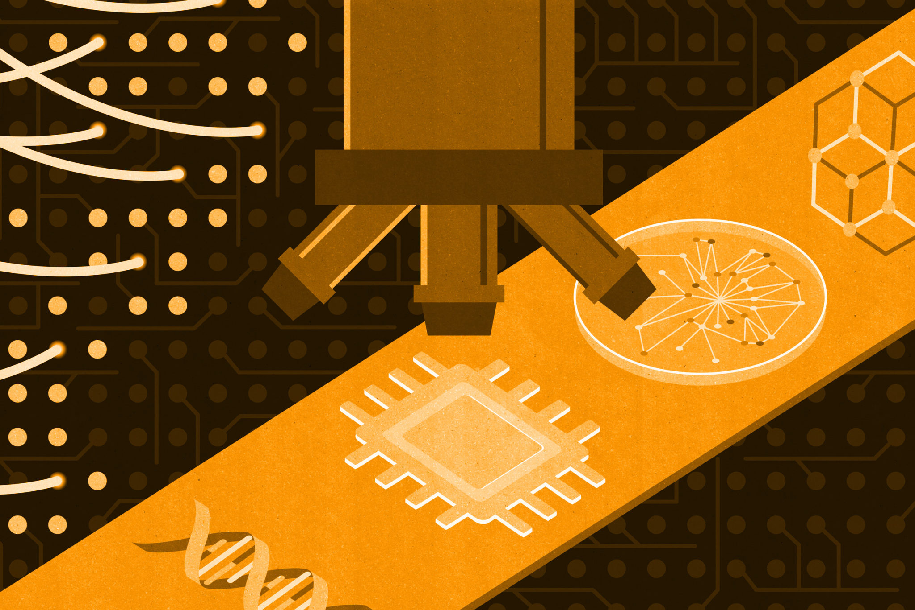
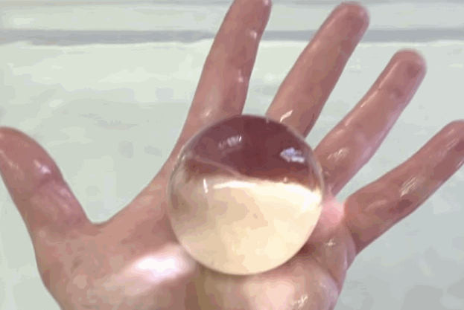
Neutrons as a Material Probe
Neutral charge
  Highly penetrating
Sensitive to:
  light elements
  isotopes
Magnetic moment

Slide 3

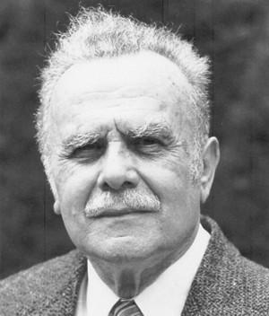
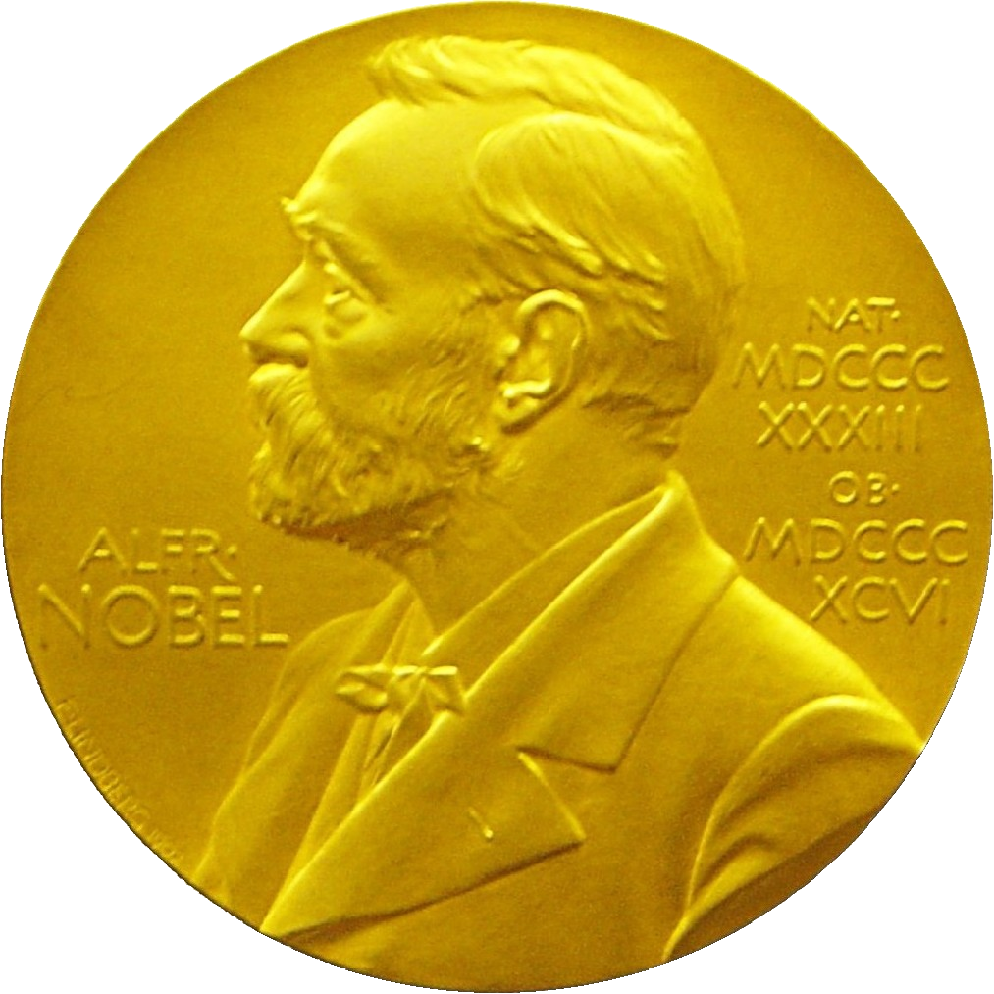
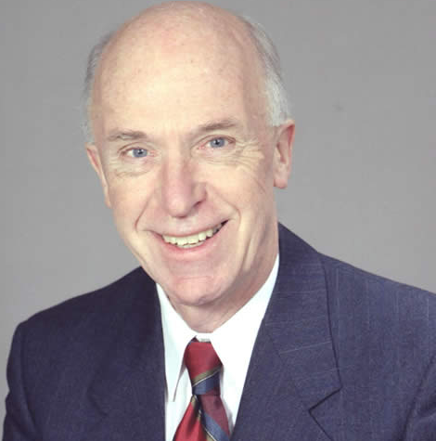
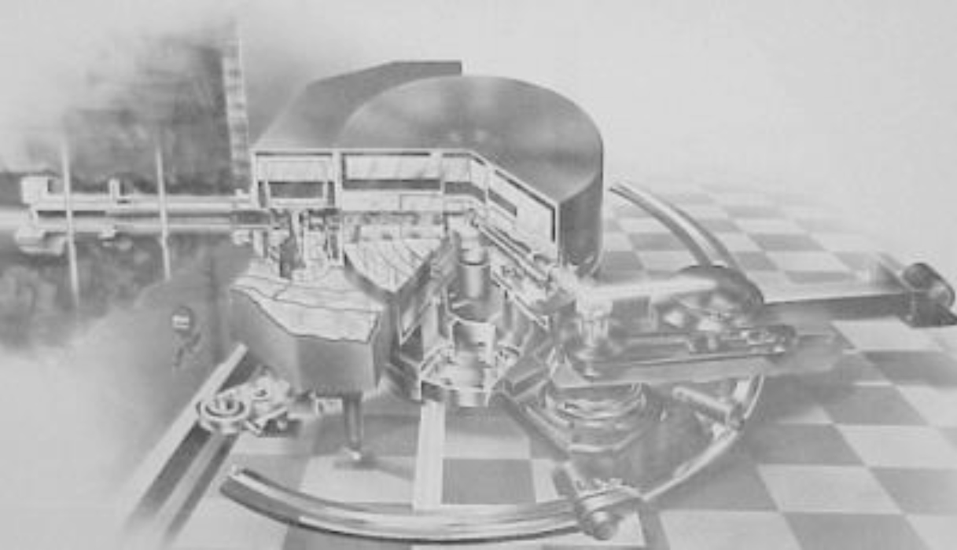
Rich History of Neutron Scattering
1994 Nobel Prize in Physics – Bertram Brockhouse
  For the development of neutron scattering techniques for condensed matter studies.
Confirmed the existence of topological materials
  Prediction of such materials was the subject of the 2016 Nobel Prize in Physics

Slide 4




Neutron’s Impact in Canada
Clean environment
  Improved the reliability of hydroelectric dams.
Economic competitiveness
  Developed methods of reducing scrap waste during manufacturing.
Safety and security
  Extended the lives of Naval ships.
Health and food security
  Develop drought resistant crops.

Slide 5
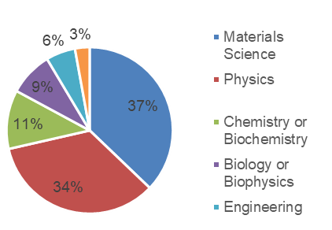
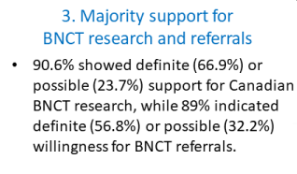
National Need
Research Community and Medical Community want and need neutrons!
Neutron beams are important for research across a wide variety of fields.
Neutron beams can serve as a powerful therapeutic tool

Slide 6
Canadian Neutron Initiative – High Level
Create a new, national governance and management framework – Neutrons Canada (Est October 2022).
Forge partnerships with neutron sources in other countries.
  Canadian Access at ISIS Neutron and Muon Source in UK (~$1.4M)
Developed a Long-Range Plan suitable for policy makers
Explore and invest in developing new neutron sources for the long term.

Slide 7
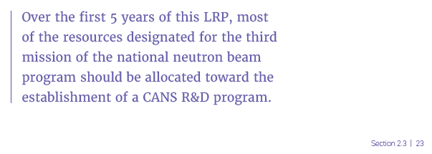
Canadian Neutron Initiative – High Level
Create a new, national governance and management framework – Neutrons Canada (Est October 2022).
Forge partnerships with neutron sources in other countries.
  Canadian Access at ISIS Neutron and Muon Source in UK (~$1.4M)
Developed a Long-Range Plan suitable for policy makers
Explore and invest in developing new neutron sources for the long term.

Slide 8
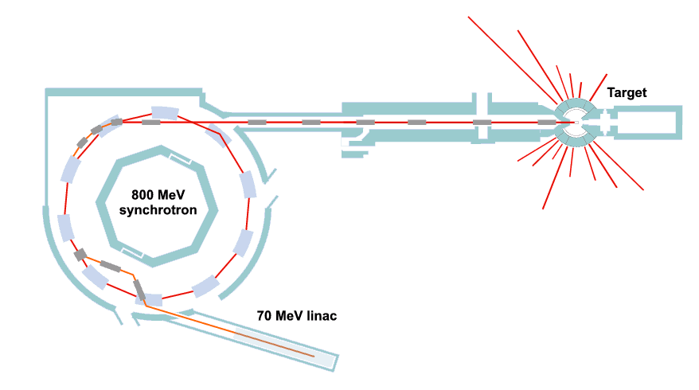
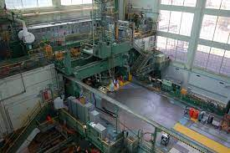
Sources of Neutrons
Fission Reactor → U²³⁵ + n (thermal)
  Expensive ~$1B
  NIMBY
Spallation → “blowing chunks” (p,n)
  Expensive ~$1-2B
  High energies
Stripping-Reaction → Be/Li(p,n)
  Low energy = small footprint = inexpensive
  Modular
  Compact Accelerator Neutron Source (CANS)

Slide 9
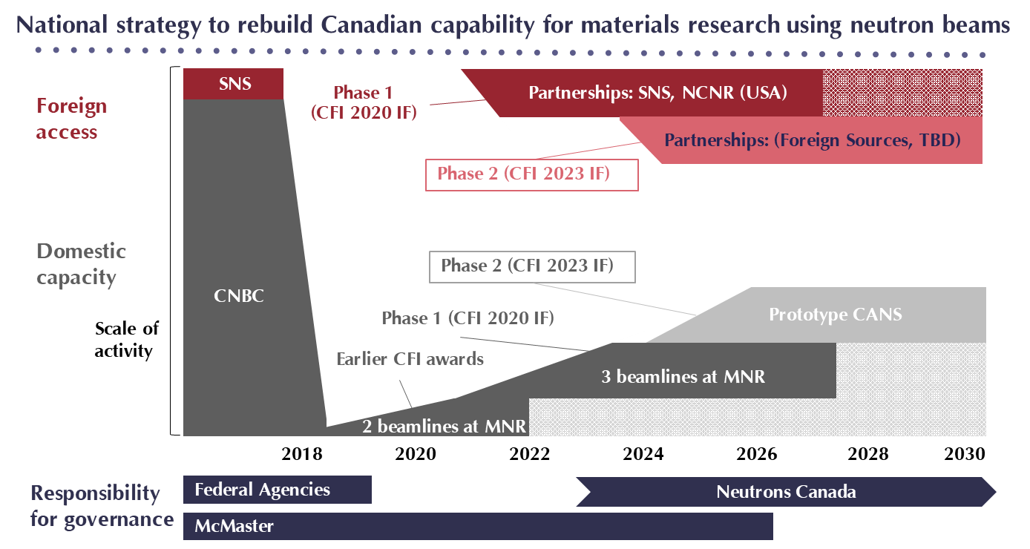
Fit Within National Strategy
Spallation Neutron Source (SNS);
Canadian Neutron Beam Centre (CNBC);
McMaster Nuclear Reactor (MNR);
NIST Center for Neutron Research (NCNR)
Partnership: ISIS Neutron Muon Source (UK)
CNRT

Slide 10
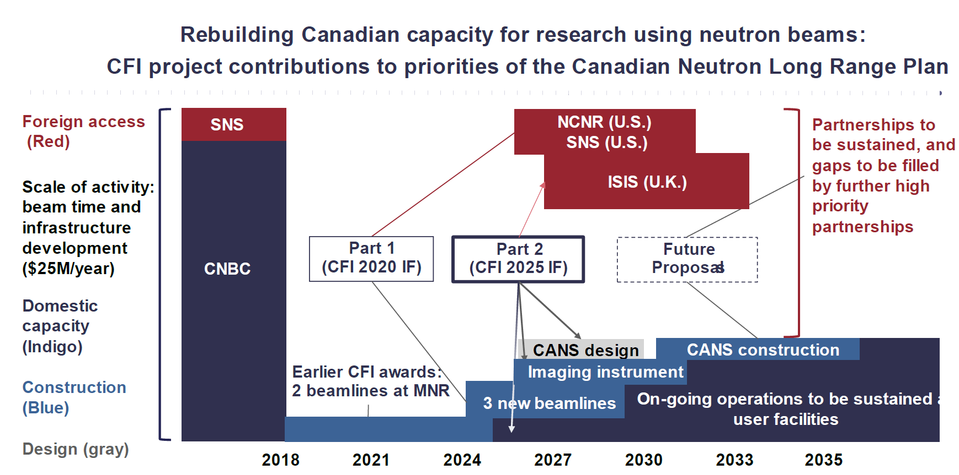
Fit Within National Strategy - Updated
Spallation Neutron Source (SNS);
Canadian Neutron Beam Centre (CNBC);
McMaster Nuclear Reactor (MNR);
NIST Center for Neutron Research (NCNR)
ISIS
(U.K.)

Slide 11
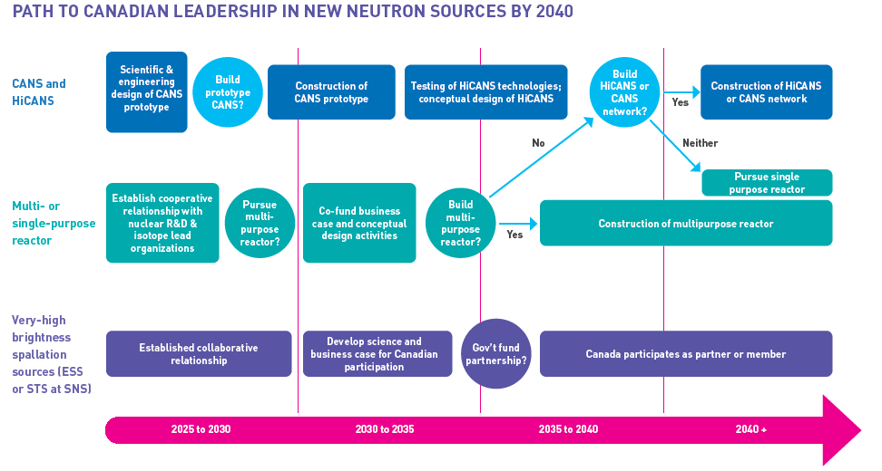
LRP Emphasis on CANS

Slide 12
Prototype Canadian-CANS: Missions
Construct a world-leading CANS prototype to demonstrate the potential for the technology
Conduct research using the following neutron methods:
  Small-angle neutron scattering
  Diffraction/Neutron imaging
  Boron Neutron Capture Therapy (BNCT)
Supply Windsor region with
Fluorine-18 isotope for the PET scanner

Slide 13
Prototype Canadian-CANS: Updates
Maks Dziura – “We CANS Do It: A Step Towards a Canadian PC-CANS”
Mina Abbaslou – “Beam Dynamics Design for Alternating Phase Focusing Proton LINAC for a Compact Accelerator Based Neutron Source” (Poster)
Daniel Banks – “Contributions to Measuring the Value of Neutron Sources”
Robert Laxdal – “PC-CANS - Conceptual Design of a Compact Accelerator Based Neutron Source for Canada”
Mina Abbaslou – “Design Considerations for a Proton Linac for a Compact Accelerator Based Neutron Source for Canada”

Slide 14
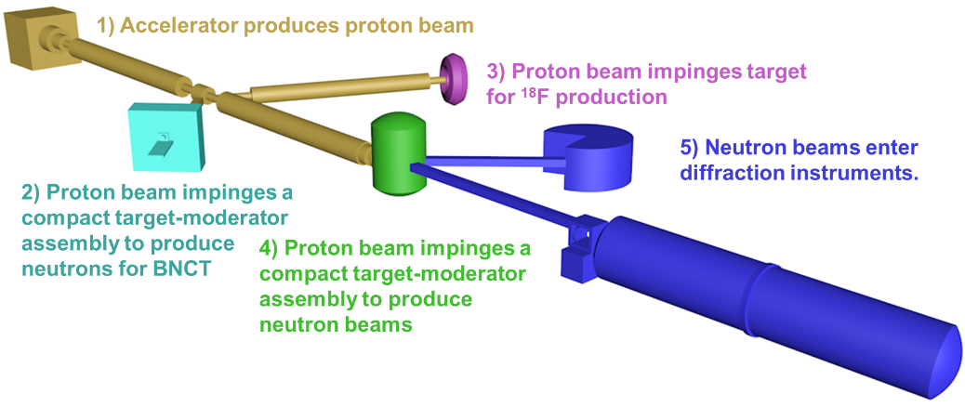
PC-CANS

Slide 15
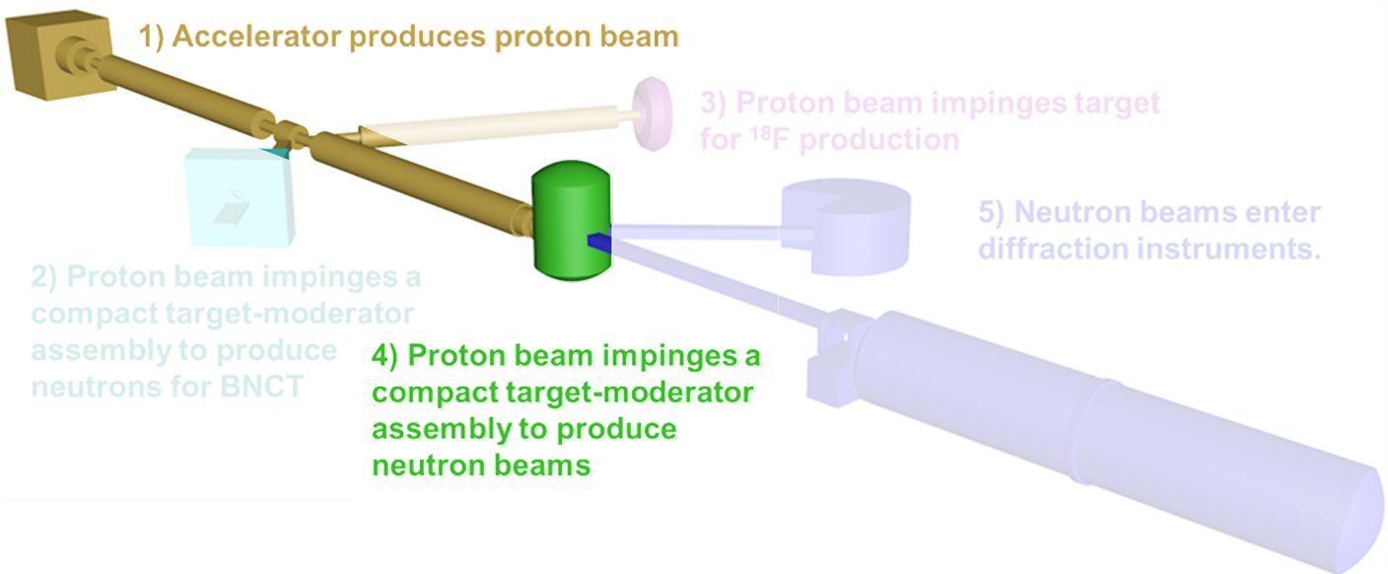
PC-CANS: Neutron Production

Slide 16



Target-Moderator Research (TMR)
Accelerator requirements for:
  Neutron scattering
  BNCT
  Isotope production
Target material and geometry
  How to handle the high powers on target
  Multiple targets?
  Optimized extraction strategy
Build from our friends at Julich (Germany) and in Japan

Slide 17
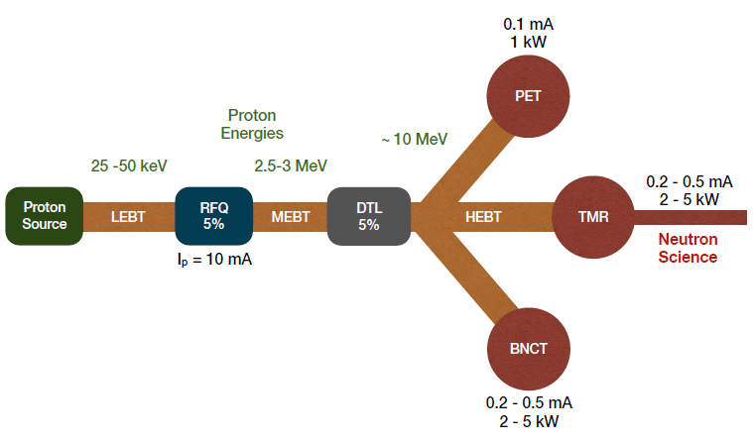
PC-CANS Linac Specifications
High intensity 10 MeV proton linear accelerator (RFQ+DTL) and multiple target stations.
Total peak beam intensity required is 10 mA at a duty factor of up to 5% (0.5 mA, average)
A pulsed switchyard in the high energy beam transport (HEBT) can be used to distribute the beam to each of the three end stations simultaneously.
As target technology develops dedicated delivery to one station could be envisaged for higher neutron flux
Main parameters | RFQ | DTL
E_{in} (MeV) | 0.045 | 3
E_{out} (MeV) | 3 | 10
Duty Factor (%) | 5 | 5
I_{peak} (mA) | 10 | 10
P_{beam} (kW) | 29.5 | 70
PC-CANS Conceptual Design Report TRIUMF, UWindsor, CNL R. Laxdal (Eds.)

Slide 18
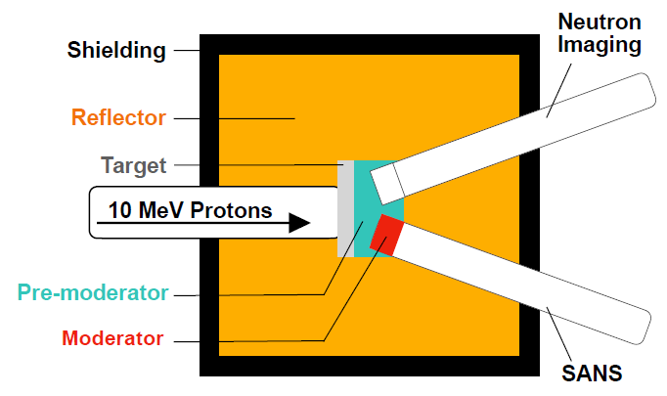
Design for a practical TMR for PC-CANS
Beryllium Target – Produces neutrons via (p,n) reactions. Using a Vanadium backing
Pre-moderator – polyethylene, slows neutrons from ~ MeV to thermal energies ~10-100 meV
Moderator – Mesitylene (cold), slows thermal neutrons to cold energies
< 10 meV
Reflector – graphite, backscatters high energy neutrons for further moderation
Shielding – layered (HDPE, BPE and Pb) protects users from exposure and being compact.
180 cm
Tools Utilized : FLUKA & MCNP
PC-CANS Conceptual Design Report TRIUMF, UWindsor, CNL R. Laxdal (Eds.)

Slide 19
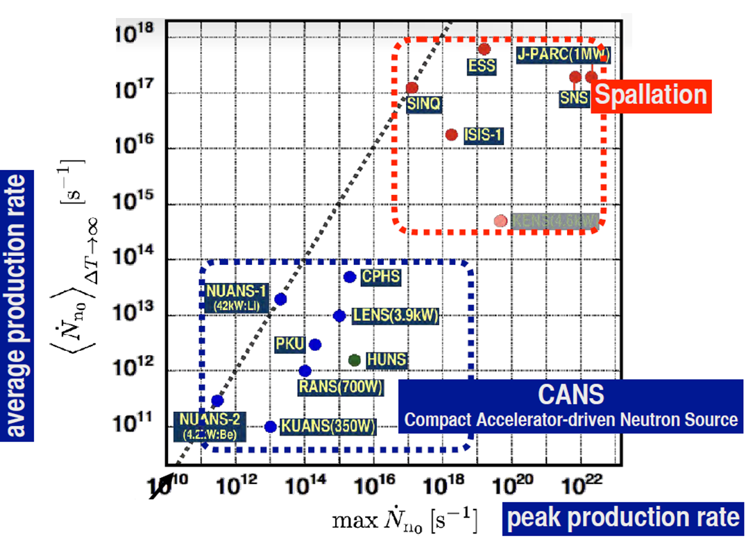
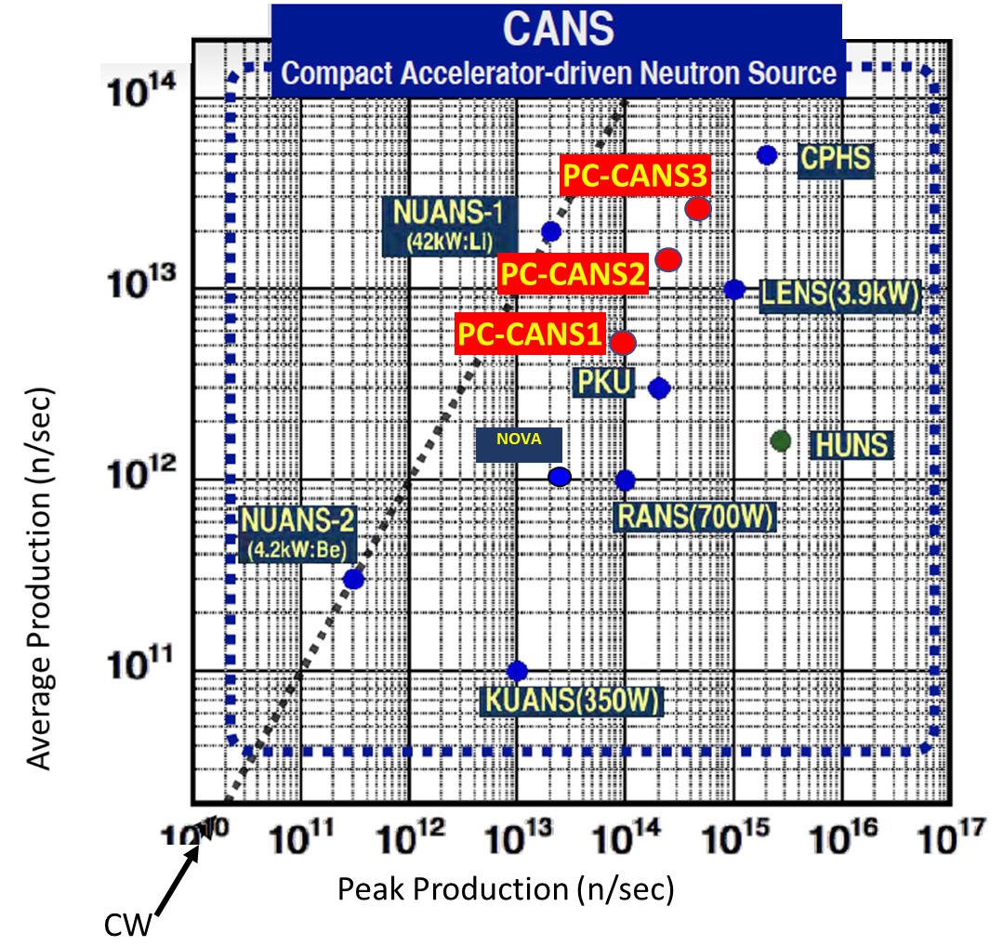
Expected performance
PC-CANS Conceptual Design Report TRIUMF, UWindsor, CNL R. Laxdal (Eds.)

Slide 20
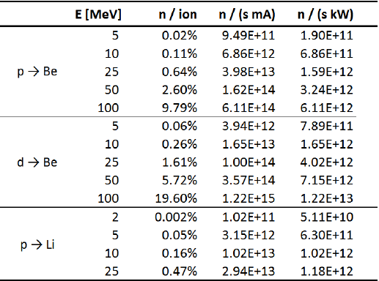
Expected performance
PC-CANS Conceptual Design Report TRIUMF, UWindsor, CNL R. Laxdal (Eds.)

Slide 21
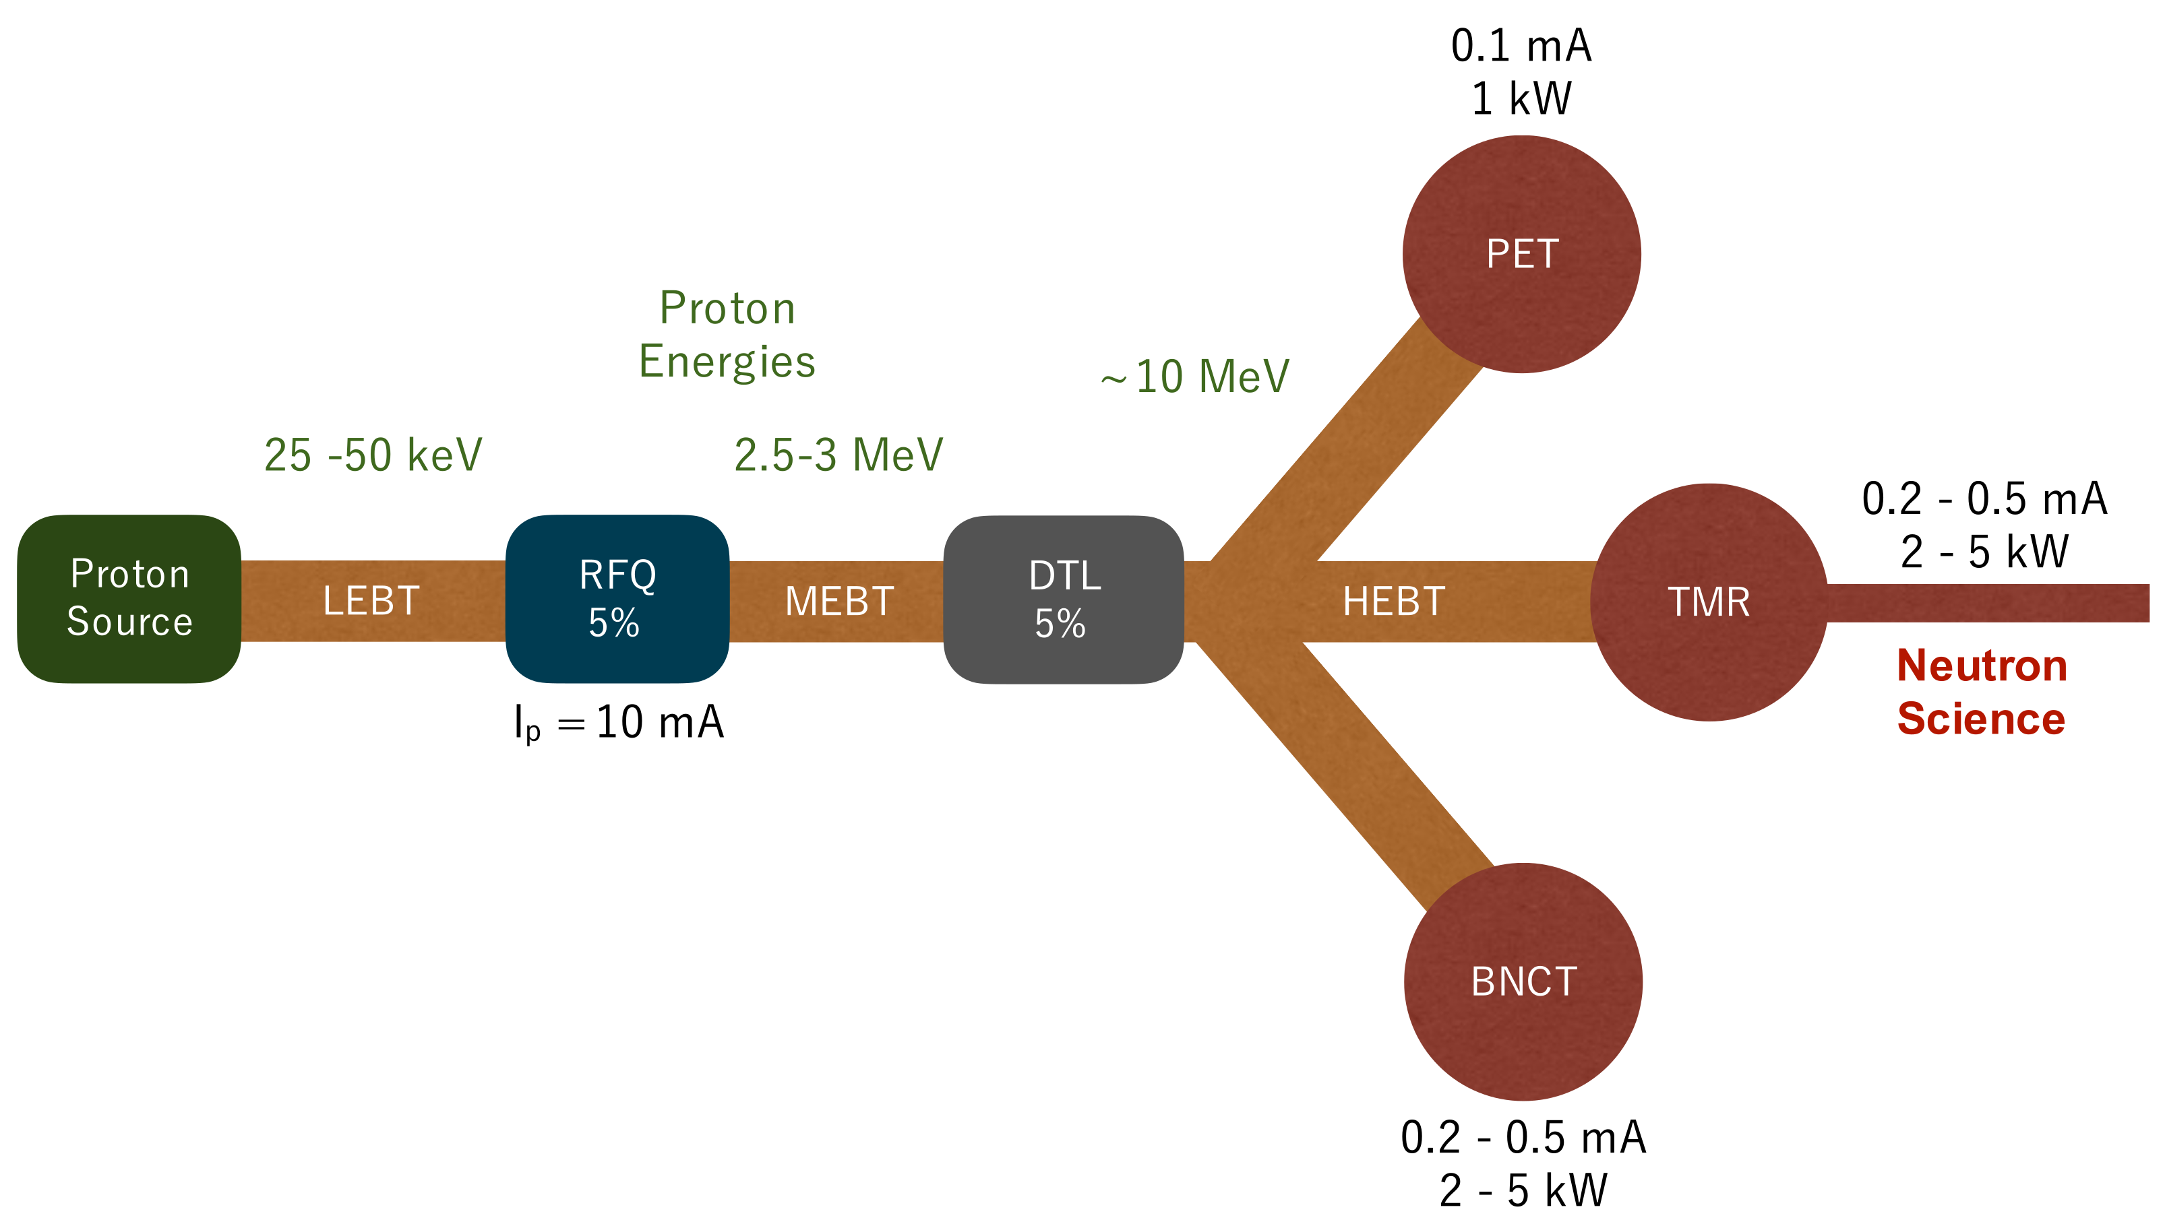
PC-CANS Stage 1
Simultaneous or separate operation
  1/5 NRU
  5-12 x NOVA ERA (Julich)

Slide 22
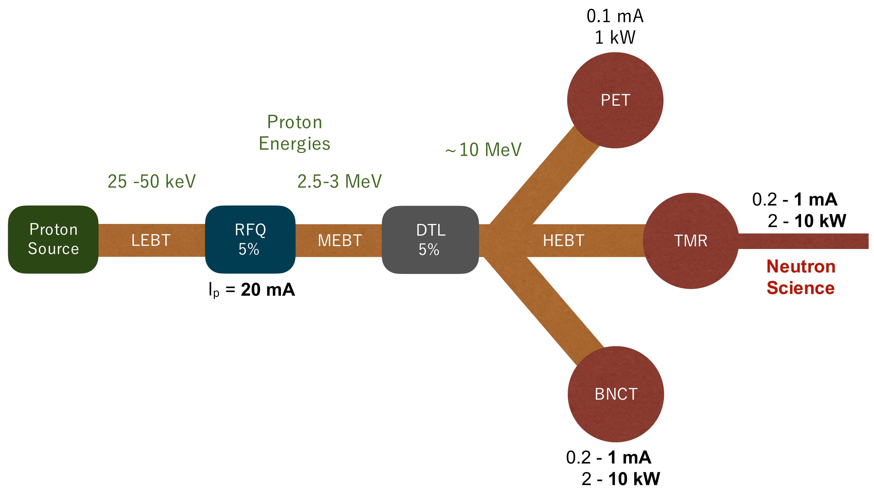
PC-CANS Stage 3
Designed to double all beam intensity
parameters in linac design
  Limiting factor is target
  technology
  ~1 NRU
  10-25 x NOVA ERA (Jülich)

Slide 23
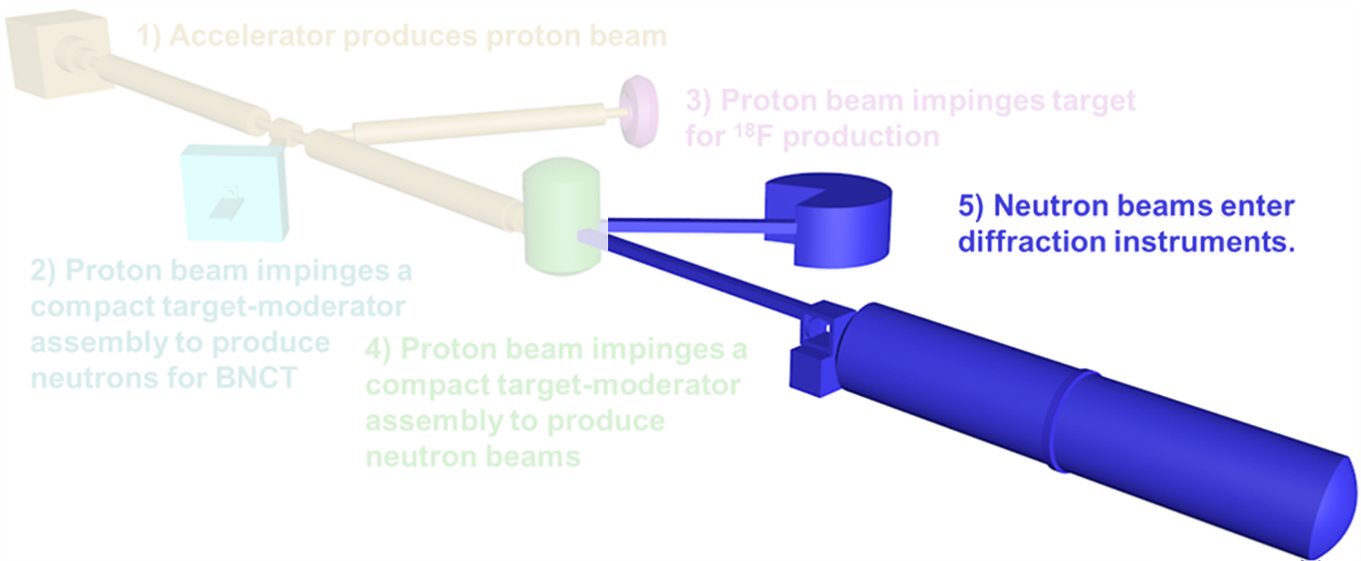
PC: CANS: Materials Science Research

Slide 24
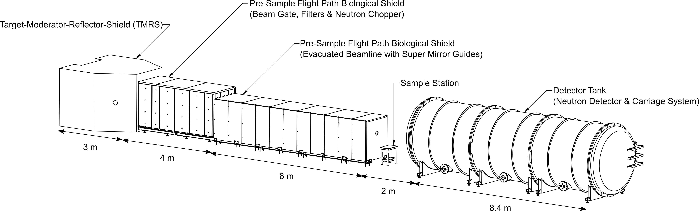

Selection Criteria for Material Instruments
Goal: Ability to demonstrate attractiveness of a low-cost CANS
Strong scientific demand for the technique in Canada
Compatible with other instruments on the same customized source
(e.g. wavelength band or pulse length)
Distinct capability from instruments at McMaster
Fits within an accessible budget

Slide 25
Candidate instruments at the CANS
Consideration | Neutron Imaging | General diffraction | SANS | PDF + Powder diffraction
Scientific demand | Medium | Medium | High | High
Distinct capability | Academic access |  | cold neutrons | PDF, Epithermal neutrons
Domestic advantage | Soils, nuclear materials, culture | nuclear materials
Cost | Low | Medium-High | Medium ~4.5M | High
Without partner investment or sacrificing instrument performance, budget will be limited to (1) imaging and (2) SANS
SANS = Small-angle neutron scattering
GI = Grazing Incidence
PDF = Pair distribution function analysis

Slide 26

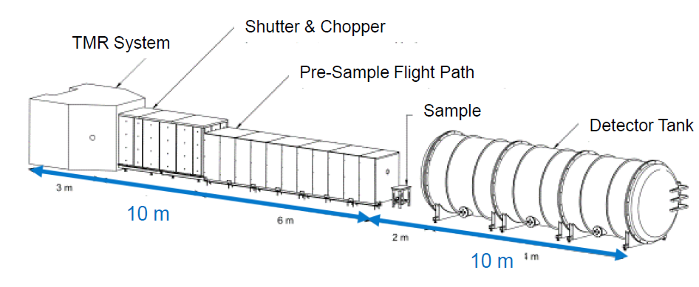
SANS Performance
PC-CANS SANS
Q_{min} = 0.006 Å⁻¹, Q_{max} = 0.39 Å⁻¹
Loq SANS
Q_{min} = 0.006 Å⁻¹, Q_{max} = 0.24 Å⁻¹
Stage 1: flux = 0.3x10⁵ n/(cm²∙s)
Stage 3: flux = 1.5x10⁵ n/(cm²∙s)
flux = 2x10⁵ n/(cm²∙s)
Maks Dziura – “We CANS Do It: A Step Towards a Canadian PC-CANS”

Slide 27
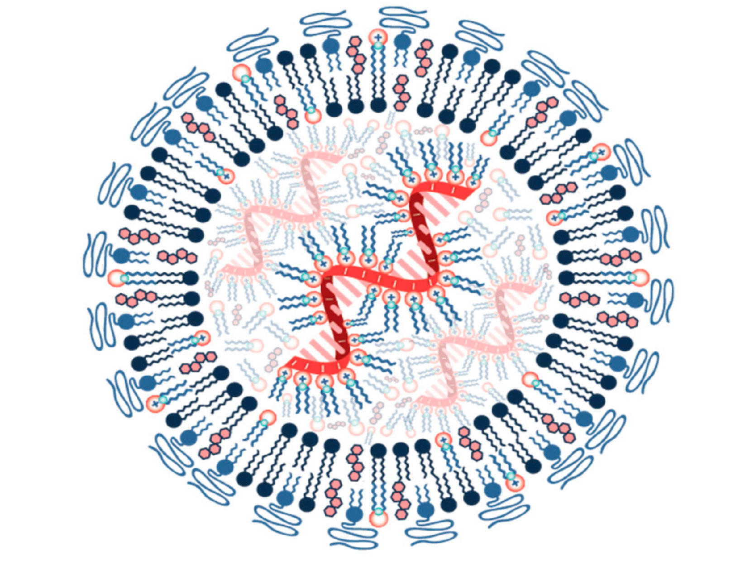
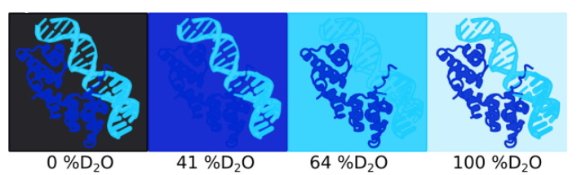
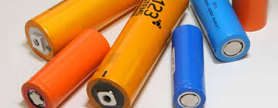

SANS Applications
Immediately applicable in the study of:
  colloids
  nanoparticles
  polymers
  bio-molecules
  alloys and composites
  porous systems
  battery technology

Slide 28
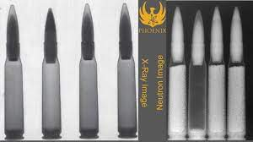
Neutron Imaging
Internal flaws of metal products
  Cracks, inclusions, voids, bubbles, foreign materials, density variations & misalignments
Radioactive & hydrogenous objects in shielding/sealed units
Authentication of artifacts from archeological digs

Slide 29
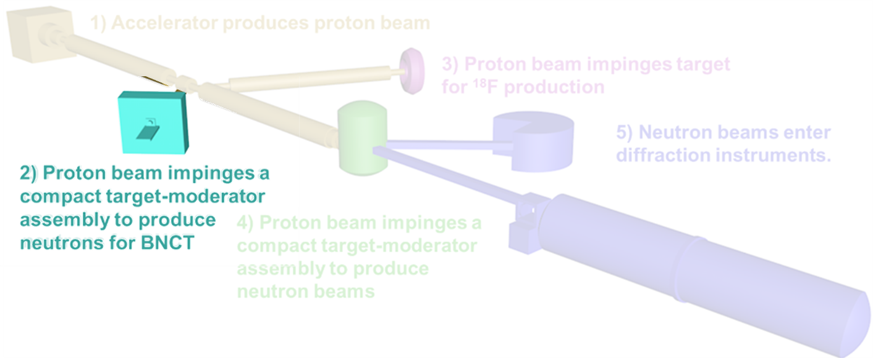
Boron Neutron Capture Therapy (BNCT)

Slide 30
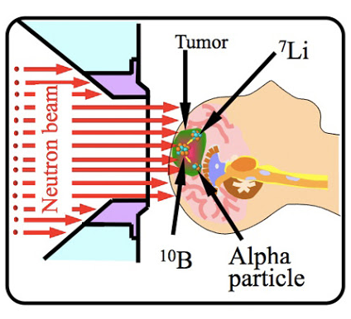
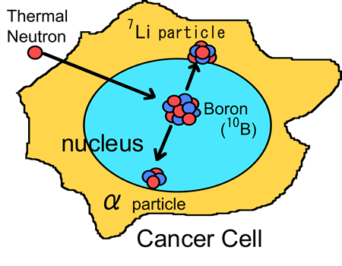
Boron Neutron Capture Therapy (BNCT)
Inject ¹⁰B agent to target a tumor
Verify ¹⁰B uptake with PET scanner
Irradiate tumor with neutrons releasing α-particle that kills host cancer cell, while leaving surrounding cells intact
BNCT is highly promising for cancers that are currently untreatable
Our CANS will be the first & only BNCT facility in Canada.
Japan Atomic Energy Agency
https://www.jaea.go.jp/english/news/p06071001/index.shtml

Slide 31
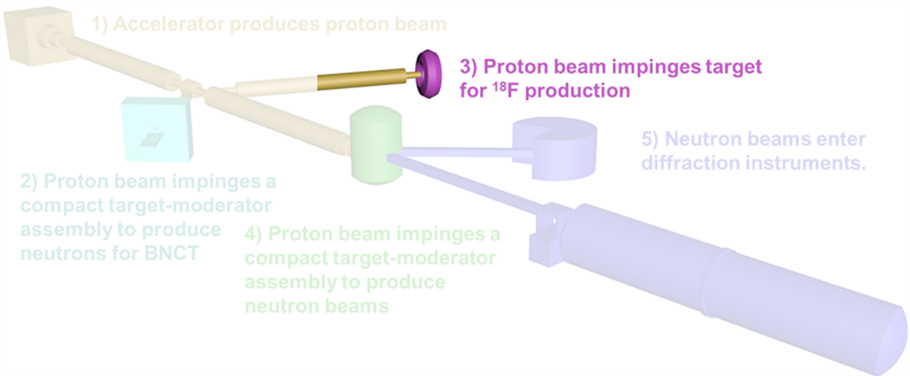
Medical Isotope Production

Slide 32
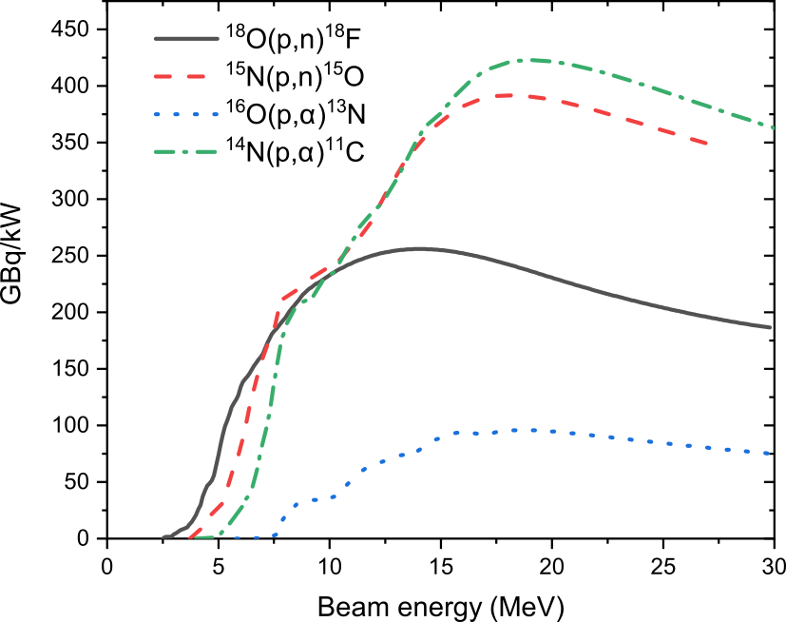
Isotope Production: [¹⁸F]-fluorodeoxyglucose
PET scanning requires FDG:
  ¹⁸F has a t_{1/2} ≈120 min.
2030 projected patient load to x3
Access to even t_{1/2}
  ¹⁵O (2 min), ¹³N (10 min), & ¹¹C (20 min)

Slide 33
Momentum
  Statements of support and endorsement for this CFI project from:
    Canadian Nuclear Laboratory (CNL)
    Canadian Institute for Neutron Scattering (CINS)
    Brain Tumor Foundation of Canada
    National Research Council Canada (NRC)
    Several Ontario companies
    TRIUMF – $1.5M in-kind for design
    Neutrons Canada – $420k in-kind
      Government Lobbying on CCNRT behalf
      Cost/Work sharing of infrastructure related tasks
“The PC-CANS prototype […] is an essential first step in proving the viability of the technology.” TRIUMF Workshop
Notes:
Demonstrate new technology for a cost-effective neutron source with adequate performance and staging opportunities to further boost performance
If the technology is successful, it will inform decisions about whether Canada should invest ~$200M investment in a brighter neutron source based on this CANS technology.
The CANS is a pulsed neutron source which will will build Canadian expertise in this area, as Canada has never had a pulsed neutron source.

Slide 34
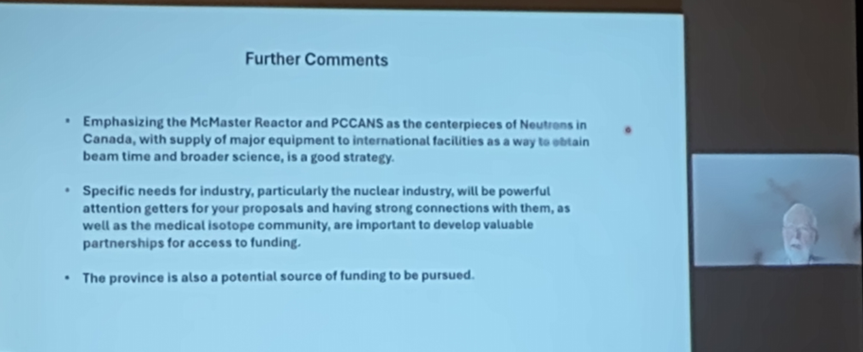
National priority
“Listening to your long-range plan and looking at the interest in developing accelerator sources, it seems to me like that being a very good idea to be the first thing on your priority …” Art McDonald, Nobel Prize Laureate
Notes:
Demonstrate new technology for a cost-effective neutron source with adequate performance and staging opportunities to further boost performance
If the technology is successful, it will inform decisions about whether Canada should invest ~$200M investment in a brighter neutron source based on this CANS technology.
The CANS is a pulsed neutron source which will will build Canadian expertise in this area, as Canada has never had a pulsed neutron source.

Slide 35








Friends and Financiers
Oliver Kester (TRIUMF)
Bob Laxdal (TRIUMF)
Alex Gottberg (TRIUMF)
Marco Marchetto (TRIUMF)
Dalini Maharaj (Jülich)
Mina Abbaslou (UVic/TRIUMF)
Zin Tun (TVB/McMaster)
Daniel Banks (TVB)
CNL Team!

Slide 36
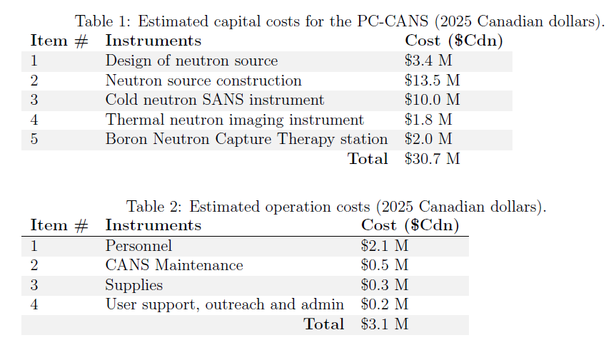
Cost estimates

