Slide 1




Design Considerations for a Proton Linac for a Compact Accelerator Based Neutron Source (CANS) for Canada
Mina Abbaslou
Supervisors: Bob Laxdal, Marco Marchetto, Tobias Junginger, Philipp Kolb
27 February 2025
*This project has received funding from the New Frontiers in Research Fund – Exploration grant NFRFE-2018-00183.​
Notes:
Good afternoon, thank you for the opportunity to present our group’s progress and outlook for compact accelerator based sources in Canada. My name is Mina Abbaslou and I am a doctoral candidate at the University of Victoria. I work collaboratively with the Accelerator group and Targets & Ion group at TRIUMF.
PC-CANS (Prototype Canadian Compact Accelerator Based Neutron Source)

Slide 2
Overview
Introduction to Project of PC-CANS
Two Frequencies RFQ Beam Dynamics Design and Optimization
DTL Variant Comparison Studies
Conclusion
Design Considerations for a Proton Linac for a Compact Accelerator Based Neutron Source (CANS) for Canada M.Abbaslou Feb.27, 2025
Notes:
Say motivation of our project: to capture my audience

Slide 3
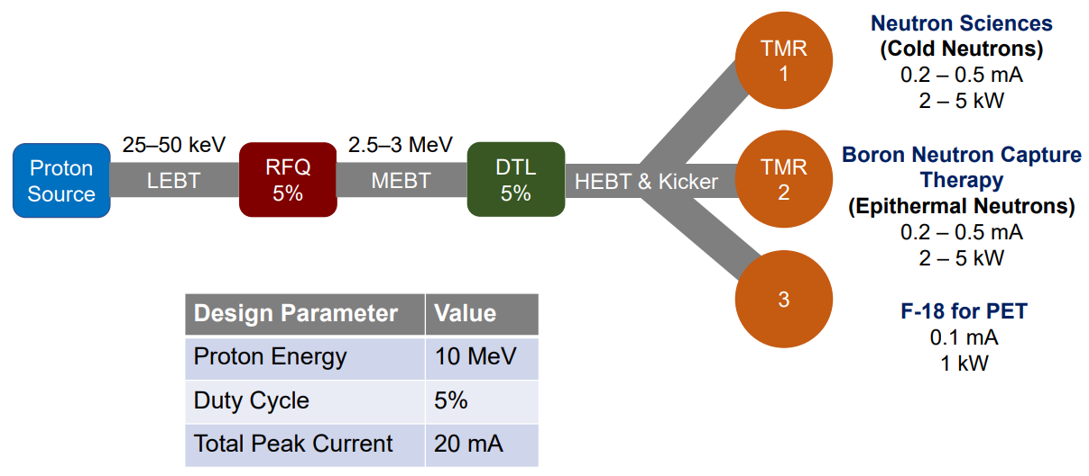
PC-CANS:
PC-CANS (Prototype Canadian Compact Accelerator Based Neutron Source) is a proposal for a high intensity pulsed proton source at the University of Windsor for the production of:
Cold Neutrons for Science (SANS)
Epithermal Neutrons for BNCT
Protons for 18F Isotope Production for PET
Present targets are foreseen to accept up to 500µA average current
The linac is being designed to accelerate protons to 10MeV with a peak intensity of 20mA at 5% duty factor for 1mA average current.
Details of PC-CANS
See prof. Drew Marquardt talk in sessin3,
prof. Robert Laxdal talk in session 6,
and Maksymilian Dziura talk in session 5
Design Considerations for a Proton Linac for a Compact Accelerator Based Neutron Source (CANS) for Canada M.Abbaslou Feb.27, 2025
Notes:
Just say this is a recall from Bob’s talk.
RFQ as you know a typical injection stage after an ion source and the DTL is a typical LINAC structure.
I am designing for the 20mA
The RFQ will accelerate the unbunched proton beam from the source potential to 3MeV with high transmission.
The DTL will accelerate bunched proton beams from 3MeV to 10MeV
The beam is sent simultaneously to three different targets by means of a multiplexer in the High Energy Beam Transfer (HEBT) [3]. Each individual beam behind the multiplexer must have a specific time structure in order to use the optimum resolution of the different instruments behind a specific target.
Switchyard: Can take advantage of the macro-pulse to simultaneously deliver beam pulses to each end-station. BNCT and PET would favour cw beam but neutron pulses could be customized to support the science.
CANS generate neutrons via the bombardment of light metal targets, for example lithium (Li) or beryllium (Be) with pulsed proton beams with high peak-current and energies on the order of 5-10 MeV
The initiative to develop a Prototype Canadian CANS (PC-CANS) at the University of Windsor seeks to close the neutron gap in Canada, demonstrate proof of concept and establish a medium brilliance neutron source. The PC-CANS will host three end users; neutron sciences, boron neutron capture therapy (BNCT) and F-18 medical isotope production for PET, as shown in Figure 1

Slide 4
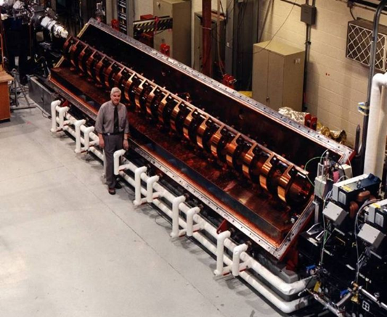
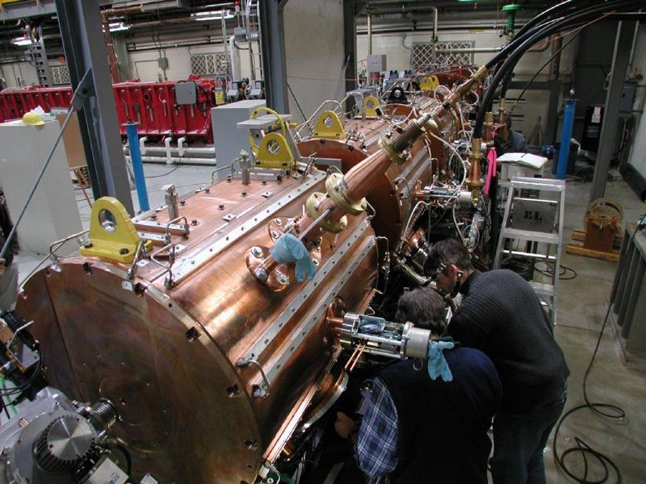
Frequency of RFQ and DTL:
There are many high intensity proton Linacs in the regime from
300-400 MHz
Based on these projects, we choose RF frequency of 352.2 MHz as the baseline for both the RFQ and DTL with an RFQ energy of 3 MeV
Project | Freq (MHz) | I_peak (mA)
CERN Linac 4 | 352 | 70
ESS | 352 | 70
SNS | 402.5 | 60
J-PARC | 324 | 60
FAIR p-linac | 325 | 70
CPHS | 325 | 50
CSNS | 324 | 40
The ISAC-I RFQ and DTL
Design Considerations for a Proton Linac for a Compact Accelerator Based Neutron Source (CANS) for Canada M.Abbaslou Feb.27, 2025
Notes:
The image below shows the names given to different regions of the EMS. Note that the visible part of the spectrum, the only type of electromagnetic radiation that we can detect with our eyes, makes up only a tiny fraction of the EMS.
The Compact Linear Collider (CLIC) is a proposed terra- electron-volt- scale high- luminosity linear electro n–positron collider that would enable the experimental searches described above..
CPHC: Compact Pulsed Hadron Source AT TSINGHUA UNIVERSITY
J-PARC (Japan Proton Accelerator Research Complex) is a high intensity proton accelerator facility.
CSNS: China Spallation Neutron Source (CSNS), The China Spallation Neutron Source (CSNS) accelerator is designed to accelerate proton beam pulses to 1.6 GeV at 25 Hz repetition rate, striking a solid metal target to produce spallation neutrons. The accelerator provides a beam power of 100 kW on the target in the first phase and then 500 kW in the second phase by increasing the average beam intensity 5 times while raising the linac output energy. The project construction has been formally launched in 2011 and it is planned to complete the project in March 2018. It is one of the high intensity proton accelerator projects in the world and it imposes a great challenge to Chinese accelerator community. This presentation will cover the status and challenges of the CSNS project.
FAIR p-linac: For the Facility for Antiproton and Ion Research (FAIR) a compact proton linac will produce proton beams
with energy of 68 MeV that will be injected into upgraded Heavy Ion Synchrotron (SIS 18), accelerated to 4 GeV, and
further accelerated to 30 GeV in SIS 100. The commissioning of the proton injector which would serve for the injection
into the proton linac has already started at CEA/Saclay. The ion source operating with a microwave frequency of
2.45 GHz based on Electron Cyclotron Resonance (ECR) plasma production with two coils each with 87.5 mT magnetic
field, will deliver a 100 mA proton beam at 95 keV of energy. The Low Energy Beam Transport (LEBT) including two
short solenoids system and integrated steerers will transport the proton beam to the RFQ entrance with an expected
emittance lower than 0.3Σ mm mrad (normalized, rms). After the LEBT an electrostatic chopper will be mounted in front
of RFQ to shorten the beam pulse to 36 Πs. This paper presents the status of the commissioning phases including first
results of proton injector.

Slide 5
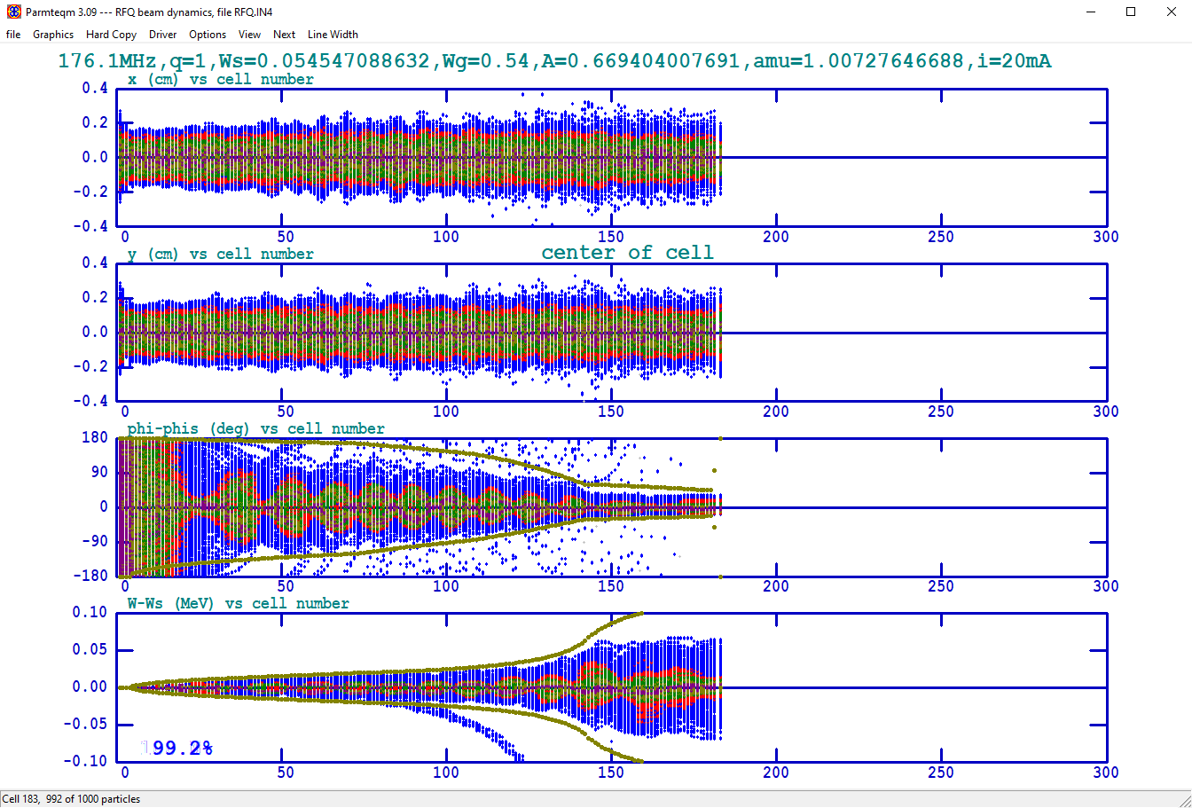
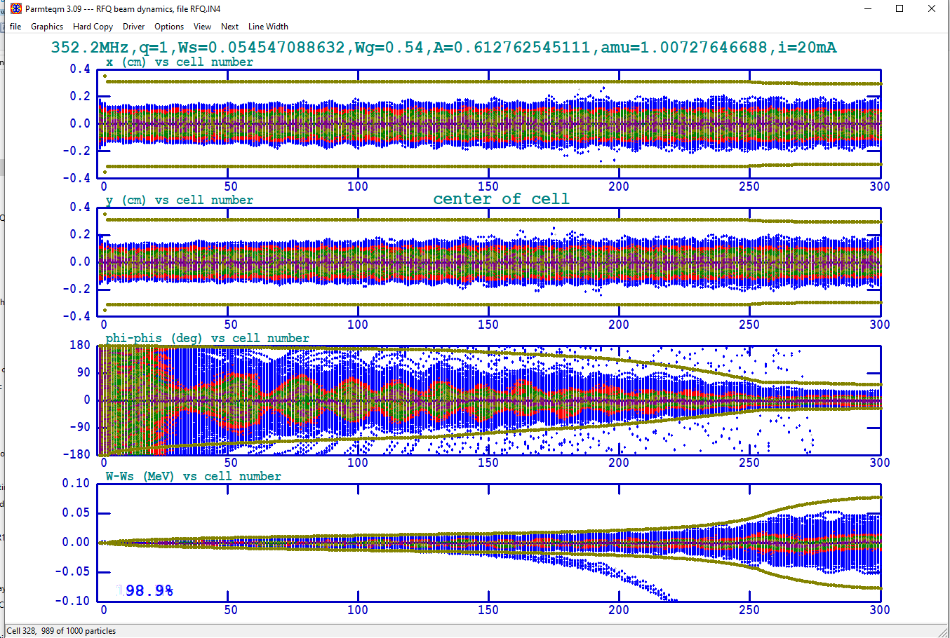
RFQ variants:
Parameters | 176.1 MHz RFQ | 352.2 MHz RFQ
Beam species | H+ | H+
Injection energy (MeV) | 0.045 | 0.045
Output energy (MeV) | 3 | 3
Resonant frequency (MHz) | 176.1 | 352.2
Peak beam current (mA) | 20 | 20
Inter-vane voltage (kV) | 130 | 78.27
Cavity length (m) | 3.6 | 3.2
minimum aperture a (cm) | 0.38 | 0.19
Ratio r_{v}/r₀ | 0.85 | 0.85
Maximum surface field (MV/m) | 26.1(1.8 Kilp) | 34.0(1.8 Kilp)
Input ɛ_{t} (n,rms)(cm.mrad) | 0.025 | 0.025
Output ɛ_{t} (n,rms)(cm.mrad) | 0.029 | 0.026
Output ɛ_{l} (n,rms)( MeV.deg ) | 0.238 | 0.135
Transmission (%) | 99.2% | 99 %
Number of cells | 181 | 326
RF power loss (peak kW) - est | 396 | 369
Two variants considered each giving 99% transmission for 20mA beam current from 45 keV to 3 MeV as simulated in PARMTEQ
Each optimized for same Kilpatrick and minimized length
176.1 MHz RFQ
  Subharmonic of DTL frequency
  RF structure – typically 4-rod
  Increased longitudinal emittance
352.2 MHz
  DTL frequency
  RF structure – typically 4-vane
  Shorter with improved output emittance
DTL studies preformed assuming 352.2 MHz RFQ
Design Considerations for a Proton Linac for a Compact Accelerator Based Neutron Source (CANS) for Canada M.Abbaslou Feb.27, 2025
Notes:
In here say that I optimize 2 frequency RFQ by changing shaper energy and gentle bunching section before acceleration section to get highest transmission and shorter length. By keeping the Kilpatrick factor lower than 1.8 for sparking reason in the cavity.

Slide 6
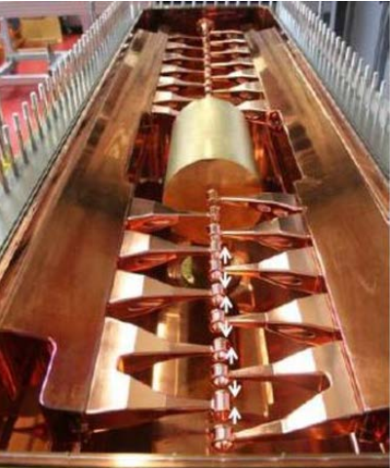
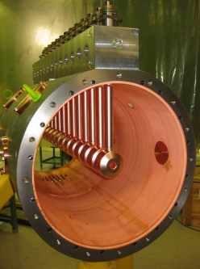
DTL Variants:
• Several variants of DTLs are considered using Alvarez or H-
mode structures with KONUS or APF
• Trace-3D used for rapid prototyping and matching
LANA and PARMILA used for Multi-particle tracking
4Q MEBT with two-gap buncher is used to match the beam from the RFQ to the DTL – optics sections lengths shown below
All simulations assume a beam intensity of 20mA
Nominal beam emittances for DTL study employ 5xRMS PARMTEQ values from 352.2 MHz RFQ simulation (see Table below)
CH DTL-KONUS Structure
Alvarez DTL
 | α | β | Units | ε _{u rms} | ε _{n rms} | Units
x_DTL | -0.67 | 10.27 | cm/rad | 1.56 | 0.13 | cm-mrad
y_DTL | 0.71 | 13.77 | cm/rad | 1.56 | 0.13 | cm-mrad
z_DTL | 0.42 | 723.1 | deg/MeV | 0.69 | 0.69 | MeV-deg
Optical | Length (cm)
4Q MEBT | 84
3Q Triplet | 37
2Q Doublet | 24
Design Considerations for a Proton Linac for a Compact Accelerator Based Neutron Source (CANS) for Canada M.Abbaslou Feb.27, 2025
Notes:
Linac-Crossbar H-mode(CH) DTL design in PARMILA
don’t talk in detail of the MEBT in here. Just say we use Trace-3D

Slide 7
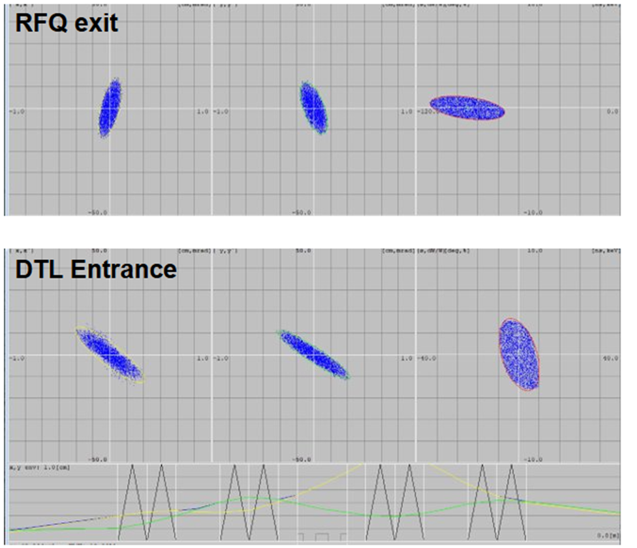
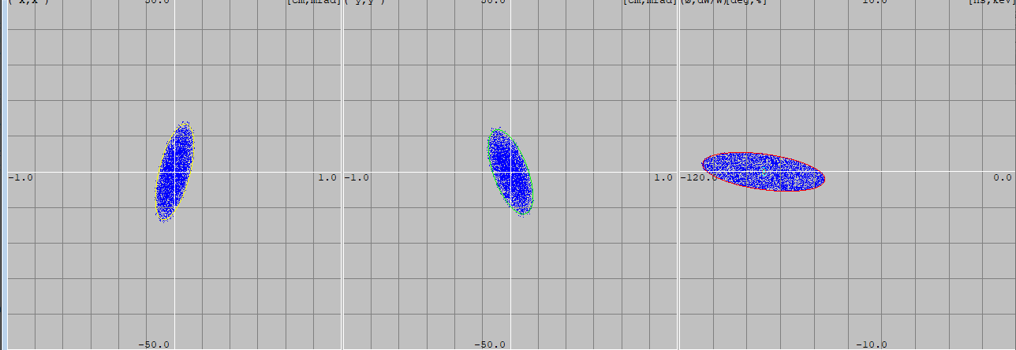
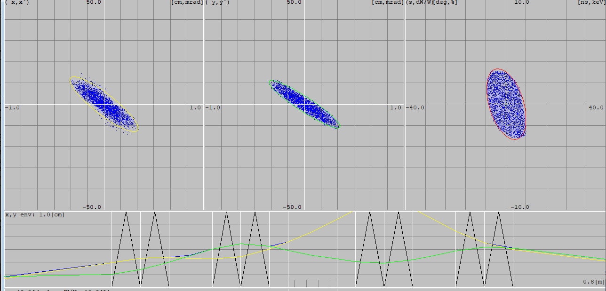
MEBT section:
RFQ exit
All variants (except 1) use a common 4 quadrupole (4Q) MEBT with a two-gap buncher at 352.2 MHz
The buncher is either placed between Q1 and Q2 or between Q2 and Q3 depending on the matching required
The MEBT is 84 cm long
DTL Entrance
84 cm
RFQ
Q
Q
B
Q
Q
DTL
15 8 6 8 12 8 6 8 13
Design Considerations for a Proton Linac for a Compact Accelerator Based Neutron Source (CANS) for Canada M.Abbaslou Feb.27, 2025

Slide 8
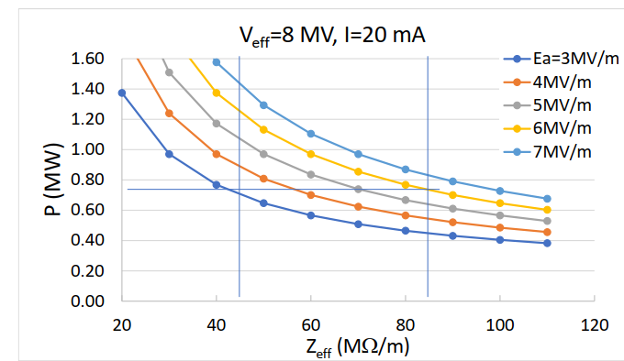
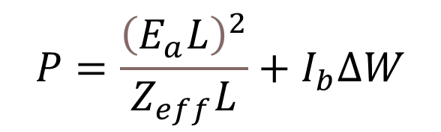
DTL Gradient Considerations:
RF power and Linac length are cost drivers
• RF efficiency is characterized by the effective shunt impedance
• Zeff ~85 MΩ/m for CH and ~45 MΩ/m for Alvarez
• RF dissipated power is dependent on the gradient chosen
• Alvarez at 3 MV/m consumes ~same power as CH at 6MV/m for
same energy gain
$$P=\frac{{\left(E_{a}L\right)}^{2}}{Z_{eff}L}+I_{b}∆W$$
CH
Alvarez
Design Considerations for a Proton Linac for a Compact Accelerator Based Neutron Source (CANS) for Canada M.Abbaslou Feb.27, 2025
Notes:
The DTL gradients are chosen as a compromise between overall length and rf power as the rf power loss in the structure is inversely proportional to length for a fixed voltage increase.
The peak surface field on the structure (Kilpatrick factor) and power density also have to be considered. Given that this is a pulsed linac power density will typically not be an issue for safe Kilpatrick values in the range of ~1.8Kilpatrick.

Slide 9
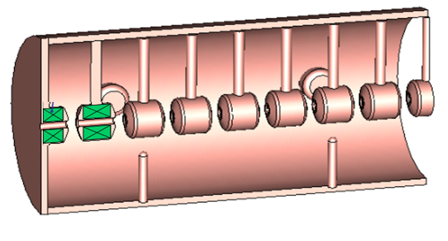
Alvarez DTL:
Strong transverse focusing with inclusion of PMQs or EMQ in every second drift tube in FODO lattice - Longitudinal focusing with -30deg synchronous phase
Two variants simulated
  Variant 1 – no MEBT but with adjustable quads in first four drift tubes for transverse matching to the FODO
  Variant 2 – 4Q MEBT with buncher
Variant 1, L=2.6 m
Variant 2, L=3.4 m
Design Considerations for a Proton Linac for a Compact Accelerator Based Neutron Source (CANS) for Canada M.Abbaslou Feb.27, 2025
Notes:
Marco said : INTRODUCE ACCELLERATE AND FOCUS THE BEAM
Give basics of the accelerating particles. Say we need to accelerate and focus the beam in here we have Alvrez to get a transverse focusing by inclusing PMQ in the tanks, in a FODO Rectangular shapes shows Quadrupoles.
Between the Alvarez DTL drift tubes on axis
electric fields are created between tubes
• A negative synchronous phase is used for
longitudinal stability
• Rf defocusing is counteracted by Magnetic
quadrupoles built inside each tube to provide
strong transverse focussing
Where I
o is the modified Bessel function of the first kind
• Typically try to limit a/g<0.7 for reasonable efficiency

Slide 10
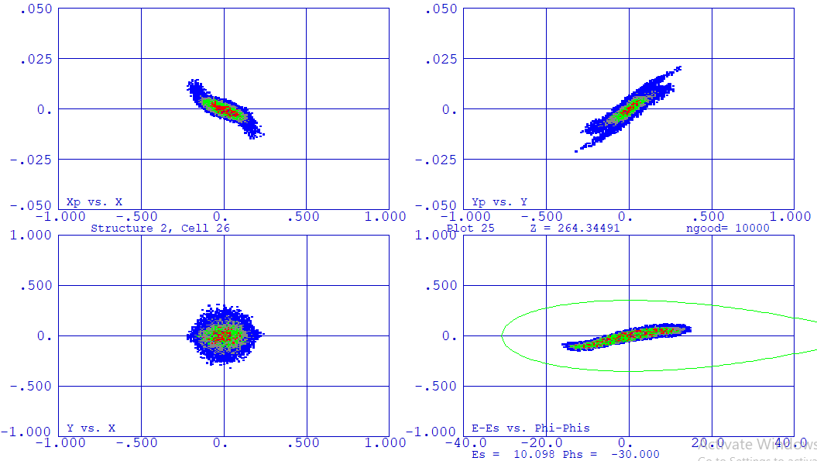
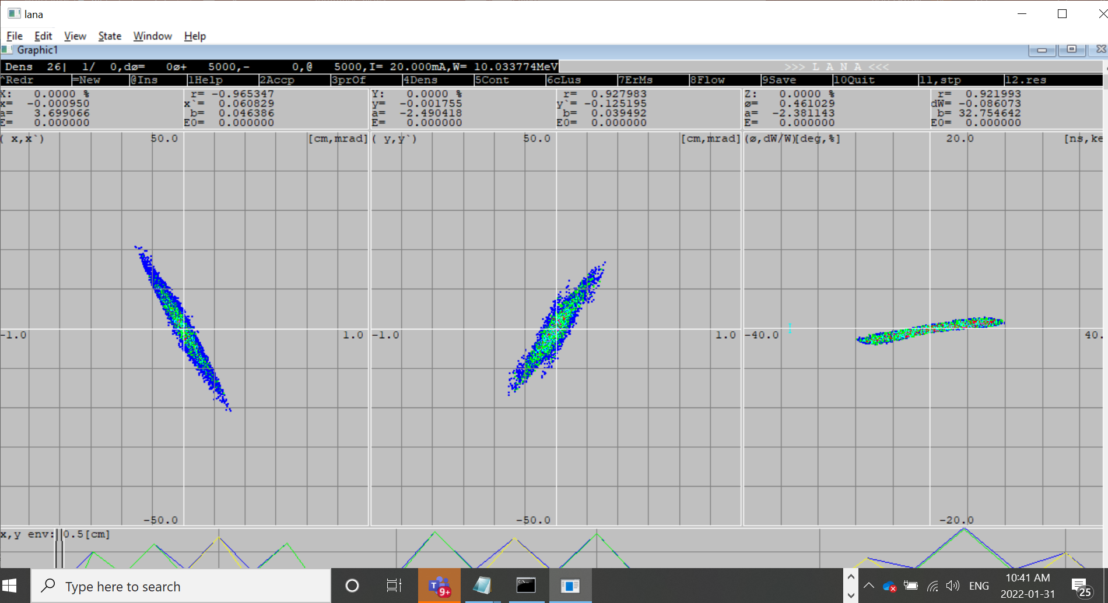
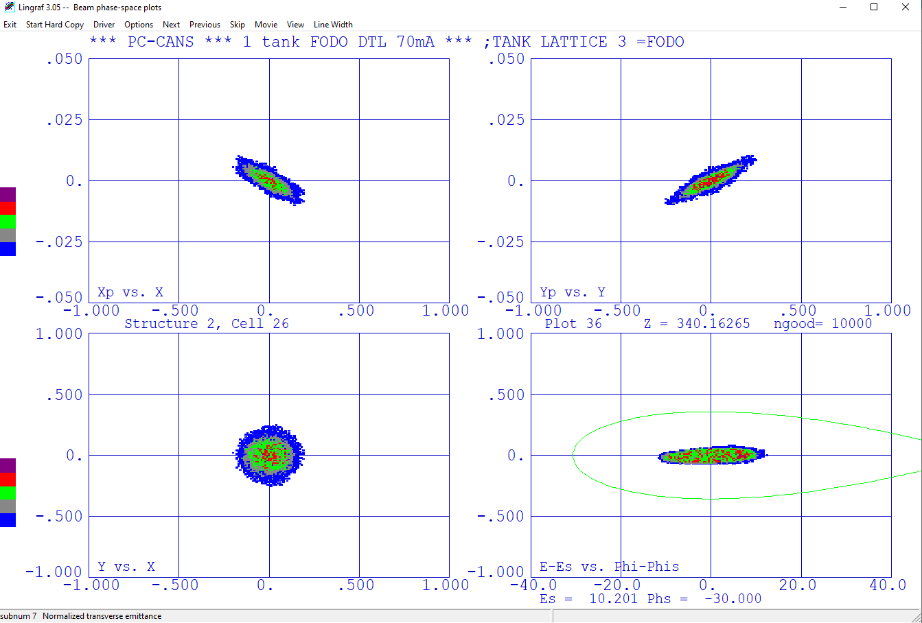
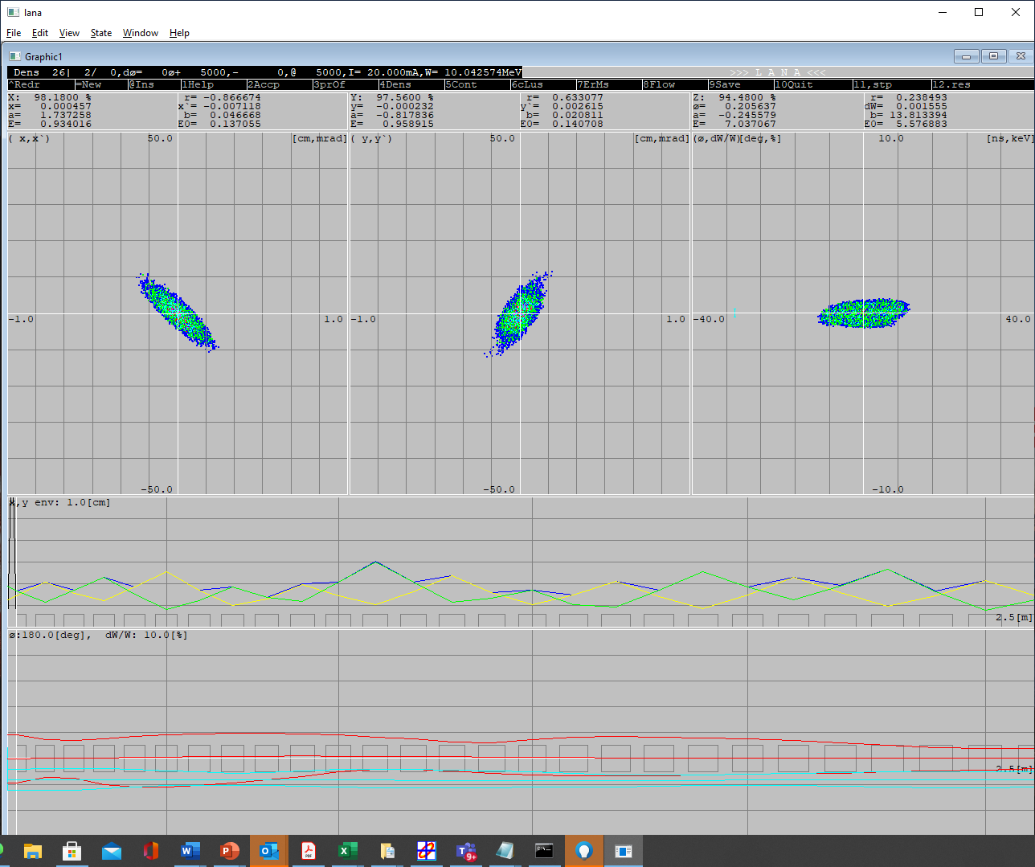
PARMILA and LANA:
Variant 1
Here’s an example comparing PARMILA and LANA simulations of the x,y,z phase spaces at 10 MeV for the two Alvarez variants
Good agreement between codes
Variant 2
Design Considerations for a Proton Linac for a Compact Accelerator Based Neutron Source (CANS) for Canada M.Abbaslou Feb.27, 2025
Notes:
We see a good agreement between two codes.we Use alvzrez two
Say we did a benchmarking between two codes.

Slide 11
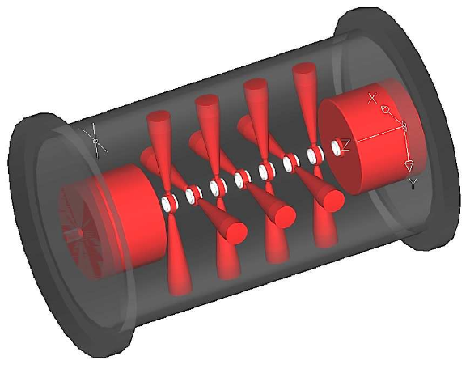
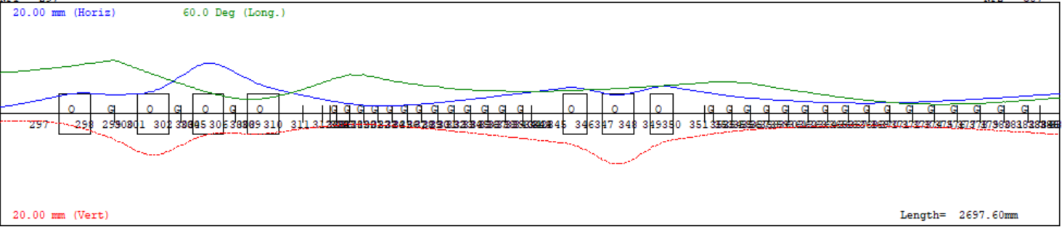
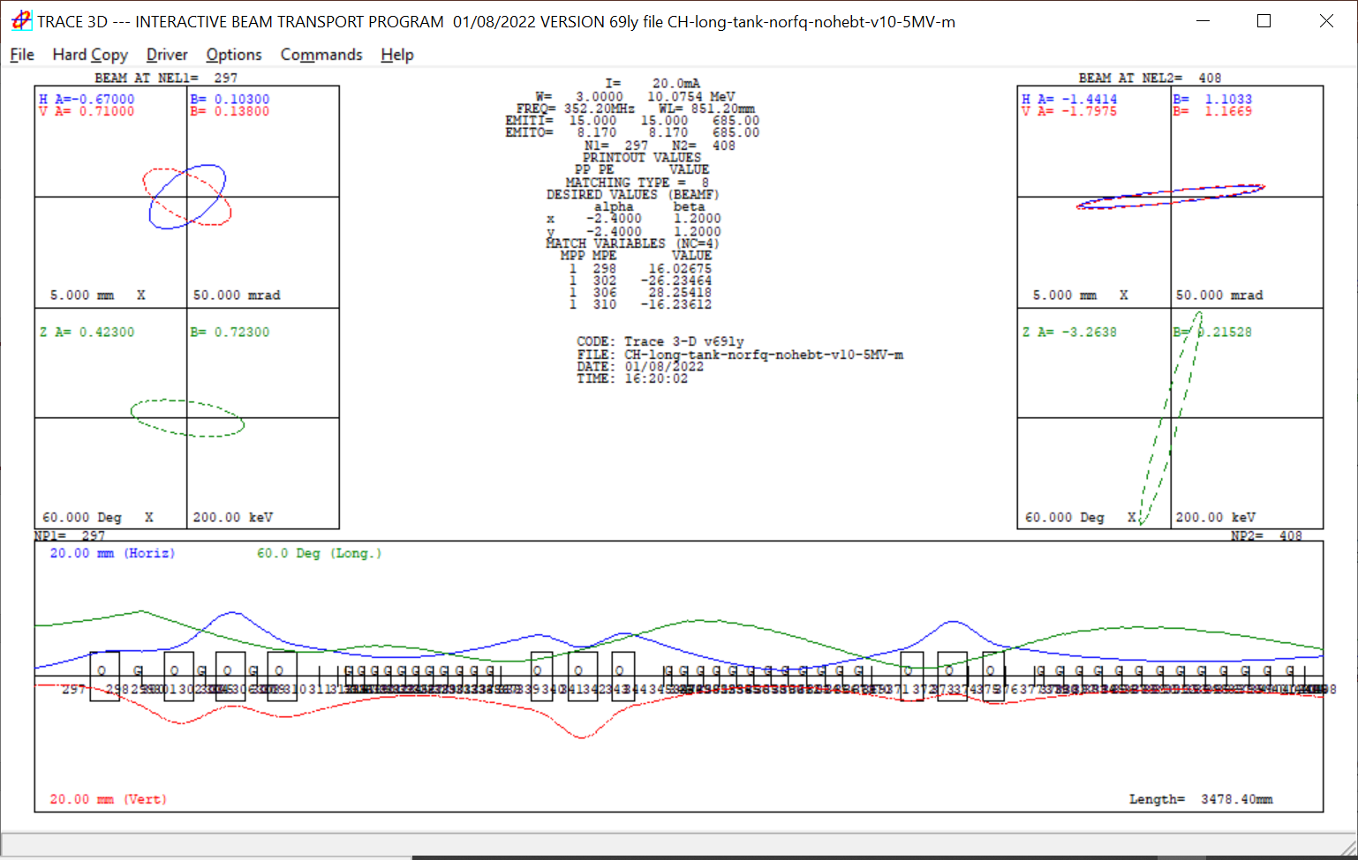
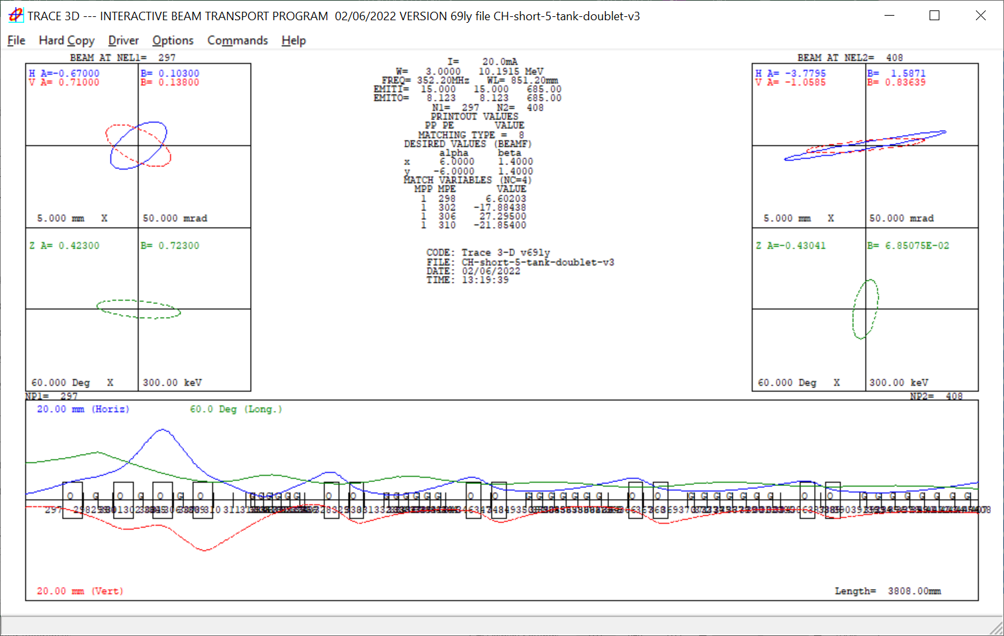
CH Structures:
The accelerating sections are typically short with quadrupole doublets or triplets in between accelerating sections
Five variants are simulated:
  Variant3: KONUS (0 degree) beam dynamics
  Variant 4, 5, 6 – constant negative synchronous phase dynamics ~-25 degrees and triplets between tanks
    variant 4: 3 tanks-6MV/m,
    variant 5: 4 tanks-5MV/m,
    variant 6: 3 tanks-5MV/m
  Variant 7 - Shorter tanks at -30degrees with doublets between tanks
G. Clemente, PhD thesis, Frankfurt
Variant 3, L=2.7 m
Variant 6 , L=3.5 m
Variant 7 , L=3.8 m
Design Considerations for a Proton Linac for a Compact Accelerator Based Neutron Source (CANS) for Canada M.Abbaslou Feb.27, 2025
Notes:
-To accelerate and focus the beam longitudinally we need a negative synchronous phase -90<ϕs<0 so that there is a restoring force to keep the motion stable.
-When -90<ϕs<0 the rf gap produces a defocusing force in the transverse dimension
-Periodic focussing must be added transversely to counteract the rf defocusing (ie quadrupoles, solenoids)
Why do we choose 5-6MV/m for Ea, and what is peak of electric field for break down and what is Kilpatrik?
It is confusing where is variant 1 and 2?
Top envelope is KONUS 0 degree
-25 degree second one

Slide 12
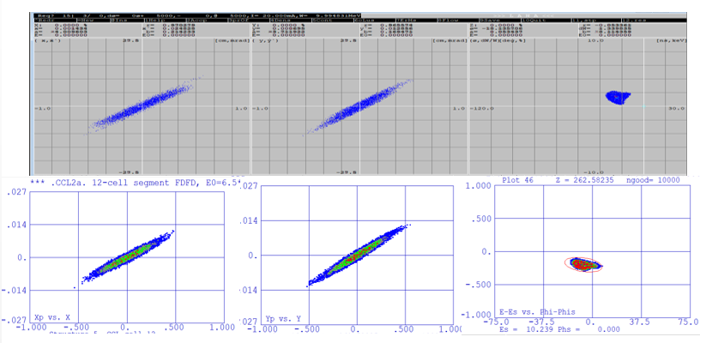
CH - Variant 3: KONUS or zero degree-PARMILA and LANA:
Consists of 2 long tanks with triplet in between tanks
Good control of longitudinal phase space
Parameter | Variant 3
Tanks | 2
Drift tubes | 12, 15
gradient | 6.4 MV/m
Transverse Focusing | Triplet 37 cm
Longitudinal focusing | ϕ_{s}=-50, 0 degrees
Beam current | 20mA
 | Initial |  | Final |  | Final/Initial
 | RMS | 99% | RMS | 99% | RMS | 99%
Emit-x (cm-mrad) | 0.02 | 0.11 | 0.0252 | 0.21 | 1.25 | 1.91
normalized
Emit-y (cm-mrad) | 0.02 | 0.11 | 0.0231 | 0.16 | 1.16 | 1.47
normalized
Emit-z (MeV-deg) | 0.17 | 0.67 | 0.18 | 1.00 | 1.06 | 1.50
Ref: https://accelconf.web.cern.ch/linac2022/papers/fr1aa05.pdf
Design Considerations for a Proton Linac for a Compact Accelerator Based Neutron Source (CANS) for Canada M.Abbaslou Feb.27, 2025
Notes:
Design a KONUS DTKL in PARMILA.
What do the pictures and table show?
Showing mulri particle results.

Slide 13
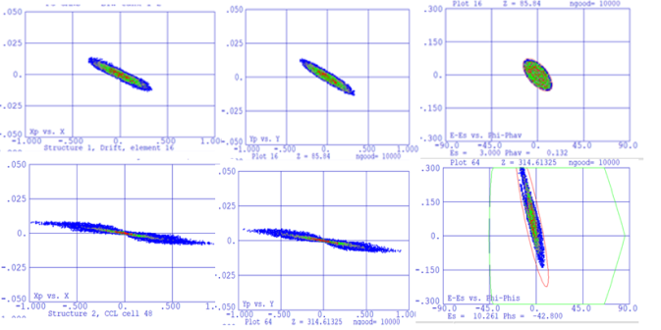
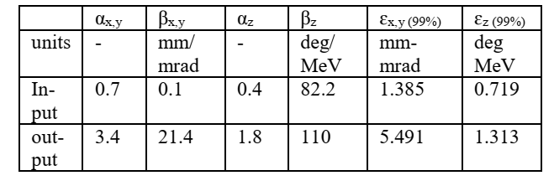
APF DTL– Variant 8:
Alternate Phase Focusing uses rf field to focus the beam both transversally and longitudinally without the need for magnetic components – 100% transmission but less efficient acceleration and some transverse emittance growth
Input beam
Output beam
Parameter | Value
Tank frequency | 352.2 MHz
gradient | 6.7 MV/m
Input energy | 3 MeV
Output energy | 10 MeV
RF gaps | 48
Beam current | 20 mA
Design Considerations for a Proton Linac for a Compact Accelerator Based Neutron Source (CANS) for Canada M.Abbaslou Feb.27, 2025
Notes:
What do the pictures and tables show?
Welook at beam emvelope and emittance growth both
MEBT with a buncher

Slide 14
Summary plot for DTL – emittance growth 99%:
All variants give 100% transmission
Lowest long emittance growth for Alvarez with MEBT and KONUS
Lowest transverse growth with Alvarez with MEBT
Largest transverse growth with APF variant
Var 1 Alv No MEBT | Var 2 Alv With MEBT | Var 3 CH - KONUS | Var 4 CH 6MV 3 tank | Var 5 CH 5MV 4 tank | Var 6 CH 5MV 3 tank | Var 7 CH 6MV doublet 5 tank | Var 8 CH APF 1 tank
Design Considerations for a Proton Linac for a Compact Accelerator Based Neutron Source (CANS) for Canada M.Abbaslou Feb.27, 2025
14

Slide 15
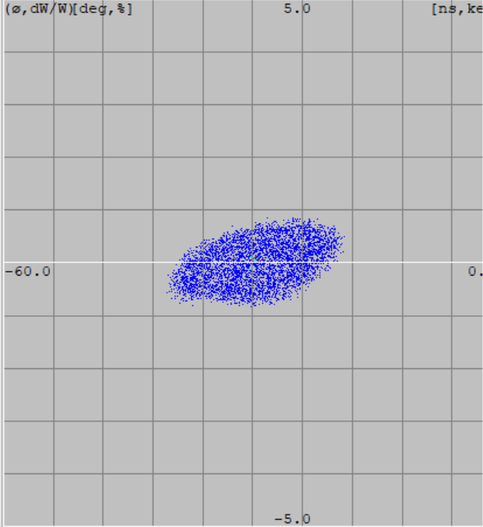
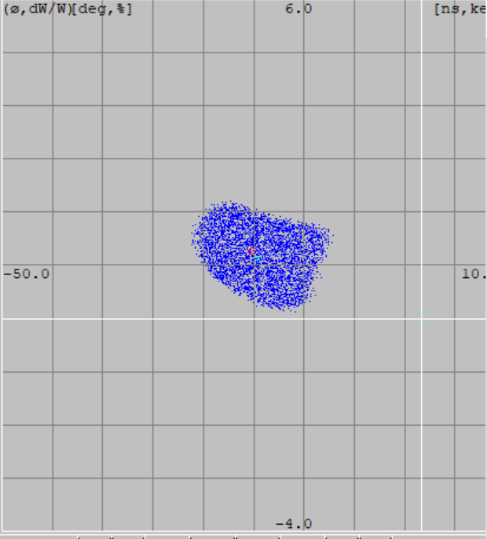
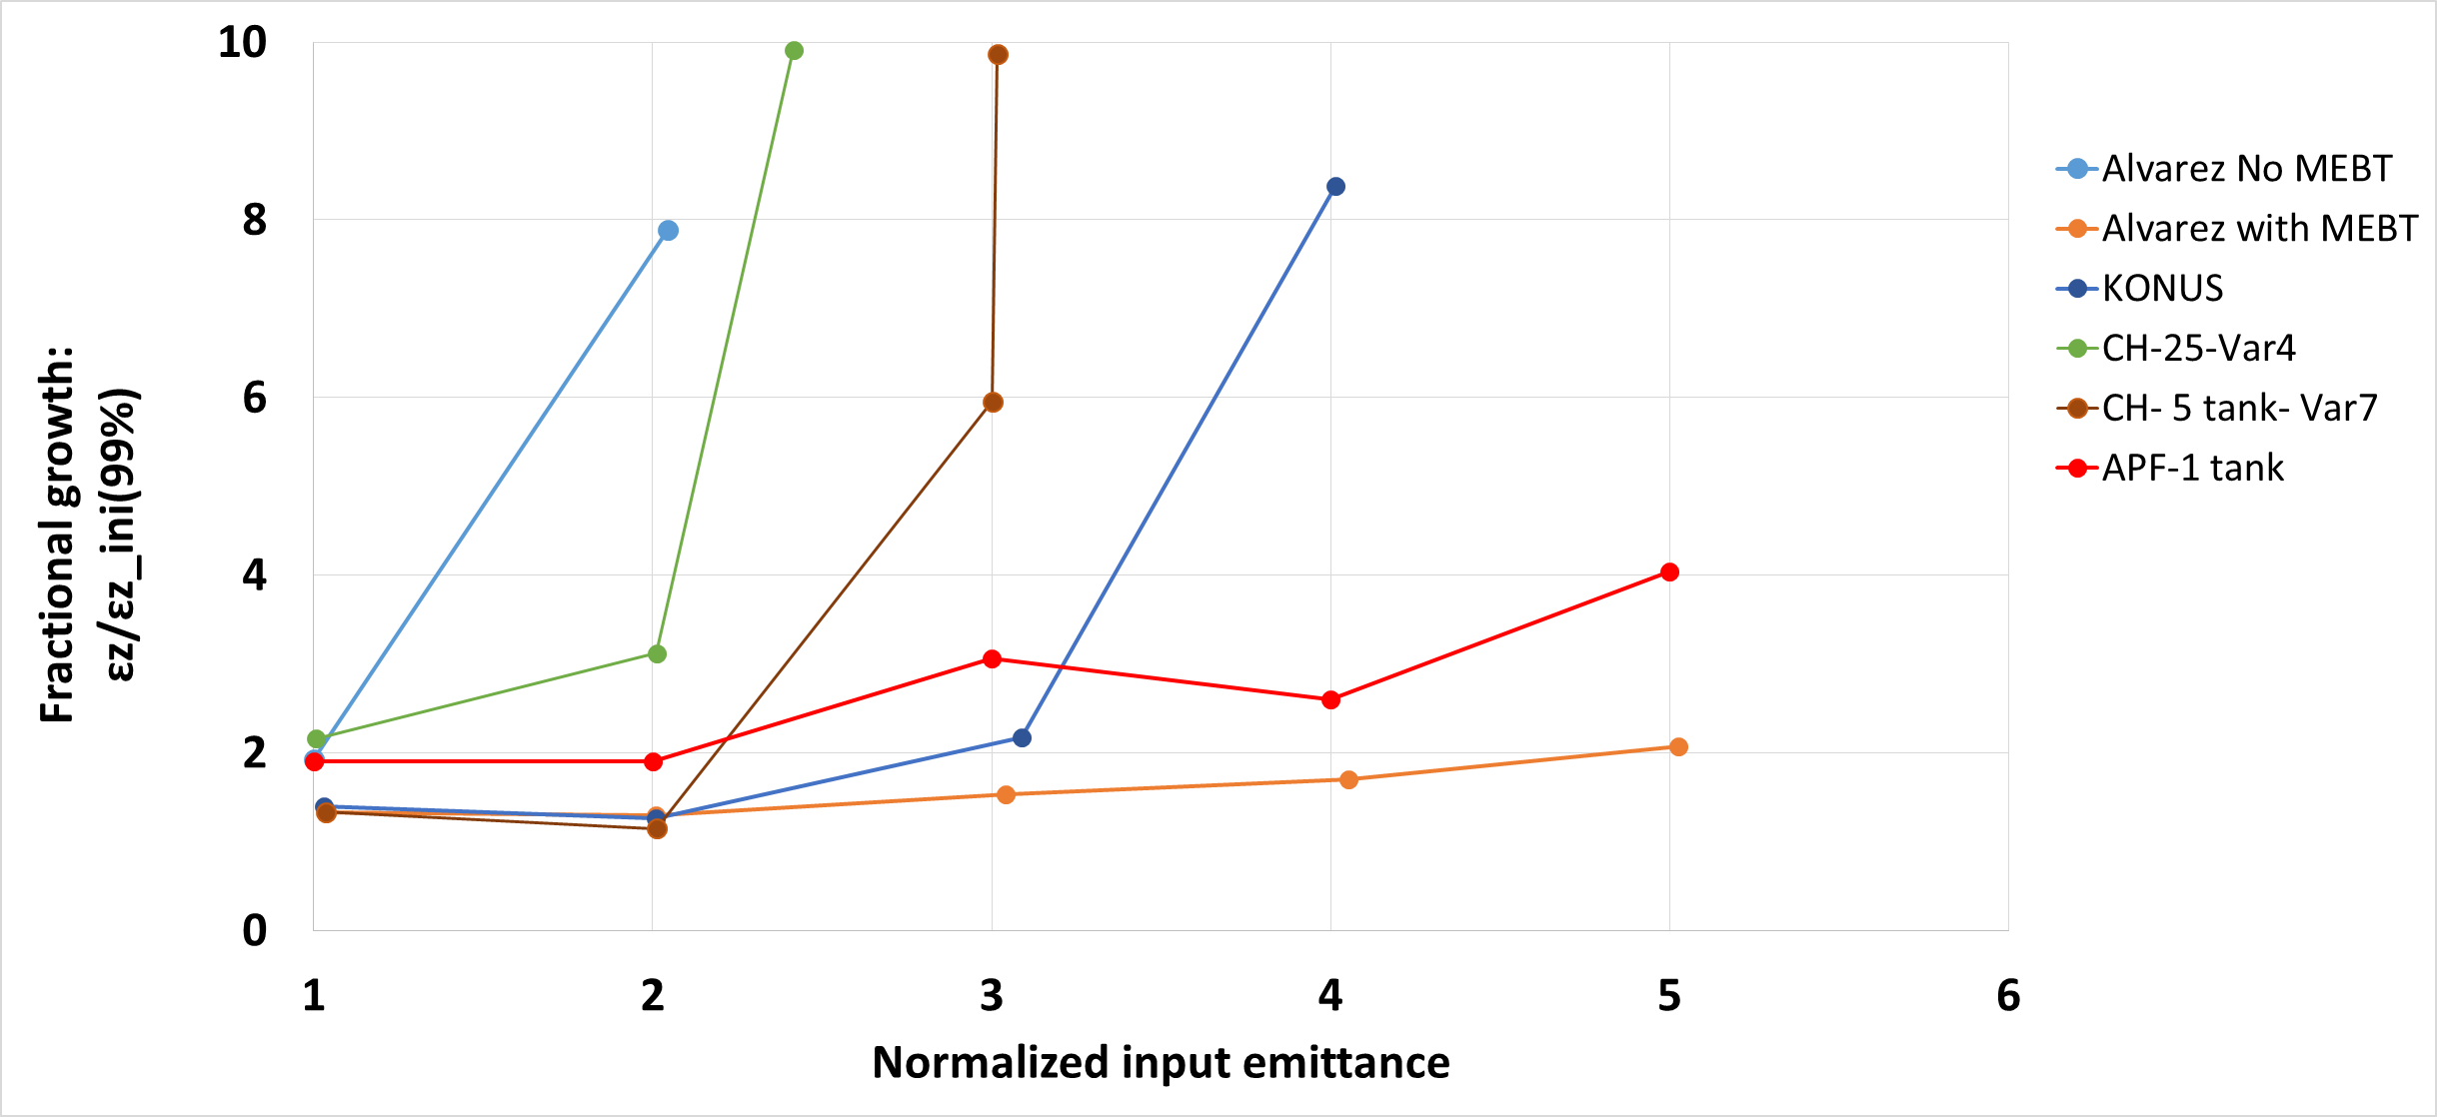
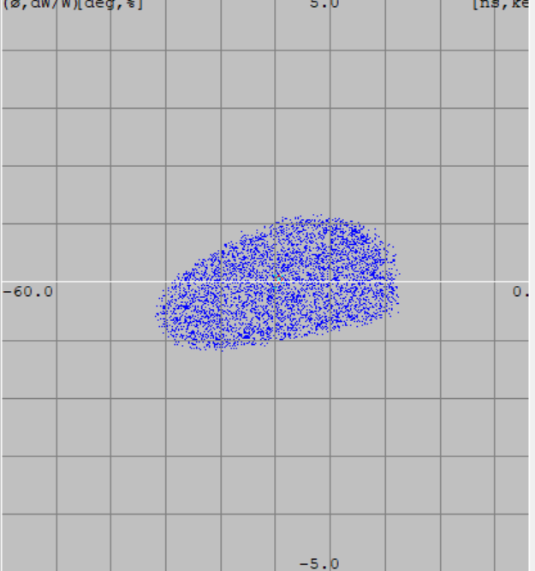
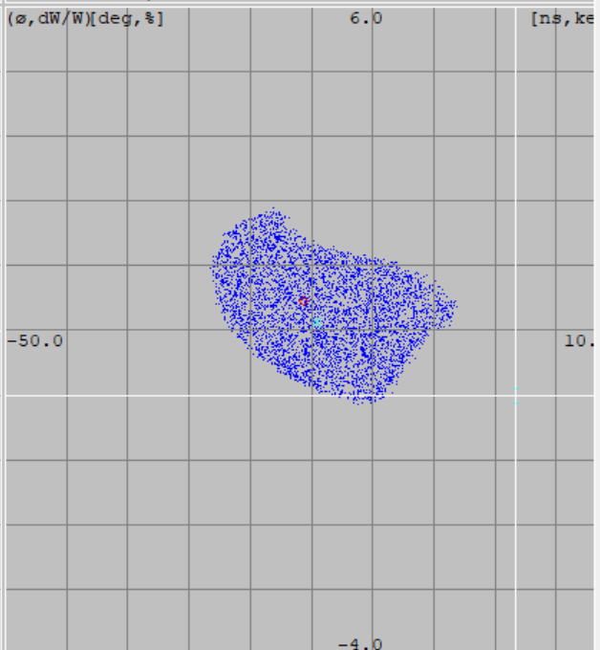
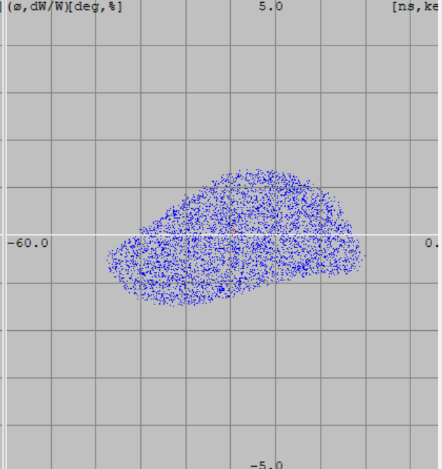
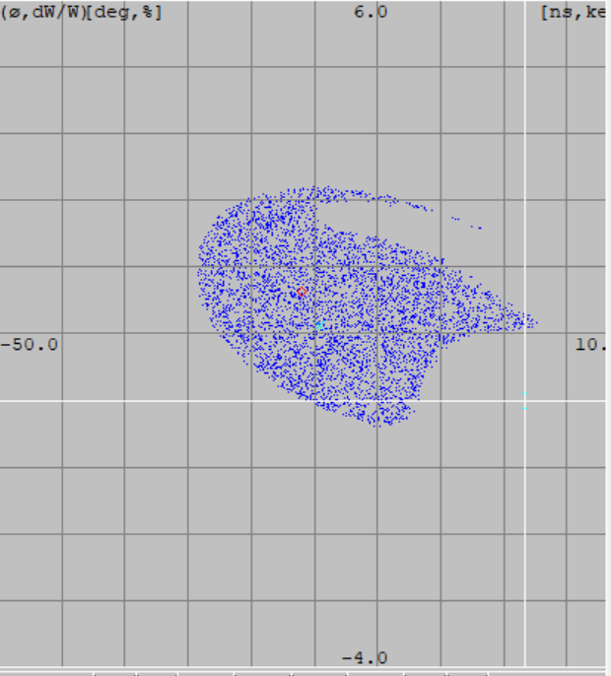
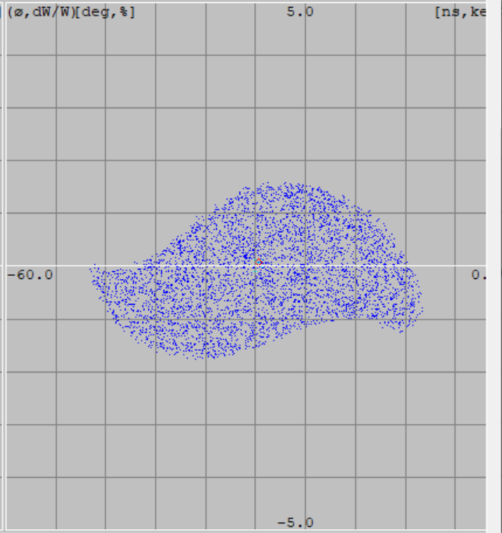
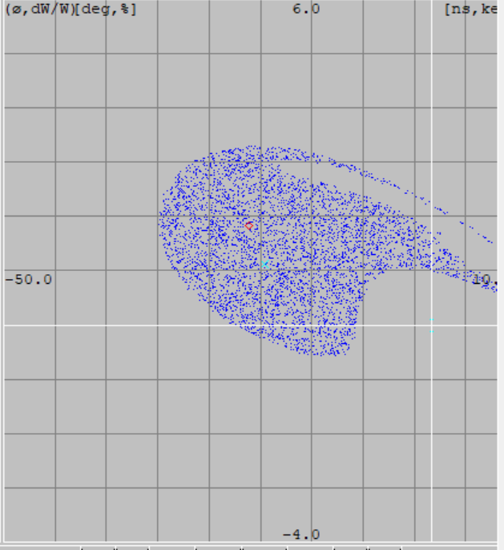
Longitudinal acceptance:
Variant 2
Alvarez
Variant 3 CH-KONUS
Longitudinal acceptance is estimated by looking at the fractional emittance growth for sequentially increasing input emittances
1x
2x
3x
4x
Design Considerations for a Proton Linac for a Compact Accelerator Based Neutron Source (CANS) for Canada M.Abbaslou Feb.27, 2025
Notes:
The longitudinal acceptance is studied by performing repeated runs with sequentially larger longitudinal emittances and looking at the relative emittance growth for 99% ellipses. As the input emittance increases beyond a factor of two a loss of transmission occurs as shown in Fig. 5
As you can see there is a distortion of the beam by increasing the input beam emittance in longitudinally, in the KONUS, which means that we are losing the good particles in our ensenmble.

Slide 16
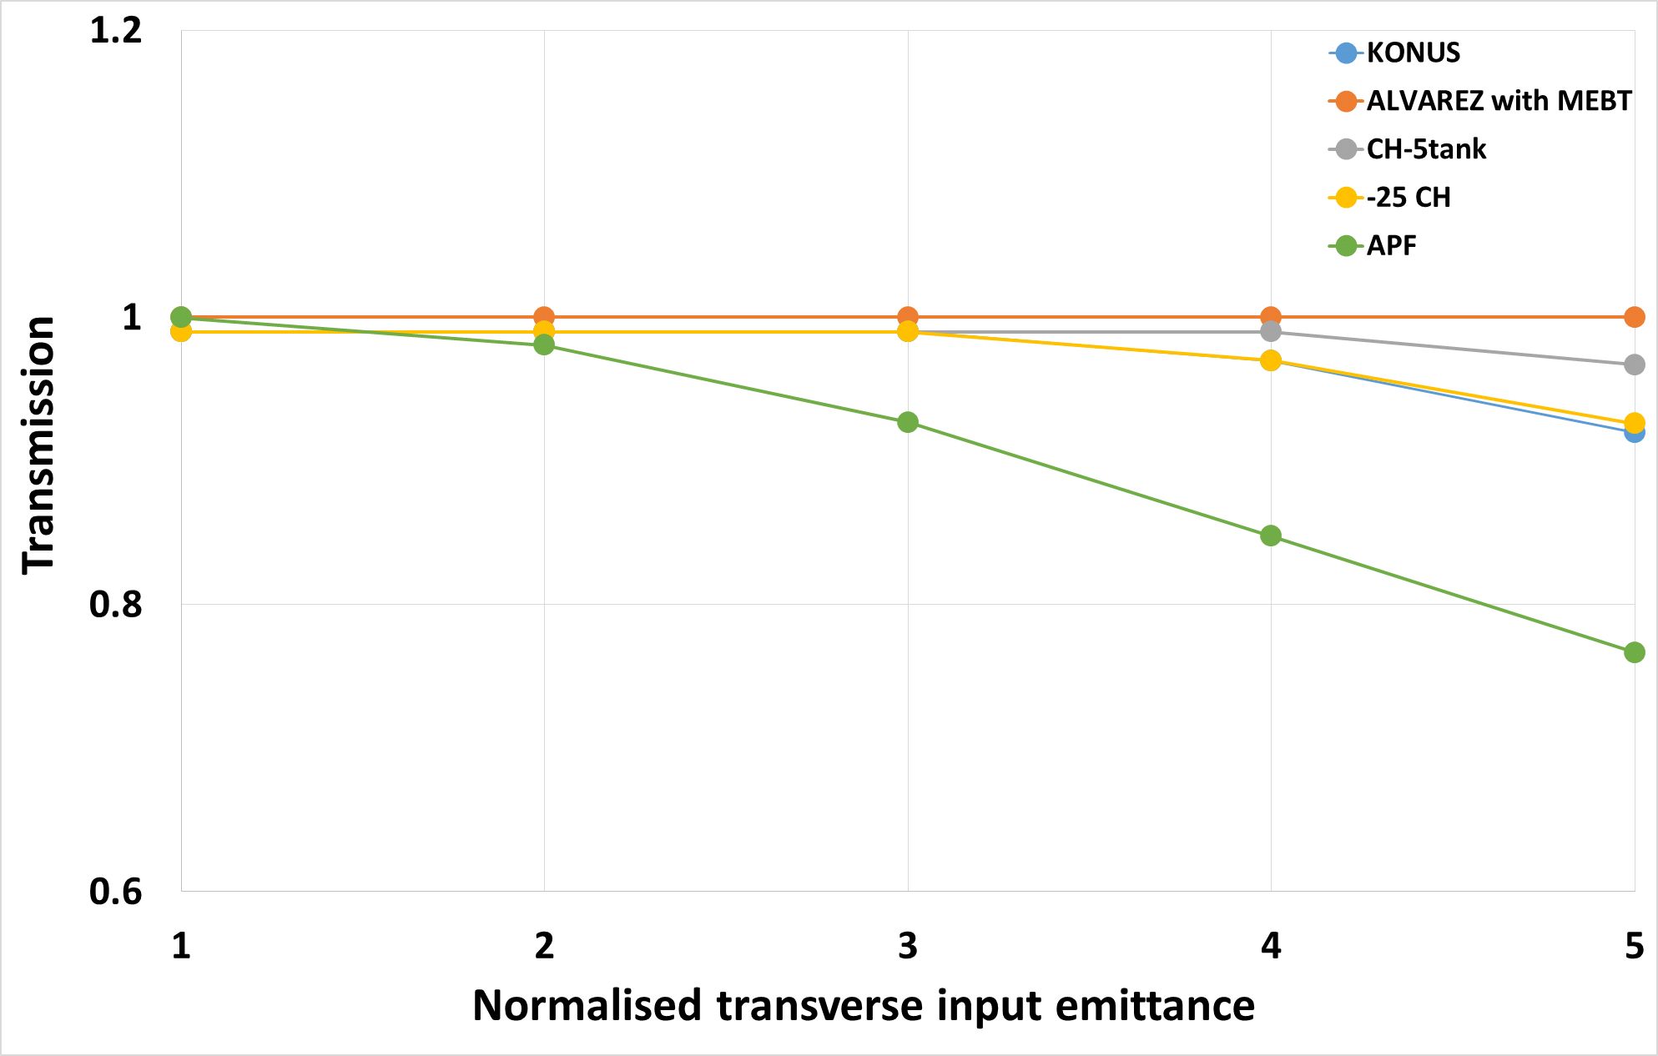
Transverse acceptance:
Transverse acceptance is estimated by looking at the transmission for sequentially increasing input emittances
Design Considerations for a Proton Linac for a Compact Accelerator Based Neutron Source (CANS) for Canada M.Abbaslou Feb.27, 2025
Notes:
variants have the most dynamic aperture yielding 100%
transmission for up to 5 times the nominal input emittance.
All variants deliver nearly 100% transmission up to 3 times the nominal emittance. The study also shows that the transverse emittance growth actually improves with the larger
emittance due to reduced space charge.

Slide 17
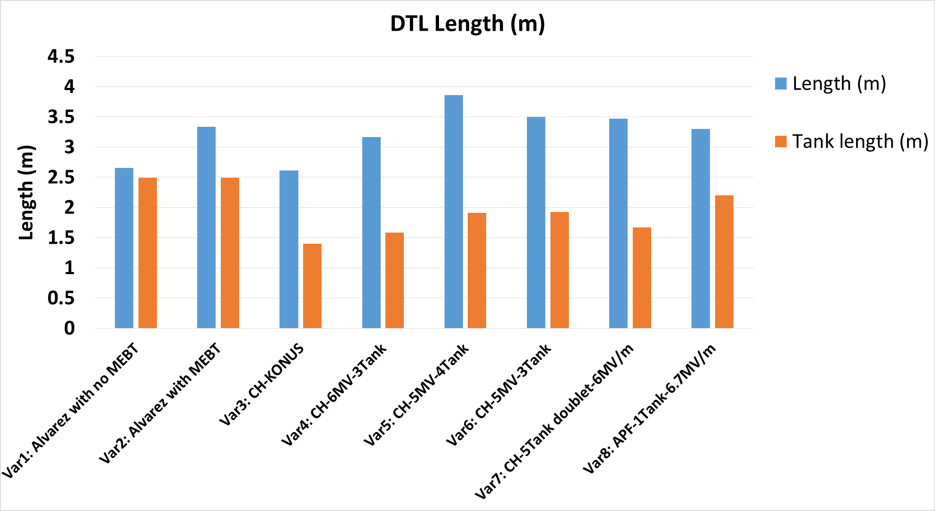
DTL – Length including MEBT excluding HEBT :
Alvarez (no MEBT) and KONUS give the shortest total DTL length – combination of tank length (defined by chosen gradient) and length of external optics (MEBT, triplets, doublets).
L_DTL=L_RF(Ea)+L_ optics
Design Considerations for a Proton Linac for a Compact Accelerator Based Neutron Source (CANS) for Canada M.Abbaslou Feb.27, 2025
Notes:
In CH we have external optics, THIS LINAC IS COMPACT AND THAT COULD BE CONSTRUCTED IN THE UNIVERSITY.
The length of the RF sections and the full length (including any MEBT and excluding any HEBT) of each variant
are highlighted in Fig. 13. The total peak power required
(with and without 20 mA of beam loading) is given in
Fig. 14. The RF length is directly related to the chosen gradient while the linac length is impacted by the number of
focusing sections required. Total power is reduced for
lower gradients but may require additional triplets in the
CH variants.
معیارا چیند؟
دنبال چه پارارمترهایی هستم؟ و در نهایت هدفم چیه؟

Slide 18
Conclusion:
PC-CANS requires a pulsed Linac capable of accelerating 20mA of protons to 10MeV
The baseline assumes the use of an RFQ to 3MeV and a DTL to 10MeV at an RF frequency of 352.2MHz
RFQ parameters have been modeled in PARMTEQ for two frequencies (352.2MHz and 176.1 MHz)
Several DTL variants have been simulated in multi-particle codes LANA and PARMILA
Alvarez variants assume ~3MV/m while CH variants assumed ~5-6 MV/m
DTL Simulation Summary
  All variants deliver 100% transmission
  The lowest emittance growth and largest acceptance was for the Alvarez DTL with MEBT
  Length of Alvarez and CH structures similar – higher gradient in CH but more efficient transverse focusing in Alvarez DTL
  The KONUS CH-DTL variant offered the lowest emittance growth from the CH structures
Design Considerations for a Proton Linac for a Compact Accelerator Based Neutron Source (CANS) for Canada M.Abbaslou Feb.27, 2025
Notes:
Then we come into DTL simulation summary pros and cons.
Where all variants …
&….
&….
Then….
&Finally….
Present in 10 min.
work on RFQ design in Track code and LANA.

Slide 19
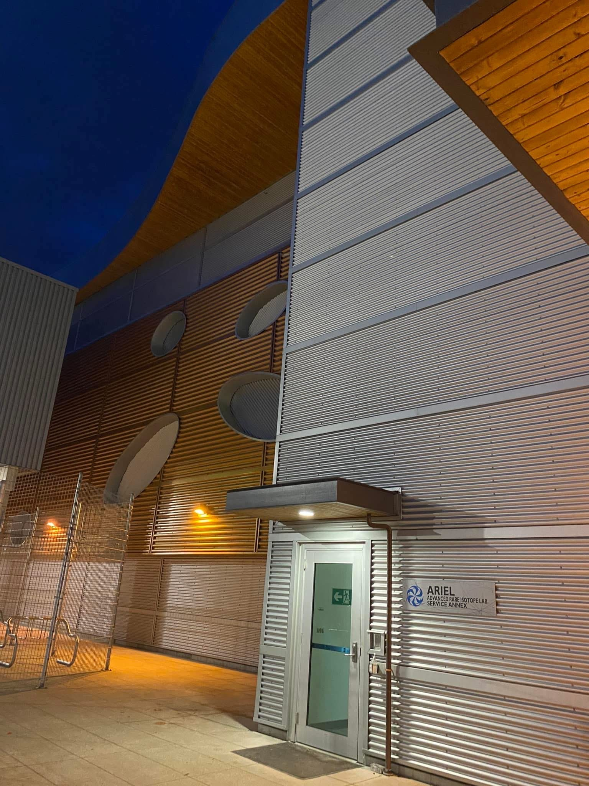
Thanks for listening
Notes:
I would like to thank my professors, the research team and colleagues who helped me in this project.
Thanks for your time and I wish to see the future success for our project.
Thank you for nice presentation. what is the size of the beam spot at enter of the RFQ and what is estimated beam size at target?

