Slide 1




RIKEN Accelerator-Driven
Compact Neutron Systems,
RANS Project
26 Feb.2025, UCANS11, Vancouver, Invited talk
RANS-RIKEN Accelerator-driven compact Neutron Systems-
Yoshie OTAKE yotake@riken.jp
Neutron Beam Technology Team, RAP、RIKEN Team leader,
T-RANS、President Technology Research Association for Neutron Next Generation System
President of Japanese Society of Neutron Science, JSNS,
Chief Technical Advisor, Rans Veiw

Slide 2

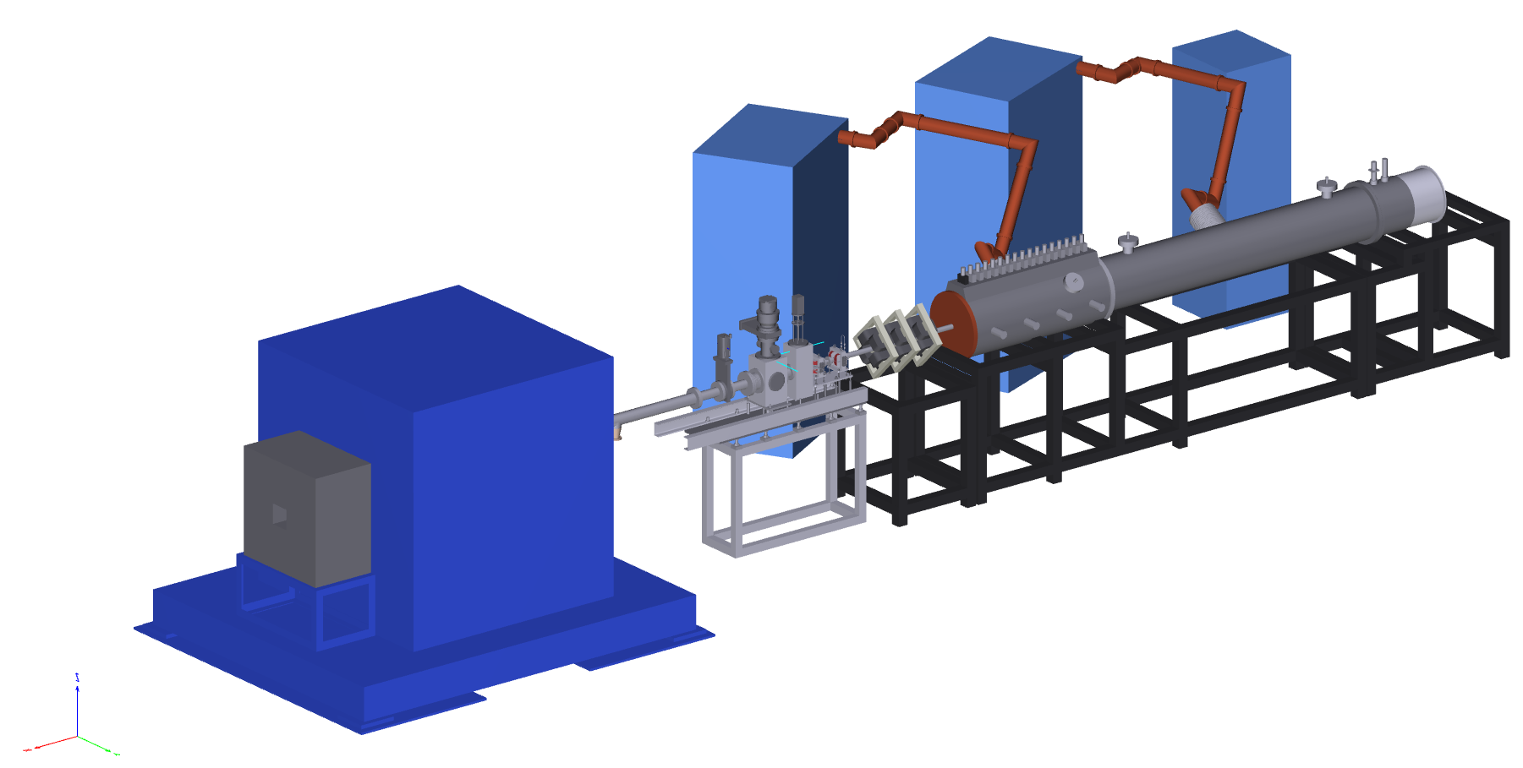

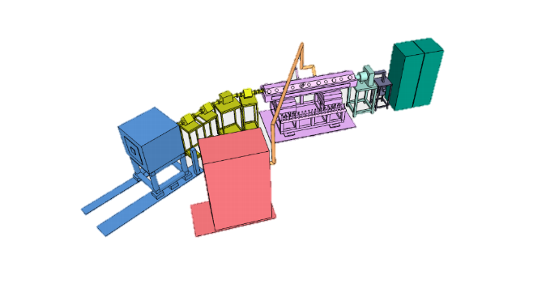
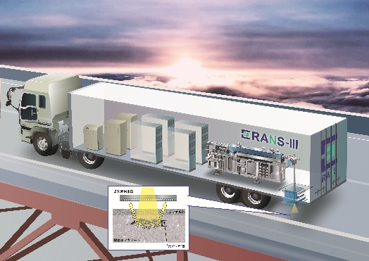
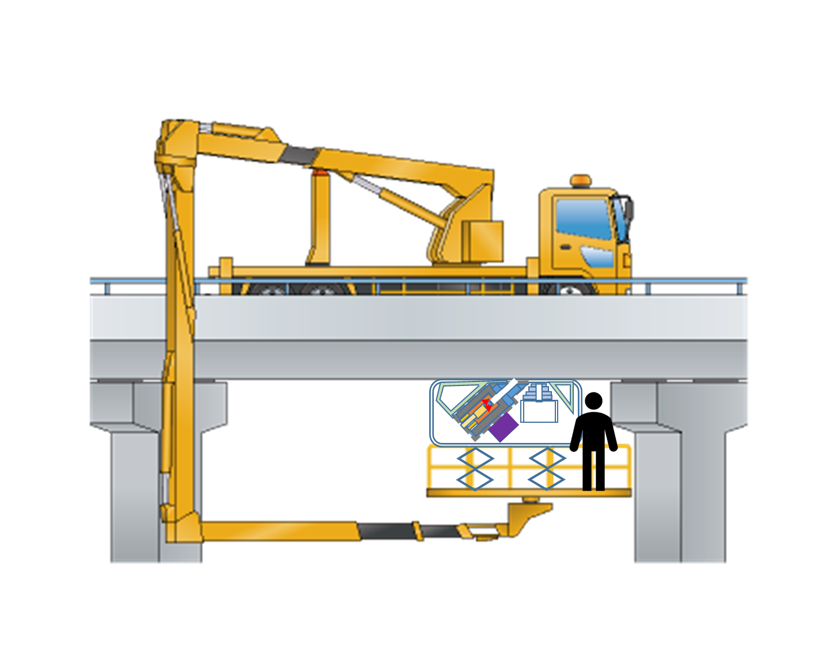


RIKEN COMPACT NEUTRON SYSTEMS: RANS-I,-II,-III & μ
In operation, RANS, RANS-II, and RANS-μ(* on-site)
7MeV proton
Be target 100μA Pulse
2.49MeV proton
Li target 100μA Pulse
Under dev.
RANS-III in trailer !
検出器
Up-grade of moderator-reflector system 2020-2021
Salt-meter:
252Cf source
PGAA (Ge+BGO)
T.Kobayashi, M.Mizuta, T.Takanashi, T.Fukuchi, Y.Wakabayashi, Y.Okuno, S.Imajo, H.Kusano, A.Muneem, T.Takamura, T.Hashiguchi, Yujiro IKEDA (Special Advisor) ,

Slide 3



Cooperation, collaboration
International, domestic, academia, industry.
HBS, Hi-CANS, Cooperation
Joint WS JCNS-RIKEN, every year, since2017
Researchers exchange- Dr.Paul Zakalek, 2022 Dr.S.Ikeda 2023, ? 2024 .
Hokkaido Univ. HUNS
50 anniv.(2023)
Akita Univ.
CANS project at CEA
Tohoku Univ.
Kanazawa Univ.
Ibaraki U.
NIMS
Tottori Univ.
J-PARC, JRR3
Spain, DIPC, etc. at Basque
April 2024 RANS, RANS-II experiments for 1 month
Osaka
Univ.
Nagoya
Univ.
NUANS
RANS
AIST AISTANS
Kyoto
Univ.
KUANS
Nihon Univ.
Tokyo City Univ.
Waseda Univ.
Xi’an Jiaotong
University
Every year, Ph.D students study at RANS since 2014.
Ph.D from XJTU
Tokyo Univ.
Companies: more than 20
Iron and steel companies, Highway, Railway,
and so on….

Slide 4

RIKEN RANS Objectives: Compact neutron systems
neutrons, anytime, anywhere
The development purpose
in order to respond to the needs! New needs
and to realize the non-destructive test instruments of neutron on-site
On-site:
Manufacturing sites, infrastructure sites, research sites, space
R&D
Neutron Source development
RANS, RANS-II, RAS-III
(Accelerator-based)
RANS-μ (RI)
+ Moderator, reflector, shielding
Instruments design, analytical methods should be
based on strong demand from the society

Slide 5

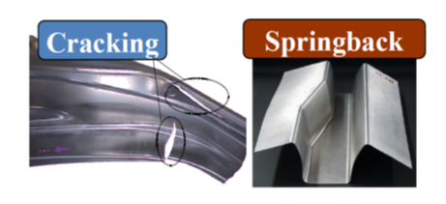
Some crtical needs from industrial applications on-site use
Non-destructive test: transmission imaging for such a large area as 10cm² with *100μm resolution
  Corrosion visualization
  bonding interface and joints of multi-materials
Material development engineering diffraction towards high strength-formability for weight reduction
  volume fraction evaluation
  texture evolution estimation
  SANS, PGAA, as well
Thin-film like hydrogen between dissimilar metals (water, adhesives, rust) and rust between metals and coatings

Slide 6
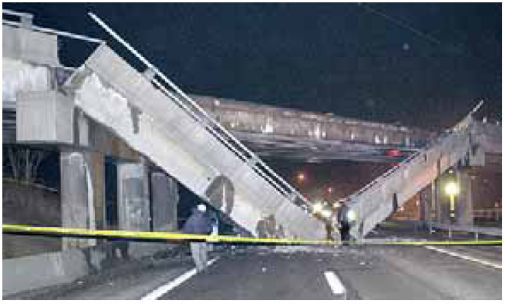
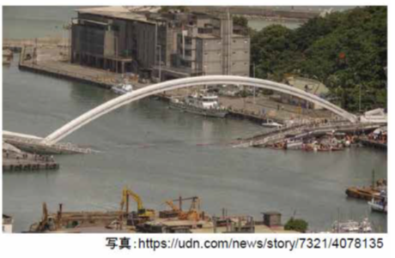
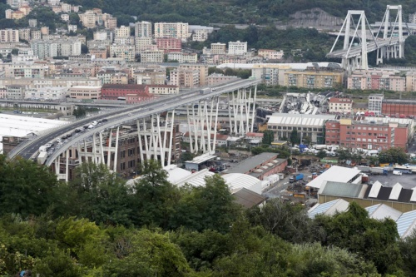
The most critical need is non-destructive diagnostic system for infrastructure:
To meet needs： preventive maintenance
Salt damage->bridges collapse
Initial construction failure
Canada Collapse of a Portion of de la Concorde Overpass
USA I-70 Concrete bridge collapse
Sept, 2006, 35 years after construction, Montreal
Initial construction failure
Dec. 2005 , 45 years after the construction Pennsylvania. Rebar corrosion because of ant freezing agent
出典：落橋に関する委員会報告書
Message from Dr. Banthia to Japanese researchers:
The novel non-destructive test methods such as x-ray, electromagnetic induction method, elastic wave method.出典：六郷ら、カナダのデラコンコルド跨道橋の崩落事故に学ぶ、コンクリート工学,2008.12
From：Pittsburg Post-Gazette
From Mr. R.Ooishi (Institute Public Work)
Italy ・Moradi bridge collapse
（14 Aug.2018. ）Salt damage
Taiwan bridge collapse1 Oct. 2019）
Vigili del Fuoco/AFP
Notes:
A number of severe and unpredictable bridge falls have so far occurred around the world.. Preventive maintenance, rather than the conventional after-the-fact maintenance that is carried out after cracks and other external damage have already started to occur, can extend service life. Non-destructive observation of the inside is essential for preventive maintenance, and expectations are high for neutrons.

Slide 7
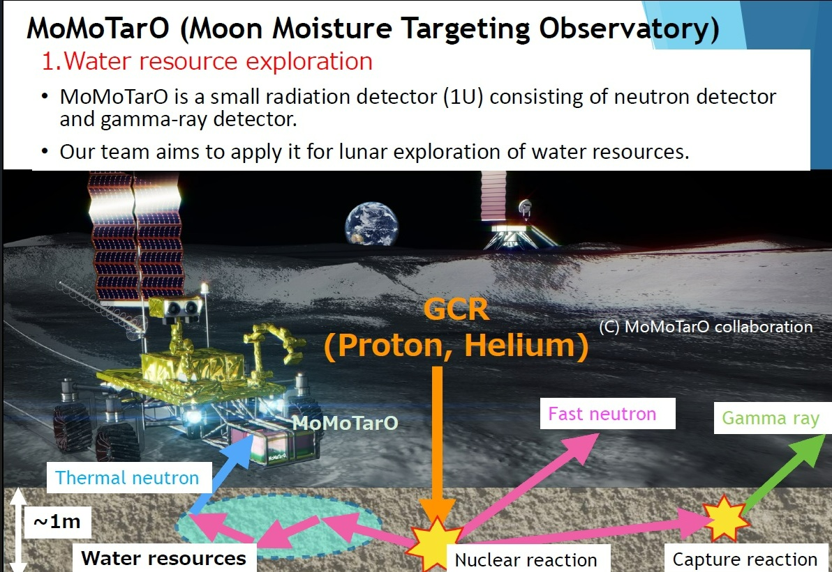
Research Projects with Space as the Place
1. water resources exploration: Moon, Mars
2. neutron lifetime: lunar orbit together with RANS team (collaboration from 2020-)
Dr. Teruaki Enoto (Kyoto Univ. RIKEN)

Slide 8
Compact neutron systems neutrons, anytime, anywhere
Development objective:
Research and development in response to needs
Needs: we focus on.
  Manufacturing sites: human resources development, materials development, non-destructive testing
    Neutron scattering instruments:<- Proof and examples of what CANS can do.
      Engineering diffraction,
      SANS,
      imaging,
      PGAA, NAA
  Infrastructure sites: preventive maintenance Conversion from after-the-fact maintenance to preventive maintenance. Conventionally, only preventing accidents before they happen
    Fast neutron scattering imaging and PGAA: RANS-III (transportable)
    PGAA on-site, of ultra-compact detection system with Cf source with reflector system: RANS-μ

Slide 9


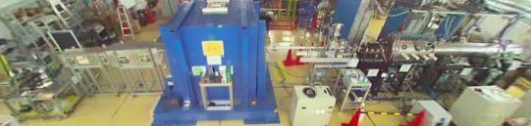
Major parameters of RANS
1.Proton 7MeV 100 μA (max. av.) Daily use
Be (p,n)reaction: Be (Dr. Y.Yamagata)
2012 7MeV proton linac was installed (Accsys co.)
2013 Operation starts with fast and thermal neutron
  Neutron max total flux ~10¹²/sec
7MeV 100 μA 700W
Pulse condition
10-180μs pulse width
20-180Hz repetition rate
Choose them under the condition 1.3 %duty, 100μA
2.compact and low cost
proton linac: in our case less than <2億円=2*10^8 yen=2 million US$
shielding design Multilayer shielding of target station
  ７MeV、100μA、Rf power supply.: 350kW(peak) duty 1.3%,Electric power peak 40kVA, Cooling water：75L/min ,pulse width (30～200μs)repetition frequency～20～180Hz RF power 425MHz, Injection energy0.030-3.5MeV

Slide 10

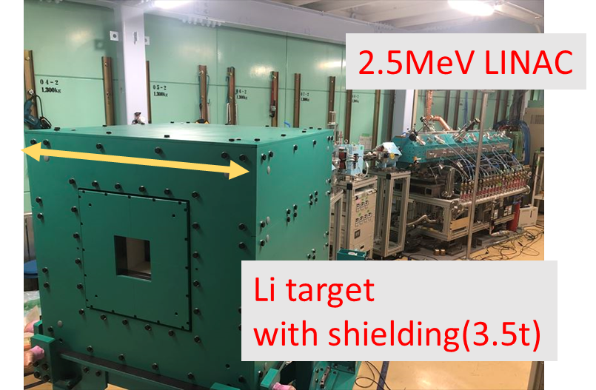
Major parameters of RANS-II
T.Kobayashi, S.Ikeda N.Hayashizaki, Okamura TIME Co.
Both the accelerator and target are robust and easy to operate stably.
1.Proton 2,49MeV 100 μA (max. av.) 200MHz
MIRROTRON CANS
RANS2.1 model
Li (p,n)reaction: Li target (covered with CrN)
  Neutron max total flux ~10¹¹/sec
2.5 MeV Proton linac plan discussion with Prof.N.Hayashizaki of TITECH
2015 Prof.Hayashizaki, Time Co., RIKEN design discussion
2019 Neutron generation
2.5 MeV 100 μA 250W
Pulse condition
  pulse width 10μs~ * ms
  repetition rate *Hz~2000Hz
under the condition 3.3 %duty, 100μA
2.compact and low cost
Easy to operate, and robust

Slide 11

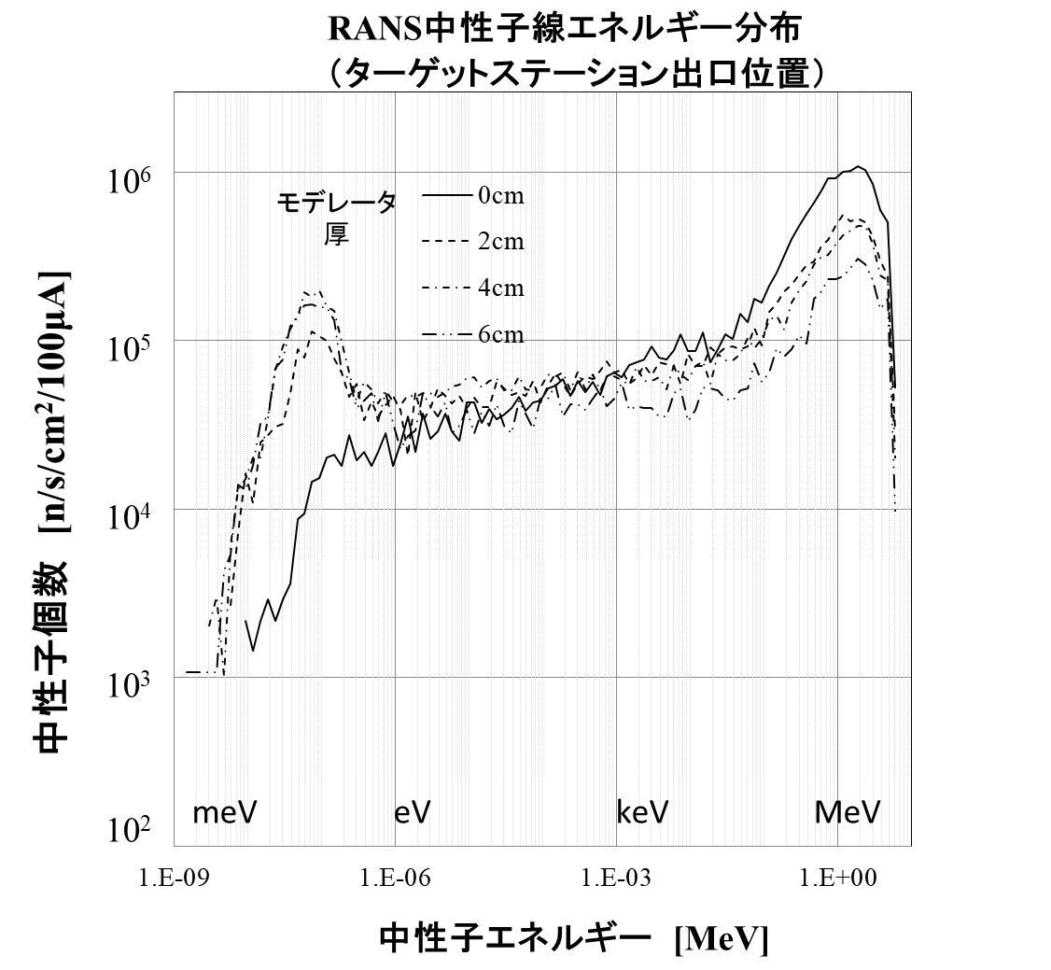
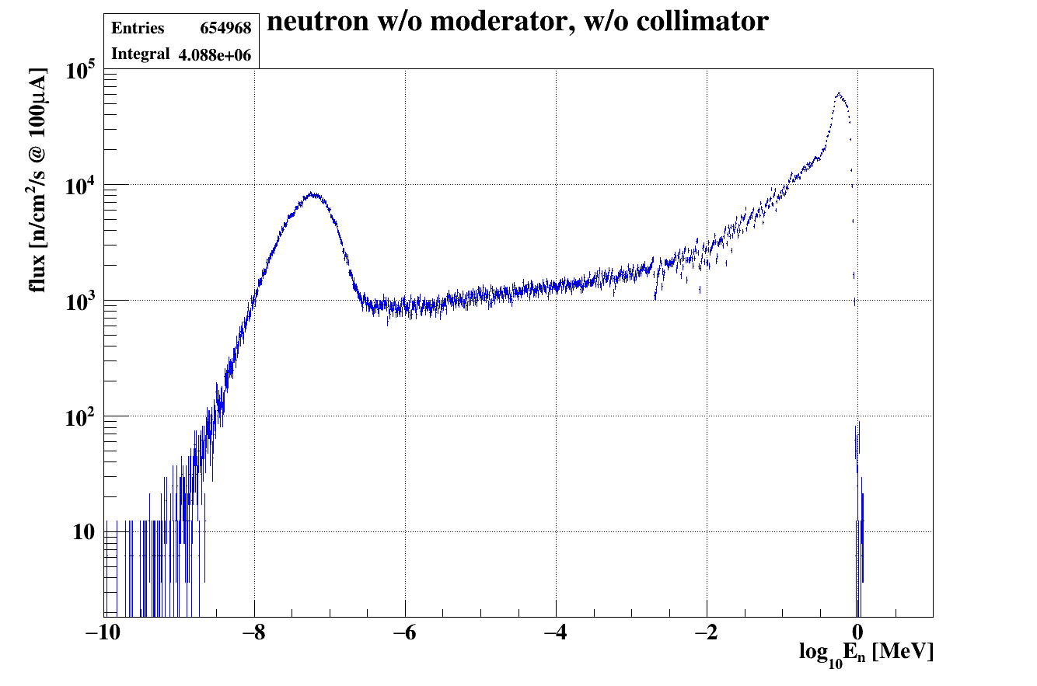
Typical Neutron Spectra for p-Be and p-Li with respective proton energy of 7 MeV and 2.5 MeV
・Thermal moderator: PE
・Cold moderator: Mesitylene
・Reflector: Graphite, and PE
・Without moderator ,
・or thermal moderator(PE)
・Reflector: PE
Spectrum 1.5m from target ( Target station exit)
Moderator thickness
Without
PE
Moderator
Without Moderator
Neutron flux
Neutron Energy
Neutron Energy

Slide 12
RANS cold neutron moderator system with a plug
Yujiro IKEDA, Teshigawara
Graphite
Mesitylene
Graphite Reflector
Cold moderator
Ti
Refrigerator
1840
PEEK insulator
15
Be Target
Air
Plug
1875
proton
Be
150
PE
30
28
400
Proton beam
Beam extractor
PE
Pb Shield
15
1250
Polyethylene
Aluminum
3030
Notes:
The conceptual structure of the RANS target station is shown in Fig with major components of the neutron source, e.g., Be neutron production target, moderator, reflector and radiation shield. The plug system is also depicted where the plug with cryogenic moderator is moved horizontally along rails placed on a support structure into the place at the central target location.
Fig. b gives a layout of the expanded TMR configuration, where the mesitylene moderator with PE pre-moderator are directly coupled with the Be target. All in detailed geometries of those components are modeled in the simulation.

Slide 13
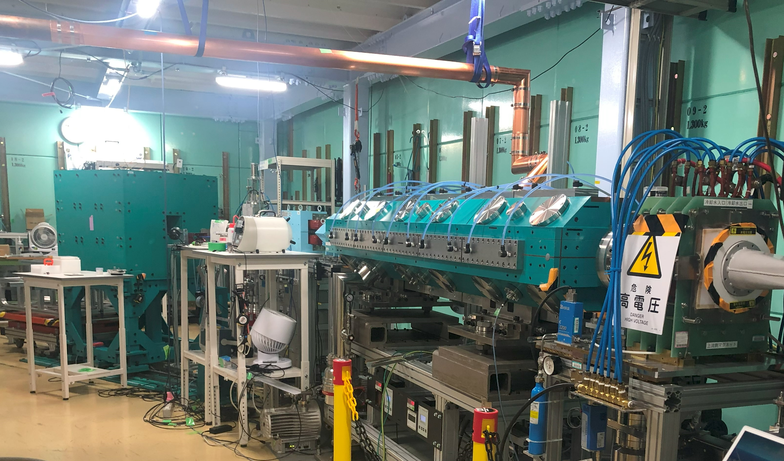


RANS, RANS-II neutron Scattering experiments
Imaging experiments special resolution, 0.5mm, 0.2mm, Non-destructive test
Engineering Diffraction, iron steel, austenite phase fraction, texture, residual stress
PGNAA, Prompt gamma-ray Neutron Activation Analysis, elemental analysis
SANS with Ibaraki Univ. (Small Angle Neutron Scattering) nano, sub-mic.
Fast neutron transmission imaging for thick samples
Fast neutron scattered imaging from the surface, infrastructure degradation visualization
Phase contrast imaging with Tohoku Univ. Prof. A. Momose
Polarized neutron experiment for fundamental physics, with Nishina-center, Tohoku Univ. Kyushu- Univ.
Neutron γ-ray irradiation application:
  Food: space application (Prof.M.Hatsuda et al)
  Neutron detectors using solar cells (Dr.Okuno, et al)
  others

Slide 14
Realized with RANS: What can be done with CANS
CANS applications from RANS and RANS-II results.

Slide 15

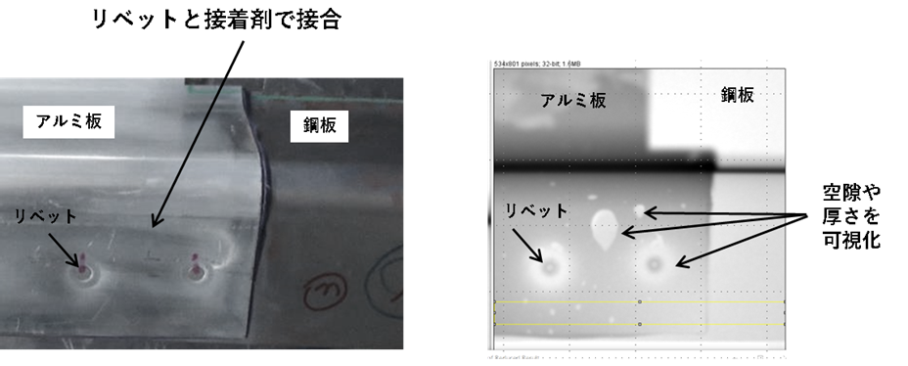
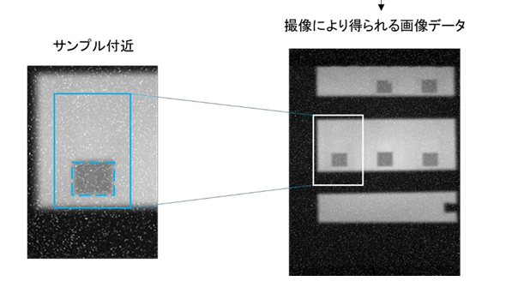
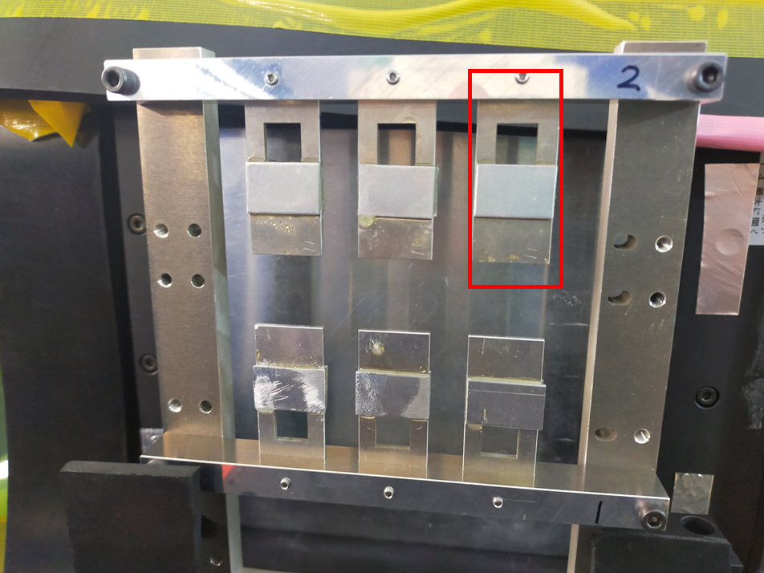
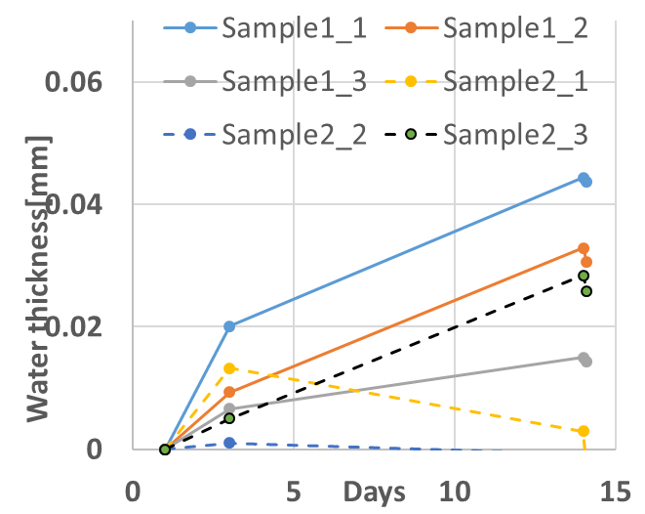
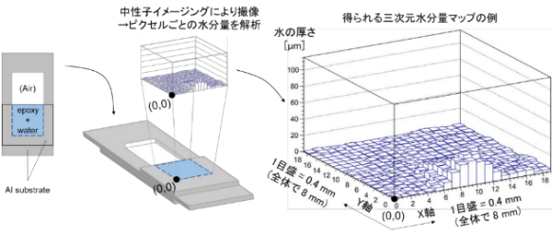
Visualization of bonding interface and joints of multi-material structural materials
NEDO/ISMA project with NIMS and AISTANS
To evaluate the bonding interface and joints of multi-material structural materials.
Quantitative observation of water penetration into the bonding interface was achieved. We have also obtained a technique for observing the state of the bonding area regardless of the bonding material.
RANS imaging
Dr.A.Taketani, Dr.Naito (NIMS), and Takahashi ( Kobe steel) by ISMA project
Rivet and adhesive connection
Aluminum
Aluminum
Steel
Steel
rivet connection
Visualization of air hole, thinner part
rivet
Higher resolution, FNTD
Dr.Saito, Dr. Abdul Muneem (25th)
Visualization of moisture penetration of bonding

Slide 16

RANS up-grade 2: Towards stress measurement
RANS: engineering diffraction
H.Suzuki, P.Xu, Y.Ikeda, C.Iwamoto
volume fraction evaluation
texture evolution estimation

Slide 17
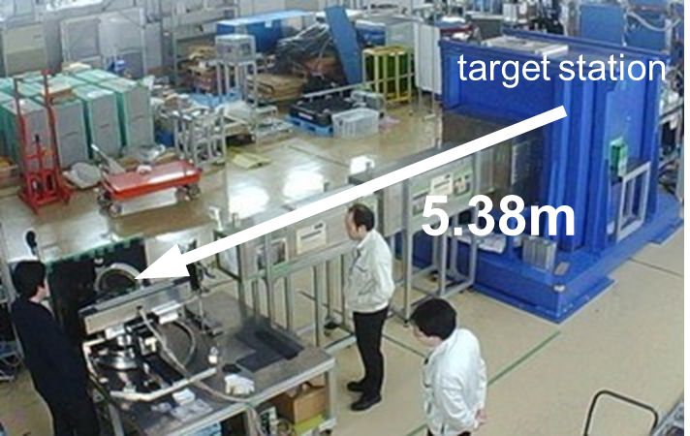
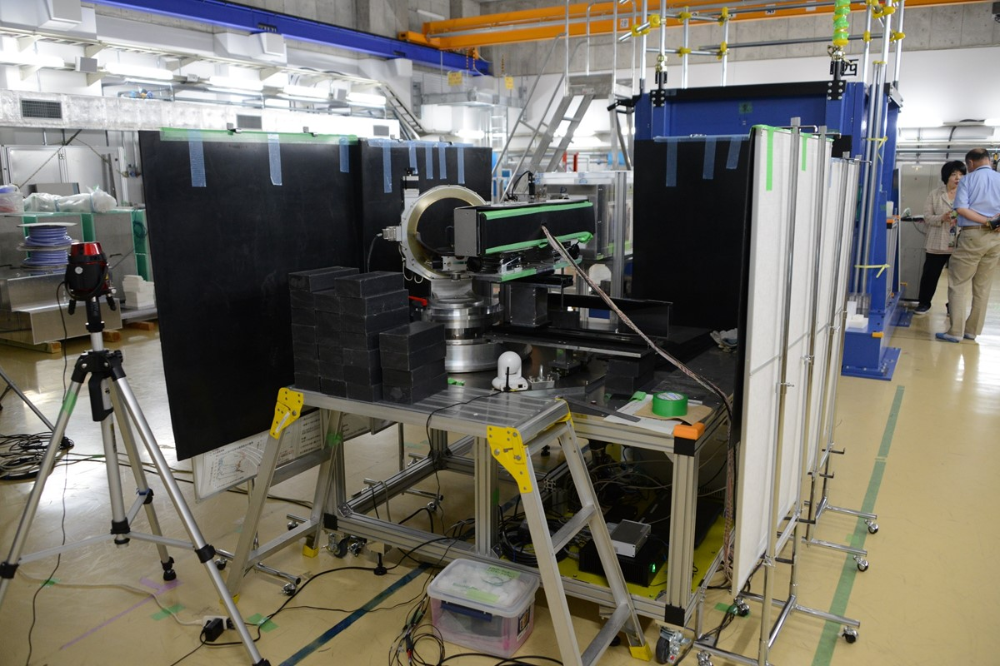
＜Engineering diffraction RANS＞
for quantitative evaluation (Iron and steel industrial use)
Institute steel and iron Japan Research Group activity ₍2014-2016₎,
Nippon Steel & Sumitomo Metal Co. JFE-Steel, Kobe steel, Daido steel
For lower background, shielding
Y. Ikeda et al.: “Prospect for application of compact accelerator-based neutron source to neutron engineering diffraction”, Nucl. Instr. Meth. A 833(2016)pp61-67

Slide 18
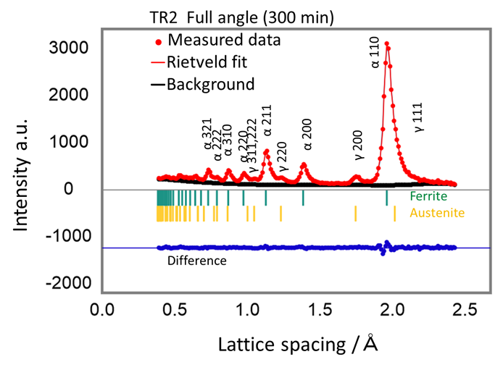
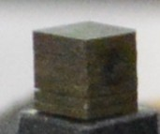
Volume fraction estimation with RANS engineering diffraction
Highly accurate agreement with measurements at the large facility (J-PARC) (only 1% or less difference)-
> Compact source has high potential to use on-site
The result of measurement during uniaxial rotation (30 min) for round robin sample is consistent with J-PARC measurement
retained austenite evaluation
Controlled samples produced
→BCC peaks
→FCC peaks
TR2 full angle(300min,
current32μA)
9mm×10mm×9.5mm
Austenite：13.1%
J-PARC Takumi: 13.9％
Y.Ikeda et al, Tetsu to Hagane vol.104, No.3 (2018) pp.18-24

Slide 19
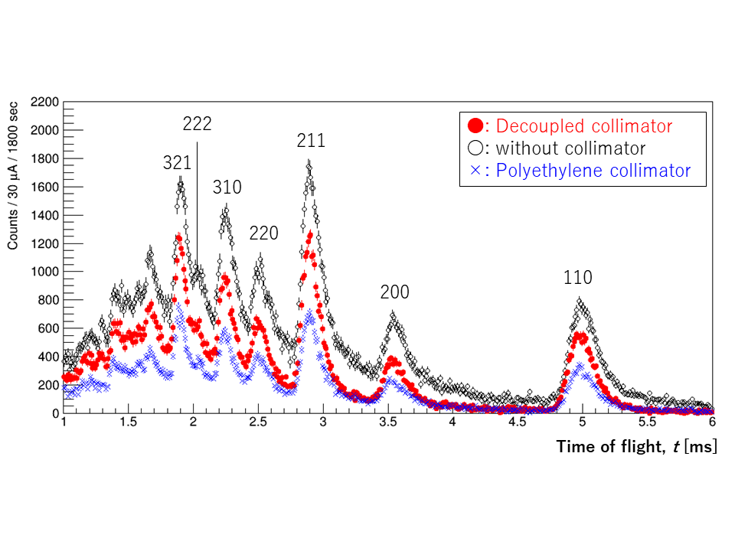

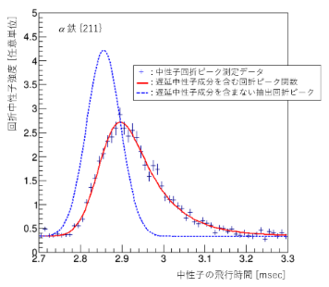
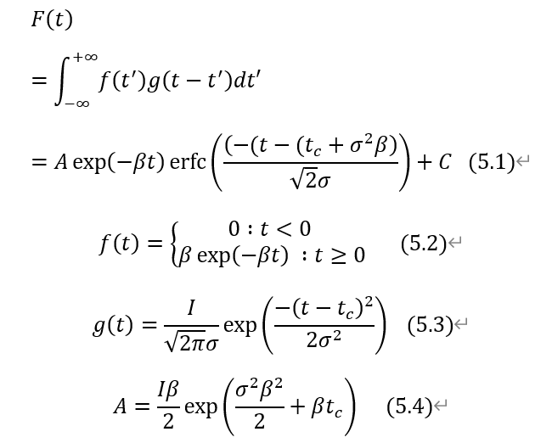
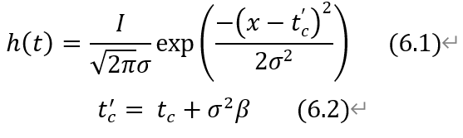
Realization of high resolution in a small size: Pulses are not shortened.
Stresses can now be measured up to 130 MPa for practically relevant steel materials in RANS.
(A) Decoupled collimator system
sample
proton
Deconvolution of delayed neutron components.
-> diffraction components-> peak fit
(B)de-convolution analytical method
Neutron intensity doubled, and sharpness increased by 30%.
Stress measurement of around 130MPa can be measured.
Notes:
One of the recent results. Now at RANS, stress measurement of around 130MPa can be measured. The key technology which enable this stress measurement are two, one is decoupled collimator system, another
Stress measurement is made possible by two breakthrough developments One is the Decoupled Collimator system and the other as a data analysis method. Deconfovution The introduction of the De-convolution method as a data analysis method has enabled only the stress-related components to be extracted .Decoupled Collimator allows The black dots in the diagram on the right show the data obtained by narrowing the pulse width without reducing the peak intensity.

Slide 20
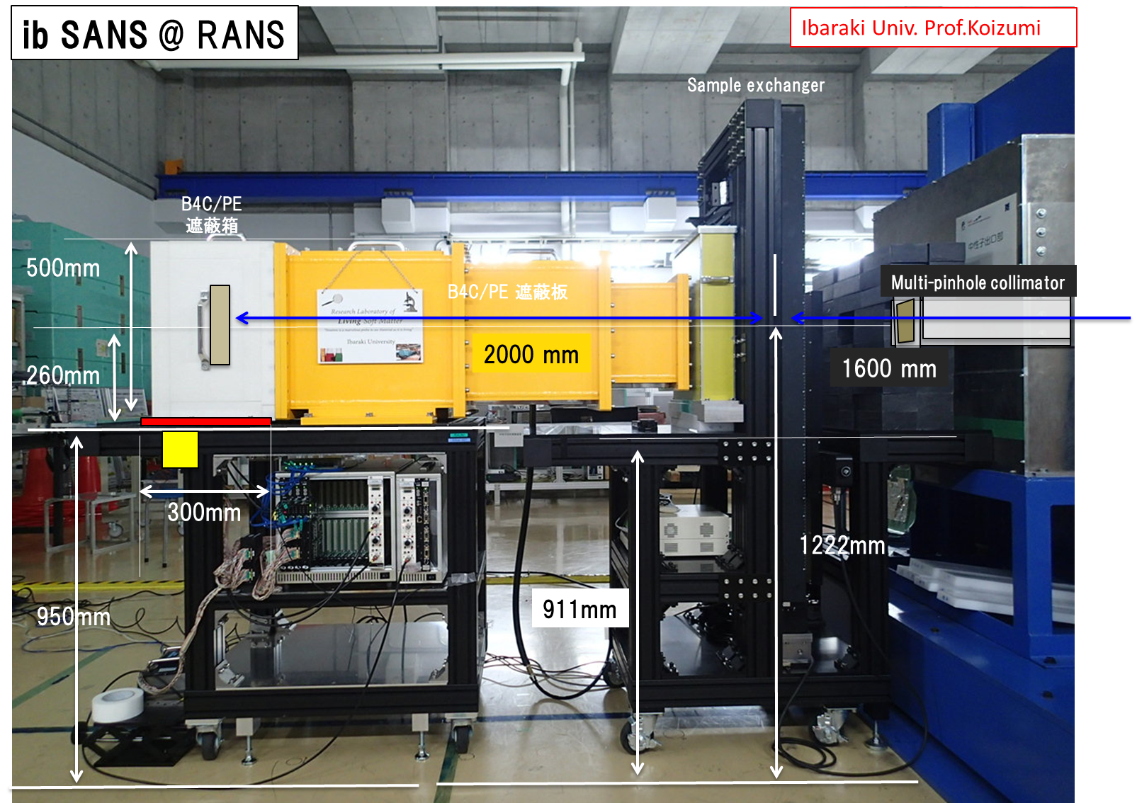
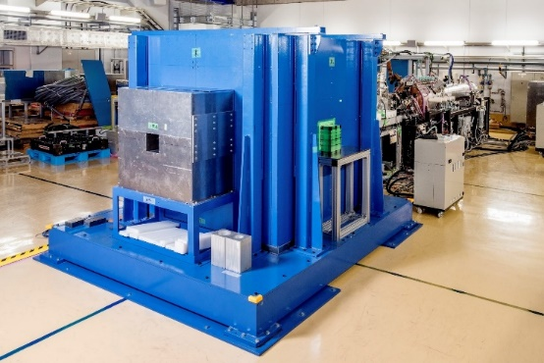
Ib-SANS(Small Angle Neutron Scattering), Ibaraki Univ. Prof.S.Koizumi

Slide 21
Ib-SANS,Ibaraki Univ. Prof.S.Koizumi
Multi-pin-hole system has succeeded at RANS
To have much lower q, Mesh Type Multi-pinhole （9x9）
2-Detector
Sample
Vacuum
Multi-pinhole
Mode-rator
Length 207cm
10mm
1
2
3
4
5
6
7
8
9
10mm
2
5mm
3
5mm
4
150mm
5
6
7
8
9
150mm

Slide 22
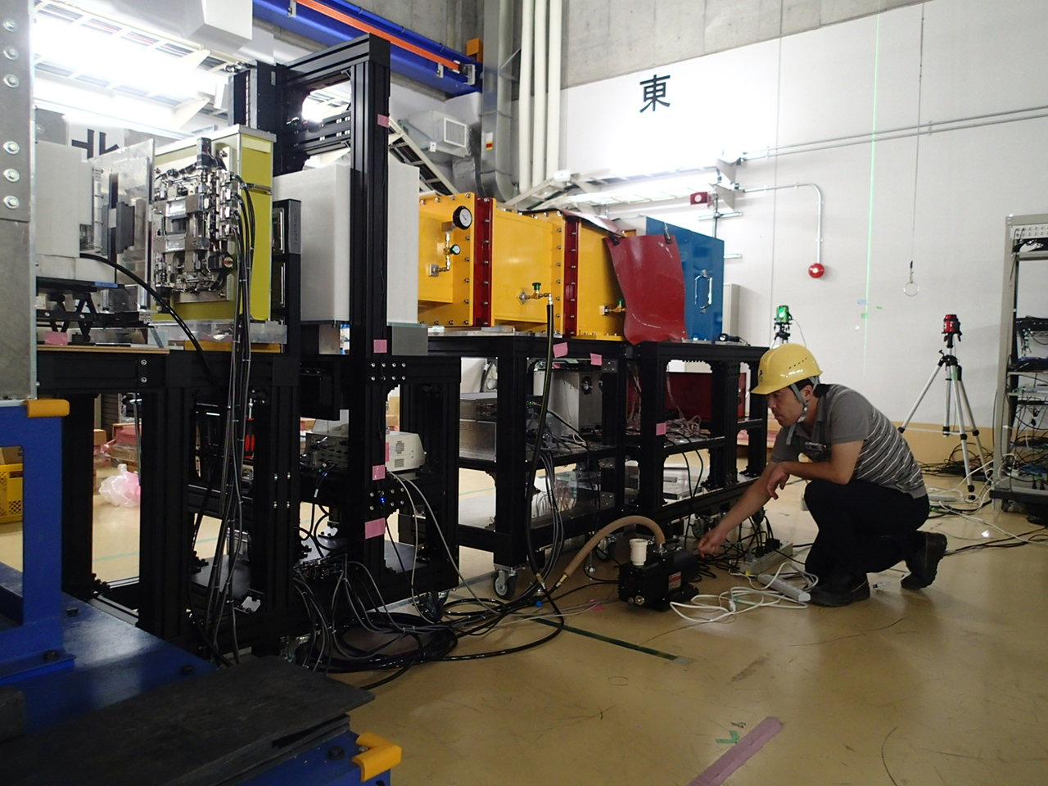

@ RIKEN RANS
Converging Beam Device: Multi-pinholes （5x5） & (9x9)
Counting Efficiency： 1/1000 → 1/40
発明名称：「中性子光学素子及び中性子源」 、出願番号：特願2017-140192

Slide 23

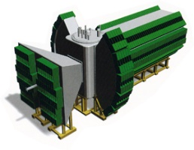
Small Angle Neutron Scattering experiment with RANS
Ib-SANS on SDS micelle solution with a cold source (before up-grade)
Developed by Prof.S.Koizumi, Ibaraki University
10²
0.007
λ = 10–1 A
10
1
Differential Scattering Cross Section
1
Red circles by ib-SANS (1 hr)
Black line by iMATERIA (0.2 hr)
Intensity (cm⁻¹)
10⁻¹
(1) Small-angle
Detector
(2) Low-angle
Detector
10⁻²
Wave number q (A⁻¹)

Slide 24

RANS-II: two function (Stational CANS)
・Standard Model of stational compact neutron system
・Accelerator- development: 2.49 MeV proton RFQ linac: Tokyo Inst.Tech.
・Li-Target: Sanki co. ( with QST,放医研)
・Proto-type of transportable compact neutron systems, same neutrons as RANS-III: All the development of detection tech. development
Power | Neutron Yield @target | TMR shielding size | Distance from TM | Neutrons @ sample position | Acce. Duty
RANS 7MeV 700W | 10¹² n s⁻¹ | Volume：~ 8m³ weight～23ton | 1.5m | *10⁵ n cm⁻² s⁻¹ | RANS 1.3% (RF Duty cycle)
 |  |  | 5m | *10⁴ n cm⁻²s⁻¹ Diffraction, ToF Imaging,
RANS-II 2.49MeV 250W | *10¹¹ n s⁻¹ | V~1m³ W~ 3.5ton | 0.5m | *10⁴~10⁵ n cm⁻² s⁻¹ | RANS-II 3% (RF Duty cycle)
 |  |  | 1.5m | *10⁴ n cm⁻² s⁻¹ Diffraction etc.

Slide 25
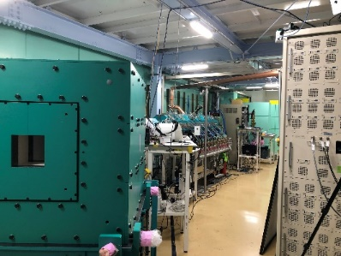
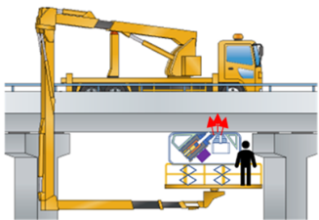
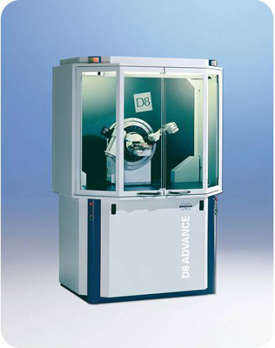
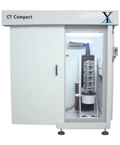

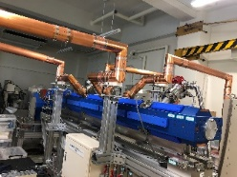

Nondestructive test on site use need two ways; Stational system on floor, and transportable compact system
Lower radiation level during operation
Easy to operate, and easy and safe for maintenance
Good S/N measurements for quantitative analysis ( No powerful source, but proper technology for compact source including shielding design, pulse structure, etc. )
As few as possible of activation products
On-site non-destructive test
Floor-standing type
On-site non-destructive test
Transportable type
Ｘ-ray, Electron,
SEM, TEM,EBSD
Neutron
RANS-II MODEL
RANS-III MODEL
RANS-μ
Neutron Salt-meter
Notes:
For on-site use, for example, the floor-standing type is intended to be used in the same way as electron microscopes and X-ray CT systems, while the transportable type is intended for outdoor use at bridge sites.
For this purpose. There are such requirements as 1….

Slide 26

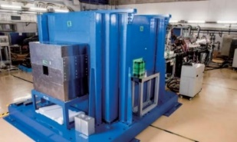
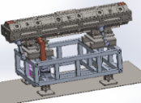

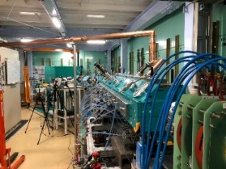
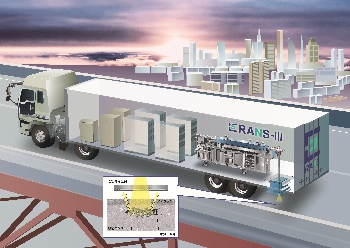
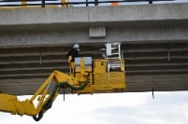
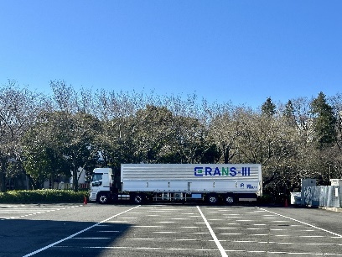
RANS challenge
to meet the needs for such non-destructive test with neutrons!
RIKEN Accelerator-driven compact Neutron Sources RANS
RANS: Research with neutron scattering at the institutes, universities, etc.
15m
5m
RANS-II: MODEL of non-destructive test instrument with neutrons on-site.
-> Hungarian case: PHOTO (from Prof. Dr. F.Mezei)
Now at RIKEN, Ex. Neutron CT instrument development is performing
4m
RANS-III: Transportable neutron system out-side
RANS-μ: Neutron salt meter with bridge inspection vehicle
It will be appeared in 2023 with T-RANS activities
70cm

Slide 27
For the infrastructure preventive maintenance
RANS-III: research and development
RANS-μ: on-site use and up-grade development
Salt damage->bridges collapse
-> Salt density measurement
Degradation
-> Visualization of the water, air hole
Canada Collapse of a Portion of de la Concorde Overpass
USA I-70 Concrete bridge collapse
Sept, 2006, 35 years after construction, Montreal
Initial construction failure
Dec. 2005 , 45 years after the construction Pennsylvania. Rebar corrosion because of ant freezing agent
出典：落橋に関する委員会報告書
Message from Dr. Banthia to Japanese researchers:
The novel non-destructive test methods such as x-ray, electromagnetic induction method, elastic wave method.出典：六郷ら、カナダのデラコンコルド跨道橋の崩落事故に学ぶ、コンクリート工学,2008.12
From：Pittsburg Post-Gazette
From Mr. R.Ooishi (Institute Public Work)
Italy ・Moradi bridge collapse
（14 Aug.2018. ）Salt damage
Taiwan bridge collapse1 Oct. 2019）
Vigili del Fuoco/AFP
Notes:
A number of severe and unpredictable bridge falls have so far occurred around the world.. Preventive maintenance, rather than the conventional after-the-fact maintenance that is carried out after cracks and other external damage have already started to occur, can extend service life. Non-destructive observation of the inside is essential for preventive maintenance, and expectations are high for neutrons.

Slide 28

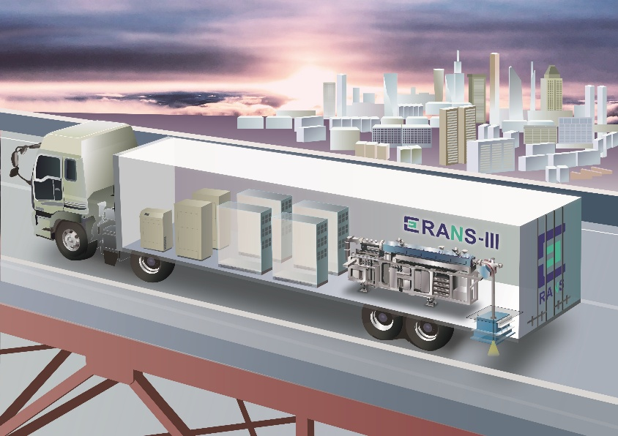
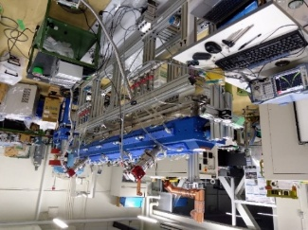
RANS-III Transportable CANS (Compact Accelerator-driven Neutron system)
Dr T.Kobayashi 25th
RANS:III: 2.49 MeV, Li target
Proton: the same energy, current
with RANS-II
・ECR ion source：Permanent magnet
・Frequency of proton linac 500MHz
Japanese radiaton regulation: Using the linac, particle energy is smaller than 4MeV, accelerator-driven quantum beam can be used for non-destructive test for bridges (Act on Prevention of Radiation Hazards due to Radioisotopes, etc)
放射性同位元素等の規制に関する法律 第１０条 および 関連規定（平成１７年７月改定）Japanese regulation 4MeV>linac
  橋梁等の非破壊検査に用いる直線加速器で４メガ電子ボルト以上のエネルギーを有する放射線を発生しないものは、放射線発生装置の使用の場所の変更を都度許可を得る必要がなく届出で足りることとする。（ただし、設備については、事前に原子力規制委員会原子力規制庁の届け出許可が必要。）
  実行線量：（3か月で1.3mSv)
  労働安全衛生法令による管理区域
  人事院規則による管理区域

Slide 29

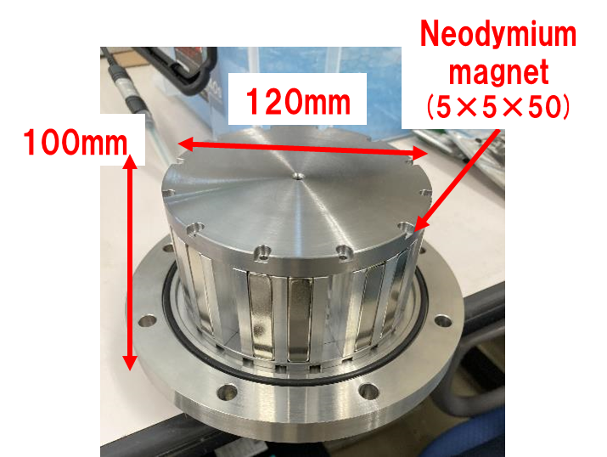
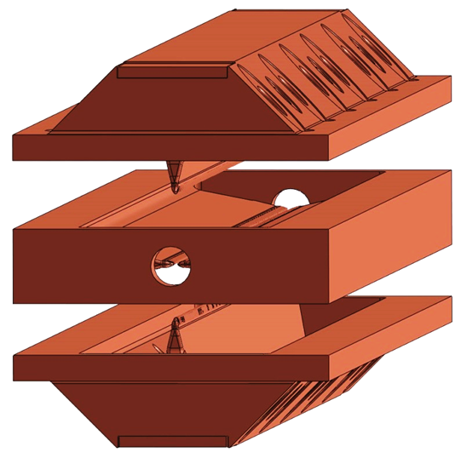
ECR ion source, proton linac for RANS-III
Dr. Shota IKEDA
T.Kobayashi, SYujiro IKEDA, M. Okamura
Background: Already working on vibration, stable operation, etc. with RANS-II.
The centerpiece of further advancement! Downsizing and weight reduction of the RANS-II ion source and acceleration cavity!
１.ECR ion source development
：Neodymium magnet used
←No cooling required
Plasma chamber
with permanent magnet
２.Proton 2,49MeV 100 μA (max. av.) 500MHz
Three-body copper construction: compact, lightweight, vibration-resistant screw-on only

Slide 30
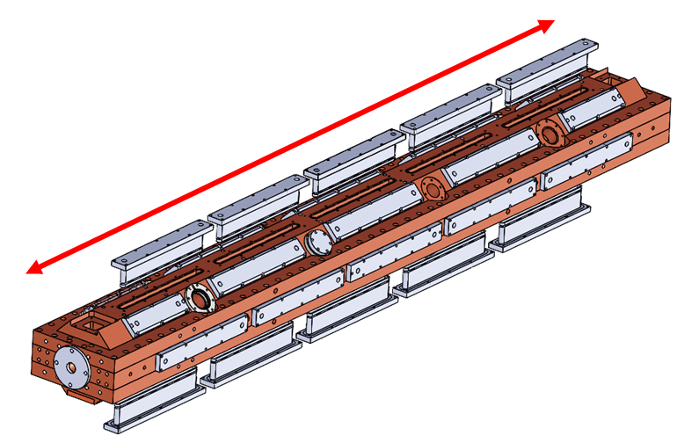
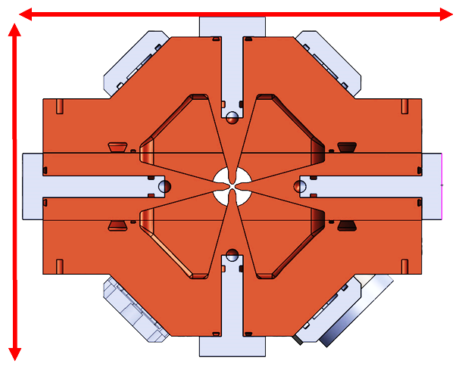
RANS-III.Proton 2.49MeV 100 μA (max. av.) 500MHz
2, Optimized cavity parameter
200MHz-> 500MHz
Higher RF frequency for lighter and smaller acceleration cavities
Width
54㎝(RANS-II)⇒33㎝( RANS-III)
Dr.Shota Ikeda, Prof.N.Hayashizaki,
Dr. Okamura, Dr.T.Kobayashi
Cavity parameter of
RANS-Ⅱ RFQ and RANS-Ⅲ RFQ
 | RANS-Ⅱ RFQ | RANS-Ⅲ RFQ
Resonant frequency [MHz] | 200 | 500
Input beam energy [keV] | 35[keV] | 30[keV]
Output beam energy [MeV] | 2.49[MeV] | 2.49[MeV]
Peak beam current [mA] | ≦10.45 | ≦10.2
MAX Duty cycle [%] | 3.3 | 3.0
Average beam current [µA] | 100 | 100
Power loss [kW, 80%Q] | 192 | 275
Unloaded Q | 11750 | 8730
Cavity length [mm] | 2555 | 2370
Cavity diameter [mm] | ~540 | ~300
Cavity weight [t] | 3 | 0.7
2370 mm
330 mm
300 mm

Slide 31
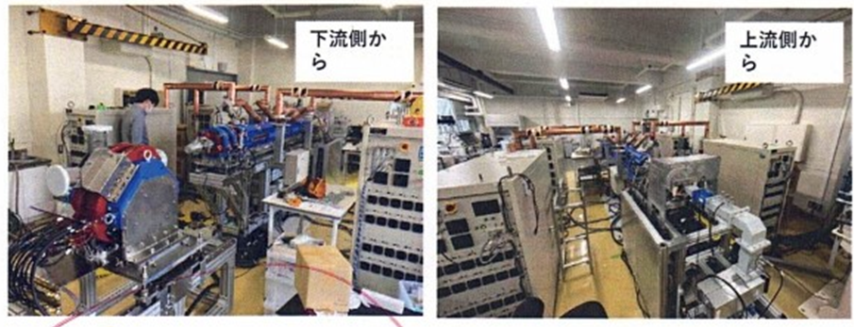

Acceleration test: success in-door RANS-III
Dr. Shota IKEDA
T.Kobayashi, SYujiro IKEDA, M. Okamura
500MHz proton accelerator.
Ion source + acceleration (500MHz) Successful indoor acceleration
Performed accelerated testing at low radiation doses.E < 2.5 MeV in a room without radiation controlled area designation,

Slide 32
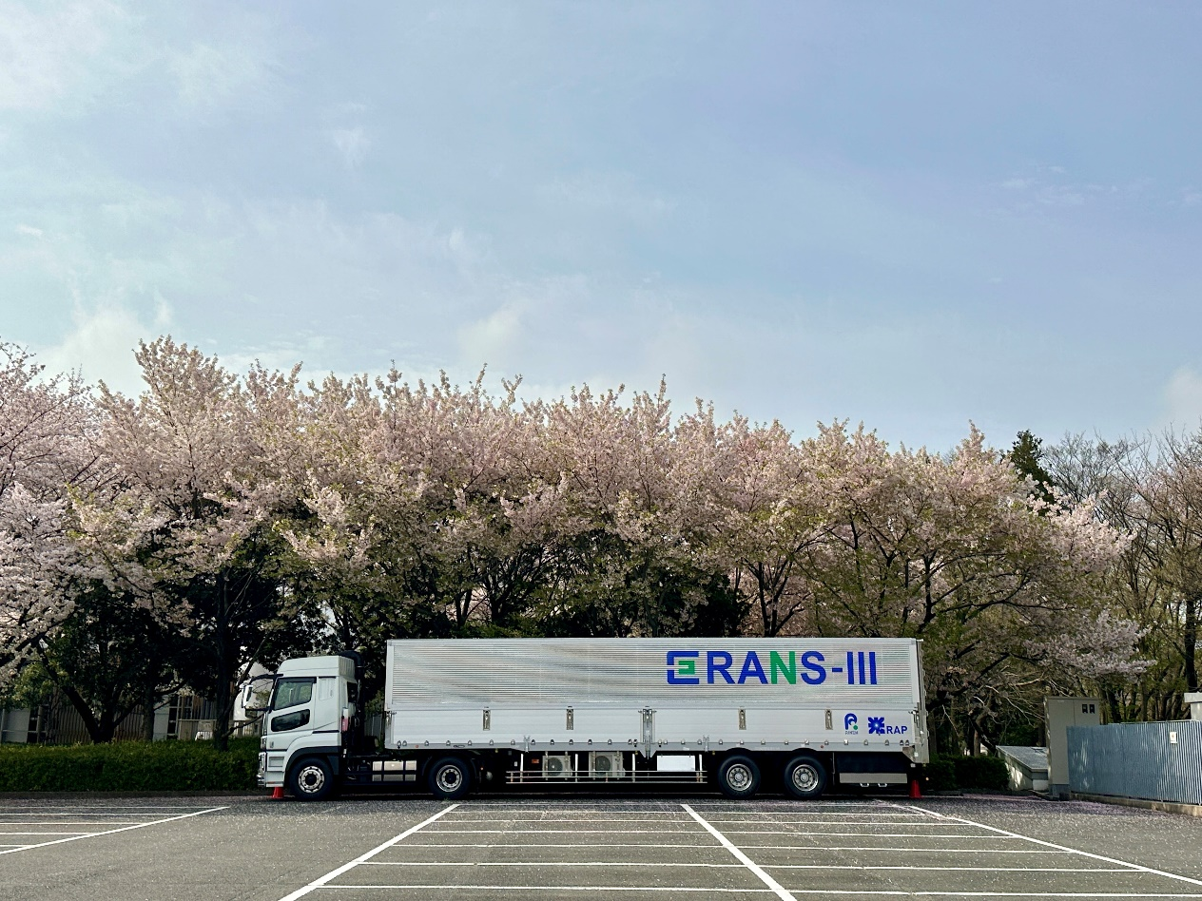


RANS-III Recent development
2.49 MeV proton Li (p,n) the same as RANS-II
Proton Acc system and target shielding system are installed in the trailer.
2.49 MeV proton acceleration test is running.
In 2025, neutron experiment will start in new building
Proton Accelerator +Magnet
Target + Shielding system

Slide 33




RANS-III non-destructive measurement technology is under development based on high demand from the society
Deterioration Visualization Method
Salt damage
Prevention of rupture accidents due to internal steel corrosion caused by salt damage → measurement of internal salt concentration
Fast neutron scattering ToF imaging method
Visualization of floor slab deterioration, sheath grout unfilled areas
PGNAA method
Concrete internal elemental analysis of PGNAA
cable-stayed bridge anchorage deterioration （High way companies）
³⁵Cl
³⁵Cl
High sensitibitiy for Cl
¹H
²⁸Si
²⁸Si
³⁵Cl
ガンマ線強度
²⁷Al
⁵⁶Fe
1165keV
⁴⁰Ca
1951keV
1959keV
6111keV
Dl density
[kg/m³]
Distribution of salt
ガンマ線エネルギー (keV)
5
5
10
0
surface）
Depth [cm]
NEXCO中日本との共同研究

Slide 34


Fast neutron scattering (back scattering) time of flight imaging method to meet the needs for the visualization of the floor slab deteorisation
Fast neutron is inserted
→Select the timing, and the energy according to the materials to be visualized
→water, or air hole (gap) in the second layer
Get 2D non-destructive imaging under the first layer

Slide 35

Fast neutron scattering imaging with time of flight method (New Tech.) (Back scattering imaging technology)
Simulation study to optimize the energy and the timing for the vilialisation at the surface
Back scattered imaging
=Scattered imaging
Energy to detect
Timing to detect
E<150 meV
50μs<t<1ms
detector
detector
reflected
reflected
Fast neutron is inserted（100keV~*MeV) injected
→Select the timing, and the energy according to the materials to be visualized
→water, or air hole (gap) in the second layer
Get 2D non-destructive imaging under the first layer
Water, airgap, rebar, etc.

Slide 36






Back scattered neutron imaging method: Results
E^{n}_{in}>fast neutron
Degradation：water
Neutrons increase 4~8 times
Healthy condition
Void, decrease 20~40%
concrete void
N
Timing(TOF), energy, intensity ratio
-> Non-destructive inspection inside concrete degradation

Slide 37

RANS-II Visualization of degradation: sedimentation
ratio
ratio
150
0
-150
1.2 1.1 1 0.9
1.2 1.1 1 0.9
N
Fast Neutron Beam
損傷部
Dry sedimentation(30mm)
中性子ビーム
x(mm)
Detector
75
1
Asphart
70
2
RC floor slab
Beam spot
Water (5mm)
60
3
Concrete
300 0 -300
300 0 -300
70
4
RC floor slab
y(mm)
y(mm)
単位: mm
Steel bar
300
Comparison between the fast and slow detection timing enables to distinguish the water+ degradation from other degradation
Detection timing
100＜t<600μs
Negative peak
= Water+ degradation
Detection timing
40＜t<100μs
Positive peak
= Water+ degradation
Water
Moisture degradation
Dry degradation
Water + degradation
Water
Moisture degradation
Dry degradation
Water + degradation
N –beam spot
N -beam
degradation
degradation

Slide 38

To prevent bridge collapse accident: corrosion Visualization of stagnant water at the suspension bridge cable anchorage ⇒RANS-II experiment
Dr T.Fukuchi 25th
NEXCONaka nihon：Collaboration
Photo of Meiko-Higashi oohashi：名港東大橋
中性子検出器

Slide 39

Development of new detection techniques: from scattering cross sections of neutrons with energies from 500 KeV to 1 MeV
To detect 1% water (hydrogen) inside iron with a diameter of 10 cm or more.
JENDL 4.0
100 KeV to 1 MeV
Fast neutrons are scattered.
H of the water, and the corrosion decelerate the neutrons
-> can be detected with ToF tech.

Slide 40
Visualization of water at the suspension bridge cable anchorage ⇒RANS-II experiments towards RANS-III
Neutron beam injected from the end of Anchorage.
Thin water detected by backscattered neutrons
Detector
Depth of the inside water: 10㎜、3㎜、1㎜
Volum: 100％、50％ 33％
Neutron
Anchorage

Slide 41


Visualization of water at the suspension bridge cable anchorage ⇒RANS-II experiments towards RANS-III
Neutron beam injected aside of the cable ancholrage reason from road level is considered.

Slide 42



Neutron experiments RANS-III: Need the new building Required to obtain a radiation permit for outdoor use
Neutron irradiation experiments indoors under the same conditions as outdoors.
Neutron Application Facility North building

Slide 43







Urgent Non-destructive test with neutrons：RANS-μ（Ready to use）and RANS-III
Neutron Salt-meter： Salt distribution according to the depth until 7cm: for preventive maintenance
Floor slab degradation
On-site use
Salt density:
Detection limit, 1.0Kg/m3 3cm
入射ビーム
アスファルト
散乱中性子
コンクリート
土砂化
Cl density [kg/m³]
Distribution Cl
5
計測結果概念図
Visualization of degradation
滞水土砂化
乾燥土砂化
Sedimentation criteria
5
10
Elemental analysis insice concrete
0
（surface）
depth[cm]
³⁵Cl
³⁵Cl
High sensitivity for Cl.
¹H
²⁸Si
²⁸Si
³⁵Cl
ガンマ線強度
²⁷Al
⁵⁶Fe
1165keV
⁴⁰Ca
1951keV
1959keV
6111keV
Wet sedimentation
Indicated by the increase of scattered neutron
dry sedimentation
ガンマ線エネルギー (keV)

Slide 44
RIKEN's RANS Project Challenges for Social Implementation of Compact Neutron Systems
Toward Practical Application of RANS-III in Outdoor Use
development and practical application of RANS-μ (RANS-micro, not “mu”),
commercialization of RANS-μ RANS-VIEW (sponsorship UCANS),
development of legislation and social implementation for the use of compact neutron systems in bridges for the approach to the Ministry of Land, Infrastructure, Transport and Tourism (MLIT) and for the spread of the use of compact neutron sources on-site

Slide 45



Urgent issue: Salt damage
RANS-μ Neutron salt meter： Non-destructive measurement of salt density distribution near the steel
Dr.Y.Wakabayashi 27th
Objectives: Salt density non-destructive detection
Salt above 1.2 kg/m³ initiates steel corrosion.
Steel corrosion progresses to the point of rupture, causing the bridge to collapse.
To prevent the bridge collapse and for preventive maintenance
Cl measurement by RANS-μ
Neutron distribution in the concrete
Concrete
Steel bar
(corrosion)
γ ray
3～7cm
Neutron
Minimum Cl detection should be 1.0±0.2 kg/m³ at 7cm depth from the concrete surface
・Non-destructive measurement
Cf &
Reflector and
Shield
Ge γ-detector
45

Slide 46


RANS－μ is now listed in the catalog of the Ministry of Land, Infrastructure, Transport, and Tourism on 31 March 2023
The content is updated annually by T-RANS.
RANS VIEW, the company established April 2023 based on the T-RANS (Technological Associate for neutron next generation system) and RIKEN

Slide 47


T-RANS and Rans View Corporation
Establishment of T-RANS Technology Research Association for Neutron Next Generation System Licensed by MILT (September 1, 2020) :
18 Companies+2 Academia (2025)
Corporate philosophy：Standardization of neutron non-destructive inspection technology.
・MILT Catalog Update
・RANS-µ Certified Metrologist
・Standardized walk-in price release (price standardization)
Establishment of Rans View Corporation (April 3, 2023)
Measurement services using non-destructive testing technology
Research and development, sales and rental of non-destructive testing equipment
Consulting using non-destructive testing technology
Numerical analysis and software development associated with non-destructive testing technology

Slide 48





























RIKEN Accelerator-driven compact Neutron sourcesRANS,RANS2, 3, μ
Non-destructive inspection; infrastructure
Non-destructive visualization
In the pavement： back-scattered imaging
Compact Neutron
Visualization of the bonding interface and joints of multi-material, corrosion and its related water movement of the painted steel
Anytime, anywhere
Ib-SANS, Ibaraki Univ.
Phase contrast, Tohoku Univ.
Visualization of water movement of the concrete
JAXA Satellite 1
RANS：15m, 25ton MeV～meV
Diffractometer volume fraction, texture evaluation, stress
PGAA Salt detection of concrete
RANS-II：~5m
E=800keV～meV
Element analysis on site
RANS-III
Salt distribution
retained austenite fraction measurement
Texture evolution
Towards stress measurement, 130 M Pa

Slide 49


Thank you for your kind attention!!!

