Slide 1
Tracking the progress of nonuniform deterioration in a lithium-ion battery using Bragg-edge imaging ~an application of the AISTANS compact neutron source~
Koichi Kino, Takeshi Fujiwara, Tatsunori Shibuya, Brian O’Rourke
National Institute of Advanced Industrial Science and Technology (AIST)
K.Kino: koichi.kino@aist.go.jp

Slide 2
Contents
Motivation
Previous research
Technique “Bragg-edge imaging”
Why experiment at CANS ?
Experiments at AISTANS
Facility, Sample, Setup, and Measurements
Results
Transmission spectra
Recently obtained images
Conclusion

Slide 3
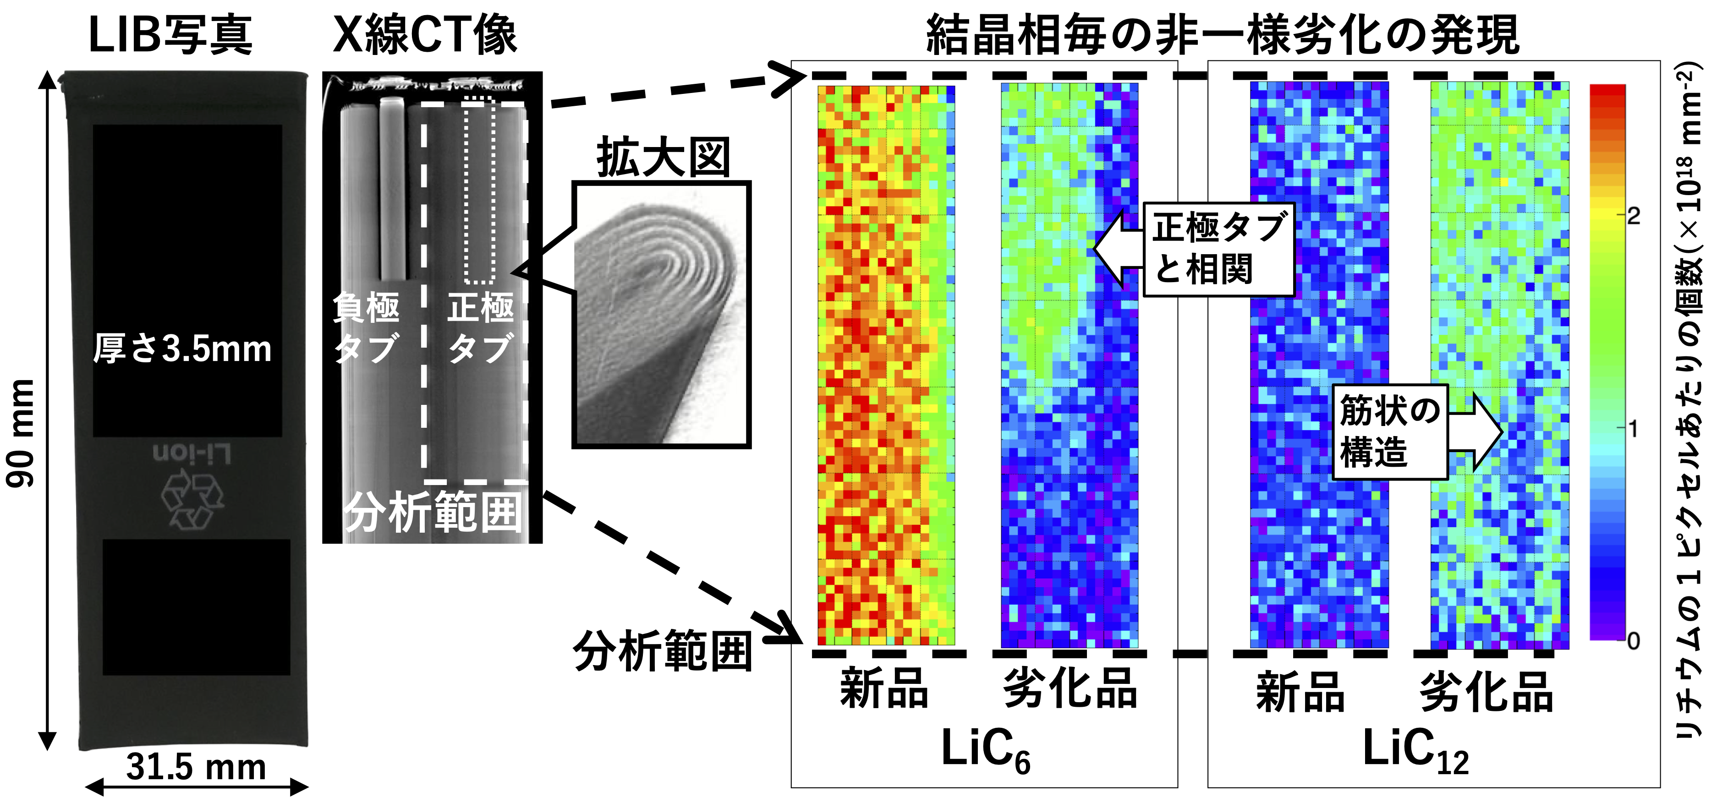
１.Motivation Previous research (K.Kino et al.)
LIB sample
photograph
X-ray CT
Negative electrode (graphite) at charged state
＠J-PARC
Measurement time:
8 to 10 hours
per single sample state
Relation
to the tab
3.5-mm thick
Negative
electrode
tab
Positive
electrode
tab
Streaky
structure
Number of Li-ion per pixel
Neutron analyzing area
K.Kino et al.,
Appl. Phys. Express
15 (2022) 027005
Fresh
Fatigue
Fresh
Fatigue
Li_{1.0}C₆
Li_{0.5}C₆
LiC₆
LiC₁₂
Nonuniform degradation in cm-order size
Different uniformity between LiC₆ and LiC₁₂
市販LIBセルを非破壊“ブラッグエッジイメージング”にて得た知見：
蓄電能力劣化LIBでは、負極材グラファイトへのLiイオンの挿入にcmオーダーの空間的非一様性
かつLiイオンの挿入度合いの異なる2つの結晶相(Li_{1.0}C₆、Li_{0.5}C₆) 間で非一様性の大きな違い

Slide 4
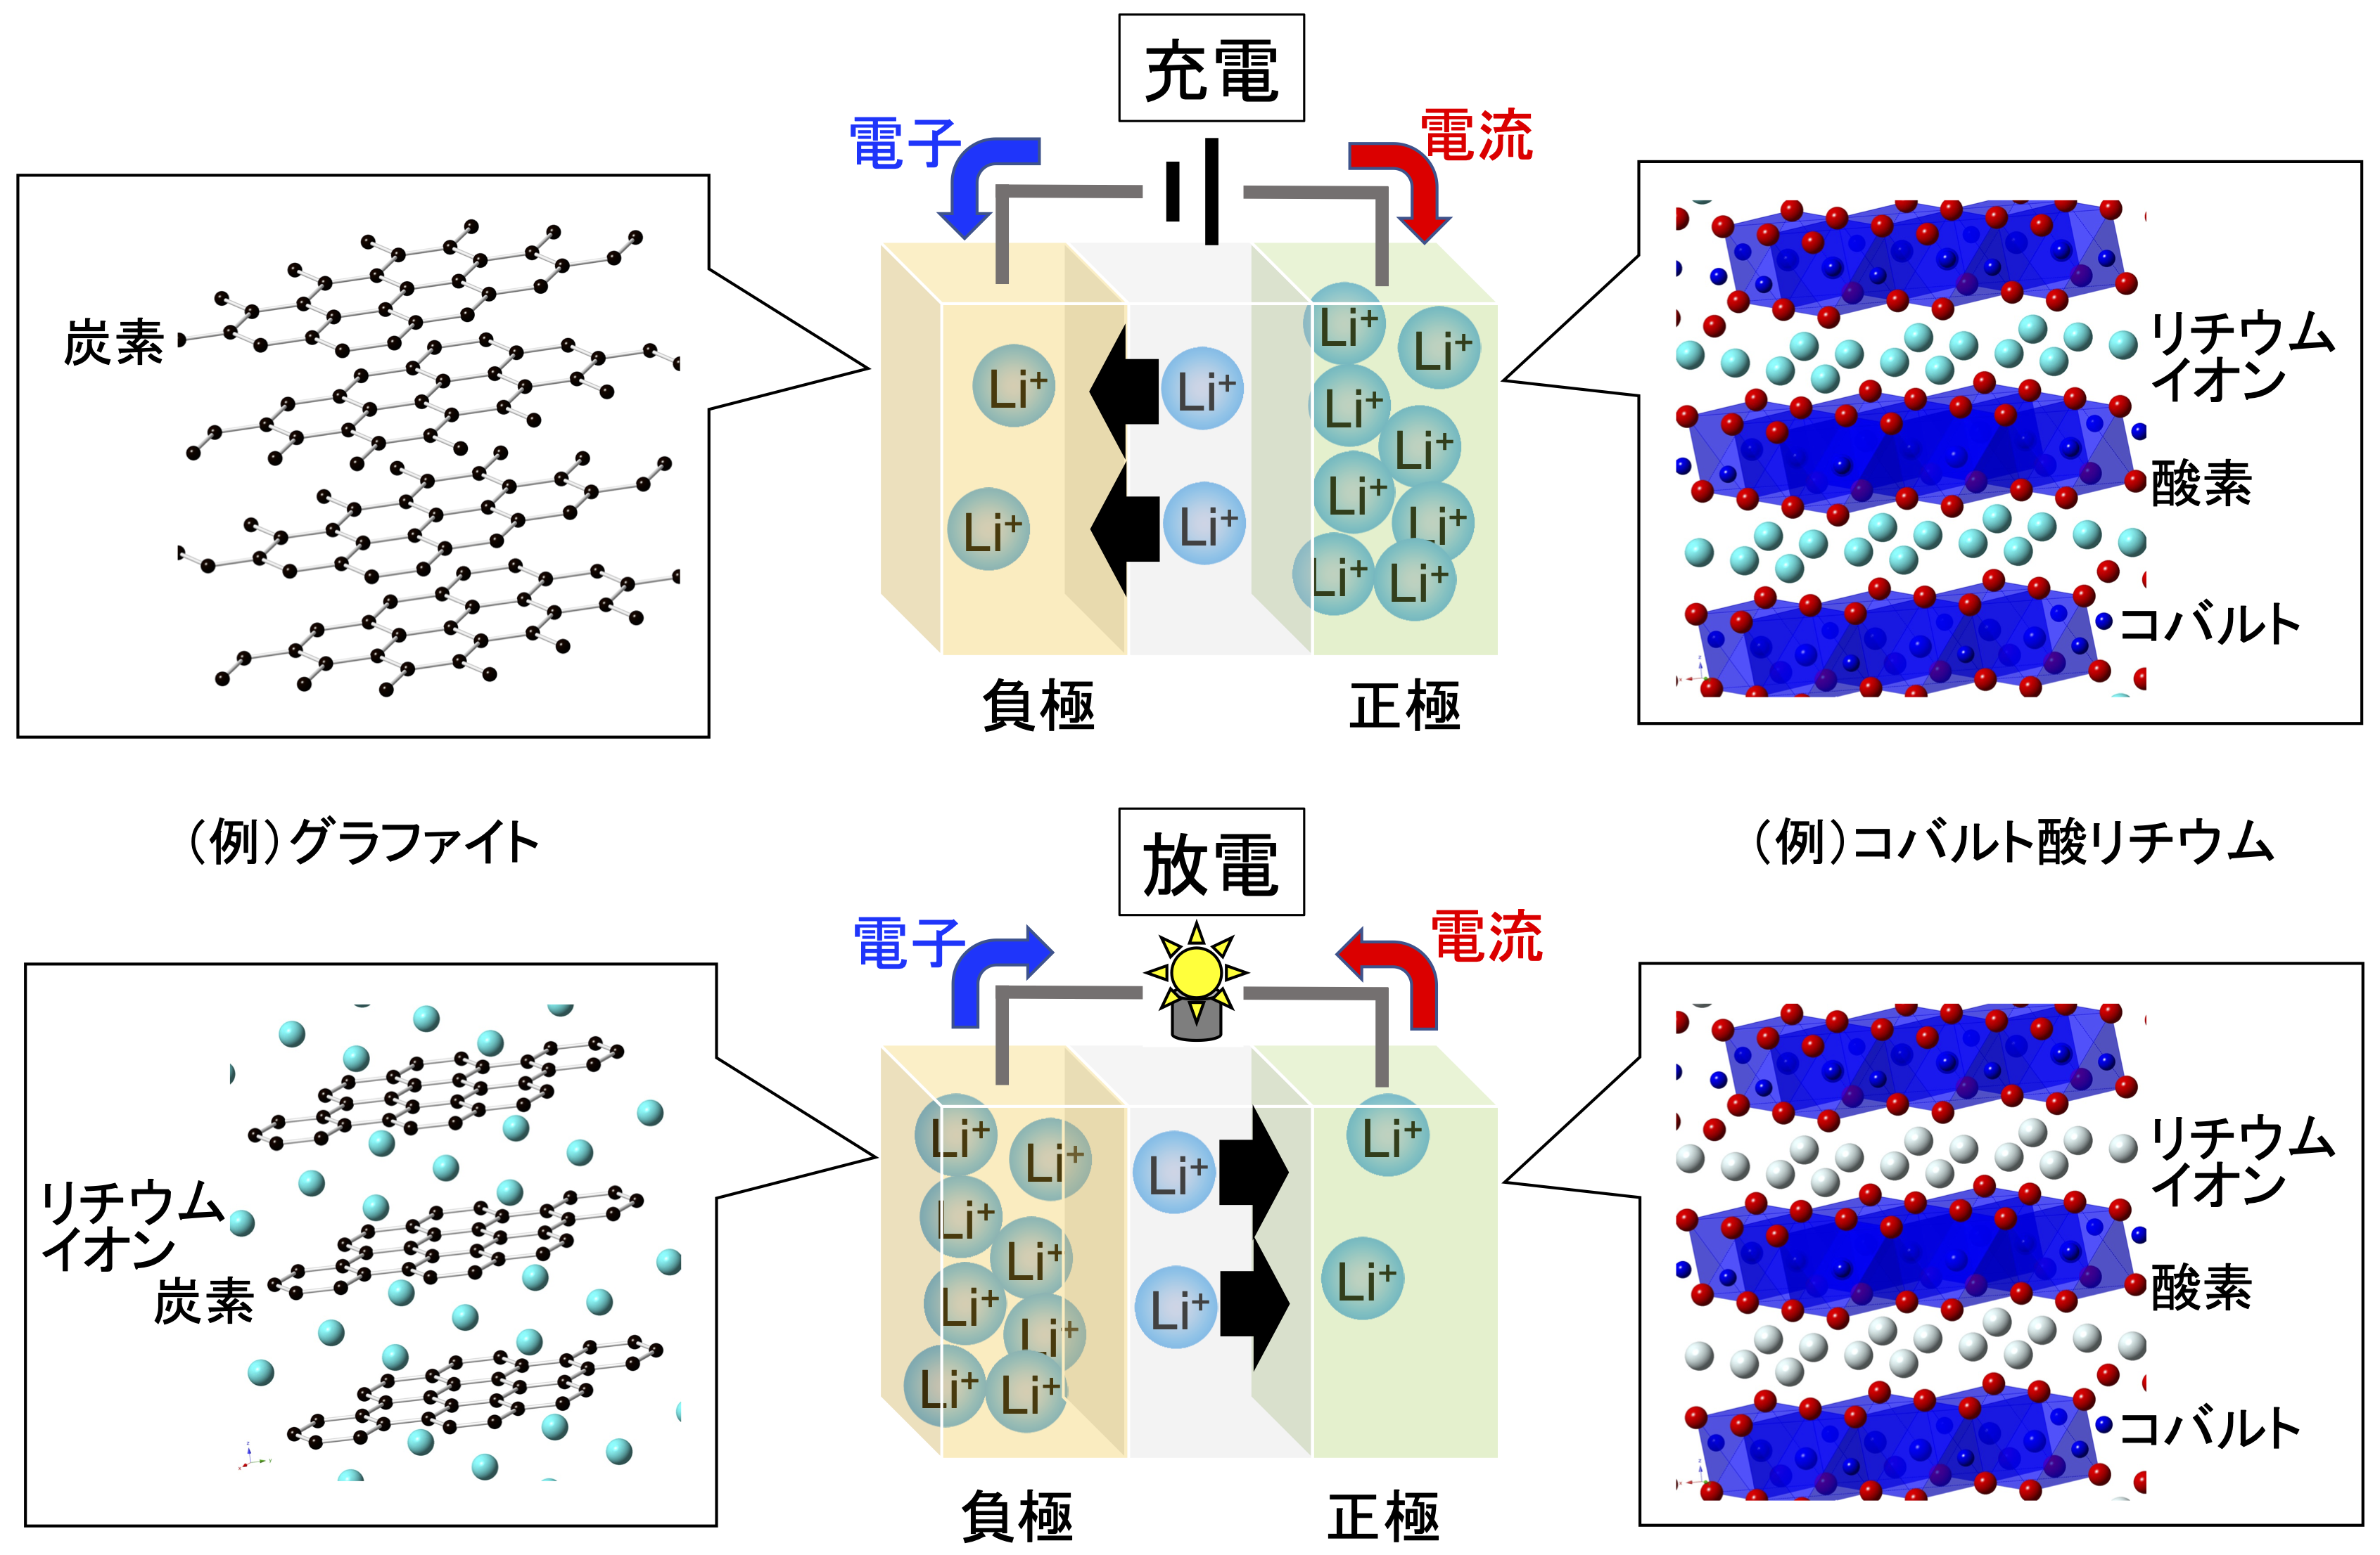
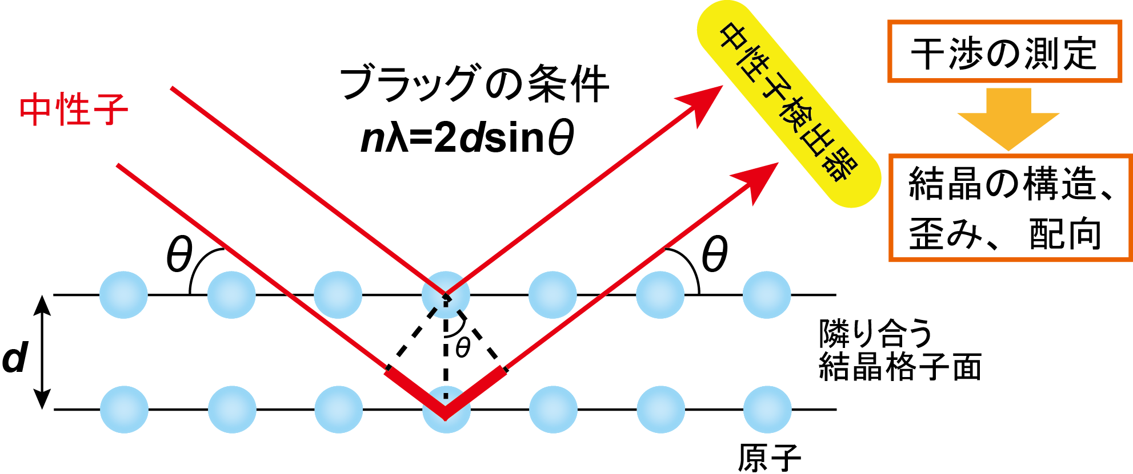
１.Motivation Bragg reflection and Lithium-ion battery
Bragg reflection
Application for Lithium-ion battery (LIB)
Bragg
condition
Charge
Interference
Electron
Current
Neutron detector
neutron
Li-ion
Carbon
Crystalline structure etc.
Oxygen
Cobalt
Negative
electrode
Positive
electrode
example:
Graphite
Discharge
example:
Lithium cobaltate
Atom
Electron
Current
Li-ion
Li-ion
Crystalline information
Carbon
Oxygen
Cobalt
Negative
electrode
Positive
electrode
Analysis of electrodes nondestructively

Slide 5
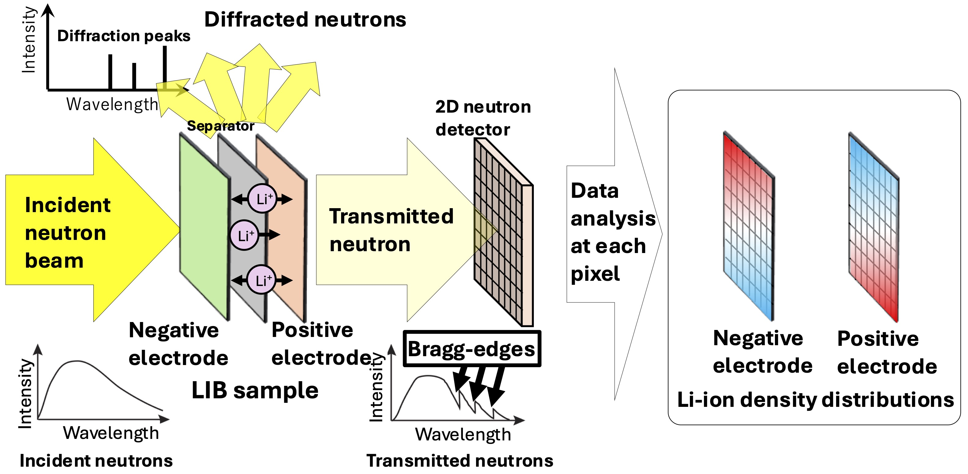
１.Motivation Bragg-edge imaging with Lithium-ion battery
Bragg-edge imaging can provide images of charge/discharge.

Slide 6
１.Motivation Questions left and Purpose
Where and how the deterioration begin ?
How does it proceed ?
Track the process of deterioration by Bragg-edge imaging at AISTANS

Slide 7
１.Motivation Why experiment at CANS ?
Why at CANS (AISTANS)
Key for successful data at CANS
Neutron beam performance
Sharp pulse
→ Bragg-edge spectra
Sufficient flux
→ Measurement time
Hard to do measurements periodically at large facilities (Huge number of proposals)
CANS
Flexibility of machine time
Easy to do measurements
Neutron detector
High detection efficiency

Slide 8
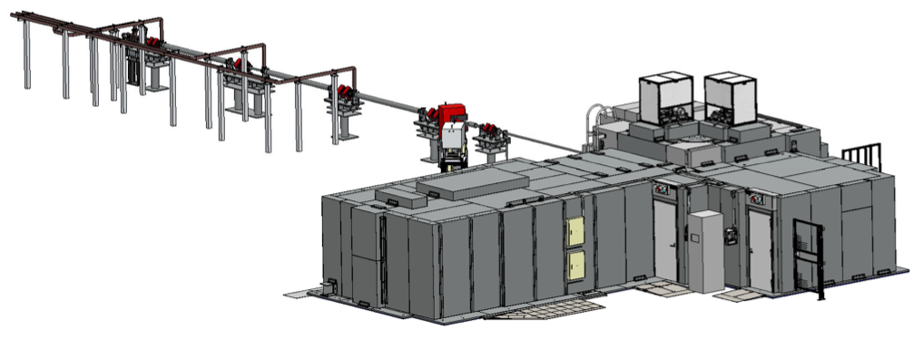
２.Experiments AISTANS
Optimized for TOF-based Bragg-edge imaging
AIST, Tsukuba, Japan
The whole components (①〜④) were optimized
High performance and Practical measurement time
~30 m
② Neutron
source
Electron beam
Neutron beam
Electron beam
① Electron linear
accelerator
③ Neutron beam line
Neutron beam
Neutron beam
Second
Beam line
④ Neutron detector
~14 m
First beam line

Slide 9
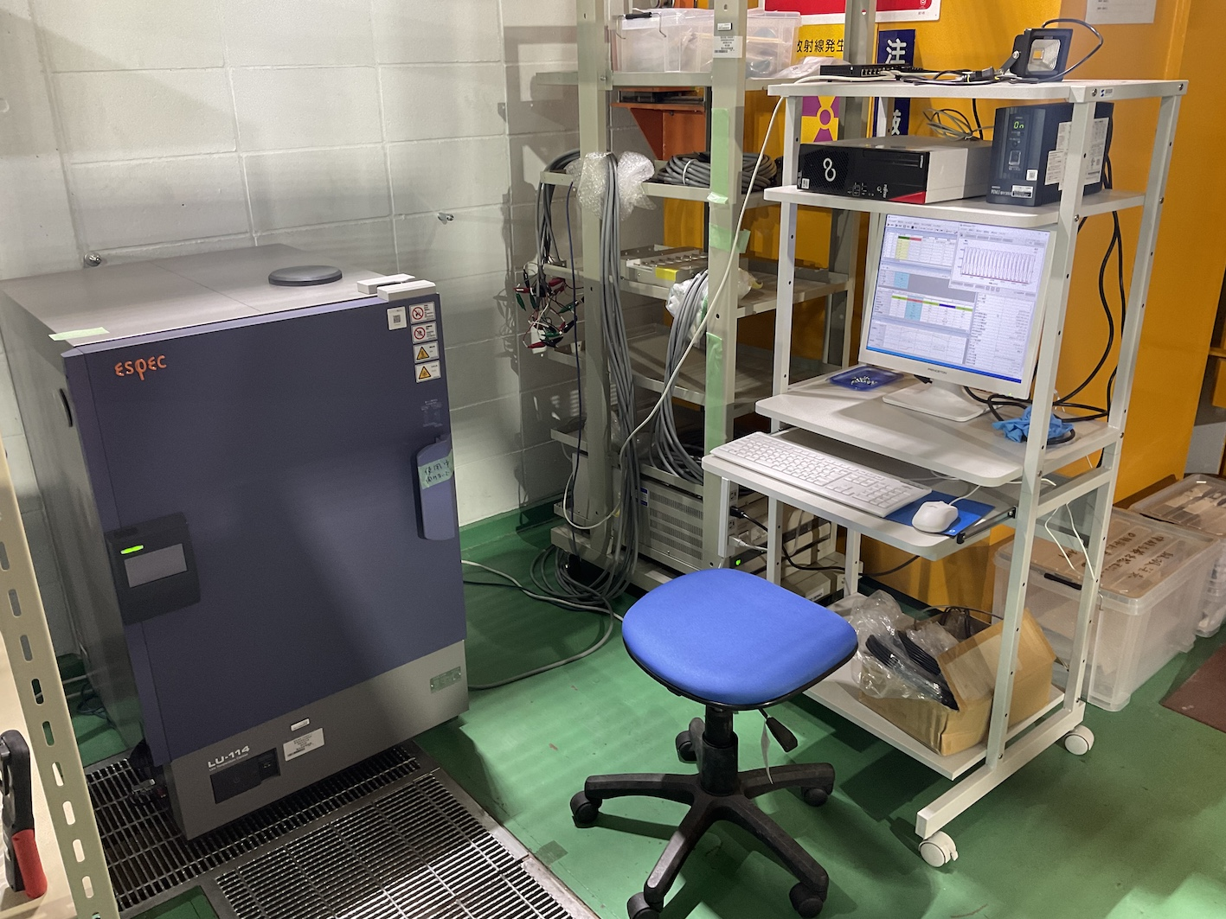
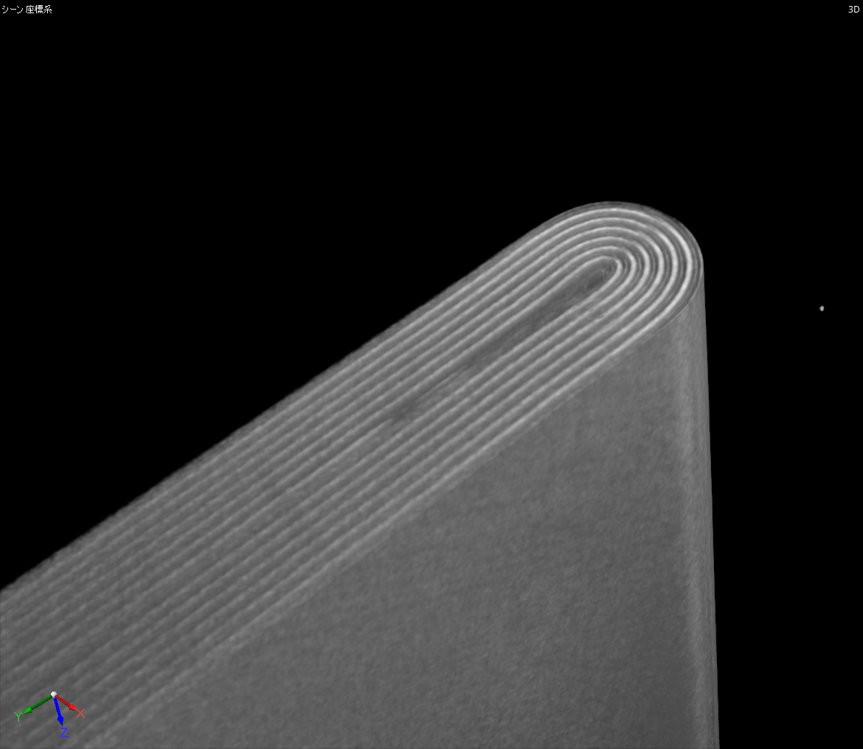
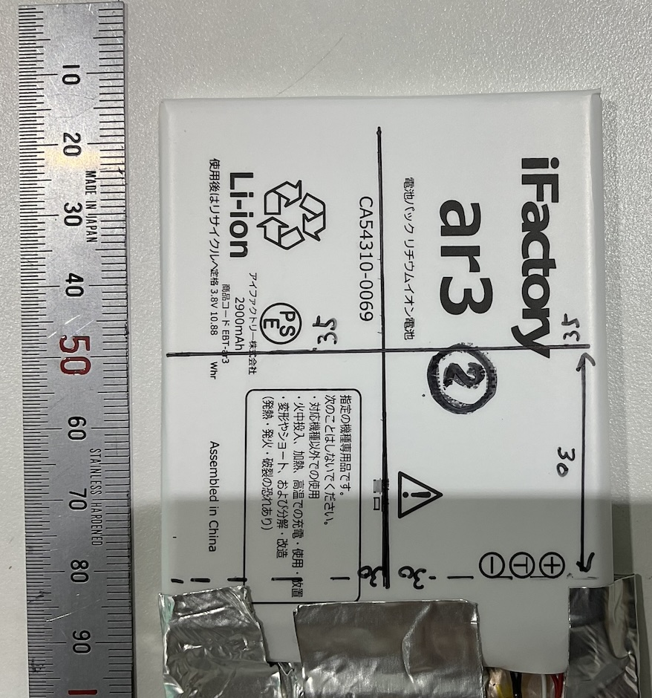
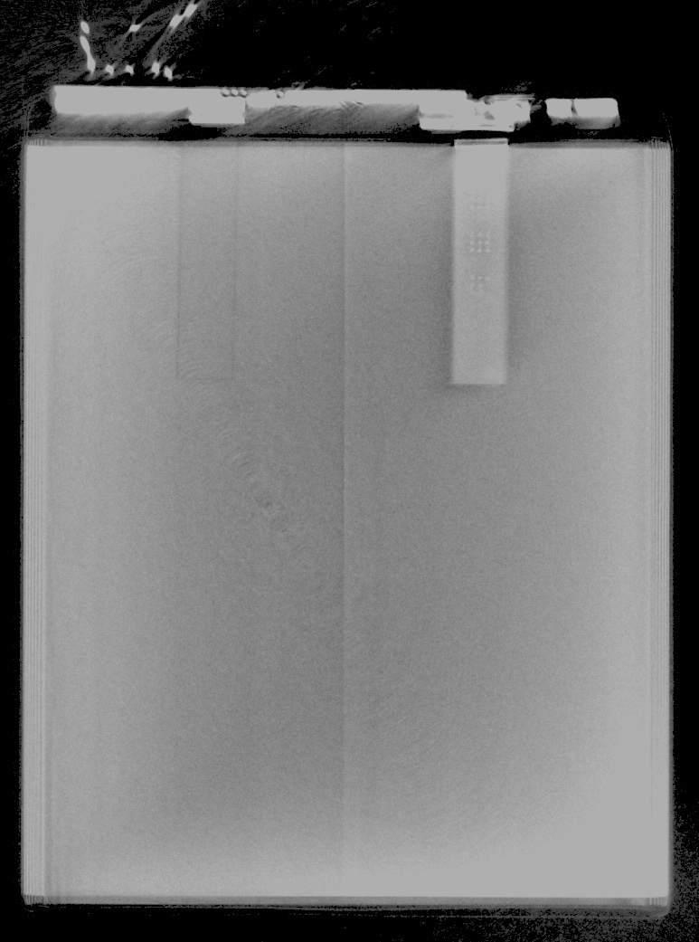
２.Experiments Sample
Sample
Instrument for cyclic
charging-discharging
A commercial LIB cell for smart phone (Android)
Capacity: 2900 mA
Constant temperature bath
LIB sample inside
55 mm
55 mm
Neutron
analysis
area
50 mm
50 mm
Electrode tabs
In the same room of AISTANS
Photograph
X-ray CT

Slide 10
２.Experiments Sample conditions at measurement
First measurement
8 hours for charged(4.2V) and discharged(2.7V) states
[Charge]
CCCV (constant current and voltage)
CC: rate 0.7C until 4.2 V
CV: keep 4.2 V until 100 mA
Temperature: 45℃
92 cycles
Second measurement
Toal 92 cycles
[Discharge]
CC (constant current)
CC: rate 1.0C until 2.7 V
Temperature: 45℃
8 hours for charged(4.2V) and discharged(2.7V) states
＋108 cycles
Third measurement
Toal 200 cycles
8 hours for charged(4.2V) state

Slide 11
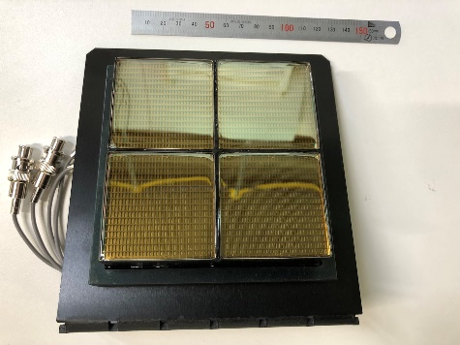
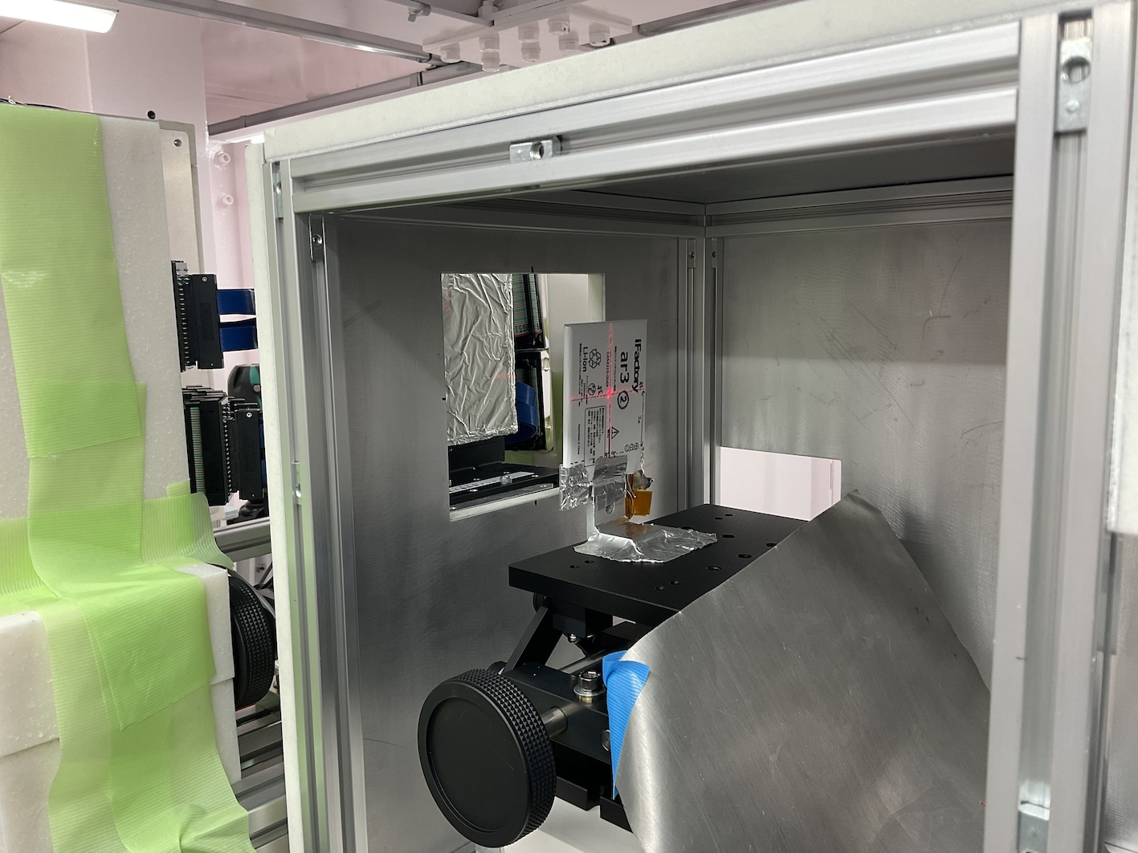
２.Experiments Experimental setup
2D neutron detector
(x,y,TOF)
Around sample
2D neutron
detector
100 mm
Sample
Neutron beam
100 mm
Scintillator + multi-anode PMT
High detection efficiency and count rate
L(Source-detector) = 8.1 m
Sample is 10 cm upstream from the detector.

Slide 12
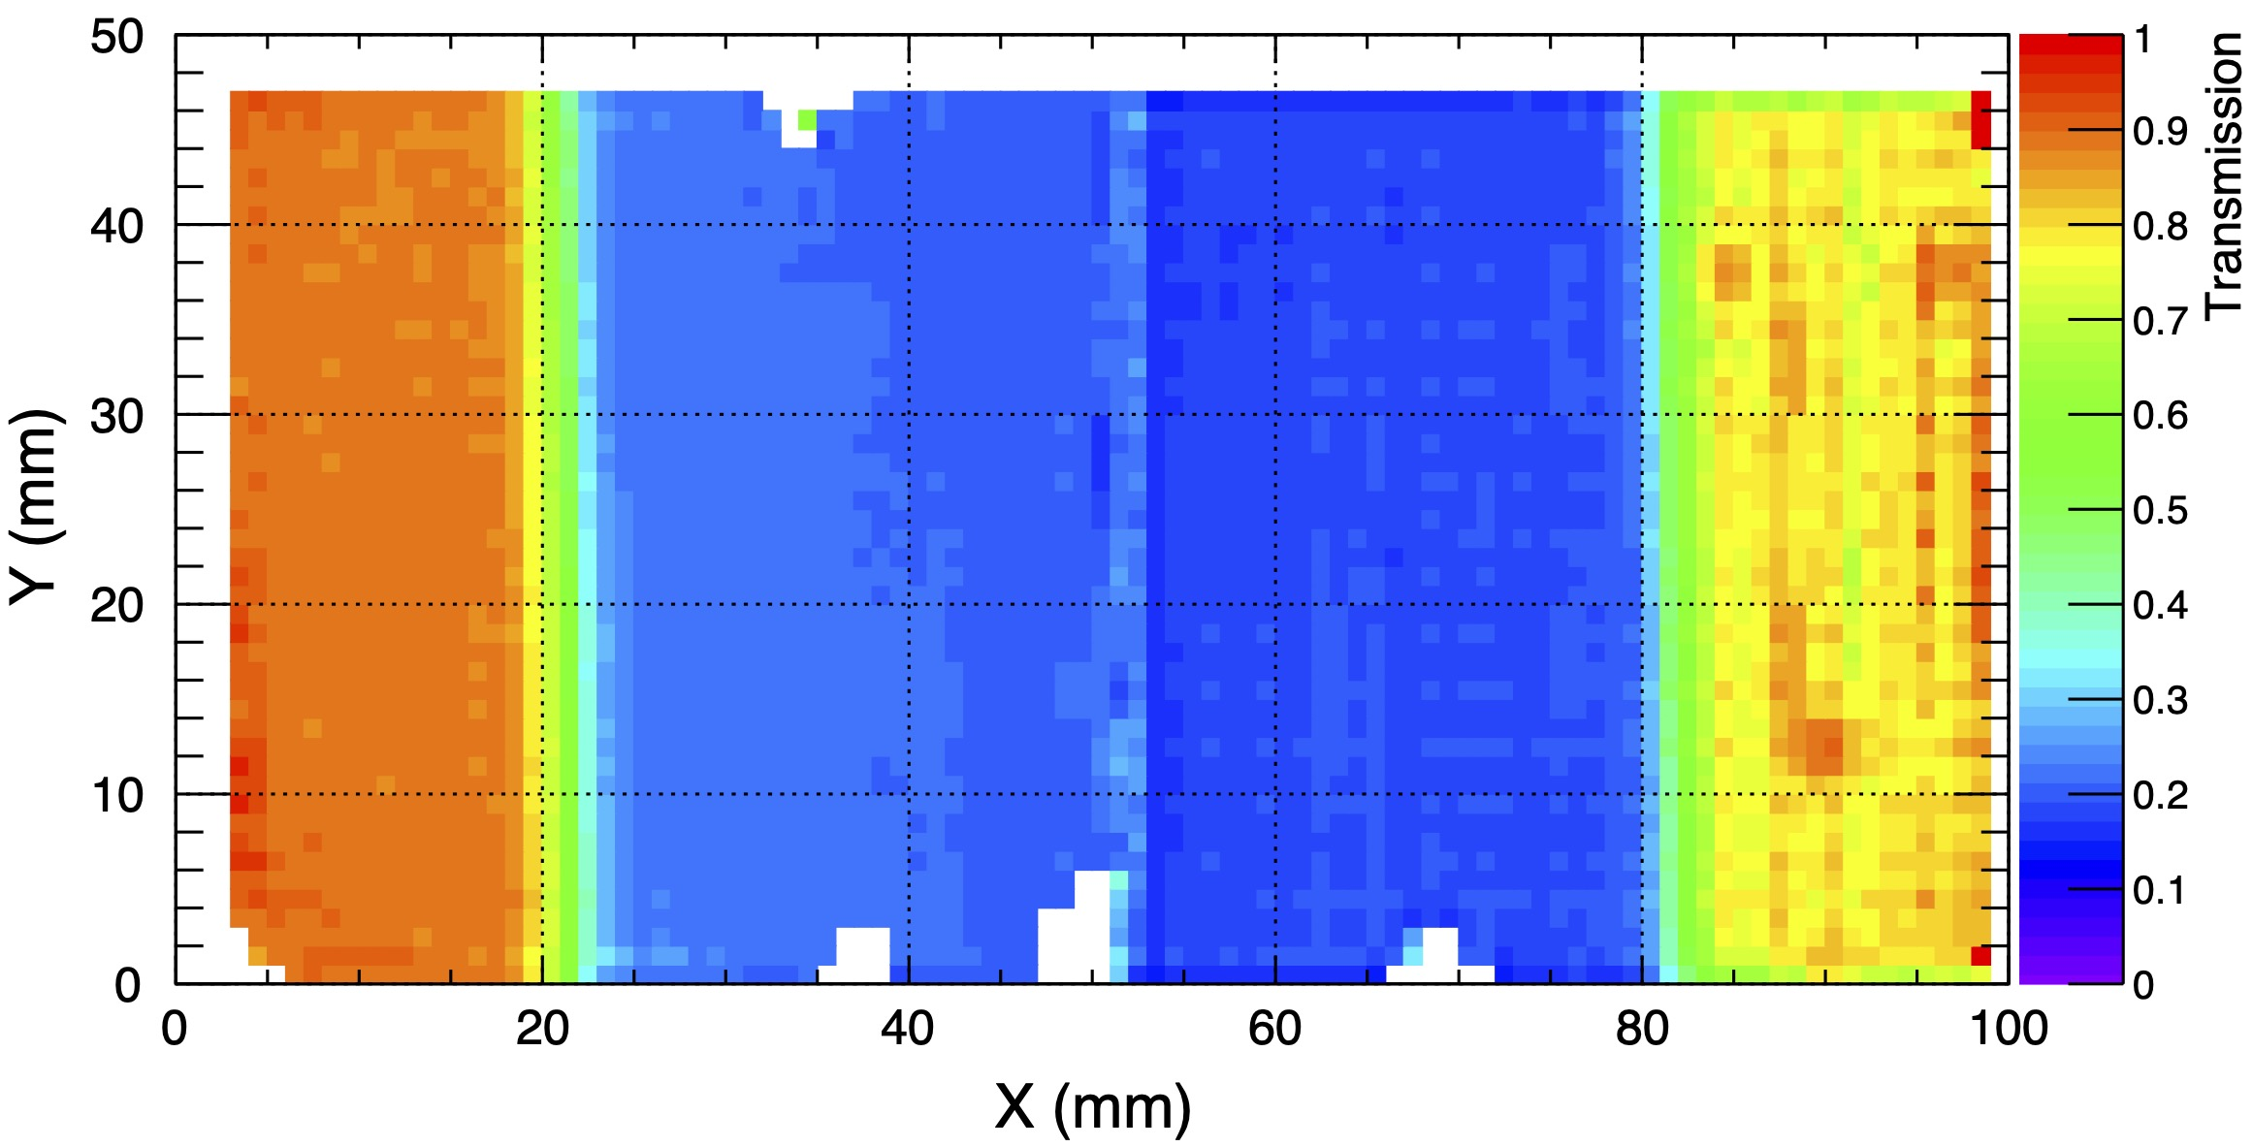
３.Results Transmission image
Shadow of the sample
55 mm
50 mm
55 mm
55 mm
Neutron
analysis
area
Neutron
analysis
area
50 mm
50 mm
Transmission image obtained
in a broad neutron wavelength region
Photograph
X-ray CT

Slide 13
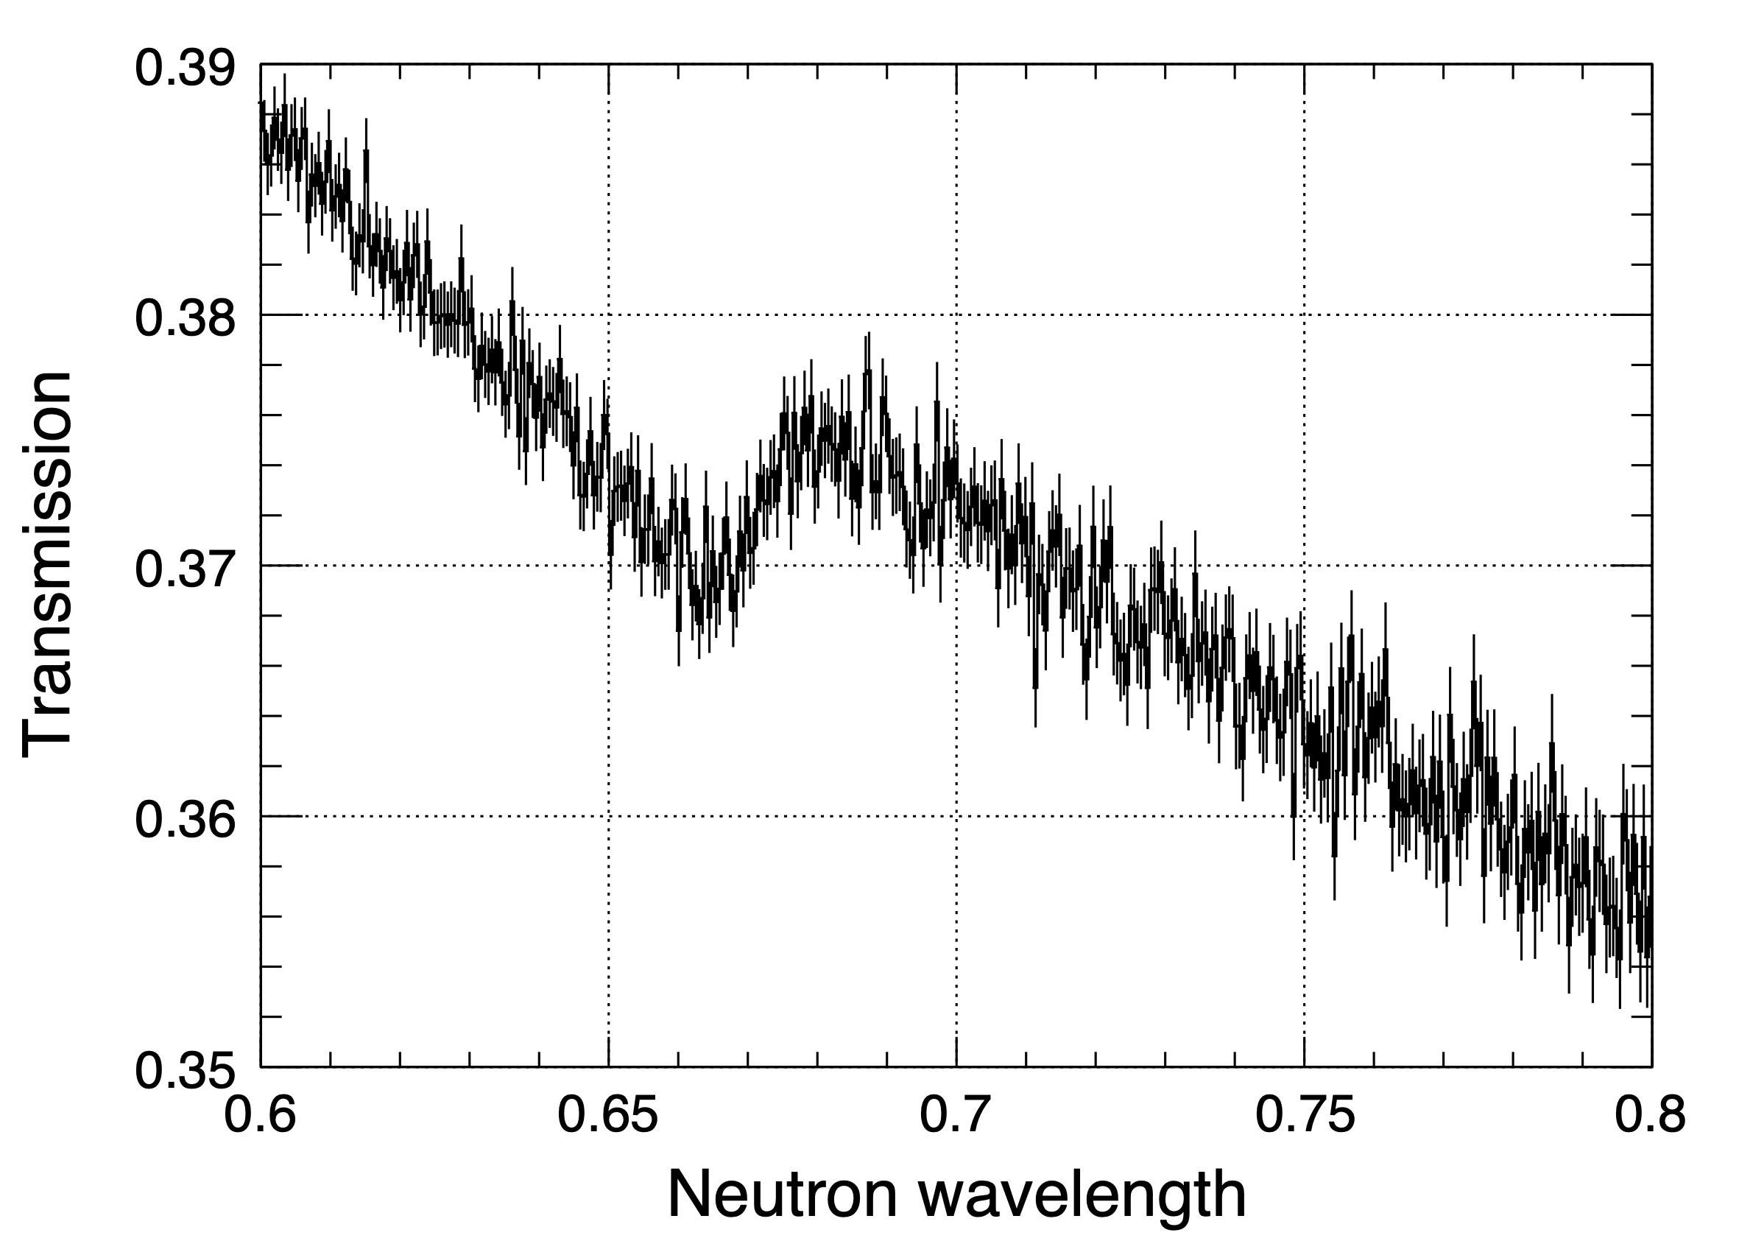
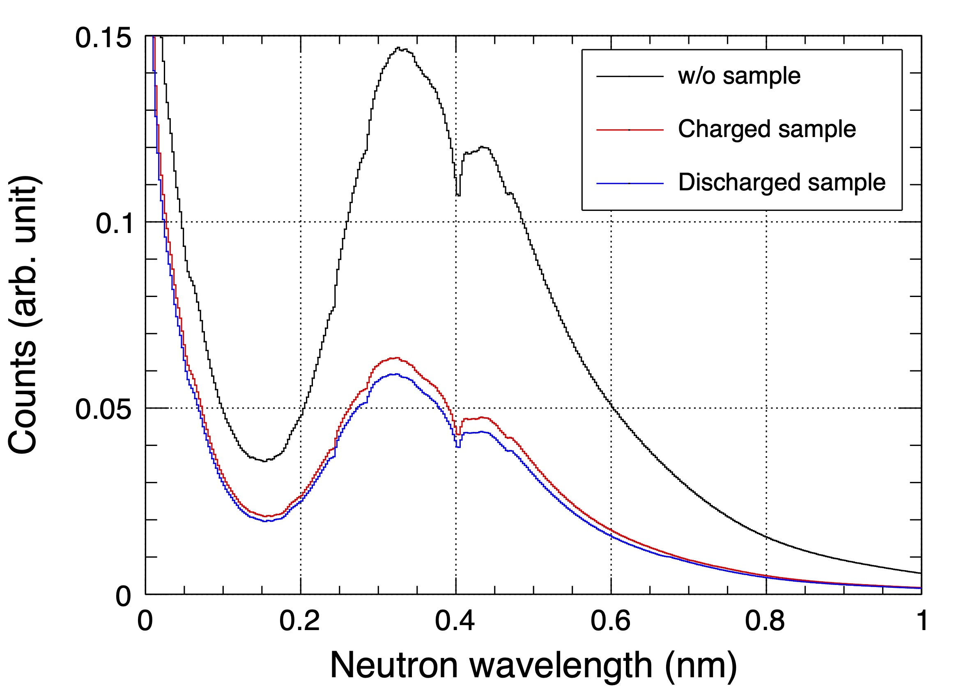
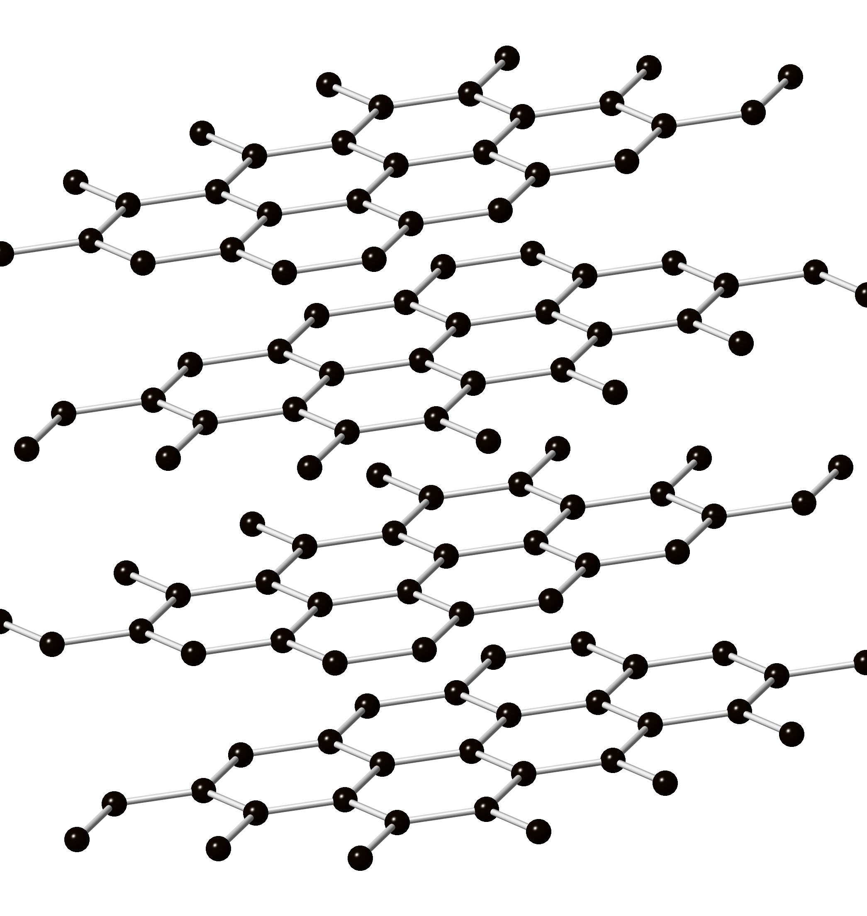
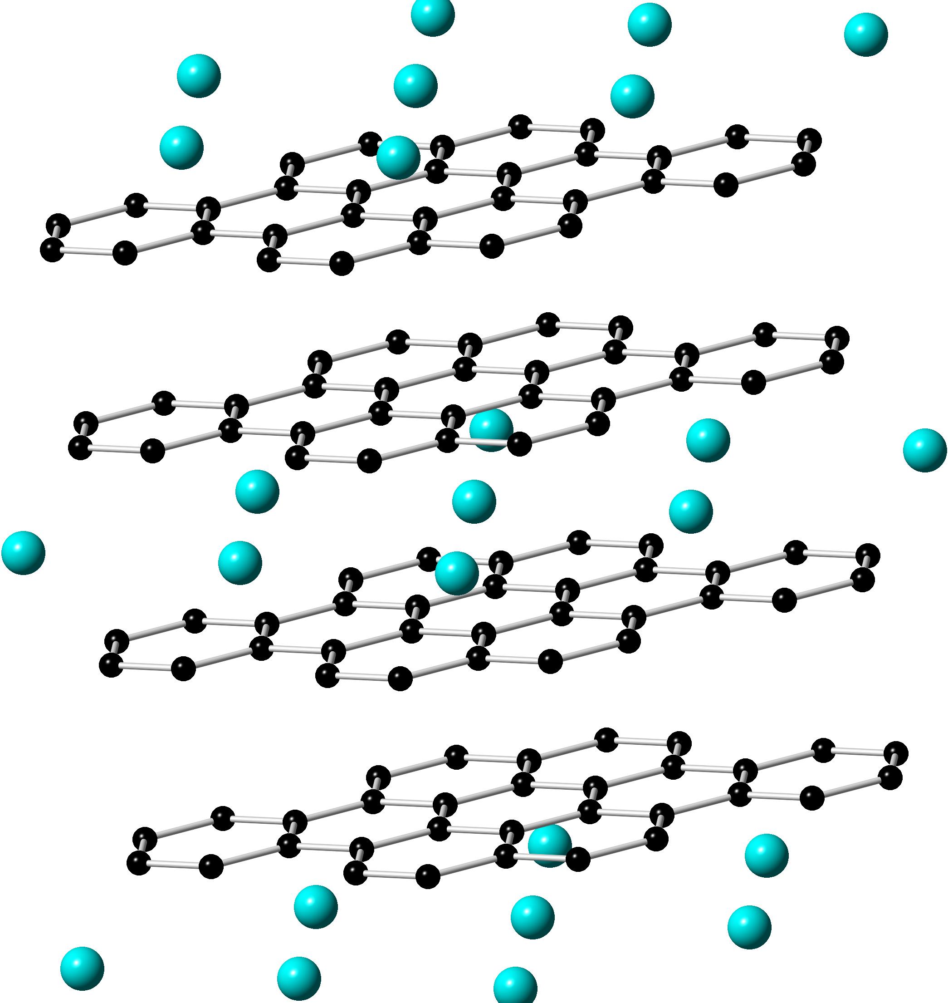
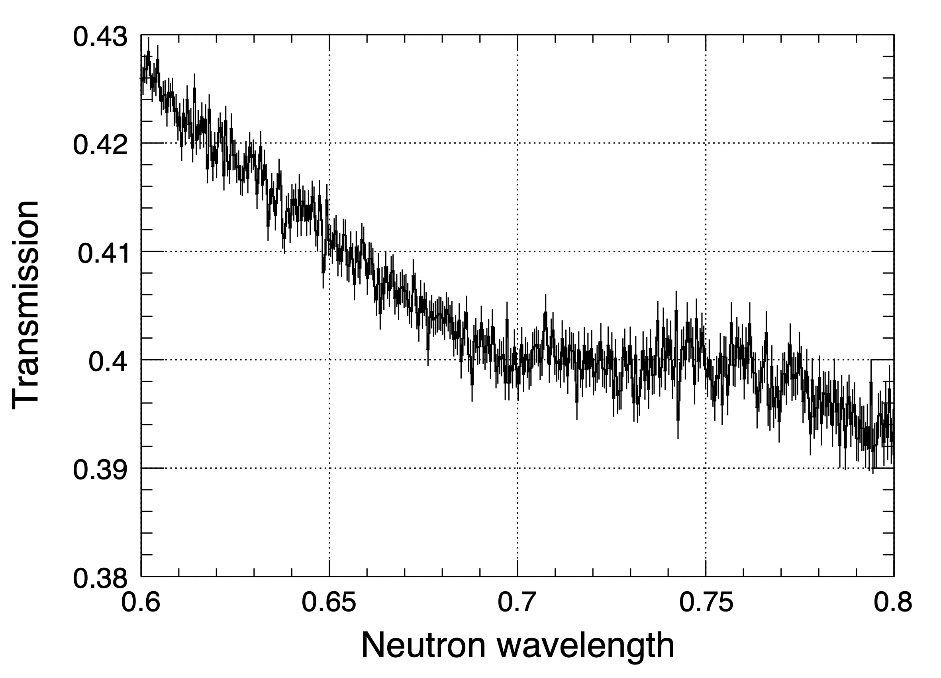
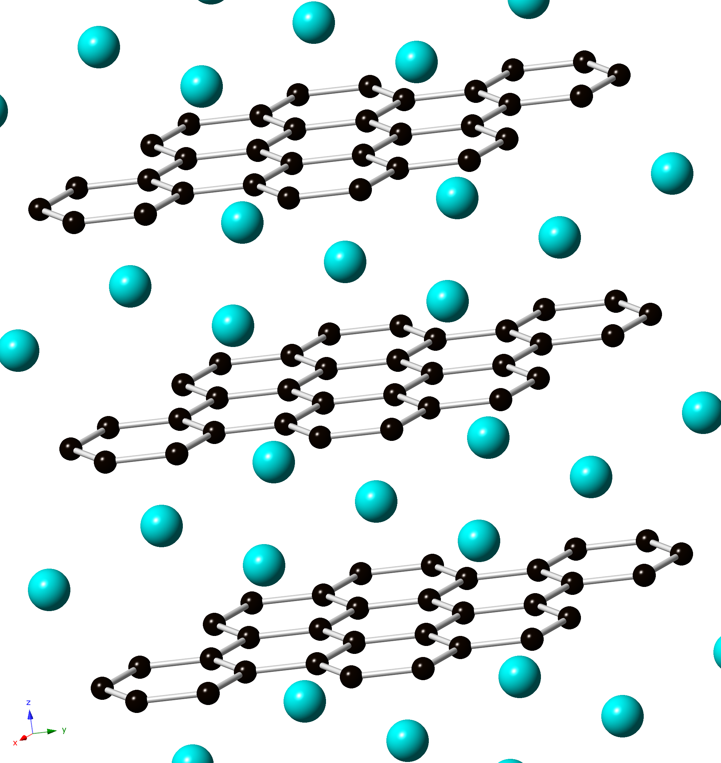
３.Results Counts and transmission spectra
92 cycles data
All pixels (50x55 mm)
Discharged
Discharged
Graphite
Graphite
Li
LiC₁₂
Sample
w/o sample
Charged
LiC₆
LiC₁₂
LiC₆
Charged
Bragg-edges of negative electrodes were observed.

Slide 14
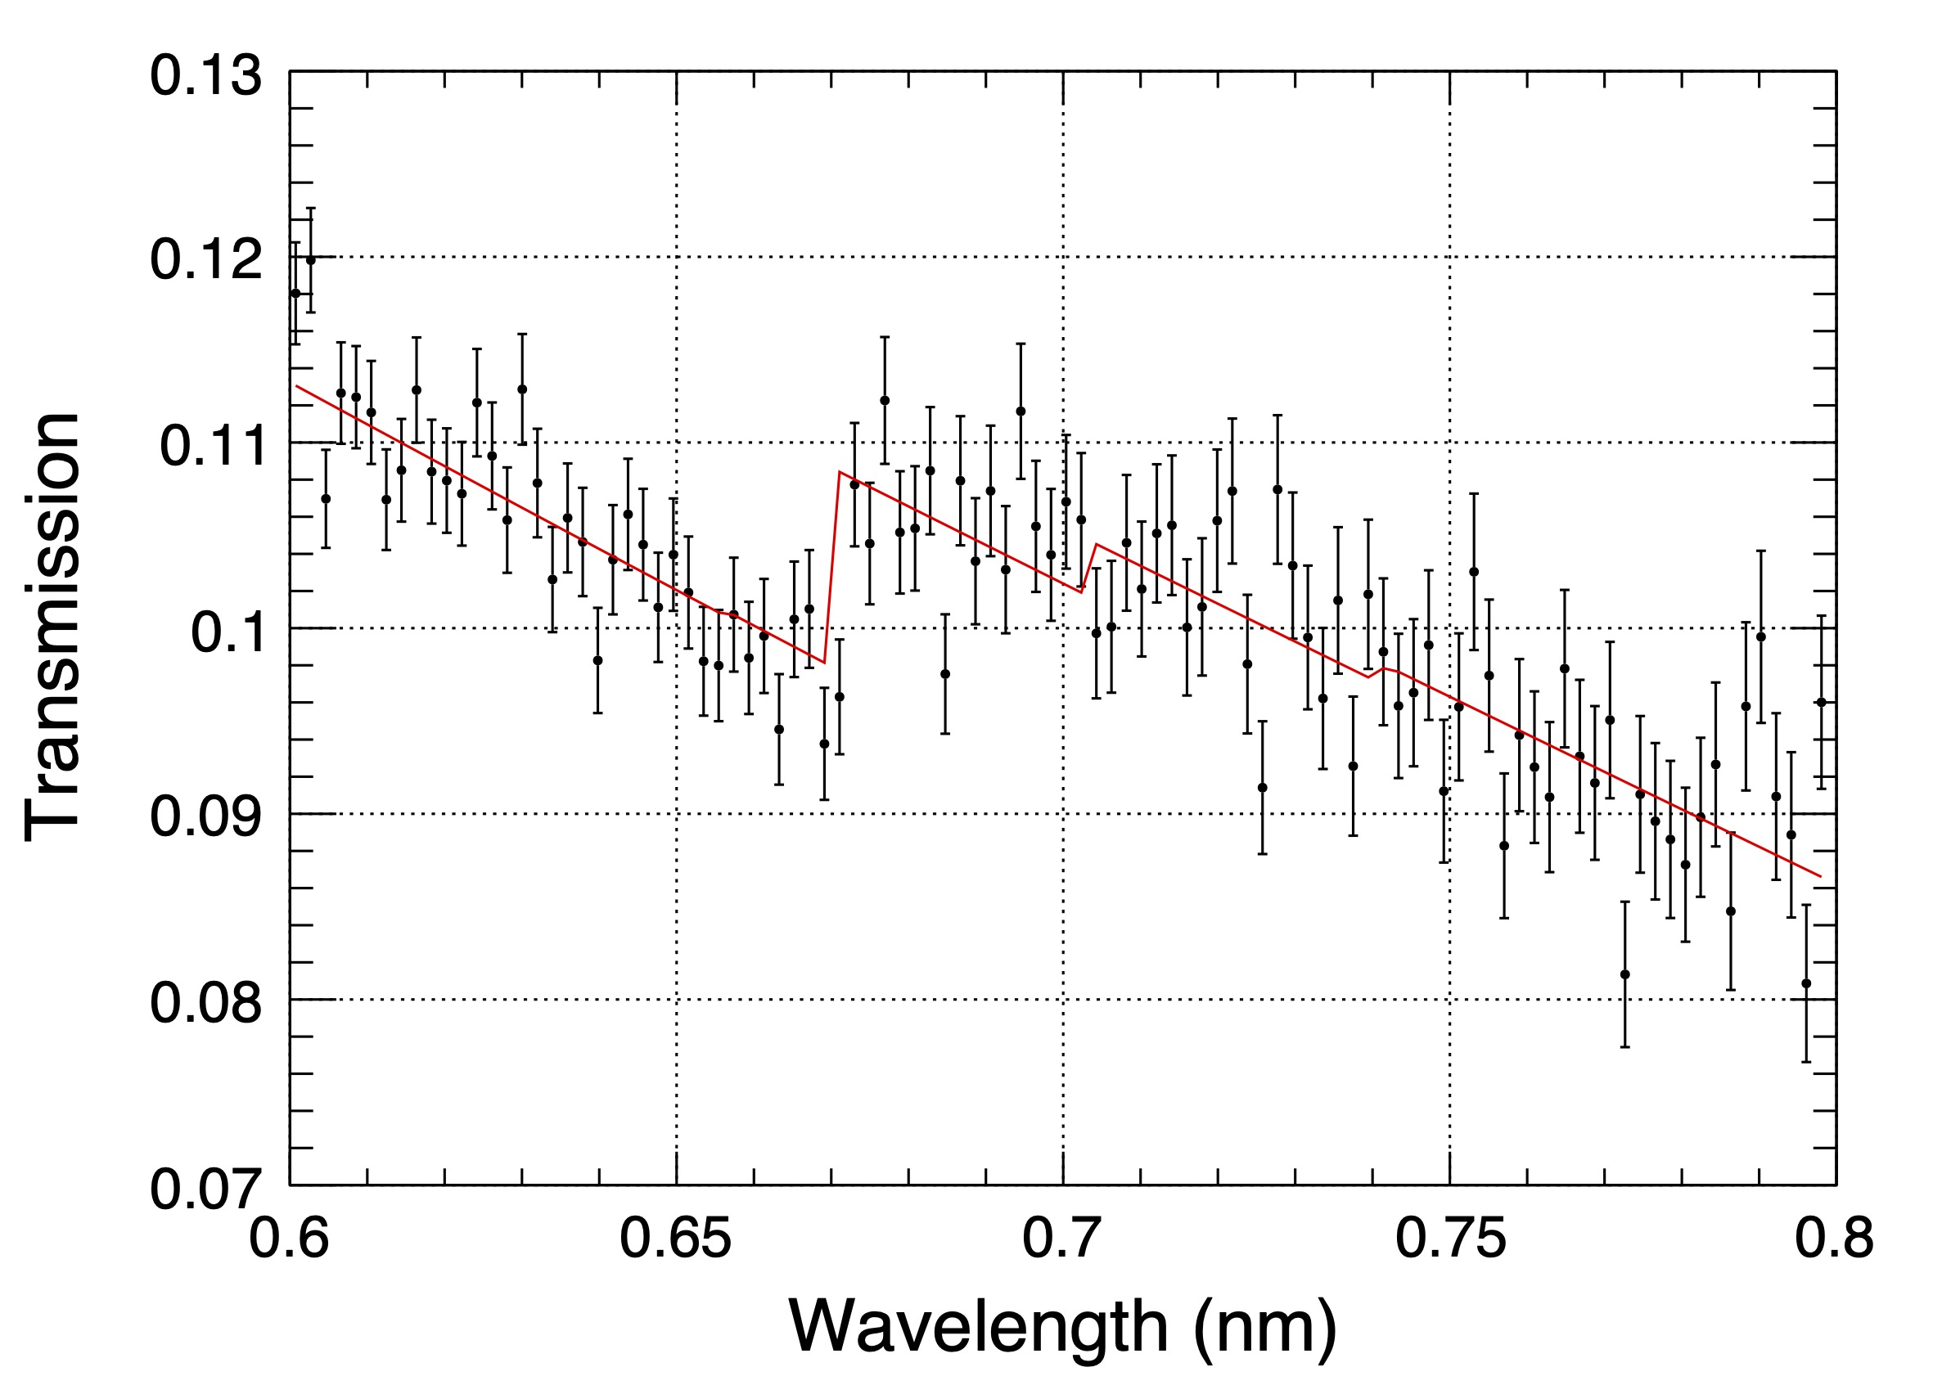
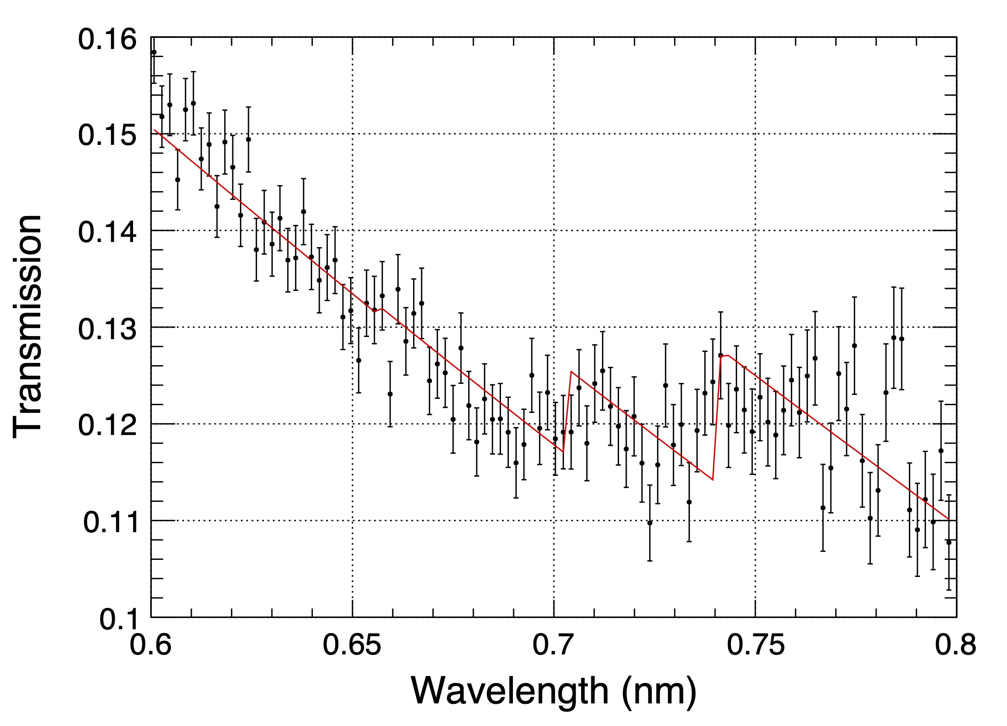
３.Results Bragg-edge analysis for negative electrode
Spectra were fitted by the Bragg-edge curves.
Discharged
Charged
92 cycles data
1pixel (5x5 mm)
Graphite
LiC₁₂
LiC₆
Depth
Crystalline
density
Including reflections: Graphite 002, LiC₆ 001, and LiC₁₂ 002
Crystalline orientation in simulation: Isotropic

Slide 15
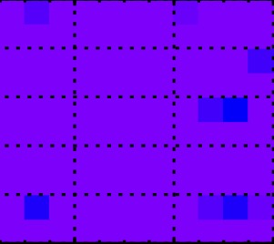
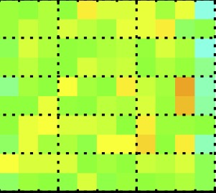
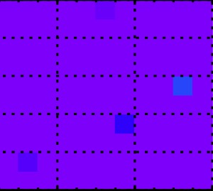
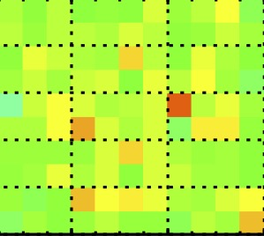
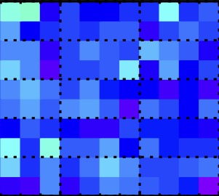
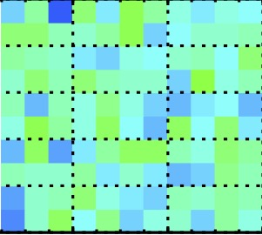
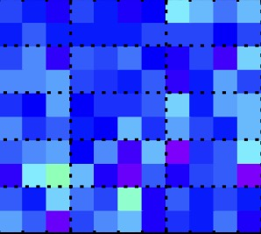
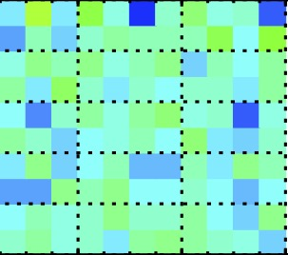
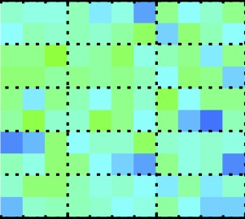
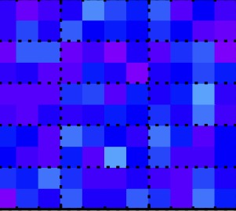
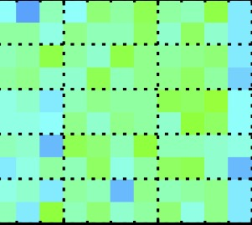
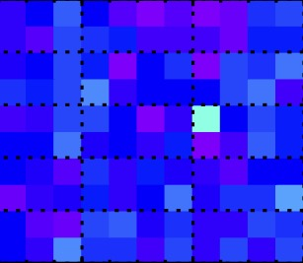
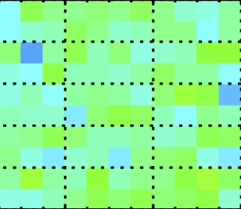
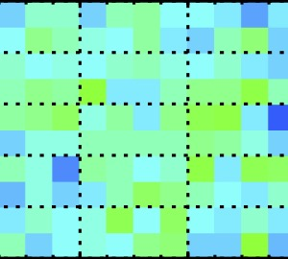
３.Results Images of negative-electrode crystal density
Graphite
55 mm
Not yet meas-ured
50 mm
LiC₁₂
Analysis area
Not yet meas-ured
55 mm
50 mm
LiC₆
Not yet meas-ured
Discharged
Charged
Discharged
Charged
Discharged
Charged
0 cycle
92 cycles
200 cycles
No clear inhomogeneity even after 200 cycles.

Slide 16
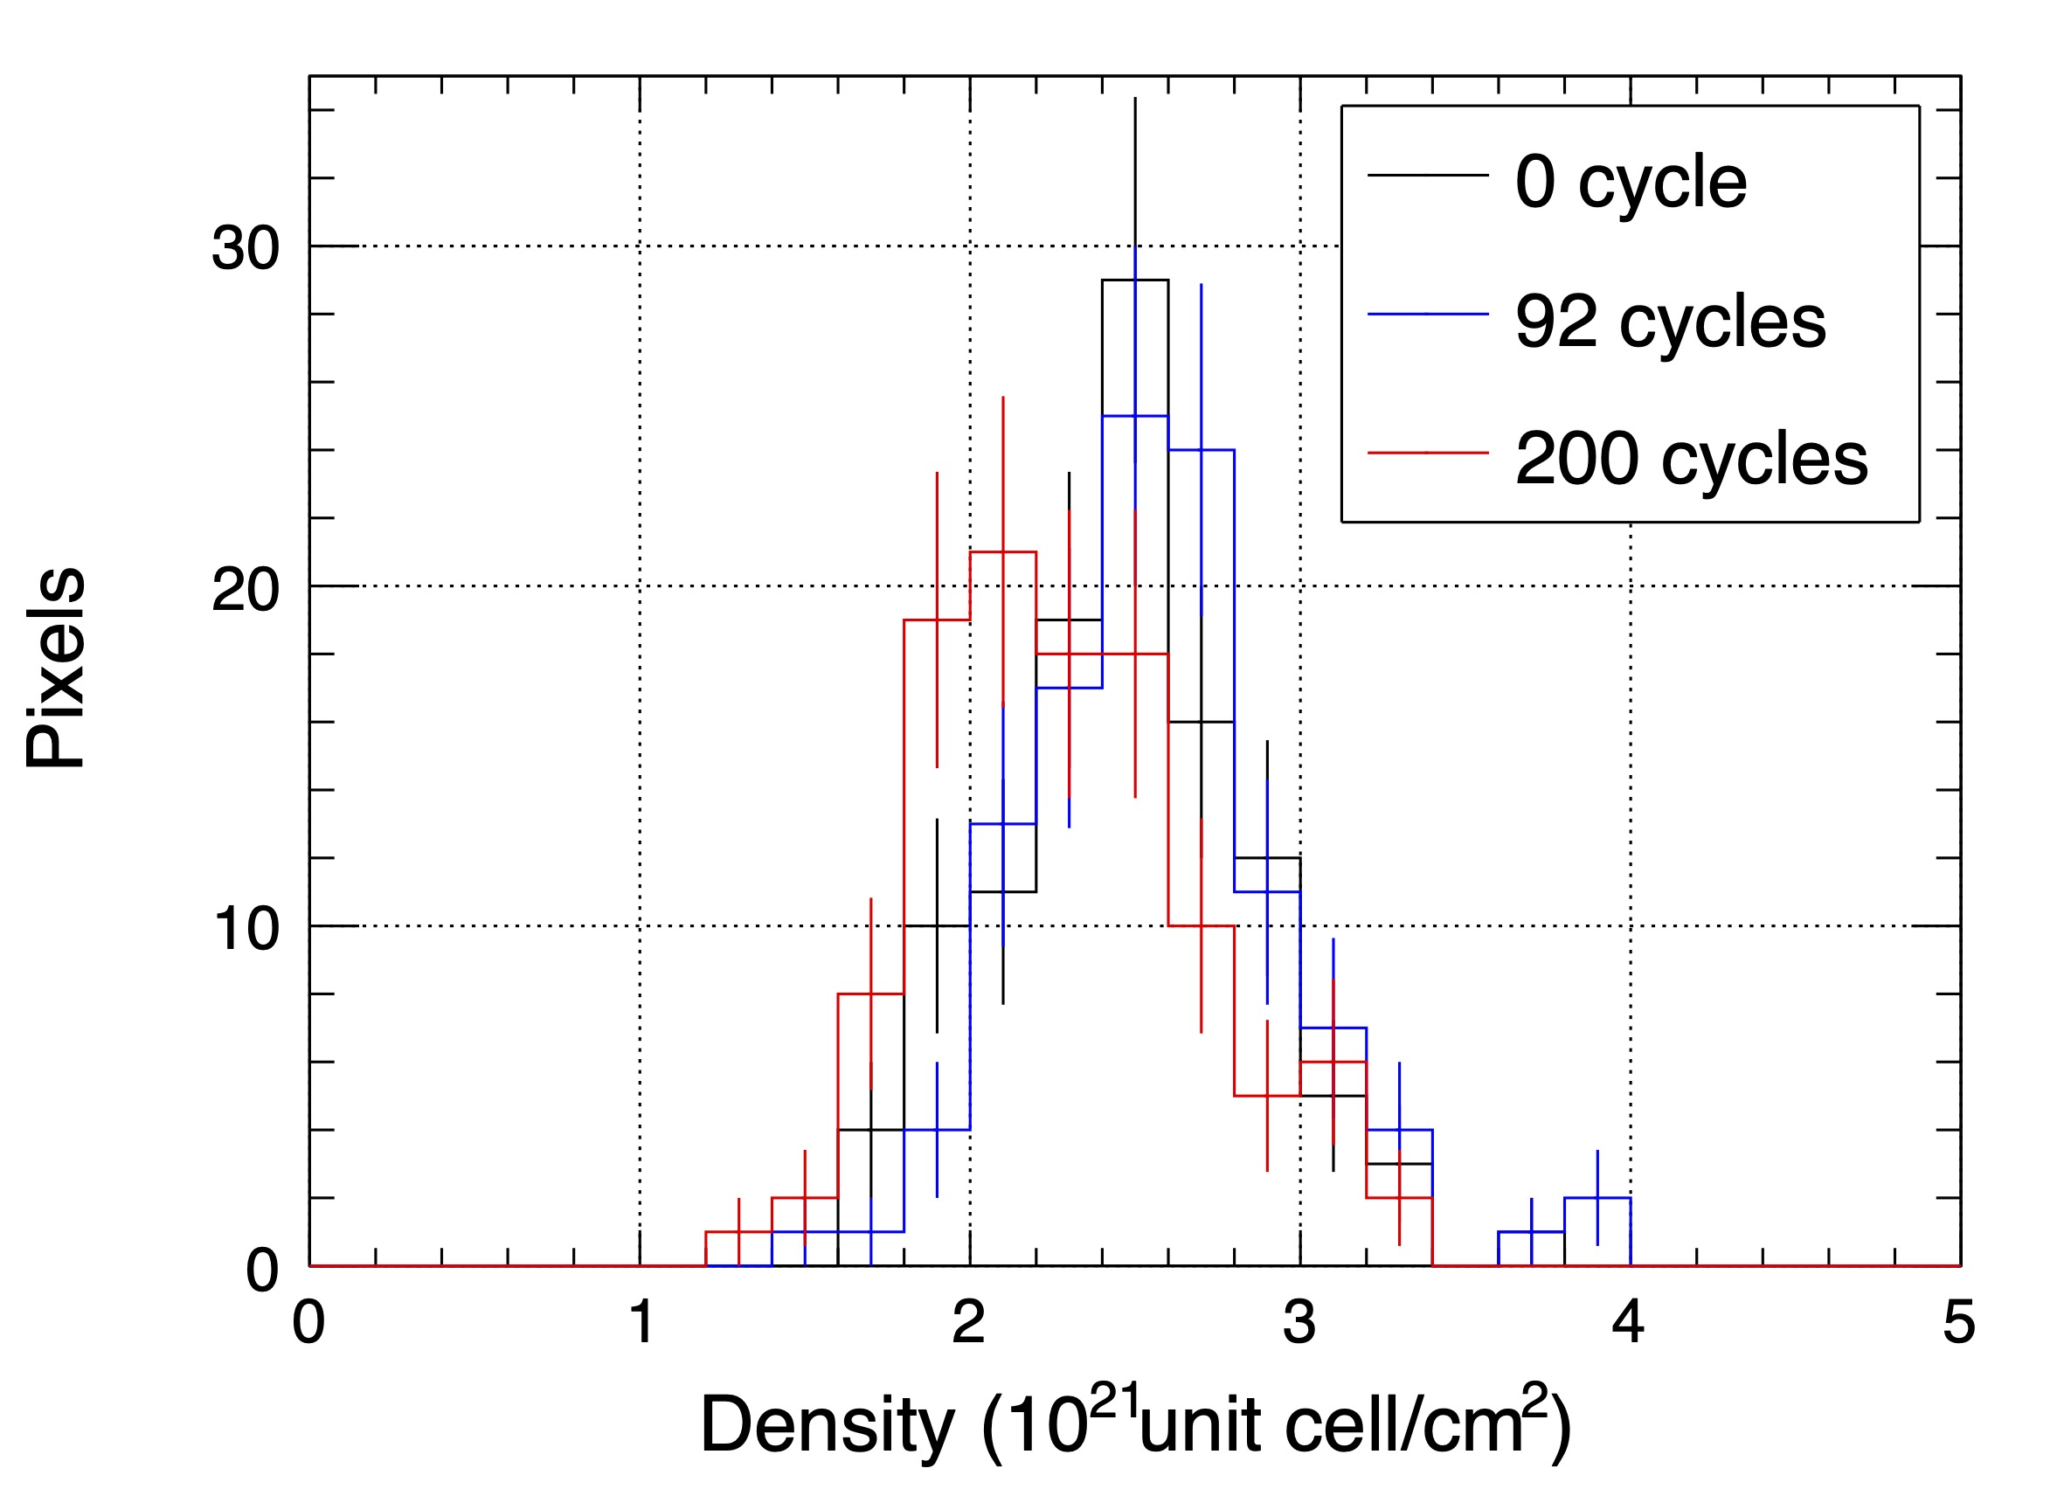
３.Results Beginning of deterioration ?
LiC₆ distributions
0 cycle
92 cycles
200 cycles
Uniform distribution even after 200 cycles
But LiC₆ density distribution shifted to a smaller value

Slide 17
４ Conclusion
Succeeded in Bragg-edge imaging of a LIB cell at AISTANS
We obtained the image which might suggest the beginning of deterioration.
We will continue periodical measurements and will try to reveal the origin and progression of the deterioration.
Thank you for your kind attention !

