Slide 1
FETS-METS: A Small-Scale Test Stand for Advancing Neutron Moderator Systems
Alexandra Chrysafi
UKRI STFC, Mechanical Engineer, IDD Targets Group
UCANS 2025

Slide 2
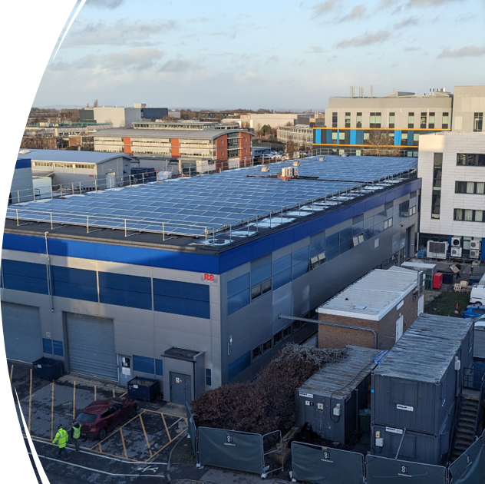
Contents
FETS-METS introduction
Purpose & Benefits
Project Scope
FETS facility
TRaM vessel
Target
Instrument
Services
Shielding
Status and Challenges

Slide 3
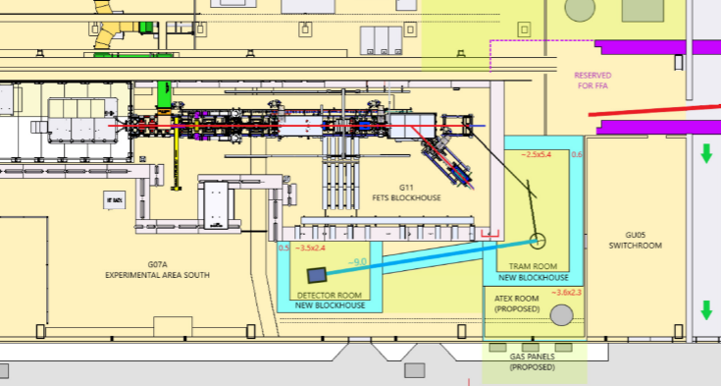
FETS-METS
FETS-METS project: Combines the existing FETS accelerator with a new neutron source for moderator testing
FETS (Front End Test Stand) at RAL, developed in collaboration with universities to advance accelerator technologies
METS (Moderator Engineering Test Stand): a shielded area with target, reflector, moderator space (TRaM), and a diagnostic neutron beamline
Project status: Concept Phase
FETS layout in building R8, RAL with one of the METS potential extensions for a TRaM and a Detector Room

Slide 4
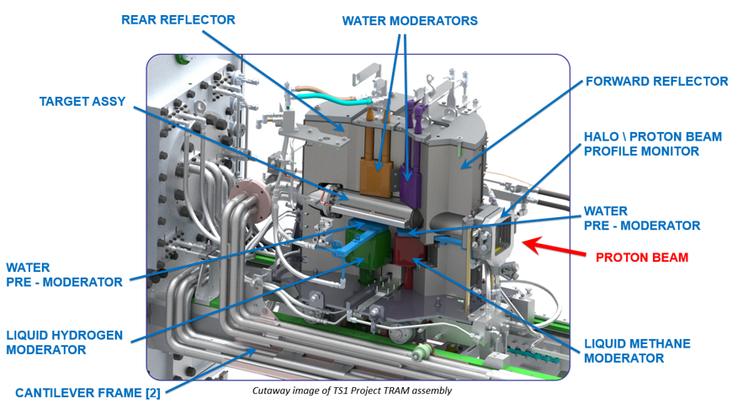
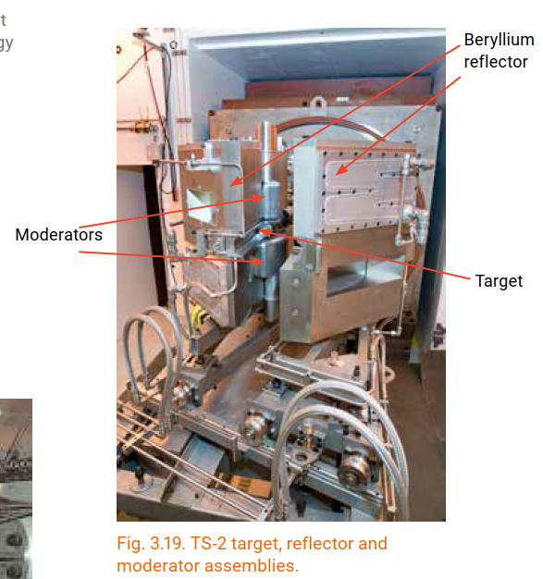
Purpose of FETS-METS
4
Primary objective: support critical offline testing and development of moderators to ensure reliability and optimum performance on ISIS and the future ISIS-II.​
Moderators slow down neutrons generated at the target, enabling their effective use by the instruments.
Difficult to diagnose or test once installed
Issues can delay experiments
ISIS Moderators
Target station 1: 2 water (300K), 1 liquid methane (100K), liquid hydrogen (20K)
Target station 2: liquid hydrogen (20K), solid methane (47K)
ISIS Target Station 1, target, reflector and moderator (TRaM) assembly
TS-2 target, reflector and moderator assemblies

Slide 5
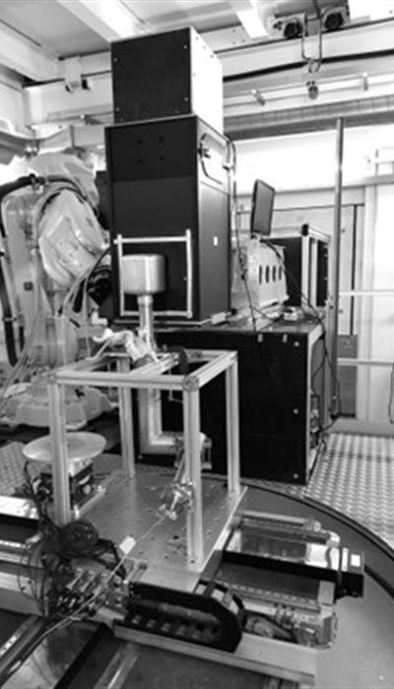
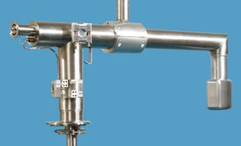
Benefits of FETS-METS
5
Improve & de-risk ISIS & ISIS-II moderator performance, operability and reliability
Provide a flexible facility for moderator testing and development
Focus on engineering systems, cryogenics, diagnostics, controls
Test new components, systems and instrumentation in a controlled environment
Benchmark neutronic performance and mechanical simulations​
Versatile neutron source for broader potential uses
Space for innovation and testing higher-risk ideas
Support staff training and skills development
The solid methane moderator assembly, TS-2
The moderator head is a multilayered container cooled by a helium gas loop (in red), at –253°C.
Using the IMAT instrument to check the new TS1 hydrogen moderator

Slide 6
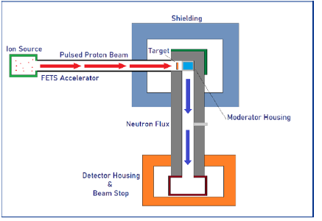
6
Project Scope
The FETS-METS Project’s key Systems:
Accelerator Extension: magnets and beam diagnostics
TRaM system: target vessel, multifunctional TRaM vessel including the moderator test space
Diagnostic beam line with detector
Additional shielding
Cryogenic system: for methane and hydrogen
Infrastructure & Support Systems
FETS-METS simplified schematics of main areas
FETS layout in R8, RAL with one of the METS potential extensions for a TRaM and a Detector Room

Slide 7
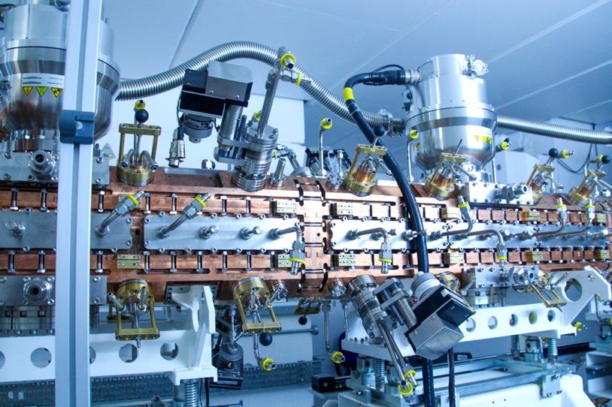
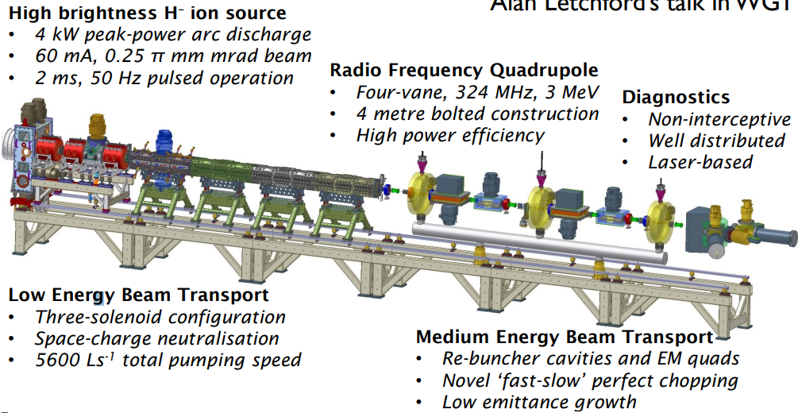
FETS
7
FETS: An existing linear accelerator for R&D based in RAL
Beam: 3 MeV proton beam with an average current of 6 mA (60 mA peak current)
Key technologies:
H-minus ion source
Magnetic low-energy beam transport (LEBT)
Radiofrequency Quadrupole accelerator (RFQ)
Medium Energy Beam Transport (MEBT)
Chopper line
Various diagnostic systems
Benefits of using FETS: time, cost, existing facility
The Radio Frequency Quadrupole (RFQ) of FETS efficiently bunches and accelerates the beam from 65 keV to 3 MeV
FETS overview of main systems (S. Gibson et Al.)

Slide 8
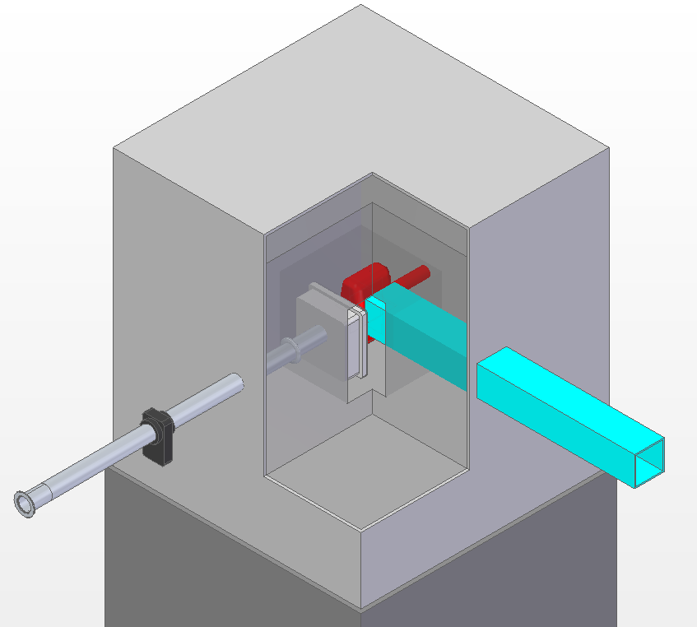
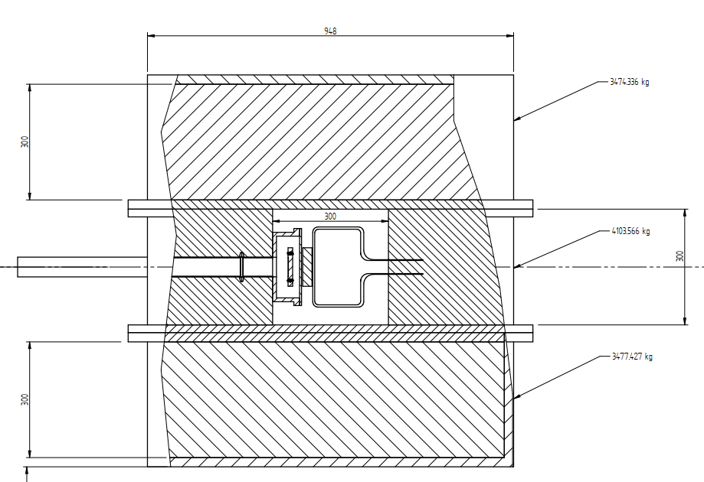
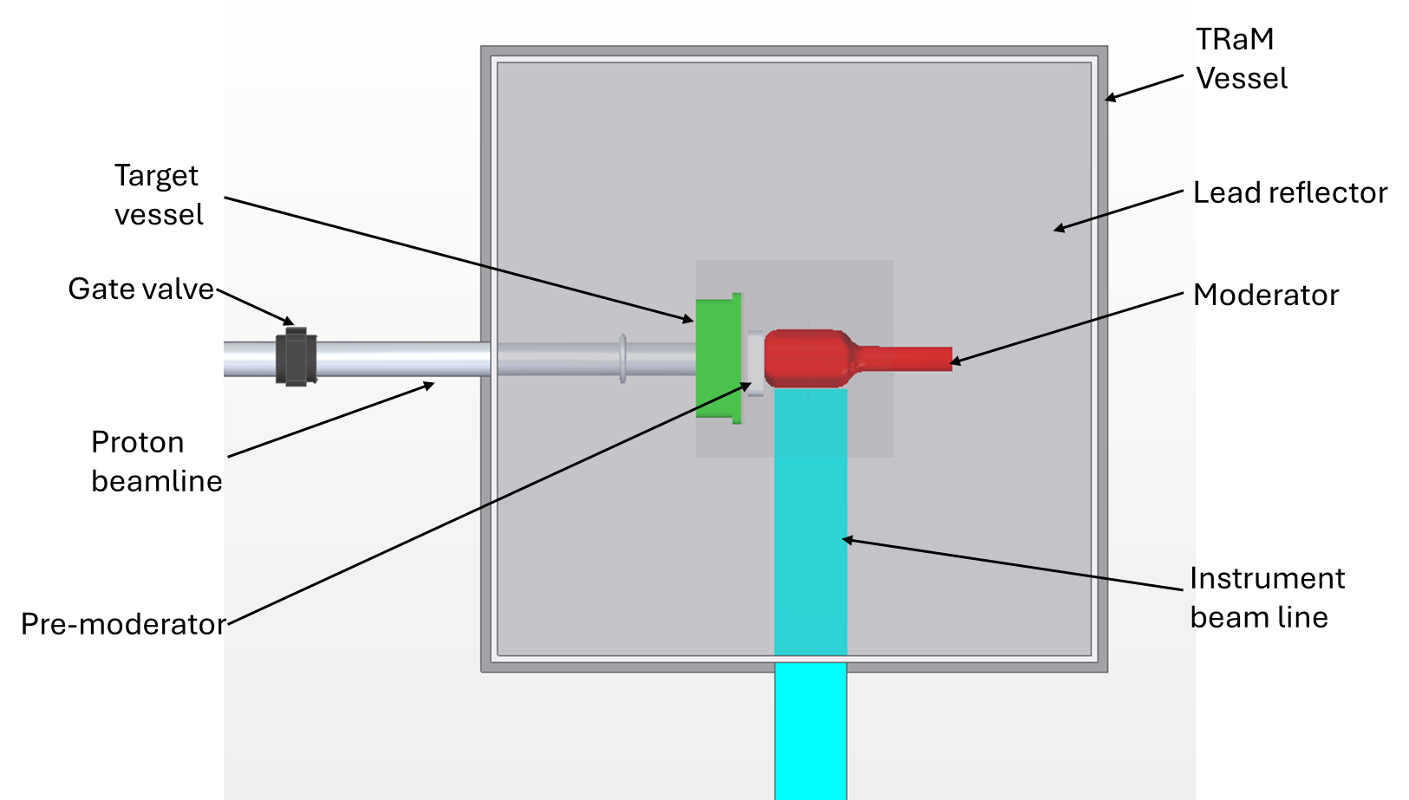
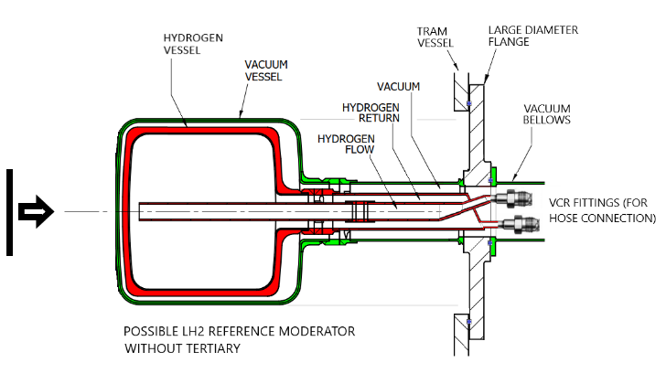
TRaM Vessel
8
Key features:
Vessel in inert gas/vacuum
Encloses target vessel, moderator and reflector
Removable lid or sides for hands on access
Configurable design to test moderators, precise and repeatable position
Multiple ports for instruments and services
Reflector (lead, beryllium)
External shielding with borated polyethylene
The TRaM vessel will enclose the reflector, the target vessel and the moderator
Early concept of TRaM vessel side cross-section indicating 3 separate compartments filled with lead
PROTON BEAMLINE DIRECTION
TRaM vessel top view indicating key components
Possible LH2 Reference moderator for testing with the FETS-METS

Slide 9
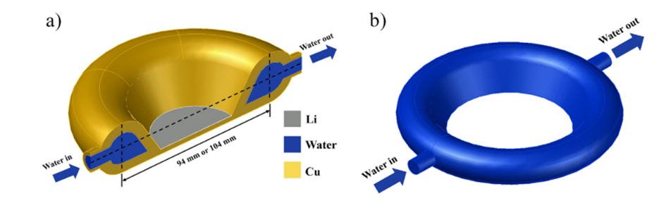
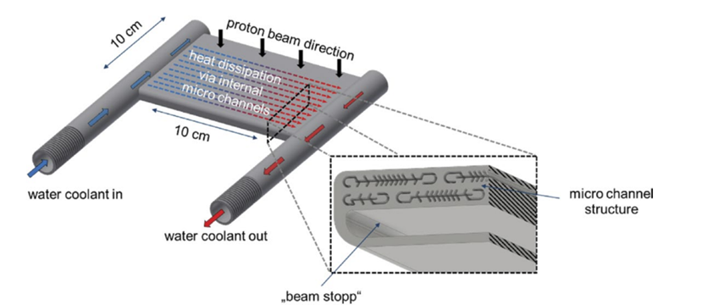
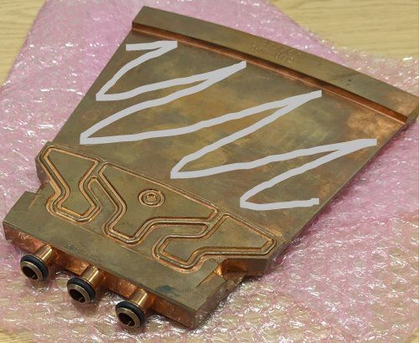
Target
9
Target bespoke design:
Early concept, preliminary neutronic calculations
Lithium layer (300-400 microns thick) on copper plate
Vessel in vacuum/inert gas to protect lithium from oxidization
Cooling method examples
Estimated replacement approx. once per year
Thin aluminum neutrons window
Edge-cooling of lithium layered copper target studied for the Transportable Accelerator-driven Neutron Source (TANS) Li Xiaobo Li et Al, 2021
Area indicating lithium layer location
A target 'petal’, used on the new University of Birmingham High Flux Accelerator Neutron Facility
Tantalum target with fin-like μ-channel structure for the High Brilliance Neutron Source (HBS) T. Gutberlet et Al, 2020
Target vessel iso view indicating key components

Slide 10
Instrument
10
FETS-METS instrument schematics, indicating the neutron beamline and the instrument key components

Slide 11
Services
Providing the necessary services is quite complex
Water
Cryo-plant
Inert gas, flammable gas & ATEX
Ventilation
Electrical & Control Systems
Vacuum
FETS-METS concept schematics of water, gases, vacuum, ventilation services

Slide 12
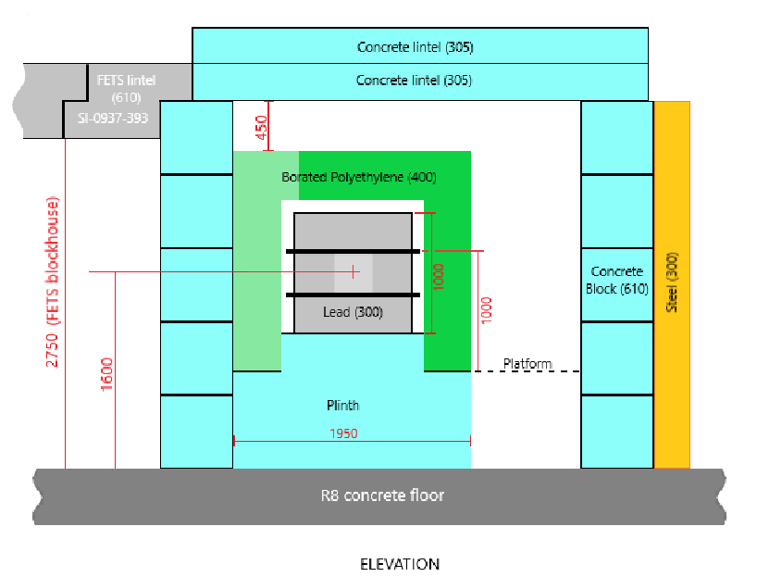
Shielding (TRaM and detector)
12
METS shielding requirements to effectively stop radiation made from a combination of steel and concrete, top view
METS shielding at the TRaM area, side view

Slide 13
13
Status & Challenges
Current challenges
Integration and consolidation of FETS
New technologies for us (e.g. lithium target)
Spatial limitations in the existing building
Implications of DSEAR (ATEX)
Identifying funding mechanism and timing
Benefits confirmation and review
Stakeholder and design co-ordination
Outline Plan
2024 - Concept phase
Neutronics & radiation studies
Design concept and system definition
Project planning and cost estimating
Resource demand and availability
2025 - Detailed design and application for full funding
2026 - Equipment specification/sourcing and enabling works
2027 - Construction
2028 - Commissioning and bring into use

Slide 14
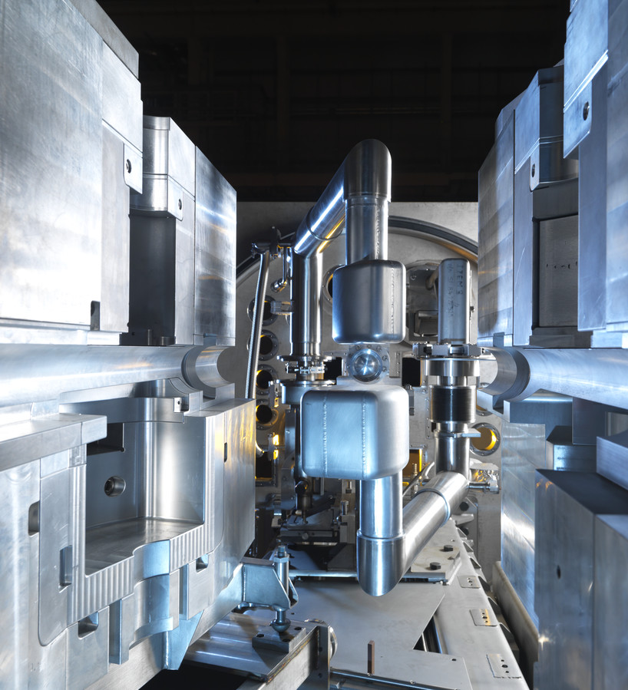
14
Key takeaways
Purpose: Develop a neutron source to test and improve moderator designs by extending the existing FETS accelerator with a new TRaM, and instrument beamline.
Key Benefits:
Improved moderator performance and reliability for ISIS & ISIS-II.
Flexible, accessible platform for innovative moderator R&D.
Engineering Areas discussed:
Lithium target development and TRaM vessel design.
Instrument beamline
Services & Shielding
Challenges & Next Steps:
Cross-team collaboration, space constraints, and funding.
2024: Feasibility studies and cost estimates.
2025: Detailed design and funding applications.
ISIS Target Station 2, liquid hydrogen and solid menthane moderators

Slide 15
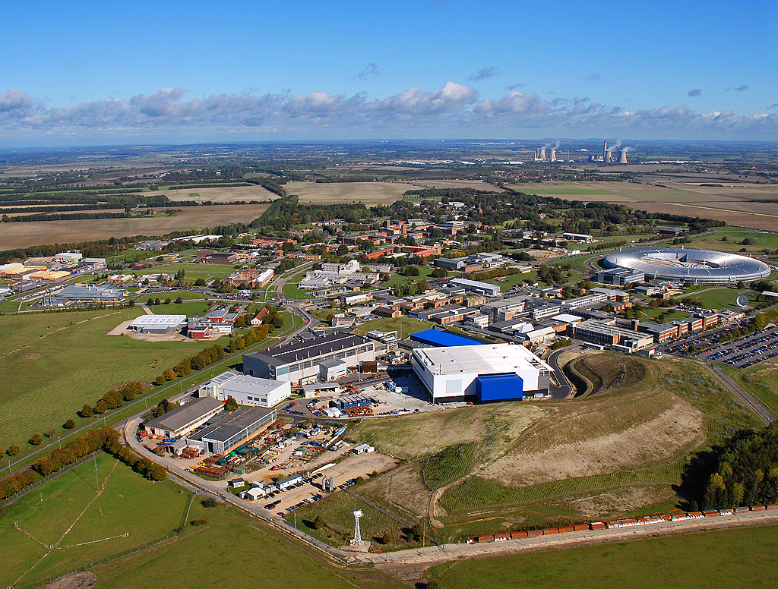
Acknowledgments: Thank you to the key members of the FETS-METS project team:
P. Morgan, S. Lilley, S. Gallimore, S. Jago
And special thanks to colleagues across ISIS who have generously shared their expertise, insights, and advice
Questions?
RAL at Harwell Campus

