Slide 1
IAEA activities in support of development and utilization of neutron sources
V. Semkova, H. Ben Abdelouahed, K. Kanaki, D. Ridikas, N. Skukan, E. Vargas
Physics Section and Nuclear Science and Instrumentation Laboratory
International Atomic Energy Agency

Slide 2
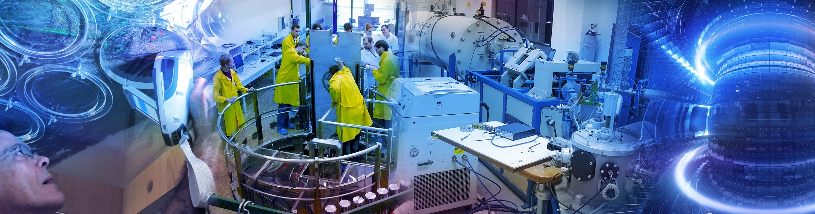
Outline
Organization
Highlights of recent achievements
Neutrons4NA initiative
CANS
BNCT
Next steps
physics@iaea.org 2

Slide 3
Division of Physical & Chemical Sciences (NAPC)
Nuclear Science, Nuclear Data, Nuclear Physics, Radiation and Isotope Sciences & Applications, Water Resource Management
Nuclear Data
Data Development
Data Services
Physics
Accelerator & Research Reactor Applications
Nuclear Instrumentation
Atomic & Molecular Data
Radiochemistry & Radiation Technology
Medical Radioisotope production, Radiopharmaceuticals
Radiotracers, NCS & NDT in industry
Radiation technology applications
Isotope Hydrology
Isotopic methods for groundwater assessment
Water resource management
Scenario modelling
Terrestrial Environment
Nuclear Fusion
3

Slide 4
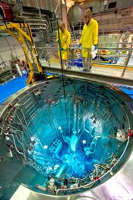
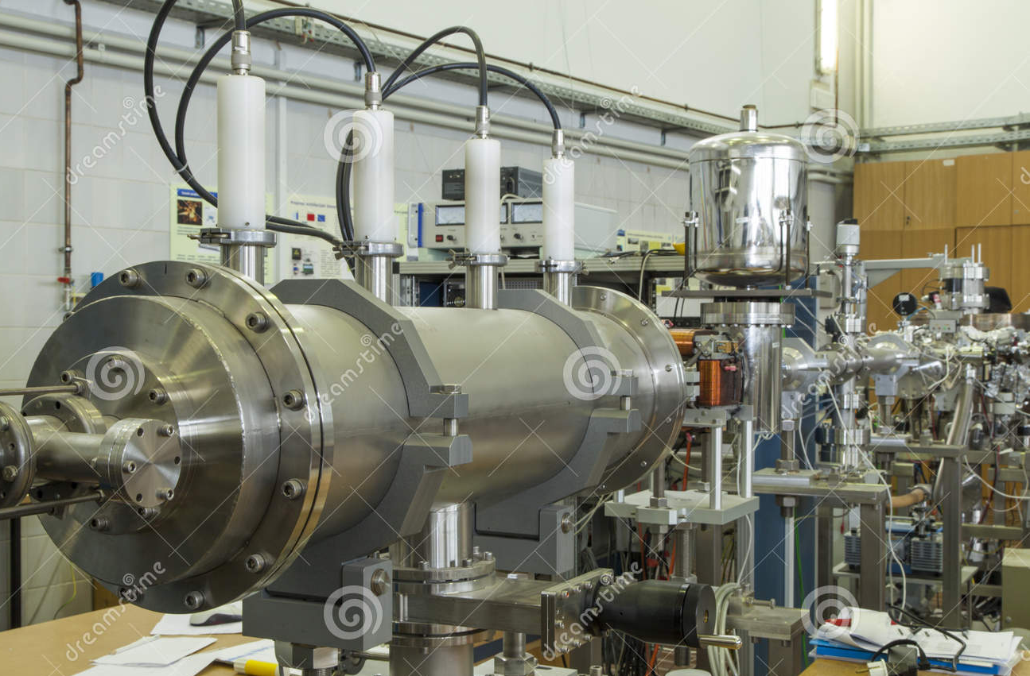
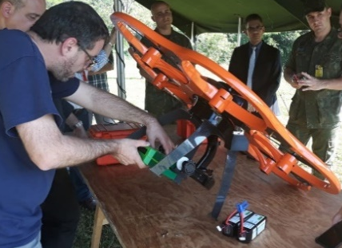
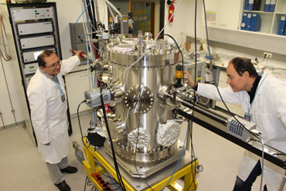
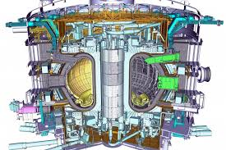
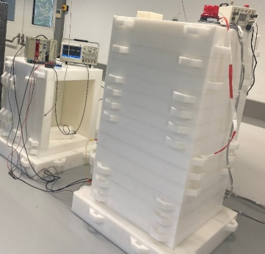
Physics Section: main technical areas
1.4.2 Research & Applications with Accelerators & Neutron Sources
(incl. CANS applications)
1.4.3 Nuclear Instrumentation
(incl. laboratory in Seibersdorf)
1.4.4 Nuclear Fusion
Science & Plasma Physics
(incl. coop. with ITER)
physics@iaea.org 4

Slide 5
Subprogramme 1.4.2 Research and Applications with Accelerators and Neutron Sources
Main Objectives:
Support MSs in strengthening their capabilities to conduct research with accelerators and neutron sources (incl. CANSs)
Support MSs in strengthening their capabilities to expand the applications of accelerators and neutron sources (incl. CANSs)
Projects:
1.4.2.1 Accelerator and neutron source applications in multiple disciplines
1.4.2.2 Enhancing research with accelerators and neutrons
physics@iaea.org 5

Slide 6
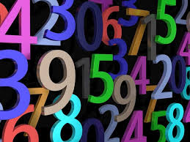
Physics Section in numbers
Coordinated Research Projects: 7 active
TC projects: >50 active in >50 Member States
Meetings/Workshops/Schools: >50/year
Major Conferences (3): Accelerators, RRs, Fusion Energy
Data bases/portals (4): accelerators, neutrons, instrumentation, fusion
Collaborating Centers (8): ANSTO, TU Delft, Elettra, iThemba Labs, Univ. Paris Saclay, Univ. of Okayama,
Univ. of Singapore, MIT PSFC
Cooperation agreements (9): ITER, UNICRI, ITU, FIA, Elettra, RBI, PPPL, ASSIP, CEA
Events in cooperation: >5/year
physics@iaea.org 6

Slide 7
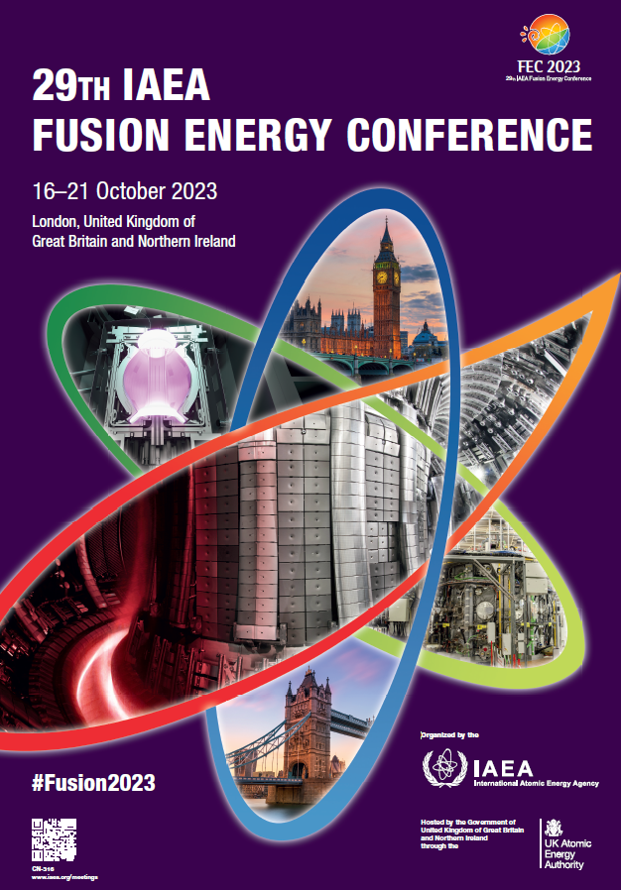

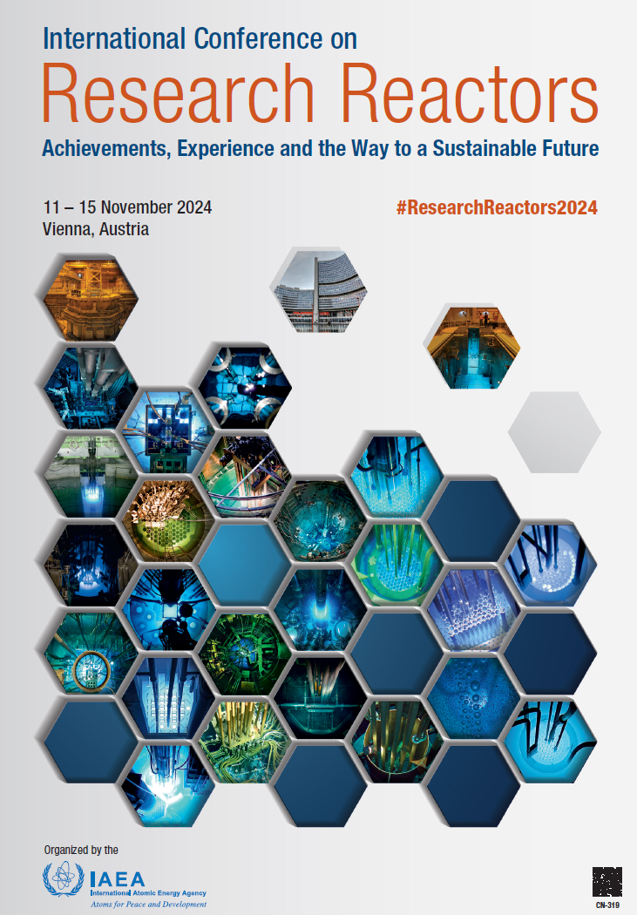
E.g. Organization of Three Major Conferences
  Next in 2025, 2027… Next in 2026 Next in 2028
physics@iaea.org 7

Slide 8
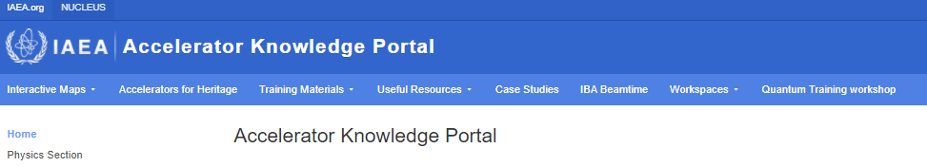
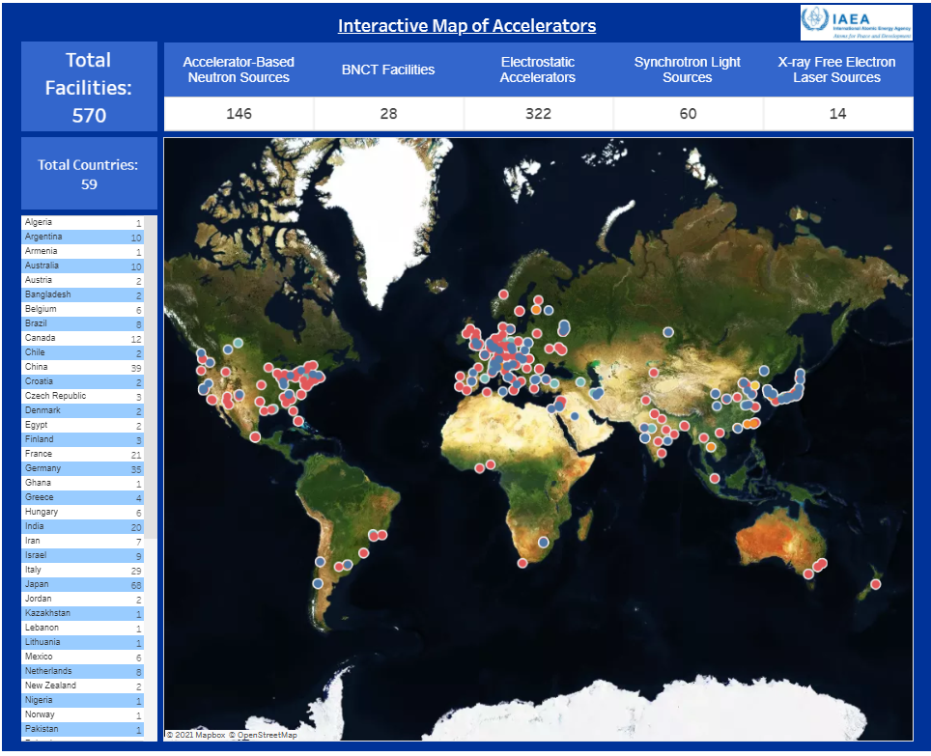
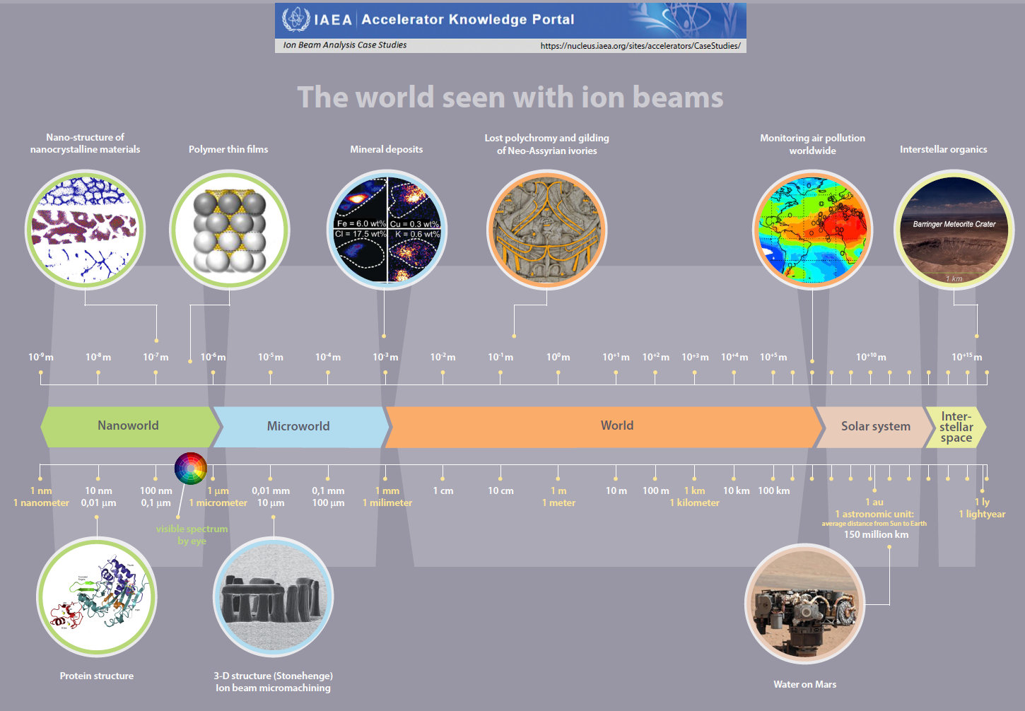
E.g. managing thematic portals and data bases
    Accelerators: https://nucleus.iaea.org/sites/accelerators/
    Neutrons: https://nucleus.iaea.org/sites/neutrons/
    Fusion: https://nucleus.iaea.org/sites/fusionportal/
    Instrumentation: https://nucleus.iaea.org/sites/nuclear-instrumentation
  E.g. Accelerator Knowledge Portal
  16000+ visitors/users in 2024; our interactive maps include
  570+ ion beam accelerators
  1200+ medical cyclotrons
  400+ neutron beam instruments
  1300+ XRF facilities
physics@iaea.org 8

Slide 9
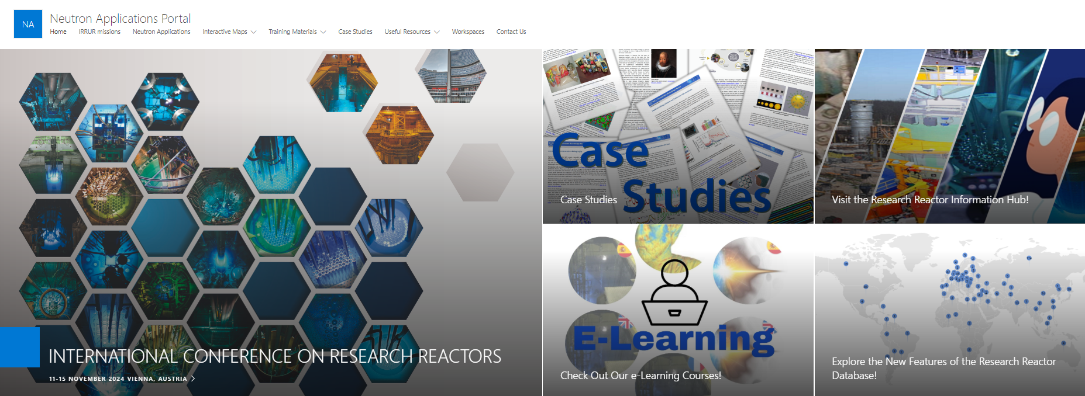
Portals and databases (1/2)
Neutron Applications Portal
https://nucleus.iaea.org/sites/neutrons, on-line since June 2022
Number of visitors/users continues to grow
9
physics@iaea.org 9

Slide 10
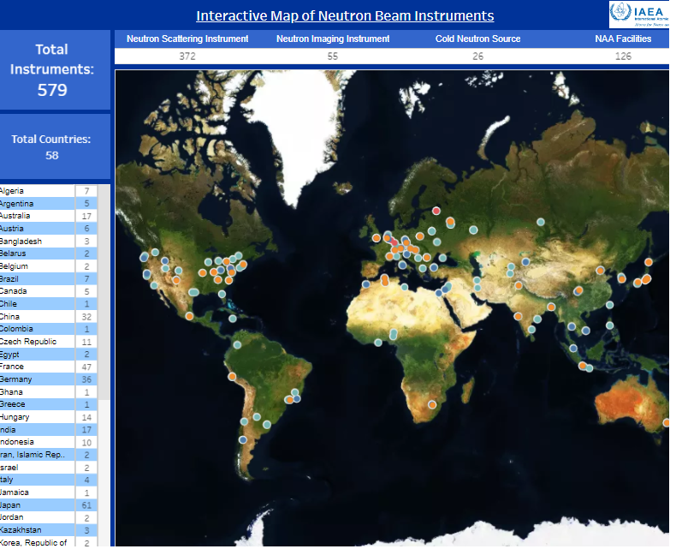
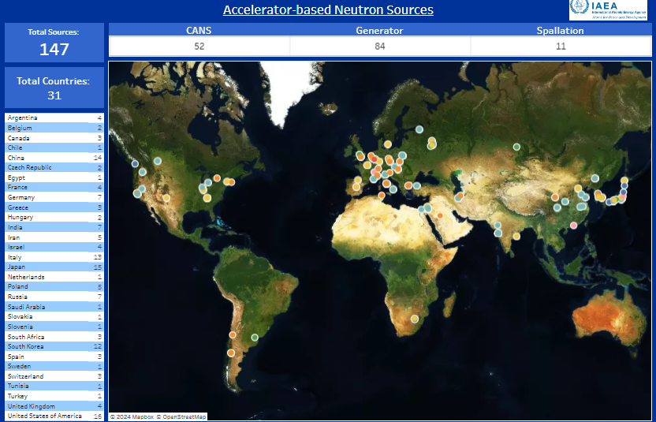
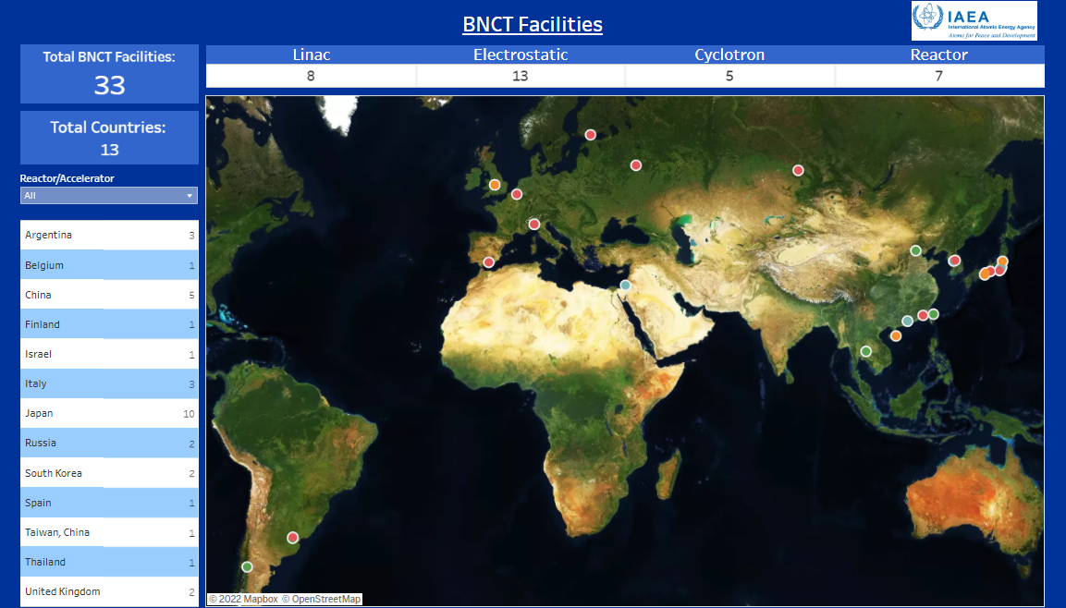
Portals and databases (2/2)
New online databases
  Neutron Beam Instruments, NAA facilities and Cold Neutron Sources
  Accelerator based neutron sources (generators, CANS, spallation)
  BNCT facilities (accelerator & RR based)
10
physics@iaea.org 10

Slide 11
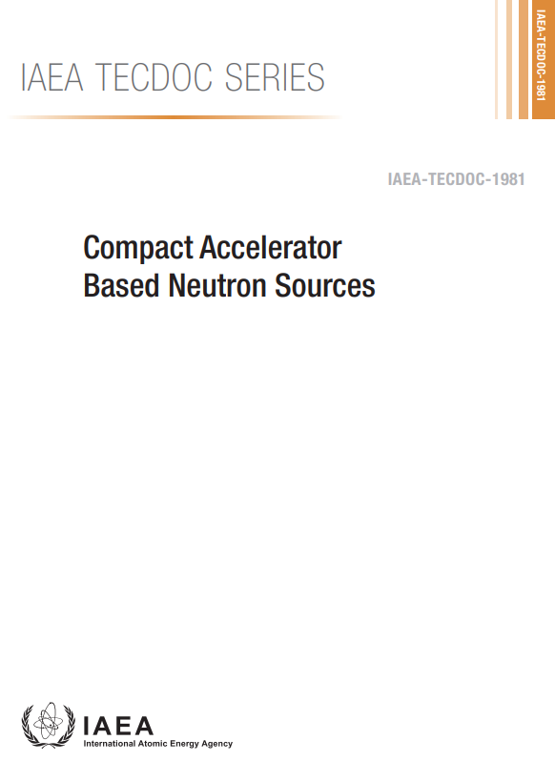
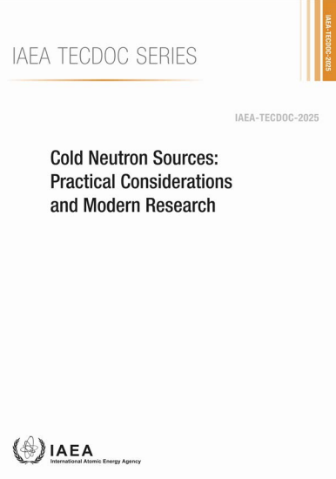
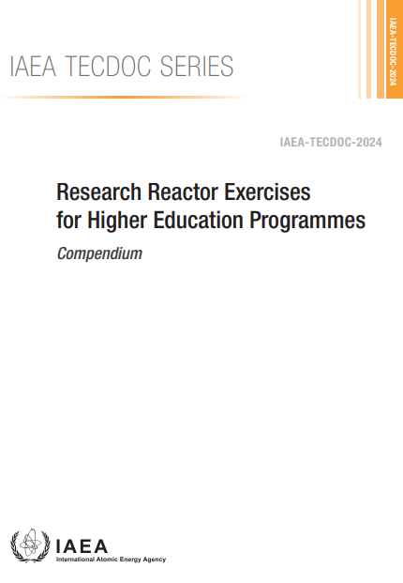
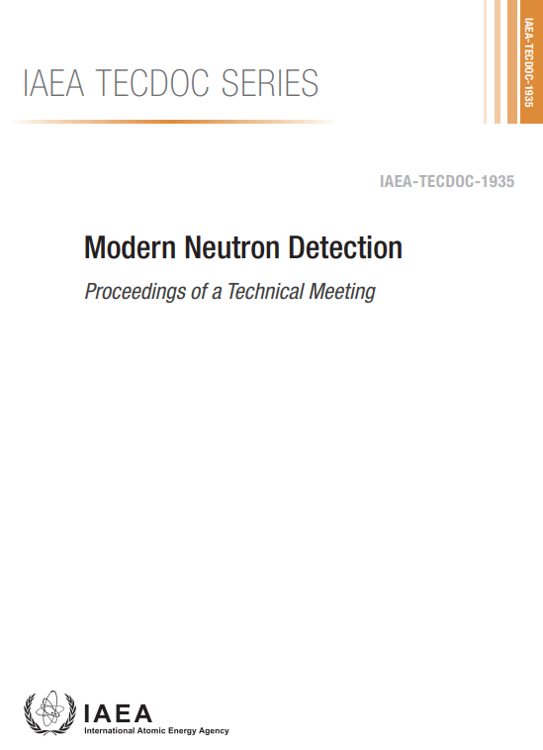
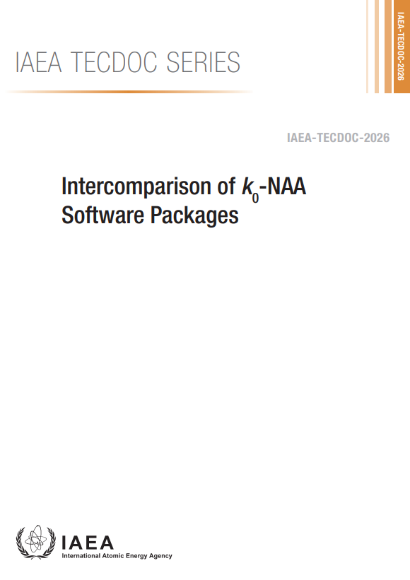
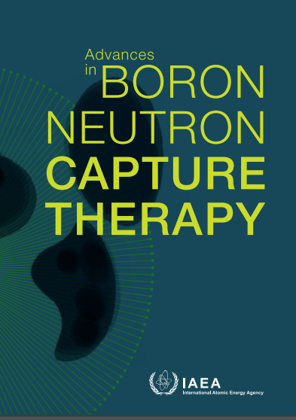
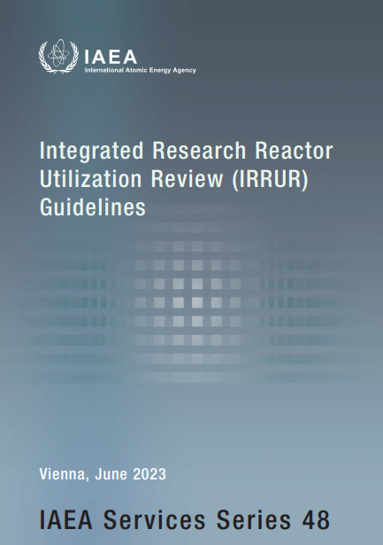
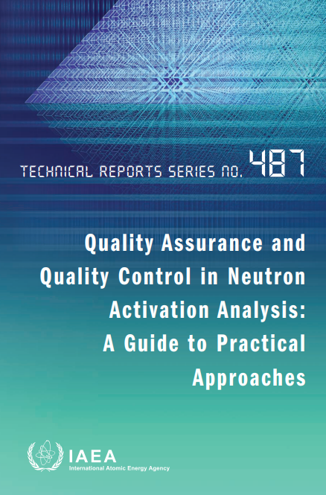
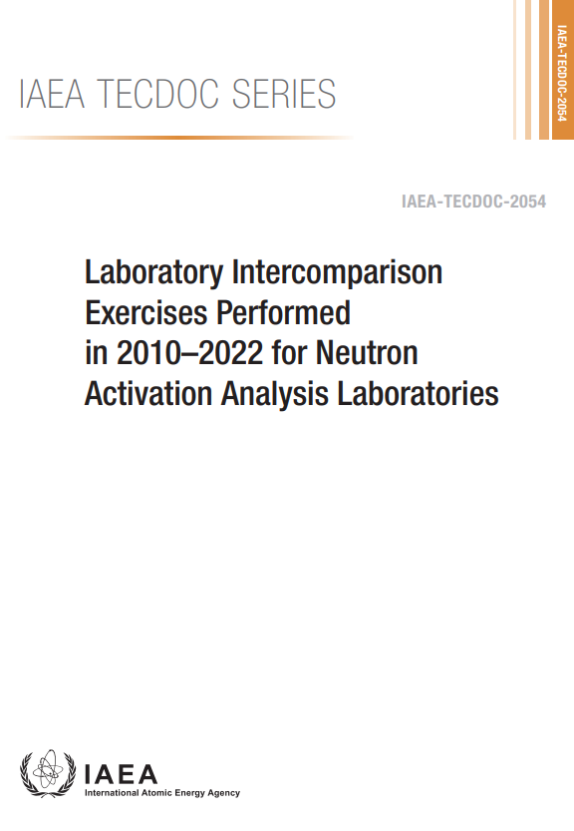
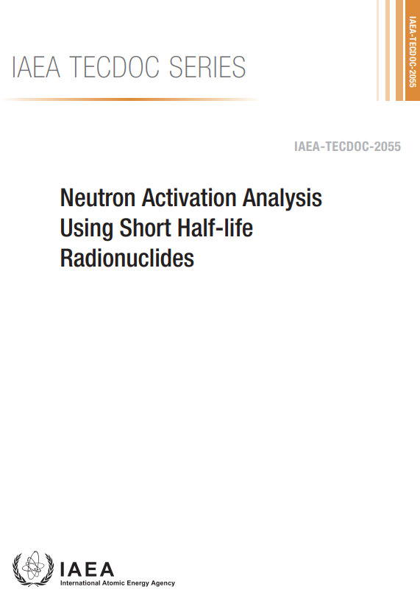
Selected Publications
https://www.iaea.org/publications
physics@iaea.org 11

Slide 12
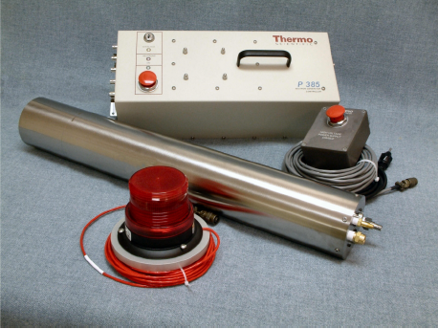

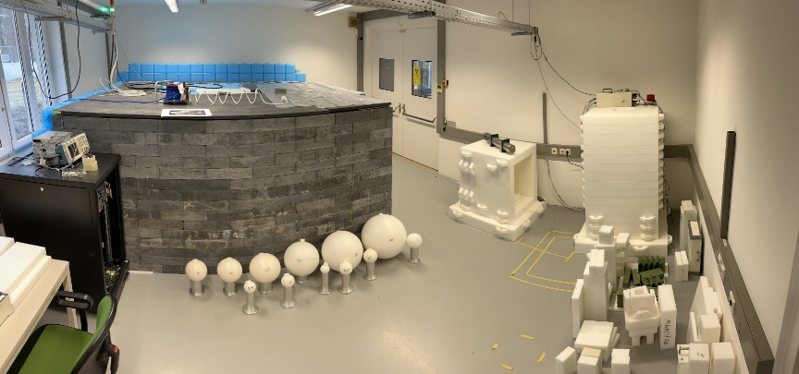
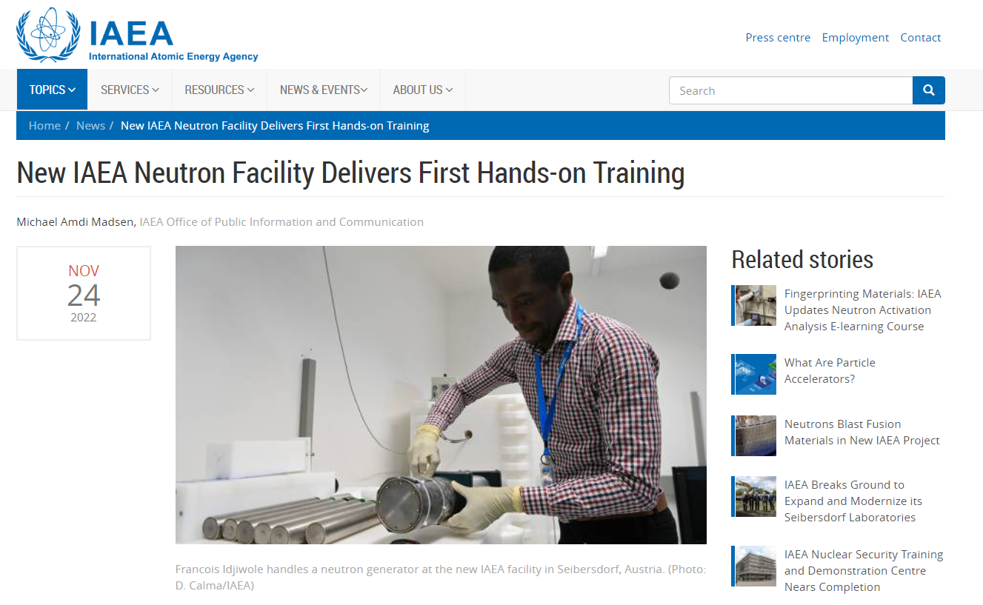
E.g. IAEA Neutron Science Facility (NSF) at SEIB
NSF is based on two neutron generators, operational since 2022
D+D reaction → 2.45 MeV neutron source (fission neutrons, 5e6 n/s); US EB funded
D+T reaction → 14.1 MeV neutron source (fusion neutrons, 5e8 n/s); Australia donation
12
physics@iaea.org 12

Slide 13
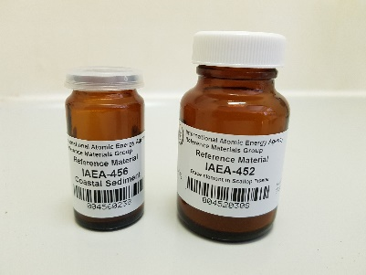

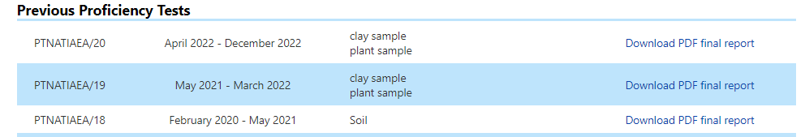
Proficiency Tests for NAA & other Analytical Techniques
Round Robin of sample
Organized twice a year in support IAEA Member States laboratories to:
identify analytical problems
improve the quality of their analytical results
acquire / maintain their accreditation
provide a regular forum for discussion and technology transfer in this area
In 2023: +90 analytical laboratories participate, representing +50 countries
Scheme of the proficiency test:
Provision of various samples at no cost
Full anonymity of laboratories is granted
Issue of final reports
More info: http://www.pt-nsil.com/
physics@iaea.org 13

Slide 14
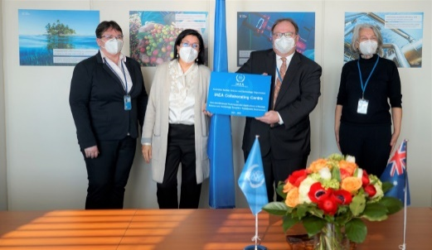
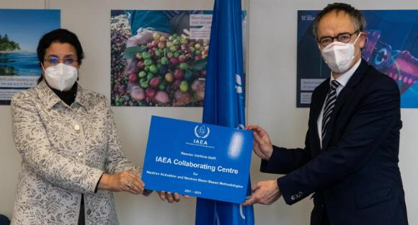
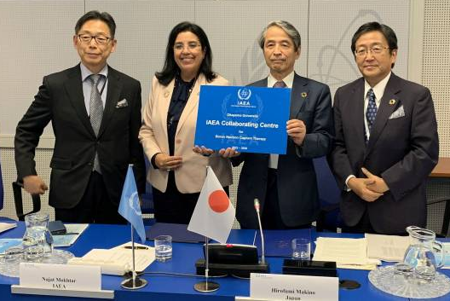

Scheme of IAEA Collaborating Centres
ANSTO, Australia (2021-2024) on New and Advanced Techniques & Applications of Nuclear Science & Technology Towards a Sustainable Environment
TU Delft Reactor Institute, Netherlands (2021-2024) on NAA & neutron-beam based methodologies
Okayama University, Japan (2022-2026) on Boron Neutron Capture Therapy (BNCT)
physics@iaea.org 14

Slide 15
Outline
Organization
Highlights of recent achievements
Neutrons4NA initiative
CANS
BNCT
Next steps
physics@iaea.org 15

Slide 16
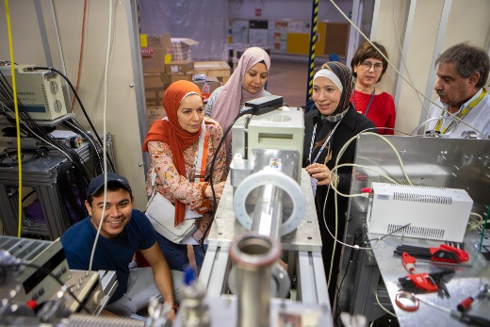
1.4.2 Acc&RR highlights of 2024
Scientific - Technical events (1250+ participants):
IAEA RR Conference 11-15 Nov. 2024, VIC, Austria; 300+ in person and 200+ virtual participants, jointly with NE and NS
10 Technical Meetings on
  neutron beams; market analysis; RR applications; small power RRs; RR utilization design; Neutrons4NA initiative
  establishment of accelerators; radiocarbon dating; forensic science;; heritage science
9 TR workshops on
  RR feasibility study; NAA techniques; RR bidding process; RR strategic planning
  accelerator technologies; synchrotron techniques; IBA techniques; environmental pollution; cultural heritage with synchrotrons;
2 ICTP schools on
  laser-driven radiation sources; synchrotron applications
2 EVTs in cooperation: AONSA neutron school (India), Microprobe Conference (Portugal)
Webinars: BNCT, NTD-Si, Atoms4Heritage series…
physics@iaea.org 16

Slide 17
Outline
Organization & involved staff
Highlights of recent achievements
Neutrons4NA initiative
CANS
BNCT
Next steps
physics@iaea.org 17

Slide 18

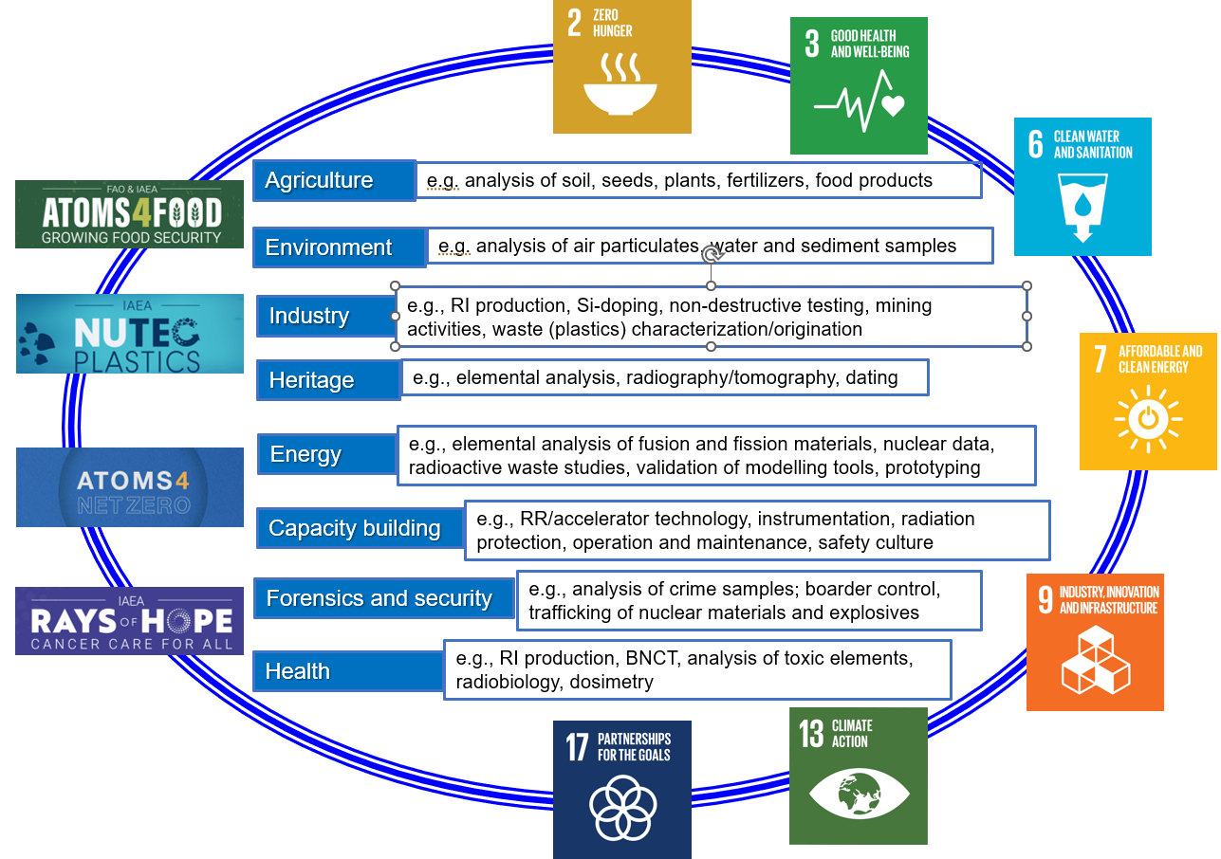
Neutrons4NA initiative: rationale
Tailored and stepwise approach through promotion, capacity building, technology transfer and facilitated access to Neutrons4NA and resulting socioeconomic development in the Member States
physics@iaea.org 18

Slide 19

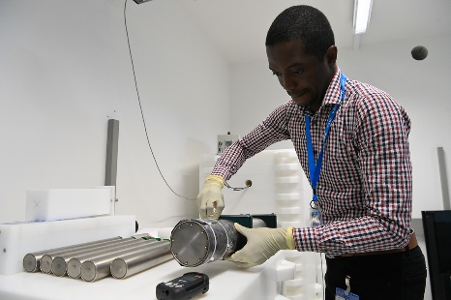
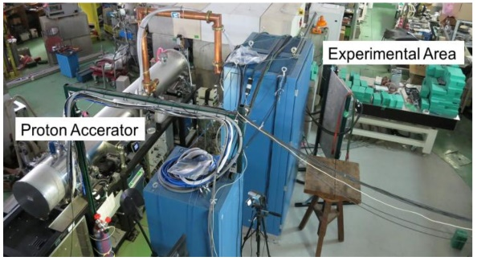
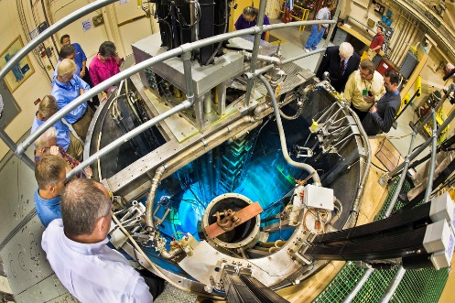
Neutrons4NA: objective
Bridging the gap between neutron generators, CANS and RRs:
tailored and stepwise approach
 | Neutron generator | Compact accelerator- based neutron source | Research reactor / spallation source
Neutron source, n/s | <10¹⁰ | <10¹⁴ | >10¹⁵
Capital cost, €M | 0.1-0.2 | 3-10 | 60-700
O&M costs, €M | 0.02 | 0.2-1.0 | 3-100
Staff, number | 1 | 2-3 | 10-100
physics@iaea.org 19

Slide 20

Neutrons4NA: scope of support
Well established facilities offering expertise and advice services to perform justification statement and feasibility study for decision making-process on investment:
  Quantification of needs,
  Choice of tailored and cost-effective technology,
  Infrastructure assessment,
  Cost-benefit and risk analysis.
Long term facilitated support of the project at different stages of implementation, e.g.
  Capacity building (hands on training…),
  Share of experience from well-established and relevant facilities,
  Share of experience regarding tailored and cost-effective technology selection.
physics@iaea.org 20

Slide 21
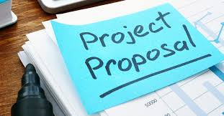
Neutrons4NA: project proposal
Proposed instrument/framework: IAEA Peaceful Uses Initiative (PUI)
Duration: 4 years minimum
Beneficiaries: target MSs without access to neutron sources
Partners: MSs with well-established facilities and technology providers
Coordination: IAEA
Funding: extrabudgetary contribution from conventional and non- conventional donors
Means of implementation:
  Expert missions
  Scientific Visits and Fellowship training
  National workshops
  Review of strategic plans and feasibility studies
  Annual progress meetings of PUI partners.
physics@iaea.org 21

Slide 22
Outline
Organization
Highlights of recent achievements
Neutrons4NA initiative
CANS
BNCT
Next steps
physics@iaea.org 22

Slide 23
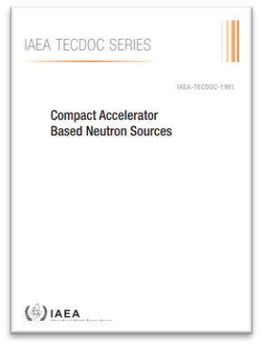
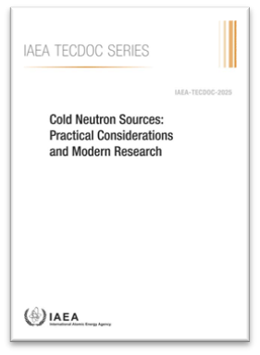
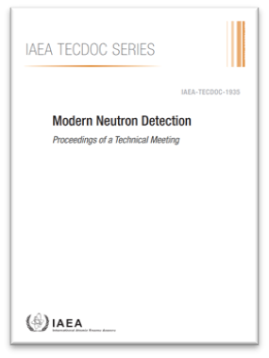
Activities in support of CANS
Meetings/Workshops:
Data bases/portals : accelerators, neutrons, instrumentation
Collaborating Centers (6): ANSTO, Elettra, iThemba Labs, Univ. Paris Saclay, Univ. of Okayama,
Cooperation agreements: CEA
Publications
physics@iaea.org 23

Slide 24
Outline
Organization
Highlights of recent achievements
Neutrons4NA initiative
CANS
BNCT
Next steps
physics@iaea.org 24

Slide 25
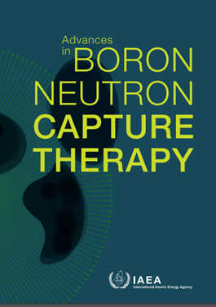
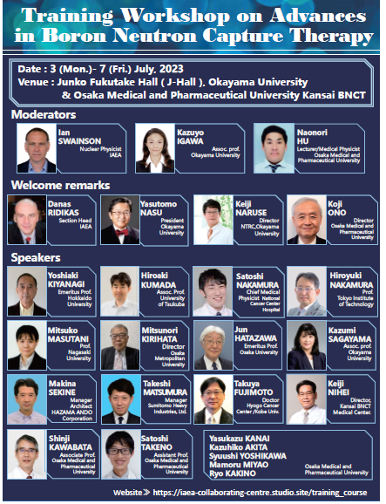
Activities in support of BNCT
Meetings/Workshops:
Data bases/portals : accelerators, neutrons, instrumentation
Collaborating Centers: Univ. of Okayama,
Publications
Webinars
physics@iaea.org 25

Slide 26
Outline
Organization
Highlights of recent achievements
Neutrons4NA initiative
CANS
BNCT
Next steps
physics@iaea.org 26

Slide 27

Next steps
New CRPs
  Boron Neutron Capture Therapy, planned
  Neutron beam instrumentation at low and medium intensity neutron sources, planned
New Collaborating Centres
  TUM FRM2 Germany, letter of intent received
Publications in progress
  History, Development and Future of the SLOWPOKE and MNSR RRs; with IAEA PC
  Research Reactor Produced Radioisotopes, update of TECDOC 1340; in draft
  Applications of Research Reactors (Rev.1), Nuclear Energy Series; in draft
  …
physics@iaea.org 27

Slide 28
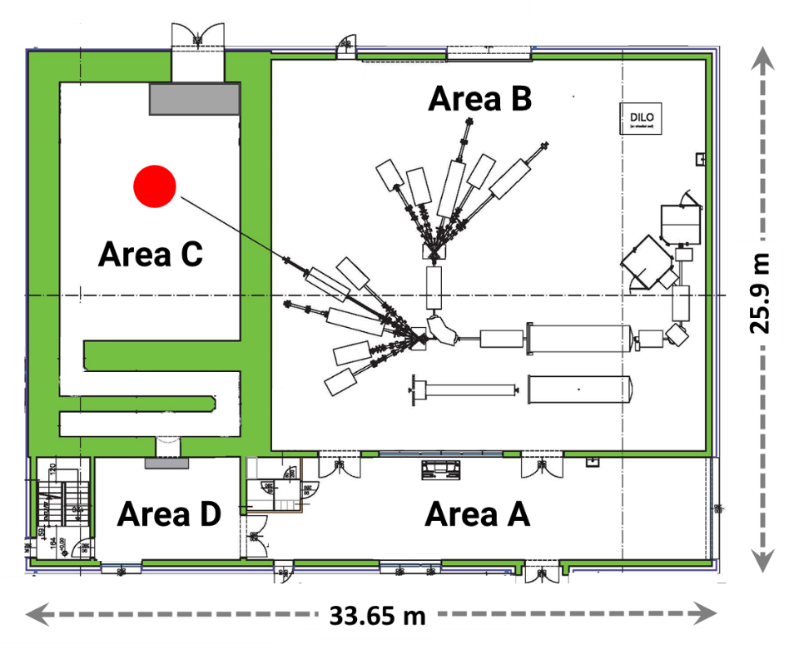
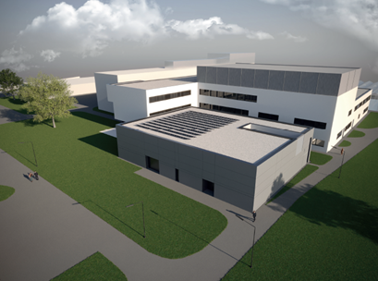
E.g. IAEA Ion Beam Facility project at SEIB
Neutron hall
→ 6MeV protons (up to 50µA current) + heavier ions
→ Multiple beam lines/end-stations (PIXE, PIGE, RBS, Microbeam, implanter…
→ Neutron production capability
Max. source intensity: 5x10¹¹ n/s
Max. thermal flux: 10⁶ n s⁻¹cm⁻²
Accelerator hall
physics@iaea.org 28

Slide 29
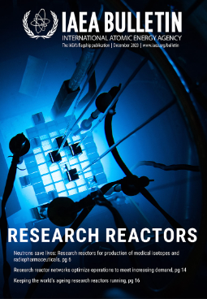
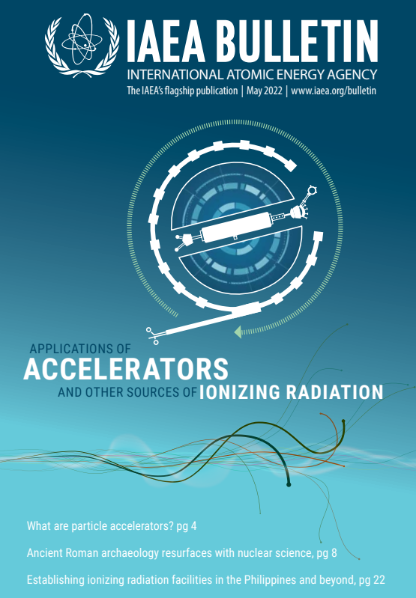

Thanks for your attention!
physics@iaea.org

