Slide 1
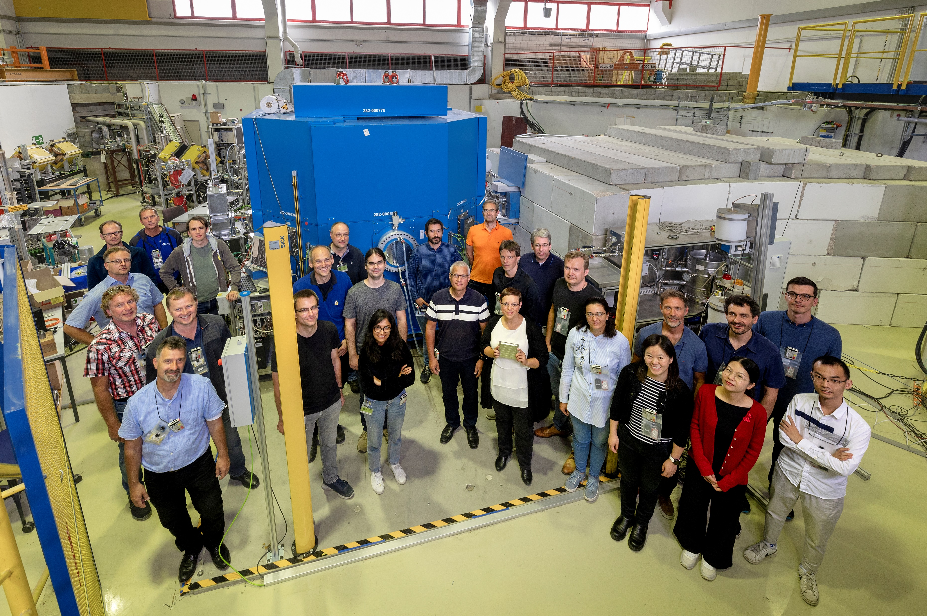
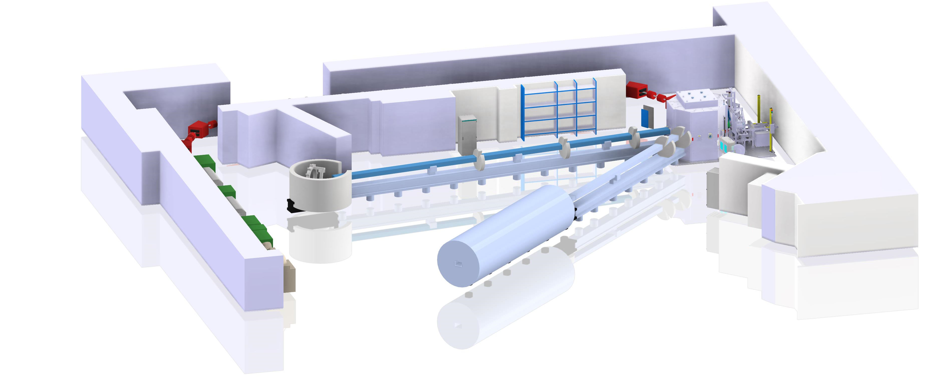
The High-Brilliance Neutron Source Project
HEREON
CEA
ZEA
TUM
JCNS
IKP
Paul Zakalek, JCNS

Slide 2










Accelerator Based Neutron Sources
From CANS* to HiCANS**
(*Compact Accelerator based Neutron Source , ** High-Current Accelerator based Neutron Source)
0.01 kW | 0.1 kW | 1 kW | 10 kW | 100 kW
0.001-0.01 mA | 0.01-1 mA | 0.5-5 mA | 1-20 mA | 50-100 mA
~10¹¹ n/s | ~10¹² n/s | ~10¹³ n/s | ~10¹⁴ n/s | ~10¹⁵ n/s
10 Mio EUR 500 Mio EUR
Running CANS facilities:
LENS, Indiana University (USA)
HUNS, Hokaido University (Japan)
RANS, RIKEN (Japan)
NUANS, Nagoya University (Japan)
CPHS, Tsinghua University (China)
IREN, JINR Dubna (Russia)
HiCANS projects:
HBS, JCNS (Germany)
ICONE, CEA LLB (France)
ARGITU, ESS Bilbao (Spain)
SARAF, SOREQ (Israel)
Notes:
2

Slide 3
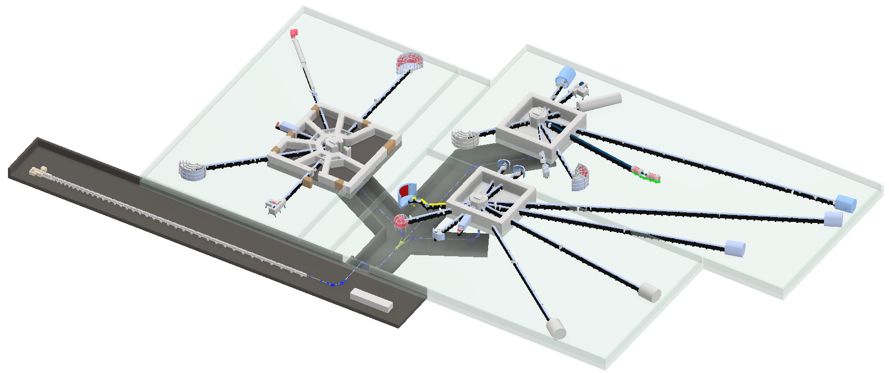
HBS, a High-Current Accelerator-driven Neutron Source (HiCANS)
Project rationale
Every beam port serves only 1 Instrument
Optimize neutron source spectrum
Several target stations
Optimize pulse structure (length, rep. rate)
Optimize geometry
Integrate neutron optics with beam port
Optimize thermal spectrum
Small shielding
Neutron guide around cold source
Chopper at <2 m from target
High current linear accelerator
100 mA, 70 MeV pulsed proton beam
Variable frequency

Slide 4

HBS Technical Design Report
https://go.fzj.de/hbs-tdr
Project Published summer 2023
Notes:
We published a TDR about the accelerator with our partners at IAP Frankfurt, who are accelerator experts. We worked on the target station and the moderators, the instrumentation with the contribution of many external experts and the TDR about infrastructure and sustainability. If anyone is interested, I would highly recommend the summery of all volumes.

Slide 5
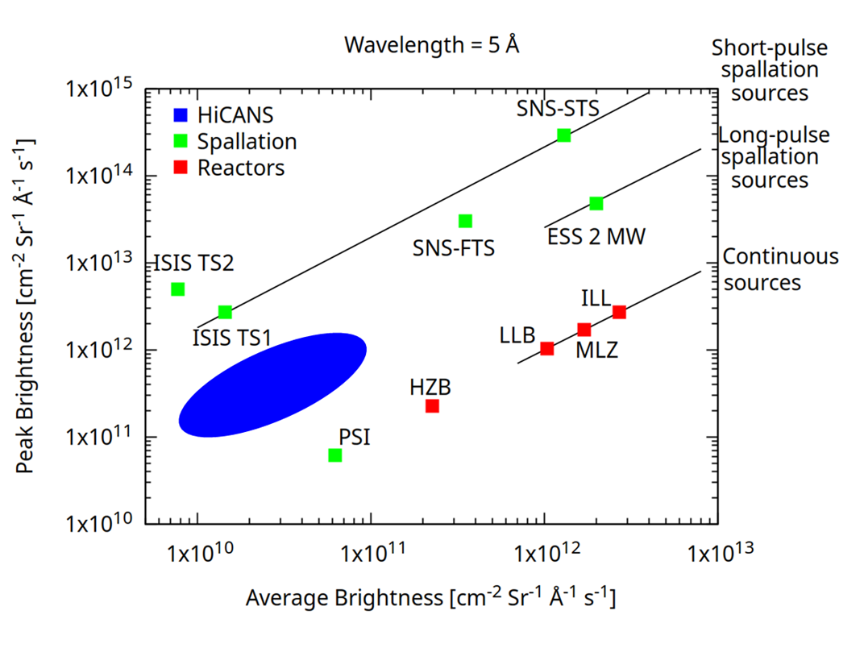
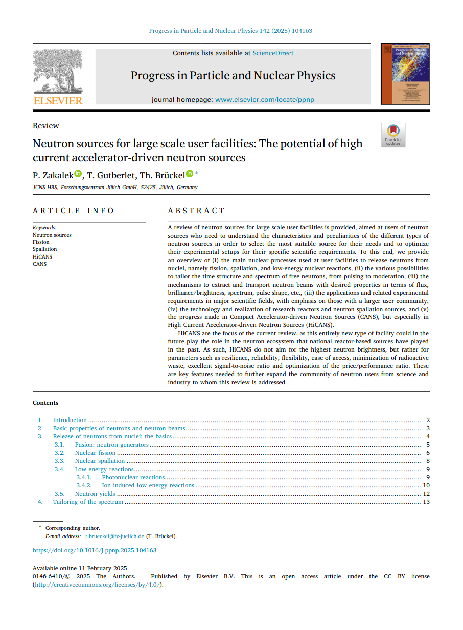
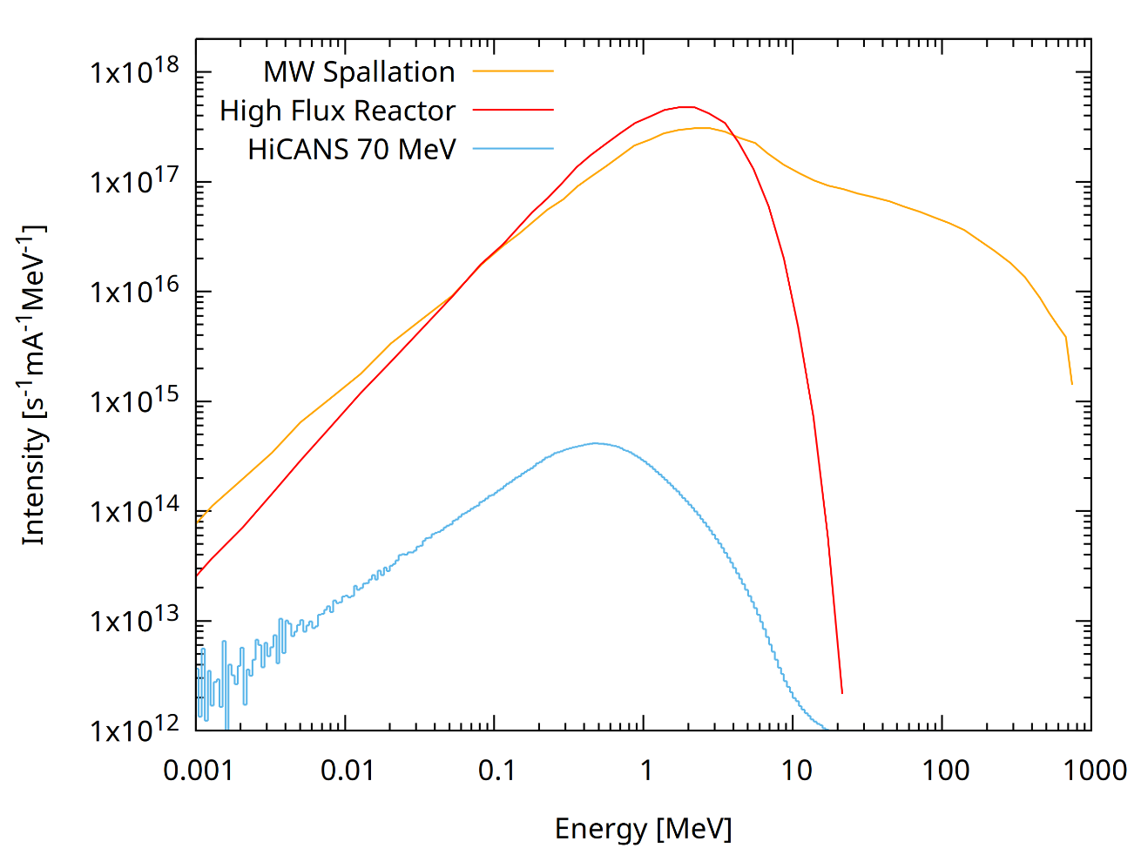

Efficient and sustainable neutron production
https://doi.org/10.1016/j.ppnp.2025.104163
Notes:
On the left hand side, you see the primary neutron spectra of all three processes. You can see, that the spectrum for a HiCANS is around 3 orders lower than for spallation and fission. But the spectrum is also much softer, you have much less high energy neutrons and also the mean energy is lower than for the other processes.
Due to this soft energy spectrum it is thus possible to built quite small target stations in comparision to reactors and especially to spallation sources. They are therefore much cheaper, reducing the cost of a facility significantly. The inner Target-moderator-structure is due to the lower energies and fluxes also very compact allowing a very efficient chain of neutron production, moderation and extraction. HiCANS are therefore efficient and sustainable neutron sources.
HiCANS, are competitive to other sources, as seen on the right side. The average extractable brightness is similar ot higher than ISIS or PSI and the peak brightness is above PSI, HZB and can be similar to LLB and MLZ.

Slide 6
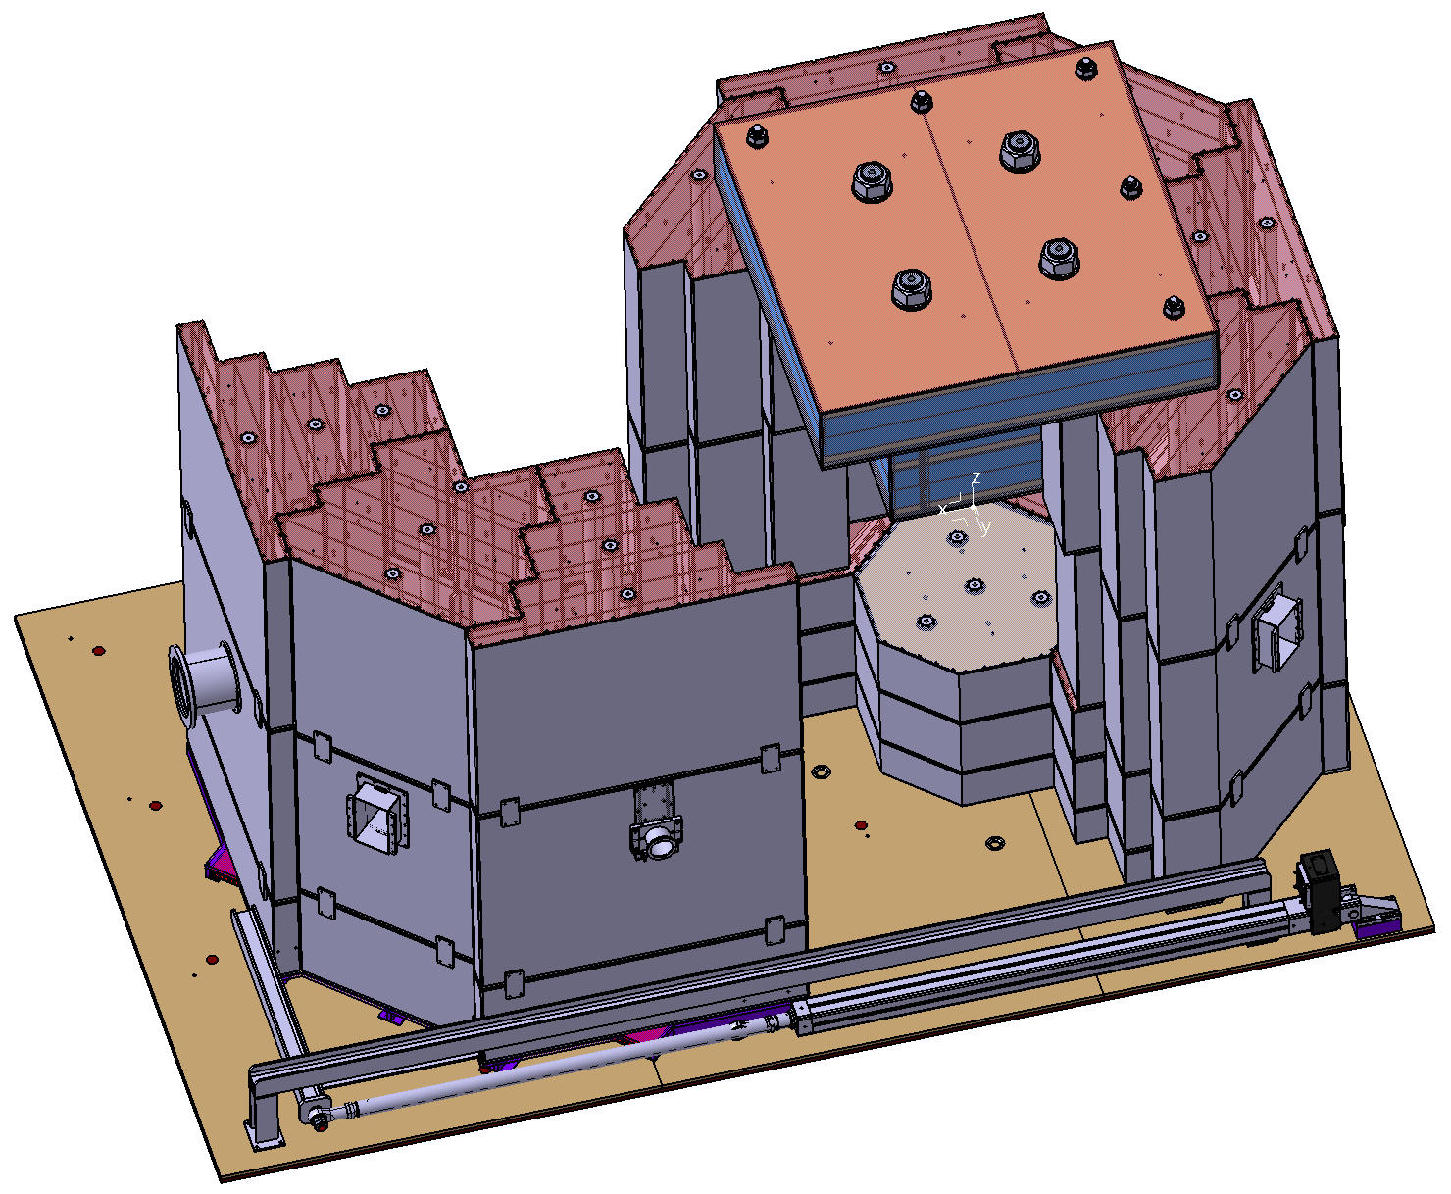

HBS, a High-Current Accelerator-driven Neutron Source (HiCANS)
Project rationale
Every beam port serves only 1 Instrument
Optimize neutron source spectrum
Several target stations
Optimize pulse structure (length, rep. rate)
Optimize geometry
Integrate neutron optics with beam port
Optimize thermal spectrum
Small shielding
Neutron guide around cold source
Chopper at <2 m from target
High current linear accelerator
100 mA, 70 MeV pulsed proton beam
Variable frequency
https://go.fzj.de/hbs-tdr

Slide 7
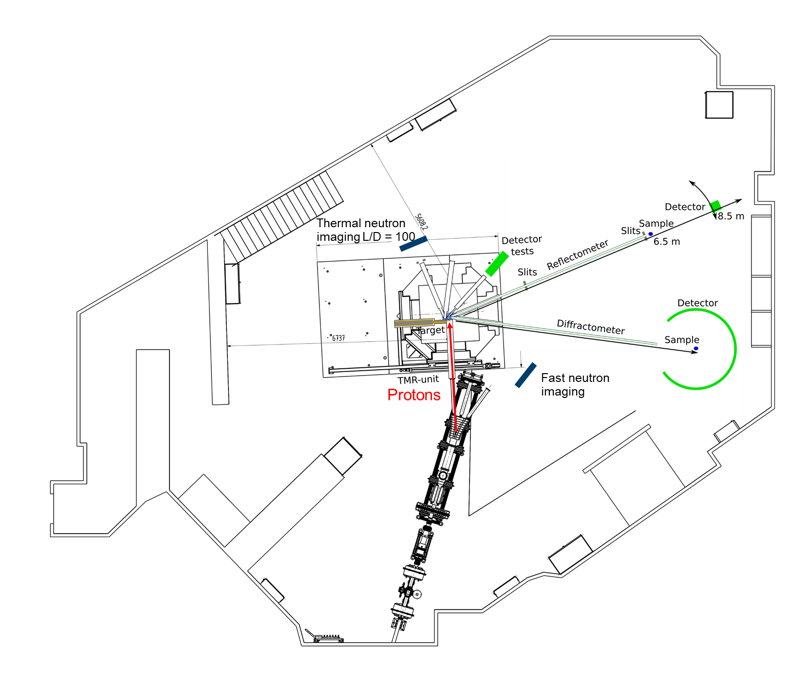
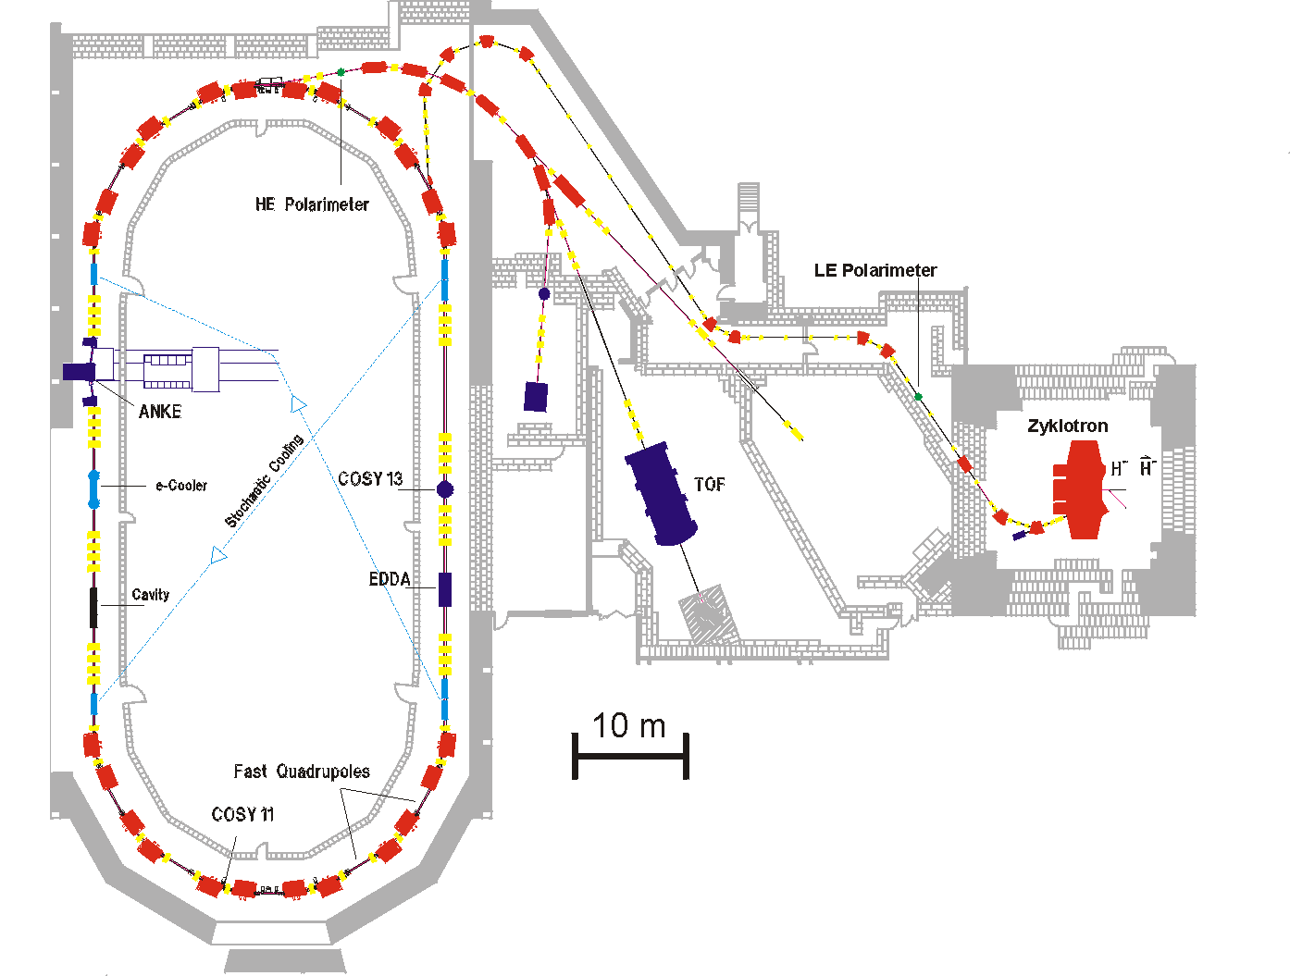
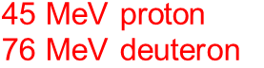

JULIC Neutron Platform
COSY Facility
Free pulse structure
Large experimental space
Flight paths of up to 7 m
2.7 GeV proton
2.1 GeV deuteron
~ 1 nA
Big Karl
~ 10 nA
45 MeV proton
76 MeV deuteron
~ 10 nA

Slide 8



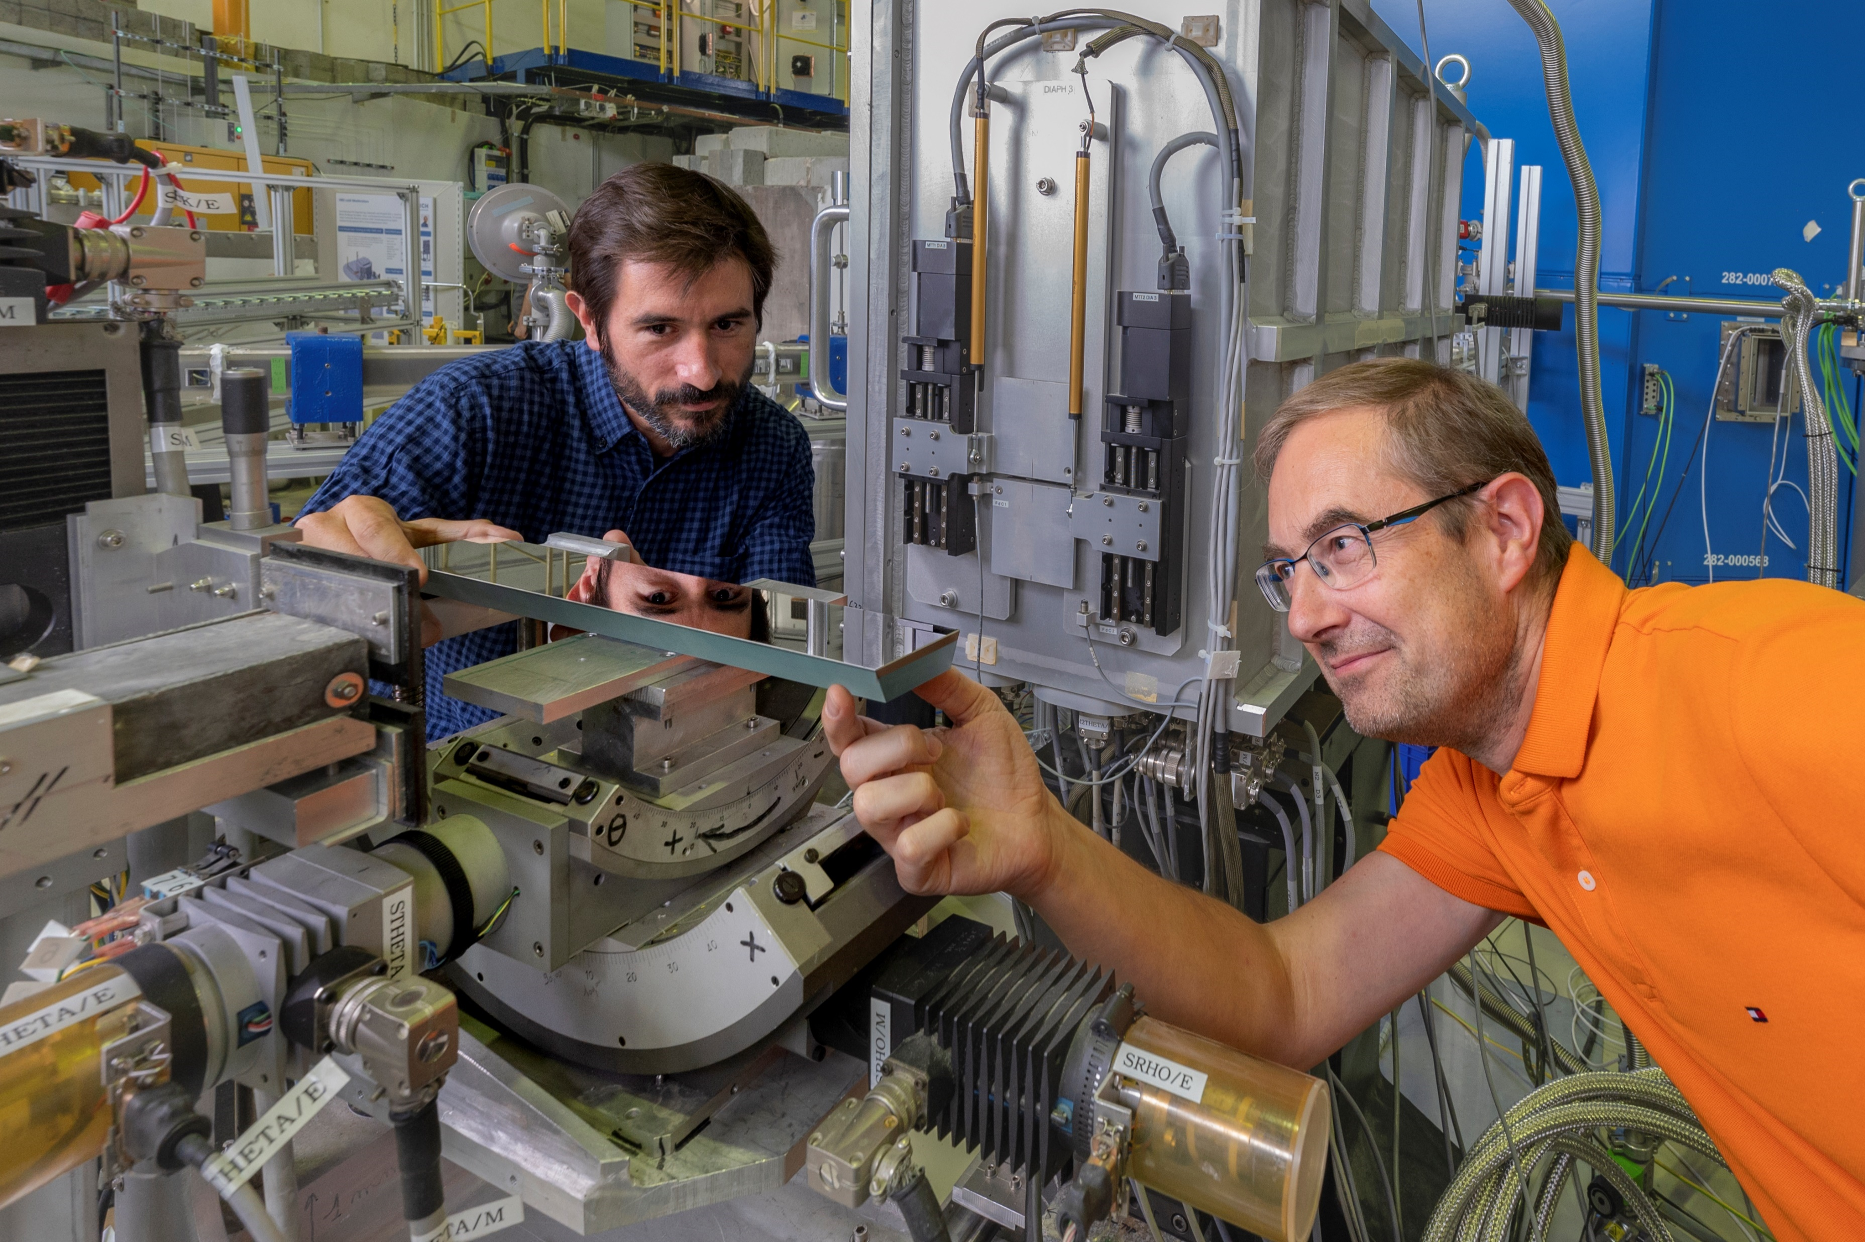
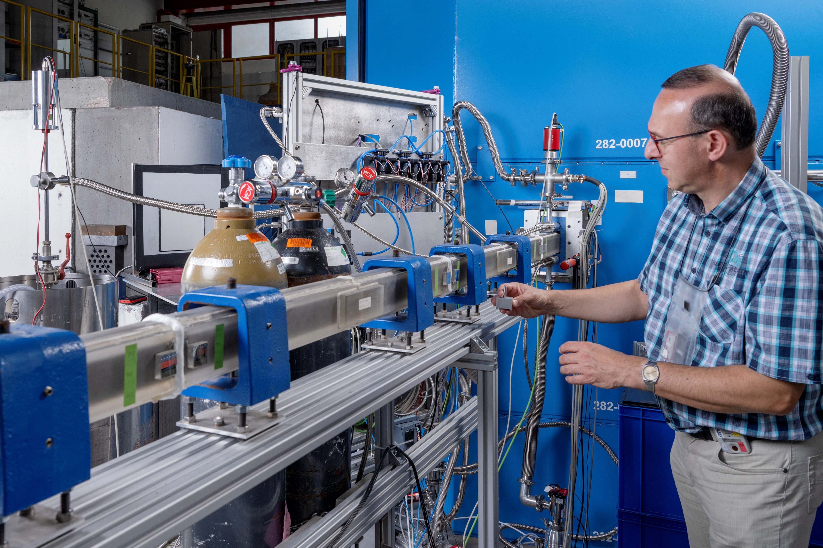
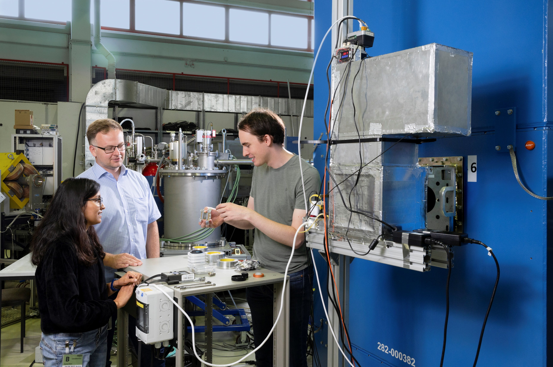
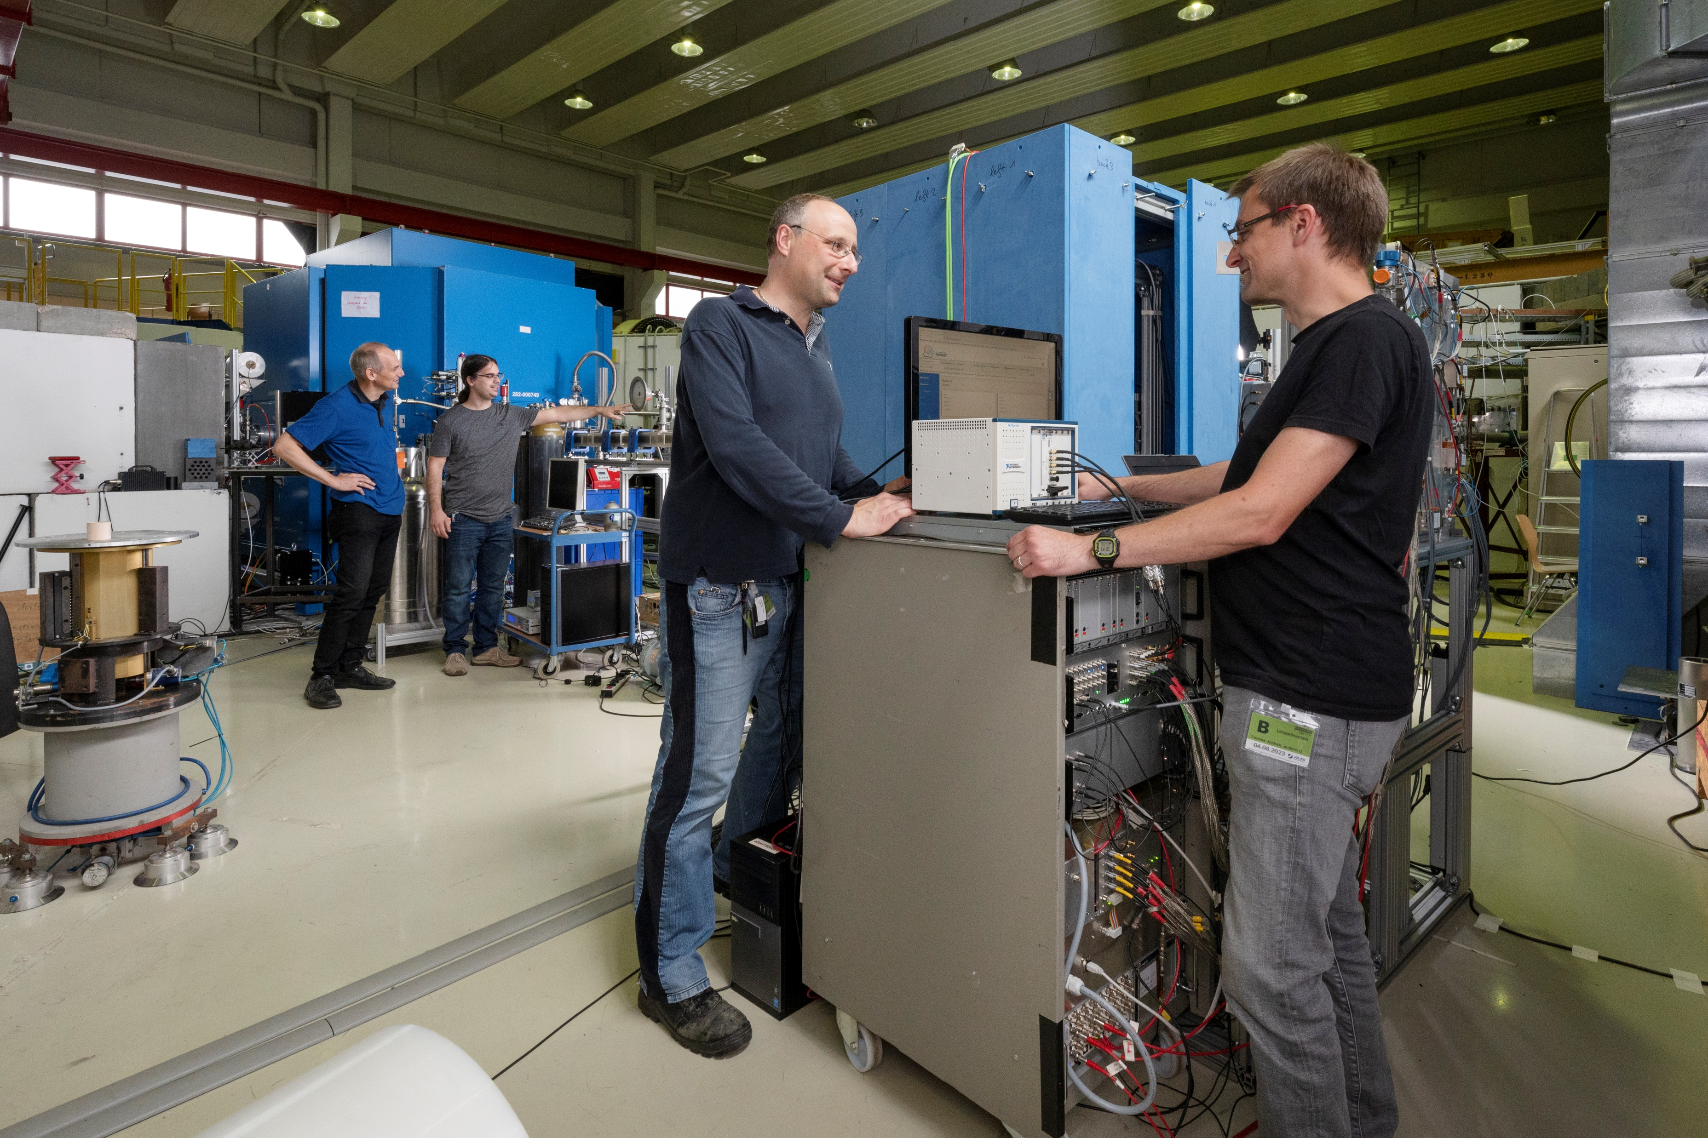
HBS Target-Moderator-Reflector Unit
Experimental Platform at Big Karl @ COSY
Reflectometry
Moderator tests
HEREON
CEA
ZEA
TUM
JCNS
Imaging
IKP
Detector tests
Notes:
Wedge shaped target within moderator
Cold “finger moderator”
Direct coupled neutron optics

Slide 9
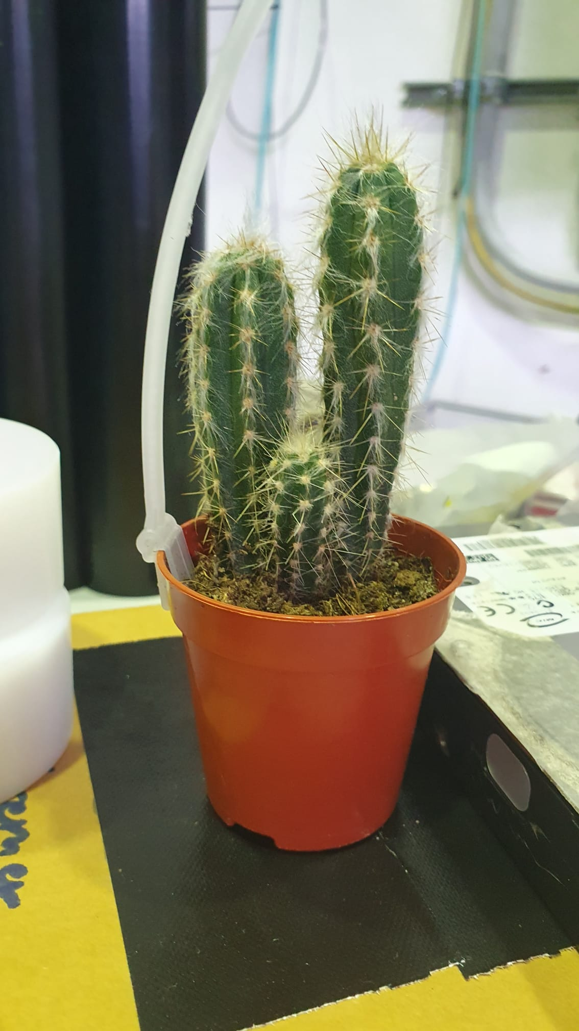
HBS Imaging Test Highlights (MLZ imaging group)
Imaging measurements with ~30 neutrons/cm2/s
Epithermal Neutron Radiograph
- Time-of-Flight (ToF) imaging proof of concept at 1m to source successful.
- High signal to noise despite proximity to target.
- Using an event counting detector, images with good counting statistics at ~250um resolution in tenth of minutes already possible.
- Due to short distance to source, energy resolution is low but sufficient for e.g. hydrogen quantification or general qualitative isotopic analysis via ToF.
115 mm
Radiograph of a Cactus
(not normalized atten.)
Thermal Neutron Radiograph
115 mm
115 mm
Contribution from:
Adrian Lasko (TUM)
Alexander Wolfertz (TUM)
Richi Kumar (HEREON)

Slide 10
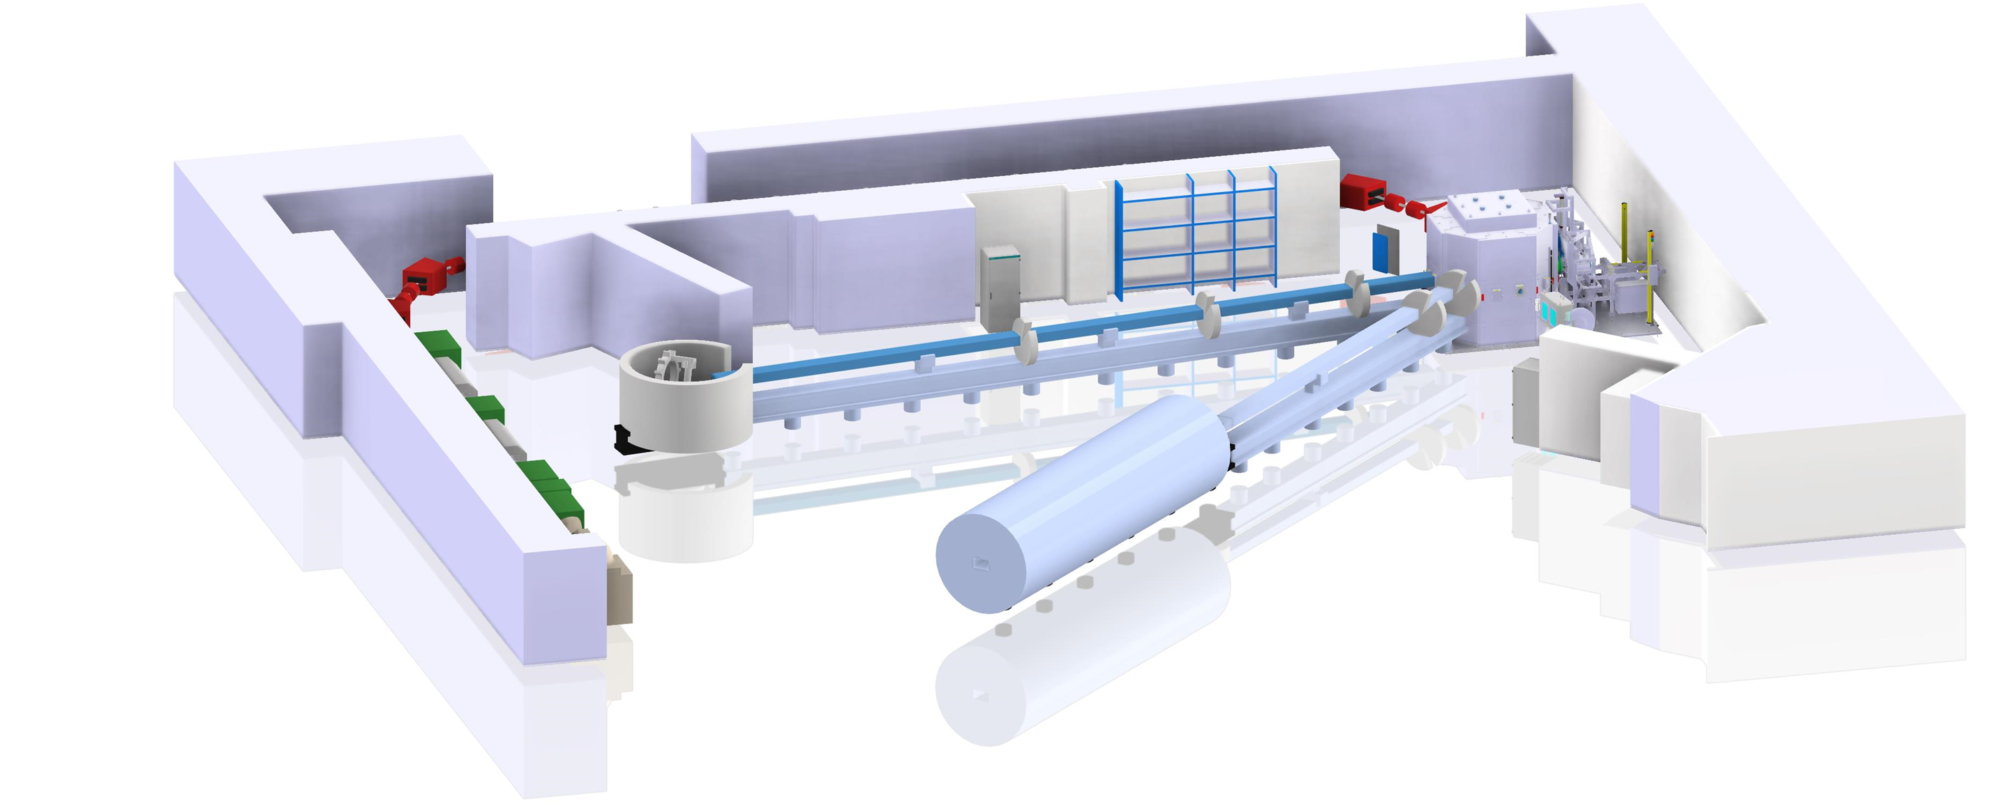
HBS – Phase I
First stage of HBS
Application for national prioritization of RIS
  106 M€ Investment
  6 M€ Anual operation cost
Facility parameters
  First stage of accelerator: 20 MeV
  1 target station
  20 kW average power
  Neutron yield of 10¹⁴ n/s
  5 Instruments: Reflectometer, diffractometer,
  SANS, imaging, PGNAA
Notes:
We published a TDR about the accelerator with our partners at IAP Frankfurt, who are accelerator experts. We worked on the target station and the moderators, the instrumentation with the contribution of many external experts and the TDR about infrastructure and sustainability. If anyone is interested, I would highly recommend the summery of all volumes.

Slide 11
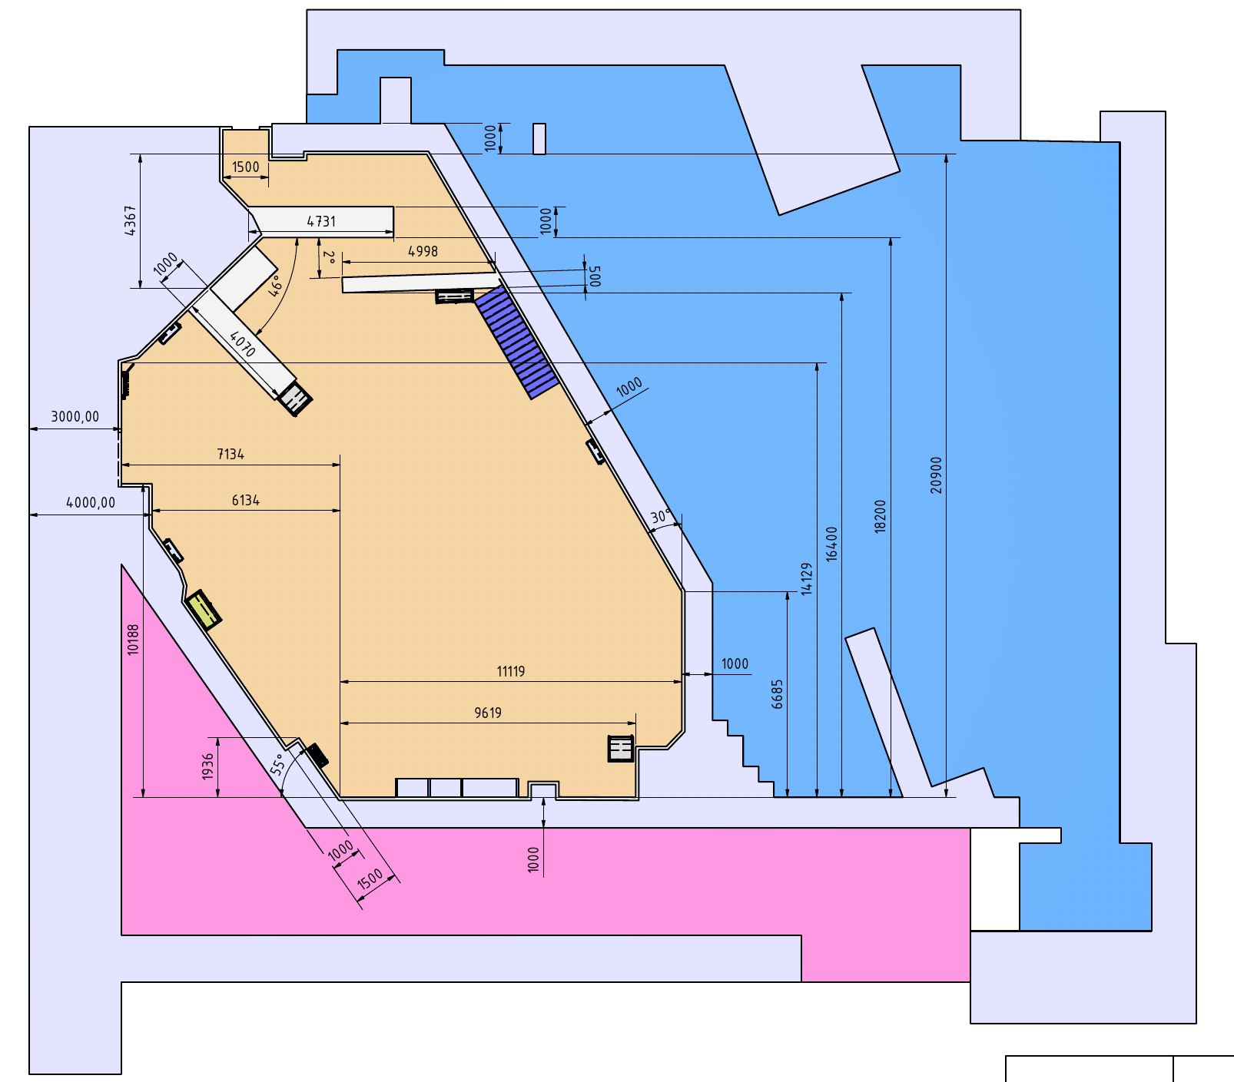
HBS – Phase I
COSY Facility shutdown 2024
Large available space ~ 25 x 30 m²
Controlled area with sufficient shielding
Can house HBS Phase I facility

Slide 12
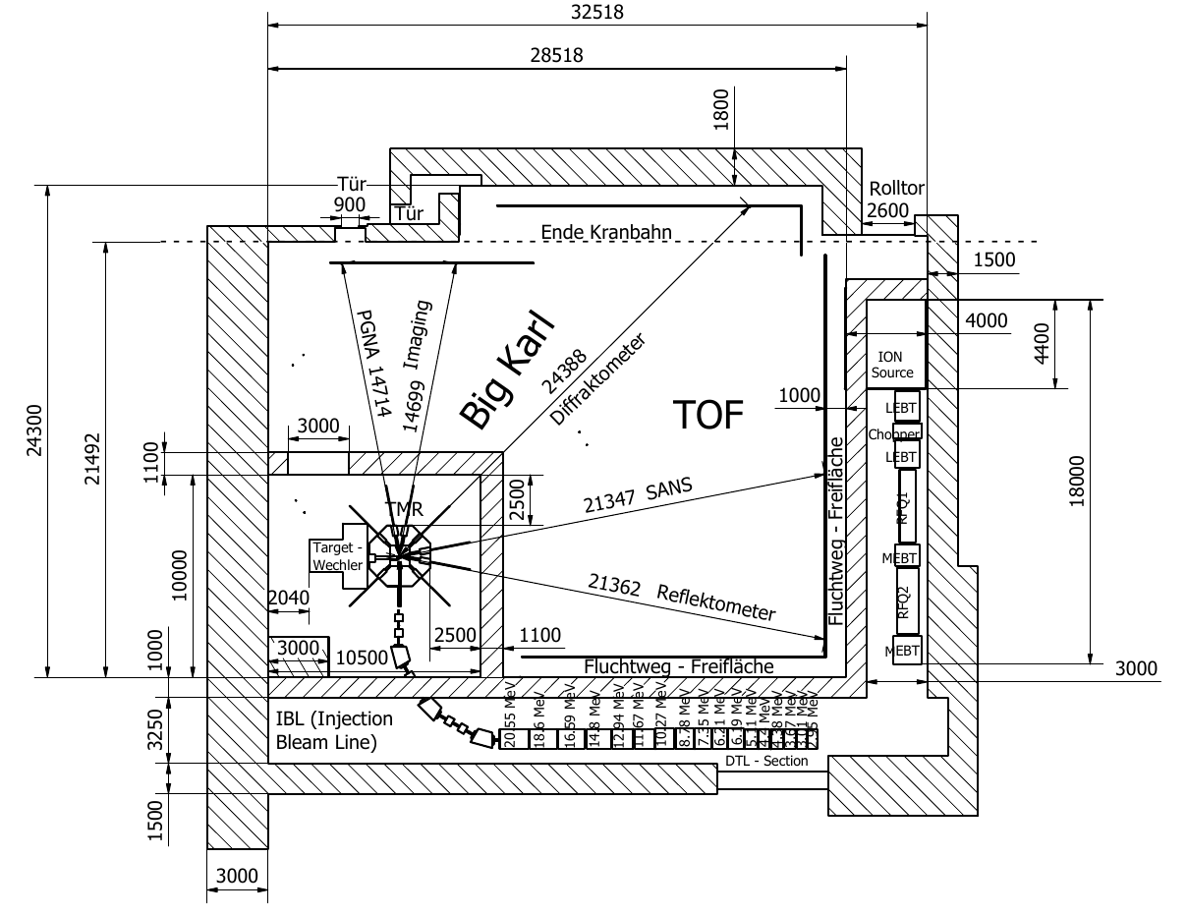
HBS – Phase I
Accelerator
Average power: 40 kW
Proton energy: 20 MeV
Duty cycle: 2% to 4%
Proton pulse current: up to 100 mA
Target station for 5 instruments
Neutron yield: ~ 5*10¹³ n/s
Frequencies: 24 - 96 Hz
Typ. neutron pulse length: 0.2 ms (96 Hz),
1.2 ms (24 Hz)
Thermal moderator: H₂O
Cold moderators: H₂, CH₄

Slide 13
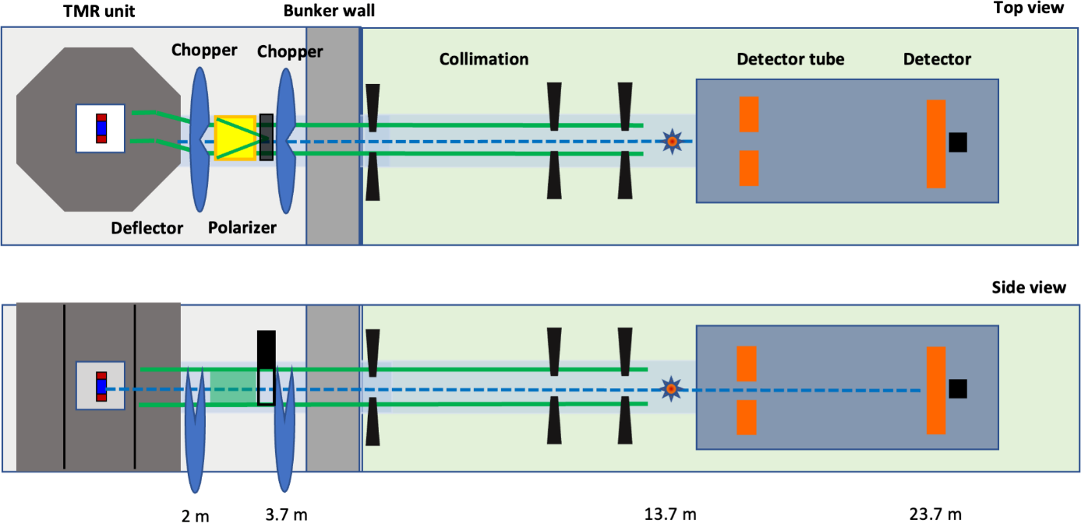
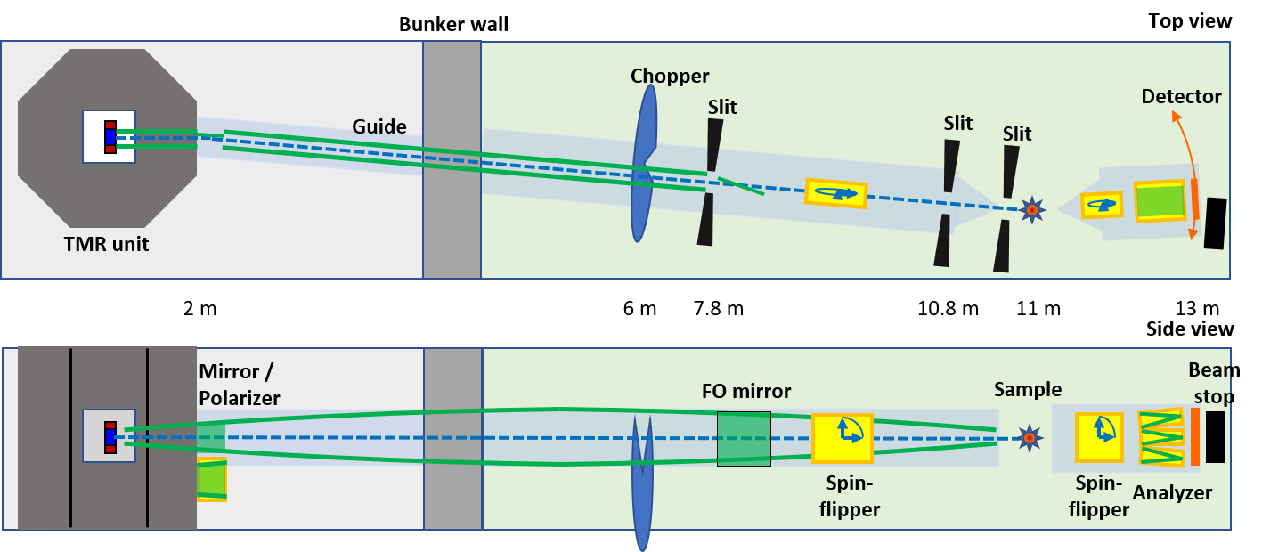
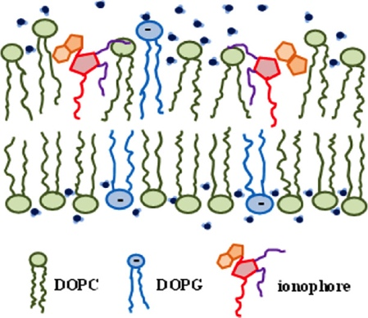
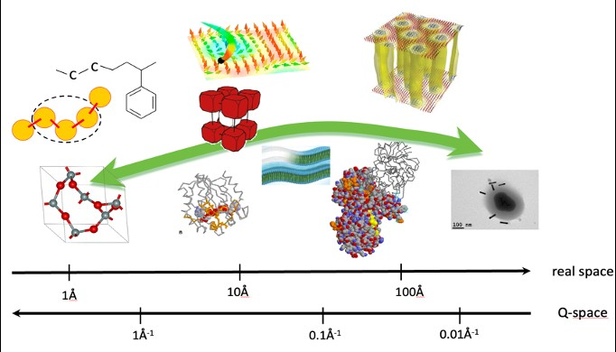
Poster for all instruments
HBS – Phase I
Instrumentation
Technical Data:
Moderator: H₂
d-spacing range: 0.005 Å⁻¹ < Q < 1 Å⁻¹
Wavelength band: 2.5 Å < λ < 20 Å
Flux at sample: 8.5·10⁵ n/(cm²s)
Length: < 18 m
Detector coverage: 1 m²
Technical Data:
Moderator: H₂ moderator
Wavelength band: 2 – 15 Å
Q range: 0.001 – 1 Å
Resolution: 10% – 15%
Flux at sample: 5·10⁵ n/(cm²s)
Length: 13 m

Slide 14
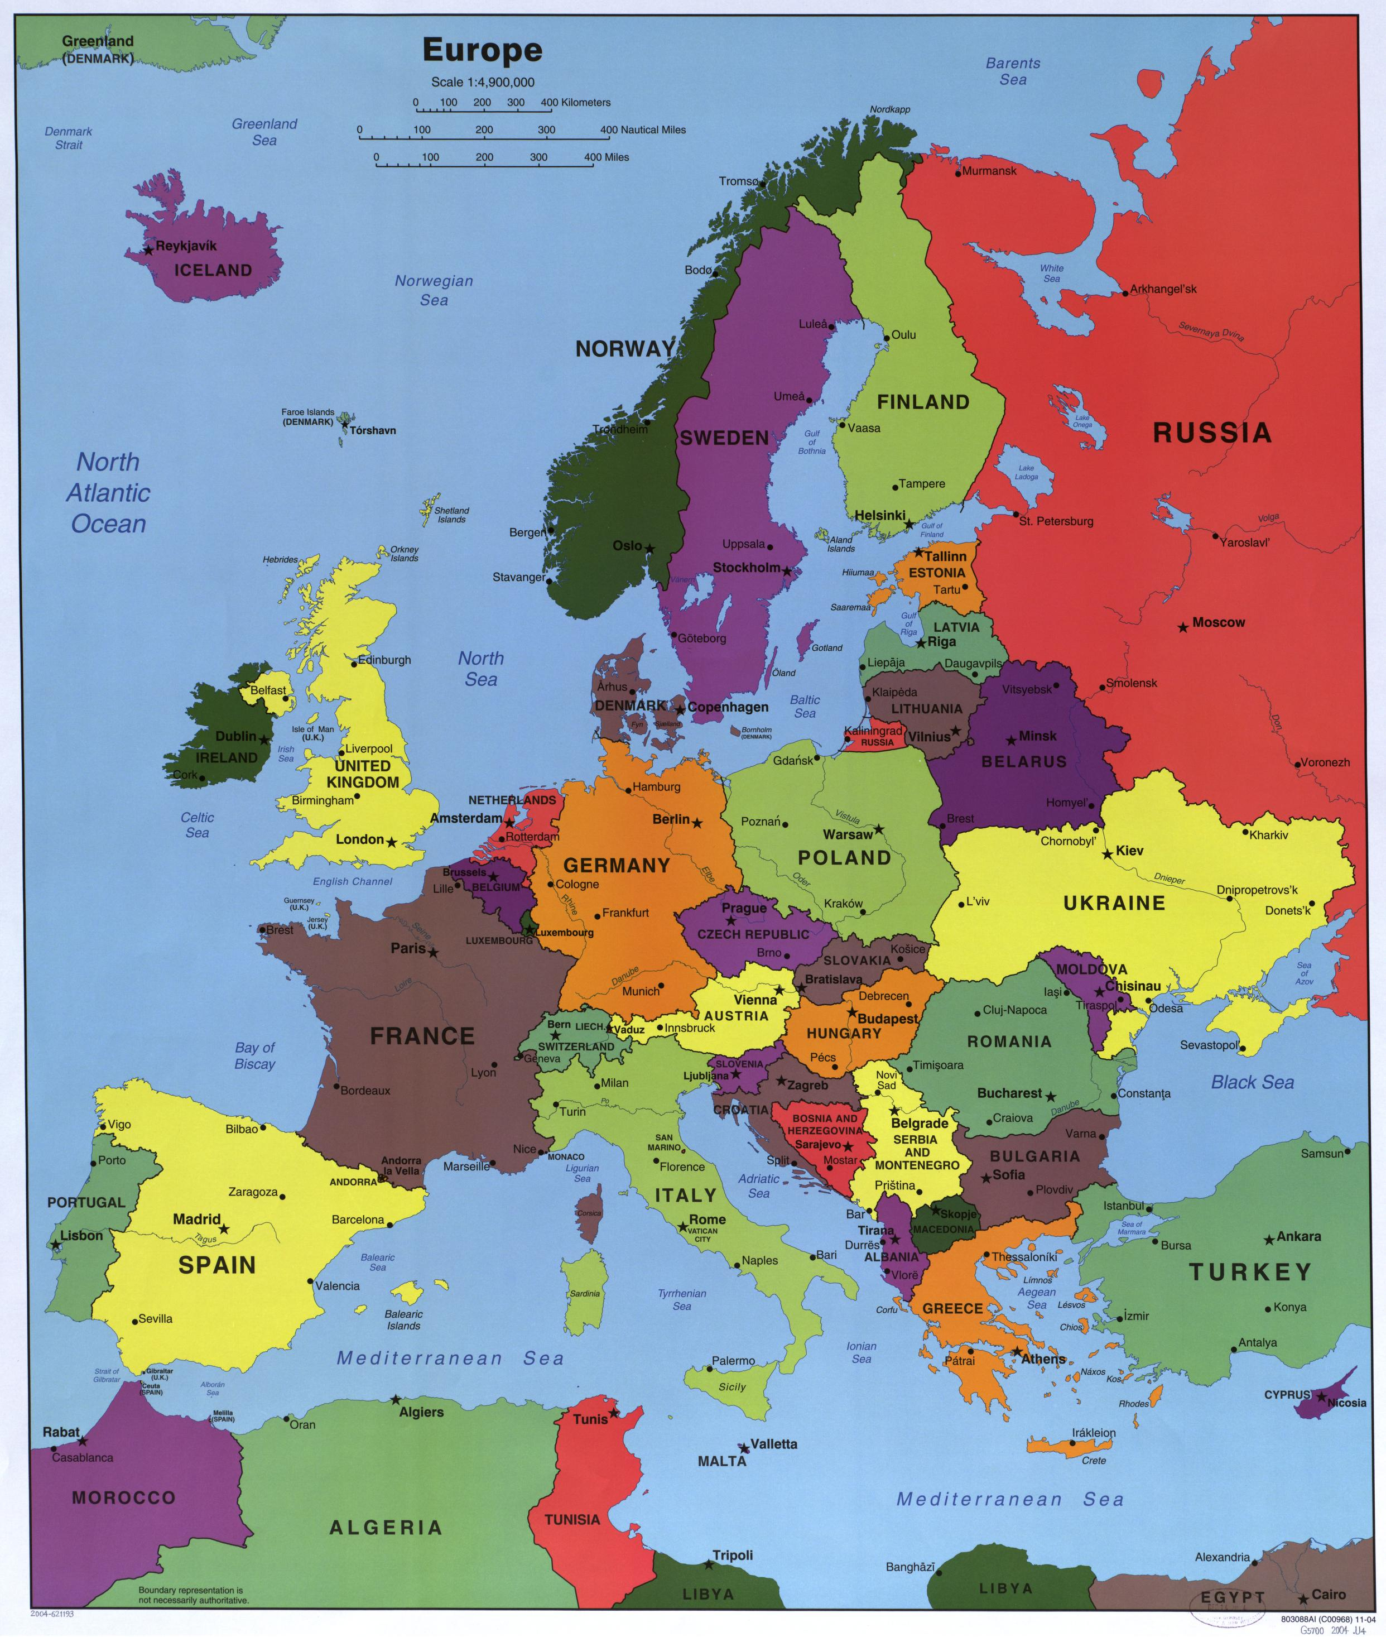
HiCANS Projects in Europe
HBS (JCNS)
Expertise: Target & Moderators, Instrumentation
Available components: Target Station, Ta Target
ICONE (LLB)
Expertise: Target, Instrumentation
Available components: Instruments (HERMES), Be Target
ARGITU (ESS Bilbao)
Expertise: Target, Accelerator
Available components: Ion source, 3 MeV RFQ, Building
HBS
ICONE
ARGITU
Joint forces between JCNS, LLB, ESS Bilbao
Complete facility

Slide 15
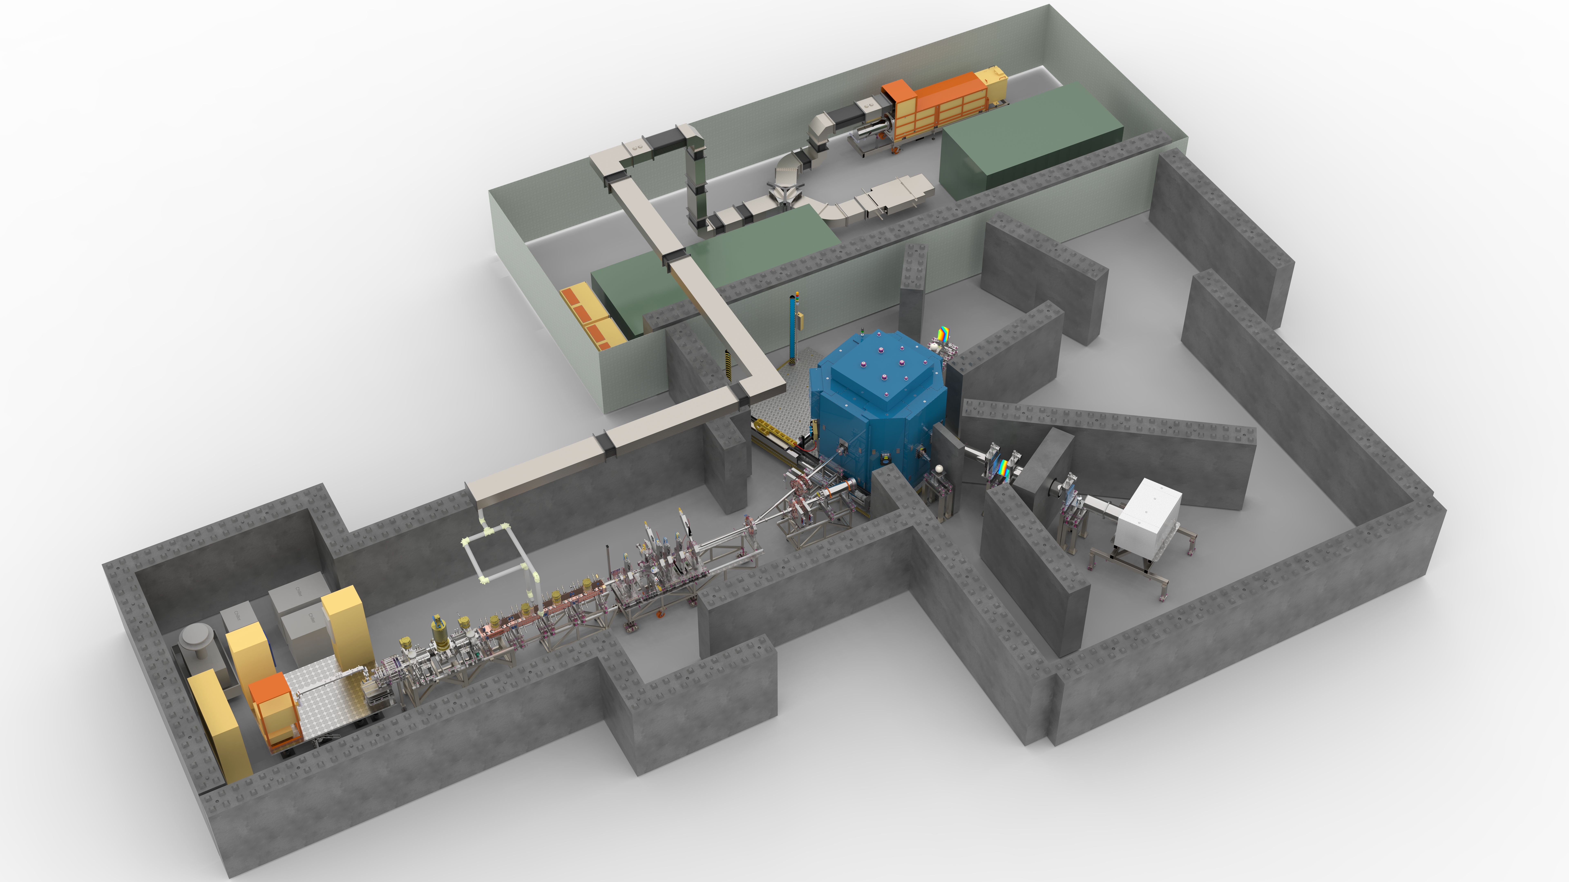
HiCANS Neutron Platform at ESS Bilbao

Slide 16
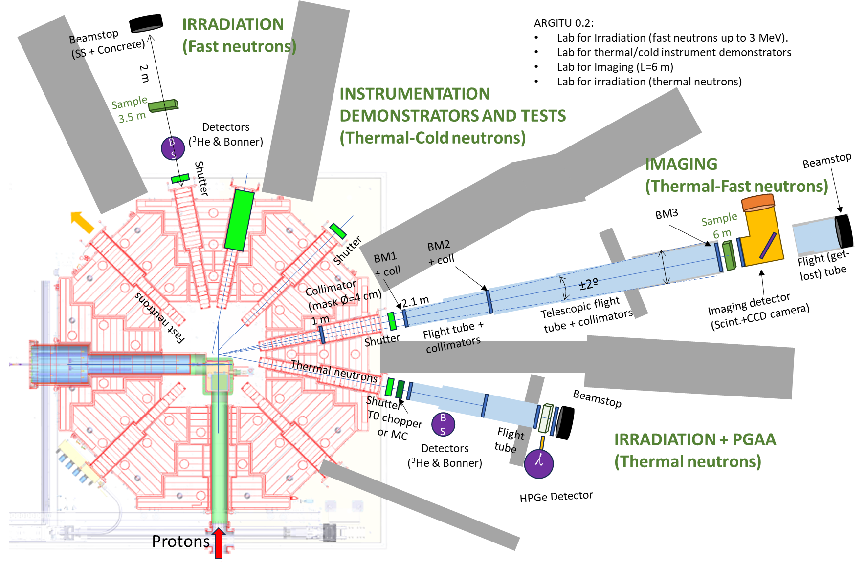
HiCANS Neutron Platform at ESS Bilbao

Slide 17
HiCANS Neutron Platform at ESS Bilbao
HBS-I
HBS-II
20
100
0,4 - 2
24 - 96
2 - 4
20 - 40
~3E+13
70
100
0,16 – 0,67
24, 96
1,6
100
~E+15

Slide 18



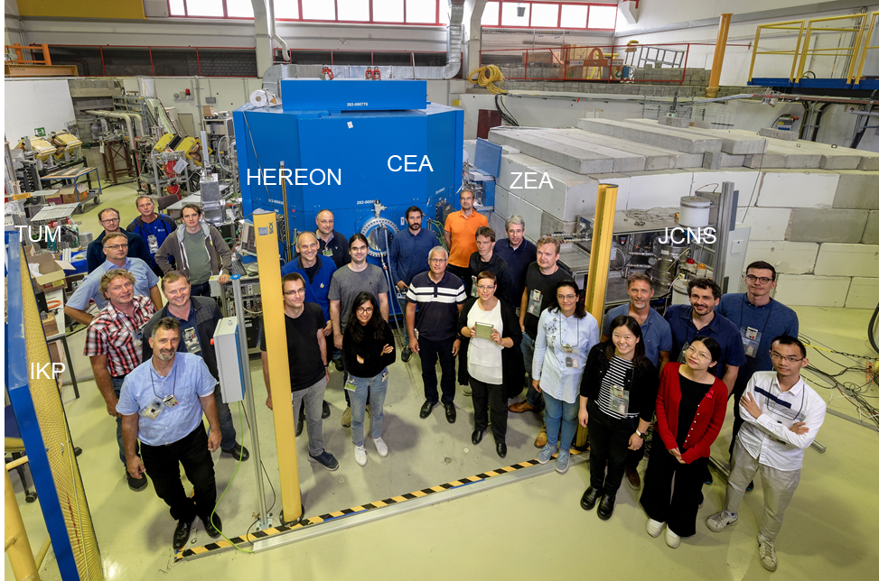
TDR Finished
HBS
National Roadmap Application
HiCANS Neutron Platform Setup at ESS Bilbao
Funding for HBS-I
HBS-II Upgrade
2023
2024
2025
2026
202X
202X+5
203X
JULIC Neutron
Platform
Decision on National Roadmap
HBS-I Construction

Slide 19


HBS Vision
A healthy landscape
of large and small
neutron sources
complementing
each other
The Landscape 2000
Thank you for your attention.

