Slide 1


The French ICONE Instruments Suite
Alain MENELLE in replacement of Xavier Fabrèges
Alexis Chennevière, Arnaud Desmedt Nicolas Pichoff (ICONE project leader)
Laboratoire Léon Brillouin Iramis
CEA Saclay, France CEA Saclay, France

Slide 2
What is the ICONE French project ?
A project to provide France with a national neutron scattering user facility for the next 50 years
Able to do similar experiments than what was done on the Orphée reactor (shutdown end of 2019)
Able to do any type of neutron scattering experiment
Able to provide an experimental capacity of about 300 experiments per year open to users
Able to train and prepare the French community for the use of ESS with the best possible efficiency
Reach these goals within a limited budget
Do it without the construction of a new nuclear reactor
Do it with available technologies in France
ICONE
Innovative COmpact NEutron facility

Slide 3

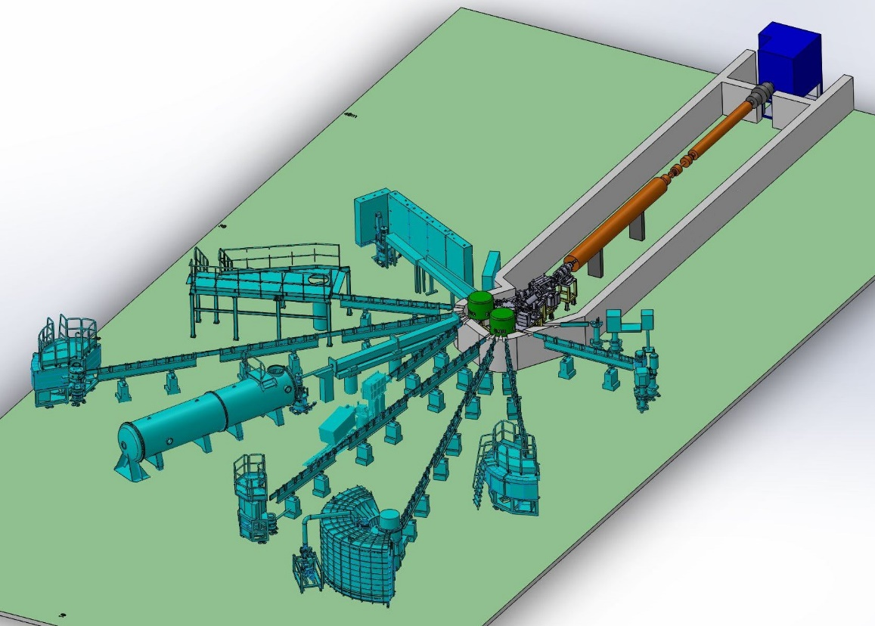
The ICONE HiCANS project
https://icone-neutron.fr
Technical solution proposed
Not a reactor : build an accelerator based neutron source
Limited budget : use a low energy accelerator (25 MeV for low cost, low activation)
Orphée performances : Be target and high peak current (80 mA), compact design
Capacity of 300 experiments/year : 2 targets, 5/6 instruments per target, 200 beam days / year
Thermal (water) and cold liquid H₂ moderators

Slide 4
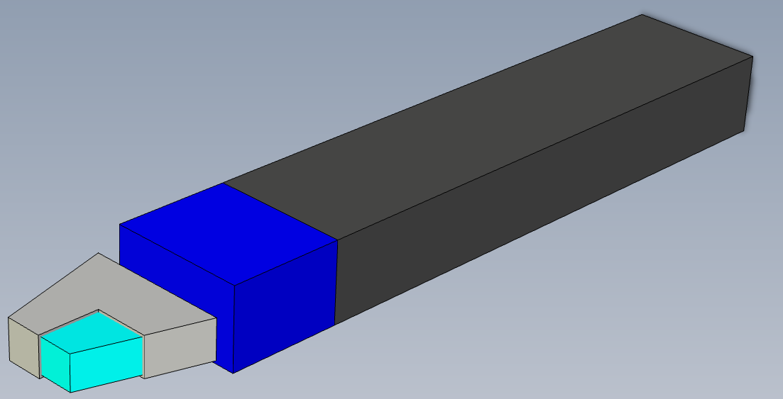
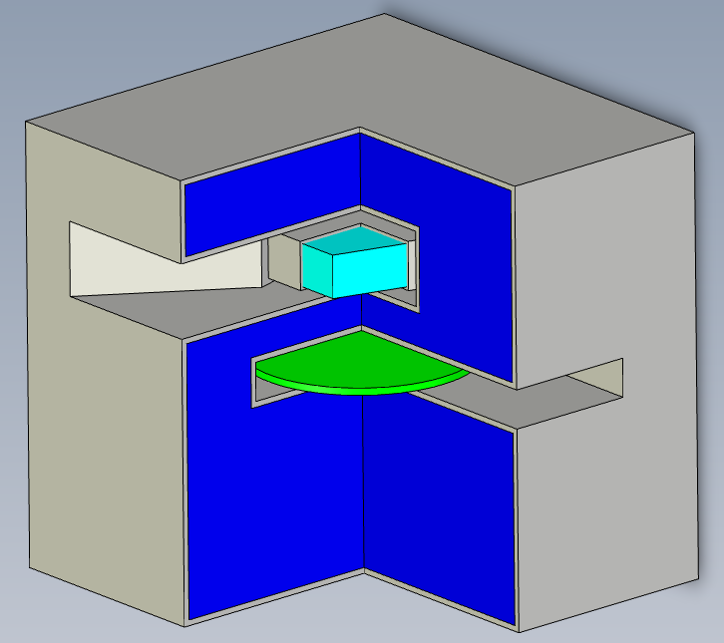
TMR assembly geometry
Cold cell insert
neutrons
Insertion / extraction from the « back »
è No interference with the guide / chopper system
Illumination
over 45°
protons

Slide 5
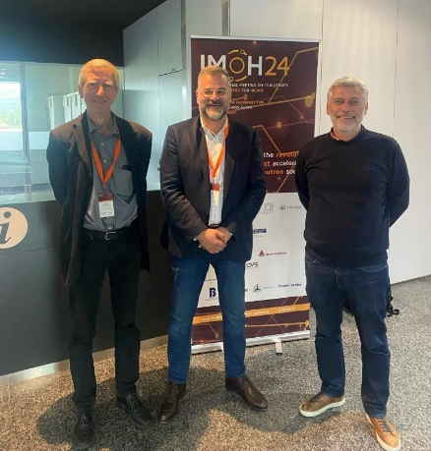
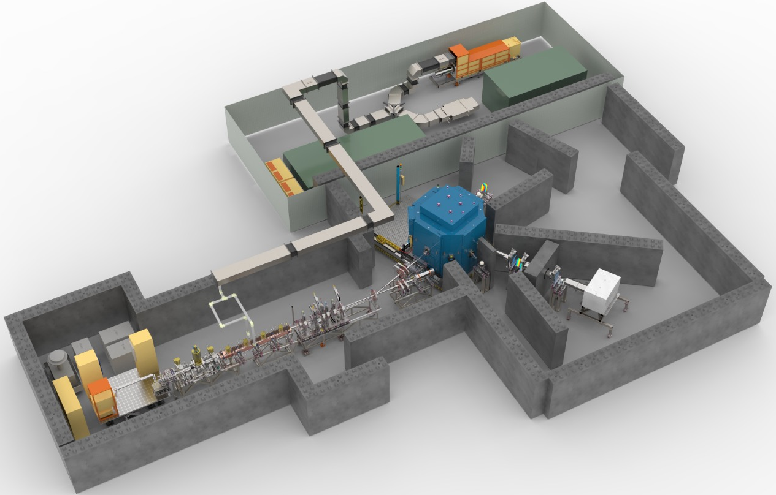
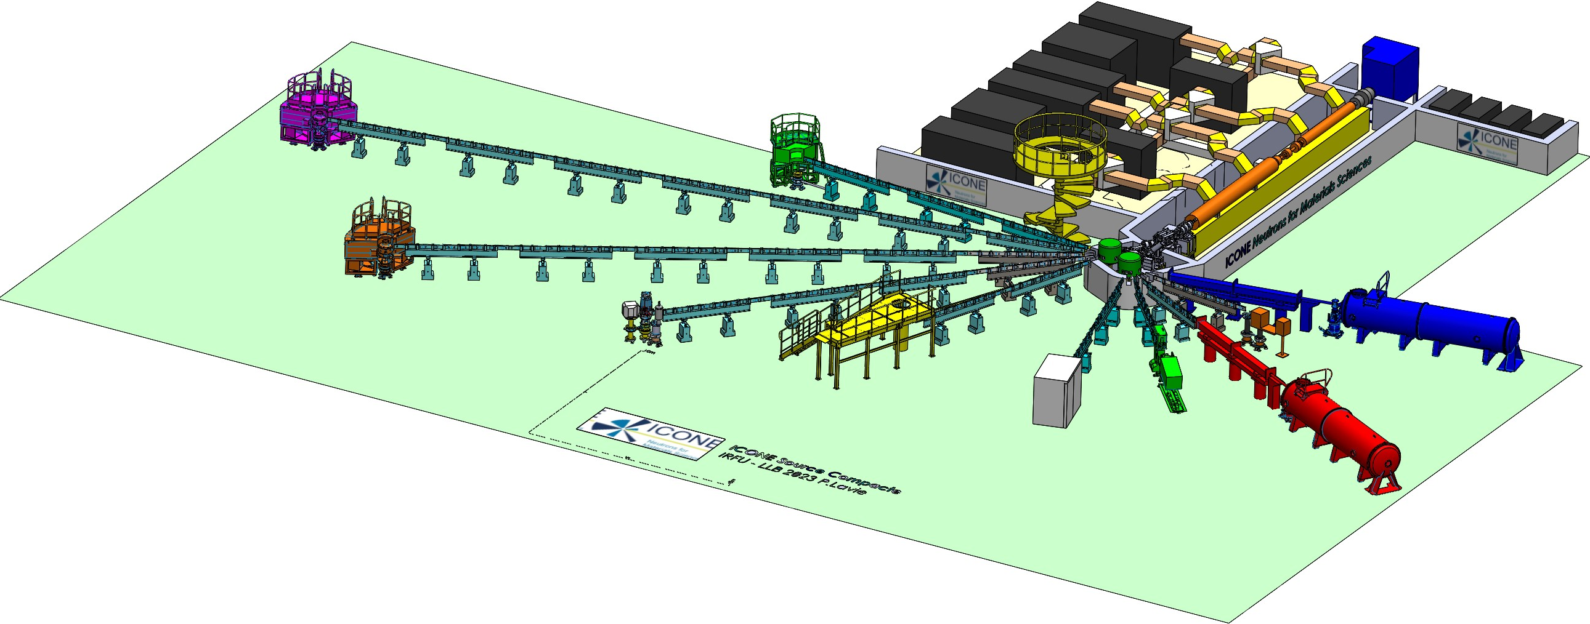
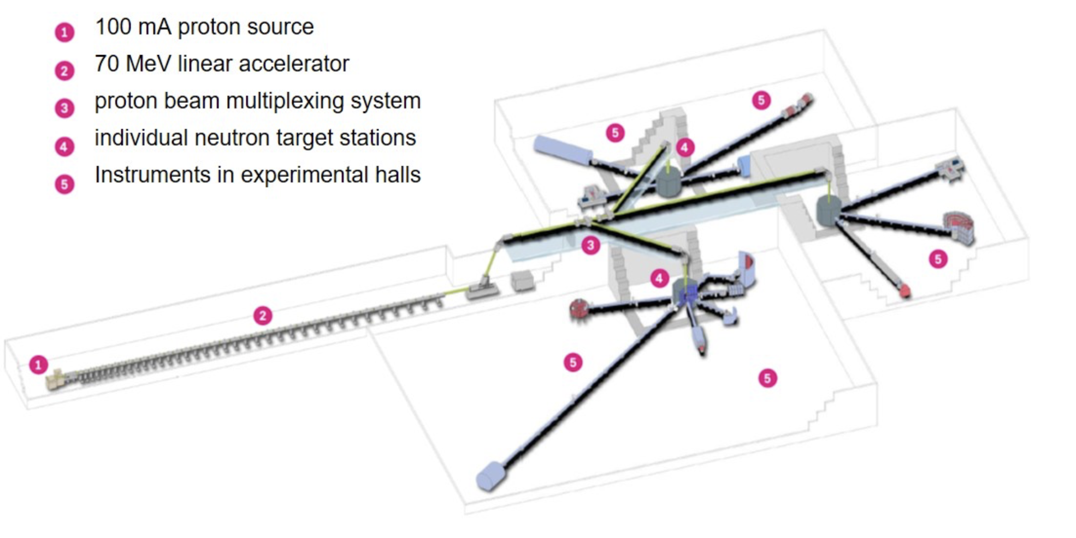
Within a European momentum
LLB, JCNS, ESS-B agreement on HiCANS development
ARGITU@Bilbao
Proton: 32mA, 31.5MeV
Single proton pulse
1 target
3 instruments
Brilliance@2.2Å: ~5.10¹¹ n/cm^{2/}s/Å/sr
~15M€
ICONE@Saclay
Proton: 80mA, 25MeV
Multiplexed proton beam
2 targets
10-12 instruments
Brilliance@2.2Å: ~10¹² n/cm²/s/Å/sr
~150M€
High Brillant Source HBS@Julich
Proton: 100mA, 70MeV
3 targets
23 instruments
Brilliance@2.2Å: ~10¹³ n/cm^{2/}s/Å/sr
~500M€

Slide 6
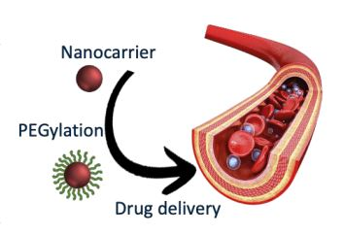
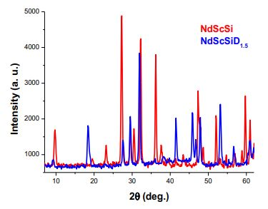
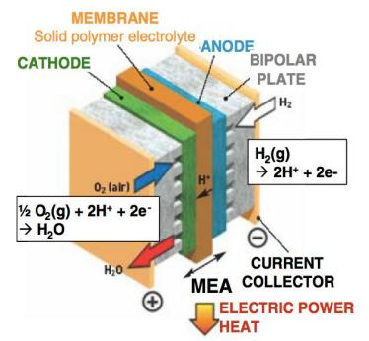
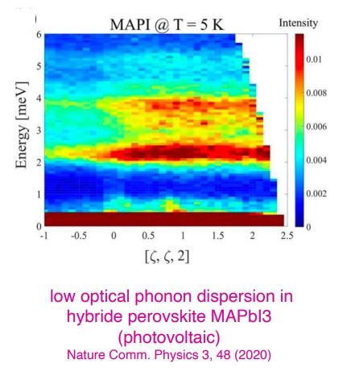
Scientific case supporting the project
Be able to address societal challenges
Health
  Medicine vectorization studied by SANS
  New drugs characterization by diffraction
Energy
  Fuel cells operations improvement by life imaging
  Better diffusion in batteries with quasi-elastic scattering
  Hydrogen storage with neutron diffraction
  High Tc superconductors with inelastic scattering
  Improved metallurgy with strain scanner and texture determination
Information technology
  Development and understanding of new quantum materials
Climate
  Studies of clathrates stability by diffraction and inelastic scattering

Slide 7
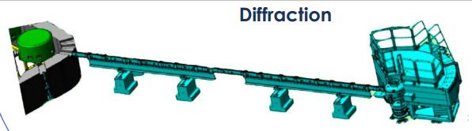
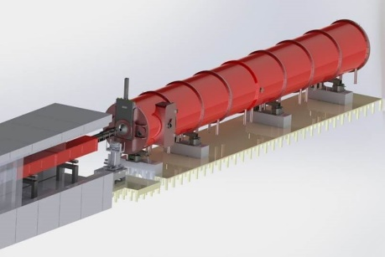
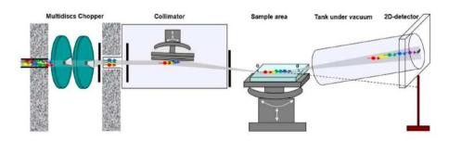
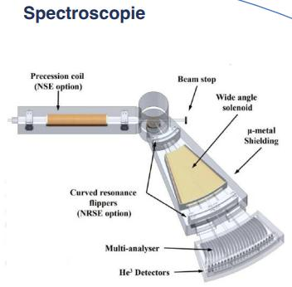
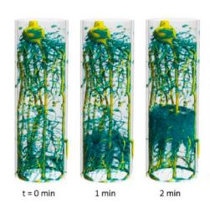

The Icone instrument suite
Provide users with all necessary neutrons scattering techniques
Diffraction (high resolution / high flux, powder and single crystal)
SANS (multipurpose) and VSANS
Reflectivity
Technological diffractometer (Texture, strain scanner)
Inelastic spectrometer (direct or indirect geometry)
Quasi-elastic spectrometers
Imaging : complementary to SANS
PGAA : elemental analysis technique
Test beam line for technical developments

Slide 8
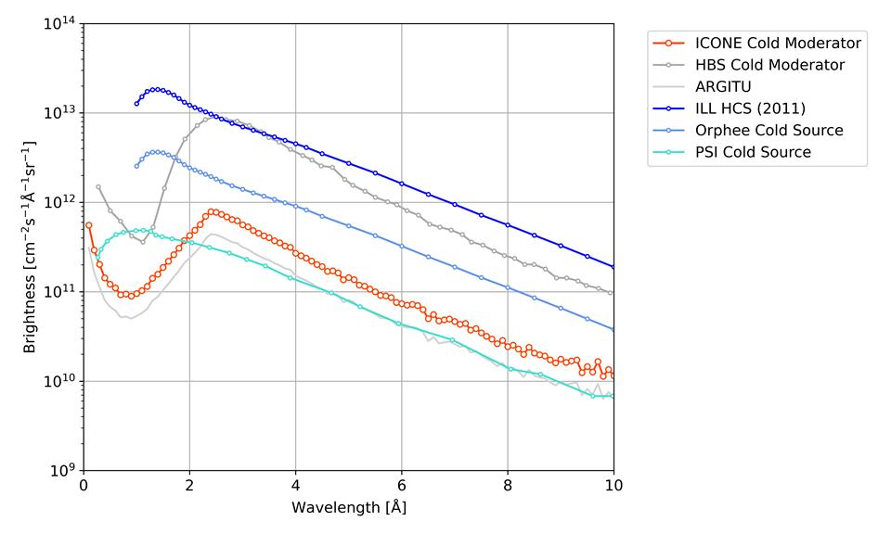
Flux available
A comparison to known and future neutron sources
(peak flux for pulsed sources)
Roughly speaking
ICONE will be between Orphée and PSI
(*) Recent improvement in moderator design to provide a bispectral distribution of flux at ICONE

Slide 9
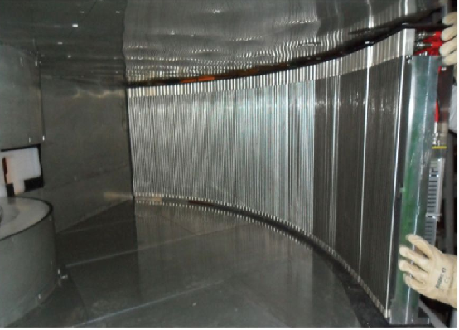
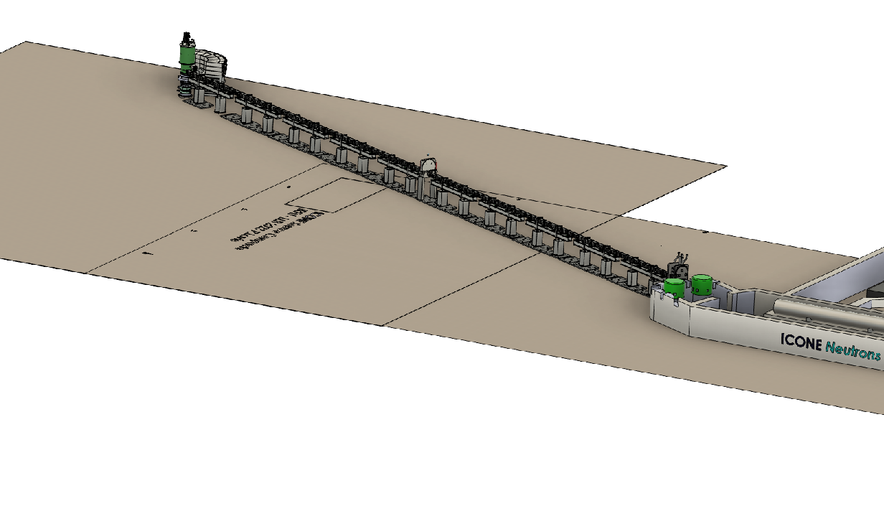
PRESTO our first powder diffractometer
Low cost powder diffractometer with re-use of 7C2 detector
Large ³He position sensitive multitube detector (256 tubes, diam. 1.25 cm, length 50 cm, 30 bars)
Position resolution improved by adding more Mesytec electronics in order to provide some SANS capabilities
1st chopper as close as possible to the target to be able to adapt resolution
7C2 Detector

Slide 10
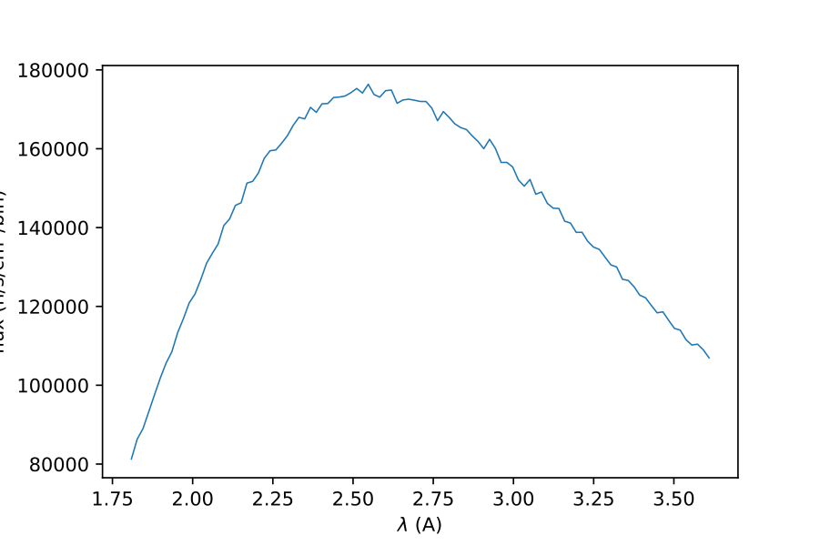
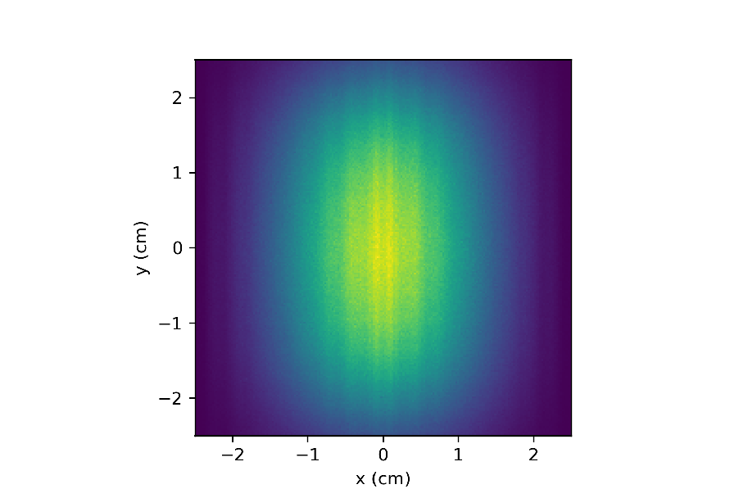
PRESTO detailed parameters
Instrument | PRESTO
𝜆min | 0.6 Å
𝜆max | 6 Å
Δ𝜆 | 2 Å
𝛿𝜆/𝜆 min | 1 %
𝛿𝜆/𝜆 max | 10 %
Sample size | 10x20 mm (WxH)
Moderator : 20x50 mm (WxH)
Cold spectrum centered at 60 K (~2.6 A)
Detector
  133°x26° angular coverage
  256 tubes, 128 pixels
400 µs @ 40 Hz (HR)
Flux: 1.4x10⁷ n/s/cm² at sample
Incident divergency : +- 0.5°
- Sample volume : 2 cm³
distance | 30 m
frequence | 50 Hz
Pulse width | 400 μs
duty cycle | 2 %
Δ𝜆 | 3.3 Å
𝛿𝜆/𝜆 min | 0.9 %
𝛿𝜆/𝜆 max | 8.8 %

Slide 11
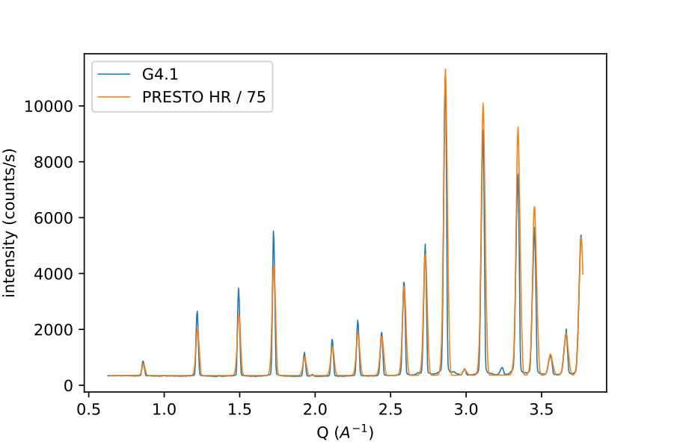
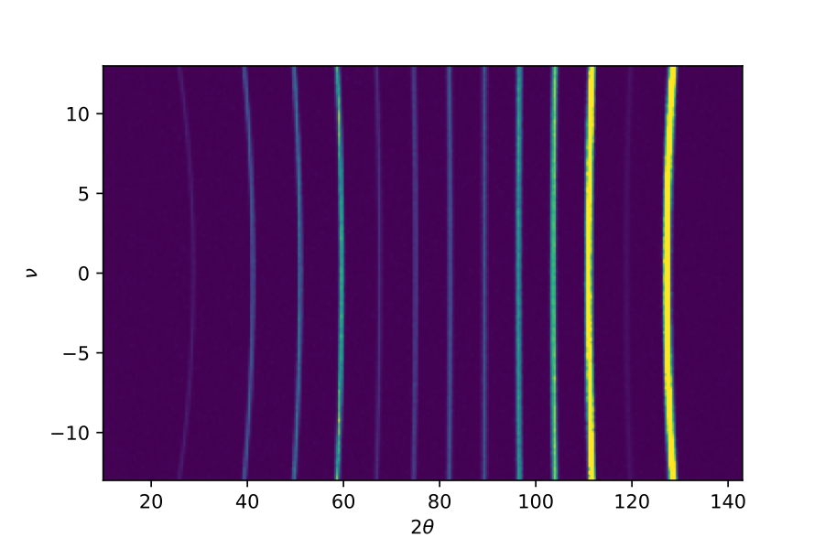
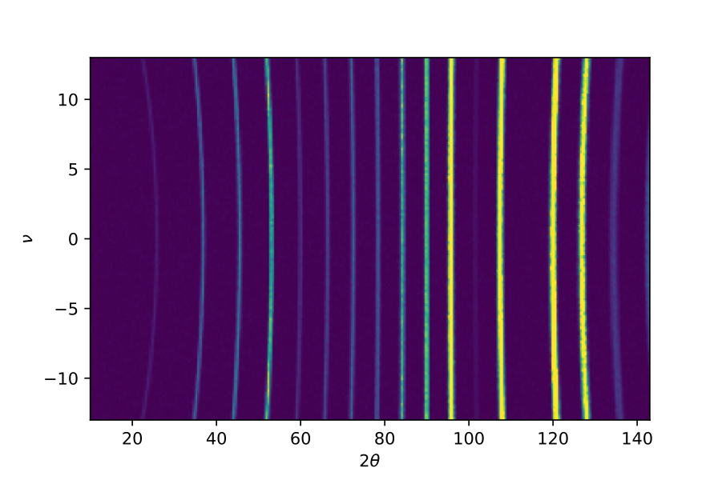
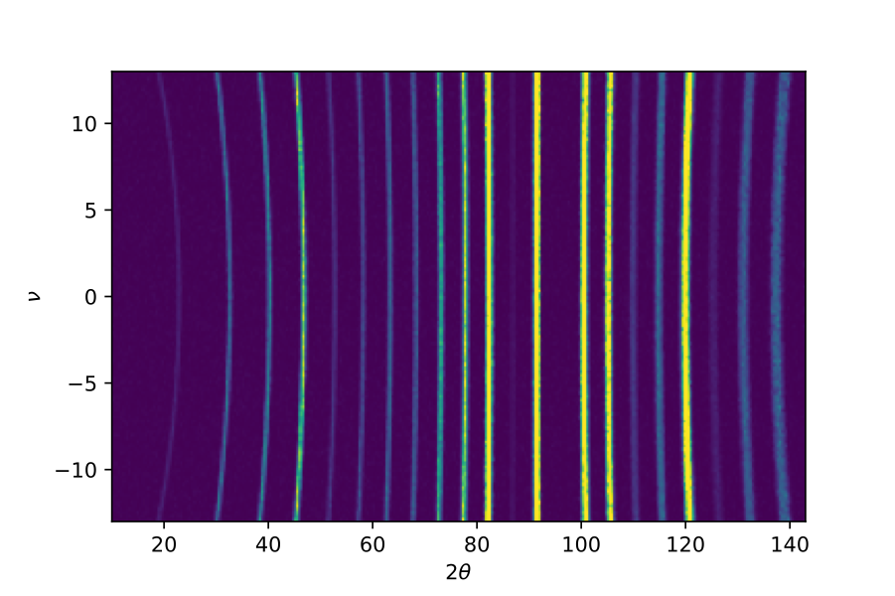
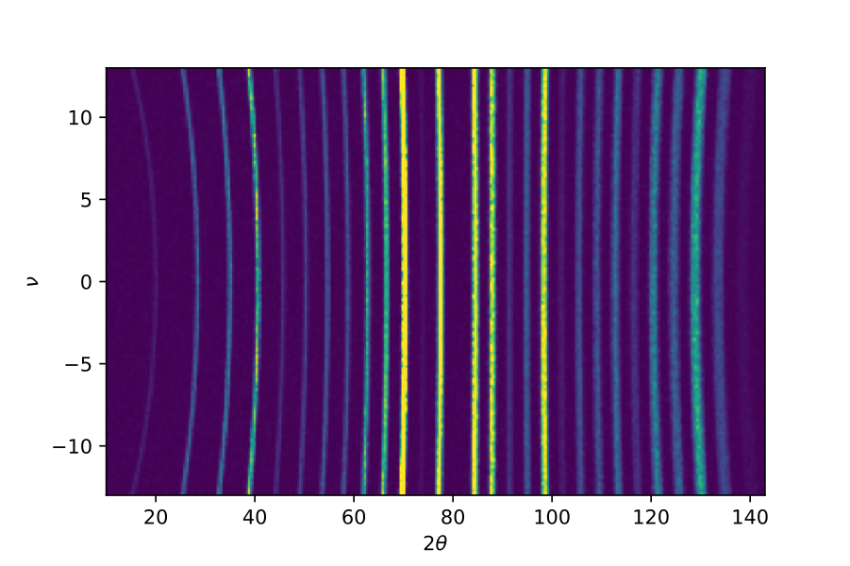
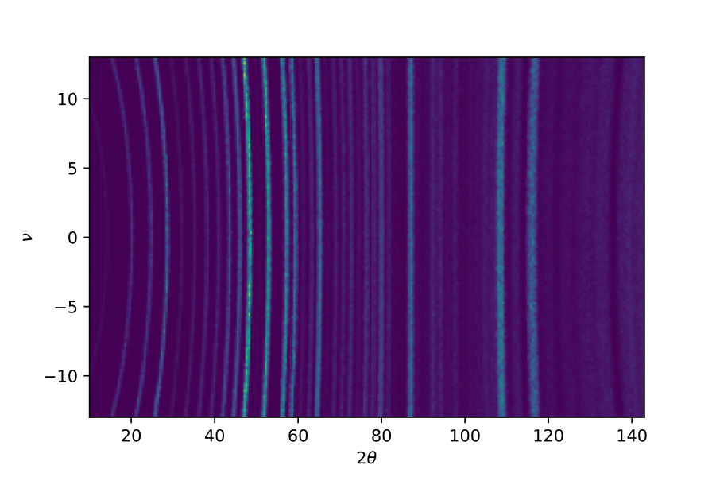
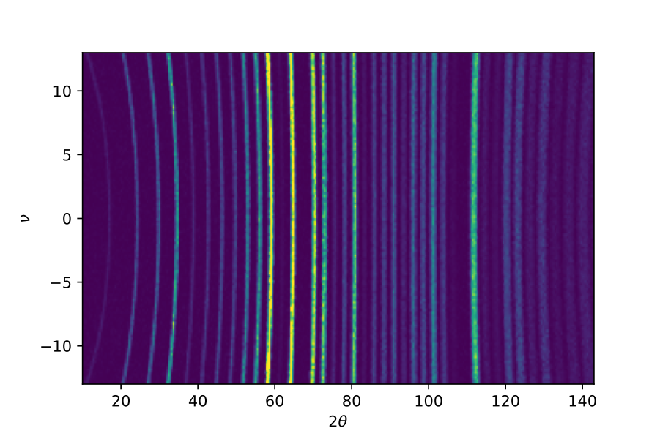
PRESTO calculated performances
Same resolution and 70 times faster than G41 on Orphée
G4.1
PRESTO
λ (Å)
1.8 2.17 2.54 2.91 3.27 3.63
Na₂Ca₃Al₂F₁₄ spectra, measured on G41 and calculated on PRESTO. Both spectra show similar resolution. PRESTO spectrum has been divided by 70 for proper resolution comparison.

Slide 12
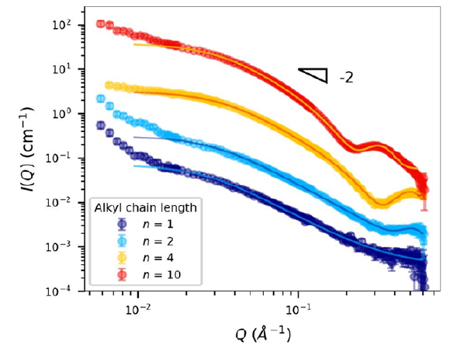
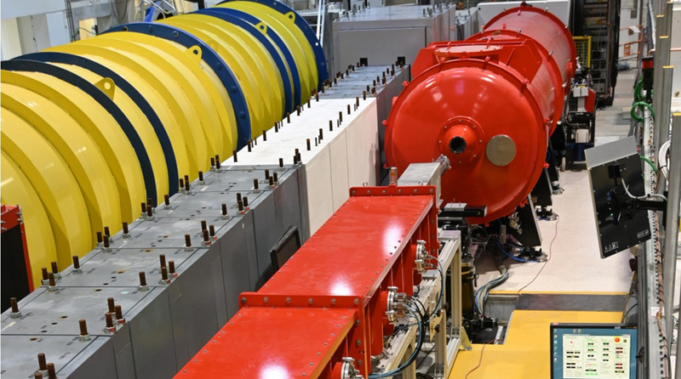
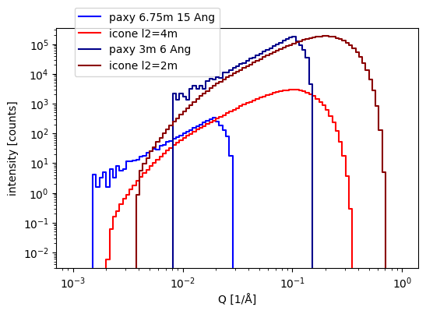
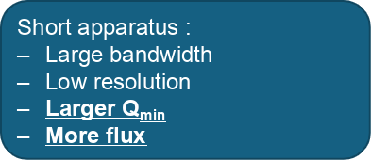
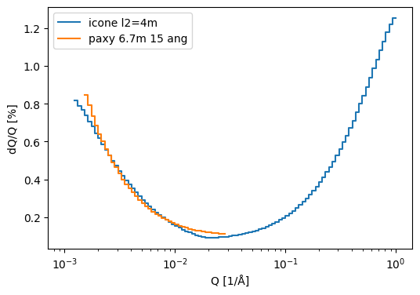
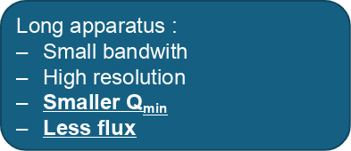
SAMBA : a SANS instrument
Requirements :
    Q range = 0.002 to 0.6 Å⁻¹
    Smaller than 20 m
    0.1 < dQ/Q < 0.5
Reference apparatus :
    PAXY (Orphée, LLB)
    SAM (ILL)
    SANS_LLB (SINQ, PSI)
A. Chennevière@LLB

Slide 13
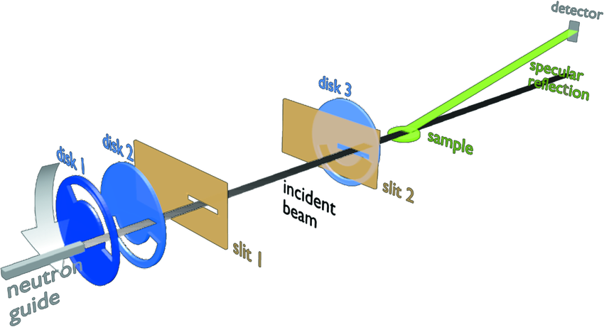
HERMES the horizontal reflectometer
Orphée reference design
On ICONE
Top view
Sample / det. distance = 2 m
Side view
1.00 x 10⁷ n/s/cm²
Total length: 10 m, High-flux target. 10 nm Ni thin film deposited on Si substrate
BG = 5%
20 mn measurement
2.17 x 10⁶ n/s/cm²
2° x 0.08°
Convergence criteria

Slide 14
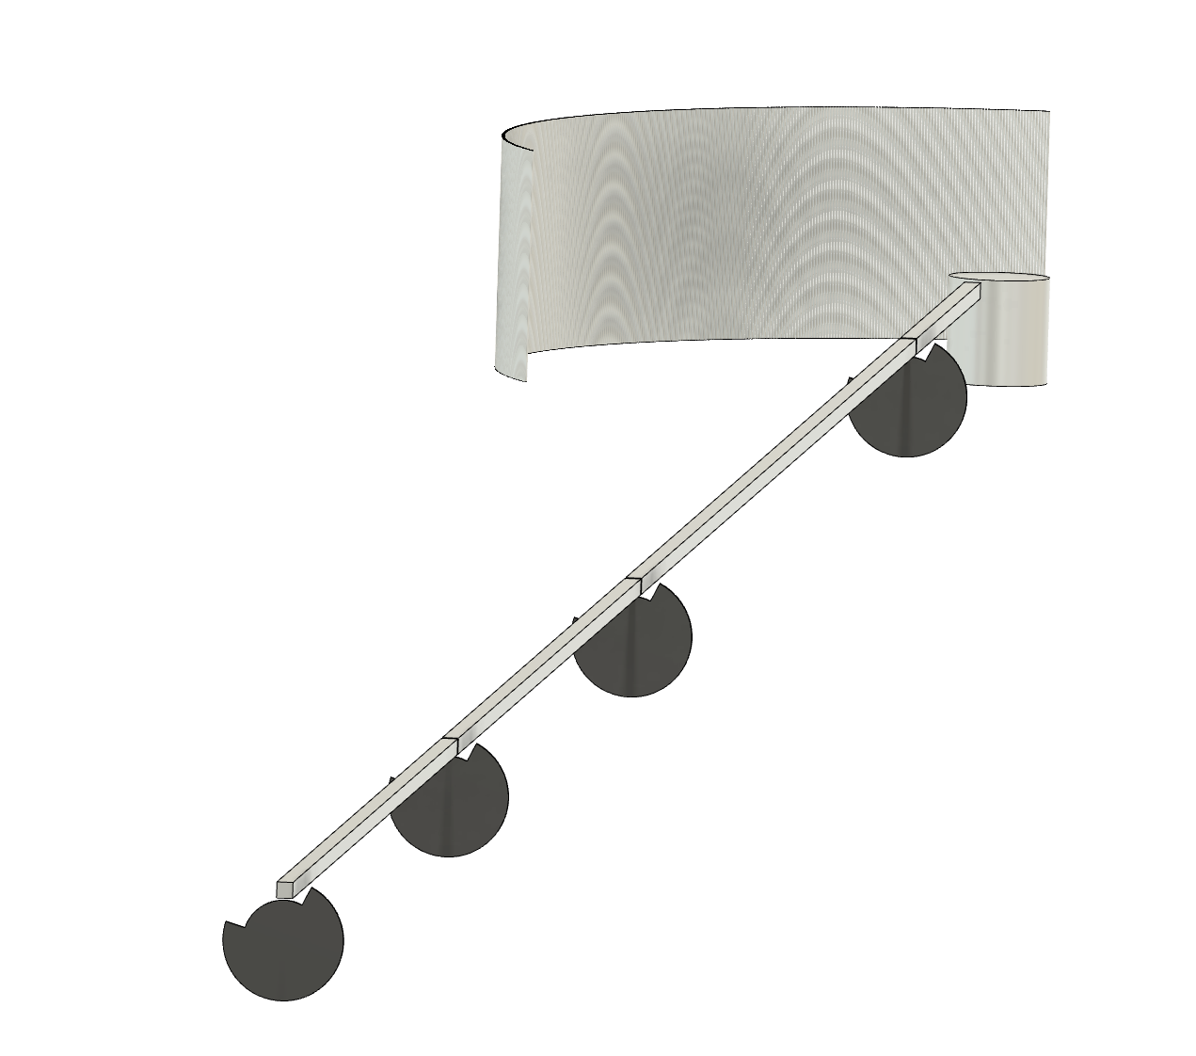
INEDIT : direct geometry inelastic spectrometer
115°
115° x 30°
337 tubes
Sample to detector : 2.5 m
Moderator to sample: 40 m
𝝀1
𝝀4
WFM 200 Hz
SC2
Anti-overlap
50 Hz
SC1
40 m
Wavelength range
SC0
Choppers cascade
Resolution
PSC

Slide 15
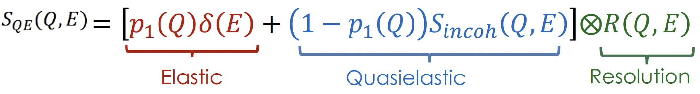
INEDIT : resolution and Q range
(Q,E) accessible
On the detector
Fit by pseudo-voigt
Lorentzian: reference
Gaussian: instrument
Suited for diffusion coefficient measurements (soft mater)
σ_{3A} = 0.40 meV FWHM
σ_{4A} = 0.24 meV FWHM
σ_{5A} = 0.13 meV FWHM

Slide 16
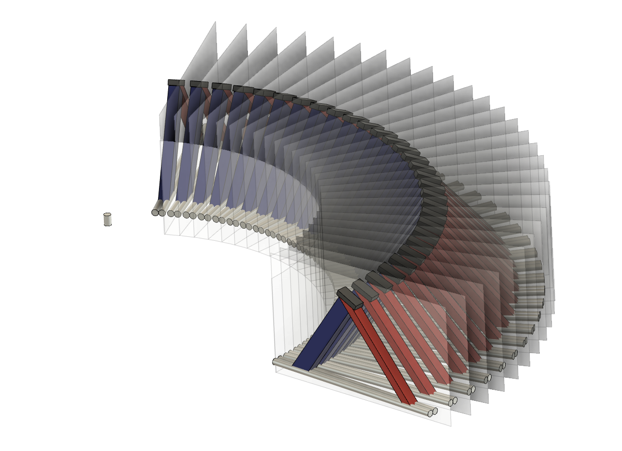
FANTASTIC : spectrometer in indirect geometry
BIFROST like
Shielding between sector (cross-talk)
    30 movable analyzors
    120 ° horizontal coverage
    1.0 < kf < 2.4
  60 tubes of ³He at 15 bars
  0.75" x 22" (from 5C1)
Sample
sample
20x10 mm
Incident white beam
HR target at 50 Hz
2𝜃ana = 120°
5.8 A
2𝜃ana = 50°
2.8 A

Slide 17
FANTASTIC : resolution and Q range
30 counts/sec expected
(Q,E) accessible
σinst = 0.4 meV
Phonons and magnons measurements (hard matter)

Slide 18
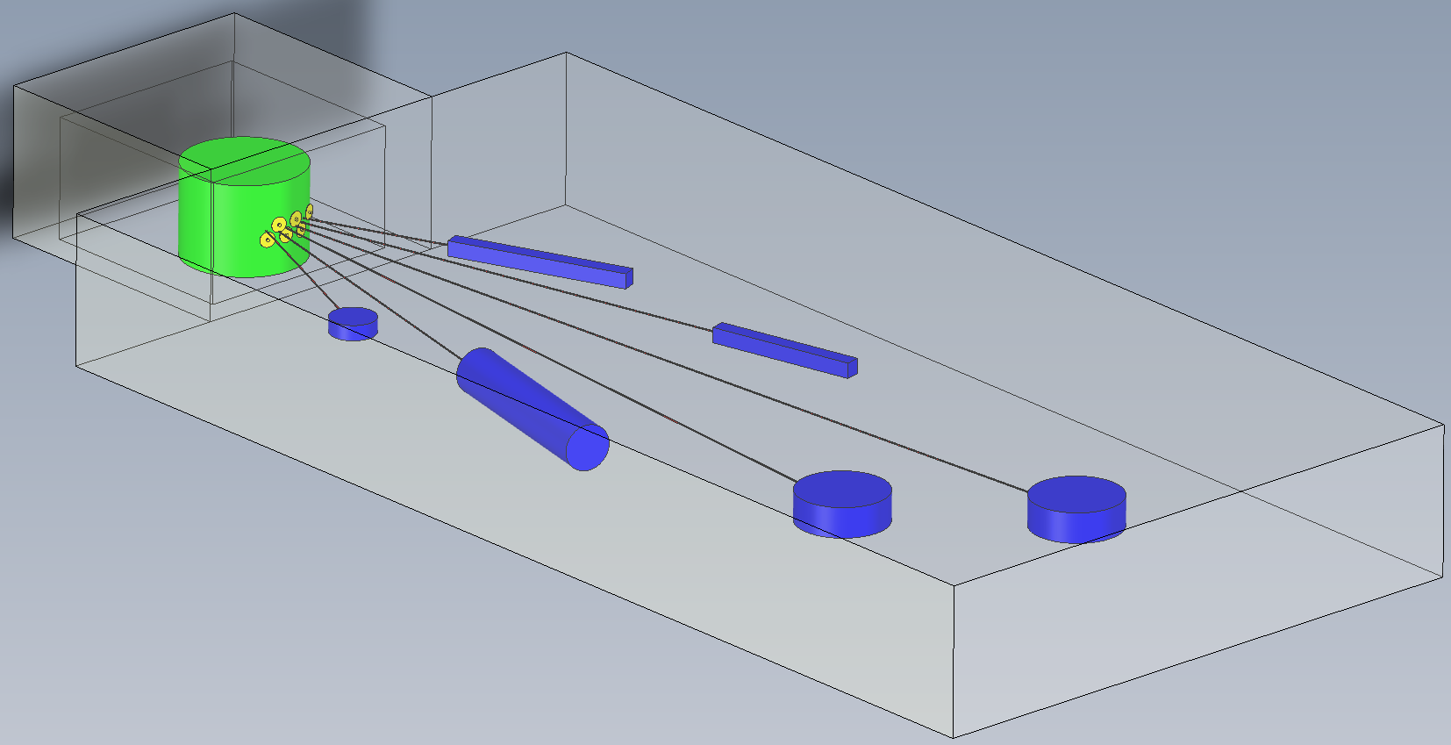
Possible layout for ICONE Phase 1
2032
Target casemate
GUIDE HALL
9° between guides
Target
monolith
IMAGING
HERMES
TEST
SAMBA
PRESTO
FANTASTIC
40m
20m

Slide 19

Thank you

Slide 20
SPARE1
Detailed specifications of ICONE
SOURCES requirements | High Flux | High Resolution
Energy p⁺ [MeV] | 25
Peak Intensity p⁺ [mA] | 80
Pulse Duration [ms] (Rate [Hz]) | 0.8(50) - 2(20) | 0.2 (100) - 0.4(50)
Duty Cycle | 4% | 2%
Average Flow p⁺ [/s] | ~2 10¹⁶ | ~10¹⁶
Average Flow n_{fast} [/s] | ~4 10¹⁴ | ~2 10¹⁴
Average Flow n_{u} [/s/cm²/sr] | ~4 10¹⁰ | ~2 10¹⁰
Neutron beam ports | 5+2 | 5+2
Pulse
Time
High resolution pulse
High flux pulse
Flexible pulse rate and duration
n_{u} : useful neutrons (<100 meV i.e. >0.9 Å)

Slide 21
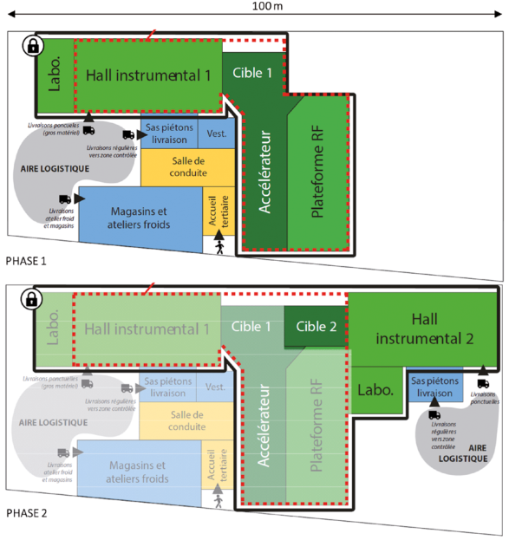
SPARE2
ICONE current possible layout

Slide 22
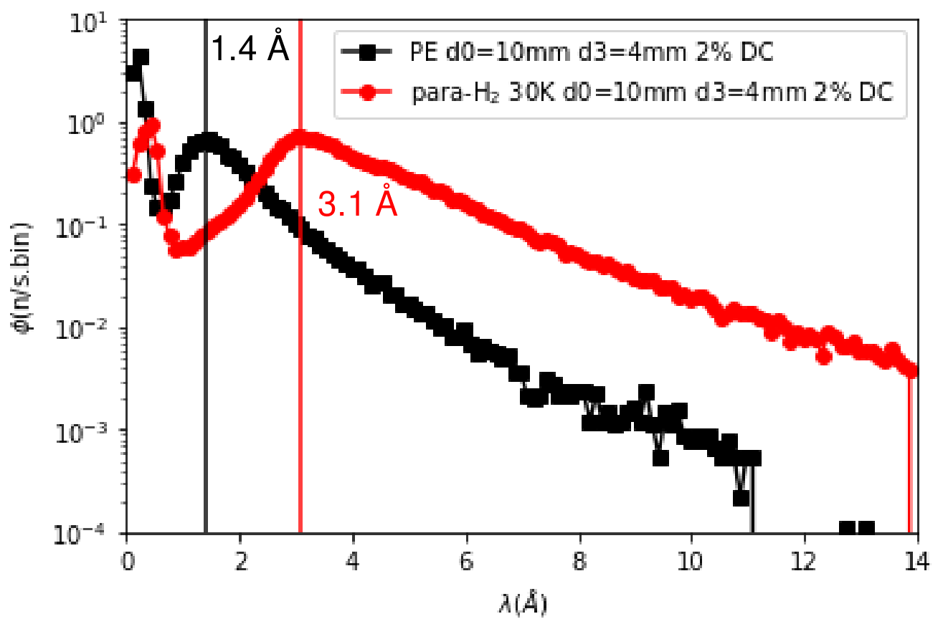
SPARE3
Estimate the lambda dependance of the thermal and cold spectra
NOTA : at JNP, Mariano mesured this (on the JCNS moderators PE Vs pH2)
Beware, there was a m=1.5 guide between the moderators and the detector

Slide 23
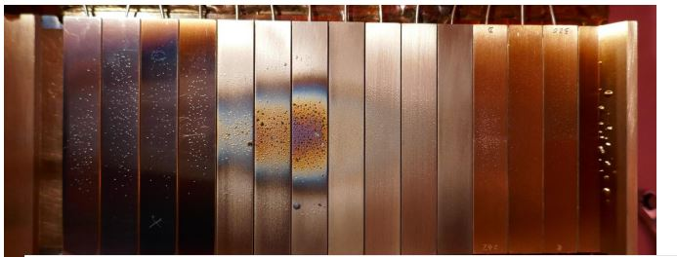
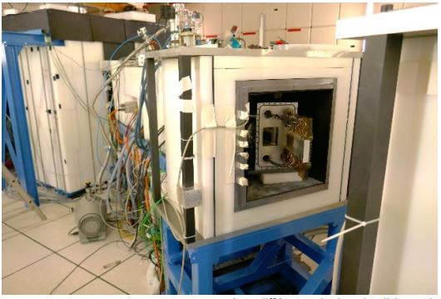
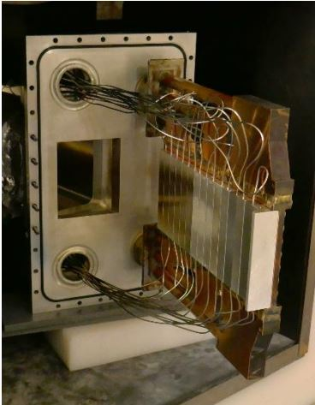
SPARE4 : Target
Various type of Be plates
Tested 100h at 3MeV >25kW

