Slide 1
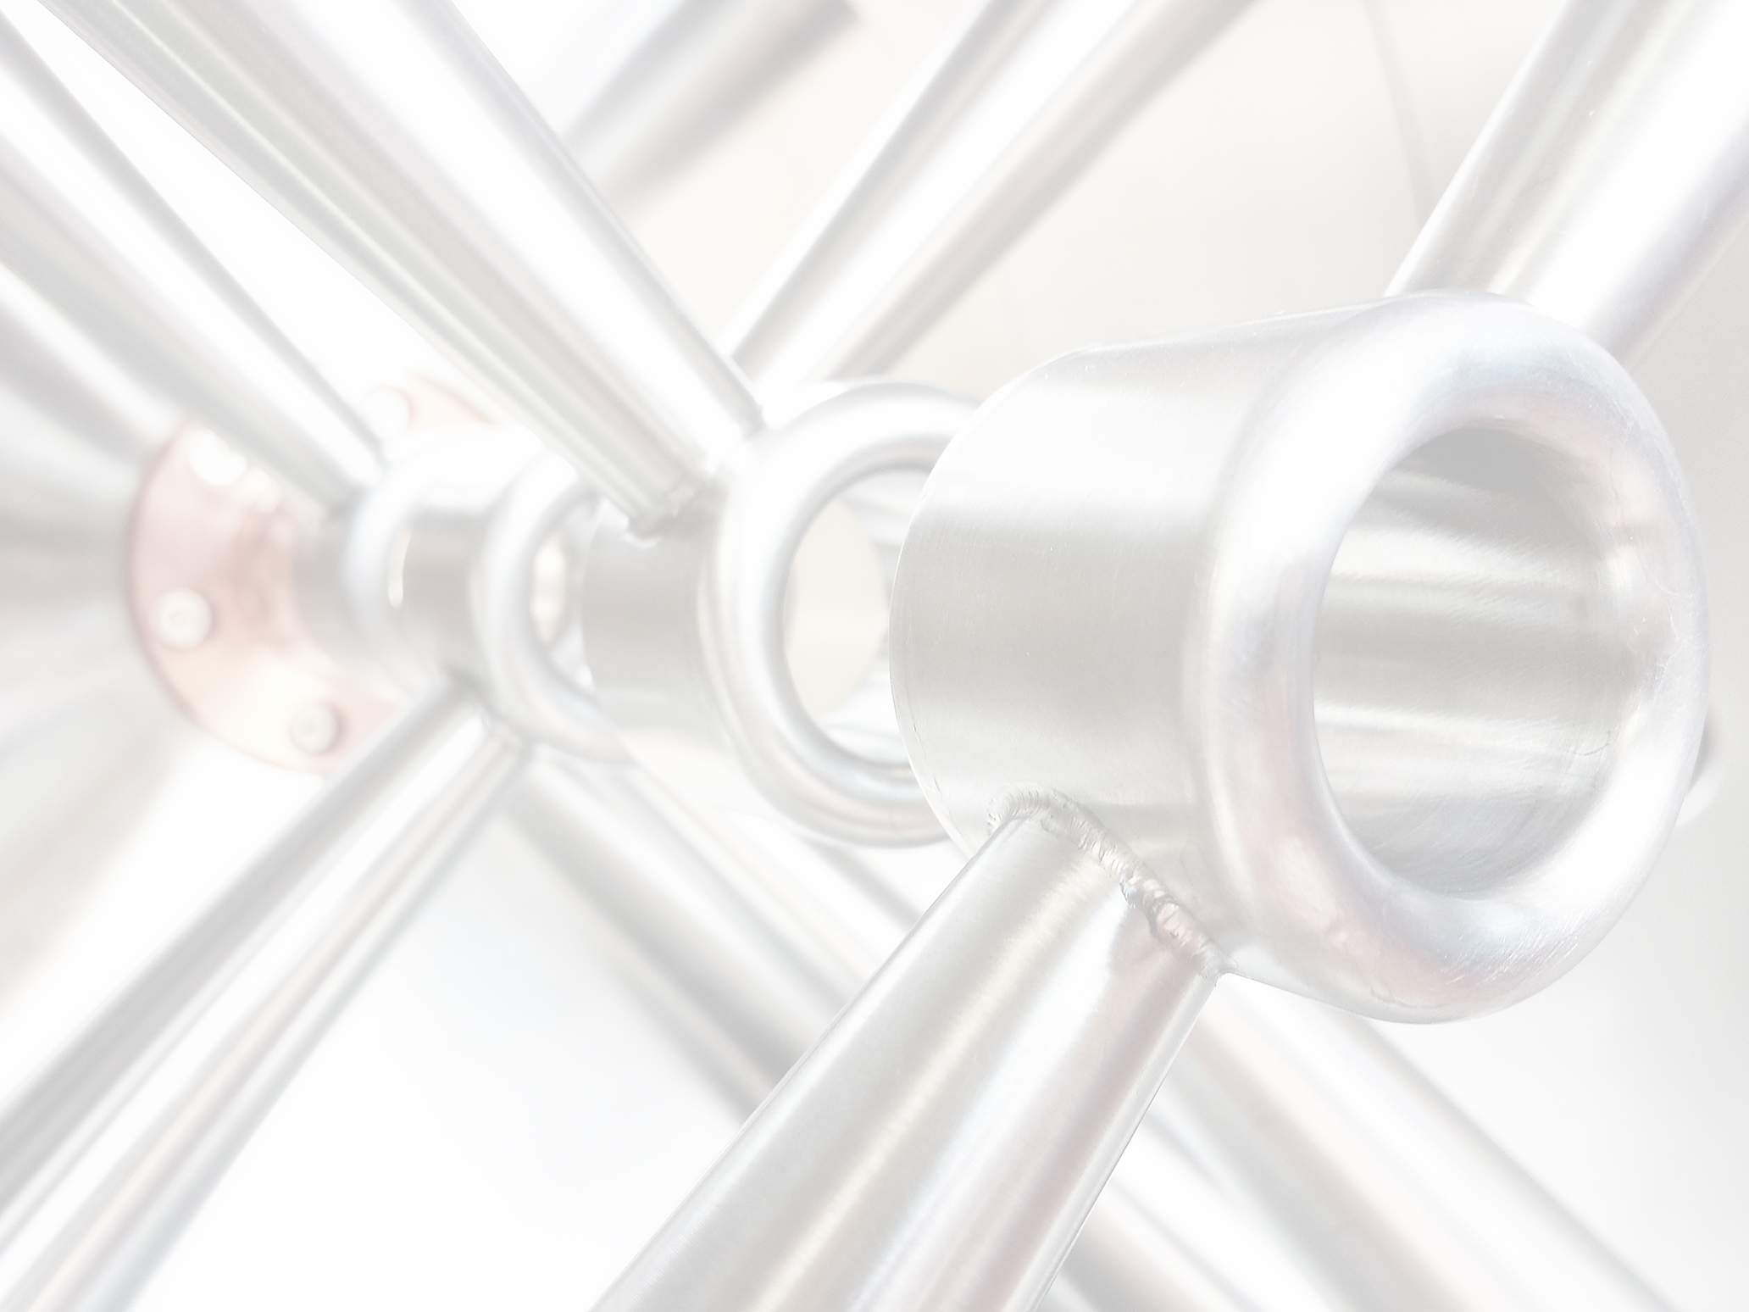


Development of Scalable High Current
Accelerator Based Neutron Sources
UCANS 2025 - Vancouver
Holger Podlech
Institute for Applied Physics, Goethe University Frankfurt
Helmholtz Research Academy Hesse for FAIR (HFHF)
Bevatech GmbH
Martin Droba, Klaus Kümpel, Sarah Lamprecht, Oliver Meusel, Nils Petry, Stephan Wagner, Malte Schwarz, Chuan Zhang, Johannes Baggemann, Thomas Brückel, Thomas Gutberlet, Eric Mauerhofer, Ulrich Rücker, Paul Zakalek, Sarah Böhm, Stephan Wagner, Julius Storch

Slide 2
Outline
Design Philosophy
Accelerator Technology
Projects
HBS
FRANZ
BNCT

Slide 3
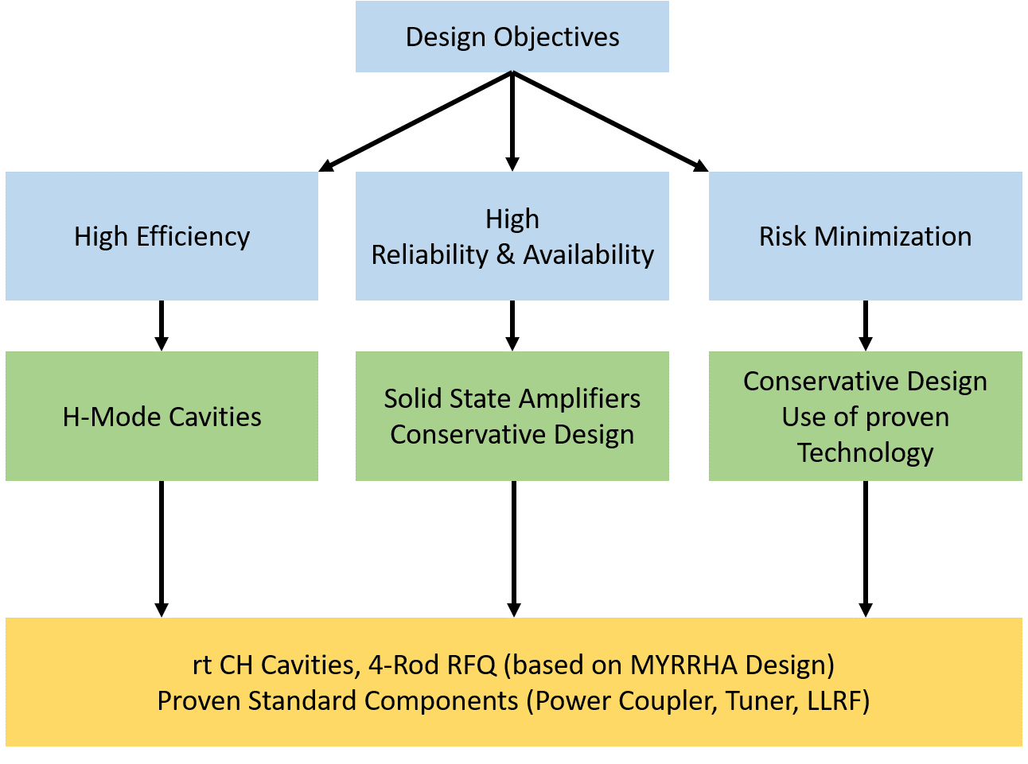
Design Philosophy High Power Scalable HiCANS Linacs
Required | Specifications | Unit
Particle type | Protons | N/A
Accelerator type | RF Linac | N/A
Beam energy | 2-100 | MeV
Beam current peak | 1-100 | mA
Beam duty factor | 1-50 | %
Ave. Beam current | 1-30 | mA
Pulse length | 5-5000 | μs
Ave. Beam power | 1-1400 | kW
Peak Beam power | 2-10000 | kW
Availability | >95 | %

Slide 4
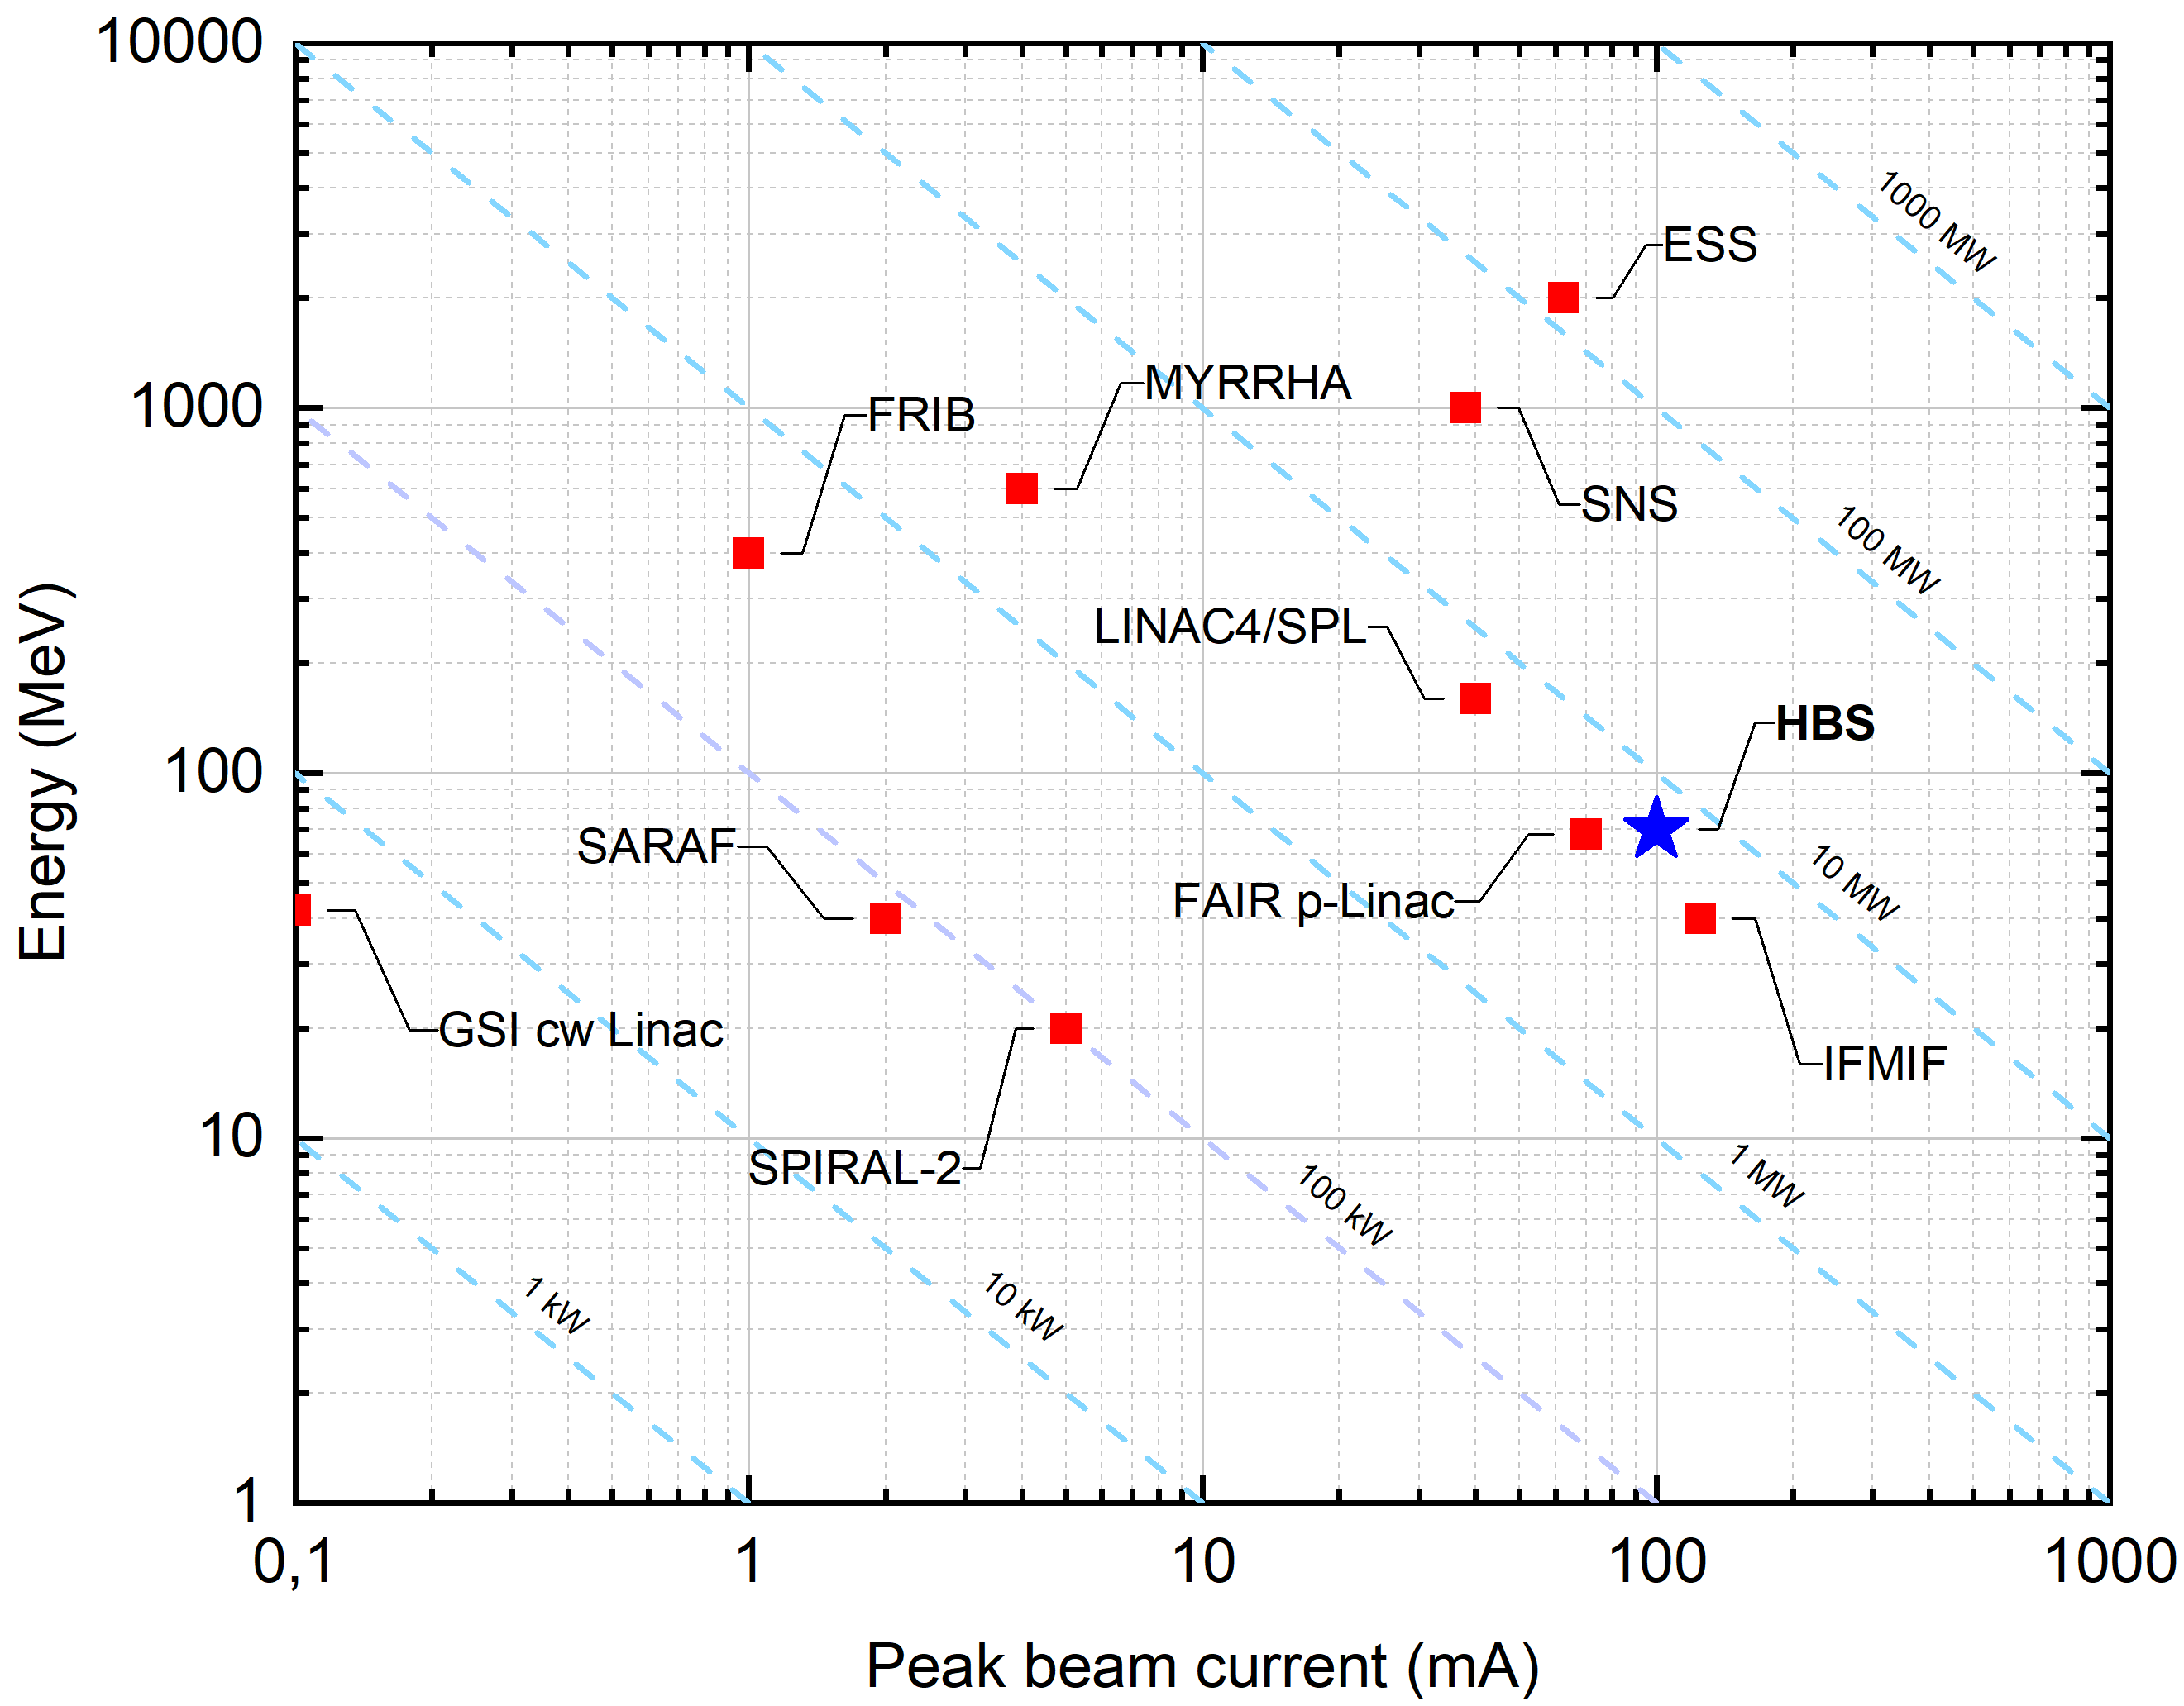
Energy and Peak Current of Hadron Linacs
BNCT/Industrial
FRANZ

Slide 5
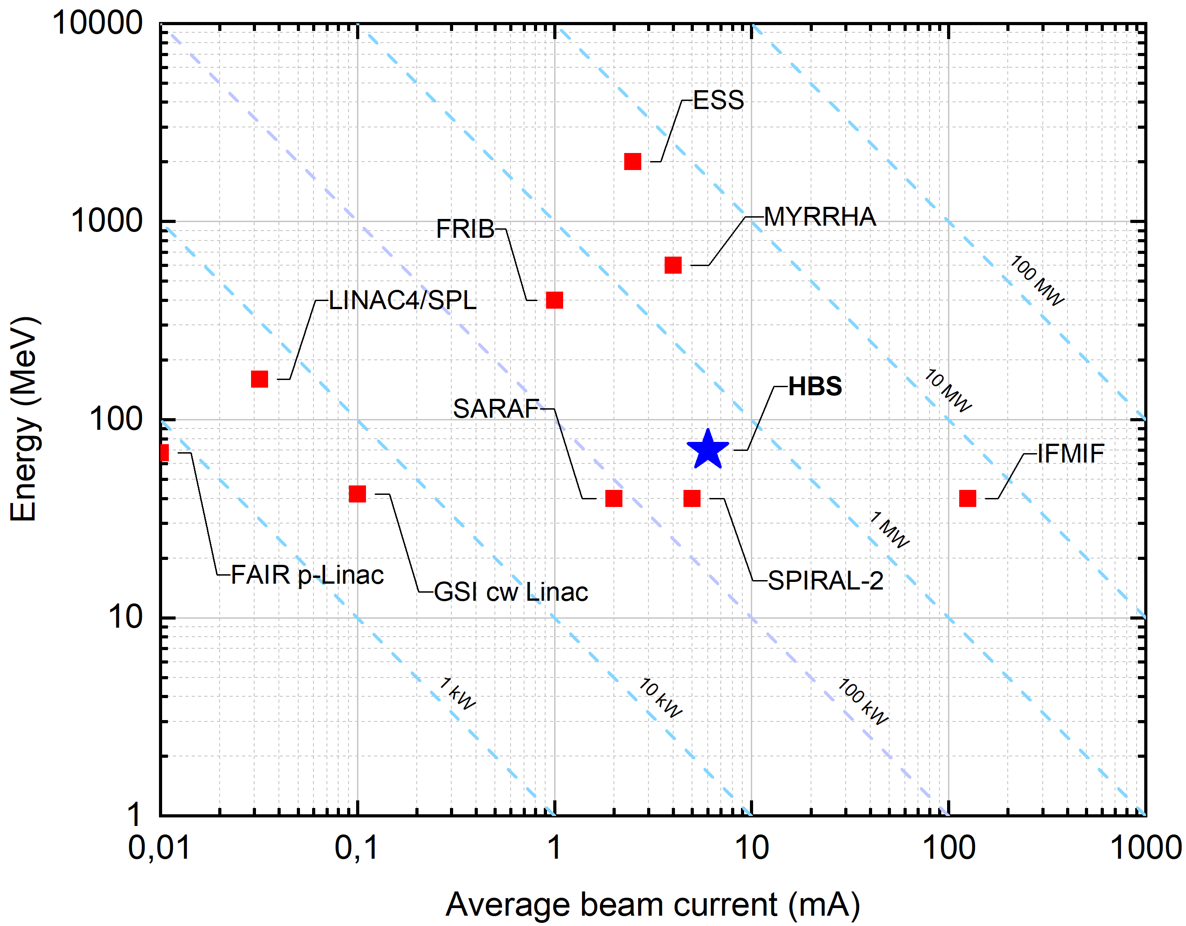
Energy and Average Current of Hadron Linacs
BNCT/Industrial
FRANZ

Slide 6
What does Scalability means?
Large parameter range: I=1-100 mA, E=2-100 MeV, DF=1-50%
Ideally, we have one design for all possible cases up to a few MeV
But this is not working because of beam dynamics (current) and duty factor
Lower gradients
But it is possible to provide a few basic designs depending on beam current (1-25 mA, 25-75 mA, >75 mA)
Energy is scalable by adding cavities
For proper design, a large variation of duty factor can be used (all RF structures have optimized and identical cooling)
For all designs, the fundamental RF structures are the same
Duty factor
RFQ Energy
Higher gradients
Beam current

Slide 7
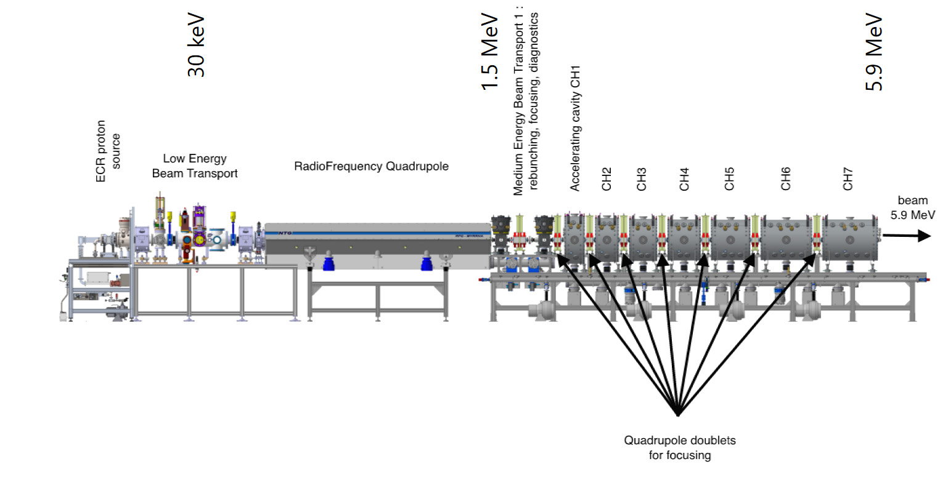
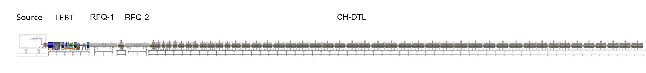
Energy and Average Current of Hadron Linacs
MEBT
20-60 keV
0.7-2 MeV
Proton source
LEBT
RFQ
CH-DTL
2-100 MeV
I < 75 mA
EM Triplets
80-100 keV
CH-DTL
BNCT/Industrial
Proton source
LEBT
RFQ
MEBT
RFQ
1.25 MeV
2.5 MeV
3-100 MeV
FRANZ
I ≈ 100 mA

Slide 8
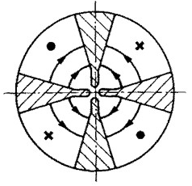
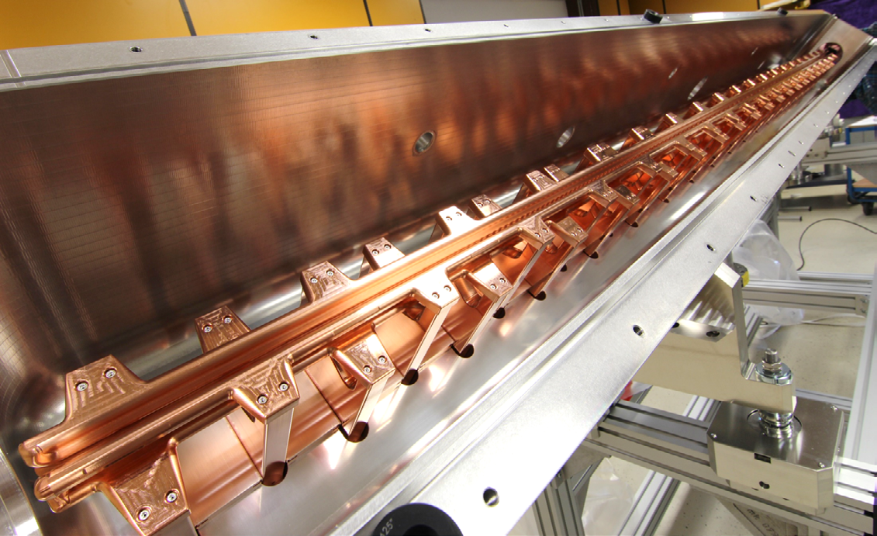
State-of-the-Art proven Accelerator Technology for HiCANS
Radio-Frequency Quadrupole
(RFQ)
4-Rod RFQ based on the MYRRHA RF design
Proven technology (>100 kW/m thermal)
Easy access, repair and maintenance
Full dipole compensation
Full entrance and exit field compensation
Use of new beam dynamics concepts with dedicated emittance transfer to minimize emittance growth
176 MHz cw RFQ

Slide 9
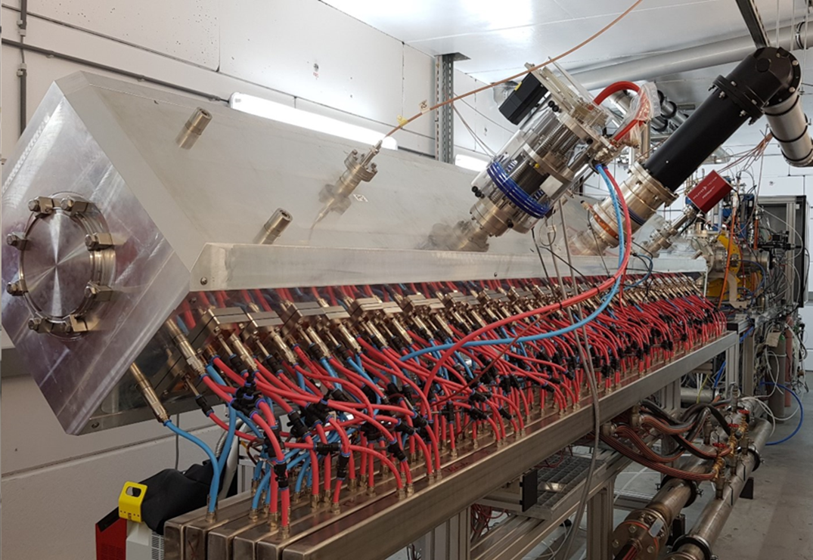
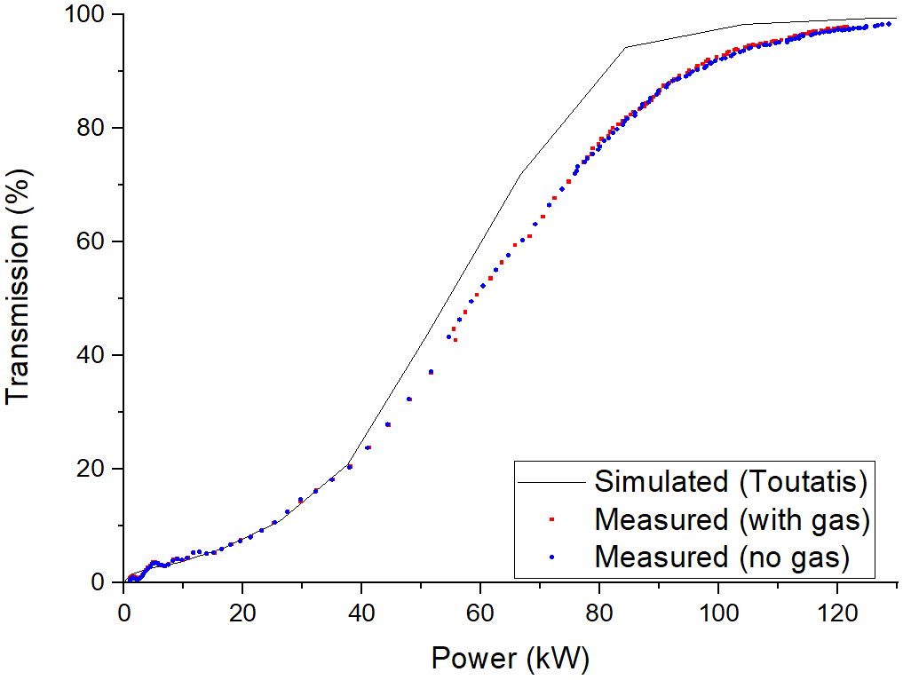
MYRRHA RFQ – Beam Test
cw operation, I=4 mA, T=98%

Slide 10
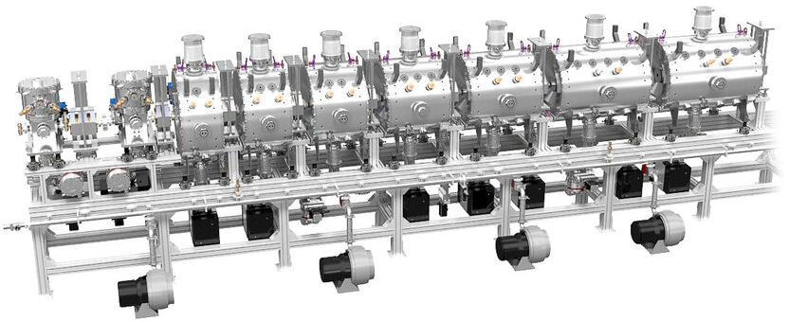
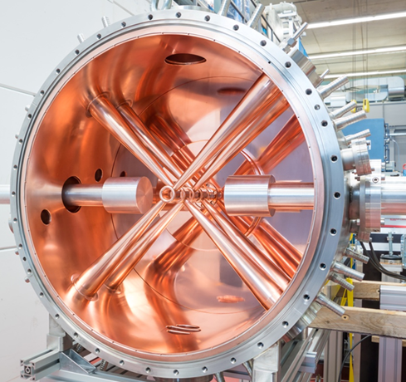
State-of-the-Art proven Accelerator Technology for HiCANS
Crossbar H-Mode (CH) Cavities
CH-cavities based on the MYRRHA RF design
Independently phased cavities
Proven technology (>50 kW/m thermal)
Easy access, repair and maintenance
176 MHz cw CH-Cavity

Slide 11
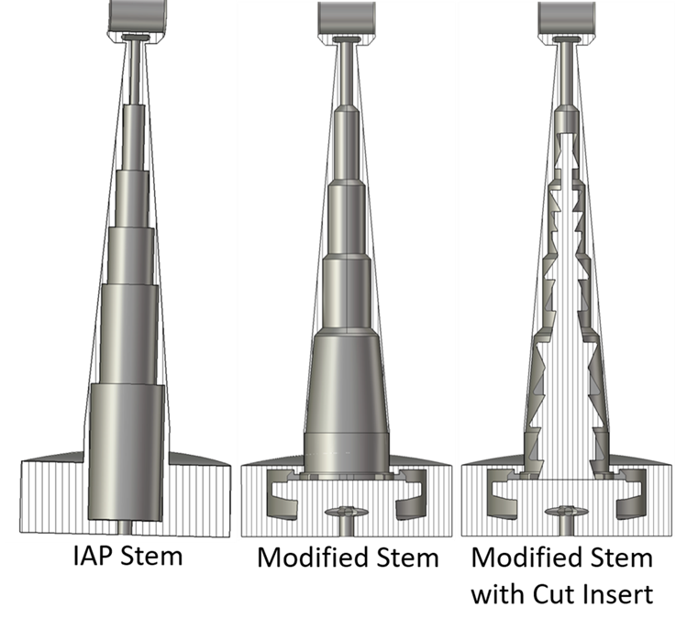
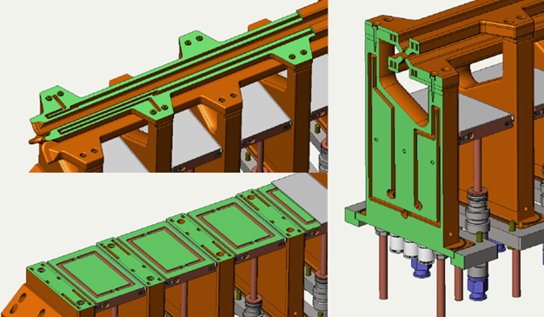
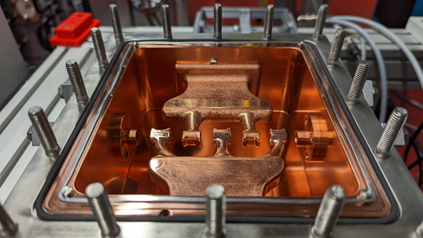
Technology Development
Additive manufacturing in one of the hot topics
IAP has started a research program for additive manufacturing of RF cavities/cavity components
RFQ
IH/CH-cavities
Goals
Faster and cheaper production
Optimzed cooling channels
J. Storch, K. Kümpel
H. Hähnel

Slide 12
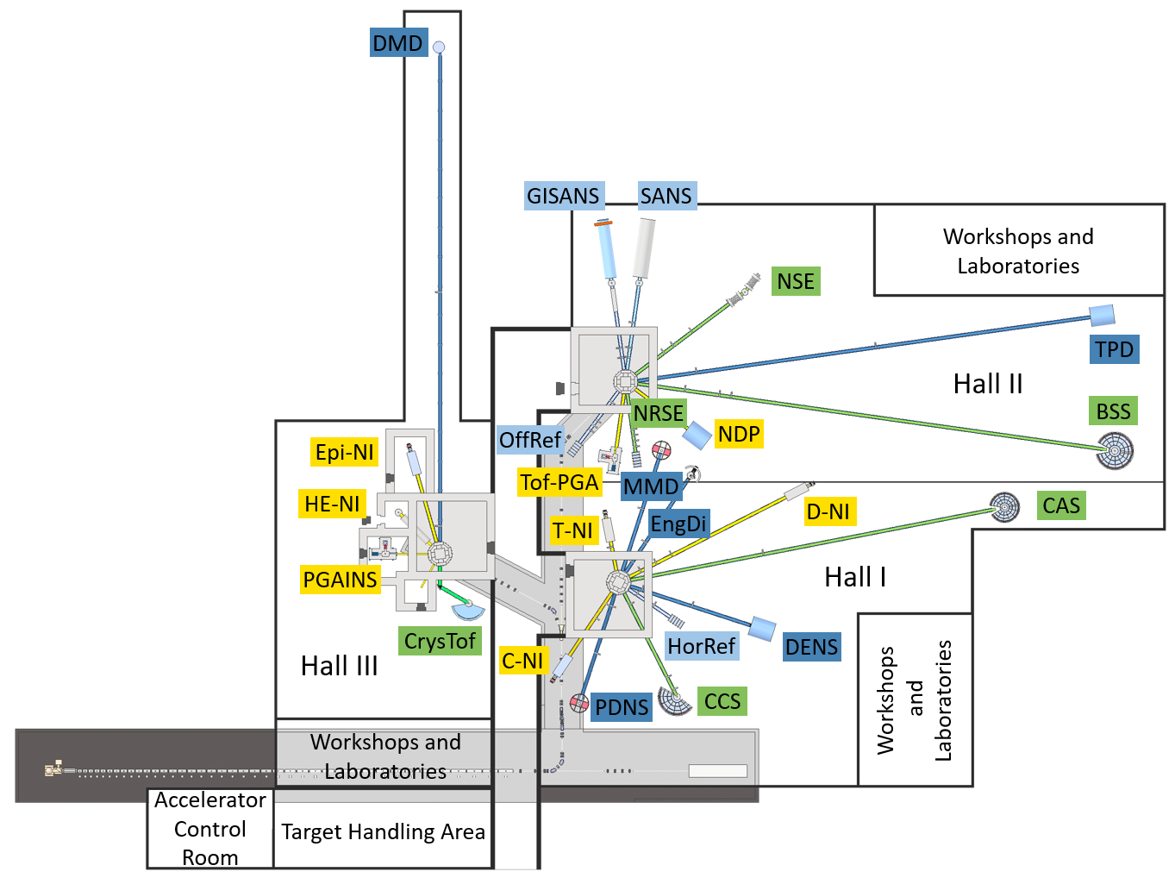
High Brilliance Neutron Source HBS at Jülich
Parameter | Specification | Unit
Type | RF Linac | N/A
Frequency | 176.1 | MHz
Amplifier | Solid State | N/A
Particles | Protons | N/A
Beam current | 100 | mA
Beam energy | 70 | MeV
Peak Beam Power | 7 | MW
Duty factor Beam | 20 | %
Ave. Beam Power | 1.4 | MW
Rep rate | variable | N/A
Pulse length | Variable, max T=2 | ms

Slide 13
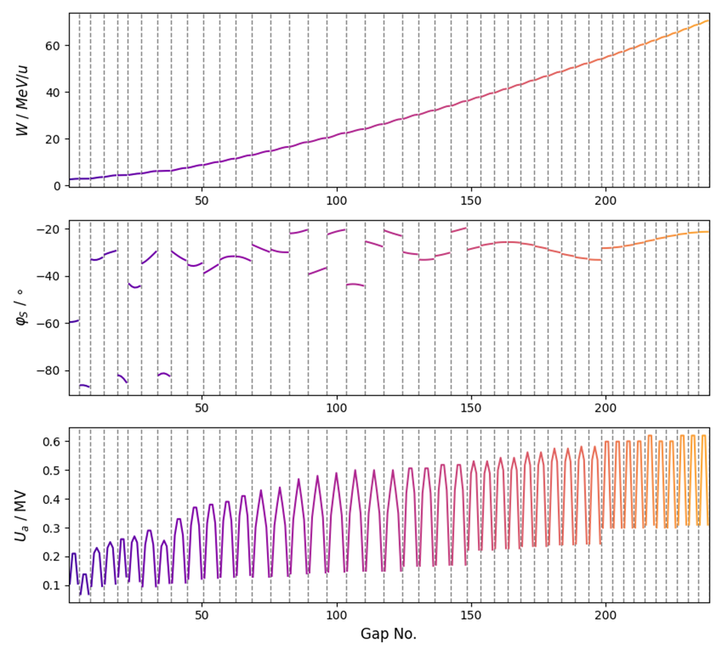
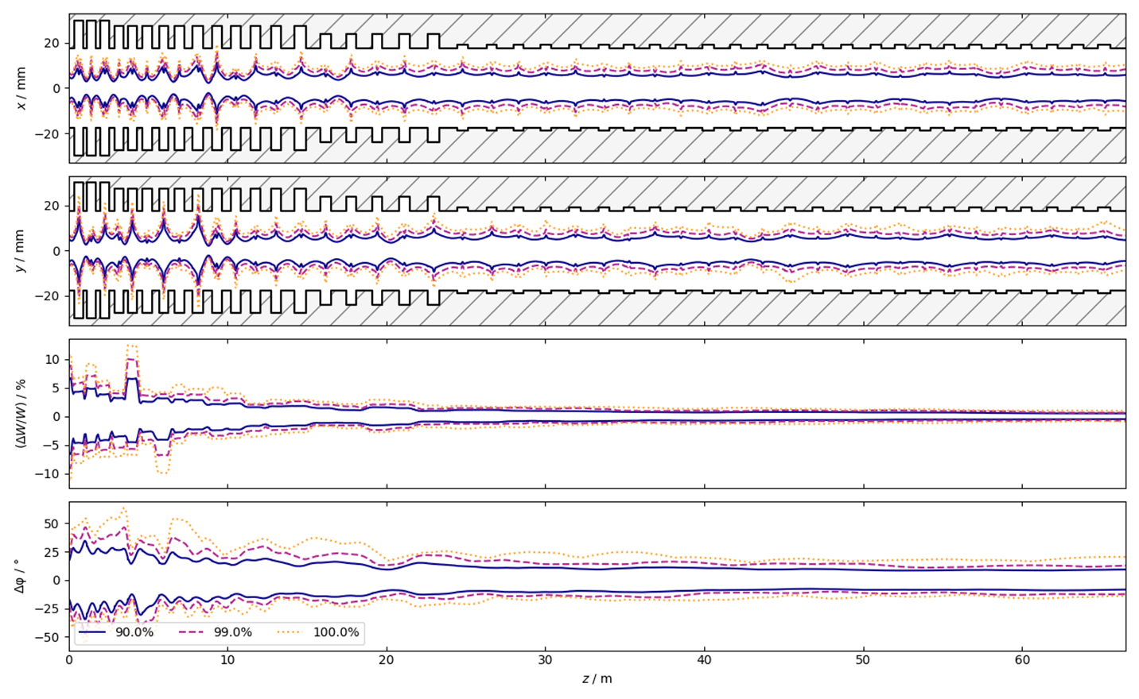
DTL Beam Dynamics - HBS
S. Lamprecht, IAP

Slide 14
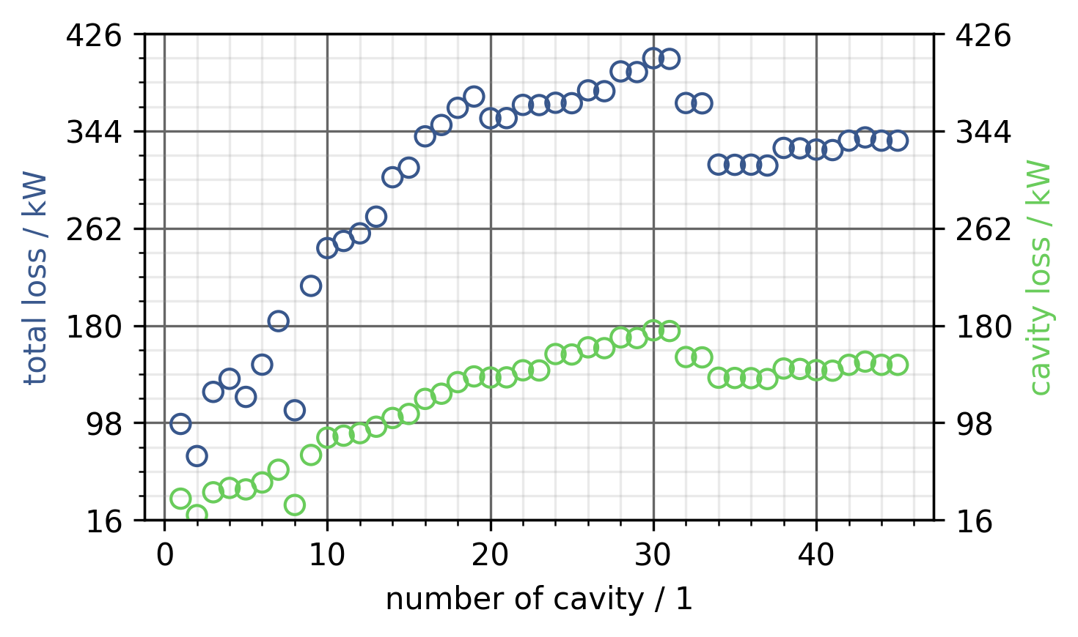
Required RF Power HBS CH-Cavities
Beam loading
N. Petry, IAP

Slide 15
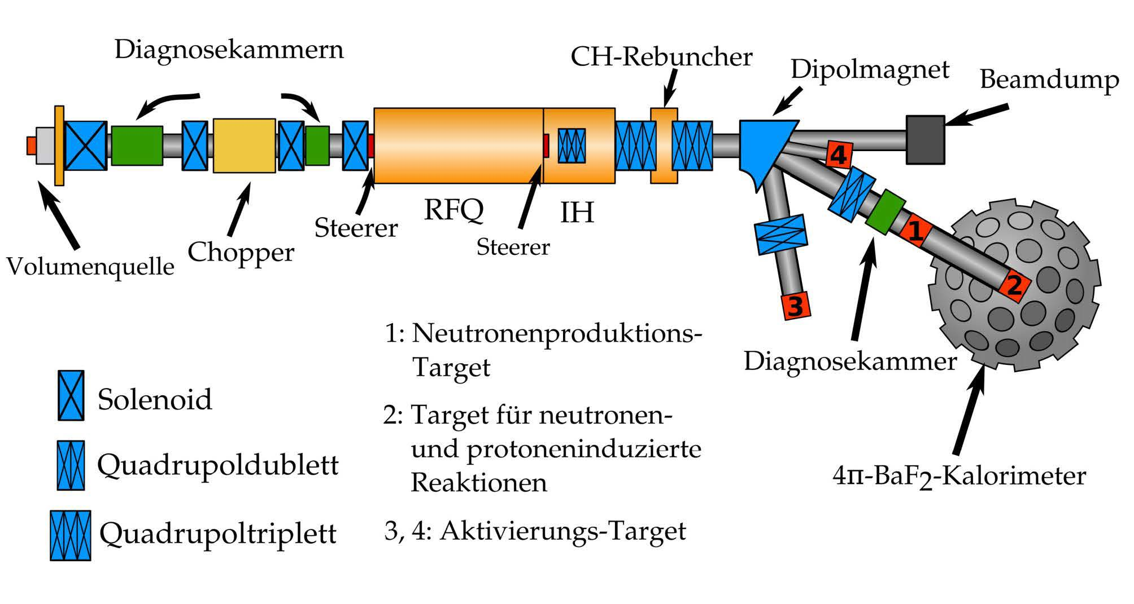
Frankfurt Neutron Source FRANZ
Beam Diagnostics
CH-Rebuncher
Dipole
Beam Dump
Parameter | Specification | Unit
Particles | Protons | N/A
Beam current | 30 | mA
Beam energy | 1.8-2.3 | MeV
Target | Li | N/A
Duty factor | 0-100 | %
Pulse length | <1 | μs - cw
Rep rate | Up to 10⁵ | N/A
Linac Length | 2.5 | m
RFQ
IH
Steerer
Steerer
Chopper
Volume Source
Beam Diagnostics
Solenoid
Quadrupole Doublet
Quadrupole Triplet

Slide 16
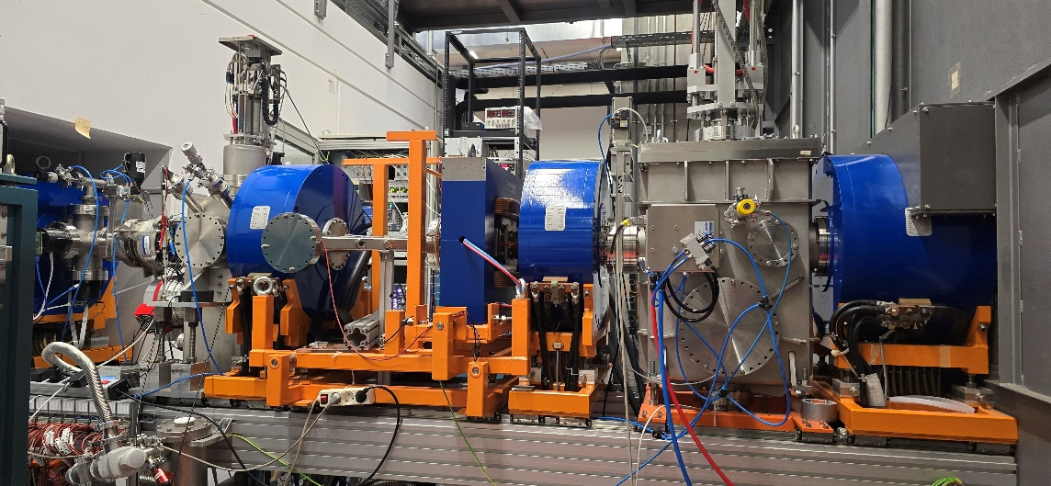
Frankfurt Neutron Source FRANZ - LEBT

Slide 17
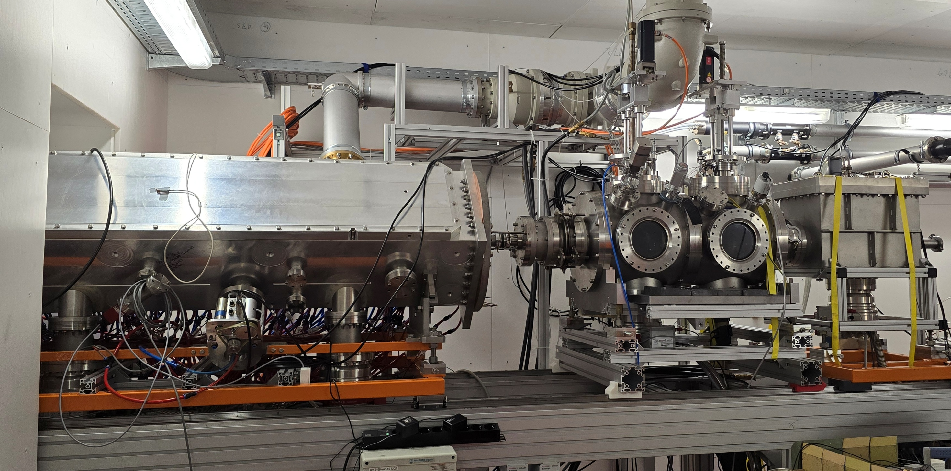
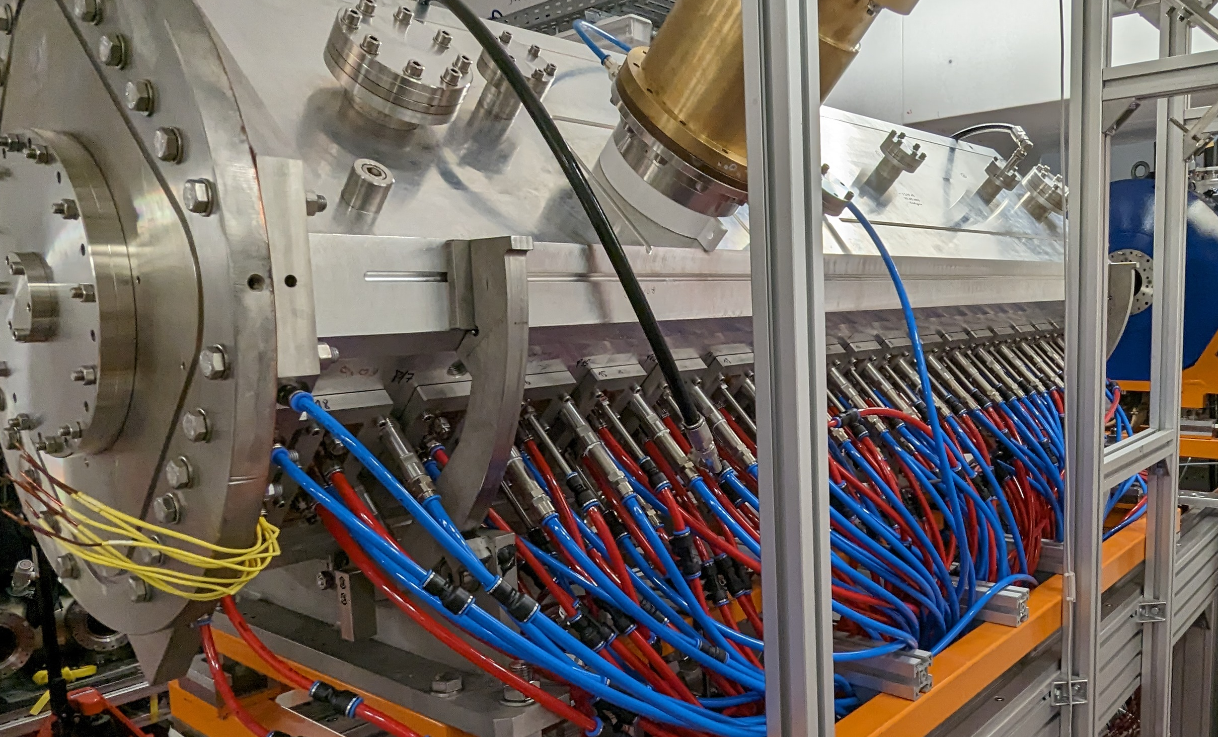
Frankfurt Neutron Source FRANZ - RFQ

Slide 18
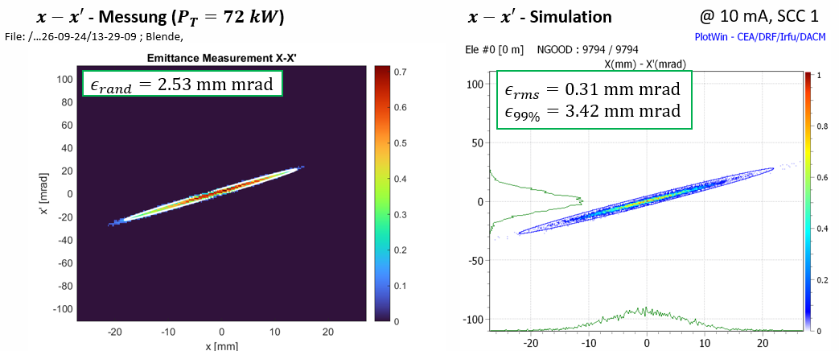

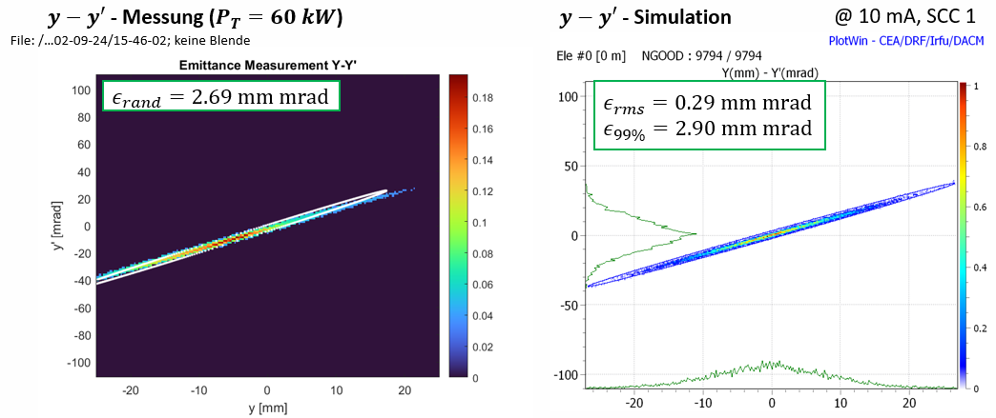
Frankfurt Neutron Source FRANZ - Commissioning
LEBT
RFQ
H. Hähnel, A. Ates, L. Bauer, Ch. Wagner

Slide 19
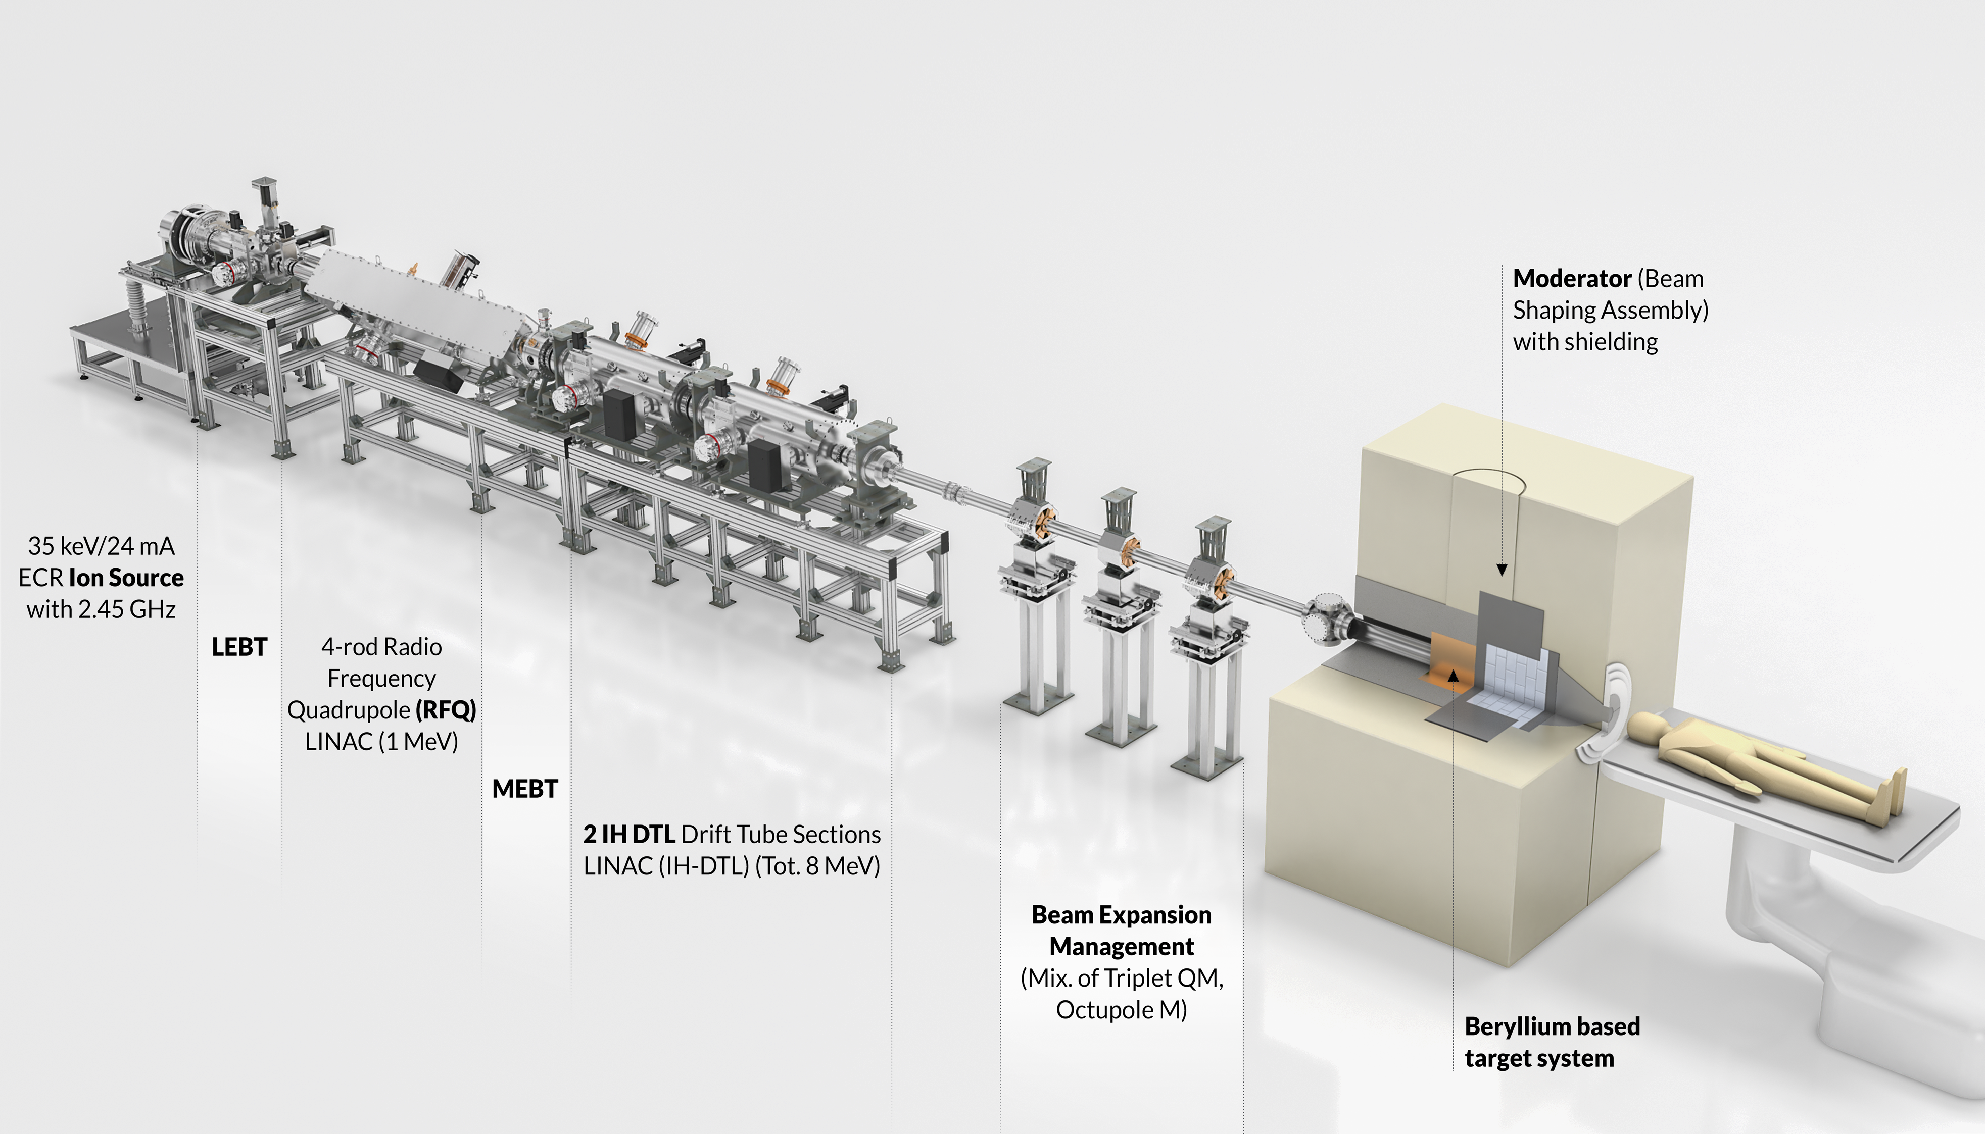

HiCANS-Linac for Industrial and BNCT Applications
Parameter
Linac length | ≤ 10 m
Linac energy | 8 MeV
Proton current (ave) | 8-15 mA
Duty factor | 50%
Ave. Beam power | 64-120 kW
Amplifier | Solid State
Target | Beryllium
Scalable | Yes

Slide 20
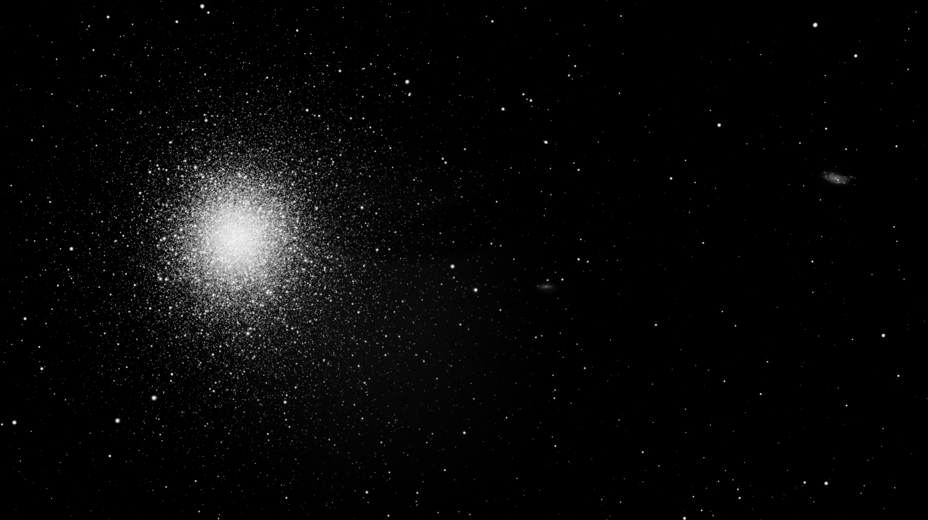

Summary
There is a demand for new accelerator based neutron sources
HiCANS facilities provide a flexible possibility to deliver neutrons
Scalable HiCANS Linacs can provide a wide range of beam power using proven state-of-the-Art accelerator technology
Projects
  FRANZ
  HBS
  Industrial/BNCT Linac

Slide 21
Backup

Slide 22
Room Temperature HBS-Accelerator
Peak beam power: 7 MW
Peak RF power: ≈12 MW
Much simpler technology
Easy access to all components
No cryo-plant
No cryo-modules
Beam losses less severe (quenches): more reliable...
Easier beam dynamics
(no additional drifts due to cold-warm-transitions)
A room temperature linac is the most reasonable and safe solution

Slide 23
HBS-Accelerator – Design Philosophy
As efficient as possible
→ „short“ CH multi-cell cavities
As reliable as possible
→ use of Solid State Amplifiers (up to 600 kW)
→ operate components well below limits
As conservative as necessary
→ conventional beam dynamics (ϕ_{s} = const)
→ quasi periodic lattice
→ use of proven state of the art cavity technology (RFQ, DTL)
Risk minimization
Beam Dynamics layout requires special care (100 mA)

Slide 24
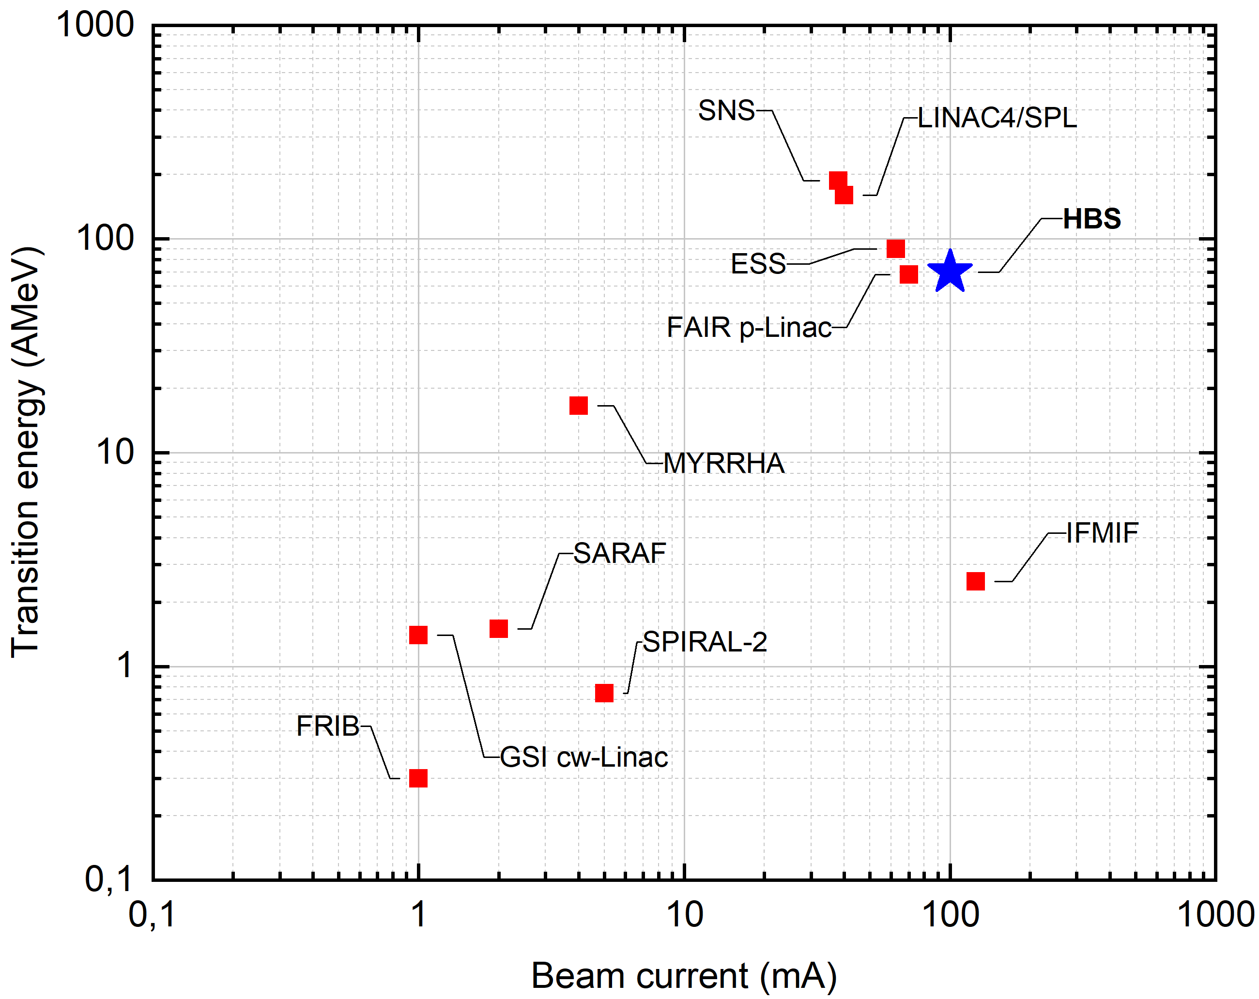
Transition Energy vs Peak Beam Current

Slide 25
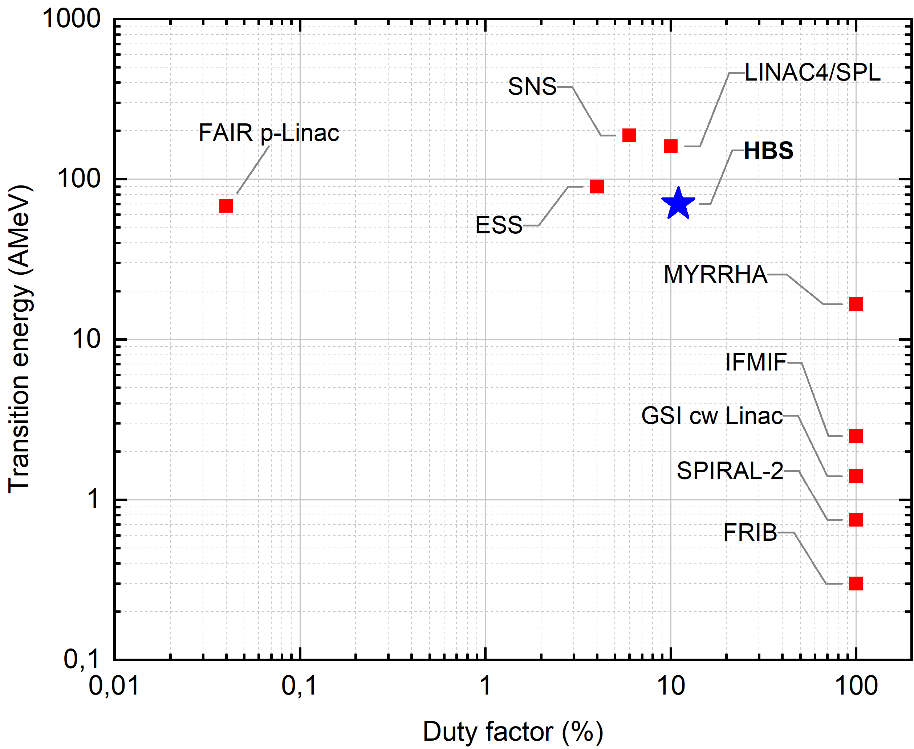
Transition Energy vs Duty Factor

Slide 26
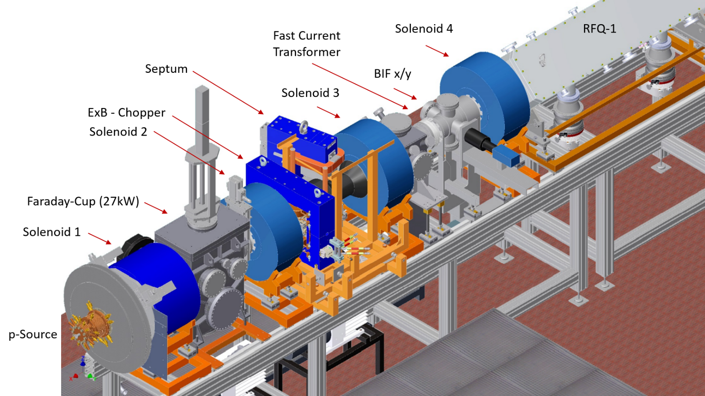
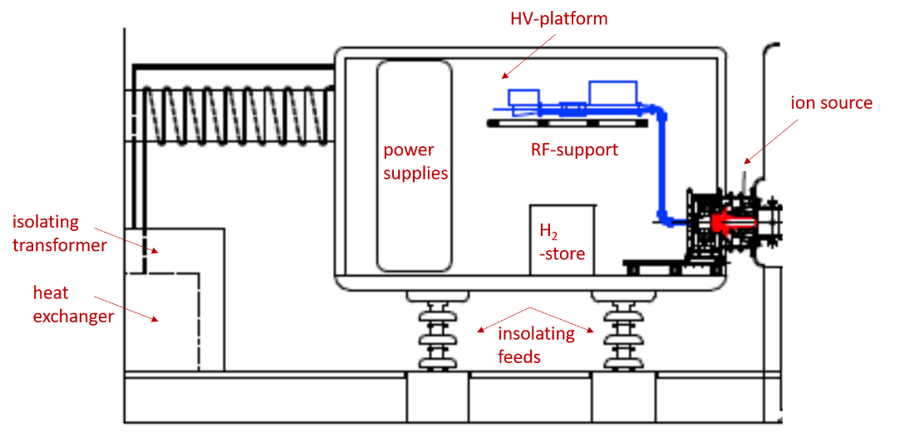
HBS Front-End
O. Meusel
LEBT with chopper
ECR Source
120 mA @95 keV

