Slide 1
The University of Birmingham’s High-Flux Accelerator-Driven Neutron Facility (HF-ADNeF)
Dr Ben Phoenix
University of Birmingham

Slide 2
History of intense accelerator driven neutron sources at Birmingham
Radiation Dynamics (later IBA) 3MV, 1.5mA Dynamitron installed vertically
Mostly used as a proton machine, but also accelerated helium ions and deuterons.
In the final two decades of it’s life used purely as a high intensity neutron source via (p,n) onto thick lithium targets
Lithium/copper bonding technique developed ‘in-house’ at Birmingham
Heavily optimised submerged (heavy) water jet cooling system allowed full beam current on a ~3cm diameter Li target
Finally decommissioned in June 2023 after >50 years of operation.
Li target references; Brown, Scott, Penetrating Radiation Systems & Applications, 4142 (2000);
Phoenix, et al., Applied Radiation and Isotopes, 106 (2015), 49.

Slide 3
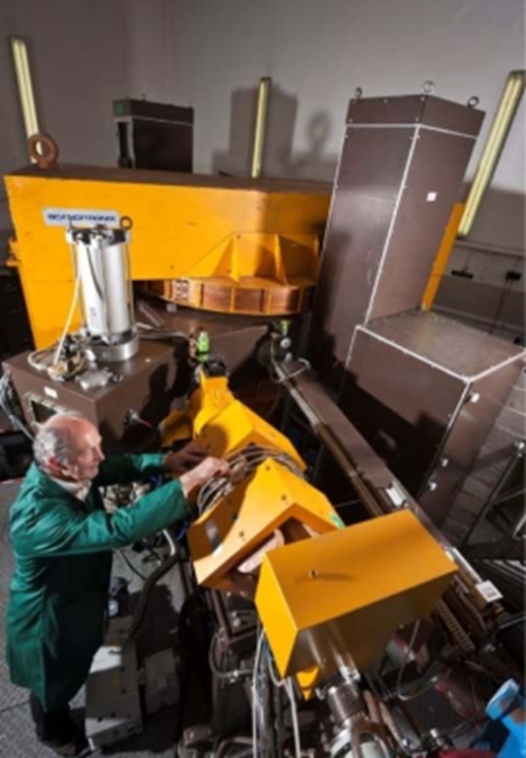
Birmingham MC40 Cyclotron
Beam Ion | Energy (N=1) | Energy (N=2)
Protons (1H) | 10.8-38 MeV | 2.7-10 MeV
Deuterons (2H) | - | 5.4-20 MeV
Helium-3 (3He) | 33-50 MeV | 8-28 MeV
Helium-4 (4He) | - | 10.8-40

Slide 4
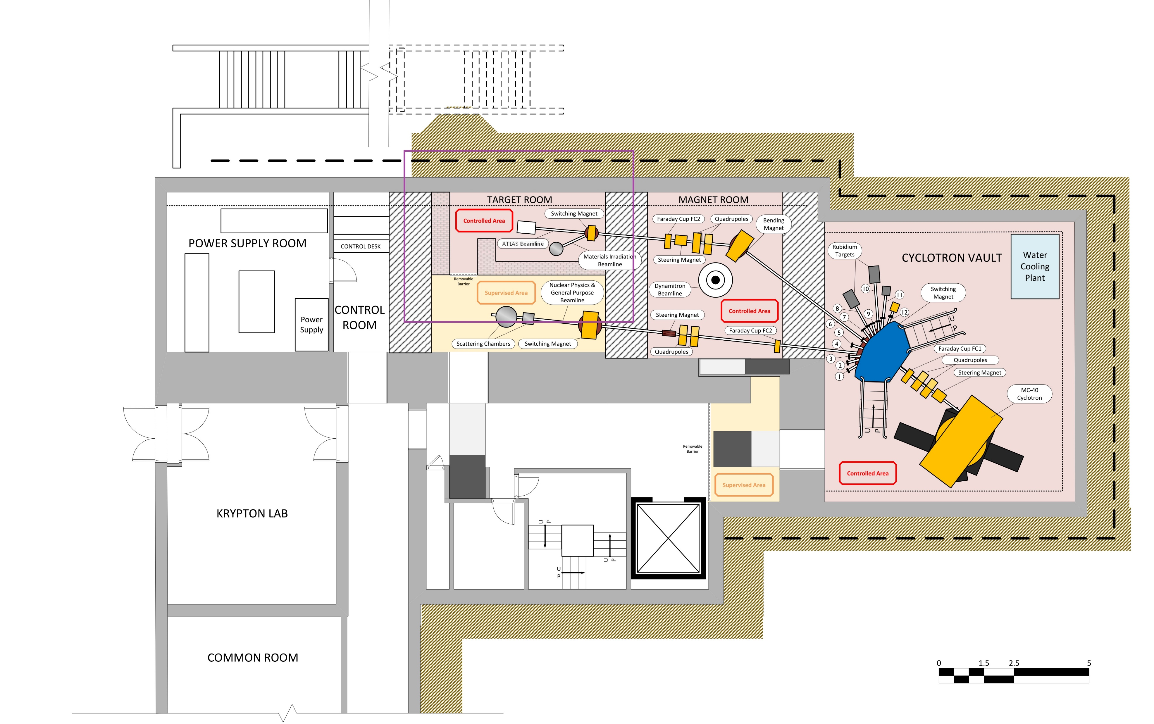
Cyclotron facility layout

Slide 5
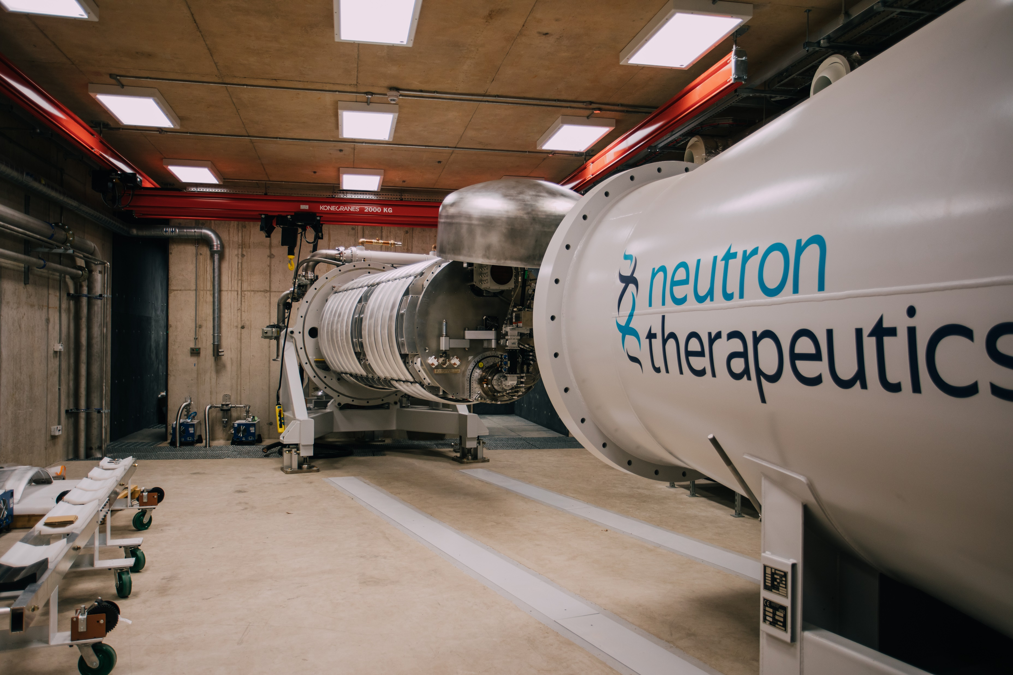
Accelerator choice
2.6 MV+ electrostatic from Neutron Therapeutics
Very high power (>30mA beam current)
Protons on to Lithium target (for now)
Commercial 50mA ECR ion source
One beamline currently (plus a beam dump)

Slide 6
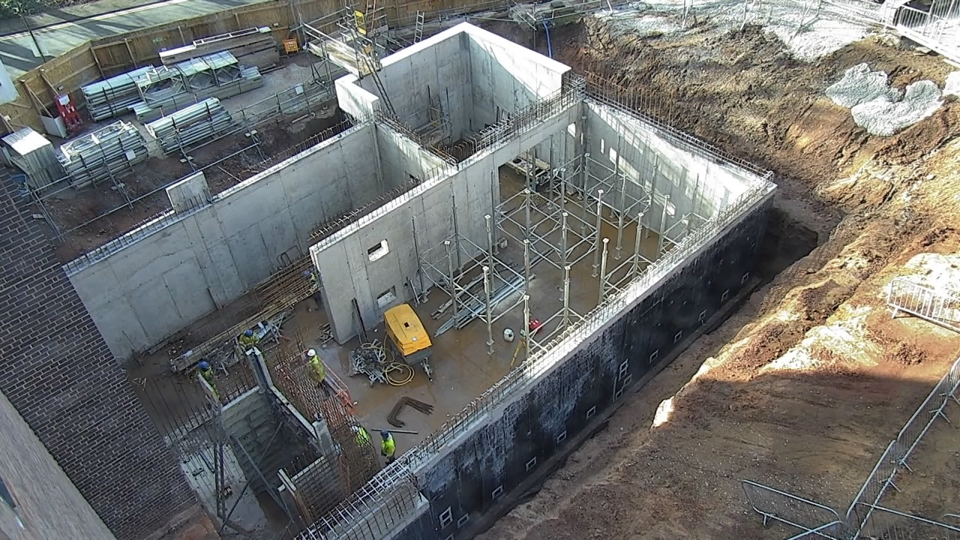
ADNeF layout and construction
Total budget of ~£11m of which the building was ~£2m
Main contractor GF Tomlinson
Required some aggressive cost saving – minimising floor areas, in house shielding designs, no HD concrete, direct purchasing of specialist materials like boron loaded poly etc.

Slide 7
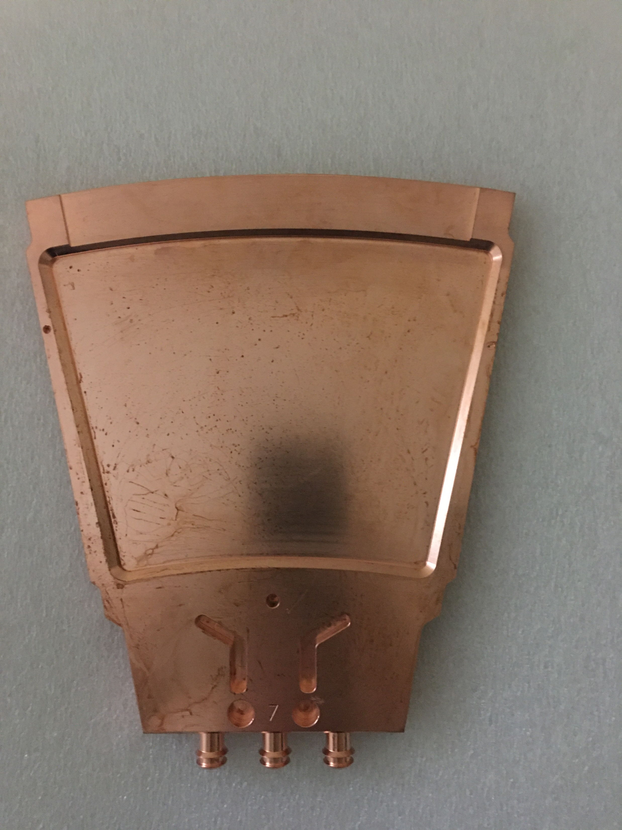
Target
Thick lithium target on a copper backing
16 individual petals making up a lithium surface ~1m in diameter
Rotates at 600rpm
Water cooled (~300L / min)
>1000 hour target life at full beam power without any significant yield drop
3 x 10^13 n/s yield at 2.6 MeV
Beam approx. 10cm diameter
Target can reach ~6 TBq of 7Be…

Slide 8
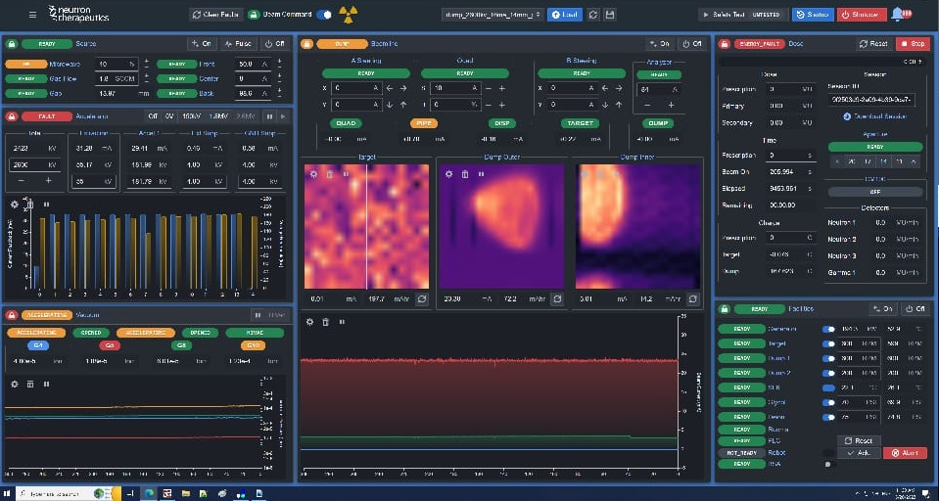
Full proton beam energy/current (2.6MeV/30+mA) achieved in March 2023, first neutrons 7th December 2023

Slide 9
First ‘serious’ experimental running - Radiation damage in optical fibres for cryo applications
Evolution of the radiation-induced attenuation of a set of five
standard optical fibers with different photobleaching light power levels at
liquid nitrogen temperature.
From “Photobleaching of Neutron Radiation Induced Attenuation of Optical Fibers at Liquid Nitrogen Temperature”, Fernandez et al, IEEE Transactions on Nuclear Science 2025 (paper in press)
Also Ludbrook, B.M., Fernandez, F.S., Ramesh, M., Phoenix, B., Moseley, D.A., Schuyt, J.J., Fernando, G. and Badcock, R.A., 2024. Resilience of Fiber-Bragg Grating Optical Sensors Under Neutron Irradiation At 77 K. IEEE Transactions on Applied Superconductivity.

Slide 10
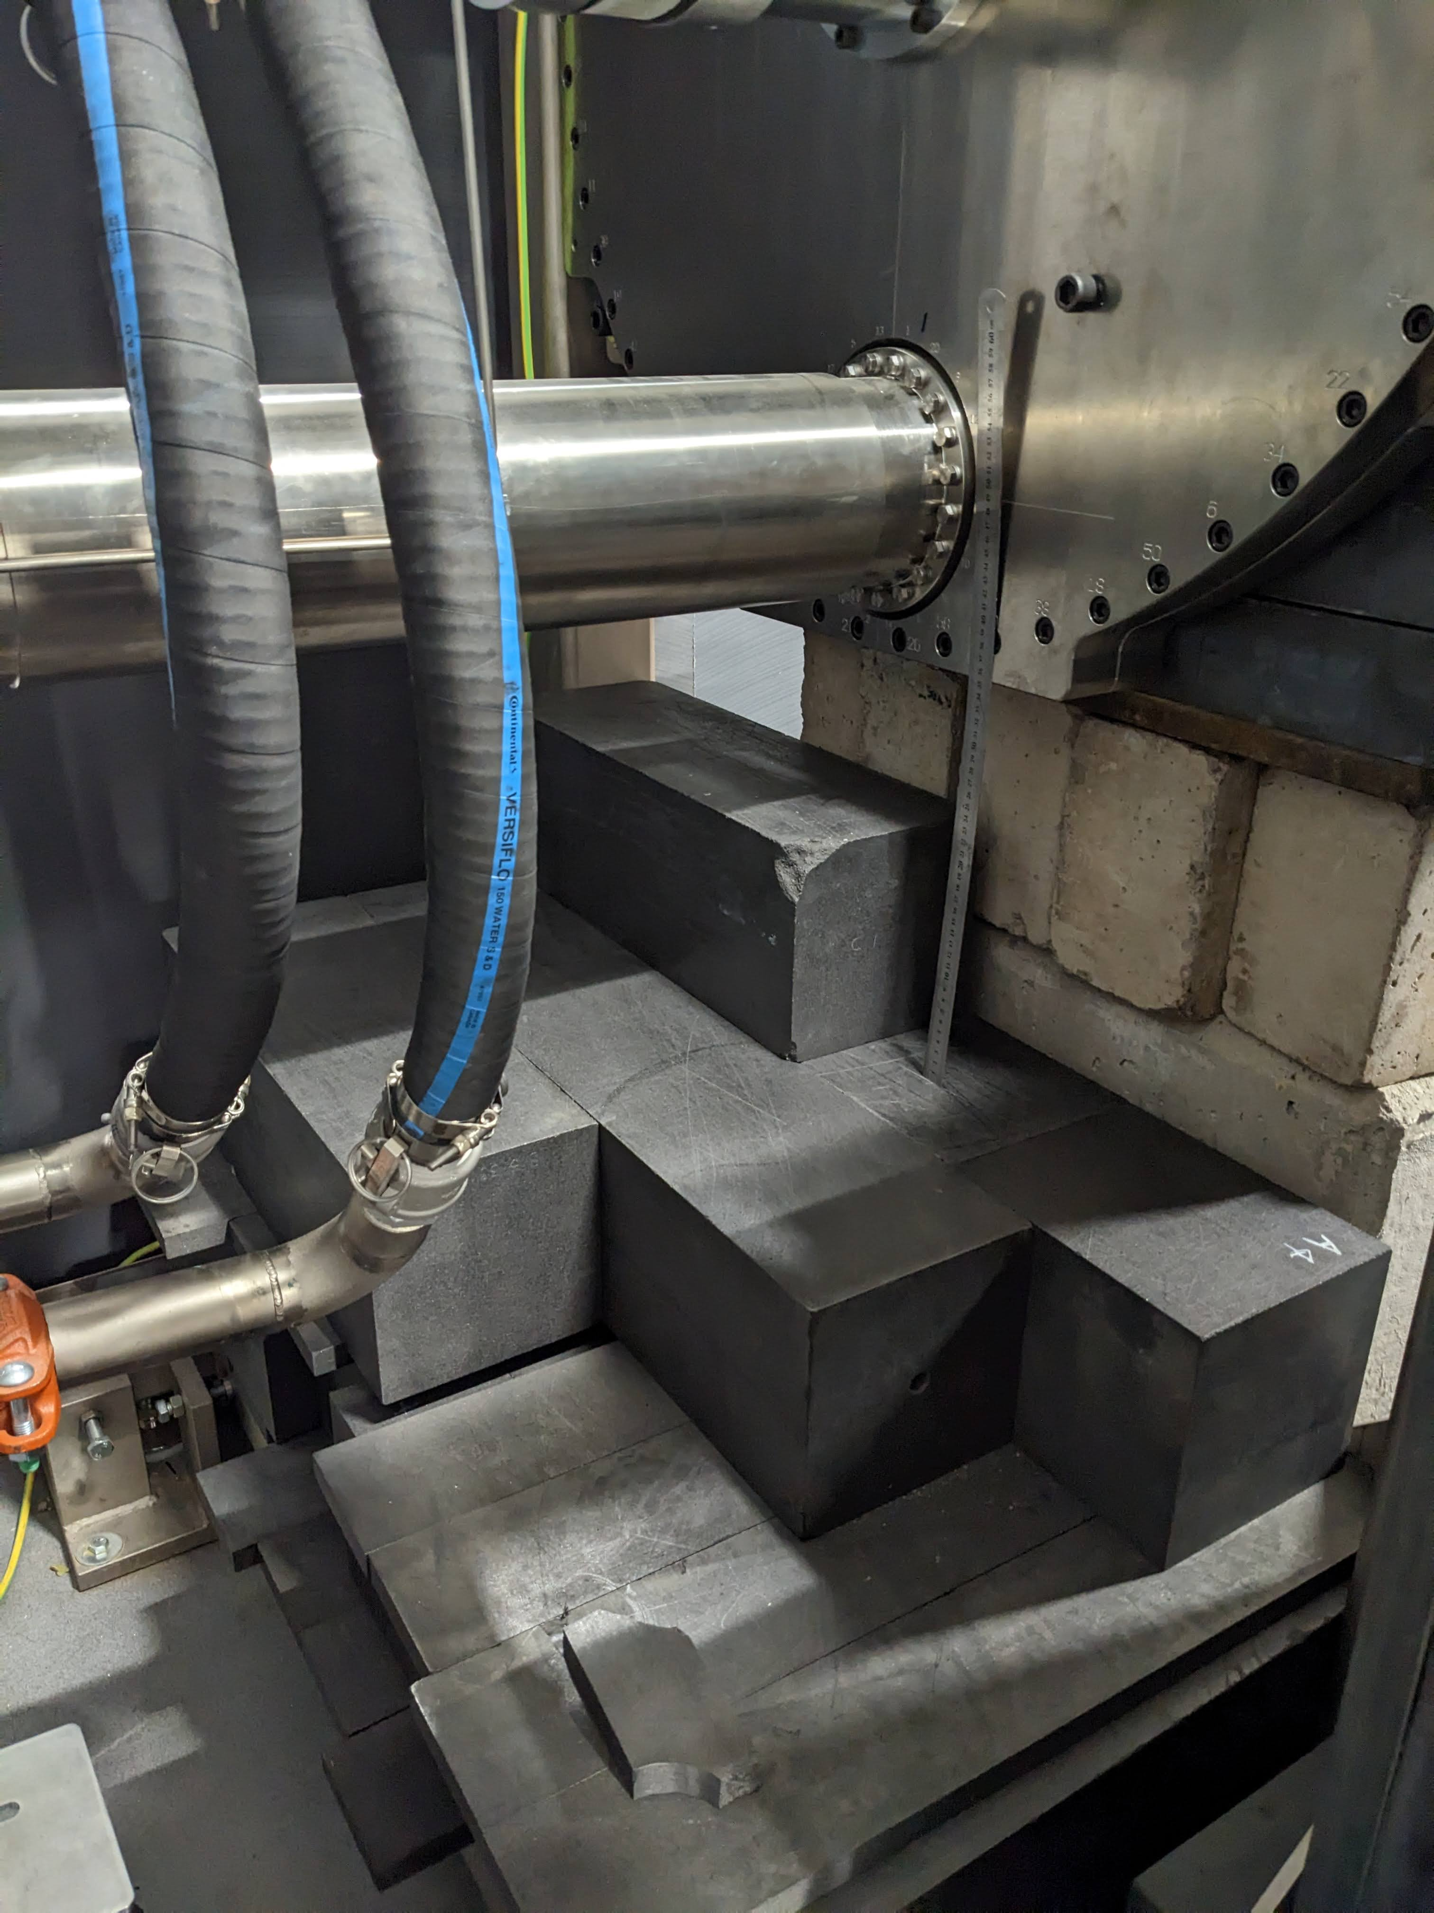
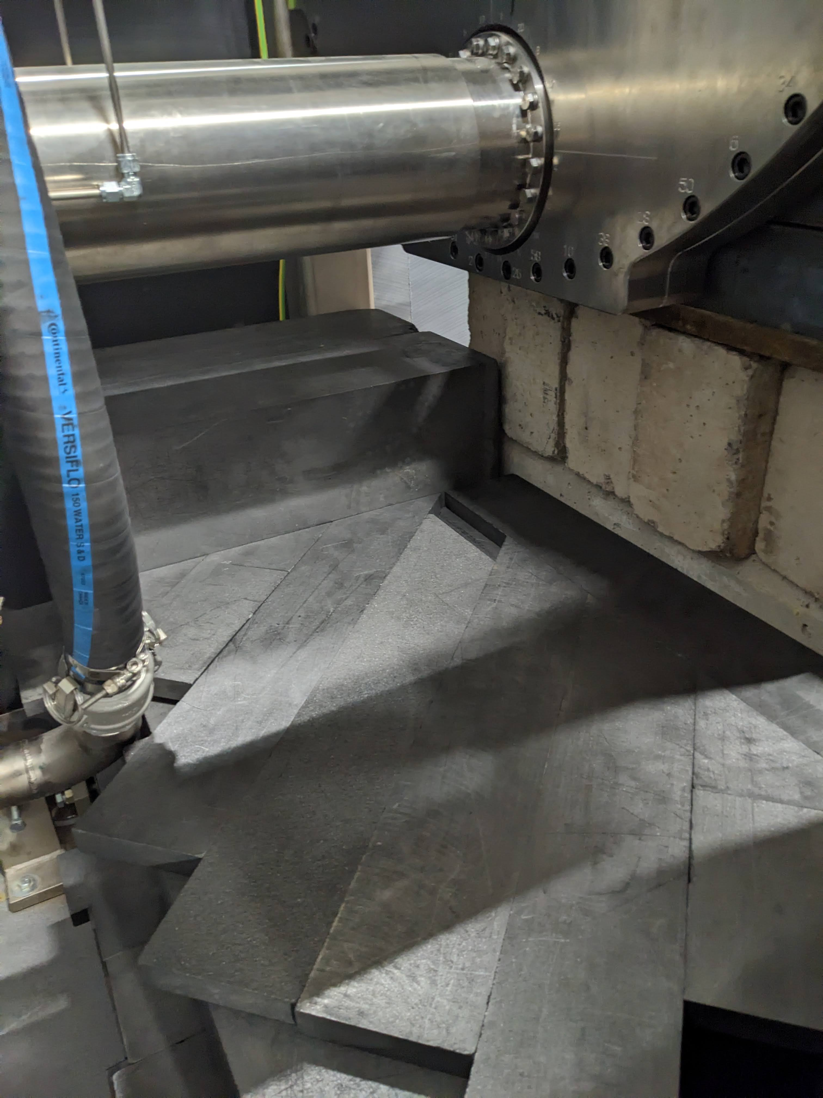
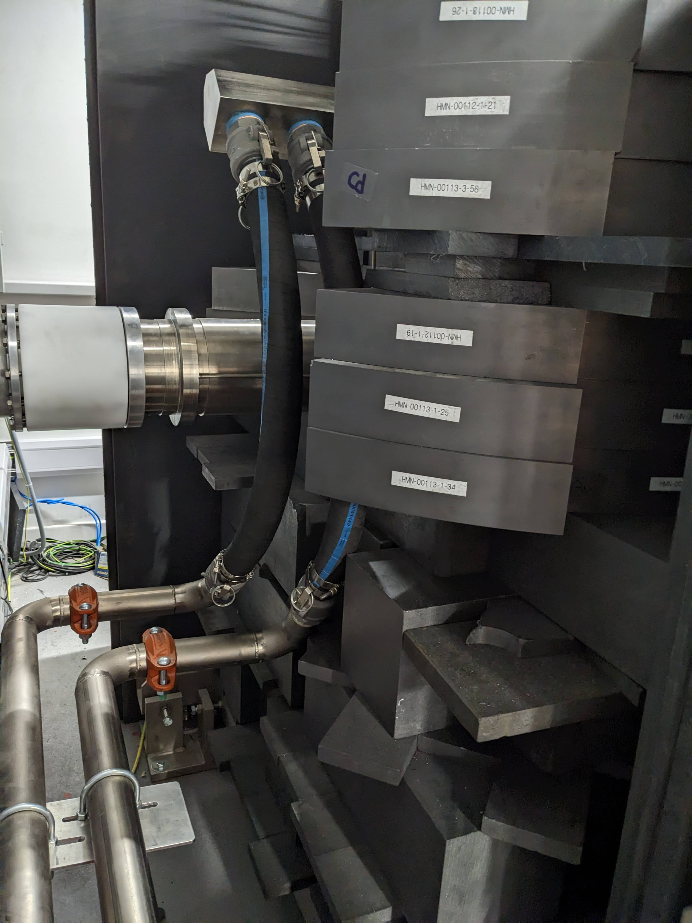
Graphite stack for thermal neutron irradiations

Slide 11
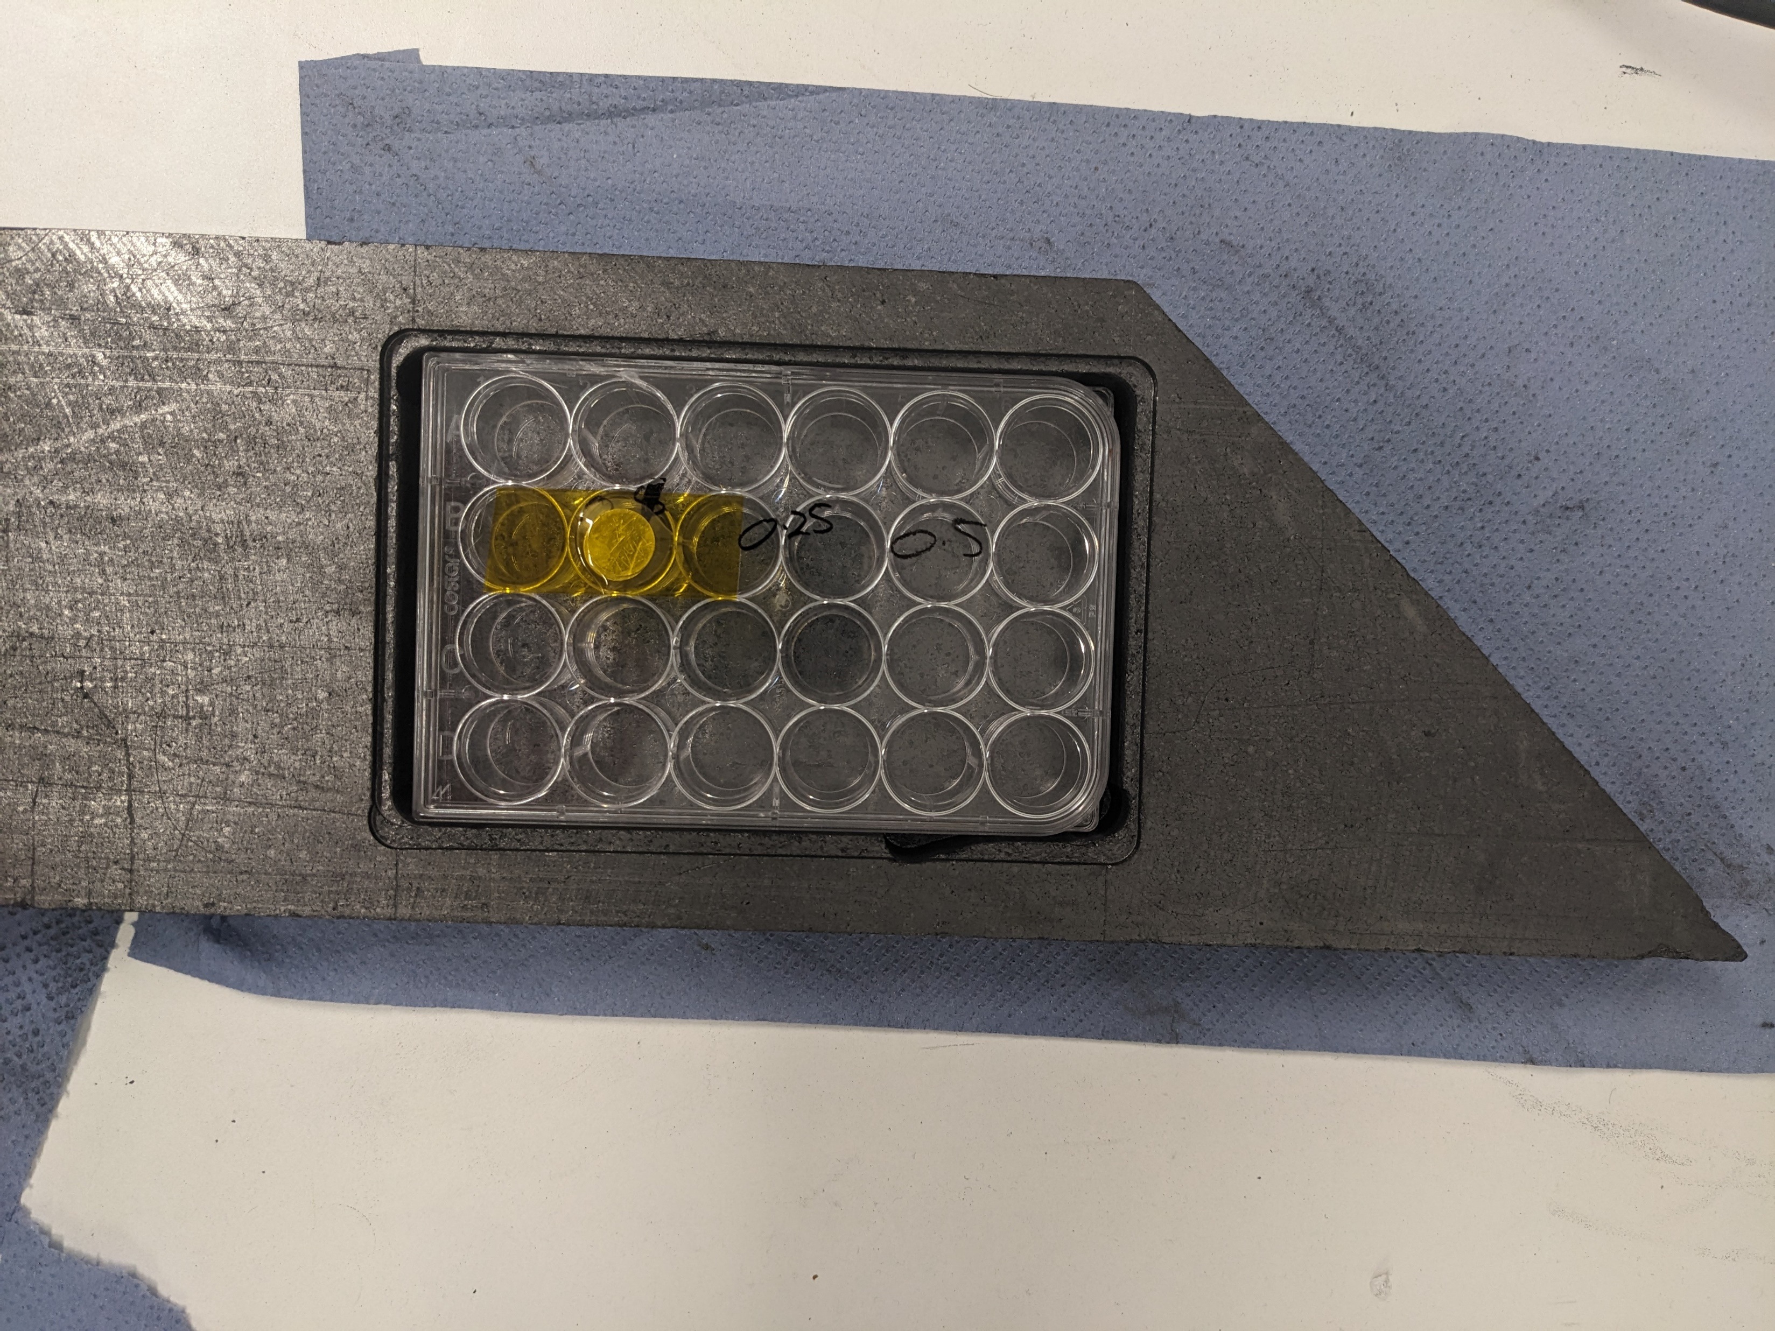
Radiobiology experiments for Boron Neutron Capture Therapy (BNCT)
Thermal flux of ~1.5e9 n/cm^2/sec with almost no fast contamination
At 50ppm boron, ~0.25 Gy/min dose rate
Uniform to +/- 3% over the cell plate
We currently run cell irradiations one or two days a week supporting a large radiobiology research group

Slide 12
Clonogenic survival of various cell lines exposed to neutrons + Boric Acid or Boronophenylalanine(BPA) - Mannitol

Slide 13
Growth assay of cell-spheroid clusters incubated in BPA / boric acid + neutrons
Boron dose (ppm)
Boric acid
BPA
0 20 50 100
FaDu
0
9.81x10¹⁰
Thermal neutrons/cm²
1.96x10¹¹
Boric acid
BPA
A253
3.93x10¹¹
Representative images - FaDu Day 15 with boric acid
Cell and spheroid data from Maria Rita Fabbrizi and Leah Punshon.
First publications in preparation now.
n=1

Slide 14
Upcoming radiobiology work
Lots more compounds; different BPA formulations (BPA-PVA), BSH, novel porphyrins etc
More survival studies but also radiation damage / repair (gamma-H2AX, Comet etc)
Combination of BNCT with DNA repair inhibitor drugs
Uptake and washout ICPMS studies using new rapid ICPMS techniques developed in Birmingham (technique paper from James Coverdale’s group coming over the next couple of months)
BNCT irradiations in chicken embryo model – currently doing the unirradiated control toxicity studies

Slide 15
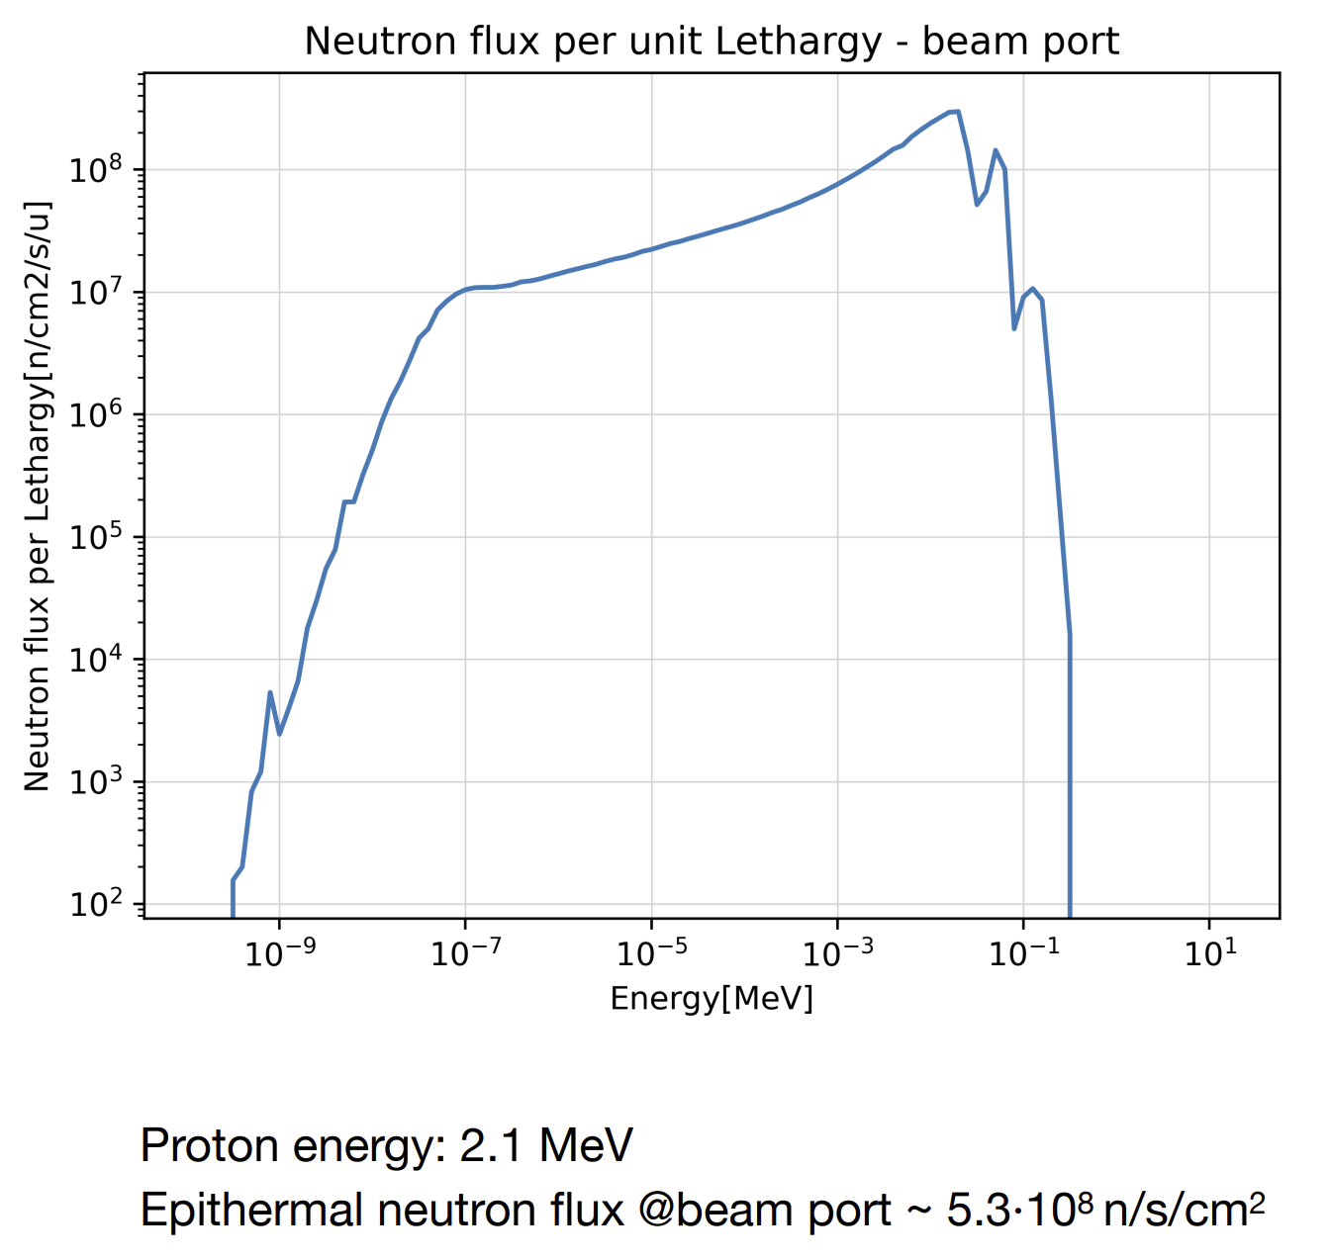
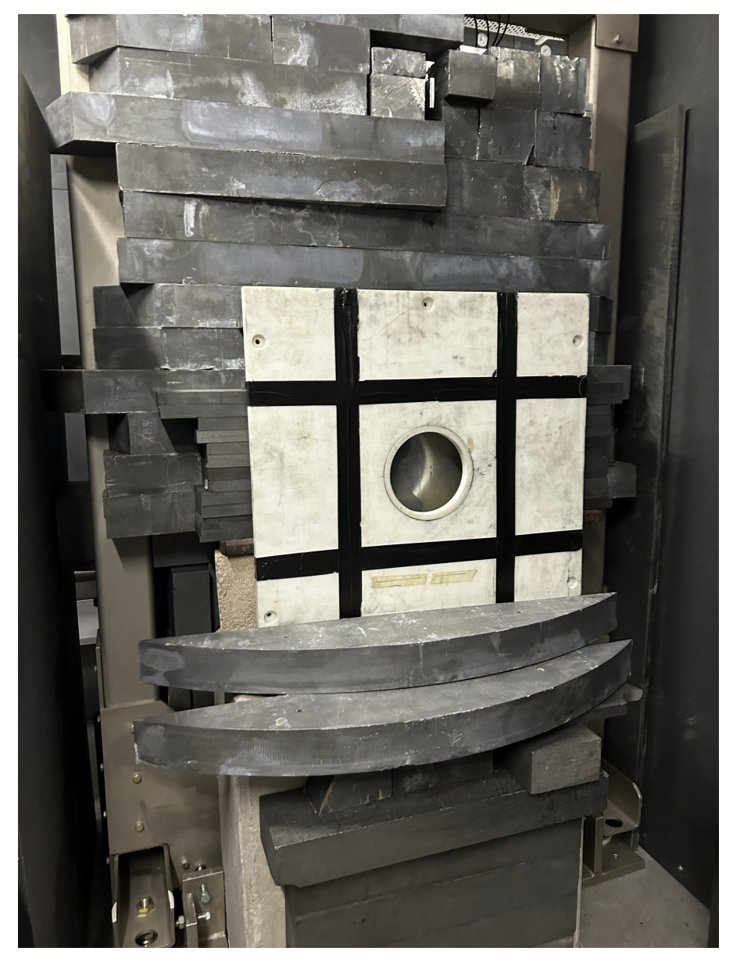
BSA for NECTAR (NEutron Capture- enhanced Treatment of neurotoxic Amyloid aggRegates)
Design by Valeria Pascali
from the University of Pavia as part of the NECTAR project. (paper submitted for publication)
22cm of Fluental as a moderator
12.24cm of Lead / 10.76cm graphite as a reflector
2.5cm lithium loaded polyethylene delimiter
Materials re-used from Dynamitron BSA
(MCNP6 simulation)

Slide 16
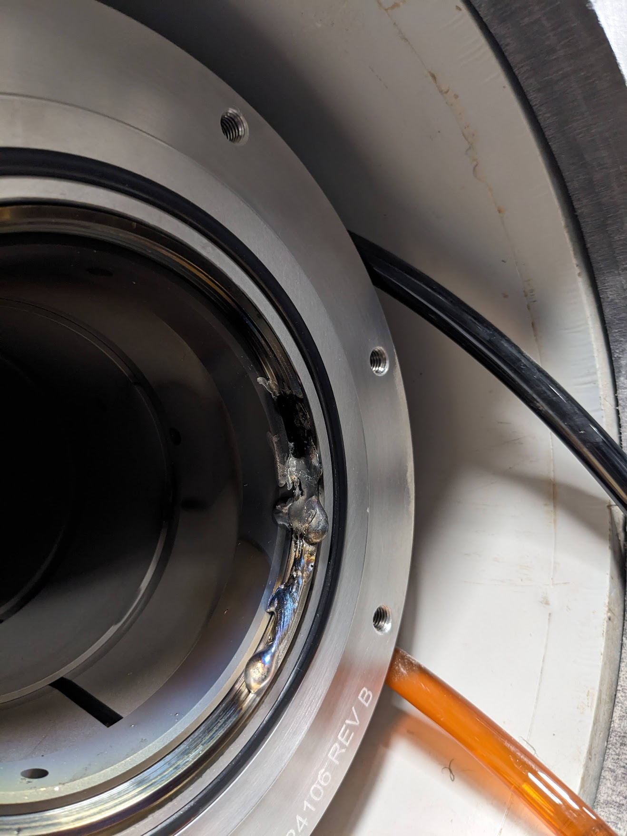
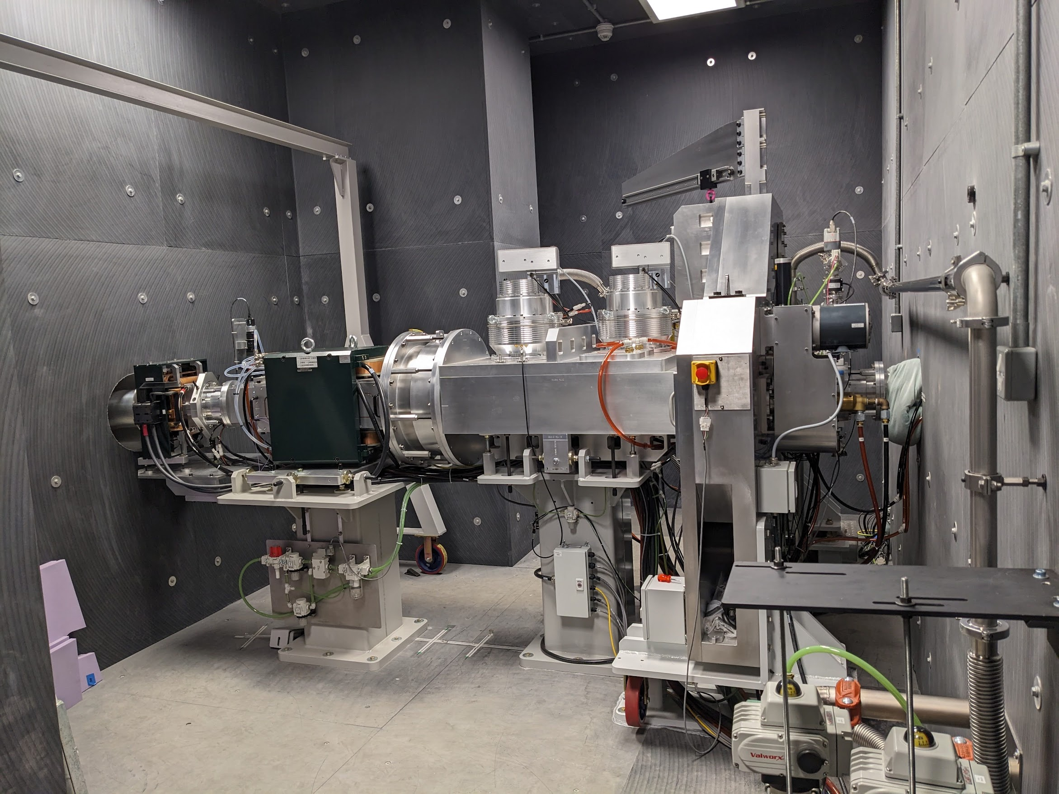
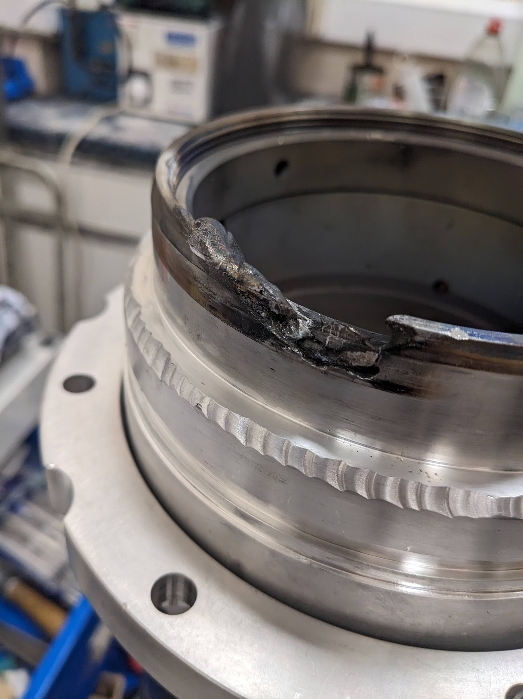
Current status…oops
New beamline section arrives in a couple of weeks time…
We will also do our first target exchange

Slide 17
Upcoming work
(BNCT) Testing / characterisation of a beam shaping assembly from the University of Granada (lead reflector / MgF moderator)
(BNCT) Boron imaging – testing of several different technologies; "Imaging Total Energy Detector“ i-TED¹ (University of Granada/CERN), “Fusion Gamma Ray Spectrometry” FUGAS (UKAEA), LaBr array² (UoB), HEXITEC (UCL)
Measurement of the high energy (17 MeV) p,gamma yields from lithium.
Radiation damage in high temperature superconductors for fusion applications– initially 20 days of 24/7 irradiation.
DD beams – testing of deuterium loaded target
Corrosion in zirconium alloys (supercritical water loop)
Radiation induced creep (in-situ creep measurement rig can measure down to sub nm)
Anything you want to do – we are a user facility and open for access!
Torres-Sánchez, Pablo, et al. "The potential of the i-TED Compton camera array for real-time boron imaging and determination during treatments in Boron Neutron Capture Therapy." Applied Radiation and Isotopes 217 (2025): 111649.
Nutter, Kiran, et al. "A feasibility study using an array of LaBr3 (Ce) scintillation detectors as a Compton camera for prompt gamma imaging during BNCT." Frontiers in Physics 12 (2024): 1347929.

Slide 18

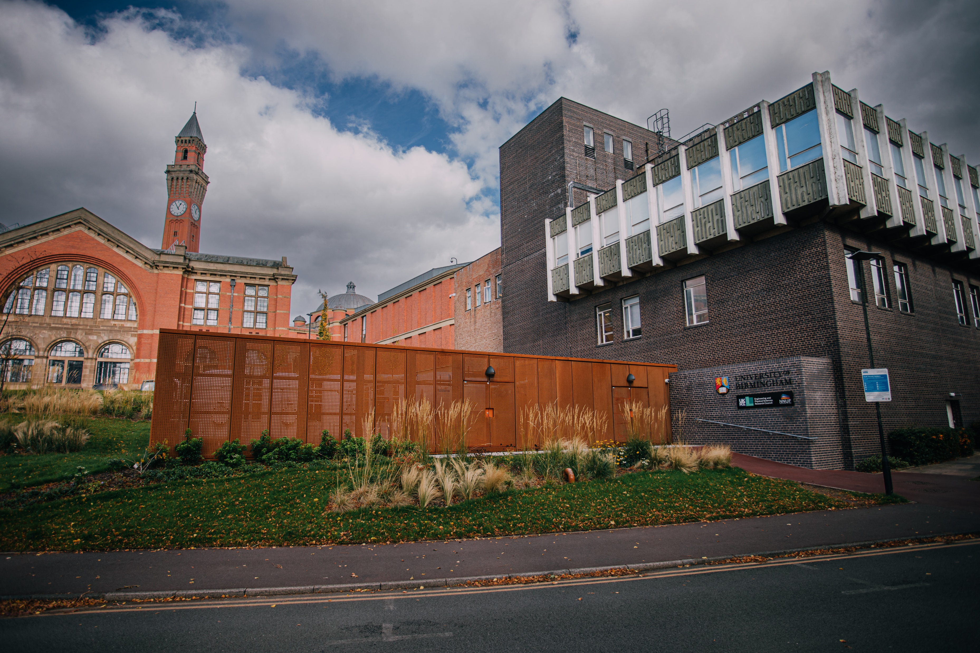
Thanks for listening and please do get in contact if you need neutrons! (b.phoenix@bham.ac.uk)

