Slide 1
Contributions to measuring the value of neutron sources
Feb 2025 – UCANS11, Vancouver, BC, Canada

Slide 2
About TVB Associates
Scientific Consulting Firm
Specializing in strategy and development of major research infrastructure
Principal consultants hold 40+ years experience in operations of neutron beam facilities
Neutron beam instrument design
Scientific and technical design
Project Management
Research infrastructure strategy
Strategic and long-range planning
Management consulting for facilities
Grant proposals
Alumni Analyzer
Career data analysis of facility alumni to show socioeconomic impact
- Former students, postdocs, or staff
Principal Consultants
Daniel Banks Zin Tun
2
Notes:
Instruments – McMaster Nuclear Reactor
Strategy – Heavily involved in all of Canada’s efforts for neutron beam facilities. NC. CANS. LRP.

Slide 3
Measuring the socioeconomic value of neutron sources
Ideally, impacts should be:
Objective
Quantitative
Monetized
Easy to communicate
Challenges
Private companies’ use of knowledge is proprietary
Many research activities contribute to an impact
Outputs are often measured, impacts less frequently
Data may be inaccessible
Economic expertise
Diverse kinds of impacts
?
3

Slide 4
Economic impact of knowledge

Slide 5
Economic impact of knowledge
Assessment of the Retrospective and Prospective Economic Impacts of Investments in U.S. Neutron Research Sources and Facilities from 1960 to 2030. Research Triangle Institute (RTI) International. May 2024
5

Slide 6
Hard drive case study
By developing a greater understanding of the properties of thin layers of magnetic film, computer scientists were able to store more information into smaller areas on hard drives: 200 MB (1992) -> 1 GB (1999) -> 1.5 TB (2008)
Neutron scattering was seminal to understanding of ferromagnetism, the basic principle on which hard drives operate [Fitzsimmons et al. (2004)]
High-density magnetic recording of hard drives depends on a thorough understanding of the giant magnetoresistance (GMR) of each nanolayer in a hard drive. Polarized neutron reflectometry is uniquely suited for acquiring this understanding (Pessoa Barradas, 2017).
U.S. neutron sources frequently published work on hard drives and magnetic materials through this period.
IBM, which has used U.S. neutron scattering facilities, has 150 patents related to the GMR effect.
Neutrons had a strong impact on hard drive development
6

Slide 7
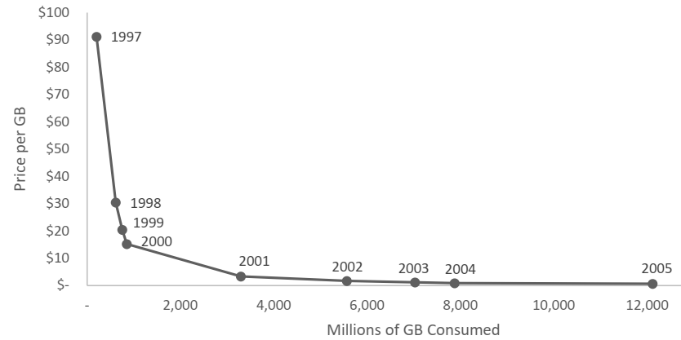
Hard drive case study
First GMR hard drive in 1997, first competing solid-state drive in 2005
RTI used the annual price and consumption levels from 1997 through 2005 to compile the long-run demand curve for hard drives in the United States
The “consumer surplus” = the value realized consumers from the drop in prices
Impacts compounded to their present value using a discount rate of 2%
$114 billion value to consumers
Findings are conservative because:
Neutron scattering informed, has continued to inform, memory storage development beyond the GMR-enabled improvements
7

Slide 8
Hard drive case study
Can the $114 billion impact be fully attributed to the neutron scattering experiments?
No, many other research techniques were used to study these materials and technologies
RTI’s key step:
Conservatively assume that the neutron scattering accelerated GMR hard drives by only 2 years
Calculate the difference economic value between the historic scenario and one in which the technology was delayed by 2 years
$10B impact attributable to U.S. neutron scattering facilities from hard drives over 1997-2005 alone
By comparison, RTI calculated costs of three major U.S. neutron facilities over 70 years at $18B.
Combining benefits from their cases studies in
Hard drives,
Electric vehicles,
GLP-1 drugs, and
Aircraft reliability,
RTI found a benefit-to-cost ratio of 2.7 for U.S. neutron facilities.
Results are conservative because they do not include many others benefits arising from neutron facilities over many years.
8

Slide 9
Calculating the impact for Canada
Reasons for translating this impact calculation to Canada:
In the years prior to the first GMR hard drives, Canadians were active contributors to GMR research through polarized neutron reflectometry at the NRU reactor
Canadian PhD graduates from such research were hired by hard drive companies (e.g. Seagate) when they were developing the first hard drives
Canada adopted higher-density hard drives along with the U.S.
These factors allow scaling the impacts in the U.S. to Canada based on size of the economy:
$9B in economic impact from higher-density hard drives
$800M is attributable to research using neutrons
The present value of all investments in Canadian neutron facilities over 70 years is ~$750M.
The hard drive impacts alone repaid all of Canada’s investments.
Similar arguments can be made for electric vehicles.
TVB calculates that the economic returns have been triple Canada’s investments based on just these 2 lines of research.
9

Slide 10
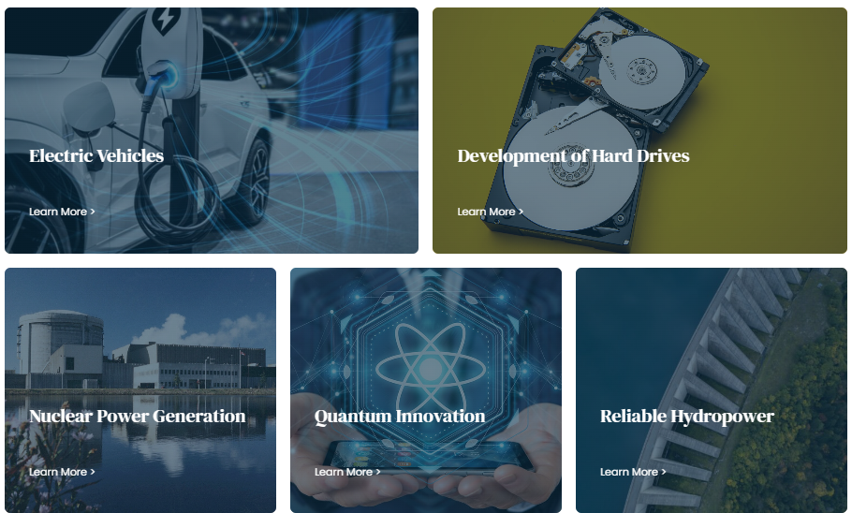
Economic impact of knowledge: Impact for Canada
Such stories of various impacts throughout the Canadian economy are a basis of government relations messaging.
See Neutrons Canada website:
https://neutrons.ca/#impacts
10

Slide 11
Isotope Production

Slide 12
Business case for a Canadian CANS
University of Windsor is proposing a CANS for:
HiCANS development
Neutron scattering
Boron Neutron Capture Therapy
Medical isotope production
TVB Associates produced an analysis of the economics of producing F-18 and FDG in Windsor using the proposed accelerator for the CANS
[F-18]fluorodeoxyglucose, known as FDG, is the radio-pharmaceutical needed for cancer diagnosis through positron emission tomography (PET)
https://tvbassociates.ca/2023/07/10/business-case-for-medical-isotope-production-in-windsor/

Slide 13
Business case for a Canadian CANS: Isotopes for PET scans
Canada’s small population is distributed over large areas
Equitable medical care across rural areas is challenging
PET scans use Fluorine-18 (F-18), half-life < 2 hours
F-18 should be produced near the PET scanner
The city of Windsor has a PET scanner, but relies on F-18 produced 2 hours’ drive away
Radioactive decay losses drive up the per-patient cost of PET scans and limit the number of patients that can be served
TVB’s model of a F-18 production business in Windsor had the ability to vary inputs:
Costs of production and transportation
Prices of FDG
Demand for PET scans
Our model was based on expert insights from FDG suppliers, suppliers of FDG production equipment, and cancer care providers

Slide 14
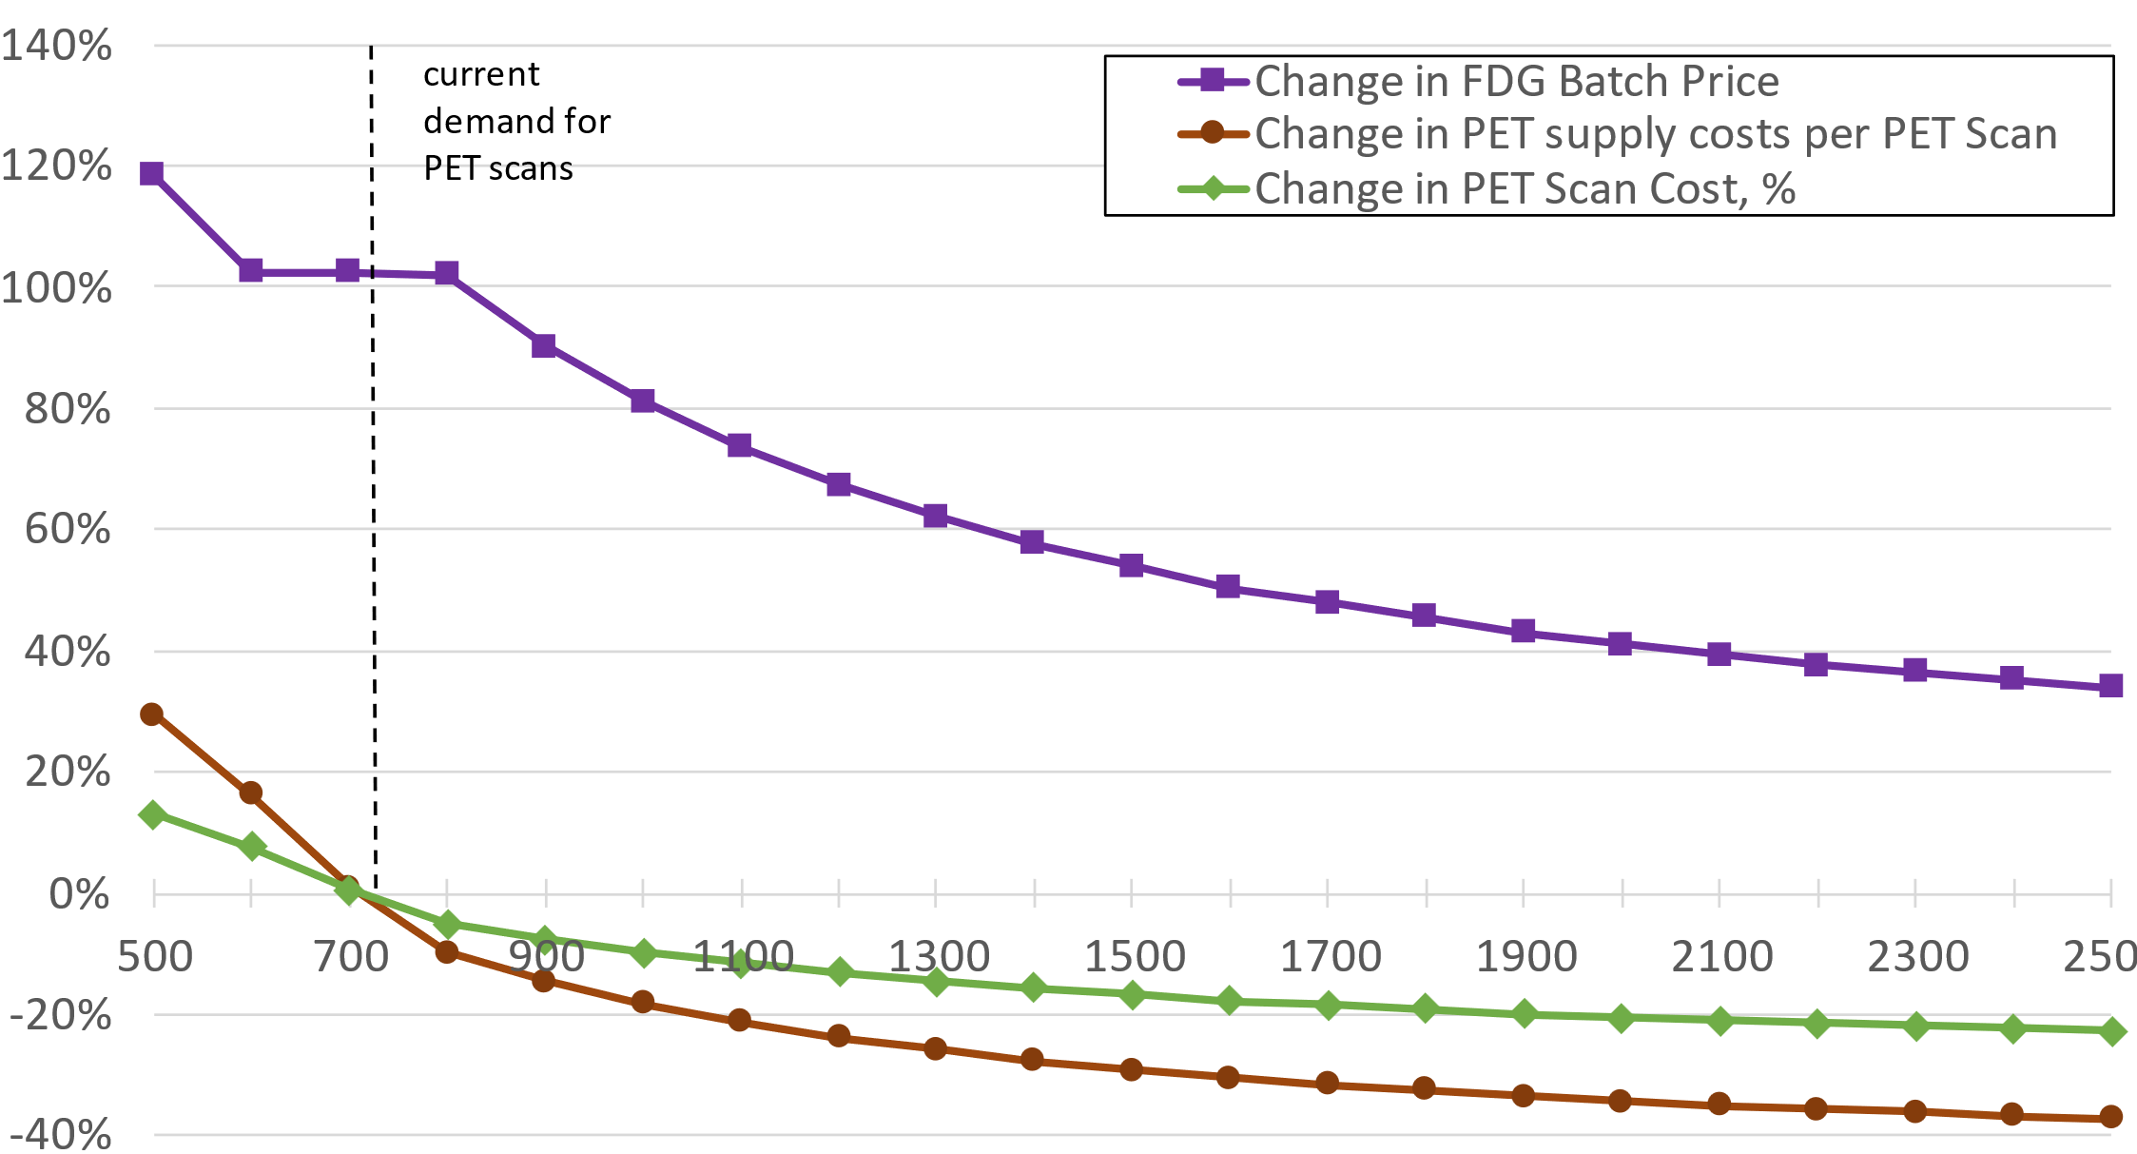
Business case for a Canadian CANS: Isotopes for PET scans
Key findings:
(1) Sustainability could be reached in Windsor if:
If cost of accelerator & building is covered
If the health payer (the government) agrees to pay 2x the cost of the FDG, offset by processing more patients per FDG batch, keeping the per-patient cost of a PET scan constant
If the local producer is a university or hospital that can employ FDG production staff elsewhere on days when FDG is not being produced
(2) Over time, growth PET scans in Windsor will make the business model more sustainable, ultimately enabling replacement of the accelerator and buildings.
Sustainable FDG Scenario: Change in PET Scan Costs
PET scans per year

Slide 15
Business case for a Canadian CANS: Economic impact
Abdur Rahman (Master’s degree student, University of Windsor Economics Department) built on this model to further determine economic impacts.
Local production of F-18 isotopes would:
generate gains from reduced decay-induced production losses of $21 million, and
save another $3 million in transportation costs.
A small-scale, local Boron Neutron Capture Therapy station would produce a cumulative benefit of at least $5 million through extended survival times in Windsor alone.
These are conservative, and additional benefits beyond other values from the CANS.

Slide 17
Governments fund research, in part, because research is done by students who learn critical science and technology skills.
These alumni will enable innovation throughout the economy.
Today, to show impact, research organizations typically count numbers of students and showcase a few alumni examples.
Is there a better way?
Social media for professional networking (e.g. LinkedIn) makes career data available
Why is this career data not often used to show impact from research?
Challenges:
Time-consuming and laborious to collect the data
Time-consuming and laborious to analyze the data to produce aggregate insights
Hard to interpret the aggregate data in a meaningful way

Slide 18
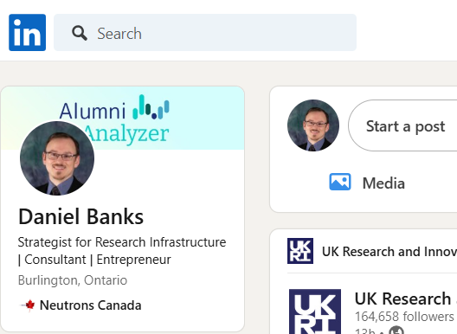
Social media websites for professional networking now make career data available.
Why is this career data not often used to show impact from research?
Challenges:
Time-consuming to collect the data
Laborious to analyze the data to produce aggregate insights
Hard to interpret the aggregate data in a meaningful way
Is it worth all that effort if the result is uncertain?

Slide 19
COLLECT
ANALYZE
BENCHMARK
SHARE
Our findings help you share impactful stories with funders, potential recruits and employers about the value your alumni bring.
We provide benchmarking of our findings for comparison, measurement, and strategic decision-making.
We perform reliable analysis, extracting valuable insights from messy, self-reported alumni data from online sources.
We systematize and accelerate the collection of alumni data and its preparation for analysis.

Slide 20
Alumni from the Canadian Neutron Beam Centre (1985-2015)
>80% are in the sectors where high-tech skills and innovation are most needed:
Manufacturing
Scientific and engineering services
Universities
3x as likely to upgrade their skills:
60% of undergrads who used neutron beams earned graduate degrees, with two-thirds earning a doctorate
By comparison, only 16% of Canadian university graduates earn graduate degrees
Over 50% of the Master’s students went on to earn a PhD
https://neutrons.ca/hqp-leaders/

Slide 21
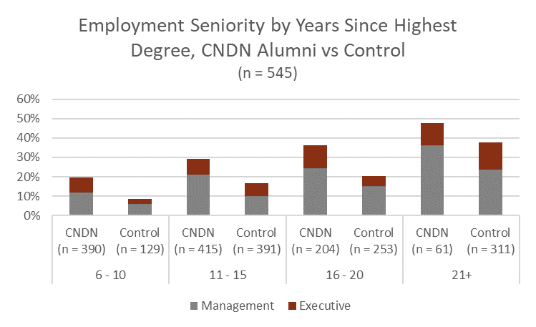
CMC Microsystems
Delivers micro-device design and fabrication services to over 10,000 researchers in Canada through Canada’s National Design Network (CNDN).
Alumni Analyzer findings:
CMC alumni enjoy accelerated career progression: 2x as likely to be in executive and management positions within 10 years.
Their employers enjoy greater employee retention and engagement: CMC alumni remain with their employers longer than peers, and this effect is seen for up to 20 years.
CMC alumni work in industry in greater proportions: 81% overall get employed by industry versus 75% for the control group.
https://alumnianalyzer.com/cmc-microsystems

Slide 22
Canadian Light Source
A national synchrotron that has provided extremely bright x-rays for materials research by over 5,500 scientists, including over 3,000 students on site.
Alumni Analyzer findings:
CLS alumni achieve higher leadership positions over time. After 10 years, CLS alumni are over 4x more likely to be in executive positions than the control group.
A strong majority of these alumni are employed in Canada’s top four most high-tech and research-intensive economic sectors.
CLS alumni have a strong tendency to pursue higher academic degrees, to stay in Canada, and to return to Canada if they study abroad.
- Bill Matiko, CEO
Canadian Light Source
"Alumni Analyzer’s findings were immediately useful in CLS government relations’ activities, enabling us to tell objective, data-driven stories about our impact on the training of highly qualified personnel."
https://alumnianalyzer.com/canadian-light-source-case-study

Slide 23
SNOLAB
The world’s leading deep underground clean lab, which hosts scientific experiments by large international research teams working on fundamental questions in astro-particle physics.
Alumni Analyzer found SNOLAB alumni:
tend to pursue higher educational achievements
have high rates of retention within Ontario and Canada
enjoy strong career progression, and
are more likely to work in high-tech and research-intensive sectors of the Canadian economy than other Canadian science graduates.
- Jodi Cooley, Executive Director, SNOLAB
"The findings support our message to funding partners about our impact on the workforce of tomorrow. I look forward to using their services again!"
https://alumnianalyzer.com/snolab-case-study

Slide 24
Summary
Neutron sources produce immense socioeconomic impacts
Quantifying the impacts are vital to evidence-based decision-making about large investments in neutron sources
With care and due diligence, some large impacts from knowledge generation can be quantified in dollar terms
Neutron sources can produce quantifiable benefits from related missions such as F-18 isotope production and BNCT
Neutron sources have strong impacts on the workforce through training of highly qualified people–and this impact can be quantified and benchmarked

Slide 25
Thank you

