Slide 1









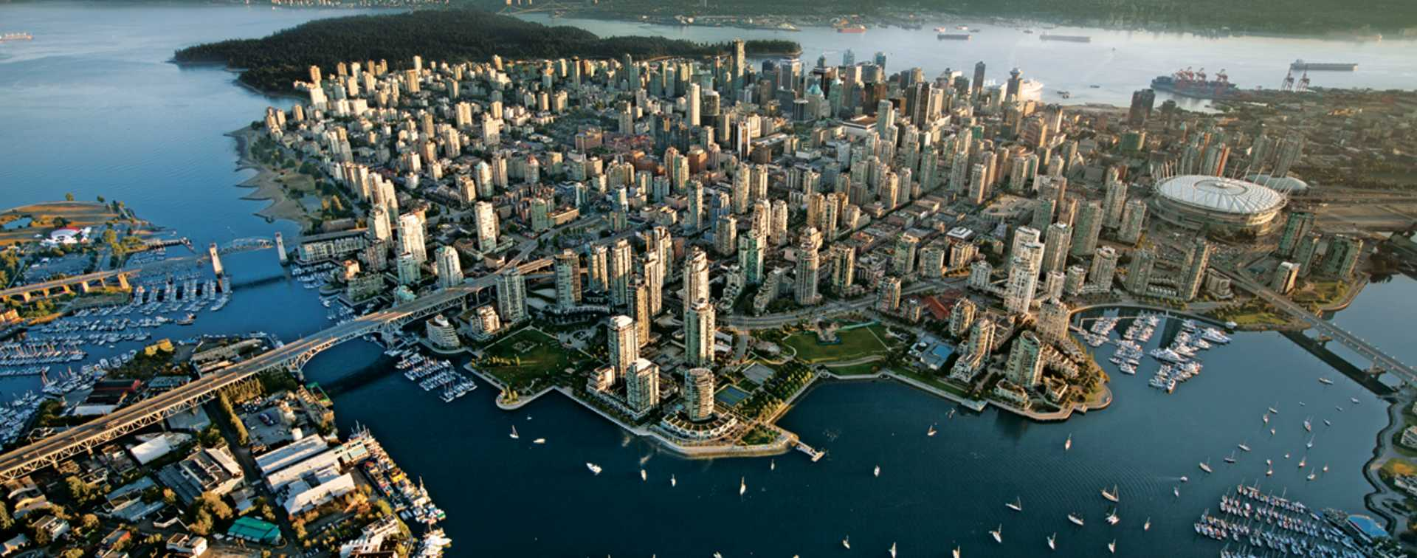
Welcome to the 11th International Meeting of the Union for Compact Accelerator Driven Neutron Sources – UCANS’11
Opening session
D. Marquardt and O. Kester
February24, 2025

Slide 2
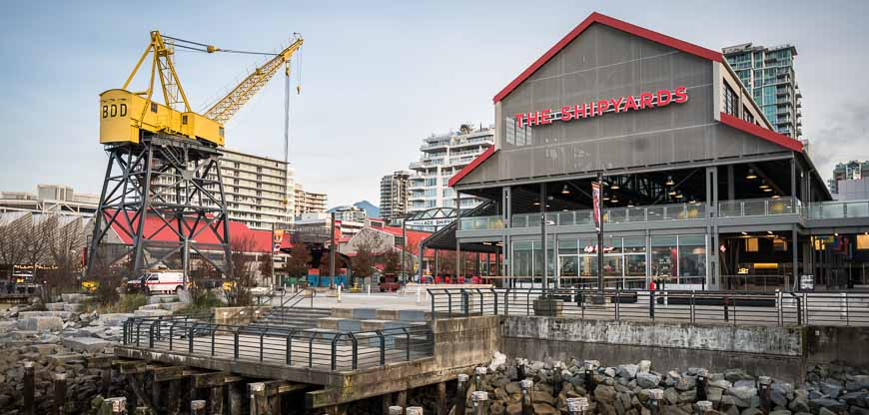
Land Acknowledgement
We respectfully acknowledge the original peoples of these lands and waters, specifically the səlilwətaɬ (Tsleil-Waututh), Sḵwx̱wú7mesh Úxwumixw (Squamish), and xʷməθkʷəy̓əm (Musqueam), on whose unceded ancestral lands the District of North Vancouver is located.
We value the opportunity to learn, share, and serve our community on these unceded lands.
Notes:
We respectfully acknowledge the original peoples of these lands and waters, specifically the Tsleil-Waututh, Squamish, and the Musqueam, on whose unceded ancestral lands the District of North Vancouver is located.
We value the opportunity to learn, share, and serve our community on these unceded lands.

Slide 3
USCANS11
The Union for Compact Accelerator-driven Neutron Sources was formed in 2010 to support the ongoing development of small accelerator-based neutron sources around the world.
UCANS11 is the 11th meeting in a biennial series of meetings that are dedicated to ongoing development of CANS, technology challenges and emerging science and novel applications.
UCANS 11 is committed to continue advancing the equal participation and collaboration between scientists in all countries in its activities and the principle of free and responsible practice of science.
Welcome to Vancouver in British Columbia!!!

Slide 4
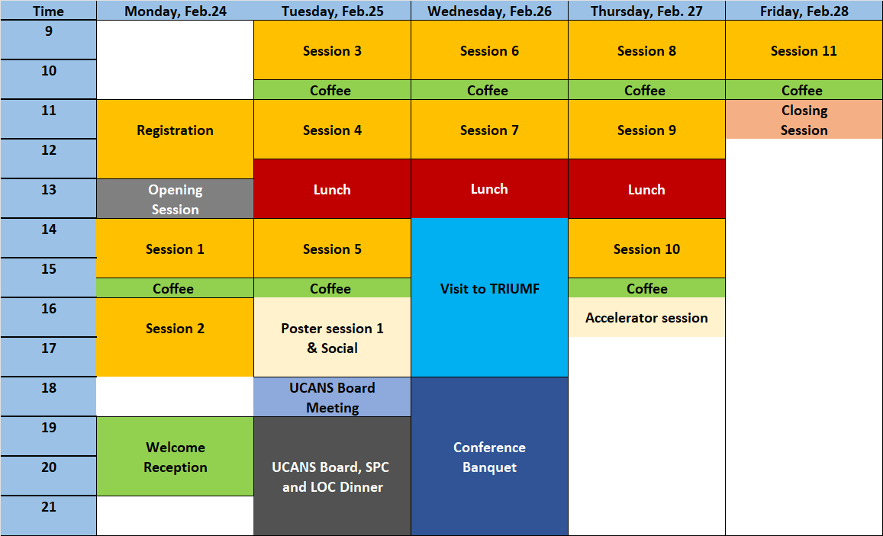
Program at a glance
We will have 8 program sessions, a poster session on Tuesday and special sessions on very cold neutron moderation and particle accelerators
On Wednesday there is a visit to TRIUMF planned, the bus will leave at 2 pm from the conference hotel.
Paper Submission deadline: March 7, 2025

Slide 5
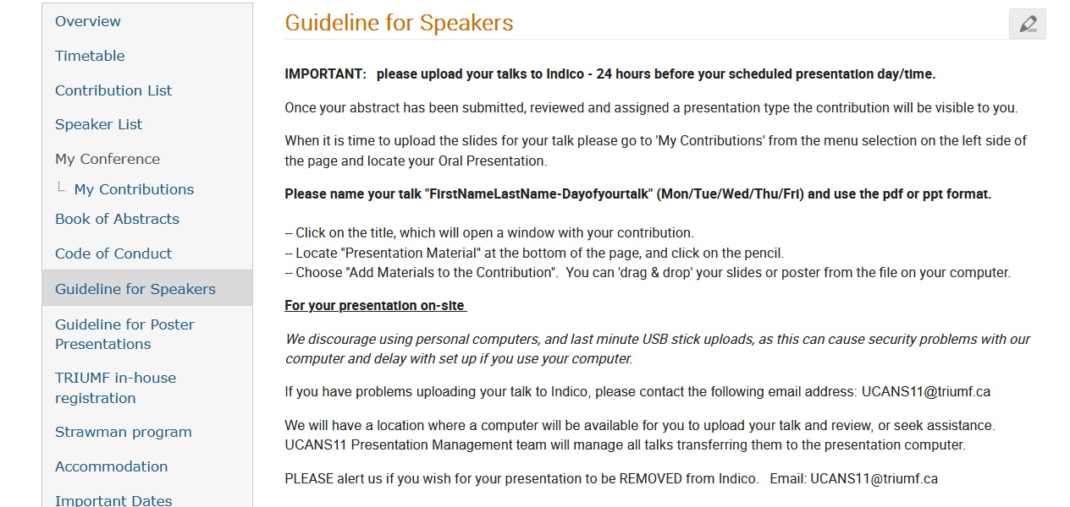
Speaker instructions
Please upload your presentations to Indico 12 hours before your scheduled presentation!

Slide 6
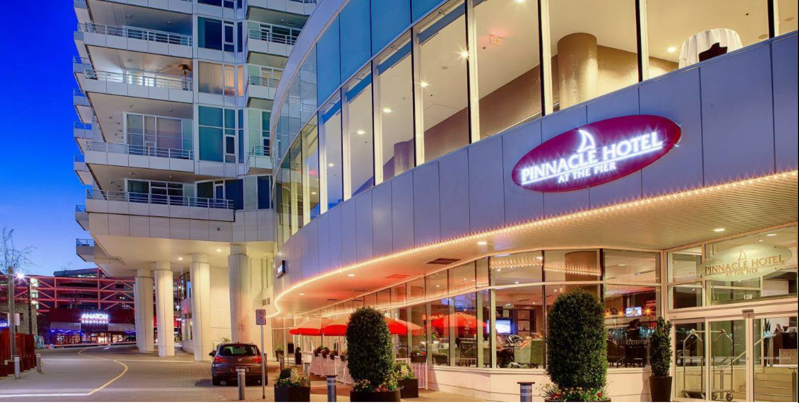
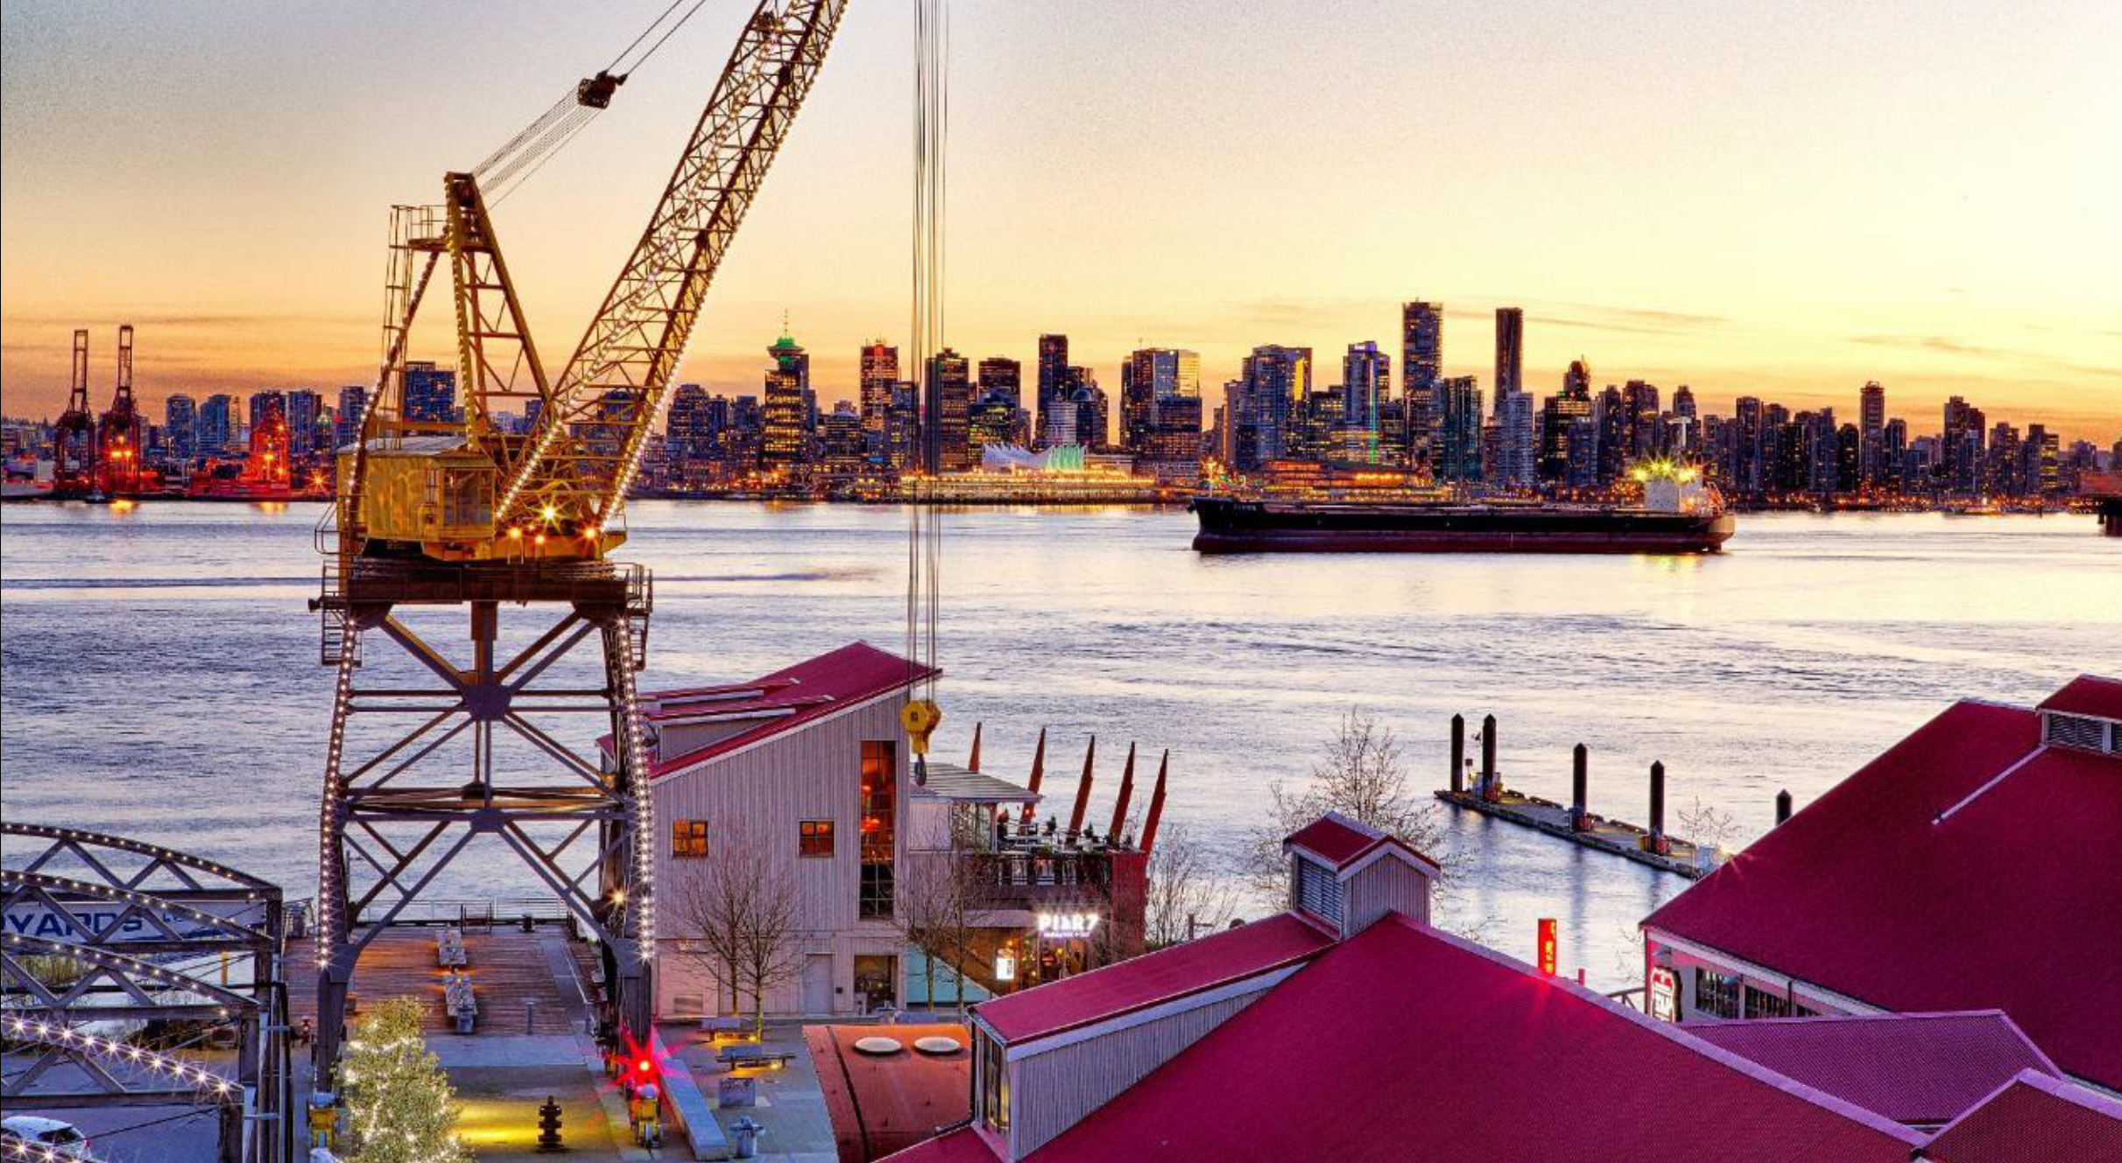
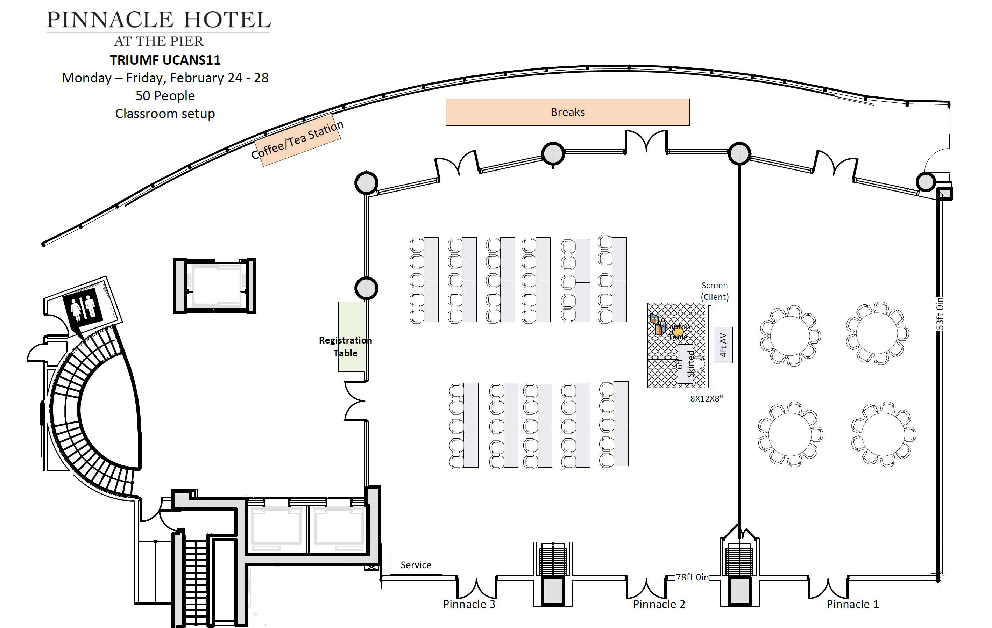
The Venue
Tickets
Monday Reception: 2 Blue tickets
Tuesday Poster Session: 1 Red ticket
Wednesday Banquet: 2 Black tickets

Slide 7


Making this possible
Local Chairs: Oliver Kester and Bob Laxdal
Coordination: Jana Thomson and Lorraine King
Science Program Committee: Dalini Maharaj, Thomas Gutberlet, Rolando Granada, Oliver Kester and Bob Laxdal
Sponsors:
Notes:
Local Chairs: Oliver Kester and Bob Laxdal​
Coordination: Jana Thomson and Lorraine King​
Science Program Committee: Dalini Maharaj, Thomas Gutberlet, Rolando Granada, Oliver Kester and Bob Laxdal

Slide 8
Welcome from the Local Organizing Committee
Oliver Kester for the LOC

Slide 9
TRIUMF is located on the traditional, ancestral, and unceded territory of the Musqueam people, who for millennia have passed on their culture, history, and traditions from one generation to the next on this site.
TRIUMF’s home has always been a seat of learning.

Slide 10
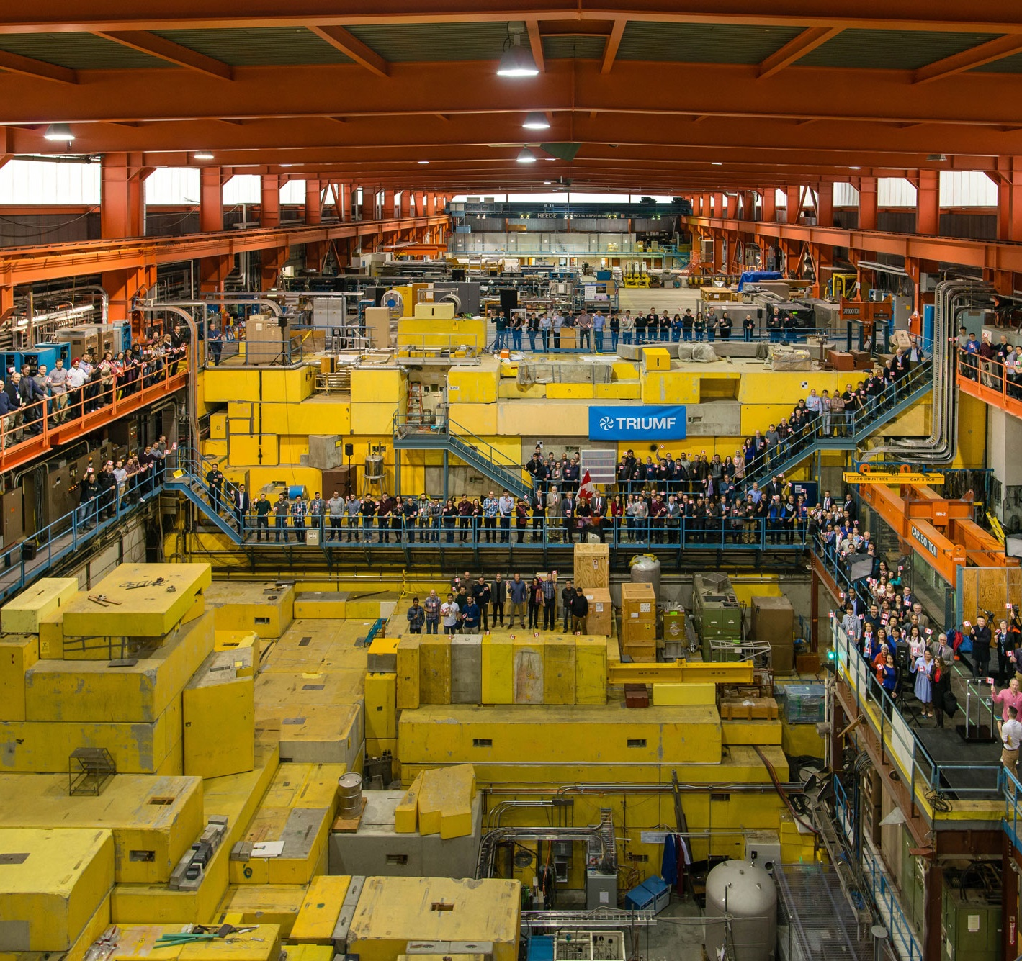
A warm welcome from TRIUMF, Canada’s particle accelerator centre.
We are a world-class hub of research, education, and innovation that is home to ~700 staff, students and post doctoral fellows.
Founded in 1968 by the University of British Columbia, Simon Fraser University, and the University of Victoria, TRIUMF is a cornerstone of BC’s innovation ecosystem.
10

Slide 11
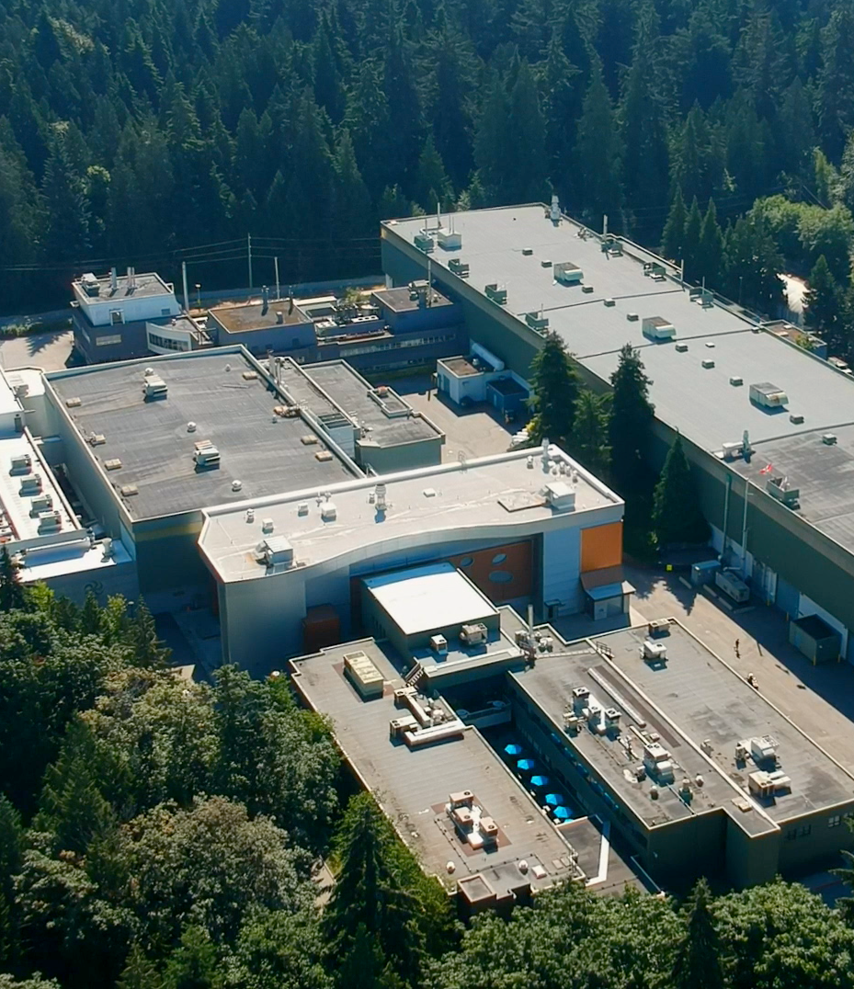
Our laboratory is one of Canada's major investments
in large-scale research infrastructure
We collaborate across communities and disciplines, from nuclear and particle physics to the life and materials sciences
We advance isotope science and technology, both fundamental and applied.

Slide 12
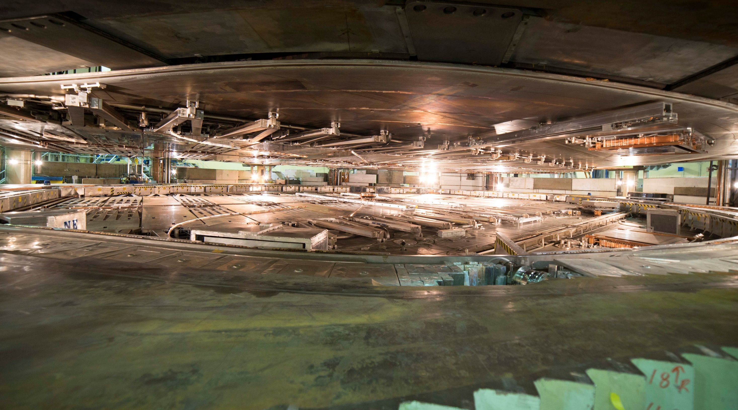
TRIUMF has five decades of experience in building a rich particle accelerator infrastructure that enables cutting-edge research while growing accelerator expertise.

Slide 13
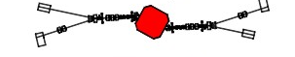
TRIUMF accelerator complex
ISAC-II
High energy
Primary beam driver (1974):
500 MeV Cyclotron, 300 μA, H⁻
Produces rare isotopes, neutrons and muons
Isotope Separator and Accelerator facility – ISAC (1996)
ISAC-I: Normal conducting-linac
  0.15-1.8 MeV/u (2000)
ISAC-II: Superconducting-linac
  1.5-16.5 MeV/u (2006)
Advanced Rare Isotope Laboratory – ARIEL (in progress)
Superconducting electron linac
  30 MeV, 10 mA, cw (2019)
4 (+1) Cyclotrons for medical isotope production – TR30 and TR13 designed by TRIUMF
ARIEL
ISAC-I
Low and
medium
energy
Isotope Cyclotrons
elinac
500 MeV Cyclotron and BL1A
IAMI

Slide 14
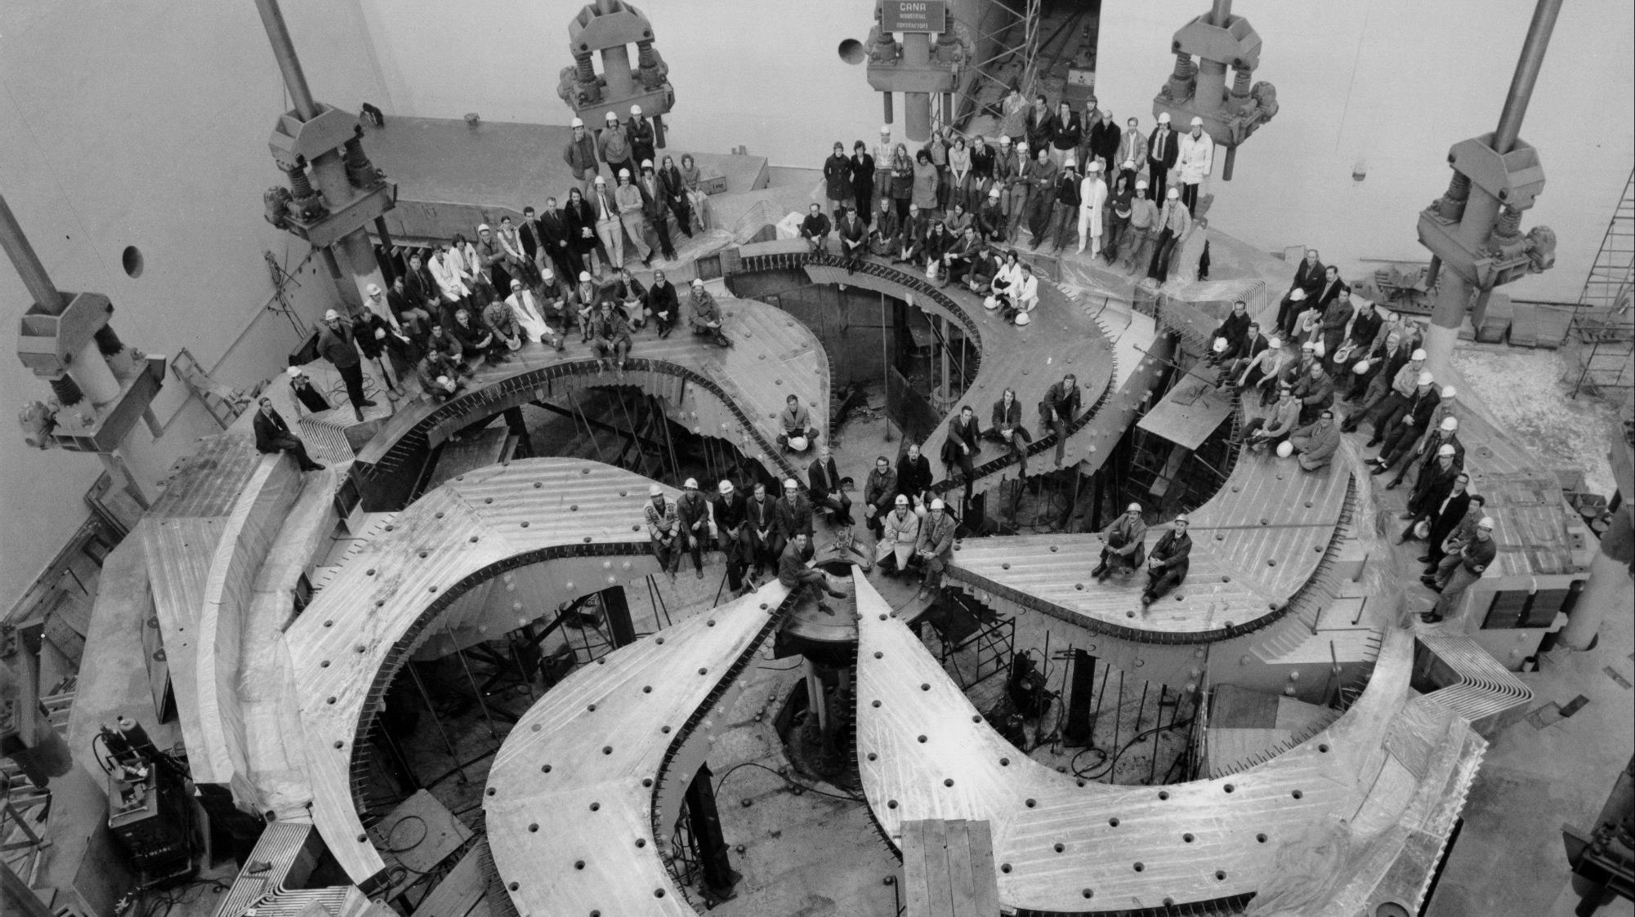
Constructed in the early 70th of last century
Largest normal conducting Cyclotron in the world: D = 18 m
Magnet weight: 4000 t, Coil current: 18500 A
H- cyclotron (multiple extraction at different energies)
5500 hours of beam delivery per year

Slide 15
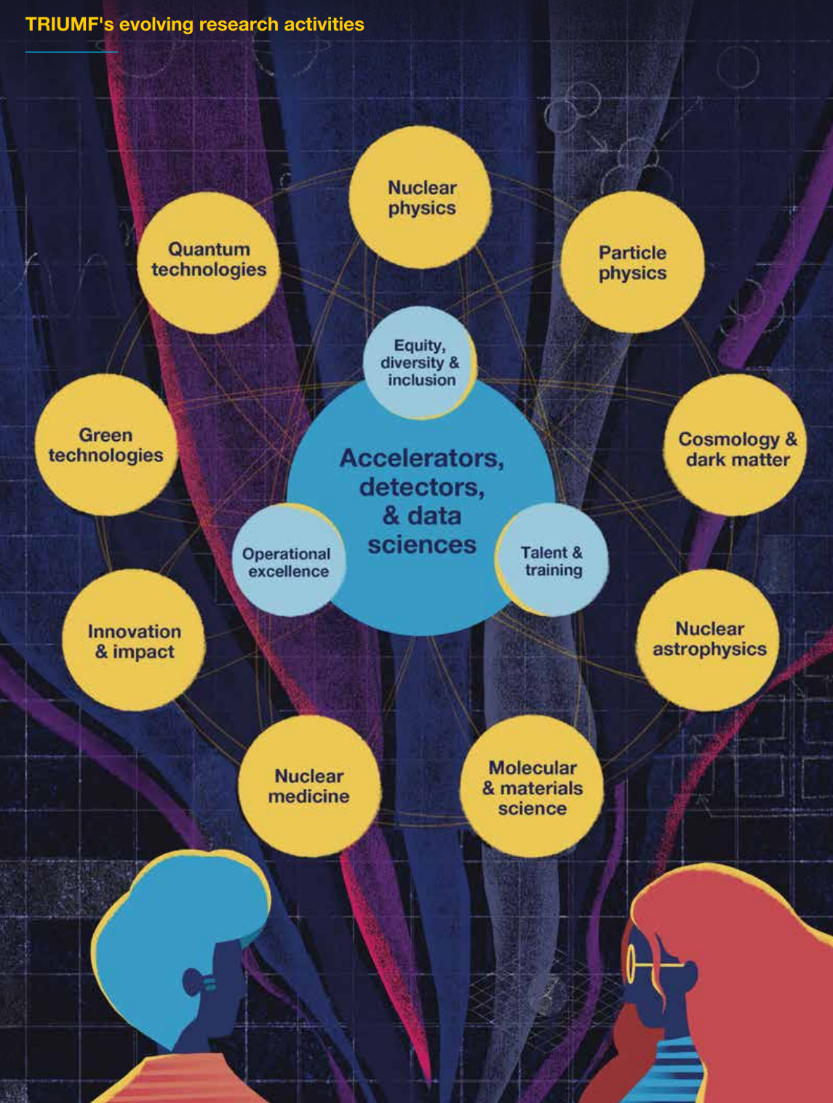
What does TRIUMF do?
TRIUMF’s work spans the entire continuum of research from fundamental science to commercialisation.
TRIUMF has cultivated a hub of excellence around a core of expertise in accelerators and isotope research.
From supporting Nobel-winning research in particle and nuclear physics to life sciences and industrial applications.
15

Slide 16
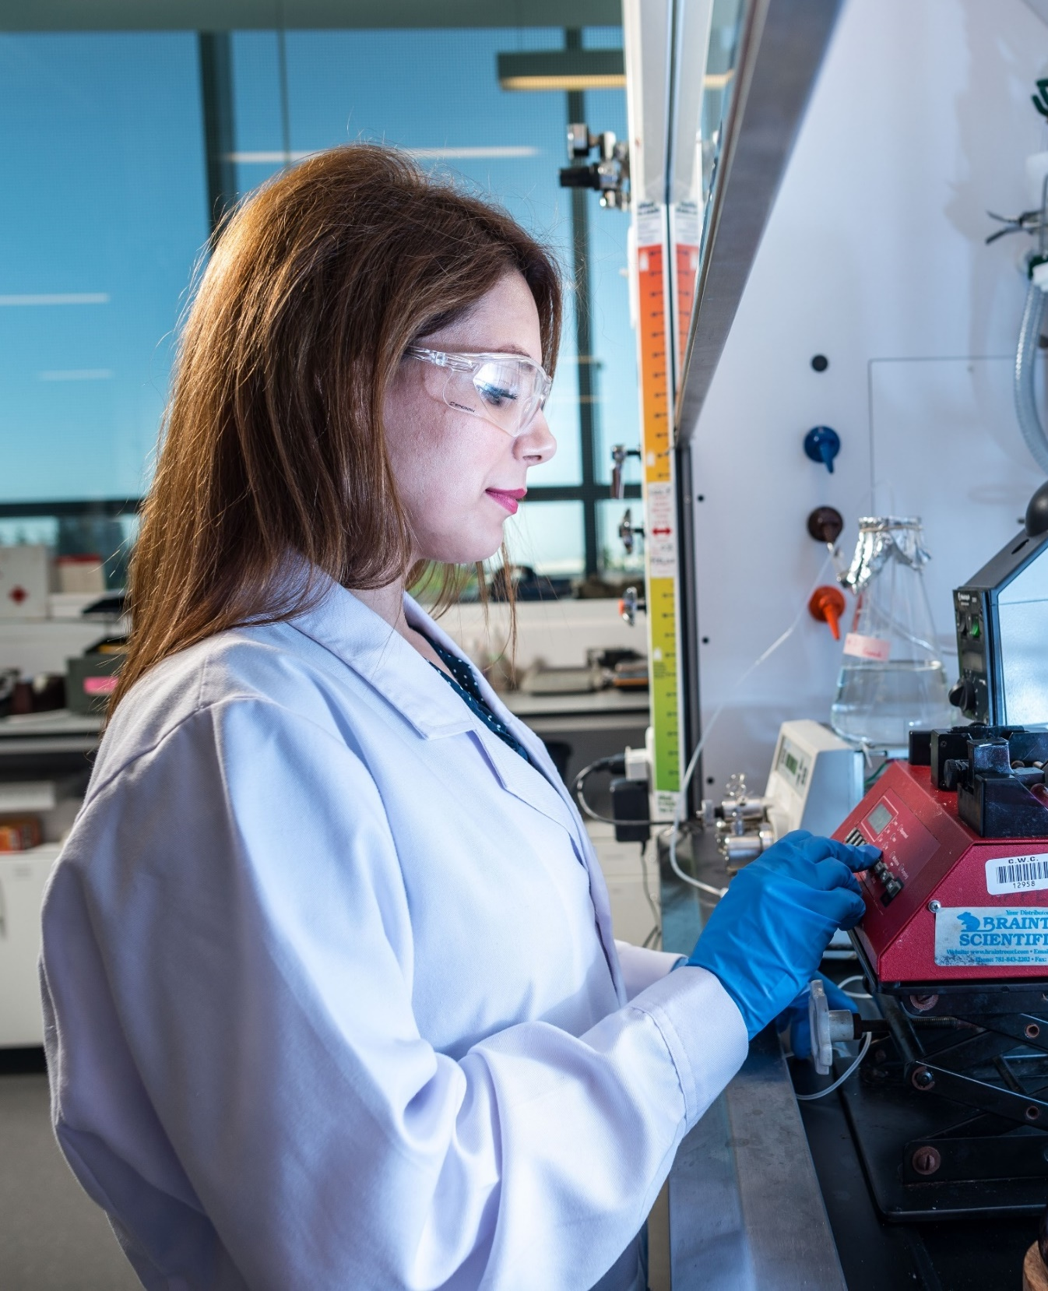

Innovation and Collaboration
  The real-world impact of TRIUMF’s reach spans well beyond its expertise in physics, with application in:
    Medicine and drug development
    Materials development and testing
    Accelerator and detector technologies
    Mining and natural resources
    Border security
    Oil and gas exploration
    Data sciences

Slide 17
Welcome and Information from the LOC
The LOC members:
  LOC Co-Chairs: Oliver Kester, Bob Laxdal
  Meeting coordinator: Jana Thomson
  IS&T support: Emile Vartanian
  Admin and coordination support: Lorraine King, Cynthia Reis, Pauline Dela Zilwa (ACC Division admin assistant)
Some information:
Coffee will be served in the Pinnacle Foyer and lunches in the Pier Salon
Posters can be put up at any time before the allocated poster sessions on the upper floor. Exact locations of your poster you can find in the Abstract Booklet.
  Posters can stay on during the entire time up to Thursday
  Posters should be taken down by NOON (12:00) THURSDAY, February 27. Any posters not removed by Thursday, 14:00 will be removed by staff and discarded.
During the sessions, please make sure your phone is switched to silent mode.
Enjoy the meeting!

Slide 18








Thanks to our sponsors

Slide 19



Thank you
Merci
www.triumf.ca
@TRIUMFLab

