Slide 1
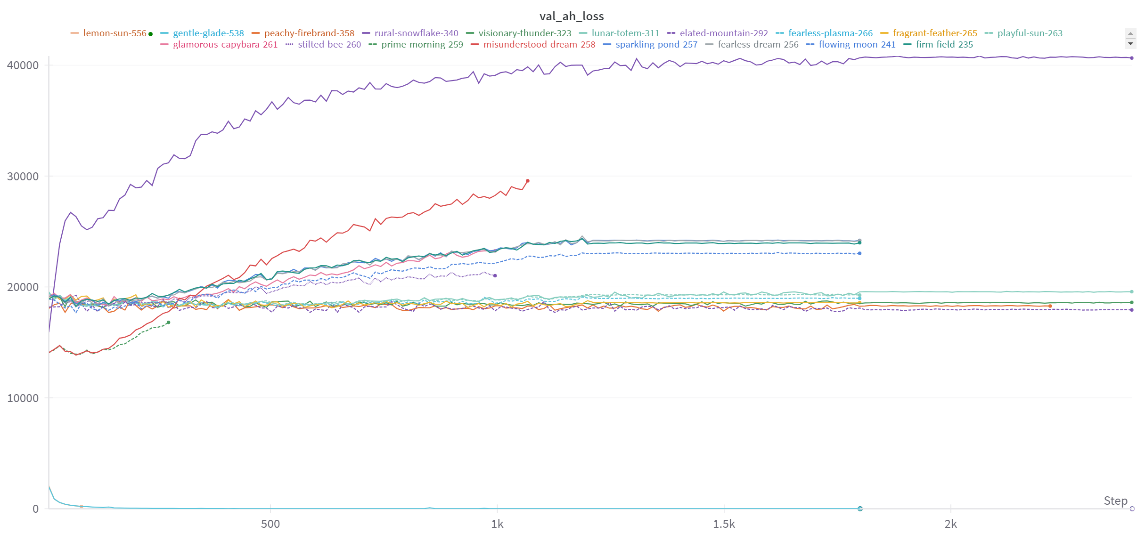
CaloQVAE
UNet for CaloQVAE – Preliminary Results

Slide 2
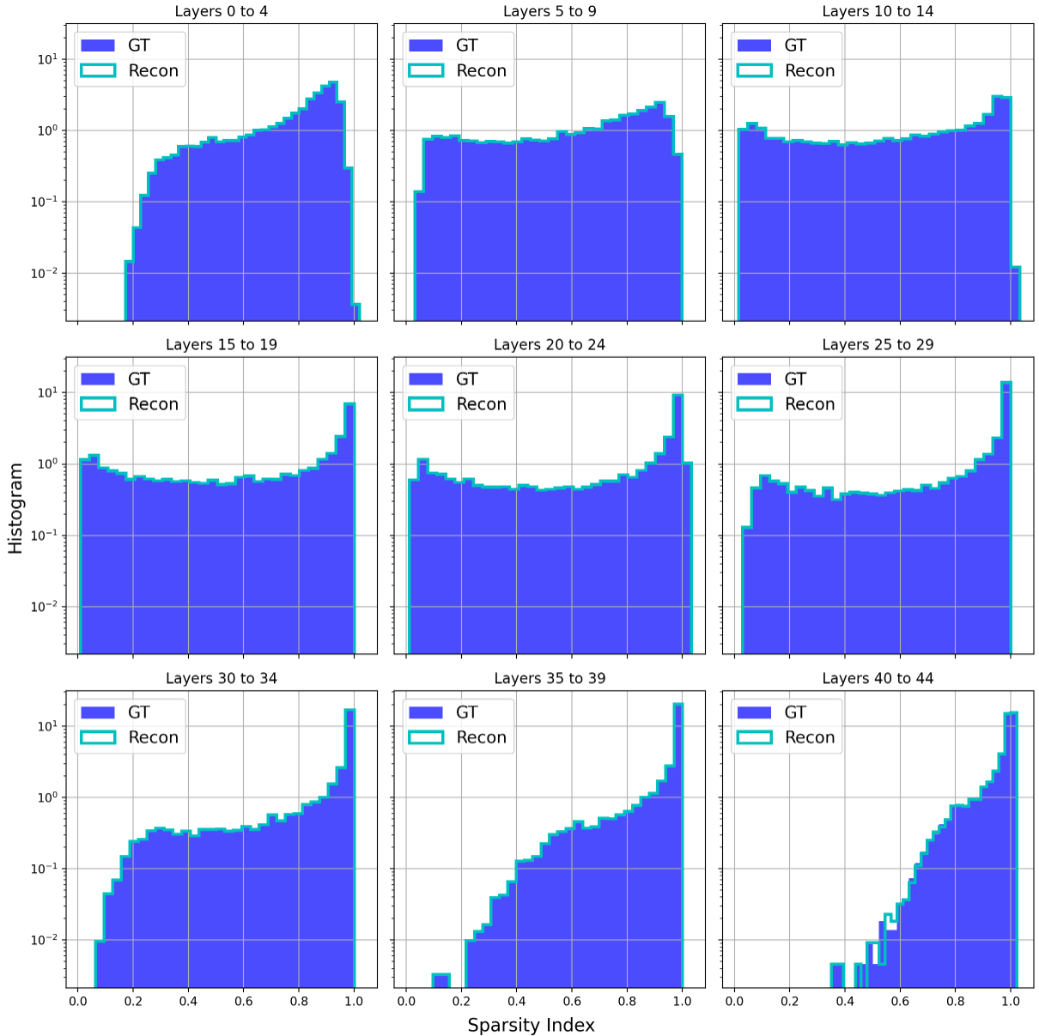
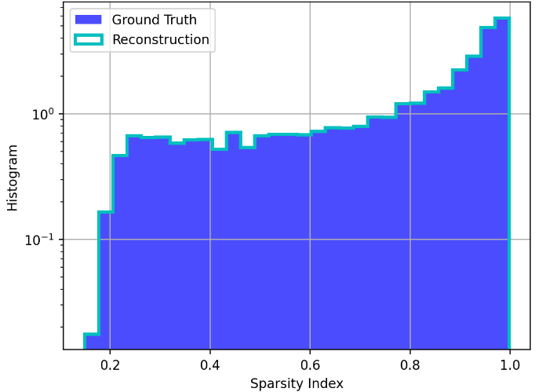
CaloQVAE
Sparsity Index Histograms – Model 538
First Implementation of UNet-Like Architecture for CaloQVAE –Pegasus Topology (Zephyr Size) – 0.01 Coefficient

Slide 3
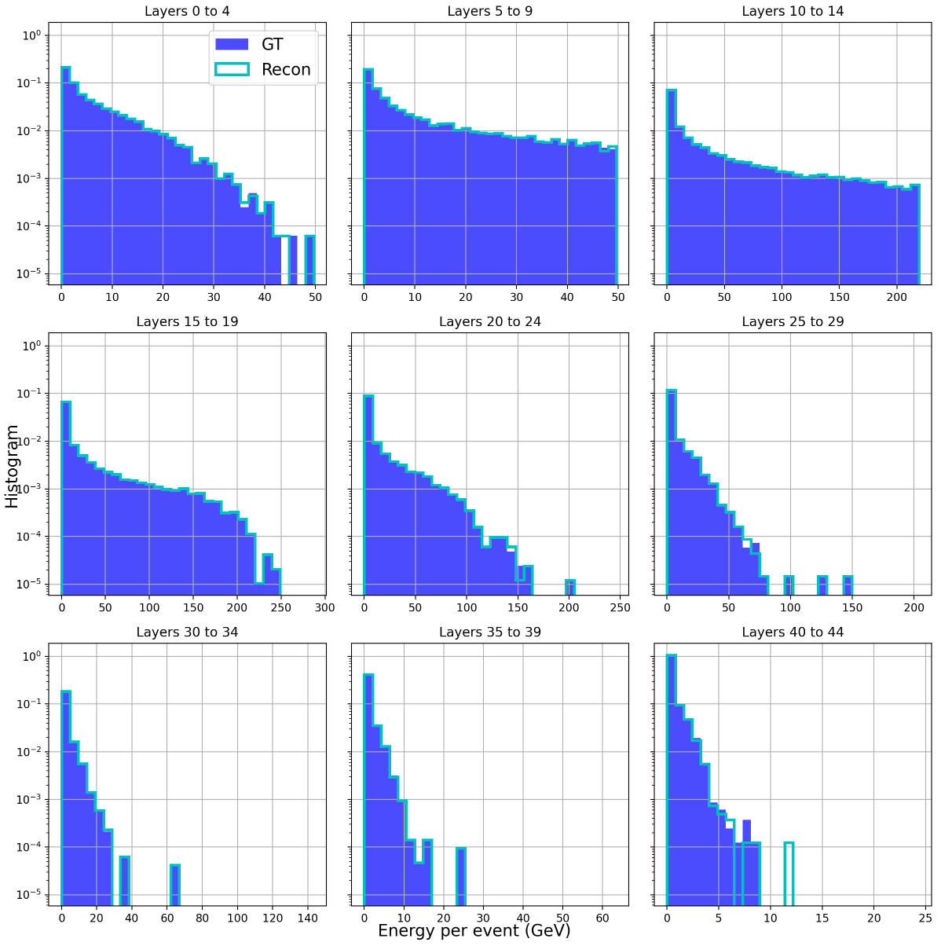
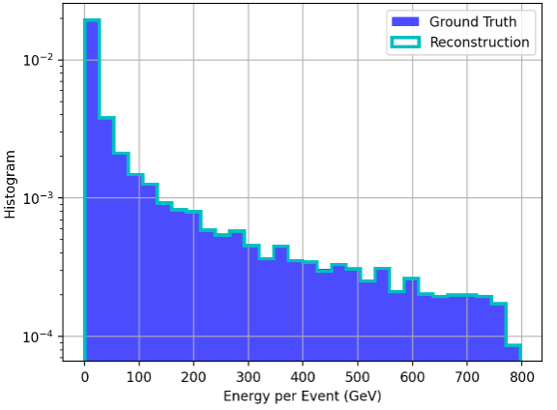
CaloQVAE
Energy Index Histograms – Model 538
First Implementation of UNet-Like Architecture for CaloQVAE –Pegasus Topology (Zephyr Size) – 0.01 Coefficient

Slide 4
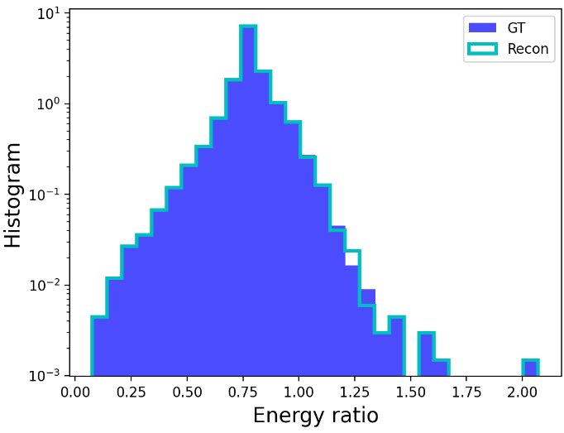
CaloQVAE
Energy Ratio Histogram– Model 538
First Implementation of UNet-Like Architecture for CaloQVAE –Pegasus Topology (Zephyr Size) – 0.01 Coefficient

Slide 5
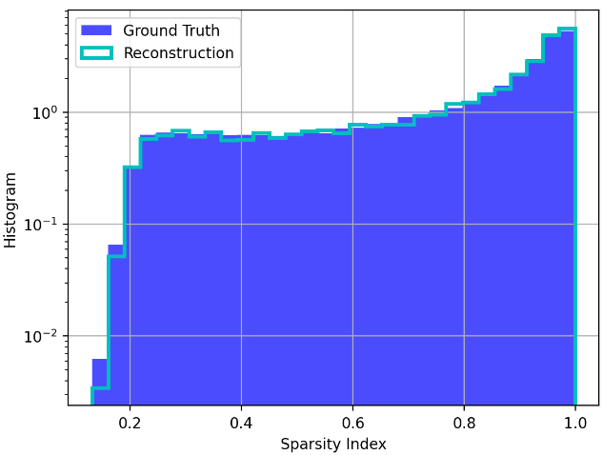
CaloQVAE
Sparsity Index Histograms – Model 538 100K RECON SHOWERS
First Implementation of UNet-Like Architecture for CaloQVAE –Pegasus Topology (Zephyr Size) – 0.01 Coefficient

Slide 6
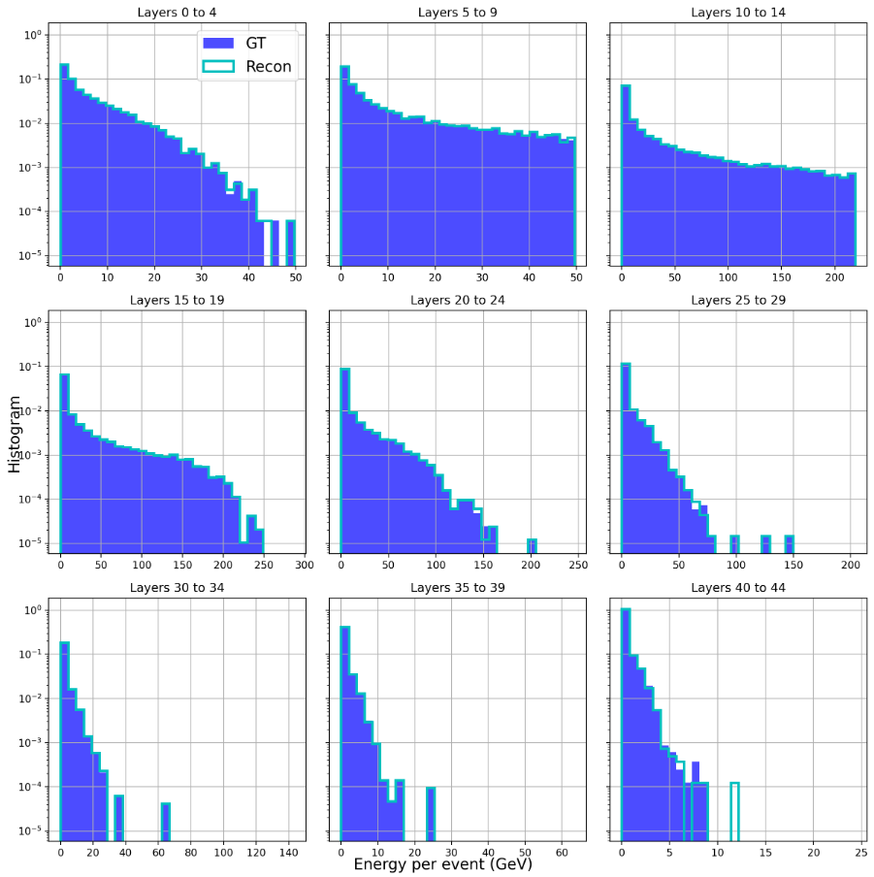
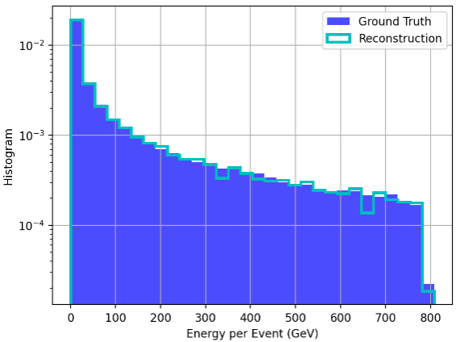
CaloQVAE
Energy Index Histograms – Model 538
First Implementation of UNet-Like Architecture for CaloQVAE –Pegasus Topology (Zephyr Size) – 0.01 Coefficient

Slide 7
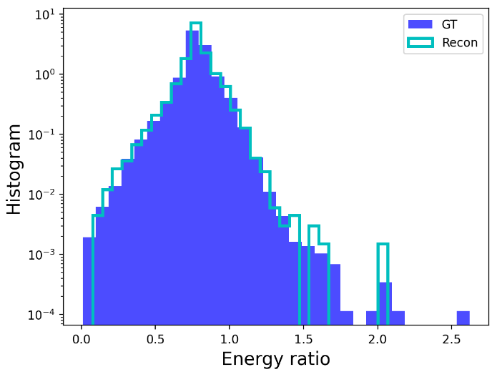
CaloQVAE
Energy Ratio Histogram– Model 538
First Implementation of UNet-Like Architecture for CaloQVAE –Pegasus Topology (Zephyr Size) – 0.01 Coefficient

