Slide 1
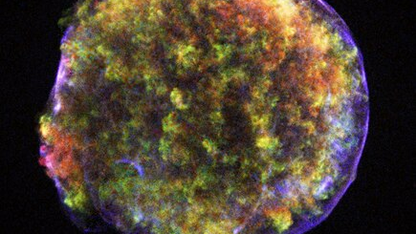
Nuclear/element production by supernovae, measured by X-ray spectra
Jakob Hansen
Supervisor Denis Leahy
https://en.wikipedia.org/wiki/SN_1572

Slide 2
Talking Points
Supernova remnants: What are they? And why do we care about them
How we measured elemental abundances
MY research.

Slide 3
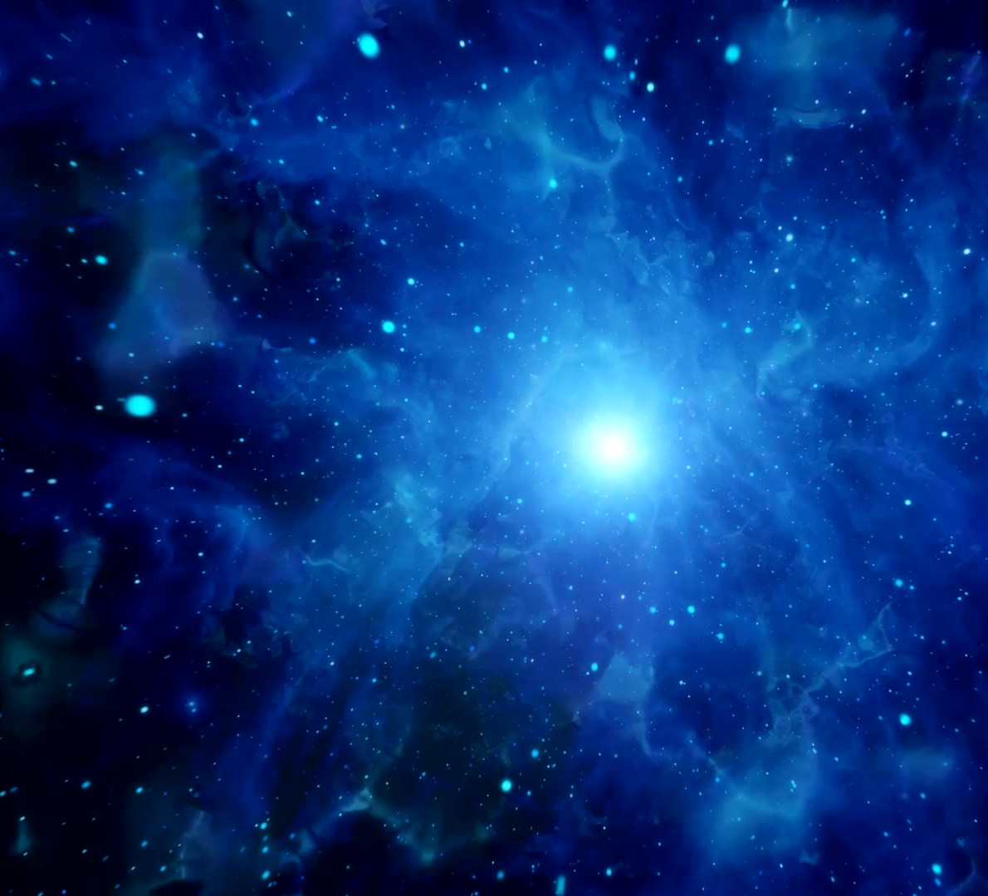
Supernova remnants: What are they? And why do we care about them

Slide 4
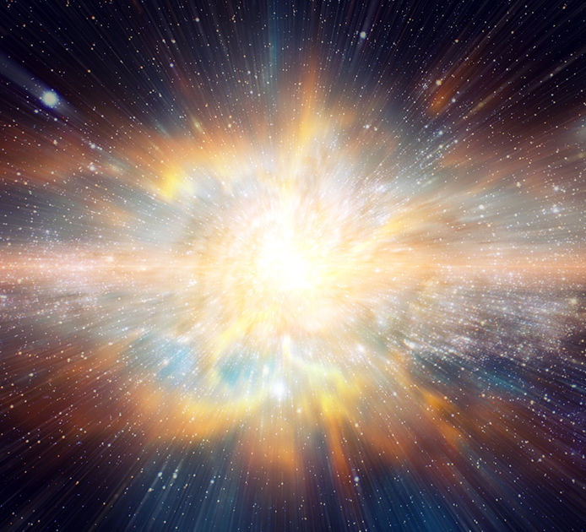
Supernova
Death of large stars or white dwarfs
Massive explosion
Creation of heavy elements
https://www.skyatnightmagazine.com/space-science/when-stars-collapse-what-is-a-supernova
Notes:
Consider type 1a supernova

Slide 5
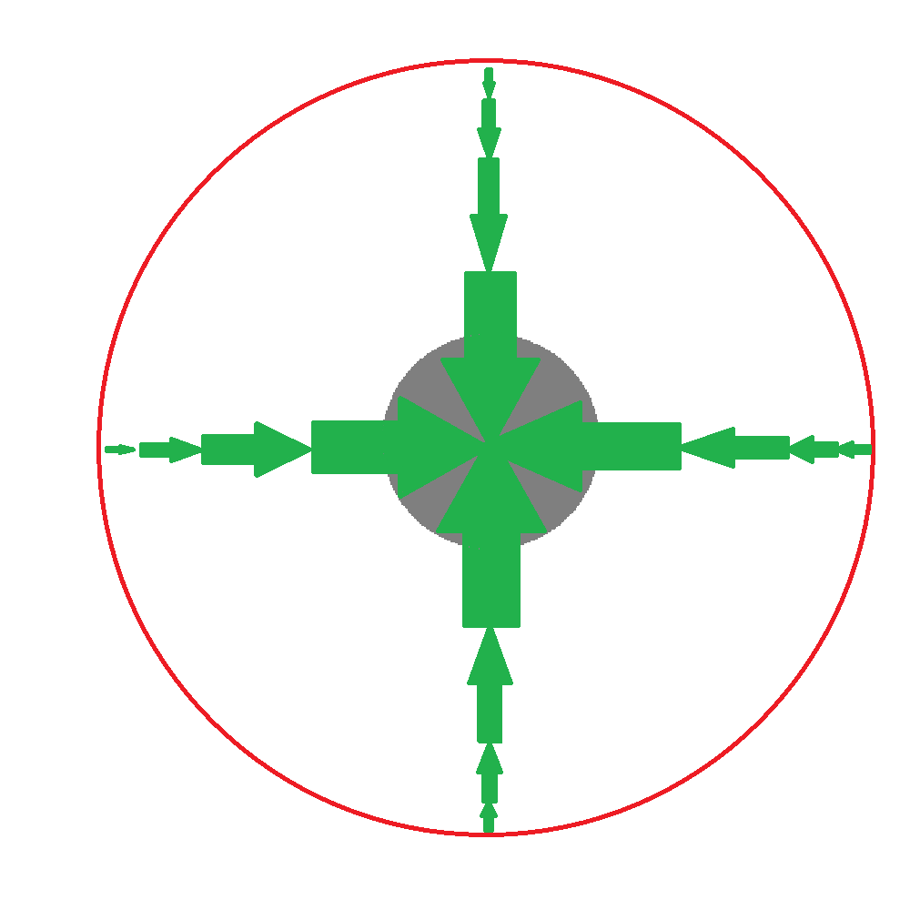
Contraction
Notes:
Some of the elements created in fusion Si, O and C come mainly fusion, gets converted to over elements. Shock burn

Slide 6
Reaction

Slide 7
Supernova
Death of large stars or white dwarfs
Massive explosion
Creation of heavy elements
https://www.skyatnightmagazine.com/space-science/when-stars-collapse-what-is-a-supernova

Slide 8
Supernova remnants
Expanding balls of hot gas and plasma
Interactions with the surrounding dust and gas (Interstellar medium)
Spreads heavy elements

Slide 9
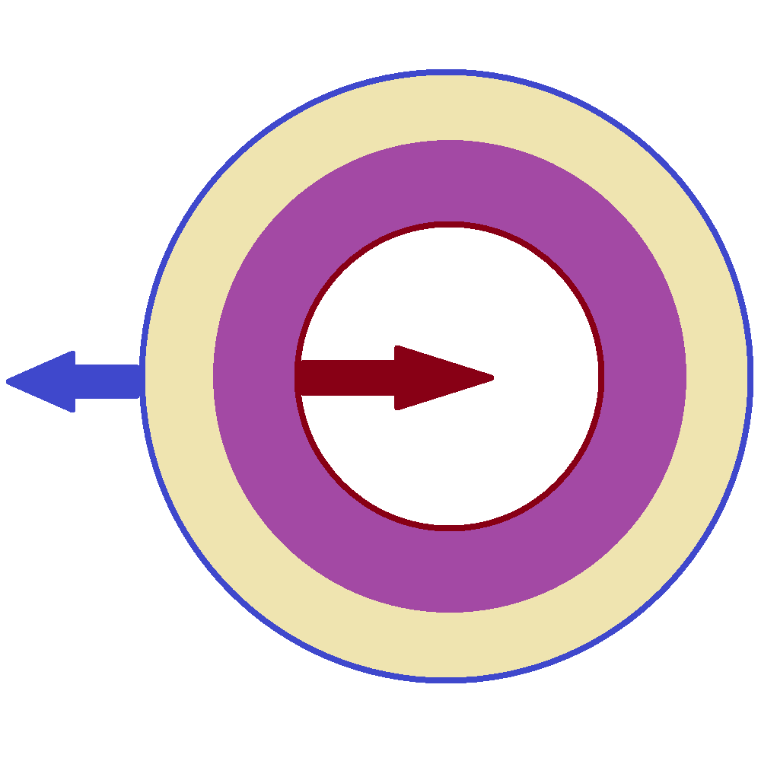
Forward and reverse shocks
Two shocks
One into ISM, one into material from star
Emission between shocks
Little to no hydrogen in purple region
Notes:
Inside is cold

Slide 10
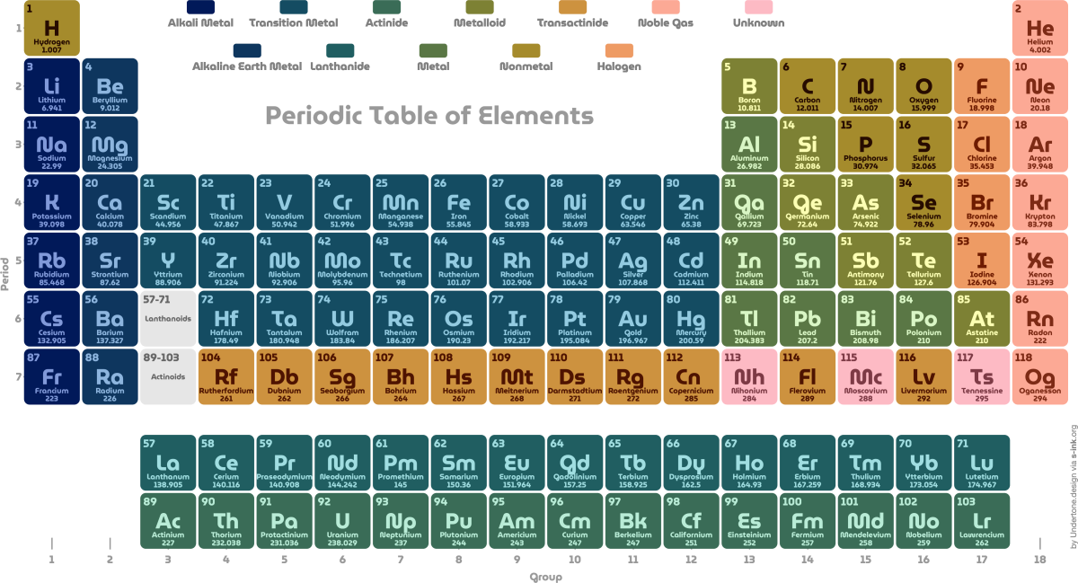
How we measured elemental abundances
X-ray Spectroscopy
https://s-ink.org/periodic-table-of-elements

Slide 11
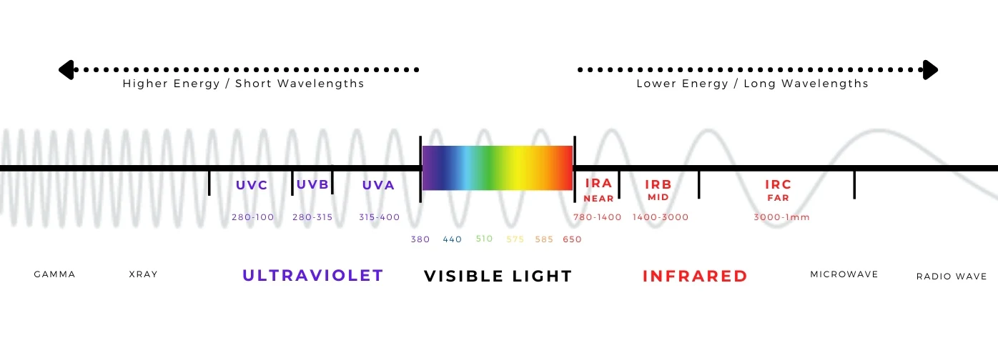
X-ray spectrum
Photon between 50 to 50,000 time more energetic than visible light
Typical studies focus of around 1-10keV (1.2-0.12 nm)
https://healthlighting.com/blogs/lighting-guide/guide-to-the-spectrum-of-light

Slide 12
X-spec
Calculates model spectrum and fits to observations
Uses solar amounts of hydrogen
Gives abundances from the model spectrum
Spectrum from:. Zhou, S.-C. Leung, Z. Li, K. Nomoto, J. Vink, and Y. Chen. Chemicalabundances in sgr a east: Evidence for a type iax supernova remnant. TheAstrophysical Journal, 908(1):31, Feb. 2021.

Slide 13
MY research

Slide 14
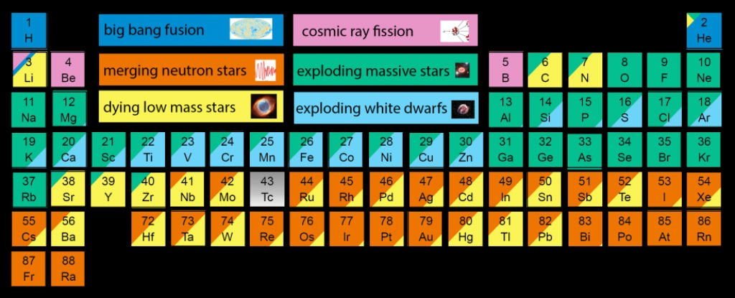
Hydrogen assumption
Little to no hydrogen in inner region
Region between shocks responsible for emission
X-spec uses approximately solar hydrogen abundances
X-spec underestimates element abundances
https://novohydrogen.com/hydrogen-101/
Notes:
Change image

Slide 15
Electron/Hydrogen density density
Element measurements based off electron to hydrogen ratio
Heavy elemental abundances are significantly underestimated

Slide 16
The process
Find the elemental abundance of supernova remnants previously studied
01
Correct the abundances while assuming little to no hydrogen
02
Calculate the masses of each element (assuming we have distance)
03
End goal of creation catalog of abundances and masses
04

Slide 17
Key points
What is a Supernova remnant
How are the element abundances messaged
My contributions
I will correct the elemental abundance measurements in regions of supernova remnants that are hydrogen deficient, where the assumption of x-spec are no longer accurate.
Super nova remnants are spheres of gas and plasma expanding into the surrounded interstellar medium. Supernova create heavy elements.
Elemental abundances are measured using the x-ray spectrum fitting software x-spec. This process assumes solar hydrogen abundances.

