Slide 1
Atom-at-a-time Chemistry:
From Actinides to Superheavies
Jennifer Pore
Lawrence Berkeley National Laboratory
Nuclear and Chemical Science Divisions

Slide 2
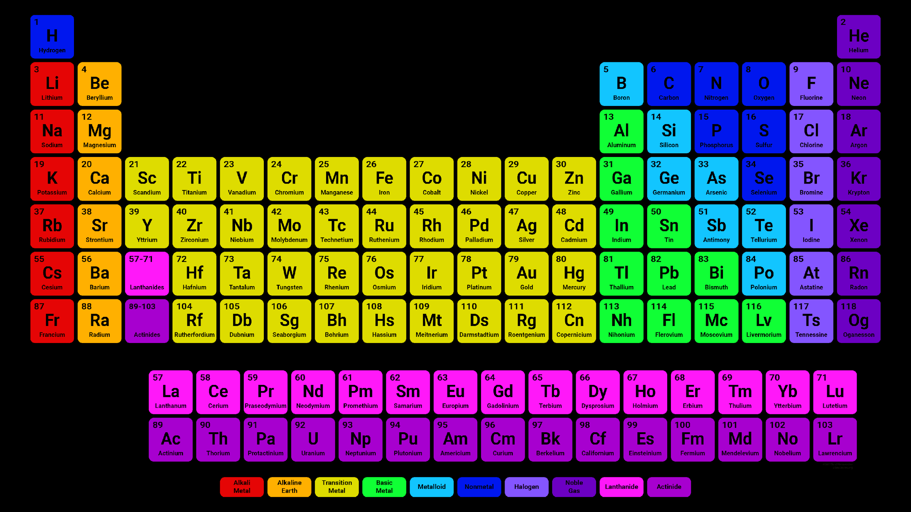
The Periodic Table
Heavy Elements
Most of these elements are man made!
Need to be produced in nuclear reactions
one-atom-at-a-time
Superheavy Elements
Actinides

Slide 3
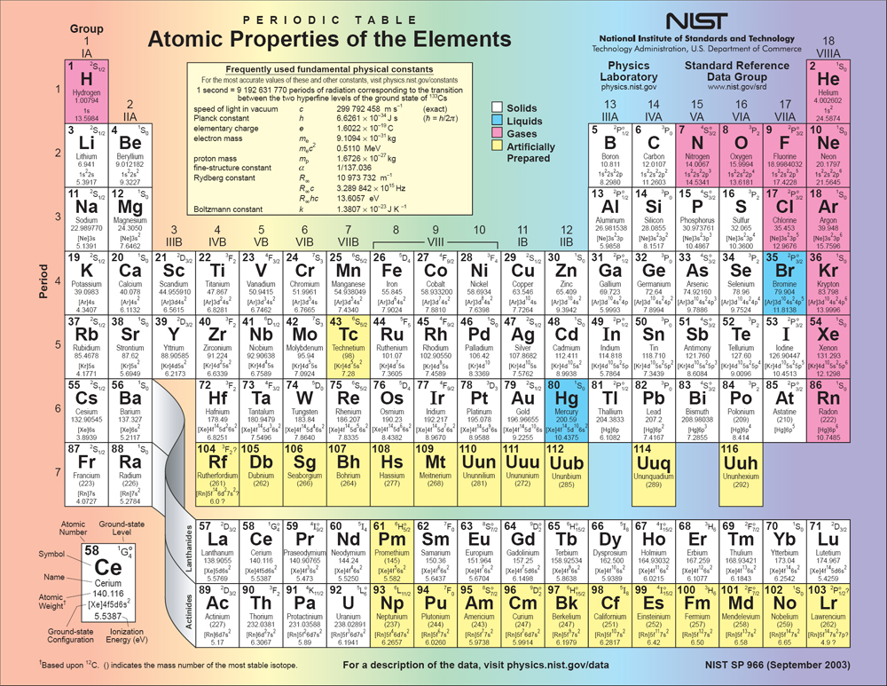

Slide 4
Back to Today’s Periodic Table

Slide 5
Back to Today’s Periodic Table

Slide 6
Why do heavy elements have such weird chemistry?
Electrons in heavier elements are more massive than in lighter elements
Relativistic Effects
1
Some electron
orbitals contract
2
Some electron
orbitals expand
3
Spin Orbit Splitting
p_{3/2}
p
p_{1/2}
s and p_{1/2} orbitals
d and f orbitals

Slide 7
Impact of Relativistic Effects for SHEs?
Group 8
Non
Rel.
Rel.
Non
Rel.
Rel.
Non
Rel.
Rel.
Electron Orbital Energy (eV)
5s
5s_{1/2}
7s
6s
6s_{1/2}
6d_{5/2}
4d_{5/2}
7s_{1/2}
4d
5d_{5/2}
4d_{3/2}
6d_{3/2}
6d
5d
5d_{3/2}
Should all have some chemical properties, right?
Ru (Z=44)
Os (Z=76)
Hs (Z=108)

Slide 8
Should we reconsider SHE placements?
What chemical properties matter?
When do we have enough information?
Where do we start?

Slide 10
Where do SHEs come from?
Ti (Z=22)
Cf (Z=98)
E120
Sounds easy, right?
Atom-at-a-time Chemistry | From Actinides to Superheavies

Slide 11
Problem 1: Atoms are Tiny
5 000 000 000 000 000 000 000 atoms
Atom-at-a-time Chemistry | From Actinides to Superheavies

Slide 12
Problem 2: Nuclei are even smaller
Really Tiny
Nucleus
Electron Cloud

Slide 13
Problem 3: And they repel each other
S
N
N
S
Repel
Atom-at-a-time Chemistry | From Actinides to Superheavies

Slide 14
Problem 4: Need to Separate Junk
Target
Beam
Beam Intensity: 10¹² pps
No Interaction: most of the time
Rutherford or Elastic Scatters: 1 in 10⁴ events
Nuclear Reaction: 1 in 10⁹ events
Compound Nucleus: 1 in 10¹³ events
SHE: 1 in 10¹⁷ events
Atom-at-a-time Chemistry | From Actinides to Superheavies

Slide 15
Separation
Beam
Target
Q1
+ g-ray
detectors
M1
Dipole
M2
Dipole
Atom-at-a-time Chemistry | From Actinides to Superheavies

Slide 16
A lot of experimental challenges for chemistry
Production rates?
²⁵⁴No
55 s
²⁵⁵Lr
22 s
²⁵⁷Rf
4.7 s
²⁵⁸Db
4 s
²⁷²Bh
12 s
²⁷⁶Mt
0.54 s
²⁸⁰Rg
3.6 s
²⁸⁴Nh
0.97 s
²⁸⁸Mc
171 ms
²⁹⁴Og
0.6 ms
Z = 102
~1/s
Z = 103
~10/min
Z = 104
~1/min
Z = 105
~6/hr
Z = 107
~1/hr
Z = 109
~10/wk
Z = 111
~1/wk
Z = 113
~1/wk
Z = 115
~1/day
Z = 118
~1/ 10 days
For Comparison . . .
5 000 000 000 000 000 000 000 atoms
(5 sextillion)

Slide 17
Traditional Chemistry Techniques
Do not work for superheavy elements

Slide 18
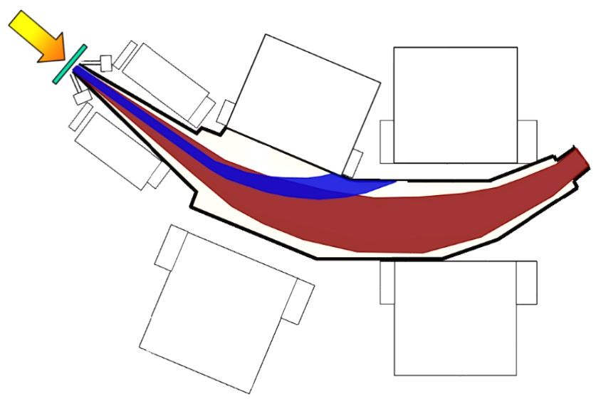
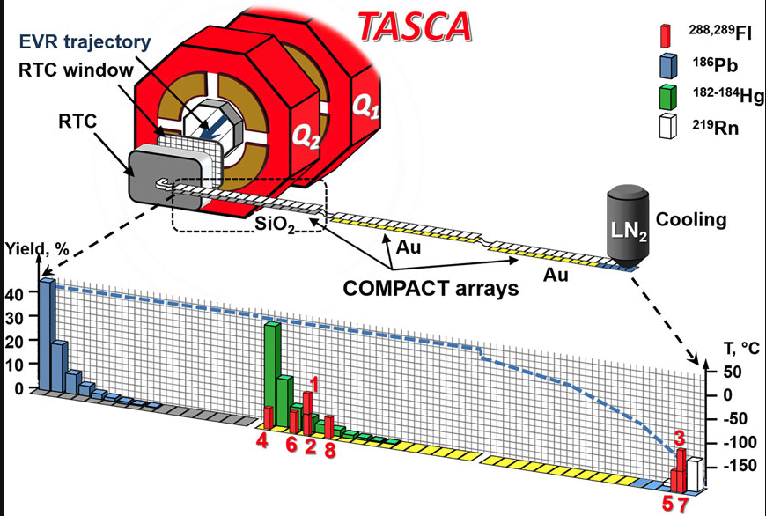
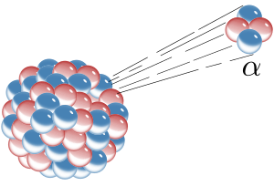
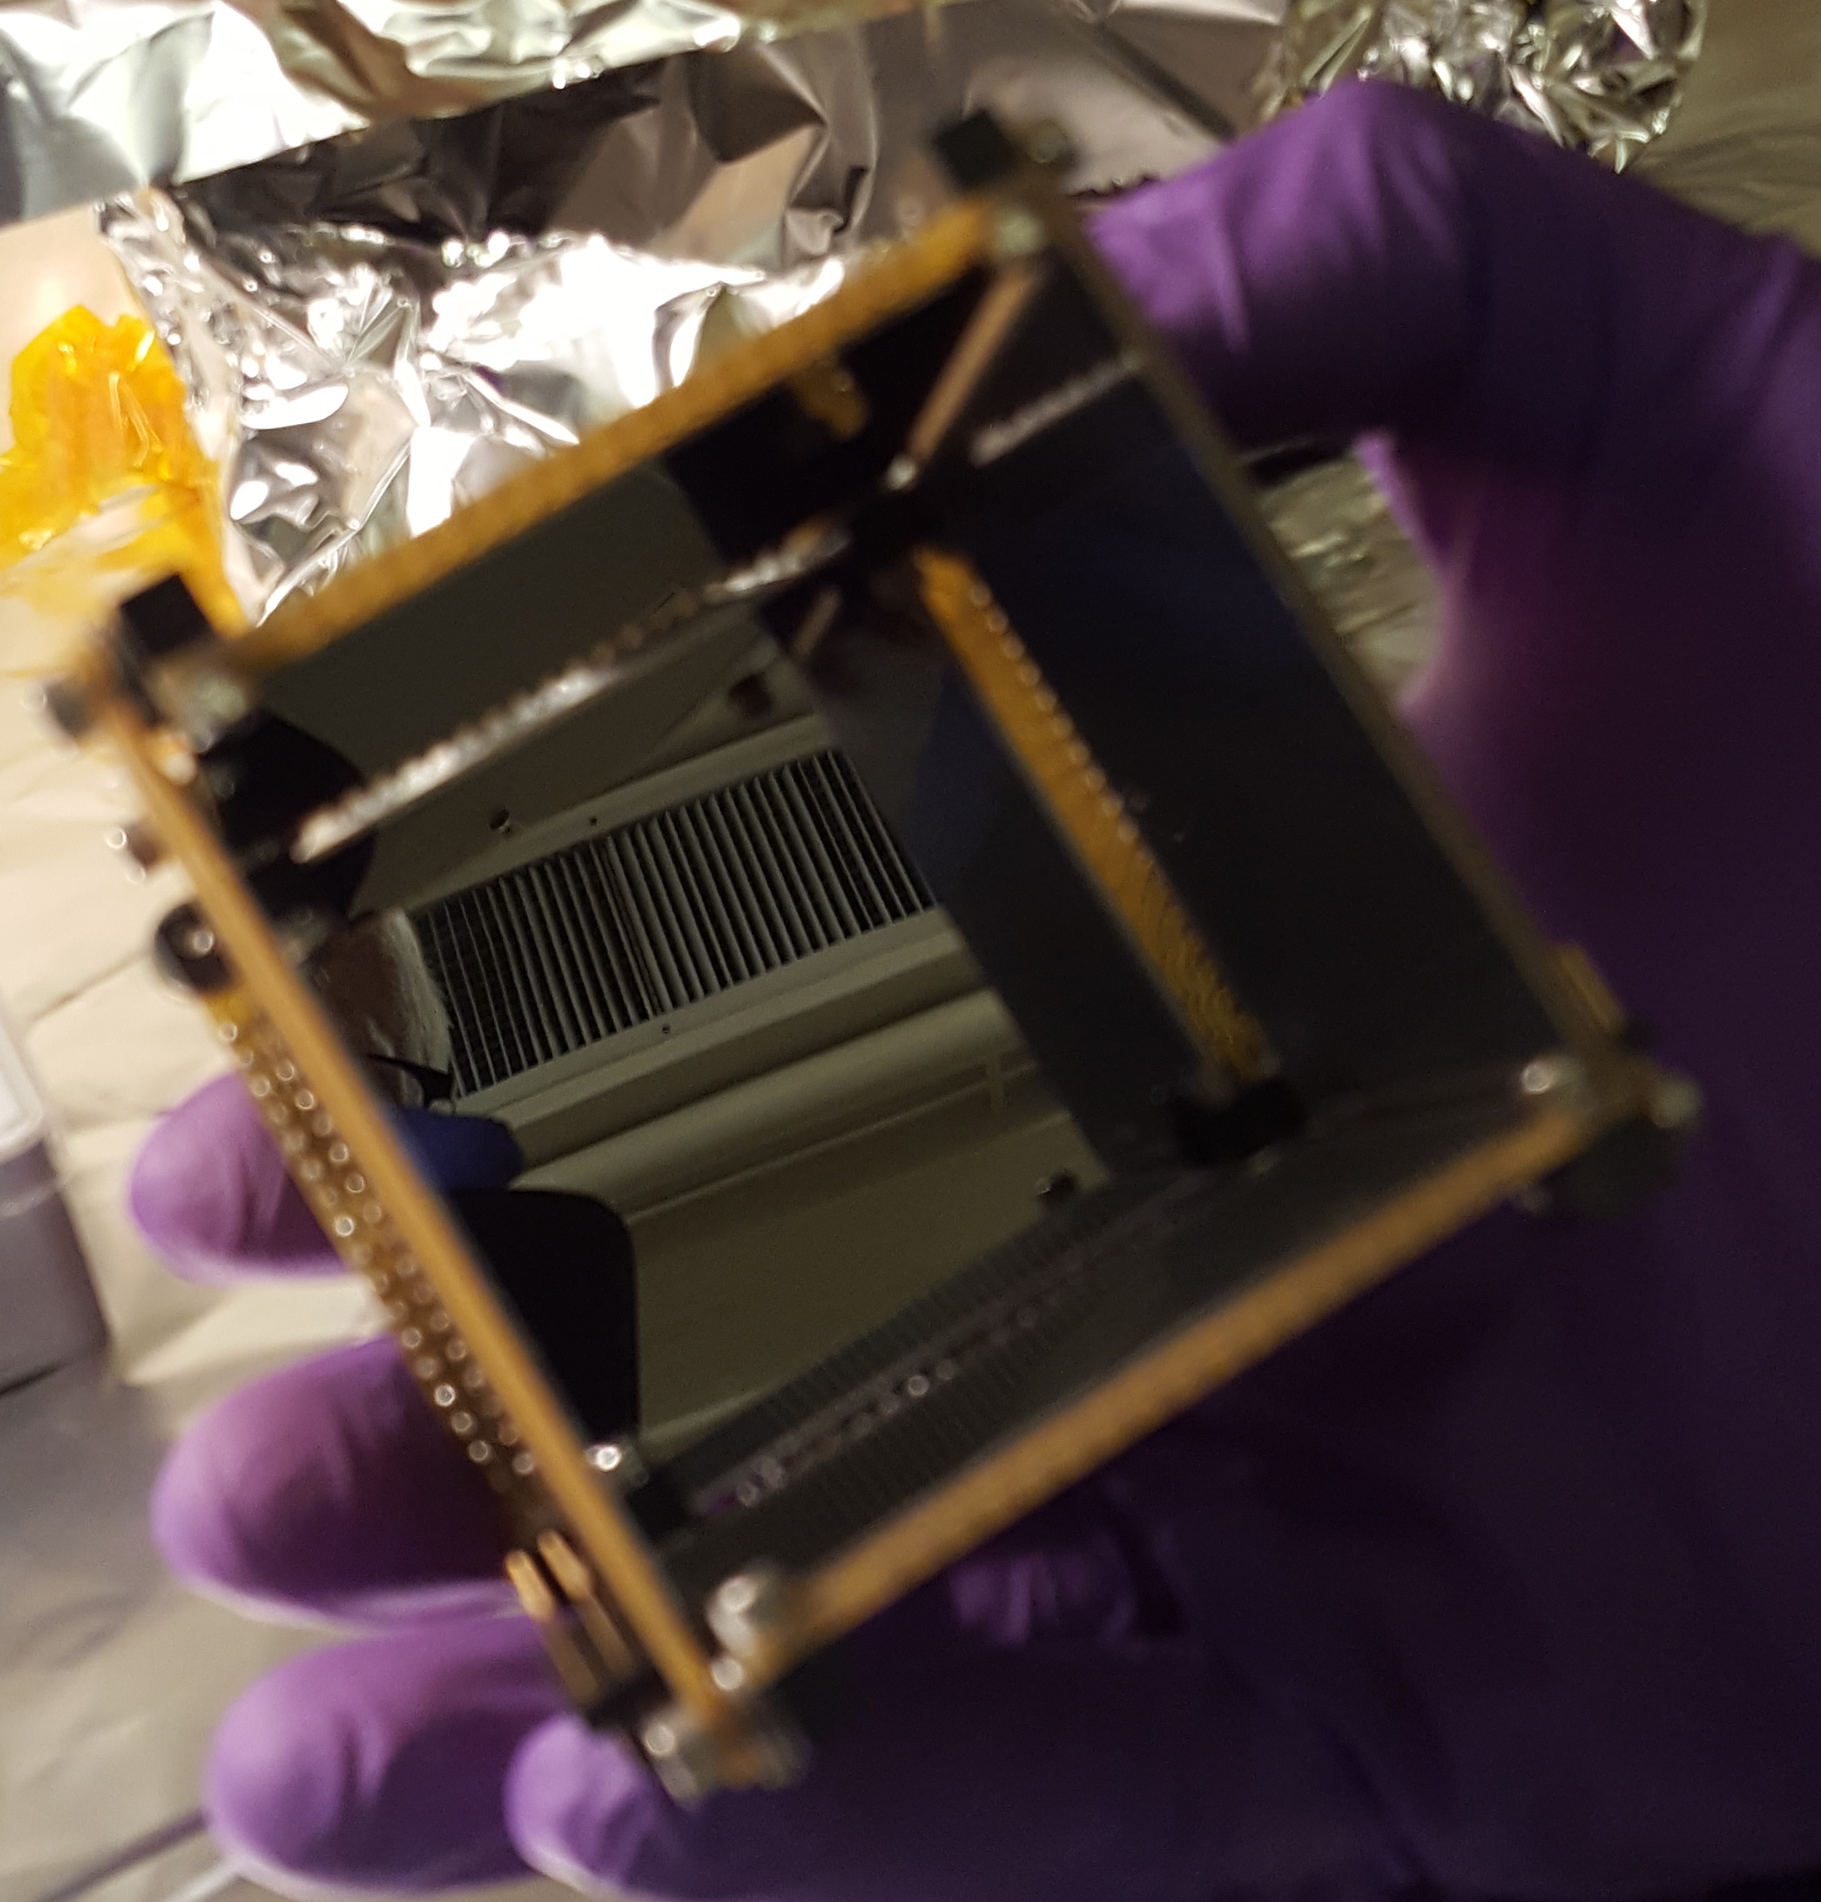
Typical Superheavy Element Chemistry Experiments
Experimental Challenges?
1. Produce Superheavy Elements in Nuclear Reactions
2. Separate Superheavy Element from junk
⁴⁸₂₀Ca₂₀
²⁰⁹₈₃Bi₁₂₆
²⁵⁷₁₀₃Lr₁₅₄
3. Perform Chemistry Quickly: one atom-at-a-time
4. Detect Radiation from Superheavy Elements
To date no study can directly identify produced molecules!
Atom-at-a-time Chemistry | From Actinides to Superheavies

Slide 19
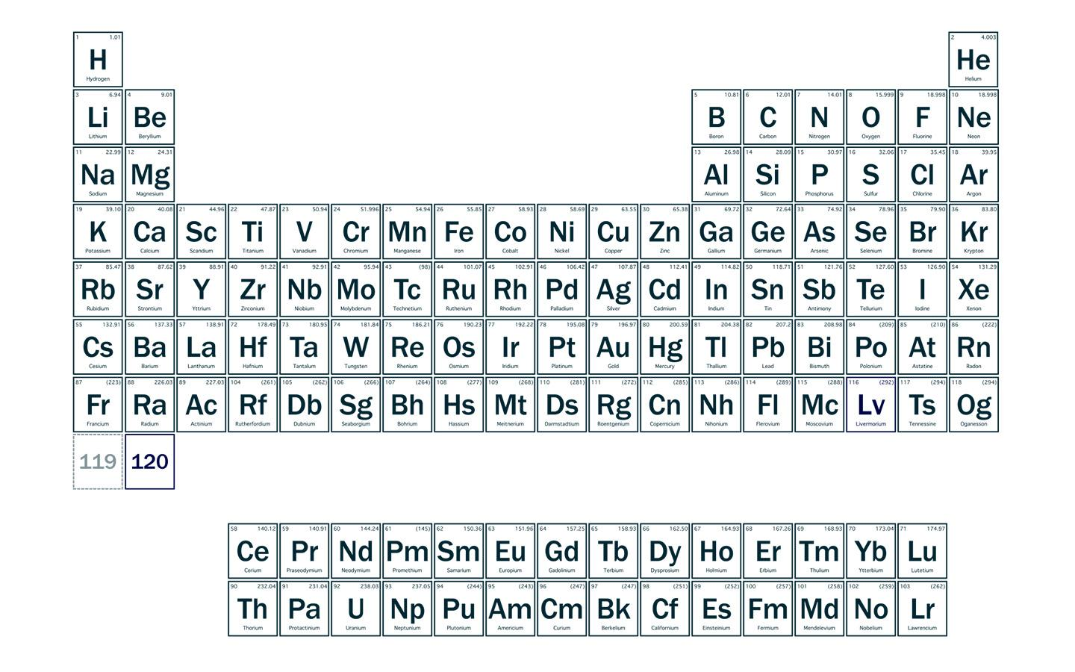
Superheavy Elements @ Berkeley Lab
Element Discovery
Fundamental Research
16 Elements Discovered

Slide 20
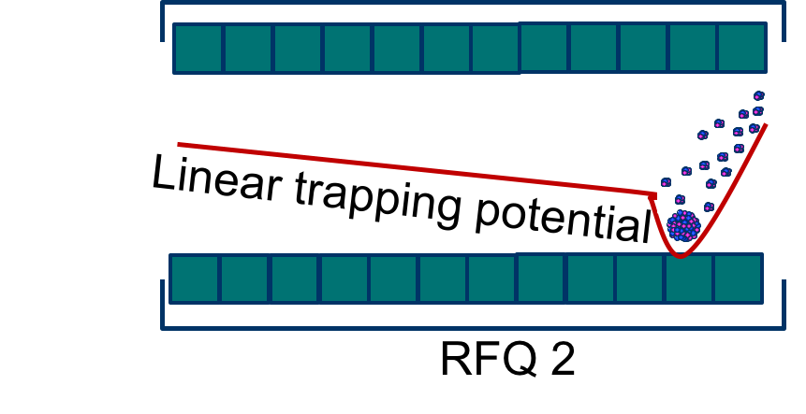
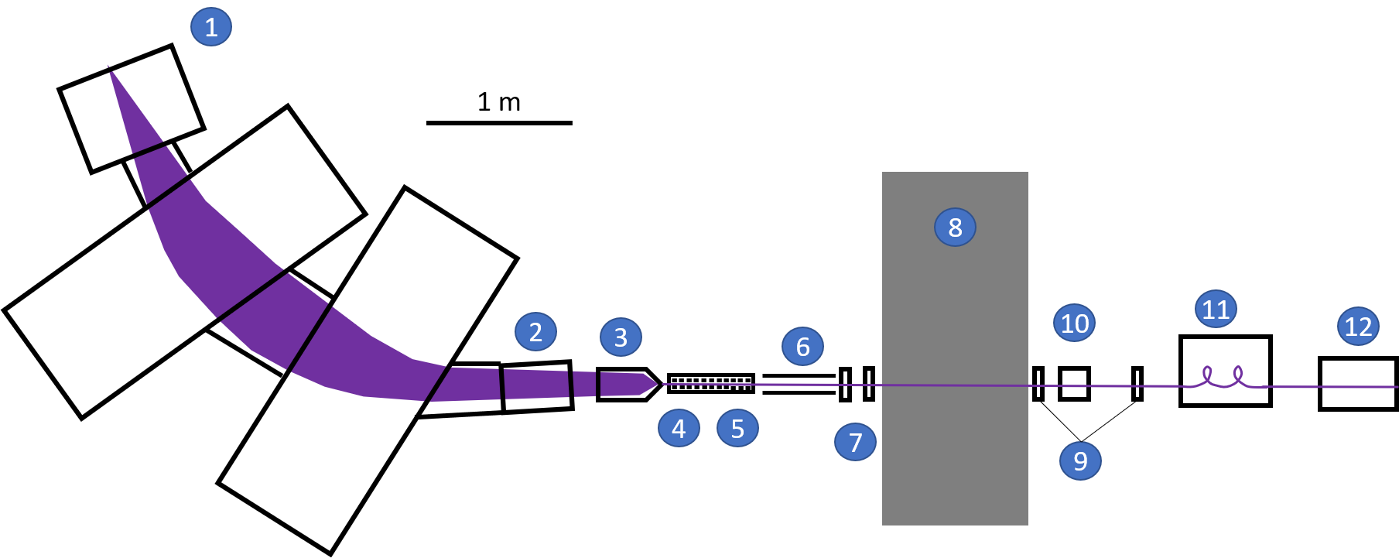
A Technique for Superheavy Element Molecule Identification
Produce Isotopes of interest
Beam
2. Separate Superheavy Elements
Ion Trap
3. Trap Ions with Reactive Gas
4. Perform mass measurements
BGS
FIONA

Slide 21
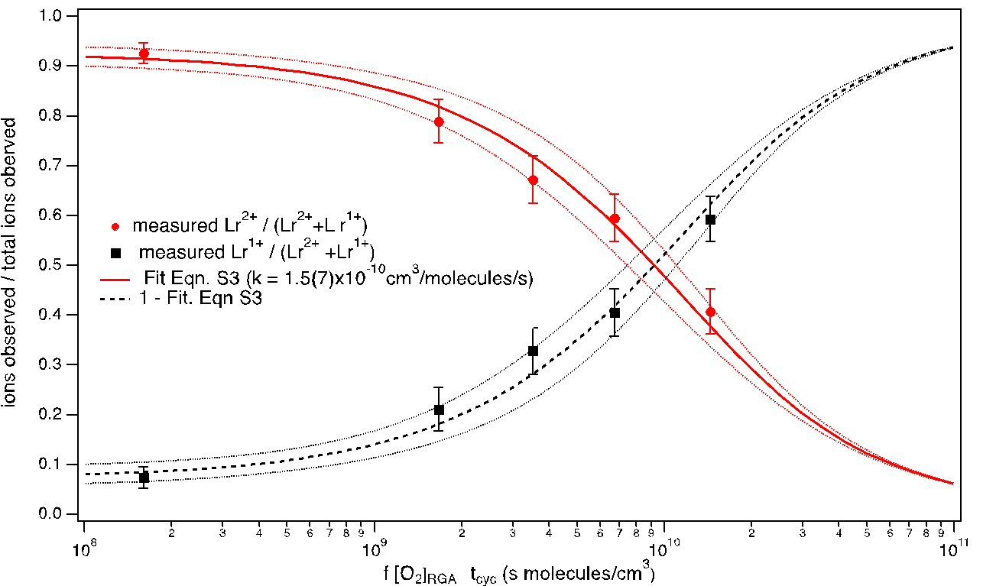
Proof-of-Principle: Lr Reduction
Lr²⁺ Decreases
Lr¹⁺ Increases
Interactions with O₂ Molecules

Slide 22
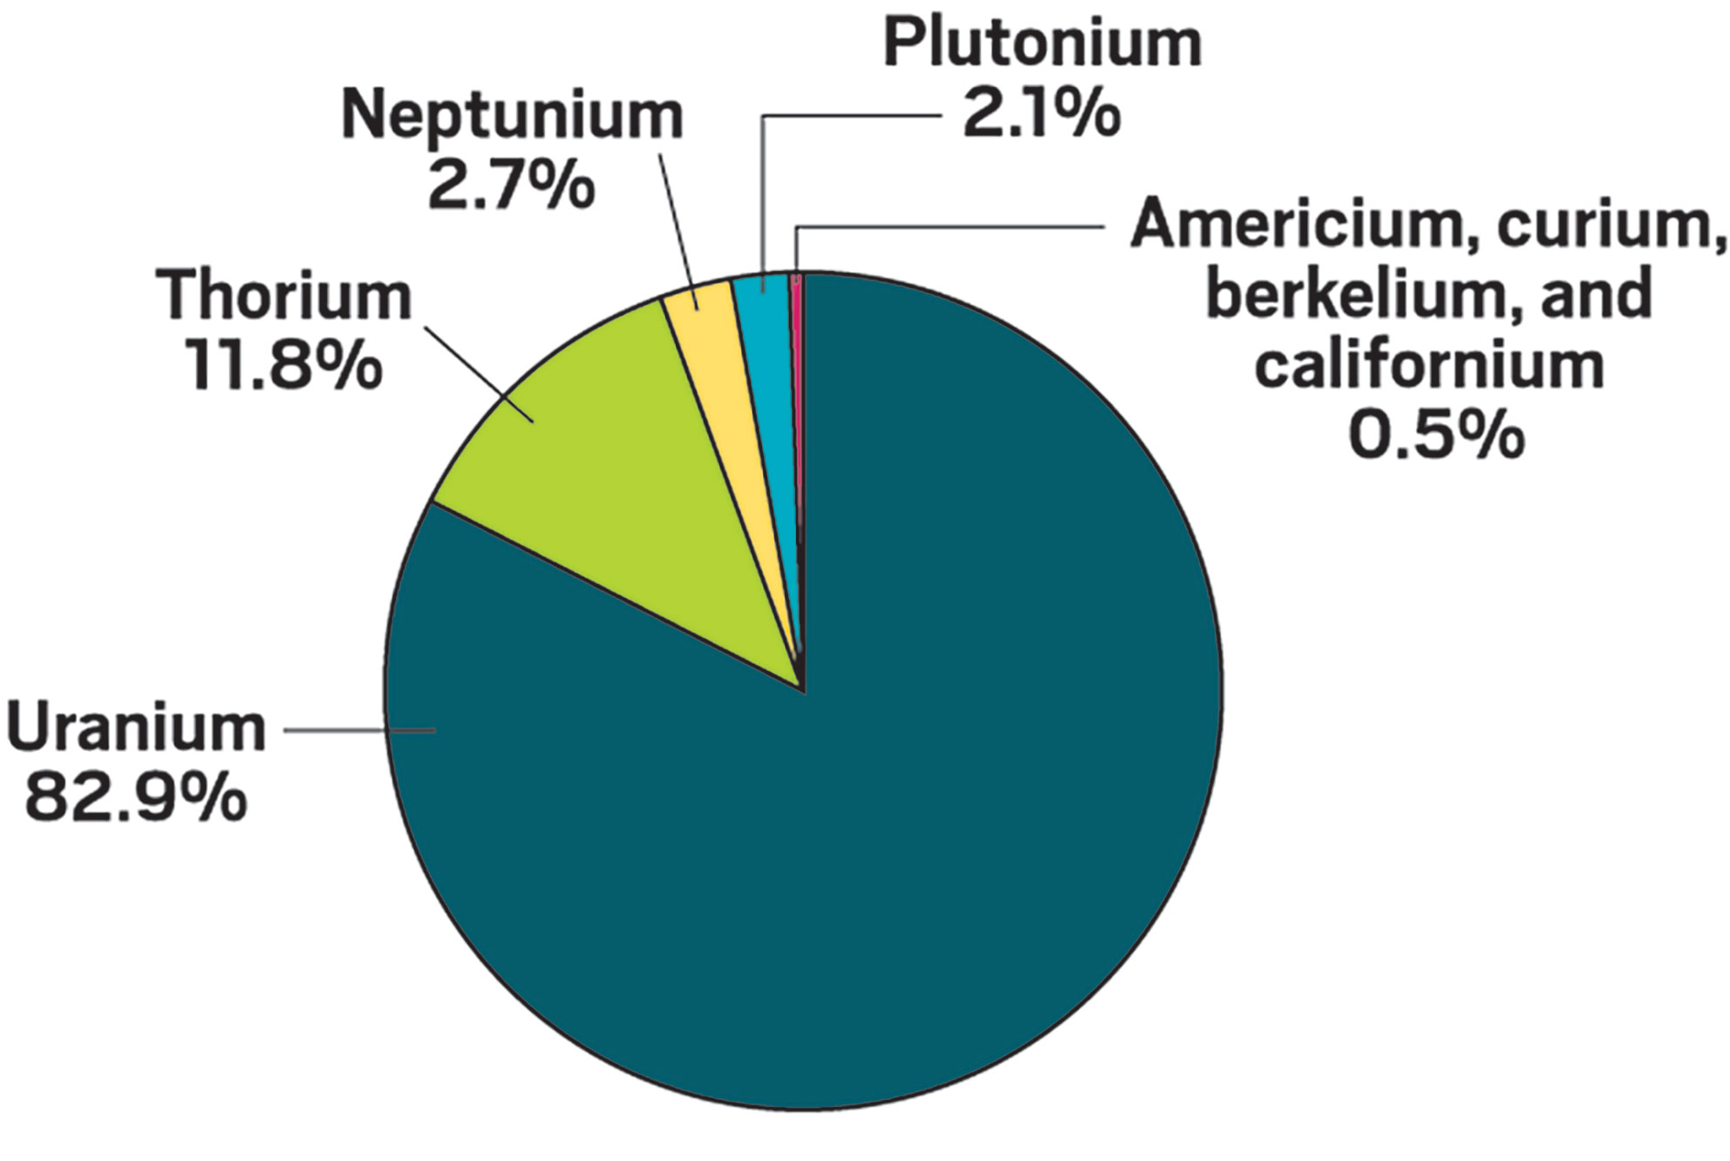
Studies of Molecule Formation: Comparing Ac and No
Ac²⁺: [Rn]7s¹
⁴⁸Ca + ^{nat}Tm
No²⁺: [Rn]5f¹⁴
⁴⁸Ca + ²⁰⁸Pb

Slide 23
Studies of Molecule Formation: Comparing Ac and No
Ac²⁺: [Rn]7s¹
⁴⁸Ca + ^{nat}Tm
No²⁺: [Rn]5f¹⁴
⁴⁸Ca + ²⁰⁸Pb
The Experiment:
Compare coordination species produced with trace contaminant species
H₂O and N₂
Confirm species with mass measurements
..
..
..

Slide 24
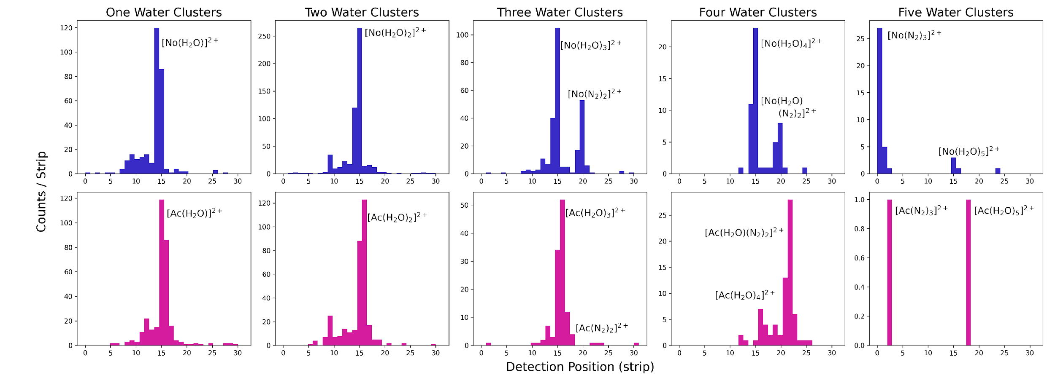
Results: Demonstrate Molecule Identification

Slide 25
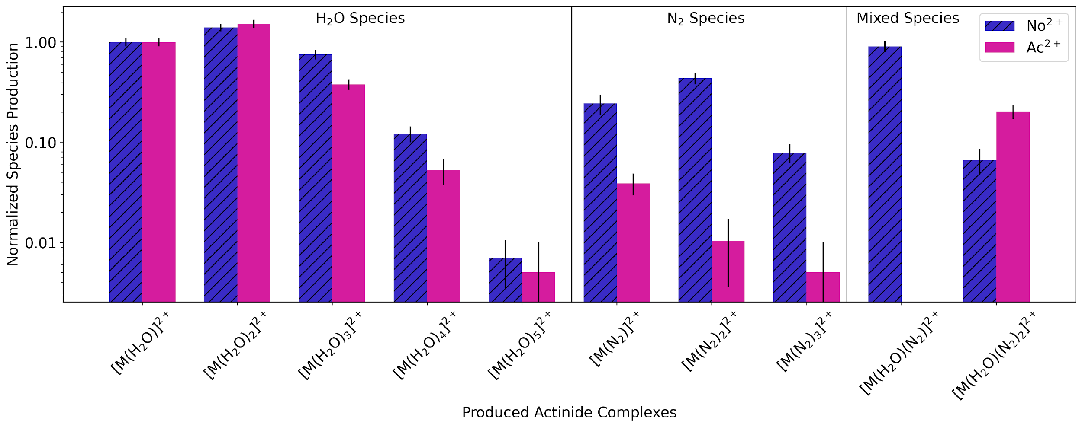
Results: Molecule Distribution
..
Water Species
Very Similar Behavior for the two ions
Two-Water Species most prominent
Ac < No population for n>3 H₂O

Slide 26
Results: Molecule Distribution
..
..
N₂ Species
Very Different Behavior
Different Product Distribution and Intensities

Slide 27
Results: Molecule Distribution

Slide 28
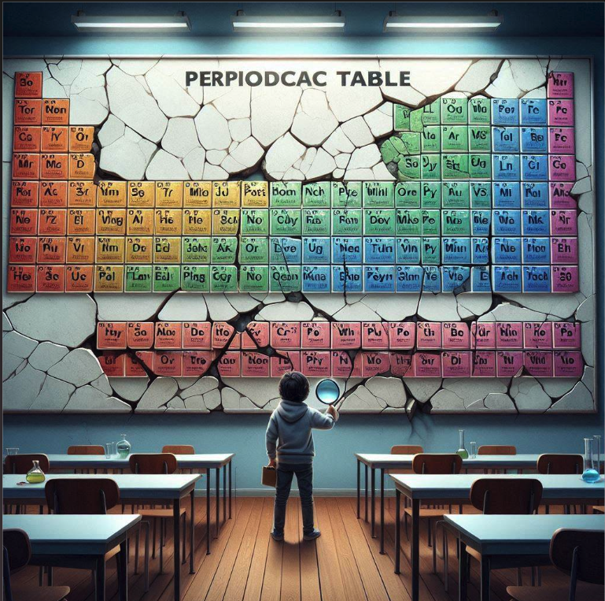
Summary
From Actinides to Superheavies
1
Superheavy elements may have very different chemical properties than their placements suggest
2
Experimental Studies are extremely challenging
3
New techniques are being developed to study their properties
4
Discussion of Periodic Table rearrangements may be on the horizon!

Slide 29
Collaborators and Funding
Jacklyn Gates
David Dixon
Fatima Garcia
John Gibson
John Gooding
Mallory McCarthy
Rodney Orford
Ziad Shafi
David Shuh
Nuclear Science Division, Lawrence Berkeley National Laboratory
Chemical Science’s Division, Lawrence Berkeley National Laboratory
University of Alabama
University of California Berkely
We gratefully acknowledge the operations staff of the 88-Inch Cyclotron. This work was supported in part by the U.S. Department of Energy, Office of Science, Offices of Nuclear Physics and Basic Energy Sciences under the contract No. DE-AC02- 05CH11231. JLP is a recipient of the DOE Early-Career Award.

Slide 30
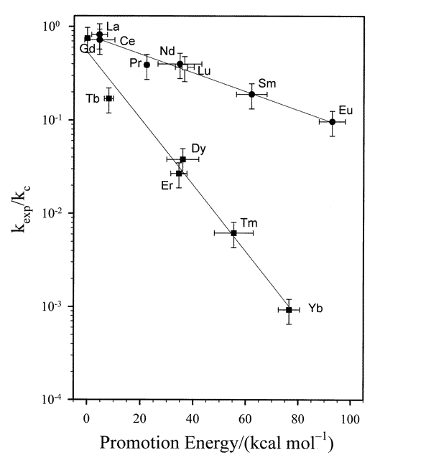
What can we learn from molecule formation?
Preferred oxidation states
Information on electrons
Db
Db
Rate of formation
+5?
or
+3?
Electronic Configuration Energy

