Slide 1
Simulation of MAPP-1 Detector in GEANT4
Abhinab Mukhopadhyay
Supervisor: James Pinfold
University of Alberta
WNPPC 2025

Slide 2
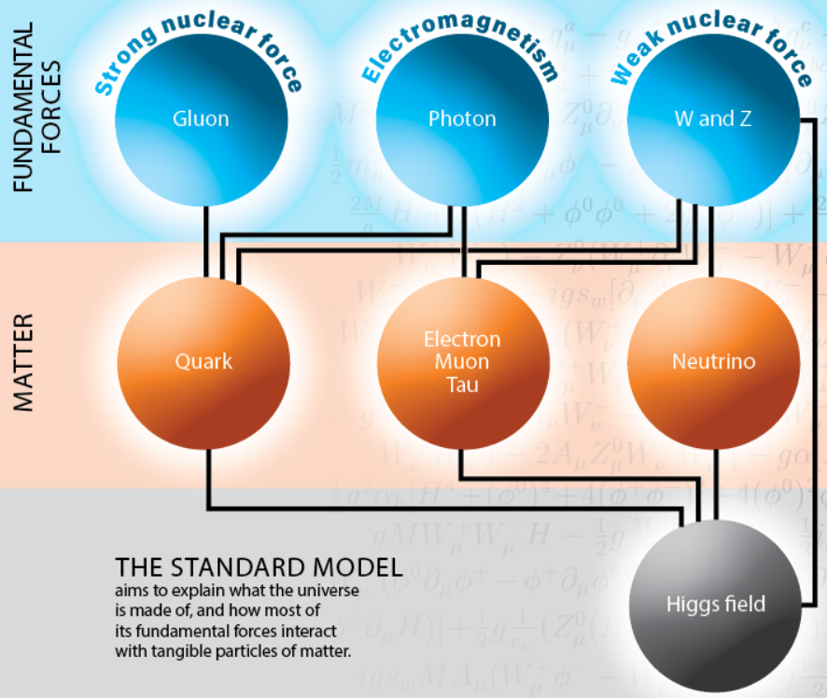
Limitations of Standard Model
SM doesn’t provide any insights to :
Charge quantization – Why is charge quantized ? "What is the mechanism of electric charge quantization?
Doesn’t explain Anti-matter matter asymmetry
Doesn’t explain Dark Matter (DM) and the nature of DM. Where are the DM particle candidates?

Slide 3
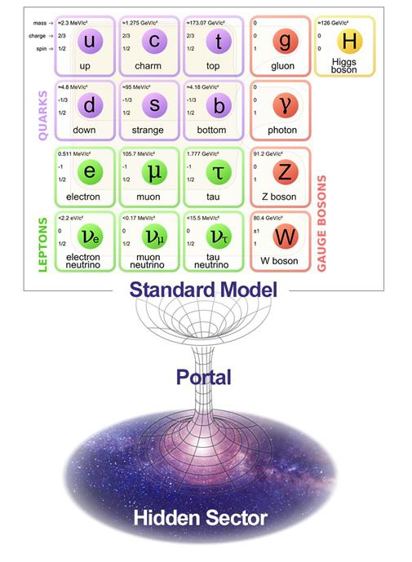
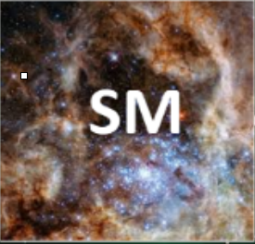
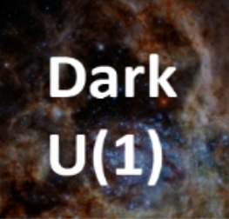
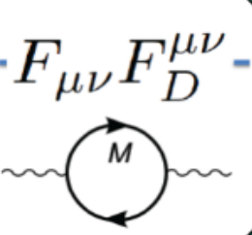
Milli-Charged Particles and Portals
Beyond Standard Model Theories: A Dark Sector
Interactions between two sectors are via mediator particles through so-called “portal interactions” - in this case vector portal
Feebly Ionizing Particles(FIPs) such as Milli-charged particles (mCPs) arising from Dark Sector models can provide a possible solutions and insight to these problems
mCP Hypothetical non-SM particles that have an effective charge with typical order of 10⁻³ e
Kunio Kaneta et al, Physical Review Letters (2017)

Slide 4
Why do we need a dedicated search Experiment ?
Major experiments such as ATLAS, CMS, ALICE and LHCb have limitations when searching for such exotic particles as they are not optimized for these searches
For example, ATLAS is unable to see mCPs below charge of 1/3e[1]
Since mCPs will deposit very little energy, they will not register at the LHC detectors sub-components
Hence you would need dedicated experiment designed to search for FIPs such as mCPs
[1] https://cds.cern.ch/record/2872119/files/ATL-GEN-PUB-2023-001.pdf

Slide 5
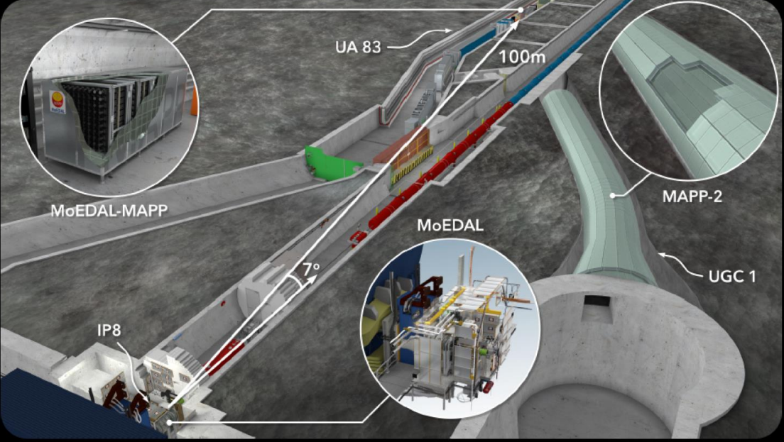
MoEDAL-MAPP Experiment
Phase 1: MoEDAL (In place)
Phase 2: MAPP-1 (Planned for Run 4)
Phase 3: MAPP-2 (Design stage)

Slide 6
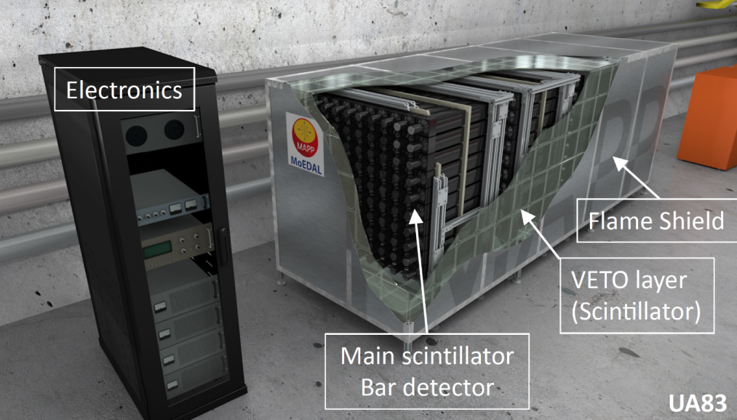
MAPP-1 Detector
Located at U83 Gallery which benefits from 110m of rock overburden, providing substantial protection from Cosmic ray
It is also protected from collision-related background by approximately 50m of rock
Each scintillator bar unit of size 10 cm x 10 cm x 75 cm coupled directly to low noise photomultiplier tube (PMT)
Design provides four-fold coincidence to reduce false signal events
Outer layer is veto layer to veto out any cosmic muon and background events

Slide 7
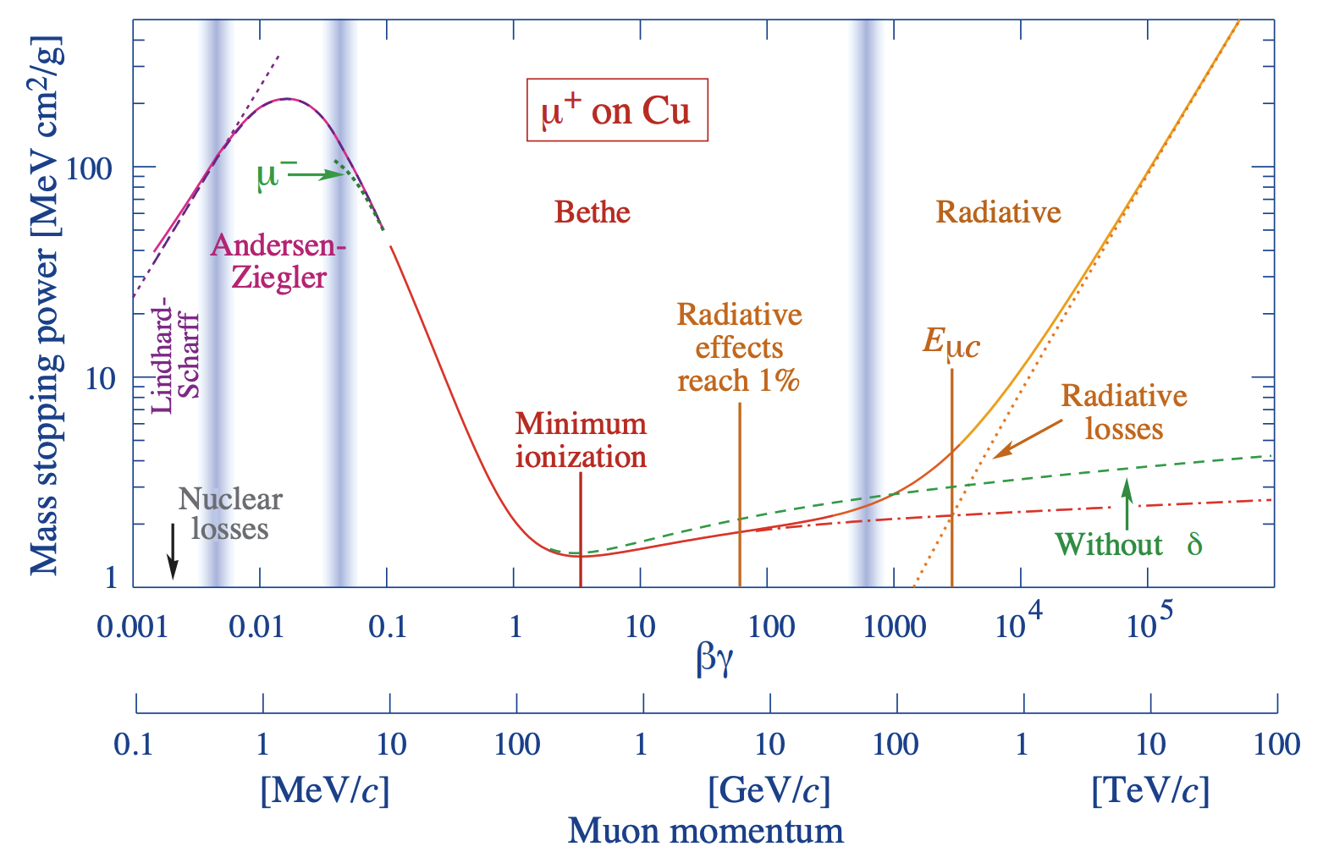
Modelling Energy loss of Milli-Charged Particle
Energy loss of mCP it is generally treated as muon with fractional charge [1]
Hence all equations for energy loss such as Bethe-Bloch for ionization is scaled with mCP charge → cross-section multiplied with ratio of charge of mCP squared
Radiative energy loss process such as Bremsstrahlung and Pair production are included. Their respective cross-section is also scaled by taking ratio of charge of mCP squared
Mass stopping power of positive muons in Copper [Taken from PDG “passage of particles”]

Slide 8
Experimental Method Simplified
Collisions are produced in LHC [p-p collisions …]
Event Generators generate physics events for targeted particles-[MADGRAPH]
Data Acquisition takes place in main collision points [ATLAS, CMS, LHCb, ALICE]
Detector Simulation – Detector response to physics events [GEANT4 - SUMMA ,
GEANT4 MAPP-1 Optical Model]
Modified Event Reconstruction:
Implementation of GEANT4 processes for Optical detector response [GEANT4 MAPP-1 Optical Model]
My current focus
Event Reconstruction
[ORCA, ATHENA]
Physics Analysis
ROOT, Python …

Slide 9
Optical Model of MAPP-1 component – Scintillator Units (Preliminary)
Plastic Scintillator with Tyvek Wrapping
The Plastic scintillator was wrapped with Tyvek in custom GEANT4 optical library
Silicone light guide was initialized as sensitive detector and attached to end of SP32 Plastic scintillator bar to record number of optical photons reaching end of the bar.
Optical photon boundary interaction between Tyvek, Plastic Scintillator and Silicone was defined
Now with optical model we can estimate our detector sensitivity !
pseudo-detector [Silicone]
Image above is Scintillator unit with Scintillator yield reduced significantly to show optical photon propagation inside the unit

Slide 10
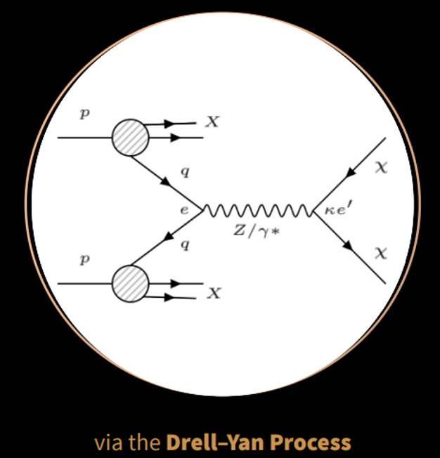
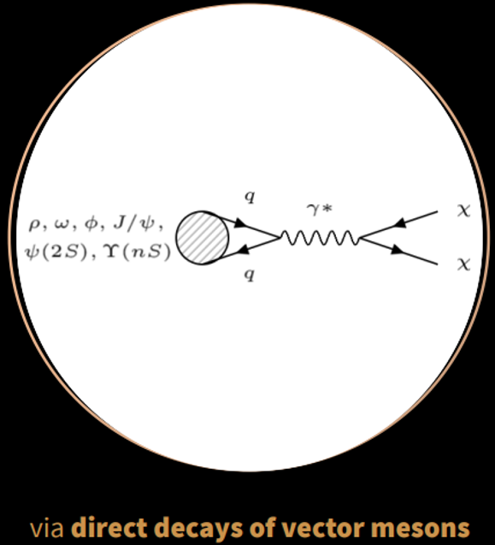
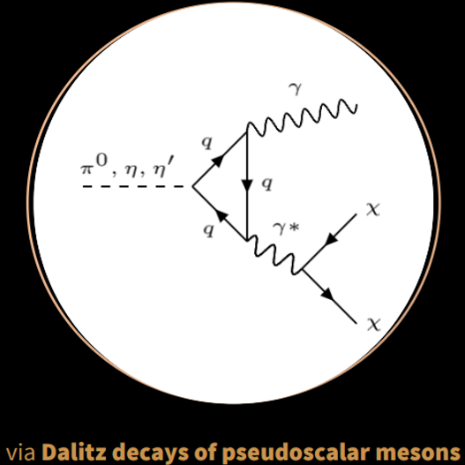
Estimating detector sensitivity by incorporating optical simulations
The sensitivity of the MAPP-1 detector to mCPs for LHC-HL run was determined based on the following formulas [1]:
Where Nχ is the number of mCPs produced, A is geometric acceptance of the detector, and P is detection probability of charged particles with n scintillator bars
Nχ values are determined by calculating the accumulative contributions from different production mechanism for mCP using MadGraph. The mCP production considered for this study is shown:

Slide 11
Estimating detector sensitivity by incorporating optical simulations
Number of Photoelectrons (N_{PE}) is computed based on the Quantum Efficiency (QE) of the XP72B20 PMT which taken to be 25% [1].
Number of Optical Photons given by Nγ reaching the silicone light guide from 1 GeV muon was obtained and converted to photoelectrons.
The charge scaling was used to determine number of photoelectrons of mCP with effective charge ϵ passing through the MAPP-1 scintillator unit.

Slide 12
Projected exclusion limits
The projected 95% confidence level (CL) Background free exclusion limits for MAPP-1 compared to other experiments
The plots show both respective luminosity for Run-3 and upcoming high luminosity run.
References:
MAPP-1: arXiv:2307.07855; J. High Energ. Phys. 2024, 137 (2024).
milliQan: Phys. Lett. B 746, 117–120 (2015); Phys. Rev. D 104, 032002 (2021).
FORMOSA: Phys. Rev. D 104, 035014 (2021).

Slide 13
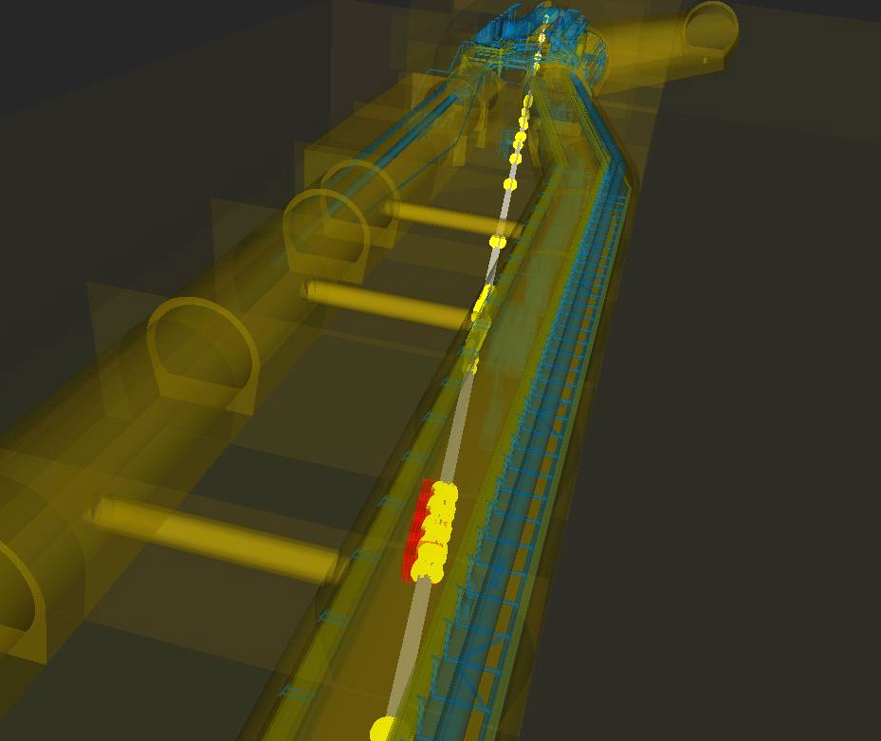
SimUlation of the MoEDAL-MAPP Arena (SUMMA) Model
A full SUMMA Model has been developed to get a more realistic simulation of MAPP-1 Detector
Includes all the interaction material from IP8 to MAPP-1 detector
Is to be interfaced with the Optical Model to get a more realistic sensitivity of MAPP-1 to mCPs
Takes account of the attenuation and scattering of mCPs as it traverses through material from IP8 to MAPP-1

Slide 14
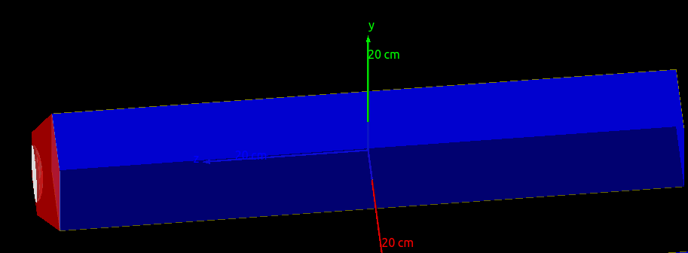
MAPP-1 Optical Model Updated
Double layer wrapped Tyvek
What’s new?
More realistic implementation of MAPP-1 plastic scintillators (SP32). Includes modified Birk coefficient , optical parameters such as relative emission spectrum of SP32 model.
Accurate geometric shapes - Silicone light guide and PMTs
Implementation of PDE (Photo Detector Efficiency) in PMT: Photoelectrons are produced based on the absorption spectrum of photons that reach the PMT.
Photodetector
Silicone waveguide
Plastic Scintillator

Slide 15
Summary and Future
Preliminary Optical Model was used to get preliminary exclusion plots of MAPP-1 detector to mCPs
By combining the SUMMA Model and MAPP-1 Optical Model we can more realistically and accurately simulate the MAPP-1 Detector reach for mCPs
Get realistic detector response to mCPs with different mass and charges using High Performance Computing
Plan is also to extend simulation for sensitivity analysis for Long Lived Particles (another exotic type of particles arising from Dark Sector)
Rendered GEANT4 image of MAPP-1 Detector with all its optical component

Slide 16
THANK YOU !
Main Collaborators:
Dr. James Pinfold [University of Alberta]
Dr. Michael Staelens [Okanagan College]
Dr. Matti Kalliokoski [University of Helsinki]
Dr. Pierre-Philippe A. Ouimet [University of Regina]

Slide 17
BACKUP SLIDES

Slide 18
Energy loss validation
Photonuclear energy loss model not implemented
Nuclear stopping model not implemented yet

Slide 19
Production mechanism of mCPs at CERN

Slide 20
Cross – sections computed via MadGraph
Charge-normalized minicharged particle production cross-sections at √s = 14TeV for all processes considered in this study. Results corresponding to meson decays are scaled by their respective branching ratios

Slide 21
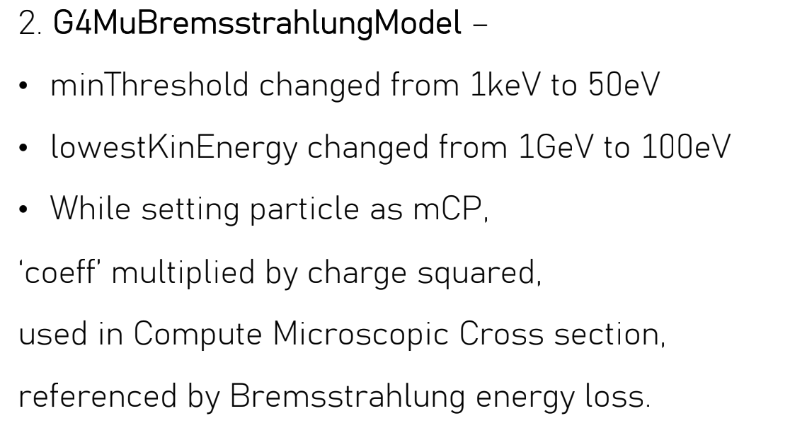
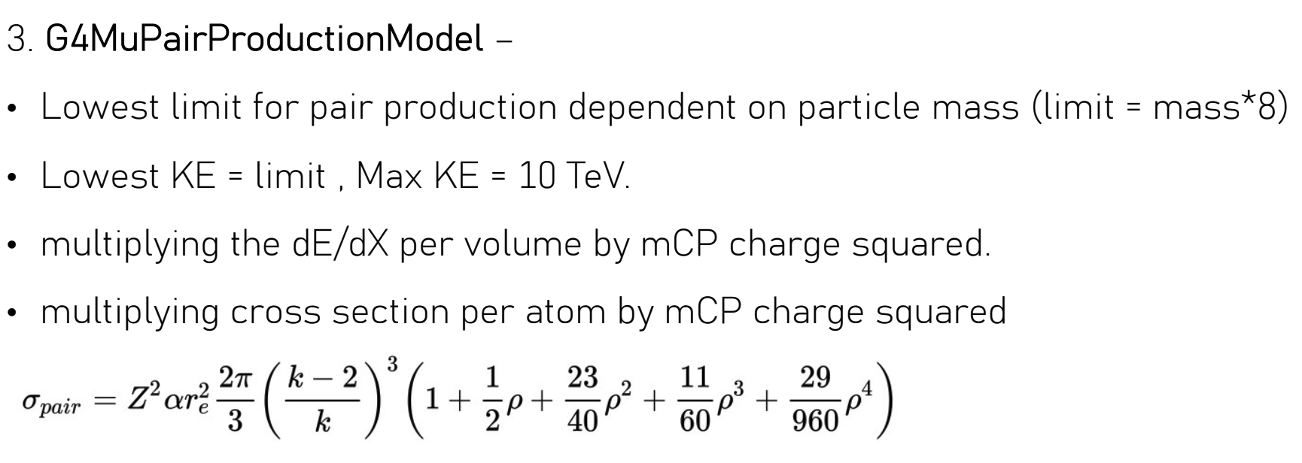
Physics changes

Slide 22
Energy loss [Continued…]

Slide 24
Background Considerations:
MAPP-1 is naturally shielded from cosmic muons by 110 m rock overburden and 47 m of materials (concrete) from IP8 to its location.
Background from muons originating from IP8 and its subsequently generated secondaries to be 1 out of 40,000 bunch-crossings
Dark current in the PMTs can also result in signal-like events; however, the four-fold coincidence design employed essentially eliminates this BG source
We assume a mean DCR of 500 Hz based on PMT Specifications. Assuming a 3-year trigger live time, a negligible result of 0.008 total signal-like events is obtained.

Slide 25
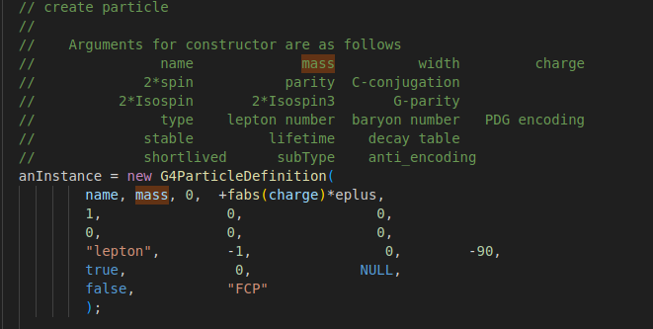
Physics changes

Slide 26
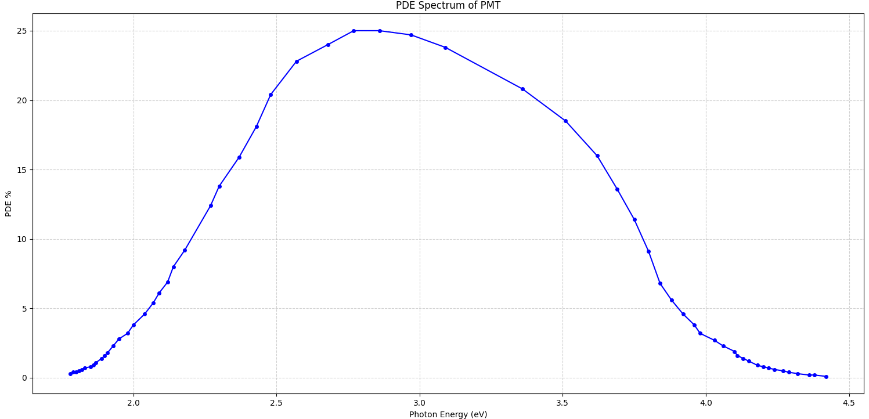
Optical Parameters [Extended]
Birk Law: Birk's coefficient quantifies the quenching effect in scintillators especially organic scintillator. It refers to loss of linearity is due to recombination and quenching effects between the excited molecules and the surrounding substrate.
PDE Plot for Photodetector

Slide 27
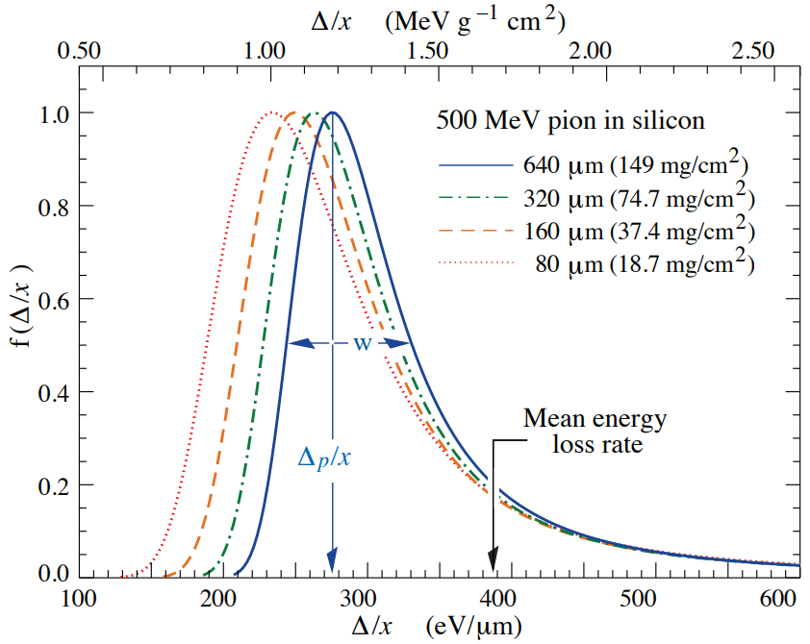
Energy Fluctuations
For detectors of moderate thickness such as plastic scintillators the energy loss probability distribution function is adequately described by highly-skewed Landau distribution [1]
The mean energy loss in absorber is influenced by the rare, high-energy-transfer collisions pushing it into the tail of the distribution.
Hence for such thickness of detectors mean given by Bethe equation is thus ill-defined experimentally and instead Landau-Vavilov most probable energy loss function should be used.
The Key questions then arises are
1] Is this applicable to exotic particle such as mCPs ?
2] How can we implement this in GEANT4 for our case?

Slide 28
Landau-Vavilov
The most probable energy loss equation for moderate thickness x detector for given in PDG [1] :
Here ξ is Landau parameter in MeV , j is a correction term [dimensionless] and $δ(βγ)$ is density correction. I is mean excitation energy in MeV.
Expression for ξ is given is:
Where K is Coefficient for dE/dx, 0.307075 MeV mol⁻¹ cm² , Z/A is ratio of Atomic and Mass number of detector material, z is charge of the incident particle and x is the detector thickness detector in gcm⁻²
“Moderate thickness” of detector is G value described by Rossi $G≤0.05−0.1$ which is same as Vavilov’s κ parameter^{[1][2]}
In that regime the fluctuations would be prominent and Landau-Vavilov should be used.

Slide 29
Vavilov parameter
We need to assess the Vavilov parameter for our case to determine if we can use fluctuation model
Vavilov parameter κ is given by ^{[1]}
E_{m} is the Maximum possible energy transfer to an electron in a single collision. M is incident particle mass and m is mass of electron.
Hence, we can then compute κ for mCP with varying charges, masses and $β$.
The mCPs in the direction of MAPP-1 detector were found to have relativistic and ultra-relativistic $β$and each $β$ per respective mass was calculated
Hence with this simplification we can compute κ for varying charge based on mass of mCP and respective $β$ .

Slide 30
Vavilov parameter
Landau Model is not [Thick detector]
Considered Moderate absorber -> Landau Model is dominant

Slide 31
Energy Fluctuations
GEANT4 default physics list includes both low-energy and high energy loss fluctuation models
However, since we are building the modified physics list, the fluctuation models are not automatically included.
Looking at GEANT4 source code for Energy Loss Fluctuations, the GEANT4 implements via 𝐺4𝑉 𝐸𝑚𝐹𝑙𝑢𝑐𝑡𝑢𝑎𝑡𝑖𝑜𝑛𝑀𝑜𝑑𝑒l
G4UniversalFluctuation model is used like the one used in default GEANT4 ionization source for muons.
It automatically takes account for charge and mass of the particle hence it is applicable to any defined exotic particle ^{[1]}

Slide 32
Edep in Plastic scintillators in MAPP-1 for mCP 0.001e charge 30 GeV Mass generated at IP8
High end fluctuations that fall on Landau tail
[MeV]

Slide 33
Geometric Acceptance of MAPP-1 detector
For a positive signal we consider geometric acceptance of mCP as it hits all 4 colinear plastic scintillators.
For Background free case we require a minimum of 3 hits(signals) for clear discovery at the 95% confidence level [credits: Michael]

